Slide 1
Introduction à la France occupée et le Régime de Vichy
Perfect tense: Verbs like sortir and choisir
SSCs [ain/in] and [aim/im] (nasal and non-nasal)
Y7 French
Term 3.2 - Week 1 - Lesson 59
Author names: Natalie Finlayson / Louise Bibbey
Artwork by: Chloé Motard
Date updated: 30/05/2022
Notes:
Artwork by Chloé Motard. All additional pictures selected are available under a Creative Commons license, no attribution required.
Native speaker feedback provided by Stéphanie Schmitt.
With thanks to Rachel Hawkes for her input on the lesson material.
Learning outcomes (lesson 1):
Introduction to occupied France and the Vichy regime (1940-1945). This lesson provides a very broad overview of events including the Battle of France, compulsory work service and la Révolution nationale. The language used to describe the events is deliberately simple so that it is accessible to young students who (i) have end of KS3-level knowledge of the French language, and (ii) may have a very limited knowledge of WW2 history. The lesson intends to provide students with basic knowledge of the period that can be built upon in KS4 by exploring these and related events in more detail. It is acknowledged that there is more material included here than can be fully explored in a 2-hour week. Teachers are invited to select the tasks they would like to focus on in class, and perhaps set others for homework. The follow-up lesson in KS4 will be deliberately shorter to allow for an even spread of tasks. Revision of SSCs [ain/in] and [aim/im], including non-nasal pronunciation before a vowel
Revision of perfect tense forms and uses
Introduction of past participle forms of verbs like sortir and choisir
Word frequency (1 is the most frequent word in French):
9.3.2.1 (introduce) établir [529], fournir [731], grandir [1936], réussir² (à) [279], ressentir [1593], servir [177], armée [1011], début [364], état [333], fin [111], gouvernement [160], est [4603], nord [1090], ouest [1690], soldat [1098], sud [1242] 9.2.1.6 (revisit) approcher [1576], avoir besoin de [n/a] téléphoner (à) [2448], voler (à) [1610], moi [131], toi [510], crime [819], fréquence [2178], responsabilité [694], sécurité [478], vol [1531], criminel [1411], proche [838], après [82], avant [40], selon [240]
9.2.1.4 (revisit) blesser [2024], jeter [1202], laisser [196], amour [967], envie [1237], mer [921], prix [310], sens [243], tellement [869]
Source: Londsale, D., & Le Bras, Y. (2009). A Frequency Dictionary of French: Core vocabulary for learners London: Routledge.
The frequency rankings for words that occur in this PowerPoint which have been previously introduced in NCELP resources are given in the NCELP SOW and in the resources that first introduced and formally re-visited those words.
For any other words that occur incidentally in this PowerPoint, frequency rankings will be provided in the notes field wherever possible.

Slide 2
ain/in
train
Notes:
Timing: 2 minutes [1/8] Note: Students have revisited the focus SSCs in this lesson several times. Teacher discretion should be used to determine the time spent on this sequence of eight slides at the beginning of the lesson.
Aim: To consolidate SSC [ain/in]
Procedure: 1. Present the letter(s) and say the [ain/in] sound first, on its own. Students repeat it with you. 2. Bring up the word ”train” on its own, say it, students repeat it, so that they have the opportunity to focus all of their attention on the connection between the written word and its sound.
3. A possible gesture for this would be to move both arms simultaneously forwards and back in a circular motion, simulating the motion of train wheel connecting rods.
4. Roll back the animations and work through 1-3 again, but this time, dropping your voice completely to listen carefully to the students saying the [ain/in] sound, pronouncing ”train” and, if using, doing the gesture.
Word frequency (1 is the most frequent word in French):
train [232] Source: Londsale, D., & Le Bras, Y. (2009). A Frequency Dictionary of French: Core vocabulary for learners London: Routledge.

Slide 3
ain/in
fin
matin
[end]
vingt
train
main
maintenant
[now]
Notes:
[2/8]
Aim: To consolidate SSC [ain/in]
Procedure:
1. Introduce and elicit the pronunciation of the individual SSC [ain/in] and then the source word again ‘train’ (with gesture, if using). 2. Then present and elicit the pronunciation of the five cluster words.
The cluster words have been chosen for their high-frequency, from a range of word classes, with the SSC (where possible) positioned within a variety of syllables within the words (e.g. initial, 2nd, final etc.). Additionally, we have tried to use words that build cumulatively on previously taught SSCs (see the Phonics Teaching Sequence document) and do not include new SSCs. Where new SSCs are used, they are often consonants which have a similar symbol-sound correspondence in English.
Word frequency (1 is the most frequent word in French): fin [111]; matin [442] vingt[1273]; maintenant [192]; main [418]; train [232]. Source: Londsale, D., & Le Bras, Y. (2009). A Frequency Dictionary of French: Core vocabulary for learners London: Routledge.

Slide 4
aim/im
faim
Notes:
[3/8]
Aim: To consolidate SSC [aim/im]
Procedure: 1. Present the letter(s) and say the [aim/im] sound first, on its own. Students repeat it with you. 2. Bring up the word ”faim” on its own, say it, students repeat it, so that they have the opportunity to focus all of their attention on the connection between the written word and its sound.
3. A possible gesture for this would be to rub your tummy as if hungry. 4. Roll back the animations and work through 1-3 again, but this time, dropping your voice completely to listen carefully to the students saying the [-(a)im] sound, pronouncing ”faim” and, if using, doing the gesture.
Word frequency (1 is the most frequent word in French):
faim [1986]
Source: Londsale, D., & Le Bras, Y. (2009). A Frequency Dictionary of French: Core vocabulary for learners London: Routledge.

Slide 5
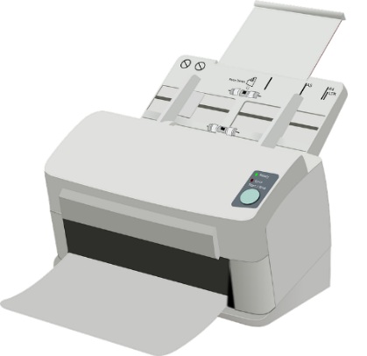
aim/im
grimper
imprimer
faim
simple
impossible
[simple]
[impossible]
important
[important]
Notes:
[4/8]
Aim: To consolidate SSC [aim/im]
Procedure:
Introduce and elicit the pronunciation of the individual SSC [aim/im] and then the source word again ‘faim’ (with gesture, if using). Then present and elicit the pronunciation of the five cluster words. The cluster words have been chosen for their high-frequency, from a range of word classes, with the SSC (where possible) positioned within a variety of syllables within the words (e.g. initial, 2nd, final etc.). Additionally, we have tried to use words that build cumulatively on previously taught SSCs (see the Phonics Teaching Sequence document) and do not include new SSCs. Where new SSCs are used, they are often consonants which have a similar symbol-sound correspondence in English.
Word frequency (1 is the most frequent word in French): faim [1986]; simple [212]; important [215]; grimper [2646]; imprimer [3092]; impossible [3092]. Source: Londsale, D., & Le Bras, Y. (2009). A Frequency Dictionary of French: Core vocabulary for learners London: Routledge.

Slide 6
ai
vrai
Notes:
[5/8]
Aim: To consolidate SSC [ai]
Procedure: 1. Present the letter(s) and say the [ai] sound first, on its own. Students repeat it with you. 2. Bring up the word ”vrai” on its own, say it, students repeat it, so that they have the opportunity to focus all of their attention on the connection between the written word and its sound.
3. A possible gesture for this would be to mime a ‘tick’.
4. Roll back the animations and work through 1-3 again, but this time, dropping your voice completely to listen carefully to the students saying the [ai] sound, pronouncing ”vrai” and, if using, doing the gesture.
Word frequency (1 is the most frequent word in French):
vrai [292].
Source: Londsale, D., & Le Bras, Y. (2009). A Frequency Dictionary of French: Core vocabulary for learners London: Routledge.

Slide 7
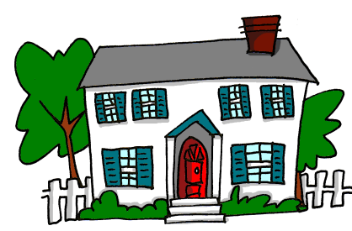
ai
maison
raison
[reason]
mauvais
vrai
faire
[bad]
semaine
[to do]
[week]
Notes:
[6/8]
Aim: To consolidate SSC [ai]
Procedure:
1. Introduce and elicit the pronunciation of the individual SSC [ai] and then the source word again ‘vrai’ (with gesture, if using). 2. Then present and elicit the pronunciation of the five cluster words.
The cluster words have been chosen for their high-frequency, from a range of word classes, with the SSC (where possible) positioned within a variety of syllables within the words (e.g. initial, 2nd, final etc.). Additionally, we have tried to use words that build cumulatively on previously taught SSCs (see the Phonics Teaching Sequence document) and do not include new SSCs. Where new SSCs are used, they are often consonants which have a similar symbol-sound correspondence in English.
Word frequency (1 is the most frequent word in French): maison [325]; raison [72] mauvais [274]; faire [25]; semaine [245]; vrai [292]. Source: Londsale, D., & Le Bras, Y. (2009). A Frequency Dictionary of French: Core vocabulary for learners London: Routledge.

Slide 8
i
midi
Notes:
[7/8]
Aim: To consolidate SSC [i]
Procedure: 1. Present the letter(s) and say the [i] sound first, on its own. Students repeat it with you. 2. Bring up the word ”midi” on its own, say it, students repeat it, so that they have the opportunity to focus all of their attention on the connection between the written word and its sound.
3. A possible gesture for this would be to draw a circle representing a clock face with one hand, with the other arm and hand pointing straight up (representing the hands on 12) within the circle. 4. Roll back the animations and work through 1-3 again, but this time, dropping your voice completely to listen carefully to the students saying the [i] sound, pronouncing ”midi” and, if using, doing the gesture.
Word frequency (1 is the most frequent word in French):
midi [2483].
Source: Londsale, D., & Le Bras, Y. (2009). A Frequency Dictionary of French: Core vocabulary for learners London: Routledge.

Slide 9
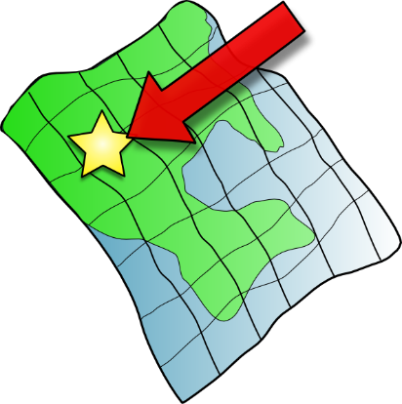
i
petit
lit
midi
ici
qui ?
il
?
Notes:
[8/8]
Aim: To consolidate SSC [i]
Procedure:
1. Introduce and elicit the pronunciation of the individual SSC [i] and then the source word again ‘midi’ (with gesture, if using). 2. Then present and elicit the pronunciation of the five cluster words.
The cluster words have been chosen for their high-frequency, from a range of word classes, with the SSC (where possible) positioned within a variety of syllables within the words (e.g. initial, 2nd, final etc.). Additionally, we have tried to use words that build cumulatively on previously taught SSCs (see the Phonics Teaching Sequence document) and do not include new SSCs. Where new SSCs are used, they are often consonants which have a similar symbol-sound correspondence in English.
Word frequency (1 is the most frequent word in French): midi [2483]; petit [138]; lit [1837] ici [167]; il[13]; qui [14]. Source: Londsale, D., & Le Bras, Y. (2009). A Frequency Dictionary of French: Core vocabulary for learners London: Routledge.

Slide 10
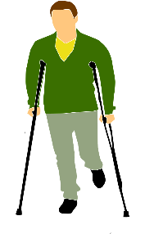
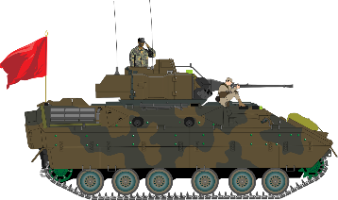
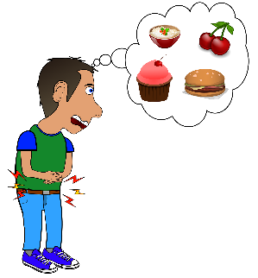
Les voyelles nasales
Are the vowels in bold nasal or non-nasal?
lire/parler
Remember that the nasal SSCs [aim/im] and [ain/in] become non-nasal sounds ([ai] + n/m and [i] + n/m) when they come before a vowel.
vainqueur [winner]
victime
[victim]
terrain
[land]
intervention
[intervention]
envahi
[invaded]
imposer
[to impose]
ministre
[minister]
aimant
[magnet]
capitaine
[captain]
These are the past participles of the verbs envahir (to invade) and fuir (to flee). Verbs like sortir and choisir form their past participles like this.
invasion
[invasion]
essaimer
[to swarm]
faim
[hunger]
fui
[fled]
Notes:
Timing: 5 minutes
Aim: Written recognition and production of nasal SSCs [aim/im] and [ain/in] and non-nasal SSCs [ai] and [i]; setting the scene for the topic of the lesson.
Procedure:
1. Use slides 2-9 to revise the sounds. Remind students that SSCs [aim/im] and [ain/in] sound identical, and that the spelling change m→n occurs when the sound appears before the letters ‘b’ and ‘p’.
2. Remind students that when [aim/im] and [ain/in] appear before a vowel, they are pronounced as non-nasal vowels + m/n. Victime could be used as an example to illustrate this.
3. Working in pairs, students use the rules to sound out the words and decide whether the sounds in bold are nasal or non-nasal.
4. Click to reveal the answers. Click on the images to hear the words said aloud by a native speaker.
5. Click to reveal a bubble drawing attention to the two words ending in -i which are past participles. This primes students for the new grammar point introduced later in the lesson.
Transcript:
vainqueur victime terrain intervention envahi imposer ministre
aimant capitaine invasion essaimer faim fui
Word frequency (1 is the most frequent word in French): vainqueur [3307], victime [697], terrain [867], intervention [intervention], envahi [envahir 2566], imposer [469], ministre [204], aimant [>5000], capitaine [2518], invasion [3911], essaimer [>5000], faim [1986], fui [fuir 1960]
Source: Londsale, D., & Le Bras, Y. (2009). A Frequency Dictionary of French: Core vocabulary for learners London: Routledge.

Slide 11
Des sens communs
écouter
Sometimes, you will see directions with a capital letter to talk about the name of an area or region, e.g.: Ils viennent du Nord.
Ressentir is used with a noun to talk about what you feel, e.g.: Il ressent de l’amour pour sa famille
Use réussir + noun to talk about making a success of something, e.g.: Elle réussit son objectif.
Use réussir à + verb to talk about succeeding in doing something, e.g.:
Nous réussissons à faire des recherches.
À quelle catégorie appartiennent les mots ? Écris les numéros dans les cercles corrects.
directions
war
the body
1
2
3
5
8
14
17
1
10
15
9
13
4
5
6
7
8
9
2
6
12
10
11
12
a point in time or distance
politics
setting up or creating something
13
14
15
4
11
3
7
16
Notes:
Timing: 5 minutes
Aim: Oral recognition of new words in this week’s vocabulary set; forming connections between semantically-related words.
Procedure:
1. Students sketch six circles as shown here.
2. Click on a number to hear the words in this week’s set read aloud.
3. Students write the number in the box they think is the best fit.
4. On a click, the number boxes move to the categories to give a suggested answer. Some words may fit more than one category. Teachers should use their discretion to decide whether a students’ suggested response is a good fit.
5. Click to reveal bubble drawing attention to the meaning of ressentir + noun to talk about what you feel. Draw a link to the English word ‘sense’. The reflexive use of se sentir + adjective to talk about how you feel will be introduced later in this term.
6. Click to bring up the bubbles with usage notes on réussir and directions.
Transcript:
1. l’armée
2. établir
3. le début 4. le gouvernement
5. l’ouest
6. fournir
7. la fin
8. l’est 9. grandir
10. le soldat
11. l’état 12. réussir, réussir à
13. ressentir
14. le nord
15. servir 16. le sud

Slide 12
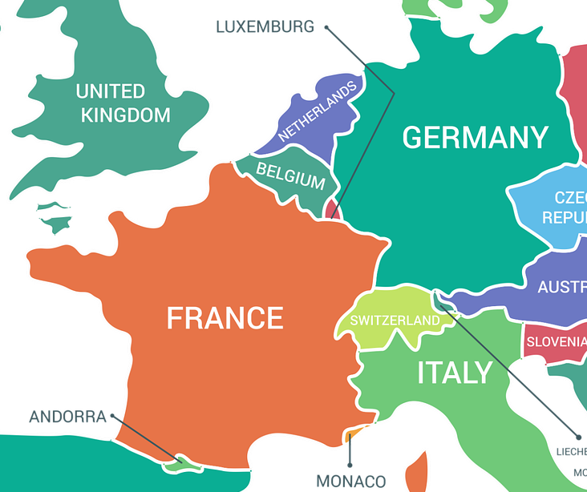
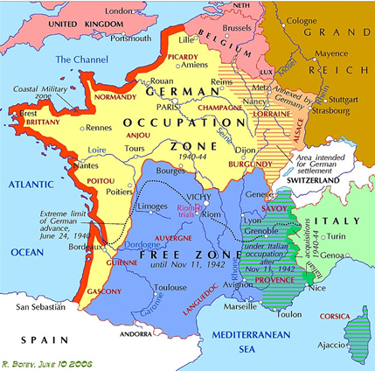
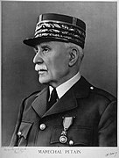
La bataille de France (1940)
*le Pays-Bas = the Netherlands *devenu = became | *jusqu'à = until
lire
Dix mois après le début de la Seconde Guerre mondiale, l'armée allemande a attaqué les Pays-Bas*, la Belgique, le Luxembourg et la France. L’attaque a pris les soldats français par surprise, et un mois après l’Allemagne nazie a réussi à prendre Paris. Le gouvernement français a capitulé et le pays est devenu* divisé en plusieurs zones. L’Allemagne a occupé les régions du Nord et de l’Ouest à côté de la mer. L’Italie a occupé une petite zone dans le Sud-Est. Le reste de la France est resté une « zone libre». C’est l'État français. Le leader, Maréchal Philippe Pétain, a établi son gouvernement à Vichy, au centre du pays. Pétain a établi un régime autoritaire et une collaboration avec Hitler. Il a fourni à l’Allemagne des soldats et des ressources jusqu'à* la fin du Régime de Vichy en 1944.
3. How long after the start of WW2 did Germany capture Paris? 11 months
2. How do we know that France was vulnerable? The attack took French soldiers by surprise
1. Which countries were attacked? The Netherlands, Luxembourg, Belgium and France
5. Describe the Vichy regime.
Authoritarian, collaboration with Hitler, supplied Germany with soldiers/resources, ended in 1944
4. Sketch a map of divided France following its defeat to Germany. Include Vichy.
Notes:
Timing: 8 minutes
Aim: Written recognition of this week’s new vocabulary; reading comprehension; cultural awareness: the Battle of France and subsequent occupation of France
Procedure:
1. Explain to students that they are going to learn about France during the Second World War in this resource. Little prior knowledge of Second World War history is assumed (here and elsewhere in this sequence of lessons), though teachers may wish to clarify the meaning of cognates nazi(e), capitulé and autoritaire and check students are aware that Hitler was the dictator of Germany at the time.
2. As students have not yet formally encountered the formation rule for past participles of verbs like sortir and choisir, explain to students that the verb forms ending in an orange –i are the past participle forms of known verbs.
3. Click to reveal questions one by one. Tell students the answers to the questions appear in order, so they can stop reading once they have located the answer to the question in the text. Allow one minute per question, and two minutes for the sketch. Students can use the first map to sketch the outline of France, and then add divisions according to the text.
4. Click to reveal answers.
5. Click to reveal another question.
6. Repeat steps 2-4 for a total of five questions.
Image Attribution Rostislav Botev, CC BY-SA 3.0 <https://creativecommons.org/licenses/by-sa/3.0>, via Wikimedia Commons
Unknown authorUnknown author, Public domain, via Wikimedia Commons; https://upload.wikimedia.org/wikipedia/commons/4/4d/Philippe_P%C3%A9tain.jpg
Word frequency of unknown words (1 is the most frequent word in French): Pays-Bas [n/a], devenu [devenir 162], jusqu’à [n/a]
Source: Londsale, D., & Le Bras, Y. (2009). A Frequency Dictionary of French: Core vocabulary for learners London: Routledge.
Word frequency of cognates (1 is the most frequent word in French): bataille [1303], second [379], attaquer [1018], Luxembourg [n/a], attaque [1655], surprise [1815], nazi [3053], capituler [>5000], divisé [diviser 1567], zone [860], occupier [159], reste [363], leader [1499], autoritaire [4661], collaboration [2037], ressource [852]
Source: Londsale, D., & Le Bras, Y. (2009). A Frequency Dictionary of French: Core vocabulary for learners London: Routledge.

Slide 13
Perfect tense: Sortir and choisir
-i
grammaire
As you know, we use the perfect tense to talk about specific or one-off events and actions that happened in the past.
The perfect tense is made up of an auxiliary verb (present form of avoir or être) and a past participle (a form of the main verb that is the same for all persons).
The past participles of verbs like sortir and choisir both end in -i. J’ai grandi dans le Nord. Nous sommes parti(e)s pour le Sud.
I grew up/have grown up in the north. We left/have left for the south.
To form them, simply remove –r from the infinitive form of the verb. choisir → j’ai choisi sortir → je suis sorti(e)
Verbs with être as an auxiliary, such as partir and sortir, normally express movement. Their past participles add an ending to agree with the subject.
___________
___________
Notes:
Timing: 2 minutes
Aim: To revise forms and uses of the perfect tense; to introduce the past participle forms of verbs like sortir and choisir.
Procedure:
1. Click to bring up information sentence by sentence.
2. Highlight that the past participle form of verbs in these two groups is formed in the same way.

Slide 14
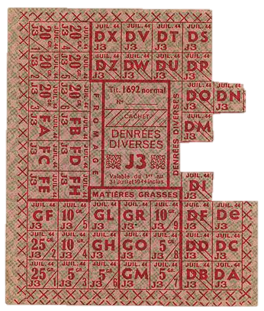
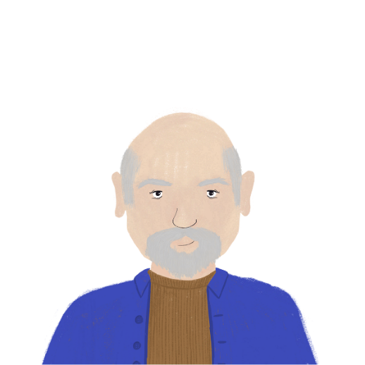
Les souvenirs de Bastien
*devenu = became
écouter
1
2
3
4
5
6
7
8
En 1940, au début du régime, Bastien a 7 ans. Il a encore des souvenirs de sa vie familiale du temps du régime. Il décrit un jour mémorable. Qui a fait quoi ?
sa mère (elle)
left early to work on a farm
didn’t serve in the army
successfully made a meal
ses frères (ils)
Le gouvernement a distribué des cartes de rationnement pour fournir des produits qui sont devenus* rares aux gens.
finished work in the afternoon
fed the family with ration cards
Bastien et ses frères (nous)
felt a lot of loneliness
left to work in Germany
grew up quickly
Notes:
Timing: 7 minutes
Aim: Oral recognition of verbs like sortir and choisir in the perfect tense; listening comprehension; cultural awareness: everyday life in occupied France
Procedure:
1. Click on a button to hear Bastien say something that happened on this day with the subject obscured. Students will need to recognise the form of the auxiliary verb to decide who the statement applies to.
2. Students locate the English translation that matches what they hear, and write it next to the correct bullet point depending on whether it applies to Bastien’s mother (elle), brothers (ils) or Bastien and his brothers (nous).
3. On clicks, the English sentences disappear and reappear next to the correct bullets.
4. Click on the English textbox to hear the sentence said aloud.
5. Click to bring up the info bubble about rationing cards, which introduced the topic on the next slide.
Transcript:
1. [Nous] avons grandi vite pendant la Seconde Guerre mondiale.
2. En ce jour, [ma mère] est sortie très tôt pour travailler dans une ferme.
3. [Elle] a fini son travail dans l'après-midi.
4. Mes frères et moi, [nous] avons nourri la famille avec des cartes de rationnement.
5. [Nous] avons réussi à faire un petit repas mais j’ai encore eu faim après.
6. [Mes frères] n’ont pas servi dans l'armée.
7. Mais ce soir-là, après le repas, [ils] sont partis pour travailler en Allemagne.
8. [Ma mère] a ressenti une grande solitude après. [re-recording in progress]
Word frequency of unknown words (1 is the most frequent word in French): Pays-Bas [n/a], devenu [devenir 162], jusqu’à [n/a]
Source: Londsale, D., & Le Bras, Y. (2009). A Frequency Dictionary of French: Core vocabulary for learners London: Routledge.
Word frequency of cognates (1 is the most frequent word in French): mémorable [>5000], distribuer [1152], rationnement [>5000], rare [1233]
Source: Londsale, D., & Le Bras, Y. (2009). A Frequency Dictionary of French: Core vocabulary for learners London: Routledge.
Image attribution Daniel*D, CC BY-SA 3.0 <https://creativecommons.org/licenses/by-sa/3.0>, via Wikimedia Commons

Slide 15
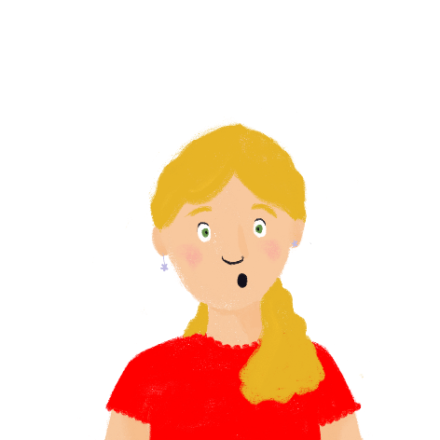
Le service du travail obligatoire
*la loi = the law
*était = was | *mentir = to lie
lire
Léa a des questions. Pourquoi il n'y avait pas assez* à manger ? Pourquoi la mère de Bastien a travaillé dans une ferme ? Et pourquoi les frères de Bastien sont partis ? Complète.
Léa a des questions. Pourquoi il n'y avait pas suffisamment à manger ? Pourquoi la mère de Bastien a travaillé dans une ferme ? Et pourquoi les frères de Bastien sont partis ?
1. Pourquoi tes frères ont choisi de travailler en Allemagne?
1. Pourquoi tes frères/on ont choisi de travailler en Allemagne?
2. On/ils n'a pas choisi. Les hommes français/nous ont servi en Allemagne parce que c'était* la loi*.
Lis encore le texte et réponds aux trois questions de Léa en anglais. Donne toutes les informations possibles.
2. On n'a pas choisi. Les hommes français ont servi en Allemagne parce que c'était* la loi*.
4. Oui. Nous avons fourni presque 600,000 hommes et beaucoup de produits aux Allemands. Les Français ont rempli les rôles que les soldats allemands ont laissés.
3. Le gouvernement français a établi cette loi ?
4. Oui. Nous/on avons fourni presque 650,000 hommes et beaucoup de produits aux Allemands. Les Français/nous ont rempli les rôles que les soldats allemands ont laissés.
3. Le gouvernement français/les Allemands a établi cette loi ?
5. Vous/La France avez nourri les Allemands et les Français aussi alors ?
5. Vous avez nourri les Allemands et les Français aussi alors ?
6. Oui. Mais on n’a pas réussi à bien nourrir chaque personne. Comme résultat, il y avait le rationnement.
6. Oui. Mais on/nous n’a pas réussi à bien nourrir chaque personne. Comme résultat, il y avait le rationnement.
7. Je comprends. Et les femmes ont pris les rôles traditionnellement masculins parce que les hommes sont partis. Mais pourquoi ? J'ai pensé que le Sud était* une zone libre française ?
7. Je comprends. Et les femmes ont pris les rôles traditionnellement masculins parce que chacun/les hommes sont partis. Mais pourquoi ? J'ai pensé que le Sud était* une zone libre française ?
8. Notre gouvernement a menti*. Il est clair que la « zone libre » était* un collaborateur nazi.
8. Notre gouvernement/les Allemands a menti*. Il est clair que la « zone libre » était* un collaborateur nazi.
Notes:
Timing: 14 minutes [1/3]
Aim: Written recognition of verbs like sortir and choisir in the perfect tense; reading comprehension; cultural awareness: compulsory work service during German occupation.
Procedure:
1. Students read the text and circle the correct subject, based on the verb form they see (4 minutes).
2. Click to reveal answers one by one.
3. Click to reveal the follow-up comprehension task. Students make notes in English (3 minutes).
4. Move to the next slide for suggested answers in English.
Word frequency of unknown words (1 is the most frequent word in French): loi [267], était [être 5], mentir [2683]
Source: Londsale, D., & Le Bras, Y. (2009). A Frequency Dictionary of French: Core vocabulary for learners London: Routledge.
Word frequency of cognates (1 is the most frequent word in French): obligatoire [2524], suffisamment [1727], ferme [1024], rôle [371], résultat [428], rationnement [>5000], traditionnellement [4815], masculin [3741], zone [860], clair [335], collaborateur [2459], nazi [3053]
Source: Londsale, D., & Le Bras, Y. (2009). A Frequency Dictionary of French: Core vocabulary for learners London: Routledge.

Slide 16
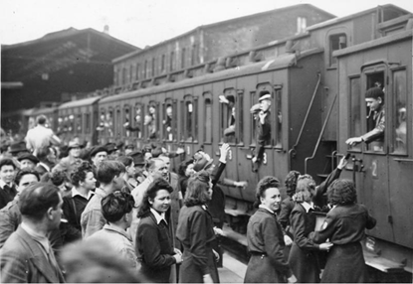
Le service du travail obligatoire
*la loi = the law
*c’était = it was | *le rôle = role
lire
écrire
Now, use your English notes to write answers to the questions in French.
Pourquoi il n'y avait pas suffisamment à manger ?
France supplied products to Germany
France fed the German people and the French people too
France did not succeed in feeding everyone well
Pourquoi la mère de Bastien a travaillé sur une ferme ?
Women worked (in traditionally masculine roles) because the men left
Pourquoi les frères de Bastien sont partis pour l’Allemagne ?
They did not choose to go to Germany
French men served in Germany because it was* the law*
France supplied Germany with almost 650,000 men
French people filled the German soldiers’ roles*)
Notes:
Aim: Written production of verbs like sortir and choisir in the perfect tense; reconstruction of a familiar text in French.
Procedure:
1. On clicks, suggested English answers to the comprehension questions on the previous slide are revealed.
2. Ask students what they think is happening in the picture. Explain that it is an image of French workers leaving for Germany from Paris (1943).
3. Click again to bring up the bubble with instructions for the text recreation task. Students try to recreate the key points in the text using their own notes and/or the English prompts on this slide. These prompts have been written so that students can recreate them using only known vocabulary, known grammar and the three glossed words. Note they will need the help of a dictionary to translate the parts in parenthesis. (6 minutes).
4. Suggested solutions appear on the next slide.
Word frequency of unknown words (1 is the most frequent word in French): loi [267], était [être 5]
Source: Londsale, D., & Le Bras, Y. (2009). A Frequency Dictionary of French: Core vocabulary for learners London: Routledge.
Word frequency of cognates (1 is the most frequent word in French): obligatoire [2524], rôle [371]
Source: Londsale, D., & Le Bras, Y. (2009). A Frequency Dictionary of French: Core vocabulary for learners London: Routledge.
Image attribution Bundesarchiv, Bild 183-J14405 / CC-BY-SA 3.0, CC BY-SA 3.0 DE <https://creativecommons.org/licenses/by-sa/3.0/de/deed.en>, via Wikimedia Commons

Slide 17
Le service du travail obligatoire
*la loi = the law
*était = was | *le rôle = role
écrire
Pourquoi il n'y avait pas suffisamment à manger ?
La France a fourni des produits à l’Allemagne
La France a nourri les Allemands et les Français aussi
La France n’a pas réussi à bien nourrir tout le monde
Pourquoi la mère de Bastien a travaillé sur une ferme ?
Les femmes on travaillé parce que les hommes sont partis
Pourquoi les frères de Bastien sont partis pour l’Allemagne ?
Ils n’ont pas choisi d’aller en Allemagne
Les hommes français ont servi parce que c’était la loi
La France a fourni presque 650,000 hommes à l’Allemagne
Les Français ont rempli les rôles des soldats allemands
Notes:
[3/3] Answers to the activity on the previous slide.

Slide 18
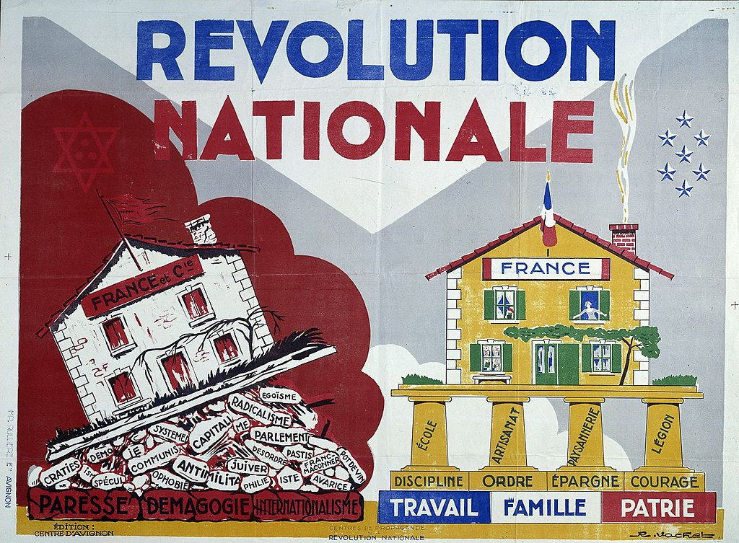
La Révolution nationale
*le droit de grève* = the right to strike la devise* = motto|*la patrie = homeland
info
Pétain a rejeté la devise* « Liberté, Égalité, Fraternité » et la démocratie. Il a choisi une nouvelle devise pour l’État français: « Travail, Famille, Patrie* ». C’est « la Révolution nationale ».
Pendant la Révolution, Pétain a interdit:
la liberté de la presse
le droit de grève*
le divorce
les partis politiques et le suffrage universel
Il a introduit et encouragé:
des lois* antisémites
une éducation traditionnelle et patriotique
une politique de collaboration avec l’Allemagne nazie
Notes:
Timing: 7 minutes [1/5]
Aim: Oral production of –ER verbs and verbs like sortir and choisir in the perfect tense; cultural awareness: La Révolution nationale.
Procedure:
1. Use this slide to introduce the concept of La Révolution nationale. Students look at the propaganda poster and consider the two mottos before suggesting some things Pétain likely did and didn’t value in society.
2. Click to reveal aspects of La Révolution nationale one by one. Ensure students understand the meaning of cognates suffrage universel and antisémite.
3. Explain that in this activity students are going to describe certain aspects of life during la Révolution nationale to one another using a mix of verb types in the perfect tense.
4. Print and distribute the role cards on slide 19.
5. Display slide 20. Partner B sketches 5 boxes in the positions shown on the slide. Partner A translates the first sentence on their role card into French. Partner B listens, and writes a number ‘1’ in the box that is next to the picture they think the sentence represents. NB: this activity can be made more or less challenging by varying the amount of English/French on the role cards, or, at higher levels, encouraging students to come up with their own novel descriptions.
6. Repeat step 5 for four further sentences.
7. Click to reveal answers. Highlight that one of the school subjects taught during the regime was religion. This might come as a surprise as students have learned about laïcité in a previous lesson. Draw attention to the importance of education and media in spreading propaganda.
8. Display slide 21. Ensure students understand the significance of the étoile jaune.
9. Students swap roles. Repeat steps 5-7. Draw attention to the importance of music in spreading propaganda.
10. Proceed to the last slide in this sequence for suggested French sentences.
Word frequency of unknown words (1 is the most frequent word in French): droit [143], grève [1803], devise [3429], loi [267], patrie [3661]
Source: Londsale, D., & Le Bras, Y. (2009). A Frequency Dictionary of French: Core vocabulary for learners London: Routledge.
Word frequency of cognates (1 is the most frequent word in French): rejeter [981], égalité [1891], fraternité [>5000], démocratie [1279], révolution [1617], presse [986], divorce [2561], parti [400], suffrage [3985], universel [1608], encourager [1434], antisémite [>5000], traditionnel [1574], patriotique [>5000], collaboration [2037], nazi [3053]
Source: Londsale, D., & Le Bras, Y. (2009). A Frequency Dictionary of French: Core vocabulary for learners London: Routledge.
Image attribution R. Vachet, Public domain, via Wikimedia Commons

Slide 19
La Révolution nationale
La Révolution nationale
parler
Partenaire B
1. fed my family with great* difficulty. [*grande] 2. I often felt hunger.
3. We did not choose a political party*. [*parti politique]
4. The government forced Jewish people to wear a star* of David. [*une étoile]
5. We sang songs about Pétain and the French state.
Partenaire A
1. Lots of men left.
2. Children studied traditional* subjects. [*traditionnelles]
3. There were no products in the shops.
4. Many French people served abroad/in Germany.
5. The government controlled* the radio. [*contrôler]
Partenaire B
1. fed my family with great* difficulty. [*grande]
2. I often felt hunger.
3. We did not choose a political party*. [*parti politique]
4. The government forced Jewish people to wear a star* of David. [*une étoile]
5. We sang songs about Pétain and the French state.
Partenaire A
1. Lots of men left.
2. Children studied traditional* subjects. [*traditionnelles]
3. There were no products in the shops.
4. Many French people served abroad/in Germany.
5. The government controlled* the radio. [*contrôler]
Partenaire A
1. Lots of men left.
2. Children studied traditional* subjects. [*traditionnelles]
3. There were no products in the shops.
4. Many French people served abroad/in Germany.
5. The government controlled* the radio. [*contrôler]
Partenaire B
1. fed my family with great* difficulty. [*grande]
2. I often felt hunger.
3. We did not choose a political party*. [*parti politique]
4. The government forced Jewish people to wear a star* of David. [*une étoile]
5. We sang songs about Pétain and the French state.
Notes:
[2/5]
Role cards for printing
Word frequency of cognates (1 is the most frequent word in French): traditionnel [1574], contrôler [1069], parti [400], étoile [2776]
Source: Londsale, D., & Le Bras, Y. (2009). A Frequency Dictionary of French: Core vocabulary for learners London: Routledge.

Slide 20
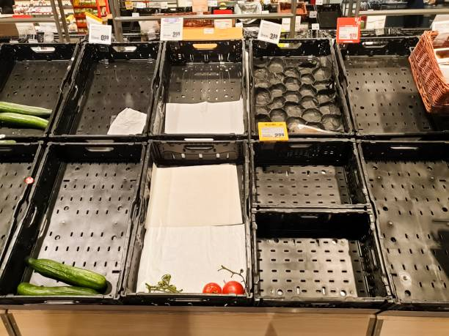
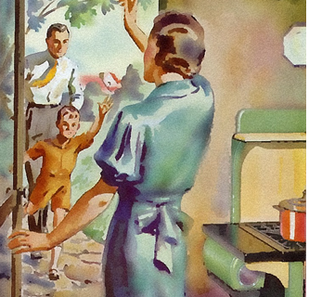
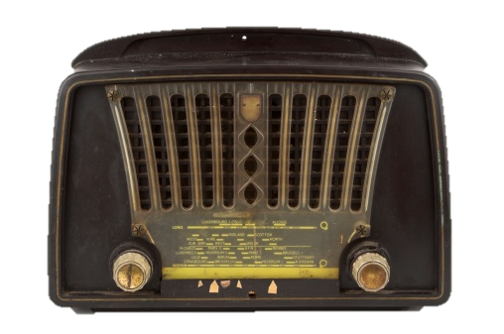
La Révolution nationale (A)
parler
3
Qu’est-ce qu’on a fait ? Qu’est-ce qu’on n’a pas fait ?
4
5
2
1
Notes:
[3/5] Display for partner B while partner A speaks.

Slide 21
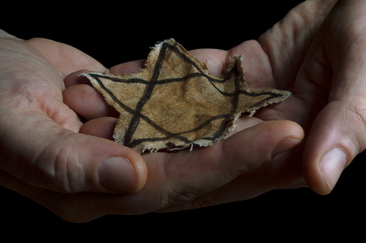
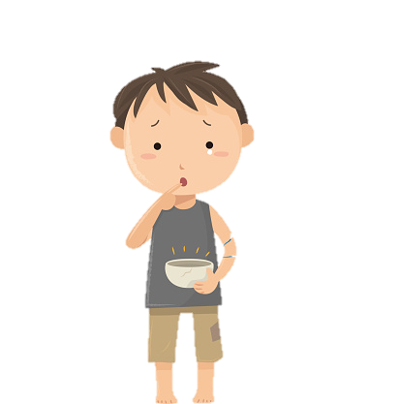
La Révolution nationale (B)
parler
4
Qu’est-ce qu’on a fait ? Qu’est-ce qu’on n’a pas fait ?
1
3
2
5
Notes:
[4/5] Display for partner A while partner B speaks.

Slide 22
La Révolution nationale
parler
Partenaire A
1. Beaucoup d’hommes sont partis.
2. Les enfants ont étudié les matières traditionnelles.
3. Il n’y avait pas de produits dans les magasins.
4. Beaucoup de Français ont servi à l’étranger/en Allemagne.
5. Le gouvernement a contrôlé la radio.
Partenaire B
1. J’ai nourri ma famille avec grande difficulté.
2. J’ai souvent ressenti la faim.
3. On n’a pas/Nous n’avons pas choisi un parti politique.
4. Le gouvernement a obligé les Juifs à porter une étoile de David. 5. Nous avons chanté des chansons sur Pétain et l’État français.
Notes:
[5/5]
Suggested answers to previous.

Slide 23
Introduction à la France occupée et le Régime de Vichy
Perfect tense: Verbs like sortir and choisir
SSCs [ain/in] and [aim/im] (nasal and non-nasal)
Y7 French
Term 3.2 - Week 1 - Lesson 60
Author names: Louise Bibbey / Natalie Finlayson
Artwork by: Chloé Motard
Date updated: 30/05/2022
Notes:
Artwork by Chloé Motard. All additional pictures selected are available under a Creative Commons license, no attribution required.
Native speaker feedback provided by Stéphanie Schmitt.
With thanks to Rachel Hawkes for her input on the lesson material.
Learning outcomes (lesson 2):
Developing knowledge of occupied France and the Vichy regime (1940-1945). This lesson provides a very broad overview of events including French resistance in WW2 and French involvement in the Holocaust/Vel’ d’Hiv’. The language used to describe the events is deliberately simple so that it is accessible to young students who (i) have end of KS3-level knowledge of the French language, and (ii) may have a very limited knowledge of WW2 history. The lesson intends to provide students with basic knowledge of the period that can be built upon in KS4 by exploring these and related events in more detail.
Revision of SSCs [en/an] and [em/am], including non-nasal pronunciation before a vowel
Revision of present and perfect tense forms and uses of verbs like sortir and choisir
Contrasting present and perfect tense forms and uses of verbs like sortir and choisir
Word frequency (1 is the most frequent word in French):
9.3.2.1 (introduce) établir [529], fournir [731], grandir [1936], réussir² (à) [279], ressentir [1593], servir [177], armée [1011], début [364], état [333], fin [111], gouvernement [160], est [4603], nord [1090], ouest [1690], soldat [1098], sud [1242]
9.2.1.6 (revisit) approcher [1576], avoir besoin de [n/a] téléphoner (à) [2448], voler (à) [1610], moi [131], toi [510], crime [819], fréquence [2178], responsabilité [694], sécurité [478], vol [1531], criminel [1411], proche [838], après [82], avant [40], selon [240]
9.2.1.4 (revisit) blesser [2024], jeter [1202], laisser [196], amour [967], envie [1237], mer [921], prix [310], sens [243], tellement [869]
Source: Londsale, D., & Le Bras, Y. (2009). A Frequency Dictionary of French: Core vocabulary for learners London: Routledge.

Slide 24
en/an
enfant
Notes:
Timing: 2 minutes [1/8]
Note: Students have revisited the focus SSCs in this lesson several times. Teacher discretion should be used to determine the time spent on this sequence of eight slides at the beginning of the lesson.
Aim: To consolidate SSC [en/an]
Procedure: 1. Present the letter(s) and say the [en/an] sound first, on its own. Students repeat it with you. 2. Bring up the word ”enfant” on its own, say it, students repeat it, so that they have the opportunity to focus all of their attention on the connection between the written word and its sound.
3. A possible gesture for this would be to mime patting a child on the head/back 4. Roll back the animations and work through 1-3 again, but this time, dropping your voice completely to listen carefully to the students saying the [en/an] sound, pronouncing ”enfant” and, if using, doing the gesture.
Word frequency (1 is the most frequent word in French):
enfant [126]. Source: Londsale, D., & Le Bras, Y. (2009). A Frequency Dictionary of French: Core vocabulary for learners London: Routledge.

Slide 25
en/an
grand
quand ?
?
enfant
penser
encore
prendre
[to take]
Notes:
[2/8]
Aim: To consolidate SSC [en/an]
Procedure:
1. Introduce and elicit the pronunciation of the individual SSC [en/an] and then the source word again ‘enfant’ (with gesture, if using). 2. Then present and elicit the pronunciation of the five cluster words.
The cluster words have been chosen for their high-frequency, from a range of word classes, with the SSC (where possible) positioned within a variety of syllables within the words (e.g. initial, 2nd, final etc.). Additionally, we have tried to use words that build cumulatively on previously taught SSCs (see the Phonics Teaching Sequence document) and do not include new SSCs. Where new SSCs are used, they are often consonants which have a similar symbol-sound correspondence in English.
Word frequency (1 is the most frequent word in French): grand [59]; quand [119] penser [116]; prendre[43]; encore [51]; enfant [126]. Source: Londsale, D., & Le Bras, Y. (2009). A Frequency Dictionary of French: Core vocabulary for learners London: Routledge.

Slide 26
em/am
[time]
temps
Notes:
[3/8]
Aim: To consolidate SSC [em/am]
Procedure: 1. Present the letter(s) and say the [em/am] sound first, on its own. Students repeat it with you. 2. Bring up the word ”temps” on its own, say it, students repeat it, so that they have the opportunity to focus all of their attention on the connection between the written word and its sound.
3. A possible gesture for this would be to look at your wrist as though checking your watch. 4. Roll back the animations and work through 1-3 again, but this time, dropping your voice completely to listen carefully to the students saying the [em/am] sound, pronouncing ”temps” and, if using, doing the gesture.
Word frequency (1 is the most frequent word in French):
temps [65]
Source: Londsale, D., & Le Bras, Y. (2009). A Frequency Dictionary of French: Core vocabulary for learners London: Routledge.

Slide 27
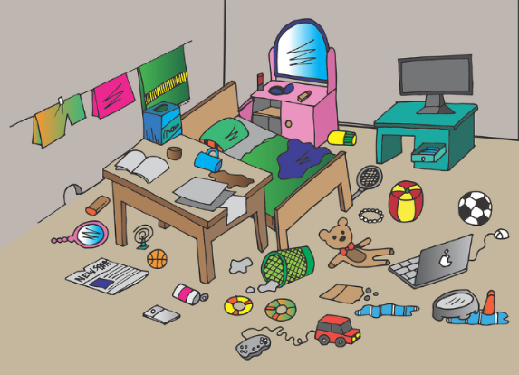
em/am
camp
chambre
ensemble
[time]
printemps
temps
[together]
[spring]
ressembler (à)
[to look like]
Notes:
[4/8]
Aim: To consolidate SSC [em/am]
Procedure:
Introduce and elicit the pronunciation of the individual SSC [em/am] and then the source word again ‘temps’ (with gesture, if using). Then present and elicit the pronunciation of the five cluster words. The cluster words have been chosen for their high-frequency, from a range of word classes, with the SSC (where possible) positioned within a variety of syllables within the words (e.g. initial, 2nd, final etc.). Additionally, we have tried to use words that build cumulatively on previously taught SSCs (see the Phonics Teaching Sequence document) and do not include new SSCs. Where new SSCs are used, they are often consonants which have a similar symbol-sound correspondence in English.
Word frequency (1 is the most frequent word in French): camps [1084]; chambre [633] ensemble [124]; printemps [1288]; temps [65]; ressembler [1398]. Source: Londsale, D., & Le Bras, Y. (2009). A Frequency Dictionary of French: Core vocabulary for learners London: Routledge.

Slide 28
a
animal
Notes:
[5/8]
Aim: To consolidate SSC [a]
Procedure: 1. Present the letter(s) and say the [a] sound first, on its own. Students repeat it with you. 2. Bring up the word ”animal” on its own, say it, students repeat it, so that they have the opportunity to focus all of their attention on the connection between the written word and its sound.
3. A possible gesture for this would be to mimic an animal’s motion, perhaps holding ones arms and hands close to the chest as ‘paws’. 4. Roll back the animations and work through 1-3 again, but this time, dropping your voice completely to listen carefully to the students saying the [a] sound, pronouncing ”animal” and, if using, doing the gesture.
Word frequency (1 is the most frequent word in French):
animal [1002]
Source: Londsale, D., & Le Bras, Y. (2009). A Frequency Dictionary of French: Core vocabulary for learners London: Routledge.

Slide 29
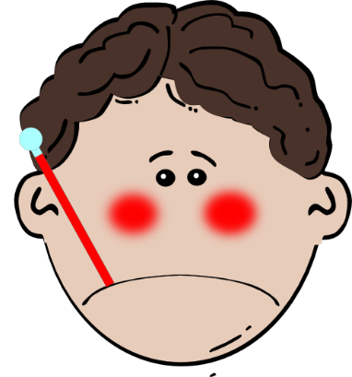
a
ça va ?
table
animal
malade
sac
mal
[badly]
Notes:
[6/8]
Aim: To consolidate SSC [a]
Procedure:
1. Introduce and elicit the pronunciation of the individual SSC [a] and then the source word again ‘animal’ (with gesture, if using). 2. Then present and elicit the pronunciation of the five cluster words.
The cluster words have been chosen for their high-frequency, from a range of word classes, with the SSC (where possible) positioned within a variety of syllables within the words (e.g. initial, 2nd, final etc.). Additionally, we have tried to use words that build cumulatively on previously taught SSCs (see the Phonics Teaching Sequence document) and do not include new SSCs. Where new SSCs are used, they are often consonants which have a similar symbol-sound correspondence in English.
Word frequency (1 is the most frequent word in French): animal [1002]; ça va? [54 (cela), 53 (aller)]; malade [1066] mal [277]; table [1019]; sac [2343] Source: Londsale, D., & Le Bras, Y. (2009). A Frequency Dictionary of French: Core vocabulary for learners London: Routledge.

Slide 30
e
je
Notes:
[7/8]
Aim: To consolidate SSC [e]
Procedure: 1. Present the letter(s) and say the [e] sound first, on its own. Students repeat it with you. 2. Bring up the word ”je” on its own, say it, students repeat it, so that they have the opportunity to focus all of their attention on the connection between the written word and its sound.
3. A possible gesture for this would be to point to oneself. 4. Roll back the animations and work through 1-3 again, but this time, dropping your voice completely to listen carefully to the students saying the [e] sound, pronouncing ”je” and, if using, doing the gesture.
Word frequency (1 is the most frequent word in French):
je [22]. Source: Londsale, D., & Le Bras, Y. (2009). A Frequency Dictionary of French: Core vocabulary for learners London: Routledge.

Slide 31
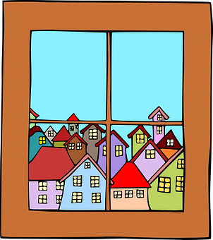
e
fenêtre
cela
[that]
je
second
cheval
devoir
[to have to]
Notes:
[8/8]
Aim: To consolidate SSC [e]
Procedure:
1. Introduce and elicit the pronunciation of the individual SSC [e] and then the source word again ‘je’ (with gesture, if using). 2. Then present and elicit the pronunciation of the five cluster words.
The cluster words have been chosen for their high-frequency, from a range of word classes, with the SSC (where possible) positioned within a variety of syllables within the words (e.g. initial, 2nd, final etc.). Additionally, we have tried to use words that build cumulatively on previously taught SSCs (see the Phonics Teaching Sequence document) and do not include new SSCs. Where new SSCs are used, they are often consonants which have a similar symbol-sound correspondence in English.
Word frequency (1 is the most frequent word in French): fenêtre [1604]; cela [54] second [379]; devoir [39]; cheval [2220]; je [22]. Source: Londsale, D., & Le Bras, Y. (2009). A Frequency Dictionary of French: Core vocabulary for learners London: Routledge.

Slide 32
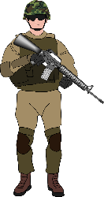
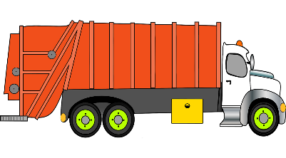
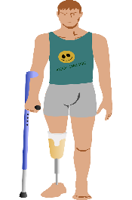
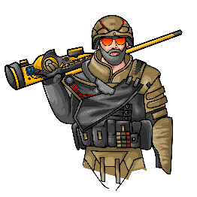
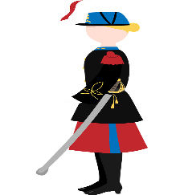
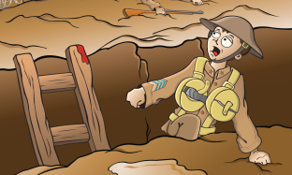
Les voyelles nasales
Are the vowels in bold nasal or non-nasal?
lire/parler
Remember that the nasal SSCs [em/am] and [en/an] become non-nasal sounds before a vowel.
bombardement [bombing]
ennemi
[enemy]
empire
[empire]
camion
[lorry]
amputé
[amputee]
grenade
[grenade]
combattant
[fighter]
super puissance
[super power]
vétérane
[veteran (f)]
vétéran
[veteran (m)]
tranchée
[trench]
Notes:
Timing: 5 minutes
Aim: Written recognition and production of nasal SSCs [em/am] and [en/an] and non-nasal SSCs [a]/[e] + m/n.
Procedure:
1. Use slides 24-31 to revise the sounds. Remind students that SSCs [em/am] and [en/an] sound identical.
2. Remind students that when [em/am] and [en/an] appear before a vowel, they are pronounced as non-nasal vowels + m/n. Grenade could be used as an example to illustrate this.
3. Working in pairs, students use the rules to sound out the words and decide whether the sounds in bold are nasal or non-nasal.
4. Click to reveal the answers. Click on the images to hear the words said aloud by a native speaker.
Transcript:
bombardement ennemi empire
amputé
camion tranchée combattant super puissance grenade vétérane vétéran
Word frequency of unknown words (1 is the most frequent word in French): camion [2542], super puissance [n/a], tranchée [2145]
Source: Londsale, D., & Le Bras, Y. (2009). A Frequency Dictionary of French: Core vocabulary for learners London: Routledge.
Word frequency of cognates used (1 is the most frequent word in French): bombardement ][3565], ennemi [1725], empire [3367], amputé [>5000], grenade [>5000], combattant [2374], vétérane [>5000], vétéran [>5000]
Source: Londsale, D., & Le Bras, Y. (2009). A Frequency Dictionary of French: Core vocabulary for learners London: Routledge.

Slide 33
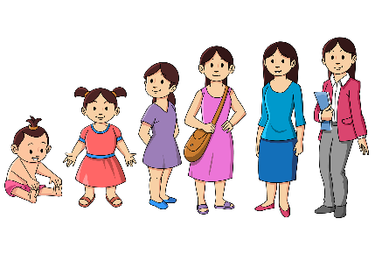
Le Grand Prix vocabulaire
Dis les mots plus vite que ton/ta partenaire pour gagner !
parler
ressentir
to feel + noun
fournir
to supply, supplying
réussir
to pass an exam,
to make a success of
2.
4.
établir
6.
to set up, setting up;
to establish, establishing
1.
servir
to serve, serving
7.
3.
grandir
to grow up, growing up
to succeed in, succeeding in
réussir à
5.
soldier
le soldat
12.
13.
le nord
north
16.
east
l’est
la fin
end
le début
17.
beginning, start
8.
le gouvernement
government
l’état (m)
10.
state
l’ouest
west
le sud
15.
army
south
9.
l’armée
14.
11.
Notes:
Timing: 3 minutes
Aim: Oral speed recall of this week’s new vocabulary.
Procedure:
1. Students compete against a partner to be the quickest to recall the words in this week’s vocabulary set.
2. Students time each other and check their partner’s translations. If they spot a mistake, the partner must repeat the correct translation three times, thereby incurring a time penalty!
3. The student who completes the track in the fastest time (or gets furthest along the track in the available time) is the winner.

Slide 34
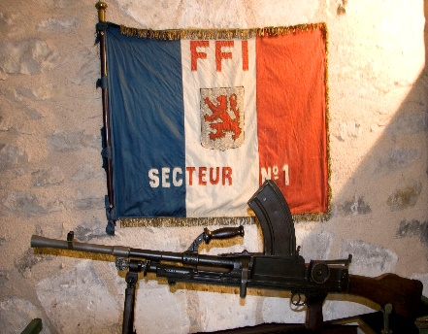
La Résistance française
*envahir = to invade *cacher = to hide
info
Après l’invasion des Allemands en France, beaucoup de personnes ont résisté.
Des groupes de jeunes Français ont attaqué les soldats allemands. Des familles ont caché* des personnes juives dans leurs maisons. D’autres personnes ont aidé des agents secrets anglais qui sont arrivés pour aider.
Mais, résister est dangereux. Beaucoup de résistants ont payé un prix considérable pour leurs efforts. Les Allemands ont arrêté*, blessé, tué ou déporté leurs ennemis.
Notes:
Timing: 1 minute
Aim: To provide key background information on the aims and activities of the French WW2 Resistance, which is the main topic of this lesson. Note that the text is unlikely to be parsed in a minute at most levels. It is intended to serve as background to the context of this lesson. It could be set as homework for pre-reading, and summarised in English at the beginning of the class.
Procedure:
1. Talk through the text with the students, pointing out the many verb cognates. Ensure students understand the meaning of déporter in this context.
Word frequency (1 is the most frequent word in French):
envahir [2566], cacher [914]
Source: Londsale, D., & Le Bras, Y. (2009). A Frequency Dictionary of French: Core vocabulary for learners London: Routledge.
Word frequency of cognates used (1 is the most frequent word in French): résister [>5000], attaquer [1018], arrêter [420], déporter [>5000]
Source: Londsale, D., & Le Bras, Y. (2009). A Frequency Dictionary of French: Core vocabulary for learners London: Routledge.

Slide 35
Nous avons aidé la Résistance!
*la nourriture = food
*l’ennemi (m) = the enemy
*marquer = to mark *envahir = to invade
écrire
Bastien et sa mère ont eu envie d'aider les résistants. Voici les souvenirs de Bastien. Traduis.
I grew up during the war.
J’ai grandi pendant la guerre.
The soldiers of the German army succeeded in invading the north and the west.
Les soldats de l’armée allemande ont réussi à envahir* le Nord et l’Ouest.
The French government served the enemy*.
Le gouvernement français a servi l’ennemi.
In the south and east, we felt fear.
Dans le Sud et l’Est, nous avons ressenti la peur.
We set up the Resistance in 1940, at the start of the war.
Nous avons établi la Résistance en 1940, au début de la guerre.
We supplied the Resistance with extra food*.
Nous avons fourni de la nourriture supplémentaire à la Résistance.
The 24th August 1944 marks* the end of the French state.
Le 24 août 1944 marque la fin de l’État français.
Notes:
Timing: 8 minutes
Aim: Written production of this week’s new vocabulary in longer contexts.
Procedure:
Students translate the sentences into French. This can be done on paper or on mini whiteboards. At higher levels, the teacher might wish to remove the box of glossed words and encourage students to research the unknown terms in a dictionary.
Draw attention to the words in bold, as this is the key vocabulary in the lesson.
Click to reveal answers.
Word frequency (1 is the most frequent word in French): nourriture [2285], envahir [2566],
Source: Londsale, D., & Le Bras, Y. (2009). A Frequency Dictionary of French: Core vocabulary for learners London: Routledge.
Word frequency of cognates used (1 is the most frequent word in French): ennemi [1715], marquer [454]
Source: Londsale, D., & Le Bras, Y. (2009). A Frequency Dictionary of French: Core vocabulary for learners London: Routledge.

Slide 36
Present vs perfect: Sortir and choisir
In spoken French, the presence or absence of an auxiliary verb is the only way to tell whether a verb like choisir is in the past or present tense. je choisis j’ai choisi
grammaire
Verbs like sortir look and sound very different in the present and perfect tenses.
Singular forms of verbs like choisir look and sound quite similar in these tenses.
present perfect present perfect
je/j’ sors suis sorti(e) choisis ai choisi
tu sors es sorti(e) choisis as choisi
il/elle/on sort est sorti(e) choisit a choisi nous sortons sommes sorti(e)(s) choisissons avons choisi vous sortez êtes sorti(e)(s) choisissez avez choisi ils/elles sortent sont sorti(e)(s) choisissent ont choisi
The past participle and present tense forms of verbs like choisir sound identical.
Listen out for an auxiliary verb to know whether the verb is in past or present.
Notes:
Timing: 3 minutes
Aim: To revisit and contrast present and perfect tense forms of verbs like sortir and choisir.
Procedure:
1. Click to bring up the sortir paradigm. Draw attention to the very different look and sound of the verbs in this tense. Remind students that sortir takes être as its auxiliary and draw attention to the participle agreement.
2. Click to bring up the choisir paradigm. Draw attention to the very different look and sound of the plural forms of verbs in this tense.
3. Focusing on the singular forms only, elicit pronunciation of the present tense. Draw attention to the SFC, and point out that although these forms look different from the past participle in reading, they sound identical in listening.
4. Click to bring up the bubble with spoken examples of je choisis and j’ai choisi. Students listen and repeat. This primes for the listening exercise on the next slide.

Slide 37
Present vs perfect: Choisir
écouter
Qui parle du présent, et qui parle du passé ? Écoute attentivement !
passé
1
présent
présent
2
passé
passé
3
présent
présent
4
passé
présent
5
passé
Notes:
Timing: 2 minutes
Aim: To practise distinguishing orally between verbs like choisir in the past and present. This simple exercise illustrates that singular forms of verbs like choisir sound identical to the past participle.
Procedure:
1. Click on the numbers to hear a man a woman saying the same sentence in different tenses.
2. Students must identify which tense each person is using.
3. Click to reveal the answers.
Transcript:
J’ai réfléchi à l’idée. Je réfléchis à l’idée.
Tu réagis vite. Tu as réagi vite.
On établit une entreprise. On a établi une entreprise.
Il a réussi ses examens. Il réussit ses examens.
Elle grandit ici. Elle a grandi ici.

Slide 38
Des emplois à temps partiel
*l’indice (m) = evidence
*le rayon = shelf
écouter
florist
kennels
Aurélie et Élodie parlent des emplois à temps partiel.
Qui travaille où ? Et qui travaillait où ? Écris tes indices* !
bakery
university
1
supplied products to several businesses
smelled the scent of flowers
chose to study languages
filled the shelves in the library
2
Aurélie dans le passé
Abdel dans le passé
3
4
5
serves meals to clients
fills glasses
feeds cats
takes dogs out in the park
6
7
Élodie
aujourd’hui
Amir
aujourd’hui
8
Notes:
Timing: 7 minutes
Aim: Oral recognition of verbs like sortir and choisir in the past and present tenses; listening comprehension.
Procedure:
1. Explain to students that they are going to hear Aurélie et Élodie talk about part time jobs that members in their family have or used to have. They will say some things that members of their family do or used to do at work. Students must use both grammatical and lexical clues to assign the four places of work to the characters.
2. Clarify that the conversation is between the two female characters. The same voice is used for both Élodie and Aurélie, so students will have to listen attentively to work out who is talking.
3. Clarify that information will be given about Aurélie and Abdel in the past tense, and about Élodie and Amir in the present.
4. Clarify the pronunciation of le rayon which is an unknown word that appears in the text.
5. Click on a number to hear a sentence read aloud. Students use the verb tense and pronoun to work out who is speaking or being spoken about. They take notes in English next to that person. For example, in the first sentence, je sers tells students Élodie is speaking (about herself in the present tense), so they write ‘serves meals to clients’ in one of the spaces next to her name.
6. Repeat step 4 for eight sentences.
7. Students read their English notes and assign a place of work to each character.
8. Pieces of evidence appear on clicks, followed by the solutions.
Transcript:
Je sers des repas aux clients.
Il a choisi d’étudier les langues.
J’ai fourni des produits à plusieurs entreprises.
J’ai établi une entreprise de pain.
Il nourrit des chats.
Je remplis des verres.
Il a rempli des rayons de bibliothèque.
Il sort des chiens dans le parc.
Word frequency of unknown words (1 is the most frequent word in French): indice [2138], rayon [2926]
Source: Londsale, D., & Le Bras, Y. (2009). A Frequency Dictionary of French: Core vocabulary for learners London: Routledge.

Slide 39
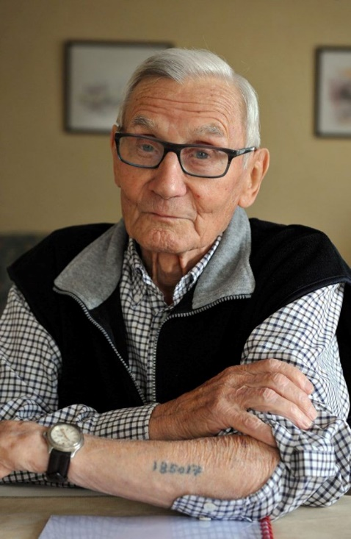
Témoins* de l’Holocauste
info
Jean Bascle a résisté aux Allemands.
Avec ses amis, il a volé des documents d’un bureau du Service du Travail Obligatoire.
Après, il a jeté les documents dans un fleuve.
Les Allemands ont arrêté et déporté Jean.
Le voyage de déportation, dans un train pour les animaux, a duré trois jours.
Il a passé un an dans un camp de concentration. Il a été témoin de l’arrivée et de la disparition* de familles juives dans le camp.
*témoin = witness,
*disparition = disappearance
Notes:
Timing: 1 minute
Aim: To provide key background information on the deportation of members of the French Resistance and introduce Jean Bascle, who is the subject of the activities that follow.
Procedure:
Click to go through information, clarifying the terms related to the Holocaust where necessary.
Attributions
Louise Bibbey (NCELP assistant resource developer) assisted director Martyn Cox on a project interviewing and filming members of the French Resistance as part of a wider project on veterans in the UK and France. Together they filmed around 25 interviews with male and female veterans, many of whom had been awarded the legion of honour or juste parmi les nations, including two concentration camp survivors. They twice hosted the BBC in France, helping with the production of two globally televised documentaries for BBC World.
They have a large archive of photos and documents, much of which is stored in the Archive of Resistance Testimony at the University of Sussex, under the leadership of Professor Rod Kedward, a leading academic in the field of French Resistance. They have kindly given NCELP to have full access to these and permission to use them in their resources.
Photograph: Louise Bibbey (with full publishing rights accorded by Jean Bascle in 2009).
Word frequency (1 is the most frequent word in French): témoin [1055], disparition [2077]
Source: Londsale, D., & Le Bras, Y. (2009). A Frequency Dictionary of French: Core vocabulary for learners London: Routledge.

Slide 40
Jean Bascle: mes mémoires de la guerre
Cherche les phrases dans le texte.
Sont-elles au passé ou au présent ?
Écris des phrases en anglais.
Mémoires de Jean Bascle
lire
Quand les Allemands ont envahi la France en 1940, j’ai ressenti de la colère*. Quand les armées envahissent* d'autres pays aujourd'hui, je ressens de la tristesse*. Pendant la guerre, j'ai servi mon pays dans la Résistance. J'ai réussi à créer des problèmes pour les Allemands, mais des soldats m'ont arrêté. Je suis parti dans un camp de concentration, et maintenant je ne dors pas bien parce que je fais des mauvais rêves.
Je sers encore mon pays quand je parle de la guerre aux enfants. Le gouvernement a menti aux Français pendant la guerre. Dans notre monde, il y a toujours des gouvernements qui mentent aux gens. C'est terrible !
I felt anger - PASSÉ
to feel anger
the armies invade - PRÉSENT
to invade
I feel sadness - PRÉSENT
to feel sadness
I served my country - PASSÉ
to serve one’s country
to succeed in creating problems
I succeeded in creating problems for the Germans - PASSÉ
to leave for a concentration camp
I left for a concentration camp - PASSÉ
to sleep well
I do not sleep well - PRÉSENT
to still serve one’s country
I still serve my country - PRÉSENT
to lie to the French
the government lied to the French - PASSÉ
to lie to the people
governments that lie - PRÉSENT
*envahir (like choisir) = to invade|la colère = anger|tristesse = sadness|mentir (like choisir) = to lie
Notes:
Timing: 6 minutes
Aim: Written recognition of present and perfect tense forms of verbs like choisir and sortir in a longer text.
Procedure:
Students draw a table with two columns, one for the past tense, one for the present.
The students read the text and locate the verbs. In English, they note down the subject/verb combinations in the correct tense in English (at higher levels, the teacher might want to increase the degree of information given).
The teacher elicits answers from the students and clicks to confirm the answers.
Students could also be asked to translate the passage into English as an extension activity. Alternatively, where the same verb appears in two tenses, students could be asked to compared what Jean did then, and does now (e.g., served his country in the resistance; serves his country now when he talks about the war to children.
More explanation of what a concentration camp was may be required.
The teacher may also wish to expand the concept of governments that lie to the people as a point of discussion.
Word frequency (1 is the most frequent word in French): colère [1568], envahir [2566], tristesse [3989], arrêter [420], cauchemar [3689], mentir [2683]
Source: Londsale, D., & Le Bras, Y. (2009). A Frequency Dictionary of French: Core vocabulary for learners London: Routledge.
Word frequency of cognates used (1 is the most frequent word in French): résistance [>5000], camp [>5000], concentration [2355], terrible [1310]
Source: Londsale, D., & Le Bras, Y. (2009). A Frequency Dictionary of French: Core vocabulary for learners London: Routledge.

Slide 41
Vel’ d’Hiv’
Le Vél' d'Hiv'
*avant de connaître = before experiencing
info
La police française a souvent aidé les Allemands, et ils ont arrêté des personnes qui ont résisté.
Le 6 et le 7 juillet 1942 à Paris, c’est le Rafle du Vél' d'Hiv' [the Winter Velodrome roundup]. les Allemands ont obligé la police française à arrêter les familles juives. Plus de 13,000 juifs ont passé cinq jours horribles dans le vélodrome, avant de connaître* la déportation et la mort* dans les camps de concentration.
En 1945, les soldats alliés* ont libéré l’Europe occupée. Ils ont trouvé tellement des camps de concentration partout. Des millions de personnes sont mortes dans ces camps.
*mort = death, alliés = allies, libérer = liberate
Notes:
Timing: 1 minute
Aim: To provide key background information on French involvement in the Holocaust and the liberation of occupied Europe, which are the topic of the activities that follow.
Word frequency (1 is the most frequent word in French): mort [276], alliés [>5000], libérer [>5000]
Source: Londsale, D., & Le Bras, Y. (2009). A Frequency Dictionary of French: Core vocabulary for learners London: Routledge.

Slide 42
C’est 1945 et Jean décrit son parcours*. Écris les verbes dans le temps correct.
écrire
Parcours* d’un jeune résistant
Vel’ d’Hiv’
After the war, the French struggled to come to terms with the state’s complicity in the Holocaust.
In 1995, President Jacques Chirac was the first French leader to publicly recognise the responsibility of the French state in the deportation and death of thousands of Jews.
Quand les Allemands ont envahi le zone ‘libre’ en 1942, j’ai réagi.
envahir
réagir
Berlin
La même année, mes amis et moi ont servi dans un groupe de résistance dans la ville de Cahors.
servir
Buchenwald
Auschwitz-Birkenau
Flossenbürg
Paris
Le 25 février 1944, la police nous* a saisis.
saisir
Le 27 avril 1944, à Paris, nous avons commencé un terrible voyage dans un train qui a fini sa course au camp de concentration d’Auschwitz.
Cahors
finir
envahir
[to invade]
finir
saisir
[to seize]
réagir
Maintenant c’est 1945 et les Américains libèrent le camp. Je sors du camp très malade, et je reviens en France. Lentement, on ressent le calme.»
Verbs like choisir
sortir
ressentir
sortir
servir
ressentir
Verbs like sortir
*nous = us | *parcours = journey
Notes:
Timing: 6 minutes [1/2]
Aim: Written production of verbs like choisir and sortir in the past and present tenses.
Procedure:
1. This activity comes with a printable gap-fill sheet (see next slide) but can be also be done using mini whiteboards.
2. Explain to students that they need to used contextual clues in the text to decide (i) what tense the verbs need to be in, and (ii) with which subjects they must agree.
3. Click to reveal the correct answers.
4. Click again to reveal the note on accountability. See below for further reading.
Useful articles on accountability:
https://www.jta.org/archive/chirac-hailed-for-recognizing-french-states-role-in-holocaust
Chirac Hailed for Recognizing French State’s Role in Holocaust, Jewish Telegraphic Agency (17th July 1995)
https://www.theguardian.com/world/2009/feb/17/france-admits-deporting-jews
France responsible for sending Jews to concentration camps, says court, The Guardian (17th February 2009)
https://www.theguardian.com/world/2017/jul/17/france-macron-denounces-state-role-holocaust-atrocity-paris-1942
'France organised this': Macron denounces state role in Holocaust atrocity, The Guardian (17th July 2017)
Word frequency (1 is the most frequent word in French): parcours [2717], bestial [>5000]
Source: Londsale, D., & Le Bras, Y. (2009). A Frequency Dictionary of French: Core vocabulary for learners London: Routledge.
Word frequency of cognates used (1 is the most frequent word in French): zone [>5000], résistance [>5000], résistant [>5000], camp [>5000], concentration [2355], terrible [1310], américain [374], libérer [1190]
Source: Londsale, D., & Le Bras, Y. (2009). A Frequency Dictionary of French: Core vocabulary for learners London: Routledge.
Photographs: Louise Bibbey (with full publishing rights accorded by Jean Bascle in 2009).

Slide 43
On parle d’images émouvantes
*émouvant = touching
*pensées = thoughts
parler
Jean
Les images, elles t'affectent comment ? Décris tes émotions et les actions ou pensées* des personnes. Utilise les verbes au présent et au passé. Trouve des mots supplémentaires dans un dictionnaire si nécessaire.
1
Des idées pour commencer les phrases…
Dans la photo 4, les garçons ont …
Quand je regarde la photo 1, je réfléchis à …
Dans la cinqurième photo, Jean…
4
2
choisir
grandir
établir
servir
réagir
réussir (à)
ressentir
réfléchir
sortir
partir
3
5
Notes:
Timing: 5 minutes
Aim: To produce sentences using past and present tense forms of verbs like choisir and sortir.
Procedure:
Give students 1 minute to write down some ideas for sentences using the verbs provided
Students can be given additional time to look up words in their dictionary (such as adjectives for describing feelings).
Split students into small groups (3-6 students). Model the task using this slide.
Word frequency (1 is the most frequent word in French): pensée [1269]
Source: Londsale, D., & Le Bras, Y. (2009). A Frequency Dictionary of French: Core vocabulary for learners London: Routledge.
Word frequency of cognates used (1 is the most frequent word in French): Source: Londsale, D., & Le Bras, Y. (2009). A Frequency Dictionary of French: Core vocabulary for learners London: Routledge.
Photographs: Louise Bibbey (with full publishing rights accorded by Jean Bascle in 2009).

Slide 44
Devoirs
Vocabulary Learning Homework (Y9, Term 3.2, Week 2)
Quizlet link: Y9 Term 3.2 Week 2
Quizlet QR code:

