Slide 1

Quizlet Guide
David Shanks
Date updated: 23/02/2021
Notes:
Handout 4. Quizlet Guide

Slide 2
Introduction
Quizlet is an online digital flashcard website and mobile app that allows learners the opportunity to practise pre-existing and custom-made vocabulary lists (called “sets”) that contain pairs of “terms” and “definitions”.
The sets can be studied in 5 different study modes – Flashcards, Learn, Write, Spell and Test. Match and Gravity game modes can also be played individually by learners.
This guide is designed for teachers to show the range of features Quizlet offers and tips on its use. Equally, you may use parts of this guide to show students how to use Quizlet effectively. Live demoing the Quizlet website itself to students is also useful.
A Quizlet Teacher account (free 30-day trial, £35.99 per year) can be used to organise sets into classes and folders, track student progress and much more. For now, we would recommend using one account for each department.
A student account is free. You can always sign up as a student to explore and understand how Quizlet works if you do not want to sign up for the free Quizlet Teacher account.
For the TRG we recommend you go through each of the study modes carefully to fully familiarise yourself with Quizlet (TPACK’s Technological Knowledge). The layout and functions have recently been updated and it’s important to understand both the student and teacher experience.
David Shanks

Slide 3
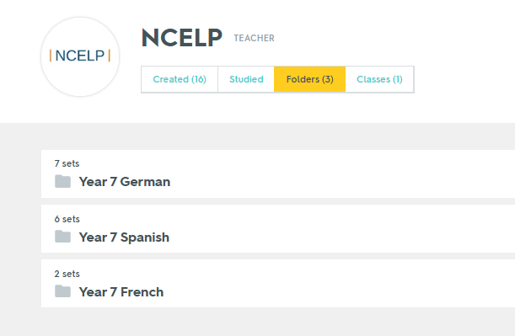
Key Links
https://quizlet.com – new sign up / login / user homepage
https://quizlet.com/NCELP - NCELP’s user page containing NCELP vocabulary sets that can be practised and, ideally, copied to your account. Click “Folders” to browse by language and year group.
https://quizlet.com/features/quizlet-teacher-guide-getting-started - a range of videos for teachers to get started on using Quizlet
David Shanks

Slide 4
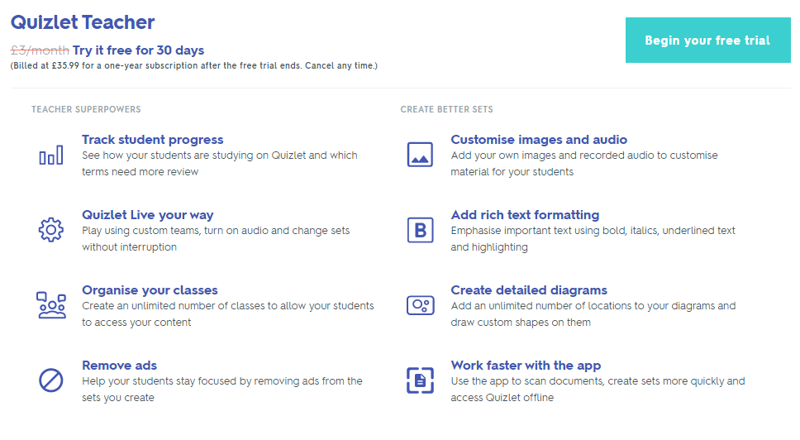
Quizlet Teacher
https://quizlet.com/upgrade?showTeacher
David Shanks

Slide 5
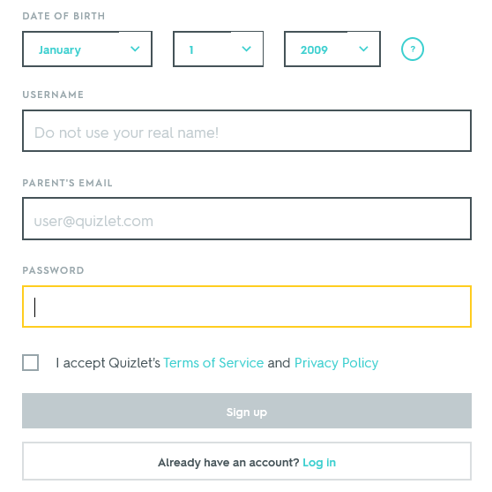
Signing Up
Choose a sensible username for yourself e.g. Mr_Shanks or department e.g. SWBGS_MFL
For students, you will need to check you have permission in school to use Quizlet and comply with GDPR.
Some schools might have a blanket policy already cleared with parents for certain websites, so check your local process. If not, you might need to contact/write to parents specifically.
For students under a certain age, a parental email is requested as shown.
If students aren’t asked for a parental email, they should use a school email address if possible.
A good idea would be to trial setting up Quizlet with students in 1 class in order to iron out the process in your school’s context.
David Shanks

Slide 6
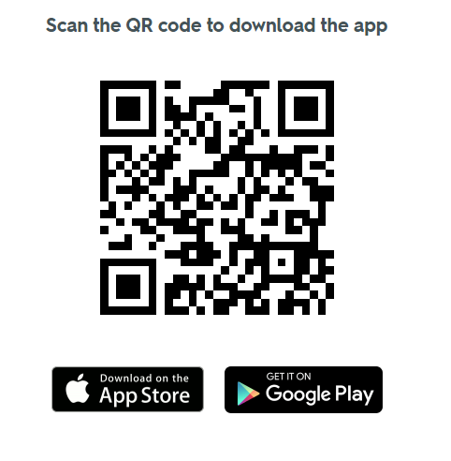
The Quizlet Mobile App
Many students may have a mobile device and more readily access the mobile app than the desktop version of Quizlet.
Learn, Flashcards, Write, Match and Test modes only are available and are presented differently on the smaller screen with more limited features.
However, work and progress completed by a logged in student will still be recorded. For the TRG, we recommend using the desktop website version.
Quizlet Mobile App
David Shanks

Slide 7
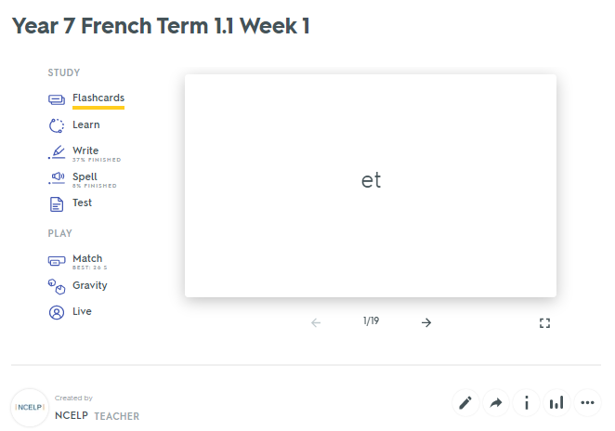
Set Homepage
This page allows you to access all the available study modes that are described later in this guide.
Click “flashcards” to enter full screen mode. From here, term order and audio options can be chosen.
In full screen mode, the cursor keys can be used to scroll through (left-right) and flip over the flashcard (up-down).
David Shanks

Slide 8
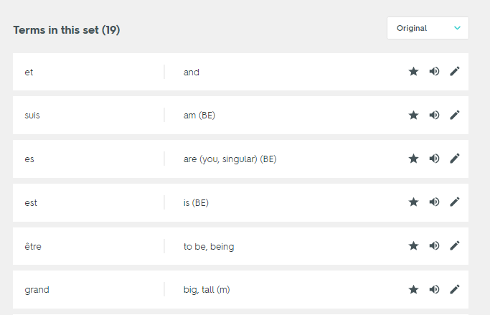
Set Homepage
Scrolling downwards on the set’s homepage shows the full list of vocabulary.
Icons can be used to star terms for additional practice, listen to audio and edit text.
NB – Quizlet will ignore content in brackets. Items separated by a comma are considered different possible answers. In write mode, both answers are required.
David Shanks

Slide 9

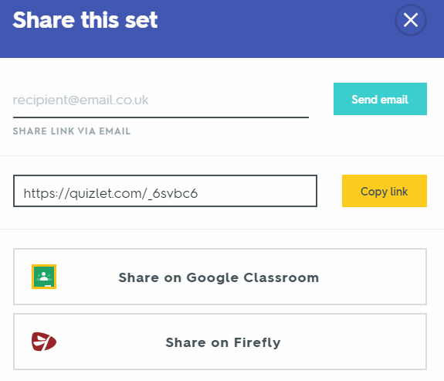
Set Homepage
The circular icons underneath the flashcard on the set’s homepage allow you to perform a range of very useful functions:
View student progress in this set across study modes and searchable by date
Edit the set name, edit terms, import or export lists as raw text e.g. from Word/Excel
Information on the number of students studying, folders and classes that this set belongs to
David Shanks

Slide 10
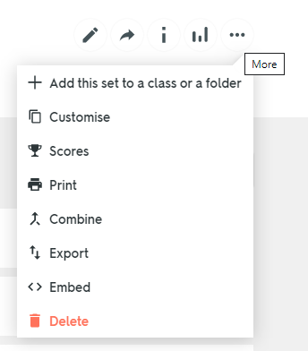
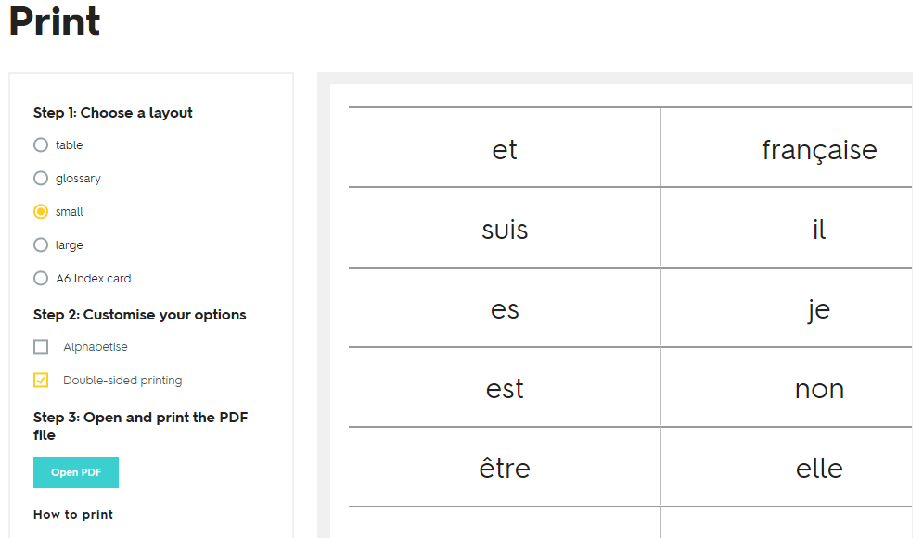
Set Homepage
The ellipse icon is particularly useful and leads to the set functions below
“Print” offers a variety of vocab list and double-sided flashcard formats
David Shanks

Slide 11
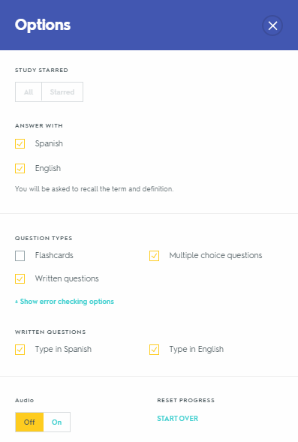
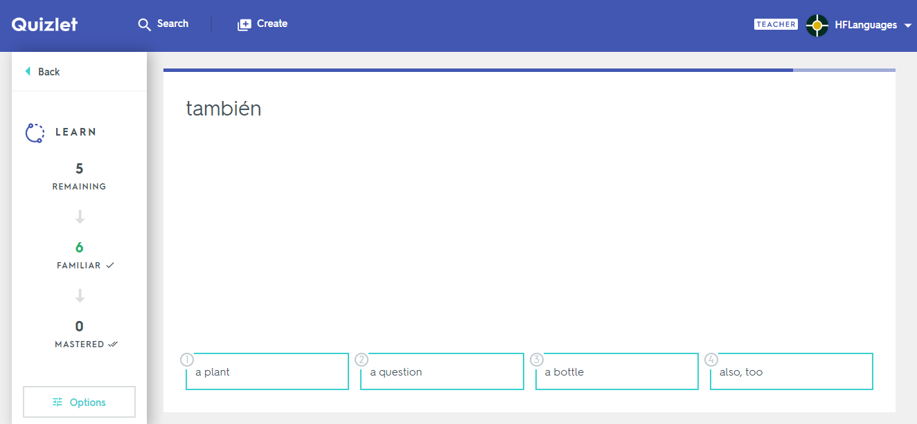

Customising Options
The options in each study mode can be customised by clicking the options button. This is important for students to know so they can turn on/off audio, swap translation direction, change question types and error checking options (e.g. accept 1 of 2 possible answers as correct)
David Shanks

Slide 12
Study Modes
The following 3 slides give an overview of the study modes and could be shared with students
Do explore each of the study modes yourself to familiarise yourself with the requirements and features of each
In particular, explore the functionality of the “options” button in each mode
David Shanks

Slide 13
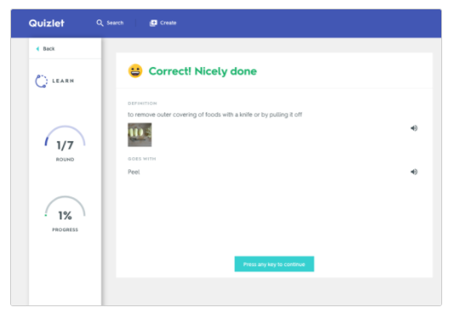
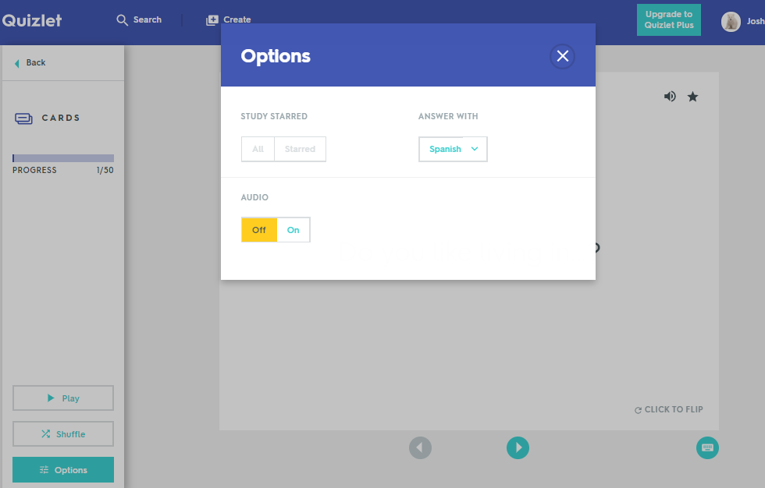
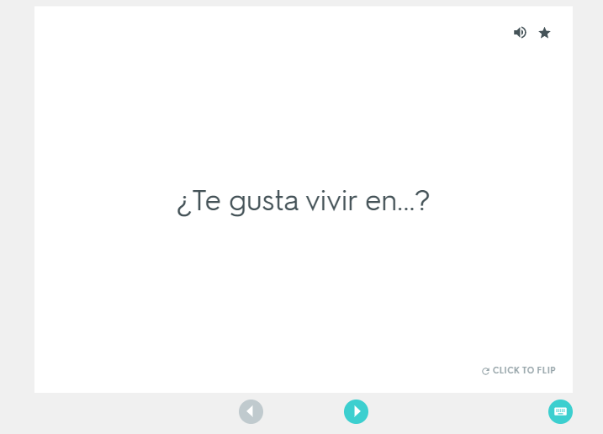
Quizlet Flashcards and Learn
Quizlet is a fun way to learn vocab. If you are new to a study set, make sure you start off by accessing Flashcards and Learn.
Flashcards
Learn
Flashcards mode lets you study Quizlet sets as flashcards. After you click on the Flashcards mode icon, you'll see the first definition (SP/GM/FR) in your set displayed. You can change the order and audio by clicking on the Options button. You can also print your flashcards.
Learn will quiz you with different types of questions including flashcards, true/false, multiple choice and written. As you begin to progress and answer questions correctly more consistently, Learn will advance you from easier questions (true/false and multiple choice) to harder ones (written).
Paula Vázquez-Valero, Comberton Village College

Slide 14
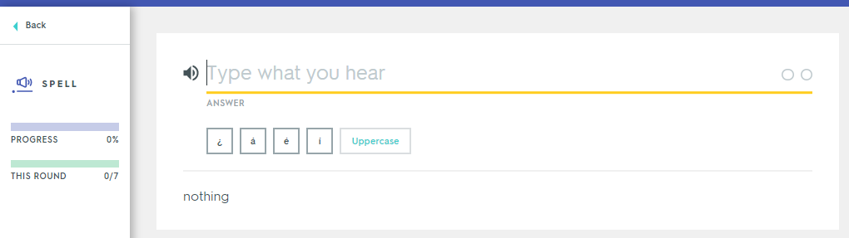
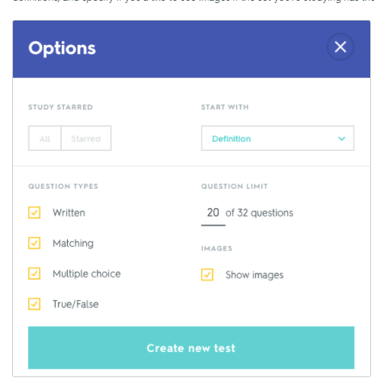
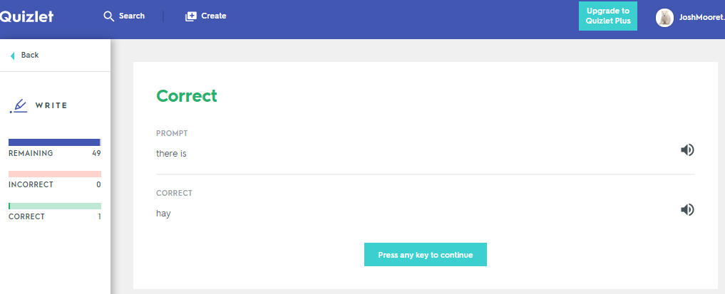
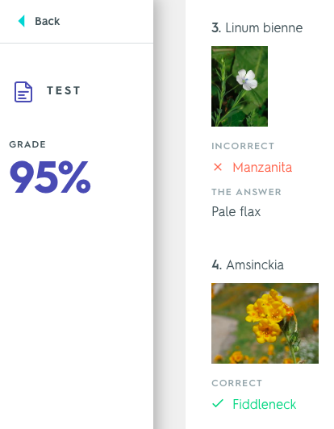
Spell, Test and Write
Spell
Test
Use Test mode to practise before a quiz or exam to make sure you've got the material down. You can choose different combinations of question types depending on what works best for you.
Spell lets you type what you hear to practise your listening and spelling.
Write
If you missed any questions, Test mode will show you which were wrong along with the right answer as you scroll down the page.
Write measures how well you know your words and keeps track of what you miss so you can focus on those terms later in your study session.
Paula Vázquez-Valero, Comberton Village College

Slide 15
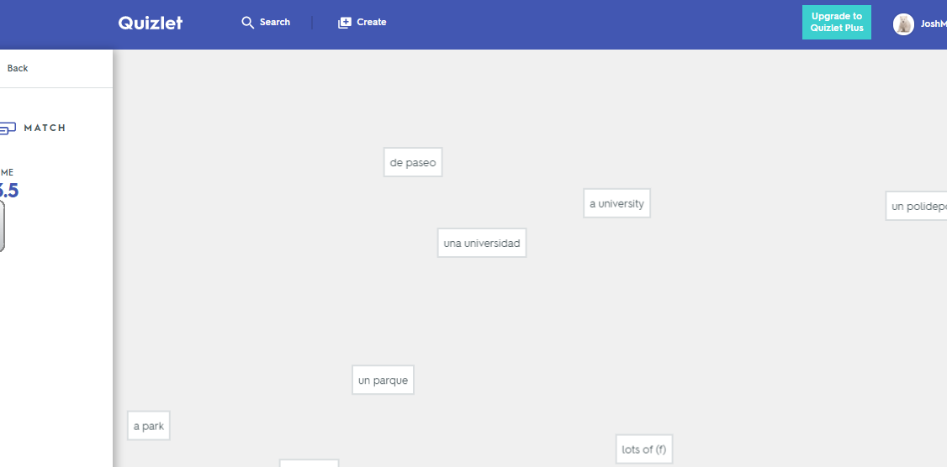
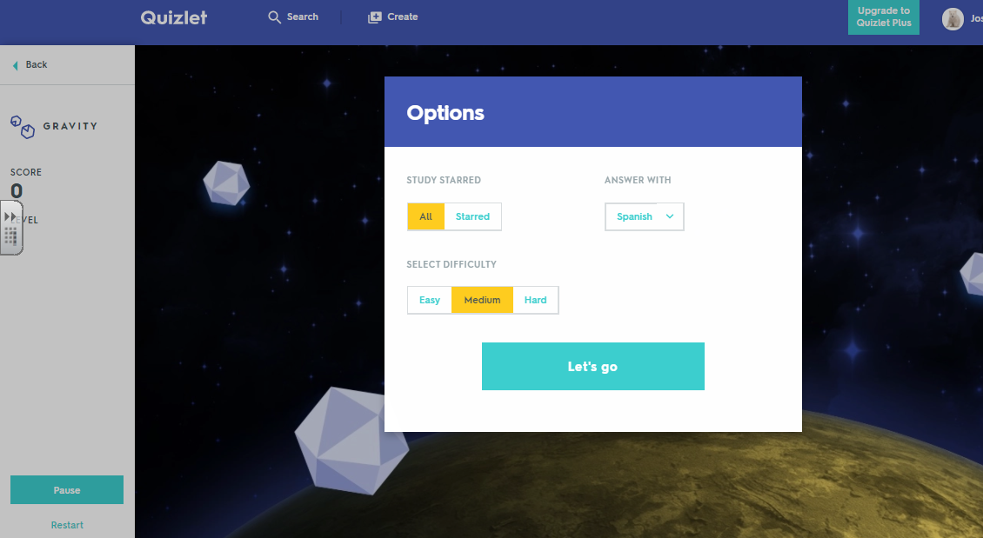
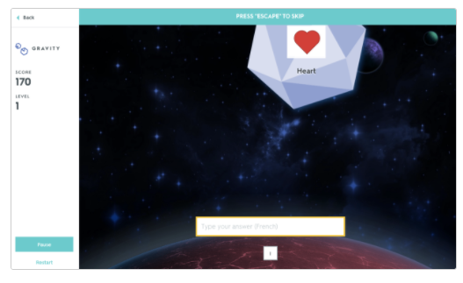
Match and Gravity
Gravity
Match
  Type your answers as the asteroids fall. Each right answer gets you one step closer to levelling up. As you pass levels, the force of gravity increases and the asteroids start to fall faster for added challenge.
Race against the clock to match your terms and definitions as quickly as possible — and compete with your classmates for the top score!
You can configure your game settings. The level of difficulty you pick determines how quickly your terms or definitions fall. On Easy, your terms will always fall slowly. If you choose Medium they'll start slowly and increase in speed. Should you choose hard, they'll start falling quickly.
To get points for an answer, you have to type it in correctly before the asteroid falls past the answer text box at the bottom of the screen. If you're not sure of an answer, you can press the Escape key to skip it and Gravity will show it to you again later.
If you miss an answer, you'll be prompted to retype it before moving on.
Paula Vázquez-Valero, Comberton Village College

Slide 16
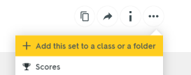
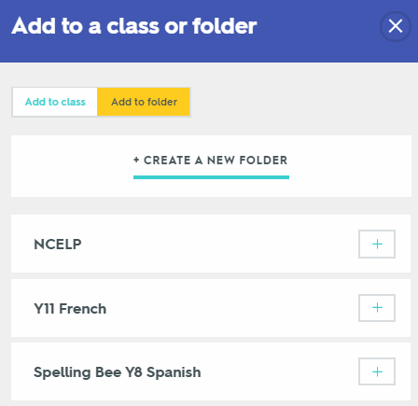
Copying sets from NCELP
Customise button
One beauty of Quizlet is the ability to copy existing content (sets) from other users!
Once logged in, in the search bar type NCELP (filter by user) or go to https://quizlet.com/NCELP
Navigate to the set you want to copy to your own sets/folders/classes
Click the ellipse button and + Add this set to a class or folder
Add the set to an existing folder or class using the + button
Alternatively, create a new folder (or class)
You now have the NCELP set in your folders/classes – go back to your homepage to check and see what this looks like
You can also click the customise button to create a new set based upon that from NCELP. This is useful as you can rename the set title and make any amendments you wish
David Shanks

Slide 17
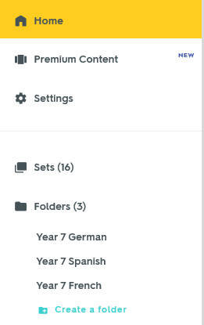

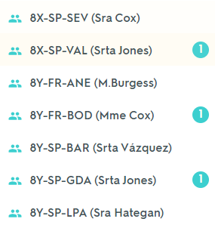
Folders and Classes
From your user homepage, on the left hand side you will see your sets, folders and classes listed
Folders allow you to organise your sets logically e.g. Year 7 French
To create a folder, click + Create a folder
Classes allows you to add study sets from folders and monitor students’ progress.
Label your folders, classes and sets in a clear and logical way for both teachers and students to navigate e.g.
David Shanks

Slide 18
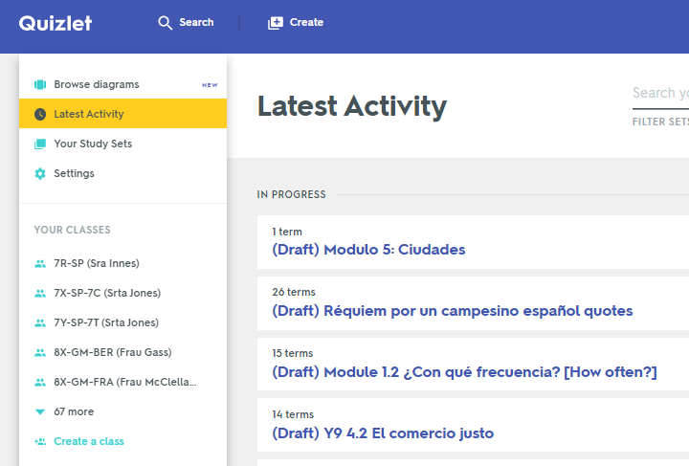
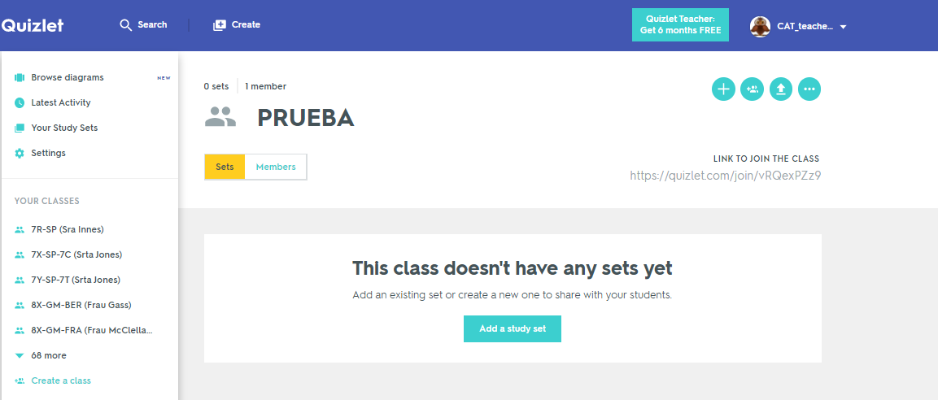
Creating Classes
From your homepage, click + create a class
Label it including your name and select your school
You now need to a) add sets to your class from folders b) add students to your class
David Shanks

Slide 19
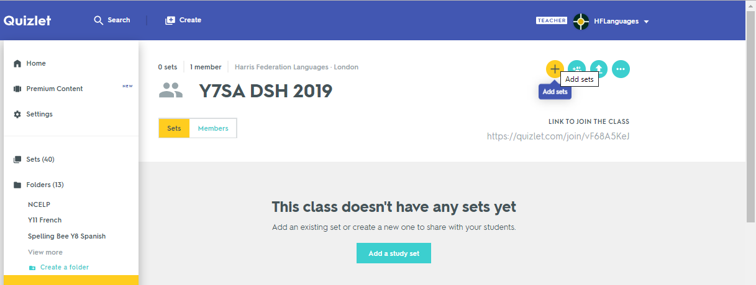
Adding Sets to Classes
There are 2 ways to do this:
  Go to your class and click the + button, and then choose your set
  Go to your set, click the ellipse and then + Add this set to a class or folder
David Shanks

Slide 20
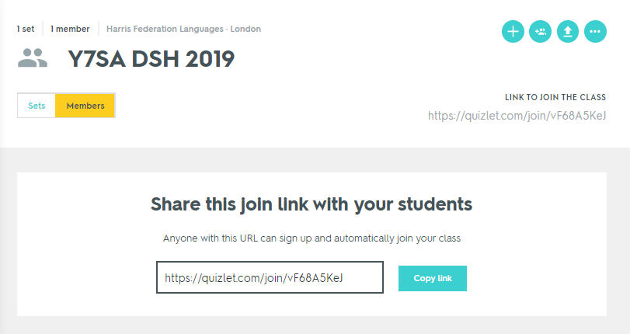
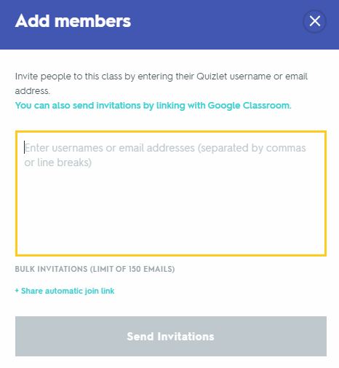
Inviting Students to Your Class
Navigate to your class to get a link you can share directly with students (as text or via a virtual learning platform)
You will need to accept students’ requests to join the class
Alternatively, click the add members icon and add usernames/email addresses

Slide 21
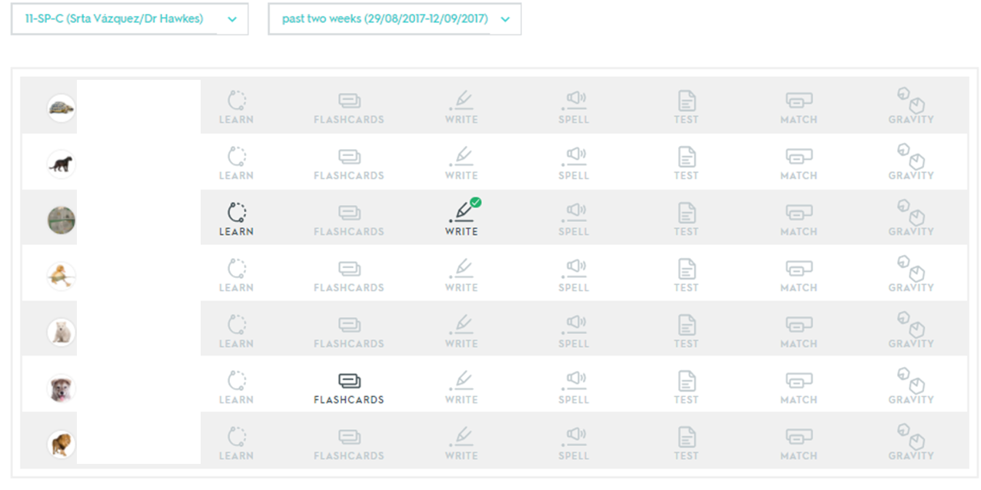
Monitoring student progress
Once your class is set up with members and sets, you can monitor student progress
Go to the class and click the view class progress graph icon
You could set students the task of completing all or particular study modes on Quizlet for homework
A green tick indicates the section has been completed
David Shanks

Slide 22



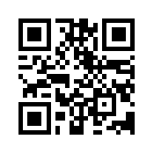
Possible TRG Tasks
Sign up as a learner or free Quizlet Teacher trial Choose username wisely!
Explore and become familiar with the different modes. It’s important to know how students will experience Quizlet
Adapt study modes through the options button (which language comes first, audio on/off, error correction settings)
Create folders and add sets to folders
Copy a set from someone else (NCELP!)
The edit button → for editing terms and definitions
The share button → for sharing the link with students
The ellipse button → printing flashcard and vocab list options
Create a set from scratch (using the import text function)
Create a class and assign sets to the class
Combine 2 sets (for revisiting)
Create a qrcode using qrstuff.com
Investigate using Quizlet Live
Getting started on Quizlet
David Shanks

