Slide 1
Phonics
Revisiting SSC [z]
Y7 Spanish
Term 3.1 - Week 1
Author names: Amanda Izquierdo / Nick Avery /
Rachel Hawkes
Date updated: 16/05/20

Slide 2
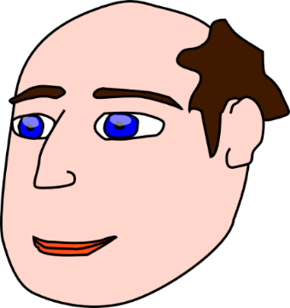
z
voz
diez
cabeza
zapato
zona
empezar
[to start]
Notes:
Introduce and elicit the pronunciation of the individual SSC ‘z’ and then the source word again (with gesture, if using). Then present and elicit the pronunciation of the five cluster words.
The cluster words have been chosen for their high-frequency, from a range of word classes, with the SSC (where possible) positioned within a variety of syllables within the words(e.g. initial, 2nd, final etc..) and additionally, we have tried to use words that build cumulatively on previously taught SSCs (see the Phonics Teaching Sequence document) and do not include new SSCs. Where new SSCs are used, they are often consonants which have a similar symbol-sound correspondence in English.

Slide 3
z
voz
diez
cabeza
zapato
zona
empezar
Notes:
Without the images, students focus this time again closely on the SSC and the cluster words.

Slide 4
z
voz
diez
cabeza
zapato
zona
empezar
Notes:
Without the images or sound, students have to pronounce the words themselves.

Slide 5
Remember there are different ways to pronounce ‘z’.
In most of Spain, ‘z’ is pronounced like the ‘th’ in English (as you just heard).
In the Canary Islands and Latin America, this ‘z’ is often pronounced like an ‘s’.
Compare:
naturaleza
(mainland Spain)
1
naturaleza
(Canaries & Latin America)
2
Notes:
Click on the orange number to hear the word.
In this slide students are reminded of the two possible pronunciations of ’z’ in the Spanish speaking world (as discussed in 1.2 Week 1). In this case, a word from the vocabulary to be revisited this week is being used.

Slide 6
Escucha.
¿Dónde está la persona?
Escucha otra vez y escribe la frase. ¿Qué significa?
 | España | Latinoamérica / Canarias
Frase | ¿Qué significa?
1
Hay pájaros azules en los árboles de la zona.
There are blue birds in the trees of the area.
2
Debo organizar los zapatos.
I must organise the shoes.
3
La plaza está a la izquierda.
The square is on the left.
Debes empezar un dibujo de la naturaleza.
You must start a drawing of nature.
4
Tiene diez ideas en la cabeza.
S/he has ten ideas in the head.
5
Notes:
Transcript:
Hay pájaros azules en los árboles de la zona;
Debo organizar los zapatos;
La plaza está a la izquierda;
Debes empezar un dibujo de la naturaleza;
Tiene diez ideas en la cabeza;
All of the phonics source and cluster words have been used, here, plus some of the vocabulary to be revisited this week has been used: T2.2 Week 3: deber [71]; debo; debes; organizar [1053] T2.1 Week 3: naturaleza [712]; pájaro [1607]; azul [811]; árbol [748]
Image with creative commons public domain licence
https://mycsres.com/freesheet/spanish-speaking-world-map-18.html.html

Slide 7
escuchar
How many times in each sentence do you hear the sound ‘z’? Tally each time. Write the words in Spanish if you can.
z | palabras
1
naturaleza
La persona, ¿está en España o en Latinoamérica / Canarias?
2
zona
plaza
3
organizan
zapatos
izquierda
4
Zara
diez
5
cabeza
azul
Notes:
TRANSCRIPT
Pasa tiempo en la naturaleza.
En la zona hay una plaza.
Organizan los zapatos a la izquierda.
Zara compra diez camisas.
La cabeza del pájaro es azul.
The person speaking pronounces with ‘distinción’ in all sentences – “La persona está en España”.
All vocabulary here has been seen by students either as source/cluster words (as per lesson 1 in this sequence) or in previous vocab sets.

