Slide 1
Saying what we think about things
Verbs with indirect objects [2]
SSC [ei] and [ie] revisited
Y8 German
Term 2.1 - Week 2 - Lesson 31
Author name(s): Inge Alferink / Rachel Hawkes
Artwork: Steve Clarke
Date updated: 10/8/21
Notes:
Artwork by Steve Clarke. All additional pictures selected are available under a Creative Commons license, no attribution required.
Learning outcomes (lesson 1):
Consolidation of SSC [ei] and contrast with [ie]
Introduction to second set of R3 (dative) verbs – those without word-for-word English translations
Word frequency (1 is the most frequent word in German):
8.2.1.2 (introduce) fehlen [420] gefallen [601] gehören [460] meinen [213] tun [123] Leid [1300] Meinung [787] fit [4080] weh [2798] dass [22] schwer [257]
8.1.2.5 (revisit) anderer, andere, anderes [59] Aktivität [1422] Hobby [3608] Jugendclub [2117/1360] Schloss [1907] Telefon [1595] langsam [526] normal [642] schnell [203] gern [278] 8.1.1.6 (revisit) verbringen [1391] Auge [222] Gesicht [346] Haar [748] Haare [748] Mund [856] Nase [1264] Schüler [557] Zeit [96] ähnlich [437] breit [847] dünn [1739] neu [84] rund [298] als [22]
Source: Jones, R.L & Tschirner, E. (2019). A frequency dictionary of German: Core vocabulary for learners. London: Routledge.
The frequency rankings for words that occur in this PowerPoint which have been previously introduced in NCELP resources are given in the NCELP SOW and in the resources that first introduced and formally re-visited those words.
For any other words that occur incidentally in this PowerPoint, frequency rankings will be provided in the notes field wherever possible.

Slide 2
ei
frei
Notes:
Timing: 1 minute
Aim: To introduce/consolidate SSC [ei]
Procedure: 1. Present the letter(s) and say the [ei] sound first, on its own. Students repeat it with you. 2. Bring up the word ”frei” on its own, say it, students repeat it, so that they have the opportunity to focus all of their attention on the connection between the written word and its sound.
3. A possible gesture for this would be to stretch both arms up in the air (pointing outwards slightly to make a Y shape with your body), and smile!
4. Roll back the animations and work through 1-3 again, but this time, dropping your voice completely to listen carefully to the students saying the [ei] sound, pronouncing ”frei” and, if using, doing the gesture. Word frequency (1 is the most frequent word in German): frei [318] Source: Jones, R.L. & Tschirner, E. (2006). A frequency dictionary of German: core vocabulary for learners. Routledge

Slide 3
ei
frei
Notes:
With sound and no pictures to focus all attention on the sound-symbol correspondence.

Slide 4
ei
frei
Notes:
Without sound to elicit pronunciation (without first hearing the teacher).
Teacher to elicit pronunciation by asking “Wie sagt man…”

Slide 5
ei
leider
ein
[unfortunately]
/a
frei
klein
allein
sein
[alone]
[to be]
Notes:
Timing: 2 minutes
Aim: To introduce/consolidate SSC [ei]
Procedure:
Introduce and elicit the pronunciation of the individual SSC [ei] and then the source word again ‘frei’ (with gesture, if using).
Then present and elicit the pronunciation of the five cluster words.
The cluster words have been chosen for their high-frequency, from a range of word classes, with the SSC (where possible) positioned within a variety of syllables within the words (e.g. initial, 2nd, final etc.). Additionally, we have tried to use words that build cumulatively on previously taught SSCs (see the Phonics Teaching Sequence document) and do not include new SSCs. Where new SSCs are used, they are often consonants which have a similar symbol-sound correspondence in English.
Word frequency (1 is the most frequent word in German): frei [318]; leider [642] ein [5]; klein [114]; sein [3]; allein [258]. Source: Jones, R.L. & Tschirner, E. (2006). A frequency dictionary of German: core vocabulary for learners. Routledge

Slide 6
ei
leider
ein
frei
klein
allein
sein
Notes:
With sound and no pictures to focus all attention on the sound-symbol correspondence.

Slide 7
ei
leider
ein
frei
klein
allein
sein
Notes:
Without sound to elicit pronunciation (without first hearing the teacher).
Teacher to elicit pronunciation by asking “Wie sagt man…”

Slide 8
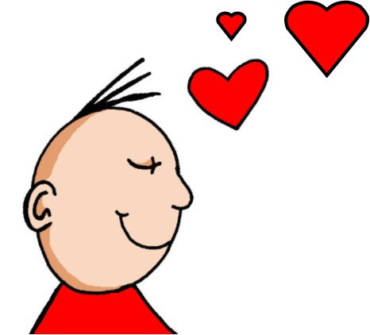
ie
Liebe
Notes:
Timing: 1 minute
Aim: To introduce/consolidate SSC [ie]
Procedure: 1. Present the letter(s) and say the [ie] sound first, on its own. Students repeat it with you. 2. Bring up the word ”Liebe” on its own, say it, students repeat it, so that they have the opportunity to focus all of their attention on the connection between the written word and its sound.
3. A possible gesture for this would be to fold both hands over your heart, and smile!
4. Roll back the animations and work through 1-3 again, but this time, dropping your voice completely to listen carefully to the students saying the [ie] sound, pronouncing ”Liebe” and, if using, doing the gesture. Word frequency (1 is the most frequent word in German): Liebe [843]
Source: Jones, R.L. & Tschirner, E. (2006). A frequency dictionary of German: core vocabulary for learners. Routledge

Slide 9
ie
Liebe
Notes:
With sound and no pictures to focus all attention on the sound-symbol correspondence.

Slide 10
ie
Liebe
Notes:
Without sound to elicit pronunciation (without first hearing the teacher).
Teacher to elicit pronunciation by asking “Wie sagt man…”

Slide 11
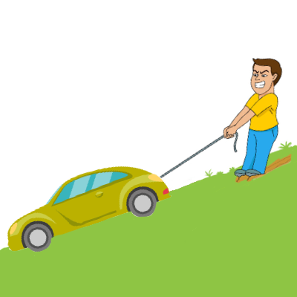
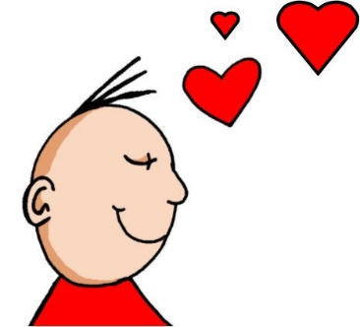
ie
ziehen
sie
Liebe
tief
Brief
liegen
2000 Kilometer
Notes:
Timing: 2 minutes
Aim: To introduce/consolidate SSC [ie]
Procedure:
Introduce and elicit the pronunciation of the individual SSC [ie] and then the source word again ‘Liebe’ (with gesture, if using).
Then present and elicit the pronunciation of the five cluster words.
The cluster words have been chosen for their high-frequency, from a range of word classes, with the SSC (where possible) positioned within a variety of syllables within the words (e.g. initial, 2nd, final etc.). Additionally, we have tried to use words that build cumulatively on previously taught SSCs (see the Phonics Teaching Sequence document) and do not include new SSCs. Where new SSCs are used, they are often consonants which have a similar symbol-sound correspondence in English.
Word frequency (1 is the most frequent word in German): Liebe [843]; ziehen[266] sie [10]; tief [506]; liegen [118]; Brief [813].
Source: Jones, R.L. & Tschirner, E. (2006). A frequency dictionary of German: core vocabulary for learners. Routledge

Slide 12
ie
ziehen
sie
Liebe
tief
Brief
liegen
Notes:
With sound and no pictures to focus all attention on the sound-symbol correspondence.

Slide 13
ie
ziehen
sie
Liebe
tief
Brief
liegen
Notes:
Without sound to elicit pronunciation (without first hearing the teacher).
Teacher to elicit pronunciation by asking “Wie sagt man…”

Slide 14
Phonetik
hören
ei
ie
frei
Liebe
Notes:
Timing: 5 seconds Aim: To recap the two source words before the listening task on the next slide.

Slide 15
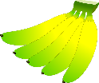
Welcher Buchstabe ist das? A, B, C…?
hören
Hör zu. Schreib 1-6 und A, B, C…
Biene
Beine
1
2
3
Wiese
Weise
Wein
Wien
4
5
Leib
lieb
hieß
heiß
Schein
schien
reif
rief
6
A
B
C
D
E
F
G
H
Antworten:
4
6
1
5
2
3
Notes:
Timing: 3 minutes Aim: To practise recognition of minimal pairs with SSC [ei] and [ie]
Procedure:
1. Click on a number to hear a recording. Students listen and follow the correct pathway, taking the left- or right-hand branch in each case according to which SSC they hear, [ei] or [ie].
2. The answers are animated and appear on clicks.
Transcript:
1. Biene, Weise, hieß 2. Beine, Wein, schien
3. Beine, Wien, reif
4. Biene, Wiese, Leib
5. Beine, Wein, Schein
6. Biene, Wiese, Lieb
Frequencies

Slide 16
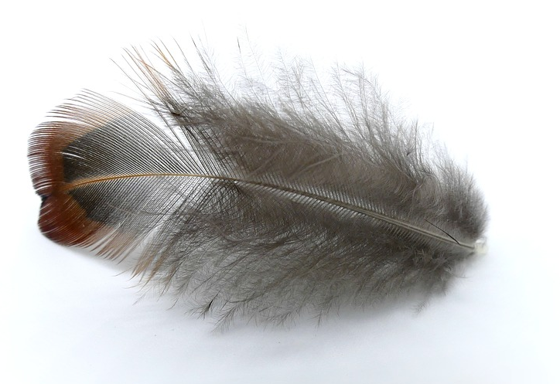
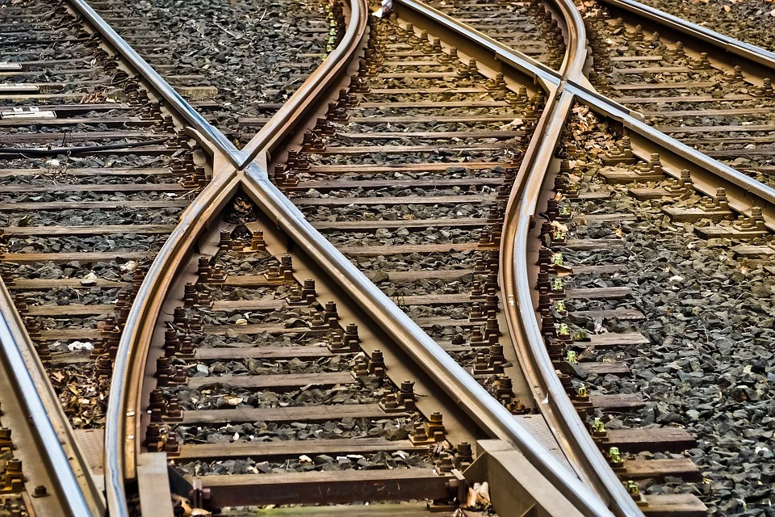
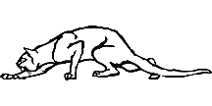
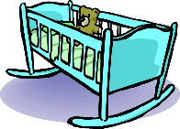
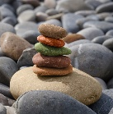
Phonetik
lesen / sprechen
60
Schiene [rail]
weich [soft]
Stein [stone]
biegen [bend]
Teich [pond]
fliehen [to flee]
Reis [rice]
schleichen [slink]
Sekunden
Leiter [ladder]
Frieden [peace]
beißen [to bite]
Wiege [crib]
Kiesel [pebble]
Sieg [victory]
Scheitel [parting]
Fliege [fly]
0
LOS!
Notes:
Timing: 1 minute for practice + 1 minute for saying them out loud Aim: To practise SSCs in unfamiliar word context. The time limit helps automatization. Procedure: 1. Students take 60 seconds to practise saying the words out loud to themselves. Click LOS! to start the timer.
2. Then teacher clicks and each word flashes a couple of times before disappearing. Students have to pronounce the word (in chorus) – teacher checks pronunciation this week (as Covid prevents circulating round the class currently).
Word frequency (1 is the most frequent word in German): Schiene [>5000], weich [1836], Stein [1404], biegen [2986], Teich [>5000], fliehen [2824], Reis [>5000], schleichen [4008], Leiter [1321], Frieden[1478], beißen [>5000], Wiege [>5000], Kiesel [>5000], Sieg [1246], Scheitel [>5000], Fliege [>5000]
Source: Jones, R.L. & Tschirner, E. (2019). A frequency dictionary of German: core vocabulary for learners. Routledge

Slide 17
Vokabeln
lesen
gefallen
Schüler
tun
Auge
gehören
langsam
rund
Zeit
gern
schnell
dünn
verbringen
fehlen
breit
neu
als
normal
Notes:
Vokabeln Timing: 3 minutes
Aim: To practise recall of meaning of words in this week’s revisited sets in the written modality.
Procedure: 1. On click a word appears.
2. Write down the translation before the word disappears.
Word frequency (1 is the most frequent word in German):
8.2.1.2 (introduce) fehlen [420] gefallen [601] gehören [460] meinen [213] tun [123] Leid [1300] Meinung [787] fit [4080] weh [2798] dass [22] schwer [257]
8.1.2.5 (revisit) anderer, andere, anderes [59] Aktivität [1422] Hobby [3608] Jugendclub [2117/1360] Schloss [1907] Telefon [1595] langsam [526] normal [642] schnell [203] gern [278] 8.1.1.6 (revisit) verbringen [1391] Auge [222] Gesicht [346] Haar [748] Haare [748] Mund [856] Nase [1264] Schüler [557] Zeit [96] ähnlich [437] breit [847] dünn [1739] neu [84] rund [298] als [22]
Source: Jones, R.L & Tschirner, E. (2019). A frequency dictionary of German: Core vocabulary for learners. London: Routledge

Slide 18
Vokabeln
lesen
to please, pleasing
pupil
gefallen
Schüler
to do, doing
eye
tun
to belong, belonging
Auge
gehören
round
time
slow
rund
gladly
Zeit
langsam
thin
gern
fast
to spend (time)
dünn
to lack, be missing
schnell
verbringen
fehlen
new
as
wide
normal
neu
als
breit
normal
Notes:
Antworten Timing: 30 seconds

Slide 19
Vokabeln
lesen
anderer
schnell
Zeit
Leid
gehören
breit
schwer
to belong, belonging
to lack, be missing
to please, pleasing
other, another
wide
slow
to do, doing
sore, hurt
sorrow, grief
difficult
fast
time
to spend (time)
gladly
verbringen
gern
gefallen
langsam
fehlen
weh
tun
Notes:
Timing: 3 minutes
Aim: To practise recognition and cued productive oral recall of one of the revisited vocabulary sets.
Procedure:
1. Students supply the German for the word which appears in English. The aim is to be able to give the German before the teacher counts drei – zwei – eins. Note: it may be helpful to give students a few moments to look through the list of German words before starting the exercise.
Notes:
The activity can be repeated, clicking faster through the animations to increase speed of recall.
Teachers may wish to give students 30 seconds to look at the German words before showing the English prompts
Word frequency (1 is the most frequent word in German):
8.2.1.2 (introduce) fehlen [420] gefallen [601] gehören [460] meinen [213] tun [123] Leid [1300] Meinung [787] fit [4080] weh [2798] dass [22] schwer [257]
8.1.2.5 (revisit) anderer, andere, anderes [59] Aktivität [1422] Hobby [3608] Jugendclub [2117/1360] Schloss [1907] Telefon [1595] langsam [526] normal [642] schnell [203] gern [278] 8.1.1.6 (revisit) verbringen [1391] Auge [222] Gesicht [346] Haar [748] Haare [748] Mund [856] Nase [1264] Schüler [557] Zeit [96] ähnlich [437] breit [847] dünn [1739] neu [84] rund [298] als [22]
Source: Jones, R.L & Tschirner, E. (2019). A frequency dictionary of German: Core vocabulary for learners. London: Routledge

Slide 20
Verbs with indirect objects
Sometimes the ‘mir’ equates to English ‘me’ and sometimes to ‘to me’.
Grammatik
Remember that certain verbs use indirect object (R3-dative) pronouns:
Das Buch
hilft
mir.
The book helps me.
Das Buch
gehört
mir.
The book belongs to me.
Some verbs translate differently. Here, to make it sound right, the German indirect object translates as the English subject.
Compare:
SUBJECT
VERB
OBJECT
Das Buch
gefällt
mir.
The book is pleasing to me.
I like the book.
Ich
mag
das Buch.
I like the book.
Note – the subject (books) is plural so the verb must also be plural.
With gefallen, and other similar R3 (dative) verbs, this word order also works:
OBJECT
VERB
SUBJECT
Mir
gefällt
das Buch.
The book is pleasing to me I like the book.
Mir
gefallen
die Bücher.
The books are pleasing to me I like the books.
Notes:
Timing: 3 minutes Aim: To explain and illustrate the meaning of mir and to highlight the word order options in German sentences. Procedure: 1. Click on the mouse to animate the explanation.
2. Ensure student understanding at each stage. Word frequency (1 is the most frequent word in German):
8.2.1.2 (introduce) fehlen [420] gefallen [601] gehören [460] meinen [213] tun [123] Leid [1300] Meinung [787] fit [4080] weh [2798] dass [22] schwer [257]
8.1.2.5 (revisit) anderer, andere, anderes [59] Aktivität [1422] Hobby [3608] Jugendclub [2117/1360] Schloss [1907] Telefon [1595] langsam [526] normal [642] schnell [203] gern [278] 8.1.1.6 (revisit) verbringen [1391] Auge [222] Gesicht [346] Haar [748] Haare [748] Mund [856] Nase [1264] Schüler [557] Zeit [96] ähnlich [437] breit [847] dünn [1739] neu [84] rund [298] als [22]
Source: Jones, R.L & Tschirner, E. (2019). A frequency dictionary of German: Core vocabulary for learners. London: Routledge

Slide 21
Was fehlt?
lesen
Was fehlt? Ich oder mir? Du oder dir? Er oder ihm? Sie oder ihr?
 |  | Who? | likes? | What?
1. | Mir gefällt die Aktivität. | ich / mir |  | the activity
2. | Er mag das Schloss nicht. | ihm / er |  | the castle
3. | Sie mag dein Gesicht. | sie / ihr |  | your face
4. | Dir gefällt ihre Nase. | du / dir |  | her nose
5. | Mir gefällt das Hobby nicht. | mir / ich |  | the hobby
6. | Ihr gefallen seine Augen. | ihr / sie |  | his eyes
7. | Mir gefallen meine Haare nicht. | ich / mir |  | my hair
8. | Er mag sein Telefon. | er / ihm |  | his phone
____
____
____
____
____
____
____
____
Notes:
Timing: 5 minutes Aim: To practise R1 (nominative) and R3 (dative) pronoun use by attending to the verbs. To practise listening out for negation. To practise listening for meaning. Procedure: 1. For each sentence say which pronoun fits.
2. Then in the second column say whether it a positive (like) or a negative (dislike) opinion
3. In the last column write the activity in English.
4. Click to reveal answers. Word frequency (1 is the most frequent word in German):
8.2.1.2 (introduce) fehlen [420] gefallen [601] gehören [460] meinen [213] tun [123] Leid [1300] Meinung [787] fit [4080] weh [2798] dass [22] schwer [257]
8.1.2.5 (revisit) anderer, andere, anderes [59] Aktivität [1422] Hobby [3608] Jugendclub [2117/1360] Schloss [1907] Telefon [1595] langsam [526] normal [642] schnell [203] gern [278] 8.1.1.6 (revisit) verbringen [1391] Auge [222] Gesicht [346] Haar [748] Haare [748] Mund [856] Nase [1264] Schüler [557] Zeit [96] ähnlich [437] breit [847] dünn [1739] neu [84] rund [298] als [22]
Source: Jones, R.L & Tschirner, E. (2019). A frequency dictionary of German: Core vocabulary for learners. London: Routledge

Slide 22
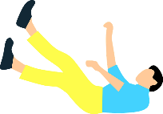
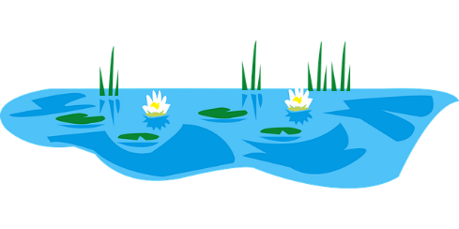
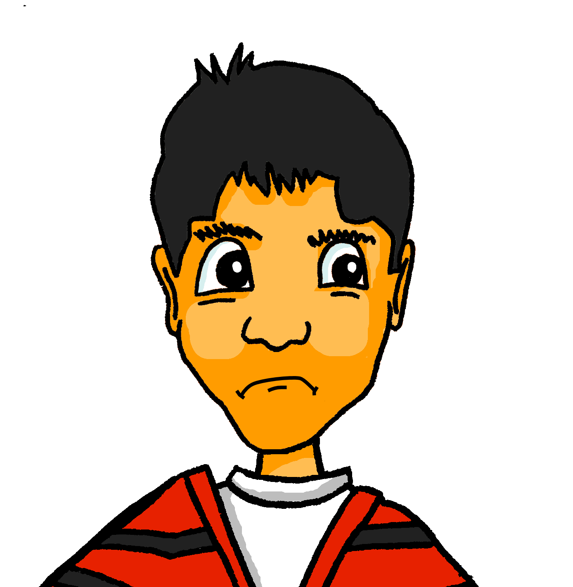
Verbs with indirect objects [2]
Grammatik
Remember, fallen means ‘to fall’:
Er
fällt
ins Wasser.
He falls / is falling into the water.
Fallen has a different meaning, when used with an indirect object.
?!?
Compare:
SUBJECT
VERB
OBJECT
Er
findet
Englisch schwer.
He finds English difficult.
Englisch
fällt
ihm schwer.
English falls to him with difficulty .
This word order also works:
He finds English difficult.
OBJECT
VERB
SUBJECT
Ihm
fällt
Englisch schwer.
To him falls Englisch with difficulty.
Notes:
Timing: 2 minutes Aim: To explain and illustrate another meaning of fallen. Procedure: 1. Click on the mouse to animate the explanation.
2. Ensure student understanding at each stage.

Slide 23
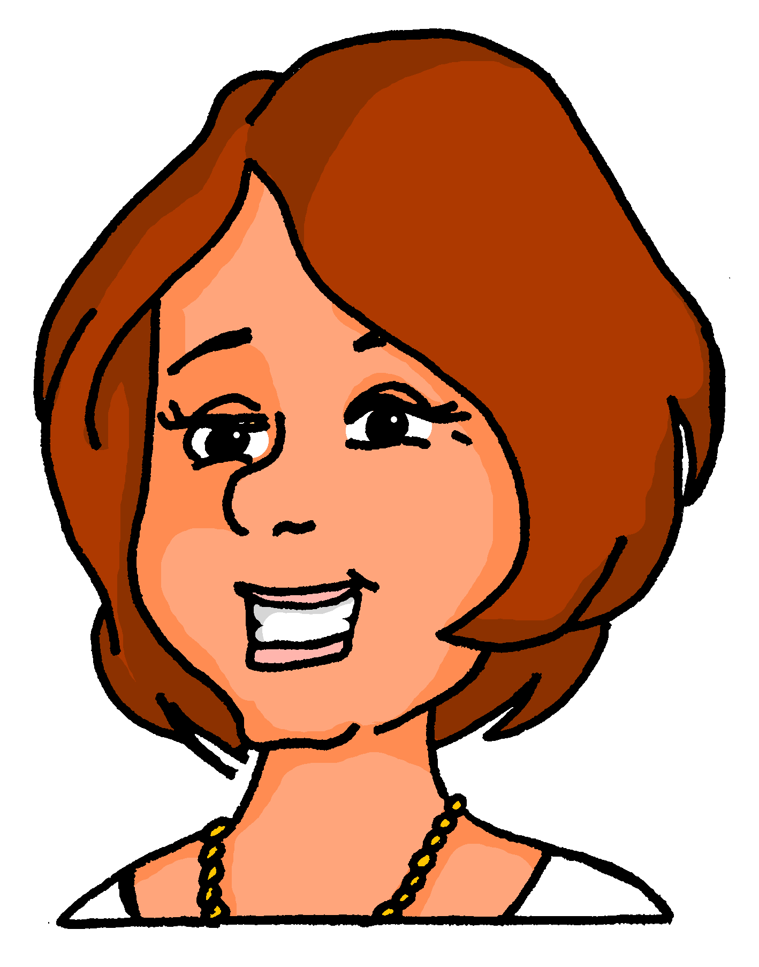
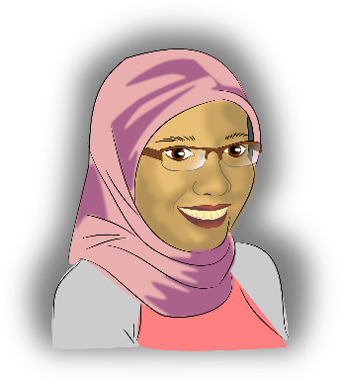
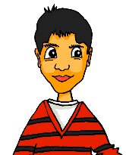
Meinungen
hören
Frau Nowak (Katjas Mutti) und Frau Bayrak (Mehmets Mutti) reden über die Schule.
Hör zu. Schreib das richtige Verb. Welches Fach? Meinung?
 |  | Fach? | Meinung?
 | findet / fällt | Mathe
 | fällt / findet | Mathe
 | gefällt / findet | Musik
 | fällt / gefällt | Englisch
 | findet / gefällt | Englisch
 | mag / gefällt | Naturwissenschaften
 | fällt / mag | Chemie
 | findet / fällt | Sport
1
1
2
2
3
3
4
4
5
5
6
6
7
7
8
8
Notes:
Timing: 5 minutes Aim: To practise using the correct verb, by listening out for the form of the personal pronoun. Also, to practise listening for meaning. Procedure: 1. Click on a number to play the recording.
2. For each item say which verb fits.
3. In the second column write in German what subject they are talking about.
4. In the final column say whether they express a positive or negative opinion.
Transcript: Nowak - 1. Sie [findet] Mathe schwer. Bayrak – 2. O! Ihm [fällt] Mathe dieses Jahr leicht. Der neue Lehrer ist gut. Nowak – 3. Und Musik [findet] er immer noch toll, nicht wahr? Bayrak – 4. Ja. Englisch [fällt] ihm aber noch ziemlich schwer. Nowak – 5. Englisch [gefällt] ihr sehr gut, denn sie mag Fremdsprachen. Bayrak – 6. Er [mag] Naturwissenschaften. Nowak – 7. Ihr [fällt] Chemie aber sehr schwer. Bayrak – 8. Sport [findet] er super wie immer.
Word frequency (1 is the most frequent word in German):
8.2.1.2 (introduce) fehlen [420] gefallen [601] gehören [460] meinen [213] tun [123] Leid [1300] Meinung [787] fit [4080] weh [2798] dass [22] schwer [257]
8.1.2.5 (revisit) anderer, andere, anderes [59] Aktivität [1422] Hobby [3608] Jugendclub [2117/1360] Schloss [1907] Telefon [1595] langsam [526] normal [642] schnell [203] gern [278] 8.1.1.6 (revisit) verbringen [1391] Auge [222] Gesicht [346] Haar [748] Haare [748] Mund [856] Nase [1264] Schüler [557] Zeit [96] ähnlich [437] breit [847] dünn [1739] neu [84] rund [298] als [22]
Source: Jones, R.L & Tschirner, E. (2019). A frequency dictionary of German: Core vocabulary for learners. London: Routledge

Slide 24
Verbs with indirect objects [3]
Grammatik
Remember: sentences can also start with the direct object, without changing the meaning:
As we have seen, certain R3 (dative) verbs do not translate into English word for word:
OBJECT
VERB
SUBJECT
Polnisch fällt mir schwer.
I find Polish difficult.
Dir
tut
die Nase weh.
Der Jugendclub gefällt mir.
I like the youth club.
also means:
Your nose hurts / You have a sore nose.
Other verbs that work in the same way are:
SUBJECT
VERB
OBJECT
Du
fehlst
You are lacking/missing/absent to me.
mir.
→ I miss you.
Die Nase
tut
dir weh.
The nose is making to you sore.
→ Your nose hurts / You have a sore nose.
That is making to him sorrow.
Das
tut
ihm Leid.
→ He is sorry.
Das
tut
That is making to her sore/hurt.
ihr weh.
→ She is hurting / That hurts her.
Notes:
Timing: 3 minutes Aim: To introduce more verbs that take R3. To illustrate English translations.
Procedure: 1. Click on the mouse to animate the explanation.
2. Ensure student understanding at each stage. Word frequency (1 is the most frequent word in German):
8.2.1.2 (introduce) fehlen [420] gefallen [601] gehören [460] meinen [213] tun [123] Leid [1300] Meinung [787] fit [4080] weh [2798] dass [22] schwer [257]
8.1.2.5 (revisit) anderer, andere, anderes [59] Aktivität [1422] Hobby [3608] Jugendclub [2117/1360] Schloss [1907] Telefon [1595] langsam [526] normal [642] schnell [203] gern [278] 8.1.1.6 (revisit) verbringen [1391] Auge [222] Gesicht [346] Haar [748] Haare [748] Mund [856] Nase [1264] Schüler [557] Zeit [96] ähnlich [437] breit [847] dünn [1739] neu [84] rund [298] als [22]
Source: Jones, R.L & Tschirner, E. (2019). A frequency dictionary of German: Core vocabulary for learners. London: Routledge

Slide 25
Wie heißt das auf Englisch?
lesen
1/12
Ich antworte dir.
Notes:
Timing: 6 minutes (for 12 slides) Aim: To practise translation from German into English, especially for verbs that take R3 in German. The time limit will help automatization. Procedure: 1. Read the German sentence on the screen.
2. Write down the English translation before the sentence disappears. Word frequency (1 is the most frequent word in German):
8.2.1.2 (introduce) fehlen [420] gefallen [601] gehören [460] meinen [213] tun [123] Leid [1300] Meinung [787] fit [4080] weh [2798] dass [22] schwer [257]
8.1.2.5 (revisit) anderer, andere, anderes [59] Aktivität [1422] Hobby [3608] Jugendclub [2117/1360] Schloss [1907] Telefon [1595] langsam [526] normal [642] schnell [203] gern [278] 8.1.1.6 (revisit) verbringen [1391] Auge [222] Gesicht [346] Haar [748] Haare [748] Mund [856] Nase [1264] Schüler [557] Zeit [96] ähnlich [437] breit [847] dünn [1739] neu [84] rund [298] als [22]
Source: Jones, R.L & Tschirner, E. (2019). A frequency dictionary of German: Core vocabulary for learners. London: Routledge

Slide 26
Wie heißt das auf Englisch?
lesen
2/12
Er wünscht ihr ‘Frohe Weihnachten!’
Notes:
2/12

Slide 27
Wie heißt das auf Englisch?
lesen
3/12
Sie dankt ihm nicht.
Notes:
3/12

Slide 28
Wie heißt das auf Englisch?
lesen
4/12
Du schenkst mir ein Buch.
Notes:
4/12

Slide 29
Wie heißt das auf Englisch?
lesen
5/12
Das Buch gehört dir nicht.
Notes:
5/12

Slide 30
Wie heißt das auf Englisch?
lesen
6/12
Ihr gefällt sein Gesicht.
Notes:
6/12

Slide 31
Wie heißt das auf Englisch?
lesen
7/12
Er sieht ihr ähnlich.
Notes:
7/12

Slide 32
Wie heißt das auf Englisch?
lesen
8/12
Dir gefallen meine Haare?
Notes:
8/12

Slide 33
Wie heißt das auf Englisch?
lesen
9/12
Oh! Das tut mir Leid!
Notes:
8/12

Slide 34
Wie heißt das auf Englisch?
lesen
10/12
Ihm tut der Mund weh.
Notes:
10/12

Slide 35
Wie heißt das auf Englisch?
lesen
11/12
Mir gefällt der neue Schüler.
Notes:
11/12

Slide 36
Wie heißt das auf Englisch?
lesen
12/12
Mir fehlt die Zeit.
Notes:
12/12

Slide 37
Saying what we think about things
Opinion verbs with / without dass (WO3)
SSC [ei] and [ie] revisited
Y8 German
Term 2.1 - Week 2 - Lesson 32
Author name(s): Inge Alferink / Rachel Hawkes
Artwork: Steve Clarke
Date updated: 10/8/21
Notes:
Artwork by Steve Clarke. All additional pictures selected are available under a Creative Commons license, no attribution required.
Learning outcomes (lesson 1):
Consolidation of SSC [ei] and contrast with [ie]
Introduction to use of WO3 conjunction dass with verbs of opinion Consolidation of R3 (dative) verbs
Word frequency (1 is the most frequent word in German):
8.2.1.2 (introduce) fehlen [420] gefallen [601] gehören [460] meinen [213] tun [123] Leid [1300] Meinung [787] fit [4080] weh [2798] dass [22] schwer [257]
8.1.2.5 (revisit) anderer, andere, anderes [59] Aktivität [1422] Hobby [3608] Jugendclub [2117/1360] Schloss [1907] Telefon [1595] langsam [526] normal [642] schnell [203] gern [278] 8.1.1.6 (revisit) verbringen [1391] Auge [222] Gesicht [346] Haar [748] Haare [748] Mund [856] Nase [1264] Schüler [557] Zeit [96] ähnlich [437] breit [847] dünn [1739] neu [84] rund [298] als [22]
Source: Jones, R.L & Tschirner, E. (2019). A frequency dictionary of German: Core vocabulary for learners. London: Routledge.
The frequency rankings for words that occur in this PowerPoint which have been previously introduced in NCELP resources are given in the NCELP SOW and in the resources that first introduced and formally re-visited those words.
For any other words that occur incidentally in this PowerPoint, frequency rankings will be provided in the notes field wherever possible.

Slide 38
Phonetik
hören
ei
ie
frei
Liebe
Notes:
Timing: 5 seconds Aim: To recap the two source words before the listening task on the next slide.

Slide 39
Phonetik [1/2]
sprechen / hören / schreiben
Partner A sagt die Wörter. Partner B schreibt.
[ei]
[ie]
1. _______
1. _______
1. Schwein [pig]
2. peinlich [embarassing]
3. Kiefer [jaw] 4. Geige [violin] 5. Ziege [goat] 6. nieder [down] 7. Riese [giant] 8. Eiche [oak]
2. _______
2. _______
3. _______
3. _______
4. _______
4. _______
Notes:
Timing: 4 minutes Aim: To practise SSC [ei] and [ie] with mostly unknown vocabulary, compelling students to apply their phonics knowledge.
Procedure: 1. Partner B draws two columns and numbers 1-4 in each column
2. Partner A reads the words aloud. Partner B must turn away from the board and must transcribe the words in the correct column.
3. The next slide has the answers. Word frequency (1 is the most frequent word in German):
Schwein [4009], peinlich [2936], Kiefer [>5000], Geige [>5000], Ziege [>5000], nieder [>5000], Riese [2794], Eiche [>5000]
Source: Jones, R.L. & Tschirner, E. (2019). A frequency dictionary of German: core vocabulary for learners. Routledge

Slide 40
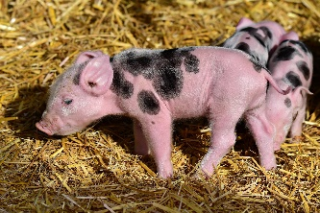
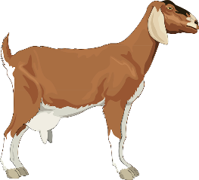
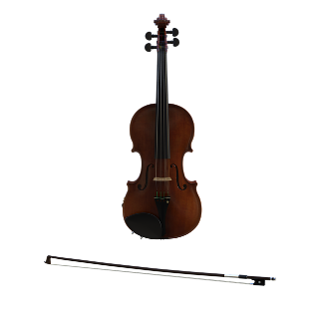
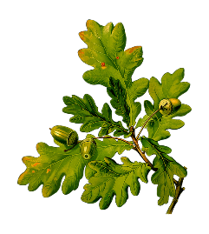
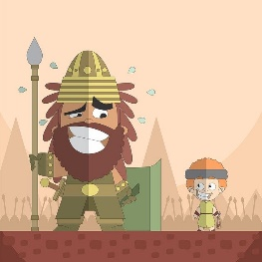
Antworten
sprechen / hören / schreiben
[ei]
[ie]
Schwein
Kiefer
1. _______
1. _______
peinlich
Ziege
2. _______
2. _______
[embarrassing]
Geige
nieder
3. _______
3. _______
Eiche
Riese
4. _______
4. _______
Notes:
Answers
Timing: 30 seconds
Aim: to check work of Partner B (who write) and Partner A (who spoke)
Answers appear in order of the transcript.
Transcript:
1. Schwein 2. peinlich 3. Kiefer 4. Geige 5. Ziege 6. nieder 7. Riese 8. Eiche

Slide 41
Phonetik [2/2]
sprechen / hören / schreiben
Partner A schreibt. Partner B sagt die Wörter.
[ei]
[ie]
1. _______
1. _______
1. Krieg [war]
2. Kleid [dress]
3. Sieb [sieve] 4. Diener [servant] 5. Feind [enemy] 6. heiter [cheerful, bright] 7. Kreide [chalk] 8. niedlich [cute]
2. _______
2. _______
3. _______
3. _______
4. _______
4. _______
Notes:
Timing: 4 minutes Aim: To practise SSC [ei] and [ie] with mostly unknown vocabulary, compelling students to apply their phonics knowledge.
Procedure: 1. Partner A draws two columns and numbers 1-4 in each column
2. Partner B reads the words aloud. Partner A must turn away from the board and must transcribe the words in the correct column.
3. The next slide has the answers. Word frequency (1 is the most frequent word in German):
Krieg [407], Kleid [1681], Sieb [>5000], Diener [>5000], Feind [24524], heiter [>5000], Kreide [>5000], niedlich [>5000].
Source: Jones, R.L. & Tschirner, E. (2019). A frequency dictionary of German: core vocabulary for learners. Routledge

Slide 42
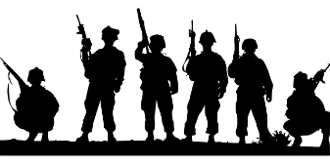
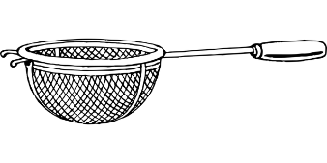
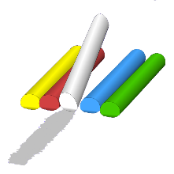
Antworten
sprechen / hören / schreiben
[ei]
[ie]
Kleid
Krieg
1. _______
1. _______
Feind
[enemy]
Sieb
2. _______
2. _______
heiter
[cheerful, bright]
Diener
3. _______
3. _______
Kreide
niedlich
4. _______
4. _______
Notes:
Answers
Timing: 30 seconds
Aim: to check work of Partner B (who write) and Partner A (who spoke)
Answers appear in order of the transcript.
Transcript:
1. Krieg
2. Kleid
3. Sieb 4. Diener 5. Feind 6. heiter 7. Kreide 8. niedlich

Slide 43
Vokabeln
lesen
breit
weh
fit
das Auge
der Schüler
wide
sore, hurt
fit
eye
pupil
der Jugendclub
das Schloss
das Telefon
youth club
castle
telephone
other
slow
anderer,
andere,
anderes
als
ähnlich
die Meinung
langsam
as
similar
opinion
gladly
dünn
gern
thin
rund
das Leid
die Aktivität
sorrow, grief
activity
round
der Mund
mouth
new
neu
Notes:
Timing: 2 minutes Aim: This slide practises the spoken form and meaning of the new vocabulary introduced this week, and some of the revisited vocabulary. Timed spoken speed recall.
Procedure:
The activity is designed like a scratch card. On clicks, the English translations appear in a random order.
Click to select a word (the word will change colour). Ask Wie heißt das auf Englisch?
Click again to trigger a 5-second ‘scratch’ animation, which slowly reveals the English equivalent. Students must race against the timer and try to say the word before it is fully revealed.
Word frequency (1 is the most frequent word in German):
8.2.1.2 (introduce) fehlen [420] gefallen [601] gehören [460] meinen [213] tun [123] Leid [1300] Meinung [787] fit [4080] weh [2798] dass [22] schwer [257]
8.1.2.5 (revisit) anderer, andere, anderes [59] Aktivität [1422] Hobby [3608] Jugendclub [2117/1360] Schloss [1907] Telefon [1595] langsam [526] normal [642] schnell [203] gern [278] 8.1.1.6 (revisit) verbringen [1391] Auge [222] Gesicht [346] Haar [748] Haare [748] Mund [856] Nase [1264] Schüler [557] Zeit [96] ähnlich [437] breit [847] dünn [1739] neu [84] rund [298] als [22]

Slide 44
Vokabeln
schreiben
?
Schreib auf Deutsch:
A. that
B. sorrow, grief
C. sore, hurt
D. to think, have an opinion
E. difficult
F. fit
G. to please, pleasing
H. to do, doing
I. to lack, be missing, be absent
J. to belong, belonging
 |  |  |  |  |  |  |  |  |  |  | D | A | S | S
 |  |  |  |  | D | A | S |  | L | E | I | D
 |  |  |  |  |  |  |  |  |  | W | E | H
 |  |  |  |  |  |  |  |  |  |  | M | E | I | N | E | N
 |  |  |  |  |  |  | S | C | H | W | E | R
 |  |  |  |  |  |  |  |  |  | F | I | T
 |  |  |  | G | E | F | A | L | L | E | N
 |  |  |  |  |  |  |  |  |  | T | U | N
 |  |  |  |  |  | F | E | H | L | E | N
 |  |  |  |  |  |  |  |  |  |  | G | E | H | Ö | R | E | N
Notes:
Starter - Vokabeln This starter activity challenges students to produce the vocabulary from this week from memory.
This starter task revises 11 items of vocabulary (shown in bold below) drawn from this week’s vocabulary set. By working out the answers to the clues and spelling out the words correctly, students create the word ‘die Meinung’, which is part of the theme for this lesson. So the activity does the task of ‘sharing the context learning objective’ with students. Most students can do this by writing A-J and the answers in their books. If students would benefit from writing in the grid, it can be printed out and reduced to A5 on the copier.
Note: The clues relate to the words directly to their right. This slide is then animated to provide the ANSWERS and give additional alphabet practice, as per the routine below, as desired:
1. Teacher elicits the answers, asking for A – J on slide. 2. Student(s) volunteer(s) the answer (e.g. dein).
3. Teacher asks ‘wie schreibt man das?’ 4. Students in chorus (slowly and steadily) respond to spell out the answer: D - E - I - N. 5. As students spell the word, teacher reveals each letter on a click. This will enable the teacher to pick up on any of the trickier letters, and do some remedial practice in the moment.
Word frequency (1 is the most frequent word in German):
8.2.1.2 (introduce) fehlen [420] gefallen [601] gehören [460] meinen [213] tun [123] Leid [1300] Meinung [787] fit [4080] weh [2798] dass [22] schwer [257]

Slide 45
English → German → English
You can often make nouns from the infinitive of verbs.
He likes to swim / swimming. Swimming is easy.
Er mag schwimmen. Schwimmen ist leicht.
Translate these sentences.
1. Tanzen macht Spaß.
2. Travelling is my favourite activity.
What would the following words be in German?
reading
winning
giving
Choose one and write a sentence in German.
All nouns made from infinitive verbs are ‘das’. However, they are usually used without the indefinite article, as in English.
Notes:
Timing: 8 minutes (two slides) Aim: To develop knowledge of word patterns within German, using examples from the poem. Procedure: 1. Click to present the pattern and examples. 2. Give students time to complete the five short tasks. 3. Answers and further tasks on the next slide.
Word frequency (1 is the most frequent word in German):
8.2.1.2 (introduce) fehlen [420] gefallen [601] gehören [460] meinen [213] tun [123] Leid [1300] Meinung [787] fit [4080] weh [2798] dass [22] schwer [257]
8.1.2.5 (revisit) anderer, andere, anderes [59] Aktivität [1422] Hobby [3608] Jugendclub [2117/1360] Schloss [1907] Telefon [1595] langsam [526] normal [642] schnell [203] gern [278] 8.1.1.6 (revisit) verbringen [1391] Auge [222] Gesicht [346] Haar [748] Haare [748] Mund [856] Nase [1264] Schüler [557] Zeit [96] ähnlich [437] breit [847] dünn [1739] neu [84] rund [298] als [22]
Source: Jones, R.L & Tschirner, E. (2019). A frequency dictionary of German: Core vocabulary for learners. London: Routledge

Slide 46
ANTWORTEN
Tanzen macht Spaß.
Travelling is my favourite activity.
reading
winning
giving
Dancing is fun.
Reisen ist meine Lieblingsaktivität.
(das) Lesen
(das) Gewinnen
(das) Schenken
…but some don’t. What do these mean? das Leben das Wissen das Essen
These words often end in –ing in English…
What is the gender of these new nouns?
to forget → forgetting
vergessen → Vergessen (ist normal!)
Don’t forget to pronounce the words.
Notes:
das Leben [life/living], das Wissen [knowledge/knowing], das Essen [food/eating] Note: in the 2019 edition of the frequency dictionary, verb nouns are not listed separately, whereas in 2019 edition they are. Source: Jones, R.L. & Tschirner, E. (2019). A frequency dictionary of German: core vocabulary for learners. Routledge

Slide 47
Meinungen mit dass
The essential meaning is the same, but after dass the verb must go to the end (WO3).
Grammatik
The verbs denken (think), glauben (believe) and meinen (have the opinion) can all be used to say what you think:
Use a comma and follow with Word Order 1:
Ich denke, Sport ist lustig.
I think sport is enjoyable.
Unlike the English example here, in German there is always a comma after an opinion verb.
Use the conjunction dass and follow with Word Order 3:
I think that sport is enjoyable.
Ich denke, dass Sport lustig ist.
Weil is another WO3 conjunction you know:
Ich denke, dass Sport lustig ist, weil es fit macht.
I think that sport is enjoyable because it makes (you) fit.
Notes:
Timing: 2 minutes Aim: To introduce the conjunction dass with WO3, and the syntax of sentences with opinion verbs with and without dass. Procedure: 1. Click to animate the explanation.
2. Ensure student understanding at each stage.

Slide 48
Meinungen
hören
Mia redet mit Wolfgang. Hör zu. Passt dass oder --?
 |  | dass | --
 | Meinst du, meine Nase ist zu dünn?
 | Ich glaube, dass Heidis Nase perfekt ist.
 | Ich denke, dein Haar ist schön heute.
 | Glaubst du, meine Augen sind grün oder blau?
 | Ich meine, dass meine Augen blau sind.
 | Ich glaube, Chemie fällt Katja sehr schwer.
 | Denkst du, dass Chemie schwer ist?
 | Meinst du, dass Musik Spaß macht?
1
1
2
2
3
3
4
4
5
5
6
6
7
7
8
8
Notes:
Timing: 5 minutes Aim: To practise using dass or [ – - ] by attending to word order Procedure: 1. Click on a number to play the recording.
2. For each item say whether dass or [--] fits.
3. Click to reveal answers. 4. Click to bring up the full audio buttons. 5. Click to reveal the full sentence/question text. Listen and read, as desired, for additional reinforcement.
Transcript: 1. Meinst du, […] meine Nase ist zu dünn? [dass / --]
2. Ich glaube, […] Heidis Nase perfekt ist. [dass / --]
3. Ich denke, […] dein Haar ist schön heute. [dass / --]
4. Glaubst du, […] meine Augen sind grün oder blau? [dass / --]
5. Ich meine, […] meine Augen blau sind. [dass / --]
6. Ich glaube, […] Chemie fällt Katja sehr schwer. [dass / --]
7. Denkst du, […] Chemie schwer ist? [dass / --]
8. Meinst du, […] [dass / --] Musik Spaß macht? Word frequency (1 is the most frequent word in German):
8.2.1.2 (introduce) fehlen [420] gefallen [601] gehören [460] meinen [213] tun [123] Leid [1300] Meinung [787] fit [4080] weh [2798] dass [22] schwer [257]
8.1.2.5 (revisit) anderer, andere, anderes [59] Aktivität [1422] Hobby [3608] Jugendclub [2117/1360] Schloss [1907] Telefon [1595] langsam [526] normal [642] schnell [203] gern [278] 8.1.1.6 (revisit) verbringen [1391] Auge [222] Gesicht [346] Haar [748] Haare [748] Mund [856] Nase [1264] Schüler [557] Zeit [96] ähnlich [437] breit [847] dünn [1739] neu [84] rund [298] als [22]
Source: Jones, R.L & Tschirner, E. (2019). A frequency dictionary of German: Core vocabulary for learners. London: Routledge

Slide 49
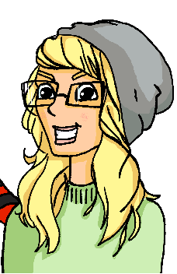
Was meinen sie?
lesen
Wolfgang und Heidi schreiben einander. Dass oder --?
Wolfgang: Ach, ich habe Montags eine Doppelstunde Englisch! Das gefällt mir gar nicht.
Wolfgang: Welches Buch? Ich glaube, [dass /--] ich keine Bücher von dir habe.
Wolfgang: Nein, es tut mir Leid, aber dieses Exemplar gehört mir.
Heidi: Na ja. Ich glaube,[dass / --] wir am Wochenende Tennis spielen, nicht wahr?
Heidi: Ah, Englisch! Ein Buch fehlt mir und ich denke, [dass / --] du hast das vielleicht?
Heidi: Oliver Twist. Ich meine, [dass / --] ich habe das in deinem Zimmer gesehen.
Notes:
Timing: 3 minutes Aim: To practise using dass / -- in a sentence context. Procedure: 1. Read Wolfgang and Heidi’s messages. What fits? Dass or --?
2. Click to reveal answers.
Word frequency (1 is the most frequent word in German):
8.2.1.2 (introduce) fehlen [420] gefallen [601] gehören [460] meinen [213] tun [123] Leid [1300] Meinung [787] fit [4080] weh [2798] dass [22] schwer [257]
8.1.2.5 (revisit) anderer, andere, anderes [59] Aktivität [1422] Hobby [3608] Jugendclub [2117/1360] Schloss [1907] Telefon [1595] langsam [526] normal [642] schnell [203] gern [278] 8.1.1.6 (revisit) verbringen [1391] Auge [222] Gesicht [346] Haar [748] Haare [748] Mund [856] Nase [1264] Schüler [557] Zeit [96] ähnlich [437] breit [847] dünn [1739] neu [84] rund [298] als [22]
Source: Jones, R.L & Tschirner, E. (2019). A frequency dictionary of German: Core vocabulary for learners. London: Routledge.

Slide 50
Virtueller Austausch*
lesen
Mias Klasse hilft Andreas Klasse online. Schreib 1-8 und ‘dass’ oder ‘--’
1) Ich denke, ______ Englisch unmöglich ist! (dass/--) DH
2) Glaubst du, ______ Berlin interessant ist? (dass/--) JS
dass
dass
4) Ich denke, ______ Katjas Haar ist wunderbar! (dass/--) MB
5) Mein Opa glaubt, ______ es regnet immer in England. (dass/--) WB
--
--
3) Ich meine, ______ Musik ist lustig. (dass/--) SW
--
dass
7) Meine Cousine glaubt, ______ ihre Vespa ganz schnell ist! (dass/--) KL
8) Meine Mutter meint, ______ Cambridge ist ganz schön. (dass/--) HZ
6) Denkst du, ______ ihre Klasse uns nochmal besucht? (dass/--) SG
dass
--
*der Austausch - exchange
Notes:
Timing: 5 minutes Aim: To practise recognising the word order used in each sentence and inferring the use of dass or -- as appropriate. Procedure: 1. Write 1-8.
2. Students read sentences and write dass or -- for each, as appropriate.
3. Click on the mouse to animate the correct answers. Context: This is a padlet wall. Mia’s class is helping Andrea’s class with their German grammar by posting dass / -- sentences for them to practise. Initials are initials of Mia’s classmates.
Word frequency (1 is the most frequent word in German):
8.2.1.2 (introduce) fehlen [420] gefallen [601] gehören [460] meinen [213] tun [123] Leid [1300] Meinung [787] fit [4080] weh [2798] dass [22] schwer [257]
8.1.2.5 (revisit) anderer, andere, anderes [59] Aktivität [1422] Hobby [3608] Jugendclub [2117/1360] Schloss [1907] Telefon [1595] langsam [526] normal [642] schnell [203] gern [278] 8.1.1.6 (revisit) verbringen [1391] Auge [222] Gesicht [346] Haar [748] Haare [748] Mund [856] Nase [1264] Schüler [557] Zeit [96] ähnlich [437] breit [847] dünn [1739] neu [84] rund [298] als [22]
Source: Jones, R.L & Tschirner, E. (2019). A frequency dictionary of German: Core vocabulary for learners. London: Routledge.

Slide 51
Wer ist das?
?
sprechen
Stefanie
Dieter
Jörg
Sport | uninteressant (dass)
Musik | unmöglich(--)
Köln | hässlich (--)
Englisch | schwer (dass)
Chemie | langweilig (--)
Spanien | zu warm (dass)
Chemie | langweilig (--l)
Köln | hässlich (--)
Englisch | schwer(dass)
Spanien | zu warm (dass)
Musik | unmöglich (--l)
Sport | uninteressant (dass)
Köln | hässlich (--l)
Musik | unmöglich (--)
Spanien | zu warm (dass)
Chemie | langweilig (--l)
Sport | uninteressant (dass)
Englisch | schwer (dass)
Leah
Moritz
Sabine
Musik | unmöglich (dass)
Sport | uninteressant (--)
Spanien | zu warm (--)
Chemie | langweilig (dass)
Englisch | schwer(--)
Köln | hässlich (dass)
Englisch | schwer (--)
Spanien | zu warm (--)
Köln | hässlich (dass)
Sport | uninteressant (--)
Chemie | langweilig (dass)
Musik | unmöglich (dass)
Spanien | zu warm (--)
Chemie | langweilig (dass)
Musik | unmöglich (dass)
Sport | uninteressant(--l)
Köln | hässlich (dass)
Englisch | schwer (--)
Notes:
Sprechen Timing: 5 minutes
Speaking activity: Wer ist das?
Aim: To practise asking ‘why?’ questions and giving answers with reasons using an opinion verb and dass or [-]. This is a variation on the ‘guess who’ game.
Procedure: 1. Student A picks a character.
2. Student B asks ‘Warum mag diese Person ..... nicht?’, naming one of the things mentioned in the left-hand column for each character.
3. Student A answers, giving the reason corresponding to the thing mentioned by Student B in the right-hand column for their chosen character (using an opinion verb (denken, meinen or glauben) and dass or -- as indicated, with correct word order).
4. By spotting the reason given in the exact form specified, Student B attempts to guess the character chosen.
5. Partners swap roles.
Note: The names include several SSC. Teachers may usefully ask students to pronounce their names before the activity starts: [St]efanie, D[ie]t[er], [J][ö]rg, L[e]ah, M[o][r]it[z], [S]ab[i]n[e] (pronounce the final ‘e’)

Slide 52
Was meinst du?
schreiben
Schreib die Antworten. Benutz die Wörter in Klammern*.
1. Wie findest du Mathe? [leicht/schwer fallen]
2. Meinst du, dass Musik ein lustiges Fach ist? [glauben, dass]
3. Glaubst du, du kriegst zu viele Hausaufgaben? [denken, kriegen]
4. Gefällt dir Englisch? Warum / warum nicht? [gefallen, weil]
5. Was fehlt dir am Wochenende? [fehlen]
6. Glaubst du, Sport ist wichtig? [glauben, denn]
7. Denkst du, dass du genug Freizeit hast? [meinen, dass]
8. Welche Aktivität gefällt dir? [gern, weil]
*Klammern = brackets
Notes:
Timing: 8 minutes Aim: To practise using the grammar and vocabulary introduced in this sequence in a semi-scaffolded task. Procedure: 1. Read the questions and write answers using the words in brackets.
Word frequency (1 is the most frequent word in German):
8.2.1.2 (introduce) fehlen [420] gefallen [601] dass [22] schwer [257]
8.1.2.5 (revisit) Aktivität [1422] gern [278]

Slide 53
Antworten [1/2]
schreiben
1. Wie findest du Mathe? [leicht/schwer fallen]
Mathe fällt mir …
2. Meinst du, dass Musik ein lustiges Fach ist? [glauben, dass]
Ja/Nein, ich glaube, dass Musik ……….. ist.
3. Glaubst du, du kriegst zu viele Hausaufgaben? [denken, kriegen]
Ja/Nein, ich denke, ich kriege…..
4. Gefällt dir Englisch? Warum / warum nicht? [gefallen, weil]
Ja/Nein, Englisch gefällt mir (nicht), weil/denn...
Notes:
ANSWER SLIDE [1/2] Timing: 2 minutes Procedure: 1. Display the answers. 2. Tell students that these suggestions are to model the overall sentence structure of possible answers and that there are different ways to finish the answers, of course.

Slide 54
Antworten [1/2]
schreiben
5. Was fehlt dir am Wochenende? [fehlen]
…fehlt/fehlen mir OR Mir fehlt/fehlen…
6. Glaubst du, Sport ist wichtig? [glauben, denn]
Ja/Nein, ich glaube, Sport ist (nicht) wichtig, denn…
7. Denkst du, dass du genug Freizeit hast? [meinen, dass]
Ja/Nein, ich meine, dass ich (nicht) genug Freizeit habe.
8. Welche Aktivität gefällt dir? [gern, weil]
Ich (schwimme) gern, weil...
*Klammern = brackets
Notes:
ANSWER SLIDE [2/2] Procedure: 1. Display the answers. 2. Tell students that these suggestions are to model the overall sentence structure of possible answers and that there are different ways to finish the answers, of course.

Slide 55
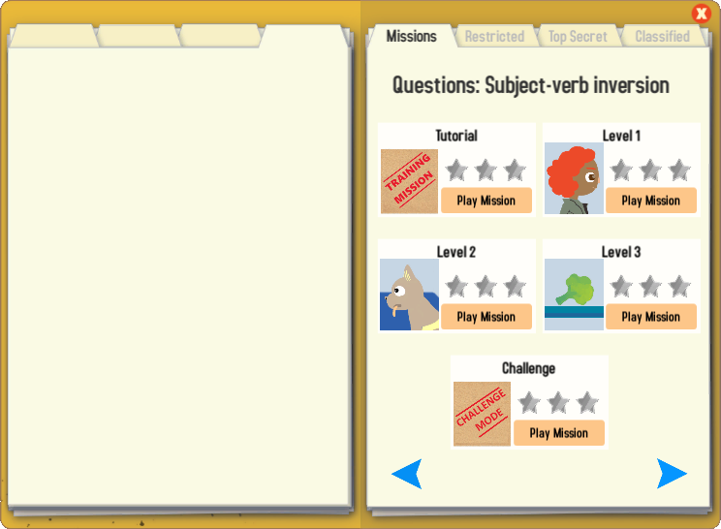
Gaming Grammar
Try the following Gaming Grammar missions to practise:

Slide 56
Hausaufgaben
Vocabulary Learning Homework (Y7, Term 2.1, Week 3)
Quizlet link
This week’s homework is Y7 Revision Mashup 3.

