Slide 1
Cultural events [1]: Le festival de Dieppe
-ER verbs (je, tu, il/elle), intonation questions, ‘pour’ and ‘sans’ + infinitive
SSCs [é/-er/-ez] and SFE
Y9 French
Term 1.1 - Week 2 - Lesson 3
Catherine Morris / Natalie Finlayson
Artwork by: Chloé Motard
Date updated: 12/11/21
Notes:
Artwork by Chloé Motard. All additional pictures selected are available under a Creative Commons license, no attribution required.
Native speaker feedback provided by Sarah Brichory.
With thanks to Rachel Hawkes for her input on the lesson material.
Learning outcomes (lesson 1):
Consolidation of SSC [é/-er/-ez] and SFe
Consolidation of -ER verbs (singular forms)
Consolidation of intonation questions
Consolidation of prepositions pour and sans + infinitive
Word frequency (1 is the most frequent word in French):
9.1.1.2 (revisit Y7 and Y8 vocabulary 2/13) acheter [636], aider [413], aimer [242], arriver [174], célébrer [2170], chercher [336], donner [46], emporter [1128], envoyer [526], expliquer [252], lever [837], manger [1338], marcher [1532], organiser [701], penser [116], penser à [116], porter [105], préférer [597], regarder [425], reposer [776], traverser [1040], trouver [105], utiliser [345], visiter [1378], voyager [2194], elle [38], elles [n/a], il [13], ils [n/a], je [22], nous [31], on¹ [29], tu [112], vous [50], qui [14], activité [452], ami [467], Angleterre [n/a], bateau [1287], billet [1976], ciel [1538], chose [125], culture [913], enfant [126], événement [573], famille [172], France [n/a], information [317], message [792], septembre [944], train [232], vacances [1726], ville [260], comment [234], où [48], pourquoi [193], quand [119], quoi [297], pour [10], sans [71]
Source: Londsale, D., & Le Bras, Y. (2009). A Frequency Dictionary of French: Core vocabulary for learners London: Routledge.
The frequency rankings for words that occur in this PowerPoint which have been previously introduced in NCELP resources are given in the NCELP SOW and in the resources that first introduced and formally re-visited those words.
For any other words that occur incidentally in this PowerPoint, frequency rankings will be provided in the notes field wherever possible.

Slide 2
Devoirs
Personne A lit sa version du texte.
Personne B écoute et prend des notes.
Quelles sont les différences ?
parler
dans le tunnel
film (m)
acheter
grand
Cannes
cadeaux (mpl)
J’aime bien la culture française. C’est pourquoi je pense à voyager en France cette année avec ma famille. Le festival* de cerfs-volants*⁽¹⁾ dans la ville de Dieppe* est un évènement très intéressant. Je vais chercher beaucoup d’informations pour aider à bien organiser les vacances. Je vais acheter des billets pour traverser la mer* entre l’Angleterre et la France en bateau.
Quand on arrive, on va prendre le train pour aller à Dieppe. À Dieppe, on va marcher sur la plage et on peut regarder des cerfs-volants⁽²⁾. Le samedi, on va manger un repas dans un petit restaurant. Pourquoi ? Parce que je veux célébrer mon anniversaire !
aller
ma sœur
film
Cannes
mieux
le voyage
dans le tunnel
Cannes
Cannes
dans la ville
acheter
cadeaux
une glace
grand
aller
sœur (f)
dans la ville
glace (f)
mieux
voyage (m)
*cerfs-volants = kites, *Dieppe/Cannes = coastal towns in France, *la mer = the sea, *festival = festival, *tunnel = tunnel
Notes:
Timing: 10 minutes Aims: i) to review the homework task set last week (9.1.1.1).
ii) to develop fluency in decoding by reading aloud the student versions. iii) to listen attentively, noting differences in the original text. iv) to make judgements about the replacements made by a peer, and engage in peer feedback.
Procedure:
Student A reads his/her adapted homework text.
Student B follows along with the original and makes a note of any substituted words s/he hears (on his/her copy of the homework sheet)
Swap roles.
Compare and contrast the two versions. Scrutinise any differences and offer opinions about the correctness of the choices.
On successive clicks the bold words replaced with the appropriate substitute word.
Note that sometimes changes are needed to other words in the sentence. All of these changes revisit previously taught grammar, which teachers can elicit and/or explain as needed.
Note that alternative substitutions are possible. Teachers should make this clear and elicit students’ suggestions.
Note: the HW task set a time limit and asked students to try to replace at least ten of the words, so it’s to be expected that they might not have got them all.
Word frequency of cognates used (1 is the most frequent word in French):
version [1165]; différence [738]
Source: Lonsdale, D., & Le Bras, Y. (2009). A Frequency Dictionary of French: Core vocabulary for learners London: Routledge.

Slide 3
é/-er/-ez
écrire
Notes:
Timing: 1 minute [2 slides]
Aim: To consolidate SSC [é]
Procedure: 1. Present the letter(s) and say the [é] sound first, on its own. Students repeat it with you. 2. Bring up the word ”écrire” on its own, say it, students repeat it, so that they have the opportunity to focus all of their attention on the connection between the written word and its sound.
3. A possible gesture for this would be to mime the act of writing (onto the palm of the other hand perhaps). 4. Roll back the animations and work through 1-3 again, but this time, dropping your voice completely to listen carefully to the students saying the [é] sound, pronouncing ”écrire” and, if using, doing the gesture.
Word frequency (1 is the most frequent word in French):
écrire [382] Source: Londsale, D., & Le Bras, Y. (2009). A Frequency Dictionary of French: Core vocabulary for learners London: Routledge.

Slide 4
SFE
Silent final -e
[shy]
timide
Notes:
Aim: To consolidate SSC [SFE]
Procedure: 1. Present the letter(s) and say the [SFE] sound first, on its own. Students repeat it with you. 2. Bring up the word ”timide” on its own, say it, students repeat it, so that they have the opportunity to focus all of their attention on the connection between the written word and its sound.
3. A possible gesture for this would be to cower and cover one’s face slightly, simulating shyness. 4. Roll back the animations and work through 1-3 again, but this time, dropping your voice completely to listen carefully to the students saying the [SFE] sound, pronouncing ”timide” and, if using, doing the gesture.
Word frequency (1 is the most frequent word in French):
timide [3835]
Source: Londsale, D., & Le Bras, Y. (2009). A Frequency Dictionary of French: Core vocabulary for learners London: Routledge.

Slide 5
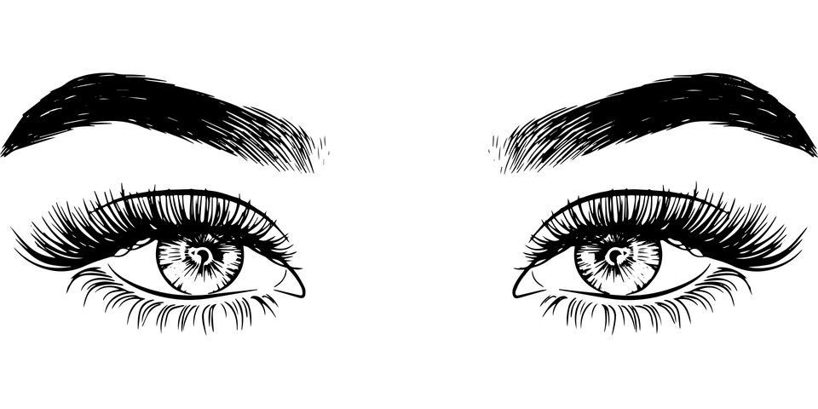
Les terminaisons de verbes
grammaire
Comment former les verbes au present ?
long form = infinitive /dictionary form
short form = forms that go with pronouns
remove -er add -e
Long form: regarder
Singular short forms: je regarde
remove -er add -es
tu regardes
il/elle regarde
remove -er add -e
Say the verb forms out loud. What is the last SSC in each word?
regarder regarde, regardes
SSC [é]
SFe
SFe + SFC
The SFE forces the consonant before it to be pronounced.
Notes:
Timing: 2 minutes
Aim: To revise long and singular short forms of –ER verbs and connect the endings with SSCs.
Procedure:
1. Remind students how to form singular short forms of –ER verbs.
2. Ask students to pronounce the verb forms, focusing on the final sound in each word (click on the names of the SSCs to hear audio).
3. Remind students that all three short forms sound the same.
4. Click to bring up the note about SFE and forced consonant production.
Word frequency of unknown words used (1 is the most frequent word in French): terminaison [>5000]
Source: Londsale, D., & Le Bras, Y. (2009). A Frequency Dictionary of French: Core vocabulary for learners London: Routledge.
Word frequency of cognates (1 is the most frequent word in French): verbe [>5000], former [486]
Source: Londsale, D., & Le Bras, Y. (2009). A Frequency Dictionary of French: Core vocabulary for learners London: Routledge.

Slide 6
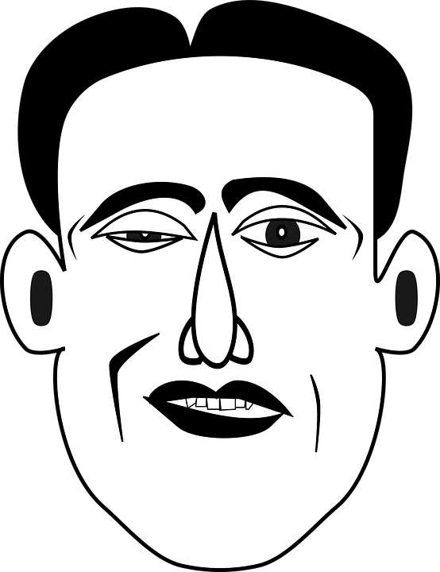
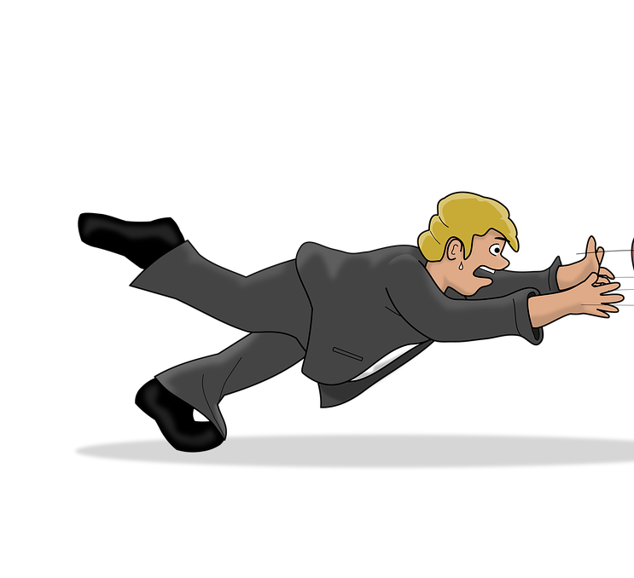
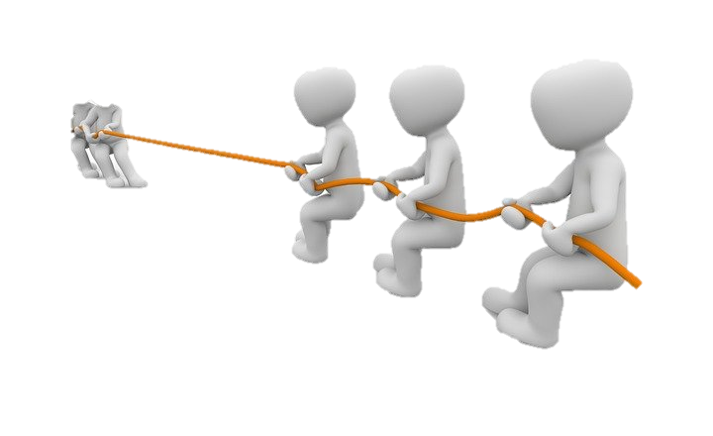
SSC [é] ou SFE ?
écouter
verb | infinitive meaning | infinitive (dictionary form) | short form (je/tu/il/elle)
cesser | to stop/quit
semble | to seem
illumine | to light up
encourager | to encourage
tirer | to pull
tomber | to fall
entre | to enter
garde | to keep
Listen out for the last SSC
in each word.
1
_
2
_
3
_
4
_
5
_
6
_
7
_
8
_
Notes:
Timing: 5 minutes
Aim: to practise aural recognition of SSCs [é/-er/-ez] and SFE and connect these with meaning (long or short form of verb).
NB: some of these unknown –ER verbs appear in the text students will work with in this lesson.
Procedure:
1. Click numbers to hear a verb.
2. Students tick whether they hear a long or short form, based on the ending they hear. Note that the options here are simply ‘long’ or ‘short’ as the singular forms (je/tu/il/elle) sound identical.
3. Click to reveal answers.
4. Listen again, this time drawing attention to stress patterns. As the last syllable in French words carries a slightly heavier stress, it is always the –er in the infinitive form that is stressed. Students repeat.
5. Students say the long and short form of each verb, focusing on the changing position of the stress (from base to ending).
Differentiation option for higher level students: Extend box to cover whole verb form. Students transcribe.
Transcript:
1. cesser
2. semble
3. illumine
4. encourager
5. tirer
6. tomber
7. entre
8. garde
Word frequency of unknown words used (1 is the most frequent word in French): sembler [180], cesser [462], garder [531], tomber [547], tirer [391]
Source: Londsale, D., & Le Bras, Y. (2009). A Frequency Dictionary of French: Core vocabulary for learners London: Routledge.
Word frequency of cognates used (1 is the most frequent word in French): encourager [1434], illuminer [>5000], entrer [337]
Source: Londsale, D., & Le Bras, Y. (2009). A Frequency Dictionary of French: Core vocabulary for learners London: Routledge.

Slide 7
Pour and sans + infinitive
grammaire
Pour means ‘(in order) to’ and sans means ‘without’.
To say ‘(in order) to do something’ or ‘without doing something’, use pour/sans before a verb in the infinitive (long form).
Elle travaille dur pour réussir.
She works hard (in order) to succeed.
Elle travaille dur sans réussir.
She works hard without succeeding.
In French, sans is followed by the infinitive (long form).
In English, without is followed by the –ing form.
Notes:
Timing: 2 minutes
Aim: To recap the use of prepositions pour and sans before infinitives.
Procedure:
1. Click through to bring up information.
2. Draw attention to the English –ing equivalent of the French infinitive after sans.

Slide 8
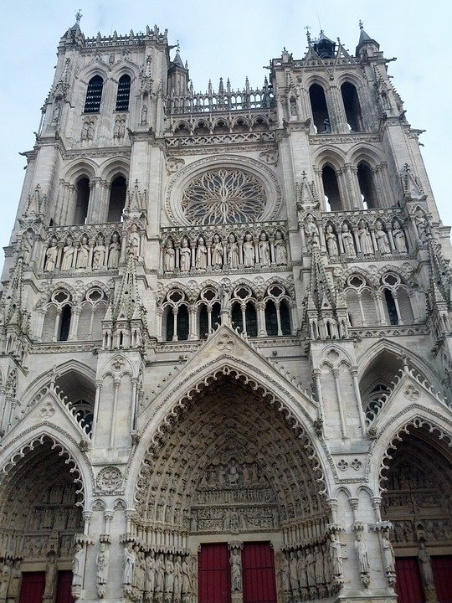
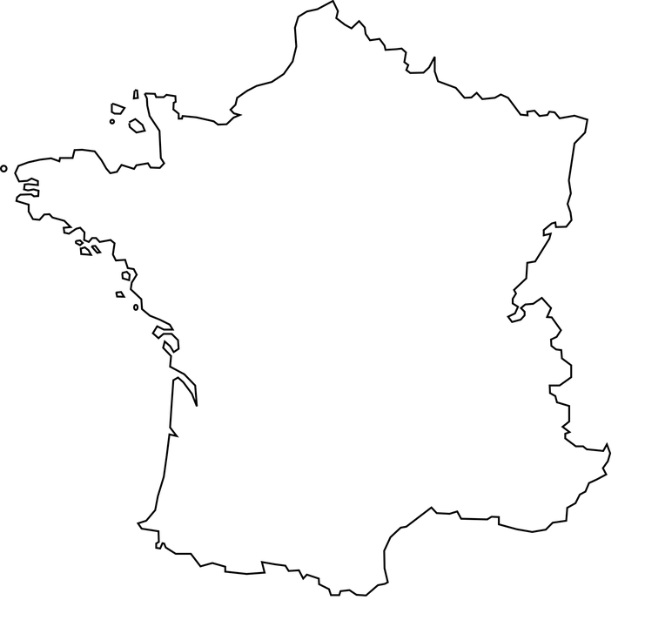
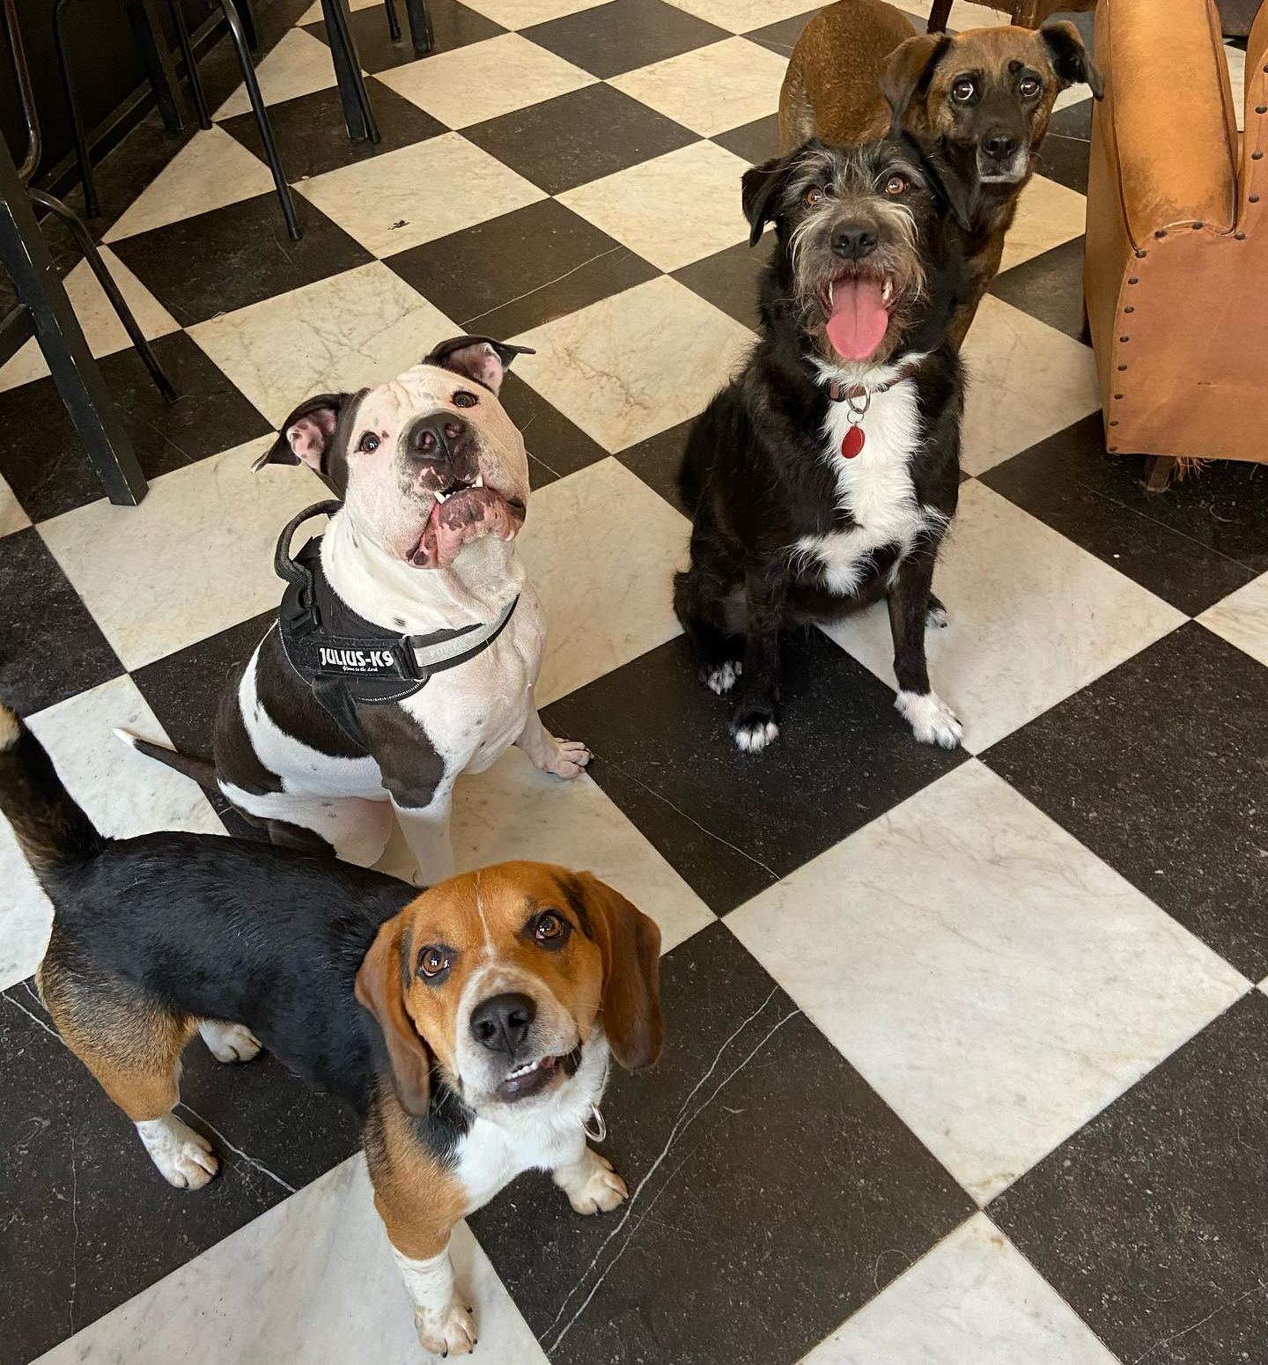
Les formes verbales (1/2)
la cathédrale = cathedral
explorer = to explore
la baguette = baguette
écouter
‘et’ + pronoun | ‘pour/sans’
Où ?
1
Amiens
Lille
2
3
Paris
Amiens Cathedral
4
5
Rocamadour
6
les Alpes
7
Le Waf dog café, Lille
8
Marseille
Cannes
Notes:
Timing: 8 minutes. This is slide 1 of 2.
Aim: Aural recognition of long and short forms of verbs based on the final SSC and to connecting these with meaning (lists of actions connected with et, or additional information about an action introduced with pour/sans); to give some cultural insights into places in France.
Procedure:
1. Review the cognates glossed on the screen before starting the activity to ensure students are familiar with the meaning and pronunciation. Cultural extension: move the placenames so that they appear above or below the map, and complete the map as a class by asking students if they know roughly where in France these places are.
2. Click audio buttons to hear sentences with the linking words (et + pronoun; pour/sans) obscured.
2. Students fill the gap based on the verb ending they hear.
3. Click to reveal answers. Click on ticks to hear full audio, including the linking word.
4. Present the cultural locations featured on the slide [top: Amiens Cathedral (the largest in France), bottom: a photo from Le Waf, dog café in Lille (the beagle at the front is called Beans)]
5. Proceed to comprehension activity on next slide.
Transcript:
Je vais à Amiens [et je] visite la cathédrale.
Tu visites le musée [sans] aimer la culture.
Il va dans les Alpes [pour] marcher en montagne.
Elle va à Lille [et elle] mange au premier café à chiens d'Europe.
Il va à Cannes [sans] regarder de films.
Tu visites Paris [et tu] achètes une baguette.
Elle va à Marseille [et elle] explore la ville.
Tu vas à Rocamadour [pour] manger du fromage.
Word frequency of cognates used (1 is the most frequent word in French): forme [369], verbal [4240], cathédrale, [>5000], explorer [3204], baguette [>5000]
Source: Londsale, D., & Le Bras, Y. (2009). A Frequency Dictionary of French: Core vocabulary for learners London: Routledge.

Slide 9
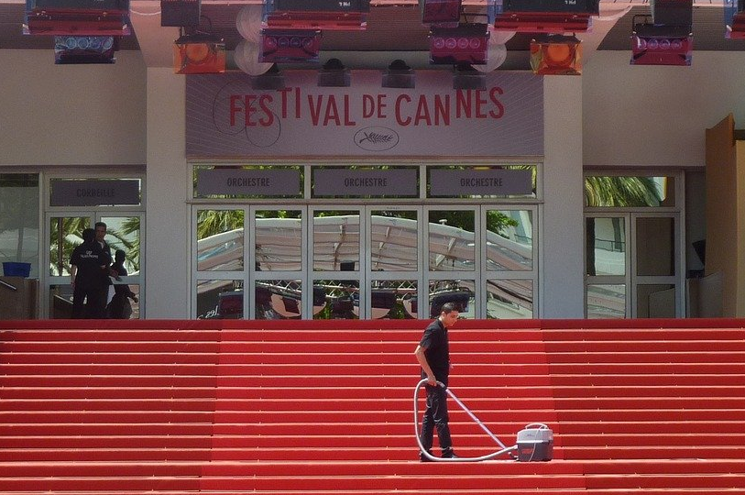
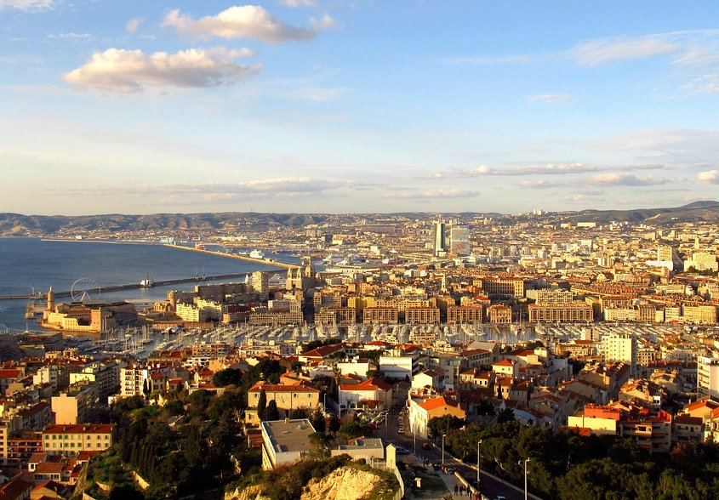
Les formes verbales (2/2)
écouter
Cannes film festival
1
visit the cathedral
2
like the culture
3
walk in the mountains
4
eat at the dog cafe
5
watch the films
6
buy a baguette
7
explore the city
8
eat cheese
Rocamadour cheese
Marseille
Notes:
This is slide 2 of 2.
Aim: listening comprehension with a focus on connecting words.
Procedure:
1. Click audio buttons to hear full sentences.
2. Students decide whether the activities from the list were done or not done.
3. Click to reveal answers.
4. Present the cultural locations featured on the slide [top: Cannes film festival, left: Marseille city overview, right: Rocamadour cheese from the village of the same name].
Transcript:
Je vais à Amiens et je visite la cathédrale.
Tu visites le musée sans aimer la culture.
Il va dans les Alpes pour marcher en montagne.
Elle va à Lille et elle mange au premier café à chiens d'Europe.
Il va à Cannes sans regarder de films.
Tu visites Paris et tu achètes une baguette.
Elle va à Marseille et elle explore la ville.
Tu vas à Rocamadour pour manger du fromage.
Word frequency of cognates used (1 is the most frequent word in French): forme [369], verbal [4240], cathédrale, [>5000], explorer [3204], baguette [>5000]
Source: Londsale, D., & Le Bras, Y. (2009). A Frequency Dictionary of French: Core vocabulary for learners London: Routledge.

Slide 10
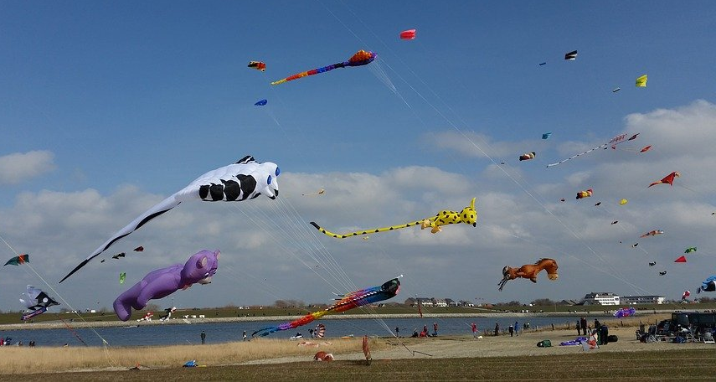
Le festival de Dieppe (1/3)
*le plus grand = the biggest
*le cerf-volant = kite
*le son = sound
écouter
Is the missing word a noun,a pronoun, pour or sans ?
Le festival de Dieppe est le plus grand* festival de cerfs-volants* au monde. On trouve le festival sur la plage en septembre.
Les visiteurs viennent de beaucoup de pays pour regarder des cerfs-volants traditionnels, de l'art et des acrobates. Un aspect important du festival est qu’on peut visiter sans acheter de billet. Il est gratuit ! Il y a beaucoup d'activités pour les enfants et le festival encourage l'imagination. Cet événement culturel célèbre les relations internationales.
Pendant le dernier week-end du festival, on
regarde les cerfs-volants illuminés pendant un show son* et lumière.
Je pense à visiter le festival. Tu voyages au festival avec ma famille ?
?
?
1
2
3
4
5
6
7
8
9
?
?
?
?
?
?
Notes:
Timing: 5 minutes
Aim: text segmentation; word prediction based on context and word form.
Procedure:
1. Click on a number button to hear a segment of the text read aloud. Students listen and read along.
2. The audio stops before a verb phrase. Students predict whether the covered word is a pronoun, noun or preposition based on the verb form that follows.
3. After receiving feedback on 2, students predict what the pronoun, noun or preposition might be from the context (note there may be several possible answers for the nouns and pronouns, but the context should help students distinguish between pour and sans).
4. Click to reveal missing answer.
5. Click on the next number to hear the following segment read aloud, starting with the verb phrase.
6. Repeat steps 1-5 for the remainder of the text.
Transcript:
1. Le festival de Dieppe est le plus grand festival de cerfs-volants au monde.
2. On trouve le festival sur la plage en septembre. Les visiteurs viennent de beaucoup de pays …
3. pour regarder des cerfs-volants traditionnels, de l'art et des acrobates. Un aspect important du festival est qu'il est gratuit ! On peut visiter
4. sans acheter de billet. Il y a beaucoup d'activités pour les enfants et
5. le festival encourage l'imagination. Cet
6. événement culturel célèbre les relations internationales. Pendant le dernier week-end du festival,
7. on regarde les cerfs-volants illuminés pendant un show son et lumière.
8. Je pense à visiter le festival.
9. Tu voyages au festival avec ma famille ?
Word frequency of unknown words used (1 is the most frequent word in French): cerf-volant [>5000], gratuit [2470], illuminé [>5000], lumière [1059]
Source: Londsale, D., & Le Bras, Y. (2009). A Frequency Dictionary of French: Core vocabulary for learners London: Routledge.
Word frequency of cognates used (1 is the most frequent word in French): festival [3858], aspect [998], visiteur [2266], traditionnel [1574], art [1181], acrobate [>5000], encourager [1434], imagination [2705], culturel [1495], relation [356], week-end [2475], show [>5000], audio [>5000]
Source: Londsale, D., & Le Bras, Y. (2009). A Frequency Dictionary of French: Core vocabulary for learners London: Routledge.
Text adapted from https://fr.wikipedia.org/wiki/Festival_International_de_Cerf-Volant_de_Dieppe

Slide 11
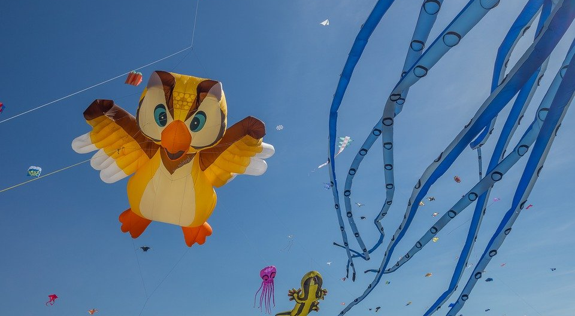
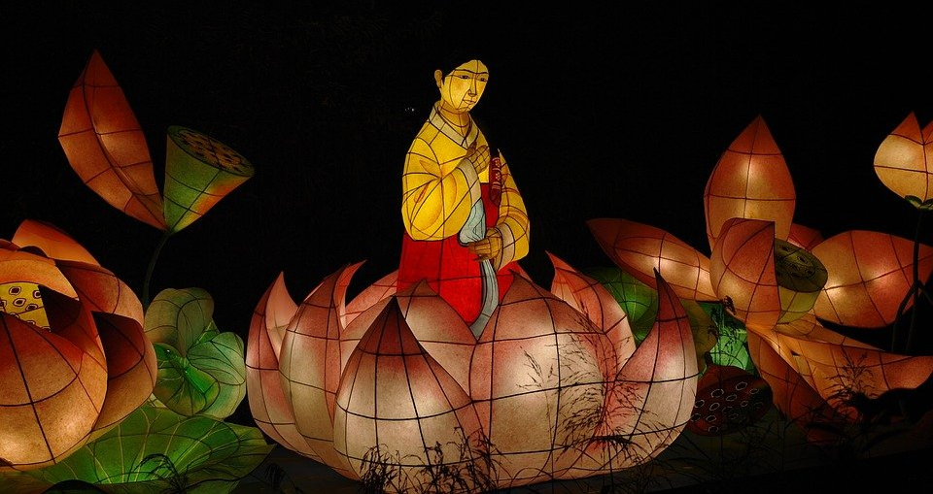
Le festival de Dieppe (2/3)
lire
*le plus grand =
the biggest
*le cerf-volant = kite
*le son = sound
Comment dit-on les mots orange en anglais ?
What noun does this word look like?
What adjective does this word look like?
What noun does this word look like?
Le festival de Dieppe est le plus grand* festival de cerfs-volants* au monde.
On trouve le festival sur la plage.
Les visiteurs viennent de beaucoup de pays pour regarder des cerfs-volants traditionnels, de l'art et des acrobates. Un aspect important du festival est qu’on peut visiter sans acheter de billet. Il est gratuit !
Il y a beaucoup d'activités pour les enfants et le festival encourage l'imagination. Cet événement culturel célèbre les relations internationales. Pendant le dernier week-end du festival, on regarde les cerfs-volants illuminés pendant un show son* et lumière. Je pense à visiter le festival. Tu voyages au festival avec ma famille ?
visitors
What does the previous sentence tell you about the festival?
acrobats
traditional
The start of this word looks like the English
free
What adjective does this look like?
This word has the same stem as the previous one you worked out. What might it mean?
event
lit up
light
What words that you already know could you use instead of the words in orange?
Notes:
Timing: 5 minutes
Aim: Developing inferencing skills by using surrounding context to work out meaning of unknown words; word substitution with known words.
Procedure:
1. Students try to work out the meaning of the highlighted words based on context (text and images) and similarity to English words.
2. If students need some help, click to bring up a clue
3. Click gain to reveal the translations.
4. Click to bring up the extension. Students think of known words that could replace the orange words to make a sensible sentence.
Some suggested answers:
visiteurs -> gens, enfants, personnes … any relevant noun to describe people
traditionnels -> grands, nouveaux… any relevant adjective to describe kites
acrobates -> artistes, chanteurs … any relevant noun to describe performers
événement -> lieu, festival … (note that any relevant masculine noun works here but ‘cet’ would need to change to agree)
illuminés -> verts, bons … any relevant adjective to describe kites
lumière -> musique, film … any relevant noun to describe a show

Slide 12
Le festival de Dieppe (3/3)
*remplacer = to replace
*le plus grand = the biggest
*le cerf-volant = kite
*le son = sound
écouter
Voici huit nouveaux mots. Cherche les définitions dans un dictionnaire et remplace* les mots en orange.
Le festival de Dieppe est le plus grand* festival de cerfs-volants* au monde. On
trouve le festival sur la plage en septembre.
Les visiteurs viennent de beaucoup de pays pour regarder des cerfs-volants traditionnels, de l'art et des acrobates. Un aspect important du festival est qu’on peut visiter sans acheter de billet. Il est gratuit !
Il y a beaucoup d'activités pour les enfants et le festival encourage l'imagination. Cet événement culturel célèbre les relations internationales.
Pendant le dernier week-end du festival, on regarde les cerfs-volants illuminés pendant un show son* et lumière.
Je pense à visiter le festival. Tu voyages au festival avec ma famille ?
installe
admirer
posséder
suscite
améliore
observe
souhaite
assistes
assister susciter observer admirer améliorer souhaiter installer posséder
Notes:
Timing: 6 minutes
Aim: Practising dictionary skills; word substitution with unknown words; manipulating unknown –ER verbs in the singular and infinitive forms.
Procedure:
1. Students look up the verbs in the box in a dictionary.
2. Students work out where each could be used in the text (to replace an orange word).
3. Students should conjugate the verbs appropriately, noticing the subject or linking word that precedes them.
4. Click to reveal suggested answers one by one (note: there may be multiple options for each orange word).
Word frequency of unknown words used (1 is the most frequent word in French): remplacer [448], assister [683], susciter [1027], observer [788] admirer [2789], améliorer [1056], souhaiter [403], installer [821], posséder [702]
Source: Londsale, D., & Le Bras, Y. (2009). A Frequency Dictionary of French: Core vocabulary for learners London: Routledge.
Word frequency of cognates used (1 is the most frequent word in French): définition [1587], dictionnaire [4094], admirer [2789], organiser [701], observer [788]
Source: Londsale, D., & Le Bras, Y. (2009). A Frequency Dictionary of French: Core vocabulary for learners London: Routledge.
Text adapted from https://fr.wikipedia.org/wiki/Festival_International_de_Cerf-Volant_de_Dieppe

Slide 13
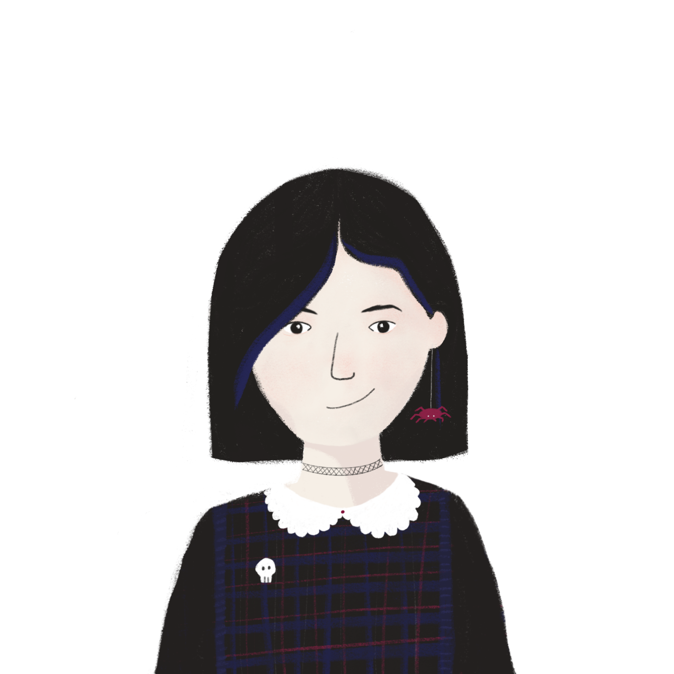
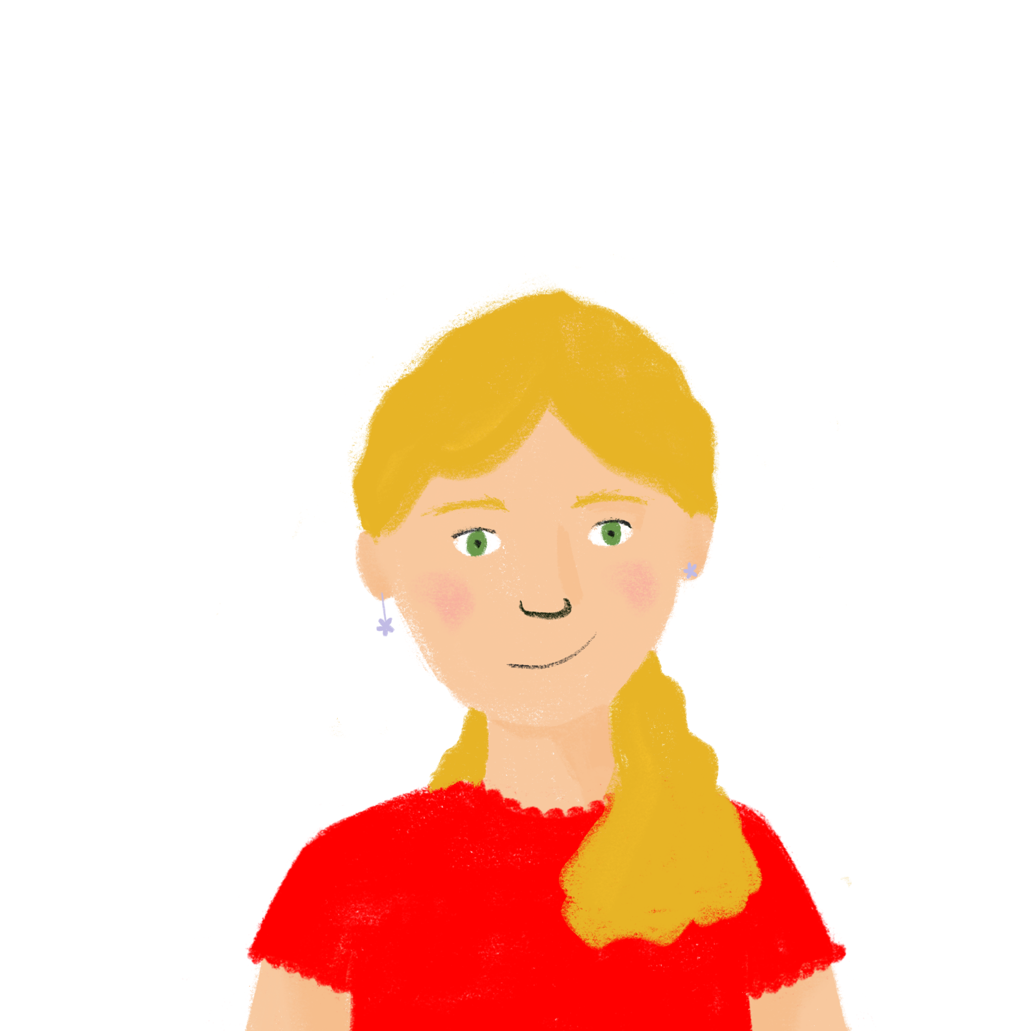
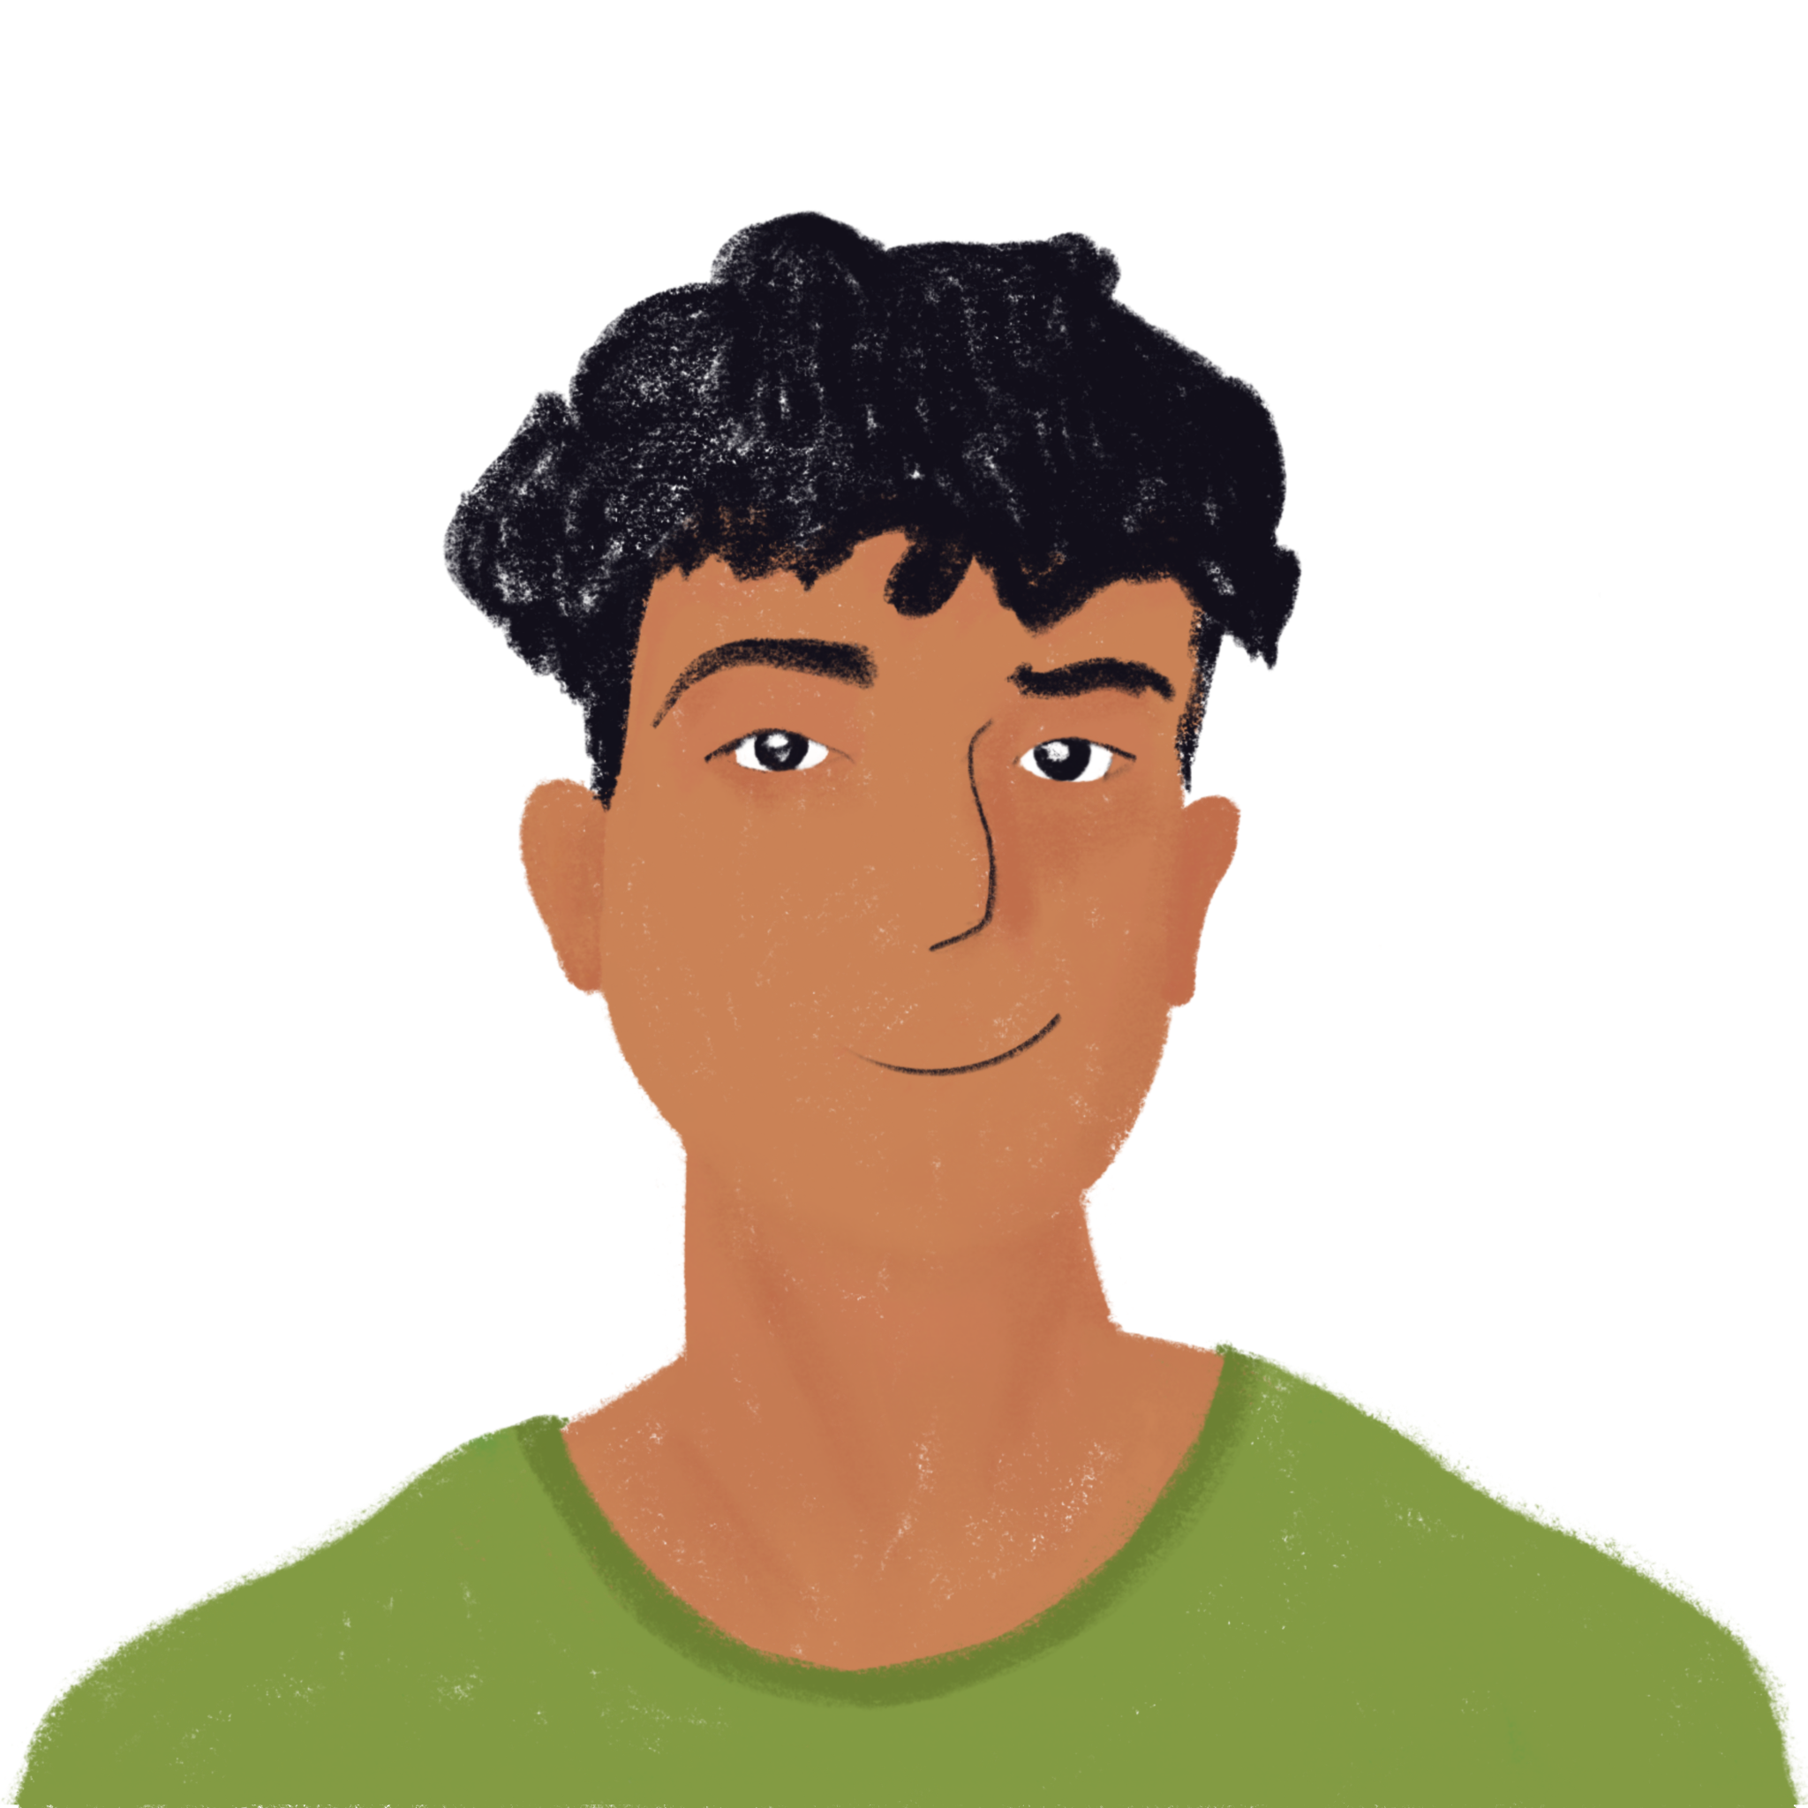
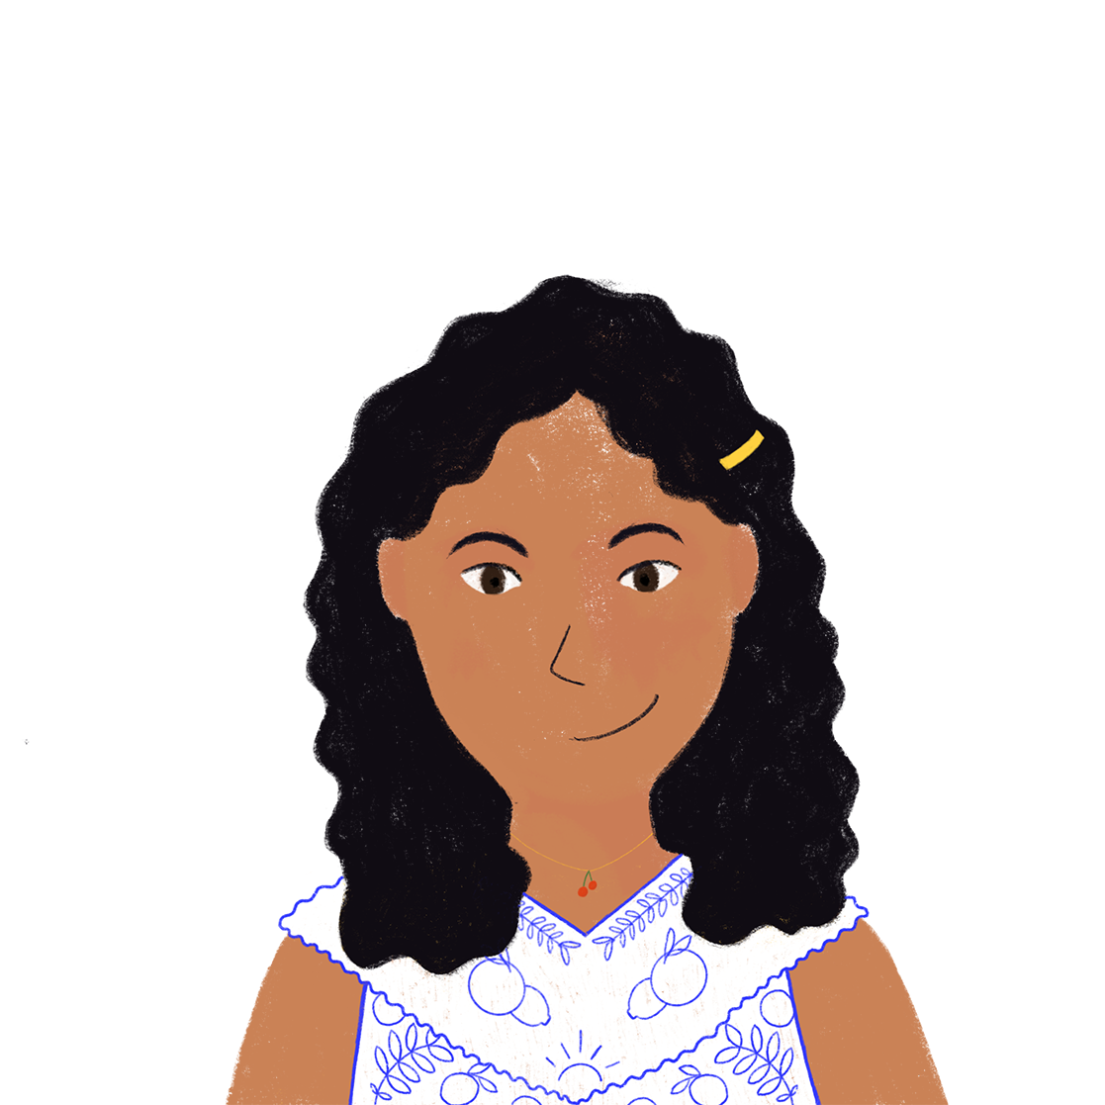
Je vais au festival …
parler
Je vais au festival pour écouter de la musique, regarder des cerfs-volants, aider ma mère et étudier.
Je vais au festival et je mange un sandwich, achète une glace, regarde des cerfs-volants et parle à Antoine.
How many different –ER verbs can you think of?
Je vais au festival et je mange un sandwich, achète une glace et regarde des cerfs-volants.
Je vais au festival pour écouter de la musique, regarder des cerfs-volants et aider ma mère.
Je vais au festival pour écouter de la musique et regarder des cerfs-volants.
Je vais au festival et je mange un sandwich et achète une glace.
Je vais au festival pour écouter de la musique.
Je vais au festival et je mange un sandwich.
Notes:
Timing: 5 minutes
Aim: Oral production of long and singular short forms of –ER verbs.
Procedure:
1. Give students 1 minute to write down as many –ER verbs as they can think of to express what they might do at an event like the kite festival.
2. Split students into small groups (3-6 students). Model the task using this slide.
3. The first student begins the game by saying ‘Je vais au festival et je …’ and finishing the sentence with a verb in short form.
4. Play passes to the second student, who says ‘Je vais au festival et je …’ and finishes the sentence by repeating the same verb that the first student said, and then adding a new verb in short form.
5. Play continues, with students repeating what others have said and adding new verbs, until a student either makes a mistake in the repetition or can’t think of a new verb to say. The ‘last player standing’ wins.
6. Mix up the groups, and start a new round, this time using the statement ‘Je vais au festival pour…’ to practise pour + infinitive (click through the second round of examples on the slide to illustrate.)

Slide 14
Les questions
grammaire
You can ask questions in French by raising the pitch of your voice.
Statement
Tu chantes.
You sing.
Question
Tu chantes ?
Do you sing?
You can add a question word to the end of the sentence for more information.
Statement
Tu chantes.
You sing.
Question
Tu chantes quand ?
When do you sing?
Question words
qui
quoi
comment
où
quand
pourquoi
who
what
how
where
when
why
Notes:
Timing: 3 minutes
Aim: To revisit intonation questions, with and without question words; to recall English meaning of French question words.
Procedure:
1. Click to bring up information.
2. Students practise use of flat intonation for statements, and rising intonation for questions.
3. Recall of question word meaning – click to reveal English translations one by one.
Transcript:
Tu chantes.
Tu chantes ?
Tu chantes.
Tu chantes quand ?

Slide 15
Vous êtes journalistes !
parler / écrire
le festival = festival
Salut Léa !
Tu aimes le festival pourquoi?
Léa aime le festival parce que les cerfs-volants sont beaux.
J’aime les cerfs-volants ! Ils sont très beaux.
Question:
Like the festival/why
Answer:
The kites are beautiful
Notes:
Timing: 8 minutes
Aim: Oral production of intonation questions to elicit specified information.
Procedure:
1. Students pretend to be journalists for the school newsletter. Their task is to interview young people at the kite festival and use the notes to write short reports about their experiences (approx. 50 words).
2. Click through demo slide so students can see how the activity works.
3. Distribute the rolecards on following slide. Students take it in turns to play the role of the interviewer and interviewee.
4. Partner A begins by forming a question in French using the question prompts on their card. Partner B responds using the answer prompts on their card. At higher levels, you may wish to distribute only the question cards to allow for free production/comprehension.
5. Students swap roles. Repeat step 4.
6. Students construct their newsletter reports from their notes, writing in the 3rd person.
7. See slide 16 for suggested short reports.

Slide 16
Vous êtes journalistes !
parler / écrire
Partner A
Partner B
Questions:
travel to the festival/how celebrate the festival/why eat at the festival/what visit the festival/who your family helps at the festival (Y/N)
Answers: (say full sentences)
by train the culture is important pizza lots of families yes, my brother helps to make the models
Answers: (say full sentences)
yes, it is interesting the kites are beautiful the singers red clothes they like to spend time here
Questions:
like the festival (Y/N) like the festival/why speak to at the festival/to who wear at the festival/what your friends think about the festival/what
Notes:
Rolecards
Do not display

Slide 17
Vous êtes journalistes !
parler / écrire
Partner A aime le festival parce que c’est intéressant et les cerfs-volants sont beaux. Il/Elle parle aux chanteurs et il/elle porte des vêtements rouges. Ses amis aiment passer du temps au festival.
Partner B voyage au festival en train. Il/Elle célèbre le festival parce que la culture est importante. Il/Elle mange de la pizza. Beaucoup de familles visitent le festival et son frère aide à faire des modèles.
Notes:
Suggested answers

Slide 18
Cultural events [1]: Le festival de Dieppe
-ER verbs (nous, vous, ils/elles), impersonal pronoun ‘on’, est-ce que questions,
SSCs [é (-er, -ez)] and SFe
Y9 French
Term 1.1 - Week 2 - Lesson 4
Catherine Morris / Natalie Finlayson
Artwork by: Chloé Motard
Date updated: 16/07/21
Notes:
Artwork by Chloé Motard. All additional pictures selected are available under a Creative Commons license, no attribution required.
Native speaker feedback provided by Sarah Brichory.
With thanks to Rachel Hawkes for her input on the lesson material.
Learning outcomes (lesson 2):
Consolidation of SSCs [é/-er/-ez] and SFE
Consolidation of -ER verbs (plural forms)
Consolidation of impersonal pronoun ‘on’
Consolidation of est-ce que questions
9.1.1.2 (revisit Y7 and Y8 vocabulary 2/13) acheter [636], aider [413], aimer [242], arriver [174], célébrer [2170], chercher [336], donner [46], emporter [1128], envoyer [526], expliquer [252], lever [837], manger [1338], marcher [1532], organiser [701], penser [116], penser à [116], porter [105], préférer [597], regarder [425], reposer [776], traverser [1040], trouver [105], utiliser [345], visiter [1378], voyager [2194], elle [38], elles [n/a], il [13], ils [n/a], je [22], nous [31], on¹ [29], tu [112], vous [50], qui [14], activité [452], ami [467], Angleterre [n/a], bateau [1287], billet [1976], ciel [1538], chose [125], culture [913], enfant [126], événement [573], famille [172], France [n/a], information [317], message [792], septembre [944], train [232], vacances [1726], ville [260], comment [234], où [48], pourquoi [193], quand [119], quoi [297], pour [10], sans [71]
Source: Londsale, D., & Le Bras, Y. (2009). A Frequency Dictionary of French: Core vocabulary for learners London: Routledge.
The frequency rankings for words that occur in this PowerPoint which have been previously introduced in NCELP resources are given in the NCELP SOW and in the resources that first introduced and formally re-visited those words.
For any other words that occur incidentally in this PowerPoint, frequency rankings will be provided in the notes field wherever possible.

Slide 19
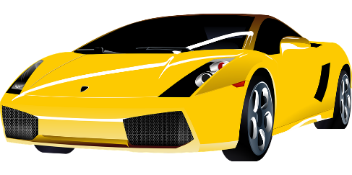
SFE
monde
moderne
[silent final –e]
[shy]
centre
timide
douze
vie
[life]
Notes:
Timing: 1 minute [2 slides]
Aim: To consolidate SSC [SFE]
Procedure:
1. Introduce and elicit the pronunciation of the individual SSC [SFE] and then the source word again ‘timide’ (with gesture, if using). 2. Then present and elicit the pronunciation of the five cluster words.
The cluster words have been chosen for their high-frequency, from a range of word classes, with the SSC (where possible) positioned within a variety of syllables within the words (e.g. initial, 2nd, final etc.). Additionally, we have tried to use words that build cumulatively on previously taught SSCs (see the Phonics Teaching Sequence document) and do not include new SSCs. Where new SSCs are used, they are often consonants which have a similar symbol-sound correspondence in English.
Word frequency (1 is the most frequent word in French): monde [77]; moderne [1239] centre [491]; vie [132]; douze [1664]; timide [3835]. Source: Londsale, D., & Le Bras, Y. (2009). A Frequency Dictionary of French: Core vocabulary for learners London: Routledge.

Slide 20
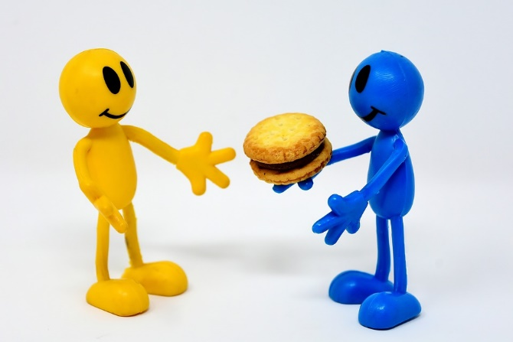
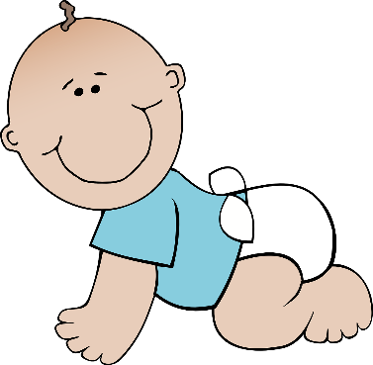
é/-er/-ez
bébé
donner
nez
parler
écrire
aller
[to go]
Notes:
Aim: To consolidate SSC [é]
Procedure:
1. Introduce and elicit the pronunciation of the individual SSC [é] and then the source word again ‘écrire’ (with gesture, if using). 2. Then present and elicit the pronunciation of the five cluster words.
The cluster words have been chosen for their high-frequency, from a range of word classes, with the SSC (where possible) positioned within a variety of syllables within the words (e.g. initial, 2nd, final etc.). Additionally, we have tried to use words that build cumulatively on previously taught SSCs (see the Phonics Teaching Sequence document) and do not include new SSCs. Where new SSCs are used, they are often consonants which have a similar symbol-sound correspondence in English.
Word frequency (1 is the most frequent word in French): écrire [382]; bébé [>5000]; aller [55] donner [46]; nez [2661]; parler [106]. Source: Londsale, D., & Le Bras, Y. (2009). A Frequency Dictionary of French: Core vocabulary for learners London: Routledge.

Slide 21
Les terminaisons de verbes
grammaire
Comment former les verbes au present ?
long form = infinitive /dictionary form
short form = forms that go with pronouns
remove -er add -ons
Long form: regarder
Plural short forms: nous regardons
remove -er add -ez
vous regardez
ils/elles regardent
remove -er add -ent
Say the verb forms out loud. What is the last SSC in each word?
regarder regardons, regardez, regardent
SSC [é]
SFC
SSC [é]
SFE + SFC
The vous form sounds the same as the infinitive
Notes:
Timing: 2 minutes
Aim: To revise long and plural short forms of –ER verbs, and connect the endings with SSCs.
Procedure:
1. Remind students how to form plural short forms of –ER verbs.
2. Ask students to pronounce the verb forms, focusing on the final sound in each word (click on the names of the SSCs to hear audio).
ick and ask students to pronounce the verb forms, focusing on the final sound in each word.
3. Click to remind students that the infinitive and the vous form sound the same.
Word frequency of unknown words used (1 is the most frequent word in French): terminaison [>5000]
Source: Londsale, D., & Le Bras, Y. (2009). A Frequency Dictionary of French: Core vocabulary for learners London: Routledge.
Word frequency of cognates (1 is the most frequent word in French): verbe [>5000], former [486]
Source: Londsale, D., & Le Bras, Y. (2009). A Frequency Dictionary of French: Core vocabulary for learners London: Routledge.

Slide 22
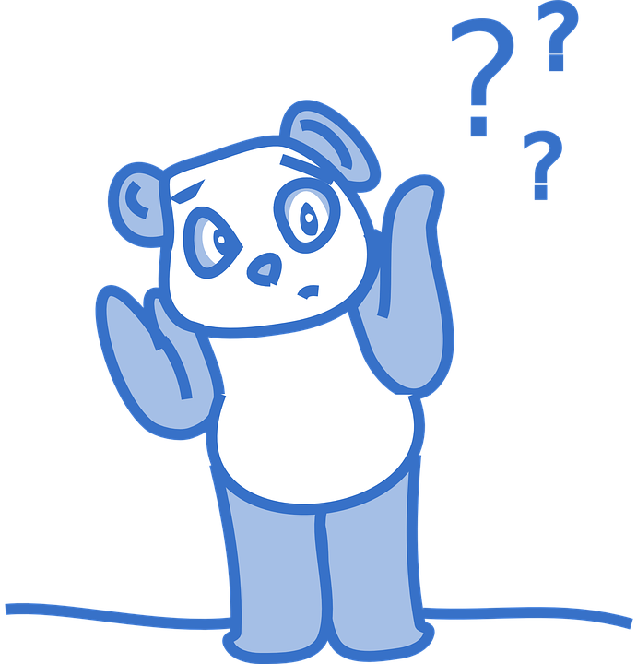
SSC [é] ou SFE ?
écouter
verb | infinitive meaning | infinitive OR ‘vous’ form | short form (ils/elles)
oublient | to forget
refuser/ez | to refuse
rencontrent | to meet
tentent | to try
ajouter/ez | to add
marquent | to mark
obliger/ez | to force
appuyer/ez | to press
Listen out for the last SSC
in each word.
1
_
2
_
3
_
4
_
5
_
6
_
7
_
8
_
Notes:
Timing: 5 minutes
Aim: Aural recognition of SSCs [é/-er/-ez] and SFE and to connecting these with meaning (long/2nd person plural vs 3rd person plural).
Procedure:
1. Click numbers to hear a verb in the long/2nd person plural or 3rd person plural.
2. Students tick whether they hear a long/2nd person plural or 3rd person plural, based on the ending they hear.
3. Click to reveal answers.
4. Listen again, this time drawing attention to stress patterns. As the last syllable in French words carries a slightly heavier stress, it is always the –er in the infinitive form that is stressed. Students repeat.
5. Students say the long and short form of each verb, focusing on the changing position of the stress (from base to ending).
Differentiation option for higher level students: extend box to cover whole verb form. Students transcribe.
Transcript:
oublient
refuser/refusez
rencontrent
tentent
ajouter/ajoutez
marquent
obliger/obligez
appuyer/apuyez
Word frequency of unknown words used (1 is the most frequent word in French): oublier [504], rencontrer [329], tenter [347], ajouter [359], obliger [499], appuyer [923]
Source: Londsale, D., & Le Bras, Y. (2009). A Frequency Dictionary of French: Core vocabulary for learners London: Routledge.
Word frequency of cognates (1 is the most frequent word in French): refuser [271], marquer [454]
Source: Londsale, D., & Le Bras, Y. (2009). A Frequency Dictionary of French: Core vocabulary for learners London: Routledge.

Slide 23
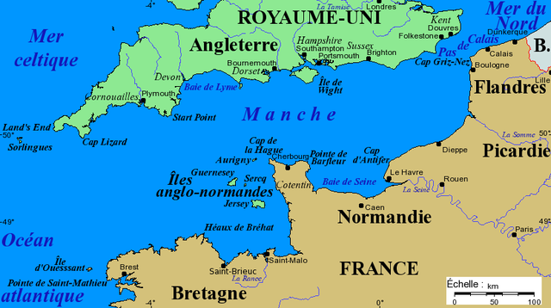
La Manche (1/3)
Où est Dieppe ?
La manche = sleeve
Adding a capital letter turns it into a proper noun:
La Manche = English Channel
The French word for the English Channel comes from its sleeve-like shape!
Notes:
Timing: 3 minutes
Aim: Visual representation of la Manche, which is the topic of the comprehension text that follows; raising cultural awareness (geography).
Procedure:
1. Students study the map and offer an English translation of La Manche.
2. Click to highlight Dieppe, where the kite festival is held.
3. Ask students if they recognise any other French place names on the map – either places they have visited in France, or the French names for places in the UK or bodies of water.
4. Click to bring up information about La Manche and why it is called that.
Image: Channel map with main capes, islands and cities. Projection of Mercator, data as of 2005. Fond de carte provenant de www.aquarius.geomar.de. Image can be found at http://cdown.edu.jm/eLibrary_Jamaica_2019//wikipedia-schools-3.0.1/images/608/60840.png.htm This file is licensed under the Creative Commons Attribution-Share Alike 3.0 Unported license.

Slide 24
La Manche (2/3)
Remplis les blancs avec les formes des verbes correctes.
lire / écrire
La Manche* sépare la France et l’Angleterre. On peut traverser la Manche en bateau ou en train sous l’eau. Quand nous visitons l’Angleterre, nous aimons prendre le train – c’est plus rapide. Ils préfèrent prendre le bateau pour regarder la vue. Comment traversez-vous la Manche ?
Le tunnel sous la Manche constitue le plus long tunnel sous-marin* du monde – on trouve 38 de ses 50 kilomètres sous la mer*.
On utilise le tunnel pour voyager entre l'Angleterre et la France. C'est idéal pour les vacances et les affaires.
[1]
[2]
[3]
[4]
[5]
[6]
[7]
[8]
*la Manche = the English Channel
*sous-marin = underwater
*la mer = sea
séparer (to separate)
visiter
aimer
préférer
traverser
constituer (to form)
trouver
utiliser
Notes:
Timing: 4 minutes
Aim: Written production of –ER verbs in all forms; raising cultural awareness (geography).
Procedure:
1. Students read the text about the English Channel and fill the gaps with the appropriate form of the given verbs. For an added challenge at higher levels, remove the numbers from the verbs in the box and mix up the order so that students must also read for semantic meaning and assign the words to the correct gaps.
2. Click to reveal answers.
3. Click to proceed to comprehension questions on next slide.
Word frequency of unknown words used (1 is the most frequent word in French): constituer [495], marin [2101], mer [921]
Source: Londsale, D., & Le Bras, Y. (2009). A Frequency Dictionary of French: Core vocabulary for learners London: Routledge.
Word frequency of cognates (1 is the most frequent word in French): séparer [946], tunnel [3386], long [202], kilomètre [1435]
Source: Londsale, D., & Le Bras, Y. (2009). A Frequency Dictionary of French: Core vocabulary for learners London: Routledge.

Slide 25
La Manche (3/3)
Écris des réponses aux questions en anglais.
lire / écrire
La Manche* sépare la France et l’Angleterre. On peut traverser la Manche en bateau ou en train sous l’eau. Quand nous visitons l’Angleterre, nous aimons prendre le train – c’est plus rapide. Ils préfèrent prendre le bateau pour regarder la vue. Comment traversez-vous la Manche ?
Le tunnel sous la Manche constitue le plus long tunnel sous-marin* du monde – on trouve 38 de ses 50 kilomètres sont sous la mer*. On utilise le tunnel pour voyager entre l'Angleterre et la France. C'est idéal pour les vacances et les affaires.
*la Manche = the English Channel
*sous-marin = underwater
*la mer = sea
What is the tunnel ideal for?
holidays / business
What are two ways you can cross the Channel?
boat / train
How long is the tunnel?
50km
How much of the tunnel is under the sea?
38km
Notes:
Timing: 4 mins
Aim: Reading comprehension.
Procedure:
1. Click to bring up a comprehension questions in English.
2. Students write an answer in English.
3. Click to reveal answer.
4. Click again to reveal the next question.
5. Repeat steps 2-5 for 4 questions in total.

Slide 26
Saying ‘we’
Remember!
‘On’ can also be used informally to talk about yourself and another person. We will revise this in a few weeks’ time.
grammaire
The pronouns on and nous both mean ‘we’.
On means ‘we’ when talking about people in general. We can also translate it as ‘people’, ‘you’ or ‘one’. It uses the il/elle verb endings.
The pronoun nous always means ‘we’ when talking about yourself and another person or people. We can also translate it as ‘you and I’. The verb ending is -ons.
On parle français ici.
We speak French here. People speak French here.
Nous parlons français.
We speak French.
You and I speak French.
Notes:
Timing: 2 minutes
Aim: Consolidation of the difference between two French translations of ‘we’ (on for ‘people in general’ vs nous for ‘you + a group of people’)
Procedure:
1. Click to bring up information.
2. Click to bring up the reminder of the second meaning of ‘on’. Explain to students that the informal use will be revisited in a future week, and that only the more formal use ‘people in general’ is used in this lesson.

Slide 27
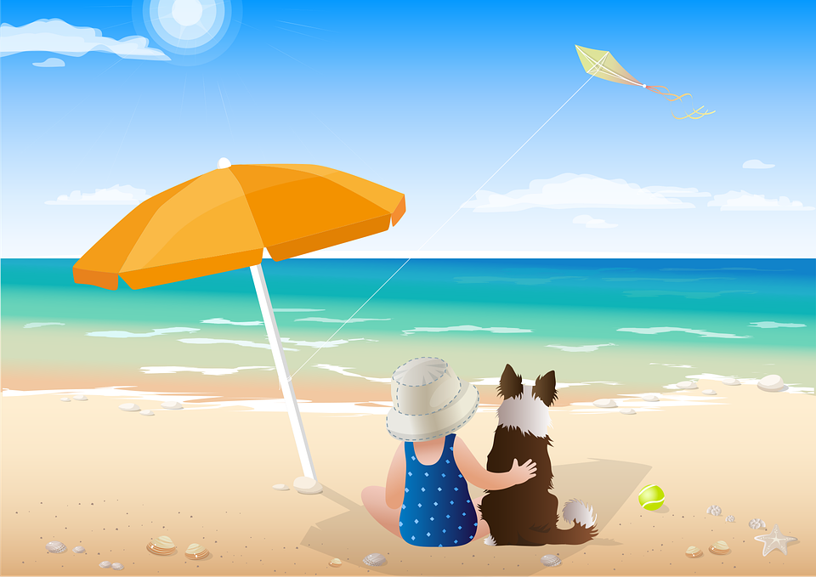
Au festival de Dieppe
le cerf-volant
= kite
lire
Tu trouves un article sur le festival dans un journal. C’est chacun (people) ou juste nous (les journalistes) ?
On emporte des cerfs-volants à Dieppe.
Nous envoyons des photos aux amis.
On lève les têtes au ciel.
On explique l’histoire du festival aux journaux.
Nous regardons le show.
On donne des informations aux enfants.
Nous cherchons les autres.
Nous achetons des cerfs-volants.
1. Everyone brings kites to Dieppe.
2. You and I send photos to friends.
3. People lift their heads to the sky.
4. People explain the history of the festival to the newspapers.
5. You and I watch the show.
6. People give information to
children.
7. You and I are looking for the others.
8. You and I are buying kites.
__
__
__
__
__
__
__
__
Notes:
Timing: 5 minutes
Aim: Written recognition of –ER verbs in the on and nous form and connecting these with meaning (‘people in general’ vs ‘you + a group of people’)
Procedure:
1. Draw attention to the context – a written newspaper article. Remind students that on can only mean ‘people in general’ in this context.
2. Students read sentences and decide, based on verb forms, whether the missing pronoun is on or nous.
3. Click to bring up answers.
4. Students then translate sentences English, focusing in particular on the translation of the pronoun. The translations ‘people’ and ‘you and I’ are given as suggestions but remind students that there are several translations of each pronoun (e.g. ‘people’/’we’/’one’ for on, ‘we’/’you and I’/any combination of referents + ‘I’ for nous). Remind students that both present simple and continuous forms of the English verbs are acceptable. At higher levels, encourage students to use a mix of these in their translations.
5. Click to bring up suggested answers.
Word frequency of unknown words (1 is the most frequent word in French): cerf-volant [>5000]
Source: Londsale, D., & Le Bras, Y. (2009). A Frequency Dictionary of French: Core vocabulary for learners London: Routledge.
Word frequency of cognates (1 is the most frequent word in French): article [604], festival [3858], show [>5000], juste [304], journaliste [>5000]
Source: Londsale, D., & Le Bras, Y. (2009). A Frequency Dictionary of French: Core vocabulary for learners London: Routledge.

Slide 28
Comment poser une question ?
grammaire
Est-ce que changes to est-ce qu’ before a vowel.
As you know, you can ask a question by putting est-ce que in front of a statement and raising your voice:
Est-ce qu’elle habite ici ?
Does she live here?
You can request more information by adding a question word at the start:
Pourquoi est-ce qu’elle habite ici ?
Why does she live here?
Notes:
Timing: 1 minute
Aim: To revisit est-ce que questions, with and without question words.
Procedure:
1. Click to bring up information.
2. Students practise use of flat intonation for statements, and rising intonation for questions.
Transcript:
Tu chantes.
Tu chantes ?
Tu chantes.
Tu chantes quand ?
Transcript:
Est-ce qu’elle est ici ?
Pourquoi est-ce qu’elle est ici ?

Slide 29
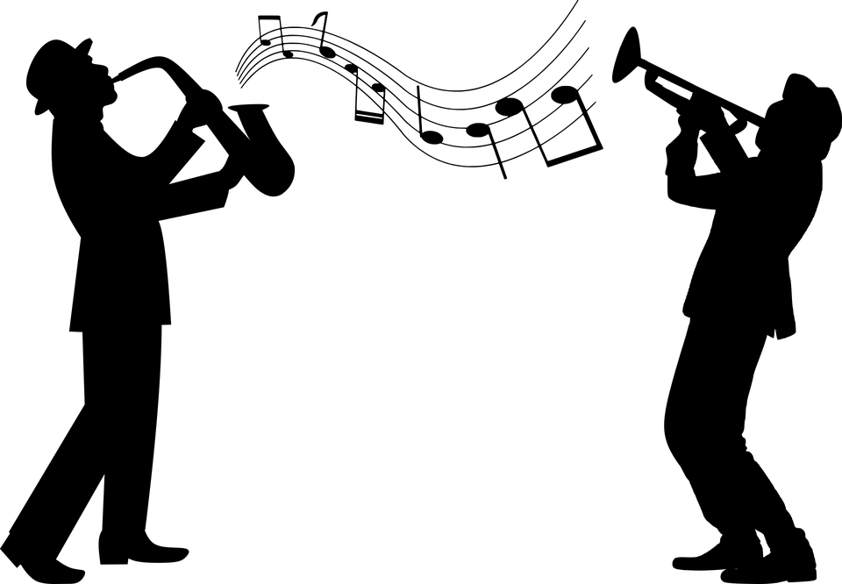
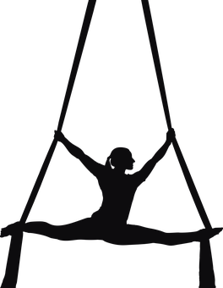
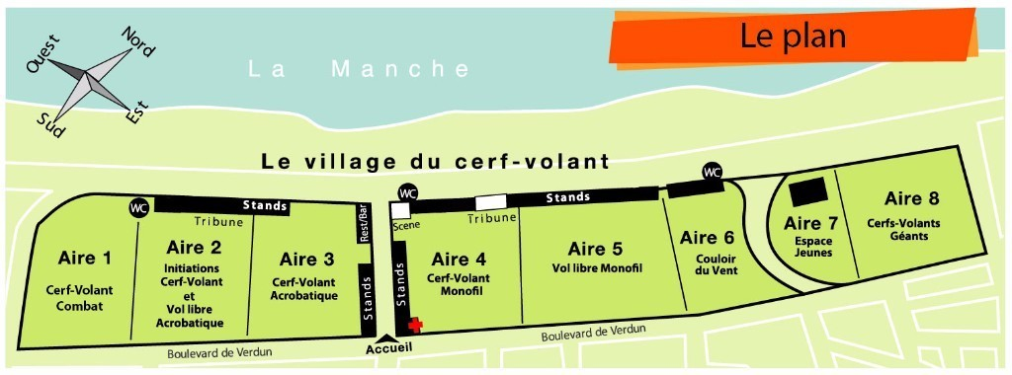
Qui est où ?
Une famille arrive au festival. Ils achètent un plan et parlent avec des employés.
écouter
Qui est où ?
1
we
A7
we
[employees]
you (plural)
[family]
they
[performers]
2
they
A3
We eat
3
you (pl)
A1
You use a mobile phone
They win a game
4
they
A5
They stay
5
we
A2
6
they
A8
7
we
A6
They share a pizza
We manage a shop
We sing
You start walking
8
you (pl)
A4
Notes:
Timing: 5 minutes
Aim: Aural recognition of plural forms of –ER verbs and connecting these with meaning (sentence subject).
Procedure:
1. Students draw a sketch of the map or list the area numbers.
2. Click buttons to hear audio with pronoun beeped out.
3. Students note down who is in which section of the map.
4. Click to reveal answers.
5. Click pronouns to hear full audio.
6. On the second listen, students note down what the individuals are doing in each area. At more advanced levels, you may wish to ask students to do this at the same time as step 3.
7. Click to reveal answers.
Transcript:
1. [nous] mangeons dans l’Aire 7. 2. [ils/elles] gagnent un jeu dans l’Aire 3.
3. [vous] utilisez un portable dans l’Aire 1.
4. [ils/elles] restent dans l’Aire 5.
5. [nous] chantons dans l’Aire 2.
6. [ils/elles] partagent un pizza dans l’Aire 8.
7. [nous] gèrons un magasin dans l’Aire 6.
8. [vous] commencez la visite dans l’Aire 4.
Word frequency of unknown words used(1 is the most frequent word in French): aire [4987]
Source: Londsale, D., & Le Bras, Y. (2009). A Frequency Dictionary of French: Core vocabulary for learners London: Routledge.
Image from https://static.actu.fr/uploads/2016/09/plan-village-2016.jpg

Slide 30
Qui fait quoi et où ?
parler
Nous mangeons dans l’Aire 2.
Utilise est-ce que pour former des questions
Qu’est-ce que vous mangez ?
Nous mangeons une pizza.
Aire 1 | Aire 2 | Aire 3 | Aire 4 | Aire 5 | Aire 6 | Aire 7 | Aire 8
nous mangeons
une pizza
Notes:
Timing: 10 minutes
Aim: Oral production and recognition of est-ce que questions and plural forms of –ER verbs.
Procedure:
1. Students work in pairs. Print and distribute the rolecards on slide 30.
2. Students sketch the map. Tell students they will use the information on their role cards and find out who is where and what they are doing.
3. Click through example slide to demonstrate an example dialogue.
5. Partner A begins by forming a sentence as indicated by the prompt on their rolecard. The verbs are provided in the infinitive, so students must remember to add the appropriate ending. 6. Partner B responds with a question, using the question word indicated by the prompt, and relevant pronoun (e.g Partner A says nous mangeons…, Partner B must respond using vous…)
7. Partner A answers the question, translating the English information on their rolecard.
8. Students check their answers against the map on slide 31.
Word frequency of unknown words (1 is the most frequent word in French): aire [4987]
Source: Londsale, D., & Le Bras, Y. (2009). A Frequency Dictionary of French: Core vocabulary for learners London: Routledge.

Slide 31
Student A rolecards
Student B rolecards
Round 1
Tell your partner this. Remember the verb ending! | Reply to your partner with this.
1. [Nous/manger] dans l’Aire 3. | an ice cream
2. [Vous/rester] dans l’Aire 6. | with your parents
3. [Mes amis/marcher] dans l’Aire 1. | quickly
Round 1
Ask your partner for this information.
1. what?
2. with who?
3. how?
Round 2
Tell your partner this. Remember the verb ending! | Reply to your partner with this.
1. [Mes amis/jouer] dans l’Aire 3. | soon
2. [Nous/commencer] dans l’Aire 8. | the task
3. [Vous/acheter] un chapeau dans l’Aire 5. | because it is blue
Round 2
Ask your partner for this information.
1. when?
2. what?
3. why?
Notes:
rolecards
Do not display

Slide 32
Qui fait quoi et où ?
parler
Réponses
Vous restez avec mes parents
Ils/Elles marchent vite
Nous mangeons une glace
Nous commençons la tâche
Vous achetez un chapeau parce qu’il est bleu
Ils jouent bientôt
Notes:
Answers
Procedure:
1. Click to bring up answers
2. Partner A’s answers will appear along the top of the map
3. Partner B’s answers will appear along the bottom of the map
Word frequency (1 is the most frequent word in French): aire [4987]
Source: Londsale, D., & Le Bras, Y. (2009). A Frequency Dictionary of French: Core vocabulary for learners London: Routledge.
Image from https://static.actu.fr/uploads/2016/09/plan-village-2016.jpg

Slide 33
-ER verbs and est-ce que questions
écrire
Write an email to a French friend about a festival or event you like to go to. Write:
what you do there (je)
what everyone does there (on)
what your family does there (nous)
what your parents or friends do there (ils/elles)
two est-ce que questions to ask a friend about a festival or event they (tu) and their family (vous) go to.
Notes:
Timing: 8 minutes
Aim: Semi-structured written production to bring together vocabulary and grammar points revised this lesson.
Procedure:
1. Students choose a festival or event they have been to (or the kite festival if they can’t think of another).
2. Students write a sentence with each specified pronoun (je, on, nous, ils/elles). Students can use dictionaries to look up new verbs if desired, but teachers may wish to provide a ‘pool’ or additional –ER verbs students can use to keep the focus on this verb group.
3. Students write two est-ce que questions to ask a friend about them and about their family.

Slide 34
Gaming Grammar
Gaming Grammar
Relevant mini game(s):
Verbs (present): 1st person singular/plural (Verb agreement (present))
Verbs (present): 2nd person singular/plural (Verb agreement (present))
Verbs (present): 3rd person singular/plural (Verb agreement (present))
Notes:
This slide links to Gaming Grammar login screen. The appropriate mission can then be selected from the menu page.
Students will progress through the game at their own rate; teachers should use the teacher interface to check progress. This will help to inform future lesson planning.

Slide 35
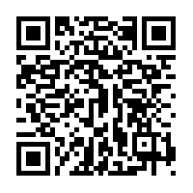
Devoirs
Vocabulary Learning Homework (Y9, Term 1.1, Week 3)
Quizlet link: Y9 Term 1.1 Week 3
Quizlet QR code:
Notes:
Answer sheet for homework can be found on the portal at https://resources.ncelp.org/concern/resources/jd472x66s?locale=en

