Slide 1
Asking about what you did/have done
Questions in the perfect tense
Irregular past participles (taking avoir)
SSC [gn], [j/soft g] revisited
Y8 French
Term 3.2 - Week 6 - Lesson 69
Amber Dudley / Catherine Morris / Natalie Finlayson
Artwork by: Chloé Motard
Date updated: 09/07/21
Notes:
Artwork by Chloé Motard. All additional pictures selected are available under a Creative Commons license, no attribution required.
Native teacher feedback provided by Sarah Brichory.
With thanks to Rachel Hawkes for her input on the lesson material.
Learning outcomes (lesson 1):
Revision of SSC [gn] and [j/soft g]
Introduction of irregular past participles (taking avoir)
Introduction of questions in the perfect tense (to translate did? and have/has? in English)
Word frequency (1 is the most frequent word in French):
8.3.2.6 (introduce) bu [boire - 1879], eu [avoir - 8], pris [prendre - 43], accident [1227], bras [1253], jambe [2472], mal¹ [277], maladie [793], petit-déjeuner [>5000], photo [1412], déjà² [58], pas encore [18/51], ensuite [265],
8.3.1.6 (revisit) attendre [155], descendre [1705], (en) bas [7/468], histoire² [263], règle² [488], piste [1902], roman [1262], texte [631]
8.2.2.3 (revisit) feu [786], hôpital [1308], jeu [291], journal [420], oiseau [2435], réseau [721], autre [28], même [42], idéal [1429], international [282], local [622], plusieurs [213], social [301]
Source: Londsale, D., & Le Bras, Y. (2009). A Frequency Dictionary of French: Core vocabulary for learners London: Routledge.
The frequency rankings for words that occur in this PowerPoint which have been previously introduced in NCELP resources are given in the NCELP SOW and in the resources that first introduced and formally re-visited those words.
For any other words that occur incidentally in this PowerPoint, frequency rankings will be provided in the notes field wherever possible.

Slide 2
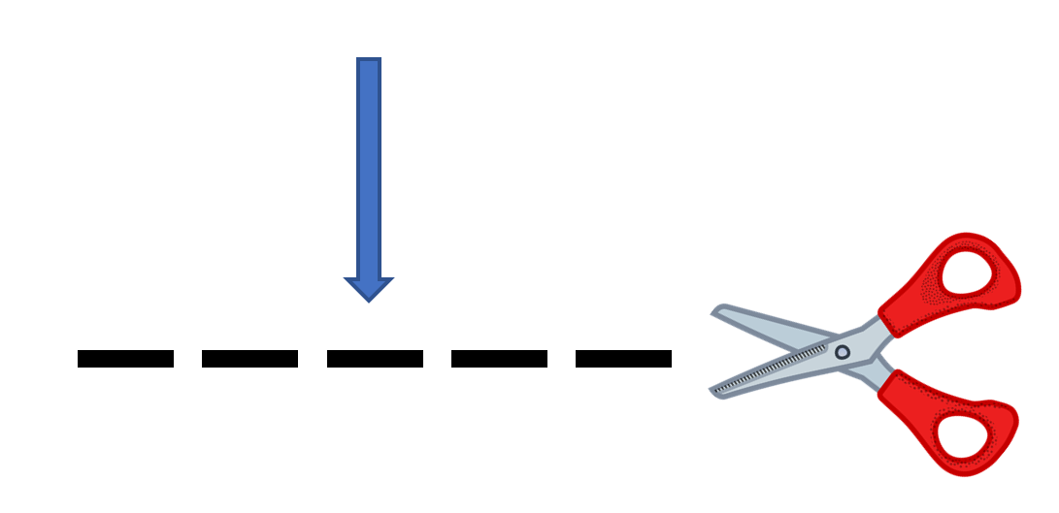
-gn-
ligne
Notes:
Timing: 1 minute
Aim: To consolidate SSC [-gn-]
Procedure: 1. Present the letter(s) and say the [-gn-] sound first, on its own. Students repeat it with you. 2. Bring up the word ”ligne” on its own, say it, students repeat it, so that they have the opportunity to focus all of their attention on the connection between the written word and its sound.
3. A possible gesture for this would be to draw a line in the air with your finger, 4. Roll back the animations and work through 1-3 again, but this time, dropping your voice completely to listen carefully to the students saying the [-gn-] sound, pronouncing ”ligne” and, if using, doing the gesture.
Word frequency (1 is the most frequent word in French):
ligne [342]
Source: Londsale, D., & Le Bras, Y. (2009). A Frequency Dictionary of French: Core vocabulary for learners London: Routledge.

Slide 3
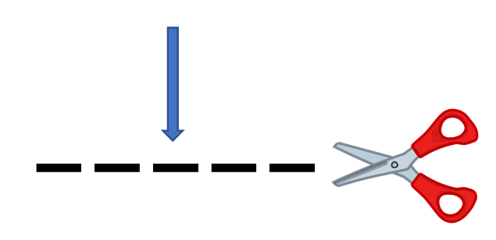
-gn-
gagner
montagne
[to win]
espagnol
ligne
Allemagne
ignorer
[to not know]
Notes:
Timing: 2 minutes
Aim: To consolidate SSC [-gn-]
Procedure:
Introduce and elicit the pronunciation of the individual SSC [-gn-] and then the source word again ‘ligne’ (with gesture, if using). Then present and elicit the pronunciation of the five cluster words. The cluster words have been chosen for their high-frequency, from a range of word classes, with the SSC (where possible) positioned within a variety of syllables within the words (e.g. initial, 2nd, final etc.). Additionally, we have tried to use words that build cumulatively on previously taught SSCs (see the Phonics Teaching Sequence document) and do not include new SSCs. Where new SSCs are used, they are often consonants which have a similar symbol-sound correspondence in English.
Word frequency (1 is the most frequent word in French): ligne [342]; gagner [258]; ignorer [639]; espagnol [1666]; montagne [1734]; Allemagne [N/A]. Source: Londsale, D., & Le Bras, Y. (2009). A Frequency Dictionary of French: Core vocabulary for learners London: Routledge.

Slide 4
j/soft g
X
jour
Notes:
Timing: 1 minute
Aim: To consolidate SSC [j/soft g]
Procedure: 1. Present the letter(s) and say the [j/soft g] sound first, on its own. Students repeat it with you. 2. Bring up the word ”jour” on its own, say it, students repeat it, so that they have the opportunity to focus all of their attention on the connection between the written word and its sound.
3. A possible gesture for this would be to mime waking up at daybreak, by stretching out ones arms and yawning. 4. Roll back the animations and work through 1-3 again, but this time, dropping your voice completely to listen carefully to the students saying the [j/soft g] sound, pronouncing ”jour” and, if using, doing the gesture.
Word frequency (1 is the most frequent word in French):
jour [78].
Source: Londsale, D., & Le Bras, Y. (2009). A Frequency Dictionary of French: Core vocabulary for learners London: Routledge.

Slide 5
j/soft g
j’ai
génial
[I have]
X
jour
sujet
jamais
[subject]
[never]
déjà
[already]
Notes:
Timing: 2 minutes
Aim: To consolidate SSC [j/soft g]
Procedure:
1. Introduce and elicit the pronunciation of the individual SSC [j/soft g] and then the source word again ‘jour’ (with gesture, if using). 2. Then present and elicit the pronunciation of the five cluster words.
The cluster words have been chosen for their high-frequency, from a range of word classes, with the SSC (where possible) positioned within a variety of syllables within the words (e.g. initial, 2nd, final etc.). Additionally, we have tried to use words that build cumulatively on previously taught SSCs (see the Phonics Teaching Sequence document) and do not include new SSCs. Where new SSCs are used, they are often consonants which have a similar symbol-sound correspondence in English.
Word frequency (1 is the most frequent word in French): j’ai [8 - avoir]; génial [3872] sujet [353]; déjà [58]; jamais [179]; jour [78]. Source: Londsale, D., & Le Bras, Y. (2009). A Frequency Dictionary of French: Core vocabulary for learners London: Routledge.

Slide 6
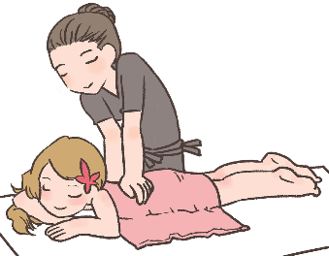
Hard and soft [g]/[j]
info
Hard [g] is pronounced like the g in ‘gold’.
[g] is hard when it comes before a, o, u or r, l, m.
Soft [g] and [j] are pronounced like the g in ‘massage’.
[g] is soft when it comes before e, i, or y.
la gare
[station]
le gilet
[cardigan]
nous plongeons
[we are diving]
la blague
[joke]
hard [g]
soft [g]/[j]
soft [g]/[j]
hard [g]
Notes:
Timing: 2 minutes
Aim: To revise spelling rules governing the pronunciation of hard and soft [g] in preparation for the listening activity that follows.
Procedure:
1. Click to bring up information.
2. Students predict the pronunciation of the four target words.
3. Click again to reveal answers one by one.
4. Click on words to hear them said aloud by a native speaker.
5. Students repeat.
Transcript:
la gare, le gilet, nous plongeons, la blague
Word frequency of unknown words used (1 is the most frequent word in French): gare [2581], gilet [>5000], plonger [1958], blague [4822]

Slide 7
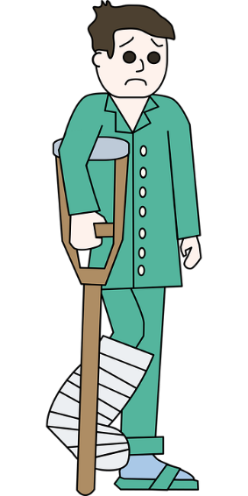
Phonétique
écouter
Romain est à l’hôpital! Qu’entendez-vous ? Hard [g], [soft g/j], ou [gn] ?
J’ai mal au genou !
[My knee hurts!]
__
1
Vous pouvez choisir un compagnon pour voir le médecin.
[You can choose a companion to see the doctor (with).]
2
__
Mon collè g ue vient avec moi.
[My colleague is coming with me.]
__
3
4
Re g ardez le rayon X.
[Look at the x-ray.]
Votre jambe est cassée.
[Your leg is broken.]
Nous devons aligner les os avec le plâtre.
[We have to align the bones with the cast.]
hard g
soft g
[gn]
__
5
__
6
__
Notes:
Timing: 4 minutes
Aim: Aural and written recognition of SSCs hard and soft [g], [j] and [gn] in longer sentences.
Procedure:
1. Click numbers to hear the sentences.
2. Students should note what the missing sound is. Remind them that they can distinguish between soft [g] and [j] by looking at the following vowel (if it is ‘a’, ‘o’ or ‘u’, it must be [j]).
3. Click to reveal answers one by one (plus tally of total SSCs).
Transcript:
1. J’ai mal au genou !
2. Vous pouvez choisir un compagnon pour voir le médecin.
3. Mon collègue vient avec moi.
4. Regardez le rayon X.
5. Votre jambe est cassée.
6. Nous devons aligner les os avec le plâtre.
Word frequency of unknown words used (1 is the most frequent word in French): genou [2967], compagnon [3023], collègue [1099], rayon [2926], jambe [2472], casser [2185], aligner [3021], os [4092], plâtre [>5000]
Source: Londsale, D., & Le Bras, Y. (2009). A Frequency Dictionary of French: Core vocabulary for learners London: Routledge.

Slide 8
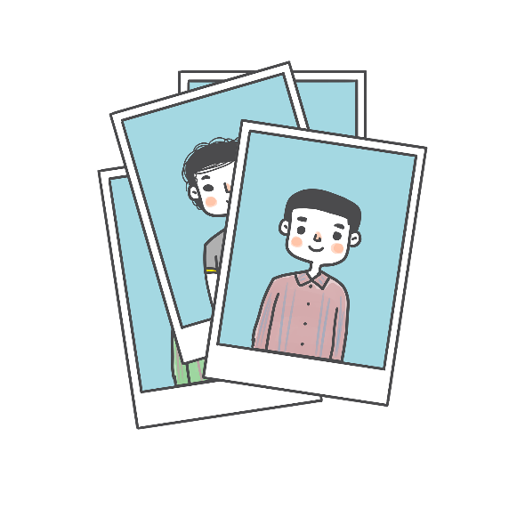
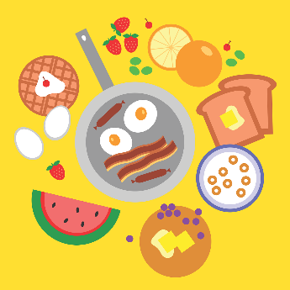
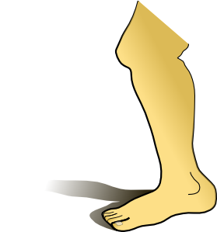
Vocabulaire
écouter
J.
1
F
Écoute et écris la lettre correcte.
2
G
had (pp)
3
D
G.
E
drank, drunk (pp)
B.
4
5
C
H.
J
A.
6
already, yet
next
7
A
D.
F.
K.
8
K
9
H
C.
10
I
took, taken (pp)
ache
11
L
not yet
I.
12
B
E.
L.
Notes:
Timing: 3 minutes
Aim: Aural comprehension of this week’s new vocabulary.
Procedure:
1. Click on the number trigger to play the audio.
2. Students match the word with the picture or English word.
3. Click to reveal the answers.
4. Click on each letter to hear the words pronounced a second time. Students repeat.
Transcript:
1. déjà
2. eu
3. le petit-déjeuner
4. pris
5. la jambe
6. la photo
7. bu
8. ensuite
9. le bras
10. le mal
11. pas encore
12. la maladie

Slide 9
Saying what hurts
vocabulaire
In French, we use the expression ‘avoir mal’ to say we are ‘in pain’ or ‘hurt’:
J’ai mal. I am in pain. / I am hurt.
Elle a mal. She is in pain. / She is hurt.
To say a specific body part hurts or is sore, we use the expression avoir mal à + definite article:
Tu as mal à la jambe. Your leg hurts / is sore.
J’ai mal au cœur. My heart hurts / is sore.
Elle a mal aux bras. Her arms hurt / are sore.
In French, we use a definite article before a body part.
In English, we use a possessive adjective before a body part.
Notes:
Timing: 1 minute
Aim: To introduce the expression avoir mal (à) with definite article + body part to mean ‘hurts/is sore’.
Procedure
1. Click to animate the explanation.
2. Draw particular attention to the cross-linguistic difference - possessive adjectives vs definite articles with body parts.
3. Remind students of the contracted forms of à + definite article. To break the expression down literally into component parts learners might find it helpful to translate the expression, as follows: You have pain / are hurting in the leg. I have pain / am hurting in the heart. She has pain / is hurting in the arms. Students are already familiar with à meaning ‘in’ with cities.

Slide 10
Vocabulaire
L'histoire de l'accident
lire
Aurélie parle à Léa de l’accident de Romain. Lis le texte et remplis les blancs !
1. Léa, tu as déjà préparé ton petit-déjeuner ?
5. Non, mais il a mal à la jambe.
6. Il a mal au bras aussi ?
2. Non, pas encore ! Mais j’ai bu un thé ! Pourquoi ?
7. Non, ça va ! Tu dois attendre à la maison . Ton grand-père va arriver bientôt.
3. Je dois aller à l’hôpital – papa a eu un accident !
8. Et on fait quoi ensuite? Envoie une photo de papa s'il-te-plait !
4. Il a une maladie?
pas encore / accident / a mal / ensuite / petit-déjeuner / jambe / maladie / déjà / bu / photo / attendre
Notes:
Timing: 5 minutes
Aim: Written recognition of words from this week’s vocabulary set in longer contexts.
Procedure:
1. Students read the dialogue and use the semantic or grammatical context to fill in the blanks using words form this week’s new vocabulary set.
2. Click to reveal answers one by one.

Slide 11
Irregular past participles
grammaire
You know two irregular past participles that do not follow the +é pattern.
je fais (I do/make) → j’ai fait (I did/have done)
elle dit (she says/is saying) → elle a dit (she said/has said)
Here are two more:
je bois (I drink/I am drinking) → j’ai bu (I drank/have drunk)
Nous avons bu du thé.
(We drank/have drunk some tea.)
elle a (she has) → elle a eu (she has had/had)
Elles ont eu un accident.
(They had/have had an accident.)
______
Remember: the French perfect tense has TWO equivalent tenses in English.
______
Notes:
Timing: 2 minutes
Aim: To introduce irregular past participles eu and bu.
Procedure:
1. Click to animate the explanation.
2. Remind students that the passé composé has two possible translations in English: the present perfect and the past simple.

Slide 12
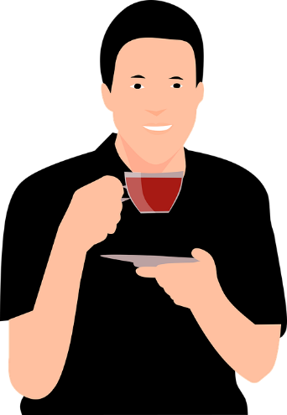
Au présent
écouter
je bois
I drink, I am drinking
Notes:
Timing: 1 minute for 4 slides
Aim: Pronunciation practice of the 1st person singular forms of boire and avoir in the present and perfect tenses.
Procedure:
1. Listen and repeat.
2. Highlight SSC [oi] and sound final consonant (SFC)
Transcript:
Je bois

Slide 13
Au passé
écouter
j’ai bu
I drank, have drunk
Notes:
Procedure:
1. Listen and repeat.
2. Draw attention to the use of the auxiliary verb.
2. Highlight SSCs [ai] and [u].
Transcript:
J’ai bu

Slide 14
Au présent
écouter
j’ai
I have, I am having
Notes:
Timing: 1 minute for 4 slides
Aim: To consolidate the concept of an auxiliary verb to show past tense and highlight the new irregular past participles.
Procedure:
1. Listen and repeat.
2. Highlight SSC [ai].
Transcript:
J’ai

Slide 15
Au passé
écouter
j’ai eu
I had, I have had
Notes:
Timing: 1 minute for 4 slides
Aim: To consolidate the concept of an auxiliary verb to show past tense and highlight the new irregular past participles.
Procedure:
1. Listen and repeat.
2. Draw attention to the use of the auxiliary verb.
2. Highlight SSCs [ai] and [eu].
Transcript:
J’ai eu

Slide 16
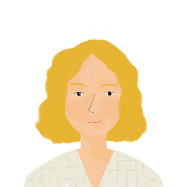
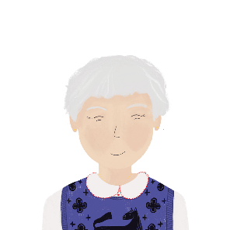
À l’hôpital !
écouter
Aurélie est à l’hôpital avec Romain. Elle parle au téléphone avec Renée. Décide si elles parlent au présent ou au passé. Ensuite, remplis le blanc.
 | Au présent ? | Au passé ? | Remplis les blancs
 |  |  | Romain a mal à la jambe ? (avoir)
 |  |  | Oui. Nous avons fait une promenade. (faire)
 |  |  | Et il a eu un accident. (avoir)
 |  |  | Le médecin a dit quoi ? (dire)
 |  |  | Pas beaucoup. Le médecin ne fait pas attention à Romain. (faire)
 |  |  | Romain boit de l’eau dans son lit. (boire)
 |  |  | Il a bu deux verres de café aussi. (boire)
 |  |  | Ah non! Bon, Bastien dit bonjour. (dire)
1
2
3
4
5
6
7
8
Notes:
Timing: 8 minutes
Aim: Aural recognition of present and perfect tense forms of irregular verbs boire, avoir, faire and dire.
Procedure
1. Click the number to listen to the audio.
2. Students listen to each sentence and decide whether it is in the present or past tense, based on the verb form. At more advanced levels, students can be encouraged to write down the verb form they hear.
3. Click to reveal the answers.
4. Students listen to each sentence for a second time and orally translate the sentence into English.
Transcript:
1. Romain a mal à la jambe?
2. Nous avons fait une promenade.
3. Et il a eu un accident.
4. Le médecin a dit quoi ?
5. Pas beaucoup. Le médecin ne fait pas attention à Romain. [re-record as ‘peu de chose’ following PANS feedback]
6. Romain boit de l’eau dans son lit.
7. Il a bu deux verres de café aussi.
8. Ahh non! Bon, Bastien dit bonjour..
Word frequency of cognates used (1 is the most frequent word in French): décider [165]
Source: Londsale, D., & Le Bras, Y. (2009). A Frequency Dictionary of French: Core vocabulary for learners London: Routledge.

Slide 17
The perfect tense: yes/no questions
grammaire
Remember: in French, you can ask a yes/no question by simply raising the pitch of your voice at the end of a sentence (intonation) :
Statement: Tu as bu du café. You drank some coffee.
Question: Tu as bu du café ? Did you drink some coffee?
Another way is to add est-ce que to the beginning of a sentence:
Statement: Il a eu un accident. He had an accident.
Question: Est-ce qu’il a eu un accident ? Did he have an accident?
S
There is no French equivalent for ‘did’ in a question.
Q
S
Q
Est-ce que → est-ce qu’ before a vowel / h.
Notes:
Timing: 2 minutes
Aim: To consolidate formation of yes/no questions using intonation and est-ce que in the perfect tense.
Procedure:
1. Click to animate explanation.
2. Click on buttons to hear audio.
Transcript:
Tu as bu du café (statement, flat intonation)
Tu as bu du café ? (question, rising intonation)
Il a eu un accident. (statement, flat intonation)
Il a eu un accident ? (question, rising intonation) [shouldn’t this be with est-ce que ? Needs re-recording]

Slide 18
Present perfect vs. simple past
grammaire
As you know, the French perfect tense has two equivalent tenses in English:
Est-ce que tu as bu du café ? Did you drink some coffee? (simple past) Have you drunk some coffee? (present perfect)
Attention! There is no word for ‘did’ in French. ‘Tu as bu ?’ means both ‘did you drink?’ and ‘have you drunk?’.
If we asking about something that happened at a specific time, we use simple past:
Est-ce que tu as bu du café hier ? Did you drink some coffee yesterday?
If we aren’t, we can use either the present perfect or the simple past.
Est-ce que tu as bu du café ? Have you drunk some coffee?
Did you drink some coffee?
Notes:
Timing: 2 minutes
Aim: To consolidate the idea that the French perfect tense has two equivalent past tenses (simple past and present perfect). To present the forms and uses of the English tenses in questions, and introduce the idea that there is no word for ‘did’ in French.
Procedure:
1. Click to animate the explanation.
2. Draw particular attention to the lack of a French equivalent for ‘did’.

Slide 19
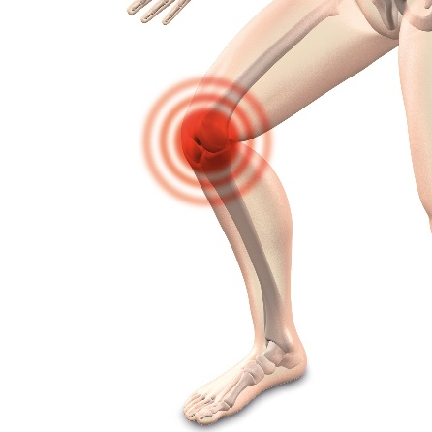
Chez le médecin !
assez de = enough
écouter
Le médecin parle à plusieurs autres patients.
Écoute ses questions et choisis la/les bonne(s) forme(s) du verbe.
Have you had / Did you have an accident at work?
Has your leg hurt / Did your leg hurt?
Have you always had / Did you always have a sore leg?
What have the doctors said / did the doctors say?
Have you done / Did you do the exercises?
Have you always had / Did you always have sore arms?
Have you drunk / Did you drink enough water?
Have you spoken / Did you speak to a doctor?
1
Remember ! If you hear a specific time, use the past simple (did).
2
3
4
5
6
7
8
Notes:
Timing: 5 minutes
Aim: Aural recognition of time phrases. French to English translation with a focus on choosing the most suitable English past tense as an equivalent to the French perfect tense.
Procedure:
1. Before starting the activity, remind students that there is no French equivalent for ‘did’ in a question. Instead, students must use the perfect tense to ask a question about the past in French.
2. Students listen to the question and decide whether the verbs in bold can be translated using the present perfect, the simple past or both.
3. Remind students to pay particular attention to the type of adverb used. Note that the English translation of the adverb is missing from the slides.
4. Click to reveal answers.
5. Try to elicit the English translation of the French adverbs heard.
Transcript:
1. Est-ce que vous avez eu un accident au travail la semaine dernière ?
2. Est-ce que vous avez eu mal à la jambe jeudi dernier ?
3. Est-ce que vous avez toujours eu mal à la jambe ?
4. Qu’est-ce que les médecins ont dit mardi dernier ?
5. Est-ce que vous avez fait les exercices ?
6. Est-ce que vous avez toujours eu mal aux bras ?
7. Est-ce que vous avez bu assez d’eau hier ?
8. Est-ce que vous avez déjà parlé de ce problème à un médecin ?
Word frequency of cognates used (1 is the most frequent word in French): patient [1569], forme [369]
Source: Londsale, D., & Le Bras, Y. (2009). A Frequency Dictionary of French: Core vocabulary for learners London: Routledge.

Slide 20
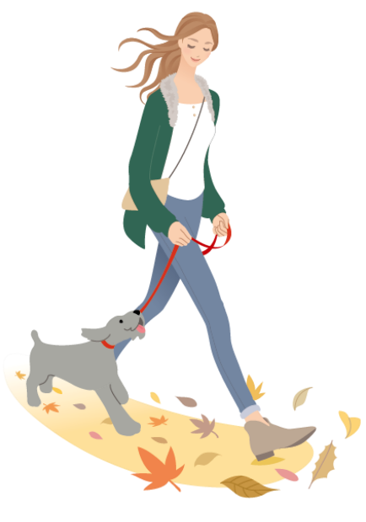
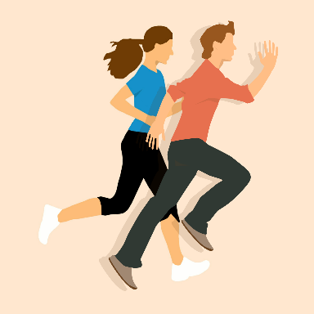
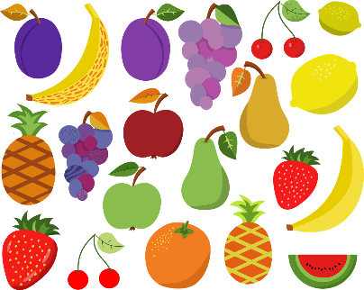
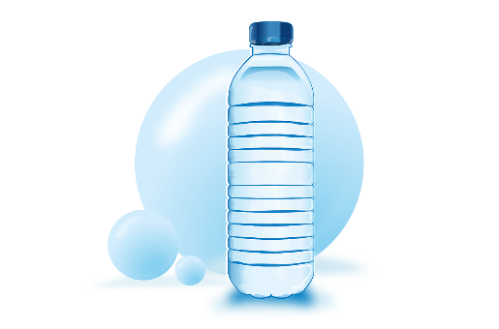
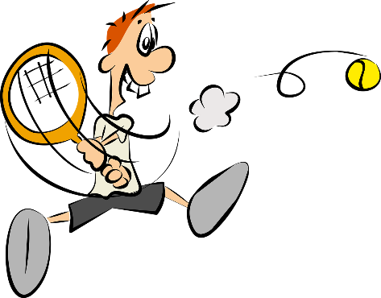
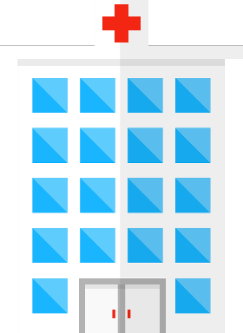
Chez le médecin
l’exercice (m)
écrire
exercise
to go for a walk
faire une promenade
coffee / tea
l’eau (f)
le café / le thé
le fruit
water
fruit
How many French words to do with health and illness can you think of?
sport
le sport
tongue
la langue
faire de la natation
to swim
milk
le lait
l’hôpital (m)
doctor
sick
hospital
le/la médecin
malade
Notes:
Timing: 4 minutes
Aim: Written recall of medical vocabulary introduced previous weeks in preparation for production tasks that follow.
Procedure:
1. Ask students to write down (or shout out) as many health-related words as possible.
2. Click to reveal each prompt (a picture with the English word(s) underneath). Use prompts to elicit more health-related vocabulary.
3. Click again to reveal the French translation of the prompt.

Slide 21
À l’hôpital anglais
l’infirmier = nurse (m.)
écrire
Ton amie française, Agnès, est dans un hôpital local en Angleterre. Elle ne comprend pas les questions du médecin ! Aide Agnès. Traduis les questions.
Commence tes questions par est-ce que.
What have you done? (faire)
Have you had an accident? (avoir)
Did you go for a walk? (faire)
Did your leg hurt yesterday? (avoir)
What did the other doctor say? (dire)
What has the nurse said? (dire)
Have you drunk some water? (boire)
Did you drink some coffee? (boire)
Remember ! To ask information questions with ‘est-ce que’, the question word (e.g., que) comes first: e.g., ‘qu’est-ce que’.
Notes:
Timing: 8 minutes
Aim: Written production of irregular past participles in questions in the French perfect tense. Recognising that French uses one tense to express two meanings, whereas English has a tense for each meaning.
N.B. This activity has been designed so that students practise translating both ‘did’ and ‘has/have’ with the same verbs into French.
Procedure:
1. Students read the sentences and translate into French.
2. Answers revealed on the next slide.
Word frequency (1 is the most frequent word in French):
infirmier [2049]
Source: Londsale, D., & Le Bras, Y. (2009). A Frequency Dictionary of French: Core vocabulary for learners London: Routledge.

Slide 22
À l’hôpital anglais
l’infirmier = nurse (m.)
écrire
Ton amie française, Agnès, est dans un hôpital local en Angleterre. Elle ne comprend pas les questions du médecin ! Aide Agnès. Traduis les questions.
Commence tes questions par est-ce que.
Remember ! To ask information questions, the question word (e.g., que) goes before est-ce que.
Qu’est-ce que tu as fait ?
Est-ce que tu as eu un accident ?
Est-ce que tu as fait une promenade ?
Est-ce que tu as eu mal à la jambe hier ?
Qu’est-ce que l’autre médecin a dit ?
Qu’est-ce que l’infirmier a dit ?
Est-ce que tu as bu de l’eau ?
Est-ce que tu as bu du café ?
Notes:
Answers to the previous slide

Slide 23
Asking about what you did/have done
Verbs like prendre in the perfect tense
SSC [gn], [j/soft g] revisited
Y8 French
Term 3.2 - Week 6 - Lesson 70
Amber Dudley / Catherine Morris / Natalie Finlayson
Artwork by: Chloé Motard
Date updated: 09/07/21
Notes:
Artwork by Chloé Motard. All additional pictures selected are available under a Creative Commons license, no attribution required.
Native teacher feedback provided by Sarah Brichory.
With thanks to Rachel Hawkes for her input on the lesson material.
Learning outcomes (lesson 2):
Revision of SSC [gn] and [j/soft g]
Introduction of verbs like prendre in the perfect tense
Introduction of inversion questions in the present and perfect tense (did? and have/has?)
Word frequency (1 is the most frequent word in French):
8.3.2.6 (introduce) bu [boire - 1879], eu [avoir - 8], pris [prendre - 43], accident [1227], bras [1253], jambe [2472], mal¹ [277], maladie [793], petit-déjeuner [>5000], photo [1412], déjà² [58], pas encore [18/51], ensuite [265],
8.3.1.6 (revisit) attendre [155], descendre [1705], (en) bas [7/468], histoire² [263], règle² [488], piste [1902], roman [1262], texte [631]
8.2.2.3 (revisit) feu [786], hôpital [1308], jeu [291], journal [420], oiseau [2435], réseau [721], autre [28], même [42], idéal [1429], international [282], local [622], plusieurs [213], social [301]
Source: Londsale, D., & Le Bras, Y. (2009). A Frequency Dictionary of French: Core vocabulary for learners London: Routledge.
The frequency rankings for words that occur in this PowerPoint which have been previously introduced in NCELP resources are given in the NCELP SOW and in the resources that first introduced and formally re-visited those words.
For any other words that occur incidentally in this PowerPoint, frequency rankings will be provided in the notes field wherever possible.

Slide 24
Hard and soft [g]/[j]
info
Hard [g] is pronounced like the g in ‘gold’.
[g] is hard when it comes before a, o, u or r, l, m.
Soft [g] and [j] are pronounced like the g in ‘massage’.
[g] is soft when it comes before e, i, or y.
la gare
[station]
le gilet
[cardigan]
nous plongeons
[we are diving]
la blague
[joke]
hard [g]
soft [g]/[j]
soft [g]/[j]
hard [g]
Notes:
Timing: 1 minute
Aim: A reminder of spelling rules governing the pronunciation of hard and soft [g] in preparation for the spoken activity which follows.
Procedure:
1. Click to bring up information.
2. Students say the four target words.
Transcript:
la gare, le gilet, nous plongeons, la blague
Word frequency of unknown words used (1 is the most frequent word in French): gare [2581], gilet [>5000], plonger [1958], blague [4822]

Slide 25
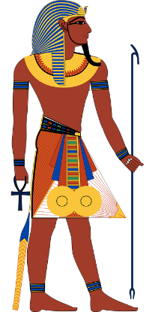
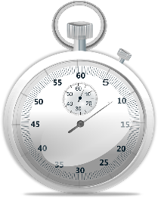
Phonétique
lire / parler
égyptien
60
chagrin
[sorrow]
englober
[to incorporate]
signature
blague
[joke]
dignité
signification
[meaning]
égalité
[equality]
secondes
fatigue
génocide
indigène
[indigenous]
analogue
langage
[language]
registre
consigne
[deposit]
0
embargo
DÉBUT
Notes:
Timing: 3 minutes for 2 slides. This is slide 1/2.
Aim: Oral pronunciation of words containing hard and soft [g] and [gn]. This is slide 1/2.
Procedure:
1. Students pair up.
2. Click début to start timer.
3. Partner A reads the words aloud.
4. Partner B listens to check pronunciation. If they spot a mispronunciation, they must stop student A who repeats the word correctly 3 times before moving on.
5. Click on words to hear them said aloud by a native speaker. Tally the total number of words said correctly within 60 seconds.
5. Partners swap roles and repeat with different words on the next slide. Whoever has pronounced the most words correctly wins!
Transcript:
Signature, égalité, analogue, embargo, chagrin, dignité, genocide, register, englober, signification, indigene, consigne, égyptien, blague, fatigue, langage
Word frequency (1 is the most frequent word in French): dignité [2171], signature [2187], signification [2798], analogue [4498], blague [4822], registre [2556], langage [1850], égalité [1898], chagrin [4560], égyptien [4137], genocide [4148], englober [4188], embargo [4450], indigene [4555], consigne [4583], fatigue [4595]
Source: Londsale, D., & Le Bras, Y. (2009). A Frequency Dictionary of French: Core vocabulary for learners London: Routledge.

Slide 26
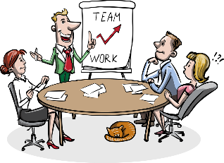
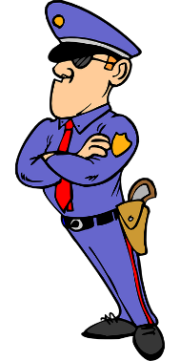
Phonétique
lire / parler
60
avantageux
gorge
[throat]
irrégulier
compagnie
[company]
gestionnaire
[managerial]
baigner
[to bathe]
ignorer
épargner
[to save money]
secondes
ligne
[line]
intégral
goutte
[drop]
significatif
[significant]
gendarme
[policeman]
engin
[gear]
0
magnifique
[magnificentl]
brigade
DÉBUT
Notes:
This is slide 1/2.
Word frequency (1 is the most frequent word in French): gorge [4194], compagnie [775], épargner [2354], ignorer [639], ligne [342], magnifique [2136], significative [2292], brigade [4224], engine [4269], goutte [4337], gestionnaire [4350], avantageux [4391], gendarme [4438], irrégulier [4606], baigner [4608], integral [4641]
Source: Londsale, D., & Le Bras, Y. (2009). A Frequency Dictionary of French: Core vocabulary for learners London: Routledge.

Slide 27
Les mots croisés
écrire / parler
 |  |  |  |  | 11
1 | L | A |  | P | I | S | T | E
 |  |  |  |  | N
 |  |  |  |  | T |  |  |  |  |  |  | 14
 |  |  |  |  | E | 2 | L | A |  | M | A | L | A | D | I | E |  |  | 17
 | 9 |  |  |  | R |  |  |  |  |  |  | ’ |  |  |  |  |  |  | P
 | L |  |  |  | N |  |  |  |  | 3 | P | A | S |  | E | N | C | O | R | E
4 | E | N |  | B | A | S |  |  |  |  |  | C |  |  |  |  |  |  | I
 |  |  |  |  | T |  |  |  |  |  |  | C |  |  |  |  |  |  | S |  | 18
 | F |  |  |  | I |  |  | 13 |  |  |  | I |  |  |  | 16 |  |  |  | 5 | L | E |  | M | A | L
 | E |  |  |  | O |  |  | L |  |  |  | D |  |  |  | L |  |  |  |  | E
 | U |  |  |  | N |  |  | A |  |  |  | N |  |  |  | A
 |  |  |  |  | A |  |  |  |  |  |  | E |  | 15 |  |  |  |  |  |  | B
 |  |  |  | 6 | L | E |  | P | E | T | I | T | - | D | É | J | E | U | N | E | R
 |  |  |  |  |  | 12 |  | H |  |  |  |  |  | É |  | A |  |  |  |  | A
 |  |  | 10 |  |  | B |  | O |  |  |  |  |  | J |  | M |  | 7 | D | E | S | C | E | N | D | R | E
 |  | 8 | E | N | S | U | I | T | E |  |  |  |  | À |  | B
 |  |  | U |  |  |  |  | O |  |  |  |  |  |  |  | E
Remember to say the word for ‘the’ and add a space if needed!
7 ACROSS
to go down,
going down
17 DOWN
took,
taken (pp)
12 DOWN
drank,
drunk (pp)
15 DOWN
already,
yet
4 ACROSS
at the bottom
11 DOWN
international
2 ACROSS
illness
3 ACROSS
not yet
1 ACROSS
ski slope
5 ACROSS
ache
6 ACROSS
breakfast
8 ACROSS
next
13 DOWN
photo
14 DOWN
accident
16 DOWN
leg
18 DOWN
arm
10 DOWN
had (pp)
9 DOWN
fire
Notes:
Timing: 5 minutes
Aim: Written and/or spoken recall of this week’s new vocabulary and some revisited vocabulary.
Procedure:
1. Click to reveal the English word.
2. Students say aloud (or write down) the translation to complete the crossword. Tell students to include the article.
3. Click to reveal the answer.
4. Click to reveal a new English word.
5. Repeat steps 1-4.

Slide 28
Verbs like ‘prendre’ in the past
grammaire
The past participle of ‘prendre’ is ‘pris’:
je prends (I take/am taking) j’ai pris (I took/have taken)
Nous avons pris une photo.
We took/have taken a photo.
With other verbs like prendre, the past participle ends in -pris:
tu apprends (you learn/ tu as appris (you learnt/have learnt)
Vous avez appris les mots. You (plural) learnt/have learnt the words.
il comprend (he understands/ il a compris (he understood/has understood)
Ils ont compris la question.
They (m.) understood/have understood the question.
___________
__________
are learning)
____________
___________
is understanding)
Notes:
Timing: 2 minutes
Aim: To introduce the past participle of the anchor verb prendre and extend this knowledge to known verbs like prendre (apprendre and comprendre).
Procedure:
1. Click to animate the explanation.

Slide 29
Au présent
écouter
je prends
I take, I am taking
Notes:
Timing: 1.5 minutes for 6 slides
Aim: Pronunciation practice of the 1st person singular forms of verbs like prendre in the present and perfect tenses.
Procedure:
1. Listen and repeat.
2. Highlight sound final consonant (SFC) and SSC [en].
Transcript:
Je prends

Slide 30
Au passé
écouter
j’ai pris
I took, have taken
Notes:
Timing: 1.5 minute for 6 slides
Aim: To consolidate the concept of an auxiliary verb to show past tense and highlight the past participle form of the anchor verb, prendre, and verbs like prendre (apprendre, comprendre).
Procedure:
1. Listen and repeat.
2. Draw attention to the use of the auxiliary verb.
3. Highlight sound final consonant (SFC) and SSCs [ai] and [i].
Transcript:
J’ai pris

Slide 31
Au présent
écouter
j’apprends
I learn, I am learning
Notes:
Timing: 1.5 minute for 6 slides
Aim: To consolidate the concept of an auxiliary verb to show past tense and highlight the past participle form of the anchor verb, prendre, and verbs like prendre (apprendre, comprendre).
Procedure:
1. Listen and repeat.
2. Highlight sound final consonant (SFC) and SSCs [a] and [en].
Transcript:
J’apprends

Slide 32
Au passé
écouter
j’ai appris
I learnt, I have learnt
Notes:
Timing: 1.5 minute for 6 slides
Aim: To consolidate the concept of an auxiliary verb to show past tense and highlight the past participle form of the anchor verb, prendre, and verbs like prendre (apprendre, comprendre).
Procedure:
1. Listen and repeat.
2. Draw attention to the use of the auxiliary verb.
3. Highlight sound final consonant (SFC) and SSCs [a] and [i].
Transcript:
J’ai appris

Slide 33
Au présent
écouter
je comprends
I understand, I am understanding
Notes:
Timing: 1.5 minute for 6 slides
Aim: To consolidate the concept of an auxiliary verb to show past tense and highlight the past participle form of the anchor verb, prendre, and verbs like prendre (apprendre, comprendre).
Procedure:
1. Listen and repeat.
2. Highlight sound final consonant (SFC) and SSC [c] and [en].
Transcript:
Je comprends

Slide 34
Au passé
écouter
j’ai compris
I understood, I have understood
Notes:
Timing: 1 minute for 6 slides
Aim: To consolidate the concept of an auxiliary verb to show past tense and highlight the past participle form of the anchor verb, prendre, and verbs like prendre (apprendre, comprendre).
Procedure:
1. Listen and repeat.
2. Draw attention to the use of the auxiliary verb.
3. Highlight sound final consonant (SFC) and SSCs [c] and [i].
Transcript:
J’ai compris

Slide 35
Dans la classe d’allemand
écouter
Léa a plusieurs problèmes en classe. Écoute sa conversation avec Sophie. Décide si les phrases sont au présent ou au passé. Ensuite, traduis les phrases.
 | Au présent ? | Au passé ? | En anglais ?
 |  |  | Sophie, did you understand the homework?
 |  |  | No, but it’s okay. My mum is learning German too,
 |  |  | And she understands all the grammar rules!
 |  |  | Are you (plural) learning the language together?
 |  |  | Yes! And I take a lot of notes.
 |  |  | Oh, that’s cool! You understood the novel, then?
 |  |  | Yes! Did you learn all the words?
 |  |  | Yes, but … oh no! Who took my German book?
1
2
3
4
5
6
7
8
Notes:
Timing: 8 minutes
Aim: Aural recognition of verbs like prendre in the present and perfect tenses. French to English translation.
Procedure
1. Click the number in the column on the left to listen to hear audio.
2. Students listen to each sentence and decide whether the sentence is in the present or past based on the verb form. At more advanced levels, students can be encouraged to note down the full verb form.
3. Click to reveal the answers.
4. Click again to reveal suggested translations.
Transcript [recording in progress]:
1. Sophie, est-ce que tu as compris les devoirs ?
2. Non, mais ça va. Ma mère apprend l’allemand aussi.
3. Et elle comprend toutes les règles de grammaire !
4. Vous apprenez la langue ensemble ?
5. Oui ! Et je prends beaucoup de notes.
6. Ah, c’est cool ça ! Tu as compris le roman alors ?
7. Oui ! Tu as appris tous les mots ?
8. Ouais … mais … ah, non ! Qui a pris mon cahier d’allemand ?
Word frequency of cognates used (1 is the most frequent word in French):
grammaire [>5000]; correct [2617], décider [165]
Source: Londsale, D., & Le Bras, Y. (2009). A Frequency Dictionary of French: Core vocabulary for learners London: Routledge.

Slide 36
Having something to eat/drink
vocabulaire
To talk about ‘having a meal’ in French, we say ‘prendre’ + name of meal:
Je prends le pétit-déjeuner. I am having breakfast.
We can extend this rule to all types of food and drink:
Elle a pris du café. She had some coffee.
Elles ont pris des fruits. They had some fruit.
Notes:
Timing: 1 minute
Aim: To introduce a cross-linguistic difference in vocabulary usage. Presenting the use of prendre to mean ‘having’ meals, food and drink.
Procedure
1. Click to animate the explanation.

Slide 37
Le jour de l’accident
lire / écrire
Romain parle du jour où il a eu son accident. Remplis les blancs avec avoir ou prendre au passé composé (perfect tense).
J'ai pris mon petit-déjeuner.
Léa et Antoine ont pris le déjeuner ensemble.
Léa a eu une surprise. Un cadeau de Sophie !
J’ai eu un accident.
Et puis j’ai eu mal à la jambe.
Nous avons pris le dîner en famille.
Antoine a eu un problème avec ses devoirs.
Léa a pris un fruit.
Notes:
Timing: 5 minutes
Aim: Raising awareness of cross-linguistic semantic differences in the use of avoir/to have and prendre/to take. Written recognition of new and revisited vocabulary. Written production of forms or avoir and prendre in the perfect tense.
Procedure
1. Students read each sentence and fill in the blank with the past tense form of either prendre or avoir.
2. Remind students that in English we use the verb ‘to have’ to talk about meals/food/drink, but in French we use the verb ‘prendre’.
3. Click to reveal answers.
Word frequency of cognates used (1 is the most frequent word in French):
dîner [2365], verbe [>5000], surprise [1815]
Source: Londsale, D., & Le Bras, Y. (2009). A Frequency Dictionary of French: Core vocabulary for learners London: Routledge.

Slide 38
Translating ‘déjà’
vocabulaire
You know that déjà means ‘already’:
J’ai déjà pris un café. I already had a coffee.
I have already had a coffee.
In questions, déjà can mean ‘already’ or ‘yet’:
Tu as déjà pris un café ? Have you had a coffee yet? Have you already had a coffee?
Use your knowledge of English to decide whether ‘yet’ or ‘already’ sounds best!
Notes:
Timing: 1 minute
Aim: To present two possible English translations of déjà.
Procedure:
1. Click to animate the explanation. Note that we do no recommend drawing explicit attention to the semantic differences between 'yet' and 'already' in English questions. If students ask, explain that English differentiates between asking about past events in general (already) and expressing expectation/urgency (yet), whereas French does not.

Slide 39
Translating ‘encore’
vocabulaire
You know that encore means ‘again’:
Ils utilisent encore des réseaux sociaux ! They’re using social networks again!
When we use encore after pas or ne...pas, it means ‘not yet’:
Tu as fait tes devoirs ? Pas encore ! Have you done your homework? Not yet!
Tu n’as pas encore pris un café. You haven’t had a coffee yet.
In sentences in the perfect tense, ne…pas surrounds the first verb (avoir).
Notes:
Timing: 2 minutes
Aim: To present two possible English translations of encore. To introduce the expression pas encore.
Procedure:
1. Click to animate the explanation.

Slide 40
Chez Aurélie et Romain !
écouter
Écoute la conversation entre Aurélie et Romain et traduis l’adverbe.
 | Quel adverbe en anglais ? |  | Phrase entière en anglais
1 | already | yet/already | Have you done the food shopping yet/already?
2 | already | yet/already | No, but I have already had breakfast.
3 | already | yet/already | Have you done the housework yet/already?
4 | already | yet/already | No, but I have already done the cooking !
1
2
déjà
3
4
1 | not yet | again | Have you taken a photo of the dog again?
2 | not yet | again | No, I have not had the time yet.
3 | not yet | again | Have you not had dinner yet?
4 | not yet | again | No, because I ate a pizza again.
5
6
encore
7
8
Notes:
Timing: 8 minutes
Aim: Aural recognition of uses of déjà and (pas) encore in context. Using contextual clues (declarative statements, negative statements and questions) to deduce English translations of déjà and (pas) encore.
Procedure:
1. Tell students they are going to hear sentences containing déjà and encore in different contexts. For the sentences containing déjà, remind them that it is the presence or absence of raised intonation indicating a question that will give them the answer. For the sentences containing encore, remind them that it is the presence or absence of a negative construction that will give them the answer.
2. Play the audio. Students select the English translation.
3. As an extension, ask students to translate the sentence that they have just heard into English.
4. Click again to reveal translation.
Transcript:
1. Tu as déjà fait les courses ?
2. Non, mais j’ai déjà pris le petit-déjeuner.
3. Tu as déjà fait le ménage ?
4. Non, mais j’ai déjà fait la cuisine !
5. Tu as encore pris une photo du chien ?
6. Non, je n’ai pas encore eu le temps.
7. Tu n’as pas encore pris le dîner ?
8. Non, parce que j’ai encore mangé une pizza.
Word frequency of cognates used (1 is the most frequent word in French):
dîner [2365], pizza [>5000]
Source: Londsale, D., & Le Bras, Y. (2009). A Frequency Dictionary of French: Core vocabulary for learners London: Routledge.

Slide 41
Present simple or continuous?
Lis et traduis !
écrire
I haven’t had breakfast yet.
Je n’ai pas encore pris le petit-déjeuner.
Notes:
Timing: 8 minutes for 5 slides. This is slide 1/5.
Aim: Written production of verbs like prendre and adverbs pas encore and déjà in perfect tense statements and questions. Recognising that French uses one tense to express two meanings, whereas English has a tense for each meaning. English to French translation.
Suggested procedure:
1. Translate the first four sentences as a class, drawing particular attention to the key grammar features studied this lesson.
2. Students then translate the four sentences on slide 45 on their own.
3. Answers revealed on clicks.

Slide 42
Present simple or continuous?
Lis et traduis !
écrire
You (pl.) already had the illness.
Vous avez déjà eu la maladie.
Notes:
Slide 2 of 5.

Slide 43
Present simple or continuous?
Lis et traduis !
écrire
Did she understand the game?
Est-ce qu’elle a compris le jeu ?
Elle a compris le jeu ?
Notes:
Slide 3 of 5.

Slide 44
Present simple or continuous?
Lis et traduis !
écrire
Have you learned the words yet?
Est-ce que tu as déjà appris les mots ?
Tu as déjà appris les mots ?
Notes:
Slide 4 of 5.

Slide 45
Present simple or continuous?
Lis et traduis !
écrire
1. Have they (f.) taken a photo of the bird?
Est-ce qu’elles ont déjà pris une photo de l’oiseau ?
Elles ont déjà pris une photo de l’oiseau ?
2. Did we buy the same newspaper?
Est-ce que nous avons acheté le même journal ?
Nous avons acheté le même journal ?
3. I haven’t had the time yet.
Je n’ai pas encore eu le temps.
4. She already drank two glasses of water.
Elle a déjà pris/bu deux verres d’eau.
Notes:
Slide 5 of 5.

Slide 46
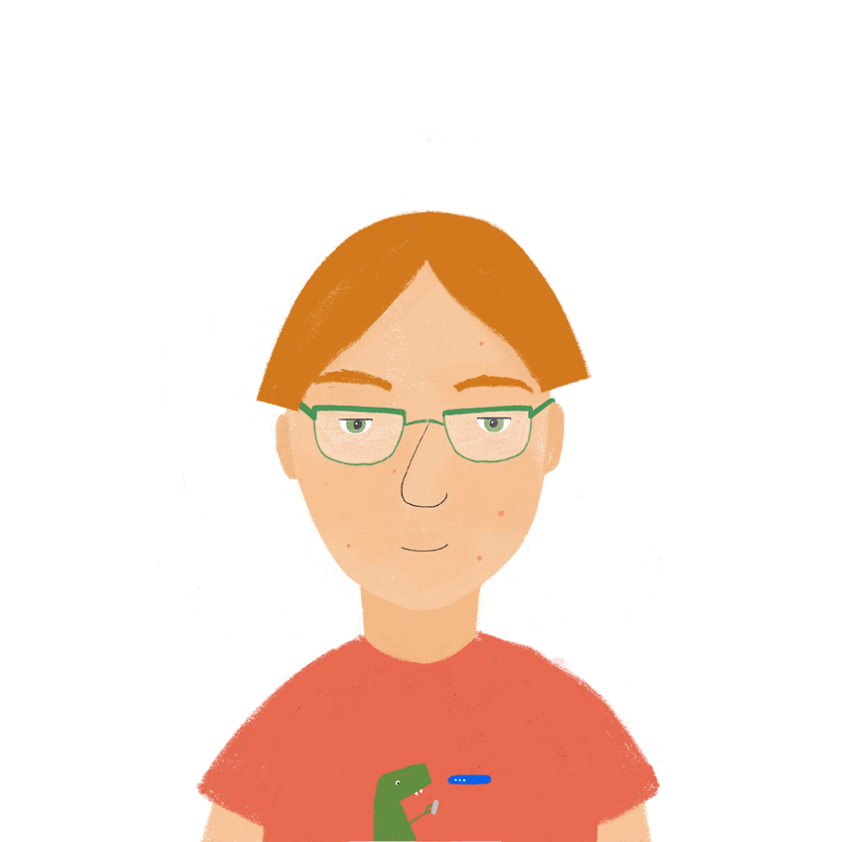
Qui est-ce ?
parler
Amélie
Had an accident last week.
Has not taken a photo yet.
Learnt the vocabulary last week.
Has already drunk some water.
Has not had breakfast yet.
Has already understood the question.
Tu as eu un accident la semaine dernière ?
Oui, j’ai eu un accident la semaine dernière.
Est-ce que tu as déjà pris une photos ?
Non, Je n’ai pas encore pris une photo.
Notes:
Timing: 5 minutes
Aim: Oral production of French questions and answers in the perfect tense. Adverb placement.
Suggested procedure:
1. Explain to the students that Qui est-ce ? is the French name for the board game ‘Guess Who’, and that they are going to ask and answer questions in the perfect tense to identify people on a picture board.
2. Use this slide to revise question and answer formation and uses of déjà and (pas) encore. Remind students that even though two English tenses are represented on the board, only one French tense is needed to express these.
3. Work through the first two examples as a class. Ask students how they would form questions to find out the first two pieces of required information, and how the answers would sound.
4. Click to bring up suggested questions and answers.
5. Partner B chooses one of the six characters on the following slide.
6. Partner A must guess who Partner B is by asking what they did or have done.
7. Partner B uses the role-play card to respond to Partner A.
8. After two iterations, Partner A and Partner B swap roles.
9. Suggested questions/answers are provided on slides 48-50.

Slide 47
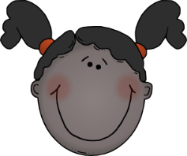
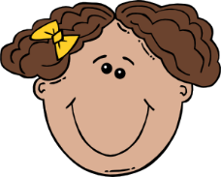
Qui est-ce ?
parler
Claude
Has already learnt the vocabulary.
Had an accident last week.
Has had breakfast already.
Has not taken a photo yet.
Has already understood the question.
Has not drunk a glass of water yet.
François
Has already had breakfast.
Has not had an accident yet.
Has already taken a photo.
Learnt the vocabulary last week.
Drank a glass of water yesterday.
Has not yet understood the question.
Hugo
Has already taken some photos.
Has not had an accident yet.
Took a photo last week.
Has already learnt the vocabulary.
Drank a glass of water yesterday.
Has already had breakfast.
Amélie
Had an accident last week.
Has not taken a photo yet.
Learnt the vocabulary last week.
Has already drunk a glass of water.
Has not had breakfast yet.
Has already understood the question.
Agnès
Had breakfast last Monday.
Has not taken a photo yet.
Understood the question last week.
Has already had an accident.
Drank a glass of water yesterday.
Has already learnt the vocabulary.
Juliette
Took a photo last week.
Has not drunk a glass of water yet.
Has already understood the question
Had an accident last week.
Has already learnt the vocabulary.
Has not had breakfast yet.
Notes:
ROLE PLAY CARDS

Slide 48
Traductions
parler
CLAUDE
J’ai déjà appris le vocabulaire.
J’ai eu un accident la semaine dernière.
J’ai déjà pris le petit-déjeuner.
Je n’ai pas encore pris une photo.
J’ai déjà compris la question.
Je n’ai pas encore bu un verre d’eau.
I have already learnt the vocabulary.
I had an accident last week.
I have already had breakfast.
I have not taken a photo yet.
I have already understood the question.
I have not drunk any water yet.
FRANÇOIS
J’ai déjà pris le petit-déjeuner.
Je n’ai pas encore eu d’accident.
J’ai déjà pris une photo.
J’ai appris le vocabulaire la semaine dernière.
J’ai bu un verre d’eau hier.
Je n’ai pas encore compris la question.
I have already had breakfast.
I have not had an accident yet.
I have already taken a photo.
I learnt the vocabulary last week.
I drank a glass of water yesterday.
I have not understood the question yet.
Notes:
Translation slides

Slide 49
Traductions
parler
AMÉLIE
J’ai eu un accident la semaine dernière.
Je n’ai pas encore pris une photo.
J’ai appris le vocabulaire la semaine dernière.
J’ai déjà bu un verre d’eau.
Je n’ai pas encore pris le petit-déjeuner.
J’ai déjà compris la question.
I had an accident last week.
I have not taken a photo yet.
I learnt the vocabulary last week.
I have already drunk a glass of water.
I have not had breakfast yet.
I have already understood the question.
AGNÈS
J’ai pris le petit-déjeuner lundi dernier.
Je n’ai pas encore pris une photo.
J’ai compris la question la semaine dernière.
J’ai déjà eu un accident.
J’ai bu un verre d’eau hier.
J’ai déjà appris le vocabulaire.
I had breakfast last Monday.
I have not taken a photo yet.
I understood the question last week.
I have already had an accident.
I drank a glass of water yesterday.
I have already learnt the vocabulary.
Notes:
Translation slides

Slide 50
Traductions
parler
HUGO
J’ai déjà pris une photo.
Je n’ai pas encore eu d’accident.
J’ai pris des photos la semaine dernière.
J’ai déjà appris le vocabulaire.
J’ai bu un verre d’eau hier.
J’ai déjà pris le petit-déjeuner.
I have already taken a photo.
I have not had any accident yet.
I took some photos last week.
I have already learnt the vocabulary.
I drank a glass of water yesterday.
I have already had breakfast.
JULIETTE
J’ai pris une photo la semaine dernière.
Je n’ai pas encore bu un verre d’eau.
J’ai déjà compris la question.
J’ai eu un accident la semaine dernière.
J’ai déjà appris le vocabulaire.
Je n’ai pas encore pris le petit-déjeuner.
I took a photo last week.
I have not drunk a glass of water yet.
I have already understood the question.
I had an accident last week.
I have already learnt the vocabulary.
I have not had breakfast yet.
Notes:
Translation slides

Slide 51
Gaming Grammar
Gaming Grammar
Relevant mini game(s):
Verbs: 1st person present & past tense (Verb agreement (past))
Verbs: 3rd person present & past tense (Verb agreement (past))
Notes:
This slide links to Gaming Grammar login screen. The appropriate mission can then be selected from the menu page.
Students will progress through the game at their own rate; teachers should use the teacher interface to check progress. This will help to inform future lesson planning.

Slide 52
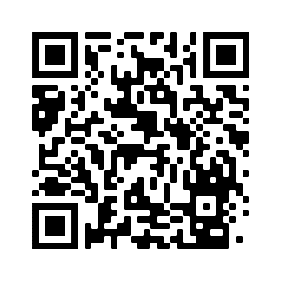
Devoirs
Vocabulary Learning Homework (Y8, Term 3.2, Week 7)
Quizlet link: Y8 Term 3.2 Week 7
Quizlet QR code:
In addition, revisit: Y8 Term 3.2 Week 1
Y8 Term 3.1 Week 1
Notes:
The answer sheet for the Y8, Term 3.2, Week 7 vocabulary learning HW is here: https://resources.ncelp.org/concern/resources/wd375x08n?locale=en

