Slide 1
Talking about the lives of Spanish speakers in the USA
-er & -ir verbs in the present tense:
1st person plural (-emos, -imos)
3rd person plural (-en)
Y9 Spanish
Term 2.1 - Week 4 - Lesson 35
Amanda Izquierdo, Nick Avery, Louise Caruso Artwork: Mark Davies
Date updated: 09/12/21
Notes:
Artwork by Mark Davies. All additional pictures selected are available under a Creative Commons license, no attribution required.
With thanks to Rachel Hawkes for her input on the lesson material.
Learning outcomes (lesson 1):
Consolidation of regular -er/-ir verbs 3rd person plural (-en) present tense
Consolidation of regular –er verbs in 1st person plural (-emos) present tense
Consolidation of regular –ir verbs in 1st person plural (-imos) present tense
Consolidation of SSCs [ge] and [je]
Word frequency (1 is the most frequent word in Spanish):
9.2.1.4 (introduce): nacer [426]; reconocer [400]; cumplir [385]; huir [1359]; sentir [136]; oír [254]; duda [531]; experiencia [416]; esperanza [987]; raíz [1304]; cubano [703]; asistir [1200]; extranjero² [765]; marido [965]; mujer² [120]; población [454]; actual [499]; ambos [536]; derecho [266]; relación [272]
Y9 1.2.7 (revisit) gastar [1866]; tener que [tener-19]; tocar² [327]; vais [ir-22]; estrella [974]; guitarra [2705]; medianoche [4663]; Navidad [3513]; programa [339]; televisión [825]; tradición [1061]; siguiente [350]; desde [60]; hasta² [70] Numbers 80-100 ochenta [1967]; noventa [2459]; cien [ciento-440]; ciento (uno) [440]
Y9 1.1.7 (revisit) les [25]; cocinar [3704]; contar [658]; mandar [588]; arroz [2882]; camiseta [4130]; dolor [591]; gafas [>5000]; invierno [1813]; pollo[3577]; gris [1751]; naranja [2924]; tanto [88]; tanta [88]
Source: Davies, M. & Davies, K. (2018). A frequency dictionary of Spanish: Core vocabulary for learners (2nd ed.). Routledge: London
The frequency rankings for words that occur in this PowerPoint which have been previously introduced in NCELP resources are given in the NCELP SOW and in the resources that first introduced and formally re-visited those words.
For any other words that occur incidentally in this PowerPoint, frequency rankings will be provided in the notes field wherever possible.

Slide 2
Vocabulario
escuchar
Escucha y decide cuál es la mejor palabra para cada frase.
Después, descubre la palabra secreta.
¡Atención! Hay una palabra que no necesitas.
Las palabras
guitarra
cocinar
siguiente
invierno
mandar
medianoche
dolor
tradición
m e d i a
n o c
h
e
_ _ _ _ _ _ _ _ _ _
1
c o c
n
a
r
i
2
_ _ _ _ _ _ _
i n v i e r n o
3
_ _ _ _ _ _ _ _
t r a d i c i ó n
4
_ _ _ _ _ _ _ _ _
m a n d a r
5
_ _ _ _ _ _
g u i t a r r a
6
_ _ _ _ _ _ _ _
d o l o r
7
_ _ _ _ _
La Nochevieja = New Year’s Eve
Notes:
Timing: 5 minutes
Aim: to practise receptive recall of 7 words from this week’s revisited vocabulary.
Procedure: 1. Students listen to each recording and try to fill in the gaps with most suitable word from the table (this is vocabulary from this week’s revisited sets), thinking carefully about the meaning of the sentences and what might be grammatically possible.
2. Once the recordings have been played, the teacher asks the students for the meaning of the word in orange.
3. The teacher reveals the answers with further clicks. Check understanding of the gender of all nouns, at this stage, asking for the definite article.
4: There is one word that has not been used: ‘siguiente’. The teacher asks students for the meaning of ‘siguiente’ (=next, following). Students could be asked, ‘¿Cómo se dice ‘the next/following day’ en español? (=el día siguiente)
Transcript:
Celebro una fiesta con mi familia hasta la [beep].
Mis padres tienen que [beep] mucha comida.
Normalmente hace mucho frío durante el [beep].
…pero me encanta la [beep] de Nochevieja.
Nunca olvido [beep] tarjetas a mis amigos y familia.
Después de cenar siempre cantamos y tocamos la [beep].
A veces mi padre tiene [beep] de cabeza porque bebe mucho vino.

Slide 3
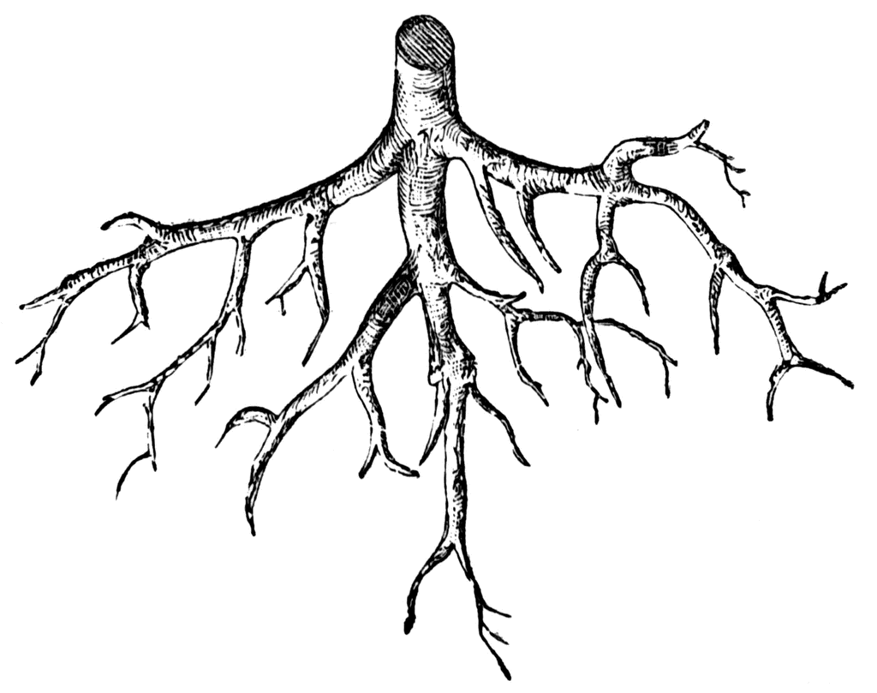
Vocabulario
hablar
In Spanish, the verb ‘sentir’ is often used with nouns:
we feel sad (‘sadness’) = sentimos pena, tristeza
we feel happy (‘happiness’) = sentimos alegría
experience
la experiencia
to feel, feeling
sentir
To form the plural of Spanish nouns ending in –z, remove –z and add –ces.
la raíz -> las raíces
la raíz
Use the preposition ‘a’ after ‘asistir’.
E.g. Asisto a un colegio genial.
I attend/go to a great school.
[root]
oír
to attend,
to go to
asistir
[to hear, hearing]
Notes:
[1/3]
Timing: 3 minutes
Aim: to introduce and embed the new vocabulary.
Procedure: 1. Pupils either work by themselves or in pairs, reading out the words and recapping their English meaning (1 minute). 2. Then the teacher removes the English words or pictures (one by one) and they try to recall the English orally (chorally), looking at the Spanish (1 minute). 3. Then the Spanish meanings are removed (one by one) and they to recall them orally (again, chorally), looking at the English (1 minute) 4. Further rounds of learning can be facilitated by one pupil turning away from the board, and his/her partner asking him/her the meanings (‘¿Cómo se dice X en español?’). This activity can work from L2 → L1 or L1 → L2.
Note: the use of ‘sentirse’ + adjective (as opposed to ‘sentir’ + noun) is not explained here as it does not relate to the current lesson.
Word frequency (1 is the most frequent word in Spanish) of words introduced in lesson 1:
oír [254]; sentir [136]; esperanza [987]; experiencia [416]; extranjero [987]; población [454]; raíz [1304]; relación [272]; actual [499]; cubano [703]; cubana [703];

Slide 4
Vocabulario
hablar
This verb has a change (e>ie) in the stem for ‘I’, ‘you singular’, ‘he/she’ and ‘they’, just like other verbs that you know (preferir, pensar...):
(yo) siento I feel
(tú) sientes you feel
(él /ella) siente s/he, it feels
(ellos / ellas) sienten they feel
to feel, feeling
sentir
This verb has a spelling change in the stem (‘y’)for ‘you singular’, ‘he/she’ and ‘they’. The ‘I’ form has a ‘g’:
(yo) oigo I hear
(tú) oyes you hear
(él /ella) oye s/he, it hears
(ellos / ellas) oyen they hear
1
oír
1
2
[to hear, hearing]
3
4
Notes:
[2/2]
This slide can be used to explain the stem changes for the verbs ‘sentir’ and ‘oír’.
Since ‘oír’ and its conjugated forms may be difficult to pronounce, audio is also provided.

Slide 5
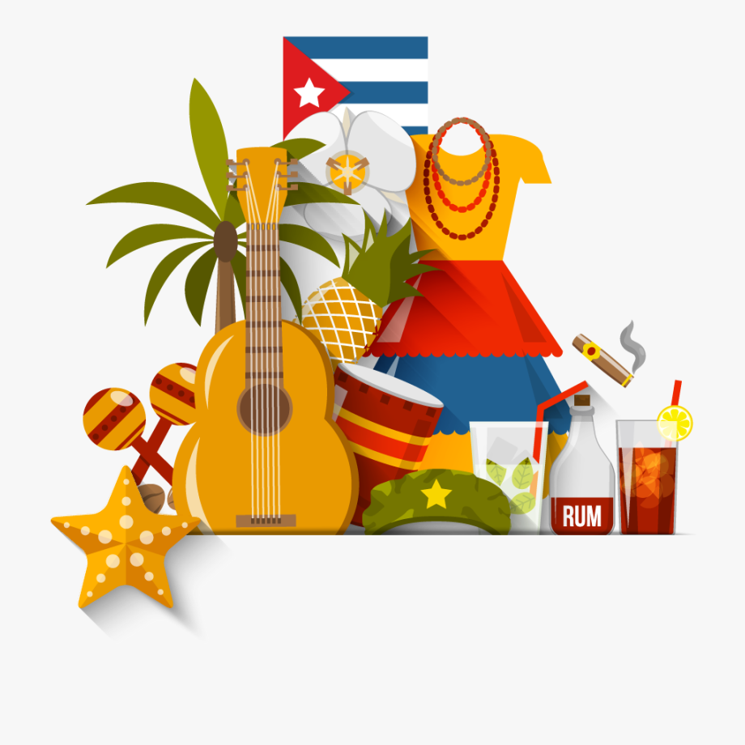
Vocabulario
hablar
‘Extranjero/a’ may also be an adjective meaning ‘foreign’.
E.g. (la) gente extranjera =
(the) foreign people
abroad,
foreigner (m)
el extranjero
la relación
[relationship]
la población
foreigner (f)
la extranjera
[population]
cubano, cubana
current
actual
[Cuban (adj), Cuban person (noun)]
Notes:
[3/3]
Notes:
Teachers can introduce the concept of a ‘false friend’ with the word ‘actual’ and remind students that ‘actual’ doesn’t mean’actual’.
The meaning of ‘extranjero’ as an adjective (‘foreign’) is flagged here because it appears in the text on slide 9.

Slide 6
Talking about what ‘we’ and ‘they’ do -er & -ir verbs in 1st and 3rd person plural
gramática
Remember, some Spanish infinitives end in –er, some in –ir.
The verb ending changes depending on who the verb refers to.
–emos
To mean ‘we’ with an –er verb, remove –er and add _______.
we offer
we know, we are familiar with
Ofrecemos = _____________
Conocemos = ______________________________
–imos
To mean ‘we’ with an –ir verb, remove –ir and add ______.
we feel
we attend, go to
Sentimos = _____________
Asistimos = ___________________
–en
To mean ‘they’ with an –er or –ir verb, remove –er/–ir and add ____.
they allow
they drink
Permiten = _____________
Beben = _______________
Notes:
Timing: 1 minute
Aim: to recap 1st person plural forms of –er and –ir verbs (-emos, -imos) and 3rd person plural form of –er/-ir verbs in the present tense.
Procedure:
Go through the grammar explanation with students, revealing each new sentence on a mouse click.

Slide 7
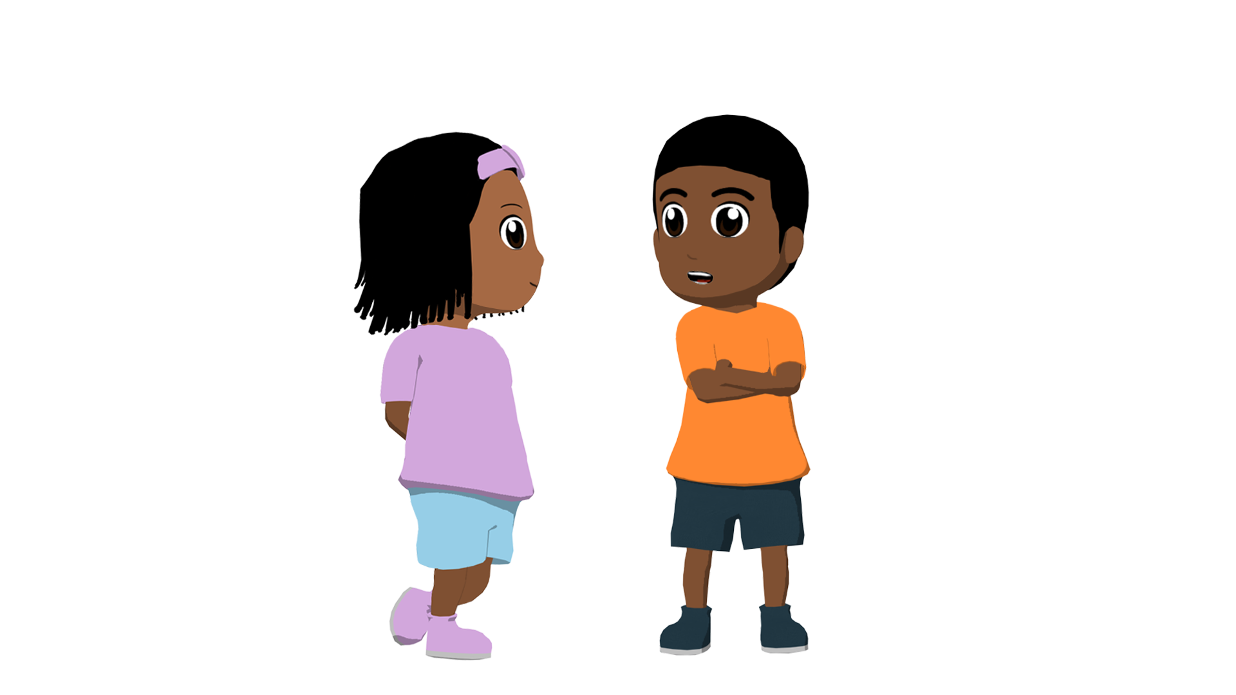
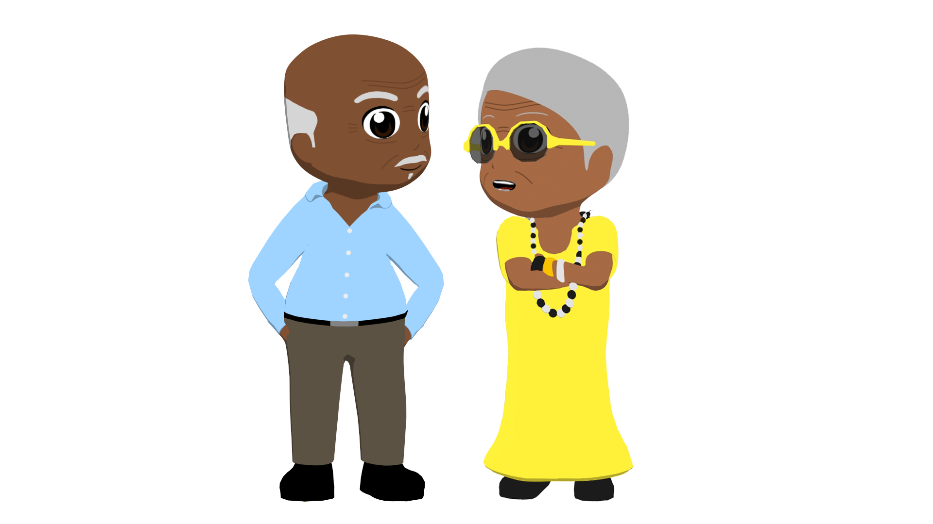
Una familia cubana en Estados Unidos
leer
leer
María de los Ángeles y Jorge Jesús son hermanos y viven en Estados Unidos. Hablan sobre la vida de los abuelos cubanos.
Who… | Los hermanos (‘we’) | Los abuelos (‘they’)
1. can’t speak English very well?
2. translates things for them?
3. feels sad?
4. doesn’t understand Spanish completely?
5. wants to go to Cuba?
6. prefers life in the United States?
Completa la tabla. También escribe los pronombres (‘nosotros’ o ‘ellos’) en español.
Ellos
1. “_________ no saben hablar inglés muy bien, pero _________ les traducimos cosas.”
nosotros
Ellos
2. “_________ sienten pena porque _________ no entendemos el español completamente.”
nosotros
Nosotros
3. “_________ queremos ir a Cuba un día, pero _________ prefieren la vida en Estados Unidos.”
ellos
Notes:
Timing: 6 minutes
Aim: to practise connecting the subject pronouns ’nosotros’ and ‘ellos’ with 1st and 3rd person plural endings in the present of –er/–ir verbs.
Procedure:
Students read the extracts in order to fill in the table, ticking the column for the person who did each action. If working in their exercise books, they can just write, e.g., 1. Los hermanos.
Click to reveal the answers in the table, and then in the speech bubble.
Notes:
The activity could easily be adapted for a higher-achieving group by changing the order of the questions, which currently appear in the same order as in the text.

Slide 8
María de los Ángeles habla sobre la vida de su familia en Estados Unidos. Escucha y completa la tabla.
escuchar
 | Los hermanos (‘we’) | Los abuelos (‘they’) | el verbo
la frase (en inglés)
1
asistimos
We attend a great
____________________ school.
2
ponen
They put a lot of food
______________________ on the table.
3
tenemos
We have a very good
______________________ relationship.
4
debemos
We must speak more
_____________________ in Spanish.
5
ofrecen
They offer typical
___________________ Cuban food.
6
They describe the landscapes
describen
_____________________________ in Cuba.
Notes:
Timing: 6 minutes
Aim: to practise connecting the verb endings –emos/–imos and –en with their corresponding subjects.
Procedure:
Go through the task context and instructions with students.
Students listen to each sentence. The first time they can just note whether it refers to ‘los hermanos’ or ‘los abuelos’.
Play the audio again. This time they should transcribe the verbs and complete the sentences.
Check the answers with students. Answers appear row by row.
Note: the teacher may wish to change the order of animations in order to check answers column by column. The advantage of this is that allows for a more controlled feedback process, which may be better suited to a lower ability group. It would, however, be more time-consuming and may involve some repetition. Possible target language interaction with the current animation sequence might include (“¿Escuchaste ‘asisten’ or ‘asistimos’? … Perfecto, y ¿cómo se escribe el verbo? … ¿Qué significa la frase?).
Transcript:
Asistimos a un colegio genial.
Ponen mucha comida en la mesa.
Tenemos una buena relación.
Debemos hablar más en español.
Ofrecen comida típica cubana.
Describen los paisajes en Cuba.

Slide 9
Lee y completa el texto. ¿Cuál es la palabra correcta para cada espacio en blanco? Luego, escucha y comprueba las respuestas.
[1/2]
leer
cubanos
Mi hermano Jorge Jesús y yo somos 1) ________, pero vivimos en los Estados Unidos. Nuestra casa está en Miami, Florida, en una zona generalmente de población 2) _______. Hay mucha gente extranjera aquí. Asistimos a un colegio genial donde aprendemos muchas cosas y hacemos ejercicio. Por ejemplo, leemos y escribimos textos 3) _______ personajes* actuales y corremos en el parque. Cuando salimos de clase cogemos el autobús y volvemos a casa.
Solemos visitar 4) _______ mis abuelos los fines de semana. 5) ____________ ponen mucha comida en la mesa y comemos platos deliciosos.
Palabras posibles
normalmente
noventa
sobre
cubanos
porque
camiseta
cubana
a
nunca
vais
cubana
sobre
a
Normalmente
*personaje = character (e.g. in film), celebrity
Notes:
[1/2]
Timing: 8 minutes
Aim: to focus on language from a range of parts of speech.
Procedure 1. Students read the text and decide which of the words in the table is the most suitable one for each gap. In some cases, a word may fit grammatically but not semantically (e.g ‘nunca’ for item 5).
2. Then, they listen to the recording and check their answers.
2. Teacher shows the answers one by one.
Notes:
Students can be encouraged to orally translate the text in pairs in order to check understanding.
In ‘te ofrecen comida típica’, ‘te’ is an impersonal ‘you’. It might be useful to point this out to students. In English, we use ‘you’ in the same way.
Students have studied the word ‘personaje’ in Year 8 (8.3.2.5) with the meaning ‘character’. Here the word is used with a different meaning, hence the gloss.
In Latin American countries, ‘tomar’ is used more often than ‘coger’ with the meaning ‘to take’, but ‘coger’ was chosen here in order to facilitate practice of SSC ‘ge’ (see slide 11).
Frequency of unknown words:
personaje [595] (not known with the meaning ‘celebrity’); típico [1934]

Slide 10
Lee y completa la segunda parte del texto. Escribe la mejor palabra para cada espacio y escucha el audio:
[2/2]
leer
Tenemos una buena relación, pero ellos sienten pena porque, 6) _______ oímos el español en casa, nosotros no lo entendemos completamente. Mis abuelos creen que debemos 7) _______ más en español porque es parte de las raíces de 8) _______ familia. Ellos no saben hablar inglés muy bien, pero nosotros les traducimos cosas cuando no entienden algo importante. Siempre comparten experiencias 9) _______ pasado en Cuba, describen los paisajes y te ofrecen comida típica* cubana. Nosotros queremos ir a Cuba un día, pero ellos prefieren la vida en Estados Unidos porque toda nuestra familia está en 10) ________ país.
aunque
Palabras posibles
arroz
del
estrella
con
este
nuestra
programa
gastar
aunque
hablar
hablar
nuestra
del
este
*típico/a = typical
Notes:
[2/2]
Note: different distractors (wrong answers) are used in the ‘palabras posibles’ table on this slide (different distractors from those used on the previous slide) because it is assumed that students will already have checked their answers to the first half of the activity when they come to do this.

Slide 11
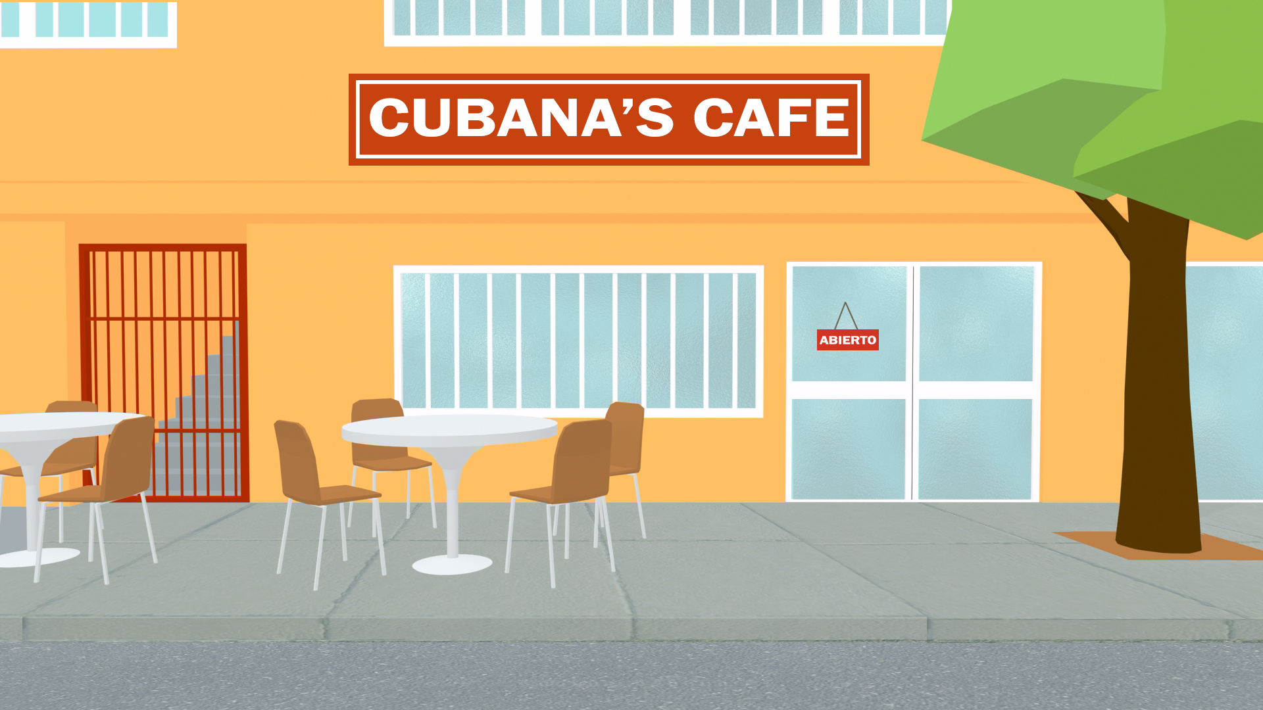
leer / hablar
Fonética
Remember: ‘ge’ and ‘je’ are pronounced the same.
Lee la primera parte del texto con tu pareja. ¡Debes pronunciar las palabras con ‘ge’ y ‘je’ correctamente!
“Mi hermano Jorge Jesús y yo somos cubanos, pero vivimos en los Estados Unidos. Nuestra casa está en Miami, Florida, en una zona generalmente de población cubana. Hay mucha gente extranjera aquí. Asistimos a un colegio genial donde aprendemos muchas cosas y hacemos ejercicio. Por ejemplo, leemos y escribimos textos sobre personajes* actuales y corremos en el parque. Cuando salimos de clase cogemos el autobús y volvemos a casa”.
*personaje = character (e.g. in a film), celebrity
Notes:
Timing: 3 minutes
Aim: to gain confidence in producing the SSCs [ge] and [je] in context.
Procedure:
Students read the text out loud in pairs, paying attention to the pronunciation of [ge] and [je].
The teacher can walk around the classroom listening to students’ pronunciation and giving support.
Frequency of unknown words:
personaje [595] (not known with the meaning ‘celebrity’); típico [1934]

Slide 12
Ahora contesta las preguntas en inglés. ¿En qué parte del texto está la respuesta?
leer
Mi hermano Jorge Jesús y yo somos cubanos, pero vivimos en los Estados Unidos. Nuestra casa está en Miami, Florida, en una zona generalmente de población cubana. Hay mucha gente extranjera aquí. Asistimos a un colegio genial donde aprendemos muchas cosas y hacemos ejercicio. Por ejemplo, leemos y escribimos textos sobre personajes* actuales y corremos en el parque. Cuando salimos de clase cogemos el autobús y volvemos a casa.
Solemos visitar a mis abuelos los fines de semana. Normalmente ponen mucha comida en la mesa y comemos platos deliciosos. Tenemos una buena relación, pero ellos sienten pena porque nosotros no entendemos el español completamente aunque lo oímos en casa. Mis abuelos creen que debemos hablar más en español porque es parte de las raíces de nuestra familia. Ellos no saben hablar inglés muy bien, pero nosotros les traducimos cosas cuando no entienden algo importante. Siempre comparten experiencias del pasado en Cuba, describen los paisajes y te ofrecen comida típica cubana. Nosotros queremos ir a Cuba un día, pero ellos prefieren la vida en Estados Unidos porque toda nuestra familia está en este país.
1) Where do they live exactly?
2) What do they do when they finish school?
3) What do they usually do on the weekend?
4) What do their grandparents always share?
5) Why do their grandparents want to stay in the USA?
*personaje = character (e.g. in film), celebrity
Notes:
[1/2]
Timing: 5 minutes
Aim: to focus on the specific details of the text.
Procedure 1. Students can read the text again and answer the questions in English individually or in pairs.
2. Answers for this activity can be displayed using the next slide.
Frequency of unknown words:
personaje [595] (not known with the meaning ‘celebrity’); típico [1934]

Slide 13
Respuestas
leer
1. Where do they live exactly?
In Miami, Florida, in an area where the population is generally Cuban.
(Nuestra casa está en Miami, Florida, en una zona generalmente de población cubana.)
2. What do they do when they finish school?
Take the bus and go back home.
(Cuando salimos de clase cogemos el autobús y volvemos a casa.)
3. What do they usually do on the weekend?
Visit their grandparents.
(Solemos visitar a mis abuelos los fines de semana.)
4. What do their grandparents always share?
Experiences from the past in Cuba.
(Siempre comparten experiencias del pasado en Cuba.)
5. Why do their grandparents want to stay in the USA?
Because all the family is in this country.
(…ellos prefieren la vida en Estados Unidos porque toda nuestra familia está en este país.)
Notes:
[2/2]
Answer slide
This slide displays the answers in written form and can be used for feedback. The relevant parts of the text in Spanish are also included in italics.
Each click reveals the answer and supporting part of the text.

Slide 14
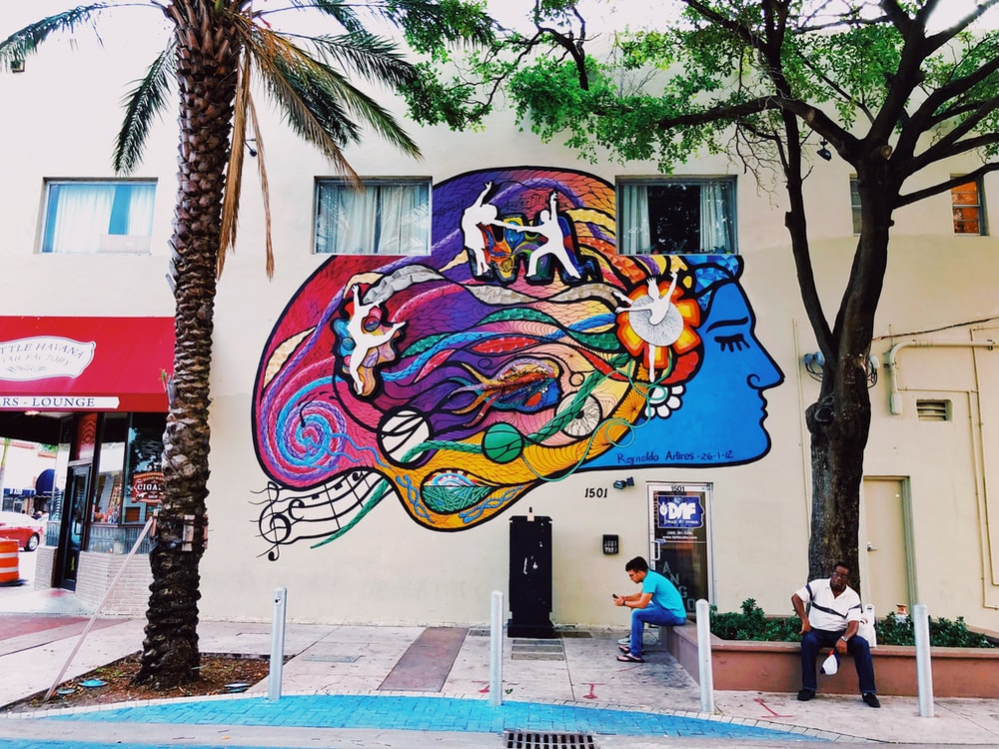
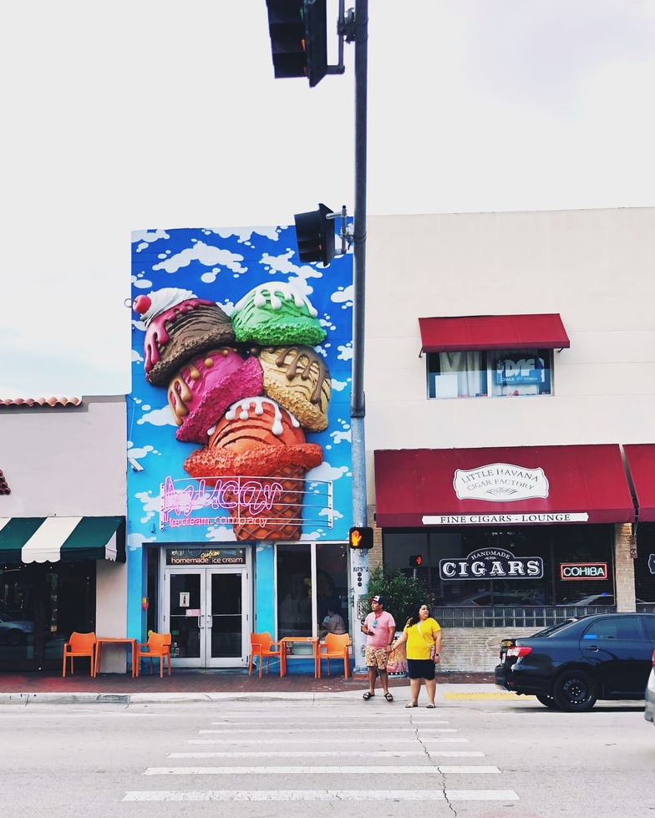
Escucha cada audio y decide cómo puede terminar la frase.
leer / escuchar
Mi hermano Jorge Jesús y yo somos cubanos, pero...
… no entendemos el español muy bien.
... no pueden entender la lengua española.
1
Asistimos a un colegio genial...
... con compañeros extranjeros.
… poder aprender historia y hacer deporte.
2
Cuando salimos de clase...
... en el autobús para volver a casa.
… solemos usar el transporte público.
3
Fotos de “Pequeña Habana”, Miami.
[1/2]
Notes:
[1/2]
Time: 5 minutes
Aim: to finish the sentences correctly, based on the grammar in the sentence starter.
Procedure:
Explain to students that they will hear a sentence starter. They will need to decide how the sentence must finish. This is based on what is grammatically correct (as opposed to what they remember having read in the previous text).
Optionally, they could listen again and suggest some alternative endings.
Then give feedback. Click to show a tick next to the correct answer. Click again to reveal the audio that was heard. This may be useful to help explain to students (or elicit answers regarding) why one why answer option is grammatical and another is not. Check understanding of the meaning of each sentence via oral translation into English.
Reasons for grammaticality:
Item 1 – the verb ‘somos’ is used, so a verb with a 1st person plural ending (e.g. –emos) must follow.
Item 2 – the preposition ‘con’ can follow this sentence starter (‘we go to a great school WITH’), whereas an infinitive cannot.
Item 3 – the subordinate clause (‘cuando salimos de clase’) requires a main clause afterwards. A main clause must have a verb.
Item 4 – after ‘comemos’ a direct object or adverb/adverbial phrase can be used, so ‘mucho’ is correct.
Item 5 – after the subject pronoun ‘ellos’ the corresponding verb needs to be in 3rd person plural (e.g. –an, -en).
Item 6 – after ‘comparten’ a noun is usually needed. ‘Actuales’ (‘current’) is an adjective and so could not appear afterwards.
Transcript:
Mi hermano Jorge Jesús y yo somos cubanos, pero...
Asistimos a un colegio genial...
Cuando salimos de clase...
Normalmente ponen mucha comida en la mesa y comemos...
Tenemos una buena relación, pero ellos...
Siempre comparten...
Photos of Little Havana by @naomitamar (free to use under the Unsplash License).

Slide 15
Escucha cada audio y decide cómo puede terminar la frase.
leer / escuchar
Normalmente ponen mucha comida en la mesa y comemos...
... a las raíces cubanas de la familia.
... mucho con toda la familia.
4
Tenemos una buena relación, pero ellos...
... creen que tenemos que pasar más tiempo juntos.
... les permitimos aprender sobre las experiencias en Cuba.
5
Siempre comparten...
... comida con la población extranjera de la zona.
... actuales para conocer la realidad del país.
6
Fotos de “Pequeña Habana”, Miami.
[2/2]
Notes:
[2/2]

Slide 16
Una familia cubana en Estados Unidos
escribir
Escribe las actividades de María de los Ángeles y Jorge Jesús con su familia.
Usa las formas –emos, –imos y –en correctamente según la persona.
¡También escribe los pronombres!
Notes:
[1/6]
Timing: 8 minutes
Aim: to successfully write sentences using 1st and 3rd person plural endings of –er/–ir verbs in the present tense for the five slides that follow.
Procedure:
Students write the sentence in Spanish as indicated by the text/images. This could be done using mini white-boards.
Note: this could also be done as a teacher-led whole-class speaking activity.

Slide 17
Una familia cubana en Estados Unidos
escribir
hear many words in Spanish at home
Nosotros oímos muchas palabras en español en casa porque ellos creen que es importante.
we
because
they believe that it is important.
they
Notes:
[2/6]

Slide 18
Una familia cubana en Estados Unidos
escribir
attend English classes for foreigners
Ellos asisten a clases de inglés para extranjeros y nosotros solemos ayudar.
they
and
we usually help.
we
‘we usually + verb’ → hint: use the verb ‘soler’!
Notes:
[3/6]
Note: a hint is included to try to prompt use of the previously taught verb, ‘soler’ (given the focus on the –emos ending in this lesson).

Slide 19
Una familia cubana en Estados Unidos
escribir
feel sad (‘sadness’) when we can’t speak Spanish correctly
Nosotros sentimos pena cuando no podemos hablar español correctamente así que ellos ofrecen ayuda.
we
so
offer help
they
hint: use ‘correcta’ to form the word for ‘correctly’
Notes:
[4/6]
Note: students already learnt the rule for adverb formation with adjectives ending in –o/–a. However, this was done some time ago, so a hint is given here about the need to use the feminine form.

Slide 20
Una familia cubana en Estados Unidos
escribir
share Cuban traditions
Ellos comparten tradiciones cubanas y nosotros aprendemos sobre las raíces de nuestra familia.
they
whereas
learn about our family roots.
we
Hint: use possessive ‘de’
(‘the roots of our family’)
Notes:
[5/6]
Note: possessive ‘de’ is needed here. This is a previously taught feature but some students may benefit from a prompt.

Slide 21
Una familia cubana en Estados Unidos
escribir
Hint: use the word ‘les’ before the verb for ‘ask for’.
ask them for Cuban food
Nosotros les pedimos comida cubana y ellos hacen platos muy ricos.
we
and
they make very tasty dishes.
they
Notes:
[6/6]
Note: the indirect object pronoun ‘les’ was taught earlier in year 9, though it may be a point of difficulty given the word order difference with the English here (‘ask them for’), so a hint is included.

Slide 22
Talking about the lives of Spanish speakers in the USA [2]
–er & –ir verbs in 1st person plural preterite (–imos)
Y9 Spanish
Term 2.1 - Week 4 - Lesson 36
Amanda Izquierdo, Nick Avery, Louise Caruso Artwork: Mark Davies
Date updated: 09/12/21
Notes:
Artwork by Mark Davies. All additional pictures selected are available under a Creative Commons license, no attribution required.
With thanks to Rachel Hawkes for her input on the lesson material and Blanca Román.
Learning outcomes (lesson 2):
Introduction of –er/–ir verbs in 1st person preterite (–imos)
Consolidation of regular –ar verbs 1st person –amos preterite
Consolidation of SSCs [ge] and [je]
Word frequency (1 is the most frequent word in Spanish):
9.2.1.4 (introduce): nacer [426]; reconocer [400]; cumplir [385]; huir [1359]; sentir [136]; oír [254]; duda [531]; experiencia [416]; esperanza [987]; raíz [1304]; cubano [703]; asistir [1200]; extranjero² [765]; marido [965]; mujer² [120]; población [454]; actual [499]; ambos [536]; derecho [266]; relación [272]
Y9 1.2.7 (revisit) gastar [1866]; tener que [tener-19]; tocar² [327]; vais [ir-22]; estrella [974]; guitarra [2705]; medianoche [4663]; Navidad [3513]; programa [339]; televisión [825]; tradición [1061]; siguiente [350]; desde [60]; hasta² [70] Numbers 80-100 ochenta [1967]; noventa [2459]; cien [ciento-440]; ciento (uno) [440]
Y9 1.1.7 (revisit) les [25]; cocinar [3704]; contar [658]; mandar [588]; arroz [2882]; camiseta [4130]; dolor [591]; gafas [>5000]; invierno [1813]; pollo[3577]; gris [1751]; naranja [2924]; tanto [88]
Source: Davies, M. & Davies, K. (2018). A frequency dictionary of Spanish: Core vocabulary for learners (2nd ed.). Routledge: London
The frequency rankings for words that occur in this PowerPoint which have been previously introduced in NCELP resources are given in the NCELP SOW and in the resources that first introduced and formally re-visited those words.
For any other words that occur incidentally in this PowerPoint, frequency rankings will be provided in the notes field wherever possible.

Slide 23
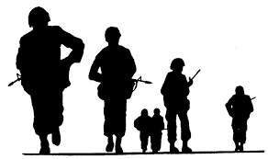
Pronuncia cada palabra correctamente.
hablar
garaje
gesto
[garage]
jefe
paisaje
[boss]
agente
tarjeta
[agent]
generación
mensaje
salvaje
generoso
inteligente
[wild]
ejército
[generous]
[intelligent]
[army]
Notes:
Timing: 3 minutes
Aim: to practise pronunciation of SSCs ‘ge’ and ‘je’.
Procedure:
Students say the word aloud in chorus when it pulsates, making sure they pronounce ‘ge’ and ‘je’ correctly.
Teacher shows all of the animations one by one, correcting students’ pronunciation if necessary.
Word frequency (1 is the most frequent word in Spanish) of unknown words:
garaje [>5000]; jefe [726]; salvaje [3458]; agente [1493]; ejército [905]; generoso [3193].

Slide 24
Vocabulario
hablar
el pollo
la medianoche
el pollo
la estrella
contar
el dolor
la medianoche
tanto
tanto
la estrella
contar
el dolor
ciento uno
desde
ciento uno
desde
¿Cómo se dice
‘the next/following day’ en español?
grey
to spend, spending
(e.g. money)
so much, so many (m)
Christmas
you (plural) go, are going
star
to them
next, following
one hundred
pain
t-shirt
one hundred and one
orange
from (e.g. a time)
eighty
ninety
glasses
chicken
to love, loving
to count, counting
to have to, having to
midnight
as far as, up to, until
les
las gafas
les
las gafas
el día siguiente
vais
vais
la Navidad
la Navidad
amar
siguiente
ochenta
gastar
amar
siguiente
hasta
ochenta
gastar
hasta
la camiseta
tener que
cien
noventa
gris
la naranja
la camiseta
tener que
cien
noventa
gris
la naranja
Notes:
Timing: 4 minutes
Aim: to practise recognising words in Spanish from this week’s revisited vocabulary sets
Procedure:
1. Students supply the Spanish for the word that appears in English. The aim is to be able to give the Spanish before the image stops spinning.
Notes:
The activity can be repeated, clicking faster through the animations to increase speed of recall.
Teachers may wish to give students 30 seconds to look at the Spanish words to try to recall their meanings before showing the English prompts.

Slide 25
Vocabulario
hablar
la esperanza
to recognise, recognising
reconocer
la duda
A veces la traducción de ‘cumplir’ cambia según el contexto.
Un ejemplo:
cumplir un sueño
= to achieve a dream
[doubt]
nacer
to fulfill,
fulfilling
cumplir
[to be born, being born]
Notes:
[1/2]
Timing: 3 minutes
Aim: to introduce and embed the new vocabulary, also some relevant vocabulary for this lesson.
Procedure: 1. Pupils either work by themselves or in pairs, reading out the words and recapping their English meaning (1 minute). 2. Then the teacher removes the English words or pictures (one by one) and they try to recall the English orally (chorally), looking at the Spanish (1 minute). 3. Then the Spanish meanings are removed (one by one) and they to recall them orally (again, chorally), looking at the English (1 minute) 4. Further rounds of learning can be facilitated by one pupil turning away from the board, and his/her partner asking him/her the meanings (‘¿Cómo se dice X en español?’). This activity can work from L2 → L1 or L1 → L2.
Word frequency (1 is the most frequent word in Spanish) of words introduced in lesson 2:
nacer [426]; reconocer [400]; cumplir [385]; huir [1359]; duda [531]; esperanza [987 marido [965]; mujer² [120]; ambos [536]; derecho [266].

Slide 26
Vocabulario
hablar
huir
la mujer
[to run away, to flee]
[woman, wife]
el derecho
[right]
both
el marido
ambos
[husband]
Notes:
[2/2]

Slide 27
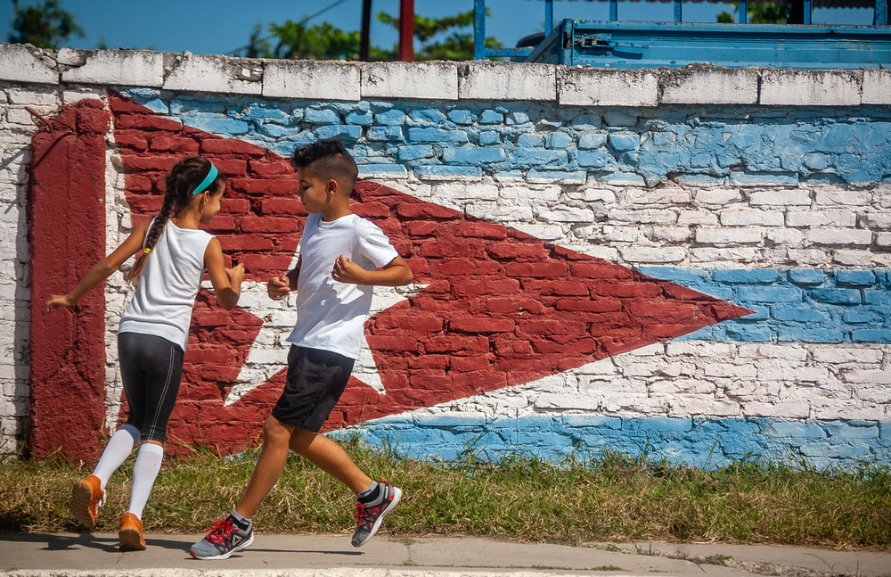
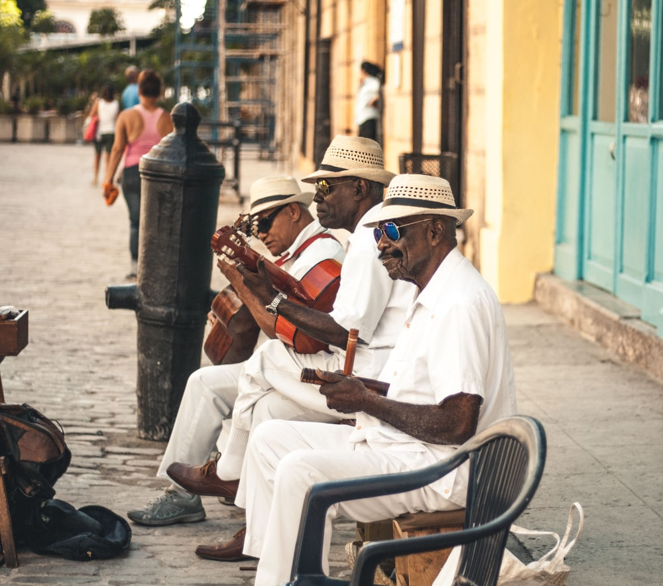
Lee unas frases sobre latinoamericanos en Estados Unidos. ¿Qué piensas? ¿Son verdaderas o falsas?
leer
*hablante = speaker
*politico = political
*posibilidad = possibility
1. Hay más hablantes* de español en Estados Unidos que en Perú.
2. Muchos latinoamericanos en Estados Unidos no hablan inglés perfectamente.
3. Los hijos de padres latinoamericanos en Estados Unidos suelen hablar el español mejor que el inglés.
4. Hay cubanos que viven en Estados Unidos por problemas políticos* en Cuba.
5. En general los latinoamericanos en Estados Unidos creen en la posibilidad* de una buena vida allí.
6. Muchos cubanos en Estados Unidos quieren volver a Cuba porque piensan que la situación política allí es mejor.
Notes:
Timing: 3 minutes
Aim: to introduce information about the life of Spanish speakers in the US.
Procedure:
Students read each statement and decide whether the answer is true or false. They could base their suppositions on what they have learned so far about the characters in the first lesson. This is a low stakes activity and isn’t intended to be a test.
Teacher shows the correct answers one by one.
Extra information about each statement:
There are 42 million Spanish speakers in the US and 28 million in Peru (Source: https://www.statista.com/statistics/991020/number-native-spanish-speakers-country-worldwide/).
An estimated 23,484,777 native Spanish speakers speak English "very well," according to the 2019 Census survey. An additional 6,762,059 reported they speak English "well”.
Quote from PEW research article: “The Center’s 2015 survey findings also show that Spanish dominance is on the decline among second- and third-generation Latinos. While 61% of Hispanic immigrants in the U.S. are Spanish dominant (and another 32% are bilingual), the share who are Spanish dominant drops to 6% among second-generation Hispanics and to less than 1% among third or higher generation Hispanics”. NB The term “Spanish-dominant” here means “more proficient in speaking and reading in Spanish than they are in English” (https://www.pewresearch.org/fact-tank/2018/04/02/most-hispanic-parents-speak-spanish-to-their-children-but-this-is-less-the-case-in-later-immigrant-generations/).
“Cubans began arriving in the United States in large numbers after the 1959 communist revolution led by Fidel Castro”. (https://www.migrationpolicy.org/article/cuban-immigrants-united-states-2018). Successive U.S. administrations pursued policies intended to isolate the island country economically and diplomatically (https://www.cfr.org/backgrounder/us-cuba-relations).
In response to a the National Survey of Latinos, 77% of Hispanics agreed with the first of these questions: “Can most people who want to get ahead make it if they’re willing to work hard? Or are hard work and determination no guarantee of success?”
“Currently, few Cubans perceive their economy as excellent or good, and most say the situation has not changed recently. Most Cubans also believe the country’s economic situation will either remain the same or deteriorate in coming years”. (https://www.norc.org/Research/Projects/Pages/survey-of-cuban-public-opinion.aspx).
Word frequency (1 is the most frequent word in Spanish) of unknown words:
hablante [>5000]; politico [258]; posibilidad [461]
Image of two kids taken by Ernesto Carrazana on Unsplash (image free to use)
Image of three men taken by Ban Yido on Unsplash (image free to use)

Slide 28
Talking about what ‘we’ did 1st person plural (-imos)
gramática
Remember, some Spanish infinitives end in –er, some in –ir.
The verb ending changes for completed actions in the past.
To mean ‘we’ with an –er or –ir verb, remove –ir and add –imos.
nacer
nac-
nacimos
1
(to be born)
(we were born)
asistir
asist-
asistimos
2
(to attend)
(we attend, we attended)
Remember, for –ir verbs, –imos is also used for ‘we’ in the present tense.
Notes:
Timing: 1 minute
Aim: to introduce 1st person plural form of –er/–ir verbs in the preterite tense (-imos) and remind students of the same ending also used with –ir verbs in the present tense.
Procedure:
Go through the grammar explanation with students, revealing each new sentence on a mouse click.

Slide 29
Lee cada frase y escribe el verbo en la forma de infinitivo. ¿Es un verbo en –er o –ir? Decide si el verbo es en el pasado o puede ser presente / pasado.
leer
‘Vivir’ is used here with a new meaning: ‘to experience’ or ‘to live through’.
 | el infinitivo | solo pasado | puede ser presente o pasado
1
2
3
4
5
6
1. Crecimos en el mismo barrio
2. Vivimos tiempos difíciles.
crecer
3. Compartimos muchas experiencias.
vivir
4. Decidimos tener un hijo.
compartir
decidir
5. Perdimos muchos derechos.
perder
6. Huimos de nuestro pueblo.
huir
Notes:
Timing: 5 minutes
Aim:
to recall infinitive forms of verbs from the verb stems given
to understand the two possible meanings of the –imos ending (completed past, present) for –ir verbs
to understand the one possible meaning (completed past) of the –imos ending for –er verbs
Procedure:
Explain the task to students. It may be useful to do the first one with the class to model the activity. All six sentences have a verb with the –imos ending. Students will first need to look at the verb’s stem (e.g. crec-, viv-, compart-) and try to remember its infinitive form (crecer, vivir, compartir). This should be possible given that all six verbs are known vocabulary items.
Students then need to decide, based on the ending (–er or –ir), whether the –imos form is referring to an action in the past (–er verbs) or an action that may be either past or present (–ir verbs).
During feedback, elicit translations of the sentences. Highlight how –ir verbs have two translations in English (e.g. 2. We live through difficult times / We lived through difficult times).
Notes:
1. A callout highlights how ‘vivir’ is used in the activity with a new meaning. This will also be used on the next slide (listening), to it is important to flag this here.

Slide 30
Escucha las frases. Escribe el verbo en la forma del infinitivo. ¿Es un verbo en –er o –ir? Decide también cómo traducir el verbo.
escuchar
*vivir = to experience, live through
Verbo en -er | Verbo en -ir | Completa la frase
(vivir)
experience, experienced
1
We __________________________ very happy times.
(elegir)
choose, chose
2
We _________________________ to flee the country.
3
sold
(vender)
We _________________________ the house.
4
recognised
(reconocer)
We _________________________ some Cuban friends.
5
saw
(ver)
We _________________________ changes in society.
achieve/achieved
6
(cumplir)
We _________________________ our dream.
Notes:
Timing: 7 minutes
Aim:
to recall infinitive forms of verbs from verb stems
to understand the two possible meanings of the –imos ending (completed past, present) for –ir verbs
to understand the one possible meaning (completed past) of the –imos ending for –er verbs
Procedure:
Students first listen to the sentences. All sentences have a verb with the –imos ending. Students will need to listen out for the verb stem and decide whether it ends in –er or –ir. This requires recall of the infinitive form of each verb. It may help them to write the verb as they do this.
They then need to complete the translation of the sentence in English. In doing so, they’ll need to decide whether the verb has only one translation (past tense only) or two (present tense and past tense). This will depend on whether the infinitive ends in –er or –ir.
Give students feedback. It may be worth exploring the most likely translations at this stage (e.g. ‘we achieve our dream’ may seem unlikely out of context, but is a grammatical meaning of the sentence).
Transcript:
Vivimos momentos muy felices.
Elegimos huir del país.
Vendimos nuestra casa.
Reconocimos a unos amigos cubanos.
Vimos cambios en la sociedad.
Cumplimos nuestro sueño.

Slide 31
Talking about what ‘we’ did 1st person plural (-amos)
gramática
Remember, some Spanish infinitives end in –ar.
The verb ending changes for completed actions in the past.
–amos
To mean ‘we’ with an –ar verb, remove –ar and add _______ .
We escape from the country.
Escapamos del país.
We escaped from the country.
Ayudamos a otras personas.
We help other people.
We helped other people.
Remember, for –ar verbs, –amos is also used for ‘we’ in the present tense.
Notes:
Timing: 1 minute
Aim: to recap 1st person plural form of –ar verbs in preterite tense (-amos).
Procedure:
Go through the grammar explanation with students, revealing each new sentence on a mouse click.

Slide 32
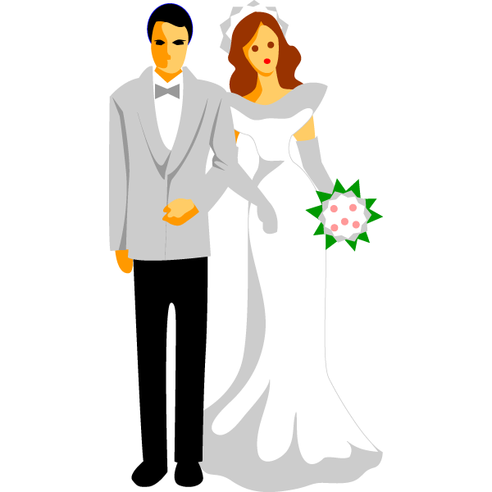
Los abuelos hablan con María de los Ángeles y Jorge Jesús. Lee la conversación y escribe la traducción de las frases.
leer / escribir
boda* = wedding
- Ambos nacimos en La Habana, la capital de Cuba. Crecimos en el mismo barrio y asistimos a la misma escuela. ¡Pasamos mucho tiempo juntos! 1) Durante varios años disfrutamos una vida simple.
- Sí, compartimos muchas experiencias y vivimos momentos muy felices. 2) Un día empezamos una relación y poco después consideramos ser marido y mujer. Pensamos en crear una familia y comprar una casa en nuestro barrio. 3) Entonces celebramos una boda* muy bonita, ¡invitamos a mucha gente!
- 4) Y un año después decidimos tener un hijo, vuestro padre Gerardo y, más tarde, vuestra tía Jezabel. 5) Pero entonces empezamos a ver muchos cambios políticos* en el país y perdimos el derecho a dar nuestra opinión.
- Pues sí, no soportamos la situación. Estudiamos las opciones y elegimos huir del país. Organizamos un equipaje* ligero y escapamos urgentemente.
- Durante el viaje a Estados Unidos reconocimos a unos amigos cubanos y los ayudamos a cruzar la frontera. Llegamos todos juntos con muchas dudas, pero también con esperanza. 6) Finalmente, cumplimos nuestro sueño.
político* = political
equipaje* = luggage
Notes:
[1/2]
Timing: 8 minutes
Aims:
to accurately translate phrases including verb forms in the 1st person plural in the preterite, together with temporal adverbs.
to understand other specific details in the text
Procedure:
Students read the text.
Then, they translate the phrases in bold into English.
Teacher can check the English translations orally or use the following slide to show the answers.
Further questions could be asked to check understanding of specific details in other parts of the text:
What is said about their background and how the couple met? (=they were born in La Habana, grew up in the same neighbourhood and went to the same school)
What did the grandparents lose when political changes started to occur? (=the right to give their opinion)
Why are the grandparents’ Cuban friends mentioned on the journey to the USA? (=because they helped them to cross the border)
Word frequency (1 is the most frequent word in Spanish) of unknown words:
boda [2473]; equipaje [>5000]; político [1388]

Slide 33
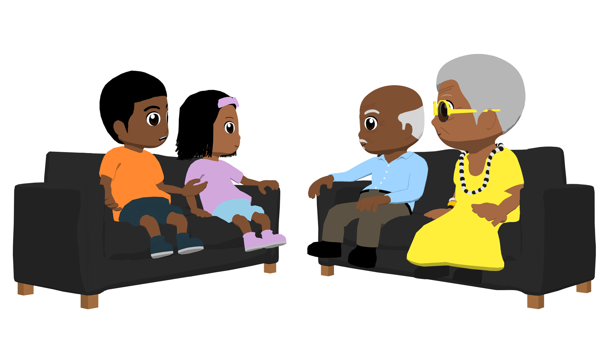
Respuestas
leer / escribir
boda* = wedding
1) Durante varios años disfrutamos una vida simple.
For several years we enjoyed a simple life.
2) Un día empezamos una relación.
One day we started a relationship.
3) Entonces celebramos una boda* muy bonita.
Then we had (‘celebrated’) a very beautiful wedding.
4) Y un año después decidimos tener un hijo.
And a year after we decided to have a child/son.
5) Pero entonces empezamos a ver muchos cambios.
But then we started to see many changes.
6) Finalmente, cumplimos nuestro sueño.
Finally, we achieved our dream.
Notes:
[2/2]

Slide 34
Ahora lee el texto con tu pareja para practicar la pronunciación. ¡Atención a las palabras con ‘ge’ y ‘je’!
leer / hablar
boda* = wedding
a) Ambos nacimos en La Habana, crecimos en el mismo barrio y asistimos a la misma escuela. ¡Pasamos mucho tiempo juntos! Durante varios años disfrutamos una vida simple.
b) Sí, compartimos muchas experiencias y vivimos momentos muy felices. Un día empezamos una relación y poco después consideramos ser marido y mujer. Pensamos en crear una familia y comprar una casa en nuestro barrio. Entonces celebramos una boda* muy bonita, ¡invitamos a mucha gente!
a) Y un año después decidimos tener un hijo, vuestro padre Gerardo y, más tarde, vuestra tía Jezabel. Pero entonces empezamos a ver muchos cambios políticos en el país y perdimos el derecho a dar nuestra opinión.
b) Pues sí, no soportamos la situación. Estudiamos las opciones y elegimos huir del país. Organizamos un equipaje* ligero y escapamos urgentemente.
a) Durante el viaje a Estados Unidos reconocimos a unos amigos cubanos y los ayudamos a cruzar la frontera. Llegamos todos juntos con muchas dudas, pero también con esperanza. Finalmente, cumplimos nuestro sueño.
equipaje* = luggage
Notes:
Timing: 3 minutes
Aim: to improve pronunciation of words with [ge] and [je].
Procedure:
Students read the text aloud, taking turns to read each part of the conversation. One student reads the sections with ‘a)’ and the other student reads the sections with ‘b)’.
Students could then swap roles for additional practice, if there is time.
Note: urgente is a near-cognate and is likely to be understood with the affix –mente, given that this has previously been taught.
Word frequency (1 is the most frequent word in Spanish) of unknown words:
boda [2473]; equipaje [>5000]; urgentemente [>5000]

Slide 35
¿Cuál es tu opinión sobre la historia?
equipaje* = luggage
Grr..
me da pena/tristeza
me da rabia
me da vergüenza
me alegra
me da miedo
me da sueño
me da risa
Puedes dar tu opinión sobre estas partes:
1. Un día empezamos una relación y poco después consideramos ser marido y mujer.
2. Y un año después decidimos tener un hijo, vuestro padre Gerardo y, más tarde, vuestra tía Jezabel.
3. Pero entonces empezamos a ver muchos cambios políticos en el país y perdimos el derecho a dar nuestra opinión.
4. Estudiamos las opciones y elegimos huir del país. Organizamos un equipaje* ligero y escapamos urgentemente.
Notes:
Timing: 2 minutes
Aim: to allow students to give an affective response to the text.
Procedure:
Click to bring up the pictures.
Elicit the translations of each one.
Either in whole-class format, or working in pairs, ask students to give their response to the story.
To provide some structure, several extracts from the text are also provided. Students could also be asked to give their opinion to teach of these, individually. They could also justify their opinion using a conjunction like ‘porque’. If so, it may be worth giving them a little extra time to consider their ideas and write notes, rather than expecting unprompted oral production.
Word frequency (1 is the most frequent word in Spanish) of unknown words:
equipaje [>5000]

Slide 36
¡Ahora tú! Escribe sobre una experiencia en tu vida.
escribir
Piensa en una experiencia de tu vida, puede ser con tu familia o con otras personas. Debes escribir una historia en pasado y usar verbos con –amos y también –imos.
Puedes intentar usar estas palabras:
Mi amiga Sara y yo nacimos en el mismo pueblo. Un día...
un día
entonces
antes de
después de
Puedes usar verbos como:
un tiempo después
finalmente
nacer
crecer
durante varios años/meses/semanas
decidir
preferir
conocer
comer
aunque
además
así que
y
ayudar
pasar
pero
sin embargo
porque
sentir
volver
Notes:
Timing: 10 minutes
Aim: to practise writing more freely with the 1st person plural forms of –ar, –er and –ir verbs.
Procedure: Students write a story of their own. They can think of a past experience with someone else and try to write about it. They can use the suggested vocabulary, or they can use any other known vocabulary, including the words introduced this week.

Slide 37
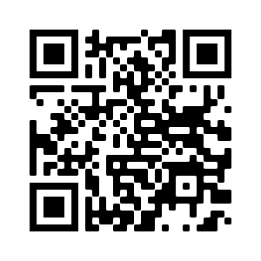
Deberes
Vocabulary Learning Homework (Y9, Term 2.1, Week 5)
Audio file
Audio file QR code:
Student worksheet
Quizlet link

