Slide 1
Talking about what isn’t happening
Negation: ne…pas
(with single-verb structures)
dormir (je, tu, il/elle)
SSC [oi] [revisited]
Y7 French
Term 3.1 - Week 4 - Lesson 55
Adeline Charlton / Natalie Finlayson/ Kirsten Somerville
Artwork by: Chloé Motard
Date updated: 16/08/2021
Notes:
Artwork by Chloé Motard. All additional pictures selected are available under a Creative Commons license, no attribution required.
Learning outcomes (lesson 1):
Consolidation of SSC [oi]
Introduction of ne…pas negation with single-verb structures
Introduction of verb dormir
Word frequency (1 is the most frequent word in French):
7.3.1.4 (introduce) dormir [1836], dors [1836], dort [1836], bureau¹ [273], équipe [814], parfois [410], sous [112], sur [16]
7.3.1.1 (revisit) apprendre [327], comprendre [95], dire [37], dis [37], dit [37], prend [43], prendre [43], prends [43], erreur [612], vérité [907], facile [822]
7.2.2.1 (revisit) aller [53], va [53], vais [53], vas [53], caisse [1881], collège [2116], jour [78], parc [1240], poste [489], samedi [1355], train [232], où [48], comment ? [234], quand ? [119]
Source: Londsale, D., & Le Bras, Y. (2009). A Frequency Dictionary of French: Core vocabulary for learners London: Routledge.
The frequency rankings for words that occur in this PowerPoint which have been previously introduced in NCELP resources are given in the NCELP SOW and in the resources that first introduced and formally re-visited those words.
For any other words that occur incidentally in this PowerPoint, frequency rankings will be provided in the notes field wherever possible.

Slide 2
oi
[to see]
voir
Notes:
Timing: 1 minute
Aim: To consolidate SSC [oi]
Procedure: 1. Present the letter(s) and say the [oi] sound first, on its own. Students repeat it with you. 2. Bring up the word ”voir” on its own, say it, students repeat it, so that they have the opportunity to focus all of their attention on the connection between the written word and its sound.
3. A possible gesture for this would be to put one’s hand above one’s brow (as if to shade one’s view) and pretend to be seeing something far off. 4. Roll back the animations and work through 1-3 again, but this time, dropping your voice completely to listen carefully to the students saying the [oi] sound, pronouncing ”voir” and, if using, doing the gesture.
Word frequency (1 is the most frequent word in French):
voir [69].
Source: Londsale, D., & Le Bras, Y. (2009). A Frequency Dictionary of French: Core vocabulary for learners London: Routledge.

Slide 3
oi
voir
Notes:
With sound and no pictures to focus all attention on the sound-symbol correspondence.

Slide 4
oi
[to see]
voir
Notes:
Without sound to elicit pronunciation (without first hearing the teacher).
Teacher to elicit pronunciation by asking “Comment dit-on …"

Slide 5
oi
droite
avoir
[to have]
to see
voir
Au revoir !
trois
Pourquoi ?
[why?]
Notes:
Timing: 2 minutes
Aim: To consolidate SSC [oi]
Procedure:
1. Introduce and elicit the pronunciation of the individual SSC [oi] and then the source word again ‘voir’ (with gesture, if using). 2. Then present and elicit the pronunciation of the five cluster words.
The cluster words have been chosen for their high-frequency, from a range of word classes, with the SSC (where possible) positioned within a variety of syllables within the words (e.g. initial, 2nd, final etc.). Additionally, we have tried to use words that build cumulatively on previously taught SSCs (see the Phonics Teaching Sequence document) and do not include new SSCs. Where new SSCs are used, they are often consonants which have a similar symbol-sound correspondence in English.
Word frequency (1 is the most frequent word in French): droite [1293]; avoir [8] au revoir [n/a]; pourquoi[193]; trois[115]; voir [69]. Source: Londsale, D., & Le Bras, Y. (2009). A Frequency Dictionary of French: Core vocabulary for learners London: Routledge.

Slide 6
oi
droite
avoir
voir
Au revoir !
trois
Pourquoi ?
Notes:
With sound and no pictures to focus all attention on the sound-symbol correspondence.

Slide 7
oi
droite
avoir
voir
Au revoir !
trois
Pourquoi ?
Notes:
Without sound to elicit pronunciation (without first hearing the teacher).
Teacher to elicit pronunciation by asking “Comment dit-on …"

Slide 8
Phonétique
Phonétique
écouter / parler
(a)in
oi
bain
[bath]
drain
[drain]
droit
[straight]
voix
[voice]
crin
[horsehair]
croix
[cross]
nain
[dwarf]
soi
[oneself]
pain
[bread]
poids
[weight]
vin
[wine]
foi
[faith]
noix
[walnut]
main
[hand]
moi
[me/
myself]
fin
[end]
sain
[healthy]
bois
[wood]
Notes:
In-class version
Timing: 5 minutes
Aim: Production and recognition of SSCs [oi] and [ain/in].
Procedure:
Each student writes 1-10 in their workbooks and chooses 10 words to write down in order (this number can be increased or decreased to fit the time available).
Students then take turns to read their list aloud, while their partner notes down either [ain] or [oi] for each word. For a more challenging task, students could find the word on the board and write it down in full as they listen.
The partners then compare lists and work together to correct any words that were mispronounced or misheard.
The teacher circulates and listens for any areas of difficulty – in particular, students may need to be reminded about the SFC.
Word frequency (1 is the most frequent word in French):
bain [3458], pain [2808], crin [>5000], drain = cognate, vin [2309], nain [>5000], sain [1763], fin [111], droit [143], toi [510], voix [414], croix [3904], poids [1102], soi [1365], foi [1368], moi [131], noix [>5000], bois [1425]
Source: Londsale, D., & Le Bras, Y. (2009). A Frequency Dictionary of French: Core vocabulary for learners London: Routledge.

Slide 9
Phonétique 1 (self-study)
Phonétique 1 – self study
écouter / parler
Click on the arrow to listen to a list of nine of the words from below.
Write down whether you hear [oi] or [(a)in]. You can write the full word if you recognise it.
Once you have listened to nine words, click the space bar to see answers.
Practise saying [oi] and [(a)in] by playing the audio again and repeating the words.
(a)in
oi
drain
[drain]
bain
[bath]
droit
[straight]
voix
[voice]
crin
[horsehair]
croix
[cross]
soi
[oneself]
foi
[faith]
pain
[bread]
nain
[dwarf]
fin
[end]
vin
[wine]
poids
[weight]
Remember! Silent Final Consonants (SFC): none of the words on this slide has the final [n], [s] or [x] pronounced.
noix
[walnut]
sain
[healthy]
moi
[me/
myself]
main
[hand]
bois
[wood]
Notes:
Home learning version (NB: an in-class version of this activity can be found on slide 8).
Timing: 5 minutes for 3 slides
Aim: Production and recognition of SSCs [oi] and [ain/in].
Procedure:
Click on the play button to hear a list of nine words
Write down whether you hear [oi] or [ain/in]
Write the full word if you recognise it
Click the space bar to reveal the answers
Practise pronunciation along with the audio
Transcript
main
moi
sain
fin
foi
voix
vin
bain
bois

Slide 10
Phonétique 2 (self-study)
Phonétique 2 – self study
écouter / parler
Click on the arrow to listen to a second list of nine of the words from below.
Write down whether you hear [oi] or [(a)in]. You can write the full word if you recognise it.
Once you have listened to nine words, click the space bar to see answers.
Practise saying [oi] and [(a)in] by playing the audio again and repeating the words.
(a)in
oi
drain
[drain]
bain
[bath]
droit
[straight]
voix
[voice]
crin
[horsehair]
croix
[cross]
soi
[oneself]
pain
[bread]
nain
[dwarf]
foi
[faith]
vin
[wine]
poids
[weight]
fin
[end]
Remember! Silent Final Consonants (SFC): none of the words on this slide has the final [n], [s] or [x] pronounced.
noix
[walnut]
sain
[healthy]
moi
[me/
myself]
main
[hand]
bois
[wood]
Notes:
Home learning version (NB: an in-class version of this activity can be found on slide 8).
Transcript
soi
pain
poids
nain
croix
noix
droit
drain
crin

Slide 11
Phonétique 3 (self-study)
Phonétique 3 – self study
écouter / parler
Click on the arrow to listen to a third list of nine of the words from below.
Write down whether you hear [oi] or [(a)in]. You can write the full word if you recognise it.
Once you have listened to nine words, click the space bar to see answers.
Practise saying [oi] and [(a)in] by playing the audio again and repeating the words.
(a)in
oi
drain
[drain]
bain
[bath]
droit
[straight]
voix
[voice]
crin
[horsehair]
croix
[cross]
soi
[oneself]
pain
[bread]
nain
[dwarf]
foi
[faith]
vin
[wine]
poids
[weight]
fin
[end]
Remember! Silent Final Consonants (SFC): none of the words on this slide has the final [n], [s] or [x] pronounced.
noix
[walnut]
sain
[healthy]
moi
[me/
myself]
main
[hand]
bois
[wood]
Notes:
Home learning version (NB: an in-class version of this activity can be found on slide 8).
Transcript
voix
pain
croix
moi
crin
vin
nain
foi
drain

Slide 12
Vocabulaire
Vocabulaire
lire / parler
determiner
+ noun
le bureau
desk
l’équipe
team
adverb
parfois
sometimes
Silent Final Consonants
sous
under
preposition
sur
on/on top of
Notes:
In-class version (NB: a home-learning version of this activity can be found on the following slide).
Timing: 3 minutes
Aim: Written recognition, categorisation and pronunciation of new vocabulary (NB the new verb dormir is introduced separately using the verbs slides 18-23).
Procedure: whole class
Click on the arrows to hear a French word said aloud.
Elicit English translations from students by asking ‘en anglais?’ or ‘c’est quoi’?
Click to reveal a transcript.
Click again to reveal the English.
Tell students the words are grouped by grammatical category and ask them to suggest what the categories might be.
Answers revealed on clicks.
SSCs to highlight:
[-eau]
[qu]
SFC: parfois, dans, sous (but not sur - crfl)
[u] vs [ou] {important as risk of confusion in speaking and listening}
[u]: rounded lips, tongue stretched towards teeth
[ou]: rounded lips BUT tongue scrunched up towards throat

Slide 13
Vocabulaire – Word Jenga
Vocabulaire – Word Jenga
lire
sur
sous
sous
☹Trouve le vocabulaire dans le Jenga.
parfois
parfois
parfois
l’équipe
sous
le bureau
parfois
Word | Number of times words appear
desk
team
sometimes
on/on top of
under
le bureau
parfois
sur
sous
le bureau
sous
l’équipe
sur
le bureau
sur
sur
sur
l’équipe
sous
parfois
parfois
parfois
sous
Notes:
Timing: 5 minutes
Aim: Recognition of forms of the new vocabulary introduced this week.
Procedure:
Print copies of the worksheet (found on the portal alongside this resource) as .pdf (x3 worksheets on 1 pdf).
Students highlight/colour the French words in the Jenga tower for each word in the table (1 colour per word) and tally the number of occurrences for each word. NB: the number of occurrences of prepositions and adverbs is higher since, as functional words, their meanings are less concrete/easy to memorise.

Slide 14
Word Jenga - réponses
parler/ lire
sur
sous
sous
parfois
parfois
parfois
l’équipe
sous
le bureau
parfois
Word | Number
desk
team
sometimes
on/on top of
under
le bureau
parfois
4
sur
3
sous
le bureau
8
sous
l’équipe
sur
6
le bureau
sur
7
sur
sur
l’équipe
sous
parfois
parfois
parfois
sous
Notes:
Answer to the activity on the previous slide.
Teacher asks ‘combien?’ to obtain total from students
34 animations in total, all appear with 1 click

Slide 15
dormir
[to sleep| sleeping]
dort
[sleeps| is sleeping]
Notes:
Timing: 3 minutes for sequence of six verbs
Aim: to introduce the verb [dormir] more explicitly. Dormir is one of the NCELP 15 prototypical verbs in French. Prototypical verbs are common verbs that illustrate the typical characteristics of a class of verb – the French prototypical verbs contain examples of regular/weak verbs, but also common examples of changes to the stem. All 15 prototypical verbs will be introduced early on using the same format. Both long form (infinitive) and short form (3rd person singular) are introduced in order to familiarise students with various forms of the same verb.
Procedure
Bring up the word [dormir] on its own, say it, students repeat it, and remind them of the phonics.
Try to elicit the meaning from the students. Students have had explicit teaching that the present tense in French communicates two different present tense meanings in English. This reinforces that learning. Emphasise the two meanings for the short form, reminding students that French only has one form and does not have a direct equivalent of the grammar for ‘is + ing’, the continuous form (as covered in previous weeks).
Bring up the picture, and, if using gestures, a possible gesture would be [to mime sleeping].
Then bring up the English translations. Emphasise the two meanings for the infinitive.
Bring up the short form [dort], say it, students repeat it.
Try to elicit the meaning from the students. Emphasise the two meanings for the short form.

Slide 16
dormir
[to sleep| sleeping]
dort
[sleeps| is sleeping]
Notes:
Cycle through the long and short form again.

Slide 17
dort
[sleeps| is sleeping]
Il dort au lit.
[He sleeps| is sleeping in bed.]
Notes:
Introduce the short form in a sentence.

Slide 18
dormir
[to sleep| sleeping]
Il aime dormir au lit.
[He likes to sleep| sleeping in bed.]
Notes:
Introduce the long form in a sentence.

Slide 19
dort
[sleeps| is sleeping]
Il au lit.
dort
[He sleeps| is sleeping in bed.]
Notes:
Cycle through the short form in context again.

Slide 20
dormir
[to sleep| sleeping]
dormir
Il aime au lit.
[He likes to sleep| sleeping in bed.]
Notes:
Cycle through the long form in context again.

Slide 21
Using the verb ‘dormir’
Using the verb ‘dormir’
grammaire
You have seen this pattern of -s, -s, -t, -t endings before:
sortir also follows this pattern.
This is the pattern of endings for the first, second and third person singular forms of dormir:
All of these verb forms sound the same due to the SFC.
je dors
I sleep / I am sleeping
tu dors
you sleep / you are sleeping
il dort
he sleeps / he is sleeping
elle dort
she sleeps / she is sleeping
Notes:
Timing: 1 minute
Aim: Present irregular verb forms
Procedure:
The first three persons singular of the verb dormir are now presented.
Highlight that all short forms sound the same, despite their different endings, due to the SFC.

Slide 22
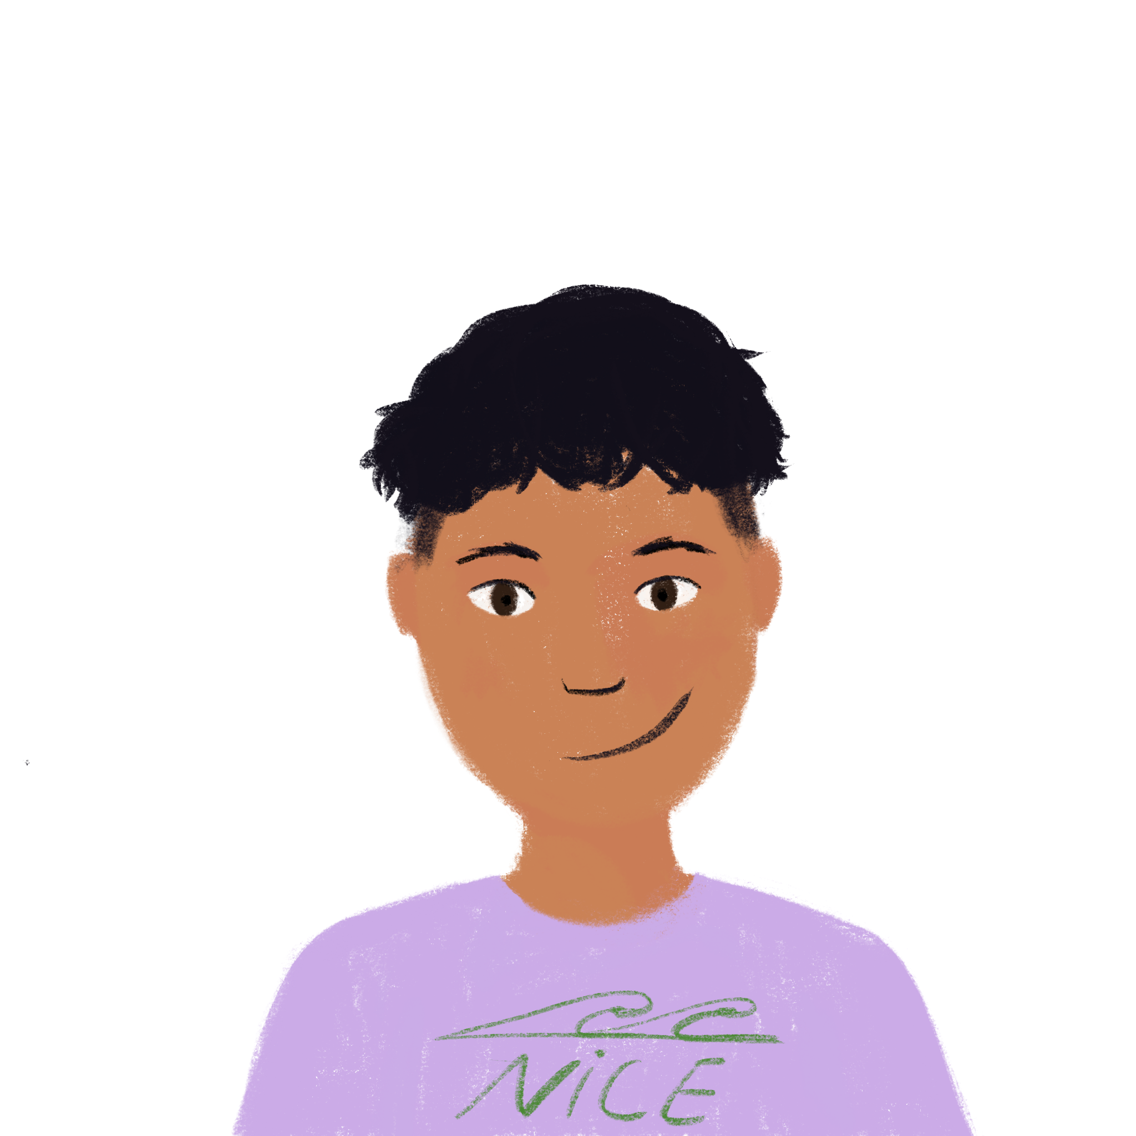
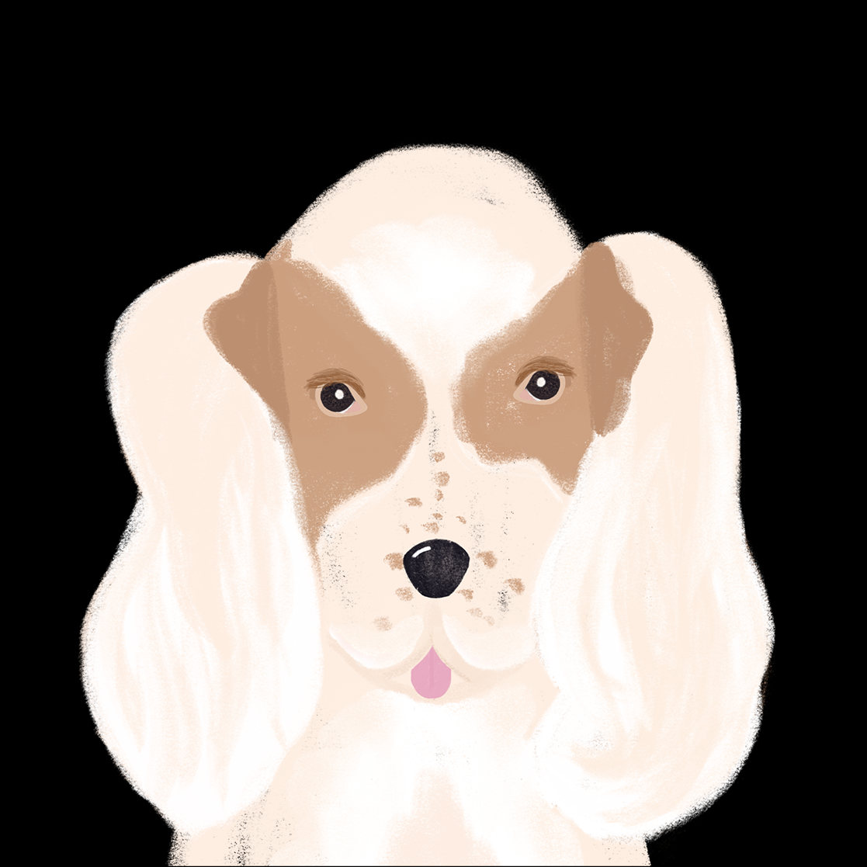
Qui dort où et quand ?
Qui dort où et quand ?
lire
Amir écrit où il dort, et où Apollon (le chien d’Amir) dort.
Qui dort où, et quand ? Coche Amir (je) ou Apollon (il).
 |  | Amir (je) | Apollon (il)
 | Souvent, il dort à la maison.
 | Quand il fait beau, il dort dehors.
 | Aujourd’hui, je dors dans ma chambre.
 | Parfois, je dors dans un hôtel.
 | Rarement, je dors dans le train.
 | En ce moment, il dort dans la voiture.
 | Normalement, il dort sous la fenêtre.
 | Le week-end, je dors sur la plage.
1
2
3
4
5
6
7
8
Notes:
Timing: 5 minutes
Aim: Written recognition of the singular forms of dormir, and connecting these with meaning.
Procedure:
Students write 1-8 and either je or il, using their knowledge of verb forms to help them.
Answers are revealed on clicks.
English translations can also be elicited, using the time phrases to choose between the present simple and continuous.

Slide 23
Grammaire: ne…pas
parler 1/8
Grammaire: ne…pas
grammaire
In English
In French
Je
parle
pas
Je parle
ne
I
speak
I speak
don’t
Add ne…pas
before and after the verb
before
Add don’t the verb
before after
Ne changes to n’ before a verb starting with a vowel.
For example: je n’aime pas [I don’t like]
Notes:
Timing: 2 minutes
Aim: Introduce ne…pas negation with single-verb structures and draw attention to differences between French and English negation structure.

Slide 24
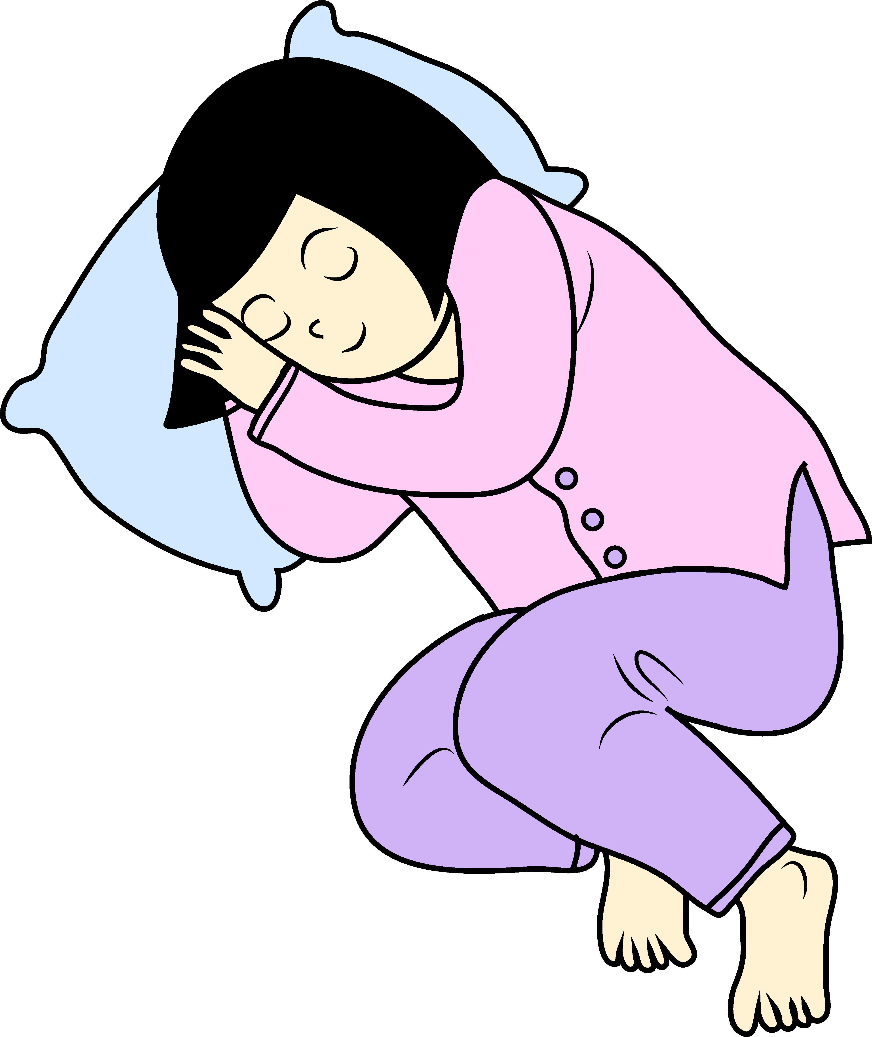
ne? pas? --?
parler 1/8
ne ? pas ? --?
lire
Phrase négative ou positive?
Où est ne? Où est pas? Où est (-)?
A
D
Elle
apprend
Elle
comprend
1
2
7
8
B
Il
ne
mange
pas
E
3
4
Elle
ne
dort
pas
9
10
C
Il
ne
marche
pas
F
5
6
Il
11
trouve
12
Notes:
Timing: 5 minutes
Aim: To raise awareness of the position of the negation elements on either side of verb. Intransitive verbs (no complement) only are used, to focus on position of negation either side of the verb and avoid over-burdening learner with a more complex sentence structure.
Procedure:
Students write down A-F, with the numbered items for each. A1 = , A2 =
Using the illustrations as a prompt, students decide whether the splodges hide ne, pas or nothing.
Then, for each statement, students decide whether splodges hide ‘ne’, ‘pas’ or ‘(-)’
Answers: splodges disappear one by one on clicks. Teachers can elicit the answers from students in French by asking e.g. ‘personne B: mange-t-elle?’ → students reply yes or no

Slide 25
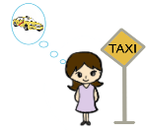
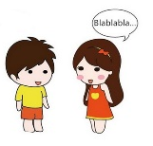
Parfois …
parler 1/8
Parfois …
écouter / écrire
Manon sometimes changes her mind about doing things! Écoute , coche (✔) ou (✖), écris en français.
activité | ✔ ou ✖ ? | français
1
✔
Parfois, j’apprends.
2
✖
Parfois, je ne comprends pas.
3
✔
Parfois, je viens.
4
✖
Parfois, je ne sors pas.
Parfois, je ne parle pas.
5
✖
Notes:
Timing: 5 minutes
Aim: Aural comprehension of affirmative and negative statements.
Procedure:
Go over the 5 pictures to recall/prompt verbs (apprendre, comprendre, venir, sortir, dire)
Gist listening: students complete column 2 with ✔ or ✖
students compare their results in pairs + justify their answer to each other (I heard/I didn’t hear ‘ne pas’),
teacher circulates to prompt justification
whole class correction (answers to column 2 appear on click)
3. Writing task based on detailed listening:
students write the answer from 2nd listening
students compare their results as above
whole class correction (answers to column 3 appear on click, 2 clicks per line (click 1: ‘parfois’, click 2: sentence)
Transcript
Parfois, j’apprends
Parfois, je ne comprends pas
Parfois, je viens
Parfois, je ne sors pas
Parfois, je ne parle pas

Slide 26
C’est vrai?
C’est vrai ?
lire / parler / écrire
Lis la description, trouve l’image. C’est vrai / ce n’est pas vrai? Écris la phrase correcte.
Elle ne dort pas.
Ce n’est pas vrai.
1
Il chante.
C’est vrai !
6
Elle dort.
Il ne mange pas.
Ce n’est pas vrai !
2
Ce n’est pas vrai.
Il parle.
Il ne parle pas !
Il mange.
7
How would you say ‘I don’t understand?’
Je ne comprends pas
3
Il regarde.
C’est vrai !
8
Elle écrit.
C’est vrai !
Elle ne joue pas.
4
Elle joue.
Ce n’est pas vrai.
9
Il travaille.
C’est vrai !
Il ne comprend pas.
Ce n’est pas vrai.
5
Il écoute.
C’est vrai !
10
Il comprend.
Notes:
Timing: 10 minutes
Aim: Written production of simple negative sentences with ne [verb] pas.
Suggested procedure
Teacher to draw attention to the fact that vrai comes after pas – i.e. ne and pas still surround the verb, pas is not necessarily the last thing in the sentence. This will prime students for the next lesson.
Teacher elicits responses (That’s true, That isn’t true) by making a statement about each picture. E.g., il chante.
Students respond orally, using c’est vrai or ce n’est pas vrai only at this stage. Answers appear on clicks.
Click to bring up the new task instruction, ‘Écris la phrase correcte.’
For the five statements which are not true, students write justifications using ne … pas. Answers appear on clicks.
Bring up the bubble which allows for introduction of classroom phrase ‘je ne comprends pas’.

Slide 27
Talking about what isn’t happening
Negation: ne…pas
(with single-verb structures)
SSC [oi] [revisited]
Y7 French
Term 3.1 - Week 4 - Lesson 56
Adeline Charlton / Natalie Finlayson/ Kirsten Somerville
Artwork by: Chloé Motard
Date updated: 16/08/21
Notes:
Artwork by Chloé Motard. All additional pictures selected are available under a Creative Commons license, no attribution required.
Learning outcomes (lesson 2):
Consolidation of SSC [oi]
Consolidation of ne…pas negation with single-verb structures
Word frequency (1 is the most frequent word in French):
7.3.1.4 (introduce) dormir [1836], dors [1836], dort [1836], bureau¹ [273], équipe [814], parfois [410], sous [112], sur [16]
7.3.1.1 (revisit) apprendre [327], comprendre [95], dire [37], dis [37], dit [37], prend [43], prendre [43], prends [43], erreur [612], vérité [907], facile [822]
7.2.2.1 (revisit) aller [53], va [53], vais [53], vas [53], caisse [1881], collège [2116], jour [78], parc [1240], poste [489], samedi [1355], train [232], où [48], comment ? [234], quand ? [119]
Source: Londsale, D., & Le Bras, Y. (2009). A Frequency Dictionary of French: Core vocabulary for learners London: Routledge.
Source: Londsale, D., & Le Bras, Y. (2009). A Frequency Dictionary of French: Core vocabulary for learners London: Routledge.
The frequency rankings for words that occur in this PowerPoint which have been previously introduced in NCELP resources are given in the NCELP SOW and in the resources that first introduced and formally re-visited those words.
For any other words that occur incidentally in this PowerPoint, frequency rankings will be provided in the notes field wherever possible.

Slide 28
Vocabulaire
parler 1/8
Vocabulaire
parler 1/2
3
[sometimes]
Secondes
le bureau
l’équipe
parfois
0
DÉBUT
Notes:
Timing 1 minute for 3 slides
Aim: Oral production of new vocabulary.
Procedure
1. Students all say 3 words before 3 seconds elapse
2. Click to reveal answers
3. Teacher can decide to repeat activity as s/he sees fit

Slide 29
Vocabulaire
parler 1/8
Vocabulaire
parler 2/2
3
Secondes
sur
dans
sous
0
DÉBUT

Slide 30
Vocabulaire - sur, dans, sous
parler 1/8
parler / écouter
Vocabulaire: sur, dans, sous
Partner B: describe where objects are on your desk using the correct prepositions.
Partner A: Ask your partner where things are on the desk
?
sur
sous
dans
Notes:
In-class version (NB: a home-learning version of this activity can be found on slides 34-37).
Timing: 10 minutes for three slides
Procedure:
1. Print copies of the accompanying worksheet for this task can be found on the portal alongside this resource. NB: worksheet contents = 2x answer grids, 2x different version of desks: partner B round 1 & 2. Single-sided printing.
2. Use this and the following slide to explain the task.
Round 1:
1 student (Partner A) asks where 10 items are on desk
1 student (Partner B) answers describing where 10 items are on desk
Round 2: Exchange roles
1 student (Partner B) asks where 10 items are on desk
1 student (Partner A) answers describing where 10 items are on desk
Correction – see slide 36

Slide 31
Sur, dans, sous? Exemple
parler 1/8
parler / écouter
Sur, dans, sous: exemple
Partner A:
Partner B:
Où est le train?
Le train est sous le bureau.
Notes:
Model Q&A
Teacher clarifies task for each partner
Partner A: Question formation
Partner B: Sentence formation, with particular attention paid to prepositions
Partner A: ticks preposition heard and writes sentence

Slide 32
Sur, dans, sous? Réponses
parler 1/8
Sur, dans, sous: réponses
parler / écouter
Round 1
Round 2
on
on
in
in
under
under
Notes:
ANSWERS
Correction procedure – Teacher displays desks for students to check their answers individually
‘Round 1’ desk displayed on left hand-side for Partner A to check where items were
‘Round 2’ desk displayed on right hand-side for Partner B to check where items were

Slide 33
Sur, dans, sous? Questions/Réponses Instructions et exemples
parler 1/8
parler / écouter
Sur, dans, sous: devoirs
Tick what you hear and write full answers.
Ask where things are on the desk.
 | objet | on, on top of | in, inside | under | Phrase de réponse
Here is an example question:
1
2
Où est le train?
3
4
Then, click on the numbers to listen to the descriptions of where things are on the desk.
5
6
7
Here is an example description:
Le train est sous le bureau.
8
9
10
Notes:
Home-learning version (NB: an in-class version of this activity can be found on slides 33-35).
Timing: 10 minutes for 4 slides
Transcript:
L’ordinateur est dans le bureau.
La règle est dans le bureau.
Le livre est sur le bureau.
Le cadeau est sous le bureau.
Le bateau est sur le bureau.
Le garçon est dans le bureau.
La fille est dans le bureau.
Le chien est dans le bureau.
Le train est sur le bureau.
Le vélo est sous le bureau.

Slide 34
Sur, dans, sous? Réponses
parler 1/8
Sur, dans, sous: devoirs
parler / écouter
Questions
Descriptions
on
Où est l’ordinateur?
Où est la règle?
Où est le livre?
Où est le cadeau?
Où est le bateau?
Où est le garçon?
Où est la fille?
Où est le chien?
Où est le train?
Où est le vélo?
L’ordinateur est dans le bureau.
La règle est dans le bureau.
Le livre est sur le bureau.
Le cadeau est sous le bureau.
Le bateau est sur le bureau.
Le garçon est dans le bureau.
La fille est dans le bureau.
Le chien est dans le bureau.
Le train est sur le bureau.
Le vélo est sous le bureau.
in
under
Notes:
Home-learning version (NB: an in-class version of this activity can be found on slides 31-33).
ANSWERS

Slide 35
Sur, dans, sous? Questions/Réponses Swap roles - Instructions et exemples
parler 1/8
parler / écouter
Sur, dans, sous: devoirs
1
2
3
4
5
6
7
8
9
10
Now swap roles:
Click on the numbers to listen to the questions asking where things are on the desk.
on
Here is an example of question:
Où est le train?
in
Then, answer the question by describing where things are on the desk.
Le train est sous le bureau.
Here is an example of description:
under
Notes:
Home-learning version (NB: an in-class version of this activity can be found on slides 31-33).
Transcript:
Où est l’ordinateur?
Où est la règle?
Où est le livre?
Où est le cadeau?
Où est le bateau?
Où est le garçon?
Où est la fille?
Où est le chien?
Où est le train?
Où est le vélo?

Slide 36
Sur, dans, sous? Réponses
parler 1/8
Sur, dans, sous: devoirs
parler / écouter
Questions
Descriptions
on
Où est l’ordinateur?
Où est la règle?
Où est le livre?
Où est le cadeau?
Où est le bateau?
Où est le garçon?
Où est la fille?
Où est le chien?
Où est le train?
Où est le vélo?
L’ordinateur est sous le bureau.
La règle est sur le bureau.
Le livre est dans le bureau.
Le cadeau est dans le bureau.
Le bateau est dans le bureau.
Le garçon est sur le bureau.
La fille est sur le bureau.
Le chien est sous le bureau.
Le train est dans le bureau.
Le vélo est sur le bureau.
in
under
Notes:
Home-learning version (NB: an in-class version of this activity can be found on slides 31-33).
ANSWERS

Slide 37
Négation
Négation
grammaire
after
To say that we do not do something, we add ne…pas before and after the verb.
before
In front of a vowel ne → n’
For example: Je n’aime pas
Je ne parle pas.
n
n
If the sentence is longer and contains more words after the verb, keep the same structure:
Spot the verb
Place ne…pas before and after the verb
Continue the sentence
What happens if pas comes before a vowel?
Je ne vais pas au collège.
Similar to:
je → j’ j’aime
le → l’ l’ami
ce → c’ c’est
Je ne vais pas au collège samedi.
ne
pas
n
n
Notes:
Timing: 2 minutes
Aim: Consolidation of ne…pas negation structure in longer sentences. Introducing morphology (word formation)/spelling changes preceding a vowel
Procedure:
This slide revisits lesson 1 negation structure in longer sentences teaching students that the structure remains the same (i.e. placing ne …pas around the verb) no matter the length of the sentence.
Bubbles alert to changes to the morphology of ‘ne’ when preceding a vowel → n’, similar to other –e ending words such as je, le, ce.
The last bubble reminds students of liaison, which is the focus of the next six slides.

Slide 38
Vocabulaire
La liaison avec ‘ne…pas’
écouter / parler
La liaison avec ‘ne…pas’
Tu ne vas pas à l'école.
You don’t go / aren’t going to school.
Notes:
Timing: 3 minutes for 6 slides
Aim: Pronunciation practice with ‘ne…pas’ + liaison.
Procedure:
1. Listen and repeat.
2. Ask students to translate the sentence.
3. Reveal picture on a click, ask students to check their translations.
4. Reveal English translation on click.

Slide 39
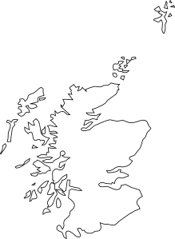
Vocabulaire
La liaison avec ‘ne…pas’
écouter / parler
La liaison avec ‘ne…pas’
La liaison avec ‘ne…pas’
Je n'habite pas en Écosse..
I don’t live / am not living in Scotland.

Slide 40
Vocabulaire
La liaison avec ‘ne…pas’
écouter / parler
La liaison avec ‘ne…pas’
Nous n'aimons pas écouter la radio.
We don’t like listening to the radio.

Slide 41
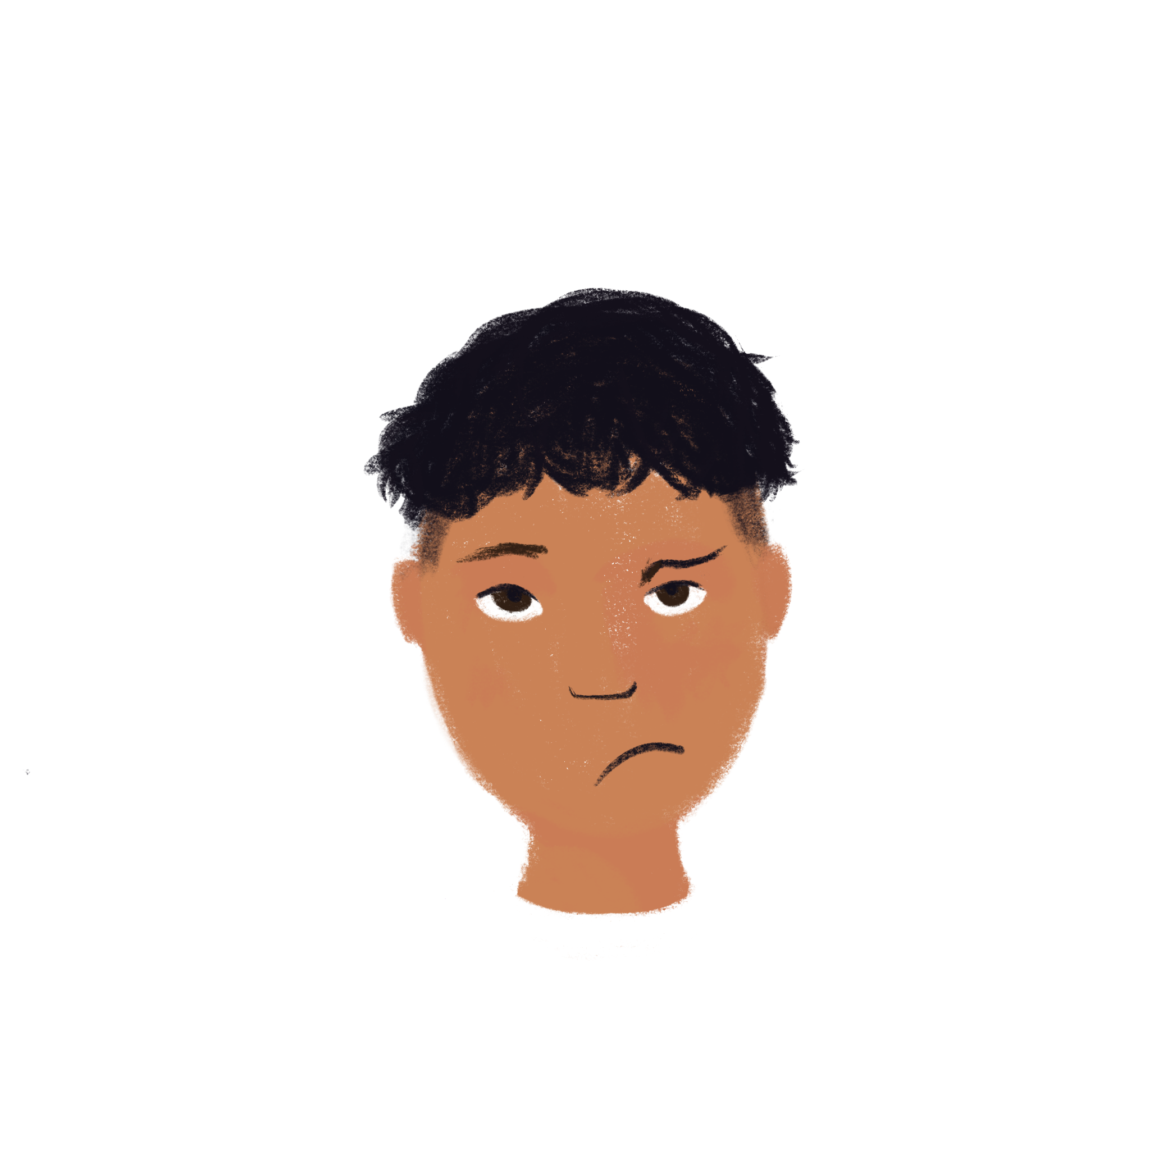
Vocabulaire
La liaison avec ‘ne…pas’
écouter / parler
La liaison avec ‘ne…pas’
La situation n'est pas amusante.
The situation isn’t funny.

Slide 42
Vocabulaire
La liaison avec ‘ne…pas’
écouter / parler
La liaison avec ‘ne…pas’
Elle ne fait pas attention.
She doesn’t pay / isn’t paying attention.

Slide 43
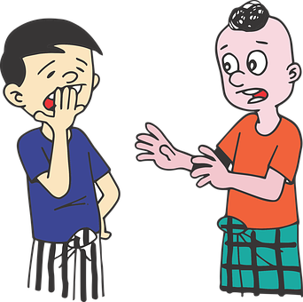
Vocabulaire
La liaison avec ‘ne…pas’
écouter / parler
La liaison avec ‘ne…pas’
Ce n'est pas intéressant.
It’s not interesting.

Slide 44
Que ne font-ils pas?
Que ne font-ils pas ?
lire
Que dit Amir?
est
1
Tu n’aimes pas le parc.
aimes ou fermes?
estv
2
Elle ne parle pas anglais.
parle ou apprend?
3
Ce n’est pas beau.
fait ou est?
Note: c’→ ce: ce n’est
estv
4
Je n’ai pas le temps.
prends ou ai?
Note: j’→ je: je n’ai
5
Nous n’allons pas à l’étranger.
est
travaillons ou allons?
est
6
Je ne vais pas en vacances samedi.
vais ou arrive?
7
Elles n’ont pas un uniforme rouge.
est
ont ou portent?
Notes:
Timing: 5 minutes
Aim: Written recognition of negation with morphology/spelling changes, and connecting the presence or absence of these with meaning.
Procedure
1.Remind students that the presence or absence of the apostrophe tells them whether the missing verb starts with a vowel or a consonant.
2.Students write 1-8 and the appropriate vowel. 3. Then teachers elicit full sentence answers from students in French, and display answers one by one. Correct verb appears on clicks. This ensures that students practise producing both the full and contracted forms of ne/n’ in sentences. 4. Teachers also elicit the English meanings of each sentence, as they proceed. Extension: With more proficient classes or individual students, it may be possible to elicit the alternative French sentences from students, and their English translations, too. e.g., 1. Tu ne fermes pas le parc. You are not shutting/closing the park.
5. Speech bubbles alert to apostrophe changes:
Sentence No3: re-establishment of ‘e’ in ‘ce’ as it is no longer in front of a vowel.
Sentence No4: re-establishment of ‘e’ in ‘je’ as it is no longer in front of a vowel.

Slide 45
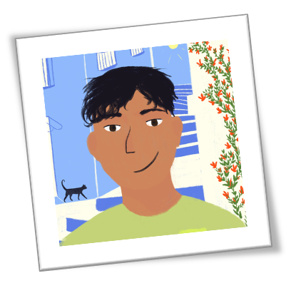
Ne … pas ou _ ?
parler 1/8
lire
Ne…pas ou -- ?
Lis et décide le reste de la phrase (1 – 2?)
Souvent, je ne vais… | …aux Etats-Unis. | …pas aux Etats-Unis.
Normalement, j’écoute | …le rap. | …pas le jazz.
Parfois, je ne viens… | …avec ma famille. | …pas en France.
Rarement, ma famille va… | …en vacances à l’étranger. | …pas en France.
Souvent, je dors… | …très bien. | …pas très bien.
Parfois, c’est… | …facile. | …pas facile.
A
1
2
B
1
2
C
1
2
D
1
2
E
1
2
F
1
2
Notes:
Timing: 5 minutes
Aim: Written recognition of affirmative and negative sentence structure.
Procedure
Students write A-F and choose sentence ending 1 or 2, using their knowledge of affirmative and negative sentence structure to inform them.
Students pair-compare + justify their answers (do they see ‘ne’ in the first half of the sentence?) and amend accordingly.
Elicit choral answers.
Word frequency (1 is the most frequent word in French): jazz [>5000]
Source: Londsale, D., & Le Bras, Y. (2009). A Frequency Dictionary of French: Core vocabulary for learners London: Routledge.

Slide 46
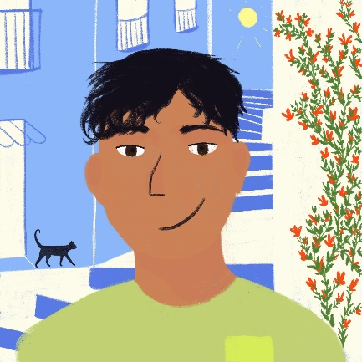
Ne … pas ou _ ?
écouter
Ne…pas ou -- ?
Lis et décide le reste de la phrase (1 – 2?)
 | …strict avec mes frères. | …pas calme avec mes frères.
 | …sages. | …pas méchants.
 | …la fête. | …pas le ménage.
 | …un tour au parc. | …la cuisine.
 | …regarde la télé. | …pas les magasins.
 | …la vérité. | …pas la vérité.
A
1
2
B
1
2
C
1
2
D
1
2
E
1
2
F
1
2
Notes:
Timing: 5 minutes.
Aim: Aural recognition of affirmative and negative sentence structure.
Procedure
Click on a letter to hear the first half of an affirmative or negative sentence.
Students write A-F and choose sentence ending 1 or 2, using their knowledge of affirmative and negative sentence structure to inform them.
Students pair-compare + justify their answers (did they hear ‘ne’ in the first half of the sentence?) and amend accordingly.
Elicit choral answers.
Full sentence can be found on the next slide.
Transcript
Souvent je suis [strict avec mes frères].
Normalement ils sont [sages].
Souvent ils ne font [pas le ménage].
Rarement nous faisons [un tour au parc].
Souvent la famille ne fait [pas les magasins].
Parfois ce n’est [pas la vérité].

Slide 47
Ne … pas ou _ ? Réponses
écouter
Ne…pas ou -- ? réponses
Lis et décide le reste de la phrase (1 – 2?)
 | …strict avec mes frères. | …pas calme avec mes frères.
 | …sages. | …pas méchants.
 | …la fête. | …pas le ménage.
 | …un tour au parc. | …pas d’exercice.
 | …regarde la télé. | …pas les magasins.
 | …la vérité. | …pas la vérité.
A
1
2
B
1
2
C
1
2
D
1
2
E
1
2
F
1
2
Notes:
Answers to the activity on the previous slide. Full sentence play on letter clicks.
Transcript
Souvent je suis strict avec mes frères.
Normalement ils sont sages.
Souvent ils ne font pas le ménage.
Rarement nous faisons un tour au parc.
Souvent la famille ne fait pas les magasins.
Parfois ce n’est pas la vérité.

Slide 48
Elle est comment? Il est comment?
Il/Elle est comment ?
écrire / parler / écouter
Student A: Dis une description de l’artiste.
Exemples :
✓ + manger des carottes → Elle mange des carottes.
✗ + regarder la télé → Elle ne regarde pas la télé.
_________________________
_________________________
Student B: Ecoute, coche (✓) et écris la description. Exemples :
✓ + manger des carottes → Elle mange des carottes.
✗ + regarder la télé → Elle ne regarde pas la télé.
1. | manger des carottes | ✓ |  | Elle mange des carottes.
2. | regarder la télé |  | ✓ | Elle ne regarde pas la télé.
Notes:
In-class version (NB: a home-learning version of this activity can be found on slides 51-52).
Timing: 10 minutes
Aim: Oral production and aural comprehension of affirmative and negative sentences.
Procedure:
1. Print copies of the accompanying worksheet for this task, which can be found on the portal alongside this resource. Print once, cut widthways. Contents = two grids for describing, two grids for asking/writing. One top grid and one bottom grid for each student.
2. Student A says the appropriate positive or negative sentence in the 3rd person singular from the cues/phrases in the infinitive. Teacher can use this slide to practise eliciting sentences from a positive and negative prompt.
3. Student B listens, and ticks the correct information (i.e. puts a ✓ for affirmative and a ✗ for negative statements) and transcribes what Student A says. At more advanced levels, student B can transcribe the sentence in full. 4. Continue until all phrases are completed.
5. Swap roles.
6. Peer-correct answers.
7. Teacher displays whole sentence for whole class correction.
Word frequency of cognates used (1 is the most frequent word in French): sexisme [>5000]
Source: Londsale, D., & Le Bras, Y. (2009). A Frequency Dictionary of French: Core vocabulary for learners London: Routledge.
Disclaimer: all facts true to our knowledge, source: Wikipedia.fr

Slide 49
Elle est comment? Il est comment?
Il/Elle est comment ?
écouter / parler
Gims
Angèle
Elle est chanteuse.
Elle n’est pas française.
Elle vient de l’étranger.
Elle a un frère.
Elle est sur Instagram.
Elle n’aime pas le sexisme.
Elle travaille en France.
Elle est jeune.
Elle ne chante pas en Angleterre.
Il est chanteur.
Il chante le rap.
Il n’est pas jeune.
Il parle français.
Il n’est pas français.
Il n’habite pas à Londres.
Il habite à Paris.
Il écoute Eminem.
Il crée des vêtements.
Notes:
Answers to activity

Slide 50
Elle est comment? Il est comment?
parler
Il/Elle est comment ?
Check your pronunciation by clicking on the arrows.
Avec la liste de verbes, dis une description de l’artiste.
Exemples :
✓ + manger des carottes → Elle mange des carottes.
✗ + regarder la télé → Elle ne regarde pas la télé.
✓ être chanteuse
✗ être française
✓ venir de l’étranger
✓ avoir un frère
✓ être sur Instagram
✗ aimer le sexisme
✓ travailler en France
✓ être jeune
✗ chanter en Angleterre
Elle est chanteuse.
Elle n’est pas française.
Elle vient de l’étranger.
Elle a un frère.
Elle est sur Instagram.
Elle n’aime pas le sexisme.
Elle travaille en France.
Elle est jeune.
Elle ne chante pas en Angleterre.
Elle ne chante pas en Angleterre
Notes:
Home-learning version (NB: an in-class version of this activity can be found on slides 49-50).
Transcript:
Elle est chanteuse.
Elle n’est pas française.
Elle vient de l’étranger.
Elle a un frère.
Elle est sur Instagram.
Elle n’aime pas le sexisme.
Elle travaille en France.
Elle est jeune.
Elle ne chante pas en Angleterre.

Slide 51
Elle est comment? Il est comment?
Il/Elle est comment ?
écouter / écrire
1. Écoute et coche les descriptions de l’artiste.
2. Écris la description de l’artiste.
Now swap roles
 | ✓
 | ✓
 |  | ✓
 | ✓
 |  | ✓
 |  | ✓
 | ✓
 | ✓
 | ✓
être chanteur
chanter le rap
être jeune
parler français
être français
habiter à Londres
habiter à Paris
écouter Eminem
créer des vêtements
Il est chanteur.
Il chante le rap.
Il n’est pas jeune.
Il parle français.
Il n’est pas français.
Il n’habite pas à Londres.
Il habite à Paris.
Il écoute Eminem.
Il crée des vêtements.
__________________________
__________________________
__________________________
__________________________
__________________________
__________________________
__________________________
__________________________
__________________________
Notes:
Home-learning version (NB: an in-class version of this activity can be found on slides 49-50).
Transcript
Il est chanteur.
Il chante le rap.
Il n’est pas jeune.
Il parle français.
Il n’est pas français.
Il n’habite pas à Londres.
Il habite à Paris.
Il écoute Eminem.
Il crée des vêtements.

Slide 52
Interview
Interview
écrire
Écris en français les questions-réponses de l’interview d’Abdel, le cousin d’Amir.
Hello, how are you?
When do you go to school?
I don’t go to school! I go to university.
Do you work?
Yes, I work.
Where and which day do you work?
I work at the post office on Saturdays.
What do you do?
I am at the till.
How are you sleeping at the moment?
Very well. I go on a journey every day and I sleep on the train.
Bonjour, ça va ?
Quand vas-tu au collège ?
Je ne vais pas au collège, je vais à l’université.
Travailles-tu ?
Oui, je travaille.
Tu travailles où et quel jour ?
Je travaille à la poste le samedi.
Tu fais quoi ?
Je suis à la caisse.
Comment dors-tu en ce moment ?
Très bien. Je fais un voyage chaque jour et je dors dans le train.
Notes:
Timing: 10 minutes
Aim: Written production of words in this week’s revisited vocabulary set. Revision of question formation.
Suggested procedure
Students translate the questions and answers in paris.
Teachers can elicit answers from students by asking ‘en français?’
Suggested translations revealed on clicks. NB: The answers on the slides are suggested translations only. Alternative, correct translations from students should be encouraged and accepted. In particular, remind students of the various types of question formation. Accepted alternatives for questions translations include:
2. Tu vas au collège quand?
4. Tu travailles?
5. Où et quel jour travailles-tu?
6. Que fais-tu?
10. Tu dors comment en ce moment?

Slide 53
Gaming Grammar
Gaming Grammar
Relevant mini game(s):
Verbs (present): 1st person singular/plural (Verb agreement (present))
Verbs (present): 2nd person singular/plural (Verb agreement (present))
Verbs (present): 3rd person singular/plural (Verb agreement (present))
Notes:
This slide links to Gaming Grammar login screen. The appropriate mission can then be selected from the menu page.
Students will progress through the game at their own rate; teachers should use the teacher interface to check progress. This will help to inform future lesson planning.

Slide 54
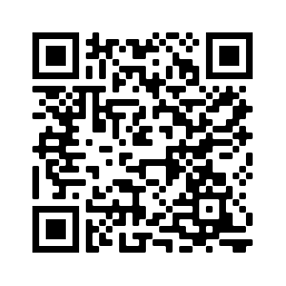
Devoirs
Vocabulary Learning Homework (Term 3.1, Week 5)
Audio file
Audio file QR code:
Student worksheet
Quizlet link
In addition, revisit: Term 3.1 Week 1
Term 2.2 Week 1

