Slide 1
German Vocabulary Learning Sequence
Unterwegs [On the road]

Slide 2
Stages of vocabulary learning
Topic-based vocabulary lists of one single word class are not optimal.
Introduction (i.e. first encounters with new words, and initial memorisation routines)
Consolidation (i.e. speed of retrieval building, controlled production, e.g. sentence-building)
Developing use (i.e. revisiting across different contexts, modalities, synthesising with previously-learnt language)
Assessment
Inge Alferink

Slide 3
First encounters
Directed, pre-learning (e.g. using Quizlet)
Peer- / Self-introduction in the lesson
Teacher-led presentation and elicitation (e.g. with pictures)
Self-made flashcard routines
Text / mini-story-based introduction
Inge Alferink

Slide 4
Unterwegs [On the road]
 | Word | Frequency ranking | Part of speech
1 | das Auto | 490 | noun
2 | der Zug | 613 | noun
3 | spät | 171 | adjective
4 | schnell | 233 | adjective
5 | langsam | 604 | adjective
6 | fahren | 169 | verb
7 | das Fahrrad | 1596 | noun
8 | nehmen | 139 | verb
9 | oft | 215 | adverb
10 | die Stadt | 186 | noun
Inge Alferink
Notes:
This is the slide of 10 words pupils are going to learn.
Note the mixed word class selection, and the frequency (all well within the top 2000 more frequently occurring words in German).

Slide 5
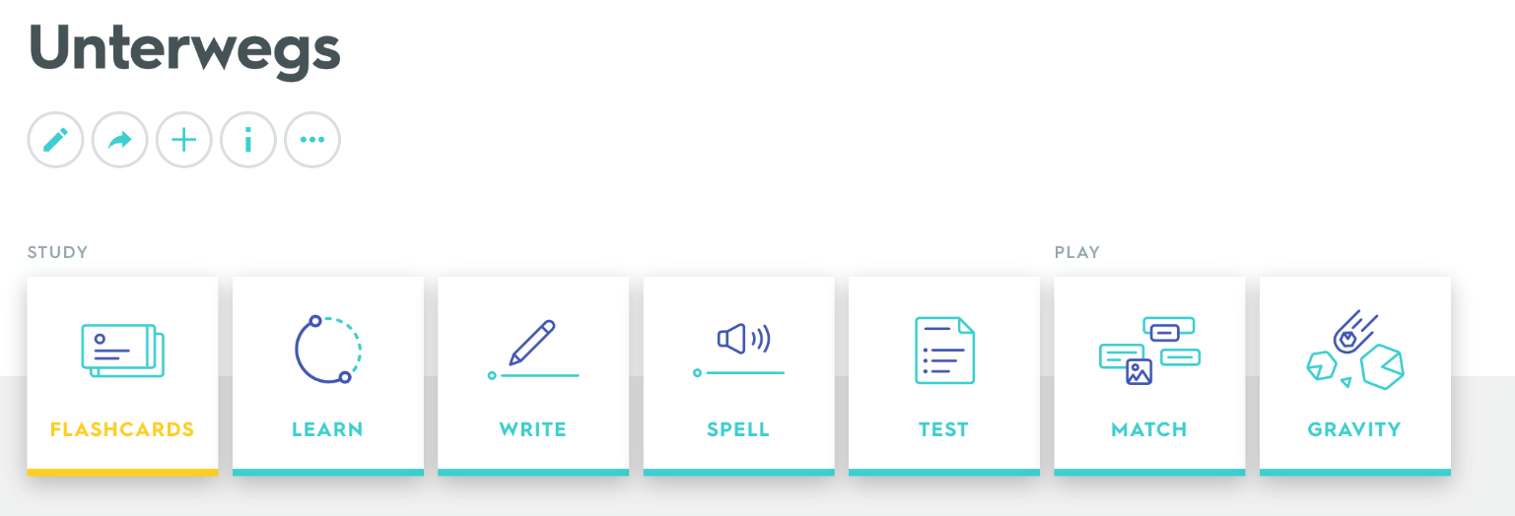
1. Quizlet
Mach den Teil LEARN
Ziel: ‘Mastered’ für alle Wörter
link to flashcards
Inge Alferink
Notes:
Pupils are given a 30-minute pre-learning homework. They need some guidance and instruction about how to use Quizlet. 1. For pre-learning spend 30 minutes on LEARN 2. Objective is to get ‘Mastered’ in all of the words 3. Have the audio audible (either headphones or out loud if you are working alone)
4. Vocalise the words as well as looking at them. Don’t just do this silently in your head – get into the habit of saying the words out loud when you learn

Slide 6
2. Peer or self introduction
60
 | Word | English meaning
1 | das Auto | car
2 | der Zug | train
3 | spät | late
4 | schnell | fast
5 | langsam | slow
6 | fahren | to drive
7 | das Fahrrad | bicycle
8 | nehmen | to take
9 | oft | often
10 | die Stadt | city
Sekunden
0
ANFANG
Inge Alferink
Notes:
2. Peer or self-introduction Pupils either work by themselves or in pairs, reading out the words and studying their English meaning (1 minute). Then the English meanings are removed and they try to recall them, looking at the German(1 minute). Then the German meanings are removed and they to recall them, looking at the English (1 minute) NB: It is not expected that they will be able to do them all. However, in a mixed ability class, some pupils will come close to being able to do this, whilst others may just manage one or two. It is important to have open-ended routines for first encounters of new words, where learners are ‘self-serving’, as it prevents the frustration hat can be caused by a mismatched pace of presentation.
Further rounds of learning can be facilitated by one pupil turning away from the board, and his/her partner asking him/her the meanings. This activity can work from L2 → L1 or L1 → L2.

Slide 7
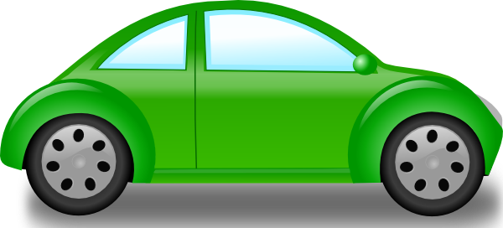
3. Teacher-led presentation
das Auto
Inge Alferink
Notes:
Teacher presentation
Here the teacher is the source of the input, and presents the written form of the word, says the spoken form and displays a picture. As there is no English in this presentation, it’s important to check that pupils are completely clear about the meanings of these new words. If they are unclear about the meaning, this may delay the learning.

Slide 8
der Zug
Inge Alferink / Pictures – Steve Clarke

Slide 9
spät
Inge Alferink / Pictures – Steve Clarke

Slide 10
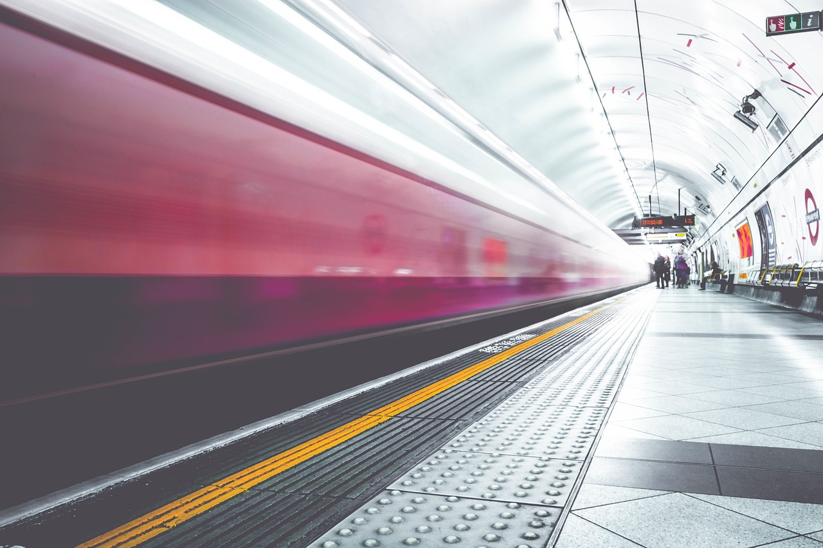
schnell
Inge Alferink

Slide 11
langsam
Inge Alferink

Slide 12
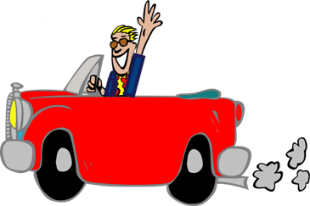
fahren
[to drive, ride / driving, riding]
fährt
[drives, rides / is driving, riding]
Inge Alferink / Rachel Hawkes

Slide 13
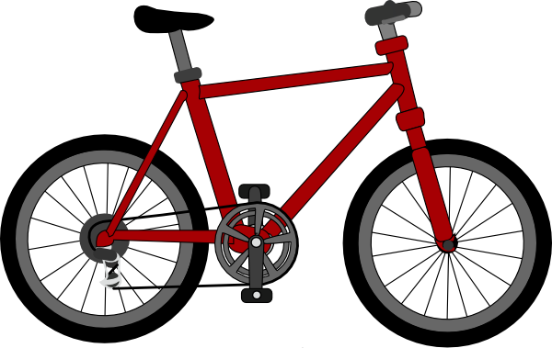
das Fahrrad
Inge Alferink

Slide 14
nehmen
[to take / taking]
nimmt
[takes / is taking]
Inge Alferink / Rachel Hawkes

Slide 15
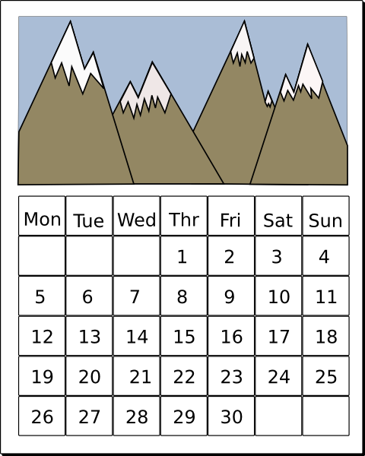
Mo.
Di.
Mi.
Do.
Fr.
Sa.
So.
oft

Slide 16
die Stadt
Inge Alferink

Slide 17
4. Self-made flashcard routines
Pupils create their own paper flashcards (English on one side, German on the other)
Beginning with German side facing up, read the word aloud and turn it over to see the meaning
Repeat 2-3 times with each word, then move to the next one
After the third word, re-visit the first and second words and try to recall their meaning
Build up until all words have been practised
Inge Alferink
Notes:
Additional details: Learners can work in pairs to do this routine. There are many uses for these paper flashcards, also in the consolidation phase. 1) in pairs, pelmanism (not guessing of course, but working from English to German – have to say the words correctly to claim the pair) 2) in fours, happy families – Hast du ‘die Stadt’ 3) listening tasks – one partner calls out the words in German, the other has to put his/her cards in the correct order (when viewing English side up) 4) sentence-building tasks – take two at random and put them into a sentence (can be written or spoken)

Slide 18
5. Text / Story presentation
Unterwegs Ich kann jetzt Auto fahren und das ist toll! Ich liebe mein Fahrrad, aber es ist langsam. Ich nehme manchmal auch den Zug und fahre in die Stadt. Der Zug ist normalerweise schnell, aber oft zu spät.
Inge Alferink
Notes:
Formatting here shows the ‘target words’ to be learned. Routine might be used either as very first encounter or after one of the methods 1,2 or 4: 1) Pupils read aloud (either for themselves or in pairs) as decoding task – teacher circulates to listen in 2) Teacher reads aloud, emphasising meaning through intonation and, where appropriate, gestures to support meaning. 3) Teacher elicits meaning of the key words from pupils (elicits meaning of the verb forms and relates them back to the infinitive 4) One pupil can read aloud, partner put his/her paper flashcards in order. 5) Pupils read and draw their understanding of the text in a picture.

Slide 19
Consolidation
Individual word level tasks (e.g. L1:L2 table completion, Look-Say-Cover-Write-Check)
Listening tasks
Sentence-completion tasks
Sentence-level production tasks
Inge Alferink

Slide 20
1a) Give the meanings of the following words:
eg | der Bus | bus | p
1 | das Auto |  |  | 6 | fahren
2 | die Stadt |  |  | 7 | schnell
3 | der Zug |  |  | 8 | das Fahrrad
4 | nehmen |  |  | 9 | spät
5 | oft |  |  | 10 | langsam
Inge Alferink

Slide 21
1a) Give the correct German spellings
(with the definite article (der/die/das), if needed,) for the following words:
e.g. | train | der | Zug | p | p
1 | city
2 | fast
3 | to take
4 | car
5 | late
6 | to drive
7 | the bike
8 | slow
9 | often
Inge Alferink

Slide 22
2) Listening: Individual words
1
2
3
4
5
6
7
8
9
10
Inge Alferink
Notes:
Pupils are looking away anyway, but if desired, this slide can be hidden, so pupils cannot see which number the teacher is clicking (because s/he will repeat the words several times).
1 individual words recorded
Use these in conjunction with the self-made flashcards, in several ways. First, pupils look at German side facing up, and when they hear the word, they just turn it over to the English side (simple recognition). The turn it back. Second, pupils look at English side facing up and select the correct card in response to what they hear [individual words]. Then turn it back.
Transcript
das Auto
der Zug
spät
schnell
langsam
fahren
das Fahrrad
nehmen
oft
die Stadt

Slide 23
2) Listening: Sentences 1a
1
2
3
4
5
6
Inge Alferink
Notes:
2 Sentences recorded [I suggest 3 x sets of 6 sentences for each bunch of 10 words] SET 1a Third, with German side up, pupils hear sentences with 2-3-4 of the items in them and they place them down in order – this might sound easy, but remember they will be seeing the infinitive, but hearing the short form, so there is still some significant processing to do (plus the fact that you will have several items together in an order, so not as easy as it might seem).
Fourth, a bingo game. Pupils place 6 of their cards English side up in a 3 x 2 formation and they turn them to German when they hear the word called. Winner is i) a complete row then ii) a full house. Fifth, with English side up, pupils listen to a set of sentences containing 2-4 of the items and have to put them in order. E.g. Der Zug fährt schnell (they would need to place ‘train’, then ‘to travel’ then ‘fast’. This is challenging - (sentences will be slow and careful), but it will be useful to have them recorded at 3 different speeds! I normally do this just with my voice).
TRANSCRIPT 1 Der Zug fährt schnell.
2 Er nimmt oft das Fahrrad.
3 Das Auto fährt langsam.
4 Der Zug ist oft spät.
5 Sie fährt in die Stadt.
6 Sie nimmt den Zug.

Slide 24
2) Listening: Sentences 1b
1
2
3
4
5
6
Inge Alferink
Notes:
1 Er fährt langsam Fahrrad.
2 Der Zug fährt in die Stadt.
3 Das Auto fährt schnell.
4 Sie nimmt oft den Zug.
5 Sie fährt in die Stadt.
6 Sie kann Auto fahren.
2 Sentences recorded [Suggestion: 3 x sets of 6 sentences for each bunch of 10 words] SET 1b Third, with German side up, pupils hear sentences with 2-3-4 of the items in them and they place them down in order – this might sound easy, but remember they will be seeing the infinitive, but hearing the short form, so there is still some significant processing to do (plus the fact that you will have several items together in an order, so not as easy as it might seem).
Fourth, a bingo game. Pupils place 6 of their cards English side up in a 3 x 2 formation and they turn them to German when they hear the word called. Winner is i) a complete row then ii) a full house. Fifth, with English side up, pupils listen to a set of sentences containing 2-4 of the items and have to put them in order. E.g. Der Zug fährt schnell (they would need to place ‘train’, then ‘to travel’ then ‘fast’. This is challenging - (sentences will be slow and careful), but it will be useful to have them recorded at 3 different speeds! I normally do this just with my voice).

Slide 25
2) Listening: Sentences 1c
1
2
3
4
5
6
Inge Alferink
Notes:
1 Sie fährt schnell Fahrrad.
2 Nimmt sie den Zug?
3 Der Zug fährt langsam.
4 Er nimmt oft das Auto.
5 Er nimmt das Fahrrad.
6 Ist der Zug oft zu spät?
2 Sentences recorded [Suggestion: 3 x sets of 6 sentences for each bunch of 10 words] SET 1c
Third, with German side up, pupils hear sentences with 2-3-4 of the items in them and they place them down in order – this might sound easy, but remember they will be seeing the infinitive, but hearing the short form, so there is still some significant processing to do (plus the fact that you will have several items together in an order, so not as easy as it might seem).
Fourth, a bingo game. Pupils place 6 of their cards English side up in a 3 x 2 formation and they turn them to German when they hear the word called. Winner is i) a complete row then ii) a full house. Fifth, with English side up, pupils listen to a set of sentences containing 2-4 of the items and have to put them in order. E.g. Der Zug fährt schnell (they would need to place ‘train’, then ‘to travel’ then ‘fast’. This is challenging - (sentences will be slow and careful), but it will be useful to have them recorded at 3 different speeds! I normally do this just with my voice).

Slide 26
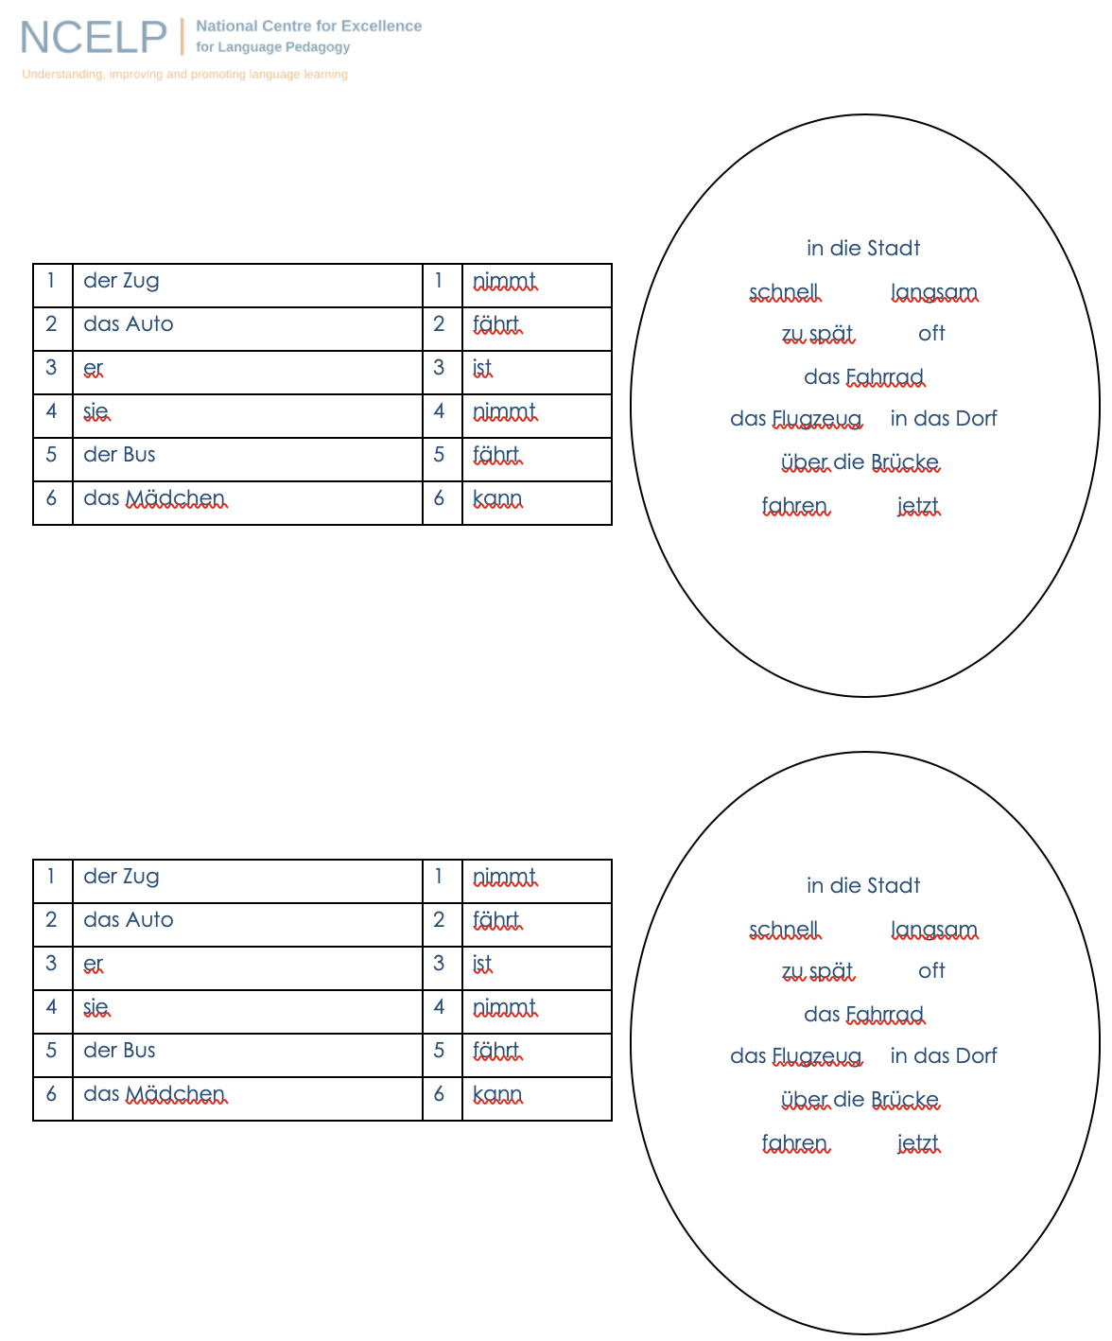
German
Sentence-level production tasks [1]
German Blank Template
 | Word | Frequency ranking | Part of speech
1 | das Auto | 490 | noun
2 | der Zug | 613 | noun
3 | spät | 171 | adjective
4 | schnell | 233 | adjective
5 | langsam | 604 | adjective
6 | fahren | 169 | verb
7 | das Fahrrad | 1596 | noun
8 | nehmen | 139 | verb
9 | oft | 215 | adverb
10 | die Stadt | 186 | noun
11 | der Bus | 1580 | noun
12 | das Mädchen | 537 | noun
13 | das Flugzeug | 1395 | noun
14 | das Dorf | 682 | noun
15 | die Brücke | 2062 | noun
16 | jetzt | 62 | adverb
Inge Alferink
Notes:
Teacher Notes
Player A rolls the dice to generate 1) a place and 2) a verb. They then choose a word from the oval to finish their sentence. Each word from the oval can only be used once. Players keep a tally of their correctly formed sentences. Once a word is used it can be crossed out. As the number of possible words decreases, players may have to ‘knock’ if there is no appropriate word to finish their sentence. In this case, play passes to their partner. E.g. Player A throws 1) der Zug and 2) fährt but there are only nouns remaining. No correct sentence can be formed and play passes to the Player B. The player who is able to make the most sentences within the time or until all the words run out is the winner.
You could use up to 11 places by using 2 dice together – in that case, just no number one and add extra rows to the first column.
The sheets could be laminated so that players could cross out the words but then wipe clean the sheets and re-use.
[NB: introduce some new vocabulary items / contexts]

Slide 27
Sentence-level production tasks [2]
1
fahren / der Zug
2
schnell / das Auto
3
der Zug / spät
4
das Fahrrad / langsam
5
nehmen / die Stadt
Inge Alferink
Notes:
Give two words – pupils create sentences

Slide 28
Developing use
Build in new vocabulary (additional nouns, adjectives, verbs)
Spot the difference
Map task
Other information gap tasks
Inge Alferink

Slide 29
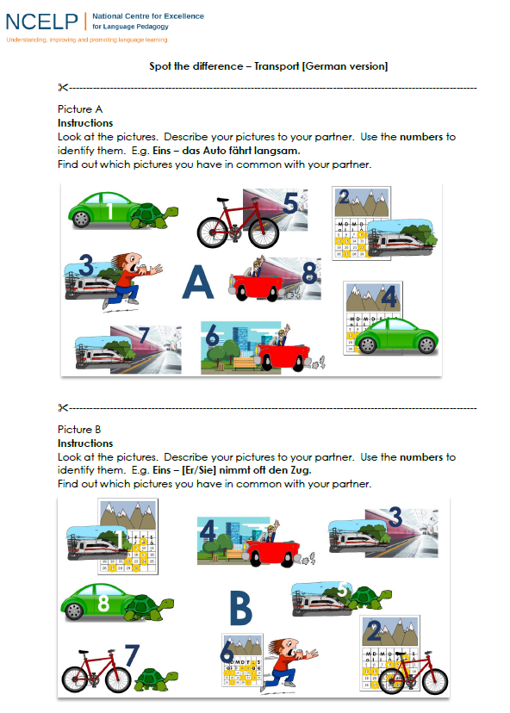
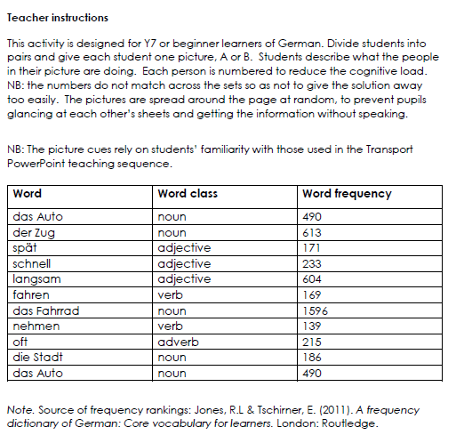
Spot the difference
Inge Alferink

Slide 30
5
2
1
1
Mo.
Di.
Mi.
Do.
Fr.
Sa.
So.
3
A
8
4
6
Mo.
Di.
Mi.
Do.
Fr.
Sa.
So.
7
3
Inge Alferink / Rachel Hawkes
Notes:
Handout: with the resources handouts
A collaborative information gap exercise to practise the verbs introduced in the 15 concrete verbs PowerPoint resource/
Work in pairs.
Pupils each have a set of pictures and ask each other questions about what is in their pictures in order to find out which pictures occur in both sets.
Each picture/ person is numbered in order to reduce cognitive load and focus attention on verbs rather than nouns.
For example, Eins schläft.
NB. the numbers do not match across the sets so as not to give the solution away that way.
Bold text shows the pictures in common
1. Eins – das Auto fährt langsam. 2. Zwei nimmt oft den Zug 3. Drei - der Zug kommt zu spät. 4. Vier nimmt oft das Auto. 5 Fünf – das Fahrrad fährt schnell. 6 Sechs fährt in die Stadt. 7 Sieben der Zug fährt schnell
8 Acht das Auto fährt schnell

Slide 31
3
4
1
Mo.
Di.
Mi.
Do.
Fr.
Sa.
So.
B
5
8
2
7
6
Mo.
Di.
Mi.
Do.
Fr.
Sa.
So.
3
Mo.
Di.
Mi.
Do.
Fr.
Sa.
So.
Inge Alferink / Rachel Hawkes
Notes:
Handout: with the resources handouts
A collaborative information gap exercise to practise the verbs introduced in the 15 concrete verbs PowerPoint resource/
Work in pairs.
Pupils each have a set of pictures and ask each other questions about what is in their pictures in order to find out which pictures occur in both sets.
Each picture/ person is numbered in order to reduce cognitive load and focus attention on verbs rather than nouns.
For example, Eins schläft.
NB. the numbers do not match across the sets so as not to give the solution away that way.
Bold type shows the three pictures in common.
1. Eins nimmt oft den Zug. 2. Zwei fährt oft Fahrrad. 3. Drei - Der Zug fäht schnell. 4. Vier fährt in die Stadt. 5 Fünf – der Zug fährt langsam. 6 Sechs ist oft spät. 7 Sieben das Fahrrad fährt langsam
8 Acht das Auto fährt langsam

Slide 32
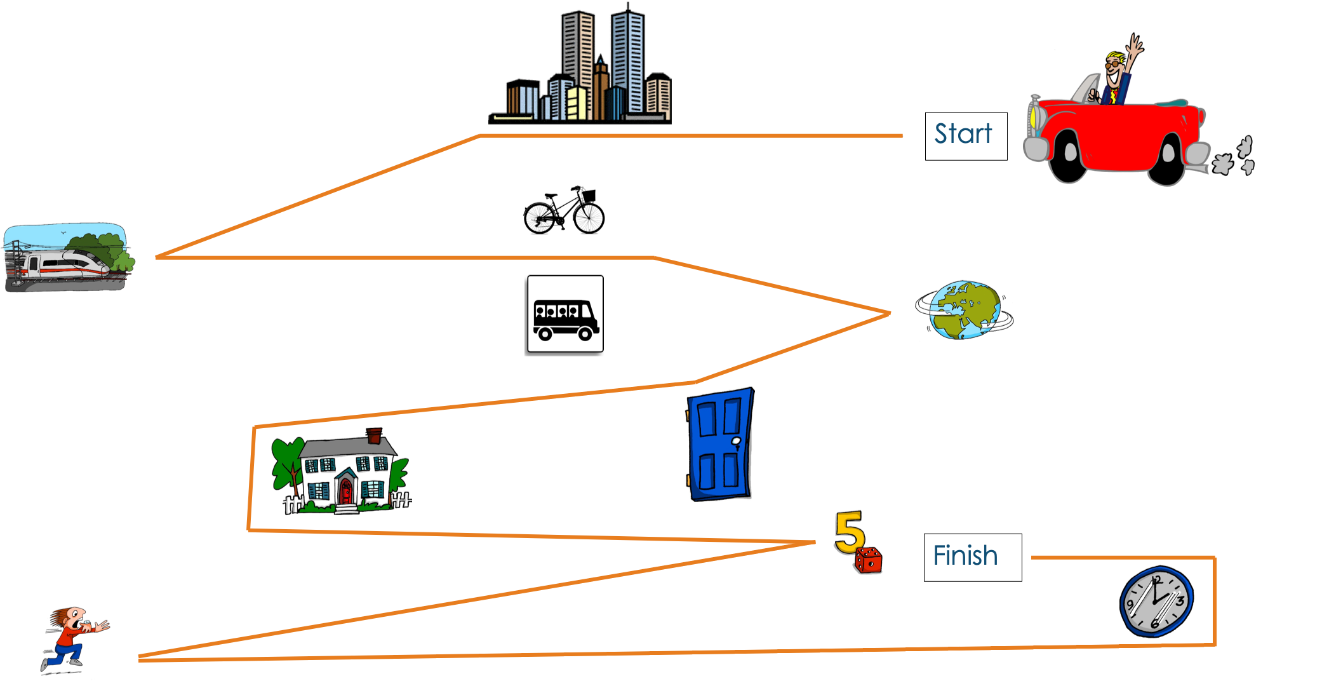
Map task
Inge Alferink
Notes:
This is available as a Handout within the Resources handouts.
Map Game
Instructions
Please look at the following map. Your partner’s map does not have the route. You must guide your partner’s car from start to finish (following the line as accurately as possible). While you are communicating to complete this task, please do not LOOK AT your partner’s map. The first step (line) has been done for your partner as an example.
NB: the vocab should be ok as it’s all been introduced here or in the phonics source words.
However, pupils will need to know ‘zu’ and how to change the articles in Row 3 (dative case). zur Stadt, zum Zug, zur Welt. They could also use ‘links / auf der linken Seite’ and ‘rechts / auf der rechten Seite’ to be sure that the partner draws the lines in exactly the right place. It is a useful example of how to deepen and extend word knowledge.

Slide 33
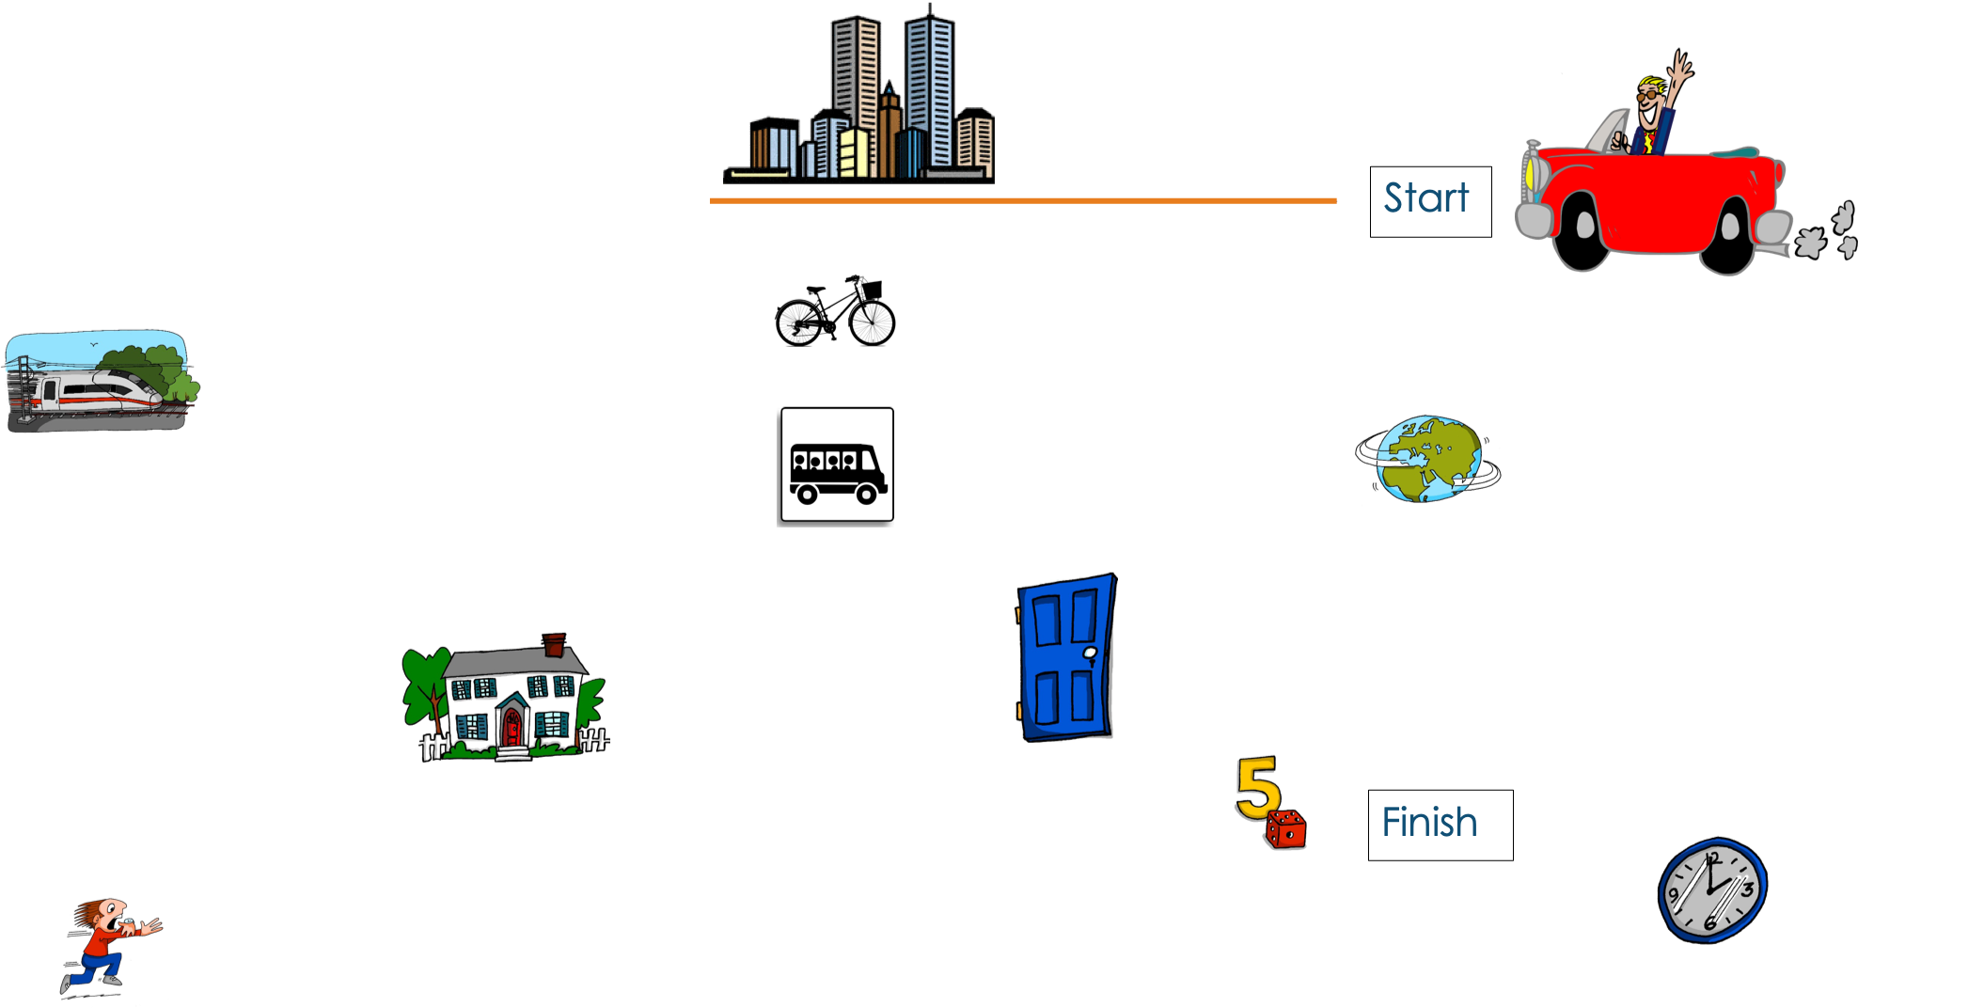
Map task
Inge Alferink

Slide 34
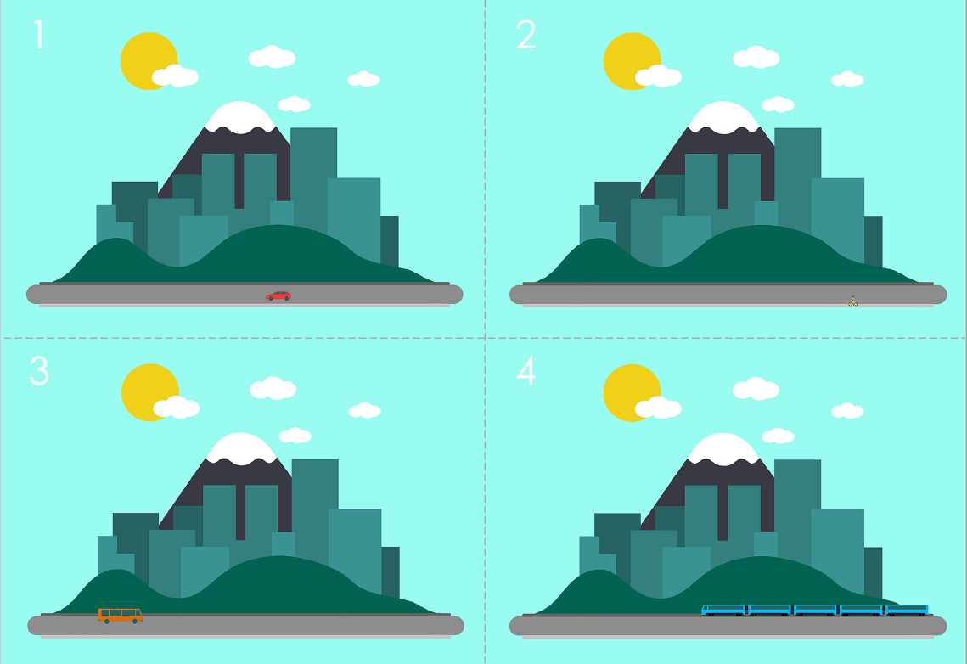
Guess where
Preparation
For each pair of pupils, you will need three sets of the pictures.
Cut them into individual cards along the dotted lines.
You can print them in colour or in black and white.
This activity takes time to prepare but the cards can be re-used time and again.
Game
Players: 2
Goal: guess which card the other person has
How to play:
This game is a variation on ‘Guess who?’.
Each player has a set of 24 cards in front of him/her.
Both players pick a card from a third set without showing the other player.
Players take turns asking each other yes/no questions about what is on the target card (e.g. Is there a car?) and turn over any cards that the answers eliminate.
The winner is the player who correctly identifies their opponent’s card first.
Word | Word class | Word frequency
geben | verb | 57
Auto (nt) | noun | 490
Zug (m) | noun | 613
Fahrrad (nt) | noun | 1596
Bus (m) | noun | 1580
Person (f) | noun | 331
Flugzeug (nt) | noun | 1395
Fluss (m) | noun | 1551
Straße (f) | noun | 355
Stadt (f) | noun | 186
Brücke (f) | noun | 2062
sonnig | adjective | <4000 [953] Sonne
sein | verb | 3
regnen | verb | 3642
Inge Alferink
Notes:
Handout also available in the resources section

Slide 35
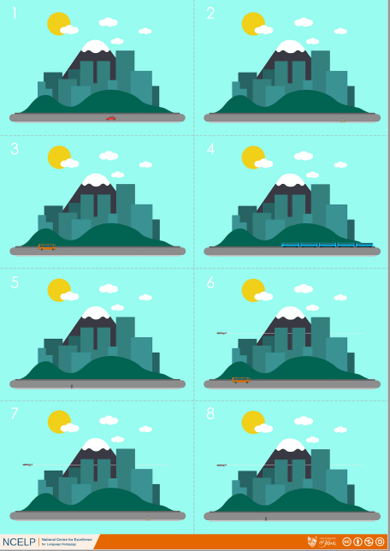
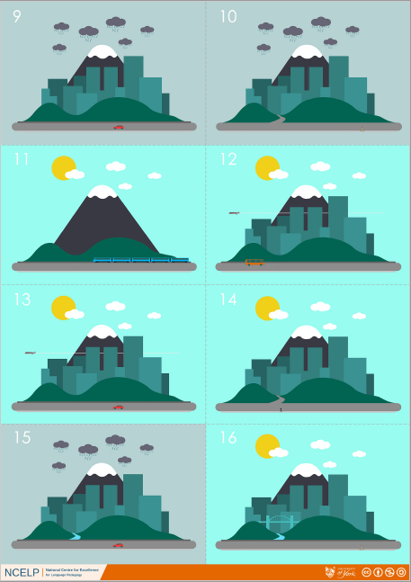
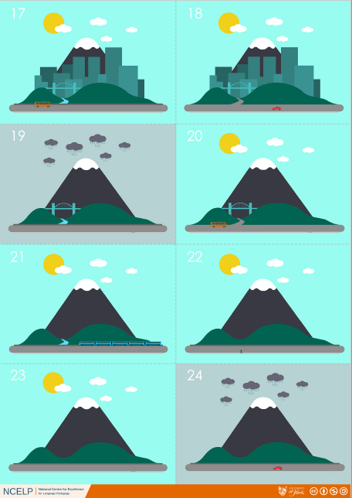
Guess where
Inge Alferink
Notes:
Screen shot of full resource – just so the game can be visualised!

Slide 36
Assessment
Self-assessment checklist
Sentence-level vocabulary test
Inge Alferink

Slide 37
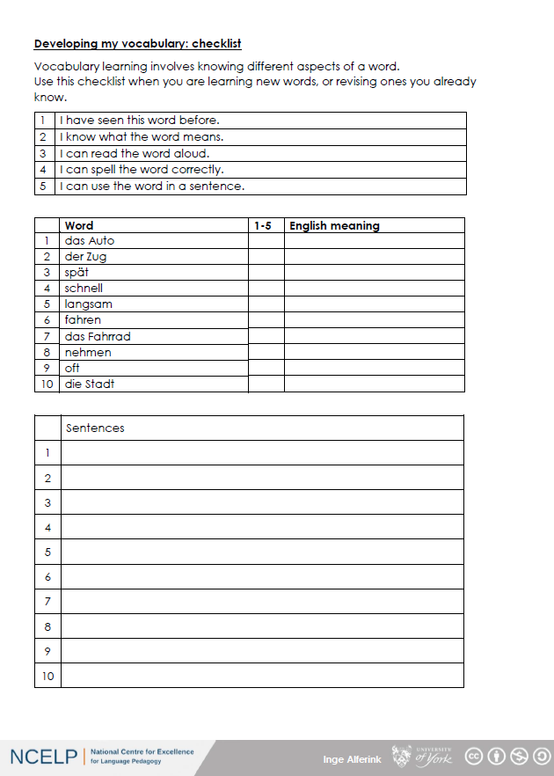
Pupil self-assessment checklist
Inge Alferink

Slide 38
Sentence level translation
1
The car drives fast.
2
She takes the train.
3
She drives into the city.
4
He often takes the bike.
5
The train is too late.
Inge Alferink
Notes:
English sentences for translation
German answers:
Das Auto fährt schnell.
Sie nimmt den Zug.
Sie fährt in die Stadt.
Er nimmt oft das Fahrrad.
Der Zug ist zu spät.

