Slide 1
Examples
production
Interpreting tasks (speaking)

Slide 2
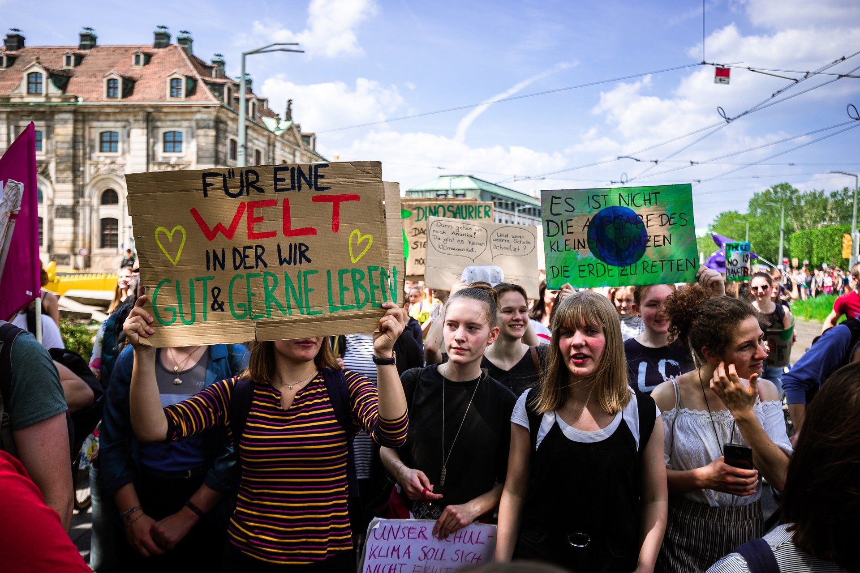
Eine Demonstration
sprechen
Notes:
9.2.1.3
Timing: 10 minutes (3 slides) Aim: to practise speaking with limited prompts and support structures. Procedure: 1. Introduce the task using this slide.
2. On the next slide, Partner A talks and Partner B makes notes. Partner B also answers Partner A’s two questions. 3. Swap roles. On the following slide, Partner B talks, Partner A makes notes. Partner A answers B’s two questions.
4. Teacher circulates to listen in and support, as needed.

Slide 3
Eine Demonstration [1/2]
sprechen
Partner A:
What can you see in the photo? Try to say at least 4 different things.
Here are some ideas but you can say different things!
Say something about the weather
Say what you see in the background
Describe any of the four girls in the foreground
Say what one of the people in the picture is doing
2. Ask the group 2 different questions.
Notes:
9.2.1.3

Slide 4
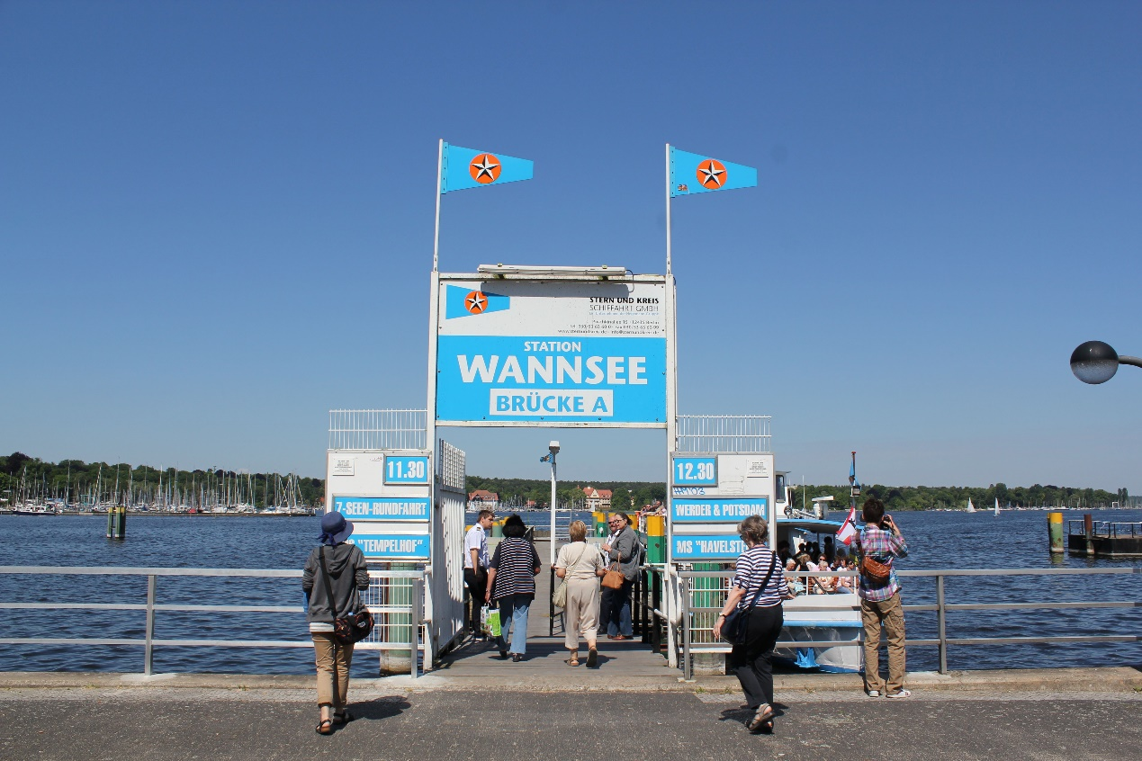
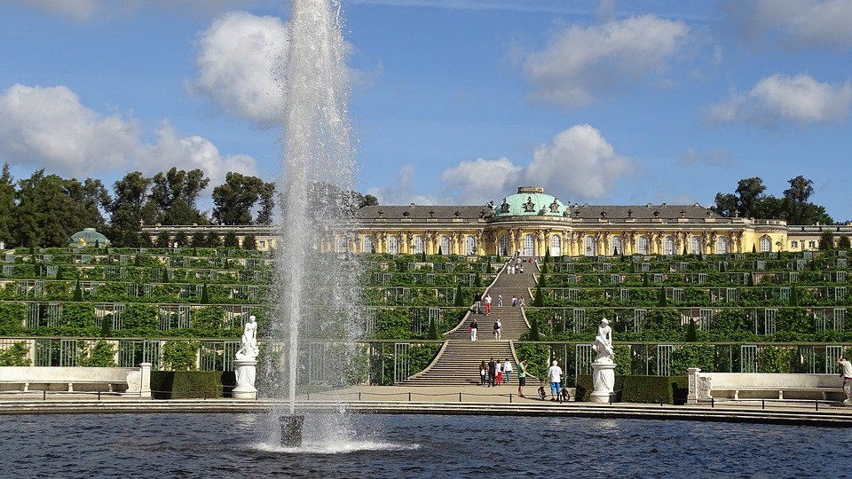
Beschreib die Fotos
Beantworte die Fragen von deinem Partner / deiner Partnerin.
sprechen
A
B
Wenn ihr noch Zeit habt, frag dann:
Welchen Urlaub magst du lieber? Warum?
Welche Urlaubsorte hast du schon besucht?
Wohin möchtest du in Urlaub fahren? Warum?
Was machen die Leute auf dem Foto A/B?
Beschreib eine Person auf dem Foto A/B.
Was machen sie gern im Urlaub A/B?
Notes:
9.2.2.3
Timing: 10 minutes Aim: to practise using gefallen, mögen, and comparatives orally. Procedure: 1. Students ask each other the questions they wrote in the previous exercise, and answer based on what they can see in the photos.
2. If they have time, they can also ask each other the questions at the bottom of the slide.

Slide 5
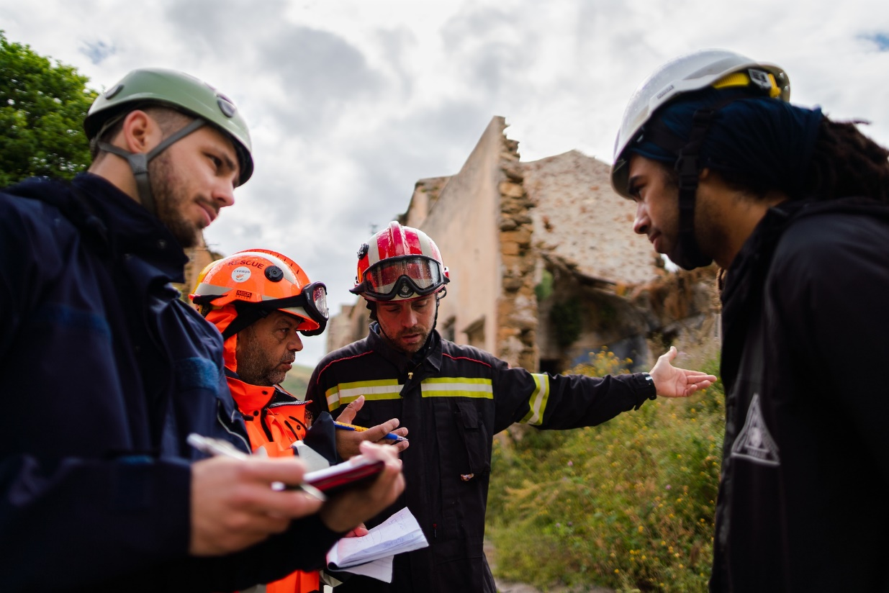
ein Foto beschreiben
sprechen
Look at the photo and answer the questions below in German.
For some questions, you will need to use your imagination to make up a possible answer.
Just try to keep going and say something that you know how to say! You have 2 minutes to prepare all of your answers before you speak.
PART A
What can you see in this photo?
Try to say at least 2 different things.
Here are some ideas about what you could say.
You can say different things if you wish!
•Say what you can see in the photo •Say what people are doing
•Say what the man on the right is going to do this afternoon
PART B
Ask the man on the left one question
Notes:
9.2.2.4
Timing: 15 minutes (two slides) Aim: to practise spoken production in response to a photo, in a freer context with limited prompts and support structures.
Procedure: 1. Students have 2 minutes each to think about what to say in the response to the prompts. Both partners can prepare this slide, and then also the next slide. 2. After preparation time (4 minutes), the teacher announces which partner will do which photo (this ensures that both students put the maximum effort into preparing both).
3. Partner A talks about the designated photo. Partner B makes notes/transcribes (depending on speed of speaking) what A says. These notes can be given to Partner A, with any oral feedback that Partner B has, anything s/he has noticed. 4. Then roles are reversed and Partner B speaks.

Slide 6
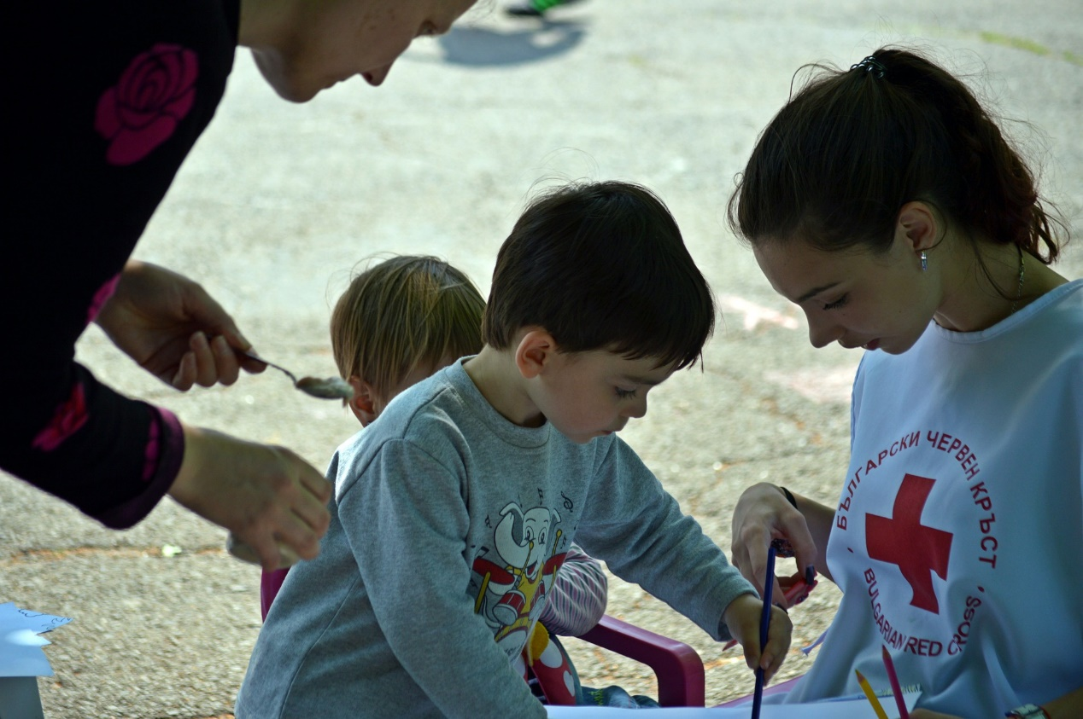
ein Foto beschreiben
sprechen
Look at the photo and answer the questions below in German.
For some questions, you will need to use your imagination to make up a possible answer.
Just try to keep going and say something that you know how to say! You have 2 minutes to prepare all of your answers before you speak.
PART A
What can you see in this photo?
Try to say at least 2 different things.
Here are some ideas about what you could say.
You can say different things if you wish!
•Say who you can see in the photo
•Say what people are doing
•Say what the girl is going to do this afternoon
PART B
Ask the woman on the left one question
Notes:
9.2.2.4

