Slide 1
Session 6: The ‘future’ you

Slide 2
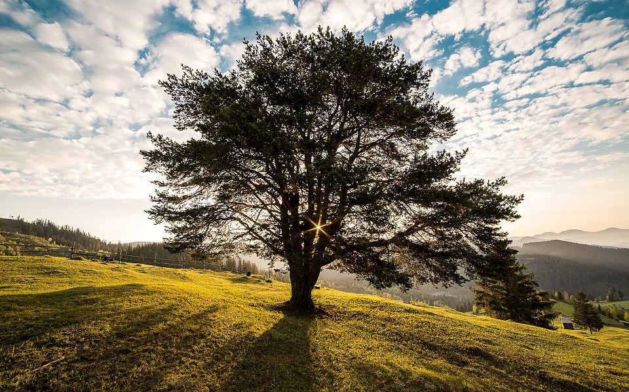
Notes:
Identity as a tree – roots are your identity.. As you grow up, you branch out, have new experiences, take on new aspects to your identity. As you do this, your roots don’t weaken, they grow stronger and deeper

Slide 3
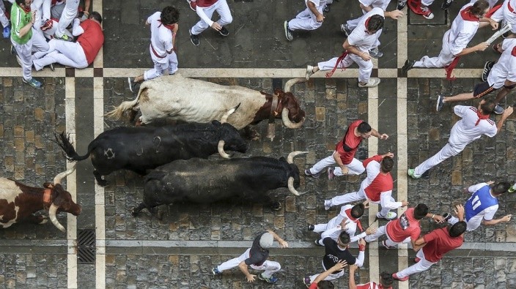
Martin Szekeresh mijas99 When running with the bulls in Pamplona Spain in 1979 I fell in love with the people and the country; I knew right then and there that I had to learn their language. I was 19 years old, on my own, independent, and free. I went straight back to California and took a two hours a day, five days a week, total immersion, Spanish class for a semester at the local Community College for free - it completely changed my life to know Spanish as a second language, it caused me to do things that I never would have done otherwise, like spending all those years in Mexico, Colombia, Argentina, and Spain.
Learning a second language changes you for the better, it also opens doors that would otherwise be shut to you your whole life. It's a lot like playing the guitar, you couldn't imagine your life without it.
Notes:
https://www.theguardian.com/commentisfree/2015/apr/27/world-view-learn-another-language Testimony from life-changing moments that involve language learning The most powerful stories about the importance of language learning are personal stories… like this one. Most stories of language learning involve exploring, in the widest sense of the world – opening doors to unexpected experiences

Slide 4
What is an explorer?
Explorer [/ɛkˈsplɔːrə/] noun
a person who explores a new or unfamiliar area.
synonyms: traveller, discoverer, voyager, globetrotter, rover; tourer, surveyor, scout, adventurer, pioneer
Notes:
You as explorer Make it clear that exploring can involve travelling but it can also involve just being open to experiences that are on our doorstep – e.g. meeting people from other countries here, or connecting with people across the world, virtually.
The key thing is that it’s about opening doors, without necessarily knowing where they will take you. New adventures, unexpected encounters.
Explorers can be anyone – they are not necessarily going to be famous people you’ve heard of. Go to google and type in Explorers – starting exploring…
More often than not, these people end up needing and learning languages…
https://en.wikipedia.org/wiki/List_of_explorers
The most important things about their lives though is that they never would have predicted how they would turn out, at the start, just like we cannot predict the journey our own lives will take.

Slide 5
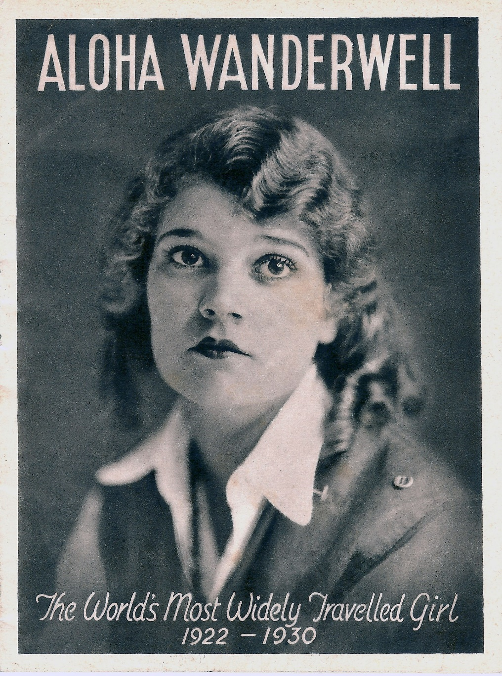
1906 – 1996
Canadian explorer, author, filmmaker and aviator
At 16 she joined a round-the-word motoring tour…
as the driver, translator and filmmaker
first woman to drive around the globe
380, 000 miles, 80 countries, 7 years
By The Nile Baker Estate - http://alohawanderwell.com/, Public Domain, https://commons.wikimedia.org/w/index.php?curid=21969184
Notes:
Aloha Wanderwell (Idris Galcia Hall née Welsh, October 13, 1906 – June 4, 1996) was a Canadian explorer, author, filmmaker, and aviatrix. In the 1920s, while still a teenager, she traveled 380,000 miles across 80 countries, becoming the first woman to circumnavigate the globe in a Ford 1917 Model T. Just 16-years-old at the outset, the journey took seven years to complete.
They called her “The World’s Most Travelled Girl.” An early filmmaker, Aloha captured her husband and two kids as they explored the world. Did she have adventures? Stranded in Brazil, she lived with and documented the Bororo people. Trying to find fuel (never mind roads) in the 1920’s, she used crushed bananas and animal fat for fuel. Her husband was mysteriously murdered. Apparently, she cut her hair and fought for the French Foreign Legion. She flew a seaplane. In Indochina, she had to shoot her way out of a gauntlet of angry elephants. She died in obscurity, and you’ve probably never heard of her. Even with a name like Aloha Wanderwell.
Wanderwell became the first woman to drive around the world, beginning and ending her journey in Nice, France, between December 29, 1922 and January 1927.^{[6]} In a Model T Ford, Wanderwell made the journey as driver, translator and filmmaker for Wanderwell Expeditions, a round-the-world motoring tour led by Walter "Cap" Wanderwell (Poland).
In 1922, when she was 16, Idris applied for a job of mechanic and filmmaker as the team motored around in 1917 Model Ts. After responding to an advertisement reading, "Brains, Beauty & Breeches – World Tour Offer For Lucky Young Woman…. Wanted to join an expedition… Asia, Africa…", she met with "Captain" Wanderwell in Paris and secured a seat on the expedition. She served as the expedition's translator, driver and film maker,
https://en.wikipedia.org/wiki/Aloha_Wanderwell

Slide 6
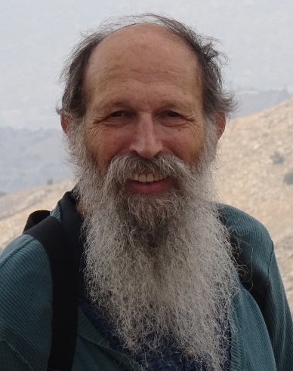
Michael Asher
1953 –
British author, historian, deep ecologist, desert explorer
studied English Language & Linguistics at Leeds University
qualified as teacher of English
enlisted in the army (in Northern Ireland in The Troubles in1970s)
in 1979 volunteer English teacher in Sudan
bought a camel, went travelling, joined the Kabbaish,a nomadic tribe
learned Arabic with them
worked with UNICEF, met and married Italian Mariantonietta Peru
in 1986, together they made the first crossing of the Sahara from west to east by camel
currently lives in Nairobi, Kenya and speaks Swahili.
has written 21 books, and presented/directed 6 documentaries
סוזן וינגרטן [CC BY-SA 4.0 (https://creativecommons.org/licenses/by-sa/4.0)]
Notes:
Michael Asher
Image link: https://upload.wikimedia.org/wikipedia/commons/f/fc/%D7%9E%D7%99%D7%9B%D7%90%D7%9C_%D7%95%D7%99%D7%A0%D7%92%D7%A8%D7%98%D7%9F.jpg
Michael Asher (born 1953) is an author, historian, deep ecologist, and notable desert explorer who has covered more than 30,000 miles on foot and camel. He spent three years living with a traditional nomadic tribe in Sudan. Michael Asher was born in Stamford, Lincolnshire, in 1953, and attended Stamford School. At 18 he enlisted in the 2nd Battalion the Parachute Regiment, and saw active service in Northern Ireland during The Troubles there in the 1970s.
He studied English Language & Linguistics at the University of Leeds, at the same time serving in B Squadron, 23rd SAS Regiment. He also studied at Carnegie College, Leeds, where he qualified as a teacher of English.
In 1978-9, he worked for the RUC Special Patrol Group anti-terrorist patrols, but left after less than a year. He took a job as a volunteer English teacher in the Sudan in 1979.
The author of twenty-one published books, and presenter/director of six TV documentaries, Asher has lived in Africa for much of his life, and speaks Arabic and Swahili. He is married to Arabist and photographer Mariantonietta Peru, with whom he has a son and a daughter, Burton and Jade. He currently lives in Nairobi, Kenya.
Notion of explorers – feature of several key explorers Marco Polo Gertrude Bell Simon Reeve Michael Turtle
make it clear that exploring can involve travelling but it can also involve just being open to experiences that are on our doorstep – e.g. meeting people from other countries here.

Slide 7
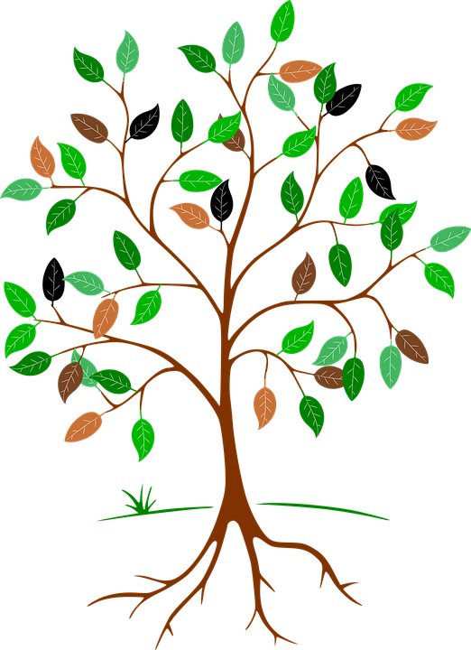
Notes:
Create own life trees Draw a tree outline with branches and roots. Write along the roots all the elements of your identity (recalling session 1) Then write along the branches some of the opportunities you would like to have, or that you think you might like to have

Slide 8
Learning [language] is like…because…
Notes:
Feedback some of the similes from the earlier session (anonymously) Discussion about these Reflection on whether there may have been change. Simile task – repeated Learning [insert name of language] is like… because…

Slide 9
The smallest changes can sometimes make the greatest of differences.
No puedo. → No, puedo.
Notes:
Poly Lima [Public domain]

Slide 10
Session 6: The ‘future’ you Who do you want to be? | Resource | Attribution
Identity as a tree¹ | Slide 2 Roots are your identity. As you grow up, you branch out, have new experiences, take on new aspects to your identity. As you do this, your roots don’t weaken, they grow stronger and deeper. | ¹Idea taken and/or adapted from Digilang project
Testimony from life-changing moments that involve language learning | Slide 3 Running with bulls in Pamplona…
Notion of explorers – feature of several key explorers¹: Aloha Wanderwell Michael Asher Marco Polo Gertrude Bell Simon Reeve Michael Turtle | Slides 4-6 Make it clear that exploring can involve travelling but it can also involve just being open to experiences that are on our doorstep – e.g. meeting people from other countries here. Rachel Hawkes chose Aloha Wanderwell and Michael Asher as she personally liked their stories! Teachers and students to choose their own favourites and explain why. | ¹Idea taken and/or adapted from Digilang project
Create own life trees¹ | Slide 7 Draw a tree outline with branches and roots. Write along the roots all the elements of your identity (recalling session 1) Then write along the branches some of the opportunities you would like to have, or that you think you might like to have | ¹Idea taken and/or adapted from Digilang project
Feedback some of the similes from the earlier session (anonymously)² | Slide 8 Discussion about these Reflection on whether there may have been change since they were written | ²Idea taken and/or adapted from Ursula Lanvers
Simile task² | Slide 8 Learning [insert name of language studied] is like… | ²Idea taken and/or adapted from Ursula Lanvers
End quote | The smallest of changes can sometimes make the greatest of differences. No puedo. → No, puedo.
Notes:
Overview of content: Session 6 – The ‘future’ you: who do you want to be? Unless otherwise attributed, all ideas contributed by Rachel Hawkes.

