Slide 1
German word order
Putting the verb second

Slide 2
Grammar explanation
In German the verb always needs to be the second idea in a sentence.
Ich | gehe | ins Kino.
I | go | to the cinema.
When you add something to the start of the sentence the subject and verb need to swap for the verb to still be second!
Am Wochenende | gehe | ich | ins Kino.
At the weekend | I | go | to the cinema.
Im Sommer | schwimmt | Paul | im Atlantik.
In summer | Paul | swims | in the Atlantic ocean.
In some cases the subject (ich/er/Paul etc.) and the verb (gehe/schwimmt/macht etc.) need to swap so that the verb comes second.
Am Wochenende
ich
gehe
ins Kino.
Inge Alferink / Rachel Hawkes / Emma Marsden
Notes:
Teacher note: Short grammar explanations can never be fully complete. (For example, word order in questions is different). But the aim is to get pupils to learn a ‘default’, main pattern and then introduce the complexities and exceptions to the rule later. In any case, evidence suggests that it is the practice activities that are most helpful for learning (rather than these grammar explanations). But … these short grammar explanations do seem to speed up some learners in becoming accurate in the practice activities that follow.

Slide 3
Grammar explanation
Learners of German often find this difficult for two reasons:
They may not be expecting to hear this word order, because it does not exist in English:
I go to the cinema.
At the weekend I go to the cinema.
2. Word order does not make a difference to the meaning, so it’s easy not to pay attention to it.
Inge Alferink / Rachel Hawkes / Emma Marsden
Notes:
Teacher note: The exception of course is when word indicates a question. Word order for questions will be dealt with separately.

Slide 4
Brieffreunde…?
lesen
Remember!
The verb is always the second idea in the phrase
Brieffreunde...
Thomas has been recruited by an international agency to spy on Louisa, a German target. In order to find out more about her, he is pretending to be pen pals with Louisa.
Unfortunately, Thomas’s overzealous colleague has shredded Louisa’s latest letter!
Using the word order as a clue, can you help Thomas piece the letter back together?
Circle the correct beginning (phrase or blank) for every sentence.
Inge Alferink / Rachel Hawkes / Emma Marsden

Slide 5
Am Wochenende
1.
gehe ich zur Universität.
Heute
2.
ich gehe einkaufen.
Im Winter
3.
gehe ich schwimmen.
Inge Alferink / Rachel Hawkes / Emma Marsden
Notes:
Frequency rankings
Verbs: gehen (69), einkaufen (1789), (ski)fahren (169), schwimmen (1832), laufen (248), spielen (197), arbeiten (200), sehen (81), haben (7)
Adverbials: Wochenende (764), heute (121), Winter (1288), Sommer (704), Montag (794), Freitag (1277), Geburtstag (1766), Woche (209), (Un)glückligerweise (>5000)
Nouns: Universität (319), Disko (>5000), Fußball (1497), Supermarkt (>5000), Kino (1825), Bruder (687), Freund (327)

Slide 6
Im Sommer
4.
laufe ich gern ski.
Montags
5.
ich gehe in die Disko.
Am Freitag
6.
ich spiele Fußball.
Inge Alferink / Rachel Hawkes / Emma Marsden

Slide 7
An meinem Geburtstag
7.
arbeite ich im Supermarkt.
Von Montag bis Freitag
8.
ich gehe ins Kino.
Zweimal in der Woche
9.
ich sehe fern mit meinem Bruder.
Inge Alferink / Rachel Hawkes / Emma Marsden

Slide 8
Unglücklicherweise
10.
ich habe keinen Freund.
Inge Alferink / Rachel Hawkes / Emma Marsden

Slide 9
Was machst du wann?
hören
Was machst du wann?
The agency wants Thomas to gather more information on Louisa. He has arranged to talk on the phone. Unfortunately, the reception of his mobile keeps breaking up.
Listen to Louisa’s statements. Using the word order, did you miss something or was there a pause?
Tick the correct beginning (phrase or blank).
Remember!
The verb is always the second idea in the sentence.
Inge Alferink / Rachel Hawkes / Emma Marsden

Slide 10
Was machst du wann?
Am Wochenende
Am Wochenende
Am Wochenende
1
2
3
Im Sommer
Im Winter
Im Herbst
4
5
6
in London
zu Hause
mit meiner Freundin
7
8
9
10
Normalerweise
11
Unglücklicherweise
12
Normalerweise
Inge Alferink / Rachel Hawkes / Emma Marsden
Notes:
Click the number to hear the audio, twice. Click again for further repetition, as required.
Transcript
1. ___ gehe ich ins Kino.
2. Ich schlafe bis 12 Uhr Mittags.
3. ___treffe ich mich mit meinen Freunden.
4. Ich gehe schwimmen.
5. ___laufe ich Schlittschuh.
6. ___fahre ich in den Urlaub.
7. Ich gehe einkaufen.
8. ___sehe ich viel fern.
9. Ich gehe in die Disko.
10. Ich lese gern Liebesromane.
11. ___habe ich keinen Freund.
12. Ich mache sehr viel Sport.
Frequency rankings
Verbs: gehen (69), schlafen (787), treffen (287), schwimmen (1832), laufen (248), fahren (169), einkaufen (1789), lessen (323), haben (7), machen (49), Fernsehen(1060)
Nouns: Urlaub (1192), Disko (>5000), Liebesromane (>5000), Kino (1825), Uhr (349), Mittag (2194), Freund (327), Sport (845)
Other: gern (235), ich (8), mit (13), in (4), bis (73), sehr (70)

Slide 11
1. 2. 3.
Am Wochenende Am Wochenende Am Wochenende
______________ _____________ ____________
4. 5. 6.
Im Sommer Im Winter Im Herbst
______________ ______________ _____________
7. 8. 9.
In London Zu Hause Mit meiner Freundin
______________ ______________ _______________
10. 11. 12.
Normalerweise Unglücklicherweise Normalerweise
______________ ______________ _______________
Notes:
Slide to copy (reduce to A5) for students to complete.

Slide 12
Antworten
1. 2. 3.
Am Wochenende Am Wochenende Am Wochenende
______________ _____________ ____________
4. 5. 6.
Im Sommer Im Winter Im Herbst
______________ ______________ _____________
7. 8. 9.
In London Zu Hause Mit meiner Freundin
______________ ______________ _______________
10. 11. 12.
Normalerweise Unglücklicherweise Normalerweise
______________ ______________ _______________
Inge Alferink / Rachel Hawkes / Emma Marsden

Slide 13
Was machst du?
sprechen / hören / schreiben
Person A
Use the cue card to tell your partner about things you like to do.
Use the phrases or blanks in the first column as the start of your sentence (but don’t say them out loud!)
Remember to think about which word order to use for each sentence.
When finished swap roles.
Person B
Write down your partner’s sentence on your answer card.
Look at the word order to determine what would have been the correct beginning.
Check with your partner whether you were right.
When finished swap roles.
Inge Alferink / Rachel Hawkes / Emma Marsden
Notes:
Teacher note:
This activity might feel a little forced (it is!), but it is intended to get learners to actively choose between the two contrasting word orders in a speaking setting. It sets up for a freer activity later.
Frequency rankings:
Verbs: spielen (197), schwimmen (1832), trinken (608), einkaufen (1789), machen (49), gehen (69), hören(1557), lesen (323), essen (655),
Noun: tennis (2948), Klavier (2775), Tee (2713), Fußball (1497), Musik (469), Buch (295), pizza (>5000), Kino (1825)
Adverbials: (am) Mittwoch (1091), heute (121), (zu) Hause (159), Wochenende (764), (im) Sommer (704), oft (215), (am) Freitag (1277), (im) Zug (613)

Slide 14
Partner A – cue card
sprechen / hören / schreiben
 | Start your sentence (silently) | Finish your sentence (out loud)
1. | Am Mittwoch
2. | …
3. | …
4. | Zu Hause
5. | Am Wochenende
Inge Alferink / Rachel Hawkes / Emma Marsden

Slide 15
Partner B – answer card
sprechen / hören / schreiben
 | Circle the correct beginning | Write your partner’s sentence
1. | Am Mittwoch / […]
2. | Heute / […]
3. | Am Meer / […]
4. | Zu Hause / […]
5. | Am Wochenende / […]
Inge Alferink / Rachel Hawkes / Emma Marsden

Slide 16
Partner B – cue card
sprechen / hören / schreiben
 | Start your sentence (silently) | Finish your sentence (out loud)
1. | Im Sommer
2. | Oft
3. | …
4. | Am Freitag
5. | …
Inge Alferink / Rachel Hawkes / Emma Marsden

Slide 17
Partner A – answer card
sprechen / hören / schreiben
 | Circle the correct beginning | Write your partner’s sentence
1. | Im Sommer / […]
2. | Oft / […]
3. | Im Zug / […]
4. | Am Freitag / […]
5. | Am Wochenende / […]
Inge Alferink / Rachel Hawkes / Emma Marsden

Slide 18
Hilfe
visit museum → Museum besichtigen
visit [Morocco/China]→[das Marokko/China] besuchen
eat [pizza/ice cream] → [Pizza/Eis] essen
swim→ schwimmen
go [to the cinema / theatre] → [ins Kino / Theater] gehen
dance → tanzen
play [football/volleyball] → [Fußball/Volleyball] spielen
lie [on the beach] → [am Strand] liegen
take [the train / bus] → [den Zug / Bus] nehmen
60
0
ANFANG
speaking / listening
Inge Alferink / Rachel Hawkes / Emma Marsden
Notes:
It is anticipated that students know most/all of these high-frequency verbs. This short activity is to re-activate their knowledge of the infinitive verbs ahead of the two speaking/writing activities, in which they will be producing 1st person present forms, referring only to the speaking cards and without reference to other notes.
Teachers will use their judgement as to the extent of the ‘re-activation’ required.
Click Anfang to start the timer. Clicking on each cloud will reveal the infinitive verb.
NB: besichtigen is far less frequent than besuchen but it is on the AQA GCSE vocabulary list, so retaining it here!
Frequency rankings
verbs: besuchen (703), besichtigen (>5000), essen (655), schwimmen (1832), gehen (69), tanzen (2011), spielen (197), liegen (118), nehmen (139)
nouns: Museum (1360) , Pizza (>5000), Eis (2818), Kino (1825), Theater (725), Fußball (1497), Volleyball (>5000), Strand (2047), Zug (613), Bus (1580)

Slide 19
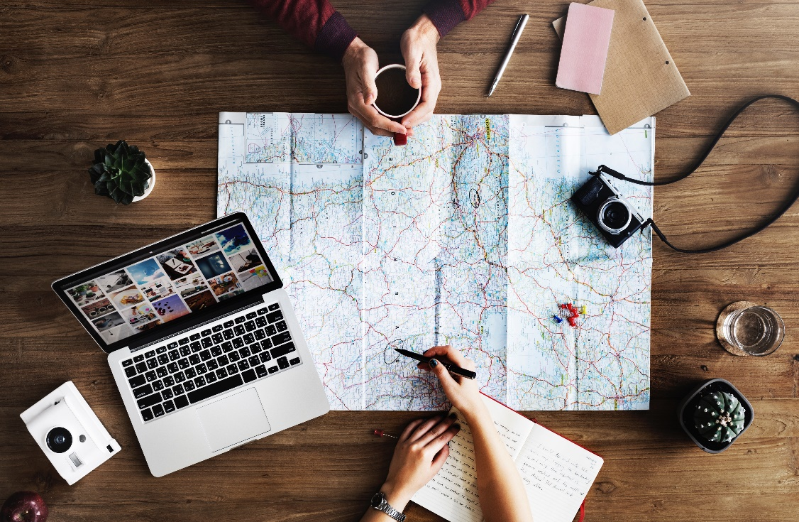
Reisen
Take a few minutes to plan 5 legs of your trip using the worksheet. For each leg select something from each of the four bubbles.
Person A: Tell your partner about your trip using your plan. You will need (at least) two sentences for each leg.
Person B: Mark the information (route, transport, activity) on the map. When you have marked all the information, repeat it back to your partner to make sure it’s correct.
Swap roles.
Fill in the plans for your trip on your itinerary.
Remember!
The verb is always the second idea in the phrase
sprechen / hören / schreiben
Inge Alferink / Rachel Hawkes / Emma Marsden
Notes:
Teacher note:
Both partners take a few minutes to plan 5 sequences (legs of the trip). For each leg they pick one item from each set, so 4 items in total. For example:
Ich nehme den Zug (1) nach London (2). Dort (3) gehe ich tanzen (4).
The first sentence will have SVO word order. Using the words from the vocabulary bubble will force VSO word order for the second sentence. In a freer setting like this it is difficult to really ‘trap the form’. Instead we try to juxtapose them and try avoid mechanical production by having variety in the verbs. For example, nehmen, fahren, fliegen for sentence 1 and spielen, essen, sehen, etc. for sentence 2.

Slide 20
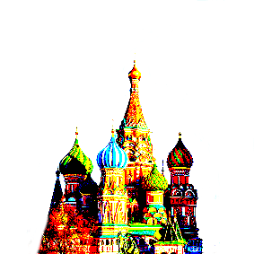
Meaningful practice
deine Reise planen
In [Land]…
Dann…
Dort…
In [Land]…
Dort…
In [Stadt]…
Dann…
In [Stadt]…
Am nächsten Tag…
Inge Alferink / Rachel Hawkes / Emma Marsden
Notes:
Students can circle and number the items they are going to use.
Frequency rankings (as this is a freer activity students could use other words).
Transport: Zug (613), Bus (1580), Fahrrad (1596), Flugzeug (1395), Auto (490), Luftballon (>5000), Roller (>5000)
Locations: not available
Connectors: Dann (33), in (4), dort (134), Tag (108), nächste (247)
Activities: segeln (4010), Fußball (1497) spielen (197), Volleyball (>5000) spielen (197), wandern (2017) , Musik (469) machen (49) / hören (1557), tauchen (3129), Eis (2818) / Pizza (>5000) essen (655), tanzen (2011), Museum (1360), Theater (725), Kino (1825), gehen (69), schwimmen (1832), Sonnenuntergang (>5000), Strand (2047), Insel (1299)

Slide 21
den Reiseplan von deinem Partner / deiner Partnerin abschreiben
Inge Alferink / Rachel Hawkes / Emma Marsden

Slide 22
deinen Reiseplan schreiben
Tag
1. | Wohin und wie?
 | Was machst du dort?
2. | Wohin und wie?
 | Was machst du dort?
3. | Wohin und wie?
 | Was machst du dort?
4. | Wohin und wie?
 | Was machst du dort?
5. | Wohin und wie?
 | Was machst du dort?
Inge Alferink / Rachel Hawkes / Emma Marsden
Notes:
Fill in your own itinerary. Students could do each other’s, but all other activities in this sequence have been first person.

