Slide 1
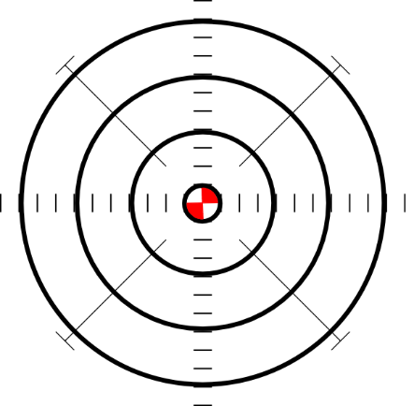
CE
necesitar
CE
[to need]
MADRID 1KM
centro
doce
cerca
Notes:
Introduce and elicit the pronunciation of the individual SSC ‘ce’ and then the source word again (with gesture, if using). Then present and elicit the pronunciation of the three cluster words.
The cluster words have been chosen for their high-frequency, from a range of word classes, with the SSC (where possible) positioned within a variety of syllables within the words (e.g. initial, 2nd, final etc..) and additionally, we have tried to use words that build cumulatively on previously taught SSCs (see the Phonics Teaching Sequence document) and do not include new SSCs. Where new SSCs are used, they are often consonants which have a similar symbol-sound correspondence in English.

Slide 2
CE
necesitar
cerca
centro
doce
Notes:
Without the images, students focus this time again closely on the SSC and the cluster words.

Slide 3
CI
ciudad
ciencias
cierto
decir
[to say; tell]
Notes:
Introduce and elicit the pronunciation of the individual SSC ‘ci’ and then the source word again (with gesture, if using). Then present and elicit the pronunciation of the three cluster words.
The cluster words have been chosen for their high-frequency, from a range of word classes, with the SSC (where possible) positioned within a variety of syllables within the words (e.g. initial, 2nd, final etc..) and additionally, we have tried to use words that build cumulatively on previously taught SSCs (see the Phonics Teaching Sequence document) and do not include new SSCs. Where new SSCs are used, they are often consonants which have a similar symbol-sound correspondence in English.

Slide 4
CI
ciudad
cierto
ciencias
decir
Notes:
Without the images, students focus this time again closely on the SSC and the cluster words.

Slide 5
There are different ways to pronounce CE and CI.
In most of Spain, the ‘c’ before ‘e’ or ‘i’ is pronounced like the ‘th’ in English (as you just heard).
In the Canary Islands and Latin America, this ‘c’ is often pronounced like an ‘s’.
Compare:
ciencias
(mainland Spain)
1
ciencias
(Canaries & Latin America)
2
Notes:
NCELP supports inclusivity in the teaching of foreign language phonics. Individual teachers may also find it useful to consider the information from exam board specifications below:
AQA : “The [listening] test will be studio recorded using native speakers speaking Castilian in clearly articulated, standard speech at near normal speed. Different types of spoken language will be used, using familiar language across a range of contemporary and cultural themes. (p. 82)
EdExcel : “For listening and reading assessments, the majority of contexts are based on the culture and countries where the assessed language is spoken. […] It is, therefore, important that students are exposed to materials relating to Spanish-speaking countries throughout the course.” (p. 7)
WJEC : “This GCSE specification in Spanish for use in Wales is based on a conviction that learners studying a modern foreign language will develop their desire and ability to communicate with and understand speakers of Spanish in a variety of contexts and for a variety of purposes.” (p. 3)

Slide 6
Is the pronunciation more likely to be mainland Spain or Latin America / Canaries?
Latin America/Canaries | Mainland Spain
1
2
3
4
Listen and tick the most likely answer.
5
6
7
8
9
10
Notes:
Transcript: 1. Doce; 2. Ciencias; 3. Decir; 4. Necesario; 5. Cine; 6. Diciembre; 7. Necesitar; 8. Centro; 9. Ciudad; 10. Cierto
Image with creative commons public domain licence
https://mycsres.com/freesheet/spanish-speaking-world-map-18.html.html

Slide 7
Escucha y escribe las letras.
¿CE o CI?
ci
__udad
ce
do__
1
6
___ntro
ce
ne___sario
ce
2
7
ci
ci
de__r
di__embre
3
8
ce
ne___sitar
4
__en__as
ci
ci
5
Notes:
To challenge students further, ask them to turn away from the board to complete the task and write the whole word independently. This allows for differentiation through more/less support. If the whole class is high attaining, then the prompts can be removed from the slide, of course, as per the following slide.

Slide 8
Escucha y escribe la palabra.
¿CE o CI?
ciudad
doce
1
6
centro
necesario
2
7
decir
diciembre
3
8
necesitar
4
ciencias
5
Notes:
Same task, but answers appear as a whole word, rather than just the target graphemes.

