Slide 1
NCELP Grammar Half-Day CPD

Slide 2
Aims of the session
Consolidate and extend learning from Residential 1: evidence relating to L2 grammar teaching and learning
Develop more concrete ideas for teaching grammar, including how to introduce, embed and consolidate, and extend grammar knowledge
Plan ahead for the Grammar Teacher Research Group
Rowena Kasprowicz & Emma Marsden
Notes:
Introduction to CPD: Aims of this session

Slide 3
Content of the session
Brief summary of key principles for grammar teaching
Key issue 1: What grammar to teach and when
(determining the difficulty of grammar; order of teaching; setting and managing expectations)
Key issue 2: Principles of how to teach grammar (and the concerns!)
Update on scheme of work (very brief in-progress extract)
Grammar teaching discussion document for observing lessons
Sample resources
Hands-on classroom activity development
Planning for the TRG
Rowena Kasprowicz & Emma Marsden
Notes:
Content of the session
Parts 1 - 3 should take about 45 minutes – these are the ground work, about underpinning principles.
Please ensure we move on to parts 4 - 7 as these include examples of resources and hands on activities.
Suggested timings for delivering the CPD:
1: Brief summary of key principles: max 5 minutes – just read it through - all this will be covered again in the session
2. Key issue 1 – about 20 minutes, including handout 1 (determining difficulty)
3. Key issue 2 – about 25 minutes, including handout 5 (principles of teaching) and ‘concerns’ (the activity critiquing grammar presentation and practice in some textbooks)
Update on SoW – no more than 5 minutes – keep this brief – it could turn into a long discussion but there will be opportunity for this in later CPD
5. Grammar teaching discussion (observation record) – about 20 minutes, including discussion
6. Sample resources – about 1 hour 15 mins in total – depending on the languages of the teachers you have, but try to present examples of each language, as they will have to use all three for when they deliver the TRG, and examples of morphology (inflections for person, number, tense) and syntax (questions, negation).
The question word slides should also be shown. These are important, and they link to the vocabulary CPD, and will be necessary for when more complex questions are being taught.
Gaming Grammar (digital game) update = max 5 mins – this could be cut if short of time. It will be covered in the next residential.
7. Hands-on activities and resource development - about 30 minutes (15 mins on listening and/or reading; 15 mins on speaking and/or writing)
8. Planning for the TRG – about 15 minutes
Summary of what covered at end - 5 minutes
This leaves a bit of time for slippage and extra discussion/ questions etc. but not much! Pace will be important, as always.
Please remind them to complete the feedback survey at the end

Slide 4
Brief summary of key principles for teaching grammar
To help learners connect grammatical features to their meaning (or function) in order to develop accurate use across modalities (oral and written) and modes (comprehension and production), it is important to:
Focus on pairs or very small sets of features and avoid introducing and practising whole paradigms at once, especially in the early stages.
Provide a short, explicit explanation
Strip out other cues so that the learner has to pay attention to the grammar and its meaning in the input (reading / listening)
Establish and practise grammatical knowledge in reading and listening
Give plenty of practice in producing the grammar in writing and speaking activities that make the grammar matter to communicate meaning
Gradually move from scaffolded production practice to more meaningful, freer production practice
Rowena Kasprowicz & Emma Marsden
Notes:
Introduction section [2] Aims of teaching grammar and six key considerations
NB: This is like the ‘take-home’ messages for grammar learning from Residential 1 and the key recommendations that formed the basis of the Residential session.
If after reading it there is a minute or two spare (from the five!), see what people remember of the WHY about these key recommendations. But this could turn in to a long discussion and all of this is covered now, so make a judgement call and perhaps move straight on if time is feeling short or the atmosphere tells you that moving on would be best.
*explanation first – most reliable for most learners most of the time
*Pre-emptive – anticipating the features learners will have difficulty with

Slide 5
Key issues
Key issue 1: What order should grammar be taught in?
What determines the difficulty of grammar?
What grammar can we expect learners to use, and when?
Key issue 2: What are the best ways to teach grammar?
Effective ways to introduce, embed and consolidate, and extend grammar
Rowena Kasprowicz & Emma Marsden
Notes:
We will cover these key areas
So the first Key issue relates to the notion of progression: what should be taught when, what can we expect learners to learn, when – that is, can we determine the difficulty of grammar to put it in a sensible order for teaching?
The second key issue is about effective methods for teaching grammar

Slide 6
Key issues: But first… is grammar teaching useful? Yes!
Even after 100s of hours of exposure to an L2, learners still struggle with certain grammar
Lots of evidence that explicitly teaching grammar can be beneficial
Explicitly teaching grammar tends to be more effective than waiting for learners to pick up grammatical patterns themselves
Brief description of the grammar before practice can speed up the rate of learning
(e.g. Kasprowicz & Marsden, 2018; Lichtman, 2016; Marsden, 2006; Norris & Ortega, 2001; Schmidt, 1990; Spada & Tomita, 2010; White, Spada, Lightbown, & Ranta, 1991)
For evidence, see summaries of research into grammar teaching: on OASIS or NCELP Resource Portal.
Rowena Kasprowicz & Emma Marsden
Notes:
We first just emphasise the importance of explicit grammar teaching. We are bothering to point this out because: whether or not to teach grammar has been under debate for several decades in foreign language education and, as a result, messages have not always been clear in policy documents, in textbooks, or across different schools and classrooms.
Point out that the 4 references in bold are those that are included in the OASIS summaries that will be sent to teachers for the TRG sessions.

Slide 7
Key issue 1: What order should grammar be taught in?
There is little strong evidence to support one prescribed order for teaching grammar
Many factors affect what can effectively be taught and learnt and when (e.g. the grammar feature, learner characteristics, task modality, context)
But we do know…
The introduction of whole ‘paradigms’ at once has little support from research
Learners can only pay attention to a limited number of features at any one time
Introducing and practising pairs of grammar features with contrasting meanings (or functions) leads to accurate understanding and use of the target grammar features.
Regular practice and re-visiting are necessary
(DeKeyser, 2005; DeKeyser, 2015; Ellis, 2006; Mitchell, Myles, & Marsden, 2019; VanPatten, 2004)
Rowena Kasprowicz & Emma Marsden
Notes:
Recapping the key recommendations from residential 1 [4] What we know (or don’t know!) about the order grammar should be taught
*Re. bullet point 2 - On next slide going to talk more about factors that can make grammar difficult to learn.
Some extra information for the CPD deliverers about the avoidance of whole paradigms. There is no need to dwell on this but we put it here for your information, in case teachers ask. This is a really important message and should not be diluted, as hedging is likely to reduce the clarity and impact of the message. The evidence and arguments for this are also explained in the ‘what makes grammar difficult’ document. The evidence is multi-layered, drawn from multiple sources and even multiple disciplines.
Explicit information in and of itself, no matter when, how or what is taught, is not as effective as the practice itself – it is the practice (not whether it is a whole paradigm or before or after practice) that has been found to help: Making grammar essential for comprehension and production is where the most benefits lie (not in the explicit information) – so, in a way, this debate is not important, and, if dwelt upon, could seriously detract attention from the much, much more important messages. But for the sake of argument… here are some additional points:
Explicit information is prone to decay over time.
Explicit information does not result in evidence of learning in different contexts, modes and modalities (evidence from the old grammar translation approaches).
The usefulness of explicit information is very variable for different learners.
There is ample evidence in cognitive psychology and language learning research that presenting whole new sets (of anything) all at once cannot be expected to result in robust or reliable learning in the longer term.
The conceptual and formal complexity of (and, often, lack of familiarity with) morphology is an additional reason not to expect ‘whole paradigms’ per se to really show many learning benefits, compared to other more conceptually-oriented presentations, which focus on the meaning and function of grammar.
Languages are not learnt in whole sets as these are artificially put together by grammarians (that are based on the early teaching of Latin).
There is evidence from cognitive linguistics that it is awareness and understanding of concepts that are often not reliably, overtly expressed in the L1 (such as plurality of subjects; temporal such as ‘complete in the past’; or ‘doubt’; habituality) that can help learning. ‘Paradigms’ (within one of these ‘concepts’, such as ‘past complete’) do not serve the aim of teaching learners about the function of grammar.
In a time-poor classroom, it is unlikely to be an efficient use of time
It risks confusing or overloading many learners during the initial presentation stages
It sets unrealistic expectations about what has really been learnt.
Grammar is learnt by frequent re-visiting and practising, and its success depends on a much wider range of factors than ‘whether the inflections happen to fit together in one paradigm’.
By sending the message that whole paradigm teaching is very unlikely to be effective (in terms of robust, reliable learning, in all modes and modalities, in the long term memory), we are helping teachers to set their expectations more realistically.
Reference in bold is included in the 5 OASIS summaries that will be sent to teachers for the TRG sessions

Slide 8
Key issue 1 (continued): What grammar can we expect learners to use, and when?
Learners need to understand the meaning (or function) of grammar before producing it
There is often a difference between the grammar learners understand (in reading or listening) and the grammar learners can produce accurately (in speech or writing)
The grammar learners can produce in writing is often different from the grammar they can use in (more spontaneous) speaking
Once knowledge has been practised, it can become “skill-specific”
This means that it can be less useful for other skills: if it has been practised and proceduralised for one purpose, the knowledge is less transferable to other purposes
Therefore, learners need lots of practice in both modalities (oral and written) and both modes (comprehension and production)
(Bui & Skehan, 2018; DeKeyser, 2015; Mitchell, Myles, & Marsden, 2019; VanPatten, 2004)
Rowena Kasprowicz & Emma Marsden
Notes:
Recapping the key recommendations from residential 1
[3] What we can expect from learners

Slide 9
Key issue 1, (continued): Determining the difficulty of grammar
What determines the difficulty of grammar?
Summing up the last two slides, please review the Handout 1, “What determines the difficulty of grammar in a second language?”
This is a key document to use with your Hub Schools.
Discussion around Handout 1:
Which grammar features do your pupils (in years 7, 8 & 9) find difficult?
How do you know they find it difficult? Across all modalities/modes?
Based on the factors mentioned in the handout, why do you think those features cause difficulty?
Rowena Kasprowicz & Emma Marsden
Notes:
Key Issue 1: Determining the difficulty of grammar (going deeper on the key recommendations from residential 1)
[5] Direct teachers to Handout [1] What determines the difficulty of grammar in a second language. They should have been sent this ahead of the CPD session and been asked to read it. But give time for teachers to skim through again to refresh themselves (about 5 or 10 minutes) and ask questions.
REFLECTION QUESTIONS:
Ques 1) which grammar features do your pupils particularly struggle with? Based on the factors mentioned in the handout, discuss why the features mentioned cause particular difficulty.
Ques 2) Follow on question: what the information in this sheet mean for ordering/SoW planning? More difficulty could mean teach it later OR introduce it sooner, of course! Sooner, with lots of revisiting and practice, might help to give more exposure; BUT if it is too conceptually or formally (e.g. new sounds or spellings) difficult, then sooner might not be sensible before other types of knowledge are in place.
The important point is: having some understanding of difficulty helps manage our expectations – it is essential for when we are testing knowledge and it informs our thinking about what we teach and how we teach it.
Note that: Once the teachers have seen the example resources, some possible orders for teaching pairs of features will start to emerge – NB this only becomes apparent after seeing some sequences, later in the session.
Ques 3) Follow on discussion if the 20 (max 25) minutes on this section hasn’t been used up yet. Handouts 2 to 4 provide a potential list of key grammar features that might be considered for teaching in Fr / Sp / Ge for Key Stage 3. These documents can be referred to, once teachers have had a few minutes to first think about what grammar features they have noticed are particularly difficult. These could be used to prompt the teachers to think about grammar features that might be taught at Key Stage 3. NB Please make it clear: not all of these features might be suitable – these documents are to prompt discussion only – they are certainly NOT prescribed content from NCELP. Ask teachers if there are any on the lists that stick out as particularly tricky (and which haven’t already been mentioned and discussed).
It would be useful, when you are delivering this CPD session, to collate a list of grammar features that are mentioned during the CPD sessions, to inform our resource creation (including Gaming Grammar).

Slide 10
Key issue 2:
What are the best ways to teach grammar?
Summary of key recommendations:
i. Provide a short description of the grammar before practice in the input
ii. Regularly strip out all other cues so that the learner has to pay attention to the grammar and its meaning in the input (in reading and listening)
iii. Establish grammatical knowledge in reading and listening before expecting learners to produce the grammar in writing and speaking
iv. Gradually move from scaffolded production practice to more meaningful, freer production practice
v. Regularly re-visit the grammar feature, in different contexts, with different vocabulary
Read Handout 5
“Principles of teaching grammar”
This is another key document for use with your Hub Schools
Discussion around Handout 5: 1) Which elements do you think align with practice in your hub schools?
2) Which elements do you think will be more challenging to establish in your hub schools?
Rowena Kasprowicz & Emma Marsden
Notes:
Key recommendations about how grammar should be taught
Allow time to remind themselves of the content of Handout 5. ‘Principles of teaching grammar’. This will probably take around 5-10 minutes. They should have been sent them before the session, so this is a chance to skim them and remind themselves.
Show the summary of key recommendations on the slide, before starting the discussion
Then host a short discussion – focus on the hub schools, but this might also elicit some challenges the STs envisage themselves.
Keep the discussion about challenges quite short so that it moves quite soon in to focusing on textbooks – the next activity.

Slide 11
Key issue 2: Effective ways of teaching grammar What are the concerns?
Review excerpts from a textbook (one held in school, even if not actually used)
Reflect on some concerns about how grammar is often presented and practised.
Keep a look out for potential problems, such as :
whole paradigms at once
no or little active (=forced) practice to link grammar to meaning in input
jumping straight from explanation or mere ‘exposure’ to production
production practice that is mechanical, e.g.,
doesn’t force learners to actively choose which grammar is needed;
practice with just a small, fixed set of vocabulary.
Rowena Kasprowicz & Emma Marsden
Notes:
Handout 6, 7, 8 – printed excerpts from textbooks (3 A3 print outs – one for each language)
In the light of the handout you have just read about principles of grammar teaching, reflect on discussion about common difficulties / challenges with the way grammar is presented in textbooks.
PLEASE ASK TEACHERS IN ADVANCE TO BRING ONE or more OF THE TEXTBOOKS THEY HOLD IN THE SCHOOL – EVEN IF THEY DON’T USE IT AT ALL – JUST A COMMERCIAL PRODUCT THAT CAN BE LOOKED AT DURING THE SESSION (NB NOT THEIR OWN MATERIALS). Enquiries email (Heather) will have done this, but a reminder from you would be useful.
BUT ALSO YOU CAN USE THE HANDOUTS USED AT THE RESIDENTIAL OF COPIES OF TEXTBOOK GRAMMAR ACTIVITIES THAT ILLUSTRATE 5 KEY CONCERNS:
INPUT BASED ACTIVITIES THAT DON’T ACTUALLY ORIENT/FORCE LEARNERS’ ATTENTION ON THE GRAMMAR, AS THEY ALLOW THEM TO ANSWER WITHOUT REALLY HAVING TO ATTEND TO THE FEATURE
WHOLE PARADIGMS BEING PRESENTED ALL AT ONCE with no clear follow up to practise them all in meaningful ways
SWIFT MOVES FROM GRAMMAR EXPLANATION TO PRODUCTION PRACTICE;
PRODUCTION PRACTICE THAT IS ‘MECHANICAL’ – THE ACTIVITIES DON’T FORCE THE LEARNER TO ACTIVELY CHOOSE BETWEEN DIFFERENT GRAMMATICAL FEATURES (E.G. THEY MIGHT SAY ‘DESCIRBE WHAT YOU DID LAST WEEKEND’ OR ‘DESCRIBE YOUR FRIEND’S APPEARNACE’ OR ‘YOUR IDEAL X’ – BUT THEY DON’T ENSURE DIFFERENT FEATURES NEED TO BE ACTIVELY CHOSEN (INSTEAD, LEARNERS CAN COPY FROM A FRAME, OR MECHANICALLY REPEAT A PATTERN THEY HAVE JUST BEEN TOLD ABOUT, WITHOUT CONNECTING TO A MEANING (OR FUNCTION) EACH TIME THEY USE IT).
PRACTICE IS JUST WITH A SMALL SET OF VOCABULARY WITHIN ONE TOPIC E.G. ‘PAS’ JUST PRACTISED WITH ‘AIMER’, OR PAST TENSE (EVEN PERHAPS IN ONE OR TWO ‘PERSONS’) WITH JUST 3 OR 4 VERBS ABOUT HOLIDAY ACTIVITIES AND THEN NOT REVISITED LATER WITH A WIDER RANGE OF VERBS

Slide 12
Wishlist of help for grammar teaching
More examples of resources to try in the classroom
More ideas and resources to use in both modalities (oral and written) and modes (comprehension and production)
Support with creating and using resources and activities that focus and teach (or test) specific elements of grammar
Ideas for revisiting grammar in different contexts
Planning for KS3
More of the grammar game! (…. launch at September residential!)
Rowena Kasprowicz & Emma Marsden
Notes:
Before we now look at some resources, here is the summary of feedback from the specialist teachers from Residential 1 – their ‘wishlist’ for the next steps. Main focus on more resources to help with teaching and testing grammar. We used this to inform the creation of this CPD and the resources that accompany it. Now going to go through lots of examples of resources and activities that can be used to support grammar teaching.
First – a quick update on SoW (bullet point 5): planning for KS3

Slide 13
Update about Scheme of Work
Resources shared so far through the CPD sessions are activity ideas for you to be trying with your classes, largely fitting them around your current plans.
By the end of Summer term 2019: draft SoW for KS3 French
By the start of Autumn term 2019: draft SoW for KS3 all three languages
Not expecting schools to abandon current SoW!
We would only suggest “switch to NCELP SoW” once we have a full set of supporting resources in place
Rowena Kasprowicz & Emma Marsden
Notes:
(if haven’t spelled out already: this ties into point 5 of ST wishlist – long-term planning for KS3)
NB: It’s important to say that the SOW development is ongoing - hope to have draft in one language, for at least years 7 and 8, by end of summer term.
Version in all three languages by end of summer holidays.
In THIS CPD session, we are addressing all of the other points raised by the STs in their feedback (previous slide) in this half-day.

Slide 14
Scheme of work update: work in progress
Illustrative skeleton outline of extract from the in-progress SoW, French, year 7
Approximate timing (based on 2 hours per week) | Grammar feature | Specific grammar sub-features | Vocabulary (high frequency nouns, adjectives) | Phonics (Sound-Symbol Correspondences) | Theme / topic
Term 1, weeks 1 & 2 | high freq verb (existential); pronouns; simple adjective agreement | être il/elle est je suis | nationalities (2 + 1 to suit individuals) (numbers to 31; two relevant months | Silent final consonant; a; i | personal information
Term 1, weeks 3 & 4 | high freq verb (possession); pronouns | avoir il/elle a j’ai | vocab for ‘possession’ (e.g.2 electronic device, 2 classroom object; 2 animals) | eu; e; o | personal information
Term 2.. | questions | raised intonation |  | ien, un | free time
Term 3… | present versus past | il/elle + verb; il + verb |  | Re-visiting previous SSCs | holidays
Update about Scheme of Work
Notes:
Please note, 1: All the hedging in this slide title is intentional:
This table is illustrative only, to show the basic lay out, the column headings
It is only a skeleton – this is not fleshed out with all the details
It is only an extract – we have got much fuller versions we are working on
It is in-progress!
Please note, 2: Our current aim is to get resources and basic principles communicated - so when the SoW is in a fuller draft, it will make sense and won’t be arriving in a vacuum, but will have lots of resources to support it and you will understand the principles that underpin it and be able to create materials easily and implement the ideas ‘on the hoof’ during lessons.
In practical terms, resources and the SoW are having to be developed in tandem, and will be released as they are ready.

Slide 15
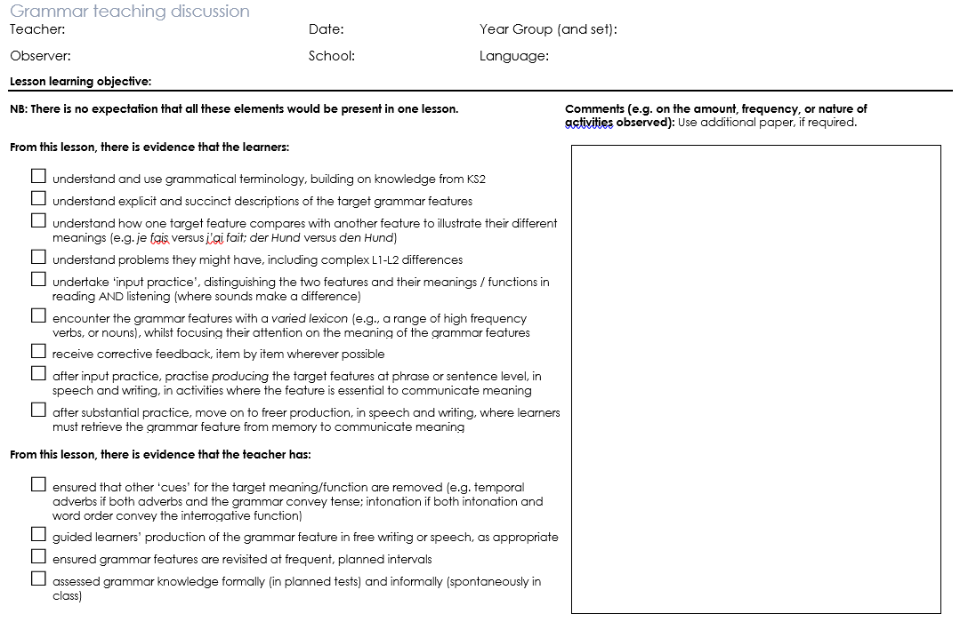
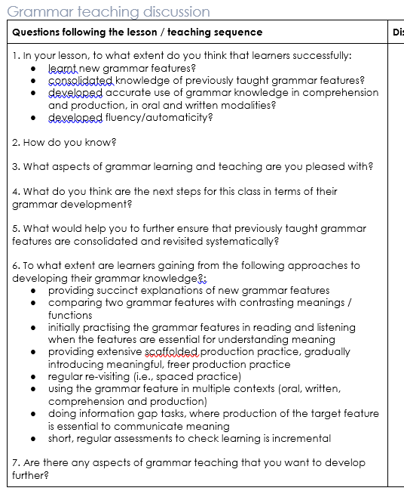
How to teach and learn grammar
In the Autumn, we will be exploring “What children bring with them from KS2”
Emma Marsden / Rowena Kasprowicz
Notes:
How to teach and learn grammar
Handout 9a – Grammar teaching discussion (and handout 9b: grammar teaching discussion sheet incl. VEO tags)
Allow time to read this document. They will not have seen it before but will be familiar with the lay out.
Explain that Autumn term will include session on knowledge about language from KS2. So more information on this to come.
Discussion / any questions – this should align with what we covered in the earlier parts today

Slide 16
Learners…
Introducing the grammar knowledge
understand and use grammatical terminology, building on knowledge from KS2
understand explicit and succinct descriptions of the target grammar features
understand how one target feature compares with another feature to illustrate their different meanings (e.g. je fais versus j’ai fait; der Hund versus den Hund)
understand problems they might have, including complex L1-L2 differences
Embedding and Consolidating: Practice
undertake ‘input practice’, distinguishing the two features and their meanings / functions in reading AND listening (where sounds make a difference)
encounter the grammar features with a varied lexicon (e.g., a range of high frequency verbs, or nouns), whilst focusing their attention on the meaning of the grammar features
receive corrective feedback, item by item wherever possible
after input practice, practise producing the target features at phrase or sentence level, in speech and writing, in activities where the feature is essential to communicate meaning
Extending
after substantial practice, move on to freer production, in speech and writing, where learners must retrieve the grammar feature from memory to communicate meaning
Teachers…
ensured that other ‘cues’ for the target meaning/function are removed (e.g. temporal adverbs if both adverbs and the grammar convey tense; intonation if both intonation and word order convey the interrogative function)
guided learners’ production of the grammar feature in free writing or speech, as appropriate
ensured grammar features are revisited at frequent, planned intervals
assessed grammar knowledge formally (in planned tests) and informally (spontaneously in class)
Rowena Kasprowicz & Emma Marsden
Notes:
How to teach and learn grammar
This slide takes the statements from the Grammar Teaching Discussion document and puts them into phases of grammar learning. The different phases are not clear cut, they definitely merge in to each other: you practise when you are establishing knowledge for the first time, and consolidating knowledge is often also extending it.
Many activities can be repeated for different purposes, depending on how well the grammar is already embedded. These ways of working with grammar are intended to broaden thinking about the range of opportunities we give learners in and outside the classroom.

Slide 17
Content of sample resources
Explanation
Reading
Listening
Writing (controlled)
Speaking (controlled)
Rowena Kasprowicz & Emma Marsden
Notes:
How to teach and learn grammar
We now provide examples of sequences of activities for each of the languages: Spanish, French & German
For each language we will present at least one full sequence:
Explanation
Reading
Listening
Writing (controlled)
Speaking (controlled)
But we will also provide examples of other grammar features, to show how the principles can be extended to a range of features, modes, modalities.
We give examples of 1) verb morphology (that is, verb inflections for person, number, tense) and 2) for syntax (S V order in French) and negation in Spanish.
We also have developed or are currently developing materials for adjectival agreement, for articles, for aspect (imperfect in French - whether something is ongoing or complete).

Slide 18
Example resources for Spanish
Explanation
Reading
Listening
Writing (controlled)
Speaking (controlled)
Rowena Kasprowicz & Emma Marsden
Notes:
How to teach and learn grammar
Go through and discuss example sequence of resources in each language (different grammar features across the three languages). Include syntax example if possible? E.g. question formation?
Please note: There will always be a challenge with the move from input (R/L) activities to production (W/S) activities, in terms of the vocabulary (nouns, prepositions, adjectives etc) needed in the production activities.
The aim is to let learners try to recall the necessary vocabulary (i.e., not always provide whole speaking or writing frames for everything).
But, where necessary, more scaffolding is possible (we have provided lists of vocabulary for teachers to use with selected pupils, perhaps)
Try to focus on rewarding the grammar point under focus, and not worry too much about other things not being accurate . If we want everything to be accurate all the time, this is what leads to very rigid formulae teaching, and the over-use of strict writing frames that don’t provide any desirable difficulty for the learners.
In other words:
The key is that learners are getting the grammatical markers correct and pulling out the verbs from memory. Support with the other vocabulary is ok (particularly in the earlier controlled production activities) and some errors in this other vocabulary can be tolerated (e.g., adjectival agreement if that hasn’t been taught yet).
Try to aim for ‘desirable difficulty’ and resist the temptation to use lots of frames and holistic phrases.

Slide 19
Extending phase: Spanish
Rowena Kasprowicz & Emma Marsden
Notes:
Examples of activities to use in ‘extending phase’
Providing examples of more meaningful practice activities

Slide 20
Example resources for French
Explanation
Reading
Listening
Writing (controlled)
Speaking (controlled)
Rowena Kasprowicz & Emma Marsden
Notes:
How to teach and learn grammar
Go through and discuss example sequence of resources in each language (different grammar features across the three languages). Include syntax example if possible? E.g. question formation?

Slide 21
Extending phase: French
Rowena Kasprowicz & Emma Marsden
Notes:
Examples of activities to use in ‘extending phase’
Providing examples of more meaningful practice activities

Slide 22
Example resources for German
Explanation
Reading
Listening
Writing (controlled)
Speaking (controlled)
Rowena Kasprowicz & Emma Marsden
Notes:
How to teach and learn grammar
Go through and discuss example sequence of resources in each language (different grammar features across the three languages). Include syntax example if possible? E.g. question formation?

Slide 23
Extending phase: German
Rowena Kasprowicz & Emma Marsden
Notes:
Examples of activities to use in ‘extending phase’
Providing examples of more meaningful practice activities

Slide 24
Further resources: Resources portal
Other grammar resources available here: https://resources.ncelp.org
Searchable database.
You will get alerts when new material has been uploaded.
For now, continue to use: https://ncelp.org/resources/resource-portal/
For the phonics, vocabulary, grammar, and residential materials
Eventually, all will be put on the database, and so searchable!
using fine-grained search terms and the title of the document
Rowena Kasprowicz & Emma Marsden
Notes:
Show the Resources portal, if they have internet. Explore what is available.
See also the RESOURCES tab, under Resources Portal, under Grammar

Slide 25
Hands on: Developing resources (R & L)
Activity: Develop a reading or listening activity
Use the principles you’ve seen illustrated
Warning! Perhaps choose one of the problematic grammar features discussed earlier, but the principles can’t always be applied easily!
Reminders:
Practise pairs of grammar features with contrasting meanings (or functions)
Strip out all other cues that might stop the learner focussing on the grammar features, so that the target grammar features are task-essential
(e.g. a car horn covers the subject pronoun, or a paint splodge obscures the temporal adverb, a
computerised voice strips out intonation that might give a clue to interrogatives)
Make sure that the activities actually provide the feature you are focusing on in the input and make learners use it to interpret meaning
Rowena Kasprowicz & Emma Marsden
Notes:
Developing resources for grammar teaching
About 15 minutes
Reviewed a sequence of grammar teaching resources in each of the three languages.
Now going to spend some time developing ideas for other resources.
Activity 1: develop a listening or reading activity for one of the problematic grammatical features discussed earlier in the session. (see slide 8 and discussion of Handout 1)
Allow plenty of time for discussing ideas, coming up with example activities and reviewing and discussing together.

Slide 26
Hands on: Developing resources (W & S)
Activity: From the examples provided, choose a pair of grammar features in one of the languages and design a writing or speaking activity to add to the sequence.
Reminders:
Make sure the target grammar features are task-essential
Use a meaningful context, where the speaker (or writer) is using the grammar to communicate a message that the listener (or reader) needs to understand
Try to avoid providing all of the language that is needed. Encourage learners to try to recall key verbs etc.
Pictures can be used to prompt particular words, so that learners are given some ideas about what to say
Rowena Kasprowicz & Emma Marsden
Notes:
Developing resources for grammar teaching
About 15 minutes
Now going to look at developing controlled production practice resources.
Provide 3 examples of input practice (one from each of 3 languages), for one pair of grammar features (or just choose one language if there is consensus in the group).
Teachers can choose one and then develop a writing and/or speaking activity to practise that pair of grammar features.
Key principle: learners must actively select which grammar they need - not a mechanical repetition of one pattern
Getting the grammar right must matter for communication – their partner or the teacher or the other children in the class should have some reciprocal listening or reading activity that demonstrates that the learners who are PRODUCING the grammar have successfully communicated their message - using the grammar. Recall the response grids that were used in the activities you saw just now.

Slide 27
Question words! What, when, why, which…
Question words cross over the vocabulary and grammar strands
To teach the formation of wh-questions, learners first need secure knowledge of the question words themselves!
But... common chunks (formulae) often give misleading evidence about the meaning of question words e.g.,
quel age as-tu? ‘quel’ doesn’t generally express English ‘how’!
comment tu t’appelles? ‘comment’ doesn’t usually express English ’what’!
(Learners would need help breaking down such chunks of language if they are taught)
Learners need to know the more ‘reliable’ words for frequent question words
Rowena Kasprowicz & Emma Marsden

Slide 28
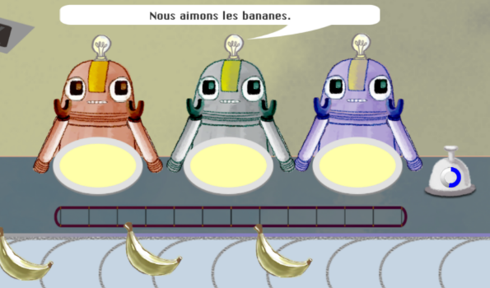
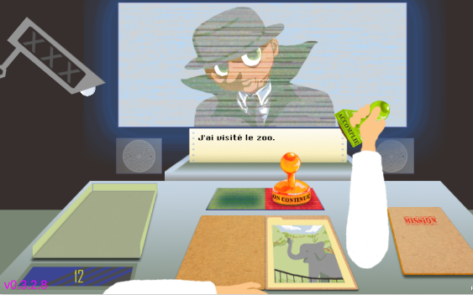
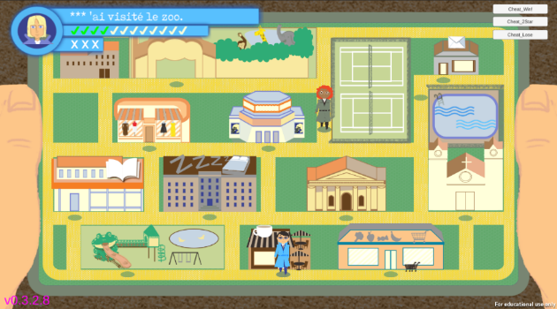
Gaming Grammar: Update
Phase 1: sub-set of mini-games and teacher interface (launch: Autumn 2019)
Mini-games
Singular vs. plural adjective endings
Subject-verb inversion (interrogatives)
Singular vs. plural 1st person present
Singular vs. plural 3rd person present
Present vs. past tense (1st person)
Present vs. past tense (3rd person)
1st vs. 3rd person past tense
Coming soon…
Masculine vs. Feminine definite articles
Rowena Kasprowicz & Emma Marsden
Notes:
These are just illustrations to show you work that is in progress.
Spend no more than about 5 minutes going through these slides about Gaming Grammar.
If there is time, then you can give the following information, as teachers asked for more of this at the residential!:
Game will consist of a series of mini-games – each mini-game practises a particular pair of grammar features. The game is based on a spy theme, and each mini-game is a ‘mission’ the player has to complete.
7 mini-games developed so far. Images are screenshots of some of the mini-games.
For info (if teachers ask about each image/mini-game):
Robots – 1st person sing/pl. Player decides whether to feed one robot, or all of the robots.
Mission file – 1st person present vs. past tense. Player is logging mission reports from other agents; player stamps mission file as ‘ongoing’ (present tense) or ‘completed’ (past tense).
Map – 1st vs. 3rd person past tense. Player has to rendezvous with another agent in the town. A fellow agent is explaining how they completed the mission previously (explaining the moves that they (I) and the other agent (he/she) made last time). Player chooses whether to move themselves (1st person) or the other agent (3rd person) to various locations in the town.

Slide 29
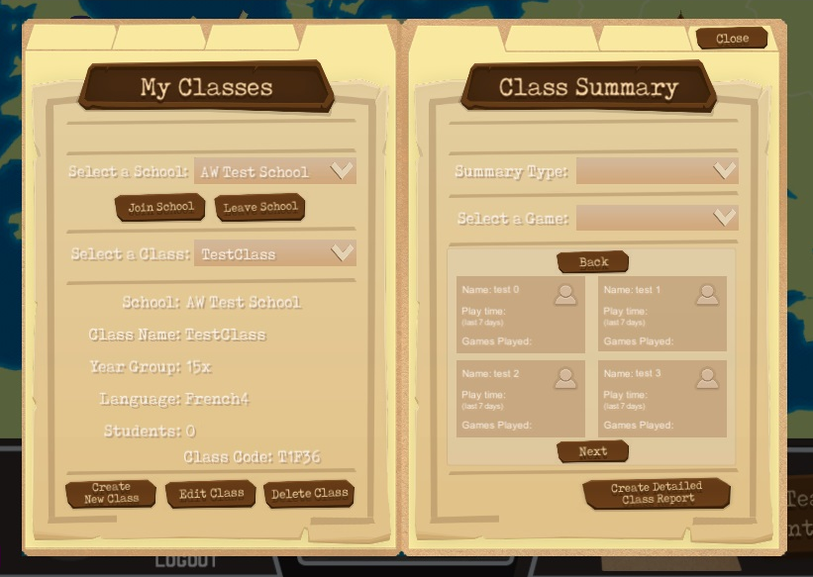
Gaming Grammar: Update
Phase 1: sub-set of mini-games and teacher interface (Autumn 2019)
Teacher interface
Teachers will be able to…
Create multiple ‘classes’ of learners
View and download summary data for a class and all pupils for each mini-game
View information about each mini-game
to support lesson planning
Rowena Kasprowicz & Emma Marsden
Notes:
The teacher interface is currently begin developed, so the screenshot is of a work in progress. Fonts, colours, layout etc will be updated, so that all of the text and information is easy to read and digest. This screenshot just gives a flavour.
Teachers will be able to set-up and manage classes of learners, and view data for their pupils, e.g. scores on each mini-game, number of attempts at each mini-game, amount of time spent playing a mini-game (useful if, for example, a particular mini-game was set as homework). Within the game itself (the right hand side of the screen shot above), teachers will be able to select a particular mini-game and view the summary data for each pupil for that mini-game (number of attempts, best score, play time). They will also be able to download a more detailed class report (button on bottom right hand corner), to view more detailed data for each mini-game (e.g. score on each item in the mini-game).
At Residential 2 and in subsequent CPD sessions, we will present the games and the teacher interface, that should be ready to actually use in schools!

Slide 30
Next steps
Teacher Research Group (TRG) Communicate early via email – directing teachers to the grammar research summaries, sending Handouts 1, 2 and 3 in advance, telling them you will present a lot of sample NCELP resources.
Video parts of lessons where you focus on grammar If possible ahead of the TRG, so you can share as part of that session. Upload to VEO and tag. Let your link specialist (or Rowena or Emma) know that the video is there, and s/he will also tag.
Plan and resources going forward Following the TRG, keep in touch with your Hub schools.
Resources will be added frequently to the Resource Portal. Encourage Hub teachers to share with you and NCELP other examples of the NCELP activities and the principles we have covered today.
If you would like to share your resources via the NCELP Resource Portal, please send them to Enquiries@ncelp.org.uk– we will advise and are happy to help with copyright free images or audio recordings
Teach and reflect Make grammar teaching the focus of your next planned visit and observation. Use the observation schedule as the framework for feedback. Share the document with us Enquiries@ncelp.org.uk .
When are your next key dates? Grammar TRG & Meaningful Practice CPD.
Rowena Kasprowicz & Emma Marsden
Notes:
About 15 minutes on this slide
Ask them if they intend to:
a) video some classes whilst trying out some of the activities and principles covered today
b) visit their hub schools and observe some teaching using the lesson discussion sheet.
For planning for the TRG. NCELP will reduce this slide deck and you will receive it via email. [For the initial two sessions, DS and EM, ask: do you have any initial suggestions about how you might like to see that done?]
Please ask the STs to send to you – to your personal emails - a week or so before their TRG the materials they intend to use and their plan. It is very important that we provide this support and also that we understand what is being delivered.
NB For the ‘Concerns’ activity in which they discuss and critique some examples of grammar presentation and practice in textbooks, we strongly advise the Specialist Teachers to use the copies of textbook extracts that we already used in the Residential (rather than asking Hub school teachers to bring their own – as this could be complex and lead to multiple issue and a discussion that becomes unwieldy).

Slide 31
Summary of the session
Please complete the short feedback survey!
Brief summary of key principles for grammar teaching
Key issue 1: What grammar to teach and when
(determining the difficulty of grammar, order of teaching, setting expectations)
Key issue 2: Principles of how to teach grammar (and the concerns!)
Update on scheme of work (brief in-progress extract)
Grammar teaching discussion document for observing lessons
Sample resources, in three languages, covering range of grammar
Hands-on classroom activity development
Planning for the TRG
✓
✓
✓
✓
✓
✓
✓
✓
✓
Rowena Kasprowicz & Emma Marsden
Notes:
Summarise what has been covered today
Please remind them to complete the feedback survey – this should have been sent to them by email.
Ideally they could complete it in the session so that we get responses.

Slide 32
References
Bui, G., & Skehan, P. (2018). Complexity, fluency and accuracy. In J. Liontas (Ed.), TESOL encyclopedia of English language teaching (pp.1-7). Hoboken, NJ: John Wiley & Sons,
DeKeyser, R. (2005). What makes learning second-language grammar difficult? A review of issues. Language Learning, 55(S1), 1-25.
DeKeyser, R. (2015). Skill acquisition theory. In B. VanPatten & J. Williams (Eds.), Theories in second language acquisition: An introduction (pp. 94–112). London, UK: Routledge. Mitchell, Myles & Marsden, E. (2018).
Ellis, N. (2006). Selective attention, and transfer phenomena in L2 acquisition: Contingency, cue competition, salience, interference, overshadowing, blocking, and perceptual learning. Applied Linguistics, 27(2), 164-194.
Kasprowicz, R. & Marsden, E. (2018). Towards ecological validity in research into input-based practice: Form spotting can be as beneficial as form-meaning practice. Applied Linguistics, 39(6), 886-911.
Lichtman, K. (2016). Age and learning environment: Are children implicit second language learners? Journal of Child Language, 43, 707-730.
Marsden, E. (2006). Exploring input processing in the classroom: An experimental comparison of processing instruction and enriched input. Language Learning, 56, 507–566.
Mitchell, R., Myles, F. & Marsden, E. (2019) Second Language Learning Theories. New York: Routledge.
Norris, J., & Ortega, L. (2001). Does type of instruction make a difference? Substantive findings from a meta-analytic review. Language Learning, 51(S1), 157-213.
Schmidt, R. (1990). The role of consciousness in second language learning. Applied Linguistics, 11(2), 129-158.
Spada, N., & Tomita, Y. (2010) Interactions between type of instruction and type of language feature: A meta-analysis. Language Learning, 60(2), 263-308.
VanPatten, B. (2004). Input processing in SLA. In, VanPatten, B. (ed.), Processing instruction: Theory, research, and commentary. Mahwah, NJ: Lawrence Erlbaum Associates.
White, L., Spada, N., Lightbown, P., & Ranta, L. (1991). Input enhancement and L2 question formation. Applied Linguistics, 12(4), 416-432.
Rowena Kasprowicz & Emma Marsden
Notes:
Selection of relevant research references. References in bold are the 5 OASIS summaries which will be sent out for the TRG meetings.

