Slide 1
Vocabulary
Y7 French
Term 2.2 - Week 5
Kirsten Somerville / Natalie Finlayson
Date updated: 03/04/20
Notes:
Frequency rankings of vocabulary introduced this week (1 is the most common word in French):
2.2.5 - arriver [174], changer [283], créer [332], gagner [258], habiter [1186], monde [77], pays [114], vêtements [2383], politique [128], de [2]
Frequency rankings of vocabulary revisited this week (1 is the most common word in French):
2.2.2 - aéroport [2113], l'étranger [305], hôtel [1774], île [1245], université [1192], États-Unis [n/a], rarement [2535], souvent [287]
2.1.1 - cinq [288], deux [41], dix [372], douze (1664), huit [877], neuf [787], onze (2447), quatre [253], sept [905], six [450], trois [115], des [2 - de]
Source: Londsale, D., & Le Bras, Y. (2009). A Frequency Dictionary of French: Core vocabulary for learners London: Routledge.

Slide 2
Vocabulaire
écouter
to arrive
of
to change
politics
to, at, in
to create
clothes
to win
country
to live
world
1
Notes:
These slides check students’ recognition and understanding of this week’s vocabulary.
This can be done as game in pairs or as a class. Students use their workbooks or mini whiteboards to write down the English translation for the word they hear – the first to hold up the correct translation wins. A more challenging variation would be to hide the English words on the board, so that students write the translation from memory.
TRANSCRIPT:
1. créer

Slide 3
Vocabulaire
écouter
to arrive
of
to change
politics
to, at, in
to create
clothes
to win
country
to live
world
2
Notes:
TRANSCRIPT:
2. le pays

Slide 4
Vocabulaire
écouter
to arrive
of
to change
politics
to, at, in
to create
clothes
to win
country
to live
world
3
Notes:
TRANSCRIPT:
3. changer

Slide 5
Vocabulaire
écouter
to arrive
of
to change
politics
to, at, in
to create
clothes
to win
country
to live
world
4
Notes:
TRANSCRIPT:
4. habiter

Slide 6
Vocabulaire
écouter
to arrive
of
to change
politics
to, at, in
to create
clothes
to win
country
to live
world
5
Notes:
TRANSCRIPT:
5. de

Slide 7
Vocabulaire
écouter
to arrive
of
to change
politics
to, at, in
to create
clothes
to win
country
to live
world
6
Notes:
TRANSCRIPT:
6. arriver

Slide 8
Vocabulaire
écouter
to arrive
of
to change
politics
to, at, in
to create
clothes
to win
country
to live
world
7
Notes:
TRANSCRIPT:
7. les vêtements

Slide 9
Vocabulaire
écouter
to arrive
of
to change
politics
to, at, in
to create
clothes
to win
country
to live
world
8
Notes:
TRANSCRIPT:
8. gagner

Slide 10
Vocabulaire
écouter
to arrive
of
to change
politics
to, at, in
to create
clothes
to win
country
to live
world
9
Notes:
TRANSCRIPT:
9. la politique

Slide 11
Vocabulaire
écouter
to arrive
of
to change
politics
to, at, in
to create
clothes
to win
country
to live
world
10
Notes:
TRANSCRIPT:
10. le monde

Slide 12
Vocabulaire
écouter
to arrive
of
to change
politics
to, at, in
to create
clothes
to win
country
to live
world
11
Notes:
TRANSCRIPT:
10. à

Slide 13
Vocabulaire
parler
arriver
de
changer
à
la politique
créer
les vêtements
gagner
le pays
habiter
le monde
to win
Notes:
Now, students’ pronunciation of the new vocabulary is checked in this speaking exercise.
Elicit the French for the English word in blue.

Slide 14
Vocabulaire
parler
arriver
de
changer
à
la politique
créer
les vêtements
gagner
le pays
habiter
le monde
world

Slide 15
Vocabulaire
parler
arriver
de
changer
à
la politique
créer
les vêtements
gagner
le pays
habiter
le monde
to create

Slide 16
Vocabulaire
parler
arriver
de
changer
à
la politique
créer
les vêtements
gagner
le pays
habiter
le monde
of

Slide 17
Vocabulaire
parler
arriver
de
changer
à
la politique
créer
les vêtements
gagner
le pays
habiter
le monde
country

Slide 18
Vocabulaire
parler
arriver
de
changer
à
la politique
créer
les vêtements
gagner
le pays
habiter
le monde
to, at, in

Slide 19
Vocabulaire
parler
arriver
de
changer
à
la politique
créer
les vêtements
gagner
le pays
habiter
le monde
clothes

Slide 20
Vocabulaire
parler
arriver
de
changer
à
la politique
créer
les vêtements
gagner
le pays
habiter
le monde
to arrive

Slide 21
Vocabulaire
parler
arriver
de
changer
à
la politique
créer
les vêtements
gagner
le pays
habiter
le monde
to live

Slide 22
Vocabulaire
parler
arriver
de
changer
à
la politique
créer
les vêtements
gagner
le pays
habiter
le monde
politics

Slide 23
Vocabulaire
parler
arriver
de
changer
à
la politique
créer
les vêtements
gagner
le pays
habiter
le monde
to change

Slide 24
Saying ‘to’ and ‘in’ in French
grammaire
Remember! To talk about going ‘to’ a place in French, we use…
the preposition à for a village, town or city:
Je vais à Paris.
aller is a verb that shows movement towards a place
I go / I am going to Paris.
the preposition en for most countries:
Je vais en France.
I go / I am going to France.
These prepositions mean ‘to’ when used with the verb aller.
Notes:
This slide reviews the previous week’s work on the prepositions “à” and “en” = “to” when talking about going to villages/towns/cities or countries.

Slide 25
Saying ‘to’ and ‘in’ in French
grammaire
These prepositions can also mean ‘in’, when used with…
the verb arriver:
J’arrive à Paris.
I arrive / I am arriving in Paris.
J’arrive en France.
I arrive / I am arriving in France.
arriver and habiter are verbs that show location in a place
the verb habiter:
J’habite à Paris.
I live / I am living in Paris.
J’habite en France.
I live / I am living in France.
Notes:
This slide introduces the meaning “in” when used with verbs of location, illustrated by the verbs “arriver” and “habiter” (which are introduced in this week’s vocabulary).

Slide 26
Saying ‘to’ and ‘in’ in French
Remember!
The translation is different for verbs of movement and location.
lire
Lis les phrases. Coche la réponse correcte.
 |  | ‘in’ | ‘to’
1. | Je vais à Lausanne.
2. | Tu habites à Lille.
3. | Il arrive à Dakar.
4. | Elle va à Londres.
 |  | ‘in’ | ‘to’
5. | J’arrive en Angleterre.
6. | Tu vas en Écosse.
7. | Il va en Guadeloupe.
8. | Elle habite en Tunisie.
Notes:
This reading activity practises the different translation of the two prepositions with verbs of movement and location.
Attention should be drawn to the fact that the same preposition can be translated differently depending on the context.

Slide 27
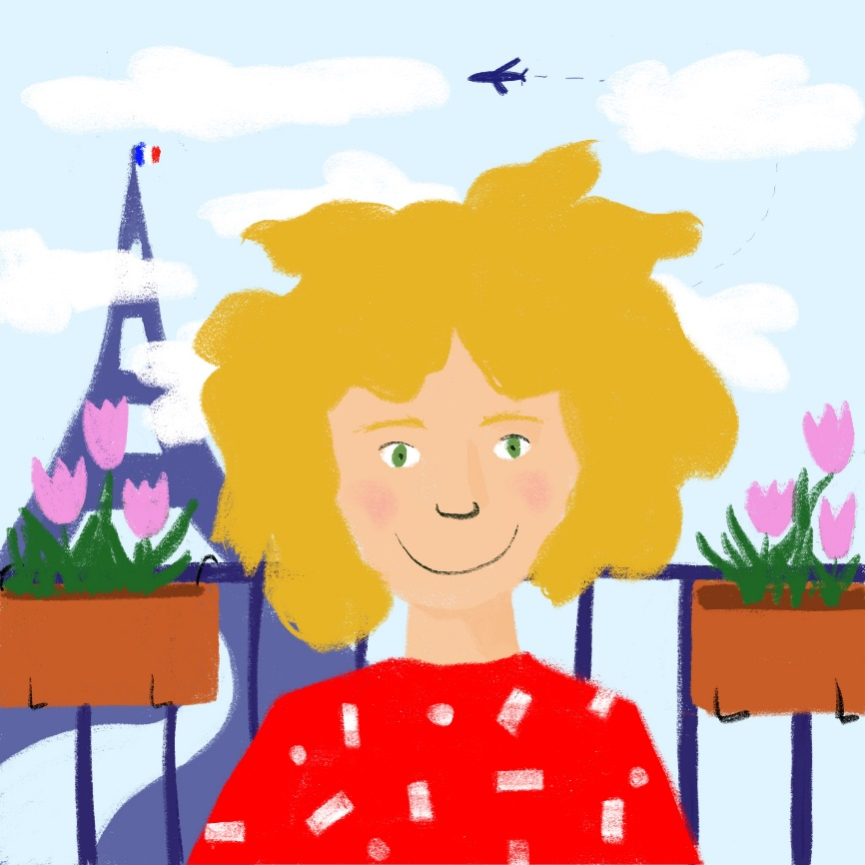
Complète le profil
lire / écrire
Salut, je suis Léa ! Je porte souvent des __________ rouges. Au collège, j’aime la géographie : j’aime étudier le __________. J’aime la __________ aussi. Ça __________ chaque jour ! J’ai un cousin, Amir. Il __________ à Paris samedi.
Remember!
Samedi means ‘on Saturday’.
Le samedi means ‘on Saturdays’.
arrive
change
créer
gagne
habite
monde
pays
politique
vêtements
de
Notes:
This vocabulary is now practised in context. This requires students to pay attention to the form and meaning of the vocabulary in relation to other words they have learned. These slides also introduce Léa and Amir, who will be recurring characters in the French Scheme of Work.
Students choose one of the orange words to fill each gap, writing them in order. This activity could be extended by translating each paragraph into English.
Frequency information for non-SOW (near-)cognates:
compléter [2034], cousin [3387], géographie [>5000], profil [2552]
Source: Londsale, D., & Le Bras, Y. (2009). A Frequency Dictionary of French: Core vocabulary for learners London: Routledge.

Slide 28
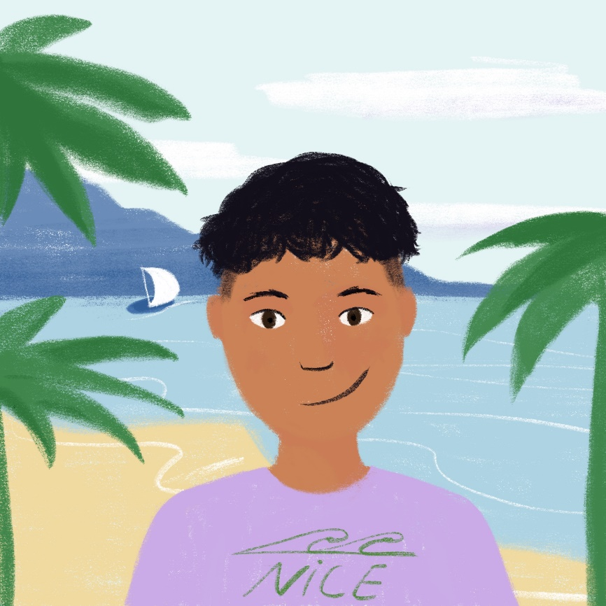
Complète le profil
lire / écrire
Salut, je suis Amir ! Je suis le cousin __________ Léa. J’__________ à Nice, mais samedi, je vais à Paris. J’ai des cousins en Algérie aussi. C’est un __________ cool ! J’aime faire la cuisine et __________ des menus. Quand je joue au foot, je __________ chaque match !
arrive
change
créer
gagne
habite
monde
pays
politique
vêtements
de
Notes:
Frequency information for non-SOW (near-)cognates:
compléter [2034], Algérie [N/A], cousin [3387], foot [2602 (football)], match [1906], menu [3470], profil [2552], cool [>5000]
Source: Londsale, D., & Le Bras, Y. (2009). A Frequency Dictionary of French: Core vocabulary for learners London: Routledge.

Slide 29
Using the preposition ‘de’
grammaire
To say ‘of’ in French, we use the preposition de:
le président de la France
the president of France
We don’t always translate this word directly into English:
le professeur de français
the French teacher
le cousin de Léa
Léa’s cousin
Sometimes, it sounds more natural to switch the nouns around.
Notes:
This slide introduces the different ways of translating of ‘de’ in English.

Slide 30
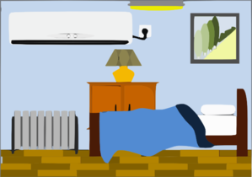
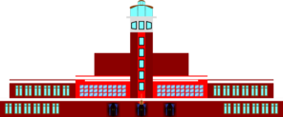
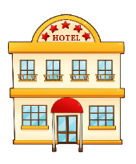
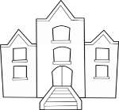
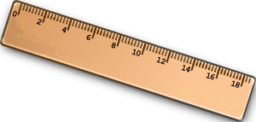
Parle en français !
e.g. 2
« Il y a deux îles »
parler
Remember to make the liaison if the word starts with a vowel!
3
9
5
1
11
8
2
10
7
6
4
12
Notes:
This slide incorporates words from each of the two vocabulary sets to be revisited in this week, as well as some previously–encountered nouns. The numbers are not sequentially-presented, in order to increase the degree of desirable difficulty’.
Students say how many of each thing pictured there are, using ‘il y a’, paying particular attention to the liaison where needed (starred below).
2.2.2 - aéroport [2113], l'étranger [305], hôtel [1774], île [1245], université [1192], États-Unis [n/a], rarement [2535], souvent [287]
2.1.1 - cinq [288], deux [41], dix [372], douze (1664), huit [877], neuf [787], onze (2447), quatre [253], sept [905], six [450], trois [115], des [2 - de]
ANSWERS :
trois aéroports*
un hôtel*
deux universités*
six voitures
neuf parcs
onze trains
dix bateaux
quatre règles
cinq chambres
huit vélos
sept portables
douze livres

