Slide 1
What is it (not) and what is it (not) like?
Negation: nicht + adjective; kein + nouns (Row 1-Nominative)
SSC [z]
Y7 German
Term 1.1 - Week 4 - Lesson 7
Rachel Hawkes
Artwork: Steve Clarke
Date updated: 15/12/21
Notes:
Artwork by Steve Clarke. All additional pictures selected are available under a Creative Common license; no attribution required.
Learning outcomes (lesson 1):
Introduction of SSC [z]
Introduction of negation: nicht + adjective; kein + nouns (Row 1-Nominative)
Word frequency (1 is the most frequent word in German):
7.1.1.4 (introduce) wissen [78] bist [4] du [54] Farbe [1079] Nummer [806] Ort [341] Tier [614] aber [31] kein [46] ich weiß nicht [n/a] wie sagt man [n/a] wie schreibt man [n/a]
das ist (nicht) klar
7.1.1.1 (revisit) sein¹, ist [4] Fenster [674] Flasche [1602] Heft [3862] Tafel [3855] Tisch [529] da [48] hier [68] wo? [108] der, die, das [1] Hallo! [1077] Tschüs! [3766]
Source: Jones, R.L. & Tschirner, E. (2019). A frequency dictionary of German: core vocabulary for learners. Routledge

Slide 2
wie
sprechen
wie?
how?
Wie sagt man…?
[How do you say…?]
Notes:
Timing: 1 minute
Aim: To introduce and practise the important phrase ‘Wie sagt man’.
Procedure: 1. Model the phrase, and use it to ask students to recall the meanings of some words from previous lessons.
2. Encourage students to realise the importance of the phrase for asking questions whenever meanings are unclear. E.g. Wie sagt man ‘ein Tisch’ auf Englisch? Wie sagt man ‘an exercise book’ auf Deutsch? Word frequency (1 is the most frequent word in German): wie [28] sagen [46] man [34] Source: Jones, R.L. & Tschirner, E. (2011). A frequency dictionary of German: core vocabulary for learners. Routledge

Slide 3
z
Zug
Notes:
Timing: 1 minute
Aim: To introduce/consolidate SSC [z]
Procedure: 1. Present the letter(s) and say the [z] sound first, on its own. Students repeat it with you. 2. Bring up the word “Zug” on its own, say it, students repeat it, so that they have the opportunity to focus all of their attention on the connection between the written word and its sound.
3. A possible gesture for this would be to mime wheels, holding your hands at your sides, elbows bent, forearms facing forwards in a right angle, and draw small circles with them, in the air (to denote the wheels of a train going round).
4. Roll back the animations and work through 1-3 again, but this time, dropping your voice completely to listen carefully to the students saying the [z] sound, pronouncing ”Zug” and, if using, doing the gesture. Word frequency (1 is the most frequent word in German): Zug [613] Source: Jones, R.L. & Tschirner, E. (2006). A frequency dictionary of German: core vocabulary for learners. Routledge

Slide 4
z
Zug
Notes:
With sound and no pictures to focus all attention on the sound-symbol correspondence.

Slide 5
z
Zug
Notes:
Without sound to elicit pronunciation (without first hearing the teacher).
Teacher to elicit pronunciation by asking “Wie sagt man…”

Slide 6
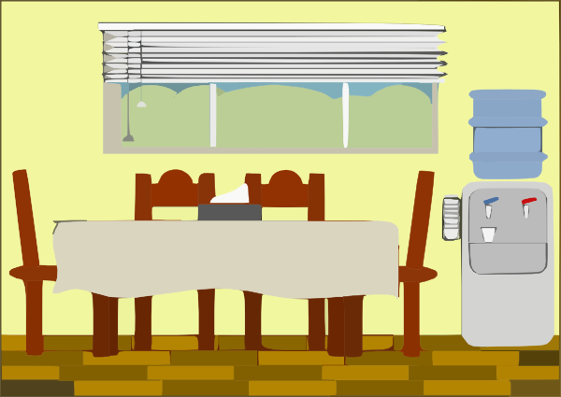
z
Zimmer
zehn
Zug
Arzt
sitzen
Platz
Notes:
Timing: 2 minutes
Aim: To introduce/consolidate SSC [z]
Procedure:
Introduce and elicit the pronunciation of the individual SSC [z] and then the source word again ‘Zug’ (with gesture, if using).
Then present and elicit the pronunciation of the five cluster words.
The cluster words have been chosen for their high-frequency, from a range of word classes, with the SSC (where possible) positioned within a variety of syllables within the words (e.g. initial, 2nd, final etc.). Additionally, we have tried to use words that build cumulatively on previously taught SSCs (see the Phonics Teaching Sequence document) and do not include new SSCs. Where new SSCs are used, they are often consonants which have a similar symbol-sound correspondence in English.
Word frequency (1 is the most frequent word in German): Zug [613]; Zimmer [609] zehn [314]; Arzt [614]; Platz [344]; sitzen [261]. Source: Jones, R.L. & Tschirner, E. (2006). A frequency dictionary of German: core vocabulary for learners. Routledge

Slide 7
z
Zimmer
zehn
Zug
Arzt
sitzen
Platz
Notes:
With sound and no pictures to focus all attention on the sound-symbol correspondence.

Slide 8
z
Zimmer
zehn
Zug
Arzt
sitzen
Platz
Notes:
Without sound to elicit pronunciation (without first hearing the teacher).
Teacher to elicit pronunciation by asking “Wie sagt man…”

Slide 9
Negation
Grammatik
In German, to say ‘not’ with adjectives, use ‘nicht’:
We sometimes use ‘no’ in English, too: That’s no problem! Das ist kein Problem!
Das ist rot.
That is red.
‘kein’ works like ‘ein’ and matches the gender of the noun.
Das ist nicht rot.
That is not red. / That isn’t red.
To say ‘not a’ with nouns, use ‘kein’:
Das ist kein Mensch.
That is not a human being.
Das ist keine Form.
That is not a shape.
Das ist kein Ding.
That is not a thing.
Notes:
Timing: 2 minutes Aim: To introduce the negative forms of ‘nicht’ with adjectives and ‘kein’ with nouns.
Procedure: 1. Click on the mouse to animate the explanation.
2. Check students’ understanding at each stage.
Word frequency (1 is the most frequent word in German): Ding [337] Form [300] Mensch [104] rot [381] wie? [28] ein, eine [5] kein. keine [50]
Source: Jones, R.L. & Tschirner, E. (2011). A frequency dictionary of German: core vocabulary for learners. Routledge

Slide 10
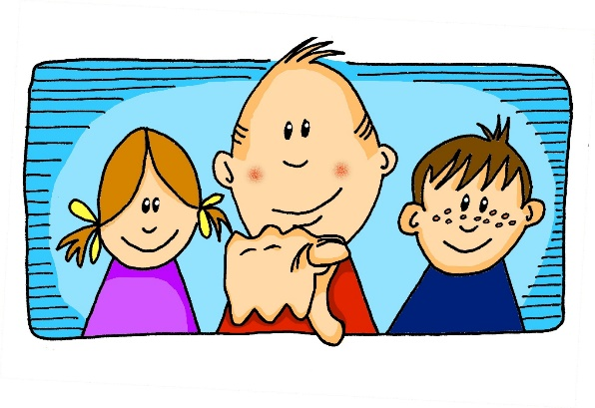
Grammatik
sprechen
Bist du …?
Ich bin keine Form.
Nein
eine Form
Ja
Notes:
Timing: 8 minutes (all 6 slides) Aim: To practise kein/keine/kein, eliciting the answer ‘Ich bin’ to ensure that these forms and meanings are fully practised, before asking students to actively differentiate between ‘kein’ and ‘nicht’.
Procedure: 1. Teacher asks ‘Bist du ein…?’
2. Students respond ‘Ich bin kein/keine/kein...’ or ‘Ich bin ein/eine/ein...’ when correct. Word frequency (1 is the most frequent word in German): Ding [337] Form [300] Mensch [104] rot [381] wie? [28] ein, eine [5] kein. keine [50]
Source: Jones, R.L. & Tschirner, E. (2011). A frequency dictionary of German: core vocabulary for learners. Routledge

Slide 11
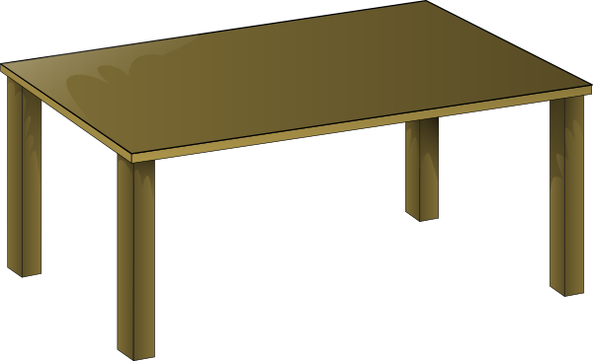
Grammatik
sprechen
Nein
eine Form
Ja
Notes:
Bist du ein Tisch? → Ich bin kein Tisch

Slide 12
Grammatik
sprechen
Nein
Ja
Notes:
Bist du ein Heft? → Ich bin kein Heft.

Slide 13
Grammatik
sprechen
Nein
Ja
Notes:
Bist du ein Tier? → Ich bin kein Tier.

Slide 14
Grammatik
sprechen
Nein
eine Form
Ja
Notes:
Bist du eine Flasche? → Ich bin keine Flasche.

Slide 15
Grammatik
sprechen
Nein
Ja
Notes:
Bist du ein Mensch? → Ich bin ein Mensch.

Slide 16
SEIN (to be | being)
Grammatik
Note: ‘bin’ (am), ‘bist’ (are) and ‘ist’ (is) are all forms of the verb
SEIN (to be | being).
Ich bin ein Mensch.
I am a human being.
Du bist ein Mensch.
You are a human being.
Das ist ein Mensch.
That is a human being.
Notes:
Timing: 2 minutes
Aim: To remind students that ‘am’, are’ and ‘is’ are all parts of the verb ‘BE’ - this is often something that students are not clear about, without explicit reminders, as the verbs are so irregular in German and English. Procedure: 1. Bring up each German phrase and elicit the English for each.
2. Then bring up the note that reminds students that bin, bist and ist are all part of the same verb SEIN (to be) Word frequency (1 is the most frequent word in German): sein [3] der Mensch [104] Source: Jones, R.L. & Tschirner, E. (2011). A frequency dictionary of German: core vocabulary for learners. Routledge

Slide 17
Grammatik
sprechen
Ist das ein Ding?
Das ist kein Ding.
Nein
Ja
Notes:
Timing: 8 minutes (all 6 slides) Aim: To prompt a deeper level of processing of ‘kein/keine/kein’ vs ‘ein/eine/ein’, as more of them are affirmative answers. Procedure: 1. Teacher asks ‘Ist das ein… ?’
2. Students respond ‘Das ist kein/keine/kein...’ or ‘Das ist ein/eine/ein...’ when correct. Word frequency (1 is the most frequent word in German): Ding [337] Form [300] Mensch [104] rot [381] wie? [28] ein, eine [5] kein. keine [50]
Source: Jones, R.L. & Tschirner, E. (2011). A frequency dictionary of German: core vocabulary for learners. Routledge

Slide 18
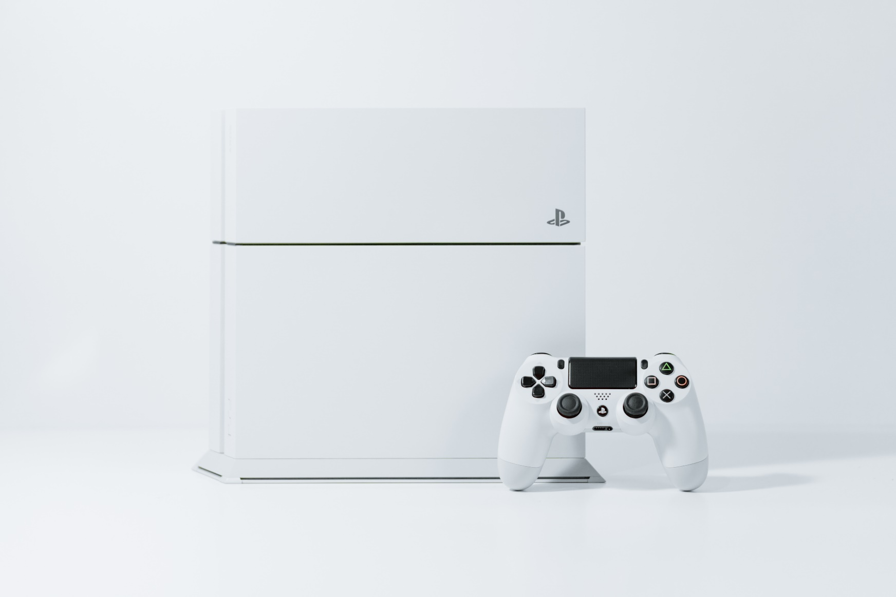
Grammatik
sprechen
Nein
Ja
Notes:
Ist das ein Mensch? → Das ist kein Mensch.

Slide 19
Grammatik
sprechen
Nein
Ja
Notes:
Ist das eine Form? → Das ist eine Form.

Slide 20
Grammatik
sprechen
Nein
Ja
Notes:
Ist das ein Mensch? → Das ist ein Mensch.

Slide 21
Grammatik
sprechen
Nein
Ja
Notes:
Ist das ein Ding? → Das ist kein Ding.

Slide 22
Grammatik
sprechen
Nein
Ja
Notes:
Ist das eine Form? → Das ist keine Form.

Slide 23
Grammatik [1]
Your boss needs help! The quiz items for a new radio show got corrupted. ☹ Look at the items described and, if necessary, add in the missing words.
lesen
1 | Ich bin _______ rot.
2 | Ich bin _______ Mensch.
3 | Ich bin _______ groß.
4 | Ich bin _______ Ding.
5 | Ich bin ________ Tafel.
6 | Ich bin ________ gelb.
7 | Ich bin ________ Tisch.
8 | Ich bin ________ blau.
nicht
keine
kein
nicht
nicht
kein
kein
nicht
Notes:
Timing: 5 minutes (either [1] or [2]) Aim: To practise selecting the correct negative form, according to the meaning.
Note: This is the more straightforward version of the task, in which only ‘nicht’ or ‘kein/keine/kein’ are possible.
A more challenging version, which works in the same way, is to be found on the next slide. Procedure: 1. Students consider each question and decide on the appropriate form to fill each gap.
2. click on the mouse to animate the answers.
Word frequency (1 is the most frequent word in German): ist [3] Heft [3598] Tafel [3660] Tisch [494] ich bin [8/3] Ding [337] Form [300] Mensch [104] blau [1016] gelb [1819] groß1 [74] klein [114] rot [381] ein, eine [5] kein, keine [50]
Source: Jones, R.L. & Tschirner, E. (2011). A frequency dictionary of German: core vocabulary for learners. Routledge

Slide 24
Grammatik [2]
Your boss needs help! The quiz items for a new radio show got corrupted. ☹ Look at the items described and, if necessary, add in the missing words.
lesen
1 | Ich bin _______ rot.
2 | Ich bin _______ Mensch.
3 | Ich bin _______ klein.
4 | Ich bin _______ Ding.
5 | Ich bin ________ blau.
6 | Ich bin ________ gelb.
7 | Ich bin ________ Tisch.
8 | Ich bin ________ Heft.
nicht
kein
nicht
kein
kein
ein
Notes:
Aim: To practise selecting the correct article or negative form, according to the meaning.
Note: This is the more challenging version of the task on the previous slide, because four answers are possible.
Stress the instruction ‘if necessary’ and reinforce the message that ‘nothing’ is a possible answer, here. The four possibilities are: nicht, kein(e), nothing, ein(e).

Slide 25
Grammatik [3]
The quiz goes live tonight! Listening to a practice session, you notice more corrupted items. Look at the items below and add in the missing words.
hören
1 | Ich bin _______ rot.
2 | Ich bin _______ Form.
3 | Ich bin _______ klein.
4 | Ich bin _______ Tisch.
1 | Ich bin _______ Ding.
2 | Ich bin _______ groß.
3 | Ich bin _______ blau.
4 | Ich bin _______ Orange.
1
1
nicht
ein
2
2
keine
nicht
3
3
nicht
nicht
4
4
kein
keine
Notes:
Timing: 5 minutes (either [3] or [4]) Aim: To practise selecting the correct article or negative form based on what is heard.
Note: A more challenging version of this activity is on the next slide. Procedure: 1. Click on the audio buttons to play each item.
2. Students read each setnece and, on the basis of what is heard, select the correct article or negative form to fill each gap.
Transcript:
Eins. [Presenter] Bist du blau?
[Contestant] Ja. Zwei. [Presenter] Bist du eine Form?
[Contestant] Nein.
Drei. [Presenter] Bist du groß?
[Contestant] Ja.
Vier. [Presenter] Bist du ein Zug?
[Contestant] Ja!
Eins. [Presenter] Bist du ein Ding?
[Contestant] Ja. Zwei. [Presenter] Bist du klein?
[Contestant] Ja.
Drei. [Presenter] Bist du gelb?
[Contestant] Ja.
Vier. [Presenter] Bist du eine Banane?
[Contestant] Ja!
Word frequency (1 is the most frequent word in German): ist [3] Heft [3598] Tafel [3660] Tisch [494] ich bin [8/3] Ding [337] Form [300] Mensch [104] blau [1016] gelb [1819] groß1 [74] klein [114] rot [381] ein, eine [5] kein, keine [50] Source: Jones, R.L. & Tschirner, E. (2011). A frequency dictionary of German: core vocabulary for learners. Routledge

Slide 26
Grammatik [4]
The quiz goes live tonight! Listening to a practice session, you notice more corrupted items. Look at the items below and, if necessary, add in the missing words.
hören
1 | Ich bin _______ rot.
2 | Ich bin _______ Form.
3 | Ich bin _______ klein.
4 | Ich bin _______ Tisch.
1 | Ich bin _______ Ding.
2 | Ich bin _______ groß.
3 | Ich bin _______ gelb.
4 | Ich bin _______ Banane.
1
1
Note: You may not ALWAYS need ‘nicht’ or ‘kein(e)’. Listen carefully. You may need ‘ein’ or nothing.
nicht
ein
2
2
keine
nicht
3
3
nicht
4
4
kein
eine
Notes:
Note: In this more challenging version of the task, students are alerted to the possibility of 4 different answers (as in the reading).
In the 2nd set of 4 questions, these possibilities are used.
Transcript:
Eins. [Presenter] Bist du blau?
[Contestant] Ja. Zwei. [Presenter] Bist du eine Form?
[Contestant] Nein.
Drei. [Presenter] Bist du groß?
[Contestant] Ja.
Vier. [Presenter] Bist du ein Zug?
[Contestant] Ja!
Eins. [Presenter] Bist du ein Ding?
[Contestant] Ja. Zwei. [Presenter] Bist du klein?
[Contestant] Ja.
Drei. [Presenter] Bist du gelb?
[Contestant] Ja.
Vier. [Presenter] Bist du eine Banane?
[Contestant] Ja!

Slide 27
Vokabeln
sprechen
 | Word | English meaning
1 | du | you (singular)
2 | du bist | you are (BE)
3 | kein | not a
4 | die Farbe | colour
5 | die Nummer | number
6 | das Tier | animal
7 | der Ort | place
8 | aber | but
9 | wie sagt man…? | how do you say…?
10 | wie schreibt man…? | how do you write…?
11 | ich weiß nicht | I don’t know
12 | wissen | to know, knowing
60
0
LOS!
Notes:
Timing: 5 minutes Aim: To present the new vocabulary for Week 4.
Note: Given the important of knowing the genders of the nouns (generally, but specifically for the upcoming speaking activity), teachers could pick out place, thing and animal and elicit the German with correct article to conclude this activity and prime for the speaking activity on the following slide.
Procedure: 1. Students first study the list for a minute, with both German and English meanings visible.
2. Then the English is covered, and in pairs, (or individually) students try to recall the English meanings of each word, noting the words that are tricky to retrieve.
3. Then the German meanings are obscured, and students work in pairs to try to recall as many of the German words as they can in one minute.
4. Reassure them that the expectation is not that they know them all at this stage, but that the process of trying to retrieve them is part of the learning itself.
5. Finally, give students a final minute with the full list, German and English, and ask them to focus on the words that were most difficulty to remember.
Word frequency (1 is the most frequent word in German): du bist [52/3] wissen [79] weiß [79] kein [50] die Farbe [929] die Form [300] die Nummer [1048] das Tier [670] der Ort [383] aber [32] ich weiß nicht [8/79/12] wie sagt man [28/48/36] wie schreibt man [28/247/48]
Source: Jones, R.L. & Tschirner, E. (2011). A frequency dictionary of German: core vocabulary for learners. Routledge

Slide 28
Vokabeln
Ort, Form oder Tier?
sprechen
Bist du ein Ort?
Ich bin kein Ort.
Mia keeps her card and it’s her turn.
Ich bin ein Tier.
Bist du ein Tier?
Wolfgang has to give up his card and it’s still Mia’s turn.
Bist du eine Form?
Ich bin keine Form.
Nein! Ach….!
Wolfgang keeps his card and it’s his turn.
Mia said ‘Nein’ so forfeits her card!
Bist du eine Form?
Notes:
Timing: 10 minutes (5 minutes’ creation + 5 minutes playing the game) Aim: To practise the forms of ‘ein’ and ‘kein’ learned so far, in the speaking modality.
Procedure: Yes/No game (i.e. you are not allowed to say Ja/Nein or you forfeit your card). The aim of the game is to win all of your partner’s cards (or be the one to have the most cards when the time runs out).
Create own set of mini flashcards (1 x piece A4 paper folded into 12 rectangles) drawing any animals, places, shapes. Set time limit for the creation – count down 5-4-3-2-1 for the drawing of each item.. Join own set with another person's. Mix them up and deal them equally.
Note: It’s important to draw students’ attention (again) to the gender of the nouns DER ORT, DIE FORM, DAS TIER, as the focus of this task is to correctly produce either ‘ein/eine’ or ‘kein/keine’ depending on the meaning, but also differentiating for gender. Place, shape or animal are the choices. You ask this of your partner, who either answers affirmatively (without Yes) or negatively (without No). If you guess correctly with your question, you win your partner’s card. If not, s/he keeps the card and play passes. If you say Nein by mistake (instead of ‘Ich bin keine Form’) you also lose your card.
Ask 'Bist du eine Form?'
Answer: Ich bin eine Form (have to give up your card)
Ich bin keine Form (get to keep your card).
Word frequency (1 is the most frequent word in German): ist [3] Heft [3598] Tafel [3660] Tisch [494] ich bin [8/3] Ding [337] Form [300] Mensch [104] blau [1016] gelb [1819] groß1 [74] klein [114] rot [381] ein, eine [5] kein, keine [50] Source: Jones, R.L. & Tschirner, E. (2011). A frequency dictionary of German: core vocabulary for learners. Routledge

Slide 29
What is it (not) and what is it (not) like?
Introduction of the German alphabet, the Spelling Bee competition
and Quizlet
Y7 German
Term 1.1 - Week 4 - Lesson 8
Rachel Hawkes
Artwork: Steve Clarke
Date updated: 15/12/21
Notes:
Artwork by Steve Clarke. All additional pictures selected are available under a Creative Common license; no attribution required.
Learning outcomes (lesson 2):
Introduction of the German alphabet, the Spelling Bee competition and Quizlet
Word frequency (1 is the most frequent word in German):
7.1.1.4 (introduce) wissen [78] bist [4] du [54] Farbe [1079] Nummer [806] Ort [341] Tier [614] aber [31] kein [46] ich weiß nicht [n/a] wie sagt man [n/a] wie schreibt man [n/a]
das ist (nicht) klar
7.1.1.1 (revisit) sein¹, ist [4] Fenster [674] Flasche [1602] Heft [3862] Tafel [3855] Tisch [529] da [48] hier [68] wo? [108] der, die, das [1] Hallo! [1077] Tschüs! [3766]
Source: Jones, R.L. & Tschirner, E. (2019). A frequency dictionary of German: core vocabulary for learners. Routledge

Slide 30
wie
sprechen
wie?
how?
____ geht’s?
Wie
[How’s it going?]
Notes:
Timing: 2 minutes (both slides)
Aim: To recap the important phrase ‘Wie geht’s?’, and the possible answers learnt last week.
Procedure: 1. Recap the phrase, and the possible answers on the next slide.
2. Students can ask 2-3 other students in the class.
Word frequency (1 is the most frequent word in German): wie [28] sagen [46] man [34] Source: Jones, R.L. & Tschirner, E. (2011). A frequency dictionary of German: core vocabulary for learners. Routledge

Slide 31
wie
sprechen
gut
Ja, es geht.
nicht so gut
Notes:
These are the possible answers.

Slide 32
wie
sprechen
wie?
how?
Wie schreibt man…?
[How do you write…?]
Rachel Hawkes
Notes:
Timing: 1 minute
Aim: To introduce and practise the important phrase ‘Wie schreibt man’.
Procedure: 1. Model the phrase, and use it to ask students to recall the meanings of some words from previous lessons.
2. Encourage students to realise the importance of the phrase for asking questions whenever spellings are unclear. This language is connected to the learning of the alphabet, and introduction to the spelling bee. Word frequency (1 is the most frequent word in German): wie [28] schreiben [247] man [34]
Source: Jones, R.L. & Tschirner, E. (2011). A frequency dictionary of German: core vocabulary for learners. Routledge

Slide 33
alphabet
hören
Notes:
Timing: 5 minutes
Aim: To introduce the letters of the alphabet.
Procedure: 1. click on the mouse to bring up each letter one at a time, with audio.
2. Students repeat.

Slide 34
alphabet
ABCDEFG
sprechen
HIJKLMN
OPQRSTU
VWXYZ
Notes:
Timing: 3 minutes
Aim: To practise the letters of the alphabet.
Procedure: 1. Use the ‘drill instructor’ chant/song to learn the alphabet. Teacher will lead first but after some practice, individuals can take on this role, or class can be split into two halves etc. Have fun with it.

Slide 35
alphabet
sprechen
 | A | B | C | D | E | F | G | H | I | J | K
P | a | l | x | i | t | e | p | b | m | y | j
Q | b | m | y | j | u | f | q | c | n | z | k
R | c | n | z | k | v | g | r | d | o | a | l
S | d | o | a | l | w | h | s | e | p | b | m
T | e | p | b | m | x | i | t | f | q | c | n
U | f | r | c | n | y | j | u | g | r | d | o
V | g | s | d | o | z | k | v | h | s | e | p
W | h | t | e | p | a | l | w | i | t | f | q
X | i | u | f | q | b | m | x | j | u | g | r
Y | j | v | g | r | c | n | y | k | v | h | s
Z | k | w | h | s | d | o | z | l | w | i | t
Notes:
Timing: 5 minutes
Aim: To practise, in pairs, saying the letters of the alphabet.
Procedure: 1. Make small grids for the pupils to stick into their books.
2. Pupil A chooses grid coordinates (e.g. C, X) and pupil B has to say which letter those coordinates meet at (e.g. f). Obviously the pronunciation of the letters is German!

Slide 36
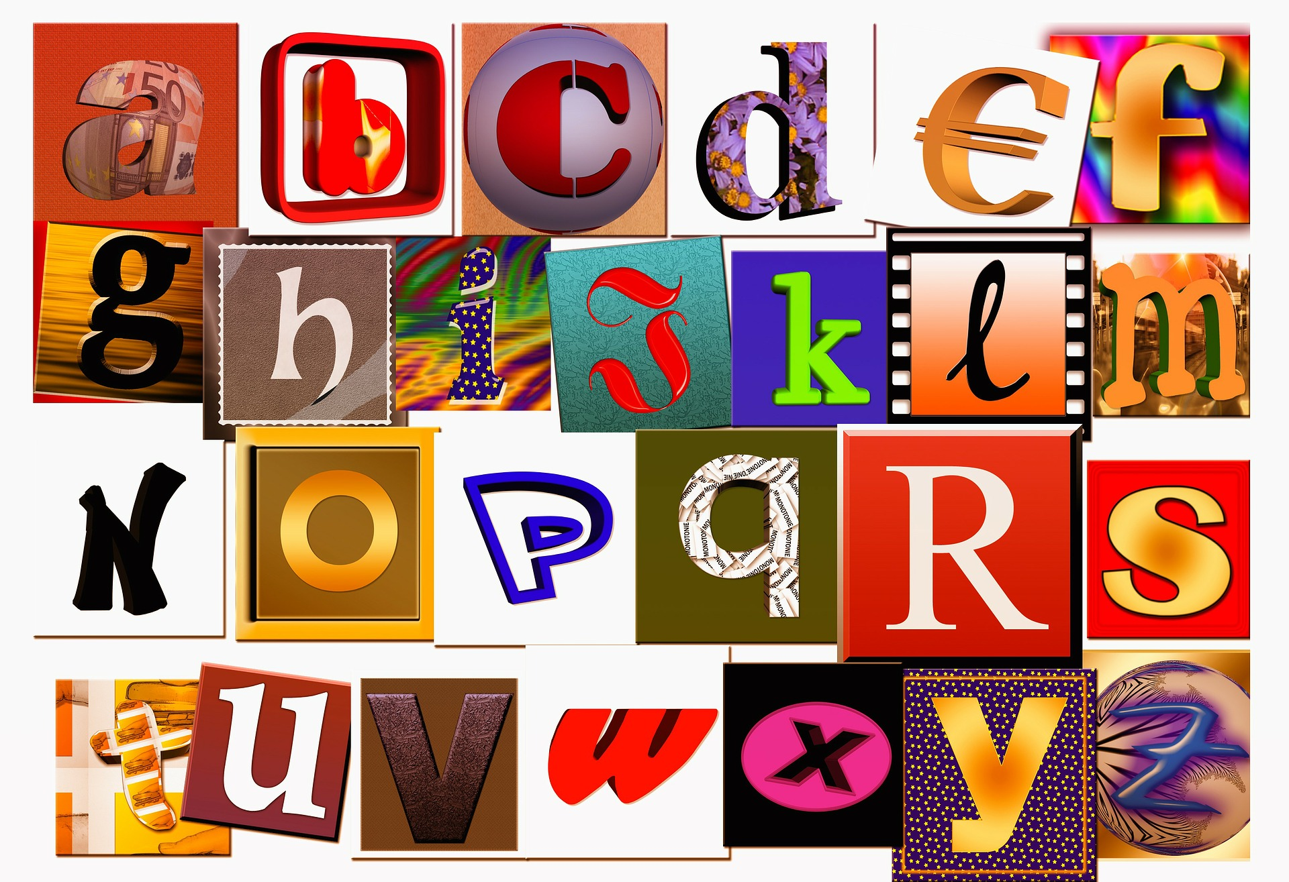
alphabet
hören
Notes:
Timing: 2 minutes
Aim: To consolidate knowledge of the alphabet in German.
Procedure: 1. Click to play the whole alphabet through for students to listen and join in with.

Slide 37
alphabet
ABCDEFG
sprechen
HIJKLMN
OPQRSTU
VWXYZ
Notes:
Timing: 2 minutes
Aim: To consolidate knowledge of the alphabet further.
Procedure: 1. Revise the alphabet again chorally using the drill instructor’s chant.

Slide 38
SPELLING BEE
Eine Person sagt und die anderen schreiben.
Notes:
Timing: 15 minutes
Aim: To introduce the Spelling Bee competition.
Procedure: 1. Explain the Spelling Bee as follows:
Pupils may want to put themselves forward for the Spelling Bee where they have to spell words aloud within a time limit. Teacher may repeat the word only once. This should encourage the pupils to repeat the word for themselves and retain it in their heads until the spelling becomes clearer – a good strategy for later listening work. The rest of the class members must write down what they think is the correct spelling and mark the speller right or wrong. There is a list of words on the next slide which you can use for this – or you may wish to choose your own.
2. Time allowing, it would be good to put students into pairs to practise. Student A calls in English, Student B faces away from the board, translates the word into German (saying the article, for nouns, but not spelling the article) and spells the word. Then they swap roles.

Slide 39
The Spelling Bee
sein | to be | being
ist | is
wo? | where?
hier | here
da | there
das Heft | exercise book
das Fenster | window
der Tisch | table
die Tafel | board
die Flasche | bottle
und | and
Deutsch | German (noun)
ja | yes
nein | no
sagen | to say, tell
Notes:
The first 15 words from the Spelling Bee, Stage 1. Students have learnt these words already, but this is the first time they will have practised spelling them out loud using the German alphabet.

Slide 40
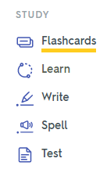
Quizlet
 | Word | English meaning
1 | du | you (singular)
2 | bist | are (you, BE)
3 | kein | not a
4 | die Farbe | colour
5 | die Nummer | number
6 | das Tier | animal
7 | der Ort | place
8 | aber | but
9 | wie sagt man…? | how do you say…?
10 | wie schreibt man…? | how do you write…?
11 | ich weiß nicht | I don’t know
12 | wissen | to know, knowing
Notes:
Timing: 15 minutes
Aim: To introduce Quizlet as part of the scheme of work.
Note: The time given here to a full introduction to Quizlet is designed to explain and set up the pre-learning routine for vocabulary that students will engage in each week. For this, it will be helpful for teachers to take time to model the different learning activities, and explain them as a sequence that builds knowledge. Teachers will also want to stress the importance of working with the audio (i.e. not just working from the written words in the LEARN activity, even though it’s possible to do so). Students need to understand that to get the maximum learning return for their time, they need to work across all modes / modalities.
Procedure: 1. Introduce Quizlet to the class. Go to www.quizlet.com and demonstrate the different stages.
If you click the Q icon, it takes you directly to this Term 1.1 Week 4 vocabulary list.
Departments may have their own Quizlet accounts and may wish to import the NCELP vocabulary sets into their school account.
2. Explain the key principles of vocabulary learning:
1] Choice of vocabulary – high-frequency words and their usefulness (teachers can share the frequency of the words on the NCELP SOW, for students’ interest).
2] Levels of word knowledge (as shared in Week 3 lesson) 1. I have seen this word before.
2. I know what the word means.
3. I can read the word aloud.
4. I can spell the word correctly.
5. I can use the word in a sentence.
3. Point out that it takes time to build up to this level of word knowledge. 3] Practice of different kinds – listen and translate L2 → L1, read and translate L2 → L1, listen and say L1→ L2, read and write L1 → L2 (all sorts of different combinations of modes/modalities strengthen retention and recall of new words
4] Memories fade and regular retrieval and re-visiting are needed to maintain word knowledge (mention recycling but also structured re-visiting after 3 weeks and after 9 weeks). 5] Usefulness of priming (learning vocabulary ahead of the lesson – helps students to be in a position to use language more readily in the lesson itself) – from now on, vocabulary learning will be set as pre-learning for the next lesson.
Quizlet is designed to support all of this.
4. Set HW (see next slide) – Learn Week 5 vocabulary (also revisiting Week 2).

Slide 41
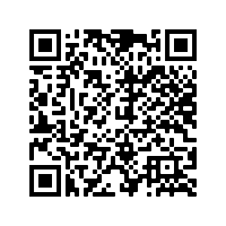
Hausaufgaben
Vocabulary Learning Homework (Y7, Term 1.1, Week 5)
Audio file
Audio file QR code:
Student worksheet
Quizlet link
In addition, revisit: Term 1.1 Week 2

