Slide 1
Vocabulary
What Is There To Know?
Without grammar very little can be conveyed,
without vocabulary nothing can be conveyed.
David Wilkins
Robert Woore / Rachel Hawkes

Slide 2
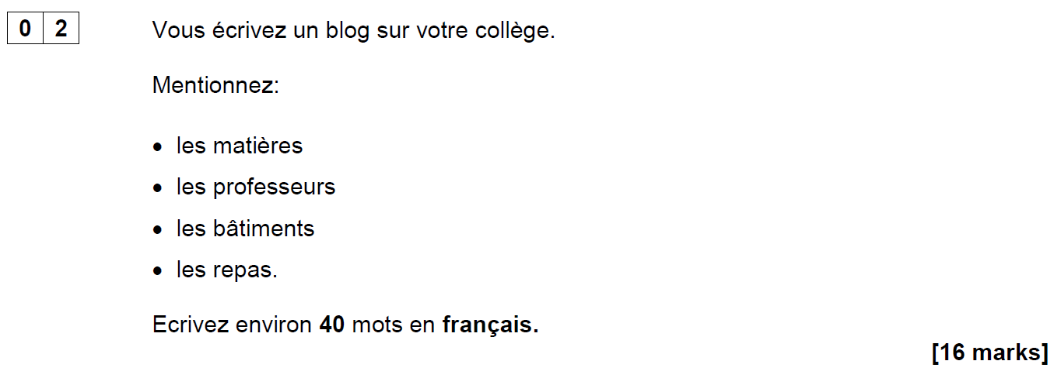
AQA French Foundation Writing Paper Q2 (June 2018)
Notes:
Opening sequence: Slides 1-6. 10 minutes Handout 1 (A copy of this question, with space to write)
Let’s start with something that confronts us with some of the issues…! This question (the 2nd easiest on the Foundation Writing paper – aimed at Grade 2/3 (old Grade E, bottom of D) required learners to know these four words (as well as the word ‘college’ of course). It’s easy to spot the words which caused problems for many foundation candidates in June 2018!

Slide 3
Are all these words…
562
1150
1952
2948
les matières
les professeurs
les bâtiments
les repas
on a list of 2000 most frequently-occurring French words?
on the AQA Foundation French Core Vocabulary list?
in the most popular French Foundation GCSE textbook?
Notes:
What do we think? Do all these words…
come into the top 2000 most frequent words in French? If you don’t think so, which one(s) don’t? Can you rank them in order of frequency?
appear on the AQA Foundation French Core Vocabulary list?
appear in the most popular GCSE textbook?
Answer a) b) c) consecutively. After a) reveal the 4 word frequencies. Ask colleagues to match them to the words.
ANSWERS a) matière (562), professeur (1150), bâtiment (1952), repas (2948) b) Yes c) Yes
OK – given that we’ve said ‘yes’ to b) and c), why do we think many students just didn’t know or recognise them?

Slide 4
Possible reasons…
an over-reliance on cognates for comprehension?
vocabulary knowledge is too context-dependent?
absence of additional contextual clues?
(Macaro & Erler, 2008)
“Vocabulary listed under a particular theme should be considered transferable, as appropriate, to the other themes.” AQA-8658-Specification 2016 French, p.22.
The words appear as individual items in a list, without the support of other words in a sentence to aid understanding.
Notes:
OK – given that we’ve said ‘yes’ to b) and c), why do we think many students just didn’t know or recognise them? Possible reasons to consider: 1) Some learners’ comprehension is limited by an over-reliance on cognates. If the word is not similar to English, it is more effort to acquire it (even receptively) and some learners, after five years, acquire relatively few non-cognate words. (Reference for this: Raising the Achievement of Young-beginner Readers of French through Strategy Instruction. (Macaro,E. & Erler, L., 2008). Applied Linguistics 29/1: 90–119. So, when we set out to improve the breadth of learners’ vocabulary, we need perhaps to consider focusing on the ‘harder to acquire’ non-cognates? 2) Two of these words (batiments and repas) are not listed in the topic of school/education on the AQA vocabulary list (they are in Home town, neighbourhood etc.. and Free time activities, respectively). The AQA vocabulary guidance states very clearly that words learnt in one topic context may be expected to be tested in another! “Vocabulary listed under a particular theme should be considered transferable, as appropriate, to the
other themes.” p.22 AQA-8658-Specification 2016 French
GO TO NEXT SLIDE: In the text book, they are also learnt in contexts other than school If learners encounter the words in one context only they may find it much harder to recognise the word in a different context. Their knowledge of certain words is too context-dependent. The other important point is that, in two cases here, the key words are the ‘category’ words, rather than the specific content words – it can be the case that these words are sometimes overlooked (or at least ‘under-worked’) in our teaching – if they are both non-cognates and category words, they are often not known by less-proficient learners.
GO BACK TO PREVIOUS SLIDE: 3) These words appear as individual words in a list, without the support of a sentence to give additional contextual clues.
The suggests that we need also to work on the depth of vocabulary knowledge – at least with respect to developing learners’ ability to know the meaning of words (readily) when they appear in a variety of different thematic contexts, but also when there are limited contextual clues – i.e. when words are presented in isolation, as individual words in a list, without the support of a sentence.

Slide 5
Studio AQA GCSE French Foundation (Pearson)
Module 6 p.132
Module 4 p.90
Module 3 p.70
Notes:
Slide

Slide 6
Possible responses…
J’adore les repas!
Je déteste les bâtiments!
Our aim should be ‘to give students the language they need in order to read texts, not to teach them to manage as well as they can without that language'. (Swan, 2008:267)
Talking sense about learning strategies, Swan (2008), RELC, Vol. 39(2), 262-273.
Notes:
Final important point to make… As teachers, when faced with a scenario like this, we search around for solutions to help our students succeed, as indeed we should. However… this particular exam question led to suggestions within the teaching community that students should be taught simply to put an opinion phrase in front of any nouns they don’t understand, in a question like this: So we might have seen: J’adore les repas or Je déteste les bâtiments
And there’s no denying that this would enable students to gain a significantly better mark than if they omit these two (unknown) words from their answer. As a examination strategy it therefore has some validity. As a communication strategy for real life, we can be less convinced…! If learners go into conversations prepared to say they like / dislike things without knowing what they’re referring to, they could get into all sorts of interesting situations…! At the end of Y11, as a last-ditch attempt to support our students’ GCSE outcomes, and compensate for a lack of knowledge, this might be justifiable (!?!). However, in the earlier stages of language learning, we have time to do more than teach compensatory approaches.
Swan (2008) in an article which critiques the over-reliance on teaching reading strategies says that the aim should be 'to give students the language they need in order to read texts, not to teach them to manage as well as they can without that language'. p.267 Talking Sense about Learning Strategies, Swan (2008). RELC, Vol 39(2) 262-273 So, just by this preliminary look at one Foundation GCSE writing task, we can conclude that there’s quite a lot to know about vocabulary!

Slide 7
There’s quite a lot to know!
Why is vocabulary important?
How many words do learners need to know?
What does it mean to know a word?
Which words do learners need to know?
How can they best learn the words?
What about different rates of learning?
Notes:
[3 mins max]
Having warmed up by thinking about some of the issues, can we suggest a list of questions? The first one was explicitly demonstrated in our opening discussion… Some of the others might not be as deducible but let’s see how we do…

Slide 8
Why is vocabulary learning important?
Notes:
Slides 8-12 10 minutes (this is presentation/exposition)

Slide 9
‘Measuring the contribution of vocabulary knowledge to proficiency in the four skills’ (Milton, 2013)
Significant correlation between vocabulary size and proficiency level
Vocabulary knowledge is a strong predictor of performance in all four skills – explaining up to about 50% of variance in performance
Breadth, depth and speed (automaticity) are all important
‘Generally speaking, the more words a learner knows, the more they are likely to know about them, and the better they are likely to perform, whatever the skill.’ (Milton, 2013: 71)
Notes:
Handout 2: OASIS summary of Milton (2013) Direct colleagues to read the summary of Milton (2013) Measuring the contribution of vocabulary knowledge to proficiency in the four skills. Milton (2013). EUROSLA MONOGRAPHS SERIES 2, L2 vocabulary acquisition, knowledge and use, 57-78.
Why is vocabulary important? 1. It correlates with performance 2. in all four skills 3. it appears to be the single most highly contributory factor

Slide 10
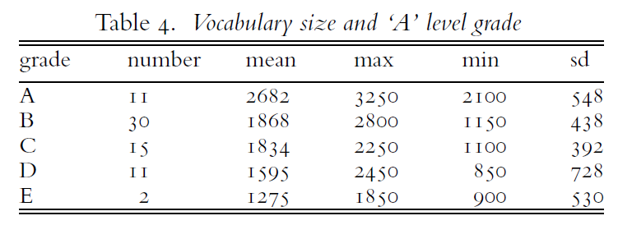
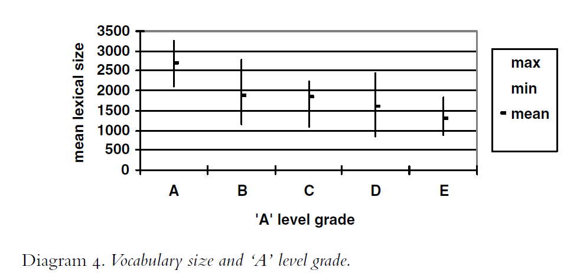
Language Lite? Learning French Vocabulary in School, Milton (2006). Journal of French Lanuage Studies, 16, 187-205
Notes:
Evidence from a UK context for ‘the more words you know, the better you do (in UK language exams)’…
Study done in one UK (grammar school) – French A level learners.
JAMES MILTON (2006). Language Lite? Learning French Vocabulary in School.
Journal of French Language Studies, 16, pp 187-205 doi:10.1017/
S0959269506002420
The vocabulary knowledge of learners who take ‘A’ level appears to be an average (mean) of a little fewer than 2000 words. Among the 69 Year 13 learners who took and passed ‘A’ level, the data concerning grades and vocabulary size are given in Table 4. The relationship between grade and lexical size is made even clearer in a graph and this is shown in Diagram 4. Learners with large French vocabularies are more likely to get high ‘A’ level grades and learners with low vocabularies are more
likely to get lower grades. An ANOVA confirms that the differences in lexical size between ‘A’ level grades are statistically significant (F = 11.906, sig < .001).
However, the variance from the mean suggests that it’s not just about vocabulary size … No student achieved an A without an indicative vocabulary size of more than 2000 words. However, students with vocabularies of more than 2000 words (in some cases, substantially more) achieved B, C and D grades, too… And one student (at least) achieved a B grade at A level with a little over 1150 words! Depth and automatisation are important, and there are other factors, too…

Slide 11
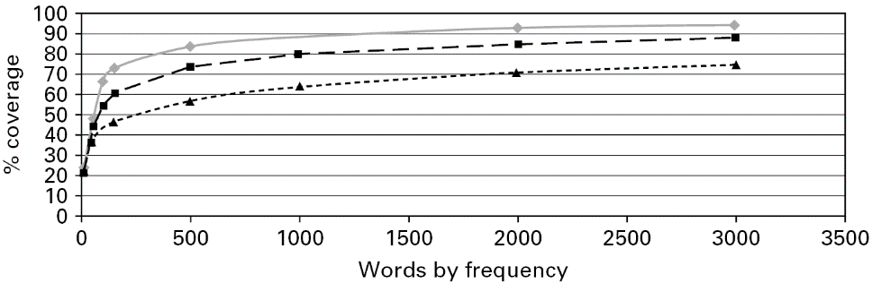
Is vocabulary size of the same importance for all modalities?
◆ General conversation  More formal speech – e.g. lectures  Written language
Comprehension of written language requires greater vocabulary breadth than spoken language
Understanding both written and spoken text requires substantial vocabulary knowledge
Measuring second language vocabulary acquisition. (Milton, 2009). SLA
Notes:
Relationship between text coverage and comprehension (by extension, communication more generally)

Slide 12
Is vocabulary size of the same importance for all modalities?
◆ General conversation  More formal speech – e.g. lectures  Written language
‘Knowing less than 1000 words of a foreign language is probably insufficient for comprehension, even in spoken language, unless communication is of the most formulaic kind, such as greetings, and lacking in any specific or specialised content.’ (Milton, 2009:58)
Notes:
Relationship between text coverage and comprehension (by extension, communication more generally)

Slide 13
How many words do our learners need to know?
Notes:
Slide 13-14 5 minute task (change of pace)
How many…
A deceptively definite sounding question… always be wary

Slide 14
What’s in a number? If this is the answer, …?
Answers
What is…
5-10
98%
1772
8
2000
3
4222
…the lexical frequency ranking of the verb SER in Spanish?
…the expected size of vocabulary needed to function adequately at CEFR Threshold B1 level?
…the number of new words learners might be expected to learn on average each lesson?
…the lexical coverage needed for comfortable comprehension of a text?
…the lexical frequency ranking of the verb SEIN in German?
…the number of words on the AQA Spanish Higher Minimal Core Vocabulary list?
…the lexical frequency ranking of the noun POULET in French?
Notes:
What’s in a word (in numbers!)?
If this is the answer…
5-10
98%
1772
8
2000
3
4222
what is the question?
…the lexical frequency rating of the verb SER in Spanish? [8]
…the expected size of vocabulary needed to function adequately at CEFR Threshold B1 level? [2000]
…the number of new words learners might be expected to learn each lesson? [5-10] NB: with 38 teaching weeks per year, 2 x lessons per week, if you take 7.5 new words per lesson, this suggests 570 words per year, which would give 2,850 words after 5 years. But the Milton (2006) study suggests learners learn on average 170 words per year up to GCSE (a little over 2 new words per lesson), and 530 words in two years to A level.
…the lexical coverage needed for comfortable comprehension of a text? [98%]
…the lexical frequency rating of the verb SEIN in German? [3]
…the number of words on the AQA Spanish Higher Minimal Core Vocabulary list? [1772]
…the lexical frequency rating of the noun POULET in French? [4222]
The point of this slide is to introduce (again) the different elements into the discussion: 1) What are the expectations for vocabulary size set by UK examination system? 2) How does this expectation match up to other measures of vocabulary size requirement for functioning at a similar level? 3) What is the expectation for rate of vocabulary learning, as laid out in the Pedagogy Review? 3) What is the relationship between coverage and comprehension? 4) What role does the word frequency play in our decision-making?
Some of these numbers are more secure than others… which? i.e. 98% (Schmitt, Jiang & Grabe, 2011) The Percentage of Words Known in a Text and Reading Comprehension The Modern Language Journal, 95, i,

Slide 15
What Lexical Coverage Do We Need?
What can you understand in the following texts, with different lexical coverage levels?
At what point do you have ‘adequate’ understanding?
At what point do you understand the text ‘well’?
How do you feel as a reader?
What do you do with the ‘missing words’?
Notes:
Slides 15 – 23 10 minutes (task and discussion)

Slide 16
____, I have _____ my _____ and _____ for what I _____ to say to you _____. I have _____ _____ what I _____ I had known at my _____ _____, and what _____ _____ I have _____ in the _____ of _____ that have _____ _____ that _____ and this.
I have _____ up with _____ _____ on this _____ ______, _____ we are _____ _____ to _____ _____ _____ _____. I have _____ to _____ to you about the _____ of _____; and, as you _____ on the _____ of what is _____ called _____ _____, I _____ to _____ the _____ _____ of _____.
Only the 50 most frequent words of English are retained
I.e. words ≥ 50 removed (57.9% coverage)

Slide 17
____, I have _____ my _____ and _____ for what I _____ to say to you _____. I have asked _____ what I _____ I had known at my own _____, and what _____ _____ I have _____ in the _____ of years that have _____ between that day and this.
I have come up with two _____ on this _____ day, when we are _____ _____ to _____ your _____ _____. I have _____ to talk to you about the _____ of _____; and, as you _____ on the _____ of what is _____ called _____ life, I want to _____ the _____ _____ of _____.
Words ≥ 200 removed (70.1% coverage)

Slide 18
Actually, I have _____ my _____ and _____ for what I _____ to say to you today. I have asked _____ what I _____ I had known at my own _____, and what important _____ I have learned in the number of years that have _____ between that day and this.
I have come up with two _____ on this _____ day, when we are _____ together to _____ your _____ _____. I have _____ to talk to you about the _____ of _____; and, as you stand on the _____ of what is _____ called real life, I want to _____ the _____ _____ of _____.
Words ≥ 400 removed (77.6% coverage)

Slide 19
Actually, I have _____ my mind and heart for what I _____ to say to you today. I have asked myself what I _____ I had known at my own _____, and what important _____ I have learned in the number of years that have _____ between that day and this.
I have come up with two answers on this _____ day, when we are _____ together to _____ your _____ success. I have decided to talk to you about the benefits of _____; and, as you stand on the _____ of what is sometimes called real life, I want to _____ the _____ _____ of _____.
Words ≥ 1K removed (85.0% coverage)

Slide 20
Actually, I have _____ my mind and heart for what I ought to say to you today. I have asked myself what I wish I had known at my own _____, and what important lessons I have learned in the number of years that have _____ between that day and this.
I have come up with two answers on this wonderful day, when we are gathered together to _____ your academic success. I have decided to talk to you about the benefits of failure; and, as you stand on the _____ of what is sometimes called real life, I want to _____ the _____ importance of _____.
Words ≥ 2K removed (92.5% coverage)

Slide 21
Actually, I have _____ my mind and heart for what I ought to say to you today. I have asked myself what I wish I had known at my own graduation, and what important lessons I have learned in the number of years that have _____ between that day and this.
I have come up with two answers on this wonderful day, when we are gathered together to celebrate your academic success. I have decided to talk to you about the benefits of failure; and, as you stand on the threshold of what is sometimes called real life, I want to _____ the crucial importance of imagination.
Words ≥ 5K removed (97.2%)

Slide 22
Full text: J. K. Rowling – Harvard Commencement Address, 2011: The Fringe Benefits of Failure and the Importance of Imagination.
Actually, I have wracked my mind and heart for what I ought to say to you today. I have asked myself what I wish I had known at my own graduation, and what important lessons I have learned in the number of years that have expired between that day and this.
I have come up with two answers on this wonderful day, when we are gathered together to celebrate your academic success. I have decided to talk to you about the benefits of failure; and, as you stand on the threshold of what is sometimes called real life, I want to extol the crucial importance of imagination.
Word frequencies based on the Corpus of Contemporary American English.
Notes:
I think I may omit slide 23 and summarise this activity, by saying that even a relatively small number of unknown words can interfere with comprehension. So, on the one hand, our goal must be for learners to learn as many words as possible in their 5-year (9-year with KS2) learning to GCSE, whilst on the other hand we must be mindful that, the GCSE reading sets out to include some unknown words (or at least, some words which are not on the Minimum Core Vocabulary list!).
We will return to this aspect later….

Slide 23
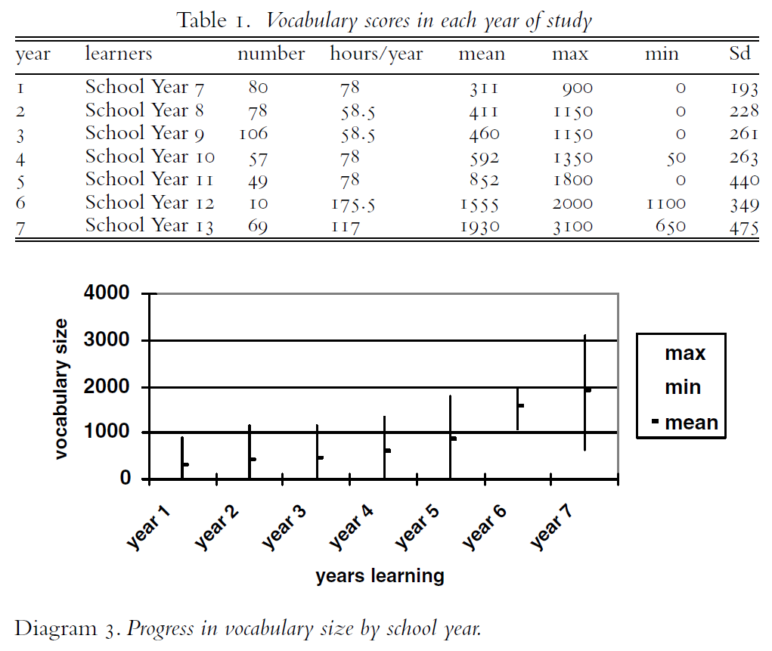
Language Lite? Learning French Vocabulary in School, Milton (2006). Journal of French Language Studies, 16, 187-205
Notes:
Slides 23-24 – Conclusion of this section 5 minutes
JAMES MILTON (2006). Language Lite? Learning French Vocabulary in School.
Journal of French Language Studies, 16, pp 187-205 doi:10.1017/
S0959269506002420
So, how many words do learners actually learn? Suggestions of one UK study of L2 French learners…………….
NB Data gathered in summer term of 2004 and study was cross-sectional not longitudinal so progress is ‘suggested’ – to be inferred rather than evidenced
So, how many do we need? No-one with more than 2,750 words failed to get an A at A level. Of the Y11 students, the largest vocabulary was 1800, and we have to assume that some students with this size of vocabulary did get the highest GCSE grade (there are no data in the study on this, though). Given that, on average, the students in this study took A level with around 2000 words, it wouldn’t be too wide of the mark to suggest that it would be helpful to aim our GCSE students towards a vocabulary size of around 2000 words. Some, certainly, may be capable of more than this, some will certainly not achieve this, but as a ‘ball park’ it’s not a terrible starting point.

Slide 24
'According to standard frequency lists, the first 1000 words make up approximately 75% word tokens of a text, and the first 2000 approximately 85% (Meara 1995, 33). The Common European Framework of References for Language Learning and Teaching (CEFR) suggests a vocabulary of 500 words for its first level, A1 (‘Breakthrough’), 1200 words for its second level, A2 (‘Waystage’), and 2000 words for its third level, B1 (‘Threshold’) (Council of Europe 2001).’
(Häcker, 2008:215)
Notes:
Eleven pets and 20 ways to express one's opinion: the vocabulary learners of German acquire at English secondary schools. (Häcker, M. (2008). Language Learning Journal,
36:2, 215-226

Slide 25
What does it mean to know a word?
Notes:
Slides 25-31 (with brainstorming task 15 mins – without 8 mins)
It’s not just about how many, it’s also about nature of the vocabulary knowledge itself…
Some dimensions and dualities to take into account here… 1) Meaning – Phonology – Orthography 2) Receptive – Productive 3) Breadth – depth – automatisation (fluency)

Slide 26
What is a Word?
Lemma The ‘dictionary form’ e.g. the verb ‘sleep’ Other inflected forms (sleeping, slept, sleeps) are forms of this lemma
Lexeme The abstract unit of meaning which includes all the different forms of a given word e.g. sleep + sleeping + slept + sleeps)
Word family A ‘base word’ plus all inflected and derived forms, so would include also, for example, ‘sleeper’ and ‘sleep-deprived’
“a word family consists of a base word and all its derived and inflected forms that can be understood by a learner without having to learn each form separately” (Bauer & Nation, 1993:253)

Slide 27
What is it to know a Word?
Meaning
Orthography
Phonology
< fish >
/ f ɪ ʃ /
→ ‘Receptive’ & ‘productive’ knowledge

Slide 28
What is it to know a Word?
breadth
fluency
depth
(Daller et al., 2007:8)

Slide 29
Definitions
Breadth (or size)
Depth
Fluency (or automaticity)
how many words you know (irrespective of how well you know them or how much you know about them)
how well you know them or how much you know about them
(Anderson & Freebody, 1981)
how readily you can access them in comprehension or production.
(Daller et al., 2007)

Slide 30
What is it to know a Word?
Notes:
If we are short of time, we would cut the ‘interaction brainstorming’ and go straight to looking at the Nation list.

Slide 31
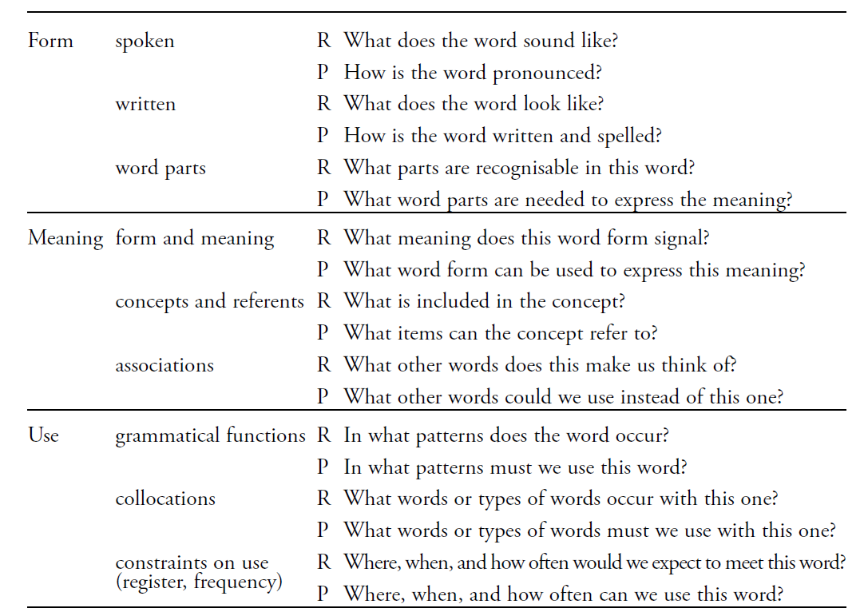
‘The nearest thing we have to a definitive list of what it means to know a word.’ (Milton, 2013:59)
(Nation 2001:27)
Notes:
Nation, I. S. P. (2001). Learning Vocabulary in Another Language. Cambridge:
Cambridge University Press.

Slide 32
Which words do learners need to know? And why?
Notes:
Slides 33 – 42 With brainstorming task 12 mins, without 7 mins.

Slide 33
Vocabulary Selection
Frequency
Examination
Types of word → verbs
Cognates / non-cognates
Word families
Notes:
Usage-based vocabulary knowledge is obviously important and will support communicative competence in ‘real world ‘situations Examination-driven vocabulary knowledge is essential for obvious reasons These two may not align 100%...

Slide 34
Vocabulary Selection
‘Vocabulary to be taught should be informed by frequency of occurrence in the language.’ p.9 Pedagogy Review
The assessment tasks at Foundation Tier will require students to understand and respond to common or familiar words and/or forms of words that are not on the vocabulary list.
Notes:
There is some overlap though…

Slide 35
Text Books and Topics
Many language courses are organised around thematic topics, such as ‘free time activities’,…. In such cases the choice of vocabulary can be too specialised, teaching relatively rarely used words at the expense of common words which it is harder to plan for re-encountering later. p.9 Pedagogy Review
One analysis of a KS3 German text book (Echo 1) suggests that, when compared against the Klett Grundwortschatz (Hamm 1995) – a 500-word-core vocabulary list for young learners – the proportion of core to total vocabulary is 39% (although an equivalent level Cambridge English book’s ratio was only 42%). (Häcker, 2008).
However, it’s important to remember the value (at examination level) to learners of knowing a range of more unusual vocabulary, and of personal interest
Presentation of vocabulary in ‘lexical sets’ (e.g. the 42 adjectives in Echo 1 belong to only five sets) may be limiting
Nouns and adjectives tend to predominate in this model, reducing the attention given to verbs (and therefore to sentence-building)
Notes:
Häcker, 2008. Eleven pets and 20 ways to express one's opinion: the vocabulary learners of German acquire at English secondary schools. Language Learning Journal, 36:2, 215-226
There is a balance to be struck…
Presentation of vocabulary in ‘lexical sets’ (e.g. the 42 adjectives in Echo 1 belong to only five sets) may be limiting
i.e. too many words of the same word class that can just slot in to the same sentence formation e.g. Ich spiele + lots of sports, Je porte + lots of clothes reduce the attention given to the verb and subject, as sentence formation is reduced to varying the noun (object) only. In addition, there is some research that suggests that clustering words of the same word class together for learning can make them harder to learn, so it may be helpful to think in terms of learning a set of words with several different word classes but linked by a common theme.

Slide 36
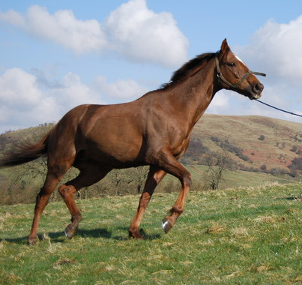
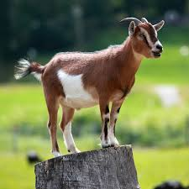
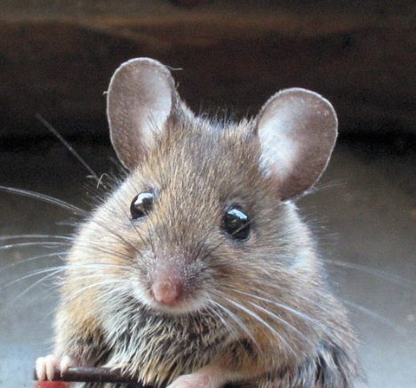
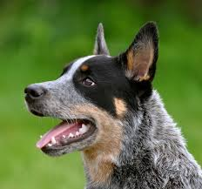
Topic-Based Vocabulary and Frequency Bands
2220
<3K
3138
<4K
6074
<7K
1744
<2K
4328
<5K
5547
<6K
Lonsdale and Le Bras (2009) A Frequency dictionary for French. Routledge.

Slide 37
Verbs
‘In the early stages of a language course, particular attention should be paid to the planned building of pupils’ verb lexicon, focussing on the meaning of the stem or infinitive form of common verbs. A strong basic verb lexicon has been found to relate positively to pupils’ ability to effectively manipulate those verbs at later stages.’ p.9 Pedagogy Review

Slide 38
Which Verbs do Y7 Learners Learn?
Notes:
If we are short of time, we would cut the ‘interaction brainstorming’ and go straight to Handout 3

Slide 39
sein | sehen
haben | lassen
werden | stehen
können | finden
müssen | bleiben
sagen | liegen
machen | heißen
geben | denken
kommen | nehmen
sollen | tun
wollen | dürfen
gehen | glauben
wissen
25 most common verbs in German.
Which verbs from our Y7 SOW are not in the 25
most common?
Source:
A frequency dictionary of German: core vocabulary for learners. Randall L.Jones and Erwin Tschirner. Routledge.
Notes:
Source:
A frequency dictionary of German: core vocabulary for learners. Randall L.Jones and Erwin Tschirner. Routledge. https://www.amazon.co.uk/Frequency-Dictionary-German-Routledge-Dictionaries/dp/0415316332/ref=tmm_pap_swatch_0?_encoding=UTF8&qid=1547270191&sr=8-1 Online: https://www.memrise.com/course/198332/4000-german-words-by-frequency-with-audio/

Slide 40
GCSE Examinations
The AQA minimum core vocabulary list (Spanish) Foundation – 1515 words Higher (additional) - 257 words Total = 1772
There are thousands of words in Spanish which, …can easily be understood with the application of a few, simple rules. When they…occur in context, students will be expected to understand them.
Vocabulary listed under a particular theme should be considered transferable, as appropriate, to the other themes.
p.21 AQA Spanish GCSE Specification
Notes:
So…cognates knowledge is expected (1000s of words!) Flexible retrieval across topic areas – understanding in different contexts – also an expectation

Slide 41
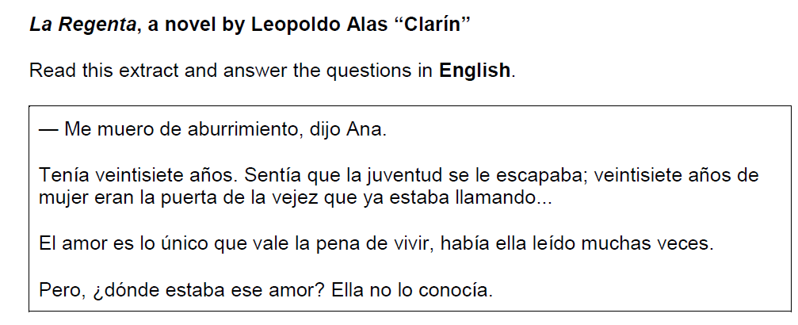
Word Families
How did Ana say she was feeling? Why was Ana depressed about being 27 years old? Give two reasons. What had Ana read about love?
Q5. AQA GCSE Higher Spanish Reading 2018
Notes:
Higher Spanish Reading paper 2018 - words which may have caused issues: 1) irregular plurals that incur a spelling change with non-cognates e.g. pez --> peces 2) forms of words including prefixes - e.g. prepagada OR antitabaco and/or suffixes on infinitives - e.g. pagarlos / saltarse etc.. 3) stem-change verbs 4) spotting referent without pronouns 5) completely unknown words - e.g. 'la vejez' (don't think this is on the word list - Tom (my son) guessed this from context and word 'viejo'...) 6) verbs used in more unfamiliar contexts - e.g. transitive use of 'subir' for 'take up' rather than intransitive 'go up' (they do meet 'subir fotos a Facebook' (upload) but this is a step away in terms of their possible 'held' translations). This last point is something we need to look at in terms of vocabulary knowledge - in Spanish there are fewer words than in English, so verbs in particular carry many different meanings - the ability of pupils to recognise these different meanings of known words is decisive in the GCSE reading paper.

Slide 42
How can they best learn the words?
Notes:
Final main section Need to allow for reading time of summary 10 full minutes Slides 43 – 50 10 minutes

Slide 43
How can they best learn the words?
Four (five?) ‘learning partners’:
Teachers
Students
Materials writers
Researchers
Parents
‘Given the magnitude of the lexical learning task, it is unlikely that it can be achieved without strong and active contributions from all four members of this learning partnership.’ (Schmitt, 2008:333)
Notes:
Make clear that we will return to this more fully in the half-days and TRGs… Give out Handout 4: OASIS summary of Schmitt (2008) article. Review article
Instructed second language vocabulary learning. Language Teaching Research 12,3 (2008); pp. 329–363

Slide 44
How?
‘Most vocabulary tasks focus their attention almost solely on introducing the meaning of new words.’ (Schmitt, 2008:343)
Learning new words (breadth)
Consolidating and extending word knowledge (depth)
Using words more quickly (automaticity/fluency)
Different tasks are needed to develop these different aspects. (Schmitt, 2008)

Slide 45
How?
L1 translation can be efficient for establishing form-meaning link initially.
Seeing and hearing words in context then becomes important to develop depth of knowledge (collocation, shades of meaning, etc.).
Multiple exposures and use are important to consolidate knowledge and develop fluency, anywhere between 5 – 20 encounters. (Nation, 2001:81)
This could be done at home, even in advance of a lesson (‘flipped learning’) and mediated by technology (e.g. Memrise, Quizlet)
For high-frequency words, spontaneous target language interaction and ‘reading for interest’ may help with this.
Notes:
NB: These next slides should tie in with the Schmitt summary – so this needs checking when VH has finished it and I will make any amendments to the next few slides.
As regards the initial establishment of the initial form-meaning link, there is substantial evidence supporting the provision of L2-L1 pairs, rather than L2-picture pairs (Lotto & de Groot, 1998) or L2-based context or meanings (Prince, 1996; Ramachandran & Rahim, 2004).
Once the link is established, attention can be given to learning more contextualised types of word knowledge, and it becomes important to encounter the new lexical items in L2 contexts. An important finding is that reading-while-listening is generally superior to reading-only in promoting vocabulary learning (Amer, 1997; Brown, Waring & Donkaewbua, 2008) Where a word is often used across different topics, care should be taken to build these links explicitly, building depth – ensuring that learners recognise them readily in more than one topic area. A useful approach here is to use a range of texts of different styles (literary extracts, poems, songs) which provide additional exposures in less familiar contexts, allowing the form-meaning link to strengthen.
5-20 is quite some range - It is not straightforward to say how many repeated encounters with a given word are necessary to learn it. Nation's (2001, p.81) review of several studies gives a range of 5 - 20 encounters. Most important, however, is that recycling of language is crucial, if it is not to be forgotten. Most forgetting occurs soon after the learning session, so the first recyclings are particularly important and need to occur quickly (Baddeley, 1990). Schmitt suggests we think in terms of 8-10 exposures. Planning for and monitoring this is important.

Slide 46
How?
Allowing time to forget and then deliberately and systematically revisiting and recycling is crucial.
This requires more planning and monitoring than a space-limited textbook course can display on its pages.
‘Recycling is necessary, and if it is neglected, many partially learned words will be forgotten, wasting all the effort already put into learning them ... Recycling has to be consciously built into vocabulary learning programs, and teachers must guard against presenting lexical items once and then forgetting about them, or else their students will likely do the same.’ (Schmitt, 2008:343)

Slide 47
How?
Vocabulary knowledge builds incrementally. Step 1 might be recognising that you have seen a word before.
Using a word appropriately in a spoken or written sentence is a useful ‘rule of thumb’ for mastery (although development often continues past this point).
There is some evidence that receptive knowledge doesn’t automatically lead to productive knowledge. Structured productive practice is helpful for improving production (Lee, 2003; Lee & Muncie, 2006).
Notes:
Lee, S. H. (2003). ESL learners’ vocabulary use in writing and the effects of explicit
vocabulary instruction. System, 31, 537–561.
Lee, S. H., & Muncie, J. (2006). From receptive to productive: Improving ESL learners’
use of vocabulary in a postreading composition task. TESOL Quarterly,
40(2), 295–320.

Slide 48
How?
Factors which facilitate vocabulary learning (Schmitt, 2008:339):
increased frequency of exposure;
increased attention focused on the lexical item;
increased noticing of the lexical item;
increased intention to learn the lexical item;
a requirement to learn the lexical item (by teacher, test, syllabus);
a need to learn/use the lexical item (for task or for a personal goal);
increased manipulation of the lexical item and its properties;
increased amount of time spent engaging with the lexical item;
• amount of interaction spent on the lexical item.

Slide 49
How?
‘Overall, it seems that virtually anything that leads to more exposure, attention, manipulation, or time spent on lexical items adds to their learning. In fact, even the process of being tested on lexical items appears to facilitate better retention.’ (Schmitt, 2008:339)
"The variety of factors which affect vocabulary learning means that there will never be one ‘best’ teaching methodology, but the meta-principle of maximizing sustained engagement with the lexical items which need to be learned appears to underlie all effective vocabulary learning.’ (Schmitt, 2008:354)
Notes:
Give out Handout 5: Sagarra and Alba Summary – keyword approach

Slide 50
How Do We Know?
Vocabulary learning is a strong indicator of performance, in all four modalities.
Currently, learners appear to know (after five years’ secondary learning) far fewer words than is ideal.
Learners need to know as many words as possible(!), but 2000 would indicate a much stronger basis for GCSE proficiency.
Vocabulary selection should balance frequency, GCSE specification, range and personal interest.
Verbs can be under-represented in text books.
Topic-based vocabulary lists of one single word class are not optimal
Notes:
Conclusion slides 51-52 5 minutes
Topic-based vocabulary lists of one single word class are not optimal – ie. it’s far more useful to have a thematically unified list of words from several different word classes (e.g. adjectives, nouns, verbs etc..) that can then be much more easily practised straightaway through sentence-building tasks.

Slide 51
How Do We Know?
There is no single, best strategy for learning vocabulary
Errorless teaching techniques (when pupils are unambiguously told the meaning of a new word) are effective…
providing they are followed by opportunities to use the new words in comprehension, and then productively.
The more times a pupil is required to recall a word, the more securely it will move into the long term memory.
Production tasks in which pupils use new words in sentences they compose themselves serve to strengthen vocabulary knowledge.
Genuine information gap activities are very helpful in assisting memorisation.
Careful, planned use of ICT can be effective.

Slide 52
Next Questions
How do we maximise the collaboration of the 5 ‘learning partners’?
What role do formulaic sequences or ‘chunks’ play in vocabulary learning?
What about different rates of learning?
How do we work (best) with different proficiency learners?
How can we motivate learners to learn vocabulary?
How do we know how well learners are doing? What is the best way to assess progress in vocabulary learning?
What about incidental vocabulary learning?
Vocabulary knowledge is not everything – what do we do when we don’t know a word?
Notes:
Looking ahead: 3 mins These are questions for the half-day. Clearly we will also want to spend time on vocabulary teaching/learning resources – providing them with some, but then allowing them time to create as well.

Slide 53
References
Anderson, R. C., & Freebody, P. (1981). Vocabulary knowledge. In J. Guthrie (Ed.), Comprehension and Teaching: Research Reviews (pp. 77-117). Newark, DE: International Reading Association. AQA. (2016). 8658-Specification French. Retrieved: https://www.aqa.org.uk/subjects/languages/gcse/french-8658 AQA. (2016). 8698-Specification Spanish. Retrieved: https://www.aqa.org.uk/subjects/languages/gcse/spanish-8698 Bauckham, I. (2016). Modern foreign languages pedagogy review: A review of modern foreign languages teaching practice in key stage 3 and key stage 4. Teaching Schools Council Bauer, L. & Nation, P. (1993). Word families, International Journal of Lexicography, Volume 6, Issue 4, 1 December 1993, 253–279. Daller, H., Milton, J., & Treffers-Daller, J. (eds.). 2007. Modelling and assessing vocabulary knowledge. Cambridge: Cambridge University Press.
Häcker, M. (2008). Eleven pets and 20 ways to express one's opinion: the vocabulary learners of German acquire at English secondary schools, The Language Learning Journal, 36:2, 215-226. Jones, R.L. & Tschirner, E. (2006). A frequency dictionary of German: core vocabulary for learners. Routledge. Lee, S. H. (2003). ESL learners’ vocabulary use in writing and the effects of explicit vocabulary instruction. System, 31, 537–561. Lee, S. H., & Muncie, J. (2006). From receptive to productive: Improving ESL learners’ use of vocabulary in a postreading composition task. TESOL Quarterly, 40(2), 295–320.
Lonsdale, D. & Le Bras, Y. (2009) A Frequency dictionary for French. Routledge.
Macaro, E. & Erler, L. (2008). Raising the Achievement of Young-beginner Readers of French through Strategy Instruction. Applied Linguistics 29/1, 90–119. Milton, J. (2006). Language Lite? Learning French Vocabulary in School. Journal of French Language Studies, 16,187-205. Milton, J. (2009). Measuring second language vocabulary acquisition. Multilingual Matters Milton, J. (2013). Measuring the contribution of vocabulary knowledge to proficiency in the four skills. Eurosla Monographs Series 2, 57-78. http://www.eurosla.org/monographs/EM02/Milton.pdf Nation, I. S. P. (2001). Learning Vocabulary in Another Language. Cambridge: Cambridge University Press.
Pearson (2016). Studio AQA GCSE French Foundation Sagarra, N. & Alba, M. (2006). The key is in the keyword: L2 vocabulary learning methods with beginning learners of Spanish. The Modern Language Journal, 90(2), 228-243. https://doi.org/10.1111/j.1540-4781.2006.00394.x
Schmitt, N. (2008). Review Article. Instructed second language vocabulary learning. Language Teaching Research, 12(3), 329–363. https://doi.org/10.1177/1362168808089921
Swan, M. (2008). Talking Sense about Learning Strategies, RELC, Vol 39(2), 262-273.

