Slide 1
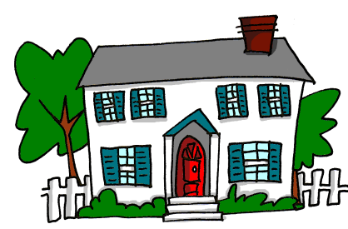
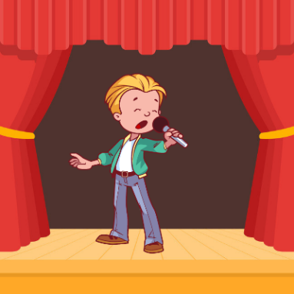
CA
¡A pronunciar!
CA
cantar
[street]
calle
casa
Nick Avery

Slide 2
CA
¡A pronunciar!
CA
cantar
casa
calle
Nick Avery

Slide 3
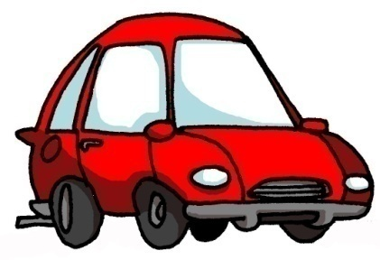
CO
CO
coche
con
comer
Nick Avery

Slide 4
CO
CO
con
comer
coche
Nick Avery

Slide 5
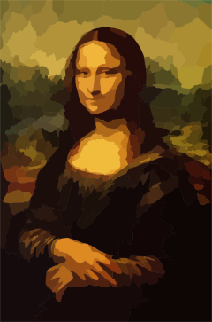
CU
CU
cultura
escuchar
documento
Nick Avery

Slide 6
CU
CU
escuchar
cultura
documento
Nick Avery

Slide 7
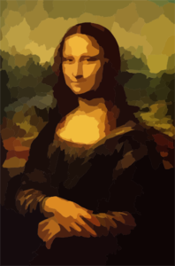
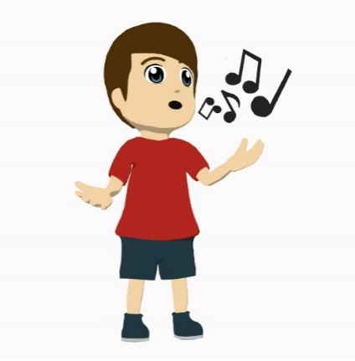
A)
casa
B)
comer
coche
1
cultura
2
casa
C)
cultura
D)
coche
3
comer
4
cantar
5
E)
cantar
F)
calle
calle
[street]
6
Nick Avery
Notes:
Two-part phonics task: dictation / word-picture matching
First, the teacher reads words aloud and students write them, then check. Then students say the word aloud that corresponds to the picture. (This could be done chorally as a group, with the teacher pointing to the pictures to elicit the correct word).

Slide 8
calle
cultura
60
cantar
escuchar
Segundos
casa
coche
comer
con
0
EMPEZAR
documento
Nick Avery
Notes:
Pairwork ‘tennis’ – pupils say the words alternately out loud with a partner, building up speed, over 1 minute’s intensive practice. They call in any order they like, pupils are not allowed to repeat the one they said in their last turn. Teacher can circulate to listen into their SSC knowledge. Click on EMPEZAR to start a one minute timer on the screen.

