Slide 1
Vocabulary
Y7 French
Term 3.1 - Week 3
Kirsten Somerville / Victoria Hobson / Adeline Charlton
Date updated: 22/04/20
Notes:
Frequency rankings of vocabulary introduced this week (1 is the most common word in French):
langue [712], maths [3438], matière [562], musique [1139], science [1114], quel [146], combien [800], que [9]
Source: Londsale, D., & Le Bras, Y. (2009). A Frequency Dictionary of French: Core vocabulary for learners London: Routledge.

Slide 2
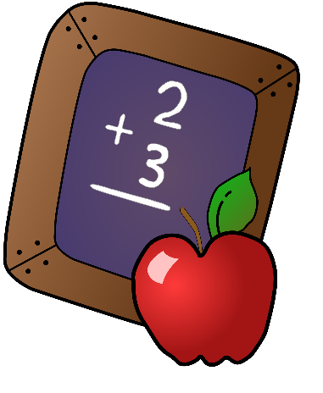
Vocabulaire
lire / parler
Les sciences = school subject
La science = science in general, or a specific science, eg.:
« La biologie est une science »
les sciences
la langue
la matière
Short for les mathématiques
la musique
les maths
Notes:
Present the vocabulary by bringing up the pictures and words, saying each word and having students repeat.
With this set, it is particularly important to emphasise that, although many of the words look similar to the English equivalents, they are pronounced differently. The SSCs [i] and [an] could be highlighted here.

Slide 3
Vocabulaire
lire / parler
les sciences
la langue
la matière
la musique
les maths
Notes:
Bring up the words one by one, for students to pronounce chorally without teacher support.

Slide 4
Vocabulaire
écouter
1
2
3
4
5
Notes:
Students listen to the words and point at the corresponding picture. Encourage exaggerated movements so the answer is clear!
TRANSCRIPT + ANSWERS:
la science [point to top left]
la langue [point to top right]
les maths [point to bottom right]
la matière [point to centre]
la musique [point to bottom left]

Slide 5
Vocabulaire
écrire / parler
les sciences
la langue
la matière
la musique
les maths
Notes:
One picture disappears at a time, students write and say which word is missing in French.

Slide 6
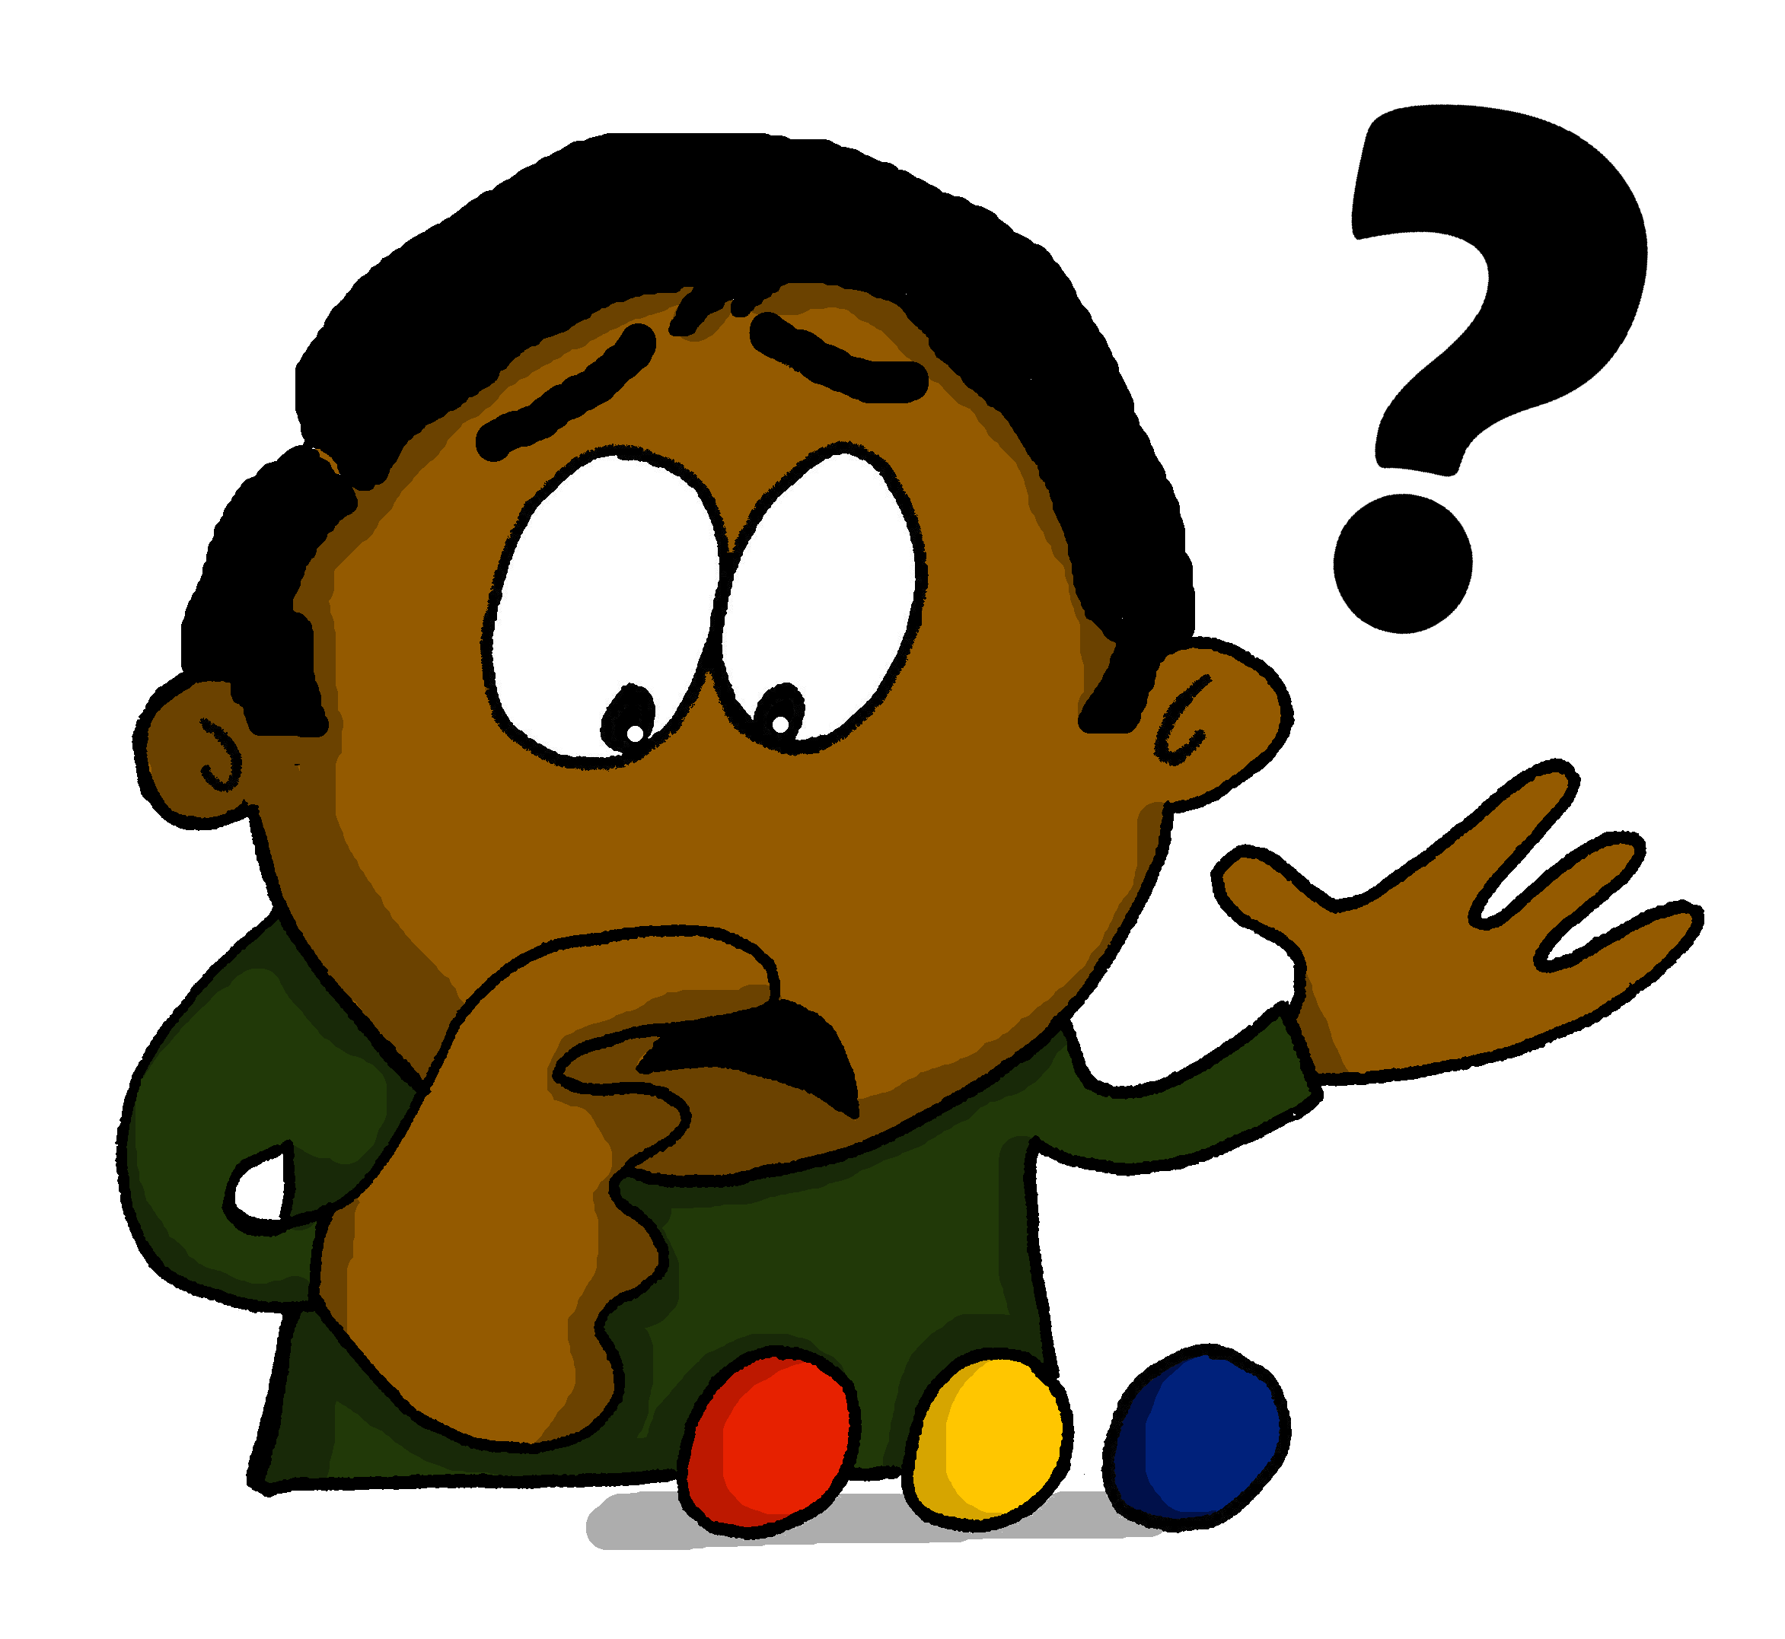
Vocabulaire
how much?
how many?
combien ?
what?
which?
que ?
quel ?
quelle ?
Notes:
Use this slide to present the vocabulary to students.
Offer a quick explanation to students of the difference between Quel? and Quelle? Say to students you are going to take a closer look at this shortly, however, reinforce that they are both pronounced the same.

Slide 7
Vocabulaire
how much?
how many?
combien ?
what?
which?
que ?
quel ?
quelle ?
Notes:
Elicit the English from students for these questions words.

Slide 8
Vocabulaire
1
how many?
how much?
2
3
which?
what?
Notes:
Students listen to the words and point at the corresponding picture. Encourage exaggerated movements so the answer is clear!
TRANSCRIPT + ANSWERS:
quel(le) [point to bottom right]
combien [point to top centre]
que [point to bottom left]

Slide 9
Vocabulaire
how much?
how many?
combien ?
what?
which?
que ?
quel ?
quelle ?
Notes:
This slide presents an opportunity for students to practise the vocabulary.
Can they give (either say/write) the French before the image stops spinning? This activity is repeated on the next slide with the images speeded up, to further embed the vocabulary and encourage faster recall .

Slide 10
Vocabulaire
how much?
how many?
combien ?
what?
which?
que ?
quel ?
quelle ?
Notes:
Repeat activity with faster custom animation. This presents a speaking recall opportunity only. (The images spin too quickly for students to be able to write!)

Slide 11
Quel? ou Quelle?
Quel livre aimes-tu ?
For masculine singular nouns
[Which book do you like?]
Quelle voiture aimes-tu ?
For feminine singular nouns
[Which car do you like?]
The form of ‘quel’ matches the gender of the noun. The two forms sound the same.
Notes:
This slide offers a worked example of both Quel? and Quelle? to illustrate its uses to students. Teacher to read out examples to illustrate that the two forms sound identical.
Only singular forms are learnt here. Plural forms will be covered later in Year 8.

Slide 12
Masculin ou féminin?
lire
Lis les questions. Écris le mot correct.
1 | Elles font | quel | modèle | ? | 5 | Tu aimes | quel | acteur | ?
 |  |  | activité |  |  |  |  | couleur
2 | Tu écoutes | quelle | musique | ? | 6 | Elle fait | quelle | exercice | ?
 |  |  | chanteur |  |  |  |  | activité
3 | Il a | quelle | voiture | ? | 7 | Il porte | quel | chemise | ?
 |  |  | vélo |  |  |  |  | uniforme
4 | Tu écris | quel | mot | ? | 8 | Tu étudies | quelle | langue | ?
 |  |  | phrase |  |  |  |  | livre
Notes:
This slide offers students the opportunity to practise the different forms of ‘quel.’
Students can write the correct word ‘quel’ or ‘quelle’ plus the correct noun in their exercise books.
All vocabulary items have been covered in the Scheme of Work so far.
Frequency rankings of vocabulary revisited this week (1 is the most common word in French):
2.2.5 - arriver [174], changer [283], créer [332], gagner [258], habiter [1186], monde [77], pays [114], politique [128], vêtements [2383], à [2], de [2]
2.1.4 - faisons [25], faites [25], font [25], quoi [297], attention [482], effort [388], exercice [1290], fête [1490]

Slide 13
Vocabulaire
how many?
how much?
combien ?
what?
which?
que ?
quel ? quelle ?
Notes:
This slide offers teachers a quick check on students’ knowledge of the question words ahead of a more challenging vocabulary activity. Students could be asked to write the answers. This will check for recall and accuracy of spelling. During the feedback the teacher can reinforce correct pronunciation. Teachers can skip this slide if they feel students are ready to go straight into the extended vocabulary practice. Answers are revealed by on teacher clicks.

Slide 14
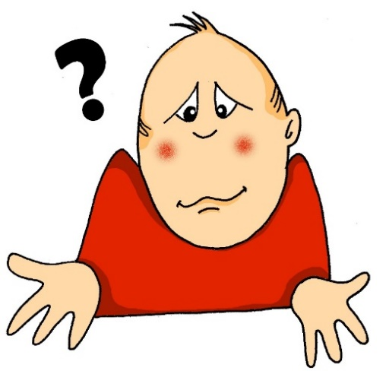
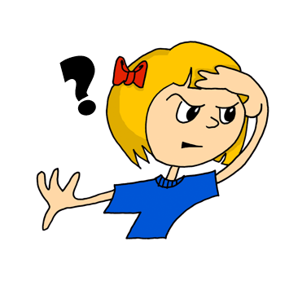
Vocabulaire
why?
how?
pourquoi ?
where?
comment?
où?
what?
when?
quand?
quoi ?
Notes:
In order that students build upon and expand their use of question words it is timely to revisit five previously-learnt question words. These will be incorporated into the upcoming sequences of activities.
Note that this week’s revisited set includes another word for ‘what’ – ‘quoi’. The difference between the use of ‘que’ and ‘quoi’ will be examined later in the lesson.

Slide 15
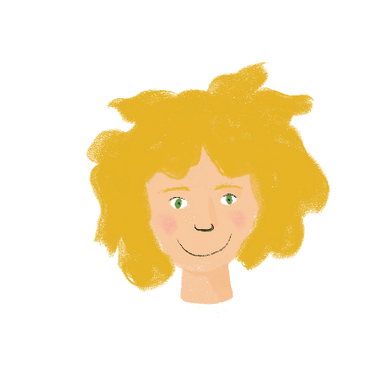
Vocabulaire
…
Amir dis ces réponses à Léa. C’est quoi la question ?
Comment ? | Où ? | Quoi ?
Je fais la cuisine.
J’aime créer des menus.
J’habite à Nice.
Nous faisons le voyage en train.
J’arrive samedi.
Tu fais quoi ?
Comment ? | Où ? | Pourquoi ?
Tu aimes ça pourquoi ?
Où ? | Pourquoi ? | Quand ?
Tu habites où ?
Quoi ? | Comment ? | Quand ?
Vous faites le voyage comment ?
Quoi ? | Quand ? | Pourquoi ?
Tu arrives quand ?
?
Notes:
This activity practises the five question words already known to students in addition to this week’s vocab set, incorporating vocabulary from the revisited sets.
Students select the correct question word for each response 1-5.
Extension – students could attempt to write the questions. Teacher to prompt them to recall the placement of the question word in intonation questions.
During the feedback teachers should clarify students’ understanding of the vocabulary in English.
Frequency rankings of vocabulary revisited this week (1 is the most common word in French):
2.2.5 - arriver [174], changer [283], créer [332], gagner [258], habiter [1186], monde [77], pays [114], politique [128], vêtements [2383], à [2], de [2]
2.1.4 - faisons [25], faites [25], font [25], quoi [297], attention [482], effort [388], exercice [1290], fête [1490]
Source: Londsale, D., & Le Bras, Y. (2009). A Frequency Dictionary of French: Core vocabulary for learners London: Routledge.

Slide 16
Saying ‘what’ in French
We have seen that the words quoi and que both mean ‘what’ in English.
We use these words for different types of questions in French.
We use quoi when making questions by raising the pitch of our voice:
Tu fais quoi ce weekend ?
What are you doing this weekend?
Quoi goes after the verb.
We use que when making questions by swapping the subject and verb around:
Que fais-tu ce weekend ?
What are you doing this weekend?
Que goes at the beginning of the question.
Notes:
This slide introduces the difference between the use of ‘que’ and ‘quoi’.

Slide 17
Écris en français !
écrire
Use a dictionary to look up any words you don’t know!
Réponds aux questions.
Combien de matières étudies-tu au collège?
Quelle matière aimes-tu ?
Pourquoi aimes-tu ça ?
Aimes-tu le professeur / la professeure ?
Comment est-il ? / Comment est-elle ?
Lis les réponses de Léa.
J’étudie douze matières au collège.
J’aime le français.
Je trouve ça intéressant. J’aime lire et écrire.
Oui !
La professeure est sympa et intelligente.
Notes:
Optional additional HW task
This writing activity practises a selection of the question words as well as the school subject vocabulary. Students can use a dictionary to help express personal responses which contain unknown vocabulary.

