Slide 1
Vocabulary
Y7 French
Term 2.2 - Week 2
Victoria Hobson / Stephen Owen / Natalie Finlayson
Date updated: 24/03/20

Slide 2
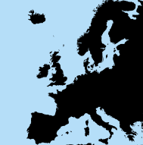
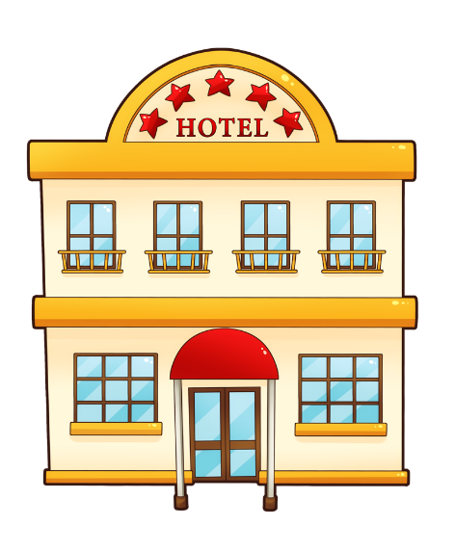
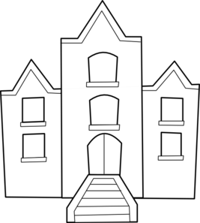
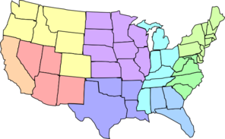
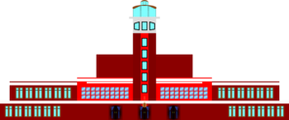
Vocabulaire
parler / écrire
un hôtel
une île
une université
l’étranger
un aéroport
les États-Unis
Notes:
Teachers can use this slide to elicit pre-learnt vocabulary pertaining to highly frequent places.
Then as follows:
1/ Three items disappear three at a time on clicks.
2/ Students are challenged to name the missing three each time.
3/ Students write down the missing words down in their exercise books or on mini-whiteboards.
4/ The spoken form is elicited. This activity could be done as whole class choral response or in pairs. Teachers/students point to a picture and ask ‘C’est quoi?’
In the final round, all six items disappear to challenge students to recall all this week’s nouns. This takes place after four sets of three.
Frequency rankings of vocabulary introduced this week (1 is the most common word in French):
aéroport [2113], l'étranger [305], hôtel [1774], île [1245], université [1192], États-Unis [n/a], rarement [2535], souvent [287]

Slide 3
Vocabulaire
problème
avez
partenaire
regardons
difficile
avons
marchons
famille
ont
avec
maison
préparons
travaillons
travaillons
Nous ____préparons_______ le déjeuner pour la _______famille_____.
Ici à la _____maison_____nous ______regardons____des films à la télé.
Nous ___travaillons_____ avec un ___partenaire___.
C’est un ___problème______ ______difficile______.
Nous ____marchons_____ dehors; nous ____travaillons____ dehors aussi.
Ils _____ont______ une maison très moderne.
Vous ______avez______ un problème _____avec_____ la famille.
Nous _____avons_____ une télé dehors.
We prepare/are preparing lunch for the family.
Here at home we watch/are watching films on the tv.
We work/are working with a partner.
It’s a difficult problem.
We walk/are walking outside; we also work/are working outside.
They have a very modern house.
You have a problem with the family.
We have a tv outside.
Notes:
The boxes disappear on a click to reveal the missing word.
Once all words are revealed, translations appear on clicks.
When completing the translation exercise, the teacher should draw attention to the English tense – both present simple and continuous are possible. (one tense in French = two in English).
Frequency rankings of vocabulary revisited this week (1 is the most common word in French):
2.1.3 - avons [8], avez [8], ont [8], enfant [126], famille [172], problème [188], difficile [296], ici [167], très [66], aussi [44], pour [10]
1.2.5 - marcher [1532], préparer [368], regarder [425], travailler [290], nous [31], déjeuner [2724], film [848], maison [325], partenaire [1077], télé [2746], dehors [1217], avec [23]
Source: Londsale, D., & Le Bras, Y. (2009). A Frequency Dictionary of French: Core vocabulary for learners London: Routledge.

Slide 4
Vocabulaire
Souvent and rarement are adverbs. They come after the verb :
Je vais souvent à l’aéroport.
This is different from English:
I often go the airport.
Je vais souvent à l’université.
Je vais souvent aux États-Unis.
souvent
rarement
Tu vas très rarement à l’hôtel.
Je vais très souvent à l’aéroport.
Il va rarement à l’étranger.
Je vais rarement à l’île.
hôtel
île
université
l’étranger
aéroport
États-Unis
Notes:
Teachers can use this slide to elicit the pre-learnt vocabulary from students of the words souvent and rarement ahead of the listening activity.
Some example sentences are given that student can translate orally or by using mini-whiteboards/ books to embed comprehension and illustrate the word order.
Frequency rankings of vocabulary introduced this week (1 is the most common word in French):
aéroport [2113], l'étranger [305], hôtel [1774], île [1245], université [1192], États-Unis [n/a], rarement [2535], souvent [287]

