Slide 1
Saying what people are like today vs in general
‘Somos’ for traits and ‘estamos’ for state
SSCs [ce], [ci]
Y7 Spanish
Term 2.2 - Week 5 - Lesson 47
Victoria Hobson / Nick Avery Artwork: Mark Davies
Date updated: 15/07/22
Notes:
Artwork by Mark Davies. All additional pictures selected are available under a Creative Commons license, no attribution required.
Learning outcomes (lesson 1):
Consolidation of SSCs [ci], [ce]
Introduction of ‘somos’
Consolidation of ser/estar for traits/state, respectively
Word frequency (1 is the most frequent word in Spanish):
7.2.2.5 (introduce) somos [7-ser]; feliz [908]; moreno [3304]; claro [1923]; oscuro [802]; aburrido [3917]; loco [846]; como [20]
7.2.1.2 (revisit) perro [888]; abuelo [4796]; abuela [717]; primo [1451]; prima [3051]; bastante [308]; hermoso [980]; activo [1278]; fuerte [435]
7.2.2.2 (revisit) poder [32]; puedo; puedes; puede; jugar [356]; participar [593]; favor [516]; pedir [217]; preguntar [219]; cambiar [255]; material [690]; ¿puedo ir a los servicios?; compañero/a [551]
Source: Davies, M. & Davies, K. (2018). A frequency dictionary of Spanish: Core vocabulary for learners (2nd ed.). Routledge: London
The frequency rankings for words that occur in this PowerPoint which have been previously introduced in NCELP resources are given in the NCELP SOW and in the resources that first introduced and formally re-visited those words.
For any other words that occur incidentally in this PowerPoint, frequency rankings will be provided in the notes field wherever possible.

Slide 2
ce
MADRID 1KM
cerca
Notes:
Introduce and elicit the pronunciation of the individual SSC ‘ce’ and then present and practise the pronunciation of the source word ‘cerca’.
A possible gesture for this source word would be to bring two open palms close together (but not touching)

Slide 3
ce
cerca
Notes:
Repeat the sound and elicit the source word.

Slide 4
ce
cerca
Notes:
Repeat the sound and elicit the source word.

Slide 5
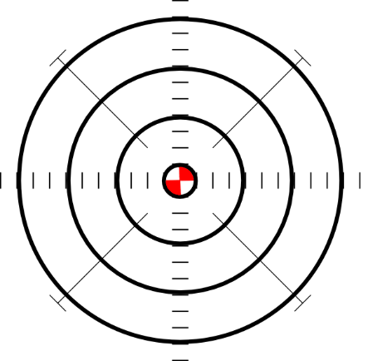
ce
doce
centro
MADRID 1KM
cerca
necesitar
necesario
[necessary]
[to need]
parecer
[to seem; appear]
Notes:
Introduce and elicit the pronunciation of the individual SSC ‘ce’ and then the source word again (with gesture, if using). Then present and elicit the pronunciation of the five cluster words.
The cluster words have been chosen for their high-frequency, from a range of word classes, with the SSC (where possible) positioned within a variety of syllables within the words (e.g. initial, 2nd, final etc.). Additionally, we have tried to use words that build cumulatively on previously taught SSCs (see the Phonics Teaching Sequence document) and do not include new SSCs. Where new SSCs are used, they are often consonants which have a similar symbol-sound correspondence in English.

Slide 6
ce
doce
centro
cerca
necesitar
necesario
parecer
Notes:
Without the images, students focus this time again closely on the SSC and the cluster words.

Slide 7
ce
doce
centro
cerca
necesitar
necesario
parecer
Notes:
Without the images or sound, students have to pronounce the words themselves.

Slide 8
ci
cierto
Notes:
Introduce and elicit the pronunciation of the individual SSC ‘ci’ and then present and practise the pronunciation of the source word ‘cierto’.
A possible gesture for this source word would be to give a ‘thumbs up’

Slide 9
ci
cierto
Notes:
Repeat the sound and elicit the source word.

Slide 10
ci
cierto
Notes:
Repeat the sound and elicit the source word.

Slide 11
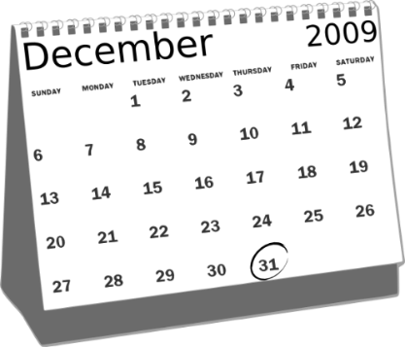
ci
cine
diciembre
ciencias
ciudad
cierto
decir
[to say; tell]
Notes:
Introduce and elicit the pronunciation of the individual SSC ‘ci’ and then the source word again (with gesture, if using). Then present and elicit the pronunciation of the five cluster words.
The cluster words have been chosen for their high-frequency, from a range of word classes, with the SSC (where possible) positioned within a variety of syllables within the words (e.g. initial, 2nd, final etc.). Additionally, we have tried to use words that build cumulatively on previously taught SSCs (see the Phonics Teaching Sequence document) and do not include new SSCs. Where new SSCs are used, they are often consonants which have a similar symbol-sound correspondence in English.

Slide 12
ci
cine
diciembre
ciencias
ciudad
cierto
decir
Notes:
Without the images, students focus this time again closely on the SSC and the cluster words.

Slide 13
ci
cine
diciembre
ciencias
ciudad
cierto
decir
Notes:
Without the images or sound, students have to pronounce the words themselves.

Slide 14
Fonética
cine
cerca
diciembre
doce
centro
cierto
ciencias
ciudad
parecer
necesitar
necesario
decir
Notes:
Phonics and vocabulary Timing: 7 minutes.
Aim: to revisit SSCs [ci], [ce]; to also revisit previously taught vocabulary.
Procedure:
This slide can be used in a number of ways:
Splat the board - (During this activity, freeze the interactive whiteboard so as to not trigger the custom animation!)
Two students stand at the front. Students play against each other in a best of three to keep the game moving at pace and generate maximum involvement.
The winner stays and players swap in and out with the losing player.
Teacher calls on students to supply the word, again to generate maximum participation.
B. Lotto - Multiple games can be played. This is fast and pacey. Again, freeze the IWB (alternatively keep track of the words called by keeping a list).
Students write down any three of the words.
Teacher (or students) call out the words one at a time.
The first student(s) to have their three called out wins.
Teacher ticks off the words as they are called to enable the feedback to be conducted swiftly.
Teacher elicits the English from students each time that the three words are given by the winner(s).
C. Pairwork
Students work in pairs. Student A sits with their back to the board whilst student B reads aloud the first six words that appear in animation.
Student A writes the word.
Students swap roles.
Students can check their spellings when they turn back to face the board.
Teacher circulates to listen to students’ pronunciation and praise/correct as necessary.
As the final activity, after any of the variations above, students write the English for as many of the words as they can to reinforce their meanings. Students could have a minute individually then team up with a partner to see if they can achieve translations for all 12 words.

Slide 15
Vocabulario
60
The spelling doesn’t change for masculine/feminine nouns, but it changes in the plural:
feliz (singular noun) felices (plural noun)
 | español | inglés
1 | somos | we are (for traits)
2 | moreno | brown, dark-haired, tanned
3 | claro | light, clear (for colours)
4 | oscuro | dark
5 | aburrido | bored, boring
6 | loco | crazy
7 | feliz | happy
8 | como | like (for comparisons)
Segundos
Accents matter!
cómo = how? Sorry?
como = like
e.g. Inglaterra no es como España.
0
England is not like Spain.
INICIO
Notes:
Vocabulary Timing: 5 minutes.
Aim: to introduce the vocabulary items for this week.
Procedure:
1. Students either work by themselves or in pairs, reading out the words and studying their English meaning (1 minute). 2. The English meanings are removed, and they try to recall them, looking at the Spanish (1 minute). 3, The Spanish meaning are removed and they try to recall them, looking at the English (1 minute) 4. Further rounds of learning can be facilitated by one pupil turning away from the board, and his/her partner asking him/her the meanings. This activity can work from L2 → L1 or L1 → L2.
Note: When introducing ‘feliz’ students could be asked which other adjectives they know which don’t change when used with the masculine/feminine nouns (alegre, importante, interesante).
‘Contento’, another word for ‘happy’, will be introduced in 8.1.1.1.

Slide 16
ser
[to be | being – for traits]
somos
[we are – for traits]
Notes:
Timing: 3 minutes (set of six slides)
Aim: to introduce the first person plural of ‘ser’.
Procedure:
Go through the verbs and their meaning with students, revealing each animation on a mouse click.

Slide 17
ser
[to be | being – for traits]
somos
[we are – for traits]
Notes:
Cycle through the infinitive and 1st person plural again.

Slide 18
somos
[we are – for traits]
Somos tranquilos.
[We are calm.]
Notes:
Introduce the 1st person plural in a sentence.

Slide 19
ser
[to be | being – for traits]
Es normal ser tranquilo.
[It’s normal to be calm.]
Notes:
Introduce the infinitive in a sentence.

Slide 20
somos
[we are – for traits]
Somos
_________ tranquilos.
[We are calm.]
Notes:
Cycle through the 1st person plural in context again.

Slide 21
ser
[to be | being – for traits]
Es normal ______ tranquilo.
ser
[It’s normal to be calm.]
Notes:
Cycle through the infinitive in context again.

Slide 22
Using ‘somos’ and ‘estamos’
Describing permanent attributes versus temporary states
In Spanish there are two verbs for ‘to be’: ser and estar.
We use ser to describe traits and estar to describe temporary states.
Compare:
Somos tranquilos.
Estamos tranquilos.
In English, we often use a verb with ‘-ing’ to talk about a temporary state (‘right now’).
For example,
We are feeling calm.
We are acting crazy.
We are being strange.
Some adjectives have different meanings when used with ser and estar. For example:
moreno / loco / aburrido
Somos morenos. – We are dark-skinned/dark-haired.
Estamos morenos. – We are tanned/brown.
Somos aburridos. – We are boring.
Estamos aburridos. – We are bored.
Somos locos. – We are insane.
Estamos locos. – We are acting crazy.
→ We are calm (in general).
We are calm (at the moment).
Notes:
Timing: 2 minutes
Aim: to to introduce the first person plural of ‘ser’; to compare the first person plural of ‘ser’ with the first person plural of ‘estar’.
Procedure:
Go through the grammar explanation with students, revealing each new sentence on a mouse click.
Note: It is worth pointing out to students that ser loco is only used in Spain to refer to people who are clinically insane / in a mental institution. It does have a broader use than this in much of South America, but it’s important to stress to students that when they want to say someone is crazy, they will want to use ‘estar’.

Slide 23
Una familia de vacaciones
leer
In general
(trait)
On holiday
(temporary state)
La familia escribe una postal. Lee las frases. ¿Qué dice la familia?
1 | Estamos morenos como los surfistas*.
2 | Somos tranquilos, descansamos en el hotel.
3 | En los museos estamos aburridos.
4 | Estamos locos por las noches, bailamos mucho en las discotecas.
5 | No usamos el ascensor* en el hotel porque somos nerviosos.
6 | Somos serios, escuchamos las instrucciones en la estación.
7 | Estamos felices en la playa y en las tiendas.
8 | No somos tontos como otras personas.
* los surfistas – surfers *el ascensor – lift
Notes:
[1/2]
Timing: 6 minutes
Aim: to consolidate the differences between ‘estamos’ and ‘somos’.
Procedure: 1. Students read each sentence and decide whether the verb is referring to something in general (trait) or on holiday (state).
2. Teachers shows the answers one by one on a mouse click.
Note: Four adjectives in this activity were taught in Term 1.1, week 2: nervioso [1521]; tranquilo [1073]; serio [856]; tonto [2379]. Ask students to recall the meaning of these.

Slide 24
Una familia de vacaciones
leer
In general
(trait)
On holiday
(temporary state)
Lee otra vez. Escribe las frases subrayadas en inglés.
1 | Estamos morenos como los surfistas.
2 | Somos tranquilos, descansamos en el hotel.
3 | En los museos estamos aburridos.
4 | Estamos locos por las noches, bailamos mucho en las discotecas.
5 | No usamos el ascensor* en el hotel porque somos nerviosos.
6 | Somos serios, escuchamos las instrucciones en la estación.
7 | Estamos felices en la playa y en las tiendas.
8 | No somos tontos como otras personas.
We are tanned / brown.
We are calm.
We are bored.
We are (acting) crazy.
We are nervous.
We are serious.
We are (feeling) happy.
We aren’t silly.
*el ascensor – lift
Notes:
[2/2]
Timing: 4 minutes
Aim: to consolidate understanding of ‘estamos’ and ‘somos’; to understand vocabulary.
Procedure: 1. Students translate the whole sentence.
2. Teacher shows the answers one by one on a mouse click.
Note: this activity could be done as a differentiation opportunity for higher ability students.

Slide 25
Una familia de vacaciones
escuchar
El padre habla por teléfono con los abuelos en Inglaterra. Describe las vacaciones. Escucha. ¿La familia describe cómo es en general o cómo está hoy? Marca la opción correcta. También escribe el adjetivo en inglés.
 | En general | Hoy
 | En general | Hoy
1
cheerful
5
bored
dark-skinned, dark-haired
2
6
serious
(being)
strange
(feeling)
nervous
3
7
(acting)
crazy
4
calm
8
Notes:
Timing: 7 minutes
Aim: to consolidate understanding of the difference between ’somos’ and ‘estamos’.
Procedure:
Students listen to each recording and tick the correct column depending on what the verb refers to: ‘en general’ (somos) or ‘hoy’ (estamos).
Students listen again to each recording and write the adjective in English.
TRANSCRIPT
Somos alegres
Somos morenos
Estamos raros
Somos raros.
Estamos aburridos
Somos serios
Estamos nerviosos
Estamos locos

Slide 26
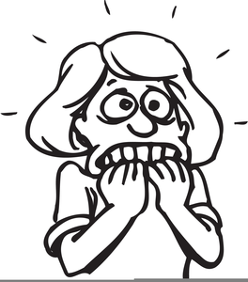
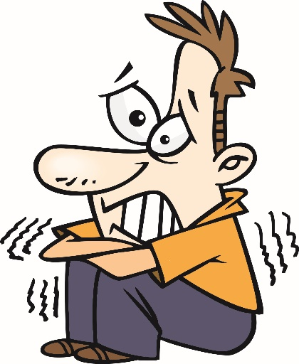
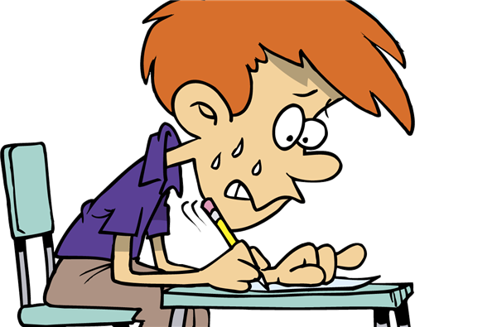
¿Somos o estamos?
escribir
24h
E.G.
E.G.
Somos
nerviosos.
Estamos
nerviosos..
We are nervous.
We are feeling nervous.
Notes:
Use this slide to model the instructions for students.
[1/2]
Timing: 8 minutes
Aim: to produce ‘somos’ and ‘estamos’ correctly to express trait and state; to consolidate use of adjective number agreement.
Procedure:
Students write two contrasting sentences, using ser and estar in first person plural, and with adjective agreement (i.e., plural -s on the adjective, to agree with the verb).
The teacher asks for translations into English of the sentences once complete so that students can evidence their understanding of 1) the person referred to by the verb; 2) the meaning of the verb (and to reinforce that they both are translated as ‘to be’); and 3) the meaning of the adjective, depending on whether it is used with ser or estar.
Note: Teachers may feel they need to give students help with the adjectives to be used if this is not immediately apparent in the picture.

Slide 27
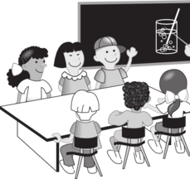
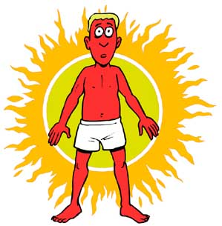
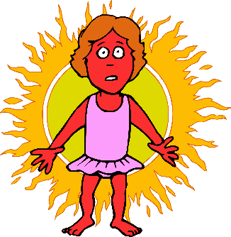
İA escribir!
escribir
zzz
zzz
2)
1)
Somos
aburridos.
Estamos
aburridos.
We are bored.
We are boring.
3)
4)
Somos
rojos.
Estamos
rojos.
We are red.
We are red (burnt).
5)
6)
Somos
locos.
We are insane/crazy.
We are acting crazy.
Estamos
locos.
7)
8)
Estamos
morenos.
We are tanned/brown.
We are dark-haired/dark-skinned.
Somos
morenos.
Notes:
[2/2]

Slide 28
İA hablar!
hablar
zzz
zzz
[We are red.]
[We are red (sunburnt).]
[We are bored.]
[We are insane, crazy.]
[We are (acting) crazy.]
[We are boring.]
[We are dark-haired/dark-skinned.]
[We are tanned, brown.]
Estamos rojos.
Somos morenos.
Estamos locos.
Somos rojos.
Estamos morenos.
Estamos aburridos.
Somos aburridos.
Somos locos.
Notes:
Timing: 5 minutes
Aim: to produce ‘somos’ and ‘estamos’ and vocabulary in oral production
Procedure: click to bring up each prompt and click again to reveal the answer.

Slide 29
Saying what people are like today vs in general
‘Ser’ for traits and ‘estar’ for state [revisited]
SSCs [ce], [ci]
Y7 Spanish
Term 2.2 - Week 5 - Lesson 48
Victoria Hobson / Nick Avery Artwork: Mark Davies
Date updated: 16/08/21
Notes:
Artwork by Mark Davies. All additional pictures selected are available under a Creative Commons license, no attribution required.
Learning outcomes (lesson 2):
Consolidation of [ce], [ci]
Consolidation of adjective agreement for gender and number
Consolidation of ser and estar for traits vs temporary states
Word frequency (1 is the most frequent word in Spanish):
7.2.2.5 (introduce) somos [7-ser]; feliz [908]; moreno [3304]; claro [1923]; oscuro [802]; aburrido [3917]; loco [846]; como [20]
7.2.1.2 (revisit) perro [888]; abuelo [4796]; abuela [717]; primo [1451]; prima [3051]; bastante [308]; hermoso [980]; activo [1278]; fuerte [435]
7.2.2.2 (revisit) poder [32]; puedo; puedes; puede; jugar [356]; participar [593]; favor [516]; pedir [217]; preguntar [219]; cambiar [255]; material [690]; ¿puedo ir a los servicios?; compañero/a [551]
Source: Davies, M. & Davies, K. (2018). A frequency dictionary of Spanish: Core vocabulary for learners (2nd ed.). Routledge: London
The frequency rankings for words that occur in this PowerPoint which have been previously introduced in NCELP resources are given in the NCELP SOW and in the resources that first introduced and formally re-visited those words.
For any other words that occur incidentally in this PowerPoint, frequency rankings will be provided in the notes field wherever possible.

Slide 30
ce
MADRID 1KM
cerca
Nick Avery
Notes:
[1/2]
Timing: 1 minute
Introduce and elicit the pronunciation of the individual SSC ‘ce’ and then present and practise the pronunciation of the source word ‘cerca’.
A possible gesture for this source word would be to bring two open palms close together (but not touching)

Slide 31
ci
cierto
Nick Avery
Notes:
[2/2]
Introduce and elicit the pronunciation of the individual SSC ‘ci’ and then present and practise the pronunciation of the source word ‘cierto’.
A possible gesture for this source word would be to give a ‘thumbs up’

Slide 32
escuchar
How many times in each sentence do you hear ‘ce’ and ‘ci’? Tally each time. Escribe las palabras en español.
escuchar
ce | palabras | ci | palabras
parece
cierto
1
centro
cinco
ciudad
2
bicicletas
cerca
estación
3
once
cine
4
necesito
ejercicio
hacer
diciembre
parece
cine
5
excelente
Notes:
Timing: 6 minutes
Aim: to continue focusing on SSCs [ci], [ce]; to also revisit previously taught vocabulary.
Procedure:
Students listen to each recording and tick the correct column depending on the sound they hear.
Students listen again and write the word in Spanish.
Transcript:
Parece ser cierto.
Hay cinco bicicletas en el centro de la ciudad.
La estación está cerca pero el cine está a once kilómetros.
Necesito hacer ejercicio en diciembre.
Estamos en el cine. La película parece excelente.
Note: All vocabulary here has been seen by students either as source/cluster words (as per lesson 1 in this sequence) or in previous vocab sets, apart from sentence five which includes a cognate: excelente [1546]. This could be used to challenge students or left out if teachers prefer, depending on the ability of the class.

Slide 33
leer
¿Cómo se dice en inglés?
leer
Parece ser cierto.
It seems/appears to be true.
Hay cinco bicicletas en el centro de la ciudad.
There are five bikes in the centre of the city.
La estación está cerca, pero el cine está a once kilómetros.
The station is near, but the cinema is eleven kilometres away.
Necesito hacer ejercicio en diciembre.
I need to do exercise in December.
Estamos en el cine. La película parece excelente.
We are in the cinema. The film seems/appears excellent.
Notes:
OPTIONAL
Timing: 5 minutes
Aim: to check understanding of the sentences used on the previous slide.
Procedure:
Students translate each sentence into English.
Teacher shows the answers by clicking on the orange bars.
Note: Teacher could focus particularly on ‘estamos’ (why is it ‘estamos’ here and not ‘somos’ – location is conveyed).

Slide 34
Identifica la palabra correcta.
puede
pedir
puedo
hablar
1 | 2 | 3
4 | 5 | 6
7 | 8 | 9
to be able to; can | to ask; asking | favour
you are able to; you can | to play; playing | I am able to; I can
to change; changing | to ask for; asking for | Can I go to the toilet?
s/he is able to; s/he can | to participate; participating | classmate
¿Puedo ir a los servicios?
poder
participar
jugar
el favor
10 11 12
compañero/a
puedes
preguntar
cambiar
Notes:
Timing: 5 minutes
Aim: to revisit the vocabulary for this week (from week 2.2.2).
Procedure:
Teacher says the number in Spanish (either in numerical or random order, to challenge students more).
Students have to search the options around the edge of the box to decide which is the corresponding word.
Teacher pauses for several seconds to allow students to search, then elicits the Spanish word from students in chorus.
Note: to allow for flexibility in the order of numbers, the answers have not been animated.

Slide 35
Vocabulario
Paco y Sofía
Luca y Lorena
Isobel
Chu-Chu
el abuelo
la abuela
los primos
la prima
el perro
quite active
beautiful
strong
nervous
quite strong
very active
quite nice
active
strange
¿Quién es nervioso?
¿Quién es fuerte?
¿Quién es bastante simpática?
¿Quiénes son activos?
¿Quién es hermosa?
¿Quién es bastante fuerte?
¿Quién es bastante activa?
Notes:
Timing: 5 minutes
Aim: to revisit the vocabulary for this week (from week 2.1.2) in comprehension and production
Procedure:
Teacher asks students ‘¿Quién es / Quiénes son?’ to recap the vocab for the members of the family.
Teacher clicks on the box to reveal the Spanish word for each family member.
Teacher shows questions on a mouse click.
Students answer each question, giving either the name of the family members, or saying/writing the words in Spanish e.g los primos.
Notes:
To force recall of the family members in Spanish teachers could conduct this activity with the boxes obscuring the word in Spanish. This would be a test not only of understanding the adjective but recalling/spelling the family members.
Given that muy is not part of this vocab set, it is not used in any of the Spanish questions.

Slide 36
Descripciones de los amigos
leer
Lee las descripciones. ¿Son de Paco y Paulina o Sara y María?
Escribe los adjetivos en inglés.
están morenos
son serias
están locas
Paco
Paulina
Sara
María
son aburridos
They are…
tanned
boring
nervous
(being) serious
They are…
serious
(acting) crazy
dark-haired/skinned
bored
son nerviosos
son morenas
están aburridas
están serios
Notes:
Timing: 5 minutes.
Aim: to reinforce the meanings of the adjectives when used with ‘son’ and ‘están’; to consolidate understanding of adjective (gender) agreement.
Procedure:
Teacher elicits the rules by asking the class how they will work out the answers.
Students give the answers in any order, considering if it’s a temporary state or a trait.
Teacher shows the answers working out which box to click by looking at the descending order from the list in Spanish.
Note: these are the adjectives listed in the order they descend in the list:
Paco & Paulina:
tanned
boring
nervous
being serious
Sara & María:
serious
acting crazy
dark-haired/skinned
bored

Slide 37
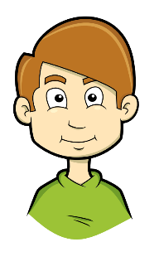
¿Qué describe Ignacio?
Marca la opción correcta y
escribe el adjetivo. Luego,
escucha otra vez. Es ‘hoy’ o ‘en general’?
escuchar
el cielo = sky
 |  | ¿Los dos? | Adjetivo en español | ¿Hoy (temporary state) o en general (trait)?
El cielo | La imagen
Los ríos | Las flores
Los abuelos | Las abuelas
Los primos | Las primas
Las camisas | Los colores
Los perros | Las chicas
Las cremas | Los zapatos
Las profesoras | Los autores
oscuro
hoy
1
claros
hoy
2
3
fuertes
en general
hermosas
hoy
4
oscuros
en general
5
activos
hoy
6
claras
en general
7
8
tranquilos
en general
Notes:
Timing: 7 minutes
Aim: to consolidate understanding of the difference in meaning between ‘son’ and ‘están’; to practise adjective agreement.
Procedure:
Students listen to each recording and mark the corresponding column depending on the gender of the adjective.
Students listen again and write the adjective in Spanish, focusing on the ending.
Students write ‘hoy’ if the sentence included ‘están’ and ‘en general’ if the sentence includes ‘son’.
Transcript:
[el cielo] está oscuro
[los ríos] están claros
[las abuelas] son fuertes
[las primas] están hermosas
[los colores] son oscuros
[los perros] están bastante activos en el parque
[las cremas] son claras
[los autores] son tranquilos
Notes:
The adjectives chosen here include three from 2.1.2 (hermoso, activo, fuerte) to offer further reinforcement of the revisited vocabulary (and evidence changing patterns of adjectives ending in -o plus adjectives ending in –e). Oscuro and claro are included from this week’s set as these have not yet been practised. This serves to offer variety of language/sentences and different contexts to further illustrate the use of ser/estar.
During the feedback, check students’ understanding of the nouns. Some of these words will be needed in the speaking activity which follows. (Los ríos / Las casas / Los chocolates / Las profesoras / Las primas / Los perros/ Las camisas / Los abuelos). Teacher could quickly write them on the board to serve as a visual support during the speaking activity.

Slide 38
hablar / escuchar
Persona A
hablar / escuchar
Say a sentence to your partner.
Escucha. Marca la opción
correcta y escribe la frase en inglés.
Usa ‘Los/las……..+ ‘son’ / ‘están’.
dark-skinned | bored
acting crazy feeling nervous | calm brown
Hoy
[in general]
[today]
Hoy
En general
En general
The………………………………………..
The………………………………………..
[today]
[in general]
Hoy
Hoy
En general
En general
The………………………………………..
The………………………………………..
Notes:
[1/3]
Do not show during activity
Timing: 10 minutes
Aim: to consolidate use and understanding of ‘son’ and ‘están’ and adjectives (with gender agreement).
Procedure:
Students take a few minutes to think about their sentences (but if possible, don’t write them down).
Student A says the sentences in Spanish to their partner.
Student B has to decide if the sentence is ‘today’ or ‘in general’ and write in English the noun and adjectives on the second half of the sheet.
Teacher circulates to check for accuracy of adjective agreement.
Students swap roles.
Students compare sheets to see if they understood the sentences correctly – the English should match. The next slide also displays the English to facilitate feedback.
Note: These prompt cards/grid are available in Word format (for ease of printing).

Slide 39
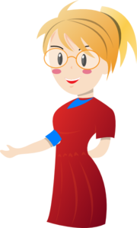
Persona B
hablar / escuchar
Say a sentence to your partner.
Escucha. Marca la opción
correcta y escribe la frase en inglés.
Usa ‘Los/las……..+ ‘son’ / ‘están’.
quite serious | clear
tanned | active
[today]
[in general]
Hoy
Hoy
En general
En general
The………………………………………..
The………………………………………..
[today]
[in general]
Hoy
Hoy
En general
En general
The………………………………………..
The………………………………………..
Notes:
[2/3]
Do not show during activity

Slide 40
hablar/escuchar
Persona A
Persona B
hablar / escuchar
Hoy
Hoy
Hoy
Hoy
En general
En general
En general
En general
The boys/cousins (m) are being quite serious.
The rivers are clear.
The cousins (m/f) are dark-skinned.
The girls/cousins (f) are bored.
Hoy
Hoy
Hoy
Hoy
En general
En general
En general
En general
The grandparents are tanned.
The teachers (f) are active.
The boys (f) are acting crazy and feeling nervous.
The dogs are calm and brown.
Notes:
[3/3]
Feedback
Here are the answers for students to be able to readily check their translations.

Slide 41
¿Ser or estar?
Lee las frases. ¿Es necesario usar ‘ser’ o ‘estar’ en español?
1 | The sky is dark today. | estar
2 | We are bored in the holidays. | estar
3 | We are happy (in general). | ser
4 | The rivers are clear in the morning. | estar
5 | The authors are boring. | ser
6 | The grandparents are tanned. | estar
7 | We are dark-skinned. | ser
8 | The cousins (f) are active today. | estar
9 | We are calm (in general). | ser
10 | They are good-looking (in general). | ser
11 | The girls are nervous (now). | estar
12 | The dogs are crazy in the car. | estar
Notes:
Timing: 5 minutes
Aim: to consolidate understanding of the contexts in which ‘estar’ and ‘ser’ are required
Procedure:
Students read each sentence and decide whether they would need to use ‘ser’ or ‘estar’ in that sentence, depending on the meaning conveyed.
Teacher shows the answers one by one. The sentences for moreno and aburrido exemplify the difference in meaning of these two adjectives when used with ser or estar. During the feedback, draw students’ attention to this. They will then be translating these sentences as a production activity next.
Notes:
Here all the adjectives used come from this week’s vocab set. Previously taught vocabulary: activo guapo nervioso were taught in Term 1.1 and Term 2.1.
Note: The use of ser + loco differs regionally. In Spain, ser loco is generally avoided, as its use is limited to someone who is clinically insane. A more general craziness might be conveyed by ‘Ser un loco’, which is a level of complexity we avoid here. In South America, ser loco is more widely used. We have, however, avoided using it with ser in this exercise. For further debate, see: https://forum.wordreference.com/threads/ser-estar-loco.442135/

Slide 42
¿Ser or estar?
escribir
Escribe las palabras subrayadas en español.
1 | The sky is dark (today). | estar
2 | We are bored in the holidays. | estar
3 | We are happy (in general). | ser
4 | The rivers are clear in the morning. | estar
5 | The authors are boring. | ser
6 | The grandparents are tanned. | estar
7 | We are dark-skinned. | ser
8 | The cousins (f) are active today. | estar
9 | We are calm (in general). | ser
10 | They are good-looking (in general). | ser
11 | The girls are nervous (now). | estar
12 | The dogs are crazy in the car. | estar
Está oscuro.
Somos morenos.
Estamos aburridos.
Las primas están activas hoy.
Somos felices.
Somos tranquilos/tranquilas.
Los ríos están claros por la mañana.
Son guapos.
Los autores son aburridos.
Las chicas están nerviosas.
Los abuelos están morenos.
Los perros están locos en el coche.
Notes:
Timing: 6 minutes
Aim: to improve productive use of ‘ser’ and ‘estar’, practising with first and third person (singular and plural) forms of both verbs
Procedure:
Students translate each sentence.
Teacher shows the answers.
Teacher discuss with students alternate translations for the sentences with estar, such as ‘the girls are feeling nervous’ (11) or ‘the dogs are acting crazy’ (12).
Note: accurate use of number agreement on the adjective is to be encouraged here (in all instances the plural marker –s is used)

Slide 43
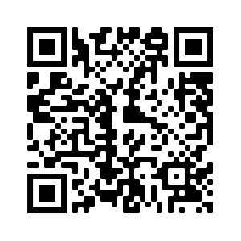
Deberes
Vocabulary Learning Homework (Term 3.1, Week 1)
Audio file
Audio file QR code:
Student worksheet
Quizlet link
In addition, revisit: Term 2.2, Week 3
Term 2.1, Week 3

