Slide 1
Saying what I do and s/he does
-ar verbs – 1st and 3rd person singular
Many Spanish infinitives end in –ar.
The verb ending changes depending on who the verb refers to.
Compare:
Escucha música.
S/he listens to music.
Escucho música.
I listen to music.
This part of the verb is called the ‘stem’.
To mean ‘I’ with an –ar verb, remove –ar and add –o.
Escuchar
Escucho
Notes:
3rd person singular form is used for comparison with the new verb form (1st person singular) as it was introduced previously in NCELP SoW.
The 2nd person singular form is taught in the second of this two-lesson sequence.

Slide 2
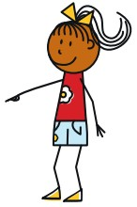
Maria and Ana are twins. María talks about herself (I) and her sister (she).
Write 1-10 and who does what, I or she.
leer
 | Maria says: | Maria (‘I’) | Ana (‘she’) | What exactly does she say?
1
2
3
4
5
6
7
8
9
10
✔
Compra unas cosas en Valencia.
“She buys some things in Valencia.”
Bailo en el sur.
✔
“I dance in the south.”
Lleva una camisa.
✔
“She wears a shirt.”
Baila en el norte.
✔
“She dances in the north.”
Necesito un amigo.
✔
“I need a (male) friend.”
Usa una bicicleta.
✔
“She uses a bike.”
Necesita una amiga.
✔
“She needs a (female) friend.”
Uso un teléfono. Es muy nuevo.
✔
“I use a phone. It’s very new.”
Lleva zapatos.
✔
“She wears shoes.”
Compro productos en Madrid.
✔
“I buy products in Madrid.”
Notes:
Reading task No need to print off the slide. Rubrics are animated to support modelling.
1. Scenario 2. Blank table with headings showing María = I and Ana = she. 3. Instruction to write 1-10 and I or she. 4. First sentence to work through together as an example. Note: At this point prompt students, if necessary, to focus on the verb ending. 5. Prompt students then to tell you exactly what María says – i.e. to translate the sentence word for word. Reveal the answer: ‘She buys some things in Valencia.’ 6. Bring up sentences 2-10. Ask students to write i/she for each sentence first AND THEN to fill in the final column. This introduces differentiation by outcome, whilst at the same time ensuring that even the lower attaining students focus their attention first on the essential grammatical understanding, and only later on the additional lexical/grammatical information from the rest of the sentence. 7. Answers are then animated to appear with the I/she AND the translation so that even those learners who haven’t managed to get to all of the translations, will be able to reinforce their knowledge during feedback.

Slide 3
Escucha.
María tiene una lista de cosas.
Marca ‘I need’ o ‘she needs’.
Escribe A o B.
“I need” | “she needs”
A
B
1
2
3
4
5
escuchar
Notes:
Listening task
There’s no need to print off the slide.
Students can just copy the first two column headings of the grid into their books and write A or B instead of circling pictures.
Note that there are 1-10 items in this task so instruct students accordingly. Numbers 6-10 are on the next slide.
Note also that the rubric is in Spanish this time. Each short sentence is animated separated so that the teacher can ensure that students understand each tiny step. If needed, the teacher can ask students to identify the difference between A and B. For example: La diferencia entre A y B? A? Qué es? Una botella or unas botellas? Sí, unas botellas. Y B? Sí, una botella. Perfecto.
Transcript: 1. Necesito una botella; 2. Necesita un caballo; 3. Necesito unas revistas; 4. Necesita una cama; 5. Necesita unas plantas (cont. on next slide)
Note: Some classes may do better to listen first time for I need / she needs and then listen again to identify if each item is singular or plural. Teachers can therefore differentiate the task, as required.

Slide 4
6 - 10
“I need” | “she needs”
A
B
6
7
8
9
10
escuchar
Notes:
Transcript: 6. Necesito un zapato. 7. Necesita unas bolsas. 8. Necesito un gato; 9. Necesita una camisa; 10. Necesito unos vasos

Slide 5
You have an identical twin!
The two of you look the same, but how are you different?
Tell your partner what you do and what your twin does, using the speaking cards.
Remember to use the right verb ending for ‘I’ and ‘s/he’.
hablar / escuchar

Slide 6
Student A
brother
[uses a pen]
me
[buy some shoes]
brother
[listens to music]
me
[need a shirt!]
me
[dance in the north]
brother
[carries some bags]
hablar
Notes:
A printer-friendly version of these cards is available in Word format.

Slide 7
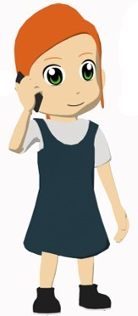
Student B
sister
[buys glasses]
me
[use a phone]
me
[listen to music]
sister
[needs a shirt!]
me
[carry some plants]
sister
[dances in the south]
hablar
Notes:
A printer-friendly version of these cards is available in Word format.

Slide 8
Student B answer grid
My partner (‘I’) | My partner’s brother (‘he’)
buy some shoes
listens to music
dance in the north
uses a pen
need a shirt
carries some bags
escuchar
Notes:
Students can just complete this in their books.

Slide 9
Student A answer grid
My partner (‘I’) | My partner’s sister (‘she’)
listen to music
buys some glasses
use a phone
dances in the south
carry some plants
needs a shirt
escuchar
Notes:
Students can just complete this in their books.

Slide 10
Respuestas
Persona A
Usa las cartas. Escribe 6 frases.
Compro
(unos)
zapatos
1) _________ ______ _________.
This sentence is also correct without ‘unos’.
It means ‘I buy shoes’ (not ‘I buy some shoes).
Escucha
música
2) _________ _________.
Usa
un
bolígrafo
3) _____ ____ ___________.
Bailo
en
el
norte
4) ______ ___ ___ ______.
Lleva
(unas)
bolsas
5) _______ _______ _______.
Necesito
una
camisa
6) __________ _____ _______.
escribir
Notes:
Writing exercise with answers – Student A

Slide 11
Persona B
Usa las cartas. Escribe 6 frases.
Respuestas
Compra
(unos)
vasos
1) _________ ______ _______.
This sentence is also correct without ‘unos’.
It means ‘She buys glasses’ (not ‘She buys some glasses).
Escucho
música
2) _________ _________.
Uso
un
teléfono
3) _____ ____ ___________.
Baila
en
el
norte
4) ______ ___ ___ ______.
Llevo
(unas)
plantas
5) _______ _______ _______.
Necesita
una
camisa
6) __________ _____ ________.
escribir
Notes:
Writing exercise with answers – Student A

Slide 12
Saying what you do and s/he does
-ar verbs –2nd and 3rd person singular
Verb endings change depending on who the verb refers to.
Compare:
Llega temprano.
S/he arrives early.
Llegas temprano.
You arrive early.
What is this verb part called?
To mean ‘you’ (singular), remove –ar from the infinitive and add –as.
escuchar
escuchas
hablar
hablas
Notes:
The 3rd person singular form is used for comparison with the new verb form (2nd person singular) as it was introduced last week in NCELP SoW.
The 1st person singular present (-o ending) was taught in lesson 1 of this two-lesson sequence.

Slide 13
Your class is doing a Spanish play.
Your teacher gives you and a friend stage directions.
Choose the correct sentence starter and translate the rest.
1. “Llevas unos vasos en una bolsa.”
You carry…
You carry some glasses in a bag.
S/he carries…
2. “Escuchas una conversación.”
S/he listens…
You listen to a conversation.
You listen…
3. “Usa un bolígrafo. Es blanco.”
You use…
S/he uses a pen. It’s white.
S/he uses…
4. “Compra una botella de Pepsi.”
S/he buys…
S/he buys a bottle of Coca-Cola.
You buy…
5. “Necesitas un periódico.”
S/he needs…
You need a newspaper.
You need…
leer

Slide 14
It’s the day of the play, but the teacher has forgotten everything!
She needs help. Translate her questions.
1. “¿Qué llevas?.”
5. “¿Hablas con Sara?.”
What do you wear/carry?
Do you speak with Sarah?
2. “¿Cómo baila?”
6. “¿Usa un télefono?.”
How does s/he dance?
Does s/he use a phone?
3. “¿Quién compra un producto?”
7. “¿Qué necesitas?.”
Who buys a product?
What do you need?
4. “¿Dónde bailas?”
8. “¿Quién usa una bolsa?.”
Where do you dance?
Who uses a bag?
leer
Notes:
This is an opportunity to revisit question words and yes-no questions along with the same pair of verb forms (2nd person singular vs 3rd person singular).
Note: This could be done as a ‘think-pair-share’ and feed back task, rather than a written activity. The following slide offers an extension to the task, whereby the Spanish questions are then re-covered, to prompt students to produce Spanish from the English prompts.

Slide 15
¿Cómo se dice en español?
1. “¿Qué llevas?.”
5. “¿Hablas con Sara?.”
What do you wear/carry?
Do you speak with Sarah?
2. “¿Cómo baila?”
6. “¿Usa un télefono?.”
How does s/he dance?
Does s/he use a phone?
3. “¿Quién compra un producto?”
7. “¿Qué necesitas?.”
Who buys a product?
What do you need?
4. “¿Dónde bailas?”
8. “¿Quién usa una bolsa?.”
Where do you dance?
Who uses a bag?
leer
Notes:
OPTIONAL EXTENSION SLIDE
Note that students can opt to produce the questions in any order. The shapes are triggered to reveal the Spanish question when the shape itself is clicked.

Slide 16
Your friend describes what your character and another character does.
Listen. Is it ‘you’ or ‘s/he’?
Talking about ‘you’ (singular) | Talking about ‘s/he’
1
2
3
4
5
6
7
8
9
10
escuchar
Notes:
Transcript: 1. Llevas una camisa. 2. Necesita unas cámaras. 3. Usas unos teléfonos. 4. Compras un bolígrafo. 5. Usa un teléfono. 6. Llega con unos amigos. 7. Necesitas una cámara. 8. Lleva unas camisas. 9. Compra unos bolígrafos. 10. Llegas con un amigo.
Here we only want learners to pay attention to the verb. On the next slide, they will listen again and have to pay attention to the article and noun (for singular vs plural).

Slide 17
B
D
A
1
K
C
2
G
[need]
[buy]
[arrive with]
3
E
[wear]
E
4
F
K
Listen again.
Match the sentence to the card.
5
I
6
A
[use]
G
7
B
[wear]
F
8
C
J
I
9
D
[need]
10
J
[buy]
[arrive with]
[use]
escuchar
Notes:
No need to print this – students can just listen and note down the letter. When checking answers, ask them to say the letter aloud for oral alphabet practice.
Transcript: 1. Llevas una camisa. 2. Necesita unas cámaras. 3. Usas unos teléfonos. 4. Compras un bolígrafo. 5. Usa un teléfono. 6. Llega con unos amigos. 7. Necesitas una cámara. 8. Lleva unas camisas. 9. Compra unos bolígrafos. 10. Llegas con un amigo.

Slide 18
You overhear the head of languages talking to a new teacher.
You challenge yourself to translate into Spanish. Choose the correct verb.
1. “You use some books.”
Uso / usas / usa unos libros.
2. “I arrive with José.”
Llegas / llega / llego con José.
3. “He arrives by car.”
Llego / llega / llegas en coche.
4. “You buy some things.”
Compra / compras / compro unas cosas.
5. “He needs a task.”
Necesitas / necesito / necesita una tarea.
6. “I forget some words.”
Olvido / olvidas / olvida unas palabras.
7. “You listen to a question.”
Escucha / escucho / escuchas una pregunta.
8. “She needs to arrive early.”
Necesitas / necesita / necesito llegar temprano.
9. “I buy magazines.”
Compro / compra / compras revistas.
10. “You listen very well!”
¡Escucha / escucho / escuchas muy bien!
leer
Notes:
Students have now had plenty of practice with 1st, 2nd and 3rd person singular -ar verbs, so here we include a more challenging reading exercise in which attention to the three verb forms is needed.
Note: This task gives teachers the opportunity to sow the seed of an idea for using language beyond the classroom. Not all will do it, of course, but setting them the challenge to go around generally (e.g. on the walks between lessons) listening out for things people say and seeing if they can translate any of those messages into Spanish.

Slide 19
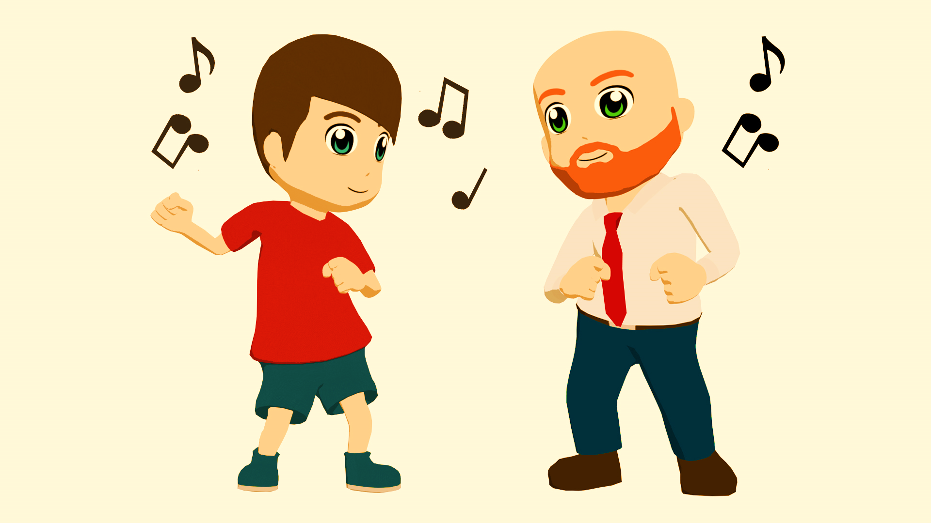
bailo
cómo
¿Qué ________?
_______ swing.
¿_________?
En un bar en Salamanca.
¿______ en el centro?
Sí, en el centro.
¿Con ________?
Un amigo.
¿________ bailas?
¡Con energía!
bailas
Bailo
está
dónde
Dónde
quién
bailas
Está
quién
Cómo
leer / hablar
Notes:
Students write the text, completing the gaps with one of the options. This will help them further practise the 1st & 2nd person singular form of verbs & question words.
Once complete, they can practise reading this conversation in pairs. After initial practice reading their own (completed) texts, an extra challenge could be to ask them to practise with the incomplete text displayed on the board. This will prompt speeded recall of the words that are missing!

Slide 20
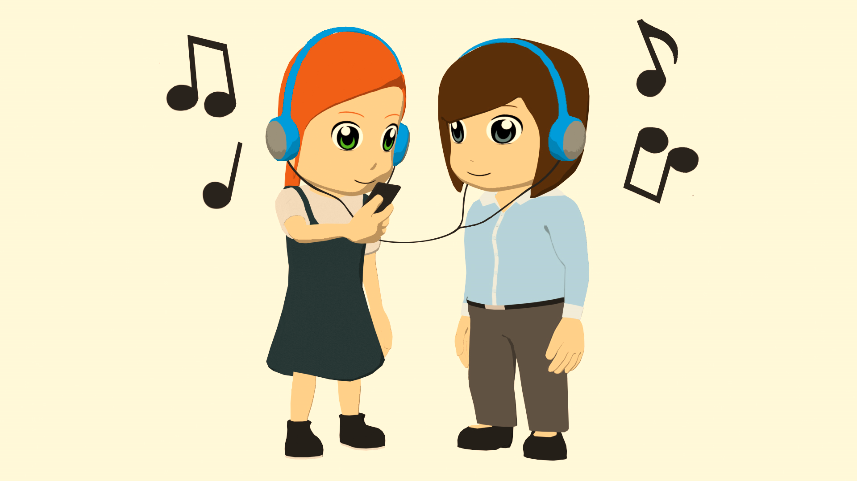
qué
bailas
¿______ música ____________?
___________ hip-hop.
¿_________?
En una casa en San Sebastián.
¿Con ________?
Con una amiga, Sara.
¿ _______ también?
Sí, ¡es fantástico!
Qué
escuchas
dónde
quién
Escucho
Dónde
escuchas
escucho
quién
Bailas
leer / hablar
Notes:
Students write the text, completing the gaps with one of the options. This will help them further practise the 1st & 2nd person singular form of verbs & question words.
Once complete, they can practise reading this conversation in pairs. After initial practice reading their own (completed) texts, an extra challenge could be to ask them to practise with the incomplete text displayed on the board. This will prompt speeded recall of the words that are missing!

