Slide 1
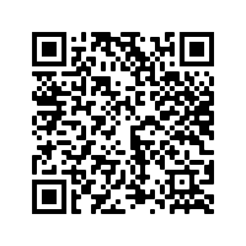
Hausaufgaben
Vocabulary Learning Homework (Y8, Term 2.1, Week 5)
Audio file
Audio file QR code:
Student worksheet
Quizlet link
In addition, revisit: 8.1.2 Week 7
8.1.1 Week 7
Notes:
URL of 8.2.1.5 answer sheet: https://resources.ncelp.org/concern/resources/4q77fr843?locale=en

