Slide 1
Spanish Question words Practice
Notes:
These are lexical activities, more than anything designed to embed the knowledge of the question words as individual vocabulary items, and increase students’ speed of recall, receptively and productively.

Slide 2
¿Cuál es la pregunta?
¿Qué música escuchas?
¿Cuánto quieres comer?
¿Cuándo es el festival?
¿Cómo vas al colegio?
¿Dónde está Rafael?
¿Cuántos libros tienes?
¿Por qué piensas eso?
¿Quién es tu profe de ciencias?
¿Cuál es tu palabra favorita?
Rachel Hawkes
Notes:
These repeat the questions from the learning presentation. It would of course be possible to use completely different questions and create a higher level of challenge.

Slide 3
how much?
which?
why?
when?
how?
where?
how many?
what?
who?
Rachel Hawkes
Notes:
Noughts and crosses game. Os and Xs is simply pupils in two halves of the class nominating a Q word from the board in turns – teachers marks off answers from one half of the class with a O and other half with a X. It’s a 2-minute activity for eliciting all the Q words again.

Slide 4
how? | what? | … | … | … | … | … | … | …
Rachel Hawkes
Notes:
Students can also draw a 3 x 2 grid and choose six of the nine question words for a bingo. Strip bingo is even better. Students write all of the nine question words in their own chosen order from left to right in English. Teacher (or another student) calls out the question words in Spanish. Pupils can only tear off from either end. The player who has nothing left on his/her strip first, wins.

Slide 5
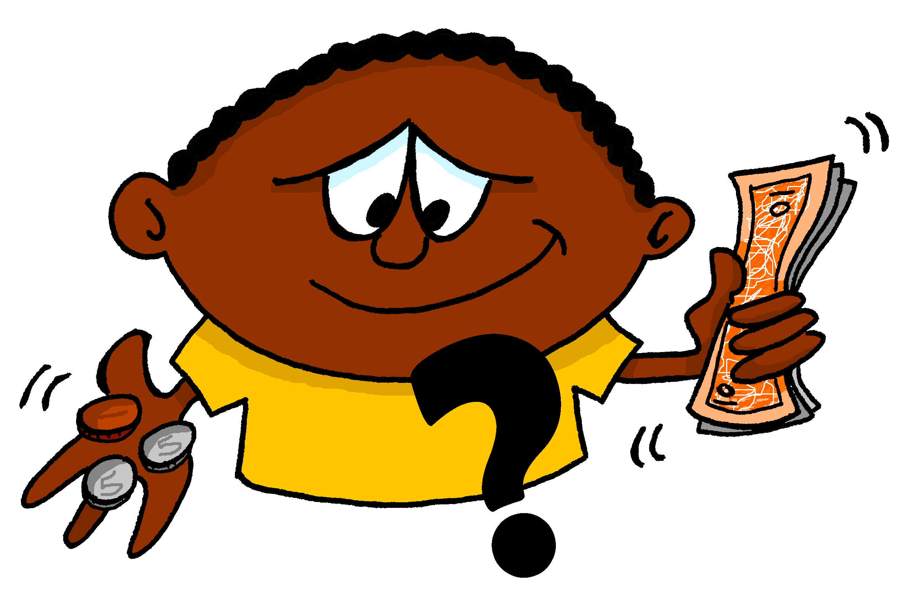
A | B | C
D | E | F
G | H | I
Images - Steve Clarke
Rachel Hawkes
Notes:
Use the images to elicit the question words and/or a whole question (can easily differentiate – a bonus point can be offered for those who are able to create new questions).

Slide 6
¿Cómo?
¿Quién?
¿Qué?
¿Por qué?
¿Dónde?
¿Cuánto?
¿Cuántos?
¿Cuándo?
¿Cuál?
Rachel Hawkes

Slide 7
¿C_ _ _?
¿Q_ _ _ _?
¿Q_ _?
¿P _ _ _ _ _?
¿D_ _ _ _?
¿C_ _ _ _ _?
¿C_ _ _ _ _ _?
¿C_ _ _ _ _?
¿C_ _ _?
Rachel Hawkes

Slide 8
when?
who?
how much?
how much?
which?
how?
why?
where?
how many?
when?
where?
why?
which?
how?
how many?
what?
who?
what?
Rachel Hawkes
Notes:
Slap the board. Could also be done the other way around for reading practice.

Slide 9
¿Qué pregunta es?
Juego al fútbol.
?
en mi colegio.
¿Dónde?
Rachel Hawkes
Notes:
This activity doesn’t use all of the question words, but is a very useful one for practising questions in a scaffolded, yet ‘contingent’ context. Students only know which question word to use by looking at both lines of dialogue either side and processing for meaning. As the first line is repeated each time, the cognitive load is firmly focused on the 3rd utterance to cue the correct question word.
Using the Q words in context to reinforce their meaning. Lines 1 – 3 are there. Students supply the question word orally. Do a couple first to model, then give each pair 20 seconds to say each dialogue first before taking the answer whole class for the rest of the slides.

Slide 10
¿Qué pregunta es?
Juego al fútbol.
?
el sábado.
¿Cuándo?
Rachel Hawkes
Notes:
Using the Q words in context to reinforce their meaning. Lines 1 – 3 are there. Students supply the question word orally. Do a couple first to model, then give each pair 20 seconds to say each dialogue first before taking the answer whole class for the rest of the slides.

Slide 11
¿Qué pregunta es?
Juego al fútbol.
?
¡JUEGO AL FÚTBOL!
¿Cómo?
¿Qué?
Rachel Hawkes
Notes:
The ‘cómo’ could be omitted here, but I think that pupils have had long enough to embed their knowledge of both this and ‘qué’ and think it is useful for them to learn an additional use of ‘cómo’ as a more polite way than ‘qué’ of requesting a repeat.

Slide 12
¿Qué pregunta es?
Juego al fútbol.
?
¡Es fenomenal!
¿Por qué?
Rachel Hawkes

Slide 13
¿Qué pregunta es?
Juego al fútbol.
?
con mis amigos.
¿Con quién?
Rachel Hawkes
Notes:
This is a way to introduce a variant of ‘quién’, and one that is very useful for students, when talking about what they do with their friends / family.

Slide 14
¡Vamos a conversar!
Aprendo español.
?
¿Con quién?
¿Dónde?
¿Cuándo?
¿Cómo?
¿Por qué?
con mi clase | ¡APRENDO ESPAÑOL! | el viernes
en el colegio |  | ¡Es muy importante!
Rachel Hawkes
Notes:
Pair work Question words are spontaneous Responses are then supported.
After students have tried this out for themselves, use the animations to elicit their responses as a whole class orally and give them feedback.
Students can then create their own sequences of questions and answers, starting with a different statement. Their partner has to select the answer that has to be given.

