Slide 1
Examples
production
Role play tasks (including transactional)
Notes:
9.3.2.3
Timing: 6 minutes (slides 3 – 8) Aim:
i) to practise gain confidence and fluency in oral production of SSC [cu]+vowel (cua, cue, cui)
ii) to practise producing and understanding a range of previously taught numbers (mostly 1-29)
Procedure:
Click to reveal each part of the explanation slide with the students. Check understanding via oral translation of the example into English.
Student A turns away from the board and asks Student B questions based on his/her six cards (slide 3). All questions begin with ‘¿Cuánto cuesta…?’. Glosses are provided for unknown words.
Teacher brings up slide 4. Person B listens, looks at the prices displayed on the board and then says the price for the relevant card in Spanish.
Person A then writes the price down in the space provided on his/her prompt card.
Students swap roles. The teacher displays slide 6 on the board.
Use slide 7 to provide feedback.
Frequency of unknown words:
cueva [4480]; objeto [567]

Slide 2
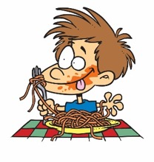
hablar / escuchar / escribir
Hablas de las vacaciones con tu compañero.
Use your cards to
ask questions in Spanish.
answer questions. Is your partner asking about you (-iste) or about your friend (-ió)?
Your partner will also ask you. Take turns.
Choose your answer depending on the verb in the question.
Un ejemplo:
¿Dónde comiste?
Persona A
(pregunta):
En el centro de la ciudad.
Persona B
(contesta):
Ask your partner these questions.
Listen for whether it’s –iste (‘you’) or –ió (‘s/he’) and then give the information in Spanish.
Write down the answer.
1. Where did you eat?
Partner asks about…
‘you’
‘s/he’
In the city center.
[where?]
on the beach
in the city center
Notes:
9.1.1.2
Timing: 12 minutes
Aim:
to practise producing and understanding verbs with the endings –iste and –ió (oral modality).
to also consolidate use of question words and vocabulary (oral modality).
Procedure:
Person A uses their cards to ask a question in Spanish.
Student B listens and says the corresponding answer depending on the question – does the question refer to ‘you’ (-iste) or to the ‘s/he’ (-ió)?
Student A then writes down their answer in Spanish.
Teacher uses the answer slide to give feedback.
Notes: 1. An active choice will be needed by the listener depending on the question asked. This makes the identification of the verb ending essential for the completion of the task.
2. Given that the grammar and vocabulary being practised here was all taught in Year 7 and 8, we can expect many students to use English prompts to produce the Spanish questions. However, there is of course a judgement to be made based on the ability of the group. For lower-ability students, for example, it might be more appropriate to scaffold the sentence, requiring only production of the verb and/or the question word.

Slide 3
Persona A
Ask your partner these questions.
Persona A
Listen for whether it’s –iste (‘you’) or –ió (‘s/he’) and then give the information in Spanish.
Write down the answer.
Partner asks about…
‘you’
‘s/he’
1. When did you collect the tickets?
[when?]
in June
in July
2. How many areas did s/he discover?
[how many?]
three
five
3. Where did you go out?
to the square
to the center
[where?]
4. What did you eat?
[what?]
meat
pintxos
5. Why did s/he take a boat?
because there is an island
because it’s fun
[why?]
6. How did s/he decide to travel?
[how?]
by train
on foot
Notes:
DO NOT DISPLAY DURING ACTIVITY
See accompanying Word doc for printable version.
Target answers for Person A during speaking, based on Person B’s questions:
En agosto.
Tres.
A la playa.
Comida tradicional.
Porque es genial.
En autobús.
Translation of questions:
¿Cuándo recogiste los billetes?
¿Cuántas zonas descubrió?
¿Dónde saliste?
¿Qué comiste?
¿Por qué cogió un barco?
¿Cómo decidió viajar?

Slide 4
Persona B
Ask your partner these questions.
Persona B
Listen for whether it’s –iste (‘you’) or –ió (‘s/he’) and then give the information in Spanish.
Write down the answer.
Partner asks about…
‘you’
‘s/he’
1. When did s/he collect the tickets?
[when?]
in August
last week
2. How many areas did you discover?
[how many?]
six
eight
3. Where did s/he go out?
to the beach
to the street
[where?]
4. What did you eat?
[what?]
traditional food
tasty food
5. Why did you take a boat?
because there is a river
because it’s great
[why?]
6. How did s/he decide to travel?
[how?]
by plane
by bus
Notes:
DO NOT DISPLAY DURING ACTIVITY
See accompanying Word doc for printable version.
Target answers for Person B during speaking, based on Person A’s questions:
En julio.
Ocho.
Al centro.
Carne.
Porque hay una isla.
A pie.
Translation of questions:
¿Cuándo recogió los billetes?
¿Cuántas zonas descrubriste?
¿Dónde salió?
¿Qué comiste?
¿Por qué cogiste un barco?
¿Cómo decidió viajar?

Slide 5
Respuestas
Persona A
Persona B
1. When did you collect the tickets?
1. When did s/he collect the tickets?
In August
In July.
2. How many areas did s/he discover?
2. How many areas did you discover?
Eight.
Three.
3. Where did you go out?
3. Where did s/he go out?
To the beach.
To the center.
4. What did you eat?
4. What did you eat?
Traditional food.
Meat.
5. Why did s/he take a boat?
5. Why did you take a boat?
Because it’s great.
Because there is an island.
6. How did s/he decide to travel?
6. How did s/he decide to travel?
By bus.
On foot.
Notes:
ANSWER SLIDE
Teacher can use this slide to give feedback.

Slide 6
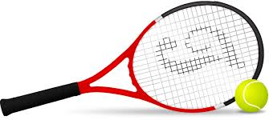
Lee las frases con un/a compañero/a. Toma turnos.
Remember, [a] and [e] are ‘strong’ vowels. Next to a ‘weak’ vowel, like [i], they make a single syllable: [ai], [ei], [ia] and [ie].
leer / hablar
*el aire libre= fresh air
*la competición = competition
1. ¿Necesitáis mejorar?
Sí, porque perdemos siempre.
2. ¿Prefieres el tenis a los otros deportes?
Me encantan los deportes al aire libre* en verano porque normalmente no hay lluvia.
3. ¿Ganas muchos partidos?
Sí, suelo ganar los partidos cada mes. ¡El mes pasado, gané seis!
4. ¿Invitas a tu familia a los partidos?
Mi familia viene cada viernes. Mi papá me da muchos consejos.
5. ¿Organizáis partidos contra vuestros amigos?
Sí, pero solo partidos de veinte minutos. No están a nuestro nivel.
6. Hay treinta jugadores en la competición*. ¿Peleas con alguien?
Solo con Diana. Es demasiado seria cuando juega.
Notes:
9.1.2.1
Timing: 5 minutes
Aim:
to practise pronouncing words with the diphthongs [ai], [ei], [ie], [ia].
to practise pronouncing words with different stress positions (penultiamate, final syllable).
to gain fluency and confidence in oral production.
Procedure:
Students practise reading the conversation in pairs.
Students take turns at playing different roles.
Notes:
The sentences have been modified slightly to include more examples of diphthongs.
In year 8, students learnt about the concept of ‘strong’ and ‘weak’ vowels and the way in which a diphthong is formed when they appear next to each other. The focus is now on automatising that knowledge in oral production.
Frequency of unknown words and cognates:
aire libre [libre [471] competición [4738]

Slide 7
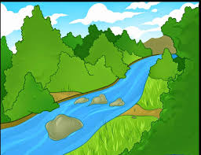
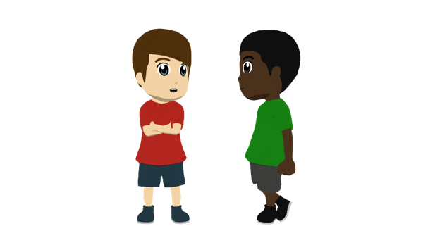
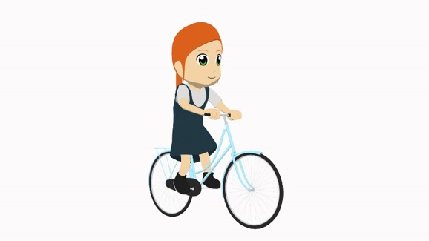
hablar / escuchar
Vamos al campo
Estudiante A habla en español.
Estudiante B completa la tabla con información.
Ejemplo:

Persona A habla:
Persona B escucha y escribe:
Somos muy activos.
 | ¿Es ‘I’ o ‘we’? | ¿Es ahora o en general? | ¿Qué adjetivo? (en inglés)
1
1
We are very active (trait).
we
en general
active
Después, estudiante B habla y estudiante A completa la tabla.
Notes:
9.1.2.3
Timing: 10 minutes
Aims:
to successfully produce sentences with soy/somos and estoy/estamos with adjectives in oral production.
to understand a partner’s sentences and use the information to complete the grid.
Procedure:
Go through the instructions with students.
Student A speaks each sentence in Spanish.
Student B completes the grid.
Then students swap roles.

Slide 8
hablar
Persona A
We are quite dark-skinned (trait)
We are excited (mood)
 | ¿Es ‘I’ o ‘we’? | ¿Es ahora o en general? | ¿Qué adjetivo? (en inglés)
1
2
3
4
5
6
1
2
I am a bit ill (mood).
We are not very boring (trait)
3
4
I am very serious. (trait)
I am very silly (mood).
5
6
Notes:
PROMPT CARDS - DO NOT DISPLAY DURING ACTIVITY
Target sentences (produced by Person A):
1. Somos bastante morenos/morenas. 2. Estamos emocionados/emocionadas. 3. Estoy un poco enfermo/enferma.
4. No somos muy aburridos/aburridas.
5. Soy muy serio/seria.
6. Estoy muy tonto/tonta.

Slide 9
hablar
Persona B
 | ¿Es ‘I’ o ‘we’? | ¿Es ahora o en general? | ¿Qué adjetivo? (en inglés)
1
2
3
4
5
6
I am quite weak (trait).
We are very funny (trait).
1
2
I am ready (mood)..
We are nervous (mood).
3
4
We are very happy (mood).
5
I am not very active (trait).
6
Notes:
PROMPT CARDS - DO NOT DISPLAY DURING ACTIVITY
Target sentences (produced by Person B): 1. Soy bastante débil. 2. Somos muy graciosos/graciosas. 3. Estoy listo/lista. 4. Estamos nerviosos/nerviosas. 5. Estamos muy contentos/contentas (felices). 6. No soy muy activo/activa.

Slide 10
hablar
Persona A - solución
Persona B - solución
 | ¿Es ‘I’ o ‘we’? | ¿Es ahora o en general? | ¿Qué adjetivo? (en inglés)
1
2
3
4
5
6
 | ¿Es ‘I’ o ‘we’? | ¿Es ahora o en general? | ¿Qué adjetivo? (en inglés)
1
2
3
4
5
6
I
en general
weak
we
en general
dark-skinned
we
en general
funny
we
ahora
excited
I
ahora
ready
I
ahora
ill
we
ahora
nervous
we
en general
not boring
we
ahora
happy
I
en general
serious
I
en general
not active
I
ahora
silly
Notes:
ANSWER SLIDE - DO NOT DISPLAY DURING ACTIVITY

Slide 11
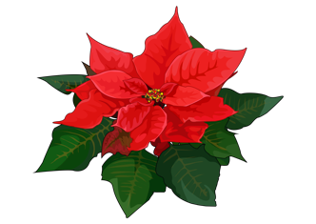
hablar / escuchar
Hablas con tu compañero sobre las vacaciones de Navidad.
Persona A habla: lee las frases en inglés. Debe decir las frases en español con vamos, vais o van según la persona.
Persona B escucha: marca ‘nosotros’ (vamos a…), ‘vosotros’ (vais a…) o ‘ellos’ (van a...) y escribe la actividad en inglés.
Ejemplo:
Vamos a cantar canciones de Navidad en la plaza.
Persona A
Persona B
¿Quién? | ¿Quién?
we | you all | they | el plan (en inglés)
1) We are going to sing Christmas songs in the square.
sing Christmas songs in the square
Notes:
9.1.2.6
Timing: 10 minutes
Aim: to produce and understand sentences using ir + a + infinitive (for future plans) in the oral modality
Procedure:
Student A looks at their card and translates the sentences into English, focusing on using the correct form of ir + a + infinitive, depending on the person on the prompt card (‘I’ or ‘s/he’)
Student B notes down who their partner is talking about and translates the plan/activity into English.
Students swap roles.
The cards are shown on the next two slides which should not be shown during the activity.
Answers are shown on the slide after that for both students.

Slide 12
Persona A
We are going to play the guitar for my family.
They are going to break the piñata.
They are going to leave the shoes next to the door.
You all go to the market to buy a Christmas flower.
They go to the shops to buy clothes for winter.
We are going to eat a large quantity of food.
 | ¿Quién?
 | we | you all | they | el plan (en inglés)
1
2
3
4
5
6
Notes:
DO NOT SHOW DURING ACTIVITY
Target answers:
Vamos a tocar la guitarra para mi familia.
Van a romper la piñata.
Van a dejar los zapatos al lado de la puerta.
Vais al mercado para comprar una flor de Navidad.
Van a las tiendas para comprar ropa para el invierno.
Vamos a comer una cantidad grande de comida.

Slide 13
Persona B
We are going to buy a grey t-shirt for my dad.
We go to the church at midnight.
They are going to leave the shoes under the tree.
You all are going to spend so much money!
You all are going to watch Christmas programmes on the television.
They go to a restaurant to eat chicken and rice.
 | ¿Quién?
 | we | you all | they | el plan (en inglés)
1
2
3
4
5
6
Notes:
DO NOT SHOW DURING ACTIVITY
Target answers:
Vamos a comprar una camiseta gris para mi padre.
Vamos a la iglesia a medianoche.
Van a dejar los zapatos debajo del árbol.
¡Vais a gastar tanto dinero!
Vais a ver programas de Navidad en la televisión.
Van a un restaurante para comer pollo y arroz.

Slide 14
Respuestas
Persona A
Persona B
 | ¿Quién?
 | we | you all | they | el plan (en inglés)
1
2
3
4
5
6
 | ¿Quién?
 | we | you all | they | el plan (en inglés)
1
2
3
4
5
6
play guitar for my family
buy a grey t-shirt for my dad.
go to church at midnight
break the piñata
leave shoes next to the door
leave the shoes under the tree
go to the market to buy a Christmas flower
spend so much money
go to the shops to buy clothes for the winter
watch Christmas programmes on TV
eat a large quantity of food
go to a restaurant to eat chicken and rice
Notes:
SHOW DURING FEEDBACK

Slide 15
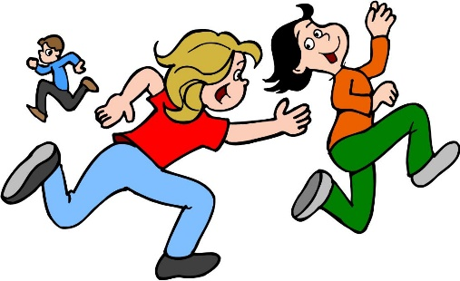
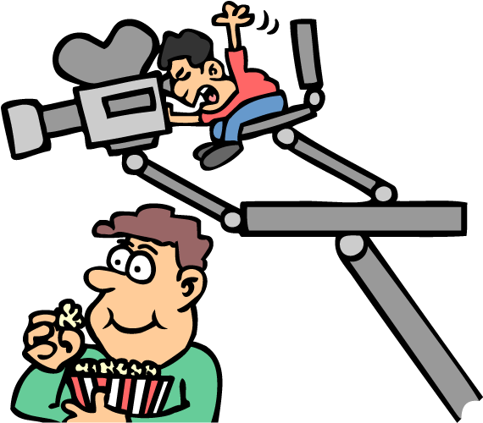
hablar
Un centro cultural divertido
hablar / escuchar
Estás en un centro cultural con muchas actividades diferentes.
Hablamos en parejas.
El estudiante A lee frases en inglés y habla en español.
El estudiante B escucha y escribe.
Ejemplo:
En este momento hago una película con cinco amigos.
Estudiante A
Estudiante B
 | ¿qué? | ¿quién? (yo, tú o ella) | it happens regularly | it’s happening now
1
1. At the moment I am making a film with five friends.
make a film
yo
Notes:
9.2.1.1
Timing: 10 minutes
Aim: to consolidate productive use of present tense verbs with –o, –as and –a ending; to consolidate understanding of temporal adverbs and time markers.
Procedure:
Teachers hand out the student cards before the activity explanation to help with the process. The teacher should explain that the verb ‘hacer’ is used here in the forms for ‘yo’, ‘tú’ and ‘ella’. Students shouldn’t say the pronoun (the idea is for the partner to listen to the verb and decide which person is referred to).
Student A reads out sentences in Spanish to student B. It may be necessary to do this a couple of items, as there are three pieces of information to fill in.
Student B completes the table.
Students swap roles.
The answer slides for this activity are slides 13 and 14.

Slide 16
hablar
Estudiante A
hablar
Say these sentences in Spanish:
Normally I do yoga first.
This morning I am making paper birds.
Now she is making comments on Twitter about the activities.
Generally she does translations in Spanish.
Today you are doing a lot of exercise.
Sometimes I ask questions about the activities.
 | ¿qué? | ¿quién? (yo, tú o ella) | it happens regularly | it’s happening now
1 | make _________________
2 | queue _________________
3 | do_________________
4 | make _________________
5 | do_________________
6 | make_________________
Notes:
DO NOT SHOW DURING ACTIVITY
Target sentences:
Normalmente hago yoga primero.
Esta mañana hago pájaros de papel.
Ahora hace comentarios en Twitter sobre las actividades.
Generalmente hace traducciones en español.
Hoy haces mucho ejercicio.
A veces hago preguntas sobre las actividades.

Slide 17
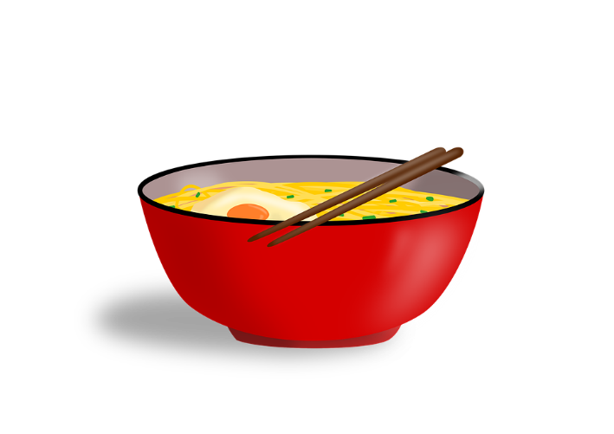
hablar
Estudiante B
hablar
Say these sentences in Spanish:
This morning I am making a film.
Sometimes you queue (in order) to enter the building.
Now I am doing an interview with an author.
Normally I make friends during the activities.
Generally she does the homework first.
Today she is making a Chinese dish.
 | ¿qué? | ¿quién? (yo, tú o ella) | it happens regularly | it’s happening now
1 | do _________________
2 | make_________________
3 | make _________________
4 | do _________________
5 | do _________________
6 | ask _________________
Notes:
DO NOT SHOW DURING ACTIVITY
Target sentences:
Esta mañana hago una película.
A veces haces fila para entrar al edificio.
Ahora hago una entrevista con un autor.
Normalmente hago amigos durante las actividades.
Generalmente hace los deberes primero.
Hoy hace un plato chino.

Slide 18
hablar
Respuestas: Estudiante A
hablar
Say these sentences in Spanish:
Normally I do yoga first.
This morning I am making paper birds.
Now she is making comments on Twitter about the activities.
Generally she does translations in Spanish.
Today you are doing a lot of exercise.
Sometimes I ask questions about the activities.
 | ¿qué? | ¿quién? (yo, tú o ella) | it happens regularly | it’s happening now
1 | make _________________
2 | queue _____________________
3 | do _________________
4 | make __________________________
5 | do _________________
6 | make _________________
a film
yo
to enter the building
tú
an interview with an author
yo
friends during the activities
yo
homework first
ella
a Chinese dish
ella
Notes:
ANSWER SLIDE: DO NOT SHOW DURING ACTIVITY

Slide 19
hablar
Respuestas: Estudiante B
hablar
Say these sentences in Spanish:
This morning I am making a film.
Sometimes you queue (in order) to enter the building.
Now I am doing an interview with an author.
Normally I make friends during the activities.
Generally she does the homework first.
Today she is making a Chinese dish.
 | ¿qué? | ¿quién? (yo, tú o ella) | it happens regularly | it’s happening now
1 | do _________________
2 | make _________________
3 | make _________________
4 | do ____________________
5 | do _________________
6 | ask _________________
yoga
yo
paper birds
yo
comments on Twitter
ella
translations in Spanish
ella
a lot of exercise
tú
questions about the activities
yo
Notes:
ANSWER SLIDE: DO NOT SHOW DURING ACTIVITY

Slide 20
Hablamos de nuestros cumpleaños en el pasado.
hablar
Estudiante A: Lee la pregunta en español.
Estudiante B: Escucha y elige la respuesta correcta según el verbo.
¡Importante! Si la pregunta tiene un verbo en –iste debes contestar con el verbo en –í.
Si la pregunta tiene un verbo en –ías debes contestar con el verbo en –ía.
Ejemplo:
¿Comías muchos dulces?
Sí, recibía mucho chocolate.
Estudiante A
Estudiante B
1. Did you used to eat many sweets?
Escucha y elige la opción correcta según el verbo. Luego debes contestar con el verbo correcto.
El año pasado
Cada año (en el pasado)
Yes, and I drank hot chocolate.
Yes, I used to receive a lot of chocolate.
Notes:
9.3.1.2
Timing: 10 minutes
Aim:
to practise the singular persons of the imperfect tense and the preterite with –er and –ir verbs.
to consolidate understanding of the use of each tense (preterite for completed actions at one specific time in the past vs imperfect for ongoing actions in the past).
Procedure:
Student A asks each question in Spanish to Student B.
Students B listens and chooses the correct answer: if the verb in the queston is imperfect (–ía or –ías), then they have to say the answer under ‘cada año’; if the verb in the question is preterite (–iste or –ió), then they have to sya the answer under ‘El año pasado’.
Then students swap roles.

Slide 21
Estudiante A
Lee las preguntas en español a tu pareja:
Escucha y elige la opción correcta según el verbo. Luego debes contestar con el verbo correcto.
Did you used to bring your friends together in your house?
Did the food consist of Spanish dishes?
Did you go out to a restaurant?
Did you drink hot chocolate?
Did you used to break a piñata?
Did you used to have games at your party?
El año pasado
Cada año (en el pasado)
Yes, my uncle shared tasty dishes.
Yes, my grandmother used to make sweets.
No, I received text messages.
Yes, I used to put all my cards in the living room.
Yes, I suffered two hours of science.
No, I used to go out with my friends
No, I decided I just wanted a bike.
Yes, I used to receive clothes and games.
Yes, I chose a Chinese restaurant.
Yes, I used to go out to different places.
No, I decided to go to a bar.
Yes, I used to share many dishes with my friends.
Notes:
DO NOT DISPLAY DURING ACTIVITY
A separate printable handout is also available.
Target questions:
¿Reunías a tus amigos en tu casa?
¿La comida consistía en platos españoles?
¿Saliste a un restaurante?
¿Bebiste chocolate caliente?
¿Rompías una piñata?
¿Tenías juegos en tu fiesta?
Target answers:
Sí, mi abuela hacía dulces.
No, recibí mensajes de texto.
Sí, sufrí dos horas de ciencias.
Sí, normalmente recibía ropa y juegos.
Sí, elegí un restaurante chino.
No, decidí ir a un bar.
Lesson: 9.3.1.2

Slide 22
Estudiante B
Lee las preguntas en español a tu pareja:
Escucha y elige la opción correcta según el verbo. Luego debes contestar con el verbo correcto.
Did your family used to bring food?
Did you receive birthday cards?
Did you attend school on your birthday?
Did you used to receive lots of presents?
Did you choose the place for your party?
Did you serve food and drinks?
El año pasado
Cada año (en el pasado)
No, I prefered to go to a park.
No, I used to go out with my family.
No, I served Mexican food.
Yes, my mum used to make a paella.
No, I ate at home.
No, I used to eat at home.
Yes, and I also ate churros.
No, I drank cold drinks.
Yes, I collected many sweets.
No, but I used to receive sweets.
Yes, I asked for some games.
Yes, I always used to bring balls.
Notes:
DO NOT DISPLAY DURING ACTIVITY
A separate printable handout is also available.
Target questions:
¿Tu familia traía comida?
¿Recibiste tarjetas de cumpleaños??
¿Asististe al colegio el día de tu cumpleaños?
¿Recibías muchos regalos?
¿Elegiste el lugar para tu fiesta?
¿Serviste comida y bebidas?
Target answers:
No, salía con mi familia.
No, serví comida mexicana.
No, comí en casa.
Sí, y también comí churros.
No, pero recibía dulces.
Sí, siempre traía pelotas.
Lesson: 9.3.1.2

Slide 23
Preguntas en el evento sobre profesiones
escuchar / hablar
Estudiante A: pregunta a tu compañero/a en español.
Usa ‘-as’ (one ‘you’) o ‘-áis’ (more than one ‘you’), según la imagen.
Estudiante B: escucha la pregunta. Debes dar la respuesta correcta en español a tu pareja.
Estudiante A: escribe la respuesta en español.
¿Realizas desafíos importantes?
Sí, con mi equipo de fútbol.
Estudiante A
Estudiante B
1. Do you carry out important challenges?
 | Nadia (one ‘you’) | Hugo y Nadia (more than one ‘you’)
1.
Yes, with my football team!
Yes, we win prizes!
Sí, con mi equipo de fútbol.
______________________________
Notes:
9.3.1.5
Timing: 8 min
Aim: to practise oral production and aural recognition of –ar verbs in second person singular and plural.
Procedure:
Students work in pairs.
Student A looks at their card and says the sentence aloud in Spanish.
Student B listens and then gives the correct answer in Spanish to their partner.
After Student A has done their six sentences, it is Student B’s turn.

Slide 24
hablar / escuchar
Estudiante A
hablar / escuchar
1. Do you forget important things often?___________________________
2. Do you always manage to hand in homework on time? ___________________________________
3. Do you support your classmates?
___________________________________
4. Do you finish tasks fast?
___________________________________
5. Do you pay attention to details*?
___________________________________
6. Do you manage to participate in activities after school?
___________________________________
*detail = detalle
 | Nadia (one ‘you’) | Hugo y Nadia (more than one ‘you’)
1 | No, never. | We try to do our homework first.
2 | No, I prefer dancing. | Yes, we play football.
3 | Yes, I want to be rich. | Being happy is more important.
4 | Only I agree with them! | Yes, we respect other opinions.
5 | Yes, I never arrive late. | If we arrive late, they shout!
6 | No, I prefer to use my phone. | Yes, it’s useful for homework.
Notes:
DO NOT DISPLAY DURING ACTIVITY
See accompanying Word doc for printable version.
Frequency of unknown vocabulary:
detalle [937]
Lesson: 9.3.1.5

Slide 25
hablar / escuchar
Estudiante B
hablar / escuchar
1. Do you leave tasks until the last minute?
___________________________________
2. Do you participate in any team sports?
___________________________________
3. Do you consider it important to earn a
lot of money?
_____________________________________
4. Do you listen to other opinions? ___________________________________
5. Do you arrive early to school?
___________________________________
6. Do you use the computer to search for information? ____________________________
 | Nadia (one ‘you’) | Hugo y Nadia (more than one ‘you’)
1 | Yes, a lot! | No, we never forget things.
2
3 | Yes, when they have a difficult task. | Yes, after finishing our work
4 | Only if the task is easy. | No, we like to take our time.
5 | Yes, I dedicate time to small things. | Yes, we don’t make errors.
6 | Yes, I love sport. | No, we don’t have time.
I try to do it.
Yes, of course.
Notes:
DO NOT DISPLAY DURING ACTIVITY
See accompanying Word doc for printable version.
Lesson: 9.3.1.5

Slide 26
Respuestas
hablar / escuchar
Estudiante A
Estudiante B
hablar / escuchar
1. Do you forget important things often?
¿Olvidáis cosas importantes a menudo?
2. Do you always manage to hand in homework on time. ¿Siempre lográis entregar los deberes a tiempo?
3. Do you support your classmates?
¿Apoyas a tus compañeros?
4. Do you finish tasks fast?
¿Terminas las tareas rápido?
5 Do you pay attention to details*?
¿Prestas atención a los detalles?
6. Do you participate in activities after school? ¿Participáis en actividades después del colegio ?
1. Do you leave tasks until the last minute
¿Dejas tareas hasta el último minuto?
2. Do you participate in any team sports?
¿Participáis en deportes de equipo?
3. Do you consider important to earn a lot
of money? ¿Consideras importante ganar mucho dinero?
4. Do you listen to other opinions?
¿Escucháis otras opiniones?
5. Do you arrive early to school?
¿Llegas temprano al colegio?
6. Do you use the computer to search for information? ¿Usas el ordenador para buscar información?
Notes:
ANSWER SLIDE
This slide displays the questions that students are expected to produce orally.
DO NOT DISPLAY DURING ACTIVITY
Lesson: 9.3.1.5

Slide 27
Respuestas
hablar / escuchar
hablar / escuchar
Estudiante A
Estudiante B
 | Nadia (one ‘you’) | Hugo y Nadia (more than one ‘you’)
1 | No, never.
2 |  | Yes, we play football.
3 | Yes, I want to be rich
4 |  | Yes, we respect other opinions.
5 |  | If we arrive late, they shout!
6 | No, I prefer to use my phone.
 | Nadia (one ‘you’) | Hugo y Nadia (more than one ‘you’)
1 |  | No, we never forget things.
2 |  | Yes, of course.
3 | Yes, when they have a difficult task.
4 | Only if the task is easy.
5 | Yes, I dedicate time to small things.
6 |  | No, we don’t have time.
No, nunca.
No, nunca olvidamos cosas.
Sí, jugamos al fútbol.
Sí, claro.
Sí, quiero ser rica.
Sí, cuando tienen una tarea difícil.
Sí, respetamos otras opiniones.
Solo si la tarea es fácil.
Si llegamos tarde, ¡gritan!
Sí, dedico tiempo a las cosas pequeñas.
No, prefiero usar mi móvil.
No, no temenos tiempo.
Notes:
ANSWER SLIDE
This slide displays the answers that students are expected to produce orally.
DO NOT DISPLAY DURING ACTIVITY
Lesson: 9.3.1.5

Slide 28
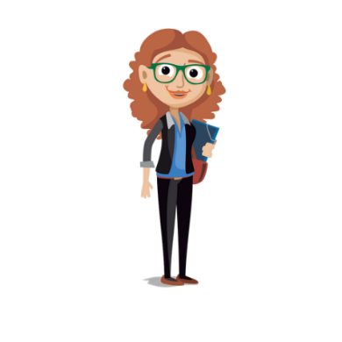
Lee el diálogo con dos compañeros/as. Traduce las palabras al español.
leer / hablar
Esta es la última clase conmigo antes de vuestros exámenes.
¿ [Do you (all) want] preguntar algo?
N: Sí, profe. ¿En [the exam] tienes que describir [an image] ? Y ¿puedes preparar unas frases antes del examen?
el examen
Queréis
una imagen
Sí. Recibís la imagen y una hoja de papel donde escribís [your (f, plural)] frases.
vuestras
L: Vosotros (los profesores),
¿ [Do you [all] decide] las notas?
iPor supuesto!
Decidís
L: Y ¿sacas [good grades] si usas muchos adjetivos diferentes?
buenas notas
Bueno, sí, además debéis usar verbos en formas diferentes. ¿Qué [you (all can] decir sobre esta imagen? ¿Nadia?
podéis
N: [En inglés] Hay una mujer, con dos familiares o [maybe] son los vecinos. Está un poco asustada. También tiene un bebé. Están en una [hill] .
quizás
¡Perfecto! Chicas, debéis estar muy orgullosas de [your (m, plural)] esfuerzos.
colina
vuestros
N: Gracias. Quiero [to pass] todos mis
exámenes – ¡no tengo ganas de repetir el año! ¿Cuál es [the date] del examen?
¿ [Do we have to] venir a esta sala antes de empezar?
aprobar
la fecha
Tenemos que
Podéis estar tranquilas. Sois muy listas. Es el viernes diez de [May] en esta sala.
mayo
Notes:
9.3.1.5
Timing: 7 minutes
Aims:
to produce this week’s grammar features in oral production
to also produce a range of new and previously taught vocabulary
Procedure:
Students get into groups of three.
They read the text as a role play, with one student as the teacher, one student as Nadia and one student as Lucía.
They orally translate the words into Spanish where prompted.
Click to reveal the missing Spanish words and give feedback.
Students then swap roles (this can be done once or even twice, given that there are three people in the conversation).
Notes: naturally the text will contain words with penultimate and final syllable stress. The teacher may want to give feedback on this, too.
Frequency of unknown words and cognates:
adjetivo [>5000]

Slide 29
¿Cuánto cuesta…?
hablar / escuchar
Persona A: Pregunta a tu compañera/a cuánto cuesta el objeto.
Ejemplo:
una entrada a la cueva
¿Cuánto cuesta una entrada a la cueva?
€12
[entry to the cave]
precio: ______
Persona B: Debes decir el precio en español.
Ejemplo:
Doce euros.
12 euros
[entry to the cave]
Persona A escribe el precio.
Después Persona B pregunta y Persona A contesta.
Notes:
9.3.2.3
Timing: 6 minutes (slides 3 – 8) Aim:
i) to practise gain confidence and fluency in oral production of SSC [cu]+vowel (cua, cue, cui)
ii) to practise producing and understanding a range of previously taught numbers (mostly 1-29)
Procedure:
Click to reveal each part of the explanation slide with the students. Check understanding via oral translation of the example into English.
Student A turns away from the board and asks Student B questions based on his/her six cards (slide 3). All questions begin with ‘¿Cuánto cuesta…?’. Glosses are provided for unknown words.
Teacher brings up slide 4. Person B listens, looks at the prices displayed on the board and then says the price for the relevant card in Spanish.
Person A then writes the price down in the space provided on his/her prompt card.
Students swap roles. The teacher displays slide 6 on the board.
Use slide 7 to provide feedback.
Frequency of unknown words:
cueva [4480]; objeto [567]

Slide 30
¿Cuánto cuesta…?
hablar / escuchar
Persona A
1
4
una cuerda
un libro de cuentos
[rope]
precio: ______
[story book]
precio: ______
2
5
un viaje de cuatro días
un recuerdo
[4-day journey]
precio: ______
[souvenir]
precio: ______
3
6
un cuarto kilo de maíz
un cuadro
[a quarter of a kilo of corn]
[painting, picture]
precio: ______
precio: ______
Notes:
Person A prompt cards (to ask person B questions)
Frequency of unknown words and cognates:
cuadro [1017]; kilo [2934]; maíz [2981]; cuento [853]
Lesson: 9.3.2.3

Slide 31
Person B
¿Cuánto cuesta…?
hablar / escuchar
Persona B
1
4
9 euros
7 euros
[rope]
[story book]
2
5
93 euros
4 euros
[4-day journey]
[souvenir]
3
6
24 euros
[a quarter of a kilo of corn]
2 euros
[painting, picture]
Notes:
Person B prompt cards (to give Person A the prices)
Lesson: 9.3.2.3

Slide 32
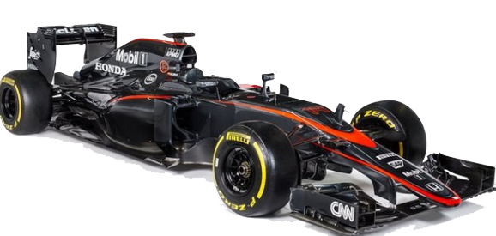
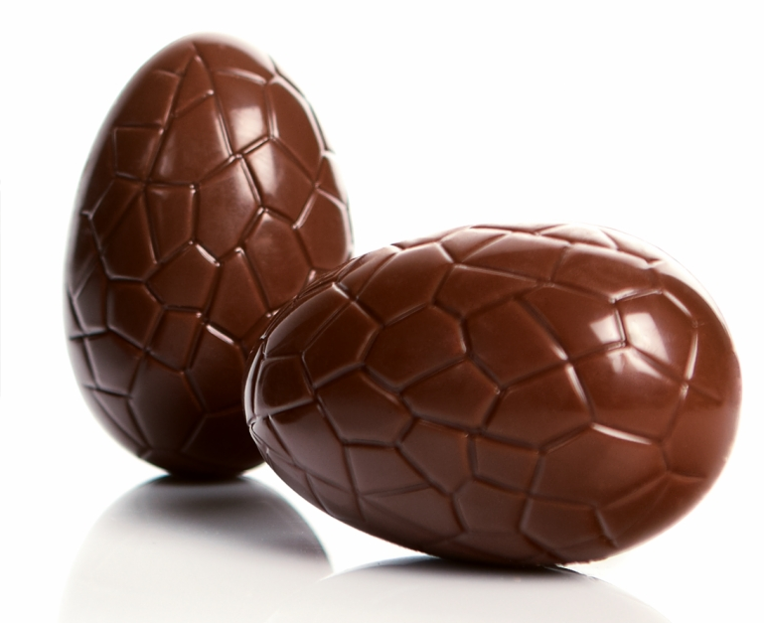
¿Cuánto cuesta…?
hablar / escuchar
Persona B
7
una chaqueta de cuero
10
un viaje a Ecuador
precio: ______
precio: ______
[leather jacket]
[a trip to Ecuador]
8
una entrada a un circuito de Fórmula -1
11
una crema para el cuerpo
[admission to a formula 1 circuit]
precio: ______
[body cream]
precio: ______
9
un huevo de Pascua
12
una licuadora
[a blender,
food processer]
[Easter egg]
precio: ______
precio: ______
Notes:
Person B prompt cards (to ask person A questions)
Frequency of unknown words and cognates:
chaqueta [4565]; circuito [3172]; Pascua [>5000]; Ecuador [>5000]; crema [4138]; licuadora [>5000]
Lesson: 9.3.2.3

Slide 33
Persona A
¿Cuánto cuesta…?
hablar / escuchar
Persona A
7
10
29 euros
195 euros
[leather jacket]
[a trip to Ecuador]
8
11
[admission to a formula 1 circuit]
28 euros
5 euros
[body cream]
9
12
9 euros
[a blender,
food processer]
15 euros
[Easter egg]
Notes:
Person A prompt cards (to give person B the prices)
Lesson: 9.3.2.3

Slide 34
Solución
hablar / escuchar
Persona A
Persona B
una cuerda
9 euros
una chaqueta de cuero
29 euros
1
7
un viaje de cuatro días
una entrada a un circuito de Fórmula-1
93 euros
28 euros
2
8
3
un cuadro
9
un huevo de Pascua
9 euros
24 euros
un libro de cuentos
7 euros
un viaje a Ecuador
195 euros
4
10
una crema para el cuerpo
un recuerdo
4 euros
5 euros
5
11
un cuarto kilo de maíz
2 euros
una licuadora
15 euros
6
12
Notes:
Answer slide
Note: students could also be challenged to spell the numbers correctly.
Lesson: 9.3.2.3

Slide 35
Persona A: lee la pregunta en español.
hablar / escuchar
Preguntas en el mercado
To ask for a price, you can either use
‘cuánto cuesta…’ or ‘cuánto es…’.
For a plural noun, use
‘cuánto cuestan…’ or ‘cuánto son…’.
Persona B: mira las tarjetas. ¿Es ‘A’ or ‘B’? Say the words below the picture in Spanish.
¿Cuánto es ese reloj?
Treinta euros.
Un ejemplo
Persona A (pregunta):
Persona B (escucha y mira las tarjetas):
How much is that watch?
A
B
30 euros
__________
Say:
30 euros
60 euros
Notes:
9.3.2.3
Timing: 10 minutes (slides 43-46)
Aims:
i) to practise production and comprehension of ‘ese’, ‘esa’, ‘esos’, ‘esas’ and vocabulary
ii) to practise number agreement on nouns (plural –s and –es)
Procedure:
This is the example slide to explain the activity. Click to go through the example step by step.
Person A begins the activity by orally translating the question into Spanish. All questions begin with ‘how much is/are’ and then prompt ‘that’ or ‘those’ + noun.
Person B listens to Person A’s question and works out which image the question refers to. S/he then orally translates the price below the correct picture into Spanish. Person A writes this next to the question on his/her prompt card.
Students swap roles after doing the first 6.
The answers to the activity are shown on slide 46.
Note: across the activity all four adjectives (ese, esa, esos, esas) are practised, but each person will only be practising with two at a time (i.e., ese vs esos for the first six items, then esa vs esas for the second six items).

Slide 36
Persona A
hablar
How much are those books?
How much is that sweet?
How much are those pens?
How much is that wedding dress?
How much are those souvenirs?
How much is that watch?
Persona B
How much are those bags?
How much is that shirt?
How much is that guitar?
How much are those boxes?
How much are those drinks?
How much is that t-shirt in size small?
Notes:
Prompt cards
DO NOT DISPLAY IN CLASS
Target sentences:
Person A
¿Cuánto son esos libros?
¿Cuánto es ese dulce?
¿Cuánto son esos bolígrafos?
¿Cuánto ese ese vestido de boda?
¿Cuánto son esos recuerdos?
¿Cuánto es ese reloj?
Person B
¿Cuánto son esas bolsas?
¿Cuánto es esa camisa?
¿Cuánto es esa guitarra?
¿Cuánto son esas cajas?
¿Cuánto son esas bebidas?
¿Cuánto es esa camiseta en talla pequeña?
Lesson: 9.3.2.3

Slide 37
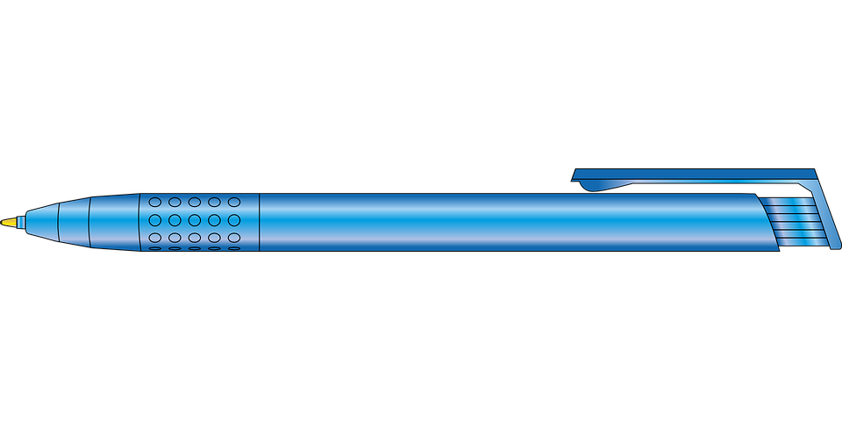
1.
A
[book]
B
[books]
4.
A
[wedding dress]
B
[wedding dresses]
€14
€27
€80
€150
2.
A
[dulce]
B
[dulces]
5.
A
[souvenir]
B
[souvenirs]
€3
€13
€8
€12
3.
A
[pen]
B
[pens]
6.
A
[watch]
B
[watches]
€5
€10
€61
€71
Notes:
Person B
DO NOT SHOW THIS SLIDE DURING THE ACTIVITY
Lesson: 9.3.2.3

Slide 38
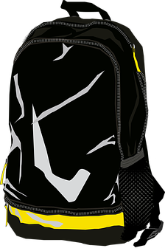
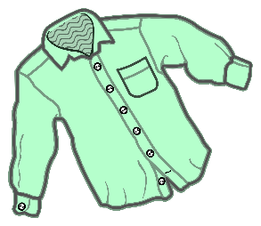
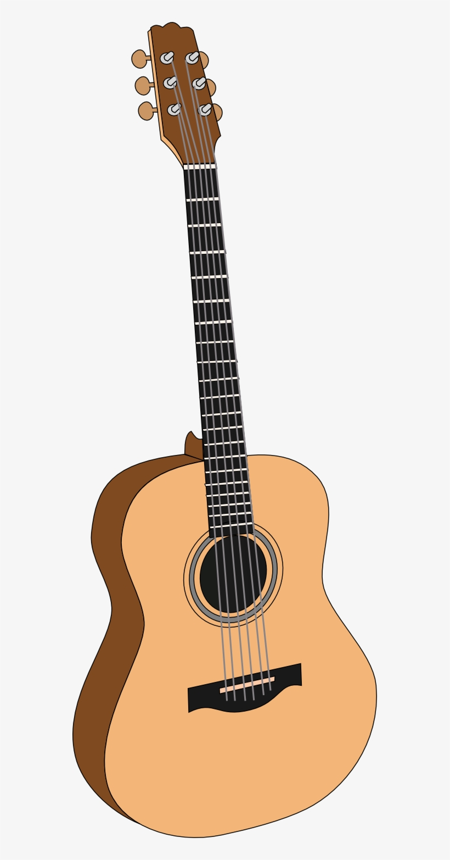
1.
A
[bag]
B
[bags]
4.
A
[box]
B
[boxes]
€66
€98
€9
€13
2.
A
[shirt]
B
[shirts]
5.
A
[drink]
B
[drinks]
€34
€57
€5
€11
3.
A
[guitar]
B
[guitars]
6.
A
[t-shirt in a small size]
B
[t-shirts in a small size]
€100
€110
€25
€42
Notes:
Person A
DO NOT SHOW THIS SLIDE DURING THE ACTIVITY
Lesson: 9.3.2.3

Slide 39
Respuestas
hablar / escuchar / escribir
Persona A:
1. Veintisiete euros.
2. Tres euros.
3. Diez euros.
4. Ochenta euros.
5. Doce euros.
6. Setenta y uno euros.
Persona B:
1. Noventa y ocho euros.
2. Treinta y cuatro euros.
3. Cien euros.
4. Trece euros.
5. Once euros.
6. Veinticinco euros.
Notes:
Answers for the speaking, listening and writing
Lesson: 9.3.2.3

Slide 40
hablar / escuchar
¡Estamos en un juicio*!
*juicio = trial
Persona A: pregunta en español. Usa ‘tuyo/a’ o ‘suyo/a’, en femenino o masculino según la palabra.
Persona B: escucha y contesta las preguntas.
Luego cambia.
Un ejemplo:
¿Esta foto vieja es tuya?
Persona A
(pregunta):
Sí, esa foto es mía.
Persona B
(contesta):
Ask your partner these questions.
Listen for whether it’s ‘tuyo/a’ or ‘suyo/a’, then give the corresponding information in Spanish.
Write down the answer.
1. Is this old photo yours?
Partner says ‘yours’
Partner says ‘his/hers’
yes, that photo is mine
yes, that photo is mine
I’m not sure
Notes:
9.3.2.4
Timing: 10 minutes
Aims:
to practise the use of possessive adjectives ‘mío/a’ and ‘tuyo/a’.
to practise noun-adjective gender agreement.
Procedure:
Person A uses their cards to ask a question in Spanish. The question will either use the masculine or feminine form of the possessive adjective (‘mío/a’ or ‘tuyo/a’).
Student B listens carefully and gives the answer that matches the question. For example, does the partner ask “is this…yours” (using ‘tuyo/a’) or “is this…his or hers” (using ‘suyo/a’)?
Student A then writes down their answer in Spanish.
Students then swap roles. The activity follows the same steps as before.
Use the answer slides to give feedback.
Notes: 1. An active choice will be needed by the listener depending on the question asked. This makes the identification of the correct form of the possessive adjective essential for task completion.
2. If teachers wish to make the task easier (e.g. for a lower ability group), they could give Spanish prompts for the questions.
Lesson: 9.3.2.4

Slide 41
Persona A
Persona A
Persona A
Listen for whether it’s ‘tuyo/a’ or ‘suyo/a’, then give the corresponding information in Spanish.
Ask your partner these questions.
Write down the answer.
Partner says ’yours’
Partner says ‘his/hers’
1. Is this red t-shirt yours?
1.
yes, I bought it
no, that painting is mine
2. Is this new phone his?
2.
no, that coin is not mine
yes, she found it
3. Is this small key yours?
yes, she always plays that guitar
3.
maybe!
4. Is this yellow skirt yours?
4.
yes, that pen is mine
yes, that pen is hers
5. Is this old camera hers?
5.
yes, my friend made it
no, she never wears dresses
6. Is this expensive gift hers?
no, I don’t have weapons
yes, he has many weapons
6.
Notes:
DO NOT DISPLAY DURING ACTIVITY
See accompanying Word doc for printable version.
Target questions in Spanish for Person A during speaking:
¿Esta camiseta roja es tuya?
¿Este teléfono nuevo es suyo?
¿Esta llave pequeña es tuya?
¿Esta falda amarilla es tuya?
¿Esta cámara antigua/vieja es suya?
¿Este regalo caro es suyo?
Target answers for Person B during speaking, based on Person A’s questions:
No, esa pintura es mía.
No, esa moneda es mía.
Sí, siempre toca esa guitarra.
Sí, ese bolígrafo es mío.
No, nunca lleva vestidos.
Sí, tiene muchas armas.
Lesson: 9.3.2.4

Slide 42
Persona A
Persona B
Persona B
Listen for whether it’s ‘tuyo/a’ or ‘suyo/a’, then give the corresponding information in Spanish.
Ask your partner these questions.
Write down the answer.
Partner says ’yours’
Partner says ‘his/hers’
1. Is this cheap painting hers?
1.
no, that t-shirt is hers
yes, she loves it
2. Is this heavy coin yours?
2.
no, my brother bought it
no, that phone is mine
3. Is this old guitar hers?
yes, that key opens my bedroom door
yes, that key opens a box
3.
4. Is this black pen yours?
4.
no, I don’t wear skirts
no, she doesn’t like skirts
5. Is this white dress hers?
5.
no, I don’t have a camera
yes, she uses that camera often
6. Is this dangerous weapon his?
yes, today it’s her birthday
6.
no, I bought it for her
Notes:
DO NOT DISPLAY DURING ACTIVITY
See accompanying Word doc for printable version.
Target questions in Spanish for Person A during speaking:
¿Esta pintura barata es suya?
¿Esta moneda pesada es tuya?
¿Esta guitarra vieja/antigua es suya?
¿Este bolígrafo negro es tuyo?
¿Este vestido blanco es suyo?
¿Esta arma peligrosa es suya?
Target answers for Person A during speaking, based on Person B’s questions:
No, esa camiseta es suya.
No, ese teléfono es mío.
Sí, esa llave abre la puerta de mi habitación.
No, no llevo faldas.
Sí, usa esa cámara a menudo.
Sí, hoy es su cumpleaños.
Lesson: 9.3.2.4

Slide 43
Persona A
Persona A
Persona B
Ask your partner these questions.
Ask your partner these questions.
Write down the answer.
Write down the answer.
1. Is this red t-shirt yours?
1. Is this cheap painting hers?
no, that t-shirt is hers
no, that painting is mine
2. Is this new phone his?
2. Is this heavy coin yours?
no, that phone is mine
no, that coin is not mine
3. Is this small key yours?
3. Is this old guitar hers?
yes, that key opens my bedroom door
yes, she always plays that guitar
4. Is this yellow skirt yours?
4. Is this black pen yours?
no, I don’t wear skirts
yes, that pen is mine
5. Is this old camera hers?
5. Is this white dress hers?
yes, she uses that camera often
no, she never wears dresses
6. Is this expensive gift hers?
6. Is this dangerous weapon his?
yes, today it’s her birthday
yes, he has many weapons
Notes:
FEEDBACK - DISPLAY AFTER THE ACTIVITY
Lesson: 9.3.2.4

Slide 44
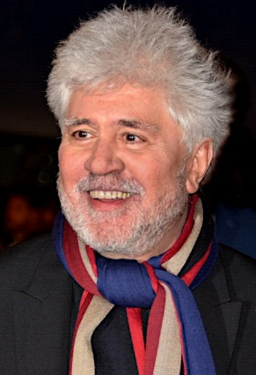
hablar / escuchar
Experencias de la vida
Eres una persona famosa. ¡El/la profesor(a) te va a decir quién eres!
Debes hacer dos cosas:
Hacer preguntas a tus compañeros. Escribe información sobre cada persona famosa en tu tarjeta. En total debes escribir información sobre tres personas diferentes.
Contesta las preguntas de tus compañeros.
Un ejemplo:
¿Quién eres?
Soy Pedro Almodóvar.
Persona A
(pregunta):
¿Dónde pasaste tu infancia?
En Cáceres porque mi familia compró una casa allí.
Persona B
(contesta):
Pedro Almodóvar
Pedro Almodóvar (director de cine)
1. Where did you spend your childhood?
I spent my childhood in Cáceres because my family bought a house there.
In Cáceres. His family bought a house there.
Notes:
9.3.2.5
Timing: 10 minutes
Aims:
i) to practise using question words
ii) to practise asking questions with –ar verbs in the 2nd person singular (-aste)
iii) to understand questions and give answers using known (or glossed) language
Procedure:
Go through the worked example with students. Check understanding.
Then give each student one A4 piece of paper. Each piece of paper will have information already complete for one of the four people. This is the person that the student is role-playing (i.e. they will respond to questions from classmates imagining that they were this person and using the information on the card). There will be three people left on the A4 piece of paper whose information needs to be added. Students will have to go around the classroom asking their peers who they are and then asking further questions to get the information needed to complete the card in full. The prompts for these questions are displayed on the next slide. To avoid making the activity too predictable, the information is not listed on the cards in order, so students will need to listen carefully to the questions and answer accordingly.
Give students feedback after the activity using the answer slide.
Note: it is important to have approximately the same number of person A, B, C and D for the activity to work effectively. Before the lesson, order the sheets in a pile with roughly equal numbers of cards A-D in random order. This way, when the cards are given out, all four individuals will be represented within the class (so students will be able to complete their cards in full).
Lesson: 9.3.2.5

Slide 45
hablar
Experiencias de la vida
Preguntas para vuestros compañeros
1. Where did you spend your childhood*?
Hint: use ‘tener’ (not ‘ser’ or ‘estar’)
2. What did you study?
3. When did you start your career?
4. How did you manage to be successful?
5. Why did you change job?
Hint: use ‘cambiar de’ + noun
*childhood = la infancia
Notes:
DISPLAY DURING THE ACTIVITY
The hints are for language previously covered in resources that may be useful to recap before starting.
Lesson: 9.3.2.5

Slide 46
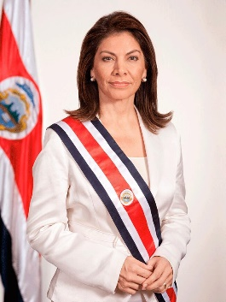
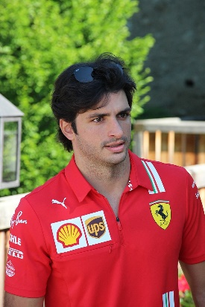
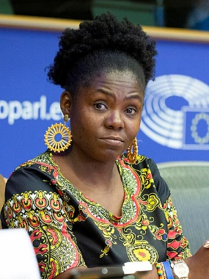
Pedro Almodóvar (director de cine)
Laura Chinchilla (presidenta de Costa Rica, 2010-2014)
I tried to study cinema in Madrid, but they closed the school.
I studied politics
I made* my first film 40 years ago.
In order to work in the USA
I spent my childhood in the city of Cáceres, Spain.
After university I started my career.
I am calm and I try to help many people.
My films are unique.
to make = realizar
I spent my childhood in San José
I left my first job to make more films
politics = la política
Carlos Sainz Junior (piloto de Fórmula 1)
Francia Márquez (abogada y activista)
I spent my childhood in Madrid.
I spent my childhood near Cali, Colombia.
In 2021 I changed team in order to drive a better car.
I didn’t change job
law = el derecho
I started to take part in demonstrations when I was 13
I didn’t need to study at university.
I always do everything to protect my community
I worked hard!
When I was 7 I started to drive.
I studied law* at university
Notes:
Picture cards (Do not show during the activity – students will have a separate handout)
Sources of pictures and facts:
Pedro Almodóvar
https://commons.wikimedia.org/wiki/File:Pedro_Almodovar_C%C3%A9sars_2017.jpg
https://www.imdb.com/name/nm0000264/awards
https://www.imdb.com/name/nm0000264/
Carlos Sainz
By XaviYuahanda - File:Formel12021-SchlossGabelhofen(15).jpg, CC BY-SA 4.0, https://commons.wikimedia.org/w/index.php?curid=107650937
https://childhoodbiography.com/carlos-sainz-childhood-biography/
Laura Chinchilla
https://commons.wikimedia.org/wiki/File:Laura_4.jpg
Francia Marquez
https://en.wikipedia.org/wiki/Francia_M%C3%A1rquez#/media/File:(Francia_M%C3%A1rquez)_F70A6326_(49199213312)_(cropped).jpg
https://www.huffingtonpost.co.uk/patrick-kane/colombia-women_b_6255064.html
https://www.goldmanprize.org/recipient/francia-marquez/
Lesson: 9.3.2.5

