Slide 1
Assessment design: achievement tests -grammar
Coverage of grammar
Test creation process
Question Types
Notes:
This selection of slides is extracted from the CPD materials produced by Rowena Kasprowicz for the TRG: ‘Assessment Part 1’. Updates have been made to ‘coverage of grammar slides’ to reflect the Feb 21 issues of Y7.1.2.6 achievement tests.

Slide 2
Coverage of grammar - German
Grammar feature | Reading | Listening | Writing | Speaking
Present continuous formation Two forms in English vs. one in TL | - | - | 4 items | 6 items
Question formation Subject-verb inversion; do-aux in English vs. TL | 4 items | 4 items
Subject-verb agreement (weak) 1st / 2nd / 3rd singular | 3 items | 3 items
Subject-verb agreement (irregular) haben / sein (1st, 2nd, 3rd sing, 1st pl); mögen (1st, 2nd, 3rd sing) | 3 items | 3 items | 4 items | 1 item
Article agreement Def / indef; gender; number; case (nom/acc) | 4 items | - | 4 items | 3 items
Plural noun formation -en; umlaut + -e; -e | - | - | 4 items | -
Negation nicht + verb; nicht + adjective | 4 items | - | - | -
Subject and object pronoun agreement Gender; number; case (nom/acc) | 4 items | - | 3 items | 3 items
Notes:
The table here shows the coverage of grammar features in the German version of the test.
By coverage here, this refers to what the pupils are actually being tested on. In the columns labelled Reading, Listening, Writing, and Speaking, I have indicated the number of items each pupil responds to for that grammar feature so you can see how the different grammatical forms were spread across the different modes and modalities.
The first step in building the grammar test was to identify which grammar features and rules had been taught so far and identify the specific structures that had been introduced for each. For example, in terms of subject-verb agreement for weak verbs in German, the 1st, 2nd, and 3rd, person singular forms have been introduced so far and so the items targeting that particular grammatical structure included instances of all of those particular forms that had been introduced so far.
Ideally, we would have tested everything in all modes and modalities, but that was simply not possible within the time constraint that we had.
Therefore, wherever possible, and as you’ll see from the table, we have tried to ensure that each structure has been tested receptively and productively either in written or spoken form.
Within the productive items, particularly in the Speaking part of the test, we were able to combine testing of multiple structures within one question, for example by asking students to produce a short phrase or sentence which would contain a number of different grammatical features. For example, in the Speaking part of the test, we have a set of items in which students had to create statements and questions with weak verbs, therefore were testing both word order and verb agreement in that set of items.
In the German test specifically we made the decision not to test negation (i.e. kein + noun) or the possessive adjective (mein +noun) in this round of testing and that was because the 2nd and 3rd person possessive adjectives will be introduced later in the spring / summer terms. Therefore, we felt it was more efficient to test all of these structures together in one go at the end of Year 7.
(Updated to reflect Feb 21 issue of Gm7.1.2.6 achievement test)

Slide 3
Coverage of grammar - French
Grammar feature | Reading | Listening | Writing | Speaking
Preposition “to” + article | - | 4 items | - | -
Subject-verb agreement (regular -ER) 1st / 2nd / 3rd singular; 1st / 2nd / 3rd plural | 8 items | - | 7 items | 9 items
Subject-verb agreement (irregular) être; avoir; faire 1st / 2nd / 3rd singular; 1st / 2nd / 3rd plural | 6 items | -
Present continuous formation Two forms in English vs. one in TL |  | -
Question formation Intonation; do-aux in English vs. TL | - | - | -
Article & adjective agreement Def / indef; gender; number | 3 items | - | 2 items
Uses of “avoir” and “être” | 3 items | - | - | -
Adjectival word order Post-nominal | 3 items | - | - | -
Noun gender agreement | 2 items | - | - | -
Two-verb structures | 2 items | - | 2 items | -
Possessive adjectives mon/ma/mes; ton/ta/tes | 2 items | - | - | -
Adjective agreement Gender; number | - | - | 2 items | -
Subject pronouns il / elle meaning “it” | - | - | 2 items | -
Noun phrases | - | - | - | 2 items
Notes:
The table here shows the coverage of grammar features in the French version of the grammar test. Again you can see the number of items included for each grammar structure in the Reading, Listening, Writing and Speaking columns. The first two structures in the table were only tested productively, because here we wanted to know that students recognise that the two present tense forms in English (the simple and present continuous) map onto only one form in French. And similarly, we wanted to check that students recognise that French does not have an equivalent of the English ‘do-auxiliary’ for questions. Therefore, for these two particular structures it seemed to make most sense to provide students with an appropriate English sentence and a test that they knew how to accurately form it in French.
In addition, French only includes one set of items in the Listening part of the test. That is because many of the structures (for example most of the verb endings) are not audible in French, therefore it made most sense to focus on testing these in Reading, rather than Listening parts of the test.
We’ve tried to make best use of the time available for the grammar section of the test, in this particular case focussing more on the written rather than the oral modality when we are testing receptive knowledge in French.
(Updated to reflect Feb 21 issue of Fr7.1.2.6 achievement test)

Slide 4
Coverage of grammar - Spanish
Grammar feature | Reading | Listening | Writing | Speaking
Question formation Intonation; do-aux in English vs. TL | - | - | 6 items | 6 items 2 items (tener, querer)
Subject-verb agreement (regular -AR) 1st / 2nd / 3rd singular | 4 items | 4 items
Subject-verb agreement (irregular) estar (1st, 2nd, 3rd sing); ser (1st, 2nd, 3rd sing / 3rd pl); tener (1st, 2nd, 3rd sing / 1st, 3rd pl); querer (1st, 2nd, 3rd sing); hacer (1st, 2nd, 3rd sing); dar (1st, 2nd, 3rd sing) | 6 items | 6 items | 4 items (all)
Article & adjective agreement Def / indef; gender; number | 4 items | - | 4 items | 2 items
Adjectival word order Post-nominal | 4 items | - | -
Negation no + verb | 4 items | - | - | 3 items (-AR)
“hay” vs. “tiene” | 4 items | - | - | -
Notes:
Similarly, to the previous two slides, here this slide shows the coverage of grammar features in the Spanish version of the test. You can see the particular structures being tested in the left-hand column and how many items were included for each structure in the four columns on the right.
I’ll give you a moment to have a look through the table.
(Updated to reflect Feb 21 issue of Sp7.1.2.6 achievement test)

Slide 5
Test creation process
Each question tests a specific grammatical feature (or combination of features)
Size of the test
Target time: 15 minutes (R/L/W); 4 minutes (S)
50 test items (R/L/W); 13 items (S)
Question item pool
Items created using vocabulary from SoW (reviewed to ensure no clash with vocabulary test)
Each pool contains an equal number of instances of each structure taught
(e.g. equally likely to be tested on 1st person singular as 2nd person singular in subject-verb
agreement questions, etc.)
Variation between languages in weighting of different modes / modalities, due to variation in nature of grammar features being tested in each language.
Notes:
In terms of creating the test, we have designed a specific type of question for each grammatical feature that we were including in the test for each language and in the later parts of the presentation we will have a look at some examples of the questions that were included.
In terms of time limit, we had 15 minutes allocated for completing the Reading, Listening, and Writing items, and 4 minutes for the Speaking part.
Pupils will respond to 50 items across the Reading, Listening and Writing sections, and 13 items in total in the Speaking part of the test.
Inevitably there is some variation between the three languages in terms of the weighting of the different modes and modalities, and this is due to the specific grammar features that were tested in each of the languages. As we saw earlier in French, for example, the Listening part of the test is much smaller than it is in German and in Spanish.
In terms of creating the question item pool, for each question type we had a pool of possible items that the pupils could respond to. In the online version of the test, we asked the survey software to select a subset of these items to show to each student (based on the number of items specified for that particular grammar feature, as listed in the coverage tables for each language, which we looked at on the previous slides).
The question items were created using vocabulary from the SoW. We also reviewed all of the items against the vocabulary test to ensure that there was no clashes.
Each pool of items for each grammar structure contains an equal number of instances of each structure that had been taught. For example, the pool of items for the questions targeting subject-verb agreement contained an equal number of items for each of 1st, 2nd, and 3rd person singular forms in German. This means that each student is equally likely to be tested on 1st person singular as they are on 2nd or 3rd person singular, etc.
Over the next few slides, I will show you some examples of the different question types. I’ve picked a selection of examples from across the languages. Where I have provided an example for a grammar feature in one language, and that feature has also been tested in another language, then the same principles were applied.

Slide 6
Test creation: examples items
Multiple choice options appear in a random order for each item
(Avoid position indicating correct answer)
Testing written and aural receptive knowledge
Testing ability to recognise meaning as well as form
Multiple choice; here matching to English equivalent
Notes:
First, we will have a look at some examples of items that were found in the Reading and Listening parts of the test, so these are testing the students’ receptive knowledge. Pretty much all of the questions in these sections are multiple choice.
With these items we really wanted to ensure that we were testing students understanding of the meaning of the grammar feature as well as their recognition of the form. So, in the example that you can see on the slide here, which is testing knowledge of subject-verb agreement, rather than giving the answer options in the target language, we have deliberately given them in English. This is therefore really testing that the pupils understand, in this case for example that the –ons verb ending refers to the first-person plural ‘we’. If we had given the answer options in French, then the student may recognise the form, for example recognise that nous always appears with the –ons ending, but we can’t be 100% sure that the student definitely knows and understands what the –ons ending means.
It’s useful to note here that students’ knowledge of pronouns is tested in the writing and speaking parts of the grammar test for French and German, were the students have to recall a phrase or a short sentence. Pronoun knowledge are also tested as part of the vocabulary test.
For the instances in French and German, where the verb ending is the same for two ‘persons’ (for example here 1st and 3rd person singular regular verb endings are the same in French), these options were combined as one option (e.g. I OR he/she above). So, it is important to acknowledge here that with these questions we are not explicitly testing that pupils know that in this case that the 1st / 3rd person take the same ending.

Slide 7
Test creation: examples items
Testing written and aural receptive knowledge
Testing ability to recognise meaning as well as form
Multiple choice; here matching to TL alternative
Isolating recognition of gender and number
Notes:
The next example, here, is an example of a question item targeting knowledge of grammatical gender.
Our aim with this question was to try to isolate students’ grammatical knowledge of gender and number agreement. Here, the student has to recognise the gender and/or number of the underlined word, in order to match it to the alternative form which has the same function. So here, successfully completing this item is not reliant on pupils recalling the gender of a particular lexical items. Rather it is trying to test whether they recognise the gender and number as it is marked on the article.

Slide 8
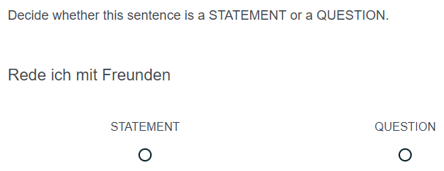
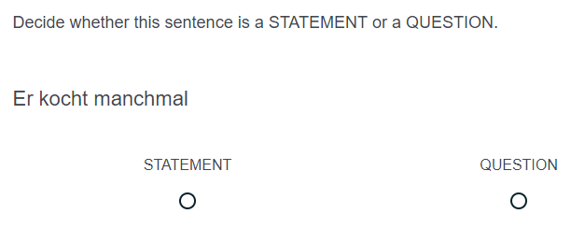
Test creation: examples items
Remove punctuation
(Avoid . or ? indicating answer)
Including variety of ‘subjects’
(Avoid reliance on ‘du’ to indicate question)
Isolating receptive knowledge of syntax
Recognising function (statement / question) indicated by word order
Notes:
In this third example, we have a receptive item which is testing learners’ knowledge of syntax, in this case word order in questions in German.
Here by removing the punctuation, we are testing whether pupils recognise the function indicated by the order of the subject pronoun and the verb in each sentence. In addition, we have used a variety of subjects for both the statements and questions, in order to avoid a reliance of ‘du’ (you) to indicate questions.

Slide 9
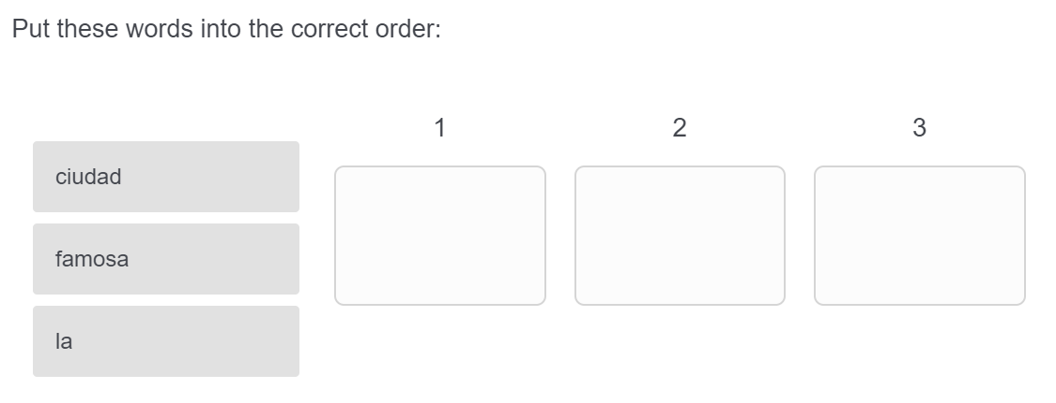
Test creation: examples items
Article / noun / adjective appear in a random (vertical) order for each item.
(Ensures learner is paying attention to each element and its correct position)
Isolating productive knowledge of syntax
Drag-and-drop into correct order
Notes:
This next item is an example of how we tested students’ productive knowledge of syntax. This question focusses on the order of words in phrases which include an article, adjective and noun in Spanish, and we had the equivalent in the French test too. So here students are given the three words and have to drag them into the correct position under columns one, two and three. By giving the pupils the three words, we are isolating students’ ability to accurately produce the syntax itself, rather than also requiring them to recall the correct lexical forms.

Slide 10
Test creation: examples items
Testing written productive knowledge
Testing ability to accurately produce the structure
Open text box
Testing understanding of question formation
(Check pupils understand that ‘do’ auxiliary is not needed)
Isolating grammatical knowledge by providing verb infinitive
(Avoid missing answers due to lack of lexical knowledge)
Notes:
Here we have examples from Spanish of written productive items.
In general, written productive items required pupils to supply just one element, rather than producing a whole sentence – this was really to make the scoring of the written items much more manageable.
The first example shows an item which is targeting students’ awareness of the fact that Spanish does not require an alternative to the English ‘do-auxiliary’.
You’ll also notice that we have provided a gloss of the verb infinitive for students. This was done in order to ensure that we were isolating grammatical knowledge of these items. By providing the verb infinitive, we are not relying on pupils being able to recall the appropriate lexical item in order to complete the question successfully. They have the correct word in the target language, so the question is really testing whether they can produce the appropriate verb inflection.

Slide 11
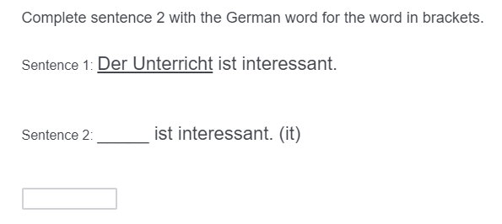
Test creation: examples items
Testing written productive knowledge
Testing ability to accurately produce the structure
Open text box
Isolating grammatical knowledge by indicating gender (directly or via article).
(Ensure that pupils are not reliant on recalling gender of a specific lexical item)
Notes:
Here we have another couple of examples of written production items.
In general, in the written items we have tried to isolate one particular grammatical feature which pupils have to supply.
These also illustrate another way in which we have tried to isolate grammatical knowledge, in this case knowledge of gender. Here we have indicated the gender of the noun either directly after the noun itself or via the article. This is to ensure that completion of these items was not reliant on pupils having to recall the gender of specific nouns, rather we wanted to know whether students were able to accurately apply the grammatical gender system in the target language and so therefore we explicitly indicated the gender of the nouns that we had used within these items.

Slide 12
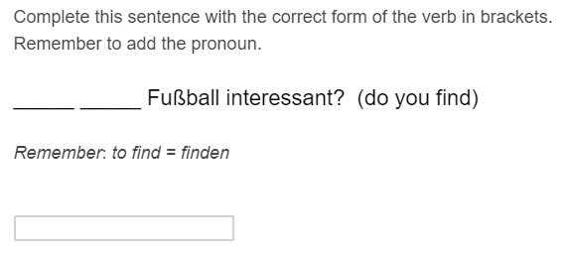
Test creation: examples items
Testing syntax alongside subject-verb agreement.
Half of the pool included verbs in present continuous form
(Check pupils’ understanding that there is one present tense structure for simple and continuous meanings)
Testing written productive knowledge
Testing ability to accurately produce the structure
Open text box
Notes:
This next item is taken from the German version of the test and illustrates a question that is targeting both syntax, in terms of subject-verb word for questions, as well as morphology, in terms of weak verb inflections.
It is worth noting that these written items that are combining testing multiple grammatical features did have implications for the automated scoring for the online version, and I’ll explain in a bit more detail in the next section how we went about scoring these sorts of items.
For future iterations of the tests, we will most likely try to separate out testing production of syntax (e.g. drag and drop) and production of verb agreement, in order to simplify the automated scoring process.

Slide 13
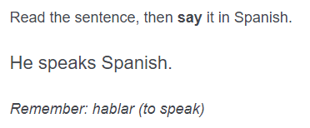
Test creation: examples items
Testing oral productive knowledge
Testing ability to accurately produce the structure(s)
Combining a number of structures within each item
Testing subject-verb agreement and question formation.
Isolating grammatical knowledge by providing verb infinitive
(Avoid missing answers due to lack of lexical knowledge)
Note: glosses not provided for other elements of the sentence which are not being tested (e.g. object)
Notes:
We are now going to look at a couple of items from the speaking part of the test. As mentioned earlier, in the speaking part of the test we have combined testing several grammar features within each item, and we did this by asking students to produce short phrase or a short sentence for each item within the speaking test.
As with the writing items, we have provided a gloss of the key target language words for example giving the verb in items testing in subject-verb agreement, and this was really in order to avoid missing answers being due to student’s struggling to recall the correct vocabulary that they needed for that particular item.

Slide 14
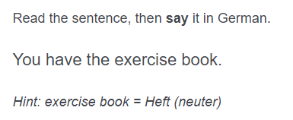
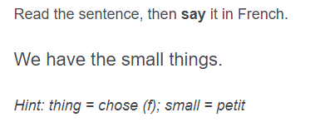
Test creation: examples items
No gloss provided for irregular verbs
(Irregular verb forms taught as individual lexical items, rather than transforming from the infinitive)
Isolating knowledge of gender / number (& case) agreement for articles (& adjectives)
(Noun form provided and gender indicated)
Testing oral productive knowledge
Testing ability to accurately produce the structure(s)
Combining a number of structures within each item
Notes:
Here we have two more examples from the speaking section which are testing irregular verb agreement, & article / noun agreement.
For irregular verbs, we have not provided a gloss of the verb infinitive. This is because in the SoW, irregular verb forms have been taught as individual lexical items, rather than as a transformation from the infinitive. So, we felt that providing the irregular verb infinitive in these items could actually cause confusion rather than being helpful for the students.
For the items testing article agreement, we provide a gloss of the target noun and the target adjective where appropriate, and we have also indicated the gender, so that we are testing whether pupils can accurately produce the correct article and adjective ending, rather than relying on them being able to recall that particular gender for that noun.

