Slide 1
German phonics collection
[z]
Artwork: Steve Clarke
Date updated: 10 / 08 / 21
Notes:
Artwork by Steve Clarke. All additional pictures selected are available under a Creative Commons license, no attribution required.

Slide 2
[z]
Phonetik
Introduction
Y7 Term 1.1 Week 4 Slides 3-8

Slide 3
z
Zug
Notes:
Timing: 1 minute
Aim: To introduce/consolidate SSC [z]
Procedure: 1. Present the letter(s) and say the [z] sound first, on its own. Students repeat it with you. 2. Bring up the word “Zug” on its own, say it, students repeat it, so that they have the opportunity to focus all of their attention on the connection between the written word and its sound.
3. A possible gesture for this would be to mime wheels, holding your hands at your sides, elbows bent, forearms facing forwards in a right angle, and draw small circles with them, in the air (to denote the wheels of a train going round).
4. Roll back the animations and work through 1-3 again, but this time, dropping your voice completely to listen carefully to the students saying the [z] sound, pronouncing ”Zug” and, if using, doing the gesture. Word frequency (1 is the most frequent word in German): Zug [613] Source: Jones, R.L. & Tschirner, E. (2006). A frequency dictionary of German: core vocabulary for learners. Routledge

Slide 4
z
Zug
Notes:
With sound and no pictures to focus all attention on the sound-symbol correspondence.

Slide 5
z
Zug
Notes:
Without sound to elicit pronunciation (without first hearing the teacher).
Teacher to elicit pronunciation by asking “Wie sagt man…”

Slide 6
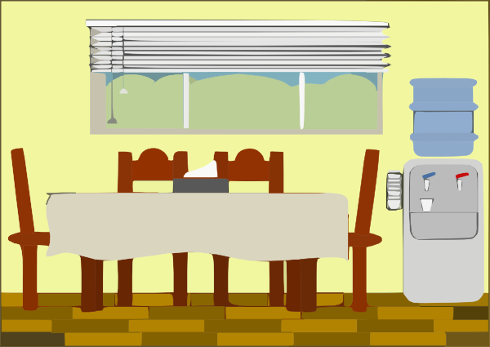
z
Zimmer
zehn
Zug
Arzt
sitzen
Platz
Notes:
Timing: 2 minutes
Aim: To introduce/consolidate SSC [z]
Procedure:
Introduce and elicit the pronunciation of the individual SSC [z] and then the source word again ‘Zug’ (with gesture, if using).
Then present and elicit the pronunciation of the five cluster words.
The cluster words have been chosen for their high-frequency, from a range of word classes, with the SSC (where possible) positioned within a variety of syllables within the words (e.g. initial, 2nd, final etc.). Additionally, we have tried to use words that build cumulatively on previously taught SSCs (see the Phonics Teaching Sequence document) and do not include new SSCs. Where new SSCs are used, they are often consonants which have a similar symbol-sound correspondence in English.
Word frequency (1 is the most frequent word in German): Zug [613]; Zimmer [609] zehn [314]; Arzt [614]; Platz [344]; sitzen [261]. Source: Jones, R.L. & Tschirner, E. (2006). A frequency dictionary of German: core vocabulary for learners. Routledge

Slide 7
z
Zimmer
zehn
Zug
Arzt
sitzen
Platz
Notes:
With sound and no pictures to focus all attention on the sound-symbol correspondence.

Slide 8
z
Zimmer
zehn
Zug
Arzt
sitzen
Platz
Notes:
Without sound to elicit pronunciation (without first hearing the teacher).
Teacher to elicit pronunciation by asking “Wie sagt man…”

Slide 9
[z]
Phonetik
Consolidation [1]
Y7 T1.1 Week 6 Slides 38-41; 45-46

Slide 10
Phonetik
hören / sprechen
sagen
geben
Welt
Zug
frei
kalt
denken
Notes:
Timing: 3 minutes Aim: To revise all the SSCs introduced so far: long and short a, long and short e, ei, W, Z.
Procedure: 1. Click on the word to play the audio. Repeat if necessary.
2. Students write the whole word in full in their exercise books.
3. The next slide allows removal of the ‘blots’ to reveal the missing SSCs.

Slide 11
Phonetik
hören / sprechen
sagen
geben
Welt
Zug
frei
kalt
denken
Notes:
Timing: 1 minute Aim: To reveal the answers to the activity. Procedure: 1. Click on the ‘blots to remove them individually and reveal the missing SSCs.

Slide 12
Phonetik
zehn
antworten
A
D
Zug
H
allein
C
E
Welt
klein
[alone]
Wasser
I
F
G
frei
B
Arzt
Notes:
Timing: 5 minutes Aim: To consolidate SSC knowledge
Ask students to write down which pictures go together (based on the obscured SSC).
The teacher can remind them of the source words they have just seen.
Clicking on the pictures will play the word if the students need an extra prompt.
Clicking on the paw prints will remove them.

Slide 13
Phonetik
Arzt
lesen / sprechen
antworten
60
zehn
Zug
allein
Sekunden
Welt
frei
klein
Wasser
0
LOS!
Notes:
Timing: 2 minutes (one minute per attempt) Aim: To consolidate SSC knowledge Procedure: 1. Pupils read out the words but in alphabetical order. They keep going for one minute.
2. Teacher can circulate to listen into their SSC knowledge.
Word frequency (1 is the most frequent word in German): der Arzt [614] allein [258] Source: Jones, R.L. & Tschirner, E. (2006). A frequency dictionary of German: core vocabulary for learners. Routledge

Slide 14
Phonetik
hören / schreiben
1
ei
Der Mann sit_t all__n. ☹
z
2
e
a
Der Arzt d_nkt ’W_s?!’
3
ei
i
Der Gast hat __n Z_mmer.
4
Der Freund ge_ innt __n B_tt.
w
ei
e
5
ei
a
Die Frau h_t __nen G_st.
a
6
a
Der Lehrer s_gt ‘Hurr_’. ☺
a
Notes:
Timing: 5 minutes Aim: To consolidate all SSCs introduced so far in a written transcription activity Procedure: 1. Click on the audio buttons to play the sentences.
2. Certain SSCs are missing from the transcript on the slide.
Students listen and write out the sentences in full.
3. Click to bring up the missing SSCs.
Transcript: As displayed on the slide. Word frequency (1 is the most frequent word in German): gewinnen [410] der Arzt [614] der Gast [675] das Zimmer [609] allein [258] Source: Jones, R.L. & Tschirner, E. (2006). A frequency dictionary of German: core vocabulary for learners. Routledge

Slide 15
Phonetik
hören / sprechen
1
Der Mann sitzt allein. ☹
2
Der Arzt denkt ’Was?!’
3
der Artzt
Der Gast hat ein Zimmer.
4
Der Freund gewinnt ein Bett.
das Zimmer
5
Die Frau hat einen Gast.
6
Der Lehrer sagt ‘Hurra’. ☺
Notes:
Timing: 5-10 minutes Aim: To consolidate SSC and word knowledge in a listening and speaking activity Procedure (alternatives): 1. Students read each sentence aloud, as a whole-class activity or in pairs.
2) Students translate the sentences into English (orally or in writing).
3) Students play a paired vocabulary tennis task (with gestures for the verbs)
Word frequency (1 is the most frequent word in German): gewinnen [410] der Arzt [614] der Gast [675] das Zimmer [609] allein [258] Source: Jones, R.L. & Tschirner, E. (2006). A frequency dictionary of German: core vocabulary for learners. Routledge

Slide 16
[z]
Phonetik
Consolidation [2]
Y7 T3.1 Week 2 Slide 18

Slide 17
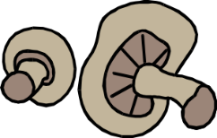
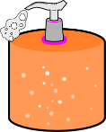
Heidis Shoppingliste
Was braucht Heide? Ordne die Dinge zu!
Zahnbürste
_
Pilze
Osterhase
_
_
s/z
s
z
Seife
_
Sonnenschutz
_
_
Salz
_
_
_
_
Säge
_
Zelt
_
Zitrone
_
Notes:
This phonics exercise contrasts two SSCs which were not revisited in lesson 1 - [s] and [z].
Students sketch the Venn-diagram in their answer books, listen to the pronunciation of these unknown words, and assign each to the appropriate part of the diagram.
Audio plays on clicking the images.
Answers are revealed (clockwise) on clicks, starting with Zahnbürste and finishing with Pilze
Frequency values of words used: Zahnbürste [2449/>4034], Osterhase [>4034], Sonnenschutz [953/1094], Säge [>4034], Zitrone [>4034], Zelt [2969], Salz [2437], Seife [>4034], Pilz [>4034]

Slide 18
[z]
Phonetik
Consolidation [3]
Y7 T3.2 Week 6 Slides 2-3; 20

Slide 19
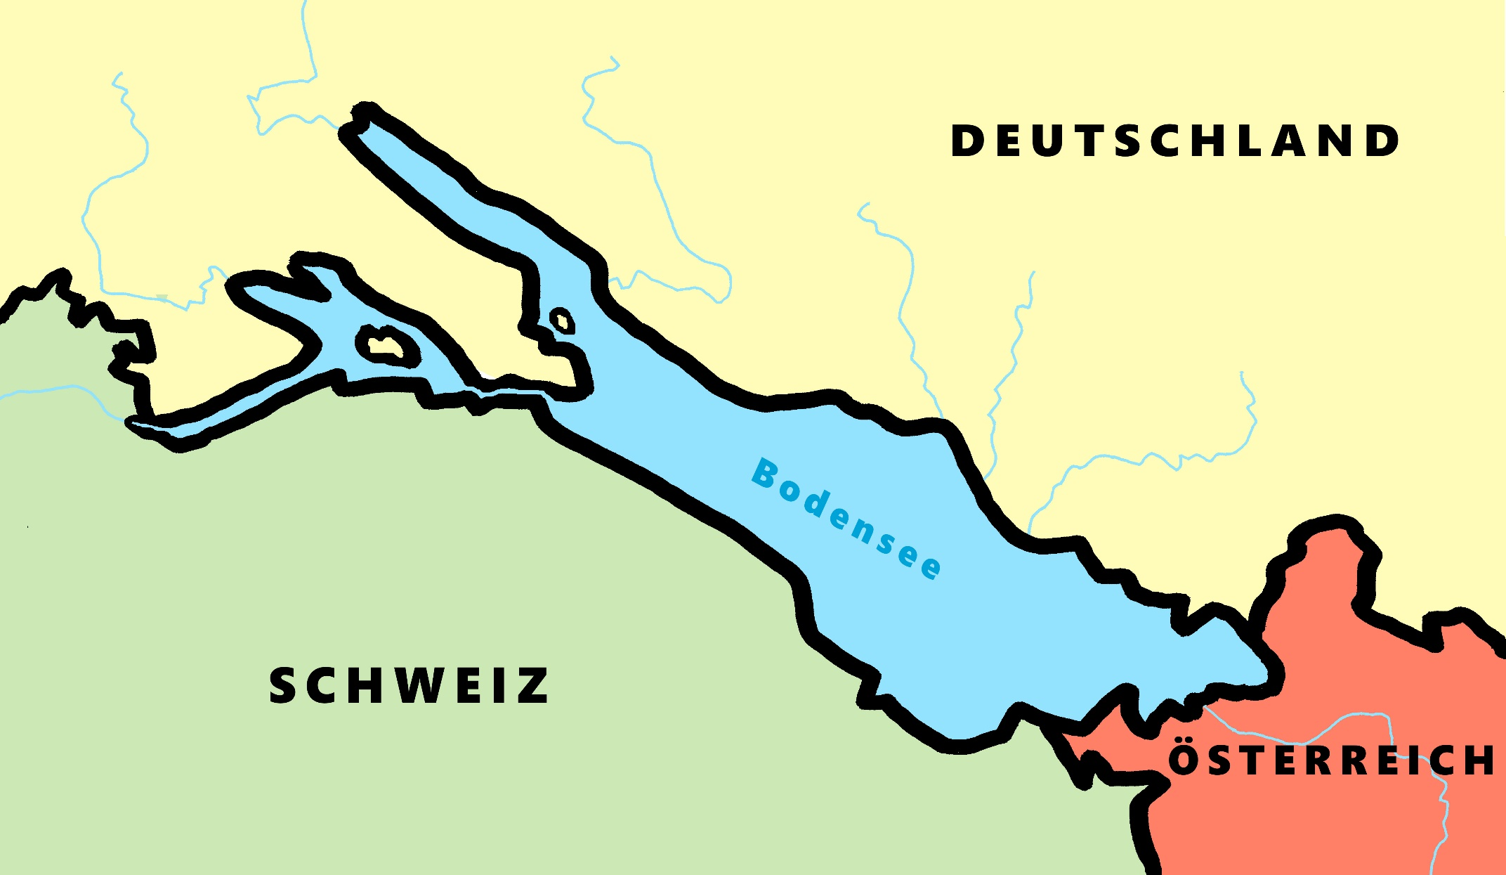
Phonetik - der Bodensee [1/2]
hören / schreiben
4
Allensbach
5
Wallhausen
3
Radolfzell
6
Hagnau
7
Friedrichshafen
1
Kreuzlingen
2
Steckborn
9
Romanshorn
8
Altenrhein
Notes:
Phonetik [1]
Time: 5 minutes Aim: To practise recognising and transcribing 10 previously taught SSC, in unknown words.
Procedure: 1. Click number to hear the full word. Students listen and transcribe only the missing letters. 2. Animations support item-by-item checking, as instant feedback on each SSC may be particularly helpful for students’ learning. 3. Teachers can additionally ask, Wo liegt [Hagnau]? Es liegt in [Deutschland]… Students have met the use of ‘in’ with die Schweiz. It will be helpful to focus their attention on the use of ‘in’ + der + Schweiz here, reminding them of the ‘in’ + movement (R2-accusative) or location (R3-dative) change. SSC revisited here: [eu] [st-] [z] [ch-hard] [w] [au] [ie] [ch-soft] [ei] [r] Transcript: 1 Kreuzlingen 2 Steckborn 3 Radolfzell 4 Allensbach 5 Wallhausen 6 Hagnau 7 Friedrichshafen 8 Altenrhein 9 Romanshorn

Slide 20
Phonetik - der Bodensee [1/2]
lesen / sprechen
9
Ludwigshafen
1
2
Friedrichshafen
Stein am Rhein
6
Konstanz
8
7
Reichenau
5
Altnau
3
Bregenz
4
Rorschach
Notes:
Phonetik [2]
Time: 5 minutes Aim: To practise reading aloud / saying 10 previously taught SSC, in unknown words (apart from Deutschland, which starts the task off). Here, 9 additional towns on the Bodensee are used.
Procedure: 1. Students work in pairs to pronounce each of the towns. 2. Click number to hear and check pronunciation. SSC revisited here: [eu] [st-] [z] [ch-hard] [w] [au] [ie] [ch-soft] [ei] [r] [sch] Transcript: 1 Deutschland 2 Friedrichshafen 3 Bregenz 4 Rorschach 5 Altnau 6 Konstanz 7 Reichenau 8 Stein am Rhein 9 Ludwigshafen

Slide 21
Wie heißt die Band?
Phonetik
Alastair telefoniert mit Mia. Sie reden über deutsche Bands. Wie heißen sie?
 | die P r i n z e n
 | J u l i
 | F e t t e s B r o t
 | die F a n t a s t i s c h e n V i e r
 | S ö h n e M a n n h e i m s
 | S p o r t f r e u n d e S t i l l e r
 | R o s e n s t o l z
 | die Ä r t z e
1
_
2
_
3
_
_
4
_
_
_
_
_
5
_
_
_
6
_
_
_
_
7
_
_
8
_
_
Notes:
Phonetik [1] Time: 5 minutes
Aim: To practise recognising and transcribing 14 previously taught SSC, in unknown words.
Note: These are real German band names.
Procedure: 1. Click number to hear the full word. Students listen and transcribe only the missing letters. 2. Animations support item-by-item checking, as instant feedback on each SSC may be particularly helpful for students’ learning. SSC revisited here: [z] [j] [r-consonantal] [o-long] [sch] [v] [r-vocalic] [ö-long] [ei] [st] [-er] [st] [ä] [-e]
Transcript: [1] die Prinzen
[2] Juli
[3] Fettes Brot
[4] die Fantastischen Vier
[5] Söhne Mannheims
[6] Sportfreunde Stiller
[7] Rosenstolz
[8] die Ärzte

Slide 22
[z]
Phonetik
Consolidation [4]
Y8 T1.2 Week 1 Slides 2-4; 7

Slide 23
z
Zug
Notes:
Timing: 1 minute
Aim: To introduce/consolidate SSC [z]
Procedure: 1. Present the letter(s) and say the [z] sound first, on its own. Students repeat it with you. 2. Bring up the word “Zug” on its own, say it, students repeat it, so that they have the opportunity to focus all of their attention on the connection between the written word and its sound.
3. A possible gesture for this would be to mime wheels, holding your hands at your sides, elbows bent, forearms facing forwards in a right angle, and draw small circles with them, in the air (to denote the wheels of a train going round).
4. Roll back the animations and work through 1-3 again, but this time, dropping your voice completely to listen carefully to the students saying the [z] sound, pronouncing ”Zug” and, if using, doing the gesture. Word frequency (1 is the most frequent word in German): Zug [613] Source: Jones, R.L. & Tschirner, E. (2006). A frequency dictionary of German: core vocabulary for learners. Routledge

Slide 24
z
Zimmer
zehn
Zug
Arzt
sitzen
Platz
Notes:
Timing: 2 minutes
Aim: To introduce/consolidate SSC [z]
Procedure:
Introduce and elicit the pronunciation of the individual SSC [z] and then the source word again ‘Zug’ (with gesture, if using).
Then present and elicit the pronunciation of the five cluster words.
The cluster words have been chosen for their high-frequency, from a range of word classes, with the SSC (where possible) positioned within a variety of syllables within the words (e.g. initial, 2nd, final etc.). Additionally, we have tried to use words that build cumulatively on previously taught SSCs (see the Phonics Teaching Sequence document) and do not include new SSCs. Where new SSCs are used, they are often consonants which have a similar symbol-sound correspondence in English.
Word frequency (1 is the most frequent word in German): Zug [613]; Zimmer [609] zehn [314]; Arzt [614]; Platz [344]; sitzen [261]. Source: Jones, R.L. & Tschirner, E. (2006). A frequency dictionary of German: core vocabulary for learners. Routledge

Slide 25
z
Zimmer
zehn
Zug
Arzt
sitzen
Platz
Notes:
Without sound to elicit pronunciation (without first hearing the teacher).
Teacher to elicit pronunciation by asking “Wie sagt man…”

Slide 26
Phonetik
hören / schreiben
Wie oft hörst du [z]?
1
Die Pflanzen brauchen viel Wasser.
/
2
Achtundzwanzig Prozent der Deutschen arbeiten in der Freizeit im Garten.
////
3
Nur elf Prozent gehen jede Woche ins Sportzentrum.
//
4
Die Jahreszeit zwischen Dezember und März ist ziemlich kalt in Deutschland .
////
5
////
Zahnärzte sind für das Ziehen von Zähnen zuständig.
6
Wann ist der beste Zeitpunkt, einen Sommerurlaub zu buchen?
//
Notes:
Timing: 4 minutes Aim: Listening for and noticing the SSC [z] in a sentence context. Procedure: 1. Click on a number to hear the sentence. Click on the number again to repeat if necessary.
2. Write down how many Rs you hear in each sentence.
3. Click to see the sentence and check the answer.
4. Check understanding of sentences.
Transcript: 1. Die Pflanzen brauchen viel Wasser. [1] 2. Achtundzwanzig Prozent der Deutschen arbeitet in der Freizeit im Garten. [4] 3. Nur elf Prozent geht jede Woche ins Sportzentrum. [2] 4. Die Jahreszeit zwischen Dezember und März ist ziemlich kalt in Deutschland [5] 5. Zahnärzte sind für das Ziehen von Zähnen zuständig. [5] 6. Wann ist der beste Zeitpunkt, einen Sommerurlaub zu buchen? [1]
Word frequency (1 is the most frequent word in German):
Prozent [172] Pflanze [1667] Dezember [1527] Jahreszeit [4818] März [987] der Punkt [427] nur [39] ziehen [266] jeder, jede, jedes [88]

Slide 27
[z]
Phonetik
Consolidation [5]
Y8 T2.1 Week 6 Slide 17

Slide 28
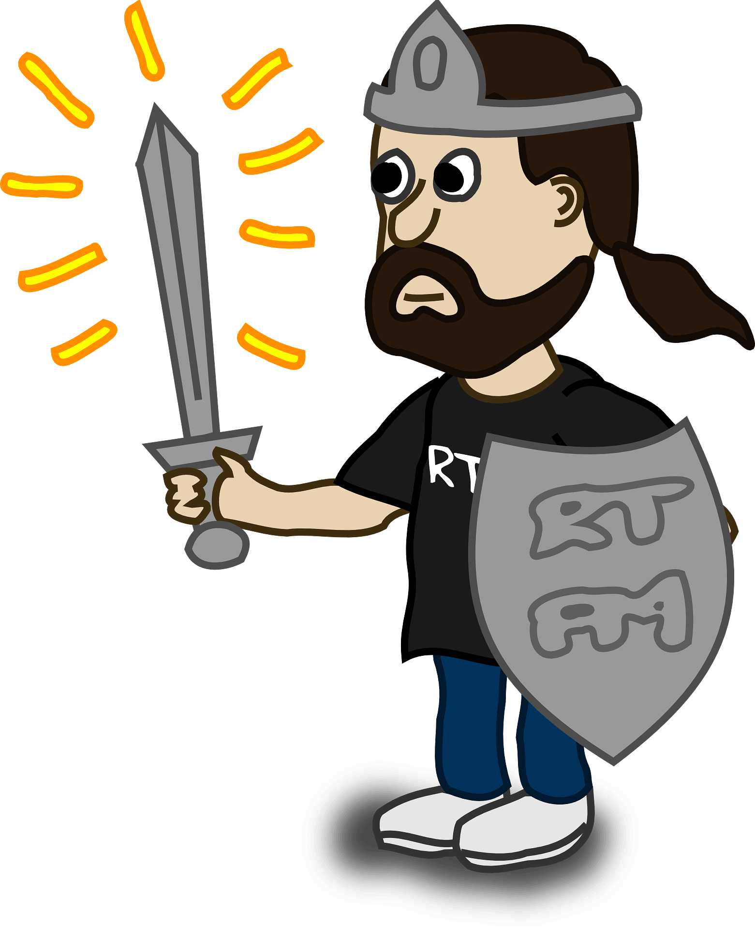
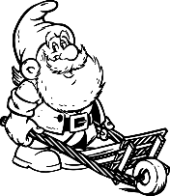
Phonetik
hören / schreiben
Hör zu. Schreib zw- oder schw-
ə
[indeed]
1
schwingen
4
Schwa
zwar
zwingen
____
_____
_____
____
[to force]
[to wield]
[schwa]
[indeed]
2
schwang
5
Schwert
Zwang
____
Zwerg
____
____
____
[swung]
[dwarf]
[sword]
[force/coercion]
3
Schwenken
6
Zwenken
zweifeln
____
____
schweifen
_____
_____
[type of grass]
[pivoting]
[to ramble]
[to doubt]
Notes:
Attributions: To force: Abu badali, based on public domain Aiga’s icons / CC BY-SA
Timing: 5 minutes Aim: to practise differentiating the SSC [zw-] and [schw-], first by transcribing correctly, then by indicating which SSC is said and heard, under increasing time pressure.
Procedure: 1. Students listen and write each SSC correctly (or the full word each time, if preferred)
2. Check answers, using animations.
3. Teacher says one of each pair again, and students lift right or left arm up, to show recognition.
4. Speed of input and responses can be increased to speed up processing.
Transcript: 1. zwingen, schwingen 2. Zwang, schwang
3. Zwenken, schwenken
4. schwa, zwar
5. Zwerg, Schwert
6. schweifen, zweifeln Word frequency (1 is the most frequent word in German): zwingen [1212] schwingen [3130] Zwang [3902] schwang [3130] zwenken [>5009] schwenken [>5009] schwa [>5009] zwar [206] Zwerg [4318] Schwert [>5009] schweifen [>5009] zweifeln [4149] Source: Jones, R.L. & Tschirner, E. (2019). A frequency dictionary of German: core vocabulary for learners. Routledge

Slide 29
[z]
Phonetik
Consolidation [5]
Y8 T2.2 Week 2 Slides 35-36

Slide 30
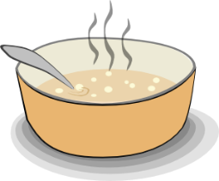
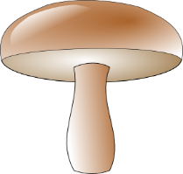
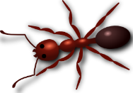
Phonetik
Deutsches [z] ist wie das Englische‘ts’. Deutsches [s-] ist wie das Englische ‘z’.
hören / schreiben
Hör zu. Schreib 1-9 und [z] oder [s].
_
_
_
7
E s el
Zirkus
4
1
Hei z ung
_
_
_
5
Pil z
2
Suppe
Zahn
8
Salat
_
_
9
_
3
Sahne
6
Amei s e
Notes:
Timing: 5 minutes Aim: To practise distinguishing between [z] and [s] Procedure: 1. Click on the numbered audio buttons to play each word.
2. Students write 1-9 and for each word note either ‘z’ or ‘s’ as the missing letter, according to what they hear.
3. Click to reveal the correct answers.
Transcript: 1. Zirkus 2. Suppe 3. Sahne 4. Heizung 5. Zahn 6. Ameise 7. Esel 8. Pilz 9. Salat Word frequency (1 is the most frequent word in German): Zirkus [>5009] Rose [3266] Suppe [>5009] Sahne [>5009] Heizung [>5009] Zahn [1871] Ameise [>5009] Esel [>5009] Pilz [3216] Salat [>5009]
Source: Jones, R.L. & Tschirner, E. (2019). A frequency dictionary of German: core vocabulary for learners. Routledge

Slide 31
Phonetik
lesen / sprechen
Remember - ‘tion’ words sound like ‘tsyon’in German!
20
1. sinken
7. Option
2. Tradition
8. angesichts
3. Kompetenz
9. Qualifikation
Sekunden
4. Zucker
10. absolut
5. sogar
11. tausend
0
6. Gesetz
12. Demonstration
LOS!
Notes:
Timing: 3 minutes Aim: To practise producing the [z] and [s (sounded like English ‘z’)] sounds in German Procedure: 1. Click on the ‘Los!’ button to start the timer.
2. Partners alternate in reading aloud the words – A reads out the odd numbers, B the even numbers. They aim to have read out all the words within the 20 seconds on the timer. Word frequency (1 is the most frequent word in German): Demonstration [3235] Option [3364] Qualifikation [3600] Zucker [2559] Kompetenz [2556] sogar [226] Gesetz [578] absolut [823] angesichts [1165] tausend [1177]
Source: Jones, R.L. & Tschirner, E. (2019). A frequency dictionary of German: core vocabulary for learners. Routledge

Slide 32
[z]
Phonetik
Consolidation [6]
Y8 T2.2 Week 4 Slide 3

Slide 33
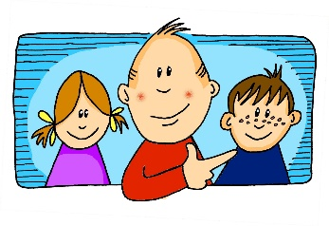
Phonetik
Hör zu. Schreib die Wörter. Wie viele enthalten die SSC?
hören / schreiben
[er-]
[-er]
[ei]
[j]
[z]
[o]
er
wieder
frei
ja
Zug
Kopf
 |  | ?
 | [er-]
 | [-er]
 | [ei]
 |  | ?
 | [j]
 | [z]
 | [o]
gern – erklären - unser
2
jung – jedoch - Jugendclub
3
alle – erzählen - anderer
1
kurz – unser - zwar
2
Kleid – weit - alleine
3
1
genau – Schloss - erlauben
Notes:
Timing: 7 minutes Aim: Transcription activity to revisit six further SSC, and to practise writing vocabulary from this week’s sets, as well as a few unknown words. As such, this is a hybrid phonics – vocabulary activity. Procedure: 1. Click on each individual SSC to hear it.
2. Elicit the source word from students, if remembered. Note that all of these words have also been taught as key vocabulary on the SOW.
3. Bring up the source words to check, and for reference for the read aloud activity.
4. Students listen to the sets of three words and transcribe them. 5. They decide how many words contain the target SSC.
6. Reveal the answers. 7. Optional – elicit the English meanings of the vocabulary.
Transcript: gern – erklären - unser
alle – erzählen - anderer
Kleid – weit – alleine
jung – jedoch – Jugendclub
kurz – unser - zwar
genau – Schloss - erlauben
Word frequency of unknown words (1 is the most frequent word in German): weit [230] zwar [227] Source: Jones, R.L. & Tschirner, E. (2019). A frequency dictionary of German: core vocabulary for learners. Routledge

