Slide 1
German phonics collection
Long and short [ü/y]
Artwork: Steve Clarke
Date updated: 10 / 02 / 21
Notes:
Artwork by Steve Clarke. All additional pictures selected are available under a Creative Commons license, no attribution required.

Slide 2
Long and short [ü/y]
Phonetik
Introduction
Y7 T1.2 Week 6 Slides 3-15; 65-66

Slide 3
ü
[y:]
Tür
Notes:
Timing: 1 minute
Aim: To introduce SSC [ü]
Procedure: 1. Present the letter(s) and say the [ü] sound first, on its own. Students repeat it with you. 2. Bring up the word ” Tür” on its own, say it, students repeat it, so that they have the opportunity to focus all of their attention on the connection between the written word and its sound.
3. A possible gesture for this would be to hold both hands touching in front of your body, palms facing inward, thumbs to the ceiling. Then, with the right hand, mime a door opening by drawing it away from the left so that it finishes at a right angle, like a fully open door.
4. Roll back the animations and work through 1-3 again, but this time, dropping your voice completely to listen carefully to the students saying the [ü] sound, pronouncing ”Tür” and, if using, doing the gesture. Word frequency (1 is the most frequent word in German): Tür [400] Source: Jones, R.L. & Tschirner, E. (2006). A frequency dictionary of German: core vocabulary for learners. Routledge

Slide 4
ü
[y:]
Tür
Notes:
With sound and no pictures to focus all attention on the sound-symbol correspondence.

Slide 5
ü
[y:]
Tür
Notes:
Without sound to elicit pronunciation (without first hearing the teacher).
Teacher to elicit pronunciation by asking “Wie sagt man…”

Slide 6
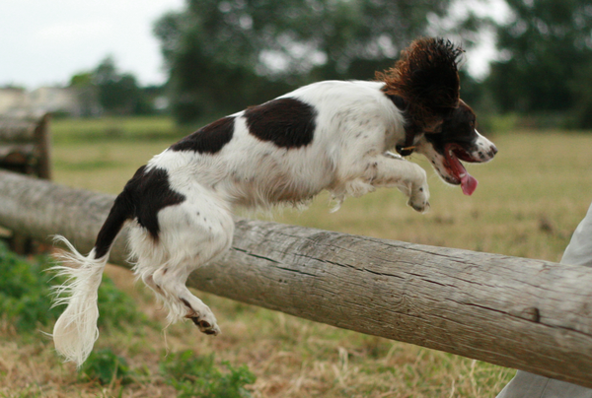
ü
fühlen
grün
Tür
Küche
über
früh
05:30!!!
Notes:
Timing: 2 minutes
Aim: To introduce SSC [ü]
Procedure:
Introduce and elicit the pronunciation of the individual SSC [ü] and then the source word again ‘Tür’ (with gesture, if using).
Then present and elicit the pronunciation of the five cluster words.
The cluster words have been chosen for their high-frequency, from a range of word classes, with the SSC (where possible) positioned within a variety of syllables within the words (e.g. initial, 2nd, final etc.). Additionally, we have tried to use words that build cumulatively on previously taught SSCs (see the Phonics Teaching Sequence document) and do not include new SSCs. Where new SSCs are used, they are often consonants which have a similar symbol-sound correspondence in English.
Word frequency (1 is the most frequent word in German): Tür [400]; fühlen [419] grün [556]; Küche [960]; früh [322]; über [48]. Source: Jones, R.L. & Tschirner, E. (2006). A frequency dictionary of German: core vocabulary for learners. Routledge

Slide 7
ü
fühlen
grün
Tür
Küche
über
früh
Notes:
With sound and no pictures to focus all attention on the sound-symbol correspondence.

Slide 8
ü
fühlen
grün
Tür
Küche
über
früh
Notes:
Without sound to elicit pronunciation (without first hearing the teacher).
Teacher to elicit pronunciation by asking “Wie sagt man…”

Slide 9
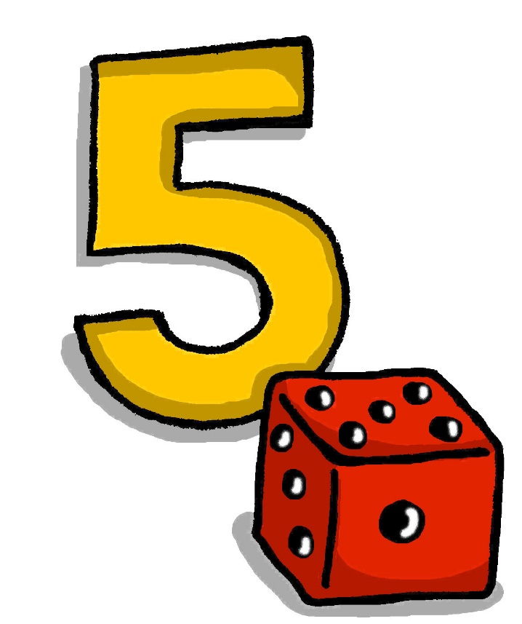
ü
[Y]
fünf
Notes:
Timing: 1 minute
Aim: To consolidate SSC [ü]
Procedure: 1. Present the letter(s) and say the [ü] sound first, on its own. Students repeat it with you. 2. Bring up the word “fünf” on its own, say it, students repeat it, so that they have the opportunity to focus all of their attention on the connection between the written word and its sound.
3. A possible gesture for this would be to hold up your right hand, five digits spread apart.
4. Roll back the animations and work through 1-3 again, but this time, dropping your voice completely to listen carefully to the students saying the [ü] sound, pronouncing “fünf” and, if using, doing the gesture. Word frequency (1 is the most frequent word in German): fünf [272]
Source: Jones, R.L. & Tschirner, E. (2006). A frequency dictionary of German: core vocabulary for learners. Routledge

Slide 10
ü
[Y]
fünf
Notes:
With sound and no pictures to focus all attention on the sound-symbol correspondence.

Slide 11
ü
[Y]
fünf
Notes:
Without sound to elicit pronunciation (without first hearing the teacher).
Teacher to elicit pronunciation by asking “Wie sagt man…”

Slide 12
ü
Rücken
wünschen
[to wish]
fünf
Stück
Glück
[luck/happiness]
müssen
[to have to/must]
Notes:
Timing: 2 minutes
Aim: To consolidate SSC [ü]
Procedure:
Introduce and elicit the pronunciation of the individual SSC [ü] and then the source word again ‘fünf’ (with gesture, if using).
Then present and elicit the pronunciation of the five cluster words.
The cluster words have been chosen for their high-frequency, from a range of word classes, with the SSC (where possible) positioned within a variety of syllables within the words (e.g. initial, 2nd, final etc.). Additionally, we have tried to use words that build cumulatively on previously taught SSCs (see the Phonics Teaching Sequence document) and do not include new SSCs. Where new SSCs are used, they are often consonants which have a similar symbol-sound correspondence in English.
Word frequency (1 is the most frequent word in German): fünf [272]; Rücken [914] wünschen [684]; Glück [763]; müssen [45]; Stück [417].
Source: Jones, R.L. & Tschirner, E. (2006). A frequency dictionary of German: core vocabulary for learners. Routledge

Slide 13
ü
Rücken
wünschen
fünf
Stück
Glück
müssen
Notes:
With sound and no pictures to focus all attention on the sound-symbol correspondence.

Slide 14
ü
Rücken
wünschen
fünf
Stück
Glück
müssen
Notes:
Without sound to elicit pronunciation (without first hearing the teacher).
Teacher to elicit pronunciation by asking “Wie sagt man…”

Slide 15
U oder Ü?
hören
 | U | Ü
1
2
3
4
5
6
1
2
3
4
5
6
Notes:
Timing: 3 minutes Aim: To practise distinguishing between [u] and [ü]
Procedure: 1. Click on the numbers to play the audio.
2. Students tick the appropriate column for each word.
3. Click to reveal the correct answers.
Transcript:
1. der Zug
2. die Nummer
3. die Tür
4. grün
5. putzen
6. wünschen

Slide 16
‘U’ oder ‘Ü’?
hören
O Tannenbaum, o Tannenbaum,
wie gr_n sind deine Blätter!
D_ gr_nst nicht n_r z_r Sommerszeit,
Nein auch im Winter, wenn es schneit.
O Tannenbaum, o Tannenbaum,
wie gr_n sind deine Blätter!
Notes:
Timing: 3 minutes Aim: Phonics practice contrasting ‘u’ and ‘ü’.
Procedure: 1. Click on the fir tree in the top right hand corner to play the song. Students write ‘u’ or ‘ü’ for each missing vowel.
2. Play the song a second time. The text could also be read aloud if the recording seems too fast.
3. Alternatively, here is a link to a commercial version: https://www.youtube.com/watch?v=lS4wTuvR7Ik
(single voice, but quite clear sound – 3 verses, only play verse 1).
4. The answers are provided on the next slide.
Note: We include the source words and pictures as a refresher.
Instructions in German:
Hör zu
Schreib ‘u’ oder ‘ü’

Slide 17
Antworten – u vs ü
Antworten
O Tannenbaum, o Tannenbaum,
wie gr_n sind deine Blätter!
D_ gr_nst nicht n_r z_r Sommerszeit,
Nein auch im Winter, wenn es schneit.
O Tannenbaum, o Tannenbaum,
wie gr_n sind deine Blätter!
grün
Du
grünst
nur
zur
grün
Notes:
Timing: 2 minutes Aim: To provide the answers to the activity on the previous slide
Procedure: 1. Ask students which SSC is missing each time.c, licking to reveal the answers one by one.

Slide 18
long and short [ü/y]
Phonetik
Consolidation [1]
Y7 T2.2 Week 5 Slides 3-4; 35

Slide 19
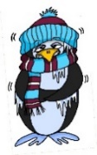
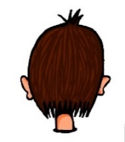
Phonetik
e
e
a
a
sagen
kalt
geben
denken
i
i
o
o
u
wir
u
finden
wo?
Kopf
ü
ü
ö
du
ö
Punkt
Tür
fünf
ä
ä
schön
plötzlich
spät
lächeln
Notes:
Timing: 3 minutes
Aim: The long and short vowel sounds in German are practised here in familiar words, with audio.
Procedure:
1. Students should listen and repeat.

Slide 20
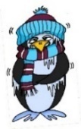
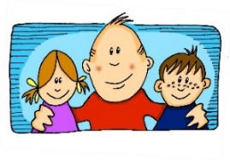
Phonetik
e
e
a
a
sagen
kalt
geben
denken
i
i
o
o
u
wir
u
finden
wo?
Kopf
ü
ü
ö
ö
fünf
du
Punkt
Tür
ä
ä
schön
plötzlich
spät
lächeln
Notes:
Timing: 3 minutes
Aim: This version of the slide is without audio.
Procedure:
1. Students should chant the words chorally first, as they appear, then perhaps individually (the teacher quizzing students on individual words; it will be important to continue to juxtapose the long and short forms of each vowel in this practice).

Slide 21
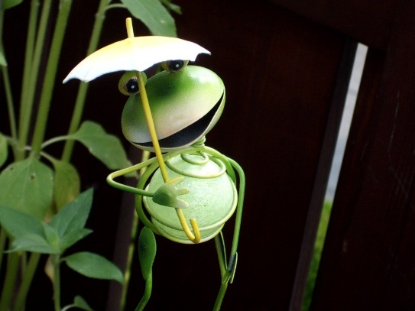
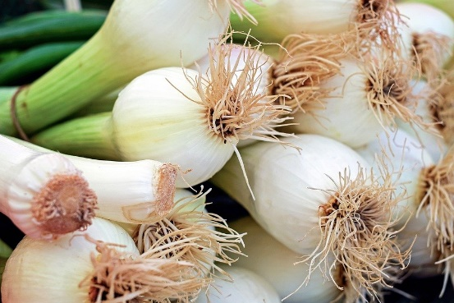
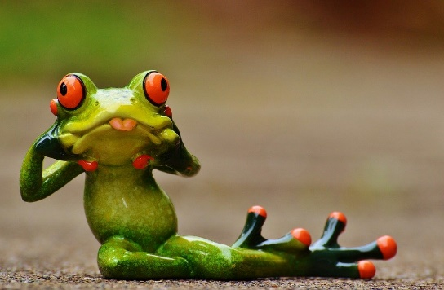
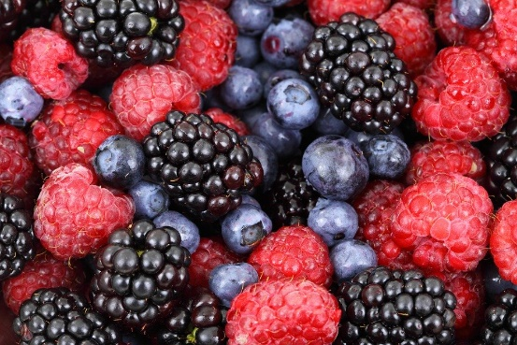
Zungenbrecher [2]
Phonetik
1
2
Fromme Frösche fressen
frische Frühlingszwiebeln,
aber freche Frösche fressen
frische Früchte.
Notes:
Timing: 3 minutes
Aim: Opportunity to practise the following SSCs: o - ö - i - ü – e.
Procedure:
1. Students listen to either the slower [1] or the faster [2] version of the tongutwister (or both in turn), then try to say it chorally or in pairs.
Transcription:
Fromme Frösche fressen
frische Frühlingszwiebeln,
aber freche Frösche fressen
frische Früchte.
Translation:
Pious frogs eat
fresh spring onions,
but eat naughty frogs
fresh fruits.
Word frequency (1 is the most frequent word in German):
fromm [>4029] Frosch [>4029] fressen [3448] frisch [1297] Frühling [3975] Zwiebel [3382] aber [32] frech [>4029] Frucht [3876]
Source: Jones, R.L & Tschirner, E. (2019). A frequency dictionary of German: Core vocabulary for learners. London: Routledge.

Slide 22
Long and short [ü/y]
Phonetik
Consolidation [2]
Y7 T3.1 Week 2 Slides 7; 8

Slide 23
Samstagnachmittag
lesen / hören
Heidi chillt jetzt ein bisschen. Sie liest ein Buch, aber es ist langweilig.
Sie findet ________ nicht so interessant.
a) Kisten
b) Küsten
4
Notes:
Here, SSCs short [i] and [ü] are contrasted.
Teacher to draw attention to strong verb stem in liest, eliciting the infinitive form and meaning from students.
Students met cognate chillen [>4034] in week 3.1.1.
Students should also be asked to suggest the singular for these plural nouns and their gender. The 3rd plural rule they learnt [1.2.7] - die → (e)n.
Frequencies of unknown vocabulary: Kiste [1943], Küste [1446]
Transcript
Kisten

Slide 24
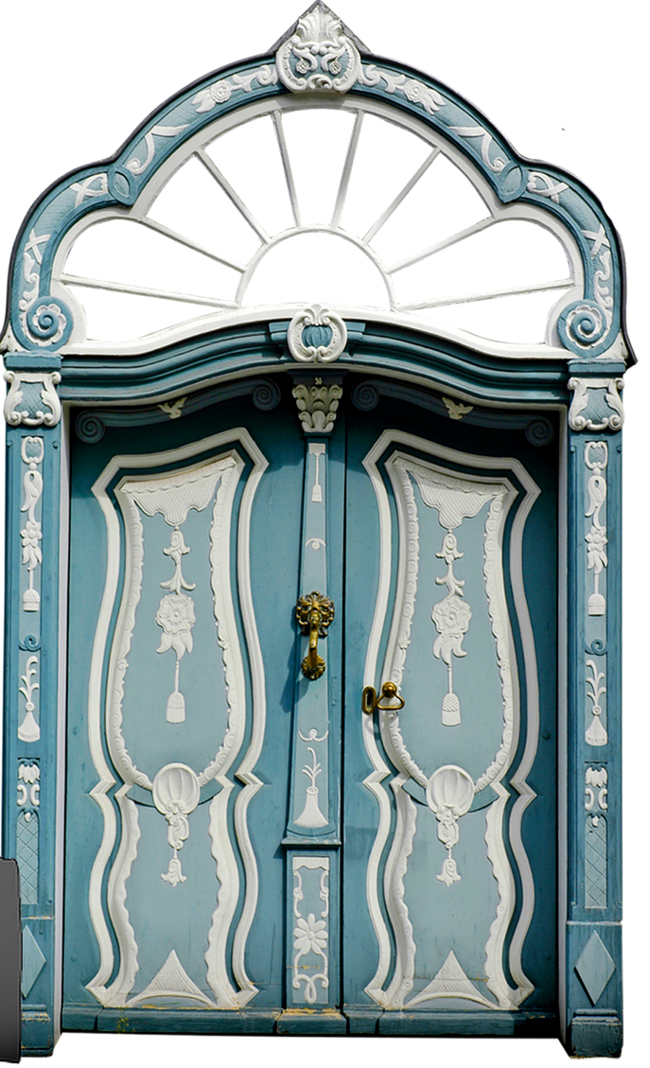
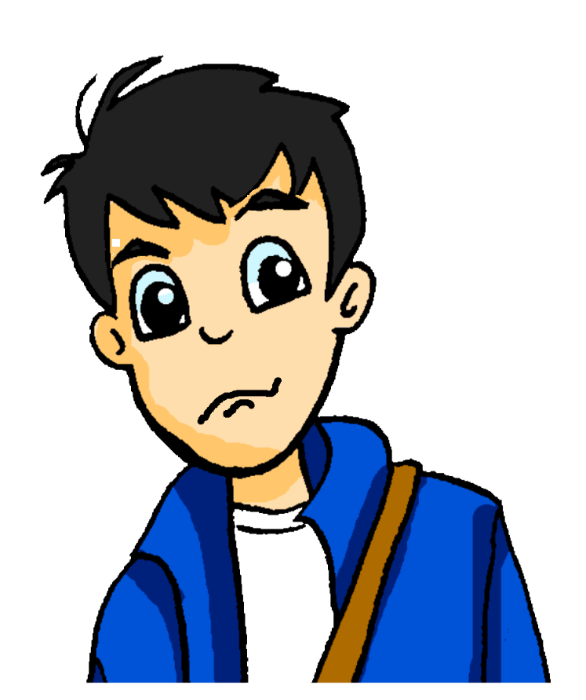
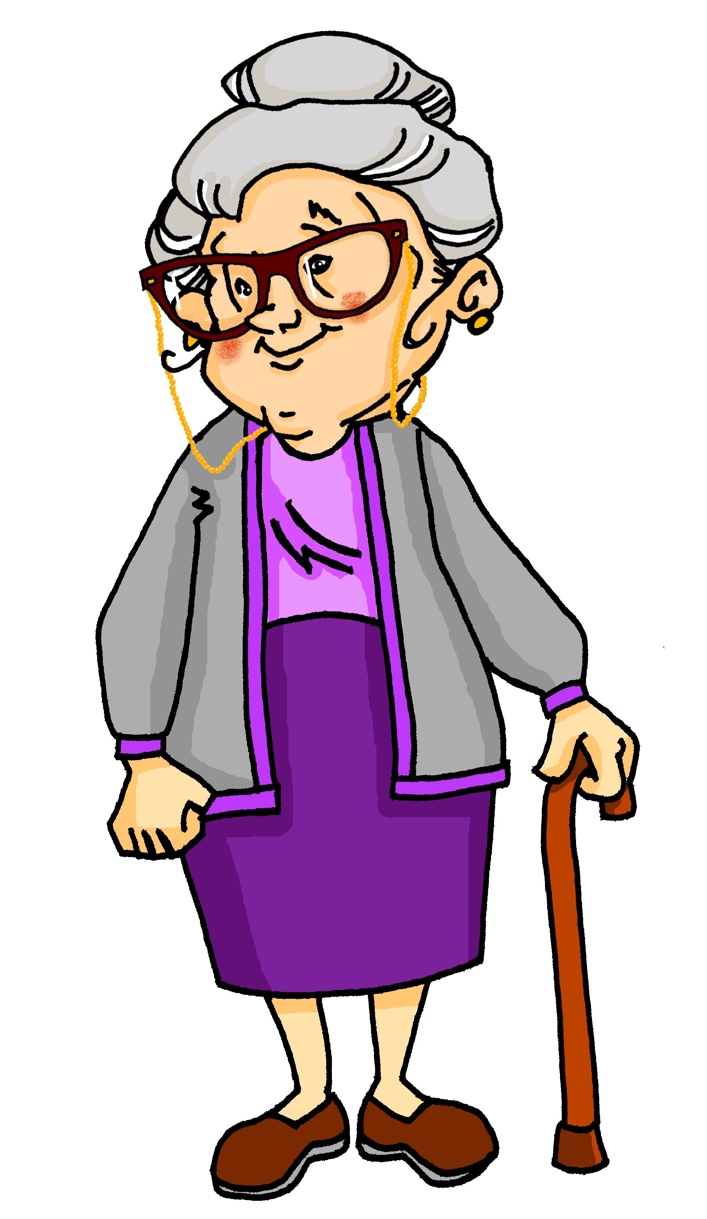
Samstagnachmittag
lesen / hören
Wolfgang hat ein bisschen Angst. Es wird spät, und er hat heute Nachmittag ein Date! Er sieht Oma im Wohnzimmer. Sie surft im Internet. Sie fragt: „Wolfgang! Wie findest du die …“
a) Tour
b) Tür
5
Notes:
Here, SSCs [u] and [ü] are contrasted.
Teacher to draw attention to the strong verb stems in sieht and wird, eliciting the infinitive form and meaning from students.
Teacher to students how they might translate ‘es wird spät’ - ‘it is getting late’ in English, rather than becoming
Teacher to point out cross-linguistic differences in punctuation conventions (speech marks)
Students have not yet met the cognate surfen [>4034]. Teacher to elicit pronunciation of this word, asking students to draw on their knowledge of SSC [s-].
Frequencies of unknown vocabulary: Tour [2474]
Transcript
Tür

Slide 25
Long and short [ü/y]
Phonetik
Consolidation [3]
Y7 T3.2 Week 3 Slides 2-11

Slide 26
SSC?
hören
05:30!!!
Notes:
Note: we are assuming that teachers will remove the [ü] from the title slide before the lesson, so as not to give away the answer!
Timing: 2 minutes
Aim: Students listen in pairs to work out the sound we are revisiting – first pair to put hands up have a go – must say all words correctly and work out the sound.
Procedure:
1. Click the image to play the audio.
2. Students guess the SSC.
3. The following slides reveal and practice the SSC.
ANSWERS:
grün
früh
fünf

Slide 27
ü
[y:]
Tür
Notes:
Timing: 1 minute
Aim: To introduce/consolidate SSC [ü]
Procedure: 1. Present the letter(s) and say the [ü] sound first, on its own. Students repeat it with you. 2. Bring up the word ” Tür” on its own, say it, students repeat it, so that they have the opportunity to focus all of their attention on the connection between the written word and its sound.
3. A possible gesture for this would be to hold both hands touching in front of your body, palms facing inward, thumbs to the ceiling. Then, with the right hand, mime a door opening by drawing it away from the left so that it finishes at a right angle, like a fully open door.
4. Roll back the animations and work through 1-3 again, but this time, dropping your voice completely to listen carefully to the students saying the [ü] sound, pronouncing ”Tür” and, if using, doing the gesture. Word frequency (1 is the most frequent word in German): Tür [400] Source: Jones, R.L. & Tschirner, E. (2006). A frequency dictionary of German: core vocabulary for learners. Routledge

Slide 28
ü
[y:]
Tür
Notes:
With sound and no pictures to focus all attention on the sound-symbol correspondence.

Slide 29
ü
[y:]
Tür
Notes:
Without sound to elicit pronunciation (without first hearing the teacher).
Teacher to elicit pronunciation by asking “Wie sagt man…”

Slide 30
ü
fühlen
grün
Tür
Küche
über
früh
05:30!!!
Notes:
Timing: 2 minutes
Aim: To introduce/consolidate [] SSC [ü]
Procedure:
Introduce and elicit the pronunciation of the individual SSC [ü] and then the source word again ‘Tür’ (with gesture, if using).
Then present and elicit the pronunciation of the five cluster words.
The cluster words have been chosen for their high-frequency, from a range of word classes, with the SSC (where possible) positioned within a variety of syllables within the words (e.g. initial, 2nd, final etc.). Additionally, we have tried to use words that build cumulatively on previously taught SSCs (see the Phonics Teaching Sequence document) and do not include new SSCs. Where new SSCs are used, they are often consonants which have a similar symbol-sound correspondence in English.
Word frequency (1 is the most frequent word in German): Tür [400]; fühlen [419] grün [556]; Küche [960]; früh [322]; über [48]. Source: Jones, R.L. & Tschirner, E. (2006). A frequency dictionary of German: core vocabulary for learners. Routledge

Slide 31
ü
fühlen
grün
Tür
Küche
über
früh
Notes:
With sound and no pictures to focus all attention on the sound-symbol correspondence.

Slide 32
ü
fühlen
grün
Tür
Küche
über
früh
Notes:
Without sound to elicit pronunciation (without first hearing the teacher).
Teacher to elicit pronunciation by asking “Wie sagt man…”

Slide 33
U oder Ü?
sprechen
das Buch
60
fühlen
grün
gut
die Nummer
Sekunden
die Küche
über
früh
der Zug
0
die Kunst
LOS!
Notes:
Timing: 2 minutes
Aim: Pairwork ‘tennis’ – pupils say the words alternately out loud with a partner, building up speed, over 1 minute’s intensive practice.
Procedure:
1. Click on ‘LOS!’ to start a one-minute timer on the screen.
2. Pupils call in any order they like, but are not allowed to repeat the one they said in their last turn. 3. Teacher can circulate to listen into their SSC knowledge.

Slide 34
U oder Ü?
hören
 | U | Ü
1
2
3
4
5
6
1
2
3
4
5
6
Notes:
Timing: 5 minutes (both slides)
Aim: Practice in distinguishing between [u] and [ü].
Procedure:
1. Click on the number to play the audio.
2. Students tick the appropriate column.
3. Click to reveal the answers one by one.
4. Activity continues on next slide.
Transcript:
1. das Museum
2. dürfen
3. ruhig
4. früh
5. genug
6. glücklich

Slide 35
U oder Ü? [2]
hören
 | U | Ü
1
2
3
4
5
6
7
8
9
10
11
12
Notes:
This slide continues the activity on the previous slide.
Transcript:
7. türkisch
8. zusammen
9. gesund
10. müssen
11. sie muss
12. du musst

Slide 36
Long and short [ü/y]
Phonetik
Consolidation [4]
Y8 T1.1 Week 3 Slides 2-3; 24

Slide 37
Phonetik
hören / schreiben
u
u
du
Punkt
ü
ü
Tür
fünf
Notes:
Timing: 1 minute Aim: To introduce/consolidate SSC long and short [u] and [ü] Procedure: 1. Present the letter(s) and say the [u] sound first, on its own. Students repeat it with you. 2. Bring up the source word ”du” on its own, say it, students repeat it, so that they have the opportunity to focus all of their attention on the connection between the written word and its sound.
3. A possible gesture for this would be to point out directly in front of you.
4. Repeat for the other three source words, with gesture suggestions as follows: short [u] - mime putting a full stop with your index finger in the air (point away from yourself, with a quick jabbing motion). long [ü] – hold both hands touching in front of your body, palms facing inward, thumbs to the ceiling. Then, with the right hand, mime a door opening by drawing it away from the left so that it finishes at a right angle, like a fully open door.
short [ü] - hold up your right hand, five digits spread apart.
Word frequency (1 is the most frequent word in German): du [52]; Punkt [427] Tür [400] fünf [272]
Source: Jones, R.L. & Tschirner, E. (2006). A frequency dictionary of German: core vocabulary for learners. Routledge

Slide 38
Phonetik
hören / schreiben
Hör zu. Schreib das Wort.
[u] du
[u] Punkt
1
absolut
unten
2
tun
nutzen
3
4
[ü] Tür
[ü] fünf
5
über
Glück
6
Küche
Rücken
7
8
Notes:
Timing: 4 minutes Aim: To practise SSC long and short [u] and [ü] Procedure: 1. Draw a 2 x 2 and write the source words. 2. Click to listen and write each word into the correct square. 3. Click to hear and see and word again. NB: Words will appear on clicks, so take care that the mouse is on action button when you click for audio (or the answers will appear too soon). Word frequency (1 is the most frequent word in German): absolut [993] tun [140];
unten [590] nutzen [463]; Küche [960]; über [48] Rücken [914] Glück [763];
Source: Jones, R.L. & Tschirner, E. (2006). A frequency dictionary of German: core vocabulary for learners. Routledge

Slide 39
[u] oder [ü] im Plural?
hören
 |  | same | different
As you know, Mutter and Bruder add an umlaut in the plural form:
eine Mutter, zwei Mütter
ein Bruder, zwei Brüder
Some nouns with [u] add umlaut + e in plural. Others add only +e. Some don’t change at all.
Listen and decide whether the vowel changes in plural.
1
2
3
4
5
6
7
8
Notes:
Timing: 5 minutes Aim: to distinguish aurally between SSCs [ü] and [u], and revise plural formation patterns. Procedure: 1. Students write 1-8 in their books.
2. Click on a number to hear nouns said in the singular and plural.
3. Students listen to see whether the SSCs are the same or different.
4. Click to reveal
Transcript: 1. die Kunst, die Künste
2. die Küche, die Küchen
3. der Bus, die Busse
4. der Fluss, die Flüsse
5. die Küste, die Küsten
6. der Kuss, die Küsse
7. die Nuss, die Nüsse
8. der Hummer, die Hummer Word frequency (1 is the most frequent word in German): Bus [1562], Fluss [1551], Hummer [>5000], Kunst [554], Küste [2628], Küche [960], Nuss [>5000] Source: Jones, R.L. & Tschirner, E. (2006). A frequency dictionary of German: core vocabulary for learners. Routledge

Slide 40
Long and short [ü/y]
Phonetik
Consolidation [5]
Y8 T2.1 Week 3 Slide 2

Slide 41
Phonetik
lesen / sprechen
Sag die Zungenbrecher.
15
1.
[u]
[ü]
Fünf gute Schüler müssen Kunst in der Küche üben.
Five good pupils must practise art in the kitchen.
üben
Sekunden
in der Küche
Kunst
fünf
müssen
gute
Schüler
0
langsamer
LOS!
Notes:
Procedure: 1. Students use the English and German prompts to construct and say aloud the tongue twister within the five seconds.
2. Click the blue text box to hear it pronounced.
3. Follow the same procedure for the next two slides.
Transcript: Fünf gute Schüler müssen Kunst in der Küche üben.
Word frequency of unknown words and cognates (1 is the most frequent word in German): üben [1928] Source: Jones, R.L. & Tschirner, E. (2019). A frequency dictionary of German: core vocabulary for learners. Routledge

Slide 42
Long and short [ü/y]
Phonetik
Consolidation [6]
Y8 T3.2 Week 1 Slides 2-9; 24; 26-27

Slide 43
y
Sounds the same as long or short [ü]
typisch
Notes:
Timing: 1 minute
Aim: To introduce SSC [y]
Procedure: 1. Present the letter(s) and say the [y] sound first, on its own. Students repeat it with you. Tell students it is the same the long or short [ü] in German. 2. Bring up the word ”typisch” on its own, say it, students repeat it, so that they have the opportunity to focus all of their attention on the connection between the written word and its sound. Ensure that students understand the meaning ‘typical’ or ‘typically’ i.e. drinking tea is typically English.
3. A possible gesture for this would be to mime drinking tea.
4. Roll back the animations and work through 1-3 again, but this time, dropping your voice completely to listen carefully to the students saying the [y] sound, pronouncing ”typisch” and, if using, doing the gesture. Word frequency (1 is the most frequent word in German): typisch [1109] Source: Jones, R.L & Tschirner, E. (2019). A frequency dictionary of German: Core vocabulary for learners. London: Routledge.

Slide 44
y
typisch
Notes:
Without sound to elicit pronunciation (without first hearing the teacher).
Teacher to elicit pronunciation by asking “Wie sagt man…”

Slide 45
y
Physik
Rhythmus
typisch
1 2& 3& 4
olympisch
System
Typ
[system]
[type]
Notes:
Timing: 3 minutes
Aim: To introduce SSC [y] – pronounced as long or short [ü]
Procedure:
Introduce and elicit the pronunciation of the individual SSC [y] and then the source word again ‘typisch’ (with gesture, if using).
Typisch/typical is a problematic concept – you may want to briefly discuss this with students. To avoid unhelpful German stereotyping, a common stereotype of British culture is used: a cup of tea. You could problematise this as ‘although not everyone in the UK drinks tea, many people around the world associate a cup of tea with British culture’, etc. The cup of tea has the advantage that it also works well as a gesture (pick up imaginary cup of tea with thumb and forefinger lifting and tilting it towards your mouth, little finger pointing away in ‘mock-posh gesture’).
Then present and elicit the pronunciation of the five cluster words.
The cluster words have been chosen for their high-frequency, from a range of word classes, with the SSC (where possible) positioned within a variety of syllables within the words (e.g. initial, 2nd, final etc.). Additionally, we have tried to use words that build cumulatively on previously taught SSCs (see the Phonics Teaching Sequence document) and do not include new SSCs. Where new SSCs are used, they are often consonants which have a similar symbol-sound correspondence in English.
Word frequency (1 is the most frequent word in German): typisch [1109] Physik [1917] Rhythmus [3823] System [384] Typ (type) [907]
Source: Jones, R.L. & Tschirner, E. (2019). A frequency dictionary of German: core vocabulary for learners. Routledge

Slide 46
y
Physik
Rhythmus
typisch
1 2& 3& 4
olympisch
System
Typ
[system]
[type]
Notes:
Without sound to elicit pronunciation (without first hearing the teacher).
Teacher to elicit pronunciation by asking “Wie sagt man…”

Slide 47
Phonetik [u], [ü], [y]
lesen / sprechen
Sag die Wörter. Wie schnell kannst du das?
Tür
du
ü
u
y
typisch
Punkt
fünf
u
ü
Notes:
Timing: 1 minute Aim: To reactivate SSC knowledge of long and short [u], [ü], and [y]. Procedure: 1. Click and elicit the SSC and the source word from students. 2. If required, the SSC and the picture can be clicked to hear the audio. 3. Give students 30 seconds to say the words as fast as they can, one after the other.

Slide 48
Phonetik
Hör zu. Wie sagt man das? Wie im Deutschen oder im Englischen? Schreib 1-8 und Deutsch oder Englisch.
hören
 | Handy
 | analytisch
 | symbolisch
 | Yeti
 | Hey
 | Physik
 | Party
 | Gymnasium
As you have seen, German [y] is usually pronounced as long or short [ü]. However, for words that come from English, initial or final [y] is often pronounced as in English, e.g., das Baby.
1
2
3
4
5
6
7
8
Gymnasium ist ein falscher Freund!
das Gymnasium = grammar school
Notes:
Timing: 5 minutes Aim: To distinguish between German and English [y]. Procedure: 1. Click sound button, students transcribe word and tick whether they hear German or English [y]. Note: lower proficiency students can just decide whether they hear German or English. Alternatively teachers can tweak the slide to provide parts of each word, as desired.
2. Click to reveal transcribed word and tick.
Transcript:
Handy
analytisch
symbolisch
Yeti
Hey
Physik
Party
Gymnasium
Word frequency (1 is the most frequent word in German): Baby [2297] analytisch [2986] Gymnasium [3081] Hey [1143] symbolisch [3913] Yeti [>5009] Source: Jones, R.L. & Tschirner, E. (2019). A frequency dictionary of German: core vocabulary for learners. Routledge

Slide 49
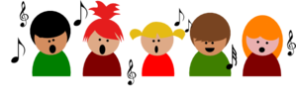
Phonetik [1/3]
Sag die Wörter. Ist die SSC [y] wie oder ?
lesen / sprechen
10
Sekunden
die City
die Hymne
das Baby
0
LOS!
Notes:
Timing: 1 minute (for three slides) Aim: Practise [y] SSC Procedure: 1. Chorally, students read out the words, paying attention to the two different pronunciations of [y]. 2. The timer is just to provide a clean start, and an approximate time to say 3 x words. 3. Click on either the word or the picture to hear the word pronounced. Note: as practised in the previous activity, although all these words are cognates or near-cognates with English, it is the initial or final [y] that is pronounced as in English.
Word frequency of unknown or cognate words (1 is the most frequent word in German):
City [2163] Hymne [>5009] Baby [2297] Source: Jones, R.L. & Tschirner, E. (2019). A frequency dictionary of German: core vocabulary for learners. Routledge

Slide 50
Phonetik [2/3]
Sag die Wörter. Wie schnell kannst du das? Ist die SSC [y] wie oder ?
lesen / sprechen
10
Sekunden
das Symbol
Yoga
olympisch
0
LOS!
Notes:
Word frequency of unknown or cognate words (1 is the most frequent word in German):
Symbol [2570] Yoga [>5009] olympisch [2469] Source: Jones, R.L. & Tschirner, E. (2019). A frequency dictionary of German: core vocabulary for learners. Routledge

Slide 51
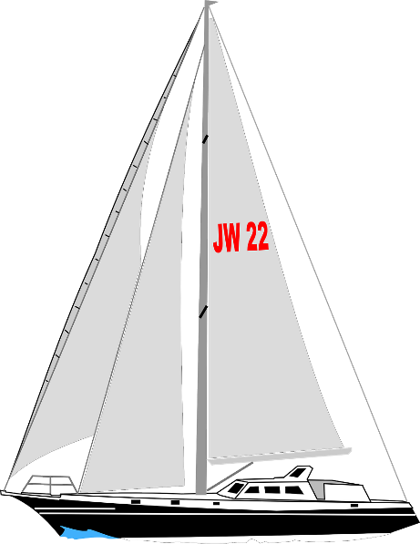
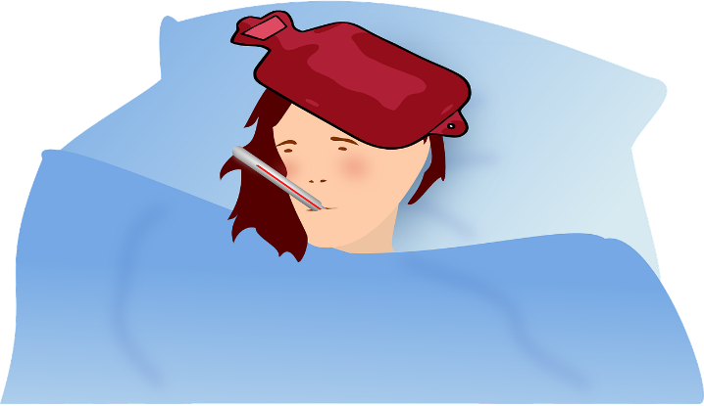
Phonetik [3/3]
Sag die Wörter. Wie schnell kannst du das? Ist die SSC [y] wie oder ?
lesen / sprechen
10
Sekunden
das Symptom
physikalisch
die Yacht
0
LOS!
Notes:
Word frequency of unknown or cognate words (1 is the most frequent word in German):
Symptom [2570] physikalisch [1164] Yacht [>5009] Source: Jones, R.L. & Tschirner, E. (2019). A frequency dictionary of German: core vocabulary for learners. Routledge

Slide 52
Phonetik [u], [ü], [y]
lesen / sprechen
Sag die Wörter. Wie schnell kannst du das?
Tür
du
ü
u
y
typisch
Punkt
fünf
u
ü
Notes:
Timing: 1 minute Aim: To reactivate SSC knowledge of long and short [u], [ü], and [y]. Procedure: 1. Click and elicit the SSC and the source word from students. 2. If required, the SSC and the picture can be clicked to hear the audio. 3. Give students 30 seconds to say the words as fast as they can, one after the other.

Slide 53
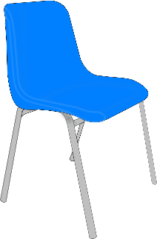
Phonetik [2/3]
Sag den Satz. Wie schnell kannst du das?
lesen / sprechen
10
Fünf Schüler dürfen über Pfützen hüpfen, dann müde auf fünf grünen Stühlen sitzen und fünf Schüsseln* süße Grütze* schlürfen.
1
2
Five pupils are allowed to hop over puddles, then sit, tired, on five green chairs, and slurp five bowls of sweet porridge.
3
Sekunden
die Schüssel – bowl die Grütze – porridge
0
LOS!
Notes:
Word frequency of unknown or cognate words (1 is the most frequent word in German):
Grütze [>5009] hüpfen [>5009] Pfütze [>5009] schlürfen [>5009] Schüssel [>5009] Stuhl [1661] süß [2796] Source: Jones, R.L. & Tschirner, E. (2019). A frequency dictionary of German: core vocabulary for learners. Routledge

Slide 54
Phonetik [3/3]
Sag den Satz. Wie schnell kannst du das?
lesen / sprechen
10
Ein Fuß zwei Füße
Ein Gruß zwei Grüße
Ein Fluss zwei Flüsse
Ein Schluss.
1
Hallo!
Hallo!
Hallo!
2
3
Sekunden
0
LOS!
Notes:
Word frequency of unknown or cognate words (1 is the most frequent word in German):
Fuß [573] Gruß [4722] Schluss [1030] Source: Jones, R.L. & Tschirner, E. (2019). A frequency dictionary of German: core vocabulary for learners. Routledge
Translation, in case needed: One/A foot, two feet One/A greeting, two greetings One/A river, two rivers An end.

Slide 55
Long and short [u]
Phonetik
Consolidation [7]
Y9 T3.1 Week 3 Slides 2; 21-22

Slide 56
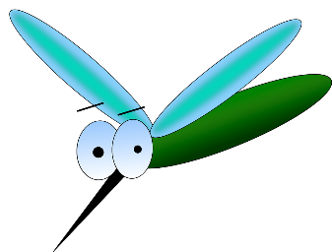
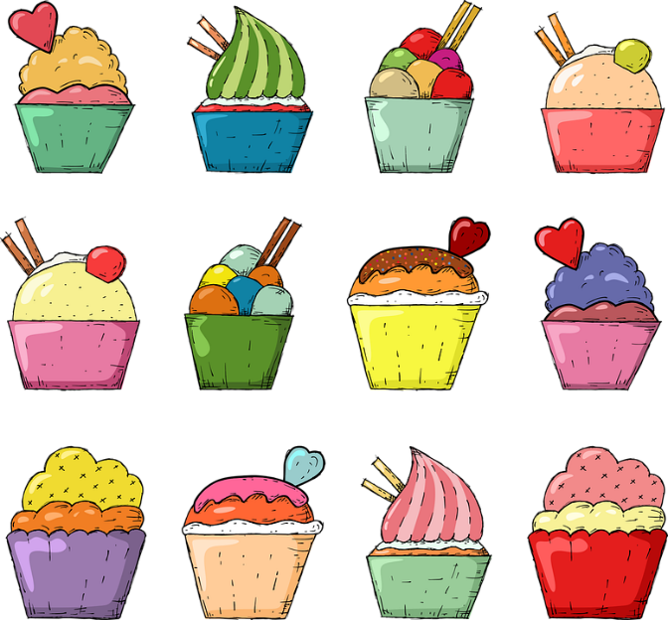
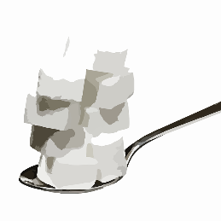
Phonetik
Zungenbrecher mit [u] und [ü]
hören / sprechen
Remember ! To say [ü] shape your mouth to say long ‘ee’ but round your lips to say ‘oo’.
Sag diese Sätze so schnell wie möglich.
*Mücken mögen müde Menschen, müde Menschen mögen Mücken meistens nicht.
1
(Edeltraud Rudatzki)
2
Süßer Zucker, kühle Butter, bunte Kuchen wirst du suchen.
*die Mücke – mosquito, midge
süß – sweet
Notes:
Timing: 5 minutes Aim: to practise spoken pronunciation of the [u] and [ü] sounds. Procedure: 1. Students listen to each other pronouncing these tongue twisters. They can make each other start again if they hear a wrong sound, so advise students not to start off too fast. They should say each one several times, improving speed and accuracy each time. (2 – 2.5 minutes)
2. Then swap roles (2 – 2.5 minutes).
3. Click to hear each one spoken by a native speaker.
Transcript: Mücken mögen müde Menschen, müde Menschen mögen Mücken meistens nicht.
Süßer Zucker, kühle Butter, bunte Kuchen wirst du suchen.
Word frequency (1 is the most frequent word in German):
Butter [4960] kühl [2730] Mücke [>5009] Zucker {2559] Source: Jones, R.L. & Tschirner, E. (2019). A frequency dictionary of German: core vocabulary for learners. Routledge

Slide 57
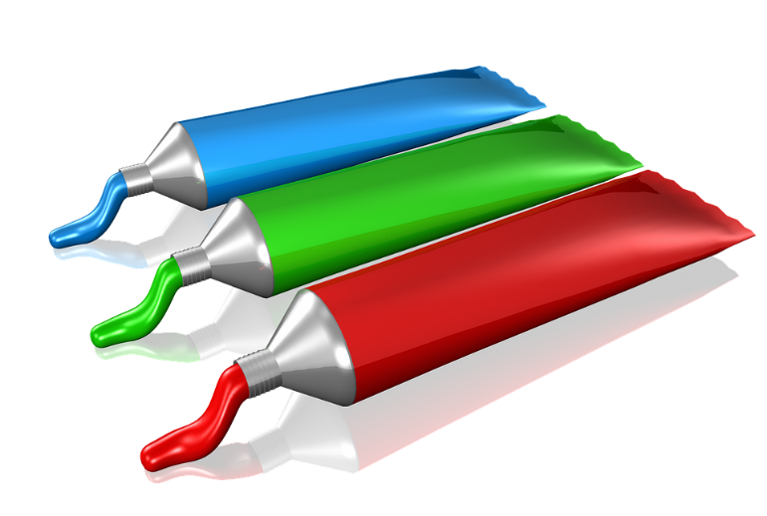
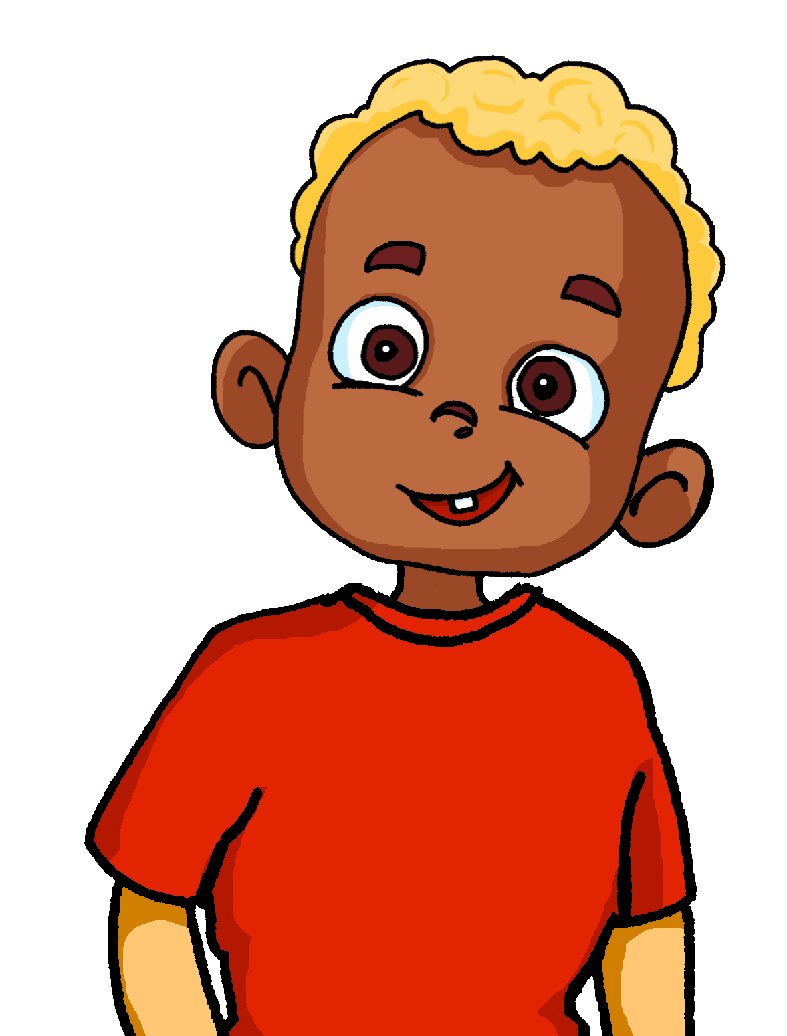
Phonetik 1/2
Heidi bemalt die Wände im Zimmer von ihrem kleinen Bruder. Er will immer eins mehr als sie! Person A ist Heidi, Person B der Bruder.
lesen / sprechen
60
1. Ein Zug?
1. Zwei Züge!
2. Ein Stuhl?
2. Zwei Stühle!
Sekunden
3. Ein Buch?
3. Zwei Bücher!
6. Eine Nuss?
6. Zwei Nüsse!
4. Ein Fluss?
4. Zwei Flüsse!
7. Ein Kuss?
7. Zwei Küsse!
5. Ein Sturm?
5. Zwei Stürme!
8. Ein Turm?
8. Zwei Türme!
0
LOS!
Notes:
Timing: 10 minutes (two slides) Aim: to practise oral production of [u] and [ü] sounds in a set of mostly unfamiliar singular and plural nouns. Procedure: 1. Ensure students understand that Heidi is painting her younger brother’s walls with pictures. She makes a suggestion but he always wants two of what she suggests.
2. Remind students that many masculine and neuter nouns (and a few feminine nouns) form their plurals by adding –e and an umlaut over the vowel.
3. Student A is Heidi and makes the singular noun suggestions. Student B is the brother who replies ‘two XXX’! to each suggestion.
4. Click to start timer.
5. Move to the next slide and swap roles.
Word frequency (1 is the most frequent word in German):
Kuss [>5009] Nuss [>5009] Sturm [2913] Turm [3118] Source: Jones, R.L. & Tschirner, E. (2019). A frequency dictionary of German: core vocabulary for learners. Routledge

Slide 58
Phonetik 2/2
lesen / sprechen
Tauscht die Rollen.
60
1. Eine Wurst?
1. Zwei Würste!
2. Ein Hut?
2. Zwei Hüte!
6. Eine Kuh?
6. Zwei Kühe!
Sekunden
3. Eine Frucht?
3. Zwei Früchte!
7. Ein Fuß?
7. Zwei Füße!
4. Ein Fuchs?
4. zwei Füchse!
8. Eine Schnur?
6. Zwei Schnüre!
5. Ein Wunsch?
5. Zwei Wünsche!
0
LOS!
Notes:
Word frequency (1 is the most frequent word in German):
Frucht [3323] Fuchs [>5009] Fuß [573] Kuh [2935] Schnur [>5009] Wunsch [1072] Wurst [3923] Source: Jones, R.L. & Tschirner, E. (2019). A frequency dictionary of German: core vocabulary for learners. Routledge

