Slide 1
German phonics collection
[sch]
Artwork: Steve Clarke
Date updated: 24 / 07 / 21
Notes:
Artwork by Steve Clarke. All additional pictures selected are available under a Creative Commons license, no attribution required.

Slide 2
[sch]
Phonetik
Introduction
Y7 T1.2 Week 3 Slides 2-7; 31-32

Slide 3
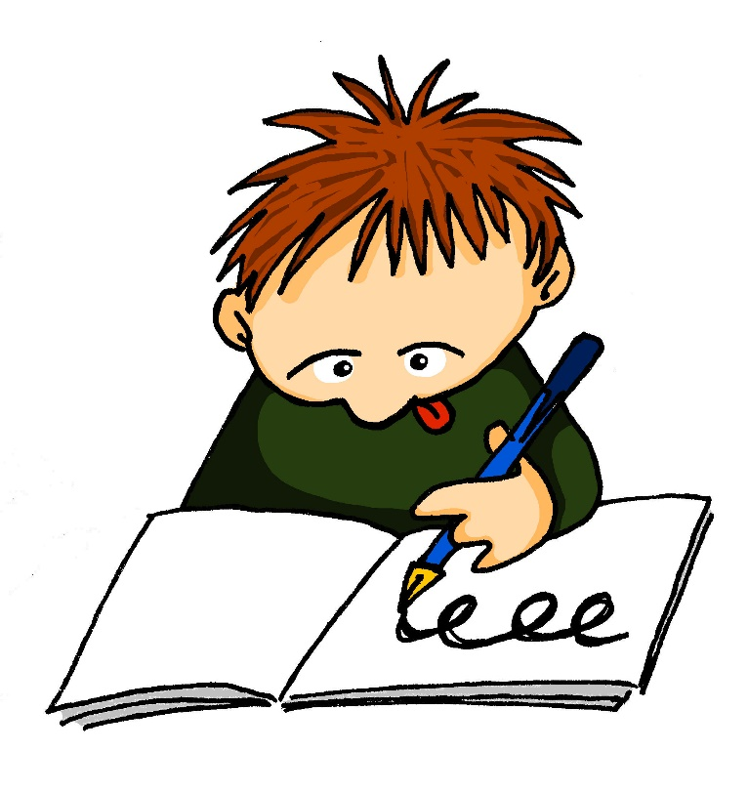
sch
schreiben
Notes:
Timing: 1 minute
Aim: To introduce/consolidate SSC [sch]
Procedure: 1. Present the letter(s) and say the [sch] sound first, on its own. Students repeat it with you. 2. Bring up the word ”schreiben” on its own, say it, students repeat it, so that they have the opportunity to focus all of their attention on the connection between the written word and its sound.
3. A possible gesture for this would be to mime writing.
4. Roll back the animations and work through 1-3 again, but this time, dropping your voice completely to listen carefully to the students saying the [sch] sound, pronouncing ”schreiben” and, if using, doing the gesture. Word frequency (1 is the most frequent word in German):
schreiben [245] Source: Jones, R.L. & Tschirner, E. (2006). A frequency dictionary of German: core vocabulary for learners. Routledge

Slide 4
sch
schreiben
Notes:
With sound and no pictures to focus all attention on the sound-symbol correspondence.

Slide 5
sch
schreiben
Notes:
Without sound to elicit pronunciation (without first hearing the teacher).
Teacher to elicit pronunciation by asking “Wie sagt man…”

Slide 6
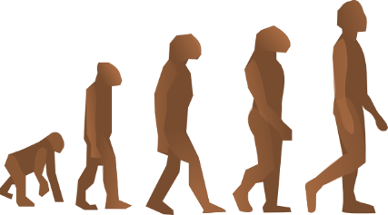
sch
falsch
schnell
[fast]
schreiben
schwarz
zwischen
Mensch
Notes:
Timing: 2 minutes
Aim: To introduce/consolidate SSC [sch]
Procedure:
Introduce and elicit the pronunciation of the individual SSC [sch] and then the source word again ‘schreiben’ (with gesture, if using).
Then present and elicit the pronunciation of the five cluster words.
The cluster words have been chosen for their high-frequency, from a range of word classes, with the SSC (where possible) positioned within a variety of syllables within the words (e.g. initial, 2nd, final etc.). Additionally, we have tried to use words that build cumulatively on previously taught SSCs (see the Phonics Teaching Sequence document) and do not include new SSCs. Where new SSCs are used, they are often consonants which have a similar symbol-sound correspondence in English.
Word frequency (1 is the most frequent word in German): schreiben [245]; falsch [638] schnell [233]; zwischen [115]; Mensch [104]; schwarz [451]. Source: Jones, R.L. & Tschirner, E. (2006). A frequency dictionary of German: core vocabulary for learners. Routledge

Slide 7
sch
falsch
schnell
schreiben
schwarz
zwischen
Mensch
Notes:
With sound and no pictures to focus all attention on the sound-symbol correspondence.

Slide 8
sch
falsch
schnell
schreiben
schwarz
zwischen
Mensch
Notes:
Without sound to elicit pronunciation (without first hearing the teacher).
Teacher to elicit pronunciation by asking “Wie sagt man…”

Slide 9
Zungenbrecher!
Phonetik
Sieben spanische Spinnen schauen ein spanisches Fußballspiel an!
1
2
3
4
Notes:
Timing: 2 minutes
Aim: This tongue twister offers practice of this week’s SSCs in a full sentence. It consists of previously encountered vocabulary with the exception of schauen [470] to look (at) and Spinne [>4037] which will need to be translated for students.
Procedure:
1. Recordings of the tongue twister said at various speeds play on clicking numbers 1 (slow) to 4 (very fast). All students should start by listening and repeating recording 1. Higher level students may enjoy the challenge of trying the faster versions.
English translation: Seven Spanish spiders are watching a Spanish football match. Word frequency (1 is the most frequent word in German):
sieben [570], spanisch [1865], Spinne [>4037] anschauen [1271], schauen [470], Fußball [1497], Spiel [500]
Source: Jones, R.L & Tschirner, E. (2019). A frequency dictionary of German: Core vocabulary for learners. London: Routledge.

Slide 10
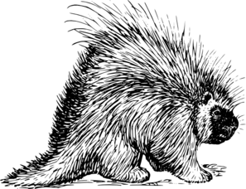
Zungenbrecher!
Phonetik
Ein Stachelschwein, ein Stachelschwein,
das muss ein Schwein mit Stacheln sein!
1
2
3
4
Notes:
Timing: 2 minutes
Aim: This tongue twister offers practice of the SSCs [sch] and [st-] in a full sentence.
Procedure:
1. Recordings of the tongue twister said at various speeds play on clicking numbers 1 (slow) to 4 (very fast). All students should start by listening and repeating recording 1. Higher level students may enjoy the challenge of trying the faster versions.
English translation: a porcupine, a porcupine, that must be a pig with spines!
Word frequency (1 is the most frequent word in German):
Schwein [4009], Stachel [>4037], müssen [45], mit [13], sein [3]
Source: Jones, R.L & Tschirner, E. (2019). A frequency dictionary of German: Core vocabulary for learners. London: Routledge.

Slide 11
[sch]
Phonetik
Consolidation [1]
Y7 T3.1 Week 2 Slide 4

Slide 12
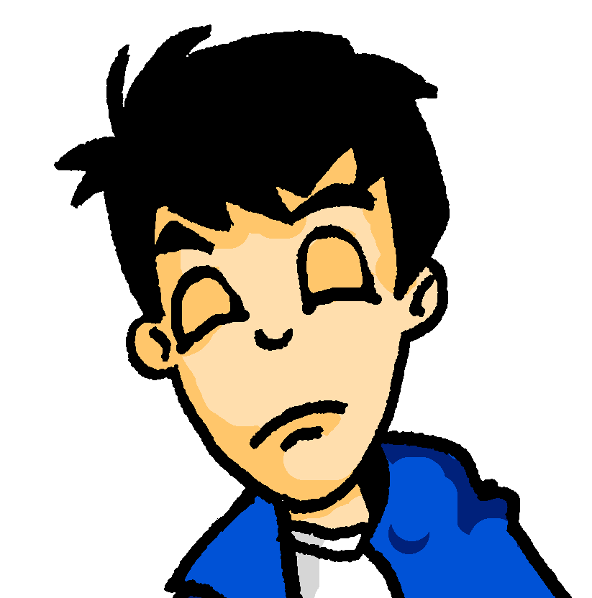
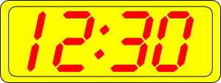
Samstagnachmittag
lesen / hören
Es ist Samstagnachmittag und Wolfgang schläft. Er träumt von …
Kirschen
Kirchen
1
Notes:
In slides 4-11, students encounter a range of known SSCs contrasted in minimal pairs. By correctly identifying the word they hear, they complete the story of Wolfgang and Heidi’s very different Saturday afternoons. The activity aims to show how a single SSC can change the meaning of a full sentence! Point out to students how differently the story would unfold if they had heard the other SSC instead!
The following SSCs are revisited in this activity: [sch], [ch], short [i], short [e], [ei], [ie], [ü], [u], [äu], [v] and [w].
Students are also encouraged to write short summaries of each slide in English. A range of vocabulary and key grammar points from across terms 1 and 2 are revisited.
Procedure for each slide:
1/ Teacher clicks on the loudspeaker to play the audio.
2/ Students hear one of the options and circle a) or b) to complete the sentence.
3/ Students write a one sentence summary in English (at more advanced levels, the teacher might wish to ask for the summary in German).
4/ The answer is revealed on a click.
5/ Teacher elicits example translations from one or two students.
6/ Teacher elicits oral pronunciation of the other word using “Wie sagt man …” to create the alternative scenario!
Here, SSCs [ch] and [sch] are contrasted.
Teacher to draw attention to compound ‘Samstagnachmittag’ and help students break it down.
Students have encountered träumen [1907] as an SSC cluster word, but not as a vocabulary item. Teacher to remind students of its meaning. Students have not yet met preposition von [11]. Teacher to explain its use here to of mean of.
Frequencies of unknown vocabulary: Kirsche [4034]
Transcript
Kirschen

Slide 13
[sch]
Phonetik
Consolidation [2]
Y7 T3.1 Week 3 Slides 34-35

Slide 14
SCH oder ST?
hören / schreiben
Schulfach
streng
1
6
stehen
Geschenk
2
7
Stück
Deutsch
3
8
schreiben
Gutschein
4
9
Fleisch
Kunst
5
10
Notes:
To challenge students further, ask them to turn away from the board to complete the task and write the whole word independently. This allows for differentiation through more/less support. If the whole class is high attaining, then the prompts can be removed from the slide, of course. Teachers should elicit meanings to confirm vocabulary knowledge. They should also point out that the –st in Kunst is pronounced as in English, to reinforce the fact that it is only a ‘sht’ sound at the beginning of word.
Frequency rankings of vocabulary featured (1 is the most common word in German):
das Schulfach [208/698] 2.1.3
stehen [87] 1.2.5
das Stück [417] 1.2.6
schreiben [245] 1.2.1
das Fleisch [1624] 2.2.4
streng [1224] 2.1.4
das Geschenk [2610] 2.1.1
das Deutsch [105] 2.1.3
der Gutschein [78/3025] 2.1.1
die Kunst [468] 2.1.3

Slide 15
SCH oder ST?
hören / schreiben
Schulfach
streng
1
6
stehen
Geschenk
2
7
Stück
Deutsch
3
8
schreiben
Gutschein
4
9
Fleisch
Kunst
5
10
Notes:
Same task, but answers appear as a whole word, rather than just the target graphemes. Teachers should elicit meanings to confirm vocabulary knowledge. They should also point out that the –st in Kunst is pronounced as in English, to reinforce the fact that it is only a ‘sht’ sound at the beginning of word.
Frequency rankings of vocabulary featured (1 is the most common word in German):
das Schulfach [208/698] 2.1.3
stehen [87] 1.2.5
das Stück [417] 1.2.6
schreiben [245] 1.2.1
das Fleisch [1624] 2.2.4
streng [1224] 2.1.4
das Geschenk [2610] 2.1.1
das Deutsch [105] 2.1.3
der Gutschein [78/3025] 2.1.1
die Kunst [468] 2.1.3

Slide 16
[sch]
Phonetik
Consolidation [3]
Y7 T3.2 Week 4 Slides 2-3

Slide 17
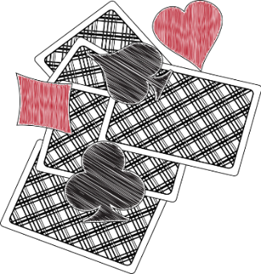
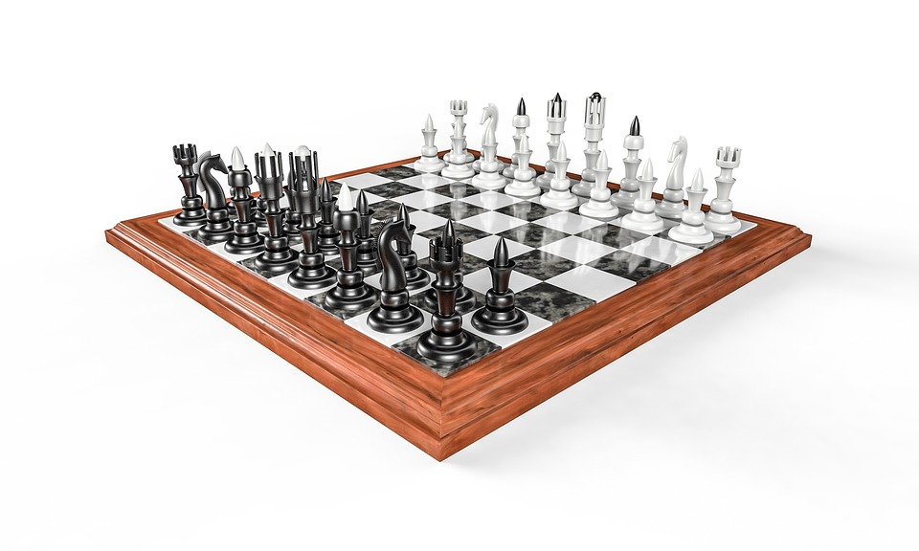
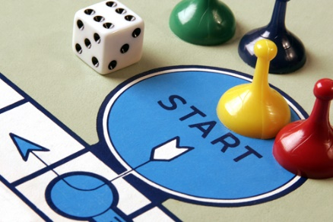
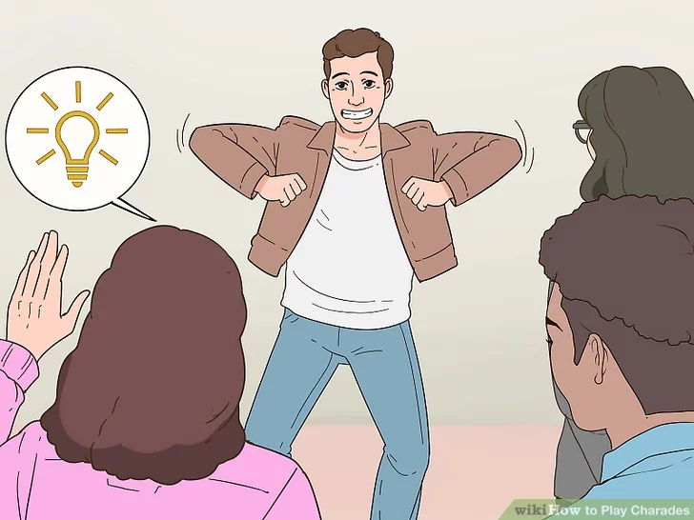
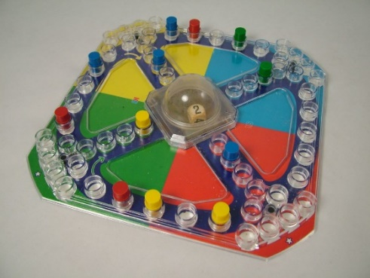
Phonetik
hören
5
Kein Stich
1
das Schach
6
das Brettspiel
2
Stadt – Land - Fluss
7
die Scharade
3
Spitzeln
4
Mensch ärgere
Dich nicht
8
Schere-Stein-Papier
Notes:
Timing: 5 minutes
Aim: This phonics listening / writing activity revisits the SSCs [sch], [sp], and [st]. The activity uses the names of common games to practise.
Cultural interest: Germany has a long history of game creation. Two famous and popular games were invented by Germans. Klaus Teuber created Die Siedler von Catan (1995) and Josef Friedrich Schmidt created Mensch ärgere dich nicht. Can students guess how old the game is? (It dates from 1907).
Procedure:
Click for the first picture and the gapped word.
Listen to the word (sound will play on clicking the number).
Write in the missing SSC.
Check the answer.
Repeat for numbers 2-8.
Transcript:
1. das Schach
2. Stadt – Land – Fluss
3. spitzeln
4. Mensch ärgere Dich nicht
5. Kein Stich
6. das Brettspiel
7. die Scharade
8. Schere – Stein – Papier
Word frequency (1 is the most frequent word in German):
Schach [>5009] spitzeln [>5009] ärgern [2841] Stich [4382] Brettspiel [>5009] Scharade [>5009] Schere [>5009] Stein [1181] Papier [1163]
Source: Jones, R.L & Tschirner, E. (2019). A frequency dictionary of German: Core vocabulary for learners. London: Routledge.

Slide 18
Phonetik
sprechen
1
Gesellschaftsspiele wie Mensch-ärgere-Dich-nicht machen Spaß*.
2
Bei Scharaden darf man nicht sprechen und auch nicht schreiben.
3
Meine Geschwister spielen Schere-Stein-Papier.
4
Seine Schwester versteht Sport ganz gut.
5
Schachfiguren sind schwarz und weiß und sehr schön.
6
Die Mitspieler sind bestimmt* schnell und stark.
*Spaß machen - to be fun *bestimmt - certainly
Notes:
Timing: 5 minutes
Aim: This phonics reading / speaking activity revisits the SSCs [sch], [sp], and [st]. The names of some of the games on the previous slide and some SSC cluster words are used in a sentence to practise production of the target SSCs.
Note: the glossed vocabulary will be explicitly taught in Y8.
Procedure:
Students read the sentences out loud (to each other).
Either bring up the sentences one by one, or alternatively all at once to allow pairs to work at their own speed.
Click on buttons to hear the spoken sentences.
Word frequency (1 is the most frequent word in German):
Schach [>5009] ärgern [2841] Scharade [>5009] Schere [>5009] Stein [1181] Papier [1163] Spaß [666] bestimmt [226] Source: Jones, R.L & Tschirner, E. (2019). A frequency dictionary of German: Core vocabulary for learners. London: Routledge.

Slide 19
[sch]
Phonetik
Consolidation [4]
Y7 T3.2 Week 6 Slides 3; 20

Slide 20
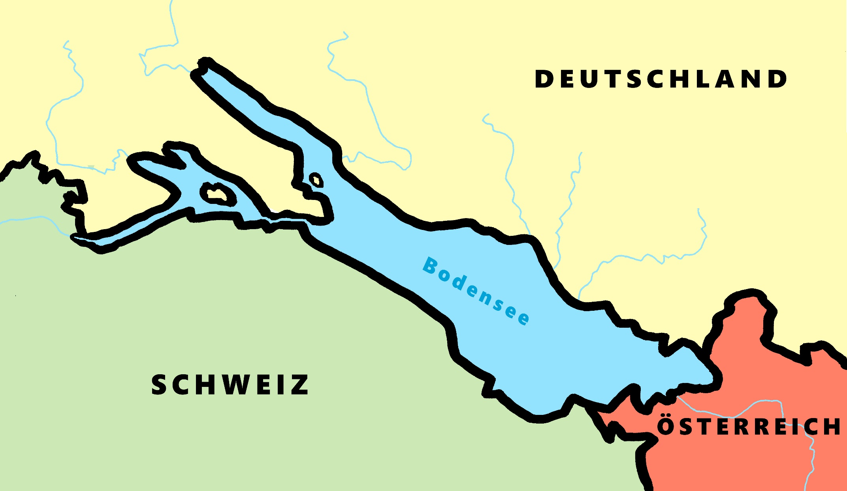
Phonetik - der Bodensee [1/2]
lesen / sprechen
9
Ludwigshafen
1
2
Friedrichshafen
Stein am Rhein
6
Konstanz
8
7
Reichenau
5
Altnau
3
Bregenz
4
Rorschach
Notes:
Phonetik [2]
Time: 5 minutes Aim: To practise reading aloud / saying 10 previously taught SSC, in unknown words (apart from Deutschland, which starts the task off). Here, 9 additional towns on the Bodensee are used.
Procedure: 1. Students work in pairs to pronounce each of the towns. 2. Click number to hear and check pronunciation. SSC revisited here: [eu] [st-] [z] [ch-hard] [w] [au] [ie] [ch-soft] [ei] [r] [sch] Transcript: 1 Deutschland 2 Friedrichshafen 3 Bregenz 4 Rorschach 5 Altnau 6 Konstanz 7 Reichenau 8 Stein am Rhein 9 Ludwigshafen

Slide 21
Wie heißt die Band?
Phonetik
Alastair telefoniert mit Mia. Sie reden über deutsche Bands. Wie heißen sie?
 | die P r i n z e n
 | J u l i
 | F e t t e s B r o t
 | die F a n t a s t i s c h e n V i e r
 | S ö h n e M a n n h e i m s
 | S p o r t f r e u n d e S t i l l e r
 | R o s e n s t o l z
 | die Ä r t z e
1
_
2
_
3
_
_
4
_
_
_
_
_
5
_
_
_
6
_
_
_
_
7
_
_
8
_
_
Notes:
Phonetik [1] Time: 5 minutes
Aim: To practise recognising and transcribing 14 previously taught SSC, in unknown words.
Note: These are real German band names.
Procedure: 1. Click number to hear the full word. Students listen and transcribe only the missing letters. 2. Animations support item-by-item checking, as instant feedback on each SSC may be particularly helpful for students’ learning. SSC revisited here: [z] [j] [r-consonantal] [o-long] [sch] [v] [r-vocalic] [ö-long] [ei] [st] [-er] [st] [ä] [-e]
Transcript: [1] die Prinzen
[2] Juli
[3] Fettes Brot
[4] die Fantastischen Vier
[5] Söhne Mannheims
[6] Sportfreunde Stiller
[7] Rosenstolz
[8] die Ärzte

Slide 22
[sch]
Phonetik
Consolidation [5]
Y8 T1.1Week 2 Slides 2-9

Slide 23
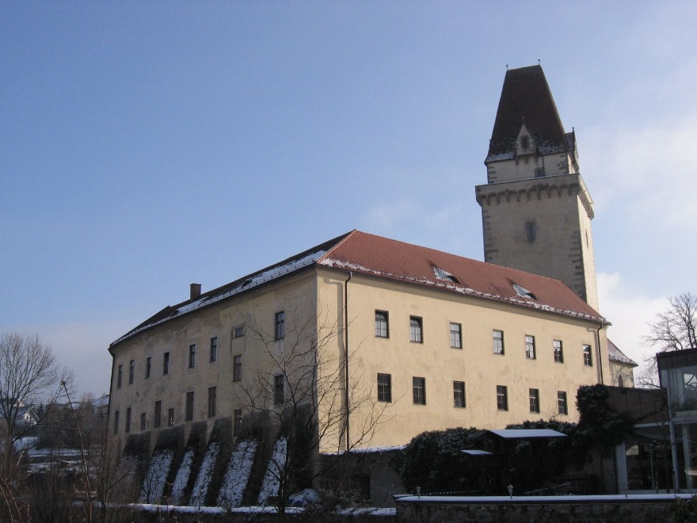
sch, st-, sp- : wie viele hörst du?
hören
1
Freistadt hat ein Schloss.
sch- | st- | sp-
Photo licensed under Creative Commons Author: Hjanko
Notes:
Timing (phonics slides)
10 minutes
Aim
Practice in recognising the following SSCs: sch-; st- ; sp-.
Suggested procedure
1. Click on the audio button to play the sentence. Students tally the SSCs as per the table on the slide. They may do this in their exercise books.
2. Click again on the mouse to make the animated answers appear.
Transcript
1. Freistadt hat ein Schloss.

Slide 24
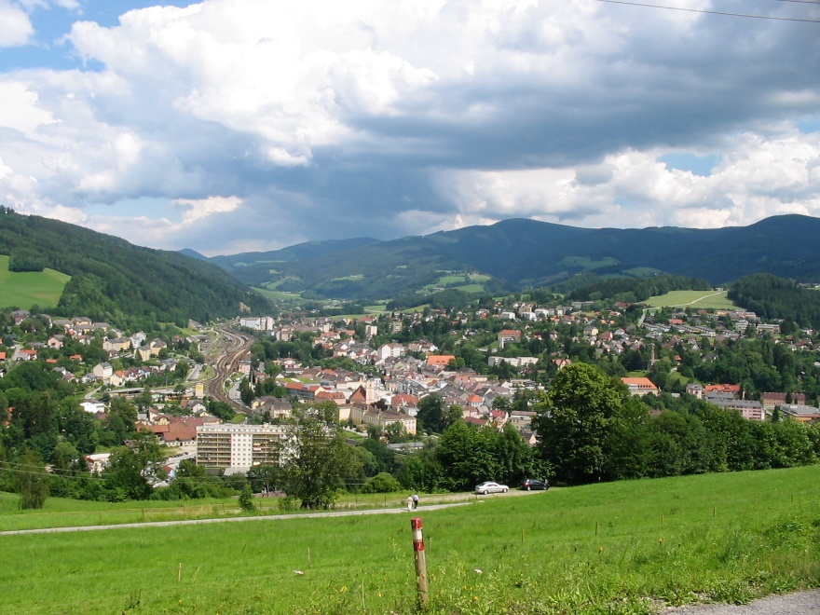
sch, st-, sp- : wie viele hörst du?
hören
2
Mürzzuschlag hat ein Wintersportmuseum.
sch- | st- | sp-
Photo licensed under Creative Commons Author: Mikegr
Notes:
Transcript
2. Mürzzuschlag hat ein Wintersportmuseum.

Slide 25
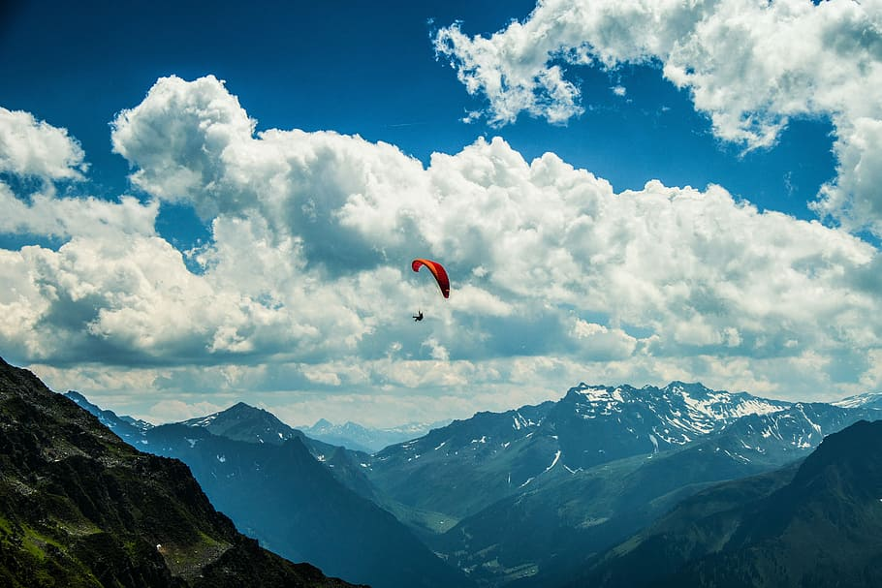
sch, st-, sp- : wie viele hörst du?
hören
3
In Schruns kann man viel Sport machen.
sch- | st- | sp-
Notes:
Transcript
3. In Schruns kann man viel Sport machen.

Slide 26
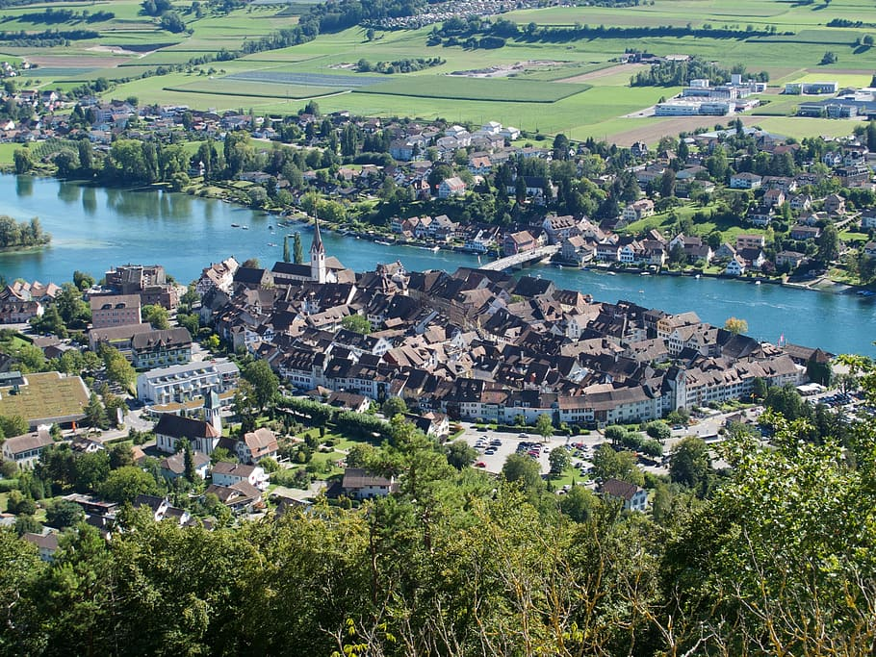
sch, st-, sp- : wie viele hörst du?
hören
4
Stein am Rhein ist historisch.
sch- | st- | sp-
Notes:
Transcript
4. Stein am Rhein ist historisch.

Slide 27
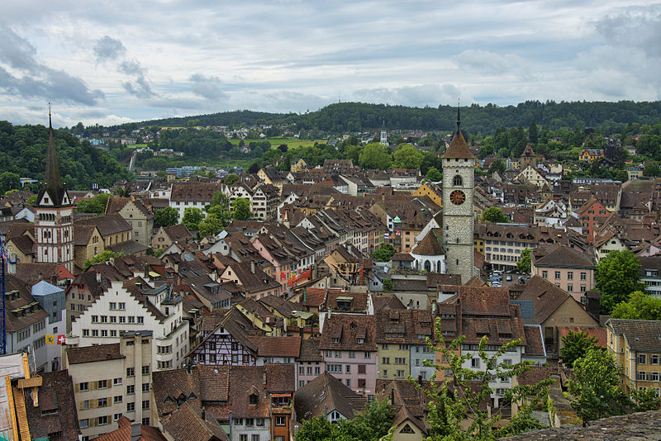
sch, st-, sp- : wie viele hörst du?
hören
5
Schaffhausen ist sehr schön!
sch- | st- | sp-
Photo licensed under Creative Commons Author: chensiyuan
Notes:
Transcript
5. Schaffhausen ist sehr schön!

Slide 28
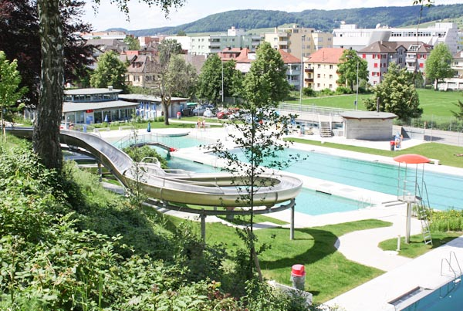
sch, st-, sp- : wie viele hörst du?
hören
6
Schlieren hat ein Schwimmbad.
sch- | st- | sp-
Notes:
Transcript
6. Schlieren hat ein Schwimmbad.

Slide 29
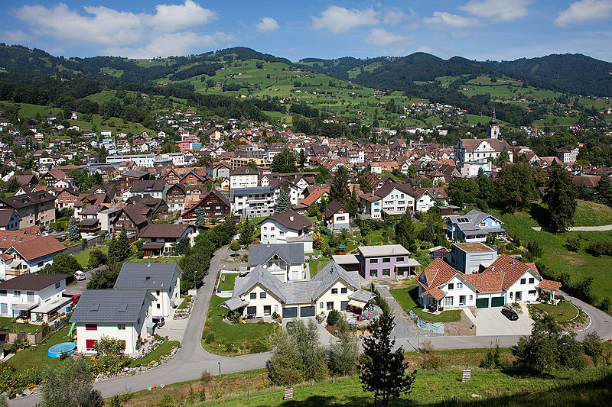
sch, st-, sp- : wie viele hörst du?
hören
7
In Altstätten spricht man Deutsch.
sch- | st- | sp-
Photo licensed under Creative Commonsm Author: Roland Zumbuehl
Notes:
Transcript
7. In Altstätten spricht man Deutsch.

Slide 30
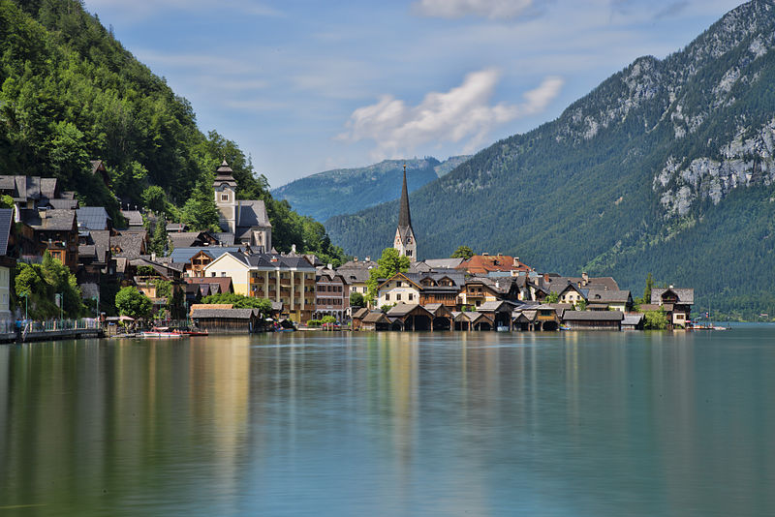
sch, st-, sp- : wie viele hörst du?
hören
8
Hallstatt is sehr touristisch.
sch- | st- | sp-
Photo licensed under Creative Commons Author: chensiyuan
Notes:
Transcript
8. Hallstatt is sehr touristisch.

Slide 31
[sch]
Phonetik
Consolidation [6]
Y8 T2.1Week 6 Slides 4-5; 17

Slide 32
Phonetik [1/2]
lesen / sprechen
Partner/Partnerin A sagt die Wörter mit [-ich]. Partner/Partnerin B sagt die Wörter mit [-isch].
12
wirklich | sportlich | musikalisch | monatlich | praktisch | historisch | kritisch
1
Partner/Partnerin A sagt die Wörter mit [-isch]. Partner/Partnerin B sagt die Wörter mit [-ich].
politisch | technisch | komisch | glücklich | ähnlich | katholisch | wöchentlich
2
0
LOS!
Notes:
Timing: 3 minutes (2 slides)
Aim: Oral production of [-ich] and [-isch] adjectives. A mixture of near-cognates and previously taught words is used. The addition of a time constraint prompts students to increase their speed of oral production.
Procedure:
1. Students partner up and label themselves A and B.
2. They then treat the table row as a script but have to say words in tandem, A saying [-ich] words and B saying [-isch] words.
3. Click 12-second timer to start round 1.
4. Click action button to hear native audio for comparison.
6. Clarify meaning of the cognate words.
Word frequency (1 is the most frequent word in German): All words are in the top 2000. Source: Jones, R.L. & Tschirner, E. (2019). A frequency dictionary of German: core vocabulary for learners. Routledge

Slide 33
Phonetik [2/2]
The audio has the Austrian pronunciation of ‘chemisch’. How would a German typically say it?
lesen / sprechen
8
Partner/Partnerin A sagt alle Wörter. Partner/Partnerin B hört ihm/ihr zu.
elektrisch | biologisch | möglich | jährlich | demokratisch | natürlich | chemisch
1
Partner/Partnerin B sagt alle Wörter. Partner/Partnerin A hört ihm/ihr zu.
russisch | täglich | amerikanisch | plötzlich | freundlich | statistisch | literarisch
2
0
LOS!
Notes:
Procedure:
1. This time, Partner A says all the words in their row (1). The timer is set for 8 seconds.
2. The listening student (Partner B) notes any pronunciation errors and gives their partner a score out of 7.
3. Click for Round 2, where students swap roles: B says all the words in their row while A listens and gives a score.

Slide 34
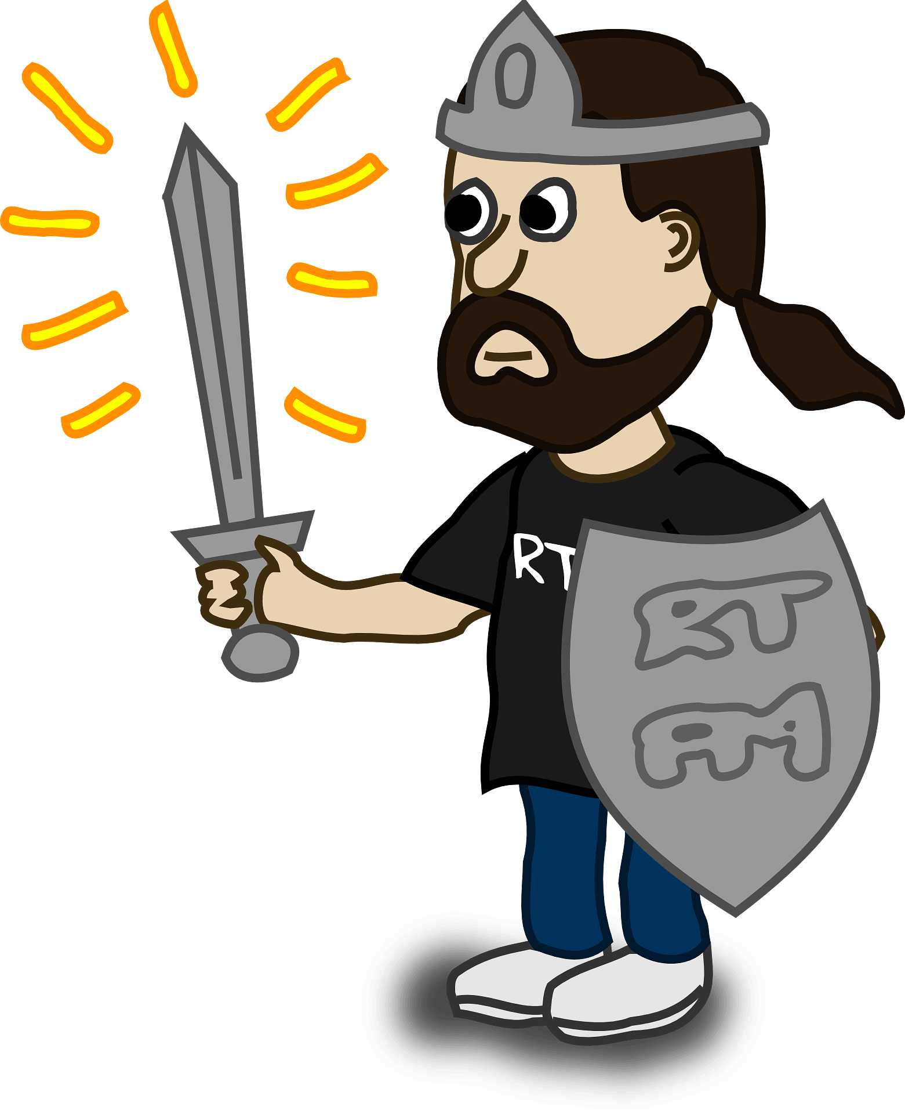
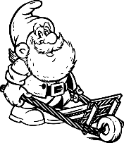
Phonetik
hören / schreiben
Hör zu. Schreib zw- oder schw-
ə
[indeed]
1
schwingen
4
Schwa
zwar
zwingen
____
_____
_____
____
[to force]
[to wield]
[schwa]
[indeed]
2
schwang
5
Schwert
Zwang
____
Zwerg
____
____
____
[swung]
[dwarf]
[sword]
[force/coercion]
3
Schwenken
6
Zwenken
zweifeln
____
____
schweifen
_____
_____
[type of grass]
[pivoting]
[to ramble]
[to doubt]
Notes:
Attributions: To force: Abu badali, based on public domain Aiga’s icons / CC BY-SA
Timing: 5 minutes Aim: to practise differentiating the SSC [zw-] and [schw-], first by transcribing correctly, then by indicating which SSC is said and heard, under increasing time pressure.
Procedure: 1. Students listen and write each SSC correctly (or the full word each time, if preferred)
2. Check answers, using animations.
3. Teacher says one of each pair again, and students lift right or left arm up, to show recognition.
4. Speed of input and responses can be increased to speed up processing.
Transcript: 1. zwingen, schwingen 2. Zwang, schwang
3. Zwenken, schwenken
4. schwa, zwar
5. Zwerg, Schwert
6. schweifen, zweifeln Word frequency (1 is the most frequent word in German): zwingen [1212] schwingen [3130] Zwang [3902] schwang [3130] zwenken [>5009] schwenken [>5009] schwa [>5009] zwar [206] Zwerg [4318] Schwert [>5009] schweifen [>5009] zweifeln [4149] Source: Jones, R.L. & Tschirner, E. (2019). A frequency dictionary of German: core vocabulary for learners. Routledge

Slide 35
[sch]
Phonetik
Consolidation [6]
Y8 T2.2 Week 3 Slides 2; 15; 16

Slide 36
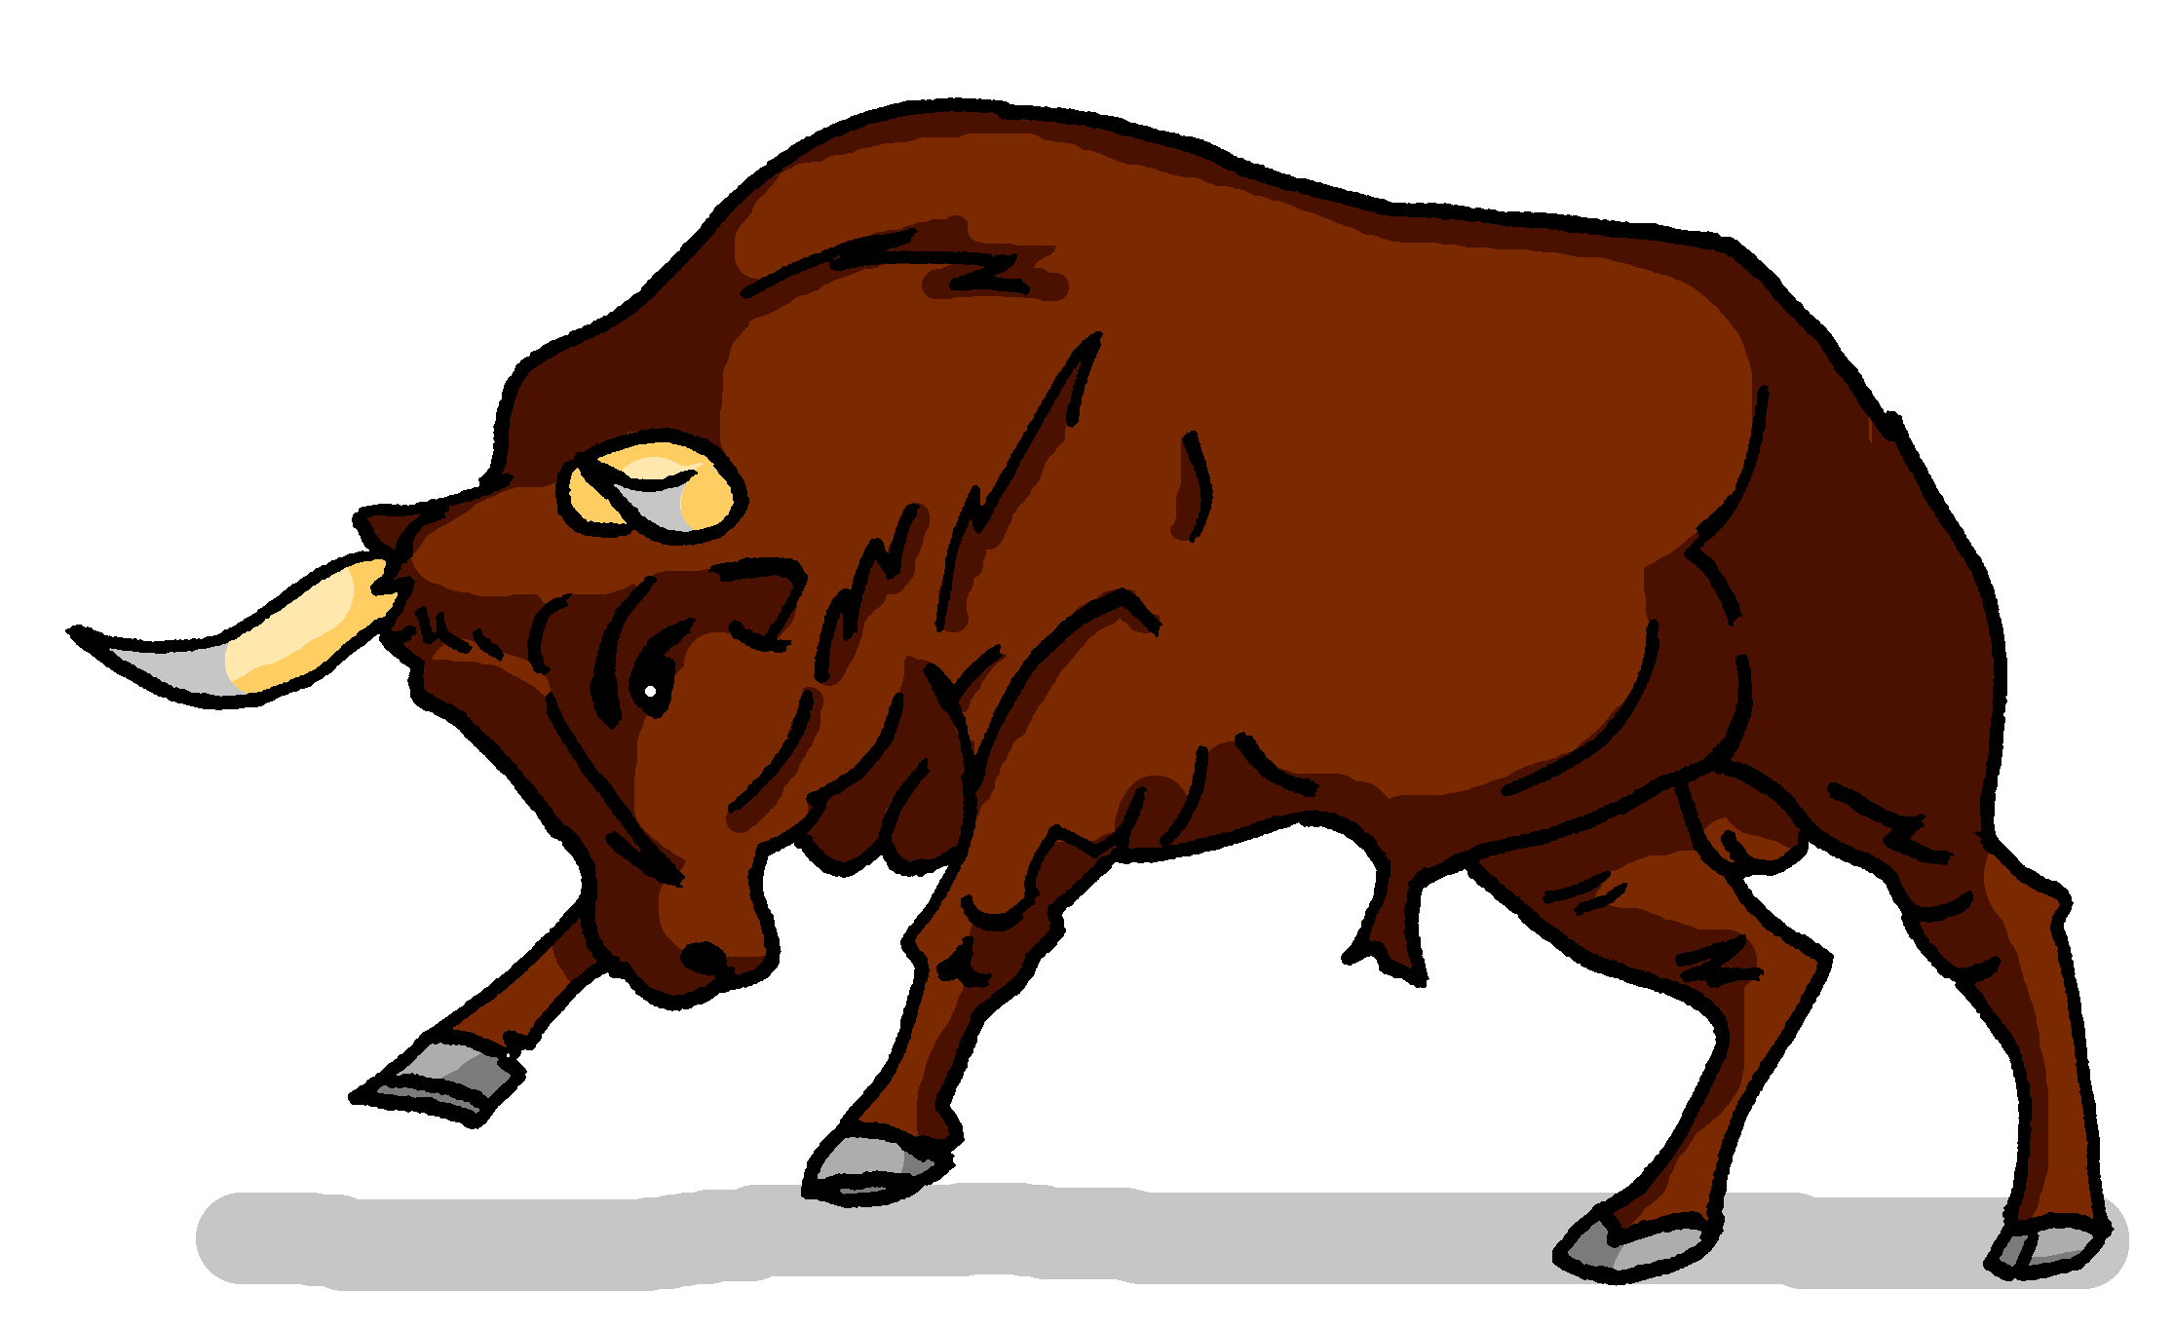
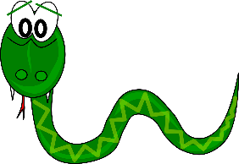
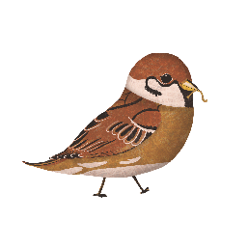
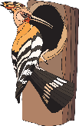
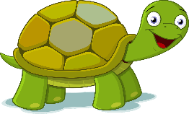
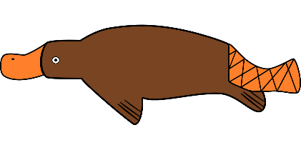
Phonetik
hören / schreiben
At the start of words, German [sp-] and [st-] are pronounced ‘schp-’ and ‘scht-’. [sch] is always pronounced ‘sh’.
Hör zu. Was fehlt? Schreib [sch], [sp-] oder [st-].
1 | 2 | 3
4 | 5 | 6
7 | 8 | 9
1
2
3
__
__
__
Schnecke
Stier
Schlange
4
5
6
__
__
__
Specht
Stinktier
Spatz
7
8
9
__
__
__
__
Schildkröte
Schnabeltier
Stachel sch wein
Notes:
Timing: 5 minutes Aim: To revisit and consolidate [sch], [sp], and [st]. Students listen out for and spell the SSCs Procedure: 1. Click the action buttons to play a word.
2. For each item write the sound that fills the gap.
3. Click to reveal and check answers.
Transcript: Schnecke, Stier, Schlange, Specht, Stinktier, Spatz , Schildkröte, Schnabeltier, Stachelschwein Word frequency (1 is the most frequent word in German): Schnecke [>5009] , Stier [>5009], Schlange [3601], Specht [4900], Stinktier [>5009], Spatz [>5009], Schildkröte [>5009], Schnabeltier [>5009], Stachelschwein [>5009]
Source: Jones, R.L. & Tschirner, E. (2019). A frequency dictionary of German: core vocabulary for learners. Routledge

Slide 37
Phonetik
lesen / hören
A
B
1. Er sieht viele Männchen.
1. Er sieht viele Menschen.
2. Ich habe das schon gemacht.
2. Ich habe das schön gemacht.
3. Sie hat die Kirsche fotografiert.
3. Sie hat die Kirche fotografiert.
4. Waschen ist schneller als Wachsen.
4. Wachsen ist schneller als Waschen.
5. Schälen oder schellen?
5. Schellen oder schälen?
6. Zeichnen ist besser als Zeigen.
6. Zeigen ist besser als Zeichnen.
das Männchen – little man die Kirsche – cherry
waschen – to wash wachsen – to grow
schälen – to peel schellen – to ring
zeichnen – to draw
Notes:
Timing: 5 minutes Aim: To practise this week’s SSCs in a sentence context. The format encourages attention to both pronunciation and listening. Procedure: 1. Students work in pairs.
2. Student says both versions of the sentence. 3. Their partner writes down in which order the sentences were said.
4. They take turns speaking and listening, so each student says three sentences. 5. Click each sentence to hear it pronounced.
Word frequency of unknown words (1 is the most frequent word in German):
Männchen [>5009] Kirsche [>5009] waschen [2315] wachsen [470] schälen [>5009] schellen [>5009] zeichnen [1259] Source: Jones, R.L & Tschirner, E. (2019). A frequency dictionary of German: Core vocabulary for learners. London: Routledge.

Slide 38
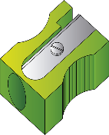
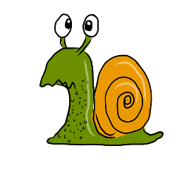
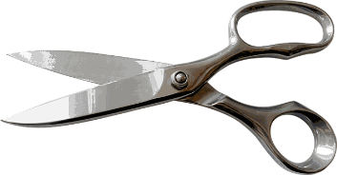
Phonetik
lesen / sprechen
20
Mein Spitzer spitzt Stifte spielend spitz.
1
My sharpener sharpens pencils effortlessly sharp.
Schnecken erschrecken, wenn sie an Schnecken schlecken.
2
Sekunden
Snails are startled, when they lick snails.
Schneiders Schere schneidet scharf –
scharf schneidet Schneiders Schere.
3
0
Schneider’s scissors cut sharply –
sharply (is how) Schneider’s scissors cut
LOS!
Notes:
Timing: 2 minutes Aim: To practise this week’s SSC in a sentences context. The time limit will help to speed up production of the words. Procedure: 1. Try to say the tongue twisters within the time available.
2. Click LOS! to start the timer.
3. Click the action buttons to hear the tongue twisters pronounced by a native speaker, first slowly, then at normal speed.

Slide 39
[sch]
Phonetik
Consolidation [7]
Y8 T3.2 Week 4 Slide 2

Slide 40
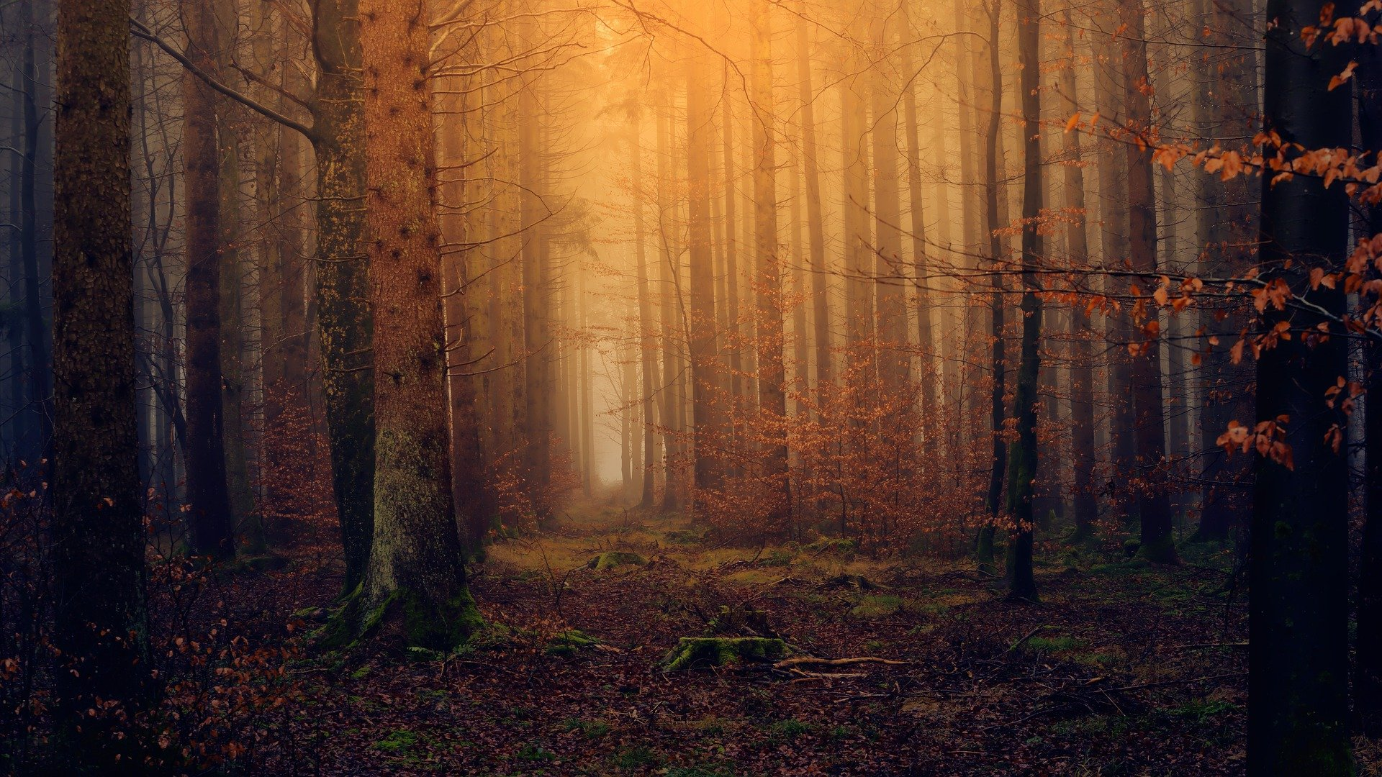
Phonetik
der Schweif – tail geschwind - quickly
sprechen / hören
schön
geschwind*
sicher
scheinen
mich
Gesicht
ächzende
schöne
brauch
Nacht
Töchter
durch
verspricht
nicht
ich
Schweif*
manch-
nächtlichen
dich
erreicht
Notes:
Timing: 3 minutes Aim: To practise the SSC [sch] and [ch] in a pairwork read aloud and listening task.
Procedure: 1. Students work in pairs. Student A picks five words from the board, jotting them down, without showing Student B.
2. Student B has to name the correct five words, by saying each one until s/he has found all five.
3. When all five words have been said students swap roles and repeat. 4. Teachers can click on each word to check pronunciation with the class, as required.
Note: all words come from the Goethe poem that we are studying in this sequence. Word frequency of unknown and/or cognate words (1 is the most frequent word in German): Schweif [>5009] geschwind >5009]
Source: Jones, R.L. & Tschirner, E. (2006). A frequency dictionary of German: core vocabulary for learners. Routledge

Slide 41
[sp]
Phonetik
Consolidation [8]
Y9 T3.1 Week 2 Slides 2; 17

Slide 42
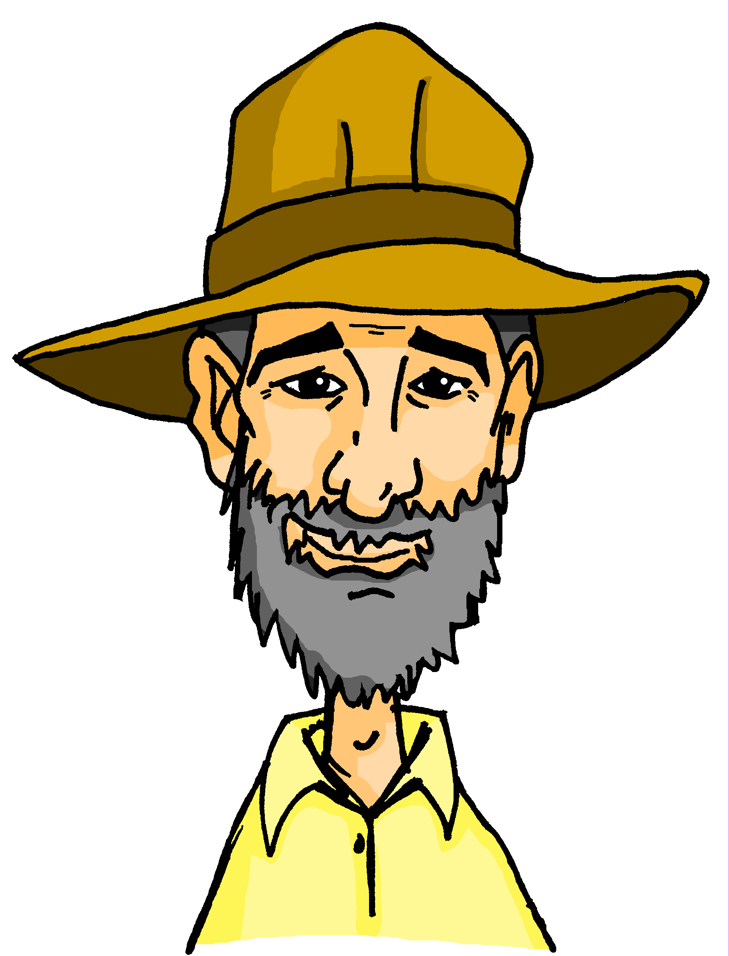
[sch] [sp [st]
hören / schreiben
1
Markranstädt
Markran___ädt
Schönberg
___önberg
2
Sprötau
3
___rötau
Eberstedt
Eber___edt
4
Springstille
5
___ring___ille
Steindorf
___eindorf
6
Schwifting
7
___wifting
___itzingsee
8
Spitzingsee
9
Bild___ein
Bildstein
___warzach
10
Schwarzach
Schaan
11
___aan
12
___ig
Stig
Notes:
Timing: 10 minutes Aim: to practise aural recognition and transcription of [sp] [st] [sch] Procedure: 1. Explain the task. Onkel Heinrich is travelling again and has gone to Liechtenstein. Mia and Wolfgang are travelling to meet him and pass through different towns en route.
2. Click on the audio buttons to hear each town.
3. Students transcribe the missing letters, either sch, sp, st
4. Click to reveal answers.
Transcript: 1. Markranstädt
2. Schönberg
3. Sprötau
4. Eberstedt
5. Springstille
6. Steindorf
7. Schwifting
8. Spitzingsee
9. Bildstein
10. Schwarzach
11. Schaan
12. Stig

Slide 43
[sch] [sp [st]
Nord
hören / sprechen
Süd
Ost
Wo ist Wolf?
West
Schöneberg
1
2
Steglitz
Spreewald
3
4
Spergau
Schmiedehausen
5
6
Bechstedtstraß
Schwarzburg
7
8
Ingolstadt
9
Spullersee
10
Stegen
11
12
Springen
Schauner
Schlins
14
Schellenberg
13
15
Steg
Notes:
Timing: 5 minutes Aim: To practise spoken production of SSCs [sp] [st] [sch] Procedure: 1. Explain the task.
2. Student A picks a town where Wolfgang is.
3. Student B tries to guess which town Student A has picked. They ask ‘Ist Wolf in…?’
4. Student A responds ‘nein, du musst nach Osten/Westen/Süden/Norden fahren‘ until Student B correctly guesses Wolfgang‘s location.
5. Students swap roles.
6. Click to reveal audio buttons to check pronunciation.
Transcript: 1. Schöneberg
2. Steglitz
3. Spreewald
4. Spergau
5. Schmiedehausen
6. Bechstedtstraß
7. Schwarzburg
8. Ingolstadt
9. Spullersee
10. Stegen
11. Schauner
12. Springen
13. Schlins
14. Schellenberg
15. Steg

