Slide 1
German phonics collection
[g] and [-g]
Artwork: Steve Clarke
Date updated: 10 / 02 / 21
Notes:
Artwork by Steve Clarke. All additional pictures selected are available under a Creative Commons license, no attribution required.

Slide 2
[g] and [-g]
Phonetik
Introduction
Y8 T1.2 Week 6 Slides 2-4; 24-25

Slide 3
Phonetik
sprechen / hören
At the start or in the middle of words, German [g] is usually pronounced like the ‘g’ in English ‘go’, including in words that are similar to English words.
Sag die Wörter. Wie im Englischen oder anders?
anders
anders
 | Beginn
 | Energie
 | Organisation
 | Generation
 | Region
 | Gruppe
 | Integration
 | Strategie
1
5
2
6
3
7
4
8
Notes:
Here English has two pronunciations for ‘g’ where German has one.
Timing: 2 minutes Aim: This activity highlights similarities and differences in the English and German pronunciation of the SSC [g], using cognates and near-cognates which have not been previously taught. The activity aims to show that while the pronunciation of this SSC changes in English, it is consistent in German. Procedure: 1. Students say the words aloud in German, (following the rule that [g] at the start or in the middle of words sounds like ‘g’ in ‘go’)
2. They compare how the words sound with the pronunciation of their English equivalents.
3. They note down for each whether the [g] sound is the same as in English or different.
4. Click to listen and check the German pronunciation.
Transcript: Beginn Energie Organisation Generation Region Gruppe Integration Strategie Word frequency (1 is the most frequent word in German): Beginn [845] Energie [455] Organisation [1114] Generation [1153] Region [803] Gruppe [369] Integration [1282] Strategie [1477] Source: Jones, R.L. & Tschirner, E. (2006). A frequency dictionary of German: core vocabulary for learners. Routledge

Slide 4
Phonetik
hören / sprechen
When you say the German [g] at the start or in the middle of a word, your vocal chords vibrate.
However, when [g] is the final sound in the word, it sounds more like ‘k’, and you don’t use your vocal chords.
Compare:
Berg
Berge
Notes:
Timing: 1 minute Aim: To explain the different sound and physiology involved in the final [g] sound in German, comparing it to the initial and mid-word sound. This prepares for the pronunciation task on the next slide.
Procedure: 1. Students listen to each word.
2. They then touch their vocal chords and say the words again, hearing the difference between the two sounds, and feeling the difference between the voiced and unvoiced [g] sounds.
Transcript: Berg Berge Word frequency (1 is the most frequent word in German): Berg [934] Source: Jones, R.L. & Tschirner, E. (2006). A frequency dictionary of German: core vocabulary for learners. Routledge

Slide 5
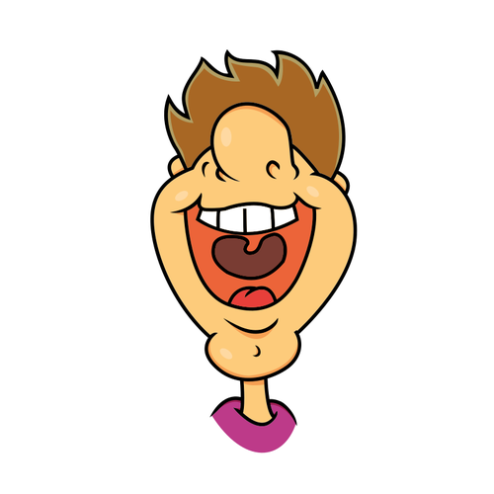
Phonetik
sprechen / hören
Sag die Wörter.
 | Singular | Plural
 | Tag | Tage
 | Zug | Züge
 | Flug | Flüge
 | Burg | Burgen
 | Spielzeug | Spielzeuge
 | Geburtstag | Geburtstage
 | Ausflug | Ausflüge
 | Fahrzeug | Fahrzeuge
1
________
2
__________
3
________
4
__________
5
________
6
__________
7
________
8
__________
Notes:
Timing: 2 minutes Aim: To practise pronunciation of two [g] sounds in German, consolidate knowledge of plural rule 1, and recall some known vocabulary. Picture prompts and/or English gloss are provided to support word recognition. Procedure: 1. Students work in pairs to pronounce / recall the words.
Transcript: Tag, Tage Zug, Züge Flug, Flüge Burg, Burgen Spielzeug, Spielzeuge Geburtstag, Geburtstage Ausflug, Ausflüge Fahrzeug, Fahrzeuge Word frequency (1 is the most frequent word in German): Beginn [845] Energie [455] Organisation [1114] Generation [1153] Region [803] Gruppe [369] Integration [1282] Strategie [1477] Source: Jones, R.L. & Tschirner, E. (2006). A frequency dictionary of German: core vocabulary for learners. Routledge

Slide 6
Phonetik [–ig] [2/3]
Sag die Wörter.
hören
German [-ig] usually occurs at the end of a word. Whether you pronounce it with [ch] or [k] you don’t use your vocal chords.
However, adding additional letters to adjectives ending in [-ig] changes its sound to a voiced [g].
Compare:
1
Das ist richtig!
Das ist eine richtige Antwort!
2
Notes:
Timing: 30 seconds Aim: To explain the difference between [-ig] and [-ig-] and prepare students for the next practice task.

Slide 7
Phonetik [–ig] [3/3]
lesen / sprechen
Sag die Satzteile auf Deutsch.
Sag die Wörter.
richtig | eine richtige Idee | a right idea
wichtig | ein wichtiges Ziel | an important goal
schwierig | ein schwieriges Spiel | a difficult game
freiwillig | eine freiwillige Person | a willing person
ruhig | ein ruhiger Platz | a quiet square
langweilig | ein langweiliger Mann | a boring man
traurig | eine traurige Frau | a sad woman
riesig | ein riesiges Stück | a huge piece
_________
1
Remember! The adjective ending depends on the gender and case of the noun. (Here, R1-nominative)
_________
2
_________
3
_________
4
_________
5
_________
6
7
_________
8
_________
Notes:
Timing: 3 minutes Aim: Practise the different forms of [-ig] and recall adjective endings (R1 – nominative) with indefinite articles, together with revisited vocabulary from Y7. Procedure: 1. Students partner up and take turns to pronounce the words. First they pronounce the adjectives on their own, and then the phrases, inserting the adjective with the correct ending (which changes the sound of the [g]). The images appear to remind students that the [-ig] in adjectives alone are unvoiced (do not use the vocal chords) but the [-ig-] within a word, i.e. once there is an adjective ending as occurs with prenominal adjectives, the sound of the [g] changes to a voiced [g].
Transcript: eine richtige Idee ein wichtiges Ziel ein schwieriges Spiel eine freiwillige Person ein ruhiger Platz ein langweiliger Mann eine traurige Frau ein riesiges Stück Word frequency (1 is the most frequent word in German): Platz [344], Stück [417] Spiel [500] Ziel [325] richtig [211] freiwillig [1718] wichtig [177] schwierig [471] langweilig [2921] ruhig [905] traurig [1871]
riesig [1075] Source: Jones, R.L. & Tschirner, E. (2006). A frequency dictionary of German: core vocabulary for learners. Routledge

Slide 8
[g] and [-g]
Phonetik
Consolidation [1]
Y9 T3.1 Week 5 Slides 2-4

Slide 9
Phonetik
sprechen / hören
Remember that at the start or in the middle of words, German [g] is usually pronounced like the ‘g’ in English ‘go’, including in words that are written in a similar way to English words.
Sag die Wörter. Wie im Englischen oder anders?
anders
anders
 | digital
 | Original
 | Migration
 | religiös
 | Signal
 | organisch
 | intelligent
 | Figur
1
5
2
6
3
7
4
8
Notes:
Timing: 3 minutes Aim: to remind students of the similarities and differences in the English and German pronunciation of the SSC [g], using cognates and near-cognates, most of which have not been previously taught. The activity aims to show that while the pronunciation of this SSC changes in English, it is consistent in German. Procedure: 1. Students say the words aloud in German, (following the rule that [g] at the start or in the middle of words sounds like ‘g’ in ‘go’)
2. They compare how the words sound with the pronunciation of their English equivalents.
3. They note down for each whether the [g] sound is the same as in English or different.
4. Click to listen and check the German pronunciation.
Transcript: digital Original Migration religiös Signal organisch intelligent Figur Word frequency (1 is the most frequent word in German): digital [1291] Figur [1285] intelligent [3121] Migration [4123] organisch [1096] original [4279] religiös [1977] Signal [1545] Source: Jones, R.L. & Tschirner, E. (2019). A frequency dictionary of German: core vocabulary for learners. Routledge

Slide 10
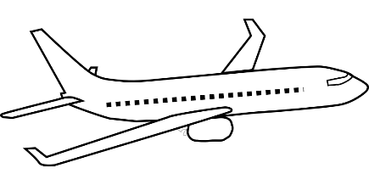
Phonetik
hören / sprechen
Remember that when you say the German [g] at the start or in the middle of a word, your vocal chords vibrate.
However, when [g] is the final sound in the word, it sounds more like ‘k’, and you don’t use your vocal chords.
Compare:
Flugzeug
Flugzeuge
The suffix –zeug often means –thing(s) in English. E.g., Flugzeug → flying thing!
Notes:
Timing: 1 minute Aim: to recap the different sound and physiology involved in the final [g] sound in German, comparing it to the initial and mid-word sound. This prepares for the pronunciation task on the next slide.
Procedure: 1. Students listen to each word.
2. They then touch their vocal chords and say the words again, hearing the difference between the two sounds, and feeling the difference between the voiced and unvoiced [g] sounds.
Transcript: Flugzeug Flugzeuge Word frequency (1 is the most frequent word in German): Flugzeug [1776] Source: Jones, R.L. & Tschirner, E. (2006). A frequency dictionary of German: core vocabulary for learners. Routledge

Slide 11
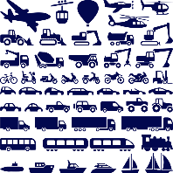
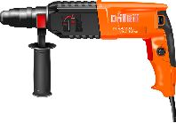
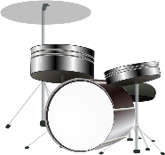
Phonetik
sprechen / hören
Sag die Wörter.
Singular
 | Singular | Plural | Was | Englisch
 | Fahrzeug | Fahrzeuge |  | vehicle
 | Spielzeug | Spielzeuge |  | toy
 | Werkzeug | Werkzeuge |  | tool
 | Schlagzeug | Schlagzeuge |  | drums
 | Feuerzeug | Feuerzeuge |  | lighter
 | Flugzeug | Flugzeuge |  | plane
1
________
________
2
__________
__________
3
________
________
Plural
4
__________
__________
5
________
________
6
__________
__________
Notes:
Timing: 4 minutes Aim: to practise pronunciation of two [g] sounds in German, consolidate knowledge of plural rule 1, and recall some known vocabulary. Picture prompts and/or English gloss are provided to support word recognition. Procedure: Students work in pairs to pronounce the words.
Transcript: Fahrzeug, Fahrzeuge Word frequency (1 is the most frequent word in German): Fahrzeug [1721] Feuerzeug {>5009] Schlagzeug [>5009] Spielzeug [>5009] Werkzeug [3681] Source: Jones, R.L. & Tschirner, E. (2019). A frequency dictionary of German: core vocabulary for learners. Routledge

