Slide 1
German phonics collection
[ei/ ai]
Artwork: Steve Clarke
Date updated: 10 / 08 / 21
Notes:
Artwork by Steve Clarke. All additional pictures selected are available under a Creative Commons license, no attribution required.

Slide 2
[ei/ ai]
Phonetik
Introduction
Y7 T1.1 Week 3 Slides 5-10

Slide 3
ei
frei
Notes:
Timing: 1 minute
Aim: To introduce/consolidate SSC [ei]
Procedure: 1. Present the letter(s) and say the [ei] sound first, on its own. Students repeat it with you. 2. Bring up the word ”frei” on its own, say it, students repeat it, so that they have the opportunity to focus all of their attention on the connection between the written word and its sound.
3. A possible gesture for this would be to stretch both arms up in the air (pointing outwards slightly to make a Y shape with your body), and smile!
4. Roll back the animations and work through 1-3 again, but this time, dropping your voice completely to listen carefully to the students saying the [ei] sound, pronouncing ”frei” and, if using, doing the gesture. Word frequency (1 is the most frequent word in German): frei [318] Source: Jones, R.L. & Tschirner, E. (2006). A frequency dictionary of German: core vocabulary for learners. Routledge

Slide 4
ei
frei
Notes:
With sound and no pictures to focus all attention on the sound-symbol correspondence.

Slide 5
ei
frei
Notes:
Without sound to elicit pronunciation (without first hearing the teacher).
Teacher to elicit pronunciation by asking “Wie sagt man…”

Slide 6
ei
leider
ein
[unfortunately]
/a
frei
klein
allein
sein
[alone]
[to be]
Notes:
Timing: 2 minutes
Aim: To introduce/consolidate SSC [ei]
Procedure:
Introduce and elicit the pronunciation of the individual SSC [ei] and then the source word again ‘frei’ (with gesture, if using).
Then present and elicit the pronunciation of the five cluster words.
The cluster words have been chosen for their high-frequency, from a range of word classes, with the SSC (where possible) positioned within a variety of syllables within the words (e.g. initial, 2nd, final etc.). Additionally, we have tried to use words that build cumulatively on previously taught SSCs (see the Phonics Teaching Sequence document) and do not include new SSCs. Where new SSCs are used, they are often consonants which have a similar symbol-sound correspondence in English.
Word frequency (1 is the most frequent word in German): frei [318]; leider [642] ein [5]; klein [114]; sein [3]; allein [258]. Source: Jones, R.L. & Tschirner, E. (2006). A frequency dictionary of German: core vocabulary for learners. Routledge

Slide 7
ei
leider
ein
frei
klein
allein
sein
Notes:
With sound and no pictures to focus all attention on the sound-symbol correspondence.

Slide 8
ei
leider
ein
frei
klein
allein
sein
Notes:
Without sound to elicit pronunciation (without first hearing the teacher).
Teacher to elicit pronunciation by asking “Wie sagt man…”

Slide 9
[ei/ ai]
Phonetik
Consolidation [1]
Y7 T1.1 Week 6 Slides 38-41; 45-47

Slide 10
Phonetik
hören / sprechen
sagen
geben
Welt
Zug
frei
kalt
denken
Notes:
Timing: 3 minutes Aim: To revise all the SSCs introduced so far: long and short a, long and short e, ei, W, Z.
Procedure: 1. Click on the word to play the audio. Repeat if necessary.
2. Students write the whole word in full in their exercise books.
3. The next slide allows removal of the ‘blots’ to reveal the missing SSCs.

Slide 11
Phonetik
hören / sprechen
sagen
geben
Welt
Zug
frei
kalt
denken
Notes:
Timing: 1 minute Aim: To reveal the answers to the activity. Procedure: 1. Click on the ‘blots to remove them individually and reveal the missing SSCs.

Slide 12
Phonetik
zehn
antworten
A
D
Zug
H
allein
C
E
Welt
klein
[alone]
Wasser
I
F
G
frei
B
Arzt
Notes:
Timing: 5 minutes Aim: To consolidate SSC knowledge
Ask students to write down which pictures go together (based on the obscured SSC).
The teacher can remind them of the source words they have just seen.
Clicking on the pictures will play the word if the students need an extra prompt.
Clicking on the paw prints will remove them.

Slide 13
Phonetik
Arzt
lesen / sprechen
antworten
60
zehn
Zug
allein
Sekunden
Welt
frei
klein
Wasser
0
LOS!
Notes:
Timing: 2 minutes (one minute per attempt) Aim: To consolidate SSC knowledge Procedure: 1. Pupils read out the words but in alphabetical order. They keep going for one minute.
2. Teacher can circulate to listen into their SSC knowledge.
Word frequency (1 is the most frequent word in German): der Arzt [614] allein [258] Source: Jones, R.L. & Tschirner, E. (2006). A frequency dictionary of German: core vocabulary for learners. Routledge

Slide 14
Phonetik
hören / schreiben
1
ei
Der Mann sit_t all__n. ☹
z
2
e
a
Der Arzt d_nkt ’W_s?!’
3
ei
i
Der Gast hat __n Z_mmer.
4
Der Freund ge_ innt __n B_tt.
w
ei
e
5
ei
a
Die Frau h_t __nen G_st.
a
6
a
Der Lehrer s_gt ‘Hurr_’. ☺
a
Notes:
Timing: 5 minutes Aim: To consolidate all SSCs introduced so far in a written transcription activity Procedure: 1. Click on the audio buttons to play the sentences.
2. Certain SSCs are missing from the transcript on the slide.
Students listen and write out the sentences in full.
3. Click to bring up the missing SSCs.
Transcript: As displayed on the slide. Word frequency (1 is the most frequent word in German): gewinnen [410] der Arzt [614] der Gast [675] das Zimmer [609] allein [258] Source: Jones, R.L. & Tschirner, E. (2006). A frequency dictionary of German: core vocabulary for learners. Routledge

Slide 15
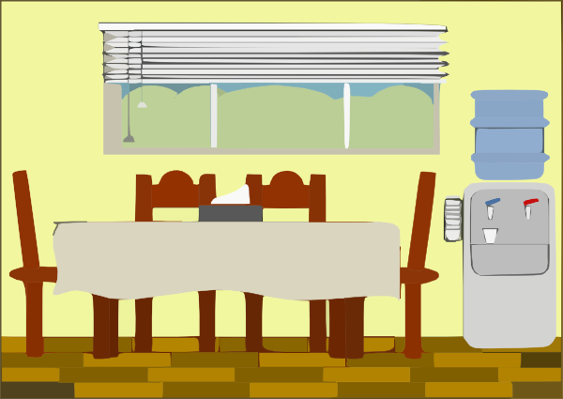
Phonetik
hören / sprechen
1
Der Mann sitzt allein. ☹
2
Der Arzt denkt ’Was?!’
3
der Artzt
Der Gast hat ein Zimmer.
4
Der Freund gewinnt ein Bett.
das Zimmer
5
Die Frau hat einen Gast.
6
Der Lehrer sagt ‘Hurra’. ☺
Notes:
Timing: 5-10 minutes Aim: To consolidate SSC and word knowledge in a listening and speaking activity Procedure (alternatives): 1. Students read each sentence aloud, as a whole-class activity or in pairs.
2) Students translate the sentences into English (orally or in writing).
3) Students play a paired vocabulary tennis task (with gestures for the verbs)
Word frequency (1 is the most frequent word in German): gewinnen [410] der Arzt [614] der Gast [675] das Zimmer [609] allein [258] Source: Jones, R.L. & Tschirner, E. (2006). A frequency dictionary of German: core vocabulary for learners. Routledge

Slide 16
Phonetik
hören / sprechen
Eine kleine Meise geigt allein eine leise Weise, eine zweite schweigt leider.
Notes:
OPTIONAL TASK
Timing: 5 minutes Aim: To provide SSC practice in the form of a tonguetwister (Zungenbrecher).
The target SSC is ei, but some of the others are covered too: W in Weise, Z in zweite, a in allein. Most of the other sounds that have not been covered so far are similar to English with the exception of sch, which should be pointed out and modelled more carefully.
Procedure: 1. Teacher reads out the whole sentence slowly and then takes the students through it word by word.
2. Teacher models word; students respond with word.
3. Discuss the meaning of the sentence.
4. Students practise saying the sentence individually.
5. They could then do a competition to see who can say it the fastest without tripping up.
Transcript:
As displayed on slide. Word frequency (1 is the most frequent word in German): geigen [>5000] schweigen [863] die Meise [>5000] die Weise [413] leise [1160] leider [642] Source: Jones, R.L. & Tschirner, E. (2006). A frequency dictionary of German: core vocabulary for learners. Routledge

Slide 17
[ei/ ai]
Phonetik
Consolidation [2]
Y7 T1.1 Week 7 Slide 29

Slide 18
Phonetik
lesen / sprechen
Liebe
ei
kein
die
ie
weiß
Brief
ich heiβe
Lieblings-
Wie schreibt man das?
Frankreich
sie
Haustier
leider
ein
wie sagt man …
hier
klein
ziehen
die Schweiz
Lied
Polizei
tief
Notes:
Timing: 5 minutes Aim: To provide practice in distinguishing between this week’s SSC [ie] and the SSC [ei] Procedure: 1. This is a paired read aloud task. The students use different colours to play. Pupil A says one of the words/phrases and pupil B has 3 seconds to locate it and cross it off with their colour. If the pupil takes longer than 3 seconds pupil A can steal the point. Clearly, the classroom conditions need to be right with the individual class for friendly competition.
2. Alternatively, they can do it more slowly and carefully, scrutinising each other’s pronunciation. If one makes a mistake (quite common with ei/ie), then the other pupil corrects and crosses off in his/her colour. Note: Not all of these words have been taught before, so there is the opportunity for some genuine decoding.
Word frequency (1 is the most frequent word in German): Lied [1726] leider [642] Lieblings- [>4034] kein [50] weiß [563] heiße [123] schreibt [245] Liebe [843] Brief [813] sie [10] hier [71] Haustier [>5000] wie [28] ziehen [266] tief [506]
Source: Jones, R.L. & Tschirner, E. (2006). A frequency dictionary of German: core vocabulary for learners. Routledge

Slide 19
[ei/ ai]
Phonetik
Consolidation [3]
Y7 T1.2 Week 6 Slides 67-68

Slide 20
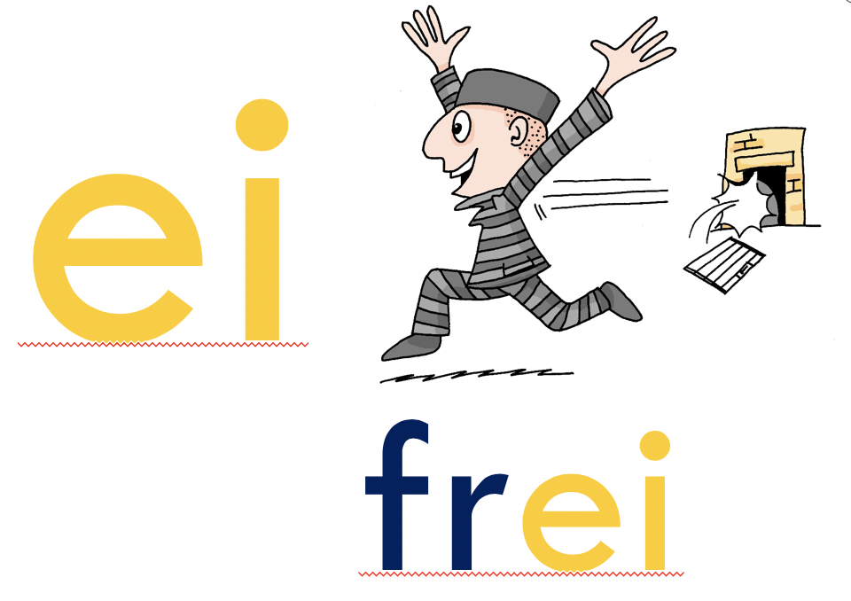
‘IE’ oder ‘EI’
hören
O Tannenbaum, o Tannenbaum,
w__ grün sind d__ne Blätter!
Du grünst nicht nur zur Sommersz__t,
N__n auch im Winter, wenn es schn__t.
O Tannenbaum, o Tannenbaum,
w__ grün sind d__ne Blätter!
Notes:
Timing: 3 minutes Aim: Phonics practice contrasting ‘ie’ and ‘ei’.
Procedure: 1. Click on the fir tree in the top right hand corner to play the song. Students write ‘ie’ or ei’ for each missing vowel.
2. Play the song a second time. The text could also be read aloud if the recording seems too fast.
3. Alternatively, here is a link to a commercial version: https://www.youtube.com/watch?v=lS4wTuvR7Ik
(single voice, but quite clear sound – 3 verses, only play verse 1).
4. The answers are provided on the next slide.
Note: Revisiting SSCs. In the NCELP SOW these SSCs have been introduced during Term 1.1, Weeks 3 (ei) and 7 (ie). We are using these as a minimal pair because of the spelling similarities. We include the source words and pictures as a refresher.
Instructions:
Hör zu
Schreib ie oder ei

Slide 21
Antworten – ie vs ei
Antworten
O Tannenbaum, o Tannenbaum,
w__ grün sind d__ne Blätter!
Du grünst nicht nur zur Sommersz__t,
N__n auch im Winter, wenn es schn__t.
O Tannenbaum, o Tannenbaum,
w__ grün sind d__ne Blätter!
wie
deine
Sommerszeit
Nein
schneit
wie
deine
Notes:
Timing: 2 minutes Aim: To provide the answers to the activity on the previous slide
Procedure: 1. Ask students which SSC is missing each time.c, licking to reveal the answers one by one.

Slide 22
[ei/ ai]
Phonetik
Consolidation [4]
Y7 T3.1 Week 2 Slides 6; 10; 11

Slide 23
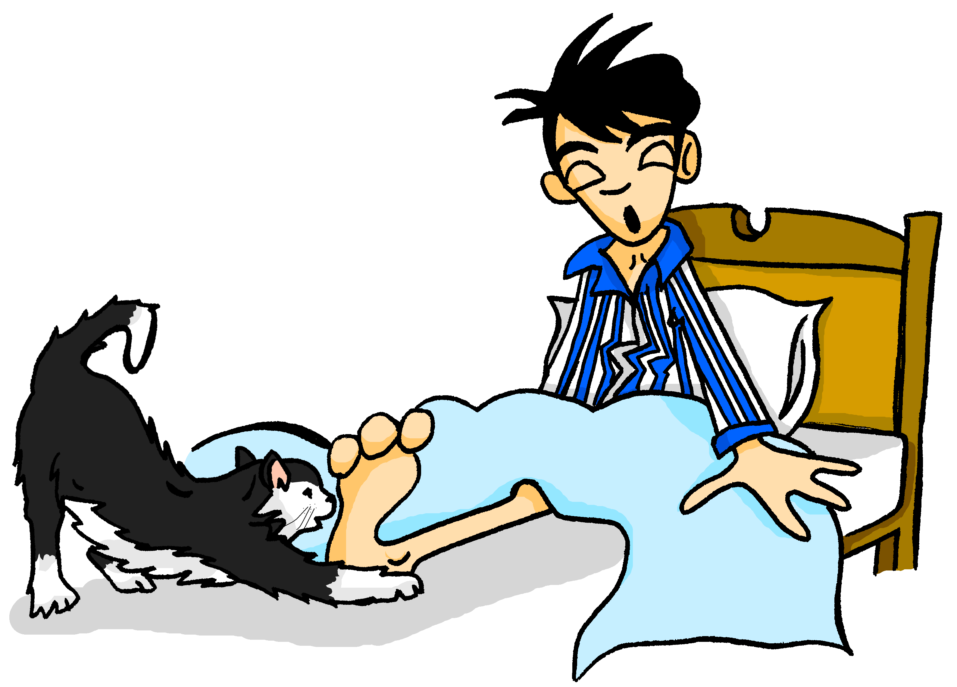
Samstagnachmittag
lesen / hören
Mieze ist auch sehr aktiv. Sie spielt mit Wolfgangs …
a) Beinen
b) Bienen
3
Notes:
Here, SSCs [ei] and [ei] are contrasted.
Frequencies of unknown vocabulary: Bein [937], Biene [>4034]
Transcript
Beinen

Slide 24
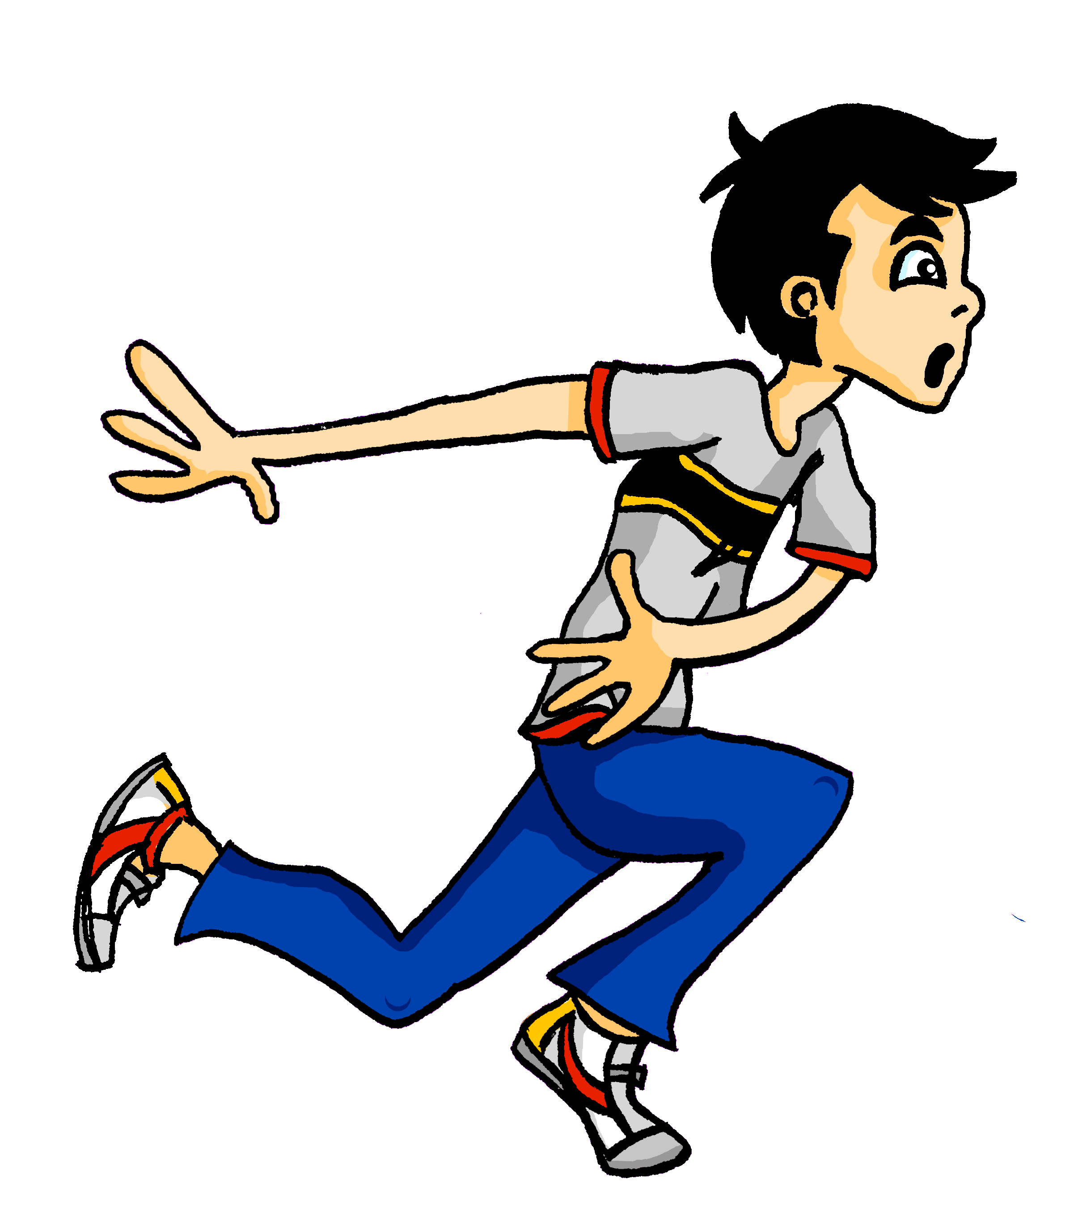
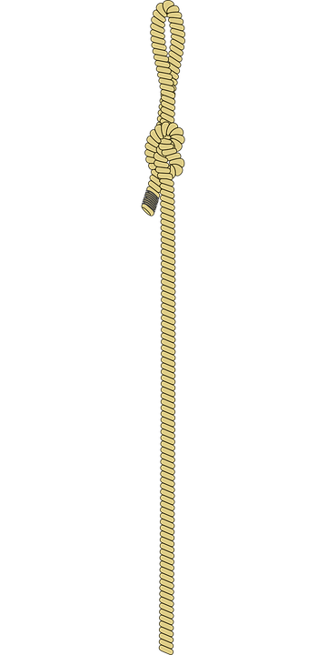
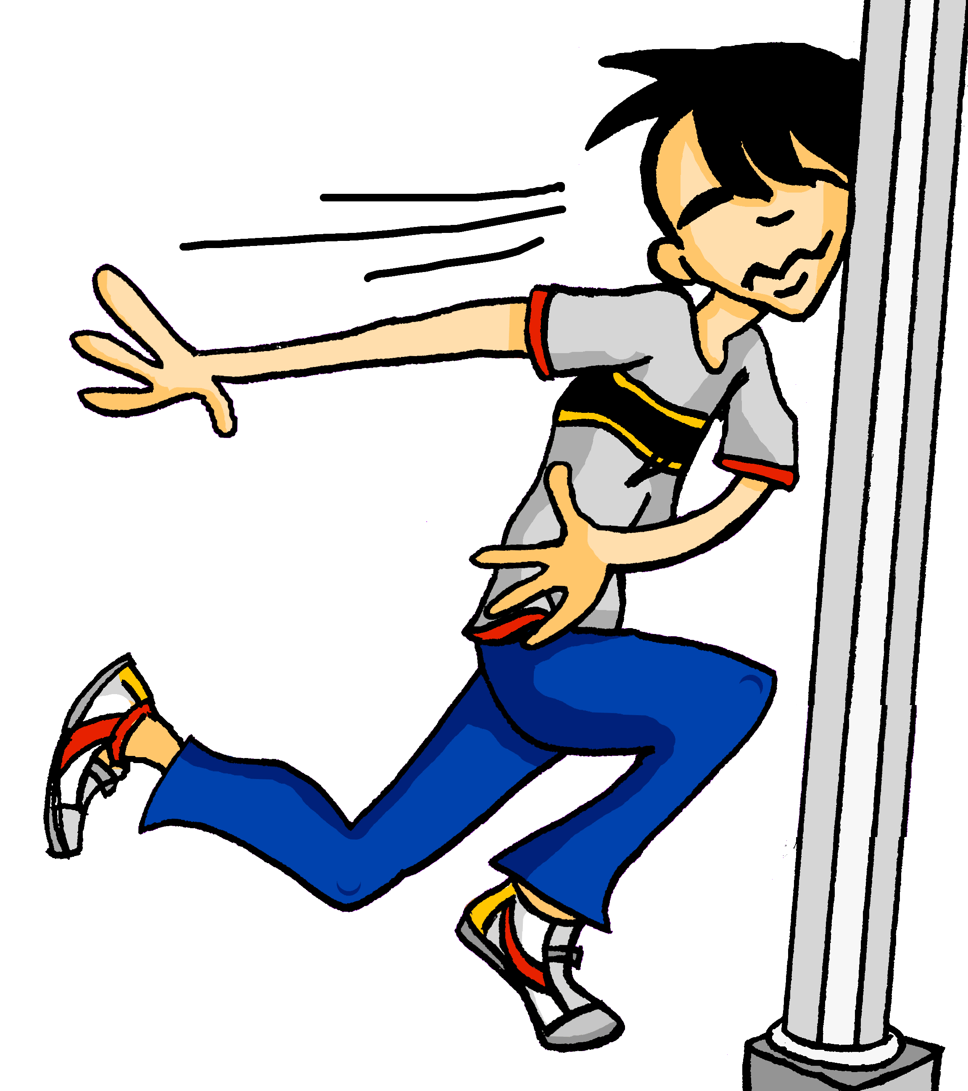
Samstagnachmittag
lesen / hören
Wolfgang ist im Stress. Er läuft in den Park. Leider sieht er nicht die …
a) Seile
b) Säule
7
Notes:
Here, SSCs [ei] and [äu] are contrasted.
Teacher to draw attention to the strong verb stem in läuft, eliciting the infinitive form and meaning from students. Students have not yet been taught ‘in’ and its use with/without movement, but this will be taught next week. The use of ‘den’ here will not be a barrier to understanding, as students know its meaning.
Students have not yet met the cognate Stress [2566]. They will need some guidance with pronunciation, as they have not yet encountered SSC [st-]. This is the SSC for next week.
Frequencies of unknown vocabulary: Seil [>4034], Säule [3778]
Transcript
Säule

Slide 25
Samstagnachmittag
lesen / hören
Jetzt hat Heidi ein bisschen Angst. Wo ist Wolfgang? Sie telefoniert mit Wolfgang. Er sagt: „Jaaa … ich brauche eine …“
a) Weile
b) viele
8
Notes:
Here, SSCs [w] and [ei] are contrasted with SSCs [v] and [ie].
Teacher to draw attention to use of word order 2 in the first sentence, which starts with a time phrase. Before eliciting the English translation, remind students that the time phrase normally appears at the end of the sentence in English.
Students have not yet met cognate telefonieren [3352].
As no pictures are provided here, teacher to elicit meaning by asking students what English word Weile sounds like.
Frequencies of unknown vocabulary: Weile [1807]
Transcript
Weile

Slide 26
[ei/ ai]
Phonetik
Consolidation [5]
Y7 T3.1 Week 4 Slides 9-15

Slide 27
ei
frei
Notes:
Timing: 1 minute
Aim: To introduce/consolidate SSC [ei]
Procedure: 1. Present the letter(s) and say the [ei] sound first, on its own. Students repeat it with you. 2. Bring up the word ”frei” on its own, say it, students repeat it, so that they have the opportunity to focus all of their attention on the connection between the written word and its sound.
3. A possible gesture for this would be to stretch both arms up in the air (pointing outwards slightly to make a Y shape with your body), and smile!
4. Roll back the animations and work through 1-3 again, but this time, dropping your voice completely to listen carefully to the students saying the [ei] sound, pronouncing ”frei” and, if using, doing the gesture. Word frequency (1 is the most frequent word in German): frei [318] Source: Jones, R.L. & Tschirner, E. (2006). A frequency dictionary of German: core vocabulary for learners. Routledge

Slide 28
ei
frei
Notes:
With sound and no pictures to focus all attention on the sound-symbol correspondence.

Slide 29
ei
frei
Notes:
Without sound to elicit pronunciation (without first hearing the teacher).
Teacher to elicit pronunciation by asking “Wie sagt man…”

Slide 30
ei
leider
ein
[unfortunately]
/a
frei
klein
allein
sein
[alone]
[to be]
Notes:
Timing: 2 minutes
Aim: To introduce/consolidate SSC [ei]
Procedure:
Introduce and elicit the pronunciation of the individual SSC [ei] and then the source word again ‘frei’ (with gesture, if using).
Then present and elicit the pronunciation of the five cluster words.
The cluster words have been chosen for their high-frequency, from a range of word classes, with the SSC (where possible) positioned within a variety of syllables within the words (e.g. initial, 2nd, final etc.). Additionally, we have tried to use words that build cumulatively on previously taught SSCs (see the Phonics Teaching Sequence document) and do not include new SSCs. Where new SSCs are used, they are often consonants which have a similar symbol-sound correspondence in English.
Word frequency (1 is the most frequent word in German): frei [318]; leider [642] ein [5]; klein [114]; sein [3]; allein [258]. Source: Jones, R.L. & Tschirner, E. (2006). A frequency dictionary of German: core vocabulary for learners. Routledge

Slide 31
ei
leider
ein
frei
klein
allein
sein
Notes:
With sound and no pictures to focus all attention on the sound-symbol correspondence.

Slide 32
ei
leider
ein
frei
klein
allein
sein
Notes:
Without sound to elicit pronunciation (without first hearing the teacher).
Teacher to elicit pronunciation by asking “Wie sagt man…”

Slide 33
ei
ei
ie
leicht
Ziel
kein
wie
schwierig
dein
heißen
Schauspieler
erreichen
ziemlich
sie
leider
schließlich
mein
sein
Lied
langweilig
ziehen
Schweiz
Computerspiel
Notes:
Timing: 5 minutes
Aim: Phonics revision.
Procedure: 1. This is a paired read aloud task. The students use different colours to play. Student A says one of the words/phrases and student B has 3 seconds to locate it and cross it off with their colour. If the student takes longer than 3 seconds pupil A can steal the point. Clearly, the classroom conditions need to be right with the individual class for friendly competition.
2. Alternatively, they can do it more slowly and carefully, scrutinising each other’s pronunciation. If one makes a mistake (quite common with ei/ie), then the other student corrects and crosses off in their colour.
Note: Not all of these words have been taught before, so there is the opportunity for some genuine decoding.

Slide 34
[ei/ ai]
Phonetik
Consolidation [6]
Y7 T3.2 Week 6 Slides 2-3; 20

Slide 35
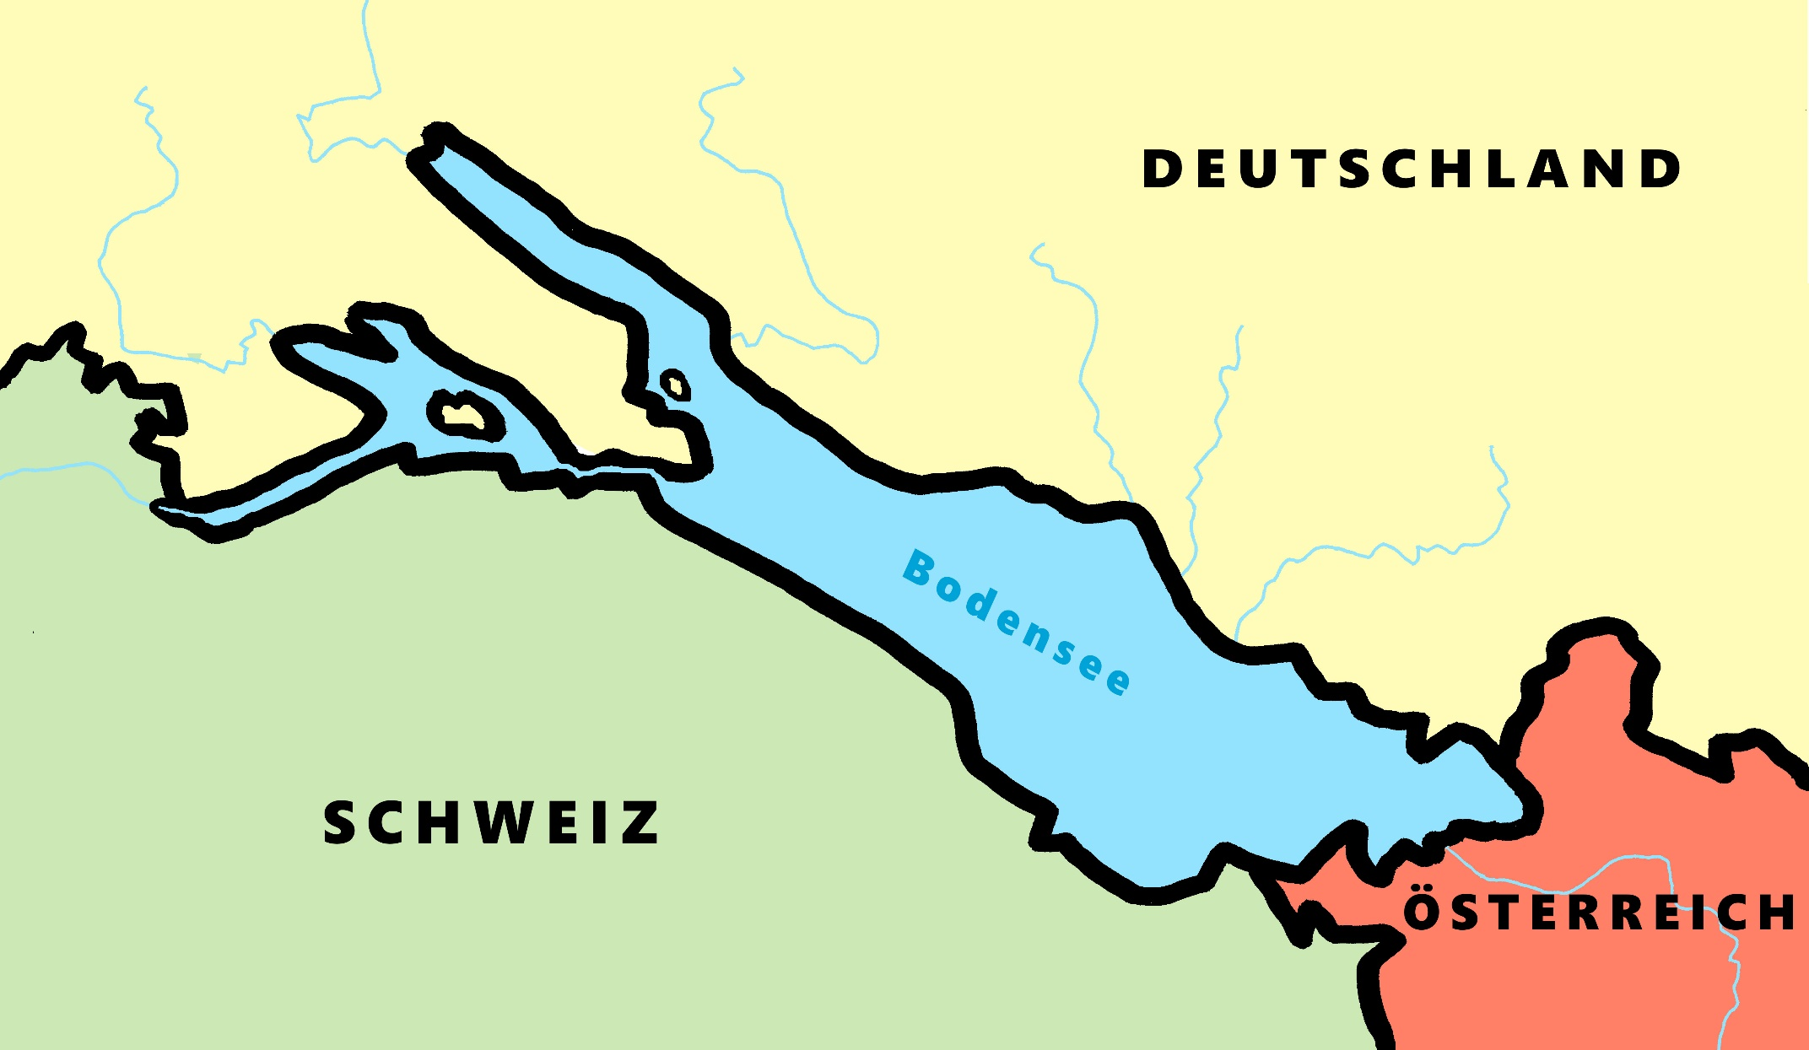
Phonetik - der Bodensee [1/2]
hören / schreiben
4
Allensbach
5
Wallhausen
3
Radolfzell
6
Hagnau
7
Friedrichshafen
1
Kreuzlingen
2
Steckborn
9
Romanshorn
8
Altenrhein
Notes:
Phonetik [1]
Time: 5 minutes Aim: To practise recognising and transcribing 10 previously taught SSC, in unknown words.
Procedure: 1. Click number to hear the full word. Students listen and transcribe only the missing letters. 2. Animations support item-by-item checking, as instant feedback on each SSC may be particularly helpful for students’ learning. 3. Teachers can additionally ask, Wo liegt [Hagnau]? Es liegt in [Deutschland]… Students have met the use of ‘in’ with die Schweiz. It will be helpful to focus their attention on the use of ‘in’ + der + Schweiz here, reminding them of the ‘in’ + movement (R2-accusative) or location (R3-dative) change. SSC revisited here: [eu] [st-] [z] [ch-hard] [w] [au] [ie] [ch-soft] [ei] [r] Transcript: 1 Kreuzlingen 2 Steckborn 3 Radolfzell 4 Allensbach 5 Wallhausen 6 Hagnau 7 Friedrichshafen 8 Altenrhein 9 Romanshorn

Slide 36
Phonetik - der Bodensee [1/2]
lesen / sprechen
9
Ludwigshafen
1
2
Friedrichshafen
Stein am Rhein
6
Konstanz
8
7
Reichenau
5
Altnau
3
Bregenz
4
Rorschach
Notes:
Phonetik [2]
Time: 5 minutes Aim: To practise reading aloud / saying 10 previously taught SSC, in unknown words (apart from Deutschland, which starts the task off). Here, 9 additional towns on the Bodensee are used.
Procedure: 1. Students work in pairs to pronounce each of the towns. 2. Click number to hear and check pronunciation. SSC revisited here: [eu] [st-] [z] [ch-hard] [w] [au] [ie] [ch-soft] [ei] [r] [sch] Transcript: 1 Deutschland 2 Friedrichshafen 3 Bregenz 4 Rorschach 5 Altnau 6 Konstanz 7 Reichenau 8 Stein am Rhein 9 Ludwigshafen

Slide 37
Wie heißt die Band?
Phonetik
Alastair telefoniert mit Mia. Sie reden über deutsche Bands. Wie heißen sie?
 | die P r i n z e n
 | J u l i
 | F e t t e s B r o t
 | die F a n t a s t i s c h e n V i e r
 | S ö h n e M a n n h e i m s
 | S p o r t f r e u n d e S t i l l e r
 | R o s e n s t o l z
 | die Ä r t z e
1
_
2
_
3
_
_
4
_
_
_
_
_
5
_
_
_
6
_
_
_
_
7
_
_
8
_
_
Notes:
Phonetik [1] Time: 5 minutes
Aim: To practise recognising and transcribing 14 previously taught SSC, in unknown words.
Note: These are real German band names.
Procedure: 1. Click number to hear the full word. Students listen and transcribe only the missing letters. 2. Animations support item-by-item checking, as instant feedback on each SSC may be particularly helpful for students’ learning. SSC revisited here: [z] [j] [r-consonantal] [o-long] [sch] [v] [r-vocalic] [ö-long] [ei] [st] [-er] [st] [ä] [-e]
Transcript: [1] die Prinzen
[2] Juli
[3] Fettes Brot
[4] die Fantastischen Vier
[5] Söhne Mannheims
[6] Sportfreunde Stiller
[7] Rosenstolz
[8] die Ärzte

Slide 38
[ei/ ai]
Phonetik
Consolidation [7]
Y8 T1.1 Week 1 Slides 2-11

Slide 39
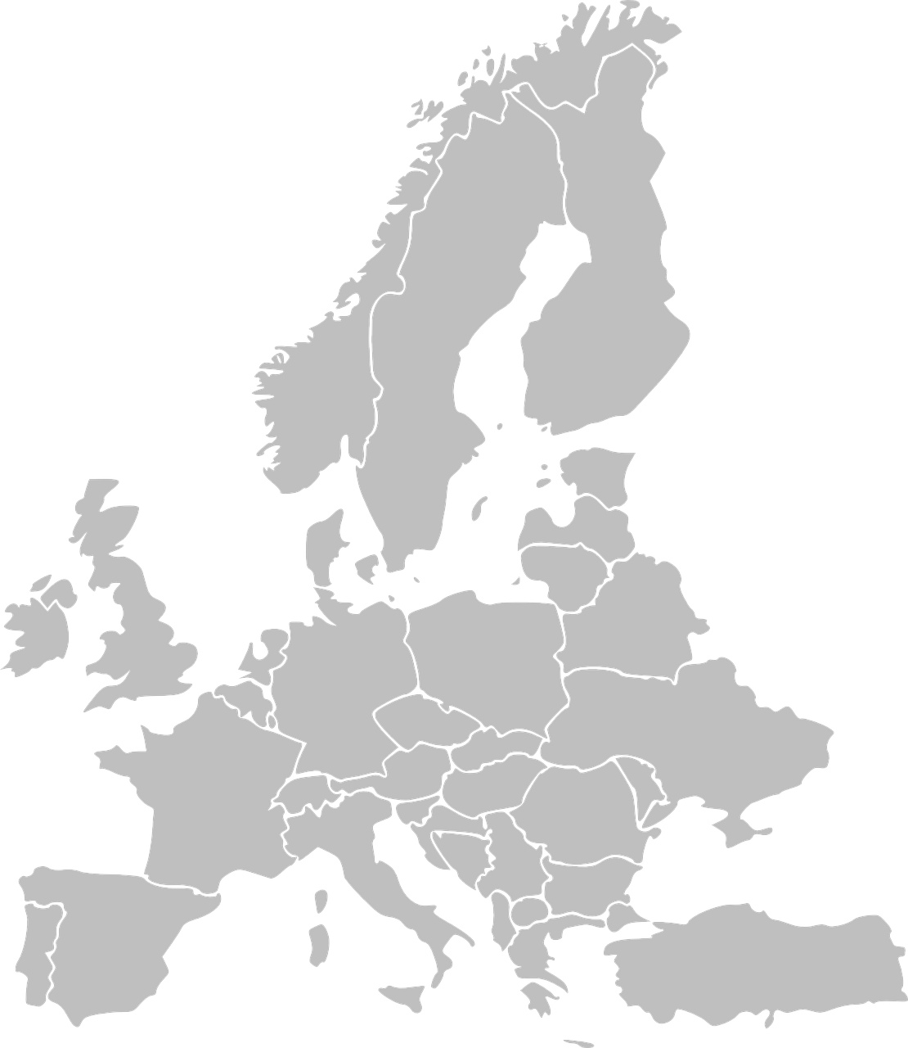
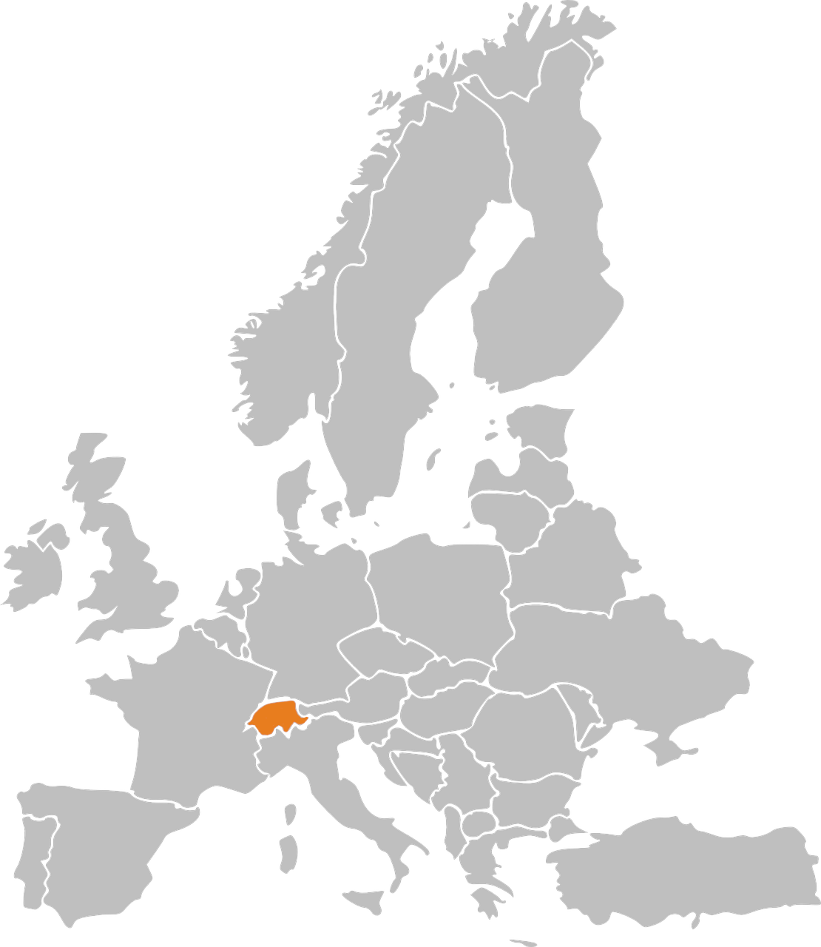
Phonetik: Stadt oder Land?
hören / schreiben
1
die Schweiz
Notes:
Timing: 3 minutes Aim: to revisit and practise the distinction between [ie] and [ei] Procedure: 1. Write 1-10.
2. Click on the number to play the sound. Note: each word is said TWICE. Transcribe either the whole word OR just the SSC [ei] / [ie].
3. Click again for spelling to appear.
4. Bist du in einer Stadt oder einem Land?
5. Click will reveal Stadt oder Land.
Transcript: die Schweiz
die Türkei
Wien
Kiel
Freiburg
Italien
Liechtenstein
Österreich
Spanien
Lienz

Slide 40
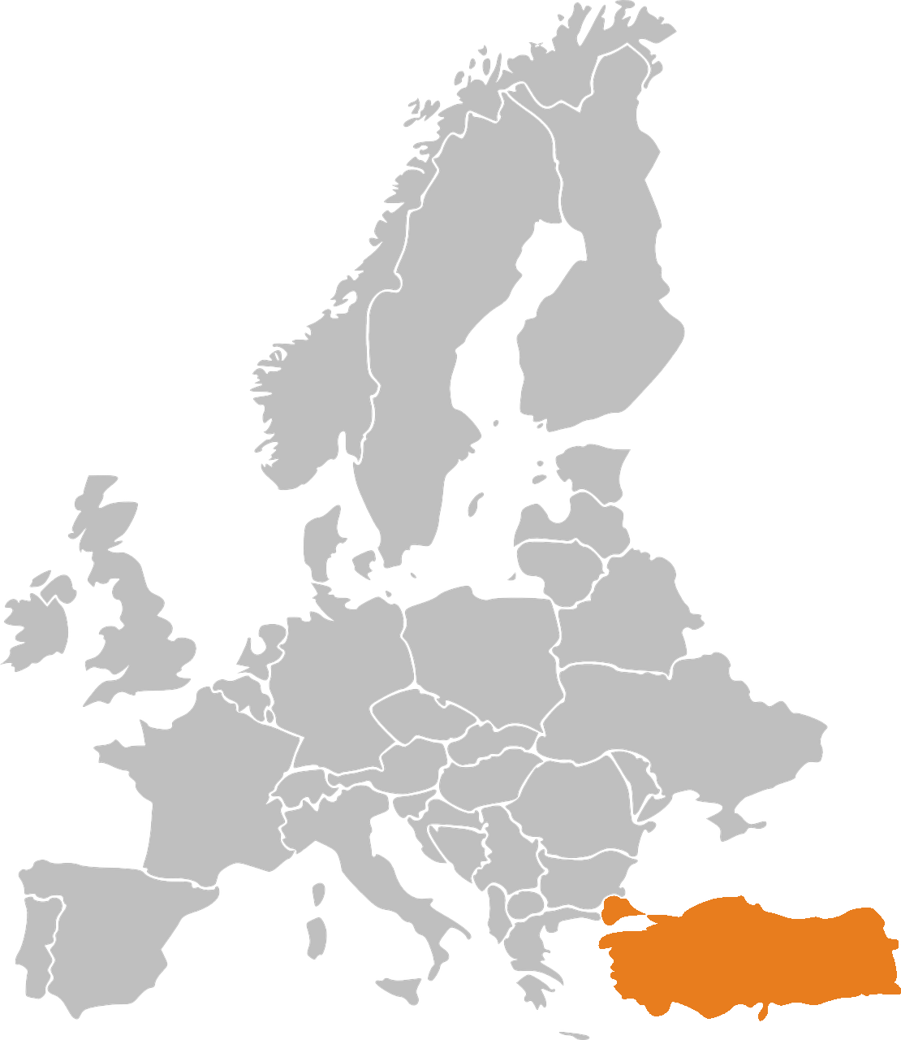
Phonetik: Stadt oder Land?
hören / schreiben
2
die Türkei

Slide 41
Phonetik: Stadt oder Land?
hören / schreiben
3
Wien

Slide 42
Phonetik: Stadt oder Land?
hören / schreiben
4
Kiel

Slide 43
Phonetik: Stadt oder Land?
hören / schreiben
5
Freiburg

Slide 44
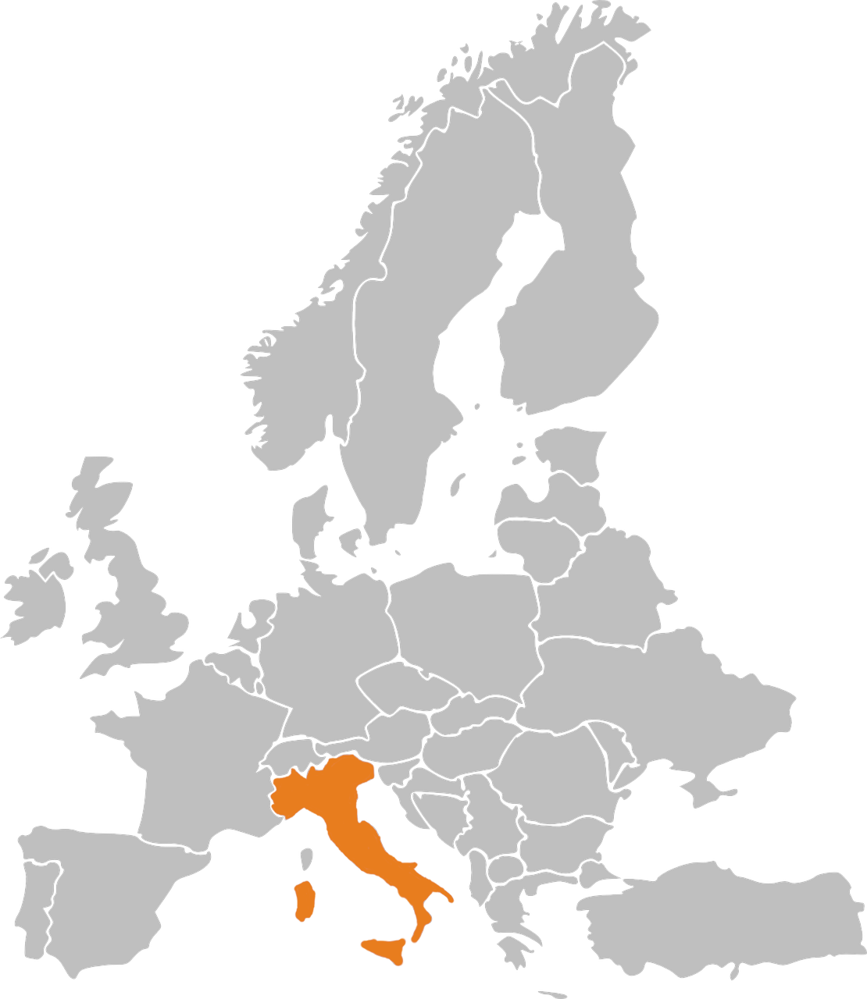
Phonetik: Stadt oder Land?
hören / schreiben
6
Italien

Slide 45
Phonetik: Stadt oder Land?
hören / schreiben
7
Liechtenstein

Slide 46
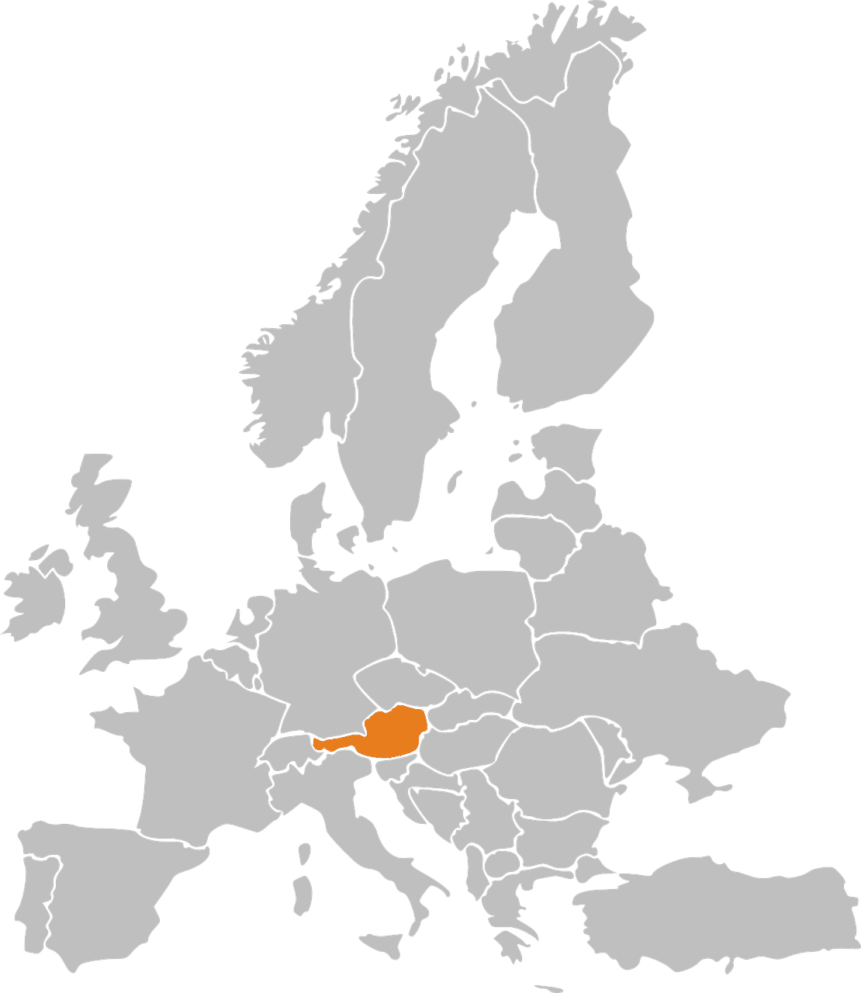
Phonetik: Stadt oder Land?
hören / schreiben
8
Österreich

Slide 47
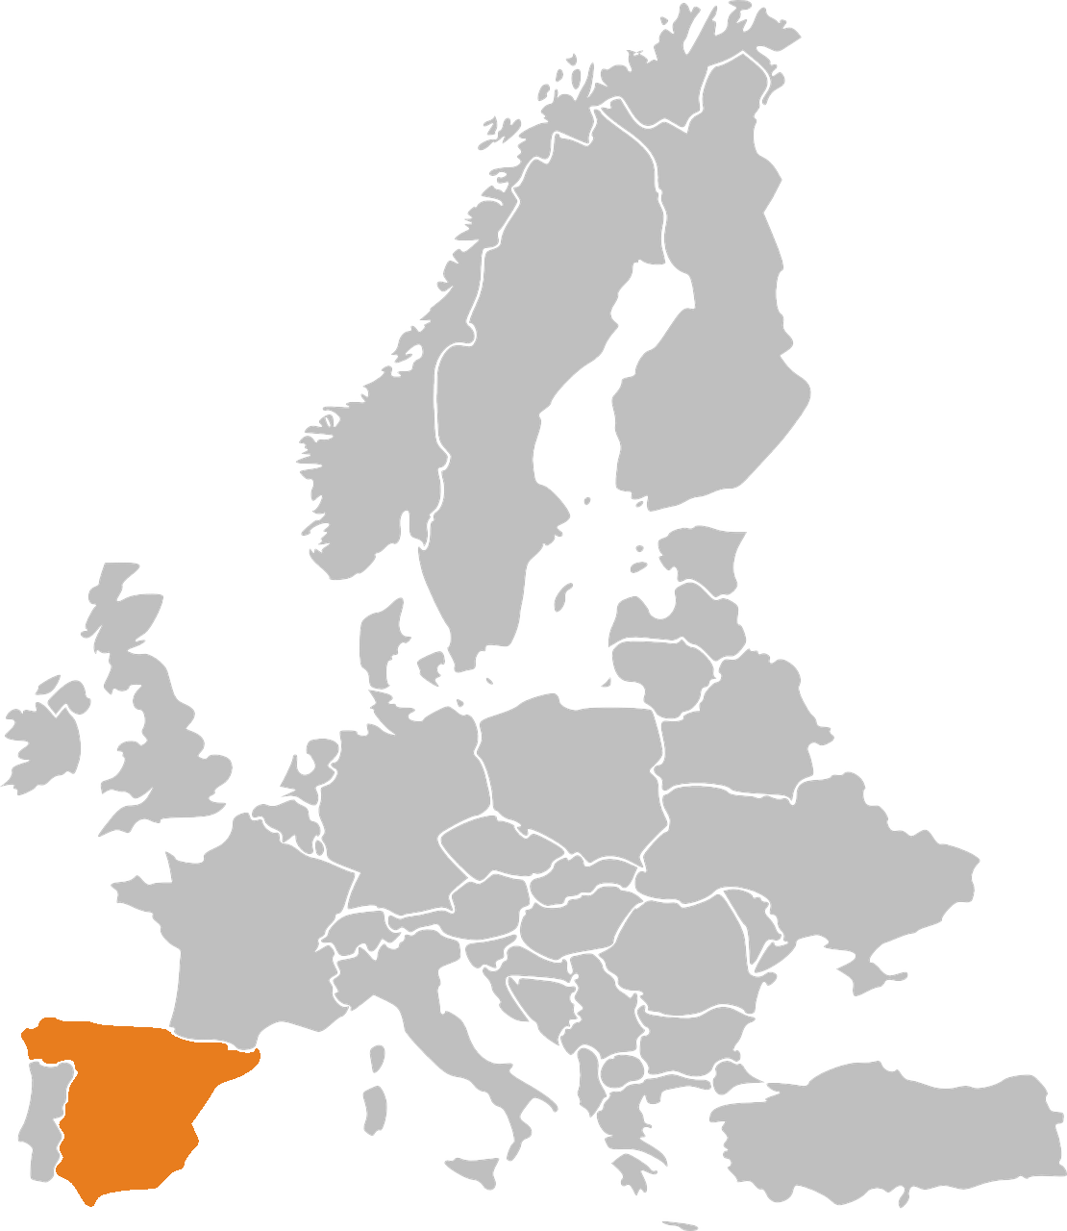
Phonetik: Stadt oder Land?
hören / schreiben
9
Spanien

Slide 48
Phonetik: Stadt oder Land?
hören / schreiben
10
Lienz
Note that when followed by –n, [ie] sometimes sounds as two syllables. Wie sagt man…? Spanien Italien Lienz

Slide 49
[ei/ ai]
Phonetik
Consolidation [8]
Y8 T1.1 Week 5 Slides 2-4

Slide 50
ei
frei
Notes:
With sound and no pictures to focus all attention on the sound-symbol correspondence.

Slide 51
ai
Haifisch
Notes:
Timing: 1 minute (slides 2 and 3)
Aim: To introduce SSC [ai] and link it to SSC [ei] which has the same pronunciation.
Procedure: 1. Present the letter(s) and say the [ai] sound first, on its own. Students repeat it with you. 2. Bring up the word ”Haifisch” on its own, say it, students repeat it, so that they have the opportunity to focus all of their attention on the connection between the written word and its sound.
3. A possible gesture for this would be [to use the right hand to make a shark fin and put it on top of your head]
4. Roll back the animations and work through 1-3 again, but this time, dropping your voice completely to listen carefully to the students saying the [ai] sound, pronouncing ”Haifisch” and, if using, doing the gesture. Word frequency (1 is the most frequent word in German): Haifisch [>5000] Source: Jones, R.L. & Tschirner, E. (2006). A frequency dictionary of German: core vocabulary for learners. Routledge

Slide 52
Auf Deutsch und auf Englisch
sprechen / hören
same [ai]
different [ai]
same [ai]
different [ai]
1
Detail
6
trainieren
2
Mai
7
Puffmais
3
Haifisch
8
Kaiserin
4
E-Mail
9
unfair
5
Mainz
10
Taiwaner
Notes:
*Put pics in
Timing: 2 minutes Aim: This activity highlights similarities and differences in the English and German pronunciation of the SSC [ai], using near-cognates which have not been previously taught. Images are provided to aid recognition. The activity aims to show that the pronunciation of [ai] changes in German, depending on whether the word is a word ‘borrowed’ from English.
Procedure: Students write 1-10 in their exercise books and decide if the [ai] in the German word sounds the same as in English, or different from the English. They then listen to the words and check their answers.
TRANSCRIPT:
Detail
Mai
Haifisch
E-Mail
Mainz
trainieren
Puffmais
Kaiserin
unfair
Taiwaner
Word frequency (1 is the most frequent word in German):
E-Mail [2172] trainieren [2256] Mai [1048] Haifisch [>5000] Detail [1787] fair [1803] Kaiserin [2563] Puffmais [>5000] Taiwaner [>5000] Source: Jones, R.L. & Tschirner, E. (2006). A frequency dictionary of German: core vocabulary for learners. Routledge

Slide 53
[ei/ ai]
Phonetik
Consolidation [9]
Y8 T2.1 Week 2 Slides 2-7; 14-16; 38-42

Slide 54
ei
frei
Notes:
Timing: 1 minute
Aim: To introduce/consolidate SSC [ei]
Procedure: 1. Present the letter(s) and say the [ei] sound first, on its own. Students repeat it with you. 2. Bring up the word ”frei” on its own, say it, students repeat it, so that they have the opportunity to focus all of their attention on the connection between the written word and its sound.
3. A possible gesture for this would be to stretch both arms up in the air (pointing outwards slightly to make a Y shape with your body), and smile!
4. Roll back the animations and work through 1-3 again, but this time, dropping your voice completely to listen carefully to the students saying the [ei] sound, pronouncing ”frei” and, if using, doing the gesture. Word frequency (1 is the most frequent word in German): frei [318] Source: Jones, R.L. & Tschirner, E. (2006). A frequency dictionary of German: core vocabulary for learners. Routledge

Slide 55
ei
frei
Notes:
With sound and no pictures to focus all attention on the sound-symbol correspondence.

Slide 56
ei
frei
Notes:
Without sound to elicit pronunciation (without first hearing the teacher).
Teacher to elicit pronunciation by asking “Wie sagt man…”

Slide 57
ei
leider
ein
[unfortunately]
/a
frei
klein
allein
sein
[alone]
[to be]
Notes:
Timing: 2 minutes
Aim: To introduce/consolidate SSC [ei]
Procedure:
Introduce and elicit the pronunciation of the individual SSC [ei] and then the source word again ‘frei’ (with gesture, if using).
Then present and elicit the pronunciation of the five cluster words.
The cluster words have been chosen for their high-frequency, from a range of word classes, with the SSC (where possible) positioned within a variety of syllables within the words (e.g. initial, 2nd, final etc.). Additionally, we have tried to use words that build cumulatively on previously taught SSCs (see the Phonics Teaching Sequence document) and do not include new SSCs. Where new SSCs are used, they are often consonants which have a similar symbol-sound correspondence in English.
Word frequency (1 is the most frequent word in German): frei [318]; leider [642] ein [5]; klein [114]; sein [3]; allein [258]. Source: Jones, R.L. & Tschirner, E. (2006). A frequency dictionary of German: core vocabulary for learners. Routledge

Slide 58
ei
leider
ein
frei
klein
allein
sein
Notes:
With sound and no pictures to focus all attention on the sound-symbol correspondence.

Slide 59
ei
leider
ein
frei
klein
allein
sein
Notes:
Without sound to elicit pronunciation (without first hearing the teacher).
Teacher to elicit pronunciation by asking “Wie sagt man…”

Slide 60
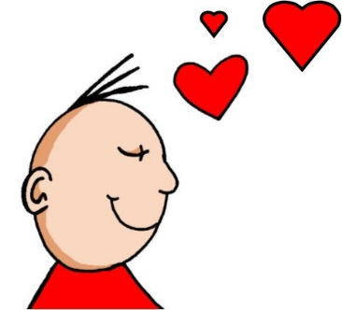
Phonetik
hören
ei
ie
frei
Liebe
Notes:
Timing: 5 seconds Aim: To recap the two source words before the listening task on the next slide.

Slide 61
Welcher Buchstabe ist das? A, B, C…?
hören
Hör zu. Schreib 1-6 und A, B, C…
Biene
Beine
1
2
3
Wiese
Weise
Wein
Wien
4
5
Leib
lieb
hieß
heiß
Schein
schien
reif
rief
6
A
B
C
D
E
F
G
H
Antworten:
4
6
1
5
2
3
Notes:
Timing: 3 minutes Aim: To practise recognition of minimal pairs with SSC [ei] and [ie]
Procedure:
1. Click on a number to hear a recording. Students listen and follow the correct pathway, taking the left- or right-hand branch in each case according to which SSC they hear, [ei] or [ie].
2. The answers are animated and appear on clicks.
Transcript:
1. Biene, Weise, hieß 2. Beine, Wein, schien
3. Beine, Wien, reif
4. Biene, Wiese, Leib
5. Beine, Wein, Schein
6. Biene, Wiese, Lieb
Frequencies

Slide 62
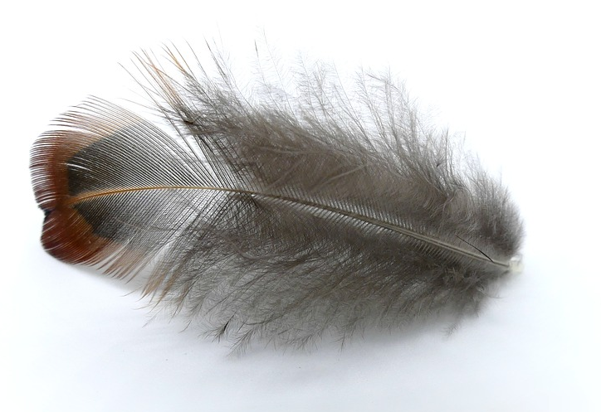
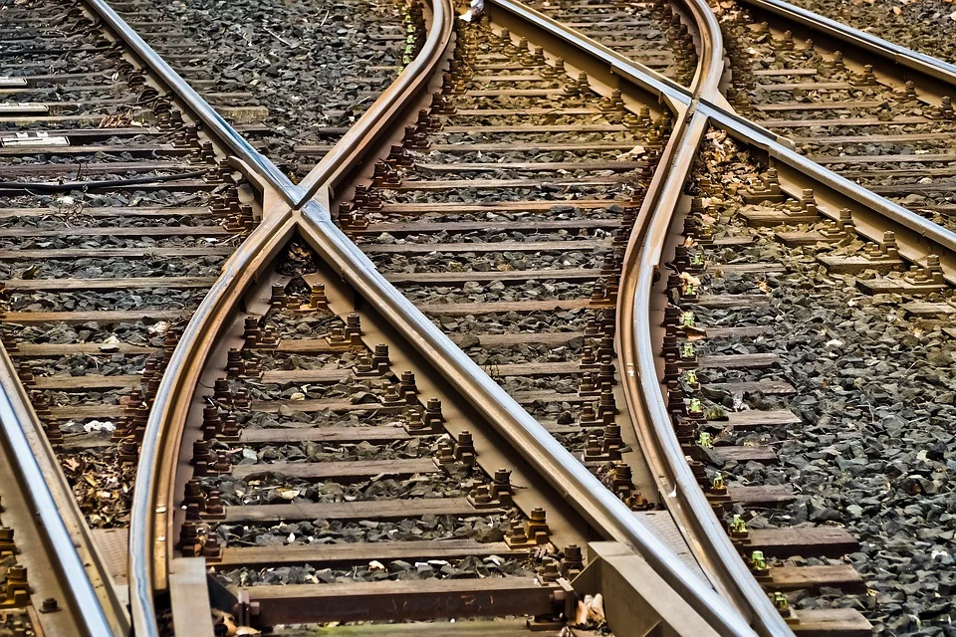
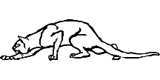
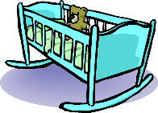
Phonetik
lesen / sprechen
60
Schiene [rail]
weich [soft]
Stein [stone]
biegen [bend]
Teich [pond]
fliehen [to flee]
Reis [rice]
schleichen [slink]
Sekunden
Leiter [ladder]
Frieden [peace]
beißen [to bite]
Wiege [crib]
Kiesel [pebble]
Sieg [victory]
Scheitel [parting]
Fliege [fly]
0
LOS!
Notes:
Timing: 1 minute for practice + 1 minute for saying them out loud Aim: To practise SSCs in unfamiliar word context. The time limit helps automatization. Procedure: 1. Students take 60 seconds to practise saying the words out loud to themselves. Click LOS! to start the timer.
2. Then teacher clicks and each word flashes a couple of times before disappearing. Students have to pronounce the word (in chorus) – teacher checks pronunciation this week (as Covid prevents circulating round the class currently).
Word frequency (1 is the most frequent word in German): Schiene [>5000], weich [1836], Stein [1404], biegen [2986], Teich [>5000], fliehen [2824], Reis [>5000], schleichen [4008], Leiter [1321], Frieden[1478], beißen [>5000], Wiege [>5000], Kiesel [>5000], Sieg [1246], Scheitel [>5000], Fliege [>5000]
Source: Jones, R.L. & Tschirner, E. (2019). A frequency dictionary of German: core vocabulary for learners. Routledge

Slide 63
Phonetik
hören
ei
ie
frei
Liebe
Notes:
Timing: 5 seconds Aim: To recap the two source words before the listening task on the next slide.

Slide 64
Phonetik [1/2]
sprechen / hören / schreiben
Partner A sagt die Wörter. Partner B schreibt.
[ei]
[ie]
1. _______
1. _______
1. Schwein [pig]
2. peinlich [embarassing]
3. Kiefer [jaw] 4. Geige [violin] 5. Ziege [goat] 6. nieder [down] 7. Riese [giant] 8. Eiche [oak]
2. _______
2. _______
3. _______
3. _______
4. _______
4. _______
Notes:
Timing: 4 minutes Aim: To practise SSC [ei] and [ie] with mostly unknown vocabulary, compelling students to apply their phonics knowledge.
Procedure: 1. Partner B draws two columns and numbers 1-4 in each column
2. Partner A reads the words aloud. Partner B must turn away from the board and must transcribe the words in the correct column.
3. The next slide has the answers. Word frequency (1 is the most frequent word in German):
Schwein [4009], peinlich [2936], Kiefer [>5000], Geige [>5000], Ziege [>5000], nieder [>5000], Riese [2794], Eiche [>5000]
Source: Jones, R.L. & Tschirner, E. (2019). A frequency dictionary of German: core vocabulary for learners. Routledge

Slide 65
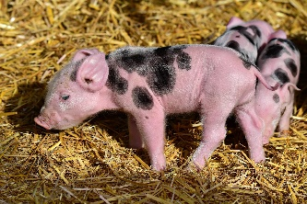
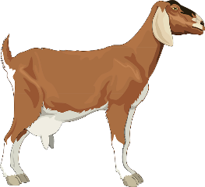
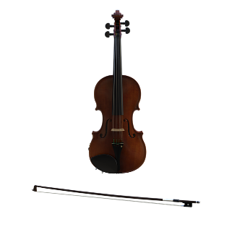
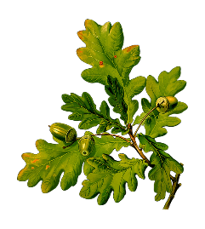
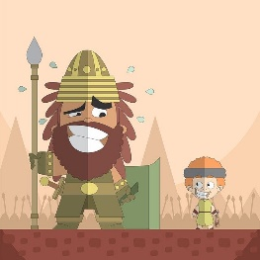
Antworten
sprechen / hören / schreiben
[ei]
[ie]
Schwein
Kiefer
1. _______
1. _______
peinlich
Ziege
2. _______
2. _______
[embarrassing]
Geige
nieder
3. _______
3. _______
Eiche
Riese
4. _______
4. _______
Notes:
Answers
Timing: 30 seconds
Aim: to check work of Partner B (who write) and Partner A (who spoke)
Answers appear in order of the transcript.
Transcript:
1. Schwein 2. peinlich 3. Kiefer 4. Geige 5. Ziege 6. nieder 7. Riese 8. Eiche

Slide 66
Phonetik [2/2]
sprechen / hören / schreiben
Partner A schreibt. Partner B sagt die Wörter.
[ei]
[ie]
1. _______
1. _______
1. Krieg [war]
2. Kleid [dress]
3. Sieb [sieve] 4. Diener [servant] 5. Feind [enemy] 6. heiter [cheerful, bright] 7. Kreide [chalk] 8. niedlich [cute]
2. _______
2. _______
3. _______
3. _______
4. _______
4. _______
Notes:
Timing: 4 minutes Aim: To practise SSC [ei] and [ie] with mostly unknown vocabulary, compelling students to apply their phonics knowledge.
Procedure: 1. Partner A draws two columns and numbers 1-4 in each column
2. Partner B reads the words aloud. Partner A must turn away from the board and must transcribe the words in the correct column.
3. The next slide has the answers. Word frequency (1 is the most frequent word in German):
Krieg [407], Kleid [1681], Sieb [>5000], Diener [>5000], Feind [24524], heiter [>5000], Kreide [>5000], niedlich [>5000].
Source: Jones, R.L. & Tschirner, E. (2019). A frequency dictionary of German: core vocabulary for learners. Routledge

Slide 67
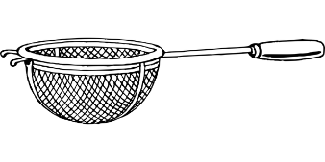
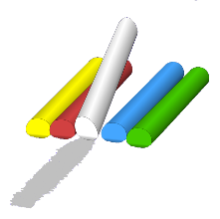
Antworten
sprechen / hören / schreiben
[ei]
[ie]
Kleid
Krieg
1. _______
1. _______
Feind
[enemy]
Sieb
2. _______
2. _______
heiter
[cheerful, bright]
Diener
3. _______
3. _______
Kreide
niedlich
4. _______
4. _______
Notes:
Answers
Timing: 30 seconds
Aim: to check work of Partner B (who write) and Partner A (who spoke)
Answers appear in order of the transcript.
Transcript:
1. Krieg
2. Kleid
3. Sieb 4. Diener 5. Feind 6. heiter 7. Kreide 8. niedlich

Slide 68
[ei/ ai]
Phonetik
Consolidation [10]
Y8 T2.2 Week 4 Slide 3

Slide 69
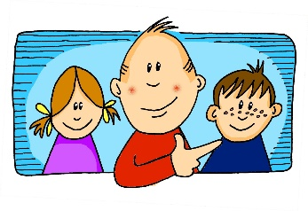
Phonetik
Hör zu. Schreib die Wörter. Wie viele enthalten die SSC?
hören / schreiben
[er-]
[-er]
[ei]
[j]
[z]
[o]
er
wieder
frei
ja
Zug
Kopf
 |  | ?
 | [er-]
 | [-er]
 | [ei]
 |  | ?
 | [j]
 | [z]
 | [o]
gern – erklären - unser
2
jung – jedoch - Jugendclub
3
alle – erzählen - anderer
1
kurz – unser - zwar
2
Kleid – weit - alleine
3
1
genau – Schloss - erlauben
Notes:
Timing: 7 minutes Aim: Transcription activity to revisit six further SSC, and to practise writing vocabulary from this week’s sets, as well as a few unknown words. As such, this is a hybrid phonics – vocabulary activity. Procedure: 1. Click on each individual SSC to hear it.
2. Elicit the source word from students, if remembered. Note that all of these words have also been taught as key vocabulary on the SOW.
3. Bring up the source words to check, and for reference for the read aloud activity.
4. Students listen to the sets of three words and transcribe them. 5. They decide how many words contain the target SSC.
6. Reveal the answers. 7. Optional – elicit the English meanings of the vocabulary.
Transcript: gern – erklären - unser
alle – erzählen - anderer
Kleid – weit – alleine
jung – jedoch – Jugendclub
kurz – unser - zwar
genau – Schloss - erlauben
Word frequency of unknown words (1 is the most frequent word in German): weit [230] zwar [227] Source: Jones, R.L. & Tschirner, E. (2019). A frequency dictionary of German: core vocabulary for learners. Routledge

Slide 70
[ei/ ai]
Phonetik
Consolidation [11]
Y8 T3.2 Week 7 Slide 16

Slide 71
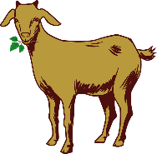
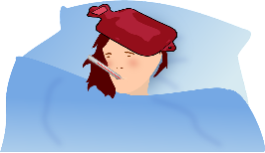
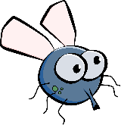
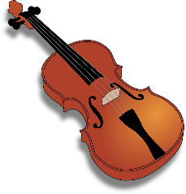
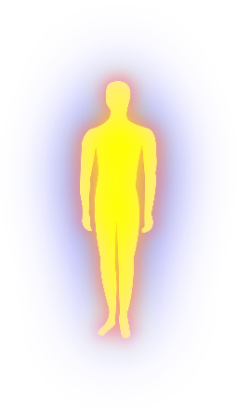
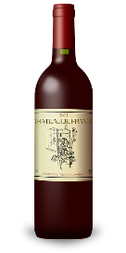
Phonetik
Partner A: Schreib fünf Wörter.
lesen / sprechen
Du sollst sie nicht zeigen!
Partner B: Sag alle Wörter.
Versuch, die fünf Wörter zu sagen.
10
die Ziege
die Wiese
das Fieber
die Liebe
die Fliege
das Schwein
Sekunden
die Freiheit
die Zeit
die Geige
die Allergie
die Beine
die Leiber*
der Haifisch
0
die Leiber – bodies
die Biene
der Frieden
der Wein
LOS!
Notes:
Timing: 3 minutes Aim: To revisit SSC [ei] and [ie] in a read aloud task. Procedure: 1. Partner A writes down 5 of the words on the slide. 2. Partner B, without seeing A’s list, says all the words on the slide as quickly as possible, trying to match all of Partner A’s list before the 40 seconds is up. Note: Partner A should listen very carefully to B’s pronunciation. S/he doesn’t need to cross a word off if the [ei] and [ie] are pronounced wrongly! 3. Swap roles. 4. Note: this activity can be repeated a couple of times.
Word frequency of cognates and unknown words (1 is the most frequent word in German): Allergie [>5009] Bein [884] Biene [>5009] Fieber [4774] Fliege [3994] Freiheit [814] Frieden [1696] Geige [>5009] Haifisch [>5009] Leib [3274] Liebe [844] Schwein [2975] Wein [1736] Wiese [2963] Ziege [>5009]
Source: Jones, R.L. & Tschirner, E. (2019). A frequency dictionary of German: core vocabulary for learners. Routledge

Slide 72
[ei/ ai]
Phonetik
Consolidation [12]
Y9 T2.2 Week 1 Slides 16-19

Slide 73
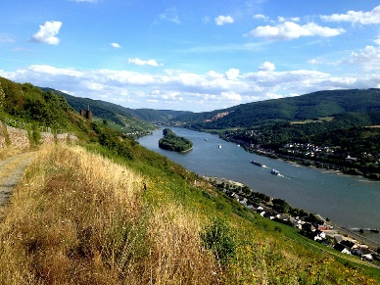
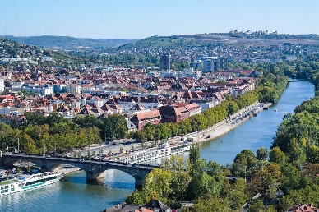
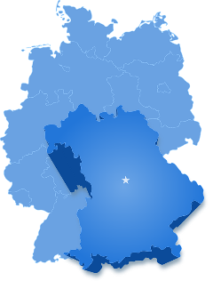
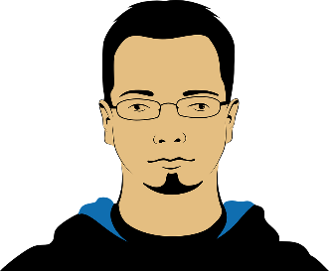
Phonetik
lesen
As you know, [ei] and [ai] sound the same.
This sound can also be spelled with the letters [ay] and [ey]:
Rhein
Main
Bayern
Meyer
Speyer
However, as you know, [ie] sounds different:
Wien
fließt
*fließen – to flow
Notes:
Timing: 2 minutes Aim: to learn the different ways the [ei] sound can be spelled.
Procedure: 1. Click to bring up the stages of the explanation.
2. Click to hear a native speaker say the example words.

Slide 74
Phonetik
lesen
Some verbs like ‘bleiben’ change ‘ei’ in their stem to ‘ie’ in the past participle.
bleiben
Du bist in Sicherheit geblieben.
You stayed safe.
beschreiben
Er hat seine Vergangenheit beschrieben.
He described his past.
schreiben
Ich habe eine Übersetzung geschrieben.
I wrote a translation.
Notes:
Timing: 2 minutes Aim: to learn the different ways the [ei] sound can be spelled in verbs.
Procedure: 1. Click to bring up the stages of the explanation.
2. Elicit German pronunciation for each element and then elicit the English translation.

Slide 75
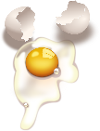
Phonetik [1/2]
lesen / hören
Dieser Dichter schreibt Sätze mit den SSC [ei] und [ie].
Hör zu. Wie viele Wörter [ei] und [ie] hörst du?
Person A liest die Sätze laut. Person B dreht sich um  und schreibt / für jede SSC.
 |  | [ei] | [ie]
 | Shhhh! Leise sein! Sie liest.
 | Oh nein! Hier ist ein Hai, der frei schwimmt!
 | Ich habe leider eine Eierallergie.
 | Herr Meyer wohnt lieber in Bayern.
/
1
//
/
2
////
/
3
///
/
4
//
/
Notes:
Timing: 6 minutes (2 slides) Aim: to practise long and short [e] sounds.
Procedure: 1. Partner B turns away.
2. Click to bring up the table of four sentences.
3. Partner A reads the four sentences.
4. Partner B writes down how many [ei] and [ie] sounds they hear in each sentence.
5. Click to reveal answers.
6. Repeat on the following slide with partners swapping roles. Note: there is no audio with this task.
Word frequency (1 is the most frequent word in German): Hai [>5009] Ei [1999] Allergie [>5009] leise [1166] Source: Jones, R.L. & Tschirner, E. (2019). A frequency dictionary of German: core vocabulary for learners. Routledge

Slide 76
Phonetik [2/2]
lesen / hören
Hör zu. Wie viele [ei] und [ie] hörst du?
Person B liest die Sätze laut. Person A dreht sich um  und schreibt / für jede SSC.
 |  | [ei] | [ie]
 | Frau Baier, die siebzig ist, lebt in Speyer.
 | Im Mai gewinnt sie wieder einen Preis.
 | Sie zeigt ein Ziel auf der Seite.
 | Er hat ein Lied vom Leid geschrieben.
1
//
//
2
///
//
3
///
//
4
//
//
Notes:
Slide 2

