Slide 1
Grammar
Definite articles: the words for ‘the’
Y7 German
Term 1.1 - Week 1
Author name(s): Inge Alferink & Rachel Hawkes
Date updated: 20/01/20

Slide 2
Nouns
All German nouns start with a capital letter, wherever they are in the sentence.
For example: Der Tag ist kalt.
Which nouns do this in English?
Proper nouns, e.g. London, September, Monday, Emily.

Slide 3
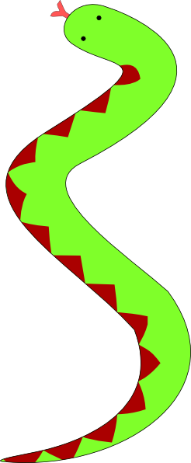
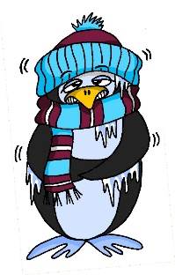
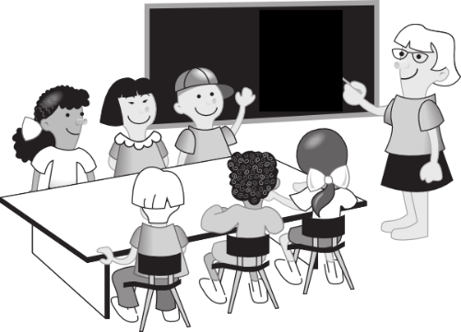
lang
Mann
danke
6 Meter
kalt
Gast
Klasse
[guest]
Notes:
Ask students why they think some of the cluster words have capital letters? Do they know any other words like this?
What is missing from these cluster words? (Answer: der, die, das)

Slide 4
der, die, und das
German has three words for the:
masculine
feminine
neuter
die Flasche
das Fenster
der
die
das
der Tisch
English speakers might find this tricky because English only uses the.
Every noun has a gender, but grammatical gender is not the same as biological gender, as you have seen.
Notes:
Note: After bringing up the der / die / das, try to elicit nouns from students – clearly they know two possibilities for ‘die’ and ‘das’ so they could get it right and wrong – i.e. guess a possibly correct word, but get the noun wrong. It’s important for teachers to draw out the importance of prediction based on gender. Depending on the class, it might be interesting for students to know that native speakers of languages with gender begin to predict what is going to be talked about as soon as the gender word is said – i.e. if there are two objects in view and just the word for ‘the’ is said, it is already clear what is being talked about. This classification of nouns by gender serves to speed up identification (fractions of a second, but still interesting and important!)
The key point for teachers to emphasise is that students need to learn nouns with their gender from the first encounter and practise recalling them frequently. The next slide models the effect of gender knowledge, by asking students to either point or turn their heads towards the correct object, in response to only hearing the word for ‘the’. This is another practice activity for learning the genders of nouns from this week.

Slide 5
masculine
feminine
neuter
Fenster
Flasche
Gast
Tisch
Tafel
Klasse
Mann
Paar
Heft
Tag
Notes:
Classify into der, die, or das

Slide 6
masculine
feminine
neuter
60
der Gast
die Flasche
das Paar
der Tisch
die Klasse
das Heft
Sekunden
der Tag
die Tafel
das Fenster
der Mann
0
ANFANG
Notes:
Slide for students to pronounce all the words aloud in pairs again. Teacher to remind students that every noun is written with a capital letter in German. That’s important for the next task!

Slide 7
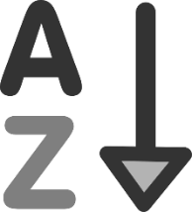
masculine
feminine
neuter
60
der Gast
die Flasche
das Paar
der Tisch
die Klasse
das Heft
Sekunden
der Tag
die Tafel
das Fenster
der Mann
0
ANFANG
Notes:
Time allowing, students could be required to read the words aloud again, taking turns, but in alphabetical order this time. This slows down their attentional resources and may just help them focus on the detail of the spelling a little better. They will be trying to write the words from memory in the next task.

Slide 8
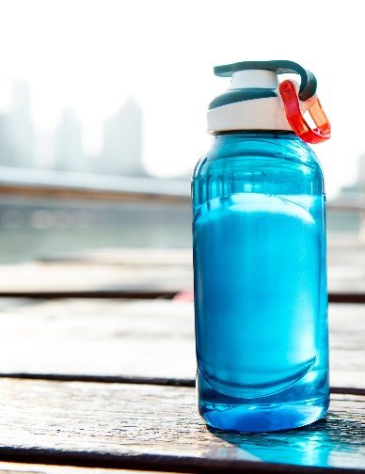
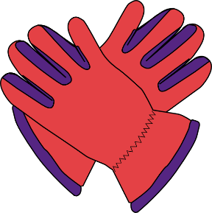
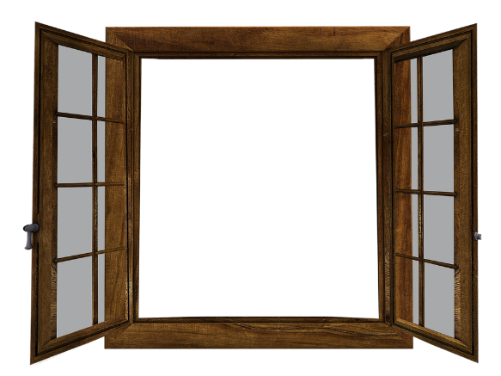
A
B
1. Wo ist die ?
2. Wo ist das ?
Notes:
Students write the word either in their exercise books OR on mini whiteboards. There are advantages to both of these – sometimes it is ‘time’ that decides! There are 6 items in the task.
The pictures are labelled A or B for differentiation purposes. Students can identify which item/picture completes the sentence (write down A / B), and then try to write the missing noun down in German (remembering the capital letter of course!) There might be some who recognise which item it should be but can't remember the noun / spelling. They are still able to engage in the activity and be rewarded for recognising the gender, even if they can't recall the noun completely correctly.

Slide 9
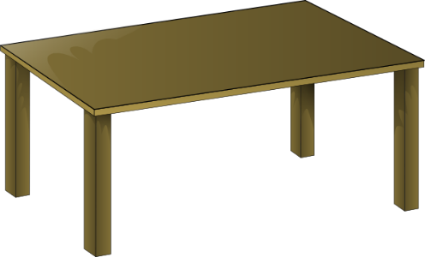
A
B
3. Wo ist der ?
4. Wo ist die ?

Slide 10
A
B
5. Wo ist das ?
6. Wo ist der ?

Slide 11
Antworten
Antworten
A
B
1. Wo ist die Flasche ? ?
2. Wo ist das Fenster ?

Slide 12
Antworten
A
B
Antworten
3. Wo ist der Tisch?
4. Wo ist die Tafel?

Slide 13
Antworten
A
B
5. Wo ist das Paar ? ?
6. Wo ist der Mann ?

Slide 14
der, die, oder das?
die Flasche
der Mann
der Tisch
die Tafel
das Heft
das Fenster
das Paar
die Klasse
der Tag
Notes:
Conclusion to lesson: First response to a noun = Ist es der, die oder das? (Incidental teaching of 'oder' - it will come back as phonics cluster word later.)
Ensure that students also recall the word meanings (as well as the gender). Eliciting the English is probably the quickest, simplest and clearest, here.

