Slide 1
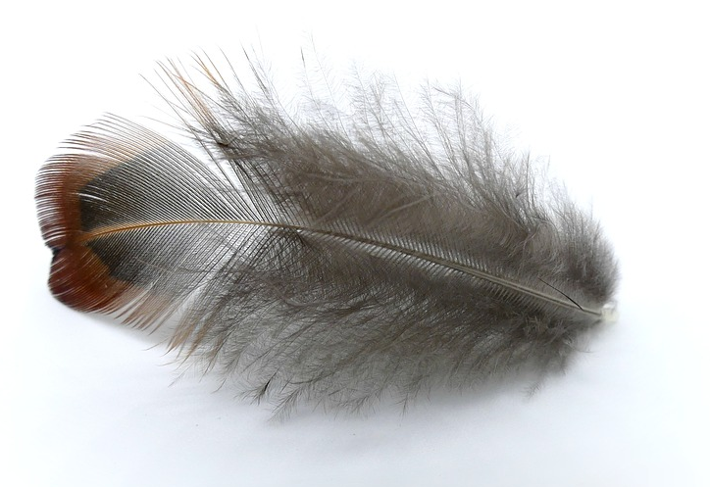
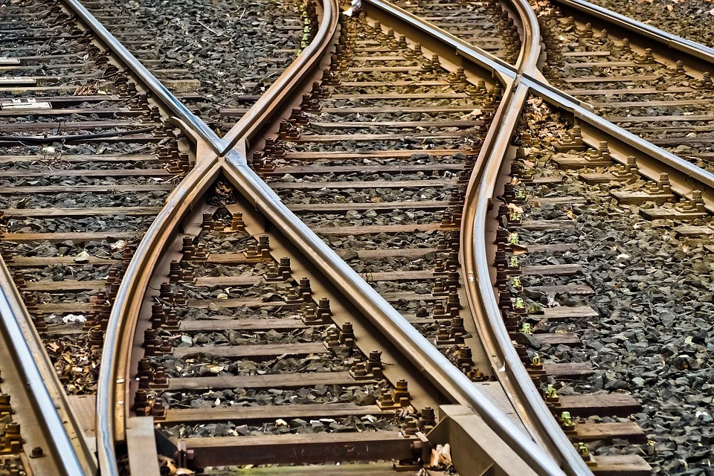
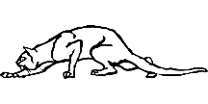
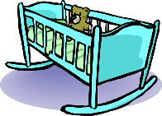
Phonetik
lesen / sprechen
60
Schiene [rail]
weich [soft]
Stein [stone]
biegen [bend]
Teich [pond]
fliehen [to flee]
Reis [rice]
schleichen [slink]
Sekunden
Leiter [ladder]
Frieden [peace]
beißen [to bite]
Wiege [crib]
Kiesel [pebble]
Sieg [victory]
Scheitel [parting]
Fliege [fly]
0
LOS!
Notes:
Timing: 1 minute for practice + 1 minute for saying them out loud Aim: To practise SSCs in unfamiliar word context. The time limit helps automatization. Procedure: 1. Students take 60 seconds to practise saying the words out loud to themselves. Click LOS! to start the timer.
2. Then teacher clicks and each word flashes a couple of times before disappearing. Students have to pronounce the word (in chorus) – teacher checks pronunciation this week (as Covid prevents circulating round the class currently).
Word frequency (1 is the most frequent word in German): Schiene [>5000], weich [1836], Stein [1404], biegen [2986], Teich [>5000], fliehen [2824], Reis [>5000], schleichen [4008], Leiter [1321], Frieden[1478], beißen [>5000], Wiege [>5000], Kiesel [>5000], Sieg [1246], Scheitel [>5000], Fliege [>5000]
Source: Jones, R.L. & Tschirner, E. (2019). A frequency dictionary of German: core vocabulary for learners. Routledge

Slide 2
Fonética
escuchar / escribir
Text
Notes:
Timing:
Aim:
Procedure:
1.
2.
3.
4.
5.
Transcript:
Word frequency (1 is the most frequent word in Spanish):
Source: Davies, M. & Davies, K. (2018). A frequency dictionary of Spanish: Core vocabulary for learners (2nd ed.). Routledge: London

Slide 3
Phonétique
écouter
Text
Notes:
Timing:
Aim:
Procedure:
1.
2.
3.
4.
5.
Transcript:
Word frequency (1 is the most frequent word in French):
Source: Londsale, D., & Le Bras, Y. (2009). A Frequency Dictionary of French: Core vocabulary for learners London: Routledge.

