Slide 1
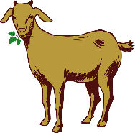
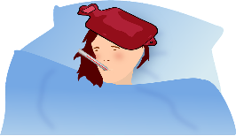
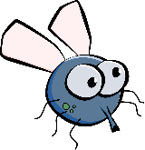
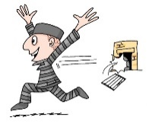
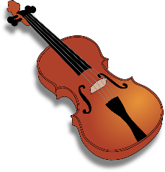
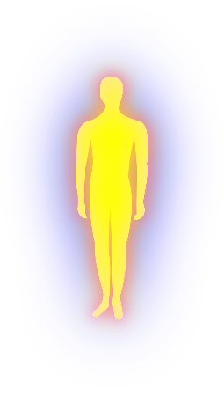
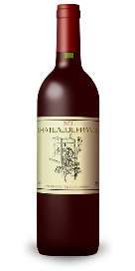
Phonetik
Partner A: Schreib fünf Wörter.
lesen / sprechen
Du sollst sie nicht zeigen!
Partner B: Sag alle Wörter.
Versuch, die fünf Wörter zu sagen.
10
die Ziege
die Wiese
das Fieber
die Liebe
die Fliege
das Schwein
Sekunden
die Freiheit
die Zeit
die Geige
die Allergie
die Beine
die Leiber*
der Haifisch
0
die Leiber – bodies
die Biene
der Frieden
der Wein
LOS!
Notes:
Timing: 3 minutes Aim: To revisit SSC [ei] and [ie] in a read aloud task. Procedure: 1. Partner A writes down 5 of the words on the slide. 2. Partner B, without seeing A’s list, says all the words on the slide as quickly as possible, trying to match all of Partner A’s list before the 40 seconds is up. Note: Partner A should listen very carefully to B’s pronunciation. S/he doesn’t need to cross a word off if the [ei] and [ie] are pronounced wrongly! 3. Swap roles. 4. Note: this activity can be repeated a couple of times.
Word frequency of cognates and unknown words (1 is the most frequent word in German): Allergie [>5009] Bein [884] Biene [>5009] Fieber [4774] Fliege [3994] Freiheit [814] Frieden [1696] Geige [>5009] Haifisch [>5009] Leib [3274] Liebe [844] Schwein [2975] Wein [1736] Wiese [2963] Ziege [>5009]
Source: Jones, R.L. & Tschirner, E. (2019). A frequency dictionary of German: core vocabulary for learners. Routledge

Slide 2
Fonética
escuchar / escribir
Text
Notes:
Timing:
Aim:
Procedure:
1.
2.
3.
4.
5.
Transcript:
Word frequency (1 is the most frequent word in Spanish):
Source: Davies, M. & Davies, K. (2018). A frequency dictionary of Spanish: Core vocabulary for learners (2nd ed.). Routledge: London

Slide 3
Phonétique
écouter
Text
Notes:
Timing:
Aim:
Procedure:
1.
2.
3.
4.
5.
Transcript:
Word frequency (1 is the most frequent word in French):
Source: Londsale, D., & Le Bras, Y. (2009). A Frequency Dictionary of French: Core vocabulary for learners London: Routledge.

