Slide 1
Spanish SSC
teaching sequence
A
Notes:
All pictures selected are available under a Creative Common license, no attribution required. This is the first 10-minute phonics sequence for the sound ‘a’

Slide 2
a
alto
Nick Avery / Juan Pedro Herrera
Notes:
Introduce and elicit the pronunciation of the individual SSC ‘A’ and then present and practise the pronunciation of the source word ‘alto’. A possible gesture for this source word would be to COMPLETE

Slide 3
a
alto
Nick Avery / Juan Pedro Herrera
Notes:
Repeat the ‘a’ sound and elicit the source word.

Slide 4
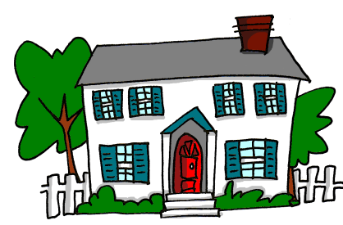
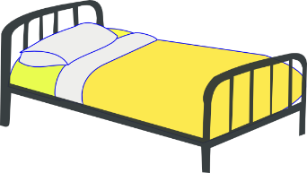
a
nada
amar
∅
casa
alto
agosto
cama
Nick Avery
Notes:
Recap individual SSC ‘A’ and then the source word again (with gesture, if using). Then present and elicit the pronunciation of the five cluster words. The cluster words have been chosen for their high-frequency, from a range of word classes, with the SSC (where possible) positioned within a variety of syllables within the words(e.g. initial, 2nd, final etc..) and additionally, we have tried to use words that build cumulatively on previously taught SSCs (see the Phonics Teaching Sequence document) and do not include new SSCs. Where new SSCs are used, they are often consonants which have a similar symbol-sound correspondence in English. Word frequency rankings: alto [231]; nada [87]; casa [106] cama [609]; amar [700]; agosto [931] Source: Davies, M. & Davies, K. (2018). A Frequency Dictionary of Spanish: Core vocabulary for learners (2nd ed.) London: Routledge.

Slide 5
a
nada
amar
casa
alto
agosto
cama
Nick Avery / Juan Pedro Herrera
Notes:
Without the images, students focus this time again closely on the SSC and the cluster words.

Slide 6
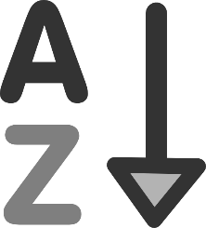
60
alto
agosto
nada
amar
Segundos
casa
cama
0
EMPEZAR
Nick Avery / Juan Pedro Herrera
Notes:
Alphabetical read aloud Individually (but all at once) pupils read out the words but in alphabetical order. They keep going for one minute.
Teacher can circulate to listen into their SSC knowledge.

Slide 7
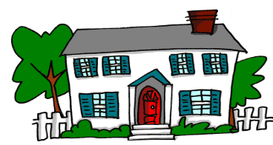
1
alto
∅
nada
2
casa
3
4
cama
agosto
5
amar
6
Nick Avery / Juan Pedro Herrera
Notes:
Optional dictation task 1-6. Teacher reads words aloud and students write them, then check. As this is the first session with this SFC, it makes sense to check the spelling after each one, and encourage students to correct any errors as they go. It’s helpful to present this as an activity, not as a test!

Slide 8
August - agosto
1
bed - cama
2
to love - amar
3
nothing - nada
4
tall - alto
5
house - casa
6
Nick Avery / Juan Pedro Herrera
Notes:
Optional dictation task 2 1-6. Teacher reads words aloud and students write them in ENGLISH, then check.
Note: The order of items has been changed to increase the challenge and prevent rote order memorisation.
This is to support the students in establishing the meaning of these HF words, as well as leaning the sound-symbol correspondence.

