Slide 1
Describing your family
être (nous, vous)
regular plural marker on adjectives (-s)
SSC [e] [revisited]
Y7 French
Term 2.1 - Week 2 - Lesson 32
Stephen Owen / Emma Marsden / Catherine Morris
Artwork by: Chloé Motard
Date updated: 04/08/2022
Notes:
Artwork by Chloé Motard. All additional pictures selected are available under a Creative Commons license, no attribution required.
Learning outcomes (lesson 1):
Consolidation of SSC [e]
Introduction of être (nous, vous)
Introduction of regular plural marker on adjectives (-s)
Consolidation of regular adjective gender agreement
Word frequency (1 is the most frequent word in French):
7.2.1.2 (introduce) êtes [5], sommes [5], sont [5], frère [1043], parent [546], sœur [1558], jeune [152], grand² [59], petit² [138], ouvert [897], sage¹ [2643], strict [1859]
7.1.2.6 (revisit) chanter [1820], étudier [960], jouer [219], ils [13], elles [38], élève [1068], fruit [896], histoire¹ [263], radio [1526], ensemble [124]
7.1.2.1 (revisit) ciel [1538], couleur [1211], poème [3031], poète [2307], rêve [1313], vague [1493], bleu [1216], jaune [2585], rouge [987], vert [1060], comme¹ [32]
Source: Londsale, D., & Le Bras, Y. (2009). A Frequency Dictionary of French: Core vocabulary for learners London: Routledge.
The additional English meanings of the following words have been added to Quizlet since the creation of this resource: petit (short, small, little)
The frequency rankings for words that occur in this PowerPoint which have been previously introduced in NCELP resources are given in the NCELP SOW and in the resources that first introduced and formally re-visited those words.
For any other words that occur incidentally in this PowerPoint, frequency rankings will be provided in the notes field wherever possible.

Slide 2
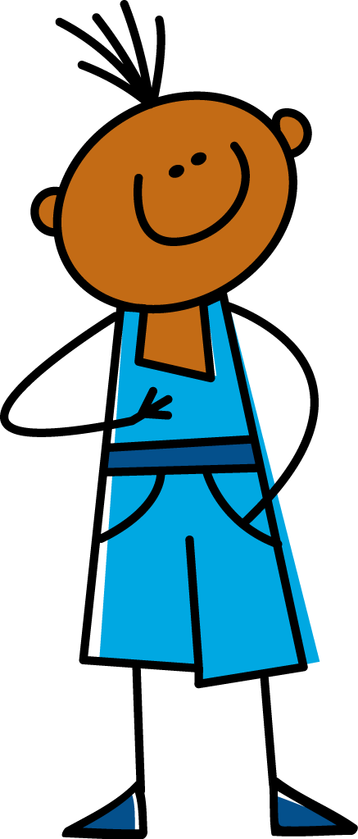
e
je
Notes:
Timing: 1 minute
Aim: To consolidate SSC [e]
Procedure: 1. Present the letter(s) and say the [e] sound first, on its own. Students repeat it with you. 2. Bring up the word ”je” on its own, say it, students repeat it, so that they have the opportunity to focus all of their attention on the connection between the written word and its sound.
3. A possible gesture for this would be to point to oneself. 4. Roll back the animations and work through 1-3 again, but this time, dropping your voice completely to listen carefully to the students saying the [e] sound, pronouncing ”je” and, if using, doing the gesture.
Word frequency (1 is the most frequent word in French):
je [22]. Source: Londsale, D., & Le Bras, Y. (2009). A Frequency Dictionary of French: Core vocabulary for learners London: Routledge.

Slide 3
e
je
Notes:
With sound and no pictures to focus all attention on the sound-symbol correspondence.

Slide 4
e
je
Notes:
Without sound to elicit pronunciation (without first hearing the teacher).
Teacher to elicit pronunciation by asking “Comment dit-on …"

Slide 5
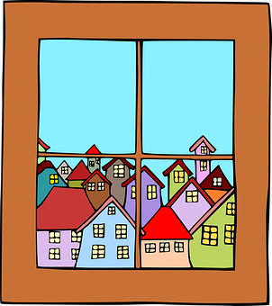
e
fenêtre
cela
[that]
je
second
cheval
devoir
[to have to]
Notes:
Timing: 2 minutes
Aim: To consolidate SSC [e]
Procedure:
1. Introduce and elicit the pronunciation of the individual SSC [e] and then the source word again ‘je’ (with gesture, if using). 2. Then present and elicit the pronunciation of the five cluster words.
The cluster words have been chosen for their high-frequency, from a range of word classes, with the SSC (where possible) positioned within a variety of syllables within the words (e.g. initial, 2nd, final etc.). Additionally, we have tried to use words that build cumulatively on previously taught SSCs (see the Phonics Teaching Sequence document) and do not include new SSCs. Where new SSCs are used, they are often consonants which have a similar symbol-sound correspondence in English.
Word frequency (1 is the most frequent word in French): fenêtre [1604]; cela [54] second [379]; devoir [39]; cheval [2220]; je [22]. Source: Londsale, D., & Le Bras, Y. (2009). A Frequency Dictionary of French: Core vocabulary for learners London: Routledge.

Slide 6
e
fenêtre
cela
je
second
cheval
devoir
Notes:
With sound and no pictures to focus all attention on the sound-symbol correspondence.

Slide 7
e
fenêtre
cela
je
second
cheval
devoir
Notes:
Without sound to elicit pronunciation (without first hearing the teacher).
Teacher to elicit pronunciation by asking “Comment dit-on …"

Slide 8
Phonétique
parler
En français, quel mot a la SSC e ?
[to sing,
singing]
chemise
ch__nter
ch__mise
chanter
Notes:
Timing: 2 minutes for 3 slides
Aim: Aural recognition of SSC [e]
Procedure:
1. Students recall the French words that relate to the pictures on screen
2. Students decide which word contains the SSC [e]
3. Click to reveal first clue (French word with gap for SSC)
4. Click again to reveal answer

Slide 9
Phonétique
parler
En français, quel mot a la SSC e ?
[to close,
closing]
fermer
f__nêtre
f__mer
fenêtre

Slide 10
Phonétique
parler
En français, quel mot a la SSC e ?
2
deux
demander
de__x
de__mander

Slide 11
Phonétique
écouter / écrire
C’est [e] ou [ê/è] ?
rejet
gêner
bêche
nous ferons
1
elle sera
suprême
tête
cinquième
[she will be]
5
[rejection]
2
[supreme]
6
[to disturb]
3
[head]
7
[spade]
4
[fifth]
8
[we will do, make]
Notes:
Timing: 6 minutes
Aim: Aural recognition of SSCs [e] and [ê/è] in unknown words.
Procedure:
1. Click numbers to hear word pronunciation
2. Students fill in the blank
3. Answers revealed on clicks (allow EITHER [ê] or [è] for words with SSC [ê/è]).
Transcript and word frequency (1 is the most frequent word in French): sera [être-5], tête [343], suprême [2022], cinquième [2030], rejet [2455], gêner [2460], bêche [>5000], ferons [faire-25],
Source: Londsale, D., & Le Bras, Y. (2009). A Frequency Dictionary of French: Core vocabulary for learners London: Routledge.

Slide 12
Vocabulaire
lire
tall, big
sage
young
brother
les parents
parents
la sœur
strict
grand
petit
open
strict
jeune
well-behaved
sister
short, small, little
ouvert
le frère
Notes:
Timing: 3 minutes
Aim: Written recognition of words in this week’s vocabulary set.
Procedure:
1. As each English term appears, students say which French term it must ‘fly’ to.
2. After this has been done with the whole class, the teacher could run the slide again and ask the students to write down the French words before they appear.

Slide 13
Vocabulaire
écouter / parler
Here are some more adjectives to describe people:
Masculine
Feminine
Meaning
ouvert
ouverte
open
strict
stricte
strict
sage
sage
well-behaved
jeune
jeune
young
These already have an ‘e’!
Notes:
Timing: 2 minutes
Aim: Presentation of the adjectives from this week’s new vocabulary set.
This slide can be used in a number of ways:
To reinforce pronunciation changes in a “listen and repeat” whole class style
To check students’ understanding of the vocab
To practise pronunciation changes.
As a help-sheet which can be printed out for reference at any point during the speaking and writing activities for those students who need it. (Duplicate the slide and select print “2 to a page” for A5 size help sheets)
Procedure:
1. Whole class – the teacher asks individuals to give the correct answer.
or:
1. Pairwork - when the adjective disappears, ask students to turn to their partner and say the adjective out loud.
2. This could be then be practised a few times, with a competition element added by shortening the time sequence on the animation. Challenge pairs to complete within the new speeded up time.
3. You could point out the irregular ‘strict’ – the final consonant IS pronounced! This is often the case when a word comes from another language – the original pronunciation is sometimes retained.
4. Point out the ‘e’ at the end of jeune means that no additional ‘e’ is needed for the feminine agreemement.

Slide 14
Vocabulaire
lire
Le cousin d’Amir
The cousin of Amir … or, Amir’s cousin
We can use de + name to talk about what belongs to someone.
 | Meaning of grand/petit
 | big | small/little | tall | short
Le cousin d’Amir est grand
La sœur d’Amir est petite
La salle est grande
La chemise est petite
L’homme est grand
L’homme est grand
Notes:
Timing: 5 minutes
Aim: To raise awareness of multiple meanings of grand and petit
Procedure:
1. Students read sentences and use the context to decide what the adjective means.
2. Answers revealed on clicks.
3. Click to bring up the bubble reminding students of the meaning of de (of) and exemplifying it here with its possessive use.
Word frequency (1 is the most frequent word in French): cousin [3387]
Source: Londsale, D., & Le Bras, Y. (2009). A Frequency Dictionary of French: Core vocabulary for learners London: Routledge.

Slide 15
Introducing “we are”
grammaire
Remember the 1st, 2nd and 3rd person singular forms of the verb être (to be):
Je suis français.
I am French.
Remember, the last letter of all these verb forms is a
Silent Final Consonant!
Remember, the last letter of all these verb forms is a
Silent Final Consonant!
Tu es français.
You are French.
Le frère de Léa est petit.
Léa’s brother is short.
La sœur de Léa est petite.
Léa’s sister is short.
Remember, the feminine form of the adjective ends in -e!
To say ‘we’ + être (first person plural):
Nous sommes contents.
We are pleased.
Notes:
Timing: 3 minutes
Aim: This slide revises the parts of ‘être’ already met, then introduces the first person plural (nous).
Students have met the ‘nous’ form ending in -ons previously, so the irregularity of this one needs to be pointed out.
Procedure:
1. Read this out to students, so that they know exactly how to pronounce the French.
2. At the end, remind them to not sound out the ‘s’ at the end of ‘suis’, ‘es’ and ‘sommes’, and the ‘t’ at the end of ‘est’.

Slide 16
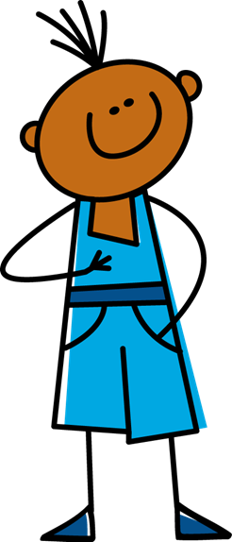
Je ou nous ?
󠇯
1
écouter
français - French
Notes:
Timing: 5 minutes for 8 slides
Aim: This series of slides provides aural input practice in distinguishing between the first person singular and first person plural forms of ‘être’.
Procedure:
1. Click the button to play audio with the pronoun obscured.
2. Students should note whether the first word of each sentence must be ‘je’ or ‘nous’.
3. They then write the English meaning of the adjective used in each sentence (to force vocabulary recall).
4. Answers appearing upon clicking the mouse.
Transcript:
[…] sommes français.

Slide 17
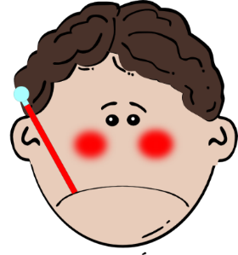
Je ou nous ?
󠇯
2
écouter
malade - ill
Notes:
Transcript
...... suis malade.

Slide 18
Je ou nous ?
󠇯
3
écouter
content - pleased
Notes:
Transcript
...... suis content.

Slide 19
Je ou nous ?
󠇯
4
écouter
grands - tall
Notes:
Transcript
...... sommes grands.

Slide 20
Je ou nous ?
󠇯
5
écouter
petit - short
Notes:
Transcript
...... suis petit.

Slide 21
Je ou nous ?
󠇯
6
écouter
anglais - English
Notes:
Transcript
...... sommes anglais.

Slide 22
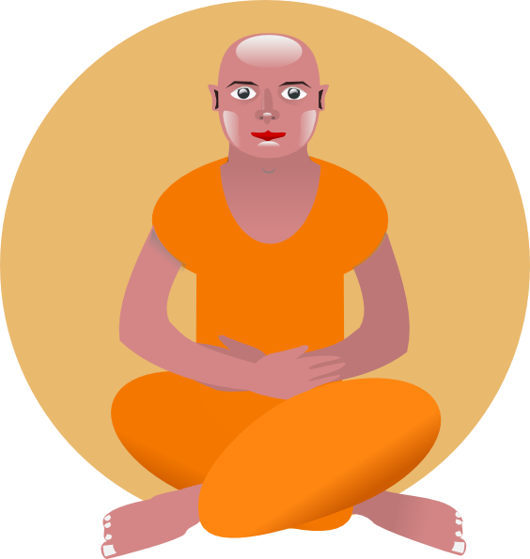
Je ou nous ?
󠇯
7
écouter
calme - calm
Notes:
Transcript
...... suis calme.

Slide 23
Je ou nous ?
󠇯
8
écouter
drôles - funny
Notes:
Transcript
...... sommes drôles.
Teachers should ask students here whether they notice anything about the adjective in the French, thereby eliciting noticing of the –s on the plural form. This grammar point is dealt with explicitly on the slides which follow.

Slide 24
Describing more than one thing
grammaire
Same as English!
Nouns make their plural with –s:
il y a un livre
there is a book
il y a deux livres
there are two books
Different
from English!
Adjectives also have to match their noun, adding –s for plural:
there are some expensive books
il y a des livres chers
The –s is not pronounced – it is a silent final consonant (SFC).
We have already met one type of adjective agreement (–e on the feminine form).
Notes:
Timing: 2 minutes
Aim: This slide recaps regular plural adjective agreement, pointing out that the adjective ‘matches’ the noun in taking the –s. The phrase ‘il y a’, introduced and practised the previous week, is revisited here. Plural nouns have also already been taught.
Procedure:
1. Also point out to students that the –s on the written form of a plural French noun/adjective is not usually pronounced (i.e. is a silent final consonant).

Slide 25
Describing more than one: We are…
grammaire
“Nous” (we) is a plural pronoun – it refers to more than one person.
Remember: There must be agreement between the adjective and noun!
So, adjectives describing “nous” need to be in a plural form:
Nous sommes contents.
We are pleased.
Don’t forget! The –s on the end of ‘sommes’ and the adjective are Silent Final Consonants.
Notes:
Timing: 2 minutes
Aim: This slide points out that the adjective must agree with the plural pronoun as well as with the noun, as in the example on the previous slide. N.B. The masculine plural form of the adjective having been introduced, the feminine plural is withheld for now, so that students may concentrate upon the new verb form (vous) to be introduced shortly, and also to avoid overcomplicating the treatment of the adjective (which would be a possibility, if we were to introduce all information at once). The feminine plural form of the adjective is dealt with as part of the next lesson.
Procedure:
1. Read this out to students so that they know exactly how to pronounce the French.
2. Remind them to not sound out the ‘s’ at the end of ‘sommes’, as well as that on the end of the adjectives.

Slide 26
C’est qui ? Nous ou je? Écris les adjectifs en anglais.
lire
 |  | nous (we) | je (I)
A | ... ... triste.
B | ... ... amusants.
C | ... ... intelligents.
D | ... ... grand.
E | ... ... petits.
F | ... ... calme.
G | ... ... intéressant.
H | ... ... contents.
sad
funny
intelligent
tall
short
calm
interesting
pleased
Notes:
Timing: 5 minutes
Aim: This reading activity asks students to recognise when the first-person plural form of the verb must have been used, by noticing the plural adjective agreement. The subject pronoun and verb is missing from each sentence, to force attention upon this aspect of the grammar.
Procedure:
1. It is worth explaining that this can only be done in reading, because the agreements are silent.
2. Students should also be asked to write the meanings of the adjectives in English.

Slide 27
“you (plural) are”: the verb être (to be)
grammaire
Earlier we learned:
You hear the ‘s’ on ‘vous’ because of the ‘ê’ which follows – this will be covered more next lesson.
s
Nous sommes content .
We are pleased.
Here is the second person plural of être: you to more than one person:
Vous êtes content .
s
You(more than one) are pleased.
Plural “YOU” (vous) also needs a plural adjective.
“êtes” does not end in –ez. This is different to the other ‘vous’ forms of verbs you have learned. This is because être – to be is an irregular verb.
Notes:
Timing: 2 minutes
Aim: Having introduced and practised recognising the ‘nous’ form, the ‘vous’ form (plural) of ‘être’ is now introduced.
Procedure:
1. Students have met the ‘vous’ form ending in –ez previously, so the irregularity of être needs to be pointed out.
2. You could explain that ‘to be’ in English is also very irregular: I am, You are, She is, We are… This helps students develop cross-linguistic awareness.
3. Note we are introducing ‘vous’ as a polite form of ‘you’ in later lessons.
4. N.B. The feminine plural of adjectives is withheld for now, so that students may concentrate upon the new verb form (vous), and also to avoid overcomplicating the treatment of the adjective. The feminine plural form of the adjective is dealt with as part of the next lesson.

Slide 28
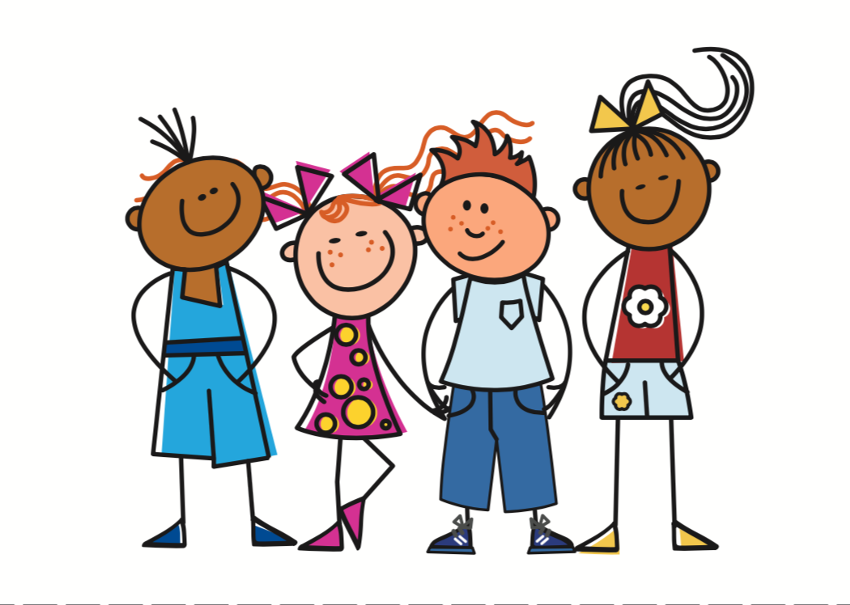
écouter
C’est qui ? Vous ou nous ?
Cochez.
vous (you plural) | nous (we)
1
2
3
4
5
6
7
8
Notes:
Timing: 5 minutes
Aim: This slide provides input (listening) practice in distinguishing between the newly-introduced ‘nous’ and ‘vous’ forms of ‘être’. It is an easier version of the task found on the next slide, which also requires some translation of vocabulary – please use the version appropriate for your students, or alternatively do this as a two-stage exercise.
Procedure:
1. N.B. While the students have not officially learned ‘cochez', the picture of the tick should help them to understand this instruction. The teacher can ask the students why the verb ‘cochez’ has –ez at the end.
Transcript:
...... sommes calmes.
...... êtes contents.
...... êtes petits.
...... sommes grands.
...... êtes tristes.
...... sommes méchants.
...... êtes amusants.
...... êtes intéressants.
Word frequency (1 is the most frequent word in French): êtes [5], sommes [5], grand², petit²
Source: Londsale, D., & Le Bras, Y. (2009). A Frequency Dictionary of French: Core vocabulary for learners London: Routledge.

Slide 29
écouter
C’est qui ? Vous ou nous ?
Écris le mot en anglais.
vous (you plural) | nous (we)
1
calm
2
pleased
3
short
4
tall
5
sad
6
mean
7
funny
8
interesting
Notes:
Timing: 2 minutes
Aim: This slide provides input (listening) practice in distinguishing between the newly-introduced ‘nous’ and ‘vous’ forms of ‘être’. N.B. While the students have not officially learned 'mot', they have met it as a phonics cluster word in 1.1.1 and 1.2.5.
Procedure:
1. In asking students to write the English for the adjectives, which have all been introduced and practised in previous weeks, it also provides an opportunity for vocabulary revision. This also raises the level of challenge of the task.
Transcript:
...... sommes calmes.
...... êtes contents.
...... êtes petits.
...... sommes grands.
...... êtes tristes.
...... sommes méchants.
...... êtes amusants.
...... êtes intéressants
Word frequency (1 is the most frequent word in French): êtes [5], sommes [5], grand², petit²
Source: Londsale, D., & Le Bras, Y. (2009). A Frequency Dictionary of French: Core vocabulary for learners London: Routledge.

Slide 30
C’est qui ? Vous ou nous ?
parler
Choose three adjectives. Say three sentences to describe yourself and your friends (we).
Choose three different adjectives. Say three sentences to describe your partner and their friends (you plural).
tall
pleased
mean
funny
interesting
-s
short
intelligent
calm
Notes:
Timing: 5 minutes
Aim: Oral production of the newly-introduced ‘nous’ and ‘vous’ forms of ‘être’. It also provides an opportunity for vocabulary revision.
Procedure:
1. Students split into pairs.
2. Students take turns to say sentences in the nous and vous forms, taking care not to pronounce the –s on the adjective. Students should use each adjective only once.

Slide 31
Écris en français !
écrire
anglais | français
1) I am calm.
2) You [singular, male] are pleased.
3) She is short.
3) He is tall.
4) We are sad.
5) You [plural] are mean.
6) We are funny.
7) You [plural] are interesting.
Je suis calme.
Tu es content.
Elle est petite.
Il est grand.
Nous sommes tristes.
Vous êtes méchants.
Nous sommes amusants.
Vous êtes intéressants.
Notes:
Timing: 10 minutes
Aim: Written production of plural adjectives.
Procedure:
1. The answers to this translation task appear upon successive clicks of the mouse.
2. N.B. Feminine forms (singular and plural) will be featured next lesson. It is unlikely that any student will put the feminine 'e' on the plural adjectives here.
Word frequency (1 is the most frequent word in French): êtes [5], sommes [5], grand², petit²
Source: Londsale, D., & Le Bras, Y. (2009). A Frequency Dictionary of French: Core vocabulary for learners London: Routledge.

Slide 32
Describing your family
être (ils/elles)
regular plural marker on adjectives (-s)
SSC [e] [revisited]
Y7 French
Term 2.1 - Week 2 - Lesson 32
Stephen Owen / Emma Marsden / Catherine Morris
Artwork by: Chloé Motard
Date updated: 04/08/2022
Notes:
Artwork by Chloé Motard. All additional pictures selected are available under a Creative Commons license, no attribution required.
Learning outcomes (lesson 2):
Consolidation of SSC [e]
Introduction of être (ils/elles)
Consolidation of regular plural marker on adjectives (-s)
Consolidation of regular adjective gender agreement
Word frequency (1 is the most frequent word in French):
7.2.1.2 (introduce) êtes [5], sommes [5], sont [5], frère [1043], parent [546], sœur [1558], jeune [152], grand² [59], petit² [138], ouvert [897], sage¹ [2643], strict [1859]
7.1.2.6 (revisit) chanter [1820], étudier [960], jouer [219], ils [13], elles [38], élève [1068], fruit [896], histoire¹ [263], radio [1526], ensemble [124]
7.1.2.1 (revisit) ciel [1538], couleur [1211], poème [3031], poète [2307], rêve [1313], vague [1493], bleu [1216], jaune [2585], rouge [987], vert [1060], comme¹ [32]
Source: Londsale, D., & Le Bras, Y. (2009). A Frequency Dictionary of French: Core vocabulary for learners London: Routledge.
The additional English meanings of the following words have been added to Quizlet since the creation of this resource: petit (short, small, little)
The frequency rankings for words that occur in this PowerPoint which have been previously introduced in NCELP resources are given in the NCELP SOW and in the resources that first introduced and formally re-visited those words.
For any other words that occur incidentally in this PowerPoint, frequency rankings will be provided in the notes field wherever possible.

Slide 33
Phonétique
belette
parler
pelage
[weasel]
45
degré
[fur]
devenir
je serai
[to become]
dedans
[I will be]
celui
secondes
menace
[inside]
[the one]
il fera
[threat]
delà
0
DÉBUT
[he will do, he will make]
[beyond]
Notes:
Timing: 3 minutes
Aim: Oral production of SSC [e]
Procedure:
1. Students work in pairs pronouncing the words on the slide, taking it in turns, and making sure all words have been said at least once.
2. The teacher can circulate during this activity to listen into students’ SSC knowledge.
3. Click to hear words pronounced by a native speaker.
Frequency of unknown vocabulary (1 is the most frequent word in French): degré [1311], devenir [162], se [17], menace [1607], fera [faire-25], dedans [3058], pelage [>5000], serai [être-5], belette [>5000], delà [4367], celui [45]
Source: Londsale, D., & Le Bras, Y. (2009). A Frequency Dictionary of French: Core vocabulary for learners London: Routledge.

Slide 34
Vocabulaire – révisions 1
lire / parler
60
 | français | anglais
1
2
3
4
5
6
7
8
9
10
jouer
to play, playing
un/une élève
pupil
ensemble
together
Secondes
chanter
to sing, singing
étudier
to study, studying
ils
they (mpl)
elles
they (fpl)
le fruit
fruit
la radio
radio
0
l'histoire (f)
history
DÉBUT
Notes:
Timing: 2 minutes
Aim: This slide facilitates a quick check of students’ knowledge of the first set of previous vocabulary revised this week (as shown below).
Procedure:
1. First, the French words appear, without the English – students should be challenged to give the meaning of each item.
2. The English then appears to confirm the meanings.
3. Then the French disappears, leaving just the English – students should then be challenged to provide the French for each item.
4. Finally, the French reappears, alongside the English.
5. Before you begin, check the pronunciation of ‘ils’ and ‘elles’ and ensure that the students understand the SFC (silent final consonant).

Slide 35
Vocabulaire – révisions 2
lire / parler
60
 | français | anglais
1
2
3
4
5
6
7
8
9
10
11
le ciel
sky
comme
like
la couleur
colour
le rêve
dream
Secondes
le poème
poem
la vague
wave
bleu
blue
jaune
yellow
rouge
red
0
vert
green
DÉBUT
le/ la poète
poet (m/f)
Notes:
Timing: 2 minutes
Aim: This slide facilitates a quick check of students’ knowledge of the second set of previous vocabulary revised this week (as shown below).
Procedure:
1. First, the French words appear, without the English – students should be challenged to give the meaning of each item.
2. The English then appears to confirm the meanings.
3. Then the French disappears, leaving just the English – students should then be challenged to provide the French for each item.
4. Finally, the French reappears, alongside the English.

Slide 36
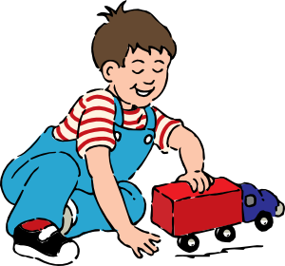
Vocabulaire (1/2)
parler
10
[tall, big]
[short, small, little]
[open]
grand
petit
ouvert
secondes
[wise, well behaved]
[young]
[strict]
0
sage
jeune
strict
DÉBUT
Notes:
Timing: 2 minutes for two slides Aim: Written production of words in this week’s vocabulary set. This is slide 1/2.
Procedure:
1. Say all words in French before ten seconds elapse.
2. Click to reveal answers.
3. Proceed to next slide and repeat steps 1-2.
Source: Londsale, D., & Le Bras, Y. (2009). A Frequency Dictionary of French: Core vocabulary for learners London: Routledge.

Slide 37
Vocabulaire (1/2)
parler
[parents]
10
les parents
[sister]
[brother]
la sœur
le frère
secondes
[you are]
(plural)
[they are]
[we are]
vous êtes
ils/elles sont
nous sommes
0
DÉBUT
Notes:
This is slide 2/2.

Slide 38
Vocabulaire
écrire
strict
strict
brother
le frère
young
jeune
sister
la sœur
open
ouvert
parents
les parents
well-behaved
sage
short, small
petit
tall, big
grand
Notes:
Timing: 3 minutes
Aim: Written production of new vocabulary.
Procedure:
1. The English word appears on mouse click.
2. Students have to try to write the French translation before it appears on second mouse click. (French words are on 20-second long animation).

Slide 39
Describing others
grammaire
We have met the third person singular (s/he) form of the verb être (to be):
Il est content.
He is pleased.
Remember: the feminine form of the adjective adds –e (agreement):
Elle est contente.
She is pleased.
The –e is silent, but it makes you pronounce the ‘t’ before it!
Notes:
Timing: 1 minute
Aim: This slide reminds students of the third person singular form of ‘être’, which will be juxtaposed with the third person plural form (about to be introduced) over the next few slides. It also reminds them of the ‘e’ feminine adjective agreement (the feminine plural adjective agreement will be introduced on the next slide).
Procedure:
1. Read this out to students so that they know exactly how to pronounce the French.

Slide 40
Describing others – THEY are
grammaire
The –s at the end of ils and elles is silent!
To talk about about the third person plural form of the verb être (to be), they are:
Ils sont intelligents.
They (masc. pl) are intelligent.
Remember: in French the pronoun ‘they’ is different for masculine and feminine:
Elles sont intelligentes.
They (fem pl) are intelligent.
The –s on the end is silent, but again the –e makes you pronounce the ‘-t’!
The feminine form of the adjective adds –e and –s
Notes:
Timing: 2 minutes
Aim: There is a lot of information here, but the following activities break it down and practise each part. The first and second person plural forms of the verb ‘être’ having been presented last lesson, this slide introduces the third person plural form – ‘sont’. This verb form has other features that come with it: the ‘ils’ and ‘elles’ pronouns, and also another type of adjective agreement.
Procedure:
1. Read out the French, so that the students hear ‘sont’.
2. Explain ‘masc pl’ and ‘fem pl’ to students – ‘masculine plural’ and ‘feminine plural’ respectively. This will get shortened to mpl and fpl in the next slides and in the Quizlet homeworks.
3. Read this out to students, so that they know exactly how to pronounce the French.
4. Remind them to not sound out the ‘s’ at the end of ‘sont’.
5. N.B. Later, we will cover later the issue that if there is one male in a group, then the ‘ils’ pronoun is used. There is a lot of information here, so we hold this back until later.

Slide 41
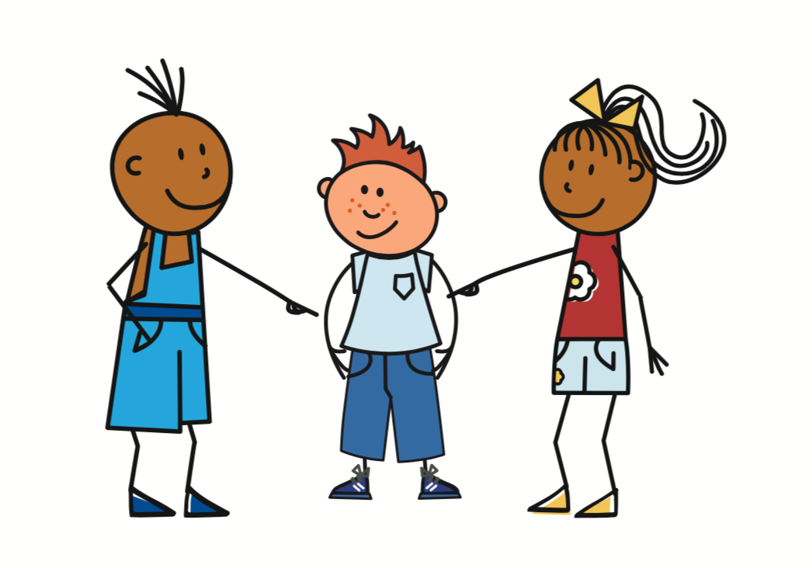
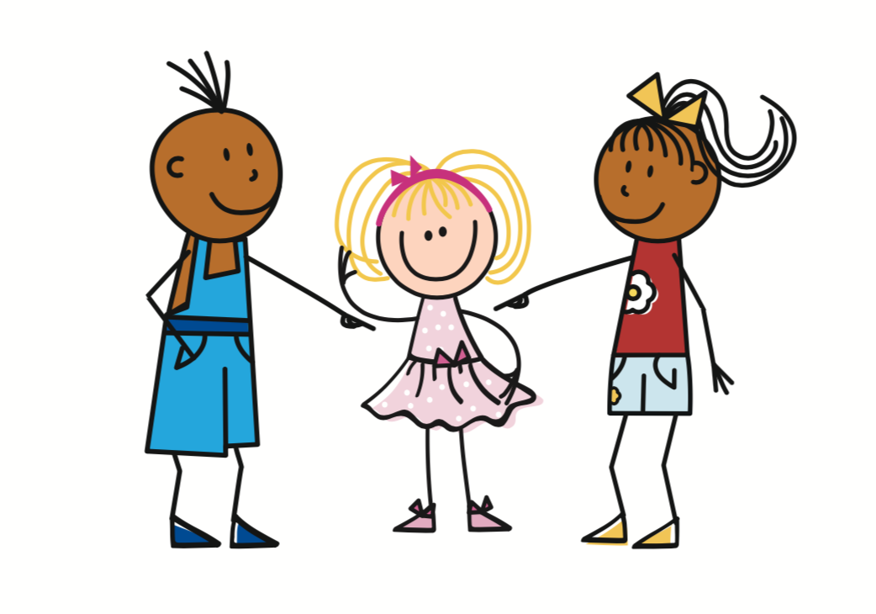
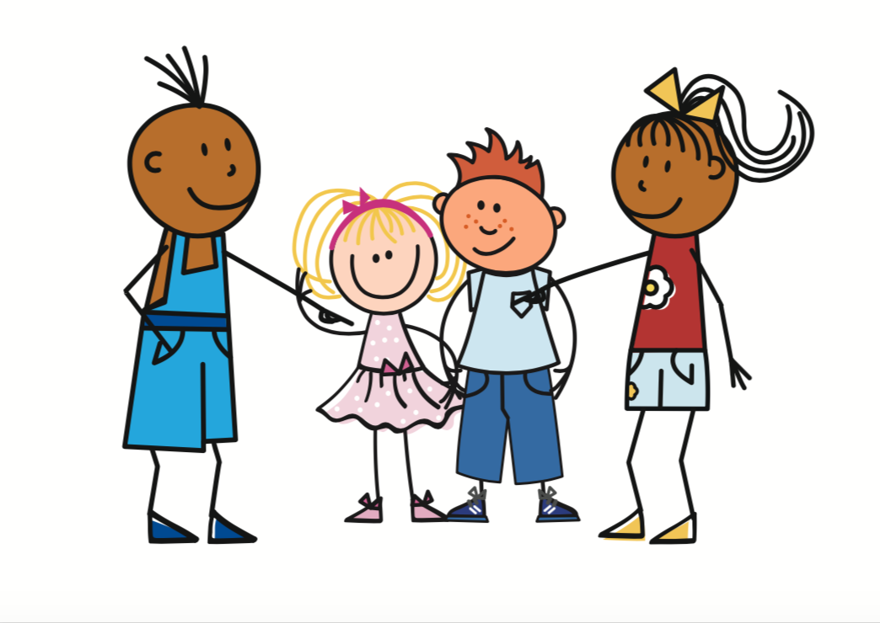
C’est qui? Il/elle ou ils/elles?
lire
 | anglais | il / elle (he / she) | ils / elles (they)
1
2
3
4
5
6
7
8
...... est petit.
...... est sage.
...... sont contents.
...... sont grandes.
...... est calme.
...... sont drôles.
...... sont anglais.
...... est intelligent.
Notes:
Timing: 5 minutes
Aim: Written recognition of the third person singular and third person plural forms of être.
Procedure:
Students attend to the verb form to determine singular or plural.
Answers revealed on clicks.

Slide 42
C’est qui? Il/elle ou ils/elles?
écouter
 | anglais | il / elle (he / she) | ils / elles (they)
1
(They - fpl) are tall.
2
(He) is pleased.
3
(S/he) is well-behaved.
4
(They - mpl) are intelligent.
5
(She) is short.
6
(They - fpl) are pleased.
7
(They - mpl) are interesting.
8
(He) is tall.
Notes:
Timing: 5 minutes
Aim: Aural recognition of the third person singular and third person plural forms of être.
Procedure:
1. Click on a number to hear a sentence with the pronoun obscured.
2. Students listen for the verb form (to determine singular or plural).
3. To provide an additional challenge and check understanding of vocabulary (a mix of new and old), they are then asked to write the English in the space provided (focusing only on singular or plural, plus the adjective meaning).
4. The answers appear upon successive mouse clicks (gender information in brackets).
Transcript:
... sont grandes.
... est content.
... est sage.
... sont intelligents.
... est petite.
... sont contentes.
... sont intéressants.
... est grand.

Slide 43
Les adjectifs
lire
Les sœurs sont ......
1 |  | intelligente | intelligentes
2 |  | contente | contentes
3 |  | drôle | drôles
4 |  | petit | petits
5 |  | sage | sages
6 |  | calme | calmes
7 |  | méchant | méchants
8 |  | amusant | amusants
La sœur est ......
Le frère est ......
Le frères sont ......
If there is a mix of male and female people in the group, we use the masculine form ils.
Les sœurs sont ......
La sœur est ......
Les parents sont ......
Le frère est ......
Notes:
Timing: 5 minutes
Aim: Written recognition of the third person singular and third person plural forms of être, and adjectives with gender and number agreement.
Procedure:
1. In this second reading activity, students are required to attend to the subject pronoun and verb form to determine singular or plural.
2. Then select the correct form of the adjective.
3. Answers revealed on clicks.
4. Click to bring up the bubble highlighting the use of ils with mixed gender groups, exemplified here with parents.
Word frequency (1 is the most frequent word in French): adjectif [>5000]
Source: Londsale, D., & Le Bras, Y. (2009). A Frequency Dictionary of French: Core vocabulary for learners London: Routledge.

Slide 44
C’est qui?
écouter
 | anglais | le frère (brother, he) | la sœur (sister; she) | les frères (brothers, they mpl) | les sœurs (sisters, they fpl)
1
(The sister) is pleased.
2
(The brothers) are intelligent.
3
(The brother) is pleased.
4
(The sisters) are interesting.
5
(The brothers) are pleased.
6
(The brother) is open.
7
(The sister) is tall.
8
(The sisters) are short.
Notes:
Timing: 5 minutes
Aim: Aural recognition of the third person singular and third person plural forms of être and masculine and feminine adjective forms.
Procedure:
1. Students listen for both the verb form (to determine singular or plural) and the adjective agreement (to determine masculine or feminine).
2. To provide an additional challenge and check understanding of vocabulary (a mix of new and old, conducive to illustrating adjective agreement), students are then asked to write the English in the space provided.
3. The answers appear upon successive mouse clicks.
Transcript:
... est contente.
... sont intelligents.
... est content.
... sont intéressantes.
... sont contentes.
... est ouvert.
... est grande.
... sont petites.

Slide 45
Il, elle, ils ou elles ?
écrire
Il
Il
1) Jean est grand. Jean est intelligent et drôle. Jean regarde la télé.
2) Sarah est jeune. Sarah est calme. Sarah fait une activité.
Elle
Elle
3) Marc et Max sont sages. Marc et Max sont contents.
Marc et Max jouent au tennis.
Ils
Ils
Elles
4) Sophie et Camille sont grandes. Sophie et Camille sont intelligentes.
Sophie et Camille font les courses.
Elles
Notes:
Timing: 5 minutes
Aim: This task might be used for some additional written homework, or saved for revision work (for example, in Week 2.2.1).
Procedure:
1. Students are now challenged to select the correct pronoun to replace the (proper) noun(s) in the second and third sentences of each example above. The third sentence in each case uses a verb other than ‘être’.
2. The exercise begins with use of proper nouns. This helps students to understand that two named persons = ‘they’, etc.
3. The correct answers are animated. The activity continues on the next slide.
Word frequency (1 is the most frequent word in French): sont [5], frère [1043], parent [546], jeune [152], grand², petit², sage¹ [2643], strict [1859]
Source: Londsale, D., & Le Bras, Y. (2009). A Frequency Dictionary of French: Core vocabulary for learners London: Routledge.

Slide 46
écrire
Il, elle, ils ou elles ?
Ils
5) Les parents sont stricts. Les parents sont contents.
Les parents écoutent la radio.
Ils
Elle
Elle
6) La fille est grande. La fille est intelligente. La fille a un frère.
7) Le garçon est petit. Le garçon est calme.
Le garçon fait le ménage.
Il
Il
Notes:
This is the continuation of the activity on the previous slide.
The correct answers are animated.

Slide 47
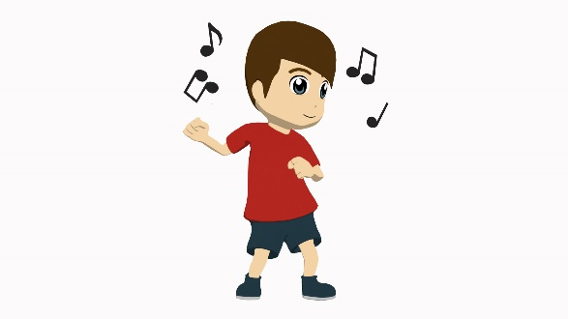
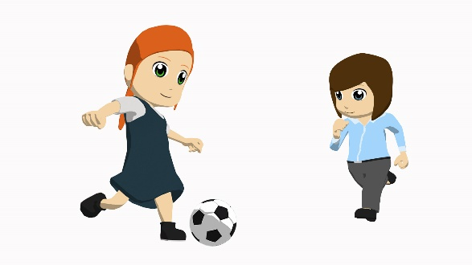
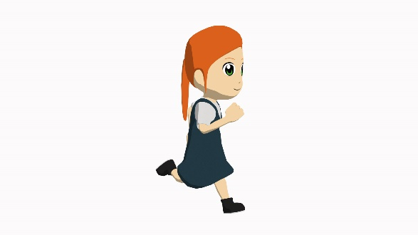
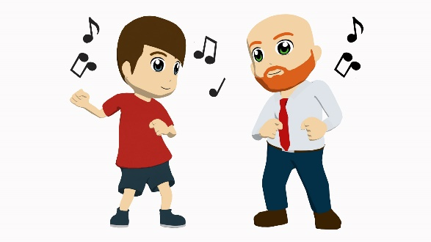
Partenaire A (Task 1):
Exemple
parler
Tell your partner about each person/pair of people pictured below.
Say ‘She is ...’, ‘He is...’, ‘They are...’, plus the adjective given, in French.
pleased
XXXX
XXXX
XXXX
XXXX
XXXX
XXXX
XXXX
XXXX
XXXX
XXXX
XXXX
Notes:
Timing: 10 minutes
Aim: Oral production of this week’s vocabulary and grammar structures.
Procedure:
1. On this example slide, only one adjective is given (pleased). The rest are shown as XXXX to indicate that there will be three adjectives per person/pair of people, to talk about.
2. Partner A: Teachers can elicit the full sentence from students ‘il est content’ and then show the next slide, the example slide for Partner B, to model what partner B has to do.

Slide 48
Partenaire B (Task 1): Exemple
parler
Listen to what your partner tells you about each person/pair of people shown.
Write three adjectives in English on the lines next to their picture.
pleased
_____________________
_____________________
_____________________
_____________________
_____________________
_____________________
_____________________
_____________________
_____________________
_____________________
_____________________
_____________________
Notes:
Procedure:
1. Partner B: Student has to write down the description (adjectives only) in English in the spaces provided on this slide. This tests understanding of the grammar (subject pronoun, verb and adjective agreement where audible) as well as of the (adjective) vocabulary.
2. Note: Teachers should encourage students NOT to say their three sentences in order; i.e., they should mix up their 12 sentences so that students have to listen out carefully for the pronoun, verb and adjective agreement and understand all in order to know where to write their English adjectives.

Slide 49
TASK 1 Roelcard (Partner B)
parler
Tell your partner about each person/pair of people pictured below.
Say ‘She is ...’, ‘He is...’, ‘They are...’, plus the adjective, in French.
mean
open
intelligent
pleased
interesting
funny
short
well-behaved
strict
tall
young
calm
Notes:
Task 1 answers check what Partner B wrote.

Slide 50
Task 2 Rolecard (Partner A)
parler
Tell your partner about each person/pair of people pictured below.
Say ‘She is ...’, ‘He is...’, ‘They are...’, plus the adjective, in French.
short
intelligent
strict
mean
young
open
well-behaved
tall
interesting
pleased
funny
intelligent
Notes:
Task 2 responses check what Partner A wrote.

Slide 51
C’est qui? nous, ils ou elles?
lire
 |  | nous (we) | ils (they - mpl) | elles (they - fpl)
A | ... sommes contentes.
B | ... sont intelligentes.
C | ... sont intéressants.
D | ... sommes calmes.
E | ... sommes stricts.
F | ... sont ouverts.
G | ... sommes jeunes.
H | ... sont contentes.
Notes:
ADDITIONAL TASK
Timing: 5 minutes
Aim: This task might be used for some additional homework, or saved for revision work (for example, in Week 2.2.1). Here we bring in the other plural verb form, learnt last lesson – ‘nous sommes.’
Procedure:
1. This reading activity asks students to distinguish between the first person plural (as recently introduced) and third person plural forms of ‘être’, by noticing the verb form in the first instance and the adjective agreement in the case of the ‘elles’ form.
2. The subject pronoun is missing from each sentence, to force attention upon these aspects of grammar.
Word frequency (1 is the most frequent word in French): sommes [5], sont [5], jeune [152], ouvert [897], strict [1859]
Source: Londsale, D., & Le Bras, Y. (2009). A Frequency Dictionary of French: Core vocabulary for learners London: Routledge.

Slide 52
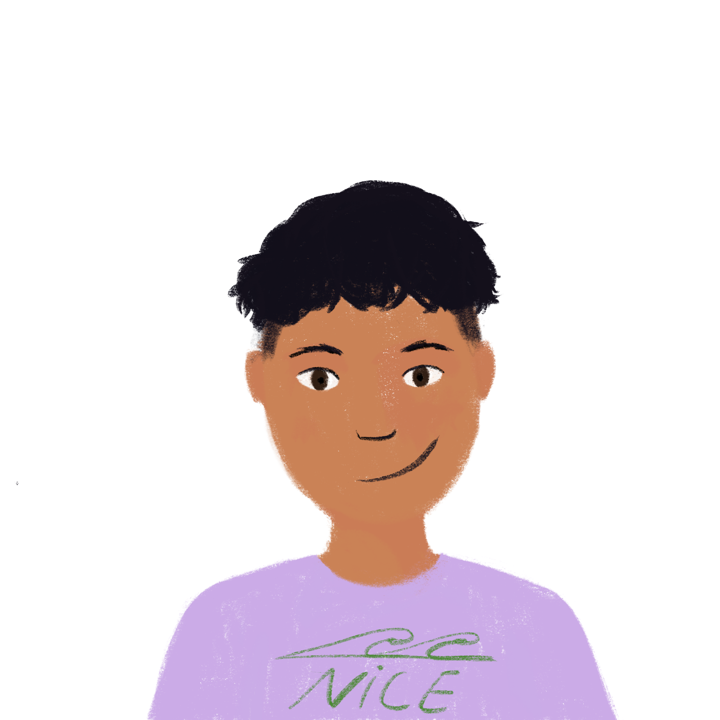
Les amis de Louise
lire / écouter / parler
Read the text whilst listening to the recording. Your teacher will ask questions.
Je suis Louise. Je suis française. J’ai six amis. Céline est petite et drôle. Elle est intelligente. Max est grand et aimable*. Il est intéressant. Patrick et Louis sont amusants mais méchants. Ils sont jeunes! Sarah et Camille sont sages et calmes. Elles sont contentes.
*aimable = kind, nice
Notes:
ADDITIONAL TASK
Timing:
Aim: This task might be saved for revision work (for example, in Week 2.2.1). This activity asks students to engage with a slightly longer text, created entirely using vocabulary and grammar already introduced in the scheme of work. It is about the imaginary character of “Louise”. As well as ‘et’, as used in the previous text, ‘mais’ (originally introduced in the second week of the course) is used to express contrast. This exercise is designed to enable practice in segmenting.
Procedure:
1. Teachers should play the recording (click on the audio icon at the bottom left of the slide to bring up the player) whilst students read the text.
2. . The audio should then be paused at an appropriate moment, teachers asking a question such as:
- what is the next word? (testing segmentation skills)
- what could be an alternative for the next word? (testing vocabulary knowledge and understanding of grammar)
- what type of word (e.g. noun, verb, adjective) could come next? (testing knowledge of grammar)
3. This process can then be repeated several times.
4. The following subsidiary grammar point arises in this text; it is at the teacher’s discretion whether to point it out briefly, though it should not be allowed to distract from the main learning points of this week’s lesson:
Adjectives normally ending in –e do not take a feminine agreement (this was covered when regular feminine adjective agreement was introduced, in the very first week of the course), but they do take an –s for the plural, e.g. ‘calmes’. You could point out that ‘jeune’ behaves in the same way, as would ‘malade’ and ‘sympathique’ (though not featured here).
Word frequency (1 is the most frequent word in French): sont [5], jeune [152], grand², petit², sage¹ [2643]
Source: Londsale, D., & Le Bras, Y. (2009). A Frequency Dictionary of French: Core vocabulary for learners London: Routledge.

Slide 53
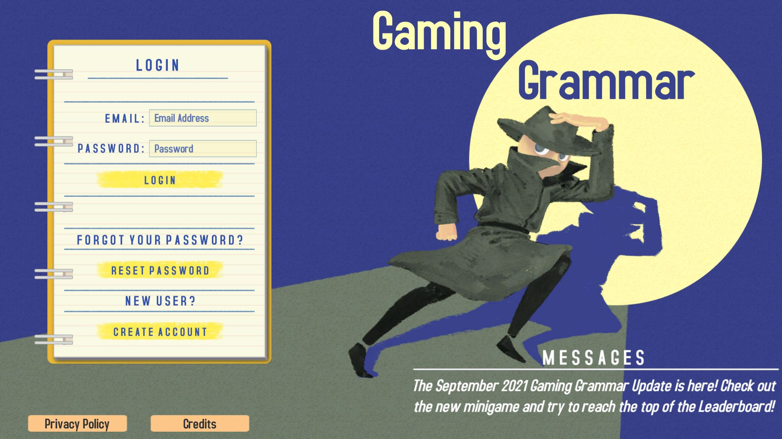
Gaming Grammar
Gaming Grammar
Relevant mini game(s):
Articles: Number (Article agreement)
To have and to be: 1st person and 3rd person singular
Notes:
This slide links to Gaming Grammar login screen. The appropriate mission can then be selected from the menu page.
Students will progress through the game at their own rate; teachers should use the teacher interface to check progress. This will help to inform future lesson planning.

Slide 54
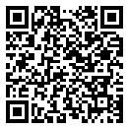
Devoirs
Vocabulary Learning Homework (Y7, Term 2.1, Week 3)
Audio file
Audio file QR code:
Student worksheet
Quizlet link
In addition, revisit: Term 1.2 Week 7
Term 1.2 Week 2
Notes:
It is acknowledged that there has been a lot to cover in this sequence of lessons; teachers may therefore wish to revisit some of the points covered here in the week following this one.

