Slide 1
Session 1: Phonics
Mel Yates
Head of Languages, Presdales School
20/11/20

Slide 2
Session aims
Examine the rationale for teaching phonics
Understand the NCELP recommended selection and sequencing of symbol-sound correspondences (SSC) in French, German and Spanish
Explore a range of teaching approaches and resources (present, practise and produce)

Slide 3
What does the Pedagogy Review say about phonics?
Rationale [1]
If students are not systematically taught the sound-writing relationship, they often rely on English correspondences and make errors
There is evidence (from research and practice) that direct teaching of phonics supports accurate pronunciation and spelling
SSC patterns focused on the key differences between English and the new language should be introduced directly and in a sensible sequence from the outset
Aims of phonics teaching are for students to pronounce accurately from the written form, and to produce plausibly accurate spelling of new words they hear
A planned approach may include practice activities such as note-taking, dictation or dictogloss
Teachers should be familiar with KS2 English phonics teaching, and apply any relevant techniques and principles
MFL Pedagogy Review, p.12

Slide 4
What does the research say about teaching phonics?
Rationale [2]
Poor decoding (reading the word off the page with the correct pronunciation/ accent), and limited progress, if not taught
Learners tend to get stuck on ‘read it as if it’s English’ unless explicit phonics work in place
Some learners try to move beyond this, but lack knowledge to decode more accurately
Phonics can be taught successfully in French – but it’s not quick or easy!
Teaching phonics must be sustained
The benefits of accurate L2 decoding go beyond reading comprehension and include a range of areas
Particular benefits for vocabulary learning and learner autonomy
No detriment for other areas of MFL learning
Notes:
There is limited research evidence on teaching phonics in foreign languages, but what there is strongly suggests some key benefits. The research, which has mainly been with L2 French learners, suggests:
Poor decoding (reading the word off the page with the correct pronunciation/ accent), and limited progress, if not taught. Learners tend to get stuck on ‘read it as if it’s English’ unless explicit phonics work in place
Some learners try to move beyond this, but lack knowledge to decode more accurately
Phonics can be taught successfully in French – but it’s not quick or easy!
Teaching phonics must be sustained
The benefits of accurate L2 decoding go beyond reading comprehension and include a range of areas
Particular benefits for vocabulary learning and learner autonomy
No detriment for other areas of MFL learning

Slide 5
quotes
These words get more ridiculous as we go along.
Some of these don't even look like real words. I reckon you're just trying to trick me.
I don't know because most of them look like gibberish, basically.
They're like really weird words, like they don't exist.

Slide 6
For further detail…
Rationale [3]
Screencast – Phonics: Research and rationale (Robert Woore)
NCELP Phonics rationale document (A4 pdf)
OASIS research summary Woore, R. et al (2018) FLEUR study
OASIS research summary Erler, L. & Macaro, E. (2011)

Slide 7
Concerns?
There’s no point teaching Phonics. They will pick it up on their own.
I think it will confuse my lower attaining learners.
Ideally, I would like to teach this, but there is no time in the Scheme of Work.
I can see the point in Spanish and German, but in French it is too complicated.
This is not my priority – my students are already OK at reading. The other skills are more important to focus on.
My students would find this boring or babyish.

Slide 8
Session aims
Examine the rationale for teaching phonics
Understand the NCELP recommended selection and sequencing of symbol-sound correspondences (SSC) in French, German and Spanish
Explore a range of teaching approaches and resources (present, practise and produce)

Slide 9
Choice of SSC - difficulty
We lack clear research evidence on which SSC are the most important to teach, and in what order
NCELP based their selection on a ‘bang for buck’ principle, drawing on evidence concerning:
Difficulty – how hard is it for students to decode the SSC accurately
Frequency – how often the SSC occur in the language
Teacher expertise and judgment
We also adopted a ‘cumulative’ principle in ordering sounds and their ‘source words’
We made a ‘working selection’ – this may yet be refined over time (with help from your feedback!)

Slide 10
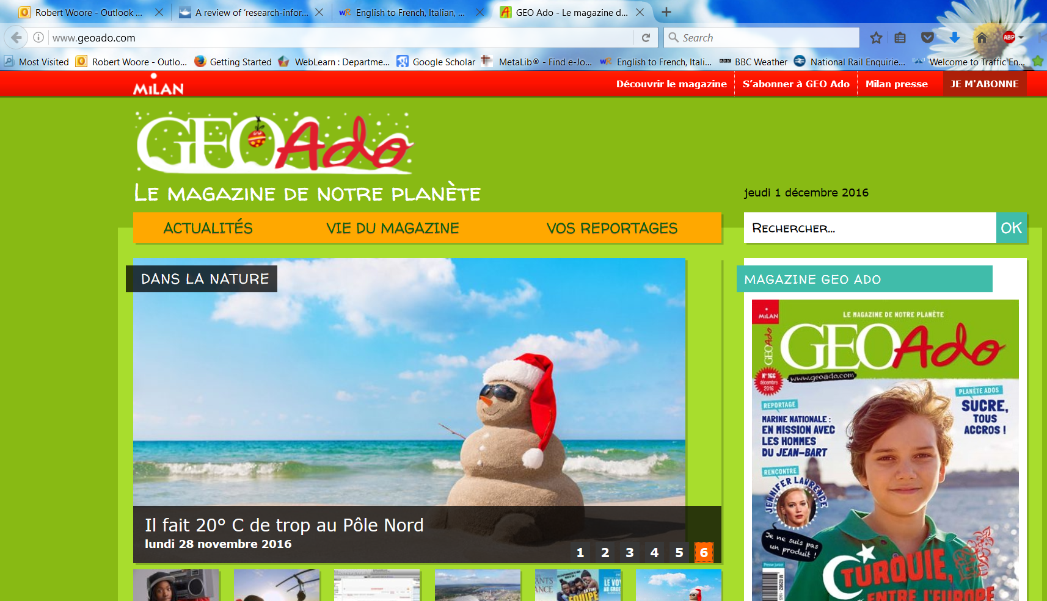
Choice of SSC - frequency
Analysis of two small corpora:
first 200 words of six ‘featured texts’ from an on-line magazine for French young people (www.geoado.com)
Analysis of words in Dynamo 1 Module 1

Slide 11
SFC
X
a
i
eu
e
au
dans
 |  |  |  |  | Francophoniques
animal
midi
deux
je
gauche
u
ou
a
en/an
on
SFE
Non!
tu
nous
X
écrire
enfant
timide
ain/in
ê/è
ai
oi
ch
c
train
tête
vrai
voir
ici
chercher
qu
j
tion
ien
un
question
jour
bien
un
Attention!
X
Notes:
Phonics

Slide 12
Target SSC in French
Teaching order | Frequency order | SSC | Teaching order | Frequency order | SSC
1 | 1 | SFC | 13 | 12 | -in / -ain
2 | 2 | a | 14 | 13 | è / ê
3 | 3 | i | 15 | 13 | ai (ais / ait)
4 | 5 | eu | 16 | 15 | oi
5 | 5 | e | 17 | 19 | ch
6 | 8 | o /eau / au | 18 | 20 | ç (and soft -c)
7 | 9 | u | 19 | 14 | qu
8 | 11 | ou | 20 | 17 | j
9 | 4 | SFe | 21 | 18 | -tion
10 | 6 | é | 22 | 21 | -ien
11 | 7 | en / an | 23 | 16 | un
12 | 10 | on
Notes:
A ‘bang for buck’ principle was implemented to achieve the maximum improvement in decoding within a time-limited teaching context. The SSC were chosen based on their difficulty for L1 English speakers, their frequency of occurrence in the language and teacher knowledge.
The notion is that one SSC would be the focus each week in Y7, with time also built in for revisiting/recycling. 10-12 minutes per lesson might be spent on introducing the new SSC and recapping one or more previously learnt SSC. Phonics work is likely to continue in Y8, too.

Slide 13
Source words in French
Teaching order | SSC | Source word | Frequency | Teaching order | SSC | Source word | Frequency
1 | SFC | dans | 11 | 13 | -in / -ain | train | 232
2 | a | animal | 1002 | 14 | è / ê | tête | 343
3 | i | midi | 2483 | 15 | ai (ais / ait) | vrai | 292
4 | eu | deux | 41 | 16 | oi | voir | 69
5 | e | je | 22 | 17 | ch | chercher | 336
6 | o /eau / au | gauche | 607 | 18 | ç (and soft -c) | ici | 167
7 | u | tu | 112 | 19 | qu | question | 144
8 | ou | nous | 31 | 20 | j | jour | 78
9 | SFe | timide | 3835 | 21 | -tion | Attention! | 482
10 | é | écrire | 382 | 22 | -ien | bien | 47
11 | en / an | enfant | 126 | 23 | un | un | 3
12 | on | non! | 72
Notes:
This table includes the frequency so people can see the rationale for the selection of the words
Source words were chosen for frequency, but also for their simplicity in terms of the pronunciation of the word in terms of the other phonemes apart from the target SSC.
We use a cumulative principle too, to ensure that later SSCs are not used before they have been learnt.
This was more important than whether the word could be easily depicted in an image or linked to a gesture, although we wanted also to achieve these things.

Slide 14
Session aims
Examine the rationale for teaching phonics
Understand the NCELP recommended selection and sequencing of symbol-sound correspondences (SSC) in French, German and Spanish
Explore a range of teaching approaches and resources (present, practise and produce)

Slide 15
Teaching steps
Present the SSC itself, the source word, and five cluster words and do initial practice of these
Practise the knowledge further in a variety of listening (with or without transcription) and read aloud activities
Produce the knowledge in several contexts, e.g., asking for the meaning of unfamiliar words (Wie sagt man…auf Englisch?), when revisiting the SSC in further activities (e.g. tongue twisters, reading aloud texts, in assessments)

Slide 16
SFC
Silent final consonant
dans
X
Notes:
Timing: 1 minute
Aim: To introduce SSC [SFC]
Explanation in English, if desired: Something that makes French sounds very different from English is that some consonants at the ends of words are silent. This means you don’t pronounce/sound them out at all. As in the word ‘dans’ in French.
Procedure: 1. Bring up the word ”dans” on its own, say it, students repeat it, so that they have the opportunity to focus all of their attention on the connection between the written word and its sound.
3. A possible gesture for this would be to hold ones finger to ones lips to indicate ‘Shhhh!’. 4. Roll back the animations and work through 1-3 again, but this time, dropping your voice completely to listen carefully to the students saying the [SFC] sound, pronouncing ”dans” and, if using, doing the gesture.
Word frequency (1 is the most frequent word in French):
dans [11] Source: Londsale, D., & Le Bras, Y. (2009). A Frequency Dictionary of French: Core vocabulary for learners London: Routledge.

Slide 17
SFC
Silent final consonant
dans
X
Notes:
With sound and no pictures to focus all attention on the sound-symbol correspondence.

Slide 18
SFC
Silent final consonant
dans
X
Notes:
Without sound to elicit pronunciation (without first hearing the teacher).
Teacher to elicit pronunciation by asking “Comment dit-on …”/

Slide 19
SFC
petit
prix
€15.95
grand
mot
dans
X
mais
[but]
Notes:
Timing: 2 minutes
Aim: To introduce SSC [SFC]
Procedure:
1. Introduce and elicit the pronunciation of the individual SSC [SFC] (in this case is [SFC] – silent final consonant so nothing to pronounce as an individual sound!) and then the source word again ‘dans’ (with gesture, if using). 2. Then present and elicit the pronunciation of the five cluster words.
The cluster words have been chosen for their high-frequency, from a range of word classes, with the SSC (where possible) positioned within a variety of syllables within the words (e.g. initial, 2nd, final etc.). Additionally, we have tried to use words that build cumulatively on previously taught SSCs (see the Phonics Teaching Sequence document) and do not include new SSCs. Where new SSCs are used, they are often consonants which have a similar symbol-sound correspondence in English.
Word frequency (1 is the most frequent word in French): dans [11]; petit [138] prix [310]; mot [220]; mais [30]; grand [59]. Source: Londsale, D., & Le Bras, Y. (2009). A Frequency Dictionary of French: Core vocabulary for learners London: Routledge.

Slide 20
SFC
petit
prix
grand
mot
dans
X
mais
Notes:
With sound and no pictures to focus all attention on the sound-symbol correspondence.

Slide 21
SFC
petit
prix
grand
mot
dans
X
mais
Notes:
Without sound to elicit pronunciation (without first hearing the teacher).
Teacher to elicit pronunciation by asking “Comment dit-on …”

Slide 22
… except for
c r f l
Be c a r e f u l with these!

Slide 23
Phonétique (1/3)
lire / parler
drap
d’accord
vert
20
[sheet]
[okay]
[green]
secondes
canard
estomac
bras
[stomach]
0
DÉBUT
Notes:
Timing: 3 minutes for 3 slides
NB: A more challenging version of this activity, which does not have the SSC scored out, can be found on slides 12-14.
Aim: To correctly pronounce unknown words containing [SFC] in decreasing amounts of time, helping automisation of SSC production. The words chosen otherwise contain sounds that are equivalent (or very similar) to English SSCs, so that students can focus fully on the [SFC] (allowances are made for English pronunciation of [r], which is covered in year 8).
Procedure:
1. Students pair up.
2. Teacher starts 20 second timer.
3. Student A tries to say the words without pronouncing the [SFC].
4. Student B makes speaker pause for 3 seconds every time an [SFC] is pronounced.
5. Complete before 20 seconds runs out.
6. Swap roles.
7. Click on the word to hear pronunciation by a native speaker. Students repeat.
7. Move onto the next slide.
Word frequency (1 is the most frequent word in French): drap [>5000], d’accord [736], vert [1060], canard [>5000], estomac [>5000], bras [1253]
Source: Londsale, D., & Le Bras, Y. (2009). A Frequency Dictionary of French: Core vocabulary for learners London: Routledge.

Slide 24
Phonétique (2/3)
lire / parler
drap
d’accord
vert
10
[sheet]
[okay]
[green]
secondes
canard
estomac
bras
[stomach]
0
DÉBUT
Notes:
As per previous slide, but with the time halved.

Slide 25
Phonétique (3/3)
lire / parler
drap
d’accord
vert
5
[sheet]
[okay]
[green]
secondes
canard
estomac
bras
[stomach]
0
DÉBUT
Notes:
As previous slide, but with the time halved again.

Slide 26
Teaching steps
Present the SSC itself, the source word, and five cluster words and do initial practice of these
Practise the knowledge further in a variety of listening (with or without transcription) and read aloud activities
Produce the knowledge in several contexts, e.g., asking for the meaning of unfamiliar words (Wie sagt man…auf Englisch?), when revisiting the SSC in further activities (e.g. tongue twisters, reading aloud texts, in assessments)
Notes:
This slide just helps to set out what you will be showing. 1) One initial presentation sequence with initial practice activity 2) A selection of a few different styles of listening and read aloud from the first time they are presented OR the first time they are revisited 3) Some later activities that bring together several SSC (could even go into Y8 resources for a couple of examples, there, so teachers can see the development) Note: it is worth telling teachers that all Y7 resources are being (Sp/Gm) / have been (French all year, Sp/Gm just term 1 so far) re-templatised and updated so if people downloaded versions some time ago, it’s worth them downloading again. They don’t need to do this resource by resource, they can (with one click), download all resources from a whole term at a time.

Slide 27
There are different ways to pronounce CE and CI.
Fonética
In most of Spain, the ‘c’ before ‘e’ or ‘i’ is pronounced like the ‘th’ in English (as you just heard).
In the Canary Islands and Latin America, this ‘c’ is often pronounced like an ‘s’.
Compare:
ciencias
(mainland Spain)
1
ciencias
(Canaries & Latin America)
2
Notes:
Y7 T1.1 Week 7 This is Y7, in the first lesson where [ce] and [ci] are introduced, just after the SSC, source and cluster words have been presented and practised. Here we see that the practice activity explicitly builds in awareness of variation in pronunciation within the Spanish-speaking world
Timing: 2 minutes
Aim: to raise awareness of variation in sound-spelling correspondences within the Spanish-speaking world
Procedure:
Click to bring up each new part of the explanation
Click on the orange action buttons to hear the difference in pronunciation modelled by a native speaker.
Notes:
1. Teachers may find it useful to consider the information from exam board specifications below:
AQA: “The [listening] test will be studio recorded using native speakers speaking Castilian in clearly articulated, standard speech at near normal speed. Different types of spoken language will be used, using familiar language across a range of contemporary and cultural themes. (p. 82)
EdExcel/Pearson : “For listening and reading assessments, the majority of contexts are based on the culture and countries where the assessed language is spoken. […] It is, therefore, important that students are exposed to materials relating to Spanish-speaking countries throughout the course.” (p. 7)
WJEC : “This GCSE specification in Spanish for use in Wales is based on a conviction that learners studying a modern foreign language will develop their desire and ability to communicate with and understand speakers of Spanish in a variety of contexts and for a variety of purposes.” (p. 3)

Slide 28
escuchar
Latin America/Canaries | Mainland Spain
1
2
Is the pronunciation more likely to be mainland Spain or Latin America / Canaries?
3
4
5
Listen and tick the most likely answer.
6
7
8
9
10
Notes:
Listening activity - phonics
Timing: 6 minutes
Aim: to help students to recognize pronunciation of [ce] and [ci] in different parts of the Spanish-speaking world
Procedure:
Click on each action button to hear the audio.
Note: you could additionally ask students to listen again and write the word
Transcript:
Doce
Ciencias
Decir
Necesario
Cine
Diciembre
Necesitar
Centro
Ciudad
Cierto
Image with creative commons public domain licence
https://mycsres.com/freesheet/spanish-speaking-world-map-18.html.html
Word frequency (1 is the most frequent word in Spanish): doce [1138], centro [ 316], necesitar [276], cierto [159], ciudad [178], decir [31], ciencia [738], necesario [362], cine [952], diciembre [1165]
Source: Davies, M. & Davies, K. (2018). A frequency dictionary of Spanish: Core vocabulary for learners (2nd ed.). Routledge: London

Slide 29
cine
cerca
diciembre
doce
centro
cierto
ciencias
ciudad
parecer
necesitar
necesario
decir
Notes:
Y7 T2.2 Week 5 These are the practice activities when [ce] and [ci] are revised for the first time.
Without the images or sound, students have to pronounce the words themselves.
This slide can be used in a number of ways:
-Splat the board – with two players up at the front. Students play against each other in a best of three to keep the game moving at pace and generate maximum involvement. The winner stays and players swap in and out with the losing player. The teacher should call on students to supply the word, again to generate maximum participation. (During this activity, freeze the interactive whiteboard so as to not trigger the custom animation!)
-Lotto – players write down any three of the words. The teacher (or students) call out the words one at a time. The first student(s) to have their three called out wins. Multiple games can be played. This is fast and pacey. The teacher should tick off the words as they are called to enable the feedback to be conducted swiftly (again freeze the IWB) or alternatively keep track of the words called by keeping a list. Elicit the English from students each time that the three words are given by the winner(s).
-Pairwork – partner A sits with their back to the board whilst partner B reads aloud the first six words that appear in animation. Partner A writes the word. Partner then swap roles. They can check their spellings when they turn back to face the board. Teachers should circulate to listen to students’ pronunciation and praise/correct as necessary.
As the final activity, after any of the variations above, students should write the English for as many of the words as they can to reinforce their meanings. Students could have a minute individually then team up with a partner to see if they can achieve translations for all 12 words.

Slide 30
escuchar
How many times in each sentence do you hear ‘ce’ and ‘ci’? Tally each time. Escribe las palabras en español.
ce | palabras | ci | palabras
parece
cierto
1
2
centro
cinco
ciudad
bicicletas
3
cerca
estación
once
cine
4
necesito
ejercicio
hacer
diciembre
parece
cine
5
excelente
Notes:
Y7 T2.2 Week 5 2nd activity
TRANSCRIPT
Parece ser cierto
Hay cinco bicicletas en el centro de la ciudad.
La estación está cerca pero el cine está a once kilómetros.
Necesito hacer ejercicio en diciembre
Estamos en el cine. La película parece excelente.
All vocabulary here has been seen by students either as source/cluster words (as per lesson 1 in this sequence) or in previous vocab sets, apart from sentence five which includes a cognate: excelente [1546]. This could be used to challenge students or left out if teachers prefer, depending on the ability of the class.
Ticks appear fist in the animation, then words, for each row.

Slide 31
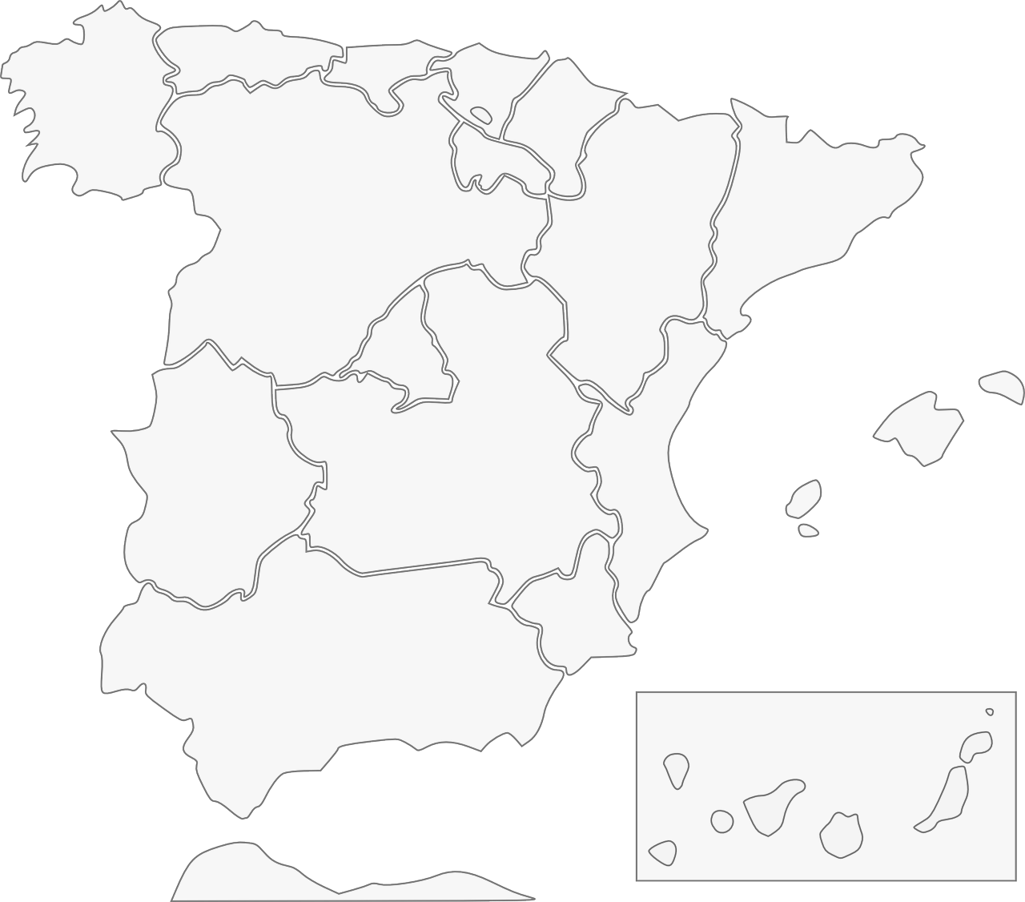
Fonética: [ci] & [ce]
escuchar / escribir
Escucha y escribe en español el nombre correcto del lugar.
1
Galicia
2
Barcelona
3
Cáceres
4
Valencia
Albacete
5
Murcia
Andalucía
7
6
Ceuta
8
Notes:
This is from Y8, when [ce] and [ci] are being revisited. By now, students are expected to write full words, most of which will be unfamiliar, because they have learnt and practised all the SSC, not just these two. This then leads into a cultural focus on the autonomous regions of Spain.
Timing: 5 minutes
Aim: to revisit the sound-spelling correspondence for the SSCs [ce] and [ci] with eight names of cities/autonomous communities Spain
Procedure:
Click on the action button to play the audio.
Reveal the place by clicking on the red line. Answers can be given in any order.
Transcript:
1. Galicia
2. Barcelona
3. Valencia
4. Murcia
5. Ceuta
6. Andalucía
7. Albacete
8. Cáceres

Slide 32
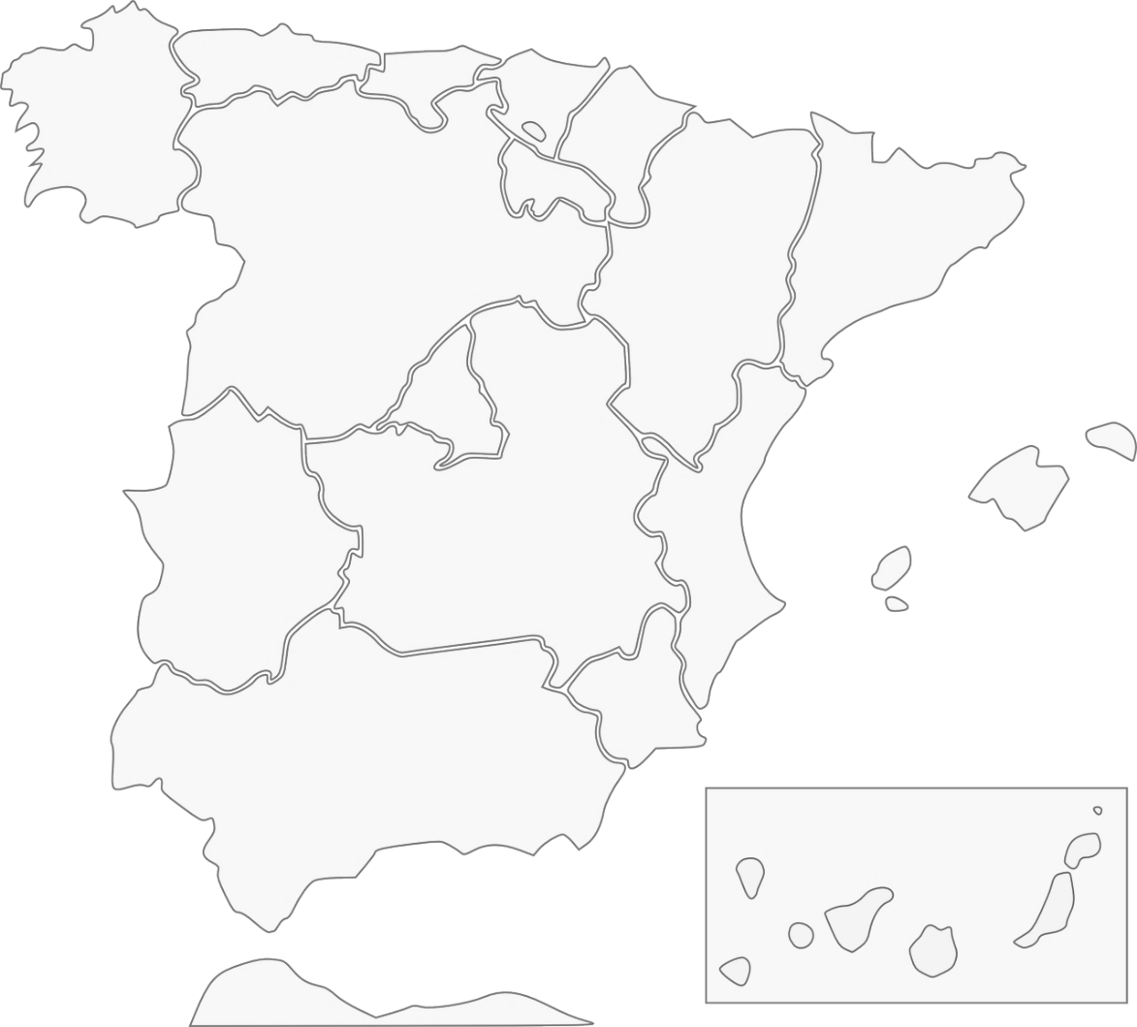
Las comunidades autónomas de España
leer
[1/2]
Hay diecisiete comunidades autónomas en España.
Cada una es una región. Aquí tienes cinco ejemplos:
Galicia
Comunidad Valenciana
Andalucía
Región de Murcia
¡Ceuta está en África!
Ceuta
Notes:
Timing: 2 minutes (slides 6 & 7)
Aim: to introduce students to the concept of Spain’s ‘comunidades autónomas’ (slide 1/2)
Procedure:
Click to reveal the five autonomous communities students have just seen as part of the phonics listening activity.
Click to show within which autonomous communities the other three cities from the listening activity are situated.
Note: teachers may want to read the information aloud for students, or alternatively ask students to read the information aloud chorally, or elicit the information from individual students.

Slide 33
Las comunidades autónomas de España
leer
[2/2]
En las comunidades autónomas hay muchas ciudades.
Aquí tienes tres ejemplos.
Barcelona es una ciudad en la comunidad de Cataluña.
Cáceres es una
ciudad en la comunidad de Extremadura.
Albacete es una ciudad en la comunidad de Castilla-La Mancha.
Notes:
Slide 2/2

Slide 34
Teaching steps
Present the SSC itself, the source word, and five cluster words and do initial practice of these
Practise the knowledge further in a variety of listening (with or without transcription) and read aloud activities
Produce the knowledge in several contexts, e.g., asking for the meaning of unfamiliar words (Wie sagt man…auf Englisch?), when revisiting the SSC in further activities (e.g. tongue twisters, reading aloud texts, in assessments)

Slide 35
Phonetik
hören
ei
ie
frei
Liebe
Notes:
To introduce the next set of examples. Introduction: In Y7 these two SSC are first introduced and practised separately, in the usual way – SSC, source word, cluster words, practice. Then, in Term 3 (7.3.1.4) the two sounds are brought together for practice. Pair activity (next slide) Pirates minimal pairs activity

Slide 36
ei
ie
leicht
Ziel
kein
wie
schwierig
dein
heißen
Schauspieler
erreichen
ziemlich
sie
leider
schließlich
mein
sein
Lied
langweilig
ziehen
Schweiz
Computerspiel
Notes:
Phonics revision.
This is a paired read aloud task. The students use different colours to play. Pupil A says one of the words/phrases and pupil B has 3 seconds to locate it and cross it off with their colour. If the pupil takes longer than 3 seconds pupil A can steal the point. Clearly, the classroom conditions need to be right with the individual class for friendly competition.
Alternatively, they can do it more slowly and carefully, scrutinising each other’s pronunciation. If one makes a mistake (quite common with ei/ie), then the other pupil corrects and crosses off in his/her colour.
Note: Not all of these words have been taught before, so there is the opportunity for some genuine decoding.

Slide 37
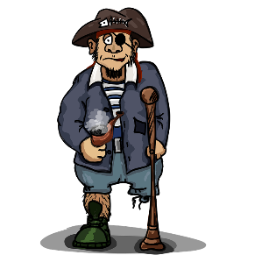
Pirates!
1
c
w
Riese
leider
Riese
One of the chests contains buried treasure. All the others contain poison!
Listen carefully to the secret code and follow the arrows to find the treasure.
Reise
Lieder
Reise
h
z
Wien
Biene
Feile
v
Wein
Beine
viele
Riese
k
Riese
Biene
Feile
leider
i
Reise
Beine
viele
Lieder
Reise
Riese
leider
Feile
leider
Riese
r
Reise
Lieder
viele
Lieder
Reise
Riese
y
j
q
Reise
Notes:
This slide and the two that follow are three versions of the activity with different solutions.
The game makes use of minimal pairs of unknown words (unknown words are used so that pupils focus on the sound. Definitions are given on a later slide).
Starting on the red square, pupils listen to the words and decide whether they hear /ei/ or /ei/. They follow the arrows indicated by their choice to finish at one of the chests. There is only one correct route per slide, so pupils must correctly identify all words to find the treasure. The order or /ei/ and /ie/ changes (i.e. sometimes /ei/ is on the white square and sometimes on the blue) so the pupils must read the spellings.
Pupils can follow the slide on the projector, or the slide can be printed so they can trace the route with a pen/finger.
Teacher asks ‘Wo bist du?’ Pupils respond ‘Z, W’ etc. to practise the alphabet. Teacher clicks on the chests they say to reveal treasure (or not!)
Audio plays on clicking play. Pupils will probably need to hear the audio at least three times.
Note: Each treasure chest is triggered to reveal what is underneath. You see a hand icon appear when you mouse over it – click and the chest disappears. Each slide only has one treasure chest – the rest reveal skulls.
Transcript:
Wein, Biene, Feile, Lieder, Riese
Treasure is located in chest r

Slide 38
Pirates!
2
c
w
Riese
leider
Riese
Reise
Lieder
Reise
One of the chests contains buried treasure. All the others contain poison!
Listen carefully to the secret code and follow the arrows to find the treasure.
h
z
Wien
Biene
Feile
v
Wein
Beine
viele
Riese
k
Riese
Biene
Feile
leider
i
Reise
Beine
viele
Lieder
Reise
Riese
leider
Feile
leider
Riese
r
Reise
Lieder
viele
Lieder
Reise
Riese
y
j
q
Reise
Notes:
Alternative: Give pupils a copy of the transcript below on a slip of paper and ask them to read to a partner.
The game makes use of minimal pairs of unknown words (unknown words are used so that pupils focus on the sound. Definitions are given on a later slide).
Starting on the red square, pupils listen to the words and decide whether they hear /ei/ or /ei/. They follow the arrows indicated by their choice to finish at one of the chests. There is only one correct route, so pupils must correctly identify all words to find the treasure. The order or /ei/ and /ie/ changes (i.e. sometimes /ei/ is on the white square and sometimes on the blue) so the pupils must read the spellings.
Pupils can follow the slide on the projector, or the slide can be printed so they can trace the route with a pen/finger.
Teacher asks ‘Wo bist du?’ Pupils respond ‘Z, W’ etc. to practice the alphabet. Teacher clicks on the chests they say to reveal treasure (or not!)
Audio plays on clicking play. Pupils will probably need to hear the audio at least three times.
Transcript:
Wien, Beine, viele, Lieder, Reise
Treasure is located in chest q

Slide 39
Pirates!
3
c
w
Riese
leider
Riese
Reise
Lieder
Reise
One of the chests contains buried treasure. All the others contain poison!
Listen carefully to the secret code and follow the arrows to find the treasure.
h
z
Wien
Biene
Feile
v
Wein
Beine
viele
Riese
k
Riese
Biene
Feile
leider
i
Reise
Beine
viele
Lieder
Reise
Riese
leider
Feile
leider
Riese
r
Reise
Lieder
viele
Lieder
Reise
Riese
y
j
q
Reise
Notes:
Alternative: Give pupils a copy of the transcript below on a slip of paper and ask them to read to a partner.
The game makes use of minimal pairs of unknown words (unknown words are used so that pupils focus on the sound. Definitions are given on a later slide).
Starting on the red square, pupils listen to the words and decide whether they hear /ei/ or /ei/. They follow the arrows indicated by their choice to finish at one of the chests. There is only one correct route, so pupils must correctly identify all words to find the treasure. The order or /ei/ and /ie/ changes (i.e. sometimes /ei/ is on the white square and sometimes on the blue) so the pupils must read the spellings.
Pupils can follow the slide on the projector, or the slide can be printed so they can trace the route with a pen/finger.
Teacher asks ‘Wo bist du?’ Pupils respond ‘Z, W’ etc. to practice the alphabet. Teacher clicks on the chests they say to reveal treasure (or not!)
Audio plays on clicking play. Pupils will probably need to hear the audio at least three times.
Transcript:
Wein, Beine, viele, Lieder, Reise
Treasure is located in chest y

Slide 40
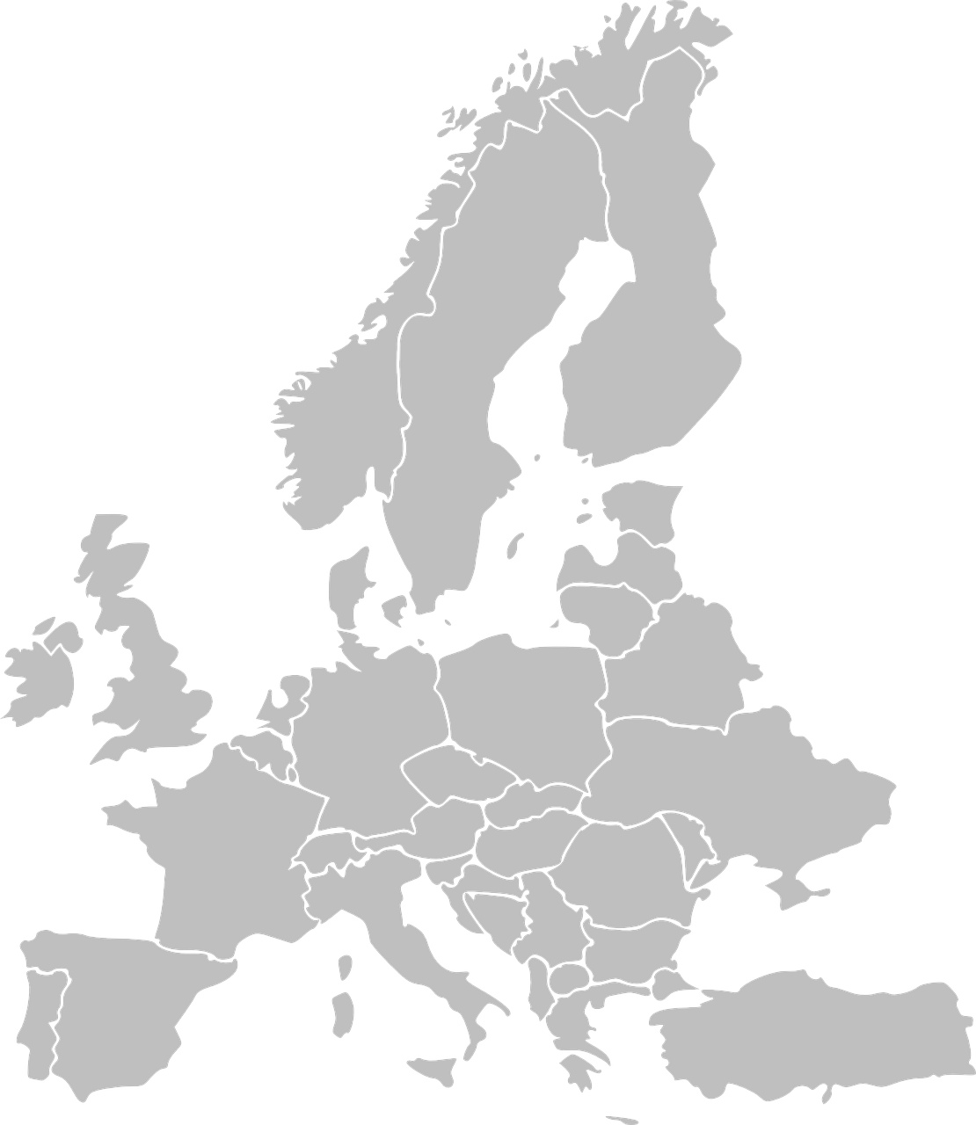
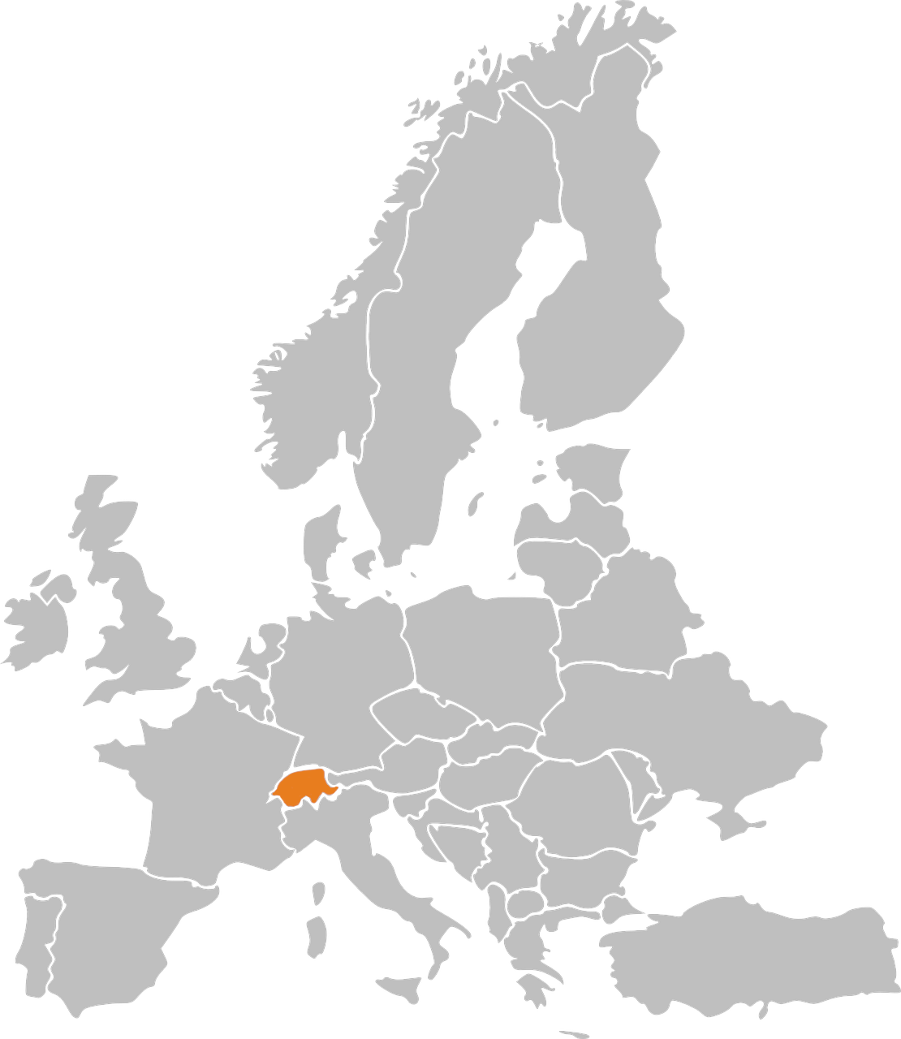
Phonetik: Stadt oder Land?
hören / schreiben
1
die Schweiz
Notes:
This is the first lesson in Y8 – starts with a gentle revision of these two SSC. Students either write the whole word or just the SSC. Click to check. Most words here are unknown – a few are revision from Y7.
Timing: 3 minutes Aim: to revisit and practise the distinction between [ie] and [ei] Procedure: 1. Write 1-10.
2. Click on the number to play the sound. Note: each word is said TWICE. Transcribe either the whole word OR just the SSC [ei] / [ie].
3. Click again for spelling to appear.
4. Bist du in einer Stadt oder einem Land?
5. Click will reveal Stadt oder Land.
Transcript: die Schweiz
die Türkei
Wien
Kiel
Freiburg
Italien
Liechtenstein
Österreich
Spanien
Lienz

Slide 41
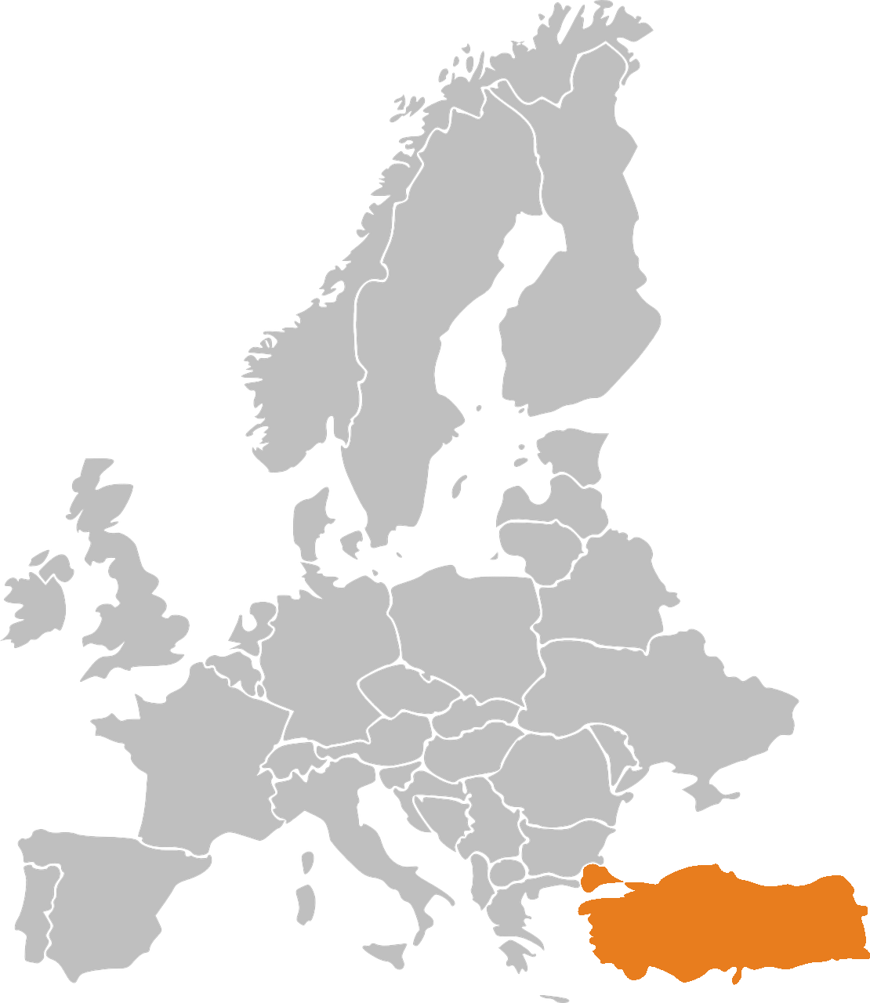
Phonetik: Stadt oder Land?
hören / schreiben
2
die Türkei

Slide 42
Phonetik: Stadt oder Land?
hören / schreiben
3
Wien

Slide 43
Phonetik: Stadt oder Land?
hören / schreiben
4
Kiel

Slide 44
Phonetik: Stadt oder Land?
hören / schreiben
5
Freiburg

Slide 45
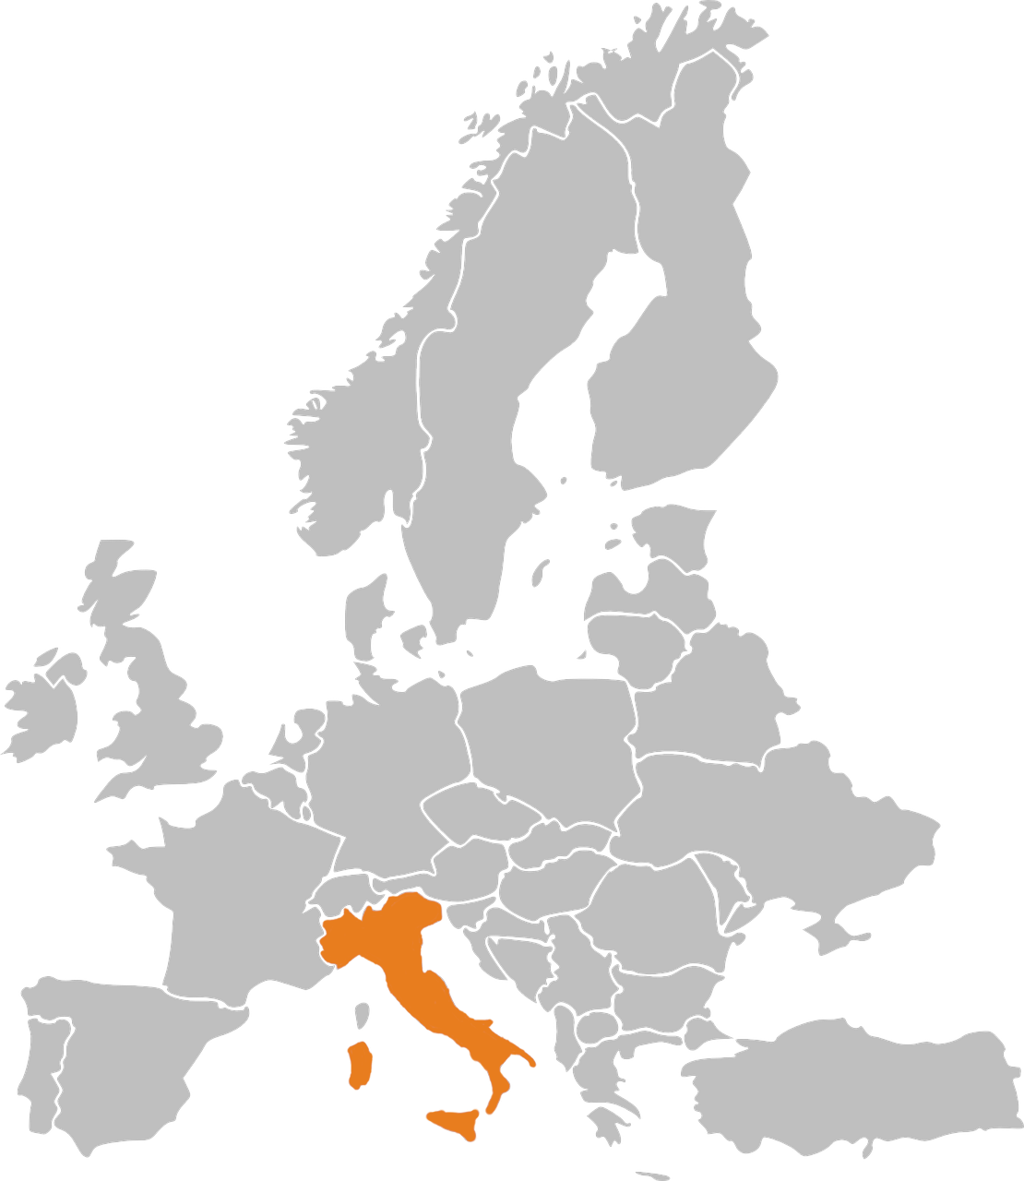
Phonetik: Stadt oder Land?
hören / schreiben
6
Italien

Slide 46
Phonetik: Stadt oder Land?
hören / schreiben
7
Liechtenstein

Slide 47
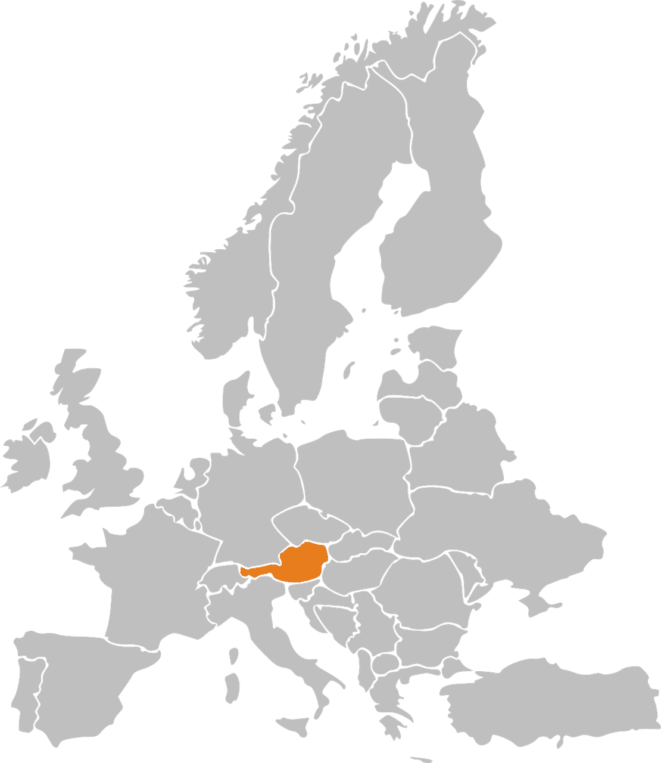
Phonetik: Stadt oder Land?
hören / schreiben
8
Österreich

Slide 48
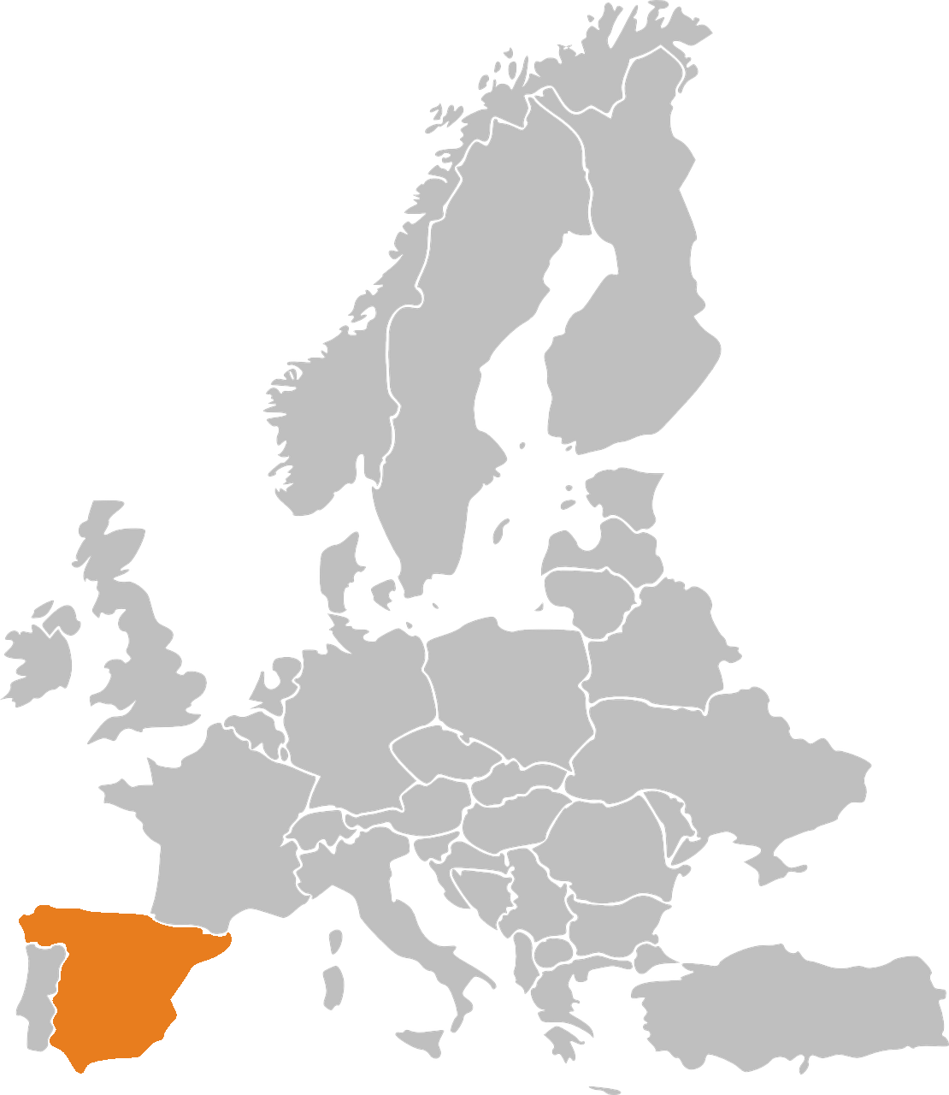
Phonetik: Stadt oder Land?
hören / schreiben
9
Spanien

Slide 49
Phonetik: Stadt oder Land?
hören / schreiben
10
Lienz
Note that when followed by –n, [ie] sometimes sounds as two syllables. Wie sagt man…? Spanien Italien Lienz

Slide 50
Welcher Buchstabe ist das? A, B, C…?
hören
Hör zu. Schreib 1-6 und A, B, C…
Biene
Beine
1
2
3
Wiese
Weise
Wein
Wien
4
5
Leib
lieb
hieß
heiß
Schein
schien
reif
rief
6
A
B
C
D
E
F
G
H
Antworten:
4
6
1
5
2
3
Notes:
Y8 Term 2.1 Week 2 Listening, based on minimal pairs
Timing: 3 minutes Aim: To practise recognition of minimal pairs with SSC [ei] and [ie]
Procedure:
1. Click on a number to hear a recording. Students listen and follow the correct pathway, taking the left- or right-hand branch in each case according to which SSC they hear, [ei] or [ie].
2. The answers are animated and appear on clicks.
Transcript:
1. Biene, Weise, hieß 2. Beine, Wein, schien
3. Beine, Wien, reif
4. Biene, Wiese, Leib
5. Beine, Wein, Schein
6. Biene, Wiese, Lieb
Frequencies

Slide 51
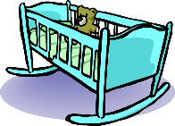
Phonetik
lesen / sprechen
60
Schiene [rail]
weich [soft]
Stein [stone]
biegen [bend]
Teich [pond]
fliehen [to flee]
Reis [rice]
schleichen [slink]
Sekunden
Leiter [ladder]
Frieden [peace]
beißen [to bite]
Wiege [crib]
Kiesel [pebble]
Sieg [victory]
Scheitel [parting]
Fliege [fly]
0
LOS!
Notes:
Read aloud with unknown words
Timing: 1 minute for practice + 1 minute for saying them out loud Aim: To practise SSCs in unfamiliar word context. The time limit helps automatization. Procedure: 1. Students take 60 seconds to practise saying the words out loud to themselves. Click LOS! to start the timer.
2. Then teacher clicks and each word flashes a couple of times before disappearing. Students have to pronounce the word (in chorus) – teacher checks pronunciation this week (as Covid prevents circulating round the class currently).
Word frequency (1 is the most frequent word in German): Schiene [>5000], weich [1836], Stein [1404], biegen [2986], Teich [>5000], fliehen [2824], Reis [>5000], schleichen [4008], Leiter [1321], Frieden[1478], beißen [>5000], Wiege [>5000], Kiesel [>5000], Sieg [1246], Scheitel [>5000], Fliege [>5000]
Source: Jones, R.L. & Tschirner, E. (2019). A frequency dictionary of German: core vocabulary for learners. Routledge

Slide 52
Phonetik
Sieben umtriebige Bienen überfliegen zielstrebig viel lieber wieder riesige Wiesen.

Slide 53
Phonetik
Eine kleine Meise geigt allein eine leise Weise, eine zweite schweigt leider.

Slide 54
Teaching steps
Present the SSC itself, the source word, and five cluster words and do initial practice of these
Practise the knowledge further in a variety of listening (with or without transcription) and read aloud activities
Produce the knowledge in several contexts, e.g., asking for the meaning of unfamiliar words (Wie sagt man…auf Englisch?), when revisiting the SSC in further activities (e.g. tongue twisters, reading aloud texts, in assessments)

Slide 55
In the classroom
Notes:
Let’s have a look at the video I mentioned.

Slide 56
Session aims
Examine the rationale for teaching phonics
Understand the NCELP recommended selection and sequencing of symbol-sound correspondences (SSC) in French, German and Spanish
Explore a range of teaching approaches and resources (present, practise and produce)

Slide 57
Session 1: Phonics Q&A
Mel Yates
Head of Languages, Presdales School
20/11/20

