Slide 1
Grammar
Definite articles: the words for ‘the’
Y7 German
Term 1.1 - Week 2
Author name(s): Inge Alferink / Rachel Hawkes
Date updated: 13/12/19

Slide 2
der, die, oder das?
60
die Flasche
der Mann
der Tisch
die Tafel
Sekunden
das Heft
das Fenster
das Paar
die Klasse
0
der Tag
ANFANG
Notes:
Ist es der, die oder das?
This starter presents the nouns with their genders covered up. All nouns were introduced during the previous week and should be familiar to the students. Students have a minute to try to recall them with a partner.
The activity focuses the attention on the take-away grammar point from week 1: grammatical gender. It also revisits the vocabulary that was introduced. Click on ‘Anfang’ when in presentation mode to start the 60 second timer.

Slide 3
der, die, oder das?
60
die Flasche
der Mann
der Tisch
die Tafel
Sekunden
das Heft
das Fenster
das Paar
die Klasse
0
der Tag
ANFANG
Notes:
Whole class feedback
Teacher asks 'Was ist das?' Students respond. Teacher models: David sagt, das ist der Tag. Ist das richtig? Ja? Nein? And so on, until all answers are checked.
This enables further whole class exposure to names of students as they will not yet know each others' names well.
This also checks pronunciation. The teacher could check meaning as well.
Vocabulary:
the verb sagen is in the vocabulary for this week. Students have already come across it in the phonics presentation in week 1. Both the verb sagen and the question word was will be more fully introduced in the following slides.
Other vocabulary for this week (richtig / falsch / ja / nein / oder) will be used extensively in this and following activities. They will not be introduced formally, but teachers should check for understanding and pronunciation.

Slide 4
Was ist die Ausnahme?
1
das Heft
die Flasche
das Paar
das Fenster
Notes:
Odd one out – Was ist die Ausnahme? Note: Students know ‘was’ ‘ist’ and ‘die’. They don’t know ‘Ausnahme’. Ensure the meaning is clear. Tell them the English meaning.
This activity has 6 items.
Each set of four words has an odd one out. The reasons are mixed bringing together the various things students have learnt so far. For example, the set might be 3 neuter words and one masculine or 3 long vowel words and one short vowel one.
Whole class feedback
Teacher asks 'Was ist das?' Students respond. Teacher models: David sagt, das ist der Tag. Ist das richtig? Ja? Nein? And so on, until all answers are checked.
This also revisits richtig / falsch / ja / nein / oder.
Set 1 (3 neuter nouns + 1 feminine):
das Heft
die Flasche
das Paar
das Fenster

Slide 5
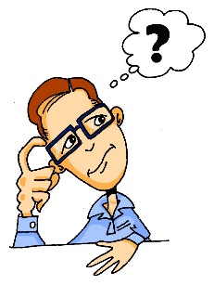
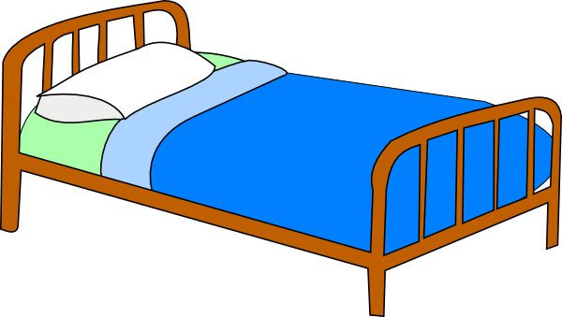
Was ist die Ausnahme?
2
besser
denken
das Bett
die Idee
Notes:
Set 2 (3 short e + one long e)
besser
denken
das Bett
die Idee

Slide 6
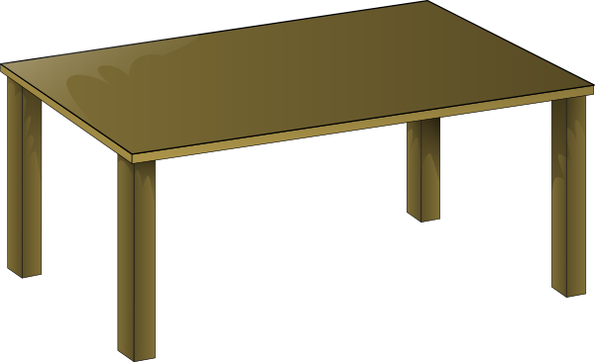
Was ist die Ausnahme?
3
der Tisch
der Tag
die Tafel
der Mann
Notes:
Set 3 (3 masculine nouns + one feminine)
der Tisch
der Tag
die Tafel
der Mann

Slide 7
Was ist die Ausnahme?
4
was?
denken
sagen
geben
Notes:
Set 4 (3 verbs and a question word)
Was?
denken
sagen
geben

Slide 8
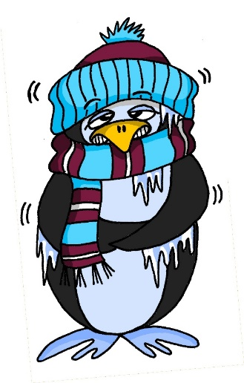
Was ist die Ausnahme?
5
geben
das Paar
kalt
die Idee
Notes:
Set 5 (3 long vowels and a short one – mixed a and e)
geben
Paar
kalt
die Idee

Slide 9
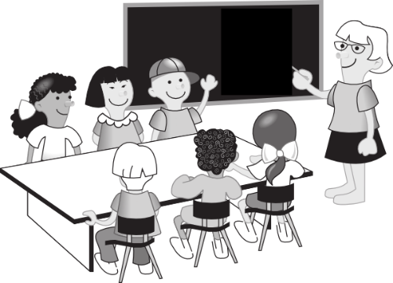
Was ist die Ausnahme?
6
der Tag
die Klasse
die Flasche
die Tafel
Notes:
Set 6 (3 feminine nouns + masculine one)
der Tag
die Klasse
die Flasche
die Tafel

