Slide 1
Vocabulary
Y7 German
Term 3.2 - Week 4 - Lesson 65
Author name(s): Inge Alferink / Rachel Hawkes
Date updated: 30/05/20

Slide 2
Vokabeln
M
I
T
T
E
B
I
L
E
E
S
P
I
S
G
C
U
Z
I
E
L
E
R
H
A
L
T
E
N
N
N
E
E
K
N
G
E
W
I
N
N
E
N
T
I
P
E
E
E
R
N
N
R
F
W
E
E
Z
I
E
H
E
N
Notes:
Vocabulary starter
All the words on the board are from the pre-learning vocab set.
Complete the words by filling in the missing letters. Clicking on a gap will make the letter appear
Make two words of the missing letters
Note: At the end click on Vokabeln to unjumble the letters.
Estimated time: 5 minutes

Slide 3
Was ist die Frage?
sprechen
Jede Person hat fünf Antworten auf der Karte.
Person A sagt die erste Antwort.
Person B muss eine Frage stellen.
Person B sagt die erste Antwort.
Person A muss eine Frage stellen….
Notes:
Vocabulary Time: 5 minutes Image: Yomomo https://commons.wikimedia.org/wiki/File:Mathematrix_Question_Answer_01.svg
This question-creation speaking task recycles vocabulary from the two revisited weeks.
Person A and B both have five answers on a card. Note: they have completely different answers from each other.
Person A gives person B one of the answers. Person B then comes up with a suitable question that would generate that answer.
Then person B gives person A an answer and s/he generates a suitable question.
They continue taking turns until all answers have been used, and ten questions generated.
Note: This task requires the separate speaking worksheet. A/B roles are on one A4 sheet, to be cut in half. Instructions for the task are in English.
Word frequencies: 3.1.4 - der Bruder [687] die Eltern [351] die Geschwister [3090] das Kind [106] der Schauspieler [2202] die Schwester [776] mein [53] dein [225] ihr [26] sein [36] über [48]
2.2.2 - benutzen [872] essen [655] ich kann [23] du kannst [23] [81] tragen [307] trinken [608] das Butterbrot [3561/1757] etwas [107] die Hose [2422] der Hut [2685] der Keks [>4000] die Leute [163] das Obst [>4000]
Note: teachers will want to circulate to give support where necessary.
Man mischt blau und gelb. Wie macht man grün?
Das kommt aus 1907. Wie alt ist Mensch, ärgere dich nicht!?

Slide 4
erhalten
[to receive | receiving]
erhält
[receives| is receiving]
Notes:
Estimated time for both verbs (Slides 17 - 27): 5 minutes

Slide 5
erhalten
[to receive | receiving]
erhält
[receives | is receiving]
Notes:
Cycle through the long and short form again.

Slide 6
erhält
[receives | is receiving]
Sie erhält ein Buch.
[She receives | is receiving a book.]
Notes:
Introduce the short form in a sentence.

Slide 7
erhalten
[to receive | receiving]
Sie will ein Buch erhalten.
[She wants to receive a book.]
Notes:
Introduce the long form in a sentence.

Slide 8
erhält
[reads | is reading]
erhält
Sie ______ ein Buch.
[She receives | is receiving a book.]
Notes:
Cycle through the short form in context again.

Slide 9
erhalten
[to receive | receiving]
erhalten
Sie will ein Buch _________.
[She wants to receive a book.]
Notes:
Cycle through the long form in context again.

Slide 10
werfen
[to throw | throwing]
wirft
[throws| is throwing]

Slide 11
werfen
[to throw| throwing]
wirft
[throws | is throwing]
Notes:
Cycle through the long and short form again.

Slide 12
wirft
[throws | is throwing]
Sie wirft einen Ball.
[She throws | is throwing a ball.]
Notes:
Introduce the short form in a sentence.

Slide 13
werfen
[to thrown | throwing]
Sie darf einen Ball werfen.
[She is allowed to throw a ball.]
Notes:
Introduce the long form in a sentence.

Slide 14
wirft
[throws | is throwing]
wirft
Sie _____ einen Ball.
[She throws | is throwing a ball.]
Notes:
Cycle through the short form in context again.

Slide 15
werfen
Don‘t confuse these two verbs! Legen (to lay/put) is a weak verb:
Jeder Spieler legt die Karte in die Mitte hin.
Liegen (to lie) is a different verb you know.
Ich komme aus Berlin. Das liegt in Deutschland.
[to throw | throwing]
werfen
Sie darf einen Ball _________.
[She is allowed to throw a ball.]
Notes:
Cycle through the long form in context again.

Slide 16
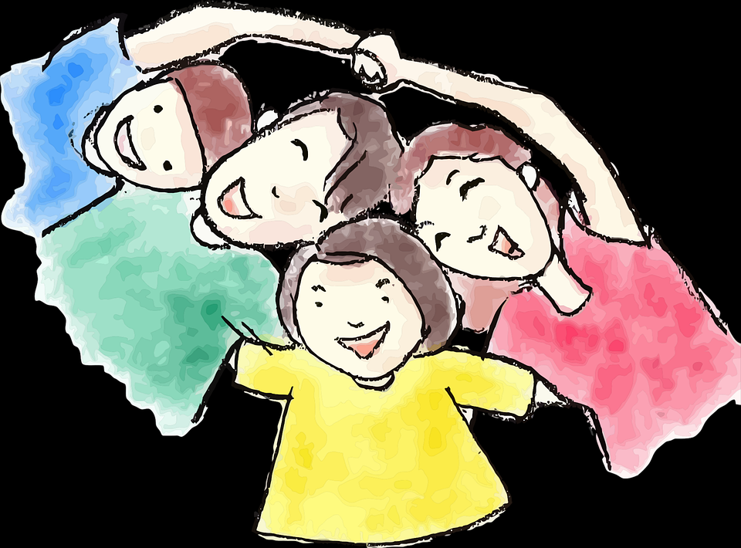
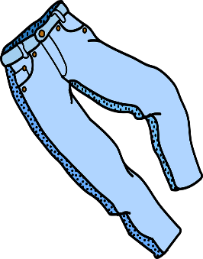
Quartett
die Familie
das Essen
die Kleidung
Bruder
Schwester
Obst
Butterbrot
Hose
Jacke
Eltern
Kind
Keks
Gemüse
Hut
T-Shirt
die Jobs
die Fahrzeuge
die Orte
Schauspielerin
Arzt
Fahrrad
Auto
Theater
Kino
Sängerin
Lehrer
Zug
Bus
Bibliothek
Markt
Notes:
Quartett
As a final activity for this lesson students play Quartett [Happy Families]. Estimated time allowed for the game: 10-15 minutes
Aim:
This game will practise grammatical gender as students have to ask for den / die / das X. It will also practise asking questions. It also practises most of the nouns in this week’s revisited vocabulary sets (plus some additional previously-taught nouns, and one cognate - das T-Shirt): Word frequencies: der Bruder [687] die Eltern [351] das Kind [106] der Schauspieler [2202] die Schwester [776] das Butterbrot [3561/1757] die Hose [2422] der Hut [2685] der Keks [>4000] das Obst [>4000] das Theater [725] das Kino [1825] die Bibliothek [927] der Markt [508] der Arzt [614] die Sängerin [3916] der Lehrer [433] das Gemüse [3450] die Jacke [>4034] das T-Shirt [3915]
Procedure:
This slide shows one card for each of the categories. The full set of cards is available as a printable pdf (3 A4 pages = one set of cards for 3-4 players).
Elicit translations for the category titles. Most are known, the exceptions being Fahrzeuge [1721] and Kleidung [2820]. The cards in each set should give students a clue as to what the category is.
Check that students know what Quartett is and explain the rules if necessary.
Elicit language about asking questions (Hast du X? Darf ich X haben?)
Remind students that they will need to pay attention to the gender of the word, and elicit from them that they will use Row 2 (accusative) articles.
Practise using the items on this slide: Hast du den Bruder? Hast du das Obst? Hast du die Hose? Hast du die Sängerin? Hast du das Auto? Hast du den Markt? Ideally students will be prompted to use Darf ich den Bruder haben, bitte? to provide additional spoken practice of one of the modal verbs.
Before starting the game, use the next slide to practise additional language to use in the game.
Students play in groups of three or four. A player wins when s/he has no cards left, i.e. all his/her cards are in families/sets of four.

Slide 17
Jetzt bist du dran! [Now you’re on! / Now it’s your turn!]
hören
2
How many cards have you got?
Wie viele Karten hast du?
So, you start.
Also, du beginnst.
It’s my turn!
Ich bin dran.
Minuten
Do you have (the father)?
Hast du (den Vater)?
May I have (the father), (please)?
Darf ich (bitte) (den Vater) haben?
Oh no! You are so mean!
Ach, nein! Du bist so gemein!
0
Ich gewinne!
LOS!
I’m winning!
Mensch, ärgere dich nicht! Man, don’t be mad!
Notes:
Quartett – du bist dran
Estimated time: 3 minutes
Before starting the game give students two minutes to come up with language that might be useful when playing the game, using the English prompts on the slide.
Review suggestions together.
Then play Quartett [Happy Families] in groups of three or four.

