Slide 1
Childhood experiences
Imperfect modal verbs – konnte, musste, wollte
Months of the year
Y9 German
Term 2.1 - Week 5 - Lesson 35
Charlotte Moss / Rachel Hawkes
Artwork: Steve Clarke
Date updated: 15/09/21
Notes:
Artwork by Steve Clarke. All additional pictures selected are available under a Creative Commons license, no attribution required.
Native-speaker teacher feedback provided by Stephanie Cross.
Learning outcomes (lesson 1):
Introduction of imperfect tense modal verbs, konnte, musste, wollte: 1st, 2nd, 3rd person singular Months of the year
Word frequency (1 is the most frequent word in German):
9.2.1.5 (introduce) einschlafen [2680] mitnehmen [1459] konnte, konntest [23] musste, musstest [43] wollte, wolltest [57] April [1004] Mai [1048] November [1273] September [1035] Zahn [1871] wach [3153]
9.2.1.2 (revisit) jemand [330] niemand [362] Blume [2463] Gegenstand [1308] Juni [1148] Meter [479] Person [357] Zentimeter [1338] gucken/kucken [1362] wachsen [470] aktiv [790] beliebt [1873] meist [705] ungefähr [1458]
9.1.1.6 (revisit) beobachten [697] entdecken [743] unterstützen [760] Bewegung [709] Chemie [486] Forscher [1246] Moment [348] Tourist [1318] Wissenschaftler [1522] historisch [901] als3 [22] bevor [537] nachdem [528]
Source: Jones, R.L & Tschirner, E. (2019). A frequency dictionary of German: Core vocabulary for learners. London: Routledge.
The frequency rankings for words that occur in this PowerPoint which have been previously introduced in NCELP resources are given in the NCELP SOW and in the resources that first introduced and formally re-visited those words.
For any other words that occur incidentally in this PowerPoint, frequency rankings will be provided in the notes field wherever possible.

Slide 2
Die Jahresuhr
lesen
*wecken – to wake
Januar, Februar, März, April
Die Jahresuhr steht niemals still
Januar, Februar, März, April
Die Jahresuhr steht niemals still
Mai, Juni, Juli, August
Weckt* in uns allen die Lebenslust
Mai, Juni, Juli, August
Weckt in uns allen die Lebenslust
September, Oktober, November, Dezember
Und dann, und dann
Fängt das Ganze schon wieder von vorne an...
Wolfgang, weißt du noch, das war immer dein Lieblingslied, als du jünger warst!
Notes:
Timing: 5 minutes (two slides) Aim: to revise the months with a traditional German song; to find out about a well-known author of German children’s songs. Procedure: 1. Read the text with students. 2. Prompt them to translate the meaning, orally, in pairs. 3. Check their understanding.
4. Play the video on the following slide and invite students to sing along. It is repetitive and catchy.
Note: all words (except wecken) have been previously taught, are compounds where both elements are known or are true cognates. However, there is still some work to do here for students to understand the text. The ideas in the compounds may be understood, but finding an English wording may be tricky, e.g. Jahresuhr (yearly clock, calendar year; clock of the year, year’s clock); Lebenslust (zest for life, love of life, joy of living).
Word frequency of unknown words and cognates(1 is the most frequent word in German): wecken [2578] niemals [1402] still [1301] Source: Jones, R.L. & Tschirner, E. (2019). A frequency dictionary of German: core vocabulary for learners. Routledge
Frequency: 97% (all words in top 2000 except wecken)

Slide 3
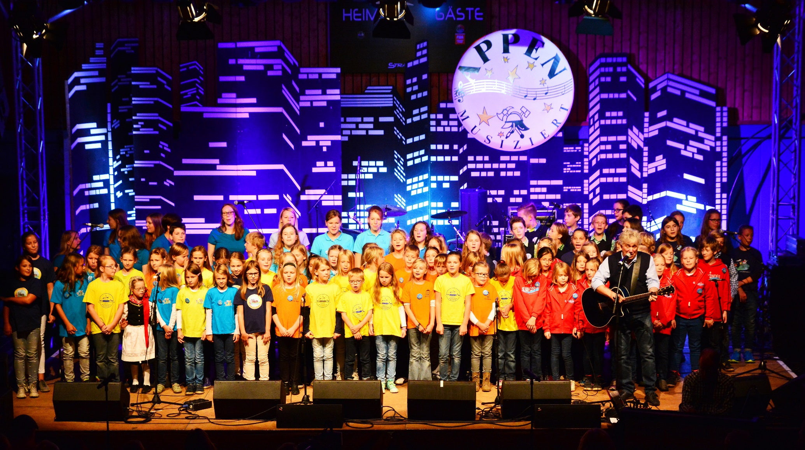
Die Jahresuhr
hören
Rolf Zuckowski ist ein deutscher Musiker, der aus Hamburg kommt. Alle deutschen Kinder wachsen mit seinen Kinderliedern auf.
Notes:
Procedure: 1. Play the video and invite students to sing along. It is repetitive and catchy. 2. Point out Rolf Zuckowski and read the two sentences about him with students.
Word frequency of unknown words (1 is the most frequent word in German): wecken [2578] Source: Jones, R.L. & Tschirner, E. (2019). A frequency dictionary of German: core vocabulary for learners. Routledge
Photo attribution: Frank Schwichtenberg, CC BY-SA 3.0 <https://creativecommons.org/licenses/by-sa/3.0>, via Wikimedia Commons
Video link: https://www.youtube.com/watch?v=WJ0uJo5kJ04

Slide 4
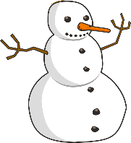
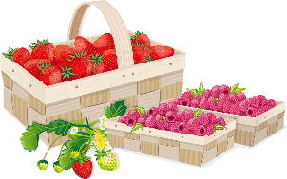
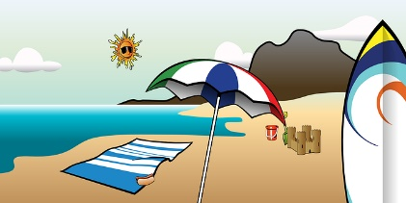
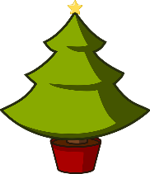
die Monate [1/3]
hören
Hör zu und schreib die Monate.
Most months stress the same syllable as in English as they are borrowed words, but which two months stress a different syllable?
Februar
März
April
Januar
_ _ _ _ _ _ _
_ _ _ _
_ _ _ _ _
_ _ _ _ _ _
_ _ _
Juni
Juli
Mai
_ _ _ _
_ _ _ _
August
_ _ _ _ _ _
September
Oktober
November
Dezember
_ _ _ _ _ _ _ _ _
_ _ _ _ _ _ _
_ _ _ _ _ _ _ _
_ _ _ _ _ _ _ _
Notes:
Timing: 5 minutes Aim: to practise associating the aural and written form of the months in a transcription task. Procedure: 1. Click the audio button to hear the months in German.
2. Ask students to transcribe what they hear for each month.
3. Click to reveal answers.
4. Click to reveal the call out and the answers. Note: Four of the months are part of this week’s vocabulary list. Students have learnt the other months over a period of time and several different contexts. Here they are all brought together for revisiting.
Transcript: Januar
Februar
März
April
Mai
Juni
Juli
August
September
Oktober
November Dezember

Slide 5
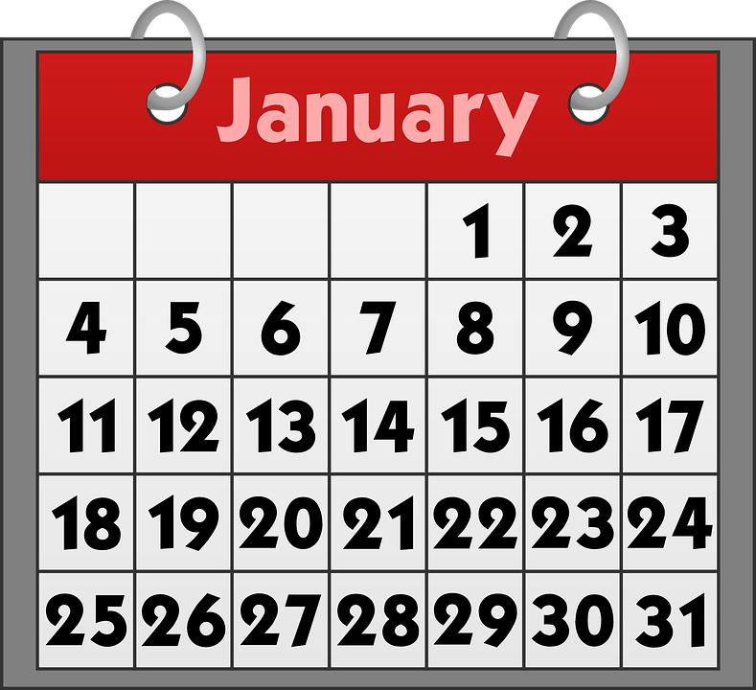
die Monate [2/3]
lesen / sprechen
Wieviele Tage hat der Monat?
Dreißig Tage hat September
April, Juni und November.
Achtundzwanzig Tage hat Februar
Neunundzwanzig nur im Schaltjahr.
Alle anderen ohne Frage
haben einunddreißig Tage.
_ _ _ _
_ _ _ _ _ _ _ _.
Note that all German months are masculine and you usually use the article (der) when you use them in a sentence: Der Januar ist ein kalter Monat in Deutschland.
_ _ _ _ _,
_ _ _ _ _ _ _ _ _ _ _ _ _ _
_ _ _ _ _
Notes:
Timing: 3 minutes Aim: to practise written comprehension and spoken production of known vocabulary. Procedure: 1. Ask students to read the poem aloud, filling in the gaps as they go.
2. Click the audio button to check answers.
3. Click to reveal the answers. 4. Elicit the meaning of ‘Schaltjahr’ (leap year) from students’ understanding of all the surrounding words and context.
Word frequency (1 is the most frequent word in German):
Schaltjahr [>5009] Source: Jones, R.L. & Tschirner, E. (2019). A frequency dictionary of German: core vocabulary for learners. Routledge

Slide 6
die Monate [3/3]
lesen / sprechen
Many German-speaking children learn which months have 31 days by using their knuckles.
Wieviele Tage hat der Monat?
Januar (31)
März (31)
Mai (31)
Juli (31)
August (31)
Oktober (31)
Dezember (31)
September
November
April
Februar
Juni
Notes:
Timing: 2 minutes Aim: to practise oral production of the months; to demonstrate how German-speaking children learn which months have 31 days. Procedure: 1. Click to reveal call out.
2. Click to reveal arrows and months.
3. Play the animated sequence of months again. Students try to keep up with the animation, as they say the months. 4. Students say the year from start to finish using their knuckles.

Slide 7
Als Kinder… [1/2]
Gucken is an informal verb for ‘look’ or ‘watch’. Pronounce it ‘kucken’ but generally write it ‘gucken’.
hören
Mia und Wolfgang denken an ihre Kindheit.
Hör zu. Welche Übersetzung ist richtig?
 | He didn’t want to get up. | He didn’t want to go to sleep. | You didn’t want to go to sleep.
 | I had to stay awake. | I had to grow up. | I wanted to stay awake.
 | You wanted to only grow a centimetre. | You could only measure a centimetre. | You could only grow a centimetre.
 | I mostly watched children’s films. | I only bought children’s films. | I didn’t watch children’s films.
1
2
3
4
Notes:
Note: if students are not routinely doing the pre-learning homework then teachers might prefer to do a more straightforward task here, where they say the words, students transcribe them and they then write any English meanings that they can, and the remaining meanings are provided by the teacher.
Timing: 5 minutes (2 slides) Aim: to practise aural comprehension of some of this week’s vocabulary. Procedure: 1. Click on the audio buttons to hear the German sentence.
2. Ask students to decide which English translation is correct.
3. Click to reveal answers.
4. Click to reveal the call-out about gucken.
5. Repeat for the following slide.
Transcript: 1. Er wollte nicht einschlafen. 2. Ich musste wach bleiben. 3. Du konntest nur einen Zentimeter wachsen. 4. Ich habe meistens Kinderfilme geguckt. 5. Du musstest immer in Bewegung sein. 6. Ich konnte meinen Teddy nicht mitnehmen. 7. Sie hat oft Insekten beobachtet. 8. Du wolltest deinen esten Zahn nicht verlieren.

Slide 8
Als Kinder… [2/2]
hören
 | You always had to be on the move. | You wanted to be on the move. | You liked to move around.
 | I couldn’t take my teddy. | You wanted to bring my teddy. | I wanted to bring my teddy.
 | She often discovered insects. | They often observed insects. | She often observed insects.
 | You had to lose your first tooth. | You didn’t want to lose your first tooth. | You lost your first tooth.
5
6
7
8
Notes:
Slide 2
Transcript: 1. Er wollte nicht einschlafen. 2. Ich musste wach bleiben. 3. Du konntest nur einen Zentimeter wachsen. 4. Ich habe meistens Kinderfilme geguckt. 5. Du musstest immer in Bewegung sein. 6. Ich konnte meinen Teddy nicht mitnehmen. 7. Sie hat oft Insekten beobachtet. 8. Du wolltest deinen ersten Zahn nicht verlieren.

Slide 9
Zahnfee* oder Zahnmaus?
Kultur
*die Zahnfee – tooth fairy
Wenn Kinder in Nordeuropa (z.B. Deutschland und England) einen Zahn verlieren, dann kommt die Zahnfee*. Normalerweise bringt sie Geld für den Zahn.
In Frankreich oder Spanien kommt die Zahnmaus. Sie bringt auch Geld mit.
Notes:
Timing: 1 minute Aim: to practise written comprehension of known vocabulary and structures in a new context: to learn about different European tooth fairy cultures. Procedure: 1. Students read the information about the tooth fairy / mouse for themselves. 2. Elicit understanding of the two different traditions.
Word frequency (1 is the most frequent word in German):
Fee [>5009] Source: Jones, R.L. & Tschirner, E. (2019). A frequency dictionary of German: core vocabulary for learners. Routledge

Slide 10
Imperfect modal verbs
Grammatik
You know that present tense modal verbs are most often used with a second verb in the infinitive, at the end of the sentence.
Ich will um 9 Uhr aufstehen.
I want to get up at 9 o’clock.
Imperfect (or simple past) modal verbs work in the same way:
Ich wollte um 9 Uhr aufstehen.
I wanted to get up at 9 o’clock.
 | können | wollen | müssen
ich | konnte | wollte | musste
du | konntest | wolltest | musstest
er/sie/es | konnte | wollte | musste
To form the imperfect (simple past) of modal verbs:
1. remove -en and any umlauts
2. add -te
3. also add -st to the du form
Notes:
Timing: 3 minutes Aim: to introduce three imperfect modal verbs in 1st, 2nd, 3rd persons singular. Procedure: Click to bring up the stages of the explanation.

Slide 11
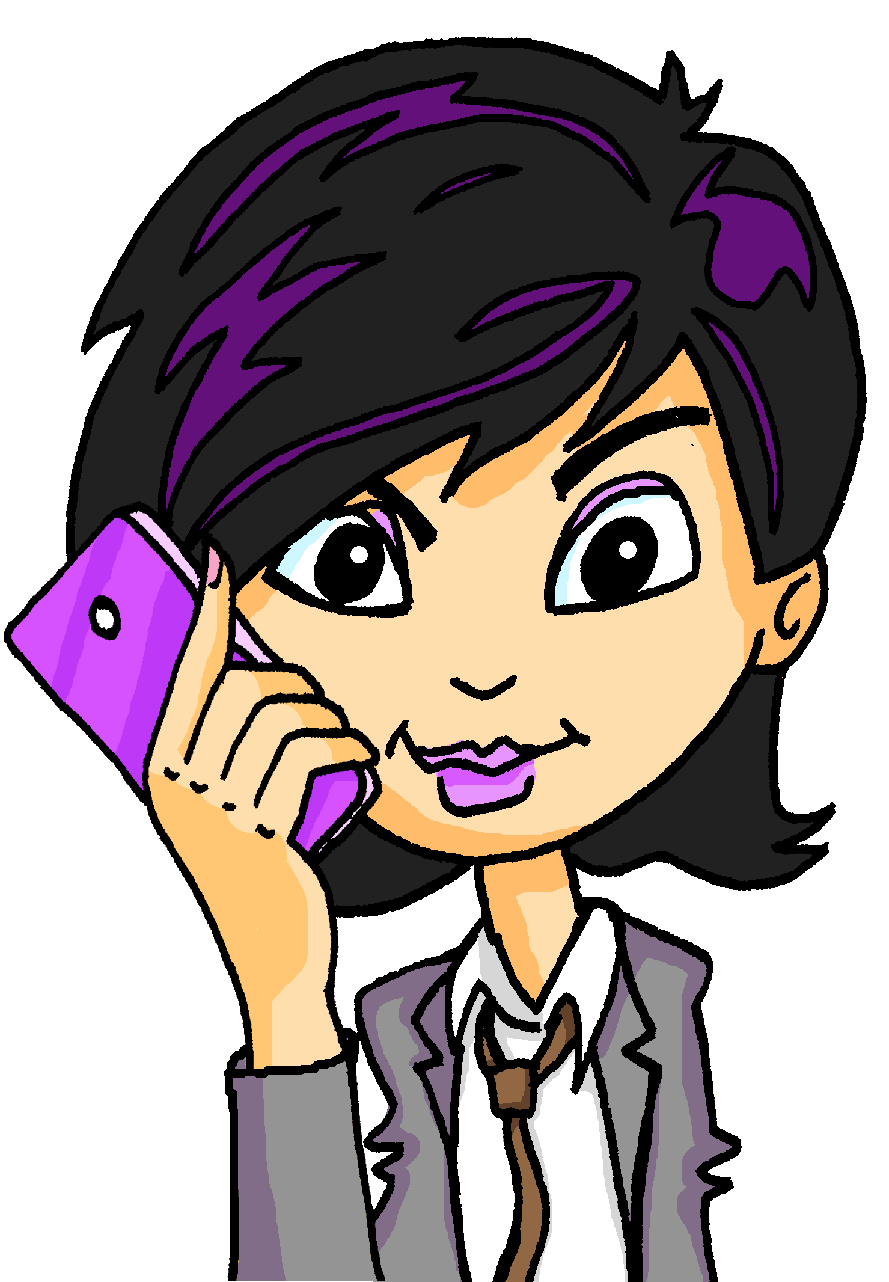
Jetzt oder früher?
hören
Katja spricht mit ihrem Vater über Mia und Paula.
 |  | Vergangenheit / Gegenwart | ich / du / sie
 | Mit acht Jahren kann sie schon Rad fahren. | Gegenwart | sie
 | Ich konnte sehr gut schwimmen. | Vergangenheit | ich
 | Ich will immer aktiv sein. | Gegenwart | ich
 | Das kannst du auch machen. | Gegenwart | du
 | Ich wollte heute in der Schule einschlafen! | Vergangenheit | ich
 | Sie will Forscherin werden. Sie ist wach geblieben! | Gegenwart | sie
 | Dann muss sie unbedingt Chemie lernen. | Gegenwart | sie
 | Das musstest du auch in der Schule lernen, oder? | Vergangenheit | du
Hör zu. Schreib 1-8, V oder G und ich, du oder sie.
1
2
3
4
5
6
7
8
Notes:
Timing: 8 minutes Aim: to practise aural recognition of present and past forms of modal verbs. Procedure: 1. Ensure students remember the words Vergangenheit (past) and Gegenwart (present).
2. Click the audio buttons to play the recording.
3. Students decide whether the modal verb is in the past or present, and write V (Vergangenheit) or G (Gegenwart ). 4. Students listen again and decide whether it is ich / du / sie.
5. Click to reveal the answers. 6. If time allows, click to reveal written versions of the statements, and elicit their English meaning.
Transcript: 1. Katja: Mit acht Jahren kann sie schon Rad fahren.
2. Katja : Ich konnte sehr gut schwimmen. 3. Katja: Ich will immer aktiv sein. 4. Vater: Das kannst du auch machen.
5. Katja: Ich wollte heute in der Schule einschlafen! 6. Katja: Sie will Forscherin werden, deshalb ist sie wach geblieben! 7. Vater: Dann muss sie unbedingt Chemie lernen. 8. Vater: Das musstest du auch in der Schule lernen, oder?

Slide 12
In der Kindheit
lesen
Wolfgang und Mia reden über ihre Kindheit. Wollten sie das machen or haben sie das gemacht?
 |  | Wanted to do or did it?
 | Ich wollte nie einschlafen. | wollte | bin
 | Und du bist abends immer spät wach geblieben. | wolltest | bist
 | Mehmet wollte schnell wachsen. | wollte | ist
 | Ja, deshalb wollte er immer aktiv sein. | wollte | ist
 | Wie Mehmet, habe ich meinen ersten Zahn mit fünf Jahren verloren. | wollte | habe
 | Aber du wolltest nie zum Zahnarzt gehen! | wolltest | bist
 | Ich habe Mutti beim Zahnarzt beobachtet. Ich hatte Angst!! | wollte | habe
_____
____
_____
____
_____
____
_____
Notes:
Timing: 7 minutes Aim: to practise written comprehension of the imperfect and perfect tenses, contrasting infinitive and past participle verb forms. Procedure: 1. Ask students to decide whether Wolfgang and Mia wanted to do or did the activity based on the form of the second verb.
2. If they wanted to do the activity, students should choose the modal verb. If they did do the activity, students should choose the auxiliary.
3. Click to reveal the answers. 4. Ask students in pairs to recreate this as a translated dialogue in English. 5. Check their understanding.

Slide 13
Jetzt oder früher?
sprechen
aktiv sein jemanden fragen
eine Blume haben
gucken beliebt sein beobachten
Wissenschaftler sein wachsen
eine Person unterstützen
Chemie studieren einen Gegenstand kaufen
Forscher sein Tourist sein
keinen Zahn verlieren
wach bleiben in Bewegung sein immer einschlafen viel entdecken
im November anfangen
 |  |  | odd = imperfect even = present
1 | I | 1 | wollen
2 | you | 2 | müssen
3 | s/he | 3 | können
4 | I | 4 | wollen
5 | you | 5 | müssen
6 | s/he | 6 | können
Notes:
Note: to keep track during the activity, it may be helpful for each pair to have one print out of this slide between them.
Timing: 8 minutes
Aim: to practise oral productions of first, second and third person singular forms of present and imperfect tense modal verbs.
Procedure:
1. Ensure that students notice that odd numbers = imperfect modal, even numbers = present modals. Player A rolls the dice twice to generate: 1) a pronoun and 2) a verb.
2. S/he changes the infinitive to produce a conjugated verb, e.g. 1+6 = Ich kann
3. S/he then chooses a word or phrase from the square to finish their sentence. Partners write down the sentence in English.
4. Partners take it in turns thereafter.
Each word from the square can only be used once. Once a word is used it can be crossed out. As the number of possible words decreases, players may have to ‘knock’ if there is no appropriate word to finish their sentence. In this case, play passes to their partner. All modals work with all verb phrases. The player who is able to make the most sentences within the time or until all the words run out is the winner.
5. To bring the learning to a close, students should translate orally into German the English sentences that their partner made (which they have noted in English in their books).

Slide 14
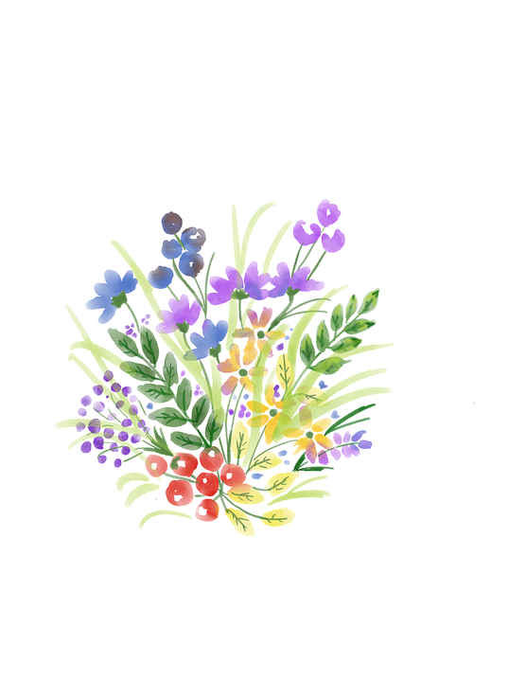
Wolfgang hat einen grünen Daumen*
schreiben
*der Daumen – thumb beim Wachsen – whilst growing
Im April will ich Blumen in meinem Garten pflanzen. Ich muss den Blumen viel Wasser geben. Ich kann sie beim Wachsen* beobachten. Ich will Mutti die bunten Blumen geben und sie kann sie neben das Fenster stellen. Sie kann auch einige zur Arbeit mitnehmen, und dann sagt jemand vielleicht: „Du musst einen sehr netten Sohn haben! “
Change this present tense into the perfect tense.
Note: change all the present modals into the imperfect, except the quote.
Willst du mir auch welche geben?
Notes:
Timing: 8 minutes (2 slides) Aim: to convert modals from the present to the imperfect in first, second and third persons singular. Procedure: 1. Ask students to read the title and suggest what it might mean. If students need a little support, tell them that a similar idiom exists in English (to refer to those who are gifted at gardening). Allow them to notice that in English you have ‘green fingers’ and in German ‘a green thumb’.
2. Ask students to convert the text from the present to the past tense. They could be asked simply to number 1-8 and change all the verbs.
3. Bring up the two callouts. Make sure they know that all modal verbs require converting from the present to the imperfect, except the direct quote from Wolfgang and that, in addition there is one present tense that needs to be converted into the perfect tense. 4. On the following slide, click to reveal the answers.
Word frequency (1 is the most frequent word in German):
Daumen [3965] Source: Jones, R.L. & Tschirner, E. (2019). A frequency dictionary of German: core vocabulary for learners. Routledge

Slide 15
Wolfgang hat einen grünen Daumen
schreiben
Im April will ich Blumen in meinem Garten pflanzen. Ich muss den Blumen viel Wasser geben. Ich kann sie beim Wachsen beobachten. Ich will Mutti die bunten Blumen geben und sie kann sie neben das Fenster stellen. Sie kann
auch einige zur Arbeit mitnehmen, und dann sagt jemand vielleicht: „Du musst einen sehr netten Sohn haben! “
wollte
musste
konnte
wollte
konnte
konnte
hat
gesagt
Wolltest
Willst du mir auch welche geben?
Notes:
Slide 2
Procedure: Click to reveal the answers.

Slide 16
Childhood experiences
Imperfect plural forms of sein and haben
Revisit SSC with same sound, different spelling
Y9 German
Term 2.1 - Week 5 - Lesson 36
Charlotte Moss / Heike Krüsemann / Rachel Hawkes
Artwork: Steve Clarke
Date updated: 15/09/21
Notes:
Artwork by Steve Clarke. All additional pictures selected are available under a Creative Commons license, no attribution required.
Native-speaker teacher feedback provided by Stephanie Cross.
Learning outcomes (lesson 2):
Consolidation of SSC with same sound, different spelling: [f] [v] vs. [w] | [ss] [ß] vs. [s-] | [ei] [ai] vs. [ie] | [eu] [äu] vs. [au] | [th] [-d] vs. [-d-] | [ch] [ig] vs. [-g-] | [y] [ü] vs. [u] | [y] [j] vs. [-y-] | [sch] [st] [sp] vs. [ss] | [-ti-] [z] vs. [s] | [ei] [ie] vs. long [i] | short [e] [ä] vs. [a]
Consolidation of imperfect tense modal verbs, konnte, musste, wollte: 1st, 2nd, 3rd person singular Introduction of imperfect plural forms of haben and sein
Word frequency (1 is the most frequent word in German):
9.2.1.5 (introduce) einschlafen [2680] mitnehmen [1459] konnte, konntest [23] musste, musstest [43] wollte, wolltest [57] April [1004] Mai [1048] November [1273] September [1035] Zahn [1871] wach [3153]
9.2.1.2 (revisit) jemand [330] niemand [362] Blume [2463] Gegenstand [1308] Juni [1148] Meter [479] Person [357] Zentimeter [1338] gucken/kucken [1362] wachsen [470] aktiv [790] beliebt [1873] meist [705] ungefähr [1458]
9.1.1.6 (revisit) beobachten [697] entdecken [743] unterstützen [760] Bewegung [709] Chemie [486] Forscher [1246] Moment [348] Tourist [1318] Wissenschaftler [1522] historisch [901] als3 [22] bevor [537] nachdem [528]
Source: Jones, R.L & Tschirner, E. (2019). A frequency dictionary of German: Core vocabulary for learners. London: Routledge.
The frequency rankings for words that occur in this PowerPoint which have been previously introduced in NCELP resources are given in the NCELP SOW and in the resources that first introduced and formally re-visited those words.
For any other words that occur incidentally in this PowerPoint, frequency rankings will be provided in the notes field wherever possible.

Slide 17
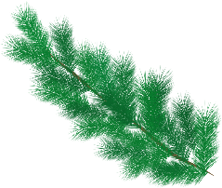
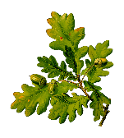
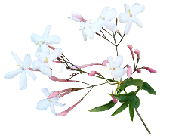
Meine Lieblingssachen
Welche Pflanzen hatte ich in meinem Garten?
Phonetik
Was passt nicht? Schreib 1-6 und A, B oder C.
 | A | B | C
 | der Löwenzahn | die Kiefer | das Veilchen
 | die Weißbirke | die Sonnenblume | die Nessel
 | die Eiche | die Lilie | die Hain-Klette
 | das Edelweiß | die Chrysantheme | der Mannsschild
 | die Rose | die Minze | die Montbretie
 | das Gänseblümchen | der Tannenbaum | die Gerbera
1
2
3
4
5
6
Notes:
Timing: 5 minutes Aim: to recognise a range of written SSCs and to produce them orally, strengthening the connection between SSCs that are written differently but sound the same. Procedure: 1. Students write 1-6 and choose which plant (A-C) is the odd one out in each set, based on the pronunciation of the letters in bold.
2. Students say the words to each other in pairs to check their answers.
3. Click to reveal the answers, eliciting the correct pronunciations.
4. Ensure the English meanings of the words are understood. 5. Click the audio buttons to hear a native speaker recording of each word.
Word frequency (1 is the most frequent word in German): Rose [3266] (all other words [>5009]) Source: Jones, R.L. & Tschirner, E. (2019). A frequency dictionary of German: core vocabulary for learners. Routledge

Slide 18
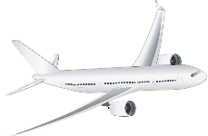
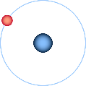
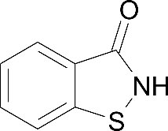
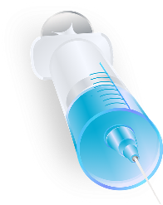
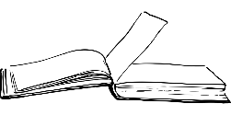
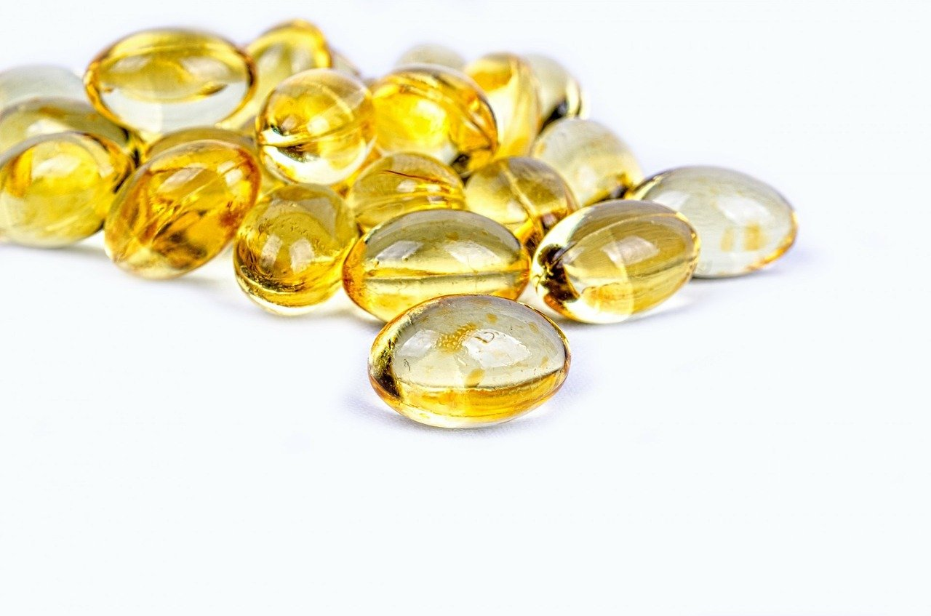
Wissenschaftler
Über welche Wissenschaftler habe ich erfahren?
Phonetik
Was passt nicht? Schreib 1-6 und A, B oder C.
 | A | B | C
 | Braun | Beutler | Anhäuser
 | Wegener | Liebig | Ehrlich
 | Richthofen | Wendt | Vogel
 | Einstein | Bosch | Forssman
 | Heisenberg | Diels | Bergius
 | Liebenthal | Bezold | Windaus
1
2
3
4
5
6
Notes:
Timing: 5 minutes Aim: to recognise a range of written SCCs and orally produce a range of SSCs strengthening the connection between SSCs that are written differently but sound the same. Procedure: 1. Students write 1-6 and choose which scientist (A-C) is the odd one out in each set, based on the pronunciation of the letters in bold.
2. Students say the words to each other in pairs to check their answers.
3. Click to reveal the answers, eliciting the correct pronunciations.

Slide 19
Mein Lieblingspiel
Dobble war früher mein Lieblingsspiel!
lesen
One of the words in circle A has a translation in circle B. Which one?
Shout the word when you’ve found it.
A
B
warm
daughter
der Beruf
room
neighbour
der Arm
führen
modern
die Sachen
music
traditionell
lady
wohin
voice, vote
der Nachbar
well
Notes:
Timing: 8 minutes (3 slides) Aim: to practise written recognition of most of this week’s new and all of this week’s revisited vocabulary. The time element facilitates automisation and fluency. Using a translation means students will have to process meanings rather than simply form spotting. Two versions are provided: a manual and a timed version. Procedure: 1. The circle on the left has eight German words. One of the words has a translation in the English circle on the left. Students try to find the word as quickly as possible. And shout out the word when they have found it. First person to find and shout the word (or translation) gets a point.
2. When the correct word is found click the mouse to change the English words to the next set.
3. The German words change after every four rounds. This change is signalled with a colour change on both circles.
4. Play until all cards have been done.
Words included and their frequency (1 is the most frequent word in German): einschlafen [2680] mitnehmen [1459] konnte, konntest [23] musste, musstest [43] wollte, wolltest [57] April [1004] Mai [1048] jemand [330] niemand [362] Blume [2463] Gegenstand [1308] Juni [1148] Meter [479] Person [357] Zentimeter [1338] gucken/kucken [1362] wachsen [470] aktiv [790] beliebt [1873] meist [705] ungefähr [1458] beobachten [697] entdecken [743] unterstützen [760] Bewegung [709] Chemie [486] Forscher [1246] Moment [348] Tourist [1318] Wissenschaftler [1522] historisch [901] als3 [22] bevor [537] nachdem [528] Source: Jones, R.L & Tschirner, E. (2019). A frequency dictionary of German: Core vocabulary for learners. London: Routledge.

Slide 20
Vokabeln
lesen / sprechen
person
flower
flower
you had to
(der) Juni
historic
object
beobachten
flower
to look, watch
musste
to look, watch
der Zentimeter
moment
der Gegenstand
scientist, scholar
May
chemistry
I, s/he, it had to
scientist,
scholar
I, s/he, it wanted
der Wissenschaftler
I, s/he, it wanted
object
historic
I, s/he, it wanted
I, s/he, it had to
to take along (with)
when (past), as, than
to observe, watch
moment
approximately, about
mostly,
usually
approximately,
about
(der) Mai
to discover, discovering
die Blume
to fall asleep,
falling asleep
bevor
popular
der Tourist
to discover,
discovering
centimetre
wachsen
flower
to discover,
discovering
mostly,
usually
object
I, s/he, it was able, could
someone, somebody
June
you wanted
chemistry
die Chemie
to support,
supporting
movement
tourist
no-one,
nobody
you had to
der Moment
person
konnte
to support, supporting
konntest
mostly, usually
wolltest
ungefähr
der Forscher
active
to observe, watch
you were able to, could
before
metre
you wanted
I, s/he, it was able, could
popular
person
popular
flower
movement
to observe, watch
centimetre
popular
to observe, watch
moment
researcher,
explorer
mostly,
usually
die Person
you were able, could
als³
to look, watch
ungefähr
to support,
supporting
active
moment
centimetre
April
you had to
moment
historic
gucken, kucken
I, s/he, it wanted
konntest
jemand
chemistry
person
jemand
der Meter
chemistry
scientist, scholar
movement
to discover, discovering
approximately, about
after
to fall asleep,
falling asleep
centimetre
May
someone, somebody
to grow, growing
nachdem
I, s/he, it was able, could
wachsen
tourist
before
to discover, discovering
niemand
researcher, explorer
movement
to take along (with)
der Moment
June
before
when (past), as, than
moment
movement
centimetre
mostly, usually
June
tourist
flower
mitnehmen
after
wachsen
to take along (with)
object
beliebt
popular
I, s/he was able, could
metre
no-one, nobody
I, s/he, it wanted
to take along (with)
to support, supporting
when (past), as, than
to grow, growing
metre
June
mostly, usually
researcher, explorer
April
die Bewegung
April
you were able,
could
researcher, explorer
flower
active
metre
to support, supporting
you wanted
active
historic
May
unterstützen
to look, watch
einschlafen
metre
historic
mostly, usually
after
flower
after
(der) April
I, s/he, it wanted
historic
movement
der Wissenschaftler
to look, watch
die Blume
I, s/he, it had to
ungefähr
der Gegenstand
historic
to support,
supporting
you were able, could
I, s/he, it had to
someone,
somebody
tourist
I, s/he, it was able, could
to fall asleep,
falling asleep
to observe, watch
chemistry
you were able, could
April
musstest
you had to
someone, somebody
object
when (past), as, than
approximately, about
to fall asleep,
falling asleep
researcher, explorer
to take along (with)
to look, watch
before
niemand
to fall asleep,
falling asleep
meist
I, s/he, it wanted
mostly, usually
to observe, watch
someone,
somebody
entdecken
to grow, growing
chemistry
to look, watch
movement
I, s/he, it had to
als³
no-one, nobody
(der) Juni
mostly, usually
historisch
movement
May
historic
tourist
object
active
flower
object
Notes:
Words included and their frequency (1 is the most frequent word in German): einschlafen [2680] mitnehmen [1459] konnte, konntest [23] musste, musstest [43] wollte, wolltest [57] April [1004] Mai [1048] jemand [330] niemand [362] Blume [2463] Gegenstand [1308] Juni [1148] Meter [479] Person [357] Zentimeter [1338] gucken/kucken [1362] wachsen [470] aktiv [790] beliebt [1873] meist [705] ungefähr [1458] beobachten [697] entdecken [743] unterstützen [760] Bewegung [709] Chemie [486] Forscher [1246] Moment [348] Tourist [1318] Wissenschaftler [1522] historisch [901] als3 [22] bevor [537] nachdem [528] Source: Jones, R.L & Tschirner, E. (2019). A frequency dictionary of German: Core vocabulary for learners. London: Routledge.

Slide 21
Wie sagt man das?
1. Sag die Wörter laut.
sprechen / schreiben
2. Schreib die Wörter schnell auf.
you wanted
du wolltest
to take along
May
der Mai
nachdem
mitnehmen
after
I had to
einschlafen
der Gegenstand
ich musste
wach
awake
to go to sleep
object
April
sie konnte
der April
she could, was able
er wollte
he wanted
you could, were able
du konntest
tooth
der Zahn
du musstest
you had to
approximately
researcher
ungefähr
der Forscher
Notes:
Timing: 5 minutes
Aim: to practise oral and then written production of this week’s new vocabulary and four previously taught words.
Procedure:
1. Click to start. The first box spins.
2. Students call out the German for that box before it stops spinning.
3. The German appears.
4. Repeat until all German words have been revealed. 5. Repeat the task, this time writing the German each time.

Slide 22
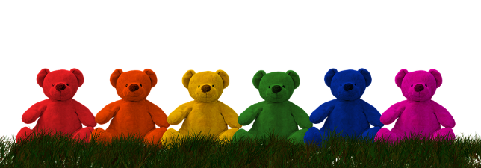
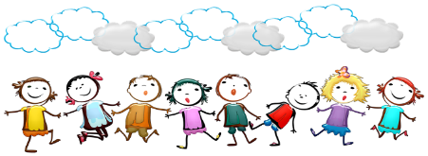
Plural imperfect verb forms
Grammatik
You know how to say ‘I have had’ and ‘I have been’ in the perfect tense:
Ich habe einen Teddy gehabt.
I had / have had a teddy.
Ich bin aktiv gewesen.
I was / have been active.
You also know that it is more common to use the one-word imperfect (past simple) as a shortcut:
Ich hatte einen Teddy.
I had a teddy.
Ich war aktiv.
I was active.
The plural imperfect of haben and sein work in the same way. Here are the forms:
sein
haben
Remember that there is no plural of es gab. It means there was AND there were.
wir (we)
waren
hatten
ihr (you all)
wart
hattet
sie/Sie (they/ you formal)
waren
hatten
Notes:
Timing: 3 minutes Aim: to introduce imperfect plural verb forms of sein and haben. Procedure: Click through the animations, explaining and eliciting as appropriate for your class.

Slide 23
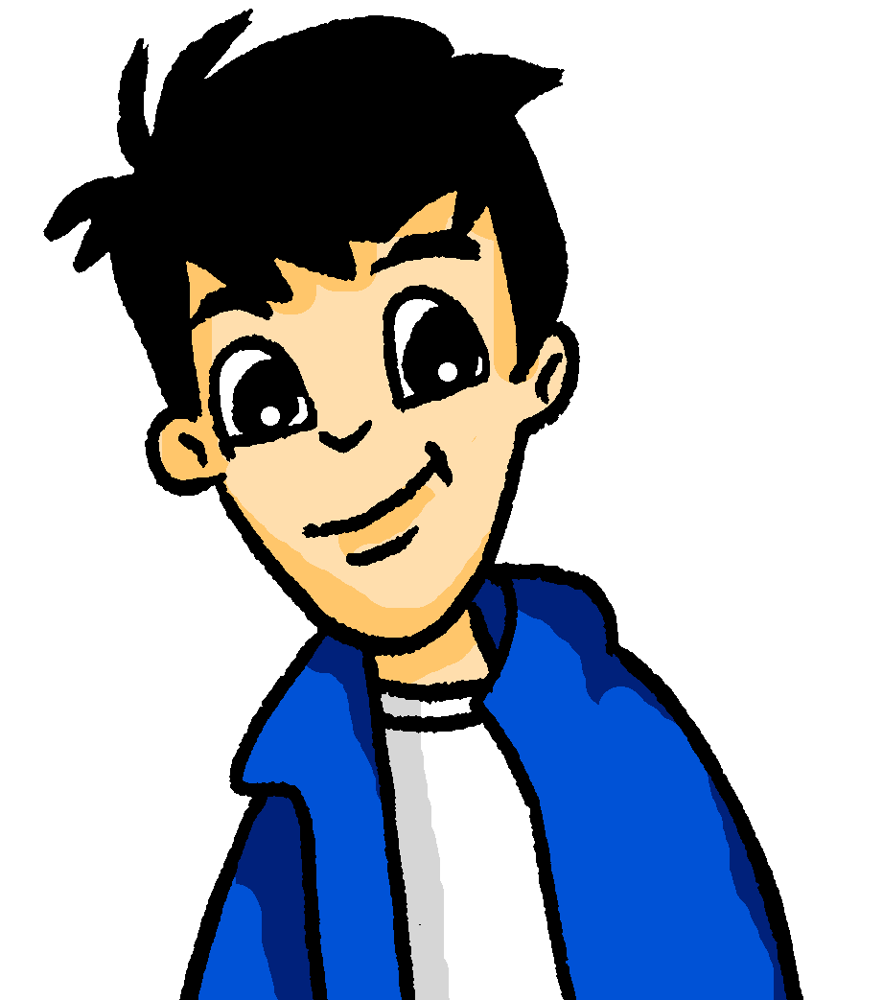
Eine(r) oder beide?
hören
Mutti erzählt von Wolfgang und Mias Kindheit.
Spricht sie über einen von ihnen (du) oder über beide (ihr)?
die Kindheit – childhood
spucken – to spit
 |  | du | ihr
 | Du hattest keine Lust einzuschlafen.
 | Ihr wart immer aktiv und in Bewegung.
 | Du warst gerne im Garten und hast die Blumen beim Wachsen beobachtet.
 | Du hattest das Talent, ungefähr einen Meter zu spucken.
 | Ihr wart meistens in der Nacht wach.
 | Ihr hattet den Plan, Wissenschaftler zu werden.
 | Du warst bei den Nachbarn beliebt.
 | Ihr hattet oft Zahnschmerzen.
1
2
3
4
5
6
7
8
Notes:
Timing: 8 minutes Aim: to practise aural comprehension of singular and plural imperfect forms of sein and haben. Procedure: 1. Explain the task: Mutti talks about Wolfgang and Mia’s childhood. Is she talking about one of them (warst/hattest), or both (wart/hattet)?
2. Click on audio buttons for item 1 to play recording.
3. Students tick whether they hear a plural (ihr) or a singular verb from (du). NB: pronouns have been bleeped out.
4. Click to reveal written from.
5. Click again to reveal answer tick.
6. Repeat for items 2-8.
Transcript: 1. [du] hattest keine Lust einzuschlafen.
2. [ihr] wart immer aktiv und in Bewegung.
3. [du] warst gerne im Garten und hast die Blumen beim Wachsen beobachtet.
4. [du] hattest das Talent, ungefähr einen Meter zu spucken.
5. [ihr] wart meistens in der Nacht wach.
6. [ihr] hattet den Plan, Wissenschaftler zu werden.
7. [du] warst bei den Nachbarn beliebt.
8. [ihr] hattet oft Zahnschmerzen.
Word frequency of unknown words and cognates (1 is the most frequent word in German): Kindheit [2323] spucken [>5009] Talent [2925] Source: Jones, R.L. & Tschirner, E. (2019). A frequency dictionary of German: core vocabulary for learners. Routledge

Slide 24
Eine(r) oder beide?
lesen
Mia macht ein Album über ihre Kindheit. Mia liest Muttis Tagebuch. Schreibt Mutti nur über Mia oder über Wolfgang UND Mia?
das Tagebuch – diary
 |  | nur Mia | Mia & Wolfgang
1. | Sie hatten den ersten Geburtstag im Mai.
2. | Sie war immer beliebt und aktiv.
3. | Sie waren keinen Moment am Tag müde.
4. | Im April hatte sie immer Blumen im Garten.
5. | Sie hatten oft Freunde zu Besuch.
6. | Sie waren gerne Forscher im Garten.
7. | Sie hatte Probleme mit dem Einschlafen.
8. | Sie war eine kleine Person von nur einem Meter.
Notes:
Timing: 8 minutes Aim: to practise written comprehension of war/waren and hatte/hatten. Procedure: 1. Explain the task: Mia is making a scrapbook album of her childhood and wants to find out where she was different from Wolfgang. She reads Mutti’s diary – but ‘sie’ can mean both she and they, so is Mutti talking about just Mia (war/hatte), or both twins (waren/hatten)?
2. Based on the verb ending (singular/ plural), students write 1-8 and nur Mia (singular) or Mia & Wolfgang (plural).
3. Click in turn for each answer tick to appear.
4. Give students 1-2 minutes further to discuss English meanings of each sentence with a partner. 5. Elicit English meanings from the class.
Word frequency (1 is the most frequent word in German): Album [3630] Tagebuch [3675]
Source: Jones, R.L. & Tschirner, E. (2019). A frequency dictionary of German: core vocabulary for learners. Routledge

Slide 25
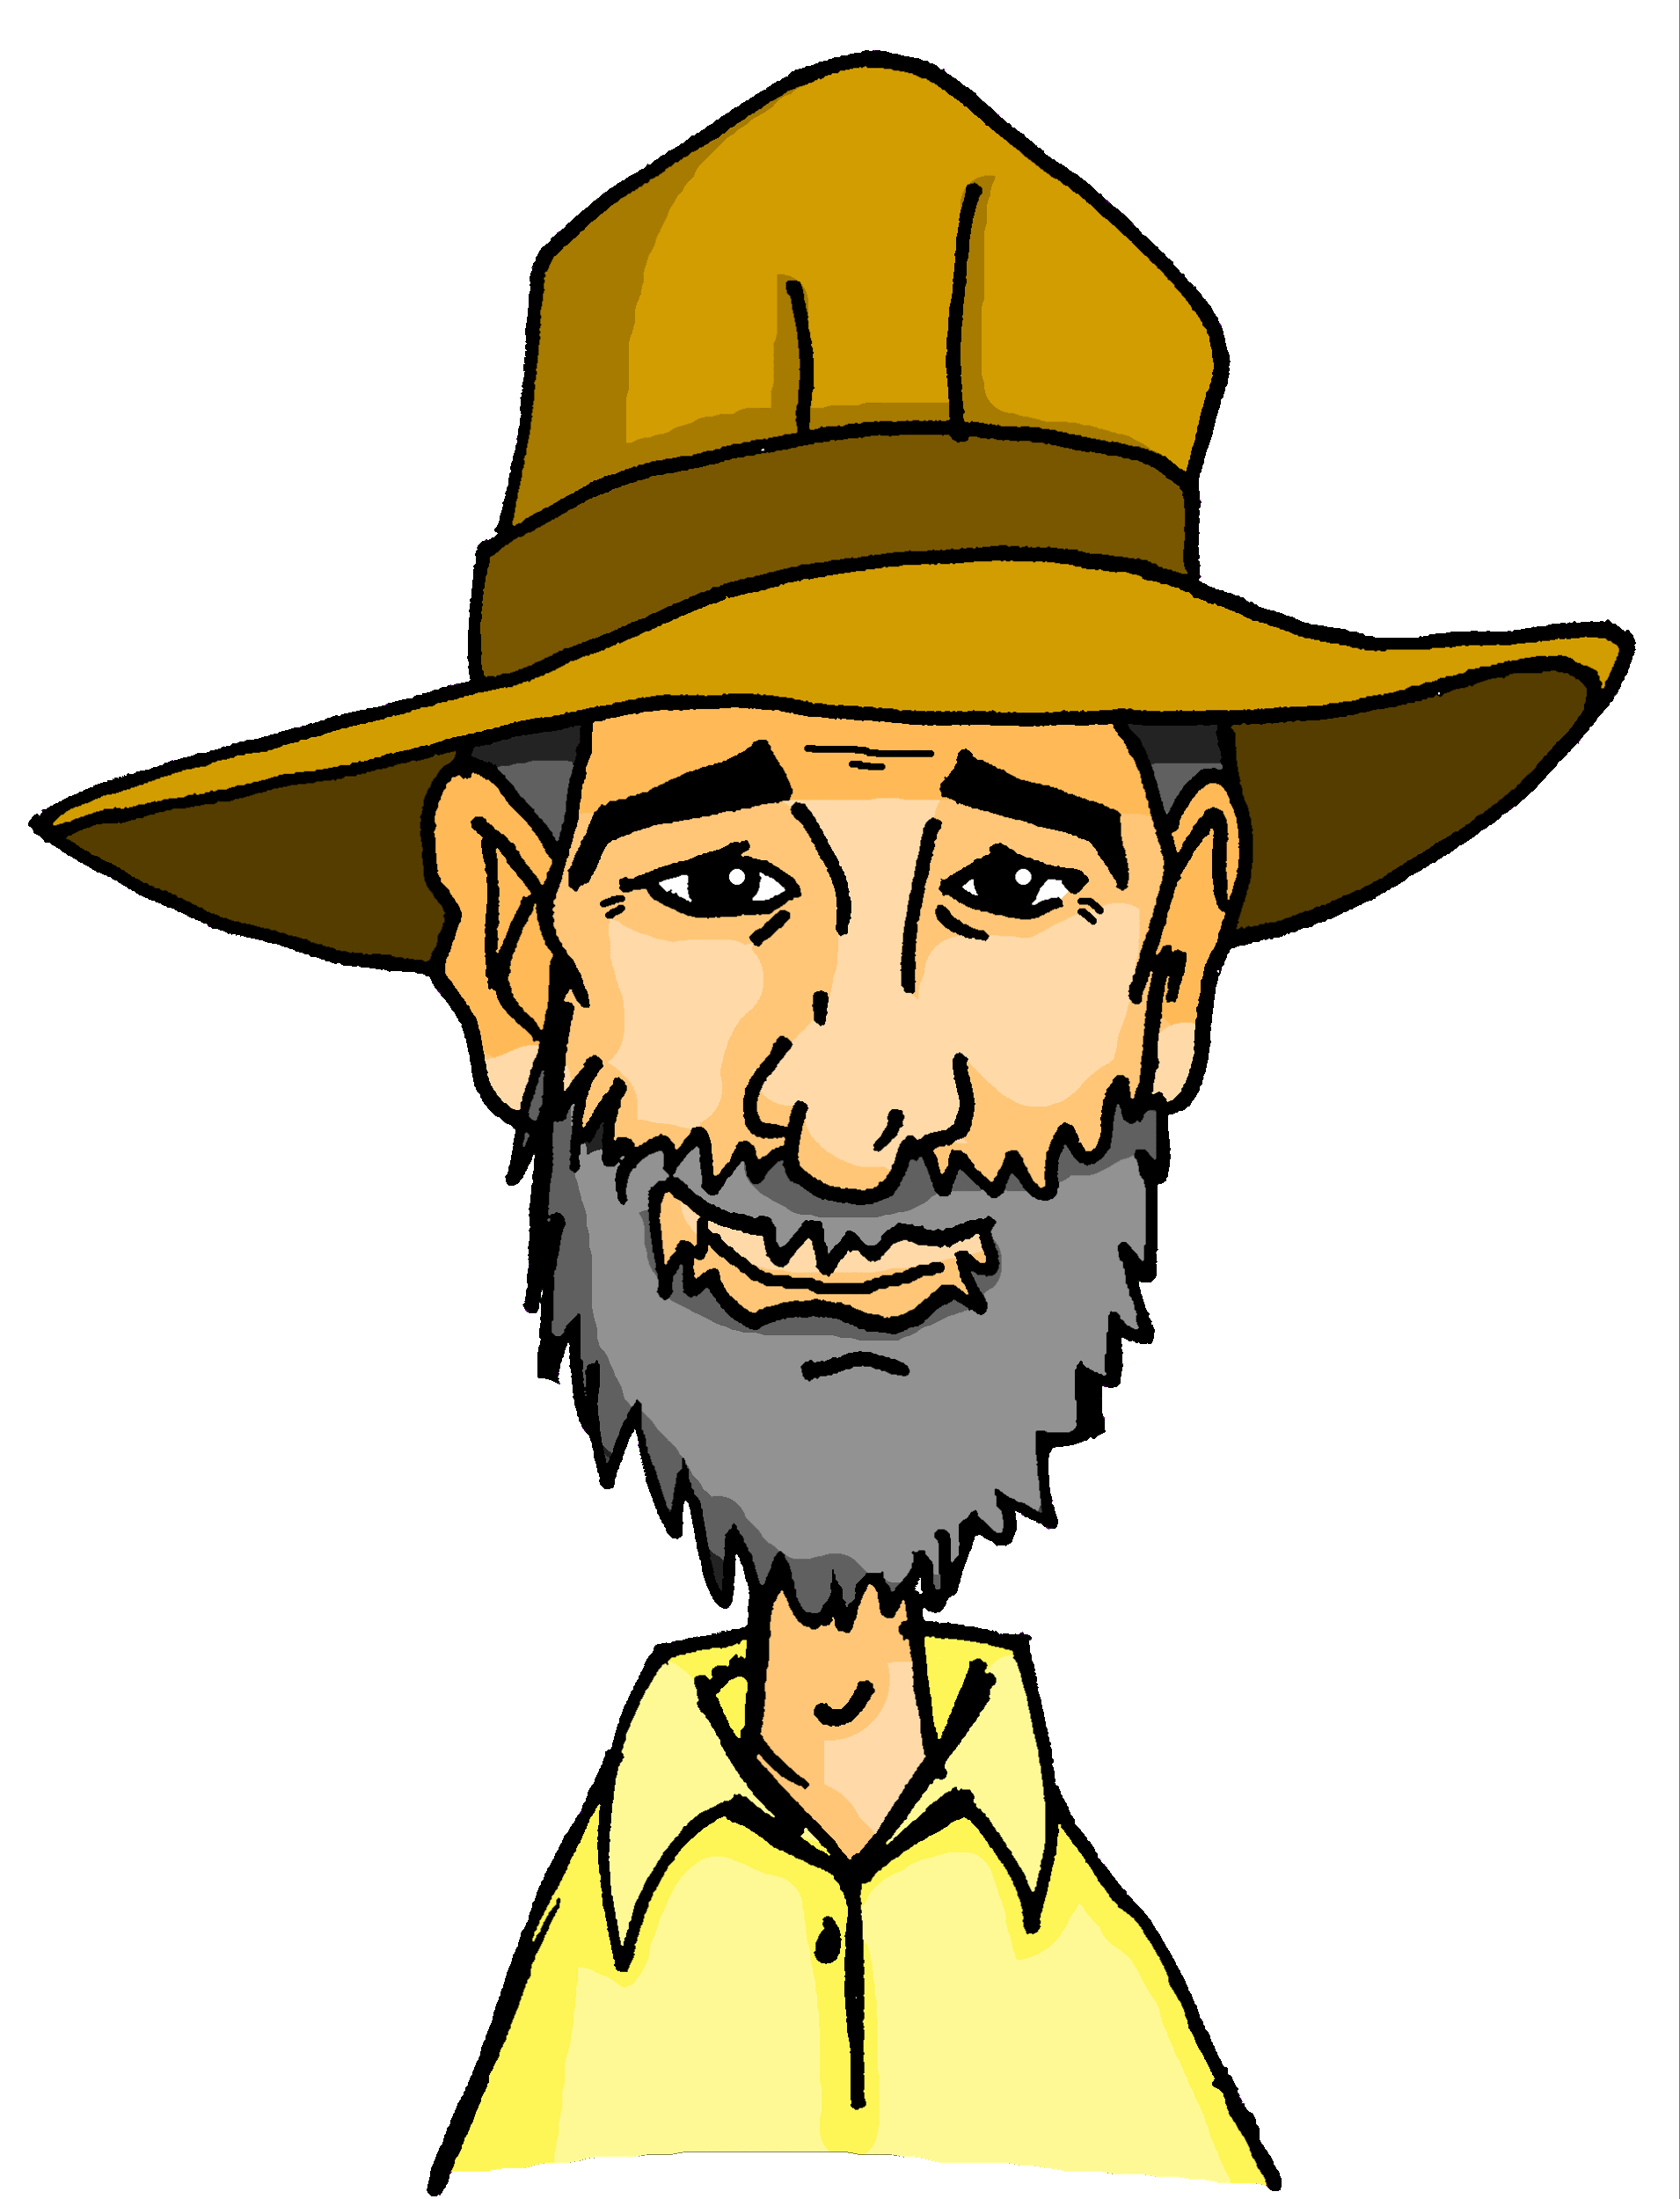
Onkel Heinrich und das Reisen
hören
Onkel Heinrich erzählt, wie das Reisen in seiner Kindheit war.
Richtig oder falsch?
1. Uncle Heinrich often went abroad as a child.
2. He really wanted to travel.
3. When he went to sleep, he used to dream about travelling with his friends.
4. He found out that scientists often travelled a lot.
5. He wanted to be an explorer as well as a tourist.
6. He went on a school trip with his friends.
7. He travelled with his brother and sister as well.
8. He supported his brother and sister, before he went travelling.
F
R
1-3
4-6
7-8
F
R
R
F
F
R
die Gelegenheit – opportunity
das Ausland – abroad unterwegs – on the go | ob – if
Notes:
SELECT EITHER THIS EXTENDED LISTENING TASK, THE EXTENDED READING OR THE FOLLOWING SPEAKING TASK Note: the listening is a challenging task for higher proficiency learners.
Timing: 8 minutes Aim: to practise aural comprehension of vocabulary and structures in a holistic listening task. Procedure: 1. Click to listen to the three parts of the audio.
2. Students decide if the statements are true or false. They may need multiple listenings.
3. Click to bring up answers.
Transcript: „In meiner Kindheit gab es wenig Gelegenheit ins Ausland zu reisen, aber ich wollte schon immer weltweit unterwegs sein. Nachts konnte ich meist nicht einschlafen, ich und auch meine Freunde waren viele lange Momente wach und haben geguckt, ob und wie wir Gelegenheit zu reisen hatten.“
„Dann habe ich beobachtet, dass historische Wissenschaftler oft weit gereist sind, und ich habe entdeckt, dass ich als Tourist, aber auch zum Beispiel als Forscher die Welt kennen lernen konnte. Nachdem wir mit der Schule fertig waren, wollte ich also mit meinen Freunden um die Welt reisen.“
„Bevor ich reisen konnte, musste ich auch meinen Bruder und meine Schwester unterstützen - mein Bruder musste noch wachsen, und meine Schwester wollte später Chemieforscherin werden, und es war wichtig, dass sie beide meine Unterstützung hatten.“
Word frequency (1 is the most frequent word in German):
Ausland [1382] Gelegenheit [1658] unterwegs [968] ob [127] Source: Jones, R.L. & Tschirner, E. (2019). A frequency dictionary of German: core vocabulary for learners. Routledge

Slide 26
Onkel Heinrich [1/3]
lesen
Onkel Heinrich erzählt, wie das Reisen in seiner Kindheit war.
„In meiner Kindheit gab es wenig Gelegenheit* ins Ausland* zu reisen, aber ich wollte schon immer weltweit unterwegs* sein. Nachts konnte ich meist nicht einschlafen. Ich und auch meine Freunde waren viele lange Momente wach und haben geguckt, ob und wie wir Gelegenheit zu reisen hatten.“
Uncle Heinrich says there was ___________________________ abroad.
At nights he usually _______________.
He and his friends _____________ for long periods.
little opportunity to travel
couldn’t sleep
were awake
die Gelegenheit – opportunity
das Ausland – abroad unterwegs – on the go | ob – if
Notes:
SELECT EITHER THE LISTENING, THIS EXTENDED READING TASK OR THE FOLLOWING SPEAKING TASK
Timing: 8 minutes (three slides) Aim: to practise written comprehension of a longer text containing vocabulary and structures for this week.
Procedure: 1. Students write 1-8, read the text and write the missing words to complete the sentences.
2. Click to reveal answers.
3. The task is spread over three slides.
Word frequency (1 is the most frequent word in German):
Ausland [1382] Gelegenheit [1658] unterwegs [968] ob [127] Source: Jones, R.L. & Tschirner, E. (2019). A frequency dictionary of German: core vocabulary for learners. Routledge

Slide 27
Onkel Heinrich [2/3]
bemerken – to notice
lesen
4. Uncle Heinrich discovered that he could learn (get) to know the world as ______________________________.
5. He wanted to _______________ with his friends, ________________________ ____________.
„Dann habe ich bemerkt*, dass historische Wissenschaftler oft weit gereist sind, und ich habe entdeckt, dass ich als Tourist, aber auch zum Beispiel als Forscher die Welt kennen- lernen konnte. Nachdem wir mit der Schule fertig waren, wollte ich also mit meinen Freunden um die Welt reisen.“
a tourist but also as an explorer
travel the world
after they were finished
with school
Notes:
[2/3]

Slide 28
Onkel Heinrich [3/3]
lesen
„Bevor ich reisen konnte, musste ich auch meinen Bruder und meine Schwester unterstützen – mein Bruder musste noch wachsen, und meine Schwester wollte später Chemieforscherin werden, und es war wichtig, dass sie beide meine Unterstützung hatten.“
6. Uncle Heinrich had to ____________________________, before _______________.
His brother still ____________.
His sister ____________________ a chemistry researcher.
support his brother and sister
he could travel
had to grow
wanted to become
Notes:
[3/3]

Slide 29
die Kindheit
sprechen
Sprich mit deinem Partner/deiner Partnerin.
Partner A
Partner B
Sag den Satzbeginn auf Deutsch.
Sag die richtige Satzendung auf Deutsch.
Schreib die Satzendung auf Englisch.
Beispiel:
…früh aufstehen.
Ich wollte…
1. I wanted… ________________
 | Infinitiv | Partizip
1 | früh aufstehen | früh aufgestanden
✍
to get up early.
Notes:
SPEAKING TASK INSTEAD OF THE PREVIOUS EXTENDED READING TASK
Timing: 8 minutes (three slides) Aim: to practise spoken production of imperfect modal and perfect tenses sentences. Procedure: 1. Use this slide to model the task.
2. Give out handouts (next two slides).
3. Complete tasks. 4. Go through the answers on following slide.

Slide 30
die Kindheit
sprechen
Sprich mit deinem Partner/deiner Partnerin.
✍
Partner A
I wanted…
 | Infinitiv | Partizip
1 | deine Freundin mitnehmen | deine Freundin mitgenommen
2 | Wildtiere beobachten | Wiltiere beobachtet
3 | im November zwei Zentimeter wachsen | im November zwei Zentimeter gewachsen
4 | Europa als Touristin entdecken | Europa als Touristin entdeckt
5 | in Urlaub fahren | in Urlaub gefahren
She has…
He had to…
Did you want…
I was able…
Notes:
DO NOT DISPLAY

Slide 31
die Kindheit
sprechen
Sprich mit deinem Partner/deiner Partnerin.
✍
Partner B
You were able…
 | Infinitiv | Partizip
1 | niemanden unterstützen | niemanden unterstützt
2 | im Mai eine Blume entdecken | im Mai eine Blume entdeckt
3 | den Moment entdecken | den Moment entdeckt
4 | ein beliebter Sänger werden | ein beliebter Sänger geworden
5 | mit fünf Jahren lesen | mit fünf Jahren gelesen
Did you (haben)…?
I have (sein)…
She was able…
Did you (sein)…?
Notes:
DO NOT DISPLAY

Slide 32
die Kindheit
sprechen
Sprich mit deinem Partner/deiner Partnerin.
✍
Partner A
OR I didn’t want to support anyone.
Partner B
I wanted…
You were able…
to support no-one.
to take your friend with you.
She has…
Did you (haben)…?
discovered a flower in May.
observe wild animals?
grown two centimetres in November.
He had to…
I have (sein)…
discover the moment.
to become a popular singer?
She was able…
Did you want…
to discover Europe as a tourist.
I was able…
Did you (sein)…?
to read at five years old.
go on holiday?
Notes:
ANSWERS Procedure: Click to bring up English sentence ending translations for Partners A and B.

Slide 33
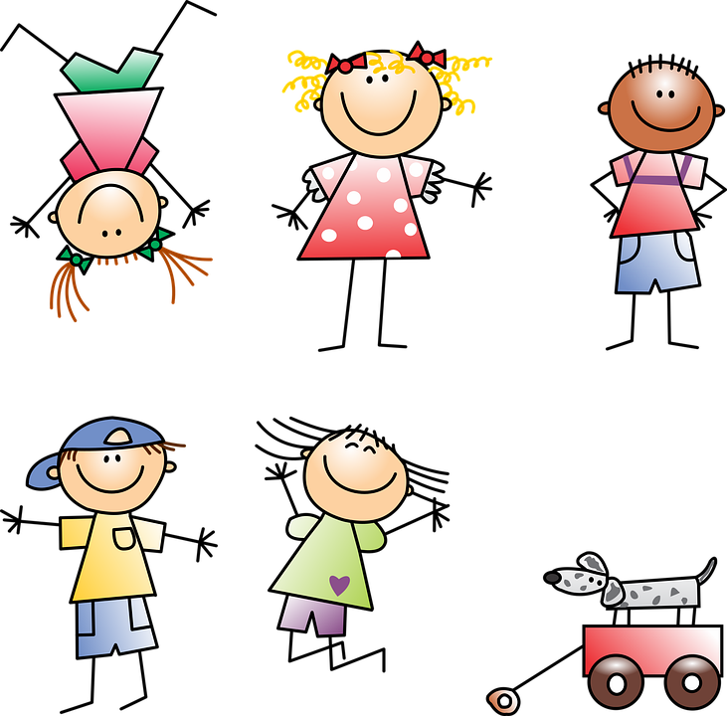
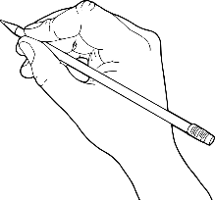
Deine Kindheit
Beantworte die Fragen über deine Kindheit.
schreiben
What could you do at different ages? Mit 5 Jahren konnte ich Rad fahren.
1. Was wolltest du immer machen?
2. Was musstest du immer machen?
3. Was konntest du machen?
Ich wollte immer…
Ich musste immer…
Ich konnte…
4. Wo waren du und deine Familie gerne?
5. Was hatten du und deine Freunde gerne in der Schule?
Wir waren gerne…
Wir hatten gerne… in der Schule.
Notes:
ADDITONAL OR ALTERNATIVE HOMEWORK TASK Timing: 30 minutes Aim: to practise written production of the newly learnt vocabulary and structures, applying it to person experience and responding to five specific questions.

Slide 34
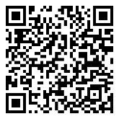
Hausaufgaben
Vocabulary Learning Homework (Y9, Term 2.1, Week 6)
Student worksheet
Quizlet link
Quizlet QR code
Notes:
Use this slide to set the homework Student homework answer sheet: https://resources.ncelp.org/concern/resources/0p096813c?locale=en

