Slide 1
Things that always, sometimes and never happen
verbs like entendre: mettre, remettre
SSC [e]
Y9 French
Term 1.1 - Week 7 - Lesson 13
Amber Dudley / Natalie Finlayson
Artwork by: Chloé Motard
Date updated: 2/08/2021
Notes:
Artwork by Chloé Motard. All additional pictures selected are available under a Creative Commons license, no attribution required.
Native speaker feedback provided by Sarah Brichory.
With thanks to Rachel Hawkes and Emma Marsden for their input on the lesson material.
Learning outcomes (lesson 1):
Revision of SSCs [e] [revisited]
Revision of verbs like entendre in the present tense, including spelling-changes in verbs ending in -mettre
Word frequency (1 is the most frequent word in French):
9.1.1.7 (introduce) mettre, met, mets [27], remettre, remet, remets [156], perdre [250], campagne [666], dollar [432], habitant [1333], fleuve [2893], lac [3121], population [509], province [861], sac [2343], jamais [179]
8.3.2.7 (revisit) lever, lève [837], reposer [776], chapeau [2908], cuisine² [2618], main [418], manteau [3764], matin [442], pluie [2217], tête [343]
8.3.1.5 (revisit) décrire [1176], traduire [1125], lit² [278], communauté [558], culture [913], expérience [679], information [317], produit [373], programme [340], tout¹, tous¹ [24] revisit: dire [37], lire [278], écrire [382]
Source: Londsale, D., & Le Bras, Y. (2009). A Frequency Dictionary of French: Core vocabulary for Léarners London: Routledge.
The frequency rankings for words that occur in this PowerPoint which have been previously introduced in NCELP resources are given in the NCELP SOW and in the resources that first introduced and formally re-visited those words.
For any other words that occur incidentally in this PowerPoint, frequency rankings will be provided in the notes field wherever possible.

Slide 2
e
je
Notes:
Timing: 1 minute
Aim: To consolidate SSC [e]
Procedure: 1. Present the letter(s) and say the [e] sound first, on its own. Students repeat it with you. 2. Bring up the word ”je” on its own, say it, students repeat it, so that they have the opportunity to focus all of their attention on the connection between the written word and its sound.
3. A possible gesture for this would be to point to oneself. 4. Roll back the animations and work through 1-3 again, but this time, dropping your voice completely to listen carefully to the students saying the [e] sound, pronouncing ”je” and, if using, doing the gesture.
Word frequency (1 is the most frequent word in French):
je [22]. Source: Londsale, D., & Le Bras, Y. (2009). A Frequency Dictionary of French: Core vocabulary for learners London: Routledge.

Slide 3
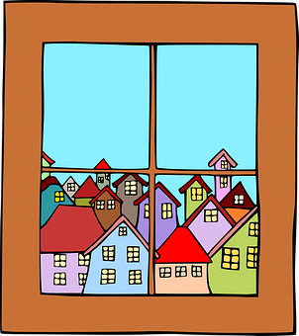
e
fenêtre
cela
[that]
je
second
cheval
devoir
[to have to]
Notes:
Aim: To consolidate SSC [e]
Procedure:
1. Introduce and elicit the pronunciation of the individual SSC [e] and then the source word again ‘je’ (with gesture, if using). 2. Then present and elicit the pronunciation of the five cluster words.
The cluster words have been chosen for their high-frequency, from a range of word classes, with the SSC (where possible) positioned within a variety of syllables within the words (e.g. initial, 2nd, final etc.). Additionally, we have tried to use words that build cumulatively on previously taught SSCs (see the Phonics Teaching Sequence document) and do not include new SSCs. Where new SSCs are used, they are often consonants which have a similar symbol-sound correspondence in English.
Word frequency (1 is the most frequent word in French): fenêtre [1604]; cela [54] second [379]; devoir [39]; cheval [2220]; je [22]. Source: Londsale, D., & Le Bras, Y. (2009). A Frequency Dictionary of French: Core vocabulary for learners London: Routledge.

Slide 4
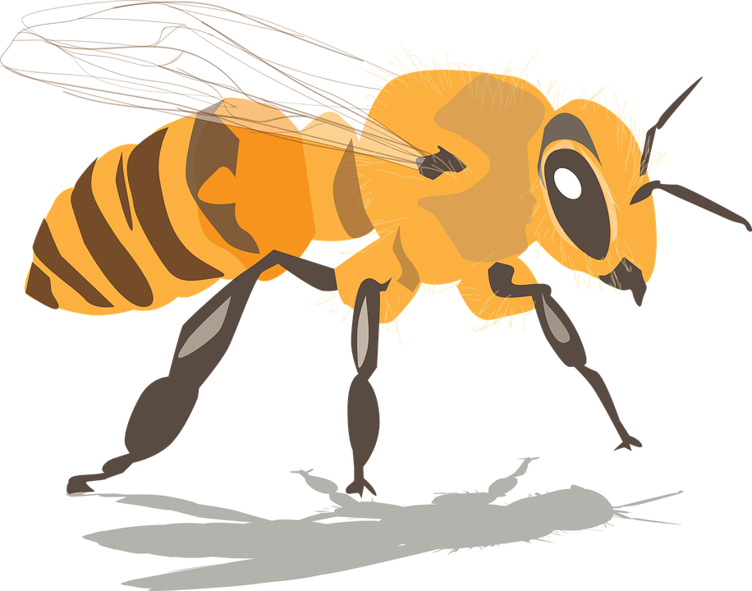
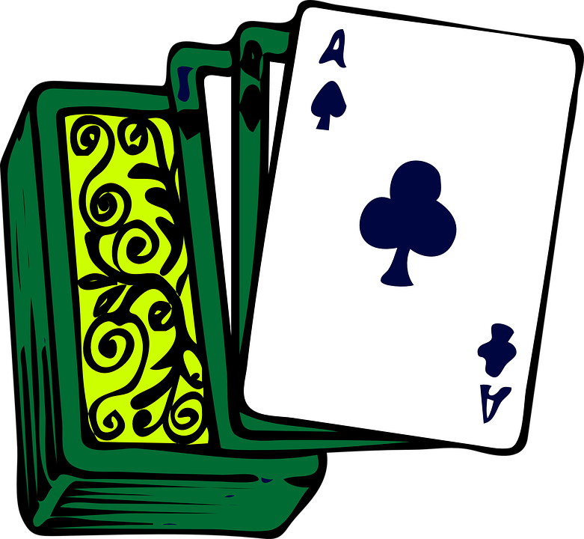
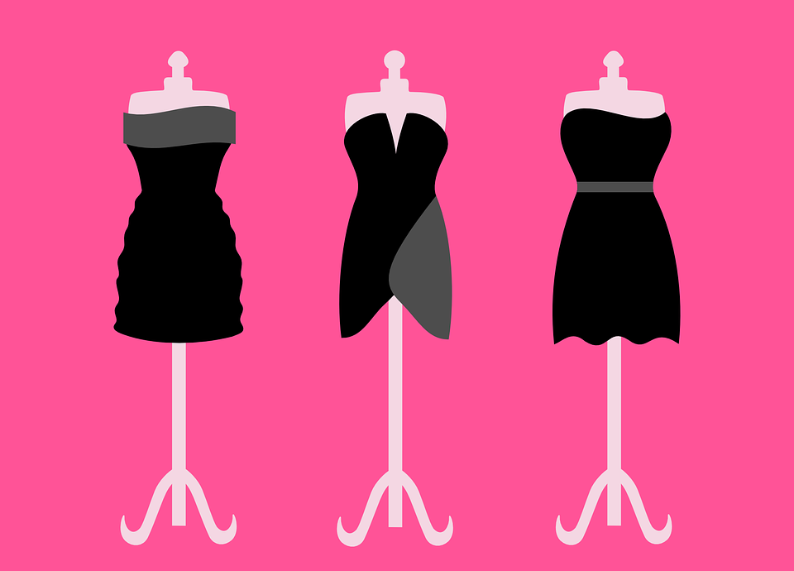
SSCs: [e] vs. [i]
Écoute ces mots et remplis les blancs avec la bonne SSC.
écouter
 | French | [e] | [i]
 | secours [aid]
 | menace [threat]
 | susciter [to provoke]
 | pari [bet]
 | regard [look]
 | bilan [outcome]
 | tenue [dress]
 | usine [factory]
1
8
_
2
_
3
_
4
_
5
_
6
_
7
_
8
_
Notes:
Timing: 5 minutes
Aim: To distinguish aurally between SSCs [e] and [i].
Procedure:
1. Click on the number button to listen to the word read aloud.
2. Students fill in the gap with the missing SSC.
3. Click to reveal the answers.
4. Students listen to and repeat the word.
Transcript:
secours
menace
susciter
pari
regard
bilan
tenue
usine
Word frequency (1 is the most frequent word in French): tenue [1899], regard [1206], menace [1607], secours [1857], susciter [1027], pari [1688], bilan [1758], usine [1482]
Source: Londsale, D., & Le Bras, Y. (2009). A Frequency Dictionary of French: Core vocabulary for learners London: Routledge.

Slide 5
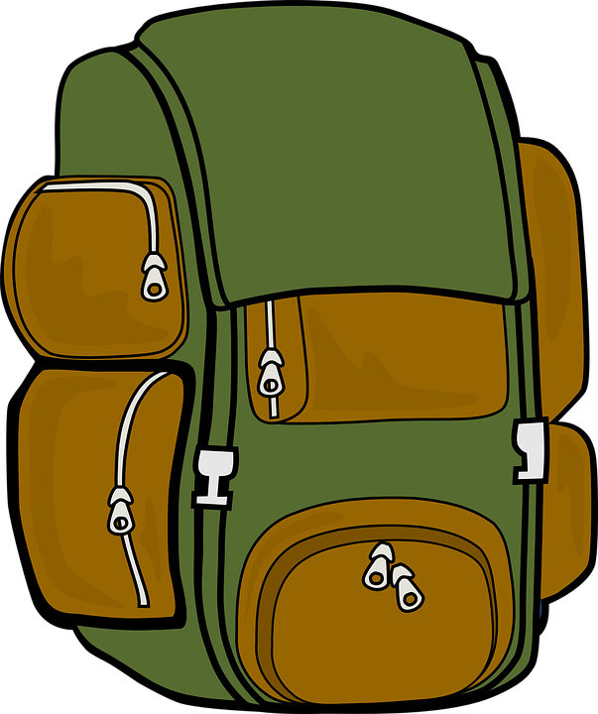
Vocabulaire
 | F
 | J
 | N
 | H
 | I
 | K
 | B
 | G
 | D
 | O
 | A
 | L
 | E
 | C
 | M
 | P
1
écouter
2
3
Écoute le mot et choisis la bonne lettre.
C
lake
4
5
s
B
(s)he puts, is putting
D
to lose, losing
6
s
A
population
G
to put, putting
7
s
F
8
s
E
to put back, putting back
9
s
countryside
H
river
10
s
I
resident (m)
K
never
11
s
J
dollar
L
province
12
s
13
s
M
I/you put, am/are putting
N
(s)he puts back, is putting back
14
s
15
s
O
I/you put back, am/are putting back
P
bag
16
s
Notes:
Timing: 4 minutes
Aim: Aural recognition of words from this week’s vocabulary set.
Procedure:
1. Click on the number trigger to play the audio.
2. Students write 1-15, and the letter which appears next to the appropriate English translation or picture.
3. Click to reveal the answers.
Transcript:
1. la campagne
2. le dollar
3. il/elle remet
4. le fleuve
5. l’habitant
6. jamais
7. il/elle met
8. mettre
9. perdre
10. je/tu remets
11. la population
12. la province
13. remettre
14. le lac
15. je/tu mets
16. le sac [audio in progress]
Word frequency of cognates used (1 is the most frequent word in French): lettre [480]
Source: Londsale, D., & Le Bras, Y. (2009). A Frequency Dictionary of French: Core vocabulary for learners London: Routledge.

Slide 6
Les langues du Canada
*ancien = former
*francophone = French-speaking
lire
Le Canada est un partenaire important de la Francophonie.
La Francophonie, c’est tous les pays et régions francophones. C’est une communauté de gens qui parlent français.
Le français est la langue maternelle de 7,3 millions d’habitants. 30% de la population canadienne est francophone.
On parle anglais et français au Québec parce que cette province est une ancienne* colonie anglaise et française.
A colony is a place controlled by another country.
Notes:
Timing: 5 minutes
Aim: Written comprehension of new and revisited vocabulary in longer contexts; to introduce students to the linguistic history of Canada.
Procedure:
1. Click to bring up the callouts one by one. Students summarise in English.
2. During feedback on the information in the first bubble, draw attention to the symbol of the Francophonie (featured on the cover of the NCELP language guide!)
3. During feedback on the information in the second bubble, write anglophone on the board, and ask students what they think it means. If they need further prompting, writ anglais on the board, too.
4. During feedback on the information in the third bubble, ask students: C’est quoi, ta langue maternelle ?
Word frequency of cognates used (1 is the most frequent word in French): million [307], maternel [2792], colonie [3375]
Source: Londsale, D., & Le Bras, Y. (2009). A Frequency Dictionary of French: Core vocabulary for learners London: Routledge.
Word frequency of unknown words used (1 is the most frequent word in French): ancien [392], francophone [3118]
Source: Londsale, D., & Le Bras, Y. (2009). A Frequency Dictionary of French: Core vocabulary for learners London: Routledge.

Slide 7
Using the verb ‘savoir’
Verbs like ‘entendre’: ‘mettre’
grammaire
‘Mettre’ and ‘remettre’ follow the same pattern of endings as ‘entendre’.
In the je, tu and il/elle forms, these verbs lose a ‘t’.
The remaining ‘t’ is a silent final consonant (SFC).
je mets
I put, am putting
nous mettons
we put, are putting
tu mets
you put, are putting
vous mettez
you put, are putting
il/elle met
he/she puts, is putting
ils/elles mettent
they put, are putting
These verb forms all sound the same!
The –s on the je and tu forms is a silent final consonant (SFC)
Note: All three singular forms sound the same in French, with a silent final consonant.
Notes:
Timing: 2 minutes
Aim: To revise the singular and plural forms of verbs like entendre; to introduce the spelling and resulting pronunciation changes in the present tense singular forms of mettre and remettre.
Procedure:
1. Click to reveal the explanation.
2. Draw attention to the fact that mettre follows the same pattern of endings as entendre, but loses a -t- in the je, tu and il/elle forms. Note that we have made the exceptional decision to introduce the singular forms met, mets, remet and remets as vocabulary items. Normally, small spelling changes in verb stems (e.g. commencer, nous commençons) are not credit-bearing. However, special focus is given to mettre and remettre due to the high frequency of these verbs, and the significant pronunciation changes that occur as a result of the spelling change.
3. Highlight that all singular forms sound the same due to the SFC.
4. Elicit the plural forms (nous mettons, vous mettez, ils/elles mettent). Note also that remettre follows the same pattern as mettre.

Slide 8
mettre
[to put | putting]
‘Mettre’ loses a -t- in the je, tu and il/elle forms.
met
[puts | is putting]
mettent
[put | are putting]
Notes:
Timing: 4 minutes for sequence of eight slides
Aim: to introduce the verb mettre more explicitly. Both long form (infinitive) and short form (3rd person singular) are introduced in order to familiarise students with various forms of the same verb.
Procedure
Bring up the word mettre on its own, say it, students repeat it, and remind them of the phonics. Draw attention to SFe.
Try to elicit the meaning from the students. Students have had explicit teaching that the present tense in French communicates two different present tense meanings in English. This reinforces that learning. Emphasise the two meanings for the short form, reminding students that French only has one form and does not have a direct equivalent of the grammar for ‘is + ing’, the continuous form (as covered in previous weeks).
Bring up the picture, and, if using gestures, a possible gesture would be to put something somewhere.
Then bring up the English translations. Emphasise the two meanings for the infinitive.
Bring up the first short form met, say it, students repeat it. Draw attention to the SFC. Note that the –et in met is equivalent to SSCs [ai] and [è/ê].
Bring up the second short form mettent, say it, students repeat it.
Try to elicit the meaning from the students. Emphasise the two meanings for the short forms.
Bring up the info bubble to introduce the stem-change.

Slide 9
mettre
[to put | putting]
met
[puts | is putting]
mettent
[put | are putting]
Notes:
Cycle through the long and short forms again.

Slide 10
met
[puts | is putting]
Elle met le chapeau sur sa tête.
[She puts | is putting the hat on her head.]
Notes:
Introduce the first short form in a sentence.

Slide 11
mettre
[to put | putting]
Je dois mettre mon cahier sur la table.
[I have to put my exercise book on the table.]
Notes:
Introduce the long form in a sentence.

Slide 12
mettent
[put | are putting]
Elles mettent les chats sur le lit.
[They put | are putting the cats on the bed.]
Notes:
Introduce the second short form in a sentence.

Slide 13
met
[put | is putting]
Elle met la guitare sur le bureau.
[She puts | is putting the guitar on the desk.]
Notes:
Cycle through the first short form in context again.

Slide 14
mettre
[to put | putting]
Je dois mettre le livre dans mon sac.
[I have to put the book in my bag.]
Notes:
Cycle through the long form in context again.

Slide 15
mettent
[put | are putting]
Ils mettent les fruits dans la cuisine.
[They put | are putting the fruits in the kitchen.]
Notes:
Cycle through the second short form in context again.

Slide 16
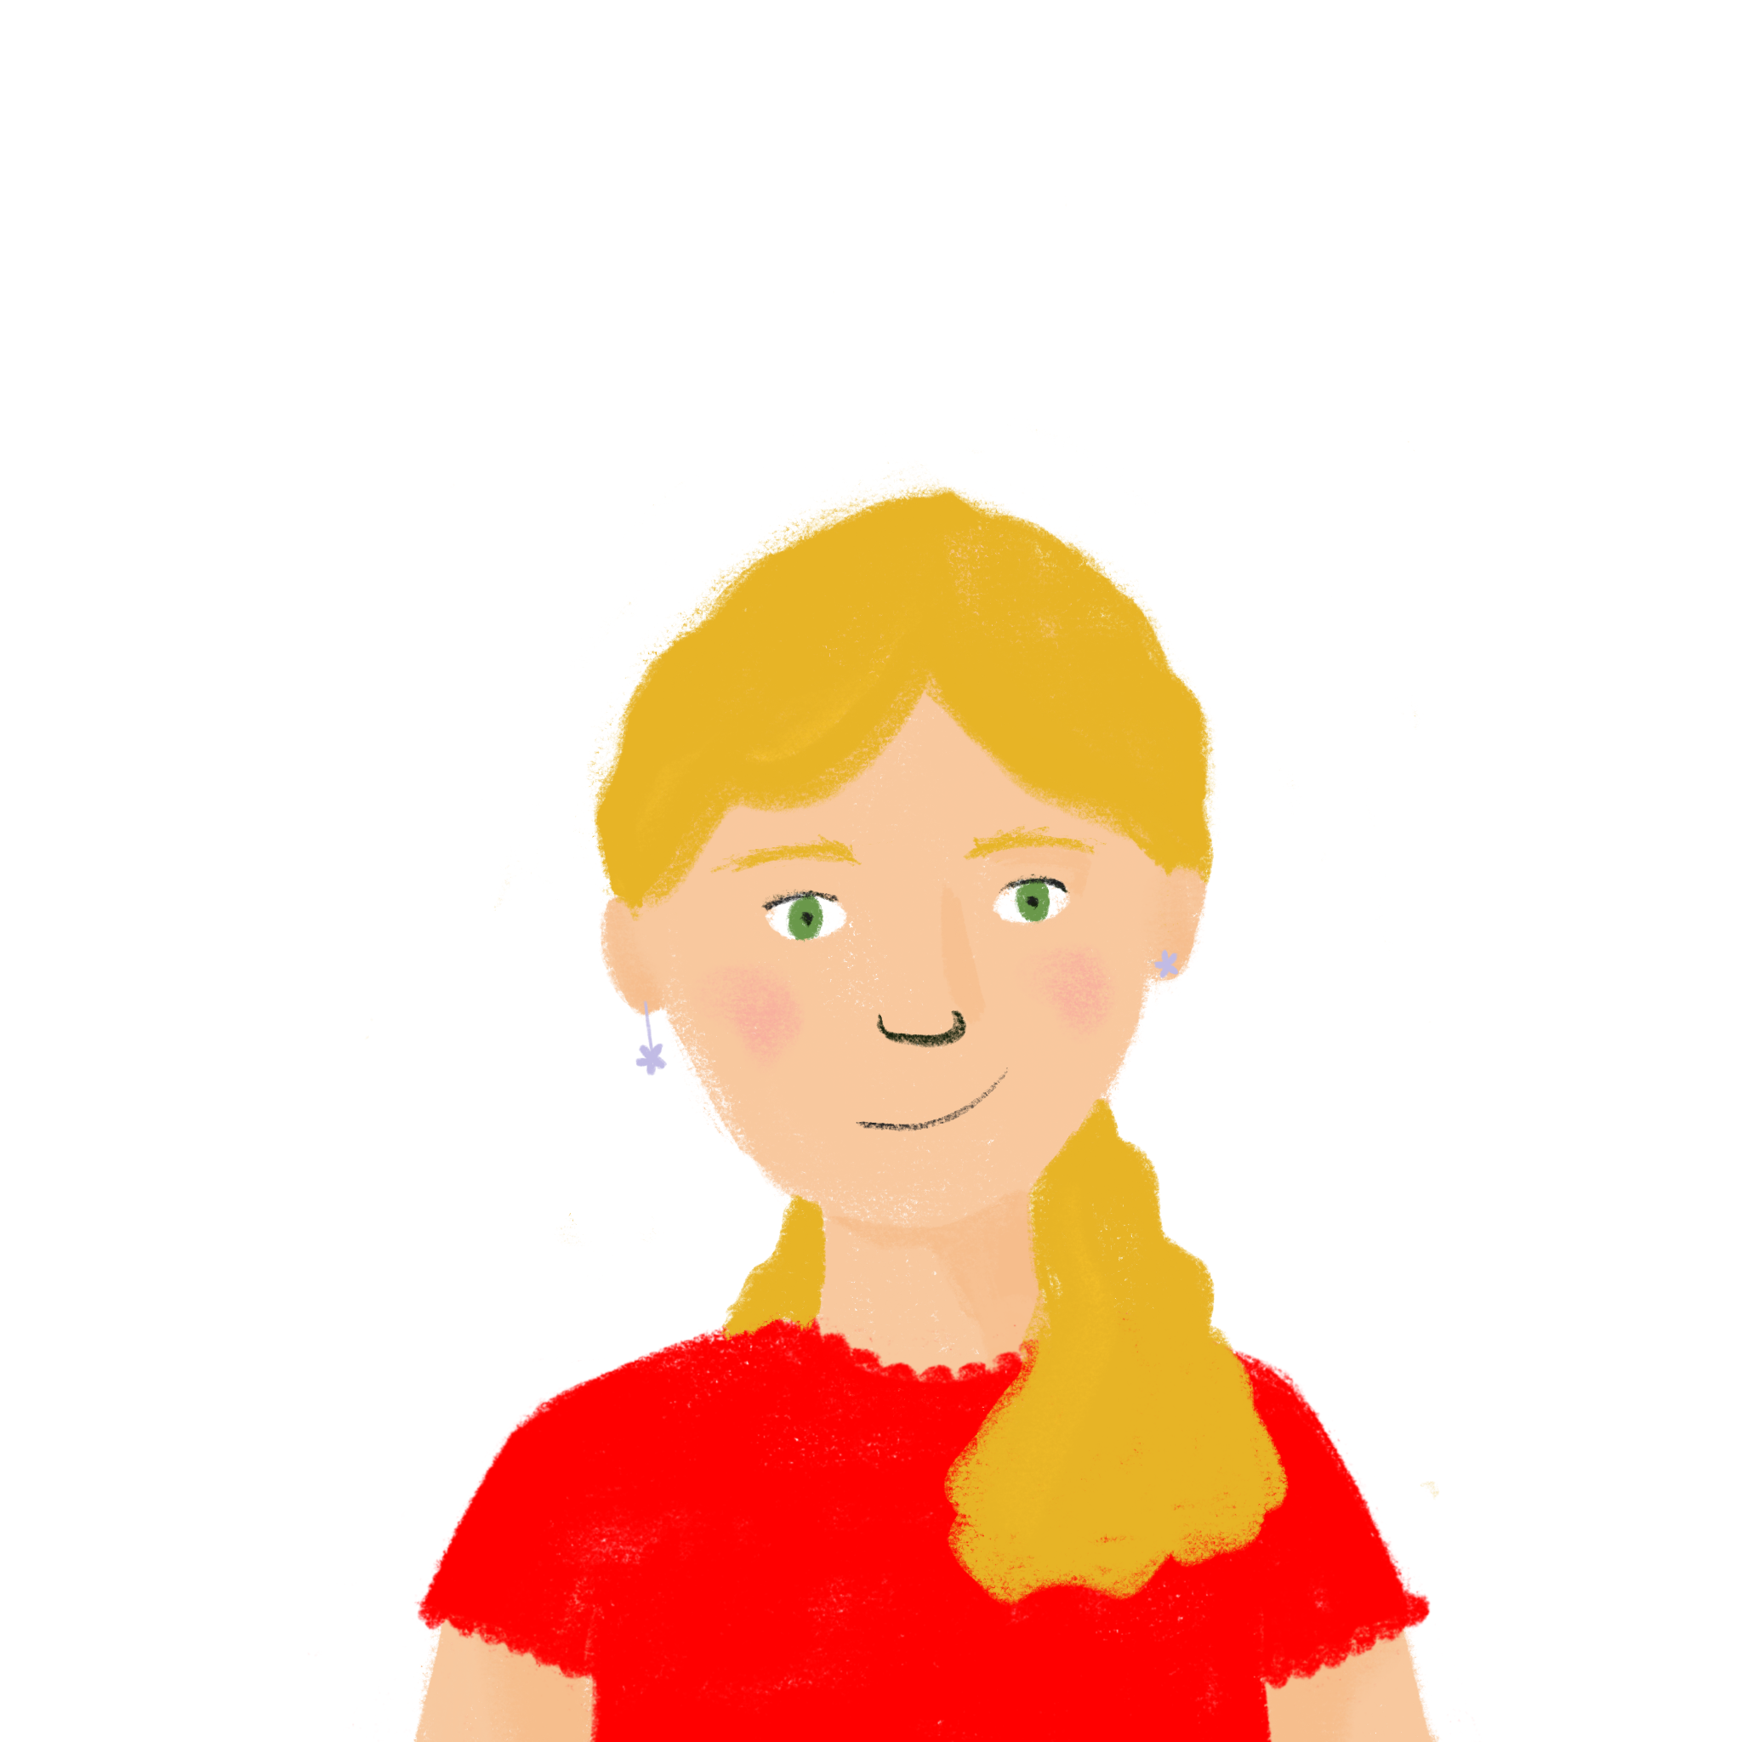
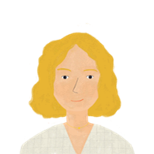
Qui (re)met quoi où ?
*défaire = unpack
*leur = their
écouter
Léa et sa maman défont* leurs* sacs. On parle de qui ?
 |  |  | Quoi ? | Où ?
 |  |  | the presents | under the bed
 |  |  | the photos | next to the window
 |  |  | the coffee | on the table
 |  |  | the clothes | in the bag
 |  |  | the schedule | on the desk
 |  |  | the newspaper | in front of the TV
 |  |  | the coats | next to the door
 |  |  | the glasses | behind the photos
1
2
3
4
5
6
7
8
Notes:
Timing: 8 minutes
Aim: Aural recognition of the short and long forms of (re)mettre and connecting these with the subject (elle/elles) to which they refer.
Procedure:
1. Check students understand the context. Work through the title of the activity with them, which contains three question words! Ensure that students understand that the pictures in the column headers represent just Léa (elle) and Léa and Aurélie (elles).
2. Click the numbers to play the audio. The pronouns are not hidden because elle and elles sound identical before a consonant.
2. Students write 1-8 and choose Léa (elle) or Léa and Aurélie (elles) for each, based on the verb form they hear.
3. Click to reveal the answers.
4. Click to listen again. This time, students note down the items and where they are being put/put back.
5. Click to reveal the answers.
Transcript:
1. Elles mettent les cadeaux sous le lit.
2. Elles remettent les photos à côté de la fenêtre.
3. Elle remet le café sur la table.
4. Elle remet les vêtements dans le sac.
5. Elles remettent le programme sur le bureau.
6. Elle met le journal devant la télé.
7. Elle met les manteaux à côté de la porte.
8. Elles mettent les verres derrière les photos.
Word frequency of unknown words (1 is the most frequent word in French):
défaire [2946], leur [35]
Source: Londsale, D., & Le Bras, Y. (2009). A Frequency Dictionary of French: Core vocabulary for Léarners London: Routledge.

Slide 17
En vacances !
*l’appel (m.) = phone call
lire
Ce matin, (1) je/on descend un fleuve en bateau, mais papa reste à l’hôtel. (2) Je/Il attend un appel* important. Mais on n’a pas de portable en ce moment. (3) Je/Papa perd toujours des choses dans le taxi.
J’aime bien faire des promenades à la campagne. (4) Je/On entend toujours des animaux comme de petits oiseaux ! (5) Un oiseau / Les oiseaux répondent toujours à Antoine quand il parle. (6) Je/Il mets du pain à côté du fleuve pour les oiseaux. Mais (7) je/maman remet toujours le pain dans son sac !
On veut visiter un grand lac demain, mais (8) je/ça dépend du temps.
Décide si les phrases anglaises sont dans le texte. Ensuite, choisis le bon sujet.
 | Dans le texte ?
1. We are going down a river. | Oui | Non
2. I am waiting for a phone call. | Oui | Non
3. I always lose things in the taxi. | Oui | Non
4. We always hear lots of animals. | Oui | Non
5. One bird always answers Antoine. | Oui | Non
6. I put bread out beside the river for the birds. | Oui | Non
7. Mum always puts the bread back. | Oui | Non
8. I’m depending on the weather. | Oui | Non
Notes:
Timing: 8 minutes
Aim: Reading comprehension to consolidate knowledge of verbs like entendre in single-verb structures in the present tense.
Procedure:
1. Students read the text and decide whether the English sentences in the table on the left are present in the text. Tell students that it is the verb forms (rather than surrounding context) that will give them the answers.
2. Students write 1-8 and ‘oui’ or ‘non’. As this is revision, we recommend that students try to answer the true/false questions without first writing in the pronouns. At lower levels, the teacher may wish to do this in stages.
3. Click to reveal answers. True/false answers and pronouns appear together on clicks.
Word frequency of unknown words used (1 is the most frequent word in French): appel [>5000]
Source: Londsale, D., & Le Bras, Y. (2009). A Frequency Dictionary of French: Core vocabulary for learners London: Routledge.
Word frequency of cognates used (1 is the most frequent word in French): décider [165]
Source: Londsale, D., & Le Bras, Y. (2009). A Frequency Dictionary of French: Core vocabulary for learners London: Routledge.

Slide 18
En vacances !
*l’appel (m.) = phone call
écouter / lire
1
2
3
4
5
6
7
8
Écoute et lis le texte en même temps.
Ce matin, on descend un fleuve en bateau, mais papa reste à l’hôtel. Il attend un appel important. Mais on n’a pas de portable en ce moment. Papa perd toujours des choses dans le taxi.
J’aime bien faire des promenades à la campagne. On entend toujours des animaux comme de petits oiseaux ! Les oiseaux répondent toujours à Antoine quand il parle ! Je mets du pain à côté du fleuve pour les oiseaux. Mais maman remet toujours le pain dans son sac !
On veut visiter un grand lac demain, mais ça dépend du temps.
Notes:
Timing: 6 minutes
Aim: Aural and written recognition to connect the spoken and written forms of the language. To consolidate vocabulary and grammar knowledge by eliciting suggested changes to the text.
Procedure:
1. Click on the numbers play the audio. Students read and listen to the text at the same time. The audio has been divided into 8 sections, as illustrated in the transcript below, to facilitate easy stop start. To support segmentation, the audio stops before the word in bold.
2. Ask students to say:
the next word
the previous word
3. To develop vocabulary and grammar knowledge, ask students to suggest an alternative word that could replace the next word. All the gaps are after the subject, so students will need to think about the verbs they can use in that context, and be aware of the verb ending that corresponds to the subject.
Transcript:
Ce matin, on (descend; some possible alternatives include: entend, visite, traverse…)
descend un fleuve en bateau, mais papa reste à l’hôtel. Il (attend; répond à, fait, écoute…)
attend un appel important. Mais on n’a pas de portable en ce moment. Papa (perd; met, cherche, trouve…)
perd toujours des choses dans le taxi. J’aime bien faire des promenades à la campagne. On (entend; regard, nourrit, écoute…)
entend toujours des animaux comme des petits oiseaux ! Les oiseaux (répondent à; parlent à/avec, écoutent, quittent…)
répondent toujours à Antoine quand il parle ! Je (mets; apporte, achète, trouve)
mets du pain à côté du fleuve pour les oiseaux. Mais maman (remets; mets, trouve, cherche…)
remets toujours le pain dans son sac ! On veut visiter un grand lac demain, mais ça dépend du temps.
Word frequency of unknown words used (1 is the most frequent word in French): appel [>5000]
Source: Londsale, D., & Le Bras, Y. (2009). A Frequency Dictionary of French: Core vocabulary for learners London: Routledge.

Slide 19
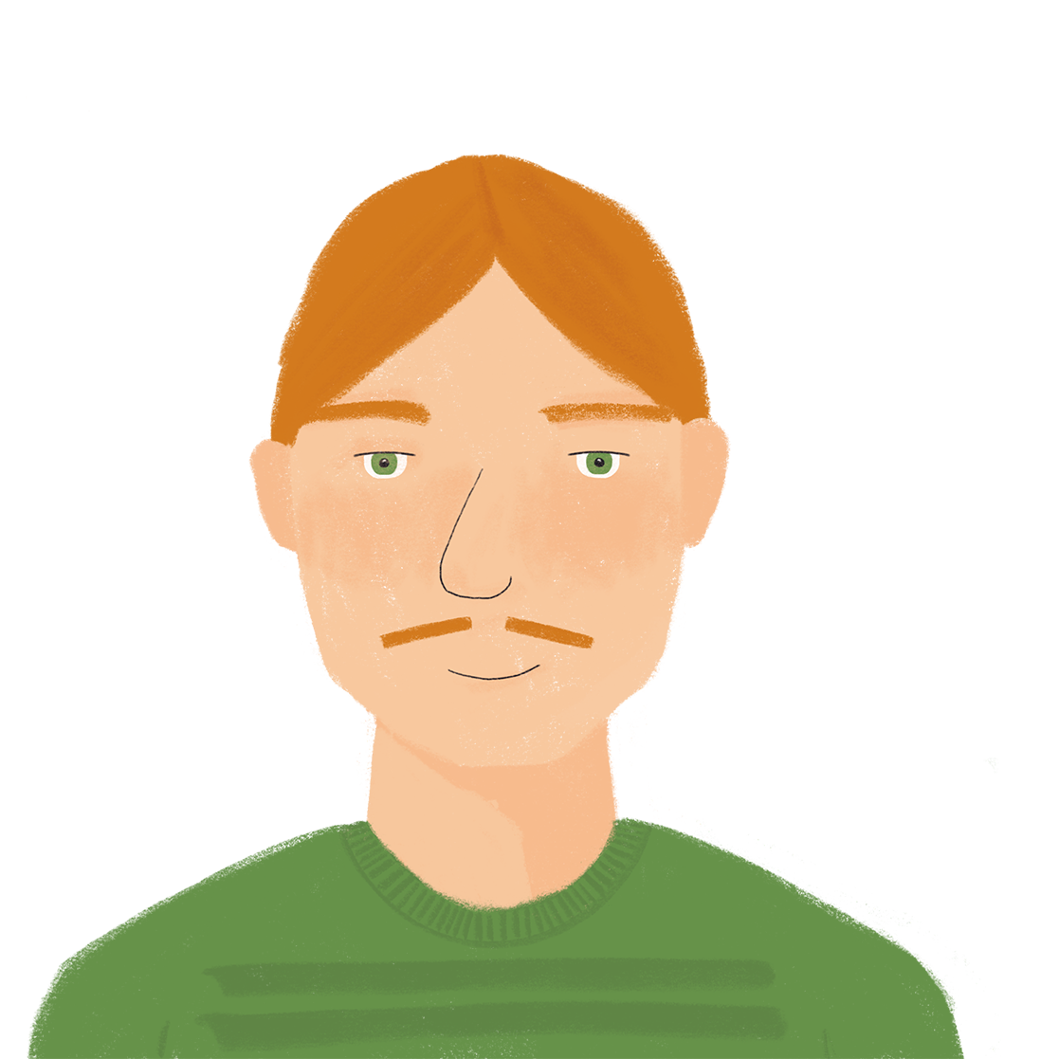
En vacances !
*l’appel (m.) = phone call
*gras = bold
écrire
Imagine que papa parle à Léa. Réécris le texte. Utilise je, tu et vous. Change les mots gras* dans la forme appropriée.
Ce matin, on descend un fleuve en bateau, mais papa reste à l’hôtel. Il attend un appel important. Mais on n’a pas de portable en ce moment. Papa perd toujours des choses dans le taxi.
J’aime bien faire des promenades à la campagne. On entend toujours des animaux comme de petits oiseaux ! Les oiseaux répondent toujours à Antoine quand il parle. Je mets du pain à côté du fleuve pour les oiseaux. Mais maman remet toujours le pain dans son sac !
On veut visiter un grand lac demain, mais ça dépend du temps.
Notes:
Timing: 5 minutes. This is slide 1/2.
Aim: Written production of verbs like entendre in the je, tu and vous forms.
Procedure:
1. Check students understand the task instructions. Ask them what they think réécris means. Compare it with remets, and highly that a re- prefix attached to a known verb often means ‘doing that verb again’.
2. Explain that students are going to re-write the story as if Romain is talking to Léa about her day, and that they will need to replace the verb phrases in bold to reflect this. Je will become tu, il and papa will become je, and on will become vous.
3. Students write 1-8 and the new verb phrase.
4. Answers appear on the next slide.
Word frequency of unknown words used (1 is the most frequent word in French): appel [>5000], gras [4018], réécrire [>5000]
Source: Londsale, D., & Le Bras, Y. (2009). A Frequency Dictionary of French: Core vocabulary for learners London: Routledge.
Word frequency of cognates used (1 is the most frequent word in French): imaginer [840], forme [369], approprié [3591]
Source: Londsale, D., & Le Bras, Y. (2009). A Frequency Dictionary of French: Core vocabulary for learners London: Routledge.

Slide 20
En vacances ! (réponses)
*l’appel (m.) = phone call
*gras = bold
écrire
Imagine que papa parle à Léa. Réécris le texte. Utilise je, tu et vous. Change les mots gras* dans la forme appropriée.
Ce matin, vous descendez un fleuve en bateau, mais je reste à l’hôtel. J’attends un appel important. Mais on n’a pas de portable en ce moment. Je perds toujours des choses dans le taxi.
Tu aimes bien faire des promenades à la campagne. Vous entendez toujours des animaux comme de petits oiseaux ! Les oiseaux répondent toujours à Antoine quand il parle. Tu mets du pain à côté du fleuve pour les oiseaux. Mais maman remet toujours le pain dans son sac !
Vous voulez visiter un grand lac demain, mais ça dépend du temps.
Notes:
This is slide 2/2.

Slide 21
Things that always, sometimes and never happen
negation with ne…jamais in single-verb structures
SSC [r] [revisited]
Y9 French
Term 1.1 - Week 7 - Lesson 14
Amber Dudley / Natalie Finlayson
Artwork by: Chloé Motard
Date updated: 2/08/2021
Notes:
Artwork by Chloé Motard. All additional pictures selected are available under a Creative Commons license, no attribution required.
Native speaker feedback provided by Sarah Brichory.
With thanks to Rachel Hawkes and Emma Marsden for their input on the lesson material.
Learning outcomes (lesson 2):
Revision of SSC [r]
Revision of negation with ne…pas in single-verb structures
Introduction of negation with ne…jamais in single-verb structures
Word frequency (1 is the most frequent word in French):
9.1.1.7 (introduce) mettre, met, mets [27], remettre, remet, remets [156], perdre [250], campagne [666], dollar [432], habitant [1333], fleuve [2893], lac [3121], population [509], province [861], sac [2343], jamais [179]
8.3.2.7 (revisit) lever, lève [837], reposer [776], chapeau [2908], cuisine² [2618], main [418], manteau [3764], matin [442], pluie [2217], tête [343]
8.3.1.5 (revisit) décrire [1176], traduire [1125], lit² [278], communauté [558], culture [913], expérience [679], information [317], produit [373], programme [340], tout¹, tous¹ [24] revisit: dire [37], lire [278], écrire [382]
Source: Londsale, D., & Le Bras, Y. (2009). A Frequency Dictionary of French: Core vocabulary for Léarners London: Routledge.
The frequency rankings for words that occur in this PowerPoint which have been previously introduced in NCELP resources are given in the NCELP SOW and in the resources that first introduced and formally re-visited those words.
For any other words that occur incidentally in this PowerPoint, frequency rankings will be provided in the notes field wherever possible.

Slide 22
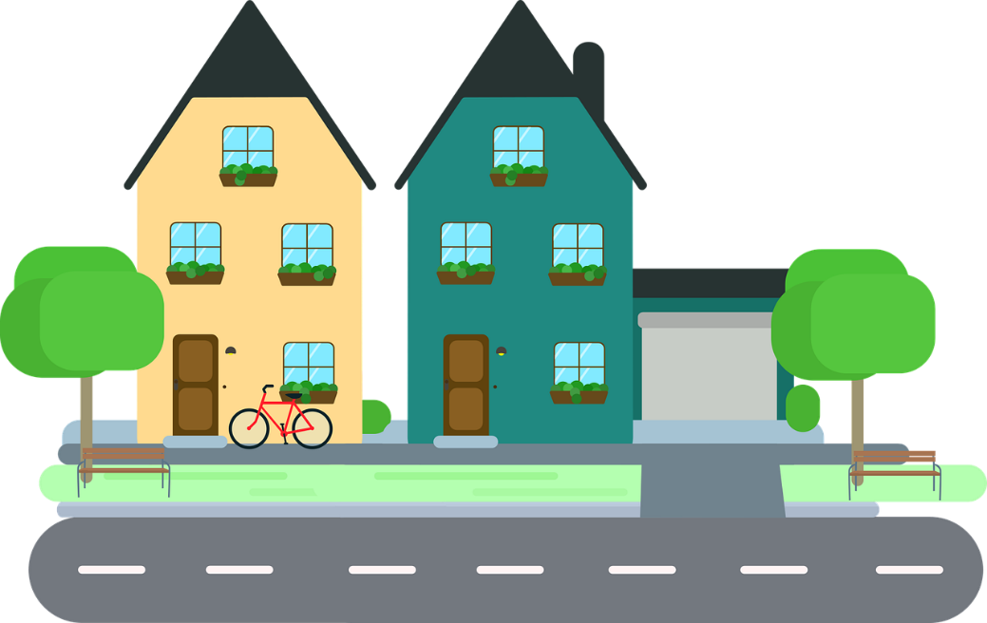
r
rue
Notes:
Timing: 1 minute [2 slides]
Aim: To consolidate [delete as appropriate] SSC [r]
Procedure: 1. Present the letter(s) and say the [r] sound first, on its own. Students repeat it with you. 2. Bring up the word ”rue” on its own, say it, students repeat it, so that they have the opportunity to focus all of their attention on the connection between the written word and its sound.
3. A possible gesture for this would be to look left and right and mime crossing a road. 4. Roll back the animations and work through 1-3 again, but this time, dropping your voice completely to listen carefully to the students saying the [r] sound, pronouncing ”rue” and, if using, doing the gesture.
Word frequency (1 is the most frequent word in French):
rue [598]
Source: Londsale, D., & Le Bras, Y. (2009). A Frequency Dictionary of French: Core vocabulary for learners London: Routledge.

Slide 23
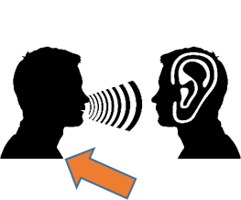
r
triste
frère
[brother]
moderne
rue
parler
[modern]
être
[to be]
Notes:
Aim: To consolidate SSC [r]
Procedure:
Introduce and elicit the pronunciation of the individual SSC [r] and then the source word again ‘rue’ (with gesture, if using). Then present and elicit the pronunciation of the five cluster words. The cluster words have been chosen for their high-frequency, from a range of word classes, with the SSC (where possible) positioned within a variety of syllables within the words (e.g. initial, 2nd, final etc.). Additionally, we have tried to use words that build cumulatively on previously taught SSCs (see the Phonics Teaching Sequence document) and do not include new SSCs. Where new SSCs are used, they are often consonants which have a similar symbol-sound correspondence in English.
Word frequency (1 is the most frequent word in French): rue [598]; frère [1043], triste [1843], moderne [1239], être [5], parler [106] Source: Londsale, D., & Le Bras, Y. (2009). A Frequency Dictionary of French: Core vocabulary for learners London: Routledge.

Slide 24
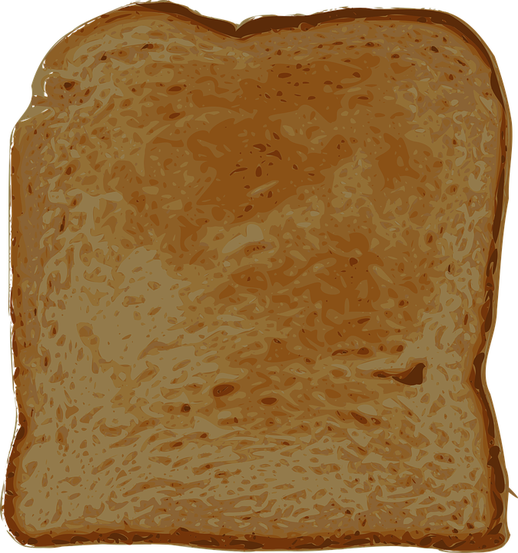
re- + verbe
phonétique
We can add re- to many verbs to create a new verb.
Like in English, re- before a verb often means doing the action again. e.g.:
re- + faire (to do, doing) → refaire (to do again/to redo)
Here, we add re- in English too. Notice the difference in pronunciation!
re- + mettre (to put, putting) → remettre (to put back, putting back)
Here, the new verb has a more specific meaning.
Notes:
Timing: 2 minutes
Aim: To introduce the re- + verb word pattern and connect this prefix with SSC [e]; to ‘break’ the association between English prefix re- and the sound ‘ree’. NB: this word pattern will not feature in NCELP assessments.
Procedure:
1. Click to animate the explanation.
2. Highlight that the prefix re- has the SSC [e].
3. Click on the verbs to hear them pronounced by a native speaker. Students repeat.
4. Draw attention to the difference in pronunciation between the re- in refaire and the re- in ‘redo’. Have students say the English and French side by side several times.
5. Students already know the verb remettre as it is introduced as part of this week’s vocabulary set. If students ask why the translation given is a little different, explain that remettre can have the general meaning to put again’ mettre encore), but it is most commonly used to mean specifically putting something back (again) where it came from.

Slide 25
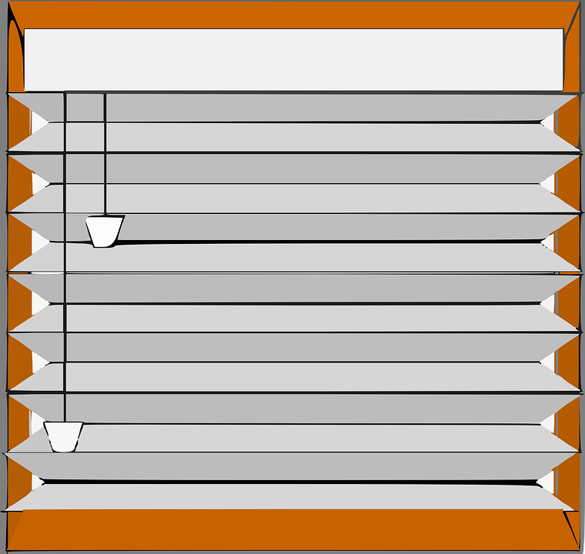
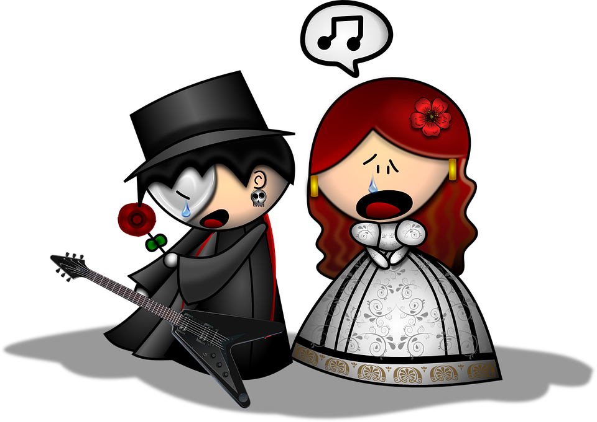
re- + verbe
*à haute voix = aloud
lire / parler
 | English | French
 | to reread, rereading | relire
 | to reshow, reshowing | remontrer
 | to leave again, leaving again | repartir
 | to win again, winning again | regagner
 | to find again, finding again | retrouver
 | to reclose, reclosing | refermer
 | to replay, replaying | rejouer
 | to recreate, recreating | recréer
Utilise la règle re- + verbe pour traduire ces verbes.
Ensuite, dis le mot à haute voix*.
1
2
3
4
5
6
7
8
Notes:
Timing: 3 minutes
Aim: Oral production of words containing SSC [e]; applying word pattern knowledge by adding the prefix re- to known words to create a new word; vocabulary recall.
Procedure:
1. Students read the list of English words. Explain that even though they don’t know these words in French, they will be able to produce them by recalling the ‘main verb’ (the part of the verb phrase after ‘re-’ or before ‘again’) and adding the re- prefix.
2. Once students have created the new word, ask them to say the word aloud. This will give them the opportunity to practise producing the SSC [e]. Depending on regional accent, the re- prefix may be pronounced similarly to French (‘rih-’) or differently (‘ree-’). Draw attention to this and ask students to say the verbs side by side.
3. Click the number button on the left to hear the new word said by a native speaker. Students repeat.
Transcript:
relire
remontrer
repartir
regagner
retrouver
refermer
rejouer
recréer
Word frequency (1 is the most frequent word in French): relire [4170], remontrer [>5000], repartir [2150], regagner [3491], retrouver [244], refermer [3759], rejouer [>5000], recréer [<5000]
Source: Londsale, D., & Le Bras, Y. (2009). A Frequency Dictionary of French: Core vocabulary for learners London: Routledge.

Slide 26
Vocabulaire
le sac
bag
écrire
je/tu mets
la campagne
I/you put
countryside
le dollar
dollar
le fleuve
river
l’habitant (m)
resident (m)
jamais
never
le lac
lake
il/elle met
he/she puts
mettre
put, putting
je/tu remets
I/you put back
perdre
il/elle remet
to lose, losing
la population
population
la province
province
remettre
put back, putting back
he/she puts back
Notes:
Timing: 4 minutes
Aim: Oral recall of words in this week’s new vocabulary set.
Procedure:
1. Students orally translate the English words into French.
2. Click to reveal answers from left to right.

Slide 27
La culture canadienne
parler
the dollar
On utilise le dollar canadien au Canada.
Notes:
Timing: 6 minutes. This is slide 1/6.
Aim: Oral production words from week’s new vocabulary in context; developing fluency through reading aloud; scaffolded oral translation.
Procedure:
1. Students read the sentences aloud and fill in the blank by translating the English word.
2. Click to reveal the answer.

Slide 28
La culture canadienne
parler
population
Quelle est la population du Canada?
Le Canada a 35 millions d’habitants !
residents
Notes:
This is slide 2/6.
Word frequency of cognates used (1 is the most frequent word in French): million [307]
Source: Londsale, D., & Le Bras, Y. (2009). A Frequency Dictionary of French: Core vocabulary for learners London: Routledge.

Slide 29
La culture canadienne
parler
a province
Le Québec, c’est une province du Canada.
Notes:
This is slide 3/6.

Slide 30
La culture canadienne
parler
lire
Il y a des millions de lacs et de fleuves au Canada.
Voici le lac Moraine dans le parc national de Banff.
lakes
rivers
the lake
Notes:
This is slide 4/6.

Slide 31
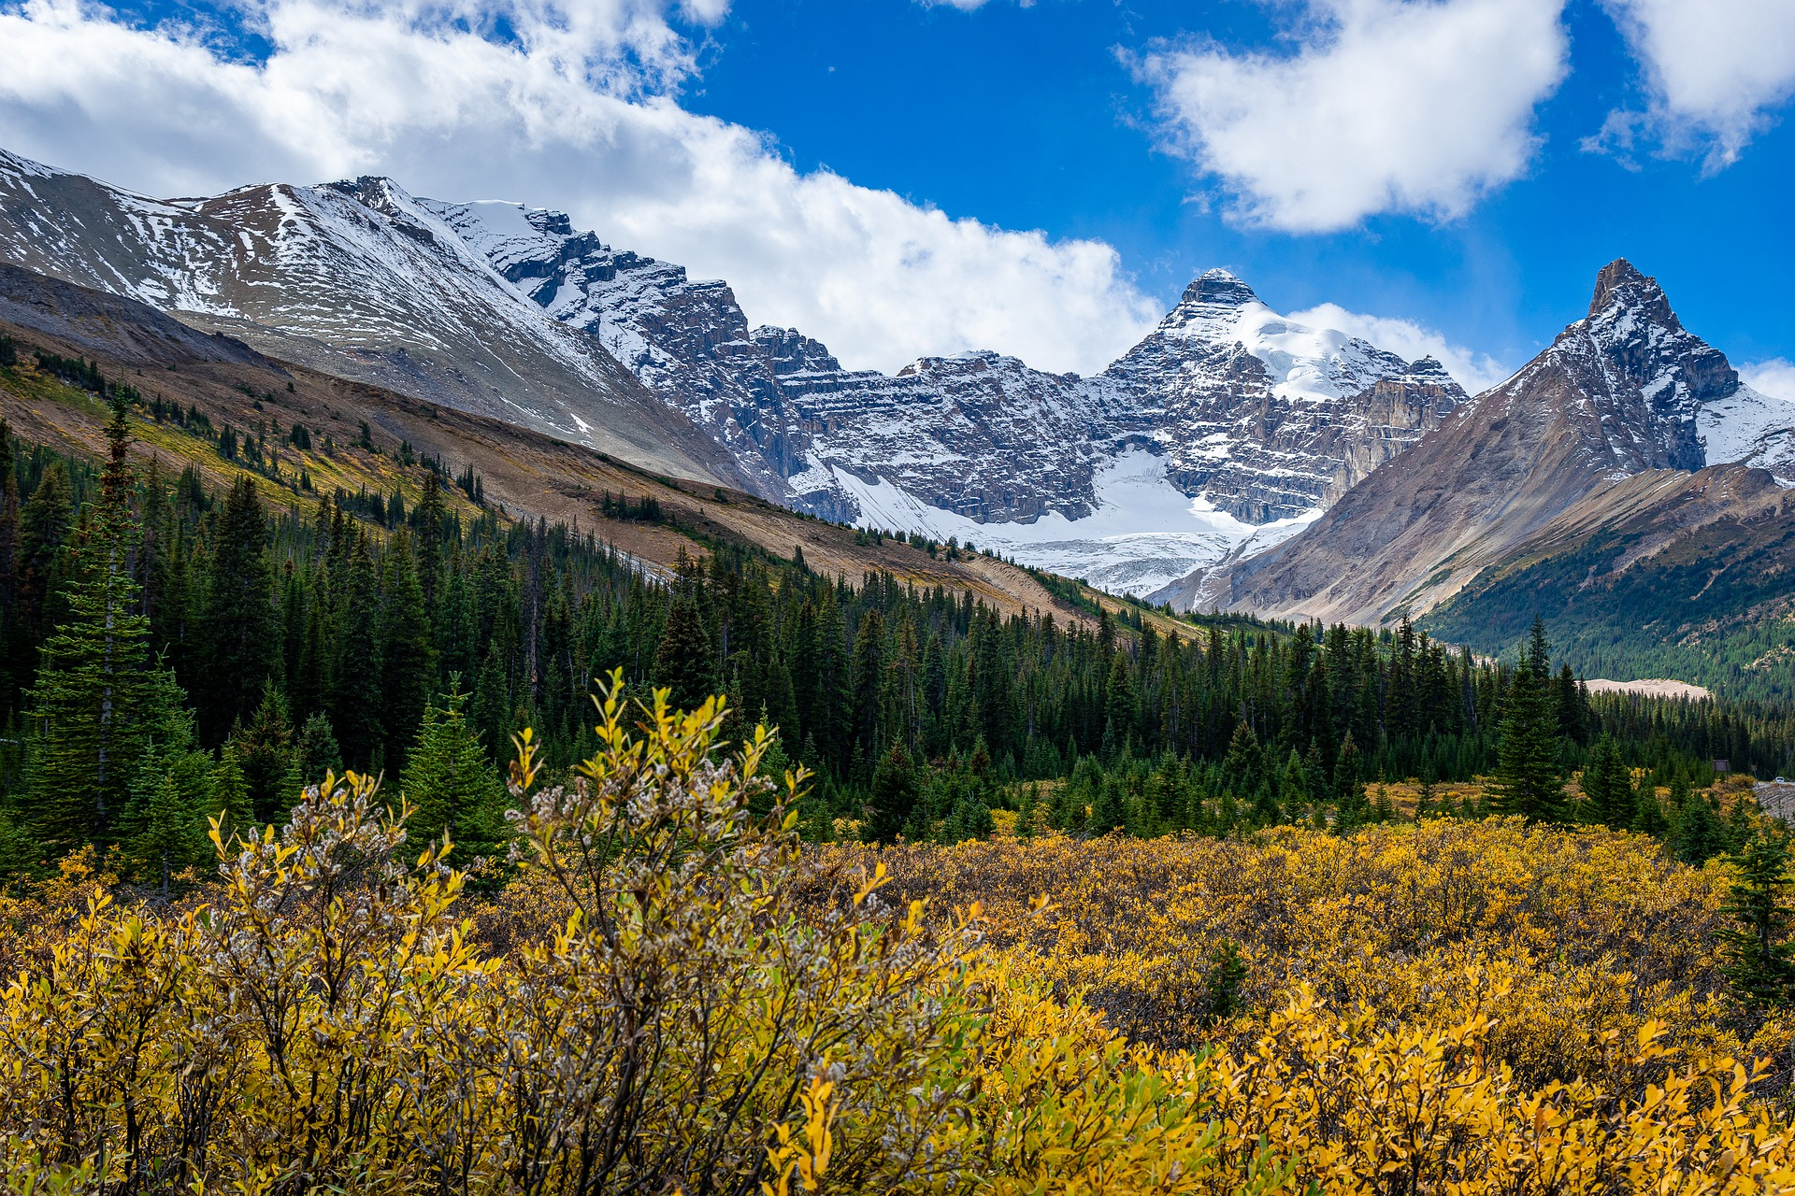
La culture canadienne
parler
countryside
On peut faire des promenades à la campagne.
Notes:
This is slide 5/6.

Slide 32
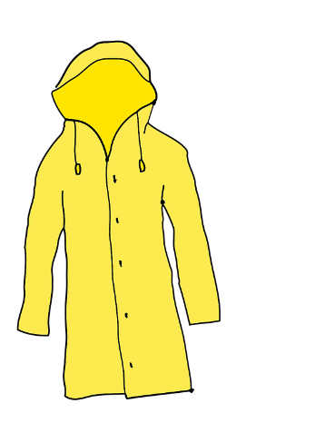
La culture canadienne
parler
to put
to put back
Je vais mettre le portable dans mon manteau et remettre le manteau dans mon sac. Il ne faut pas perdre le sac !
to lose
Notes:
This is slide 6/6.

Slide 33
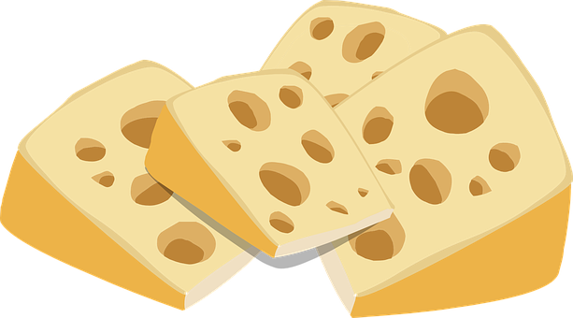
Saying ‘never’: ne… jamais
Remember!
Indefinite articles (un, une, des) and partitive articles (du, de la, de l’, des) change to de after a negative.
grammaire
We know that ne…pas around a verb in short form makes a sentence negative:
Tu ne manges pas de fromage. You are not eating cheese.
Elle ne lit pas de journaux. She does not read newspapers.
Ne…jamais means ‘never.’ It surrounds a verb in short form in the same way:
Tu ne manges jamais de fromage. You never eat cheese.
Elle ne lit pas de journaux. She never reads newspapers.
Notes:
Timing: 3 minutes
Aim: To revise verb negation with ne…pas and introduce negation with ne…jamais in single-verb structures in the present tense.
Procedure:
1. Click to animate the explanation.
2. Draw particular attention to negative article de. The ability to distinguish between partitive and indefinite articles in declarative and negative sentences is crucial to the successful completion of the referential activities that follow.

Slide 34
Romain parle de ses vacances
la carte postale = postcard
écouter
Romain parle de ses vacances. Écoute et prend des notes en anglais.
Things that Romain isn’t doing on this holiday:
going to the national park
going down the river in a boat
spending the week in the hotel
sending any postcards to his friends
Things that Romain never does on holiday:
visits lakes
goes for walks in the countryside
reads all the information in the museums
1
2
3
4
never takes photos
5
6
7
8
Notes:
Timing: 8 minutes
Aim: Aural recognition of present tense, single-verb structures with ne…pas and ne…jamais.
Procedure:
1. Click the numbers to play the audio.
2. Students listen to each sentence in French, and take notes in English under the correct heading, depending on whether they hear ne…pas or ne…jamais.
3. Click to reveal the answers.
Transcript:
1. Je ne visite jamais de lacs.
2. Je ne fais jamais de promenades à la campagne.
3. Je ne vais pas au parc national.
4. Je ne descends pas le fleuve en bateau.
5. Je ne lis jamais toutes les informations dans les musées.
6. Je ne passe pas la semaine dans l’hôtel.
7. Je ne prends jamais de photos.
8. Je n’envoie pas de cartes postales à mes amis.
Word frequency of cognates used (1 is the most frequent word in French): postal [3625], note [1161]
Source: Londsale, D., & Le Bras, Y. (2009). A Frequency Dictionary of French: Core vocabulary for learners London: Routledge.

Slide 35
Léa décrit ses expériences
la carte postale = postcard
lire
Que fait-elle toujours en vacances ? Que ne fait-elle jamais ?
1. On utilise toujours des dollars à l’aéroport. | utilise toujours | n’utilise jamais
2. On porte toujours un manteau dehors. | porte toujours | ne porte jamais
3. On ne fait jamais de promenades à la campagne. | fait toujours | ne fait jamais
4. On ne visite jamais de lacs. | visite toujours | ne visite jamais
5. On traverse toujours un fleuve. | traverse toujours | ne traverse jamais
6. On ne prend jamais de photos en famille. | prend toujours | ne prend jamais
7. On n’écrit jamais de cartes postales. | écrit toujours | n’écrit jamais
8. On achète toujours des produits locaux. | achète toujours | n'achète jamais
Notes:
Timing: 5 minutes
Aim: Written recognition of toujours and ne…jamais with single-verb structures in the present tense; presenting toujours and jamais as opposites (always vs never)
Procedure:
1. Students read the sentences and decide whether Léa is talking about something things she always does on holiday, or things she never does. Remind students that they will need to look at the form of the article to give them the answer.
2. Click to reveal answers. Draw attention to the positions of toujours and jamais (after the verb), which differs from English.
3. Oral translation of full sentences.
Word frequency of cognates used (1 is the most frequent word in French): postal [>5000]
Source: Londsale, D., & Le Bras, Y. (2009). A Frequency Dictionary of French: Core vocabulary for learners London: Routledge.

Slide 36
Écris le contraire !
écrire
Attention!
Indefinite articles (un, une, des) and partitive articles (du, de la, de l’, des) change to de after a negative.
Mets ces phrases à la forme négative.
1. Romain achète toujours un nouveau portable.
Romain n’achète jamais de nouveau portable.
2. Romain perd toujours son portable.
Romain ne perd jamais son portable.
3. Je lève toujours la main en classe.
Je ne lève jamais la main en classe.
4. Élodie écoute toujours de la musique sur son portable.
Élodie n’écoute jamais de musique sur son portable.
Notes:
Timing: 8 minutes. This is slide 1/2.
Aim: Written production of sentences with ne…jamais + de and toujours + partitive/indefinite article in present tense, single-verb structures.
Procedure:
1. Students write 1-4 in their books and re-write the sentences in the negative, using ne…jamais. Remind students that ne…jamais is the opposite of toujours and that the partitive and indefinite articles changes to de after ne…jamais. Note that possessive adjectives and definite articles don’t need to change.
2. Click to reveal the answers.
3. Display slide 45. Students write 5-8 in their books and re-write the sentences in the declarative, using toujours. Remind students that toujours is the opposite of ne…jamais and that partitive and indefinite articles must be used. Note that possessive adjectives and definite articles don’t need to change.
4. Click to reveal the answers.
Word frequency of cognates used (1 is the most frequent word in French):
négatif [>5000], forme [369], contraire [619] Source: Londsale, D., & Le Bras, Y. (2009). A Frequency Dictionary of French: Core vocabulary for Léarners London: Routledge.

Slide 37
Écris le contraire !
écrire
Attention!
Indefinite articles (un, une, des) and partitive articles (du, de la, de l’, des) change to de after a negative.
Réécris ces phrases. Utilise ‘toujours’.
5. Léa ne porte jamais de manteau sous la pluie.
Léa porte toujours un manteau sous la pluie.
6. Léa n’envoie jamais de messages à son amie.
Léa envoie toujours des messages à son amie.
7. Je ne prends jamais de photos avec mon portable.
Je prends toujours des photos avec mon portable.
Antoine ne repose jamais son chapeau.
Antoine repose toujours son chapeau.
Notes:
This is slide 2/2.
Word frequency of cognates used (1 is the most frequent word in French):
négatif [>5000], vidéo [2611]
Source: Londsale, D., & Le Bras, Y. (2009). A Frequency Dictionary of French: Core vocabulary for Léarners London: Routledge.

Slide 38
On fait quoi en vacances ?
Attention! Indefinite articles (un, une, des) → de after ne...jamais.
parler
Fais des phrases avec ‘ne…jamais’ et ‘toujours’.
utiliser des dollars | visiter des lacs | perdre son portable | porter un manteau
écrire des cartes postales | acheter des produits locaux | traverser des fleuves | prendre des photos
Notes:
Timing: 8 minutes
Aim: Scaffolded oral production of sentences with ne…jamais and toujours in single-verb structures in the present tense.
Procedure:
1. Students use the picture and infinitive verb phrase to make sentences using ne…jamais and toujours. Tell students that a cross means ‘never’ and a tick means ‘always’.
2. Remind students that toujours and jamais come after the verb (unlike in English) and that any indefinite articles must become de after jamais.
Word frequency of cognates used (1 is the most frequent word in French): postal [>5000]
Source: Londsale, D., & Le Bras, Y. (2009). A Frequency Dictionary of French: Core vocabulary for learners London: Routledge.

Slide 39
Gaming Grammar
Gaming Grammar
Relevant mini game(s):
Verbs (present): 1st person singular/plural (Verb agreement (present))
Verbs (present): 2nd person singular/plural (Verb agreement (present))
Verbs (present): 3rd person singular/plural (Verb agreement (present))
Notes:
This slide links to Gaming Grammar login screen. The appropriate mission can then be selected from the menu page.
Students will progress through the game at their own rate; teachers should use the teacher interface to check progress. This will help to inform future lesson planning.

Slide 40
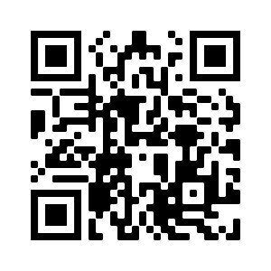
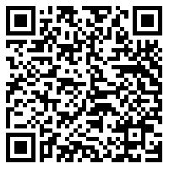
Devoirs
Vocabulary Learning Homework (Y9, Term 1.2 Week 1)
Quizlet link
Homework Audio link
In addition, revisit: Year 9 Term 1.1 Week 4
Year 8 Term 3.1 Week 6
Notes:
Y9 T1.2 W1 Vocabulary learning homework answers available at https://resources.ncelp.org/concern/resources/t148fj238?locale=en

