Slide 1
Adjective agreement (with SER)
Masculine & feminine singular

Slide 2
Adjective agreement
In Spanish, we already know that adjectives ending in ‘o’ change to an ‘a’ when the person being described is female.
Masculine
Es simpático.
He is nice.
Feminine
Es simpática.
She is nice.
Note: when the adjective ends in ‘e’, there is no change.
Es alegre.
He/She is cheerful.
Victoria Hobson

Slide 3
Lire
A poster advertises for the lead roles in a school play, the male lead (Pablo) and female lead (Claudia). The text has been smudged. Are these descriptions for Pablo (P) or Claudia (C)? Or could it be both?
1 | alta |  |  | 5 | tranquila
2 | simpático |  |  | 6 | interesante
3 | bajo |  |  | 7 | rica
4 | alegre |  |  | 8 | famoso
P
C
P
C
Victoria Hobson
Notes:
famoso [997] and rica [398] are high-frequency adjectives that are formally introduced in the second half of the autumn term. The meaning can be given during class feedback. Here the focus is on the adjective ending, and both these adjectives follow the ‘o’ → ‘a’ rule. interesante [617] has been encountered in the phonics ‘I’ cluster words and is a cognate. It gives another example of an adjective ending in ‘e’ which doesn’t change for masculine/feminine singular.

Slide 4
Écouter
At lunchtime a tannoy announces 8 more characters for the play. Is it a male or female character? How is each described? Write the English.
1
cheerful, tall
5
cheerful, short
2
6
short, nice
calm, short
3
good-looking, calm
7
nice, tall
4
tall, good-looking
8
tall, calm
Victoria Hobson
Notes:
Instruct students to write 1-8 and male or female for each question. Depending on the class, the character description could be written on the 2nd time of listening.
Transcript
Es alegre y alta.
Es bajo y simpático.
Es guapo y tranquilo.
Es alta y guapa.
Es alegre y baja.
Es tranquilo y bajo.
Es simpático y alto.
Es alta y tranquila.

Slide 5
¿Quién soy?
Hablar
Partner A
Partner B
Soy (+ adjective)
Eres (+ name)
Sí / No
Victoria Hobson
Notes:
Explain the title of the slide – who am I? Explain the two component parts of the phrase.
Teachers may wish to use this slide to model/aid the instructions for the pair work before displaying the master, slide 29.
1. Give students 30 seconds to write down 8 names (mixture of boys/girls). Alternatively, use the final slide in this PPT to allocate 8 names to each student.
2. Work in pairs. Partners take it in turns to select a name from their own list. They give a sentence to describe themselves (Soy…).
3. The other player has to identify who is being described, using flat statement intonation. (Eres X).
Explain to the pupils that they have to pronounce the adjective correctly, with the correct ending, otherwise their partner cannot guess who they are.
4. The aim is to work with your partner, to identify all 16 people as quickly as possible.
Students put their hands up when they have finished.
Note: alegre and interesante have been included deliberately here. Students may have to guess twice to get this identity.
At the end of the game, point out to them that grammar features (in this case masc/fem adjective endings) often help us to pinpoint the correct meaning more quickly, but not always!
Note: the pronunciation of names gives an opportunity for decoding. Names have been chosen for re-vising vowels, and a few consonants that students have met in passing, J, R.
Adjectives used in the task: alto, bajo, guapo, alegre, simpático, tranquilo, famoso, interesante

Slide 6
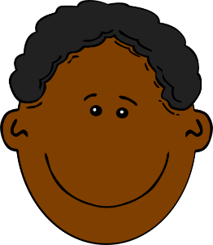
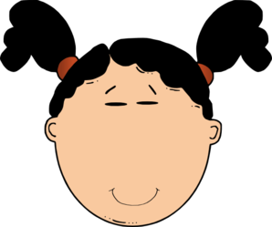
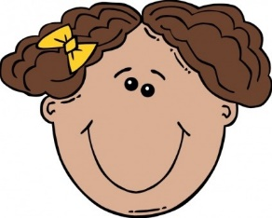
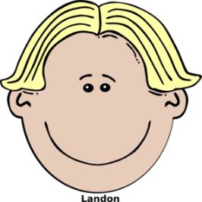
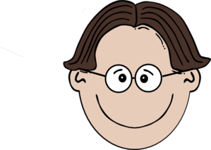
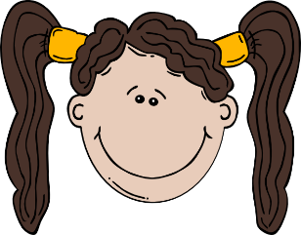
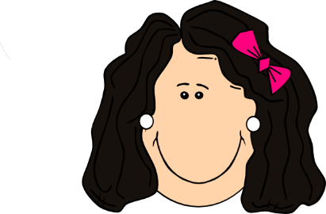
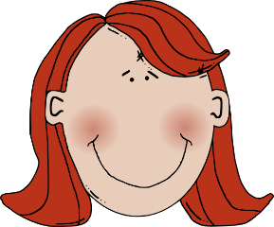
Paco
Elena
Clara
Pablo
(quiet, calm)
(quiet, calm)
(famous)
(interesting)
Irene
David
Serena
Rafa
(tall)
(short)
(tall)
(good-looking)
Juan
Carlos
Arturo
(short)
(nice)
(cheerful)
(famous)
Clementina
Fidelia
Alma
Raúl
Belén
(interesting)
(nice)
(good-looking)
(cheerful)
Victoria Hobson
Notes:
Quién soy? Who am I?
Master (Slide 29) – display this on the IWB whilst the speaking activity is taking place.

Slide 7
Escribir
The following characters will also appear in the school play. You can decide their characters. Write a description of each. Pay attention to adjective spellings.
1 | Señora Fuentes
2 | Señor Gris
3 | Rafaela
4 | Sofía
5 | Diego
6 | Mía
7 | Roberto
8 | Ernesto
e.g. 1) Es alta y alegre.
Victoria Hobson

Slide 8
Carlos Serena Juan Arturo Fidelia Elena David Clementina
Carlos Serena Juan Arturo Fidelia Elena David Clementina
Carlos Serena Juan Arturo Fidelia Elena David Clementina
Carlos Serena Juan Arturo Fidelia Elena David Clementina
Carlos Serena Juan Arturo Fidelia Elena David Clementina
Carlos Serena Juan Arturo Fidelia Elena David Clementina
Carlos Serena Juan Arturo Fidelia Elena David Clementina
Carlos Serena Juan Arturo Fidelia Elena David Clementina
Carlos Serena Juan Arturo Fidelia Elena David Clementina
Carlos Serena Juan Arturo Fidelia Elena David Clementina
Carlos Serena Juan Arturo Fidelia Elena David Clementina
Carlos Serena Juan Arturo Fidelia Elena David Clementina
Carlos Serena Juan Arturo Fidelia Elena David Clementina
Carlos Serena Juan Arturo Fidelia Elena David Clementina
Carlos Serena Juan Arturo Fidelia Elena David Clementina
Carlos Serena Juan Arturo Fidelia Elena David Clementina
Clara Pablo Paco Alma Irene Raúl Rafa Belén
Clara Pablo Paco Alma Irene Raúl Rafa Belén
Clara Pablo Paco Alma Irene Raúl Rafa Belén
Clara Pablo Paco Alma Irene Raúl Rafa Belén
Clara Pablo Paco Alma Irene Raúl Rafa Belén
Clara Pablo Paco Alma Irene Raúl Rafa Belén
Clara Pablo Paco Alma Irene Raúl Rafa Belén
Clara Pablo Paco Alma Irene Raúl Rafa Belén
Clara Pablo Paco Alma Irene Raúl Rafa Belén
Clara Pablo Paco Alma Irene Raúl Rafa Belén
Clara Pablo Paco Alma Irene Raúl Rafa Belén
Clara Pablo Paco Alma Irene Raúl Rafa Belén
Clara Pablo Paco Alma Irene Raúl Rafa Belén
Clara Pablo Paco Alma Irene Raúl Rafa Belén
Clara Pablo Paco Alma Irene Raúl Rafa Belén
Clara Pablo Paco Alma Irene Raúl Rafa Belén

