Slide 1
Comparing how you feel and felt
ESTAR for states
Present tense (estoy, estás) [revisited]
Imperfect tense (estaba, estabas)
Y9 Spanish
Term 2.2 - Week 2 - Lesson 41
Louise Caruso / Nick Avery Artwork: Mark Davies
Date updated: 09/12/21
Notes:
Artwork by Mark Davies. All additional pictures selected are available under a Creative Commons license, no attribution required.
With thanks to Rachel Hawkes for her input on the lesson material and Blanca Román for native teacher feedback.
Learning outcomes (lesson 1):
Consolidation of ESTAR in present tense (1st person and 2nd person singular – estoy, estás) for states
Introduction of ESTAR in imperfect tense (1st person and 2nd person singular – estaba, estabas) for states
Consolidation of regular and irregular comparatives
Consolidation of SSCs [ce] and [ci]
Frequency rankings of vocabulary introduced this week (1 is the most common word in Spanish):
castillo [2545]; colina [4004]; sala [841]; baño [1340]; patio [1197]; piso [889]; región [545]; carretera [1718]; satisfecho [2261]; orgulloso [2688]; asustado [3170]; vivo [807]; alrededor [2274]; [1718]; por eso [eso-56]; a pesar de [pesar-405]
Frequency rankings of vocabulary revisited this week:
9.2.1.4: nacer [426]; reconocer [400]; cumplir [385]; huir [1359]; sentir [136]; oír [254]; duda [531]; experiencia [416]; esperanza [987]; raíz [1304]; cubano [703]; asistir [1200]; extranjero² [765]; marido [965]; mujer² [120]; población [454]; actual [499]; ambos [536]; derecho [266]; relación [272]
9.1.2.7: vais [ir-22]; gastar [1866]; tener que [tener-19]; tocar² [327]; guitarra [2705]; Navidad [3513]; programa [339]; televisión [825]; siguiente [350]; tradición [1061]; estrella [974]; medianoche [4663]; desde [60]; hasta² [70]; ochenta [1967]; noventa [2459]; cien [ciento-440]; ciento (uno) [440]
Source: Davies, M. & Davies, K. (2018). A frequency dictionary of Spanish: Core vocabulary for learners (2nd ed.). Routledge: London
The frequency rankings for words that occur in this PowerPoint which have been previously introduced in NCELP resources are given in the NCELP SOW and in the resources that first introduced and formally re-visited those words.
For any other words that occur incidentally in this PowerPoint, frequency rankings will be provided in the notes field wherever possible.

Slide 2
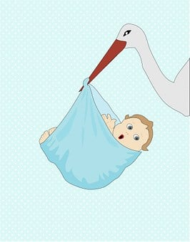
Fonética
hablar / escuchar
Escribe las palabras en español. ¿Cuál tiene la SSC [CE]?
to feel, feeling
o
[to be born]
sentir
nacer
Ahora escucha y lee. ¿Dónde está la persona (probablemente)?
1
El bebé de mi tía va a nacer el próximo mes.
a) Latinoamérica o Canarias
b) España (península)
Notes:
Timing: 4 mins (slides 2-7)
Aim: to revise SSC knowledge and practise recall of vocabulary.
Procedure: 1. Students write down both words in Spanish. All of these words are previously taught vocabulary items. They say them aloud and decide which one contains the target SSC. 2. Answers are animated to show the word with the SSC first.
3. Click again to reveal the second half of the activity.
3. Ask students to listen to a sentence (click the orange button). They will read and listen to a sentence with the target SSC.
4. Elicit an oral translation of the sentence in English.
5. Ask students to decide where the speaker is most likely from, based on the pronunication (they have covered this multiple times in KS3, though a recap may be needed before starting). In feedback, it is worth contrasting the pronunciation of the correct answer with the pronunciation if the speaker were from the other part of the Spanish-speaking world.
Transcript:
El bebé de mi tía va a nacer el próximo mes. (LatAm)
Note:
‘LatAm’ in transcript indicates ‘Latin America and Canaries’
‘Esp’ in transcript indicates ‘mainland Spain’

Slide 3
Fonética
hablar / escuchar
Escribe las palabras en español. ¿Cuál tiene la SSC [CE]?
to recognise, recognising
essential
o
reconocer
esencial
Ahora escucha y lee. ¿Dónde está la persona (probablemente)?
2
El gobierno no quiere reconocer los derechos de los cubanos.
a) Latinoamérica o Canarias
b) España (península)
Notes:
Slide 2/6
Transcript: El gobierno no quiere reconocer los derechos de los cubanos. (Esp)

Slide 4
Fonética
hablar / escuchar
Escribe las palabras en español. ¿Cuál tiene la SSC [CE]?
o
[head]
[roots]
la cabeza
las raíces
Ahora escucha y lee. ¿Dónde está la persona (probablemente)?
3
Estoy orgulloso de mis raíces latinas.
a) Latinoamérica o Canarias
b) España (península)
Notes:
Slide 3/6
Transcript:
Estoy orgulloso de mis raíces Latinas. (LatAm)
Note: this is an opportunity to very briefly recap how nouns ending in –z pluralise with –ces.

Slide 5
Fonética
hablar / escuchar
Escribe las palabras en español. ¿Cuál tiene la SSC [CI]?
o
[population]
[heart]
la población
el corazón
Ahora escucha y lee. ¿Dónde está la persona (probablemente)?
4
Los Estados Unidos tienen una población muy grande.
a) Latinoamérica o Canarias
b) España (península)
Notes:
Slide 4/6
Transcript:
Los Estados Unidos tiene una población muy grande. (Esp)

Slide 6
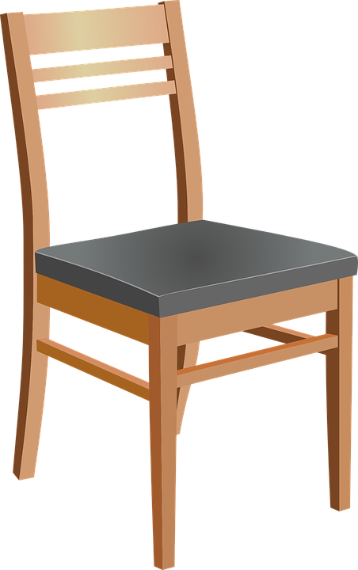
Fonética
hablar / escuchar
Escribe las palabras en español. ¿Cuál tiene la SSC [CI]?
100
o
[chair]
cien
la silla
Ahora escucha y lee. ¿Dónde está la persona (probablemente)?
5
Cien de los extranjeros son peruanos.
a) Latinoamérica o Canarias
b) España (península)
Notes:
Slide 5/6
Transcript:
Cien de los extranjeros son peruanos. (Esp)

Slide 7
Fonética
hablar / escuchar
Escribe las palabras en español. ¿Cuál tiene la SSC [CI]?
hope
experience
o
esperanza
la experiencia
Ahora escucha y lee. ¿Dónde está la persona (probablemente)?
6
Mi abuela tuvo experiencias difíciles como otros cubanos.
a) Latinoamérica o Canarias
b) España (península)
Notes:
Slide 6/6
Transcript:
Mi abuela tuvo experiencias difíciles como otros cubanos (LatAm).

Slide 8
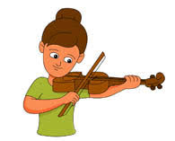
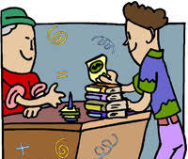
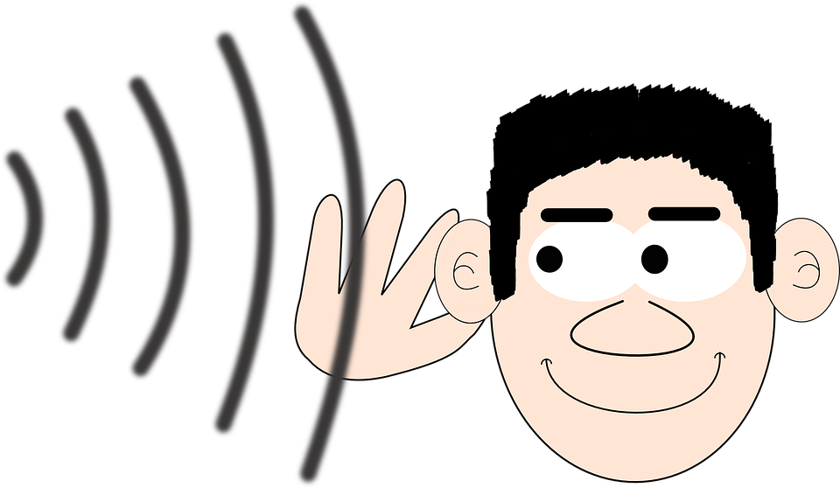
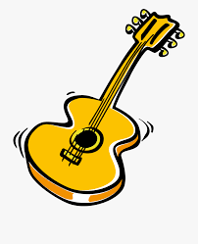
¿Cuál es la palabra en español?
Vocabulario
leer
ambos, ambas
Navidad
televisión
estrella
gastar
vais
tocar
noventa
guitarra
hasta
desde
oír
both
you (plural) go, are going
from (time)
[to play, playing (instrument)]
as far as,
up to, until
90
[to spend, spending (money)]
[star]
[Christmas]
[television]
[to hear, hearing]
Notes:
Timing: 2 minutes
Aim: to identify previously taught vocabulary
Procedure:
Students look at the picture or read the word in English when it appears on the slide and say out loud the corresponding word in Spanish from the list. NB: if the words are nouns, teachers should ask students to produce the correct definite article as well. e.g. el periódico.
Click to bring up the correct answer.
Note: this activity focuses on identification of vocabulary. The next activity requires students to recall the vocabulary themselves. Teachers might wish to use this slide as a lead in/recap ahead of the next activity. Alternatively, with a higher ability group, it may be preferable to go straight to slide 9.

Slide 9
¿Cómo se dice en español?
hablar
both
[to play, playing (instrument)]
you (plural) go, are going
from (time)
desde
?
?
?
?
tocar
vais
ambos/as
as far as,
up to, until
[Christmas]
[to spend, spending (money)]
?
gastar
?
?
hasta
?
la guitarra
la Navidad
90
[star]
[to hear, hearing]
noventa
?
?
?
?
oír
la televisión
la estrella
Notes:
Timing: 2 minutes
Aim: to promote productive oral recall of the 12 items of revisited vocabulary.
Procedure:
Click to see one of the images flash. Images flash in a random order.
Students say the correct Spanish word (this time without the list to help).
Click to reveal the answer.

Slide 10
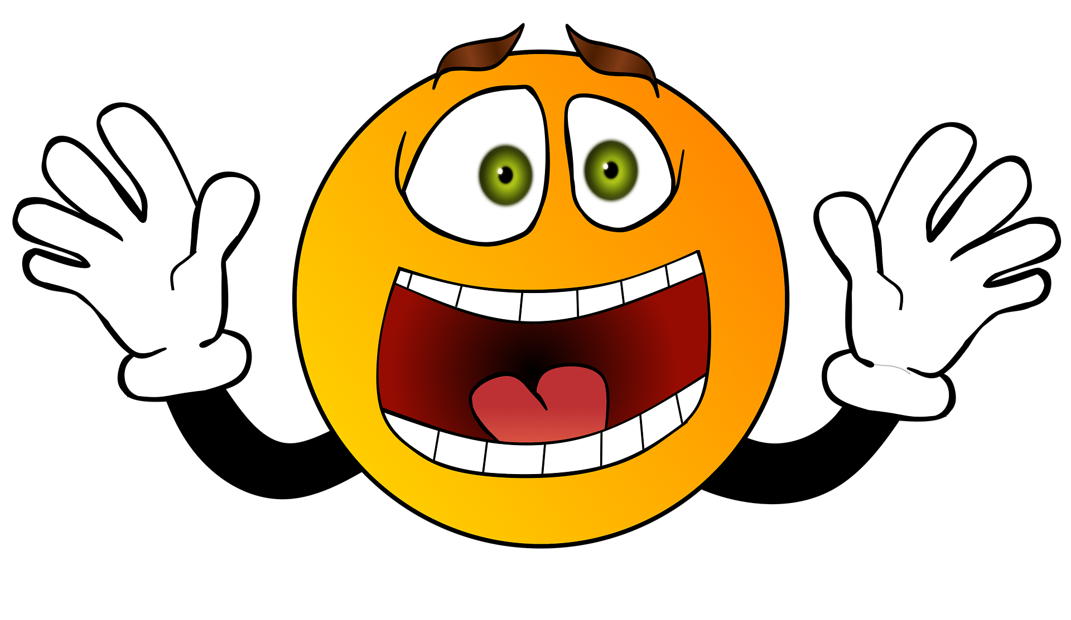
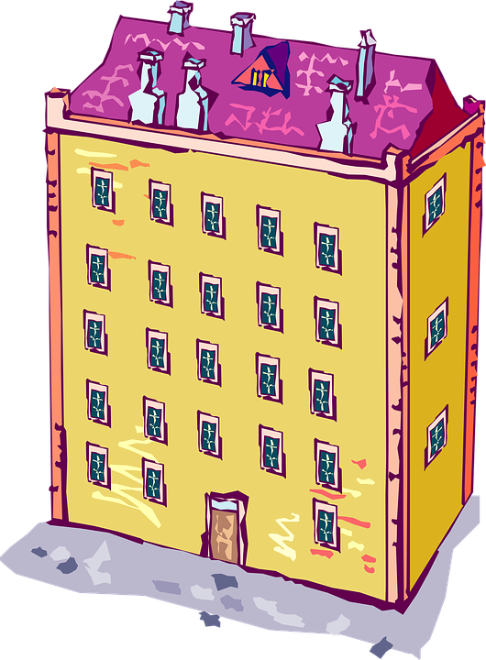
Vocabulario
leer / hablar
[1/2]
asustado, asustada
orgulloso, orgullosa (de)
[proud (of)]
[scared]
‘Orgulloso’ has the meaning ‘proud’ when used with ‘estar’. Used with ‘estar’, it has a positive meaning.
The phrase ‘seguir vivo’ means ‘to stay alive’.
satisfecho, satisfecha
alive
vivo, viva
[satisfied]
in spite of
a pesar de
el piso
[flat]
that’s why
por eso
la carretera
[road]
Notes:
Vocabulary practice slides (1/2)
Timing: 4 minutes
Aim: to introduce and embed this week’s new vocabulary.
Procedure 1. Pupils either work by themselves or in pairs, reading out the words and recapping their English meaning (1 minute).
2. Then the teacher removes the English words or pictures (one by one) and they try to recall the English orally (chorally), looking at the Spanish (1 minute).
3. Then the Spanish meanings are removed (one by one) and they to recall them orally (again, chorally), looking at the English (1 minute)
4. Further rounds of learning can be facilitated by one pupil turning away from the board, and his/her partner asking him/her the meanings (‘¿Cómo se dice X en español?’). This activity can work from L2 -> L1 or L1 -> L2.
Image (free to use) by Christian Dorn from Pixabay

Slide 11
Talking about how people feel and felt ESTAR in the 1st person singular
gramática
states
locations
Remember, we use the verb ‘estar’ to talk about ________ and ___________.
estoy
To say ‘I am’ for a state or location, use __________.
Estoy vivo.
I am alive.
estaba
To say ‘I was’ for a state or location at a particular past time, use __________.
Estaba emocionado durante el partido.
I was excited during the match.
This tense is called the ‘imperfect’.
Notes:
Timing: 2 minutes
Aim: to recap ‘estar’ in 1st singular present (estoy) and introduce the 1st person singular imperfect form (estaba).
Procedure:
Go through the grammar explanation with students, revealing each new sentence on a mouse click.
Notes:
1. Lesson 2 will introduce the use of ‘estaba’ with the meaning 3rd person singular meaning (‘s/he was, it was’).
2. The imperfect can also be translated using the English ‘used to’. This will be introduced in week 9.3.1.1, where the imperfect is revisited. In that lesson, there will be more awareness raising about when in English we might use ‘was’ and ‘used to’ (and when they are interchangeable).
3. The use of the imperfect for repeated past events will be introduced in that week. Because the focus this week is on ‘estar’, we do not yet go into the explanation of this.
4. So far, students have only done the preterite, which is used for completed events in the past.

Slide 12
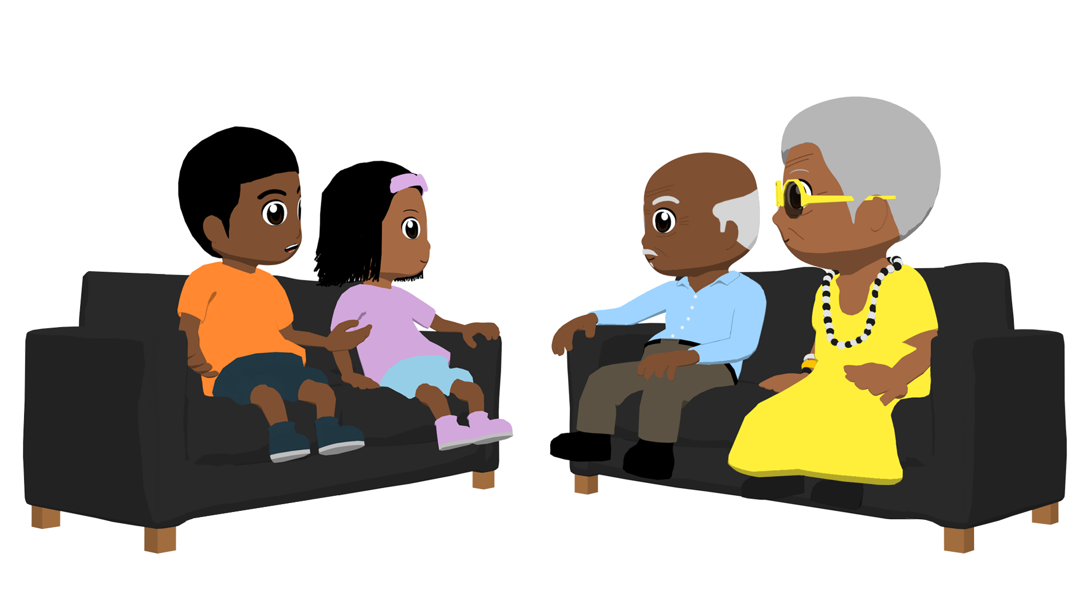
Los abuelos hablan sobre la experiencia de llegar a Estados Unidos (en el pasado). También hablan sobre cómo están ahora. Lee las frases y completa la tabla.
leer
1. En general estoy contento aquí.
2. Sí, es verdad. Estaba triste por los cambios en nuestro país.
3. Estaba asustada por todos los coches rápidos en las carreteras.
 | ahora (‘I am’) | después de llegar a Estados Unidos (‘I was’)
1
2
3
4
5
6
7
8
4. Un piso grande y un buen coche - por eso estoy muy satisfecho.
5. Claro, estoy muy orgullosa de mis raíces cubanas.
6. Estaba asustada, ¡pero viva!
8. ¡Ay no! No estoy lista para volver.
7. Huimos porque yo no estaba seguro.
Notes:
Timing: 6 minutes
Aims:
to practise differentiating between ‘estoy’ and ‘estaba’ (reading activity)
to understand the new and revisited vocabulary in the sentences
Procedure:
Students read the phrases and determine whether the grandparents are talking about how they feel now (using ‘estoy’) or how they felt in the past (using ‘estaba’)
Click to reveal the correct answers in the table on the right.
Note: ‘después de + infinitive’ was first introduced in 7.3.1.5. It is worth using the table header (‘después de llegar a Estados Unidos’) to recap this construction here.

Slide 13
Talking about how people feel and felt ESTAR in 2nd person singular
gramática
To say ‘you are’ for a state or location, use ________.
estás
Estás asustada.
You are scared.
estabas
To say ‘you were’ for a state or location at a particular past time, use _________.
Estabas muy orgullosa de tu prima.
You were very proud of your cousin (f).
Remember, adjectives ending in –o or –a agree with the gender of the subject:
–o for a masculine subject
–a for a feminine subject
Notes:
Timing: 2 minutes
Aim: to recap the 2nd person singular form ‘estás’ and introduce ‘estabas’
Procedure: go through the grammar explanation with students, revealing each new sentence on a mouse click.

Slide 14
Comparing things Regular comparatives [revisited]
gramática
‘más’ + adjective + ‘que’
As you know, when comparing things in Spanish, use _________________________ to mean ‘more… than’.
My friend is prouder than Lucía.
más orgullosa que
Mi amiga está ___________________ Lucía.
Sometimes we just add –er to the adjective in English to mean ‘more’.
‘menos’ + adjective + ‘que’
To say something is ‘less…than’, use ___________________________.
menos asustada que
I was less scared than Ana.
Estaba ______________________ Ana.
Remember, the adjective agrees with the gender and number of the first noun.
Notes:
Timing: 1 minute
Aim: to recap the formation of regular comparatives taught in Year 8
Procedure:
Click to bring up an incomplete sentence about the formation of sentences with ‘más…que’ and ‘menos ... que’. Words are left out for students to complete the sentence.
Click to show two examples. The English is given first to allow students to provide the Spanish translation.
A callout also appears on a further click to remind students about the need for gender and number agreement between the adjective and noun.
Note: the slide could easily be adapted for a higher group so that students are required to produce the full sentence translation in Spanish.

Slide 15
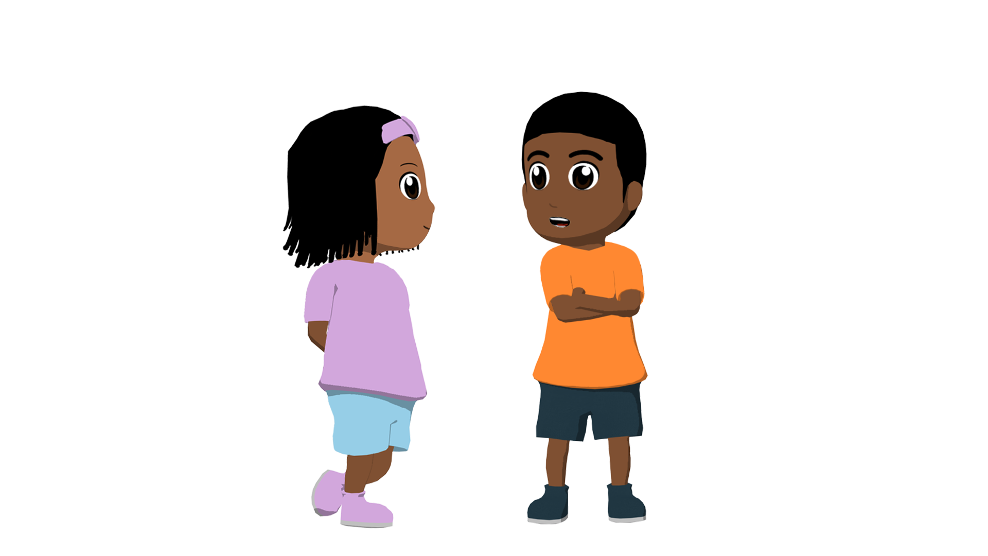
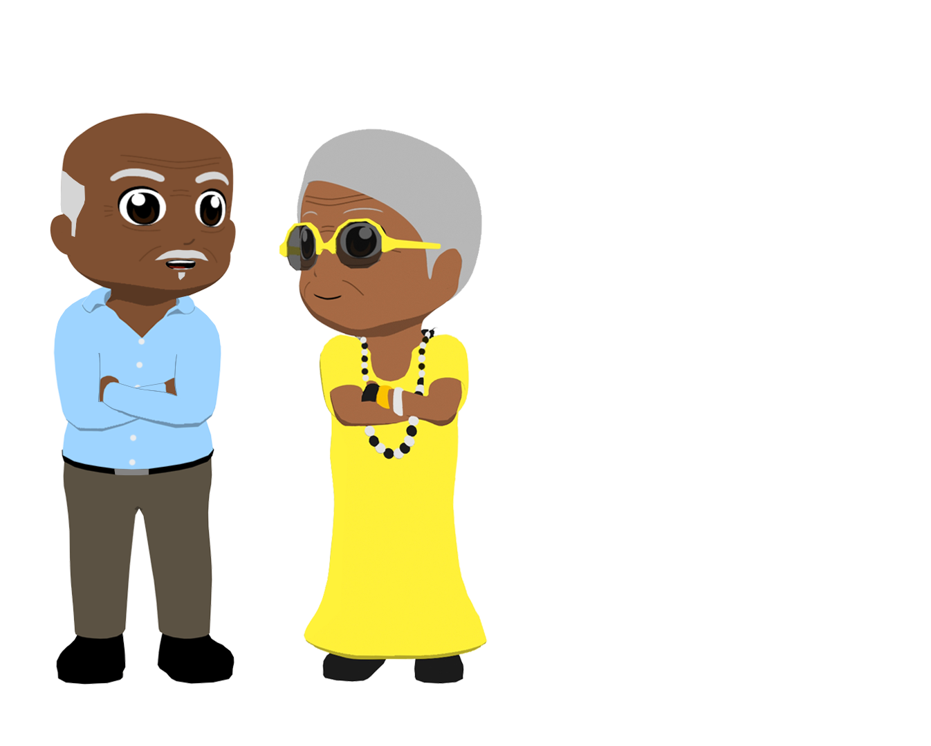
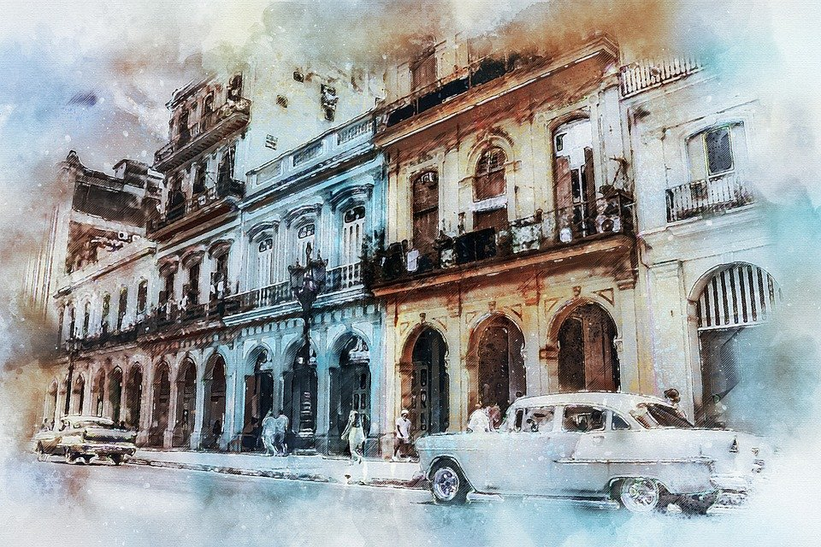
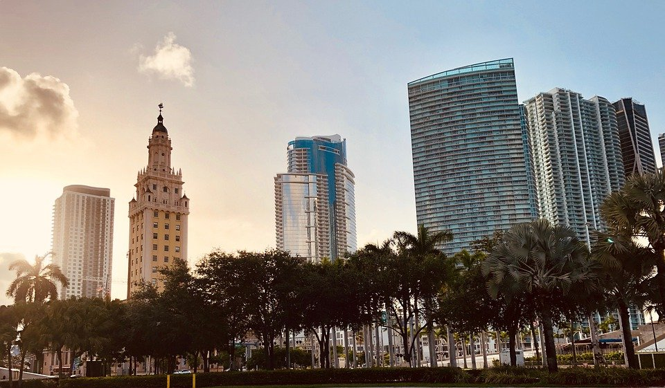
María de los Ángeles tiene unas preguntas para el abuelo y también para la abuela. Escucha y completa la tabla.
escuchar
 | ahora (‘Are you…?’) | después de llegar a Estados Unidos (‘Were you…?’) | Completa la frase
 |  |  | _________________________ your brother?
 |  |  | ___________________ before (‘in the past’)?
 |  |  | ________________________ Grandad?
 |  |  | _________________________ my mother?
 |  |  | _________________________ your friends in Cuba?
 |  |  | ___________________ before with the Cuban government?
1
happier than
2
less sad than
3
more scared than
4
less excited than
5
more satisfied than
6
less angry than
Notes:
Timing: 8 minutes
Aims:
i) to practise distinguishing between ‘estás’ and ‘estabas’ (listening activity)
ii) to understand regular comparative adjectives (más/menos + adjective + que)
Procedure:
Click the orange audio buttons to hear the questions. Students decide whether they refer to how María’s grandmother feels now (estás) or how she felt (estabas) after arriving in the U.S
Students listen again to complete the sentence by translating the comparative phrase into English..
Click to reveal the answers.
Notes:
1. Steps 1 and 2 could be done at the same time. The animation sequence could be adapted to give feedback for both of these parts at the same time (i.e., row by row).
2. An optional use of the activity could be to listen again and decide whether each question is addressed to a) grandpa, b) grandmother or c) could be either, depending on the adjective ending (-o, -a or other ending).
3. The final item is slightly more complex in that it the English translation isn’t word for word. The reason for this is that, although it could be ‘less angry with the Cuban government than before’, this would mean separating ‘than’ from ‘less angry’ in the gap, and so would differ from the rest of the question items.
Transcript:
¿Estabas más contento que tu hermano?
¿Estás menos triste que en el pasado?
¿Estabas más asustada que mi abuelo?
¿Estabas menos emocionada que mi madre?
¿Estás más satisfecha que tus amigos en Cuba?
¿Estás menos enojada que antes con el gobierno cubano ?

Slide 16
Comparing things Irregular comparatives [revisited]
As you know, some comparatives are irregular.
‘mejor que’
To say something is ‘better than’, use _____________.
My life here is better than in Cuba...
Mi vida aquí es mejor que en Cuba...
‘peor que’
To say something is ‘worse than’, use _______________.
...but the food is worse than in Havana.
...pero la comida es peor que en La Habana.
Remember, for plural nouns, you need to use ‘mejores’ and ‘peores’.
Notes:
Timing: 1 minute
Aim: to recap irregular comparatives ‘mejor’ and ‘peor’ before the next activity
Procedure: click to reveal each part of the explananation.

Slide 17
María de los Angeles y Jorge Jesus hablan con los abuelos sobre la experiencia de vivir en Estados Unidos. Lee el texto y contesta las preguntas.
leer
*seguir vivo = to stay alive
¿Abuelo, estás satisfecho con tu decisión de dejar tu país?
Pues sí, estoy muy bien en Florida pero la verdad es que tuvimos que huir para seguir vivos*. Yo tuve que proteger a mi mujer y mis hijos de la violencia. Oí que la situación política en Estados Unidos estaba más segura que en Cuba y por eso busqué una forma de salir del país.
¿Y desde vuestra llegada estabas contento con la vida aquí?
Cuando llegamos, y en los meses siguientes, nuestra vida estaba peor que ahora. Es duro para un extranjero llegar sin trabajo, sin derechos y sin hablar el idioma, pero yo estaba optimista* para el futuro.
¿Y tú, abuela, también estabas emocionada o estabas asustada?
Bueno, estaba menos emocionada que tu abuelo. Yo estaba triste porque tuve que huir de mi país. Estaba preocupada por la salud de mi madre en los meses antes de viajar. A pesar de mis dudas, decidí seguir a mi marido.
¿Pero estás feliz ahora?
La vida es mejor que en Cuba, estoy segura, pero todavía estoy orgullosa de mis raíces cubanas.
During the Cuban Revolution of 1959, Fidel Castro and his communist army overthrew the Cuban President, Batista, and took over the country. Supporters of Batista fled to the U.S.
*optimista = optimistic
Notes:
Timing: 10 minutes
Aim:
i) to understand the new language features in context
ii) to correctly answer the comprehension questions
Prodecure:
Students read the dialogue and answer questions based on the test. The answers are provided in English and in Spanish on an accompanying handout.
See the following slide for the answers.
Note: students have already done ‘tener’ in the preterite, so should recognise the stem ‘tuv-’. In line 1 this is used with the ‘–imos’ preterite ending that they have also studied.
Frequency of unknown vocabulary and cognates:
política [258]; optimista [1025]; violencia [1100]

Slide 18
Solución
[1/2]
leer
1. Why did the grandfather leave Havana? ¿Por qué el abuelo dejó La Habana?
He had to protect his wife and family.
(Tuve que proteger a mi mujer y mis hijos.)
2. What did he hear about life in U.S? ¿Qué escuchó sobre la vida en los Estados Unidos?
He heard that the situation was safer in the U.S. than in Cuba.
(Oí que la situación política en Estados Unidos estaba más segura que en Cuba. )
3. What problems face foreigners in the U.S? ¿Qué problemas hay para los extranjeros en los Estados Unidos?
It’s hard for a foreigner to arrive without work or rights, and without speaking the language.
(Es duro para un extranjero llegar sin trabajo, sin derechos y sin hablar el idioma.)
Notes:
Answer slide

Slide 19
Solución
[2/2]
leer
Who was more excited? ¿Quién estaba más emocionado?
The grandfather.
(Bueno, estaba menos emocionada que tu abuelo.)
5. Why was she worried? ¿Por qué estaba preocupada?
She was worried about her mother’s health in the months before leaving.
(Estaba preocupada por la salud de mi madre en los meses antes de viajar.)
6. Does the grandmother prefer living in the U.S or Cuba? ¿La abuela prefiere vivir en los Estados Unidos o en Cuba?
Life is better (in the USA) than in Cuba.
(La vida es mejor que en Cuba.)
Notes:
Answer slide

Slide 20
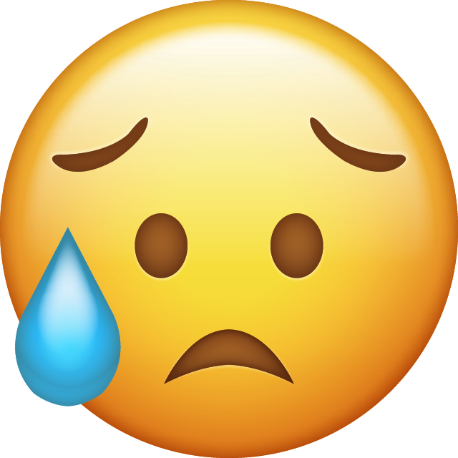
Imagina que ahora vives en otro país con tu familia. ¿Cómo estás? Y ¿cómo estabas al principio, después de llegar?
hablar / escuchar
Persona A: debes leer la frase completa a tu compañero en español.
Persona B: escucha la frase de tu compañero.
Elige la opción correcta y completa la traducción en inglés.
“Estoy menos asustada que antes.”
Persona A (habla)
Persona B (escucha y escribe)
1. I am less scared than before.
less scared than
1. I am / I was ___________________ before.
Notes:
Note: there are two options for the final activity. We recommend doing one of these.
Option 1: slides 20-24: paired speaking and listening involving production and comprehension of estoy vs estaba + comparatives
Option 2: slides 25-30: paired speaking and listening involving production and comprehension of estoy vs estaba + adjective (more suitable for a lower ability group)
Timing: 10 minutes
Aims:
i) oral production and comprehension of ‘estoy’ and ‘estaba’
ii) comparatives (regular and irregular) and vocabulary
Procedure:
1. The cards should be handed out to students before beginning the activity so they get an idea of what is going to happen.
2. The teacher clicks through the slide to show a worked example of the activity.

Slide 21
Persona A
hablar / escuchar
Lee estas frases en español:
I am more satisfied than José.
I was less scared than María.
I was less worried than my father.
I am happier than before.
I was prouder than my sister.
I am less nervous than my teacher (m).
Elige y la opción correcta y completa las frases:
I am / I was ________________________ Jorge.
I am / I was ________________________ Sofía.
I am / I was ________________________ my brother.
I am / I was ________________________ my uncle.
I am / I was ________________________ before.
I am / I was ________________________ my aunt.
Notes:
Person A prompt cards and sentences to complete
DO NOT DISPLAY DURING ACTIVITY
See accompanying Word doc for printable version.

Slide 22
Persona B
hablar / escuchar
Lee estas frases en español:
I was sadder than Jorge.
I am less excited than Sofía.
I am more cheerful than my brother.
I was angrier than my uncle.
I am calmer than before.
I was less sure than my aunt.
Elige y la opción correcta y completa las frases:
I am / I was ________________________ José.
I am / I was ____________________ María.
I am / I was ____________________ my father.
I am / I was ___________________ before.
I am / I was __________________ my sister.
I am / I was ______________________ my teacher (m).
Notes:
Person B prompt cards and sentences to complete
DO NOT DISPLAY DURING ACTIVITY
See accompanying Word doc for printable version.

Slide 23
Respuestas: Persona A
I am / I was ________________________ Jorge.
I am / I was ________________________ Sofía.
I am / I was ________________________ my brother.
I am / I was ________________________ my uncle.
I am / I was ________________________ before.
I am / I was ________________________ my aunt.
sadder than
less excited than
more cheerful than
angrier than
calmer than
less sure than
Respuestas: Persona B
more satisfied than
I am / I was ________________________ José.
I am / I was ________________________ María.
I am / I was ________________________ my father.
I am / I was ________________________ before.
I am / I was ________________________ my sister.
I am / I was ________________________ my teacher (m).
less scared than
less worried than
happier than
prouder than
less nervous than
Notes:
Answer sheet for listening / writing part of the activity
DO NOT DISPLAY DURING ACTIVITY
See accompanying Word doc for printable version.

Slide 24
Respuestas (de la parte oral)
Persona A
I am more satisfied than José.
I was less scared than María.
I was less worried than my father.
I am happier than before.
I was prouder than my sister.
I am less nervous than my teacher (m).
Estoy más satisfecho/a que José.
Estaba menos asustado/a que María.
Estaba menos preocupado/a que mi padre.
Estoy más contento/a OR feliz que antes.
Estaba más orgulloso que mi hermana.
Estoy menos nervioso/a que mi profesor.
Persona B
I was sadder than Jorge.
I am less excited than María de los Ángeles.
I am more cheerful than my brother.
I was angrier than my uncle.
I am calmer than before.
I was less sure than my aunt.
Estaba más triste que Jorge.
Estoy menos emocionado/a que Sofía.
Estoy más alegre que mi hermano.
Estaba más enojado/a que mi tío.
Estoy más tranquilo/a que antes.
Estaba menos seguro/a que mi tía.
Notes:
OPTIONAL
Teachers may wish to use this additional slide to give feedback on the oral production part of the activity.
Answers begin with Person A and appear individually on each click.

Slide 25
hablar / escuchar
Hablamos de las emociones.
Persona A lee cada tarjeta en inglés y habla en español.
Persona B mira las opciones con el mismo número y escucha: ¿es presente o pasado? Luego, escribe el nombre correcto, según el verbo.
Ejemplo:
Persona B escucha, mira las opciones y escribe el nombre correcto en una lista:
Persona A habla:
 | Nombres
1
2
3
4
5
6
7
8
Estaba contenta.
Paula
1
I am happy
[Marta]
I was happy
[Paula]
1
Say: I was happy (f).
Después, Persona B habla y Persona A escucha.
Notes:
OPTIONAL – ALTERNATIVE FINAL ACTIVITY
This alternative final activity may be more suited to students who need more support.
It involves production and comprehension of ‘estar’ + adjective (rather than ‘estar’ + comparatives in the previous activity).
Timing: 10 min.
Aim:
i) to practise producing and understanding ‘estoy’ and ‘estabas’ in the oral modality
ii) to practise producing and understanding vocabulary
Procedure:
1. Person A says the card number and reads the question aloud in Spanish. (Saying the card number will help the partner to follow the order.)
2. Person B looks at the card displayed on the interactive whiteboard with the same number that s/he just heard. Depending on what Person A says, Person B writes the name of the person that the sentence corresponds to (e.g. 1. Paula).
Notes:
The cards for the person speaking are on the next slide. These need to be printed.
The cards for the person listening are on the following slide. These can be displayed on the board during the activity (no need to print).

Slide 26
HABLAR
Persona A
Persona B
1
2
1
2
Say: I was excited.
Say: I was sad.
Say: I was scared.
Say: I am ill.
3
4
3
4
Say: I am tired.
Say: I am proud.
Say: I was ready.
Say: I was nervous.
5
6
5
6
Say: I am satisfied.
Say: I was crazy.
Say: I am alive.
Say: I am happy.
7
8
7
8
Say: I am worried.
Say: I was cheerful.
Say: I am calm.
Say: I was angry.

Slide 27
hablar
Persona B
1
2
3
I am excited.
[Marta]
I was excited.
[Paula]
I am sad.
[Pablo]
I was sad.
[Quique]
I am tired.
[Irene]
I was tired.
[David]
4
5
6
I am proud.
[Alba]
I was proud.
[Adrián]
I am satisfied.
[Nerea]
I was satisfied.
[Álvaro]
I am crazy.
[Pablo]
I was crazy.
[Marta]
7
8
I am worried.
[Irene]
I was worried.
[Adrián]
I am cheerful.
[Alba]
I was cheerful.
[Álvaro]

Slide 28
hablar
Persona A
1
2
3
I am ill.
[Marta]
I was ill.
[Paula]
I am scared.
[Pablo]
I was scared.
[Quique]
I am ready.
[Irene]
I was ready.
[David]
4
5
6
I am nervous.
[Alba]
I was nervous.
[Adrián]
I am happy.
[Pablo]
I was happy.
[Marta]
I am alive.
[Nerea]
I was alive.
[Álvaro]
7
8
I am calm.
[Irene]
I was calm.
[Adrián]
I am angry.
[Alba]
I was angry.
[Álvaro]

Slide 29
hablar
Persona B
1
2
3
I am excited.
[Marta]
I was excited.
[Paula]
I am sad.
[Pablo]
I was sad.
[Quique]
I am tired.
[Irene]
I was tired.
[David]
4
5
6
I am proud.
[Alba]
I was proud.
[Adrián]
I am satisfied.
[Nerea]
I was satisfied.
[Álvaro]
I am crazy.
[Pablo]
I was crazy.
[Marta]
7
8
I am worried.
[Irene]
I was worried.
[Adrián]
I am cheeful.
[Alba]
I was cheerful.
[Álvaro]
Notes:
STUDENT B ANSWER SLIDE – DO NOT SHOW DURING THE ACTIVITY

Slide 30
hablar
Persona A
1
2
3
I am ill.
[Marta]
I was ill.
[Paula]
I am scared.
[Pablo]
I was scared.
[Quique]
I am ready.
[Irene]
I was ready.
[David]
4
5
6
I am nervous.
[Alba]
I was nervous.
[Adrián]
I am happy.
[Pablo]
I was happy.
[Marta]
I am alive.
[Nerea]
I was alive.
[Álvaro]
7
8
I am calm.
[Irene]
I was calm.
[Adrián]
I am angry.
[Alba]
I was angry.
[Álvaro]
Notes:
STUDENT A ANSWER SLIDE – DO NOT SHOW DURING THE ACTIVITY

Slide 31
Describing people and things
ESTAR for location
Present tense (3rd person singular - está)
Imperfect tense (3rd person singular - estaba)
Y9 Spanish
Term 2.2 - Week 2 - Lesson 42
Louise Caruso / Nick Avery Artwork: Mark Davies
Date updated: 09/12/21
Notes:
Artwork by Mark Davies. All additional pictures selected are available under a Creative Commons license, no attribution required.
With thanks to Rachel Hawkes for her input on the lesson material and Blanca Román for native teacher feedback.
Learning outcomes (lesson 1):
Consolidation of ESTAR in present tense (3rd person singular – está)
Introduction of ESTAR in imperfect tense (3rd person singular – estaba)
Introduction of relative pronoun ‘que’ for subject relative clauses (with meaning ‘who’ and ‘that’)
Consolidation of SSCs [ce] and [ci]
Frequency rankings of vocabulary introduced this week (1 is the most common word in Spanish)
castillo [2545]; colina [4004]; sala [841]; baño [1340]; patio [1197]; piso [889]; región [545]; carretera [1718]; satisfecho [2261]; orgulloso [2688]; asustado [3170]; vivo [807]; alrededor [2274]; [1718]; por eso [eso-56]; a pesar de [pesar-405]
Frequency rankings of vocabulary revisited this week:
9.2.1.4: nacer [426]; reconocer [400]; cumplir [385]; huir [1359]; sentir [136]; oír [254]; duda [531]; experiencia [416]; esperanza [987]; raíz [1304]; cubano [703]; asistir [1200]; extranjero² [765]; marido [965]; mujer² [120]; población [454]; actual [499]; ambos [536]; derecho [266]; relación [272]
9.1.2.7: vais [ir-22]; gastar [1866]; tener que [tener-19]; tocar² [327]; guitarra [2705]; Navidad [3513]; programa [339]; televisión [825]; siguiente [350]; tradición [1061]; estrella [974]; medianoche [4663]; desde [60]; hasta² [70]; ochenta [1967]; noventa [2459]; cien [ciento-440]; ciento (uno) [440]
Source: Davies, M. & Davies, K. (2018). A frequency dictionary of Spanish: Core vocabulary for learners (2nd ed.). Routledge: London
The frequency rankings for words that occur in this PowerPoint which have been previously introduced in NCELP resources are given in the NCELP SOW and in the resources that first introduced and formally re-visited those words.
For any other words that occur incidentally in this PowerPoint, frequency rankings will be provided in the notes field wherever possible.

Slide 32
Supersticiones cubanas
hablar
Lee el texto. ¿Qué significa? Luego lee con un compañero para practicar la pronunciación de [ce] y [ci].
Estoy orgullosa de mis raíces cubanas. En Cuba hay tantas tradiciones, celebraciones y supersticiones.
¿Cómo celebran el treinta y uno de diciembre a las doce? Queman* un muñeco* como representación de la eliminación de todas las cosas malas del año pasado.
1
2
3
Latinoamérica y Canarias
*quemar – to burn, burning
*el muñeco – doll
1
2
3
España (peninsula)
Notes:
A tonguetwister
Timing: 4 mins
Aim: to gain confidence in practising the SSC [ll] in oral production.
Procedure:
The teacher first asks students to read the short text and think about what it means.
The teacher reads the text aloud in fragments, eliciting the meanings from students.
Students then practise saying the sentence in pairs, at increasing speed. One person could either pronounce the [ce] and [ci] with ‘seseo’ (as would be heard in Cuba) and the other could pronounce it with distinción (as would be heard in mainland Spain). They could then swap roles.
The teacher can also challenge students to listen to a native speaker read the text at three different speeds (1=slow; 3=very fast). Audio is provided both for ‘seseo’ and for ‘distinción’. Each time, students can be challenged to say it at the same speed.
Frequency of unknown vocabulary and cognates:
celebración [2711]; superstición [>5000]; quemar [1648]; muñeca [2562]; representación [1640]; eliminación [4193]

Slide 33
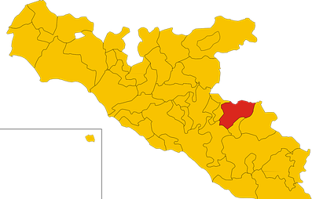
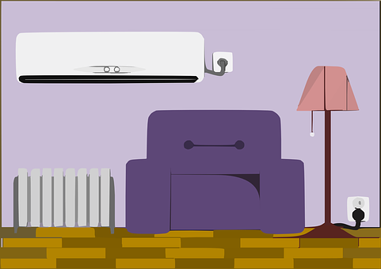
Vocabulario
leer / hablar
el castillo
el patio
[courtyard]
la colina
el baño
[hill]
[baño]
‘Alrededor de’ can be used to describe the location of something.
e.g. Las sillas están alrededor de la mesa.
The chairs are around the table.
‘Sala’ and ‘salón’ both mean ‘living room’. ’Sala’ is also used for larger rooms e.g. a hall or rooms with a specific use e.g. ’sala de espera’ (waiting room).
la región
alive
vivo, viva
[region]
around
alrededor de
la sala
[living room]
Notes:
Vocabulary practice slides (1/2)
Timing: 3 minutes
Aim: to introduce and embed this week’s new vocabulary.
Procedure 1. Pupils either work by themselves or in pairs, reading out the words and recapping their English meaning (1 minute).
2. Then the teacher removes the English words or pictures (one by one) and they try to recall the English orally (chorally), looking at the Spanish (1 minute).
3. Then the Spanish meanings are removed (one by one) and they to recall them orally (again, chorally), looking at the English (1 minute)
4. Further rounds of learning can be facilitated by one pupil turning away from the board, and his/her partner asking him/her the meanings (‘¿Cómo se dice X en español?’). This activity can work from L2 -> L1 or L1 -> L2.
Images (free to use) from Pixabay
Note: ‘vivo’ was introduced in lesson 1 but is included here for additional practice.

Slide 34
Talking about how people feel ESTAR in the present tense
gramática
states
locations
Remember, we use the verb ‘estar’ to talk about ________ and ___________.
estoy
To say ‘I am’ for a state or location, use __________.
Estoy en el castillo.
I am in the castle.
estás
To say ‘you are’ for a state or location, use __________.
Veo que estás asustada en las carreteras.
I see that you are scared on the roads.
está
To say ‘s/he is’ or ‘it is’ for a state or location, use __________.
La tienda de Navidad está cerrada hasta el próximo año.
The Christmas shop is closed until next year.
Notes:
Timing: 1 minute
Aim: to recap ‘estar’ in singular persons in the present tense (estoy, estás, está)
Procedure:
1. Go through the grammar explanation with students, revealing each new sentence on a mouse click.

Slide 35
Talking about how people felt ESTAR in the imperfect tense
gramática
We can also use ‘estar’ for states and locations at a particular time in the past.
estaba
To say ‘I was’, use __________.
Estaba cansada porque el programa terminó a medianoche.
I was tired because the programme finished at midnight.
estabas
To say ‘you were’, use __________.
A pesar de los problemas, ¿estabas satisfecho con tu trabajo?
Despite the problems, were you satisfied with your job/work?
To say ‘s/he was’ or ‘it was’, use ‘estaba’.
Su casa estaba en una colina.
Her house was on a hill.
Note: ‘estaba’ also means ‘I was’!
Notes:
Timing: 1 minute
Aim: to recap the 1st and 2nd person singular forms (estaba and estabas) and introduce the 3rd person singular form (estaba).
Procedure:
Go through the grammar explanation with students, revealing each new sentence on a mouse click.
Note: ‘estar’ can also be translated in the imperfect using ‘used to’. In week 9.3.1.1. we will introduce this.

Slide 36
Talking about places and locations Using ‘del’ and ‘de la’ with adverbs
gramática
Remember, you can give locations in Spanish by using adverbs like ‘cerca’.
You often use ‘de’ after these adverbs to refer to a person, place or thing.
Your husband is outside the room.
Tu marido está fuera de la sala.
del
To refer to a singular masculine noun (e.g. el castillo), change de + el to _____.
My flat is behind the castle.
Mi piso está detrás del castillo.
To refer to a singular feminine noun (e.g. la carretera), use ‘de la’.
Your house is far from the road.
That’s why I like it.
Tu casa está lejos de la carretera.
Por eso me gusta.
Notes:
Timing: 1 minute
Aim: to recap the rules on ‘del’ vs ‘de la’. These features were introduced in Year 7.
Procedure:
Go through the grammar explanation with students, revealing each new sentence on a mouse click.
Note: another example using revisited language could be ‘La estrella está encima del árbol de Navidad’.

Slide 37
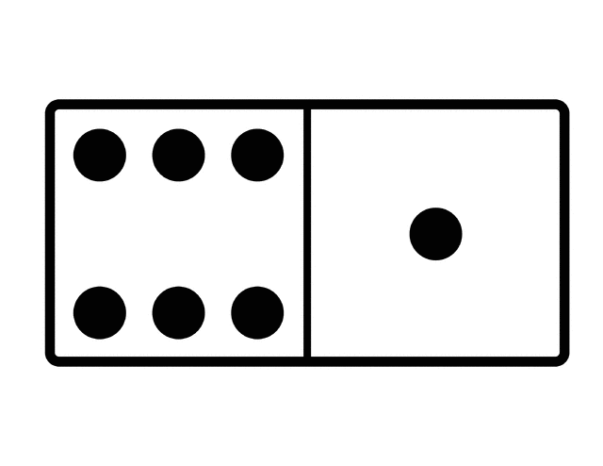
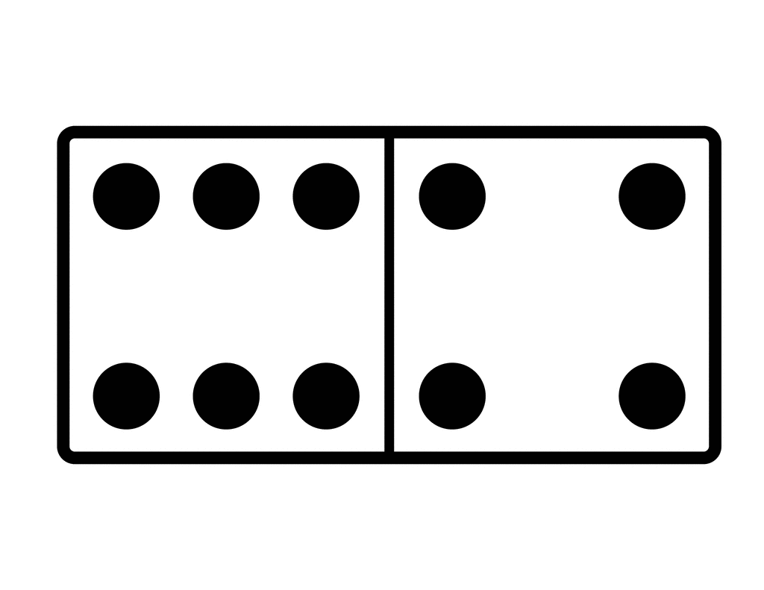
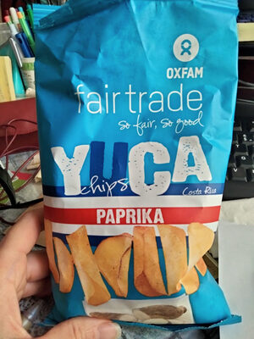
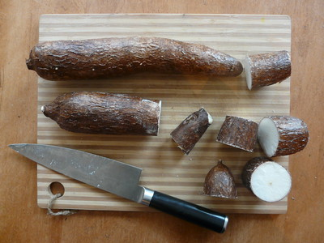
El abuelo busca varias cosas. María de los Ángeles le dice dónde está cada cosa o dónde estaba en el pasado. Lee las frases y elige ‘ahora’ o ‘antes’. También elige ‘A’ o ‘B’. A veces ambas opciones (A y B) son correctas.
leer
 | ahora | antes | A | B
1. El libro está dentro del… |  |  | habitación | baño
2. La yuca* estaba detrás de la… en la cocina. |  |  | carne | fruta
3. Tu guitarra está debajo de la… en el patio. |  |  | mesa | silla
4. La caja de dominó está encima de la… |  |  | periódico | televisión
5. Todo el arte estaba alrededor de la... |  |  | cocina | baño
6. Tu camiseta con la estrella estaba al lado del… |  |  | espejo | ordenador
*Yuca is a root vegetable eaten in some parts of Latin America. It can be boiled or fried to make chips or crisps.
Notes:
Timing: 6 minutes
Aim:
i) to practise understanding ‘está’ and ‘estaba’ (3rd person singular only)
ii) to practise connecting ‘del’ and ‘de la’ to nouns of the correct gender
Procedure:
Students read the phrase and decide whether it refers to where the object is now (ahora) or before (antes) depending on if they see ‘está’ or ‘estaba’ in the phrase.
Students then decide which word completes the sentences by identifying the word with the correct gender to follow ‘del’ or ‘de la’. Some questions will have two correct responses.
Click to reveal the answers.
Frequency of unknown vocabulary and cognates:
dominó [>5000]; yuca [>5000}
Notes:
Yuca crisps picture is is licensed under the Creative Commons Attribution-Share Alike 3.0 Unported license. (Original Image)
Yuca vegetable picture by EBarney is licensed under Attribution-NonCommercial 2.0 Generic (CC BY-NC 2.0)
https://www.flickr.com/photos/ebarney/3559792794/in/photostream/

Slide 38
Jorge Jesús también ayuda al abuelo a buscar todo. Escucha las frases y completa la tabla.
escuchar
ahora | antes | A | B
 |  | cama | baño
 |  | sala | coche
 |  | televisión | patio
 |  | espejo | cama
 |  | puerta | país
 |  | mesa | jardín
1
1
2
2
3
3
4
4
5
5
6
6
Notes:
Timing: 8 minutes
Aim:
i) to practise differentiating between ‘está’ and ‘estaba’ (3rd person singular only)
ii) to practise connecting ‘del’ and ‘de la’ to nouns of the correct gender
Procedure:
Click the orange audio button. Students listen to each phrase and decide whether it refers to where the object is now (ahora) or before (antes) depending on if they hear ‘está’ or ‘estaba’ in the phrase.
Students listen again and decide which word completes the sentences by identifying the word with the correct gender to follow ‘del’ or ‘de la’. In some cases, both A and B are correct.
Click to reveal the answers. To support feedback, the full sentence is also provided (click the beige audio buttons).
Transcript (orange buttons):
El libro estaba encima de la...
Abuela está dentro de la…
La pelota estaba al lado del…
Tu bolsa estaba delante del…
La mujer de Señor Pérez está fuera de la…
La gente estaba alrededor de la …
Transcript (beige buttons):
El libro estaba encima de la cama.
Abuela está dentro de la sala.
La pelota estaba al lado del patio.
Tu bolsa estaba delante del espejo.
La mujer de Señor Pérez está fuera de la puerta.
La gente estaba alrededor de la mesa.

Slide 39
Giving information about something Using the relative pronoun ‘que’
gramática
In English, we often give extra information about someone or something by using the words ‘who’ or ‘that’ in a sentence.
1. Carlos is the student who / that lives on the hill.
2. Florida is a state that has a big Cuban population.
These words are called relative pronouns. In English, ‘who/that’ is used for people and ‘which/that’ can refer to animals and things.
In Spanish, you can use the word ‘que’ to mean both ‘who’ and ‘that’.
1. Carlos es el estudiante que vive en la colina.
2. Florida es un estado que tiene una gran población cubana.
Remember, ‘que’ also has the meaning _______ when used for comparisons.
than
Notes:
Timing: 2 minutes
Aim: to introduce the relative pronoun ‘que’ with its function and meanings.
Procedure:
Go through the grammar explanation with students, revealing each new sentence on a mouse click.
Notes:
1. Although there is not space on the slide to highlight this, it worth also highlighting that ‘qué’ (with accent) has a different meaning (‘what?’).
2. In this lesson, we are only focusing on subject relative pronouns (rather than object relative pronouns, as in ‘Volver es la película que vi’).

Slide 40
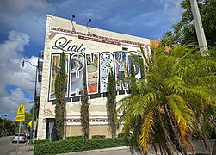
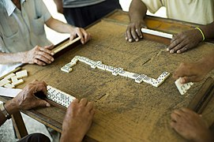
Pequeña Habana es un barrio de Miami, Estados Unidos, que tiene una gran población cubana. Lee las frases sobre personas y lugares allí. ¿Qué significa ‘que’?
leer
*mayor = older, elderly
*el muro = wall
*secundario = secondary
1. Jorge Jesús es un chico que vive en Pequeña Habana. Le gusta el barrio por su arte y cultura.
 | who / that | that / which
1
2
3
4
5
6
2. Café Cubano es un café que prepara comida muy rica de diferentes regiones de Cuba.
3. ”Los veteranos” son cubanos mayores* que juegan al dominó en el parque.
un muro* del barrio
Dominoes is played all over the world, but in Cuba it is almost a national sport. It is played both socially and competitively.
4. En los edificios hay imágenes que muestran artistas cubanos famosos.
5. Hay tiendas que venden camisas tradicionales.
6. Casi todos los estudiantes que asisten a la escuela secundaria tienen raíces latinoamericanas.
un juego de dominó
Notes:
Timing: 6 minutes
Aim: to practise differentiating between the different meanings of ‘que’ in subject relative clauses.
Procedure:
If necessary, explain to students before starting that ‘who / that’ will only refer to people (‘solo es para personas’) and that ‘that’ may refer to things or places (‘puede ser para cosas, lugares etc.’).
Read the speech bubbles (1-6) and work out whether ‘que’ refers to people (meaning who/that) or places (meaning ‘that’).
Click to reveal the answers.
Note: it may be of interest to explain to students that ‘pared’ (the word they already know for ‘wall’) is used more for a wall within a house. When referring to an outdoor wall, particularly of a larger size, ‘muro’ is the appropriate word.
‘Latinoamericana’ is not glossed as it has been extensively used in NCELP resources to date.
Frequency of unknown vocabulary and cognates:
dominó [>5000]; secundario [>5000]; latinoamericano [2184]; mayor [154]; muro [1874]
Images free to use from Pixabay

Slide 41
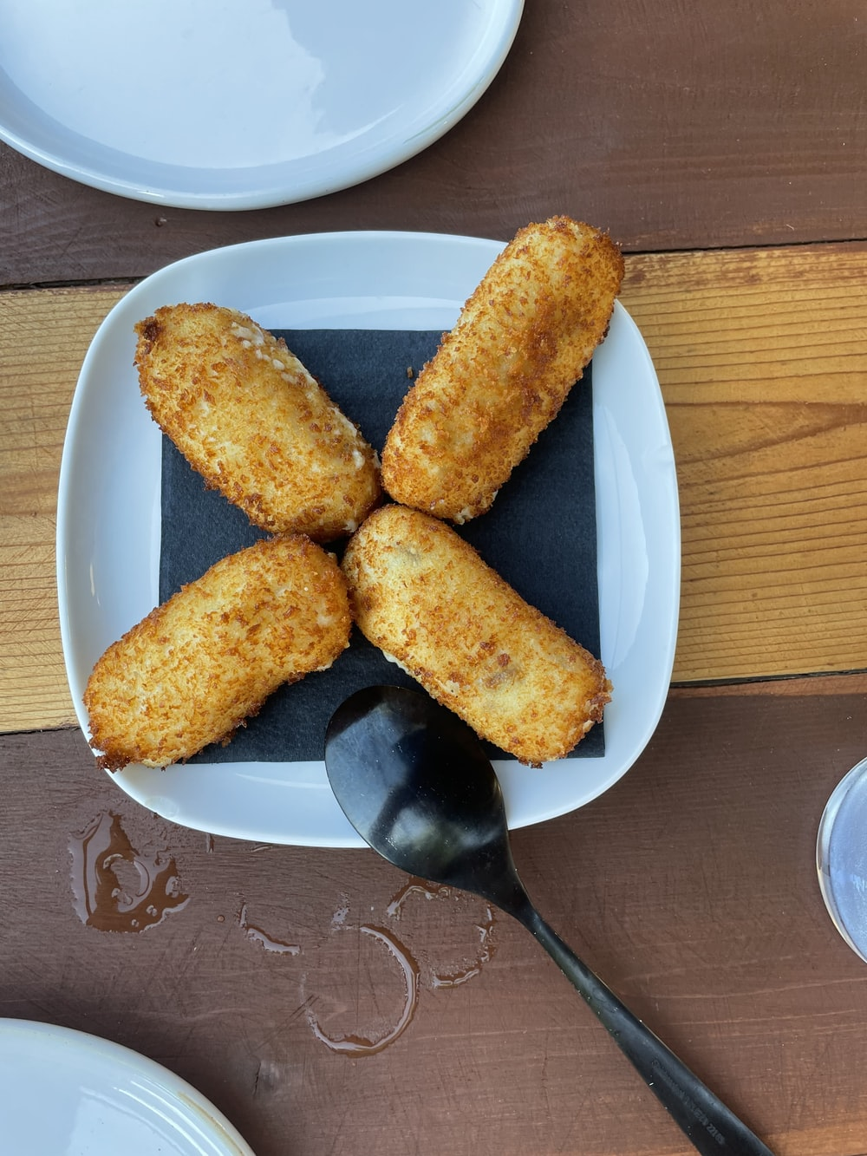
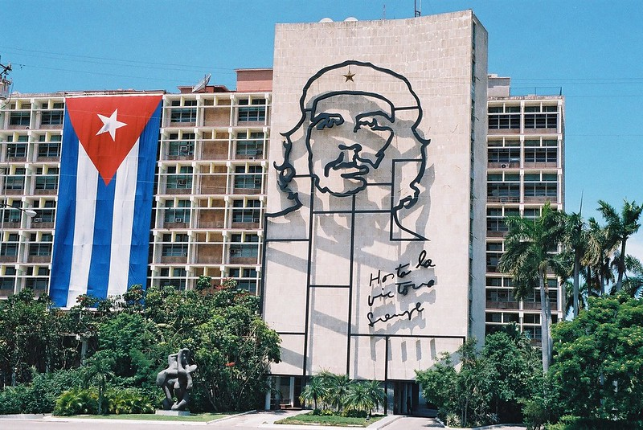
Un diálogo
*el puerto = port
*el ron = rum
*el puro = cigar
cultura
Vamos a escuchar y leer un diálogo. Las personas mencionan comida y lugares de la capital de Cuba, La Habana. Lee las descripciones.
La Habana es un puerto* grande en la costa de Cuba. La ciudad está en unas colinas y también hay un bosque pequeño cerca del centro. Es famoso por sus edificios y coches antiguos, el café, el ron* y los puros*.
Croquetas
La Plaza de la Revolución
This is a type of fried roll filled with ham, cheese, potatoes or other fillings. It is coated in breadcrumbs before being fried. It is popular in many Spanish-speaking countries.
This is one of the largest squares in the world. There is a mural dedicated to Ché Guevara, a key leader in the 1953 Cuban revolution.
Notes:
Timing: 2 minutes
Aim: to familiarise students with cultural references made in the conversation on the next slide
Procedure: click to reveal each description from left to right.
Images from Unsplash, Flickr and Wikimedia are free to use
https://unsplash.com/photos/8XDvZ_VTtjw
https://www.flickr.com/photos/jadis1958/4932111682
https://commons.wikimedia.org/wiki/File:Bosque_de_La_Habana_09.jpg
Note: in Spain, the word ‘cigarro’ is sometimes used to refer to ‘cigarettes’ (along with the word ‘cigarillo’). Cigars in Cuba may also be referred to either as ‘puros’ or ‘habanos’.
Frequency of unknown vocabulary and cognates:
puerto [1077]; ron [>5000]; puro [>5000]

Slide 42
La abuela en Miami está hablando con su hermana en La Habana. Lee y escucha. ¿Cómo puedes cambiar la conversación?
*el dólar = dollar;
*cumplir 80 años = to turn 80
¡Hola, Isabel! ¿Cómo estás?
Un poco cansada. Esta tarde
fui de compras en un mercado
cerca de la Plaza de la Revolución.
Abuela
Ah..¿Fuiste al café que vende comida tradicional? A
¡Por supuesto! Sabes, la vida en Miami es mejor que aquí, pero la comida es menos rica. I
Isabel
Tienes razón. ¿Estaba allí el señor que hace las croquetas? A
1
¡Sí, son tan ricas! Después caminé por el bosque y vi a una persona que te conoce. I
¿Quién? Nací y viví allí, pero ahora itú eres la única persona que me conoce en La Habana! A
2
3
¡No, no es verdad! ¿Te acuerdas de Gloria, la chica que estaba en tu clase en el colegio? I
4
Sí, claro. Su casa estaba cerca de un castillo que me encanta… A
Ah, ¡el Castillo del Morro! Sí, es muy bonito. El próximo mes Gloria va a cumplir ochenta años. ¿Tú y tu marido queréis ir a la fiesta? I
5
No sé. Mis amigos que fueron a Cuba en abril pagaron cuatrocientos dólares* por ambos billetes. A
6
7
Ay, qué caro. I
Notes:
Timing: 8 minutes
Aims:
to help students to connect the spoken and written forms of the language more securely.
to consolidate vocabulary and grammar knowledge by eliciting suggested changes to the text.
Procedure:
Click on the audio button to play the text. Read and listen.
Note: There is a full version of the audio top right with a player. Alternatively, the audio is in 7sections with a pause just after the words 2-7 in bold in the transcript below, to facilitate easy stop/start.
To support segmentation, stop the audio and ask students to say: a) the next word b) the previous word
In addition, to develop understanding, vocabulary and grammar knowledge, pause at key points and ask students to suggest an alternative word that could replace the next word. This is a chance to draw on previously taught grammar and vocabulary knowledge.
Notes:
1. Students won’t previously have seen ‘fueron’. However, they should be able to understand it, having learnt ‘fue’ and the similarly spelt ‘-ieron’ ending.
2. ‘Que me encanta’ is likely to be more difficult to process given that the English translation is not literal (‘that I love’).
3. The expression ‘qué caro’ uses ‘qué’ in an unfamiliar sense (‘how expensive!’). It would be helpful to draw students’ attention to this.
Transcript:
(1) ¡Hola, Isabel! ¿Cómo estás? Un poco cansada. Esta tarde fui de compras en un mercado cerca de la Plaza de la Revolución. Ah..¿Fuiste al café (2) que vende comida tradicional? ¡Por supuesto! Sabes, la vida en Miami es mejor que aquí, pero la comida es menos rica. Tienes razón. ¿Estaba allí el señor que (3) hace las croquetas ? ¡Sí, son tan ricas! Después caminé por el bosque y vi a una persona que (4) te conoce. ¿Quién? Nací y viví allí, pero ahora tú eres la única persona que me conoce en La Habana. ¡No, no es verdad! ¿Te acuerdas de Gloria, la chica que (5) estaba en tu clase en el colegio? Sí, claro. Su casa estaba cerca de un castillo que (6) me encanta… iAh, el Castillo del Morro! El próximo mes Gloria va a cumplir ochenta años. Tu y tu marido queréis ir a la fiesta? No sé. Mis amigos que (7) fueron a Cuba en abril pagaron cuatrocientos dólares por ambos billetes. Ay, qué caro.
Suggestions for posible changes:
2) adjectives (grande, bonito, nuevo); adverbs of position (cerca, lejos, al lado, delante del/dela…); relative pronoun ‘que’, e.g., que está… (en el centro, en la playa), que vende/prepara (croquetas, churros)
3) que hace… (buen café, churros)
4) que es… (muy famoso en Cuba), que estaba (contento, alegre, bailando, tocando la guitarra) – NB imperfect continuous not yet taught, but students do know –ando and –iendo forms with estar)
5) que estaba… (en el centro, en el bosque, en + otro lugar)
6) que me gusta, que me interesa
7) que visitaron Cuba, volvieron de Cuba ayer.
Frequency of unknown vocabulary and cognates:
dólar [677]

Slide 43
iAhora escribe tus propias frases! Usa un verbo en tercera persona singular (e.g. es, tiene, habla).
iPuedes usar tu imaginación!
escribir
1. Jorge Jesús is a boy who…
(Jorge Jesús es un chico que…)
2. Cuba is a country that…
(Cuba es un país que…)
3. The granny is a person who…
(La abuela es una persona que…)
4. Little Havana is a neighbourhood that…
(Pequeña Habana es un barrio que…)
5. In Little Havana there are people who…
(En Pequeña Habana hay gente que…)
6. In Havana there is a café that…
(En La Habana hay un café que…)
Notes:
Timing: 8 minutes
Aims:
to produce sentences with subject relative clauses and the pronoun ‘que’.
to give students the opportunity to write with some freedom, creating their own meanings.
Procedure:
Students translate the sentence starters and then complete the phrase using a verb in the third person according to whether the ‘que’ refers to a person or not.
Click to reveal the translations for the sentence starters.
Notes:
Students could also be challenged to write their own sentences without the sentence starters above.

Slide 44
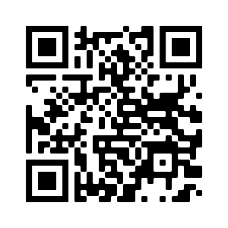
Deberes
Vocabulary Learning Homework (Y9, Term 2.2, Week 3)
Audio file
Audio file QR code:
Student worksheet
Quizlet link
In addition, revisit:
Year 9, Term 2.1, Week 5
Year 9, Term 2.1, Week 2

