Slide 1
Describing people
Plural forms of être; regular plural forms of adjectives
Y7 French - Term 2.1 - Week 2 - Lesson 31
Stephen Owen / Emma Marsden
Date updated: 10/01/20
Notes:
Learning outcomes
SSC /e/
This week the first, second and third person plural forms of ‘être’ are introduced (the singular forms were introduced in Term 1.1, Weeks 1 & 2). Regular plural marking on adjectives is also introduced, following the introduction of regular plural noun forms the previous week.
Frequency rankings of vocabulary introduced this week (1 is the most common word in French):
2.1.2 - frère [1043], sœur [1558], parent [546], ouvert [897], prudent [1529], strict [1859], jeune [152]
N.B. This new vocabulary is not presented until the second lesson, owing to the amount of grammar covered in the first lesson. This lesson’s grammar is presented using previously-encountered vocabulary, which serves to reduce the cognitive load and is a useful way of revising this vocabulary.
Frequency rankings of vocabulary revisited this week (1 is the most common word in French):
1.2.6 - jouer [219], manger [1338], écouter [429], chanter [1820], étudier [960], ils, elles, fruit [896], radio [1526], histoire [263]
1.2.1 - ciel [1538], comme [32], couleur [1211], rêve [1313], sable [3263], vague [1493], bleu [1216], jaune [2585], rouge [987], vert [1060], violet [>5000]
Source: Londsale, D., & Le Bras, Y. (2009). A Frequency Dictionary of French: Core vocabulary for learners London: Routledge.
Teachers should conduct a spot check of the revisited vocabulary each week, to ensure that the required independent learning has been done. This could be in the form of an informal, oral ‘test’, and/or a more formal (but quick) written vocabulary test. Aim to test knowledge of all types: comprehension (L2-L1), production (L1-L2), oral (listening and speaking) and written (reading and writing) modalities.

Slide 2
Vocabulaire – révisions 1
lire / parler
Vocabulario
60
 | français | anglais
1
2
3
4
5
6
7
8
9
10
jouer
to play, playing
manger
to eat, eating
écouter
to listen, listening
Secondes
chanter
to sing, singing
étudier
to study, studying
ils
they (mpl)
elles
they (fpl)
fruit
fruit
0
radio
radio
histoire
history
DÉBUT
Notes:
This slide facilitates a quick check of students’ knowledge of the first set of previous vocabulary revised this week (as shown below).
First, the French words appear, without the English – students should be challenged to give the meaning of each item. The English then appears to confirm the meanings.
Then the French disappears, leaving just the English – students should then be challenged to provide the French for each item. Finally, the French reappears, alongside the English.
Before you begin, check the pronunciation of ‘ils’ and ‘elles’ and ensure that the students understand the SFC (silent final consonant).
Frequency rankings (1 is the most common word in French):
1.2.6 - jouer [219], manger [1338], écouter [429], chanter [1820], étudier [960], ils, elles, fruit [896], radio [1526], histoire [263]
Source: Londsale, D., & Le Bras, Y. (2009). A Frequency Dictionary of French: Core vocabulary for learners London: Routledge.

Slide 3
Vocabulaire – révisions 2
lire / parler
Vocabulario
60
 | français | anglais
1
2
3
4
5
6
7
8
9
10
11
ciel
sky
comme
like, as
couleur
colour
rêve
dream
Secondes
sable
sand
vague
wave
bleu
blue
jaune
yellow
rouge
red
0
vert
green
DÉBUT
violet
purple
Notes:
This slide facilitates a quick check of students’ knowledge of the second set of previous vocabulary revised this week (as shown below).
First, the French words appear, without the English – students should be challenged to give the meaning of each item. The English then appears to confirm the meanings.
Then the French disappears, leaving just the English – students should then be challenged to provide the French for each item. Finally, the French reappears, alongside the English.
Frequency rankings (1 is the most common word in French):
1.2.1 - ciel [1538], comme [32], couleur [1211], rêve [1313], sable [3263], vague [1493], bleu [1216], jaune [2585], rouge [987], vert [1060], violet [>5000]
Source: Londsale, D., & Le Bras, Y. (2009). A Frequency Dictionary of French: Core vocabulary for learners London: Routledge.

Slide 4
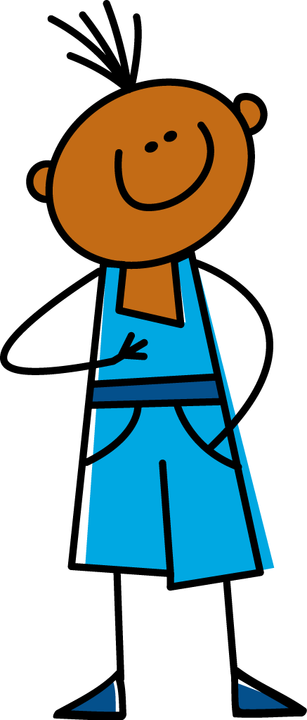
e
je
Notes:
The SSC for this week’s phonics revision is ‘e’.
Introduce and elicit the pronunciation of the individual SSC ‘e’ and then present and practise the pronunciation of the source word ‘je’. A possible gesture for this source word would be to point to oneself.

Slide 5
e
je
Notes:
The same slide, but without the picture, to focus students’ attention on the SSC.

Slide 6
e
je
Notes:
The slide without audio this time, to enable students to pronounce the SSC unaided.

Slide 7
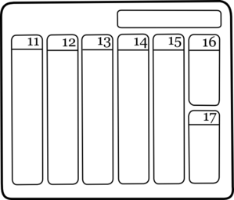
e
samedi
cela
[that]
je
second
cheval
devoir
[to have to]
Notes:
Introduce and elicit the pronunciation of the individual SSC ‘e’ and then the source word ‘je’ again (with gesture, if using). Then present and elicit the pronunciation of the five cluster words. The cluster words have been chosen for their high frequency, from a range of word classes, with the SSC positioned within a variety of syllables within the words (e.g. initial, 2nd, etc.) and, additionally, we have tried to use words that build cumulatively on previously taught SSCs (see the Phonics Teaching Sequence document) and do not include new SSCs. Where new SSCs are used, they are often consonants which have a similar symbol-sound correspondence in English. NB: reinforce the SFC with ‘second’ – i.e. silent ‘d’.
Word frequency rankings (1 is the most common word in French): samedi [1355]; cela [54] second [379]; devoir [39]; cheval [2220]; je [22]. Source: Londsale, D., & Le Bras, Y. (2009). A Frequency Dictionary of French: Core vocabulary for learners London: Routledge.

Slide 8
e
samedi
cela
je
second
cheval
devoir
Notes:
The slide without the pictures this time, to enable students to focus on the SSC alone.

Slide 9
e
samedi
cela
je
second
cheval
devoir
Notes:
The slide without audio this time, to enable students to pronounce the SSC unaided.

Slide 10
Introducing “we are”
grammaire
Remember the 1st, 2nd and 3rd person singular forms of the verb être (to be):
Je suis français.
I am French.
Remember, the last letter of all these verb forms is a
Silent Final Consonant!
Remember, the last letter of all these verb forms is a
Silent Final Consonant!
Tu es français.
You are French.
Il est petit.
He is small.
Remember, the feminine form of the adjective ends in -e!
Elle est petite.
She is small.
To say ‘we’ + être (first person plural):
Nous sommes contents.
We are happy.
Author names: Stephen Owen / Emma Marsden
Author names: Stephen Owen / Emma Marsden
Notes:
This slide revises the parts of ‘être’ already met, then introduces the second person plural (nous).
Students have met the ‘nous’ form ending in –ons previously, so the irregularity of this one needs to be pointed out.
Read this out to students, so that they know exactly how to pronounce the French.
At the end, remind them to not sound out the ‘s’ at the end of ‘suis’, ‘es’ and ‘sommes’, and the ‘t’ at the end of ‘est’.
N.B. The new vocabulary set is not presented this lesson, owing to the amount of grammar introduced (however, revision of the specified previous weeks’ vocabulary has been assumed, as explained on the title slide of this presentation, and recapped on the two slides which follow it). The new vocabulary set will be presented and practised next lesson. This lesson therefore recycles previously-learnt vocabulary.

Slide 11
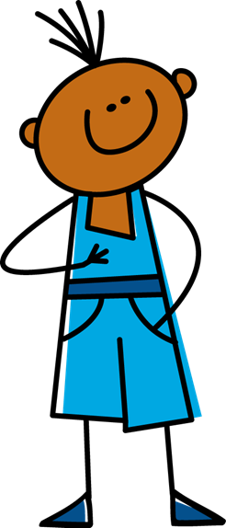
Je ou nous ?
󠇯
écouter
1
Notes:
This series of slides provides input practice (listening) in distinguishing between the first person singular and first person plural forms of ‘être’.
Students should note
whether ‘je’ or ‘nous’ would have been the first word of each sentence;
they then write the English meaning of the adjective used in each sentence (to force vocabulary recall).
Click the button to play the audio. The slide sequence is then repeated, the answers appearing upon clicking the mouse.
Transcript
...... sommes français.

Slide 12
Je ou nous ?
󠇯
écouter
2
Notes:
Transcript
...... suis malade.

Slide 13
Je ou nous ?
󠇯
écouter
3
Notes:
Transcript
...... suis content.

Slide 14
Je ou nous ?
󠇯
écouter
4
Notes:
Transcript
...... sommes grands.

Slide 15
Je ou nous ?
󠇯
écouter
5
Notes:
Transcript
...... suis petit.

Slide 16
Je ou nous ?
󠇯
écouter
6
Notes:
Transcript
...... sommes anglais.

Slide 17
Je ou nous ?
󠇯
écouter
7
Notes:
Transcript
...... suis calme.

Slide 18
Je ou nous ?
󠇯
écouter
8
Notes:
Transcript
...... sommes drôles.

Slide 19
Je ou nous ?
󠇯
écouter
1
français - French
Notes:
This series of slides provides the answers. These could be used instead of the previous slides, if the teacher wants to give / check the answer after each item.
Also, elicit the meaning of the adjectives from the pupils to check understanding.
Click the button to play the audio again, if desired.
Transcript
...... sommes français.

Slide 20
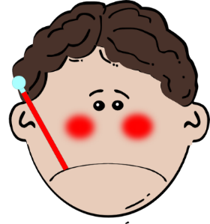
Je ou nous ?
󠇯
écouter
2
malade - ill
Notes:
Transcript
...... suis malade.

Slide 21
Je ou nous ?
󠇯
écouter
3
content - happy
Notes:
Transcript
...... suis content.

Slide 22
Je ou nous ?
󠇯
écouter
4
grands - tall
Notes:
Transcript
...... sommes grands.

Slide 23
Je ou nous ?
󠇯
écouter
5
petit - small
Notes:
Transcript
...... suis petit.

Slide 24
Je ou nous ?
󠇯
écouter
6
anglais - English
Notes:
Transcript
...... sommes anglais.

Slide 25
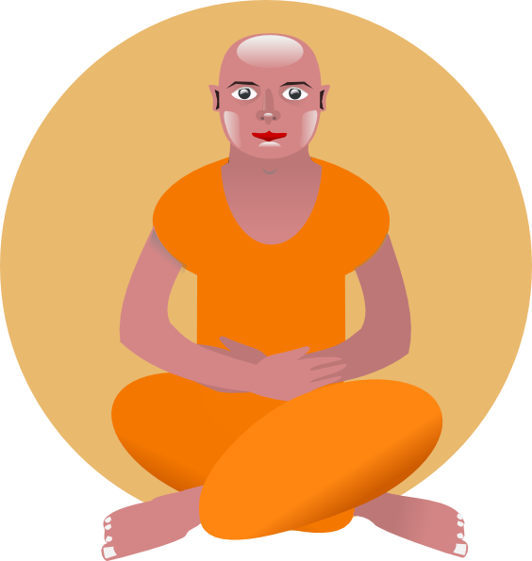
Je ou nous ?
󠇯
écouter
7
calme - calm
Notes:
Transcript
...... suis calme.

Slide 26
Je ou nous ?
󠇯
écouter
8
drôles - funny
Notes:
Teachers should ask students here whether they notice anything about the adjective in the French, thereby eliciting noticing of the –s on the plural form. This grammar point is dealt with explicitly on the slides which follow.
Transcript
...... sommes drôles.

Slide 27
grammaire
Describing more than one thing
Same as English!
Nouns make their plural with –s:
il y a un livre
there is a book
s
il y a deux livre
there are two book
Different
from English!
s
Adjectives also have to match their noun, adding –s for plural:
there are some expensive book
s
s
il y a des livre cher
s
This is called adjective agreement (like the –e on the feminine form you already know).
The –s is not pronounced – it is a silent final consonant (SFC).
Notes:
This slide presents regular plural adjective agreement, pointing out that the adjective ‘matches’ the noun in taking the –s. The phrase ‘il y a’, introduced and practised the previous week, is revisited here. Plural nouns have also already been taught.
Also point out to students that the –s on the written form of a plural French noun/adjective is not usually pronounced (i.e. is a silent final consonant).
N.B. We have not covered liaison at this stage.

Slide 28
Describing more than one: We are…
grammaire
“Nous” (we) is a plural pronoun – it refers to more than one person.
Remember: There must be agreement between the adjective and noun!
So, adjectives describing “nous” need to be in a plural form:
Nous sommes contents.
We are happy.
Don’t forget! The –s on the end of ‘sommes’ and the adjective are Silent Final Consonants.
Notes:
This slide points out that the adjective must agree with the plural pronoun as well as with the noun, as in the example on the previous slide.
N.B. The masculine plural form of the adjective having been introduced, the feminine plural is withheld for now, so that students may concentrate upon the new verb form (vous) to be introduced shortly, and also to avoid overcomplicating the treatment of the adjective (which would be a possibility, if we were to introduce all information at once). The feminine plural form of the adjective is dealt with as part of the next lesson.
Read this out to students so that they know exactly how to pronounce the French.
Remind them to not sound out the ‘s’ at the end of ‘sommes’, as well as that on the end of the adjectives.

Slide 29
C’est qui ? Nous ou je? Écris les adjectifs en anglais.
lire
 |  | nous (we) | je (I)
1 | ... ... aimable.
2 | ... ... amusants.
3 | ... ... intelligents.
4 | ... ... grand.
5 | ... ... petits.
6 | ... ... calme.
7 | ... ... intéressant.
8 | ... ... contents.
pleasant, kind, nice
amusing, entertaining
intelligent
big, tall
small, little
calm
interesting
pleased, happy
Notes:
This reading activity asks students to spot when the first person plural form of the verb must have been used, by noticing the plural adjective agreement. The subject pronoun and verb is missing from each sentence, to force attention upon this aspect of the grammar. It is worth explaining that this can only be done in reading, because the agreements are silent.
Students should also be asked to write the meanings of the adjectives in English.

Slide 30
“you (plural) are”: the verb être (to be)
grammaire
Earlier we learned:
s
Nous sommes content .
We are happy.
Here is the second person plural of être: you to more than one person:
Vous êtes content .
s
You(more than one) are happy.
Plural “YOU” (vous) also needs a plural adjective.
“êtes” does not end in –ez. This is different to the other ‘vous’ forms of verbs you have learned. This is because être – to be is an irregular verb.
Notes:
Having introduced and practised recognising the ‘nous’ form, the ‘vous’ form (plural) of ‘être’ is now introduced.
Students have met the ‘vous’ form ending in –ez previously, so the irregularity of être needs to be pointed out. You could explain that ‘to be’ in English is also very irregular: I am, You are, She is, We are… This helps learners develop cross-linguistic awareness.
Note we are introducing ‘vous’ as a polite form of ‘you’ in later lessons.
N.B. The feminine plural of adjectives is withheld for now, so that students may concentrate upon the new verb form (vous), and also to avoid overcomplicating the treatment of the adjective. The feminine plural form of the adjective is dealt with as part of the next lesson.

Slide 31
écouter
C’est qui ? Vous ou nous ?
Cochez.
vous (you) | nous (we)
1
2
3
4
5
6
7
8
Notes:
This slide provides input (listening) practice in distinguishing between the newly-introduced ‘nous’ and ‘vous’ forms of ‘être’. It is an easier version of the task found on the next slide, which also requires some translation of vocabulary – please use the version appropriate for your students, or alternatively do this as a two-stage exercise.
N.B. While the students have not officially learned ‘cochez', the picture of the tick should help them to understand this instruction. The teacher can ask the pupils why the verb ‘cochez’ has –ez at the end.
Transcript
...... sommes calmes.
...... êtes contents.
...... êtes petits.
...... sommes grands.
...... êtes aimables.
...... sommes méchants.
...... êtes amusants.
...... êtes intéressants.

Slide 32
écouter
Vous ou nous ?
Écris le mot en anglais.
vous (you plural) | nous (we)
1
calm
2
happy
3
small
4
tall
5
pleasant, nice
6
naughty
7
amusing, fun
8
interesting
Notes:
This slide provides input (listening) practice in distinguishing between the newly-introduced ‘nous’ and ‘vous’ forms of ‘être’. In asking students to write the English for the adjectives, which have all been introduced and practised in previous weeks, it also provides an opportunity for vocabulary revision. This also raises the level of challenge of the task.
N.B. While the students have not officially learned 'mot', they have met it as a phonics cluster word in 1.1.1 and 1.2.5.
Transcript
...... sommes calmes.
...... êtes contents.
...... êtes petits.
...... sommes grands.
...... êtes aimables.
...... sommes méchants.
...... êtes amusants.
...... êtes intéressants.

Slide 33
Nous ou vous ?
parler
Partners A and B
Choose 3 adjectives. Write a sentence for each, to describe yourself and your friends (“we”). Then choose 3 different adjectives and write a sentence for each, to describe your partner and his/her friends (“you”). Partner A: Say these six sentences to your partner, in any order. Partner B: Write ‘we’ or ‘you(plural) and the English adjective for each sentence, 1-6. Then swap roles.
happy
naughty
small
tall
pleasant
calm
amusing
interesting
Notes:
This slide provides speaking practice in distinguishing between the newly-introduced ‘nous’ and ‘vous’ forms of ‘être’. It also provides an opportunity for vocabulary revision.

Slide 34
Écris en français
Translate each sentence below into French. Think about the adjective agreement!
écrire
anglais | français
1) I am calm.
2) You [singular, male] are happy.
3) She is small.
3) He is tall.
4) We are pleasant.
5) You [plural] are naughty.
6) We are amusing.
7) You [plural] are interesting.
Je suis calme.
Tu es content.
Elle est petite.
Il est grand.
Nous sommes aimables.
Vous êtes méchants.
Nous sommes amusants.
Vous êtes intéressants.
Notes:
The answers to this translation task appear upon successive clicks of the mouse.
N.B. Feminine forms (singular and plural) will be featured next lesson. It is unlikely that any pupil will put the feminine 'e' on the plural adjectives here.

Slide 35
Describing people
Plural forms of être; regular plural forms of adjectives
Y7 French - Term 2.1 - Week 2 - Lesson 32
Stephen Owen / Emma Marsden
Date updated: 10/01/20
Notes:
Learning outcomes
SSC /e/
This is the second lesson of this week.
This week the first, second and third person plural forms of ‘être’ are introduced (the singular forms were introduced in Term 1.1, Weeks 1 & 2). Regular feminine plural marking on adjectives is also introduced, following the introduction of regular plural noun forms the previous week.
Frequency rankings of vocabulary introduced this lesson (1 is the most common word in French):
2.1.2 - frère [1043], sœur [1558], parent [546], ouvert [897], prudent [1529], strict [1859], jeune [152]
Frequency rankings of vocabulary revisited this week (1 is the most common word in French):
1.2.6 - jouer [219], manger [1338], écouter [429], chanter [1820], étudier [960], ils, elles, fruit [896], radio [1526], histoire [263]
1.2.1 - ciel [1538], comme [32], couleur [1211], rêve [1313], sable [3263], vague [1493], bleu [1216], jaune [2585], rouge [987], vert [1060], violet [>5000]
Source: Londsale, D., & Le Bras, Y. (2009). A Frequency Dictionary of French: Core vocabulary for learners London: Routledge.
Teachers should conduct a spot check of the revisited vocabulary each week, to ensure that the required independent learning has been done. This could be in the form of an informal, oral ‘test’, and/or a more formal (but quick) written vocabulary test. Aim to test knowledge of all types: comprehension (L2-L1), production (L1-L2), oral (listening and speaking) and written (reading and writing) modalities.

Slide 36
Parlez en francais!
cela
parler
samedi
60
devoir
second
je
petit
cheval
Secondes
demander
dehors
le
0
promenade
DÉBUT
chemise
Notes:
Recap of this week’s (revisited) SSC.
Task:
1. Students spend one minute in pairs, pronouncing the words on the slide, taking it in turns, and making sure all words have been said at least once. 2. Spend another minute in pairs, one partner saying the French and the other trying to recall the English word.
The words have been selected from vocabulary presented in the course (therefore forming useful vocabulary revision), from a range of word classes, with the SSC positioned within a variety of syllables within the words (initial, 2nd, final). The teacher can circulate during this activity to listen into learners’ SSC knowledge.

Slide 37
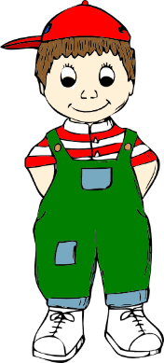
Vocabulary introduction
Vocabulaire
le
frère
la
sœur
Silent Final Consonant
les parents
Notes:
Presentation of the nouns from this week’s new vocabulary set. Depending on the class, the teacher can either model pronunciation and then elicit from the students, or elicit directly from the students.
N.B. This NEW vocabulary was not included last lesson owing to the amount of grammar introduced. However, as usual, the students would have learned this new vocabulary at home before the previous lesson. So, they should already be familiar with it to some extent. Now in this lesson, we practise it a little at the start of the lesson to refresh memories.
(Note, revision of the specified two weeks’ of previously encountered vocabulary WAS assumed in the last lesson and practised at the start of that lesson).
Frequency
frère [1043], sœur [1558], parent [546]

Slide 38
Vocabulaire
écouter / parler
Vocabulaire
Here are some more adjectives to describe people:
Masculine
Feminine
Meaning
ouvert
ouverte
open
strict
stricte
strict
sage
sage
well-behaved
jeune
jeune
young
These already have an ‘e’!
Notes:
Presentation of the adjectives from this week’s new vocabulary set.
This slide can be used in a number of ways:
To reinforce pronunciation changes in a “listen and repeat” whole class style
To check students’ understanding of the vocab
To practise pronunciation changes.
Whole class – the teacher asks individuals to give the correct answer.
or:
Pairwork: when the adjective disappears, ask students to turn to their partner and say the adjective out loud. This could be then be practised a few times, with a competition element added by shortening the time sequence on the animation. Challenge pairs to complete within the new speeded up time.
4) As a help-sheet which can be printed out for reference at any point during the speaking and writing activities for those students who need it. (Duplicate the slide and select print “2 to a page” for A5 size help sheets)
You could point out the irregular ‘strict’ – the final consonant IS pronounced! This is often the case when a word comes from another language – the original pronunciation is sometimes retained.
Point out the ‘e’ at the end of jeune means that no additional ‘e’ is needed for the feminine agreemement.
Frequency
ouvert [897], sage [2643], strict [1859], jeune [152]

Slide 39
Vocabulaire
lire
sage
young
the brother
the parents
les parents
la sœur
strict
open
strict
jeune
well-behaved
the sister
ouvert
le frère
Notes:
Further practice with the new vocabulary; as each English term appears, students say which French term it must ‘fly’ to.
After this has been done with the whole class, the teacher could run the slide again and ask the students to write down the French words before they appear.

Slide 40
Vocabulaire
écrire
strict
strict
the brother
le frère
young
jeune
the sister
la sœur
open
ouvert
the parents
les parents
well-behaved
sage
Notes:
Further written practice of seven new words.
The English word appears on mouse click. Students have to try to write the French translation before it appears on second mouse click. (French words are on three-second long animation).

Slide 41
Vocabulaire
lire / parler
Vocabulario
60
français | anglais
le frère
the brother
la sœur
the sister
les parents
the parents
Secondes
ouvert
open
sage
well-behaved
strict
strict
0
jeune
young
DÉBUT
Notes:
Vocabulary recap slide
Pupils either work by themselves or in pairs, reading out the words and recapping their English meaning (1 minute). Then the French meanings are removed and they to recall them, looking at the English (1 minute). Further rounds of learning can be facilitated by one pupil turning away from the board, and his/her partner asking him/her the meanings. For a greater challenge, students could try to complete both cycles within the minute.
SPEED WRITING. The pupils have a minute (or two, depending on the class) to write all the words in French.

Slide 42
Describing others
grammaire
We have met the third person singular (s/he) form of the verb être (to be):
Il est content.
He is happy.
Remember: the feminine form of the adjective adds –e (agreement):
Elle est contente.
She is happy.
The –e is silent, but it makes you pronounce the ‘t’ before it!
Notes:
This slide reminds students of the third person singular form of ‘être’, which will be juxtaposed with the third person plural form (about to be introduced) over the next few slides. It also reminds them of the ‘e’ feminine adjective agreement (the feminine plural adjective agreement will be introduced on the next slide).
Read this out to students so that they know exactly how to pronounce the French.

Slide 43
Describing others – THEY are
grammaire
The –s on the end of ils and elles is silent!
To talk about about the third person plural form of the verb être (to be), they are:
Ils sont intelligents.
They (masc. pl) are intelligent.
Remember: in French the pronoun ‘they’ is different for masculine and feminine:
Elles sont intelligentes.
They (fem pl) are intelligent.
The –s on the end is silent, but again the –e makes you pronounce the ‘t’!
The feminine form of the adjective has –e and –s
Notes:
There is a lot of information here, but the following activities break it down and practise each part.
The first and second person plural forms of the verb ‘être’ having been presented last lesson, this slide introduces the third person plural form – ‘sont’. This verb form has other features that come with it: the ‘ils’ and ‘elles’ pronouns, and also another type of adjective agreement.
Read out the French, so that the students hear ‘sont’.
Explain ‘masc pl’ and ‘fem pl’ to students – ‘masculine plural’ and ‘feminine plural’ respectively. This will get shortened to mpl and fpl in the next slides and in the Quizlet homeworks.
Read this out to students, so that they know exactly how to pronounce the French.
Remind them to not sound out the ‘s’ at the end of ‘sont’.
N.B. Later, we will cover later the issue that if there is one male in a group, then the ‘ils’ pronoun is used. There is a lot of information here, so we hold this back until later.

Slide 44
C’est qui? Il/elle ou ils/elles?
écouter
 | anglais | il / elle (he / she) | ils / elles (they)
1
(They - fpl) are tall.
2
(He) is happy.
3
(S/he) is well-behaved.
4
(They - mpl) are intelligent.
5
(She) is small.
6
(They - fpl) are happy.
7
(They - mpl) are interesting.
8
(He) is tall.
Notes:
This listening activity now juxtaposes the third person singular with the third person plural, requiring that students listen for the verb form (to determine singular or plural).
To provide an additional challenge and check understanding of vocabulary (a mix of new and old), they are then asked to write the English in the space provided (focusing only on singular or plural, plus the adjective meaning). The answers appear upon successive mouse clicks (gender information in brackets).
Transcript
... sont grandes.
... est content.
... est sage.
... sont intelligents.
... est petite.
... sont contentes.
... sont intéressants.
... est grand.

Slide 45
C’est qui? Il/elle ou ils/elles?
lire
 | anglais | il / elle (he / she) | ils / elles (they)
1
2
3
4
5
6
7
8
...... est petit.
...... est sage.
...... sont contents.
...... sont grandes.
...... est calme.
...... sont drôles.
...... sont anglais.
...... est intelligent.
Notes:
This reading activity juxtaposes the third person singular with the third person plural in a similar way to the previous listening task, requiring that students attend to the verb form to determine singular or plural.

Slide 46
Tick the correct form of the adjective.
lire
 | anglais
1 |  | intelligente | intelligentes
2 |  | contente | contentes
3 |  | drôle | drôles
4 |  | petit | petits
5 |  | sage | sages
6 |  | calme | calmes
7 |  | méchant | méchants
8 |  | amusant | amusants
Elles sont ......
Elle est ......
Il est ......
Ils sont ......
Elles sont ......
Elle est ......
Ils sont ......
Il est ......
Notes:
In this, second reading activity, students are required to attend to the subject pronoun and verb form to determine singular or plural, then select the correct form of the adjective.

Slide 47
C’est qui? il, elle, ils ou elles?. Écris l’anglais.
écouter
 | anglais | il (he) | elle (she) | ils (they – mpl) | elles (they – fpl)
1
(She) is happy.
2
(They – mpl) are intelligent.
3
(He) is happy.
4
(They - fpl) are interesting.
5
(They - mpl) are happy.
6
(He) is open.
7
(She) is tall.
8
(They - fpl) are small.
Notes:
This listening activity now juxtaposes the third person singular forms with the third person plural, requiring that students listen for both the verb form (to determine singular or plural) and the adjective agreement (to determine masculine or feminine).
To provide an additional challenge and check understanding of vocabulary (a mix of new and old, conducive to illustrating adjective agreement), learners are then asked to write the English in the space provided. The answers appear upon successive mouse clicks.
Transcript
... est contente.
... sont intelligents.
... est content.
... sont intéressantes.
... sont contentes.
... est ouvert.
... est grande.
... sont petites.

Slide 48
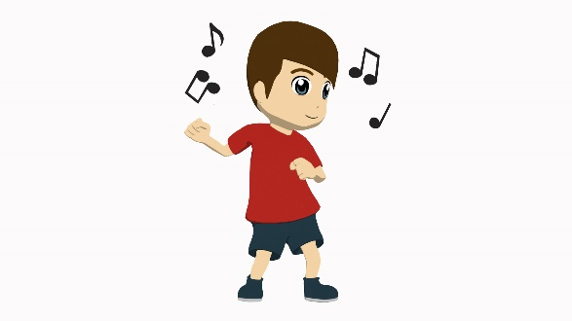
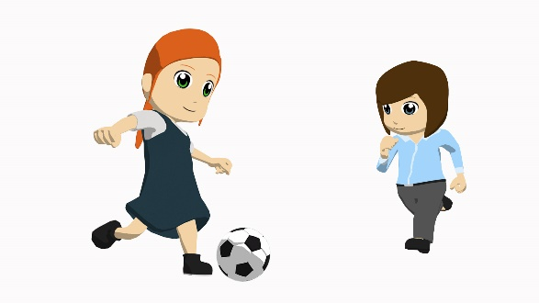
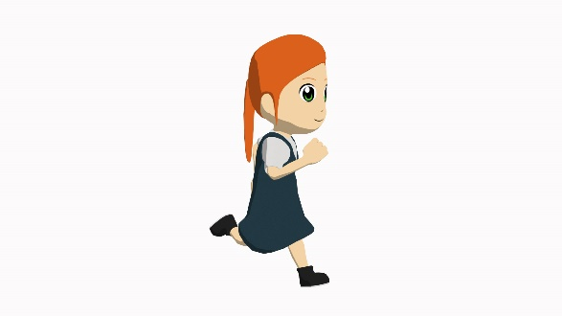
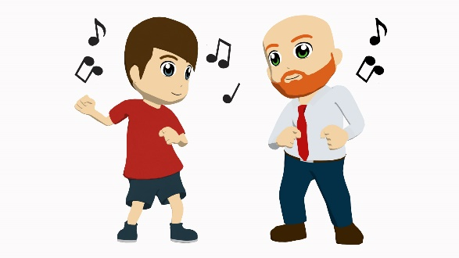
Partenaire A (Task 1):
Exemple
parler
Tell your partner about each person/pair of people pictured below.
Say ‘She is ...’, ‘He is...’, ‘They are...’, plus the adjective given, in French.
happy
XXXX
XXXX
XXXX
XXXX
XXXX
XXXX
XXXX
XXXX
XXXX
XXXX
XXXX
Notes:
Speaking task - example for teachers to model with learners.
On this example slide, only one adjective is given (happy). The rest are shown as XXXX to indicate that there will be three adjectives per person/pair of people, to talk about.
Partner A Teachers can elicit the full sentence from learners ‘il est content’ and then show the next slide, the example slide for Partner B, to model what partner B has to do.

Slide 49
Partenaire B (Task 1): Example
parler
Listen to what your partner tells you about each person/pair of people shown.
Write three adjectives in English on the lines next to their picture.
happy
_____________________
_____________________
_____________________
_____________________
_____________________
_____________________
_____________________
_____________________
_____________________
_____________________
_____________________
_____________________
Notes:
Speaking task - example for teachers to model with learners.
Partner B has to write down the description (adjectives only) in English in the spaces provided on this slide. This tests understanding of the grammar (subject pronoun, verb and adjective agreement where audible) as well as of the (adjective) vocabulary.
Note: Teachers should encourage students NOT to say their three sentences in order; i.e., they should mix up their 12 sentences so that students have to listen out carefully for the pronoun, verb and adjective agreement and understand all in order to know where to write their English adjectives.

Slide 50
TASK 1 Réponses (Partner B)
parler
Tell your partner about each person/pair of people pictured below.
Say ‘She is ...’, ‘He is...’, ‘They are...’, plus the adjective, in French.
naughty
open
intelligent
happy
interesting
pleasant, nice
small
well-behaved
strict
tall
young
amusing, fun
Notes:
Task 1 answers check what Partner B.

Slide 51
Task 2 Réponses (Partner A)
parler
Tell your partner about each person/pair of people pictured below.
Say ‘She is ...’, ‘He is...’, ‘They are...’, plus the adjective, in French.
small
intelligent
strict
naughty
young
open
well-behaved
tall
interesting
happy
amusing, fun
pleasant, nice
Notes:
Task 2 responses check what Partner A wrote.

Slide 52
écrire
Now write three sentences in French about each person/pair of people below.
Don’t forget the adjective agreement if required!
e.g. Elle est grande. Ils sont contents.
small
intelligent
strict
naughty
young
open
well-behaved
tall
interesting
happy
amusing, fun
pleasant, nice
Notes:
Students are now challenged to write complete sentences like the ones they have just produced for the speaking task – they need to select the correct subject pronoun, verb form, adjective (and agree the adjective where necessary), fulfilling the context of this week’s language: describing people.

Slide 53
réponses
Now write three sentences in French about each person/pair of people below.
1. il est petit.
2. il est intelligent.
3. il est jeune.
1. elle est grande.
2. elle est intéressante.
3. elle est amusante.
Notes:
ANSWERS

Slide 54
réponses
Now write three sentences in French about each person/pair of people below.
1. elles sont strictes.
2. elles sont méchantes.
3. elles sont ouvertes.
1. ils sont sages.
2. ils sont contents.
3. ils sont aimables.
Notes:
ANSWERS

Slide 55
écrire
Replace the words in bold below with the correct pronoun
(il / elle / ils / elles) each time.
Il
Il
1) Jean est grand. Jean est intelligent et drôle. Jean regarde la télé.
2) Sarah est jeune. Sarah est calme. Sarah fait une activité.
Elle
Elle
3) Marc et Max sont sages. Marc et Max sont contents.
Marc et Max jouent au tennis.
Ils
Ils
Elles
4) Sophie et Camille sont grandes. Sophie et Camille sont aimables.
Sophie et Camille font les courses.
Elles
Notes:
ADDITIONAL TASK This task might be used for some additional written homework, or saved for revision work (for example, in Week 2.2.1).
Students are now challenged to select the correct pronoun to replace the (proper) noun(s) in the second and third sentences of each example above. The third sentence in each case uses a verb other than ‘être’.
The exercise begins with use of proper nouns. This helps students to understand that two named persons = ‘they’, etc.
The correct answers are animated. The activity continues on the next slide.

Slide 56
écrire
5) Les parents sont stricts. Les parents sont contents.
Les parents écoutent la radio.
Ils
Ils
Elle
Elle
6) La fille est grande. La fille est intelligente. La fille a un frère.
7) Le garçon est petit. Le garçon est calme.
Le garçon fait le ménage.
Il
Il
Notes:
This is the continuation of the activity on the previous slide.
The correct answers are animated.

Slide 57
C’est qui? nous, ils ou elles?
lire
 |  | nous (we) | ils (they - mpl) | elles (they - fpl)
1 | ... sommes contentes.
2 | ... sont intelligentes.
3 | ... sont intéressants.
4 | ... sommes calmes.
5 | ... sommes stricts.
6 | ... sont ouverts.
7 | ... sommes jeunes.
8 | ... sont contentes.
Notes:
ADDITIONAL TASK This task might be used for some additional homework, or saved for revision work (for example, in Week 2.2.1).
Here we bring in the other plural verb form, learnt last lesson – ‘nous sommes.’
This reading activity asks students to distinguish between the first person plural (as recently introduced) and third person plural forms of ‘être’, by noticing the verb form in the first instance and the adjective agreement in the case of the ‘elles’ form. The subject pronoun is missing from each sentence, to force attention upon these aspects of grammar.

Slide 58
Les amis de Louise
lire, écouter et parler
Read the text whilst listening to the recording. Your teacher will ask questions.
Je suis Louise. Je suis française. J’ai six amis. Céline est petite et drôle. Elle est intelligente. Max est grand et aimable. Il est intéressant. Patrick et Louis sont amusants mais méchants. Ils sont jeunes! Sarah et Camille sont sages et calmes. Elles sont contentes.
Notes:
ADDITIONAL TASK This task might be saved for revision work (for example, in Week 2.2.1).
This activity asks students to engage with a slightly longer text, created entirely using vocabulary and grammar already introduced in the scheme of work. It is about the imaginary character of “Louise”. As well as ‘et’, as used in the previous text, ‘mais’ (originally introduced in the second week of the course) is used to express contrast.
This exercise is designed to enable practice in segmenting. Teachers should play the recording (click on the audio icon at the bottom left of the slide to bring up the player) whilst students read the text. The audio should then be paused at an appropriate moment, teachers asking a question such as:
- what is the next word? (testing segmentation skills)
- what could be an alternative for the next word? (testing vocabulary knowledge and understanding of grammar)
- what type of word (e.g. noun, verb, adjective) could come next? (testing knowledge of grammar)
This process can then be repeated several times.
The following subsidiary grammar point arises in this text; it is at the teacher’s discretion whether to point it out briefly, though it should not be allowed to distract from the main learning points of this week’s lesson:
Adjectives normally ending in –e do not take a feminine agreement (this was covered when regular feminine adjective agreement was introduced, in the very first week of the course), but they do take an –s for the plural, e.g. ‘calmes’. You could point out that ‘jeune’ behaves in the same way, as would ‘malade’ and ‘sympathique’ (though not featured here).

Slide 59
Devoirs
Vocabulary Learning Homework (Term 2.1, Week 3)
Audio file: to follow shortly
Audio file QR code: to follow shortly
Student worksheet: to follow shortly
Quizlet link
In addition, revisit: Term 1.2 Week 6
Term 1.2 Week 1
Notes:
It is acknowledged that there has been a lot to cover in this sequence of lessons; teachers may therefore wish to revisit some of the points covered here in the week following this one.

