Slide 1
SOW-based grammar testing for NCELP Y7
Principles, design, creation
NCELP Residential 3
Rowena Kasprowicz / Nicholas Avery / Stephen Owen
Last updated: 02/03/20

Slide 2
Outline
Grammar testing team
Principles of grammar testing
Coverage of grammar (by language)
4. Test creation and example items
5. Scoring

Slide 3
1. Grammar testing team
Test lead: Rowena Kasprowicz
French
Test developers
Stephen Owen
Rowena Kasprowicz
Proofreader
Ivan Avaca
Spanish
Test developers
Nicholas Avery
Rowena Kasprowicz
Proofreader
Amanda Izquierdo
German
Test developers
Stephen Owen
Rowena Kasprowicz
Proofreaders
Inge Alfernik
Natalie Finlayson
With huge thanks to: Giulia Bovolenta, Victoria Hobson, Chloé Motard, Geraldine Bengsch

Slide 4
2. Grammar testing principles
Objective
To test receptive and productive knowledge of grammar studied in Y7 Terms 1.1.1-2.1.6
Considerations
Isolating grammatical knowledge; disassociating from lexical knowledge
Ensuring coverage of the range of grammar features taught (including relevant morphology and syntax)
Receptive knowledge (recognising meaning as well as form)
Productive knowledge (accuracy of production)
Written and oral modalities

Slide 5
3. Coverage of grammar: GERMAN
Grammar feature | Reading | Listening | Writing | Speaking
Present continuous formation Two forms in English vs. one in TL | - | - | 4 items | 6 items
Question formation Subject-verb inversion; do-aux in English vs. TL | 4 items | 4 items
Subject-verb agreement (weak) 1st / 2nd / 3rd singular | 3 items | 3 items
Subject-verb agreement (irregular) haben / sein (1st, 2nd, 3rd sing, 1st pl); mögen (1st, 2nd, 3rd sing) | 3 items | 3 items | 4 items | 4 items
Article agreement Def / indef; gender; number; case (nom/acc) | 4 items | - | 4 items
Plural noun formation -en; umlaut + -e; -e | - | - | 3 items | -
Negation nicht + verb; nicht + adjective | 4 items | - | - | -
Subject and object pronoun agreement Gender; number; case (nom/acc) | 4 items | - | 3 items | 3 items

Slide 6
3. Coverage of grammar: FRENCH
Grammar feature | Reading | Listening | Writing | Speaking
Present continuous formation Two forms in English vs. one in TL | - | - | 8 items | 6 items
Question formation Intonation; do-aux in English vs. TL | - | -
Subject-verb agreement (regular -ER) 1st / 2nd / 3rd singular; 1st / 2nd / 3rd plural | 10 items | -
Subject-verb agreement (irregular) être (all persons); avoir (all persons); faire (all persons); aller (1st, 2nd, 3rd sing) | 8 items | - | 4 items | 4 items
Article & adjective agreement Def / indef; gender; number | 4 items | - | 4 items
Adjectival word order Post-nominal | 4 items | - | -
Preposition “to” + article | - | 4 items | 4 items | 3 items
“il y a” vs. “est” vs. “a” | 4 items | - | - | -

Slide 7
3. Coverage of grammar: SPANISH
Grammar feature | Reading | Listening | Writing | Speaking
Present continuous formation Two forms in English vs. one in TL | - | - | 6 items | 6 items
Question formation Intonation; do-aux in English vs. TL | - | -
Subject-verb agreement (regular -AR) 1st / 2nd / 3rd singular | 4 items | 4 items
Subject-verb agreement (irregular) estar (1st, 2nd, 3rd sing); ser (1st, 2nd, 3rd sing / 3rd pl); tener (1st, 2nd, 3rd sing / 1st, 3rd pl); querer (1st, 2nd, 3rd sing); hacer (1st, 2nd, 3rd sing); dar (1st, 2nd, 3rd sing) | 6 items | 6 items | 4 items (all) | 4 items (tener, querer)
Article & adjective agreement Def / indef; gender; number | 4 items | - | 4 items
Adjectival word order Post-nominal | 4 items | - | -
Negation no + verb | 4 items | - | - | 3 items (-AR)
“hay” vs. “tiene” | 4 items | - | - | -

Slide 8
4. Test creation process
Each question tests a specific grammatical feature (or combination of features)
Size of the test
Target time: 15 minutes (R/L/W); 4 minutes (S)
50 test items (R/L/W); 13 items (S)
Question item pool
Items created using vocabulary from SoW (reviewed to ensure no clash with vocabulary test)
Each pool contains an equal number of instances of each structure taught
(e.g. equally likely to be tested on 1st person singular as 2nd person singular in subject-verb
agreement questions, etc.)
Variation between languages in weighting of different modes / modalities, due to variation in nature of grammar features being tested in each language.

Slide 9
4. Test creation: examples items
Multiple choice options appear in a random order for each item
(Avoid position indicating correct answer)
Testing written and aural receptive knowledge
Testing ability to recognise meaning as well as form
Multiple choice; here matching to English equivalent

Slide 10
4. Test creation: examples items
Testing written and aural receptive knowledge
Testing ability to recognise meaning as well as form
Multiple choice; here matching to TL alternative
Isolating recognition of gender and number

Slide 11
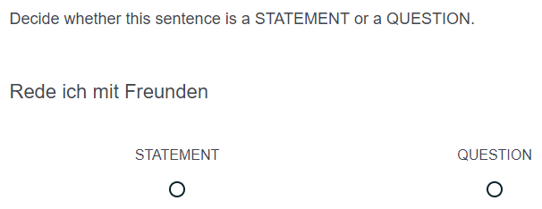
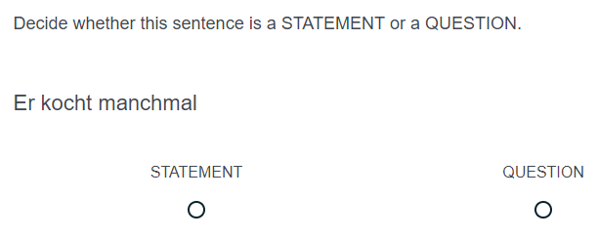
4. Test creation: examples items
Remove punctuation
(Avoid . or ? indicating answer)
Including variety of ‘subjects’
(Avoid reliance on ‘du’ to indicate question)
Isolating receptive knowledge of syntax
Recognising function (statement / question) indicated by word order

Slide 12
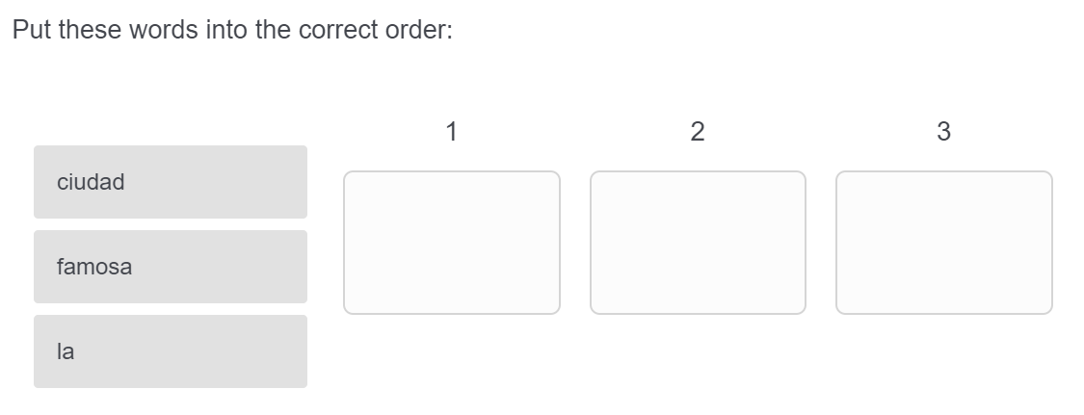
4. Test creation: examples items
Article / noun / adjective appear in a random (vertical) order for each item.
(Ensures learner is paying attention to each element and its correct position)
Isolating productive knowledge of syntax
Drag-and-drop into correct order

Slide 13
4. Test creation: examples items
Testing written productive knowledge
Testing ability to accurately produce the structure
Open text box
Testing understanding of question formation
(Check pupils understand that ‘do’ auxiliary is not needed)
Isolating grammatical knowledge by providing verb infinitive
(Avoid missing answers due to lack of lexical knowledge)

Slide 14
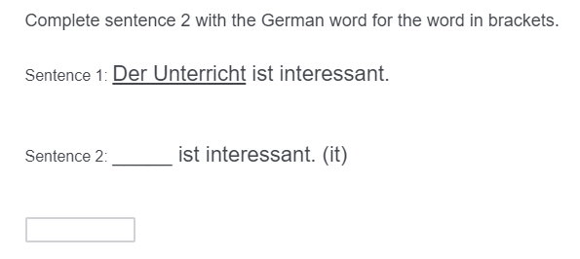
4. Test creation: examples items
Testing written productive knowledge
Testing ability to accurately produce the structure
Open text box
Isolating grammatical knowledge by indicating gender (directly or via article).
(Ensure that pupils are not reliant on recalling gender of a specific lexical item)

Slide 15
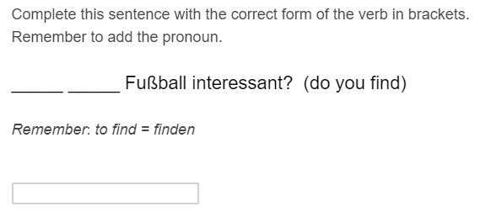
4. Test creation: examples items
Testing syntax alongside subject-verb agreement.
Half of the pool included verbs in present continuous form
(Check pupils’ understanding that there is one present tense structure for simple and continuous meanings)
Testing written productive knowledge
Testing ability to accurately produce the structure
Open text box

Slide 16
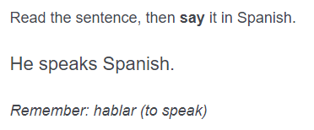
4. Test creation: examples items
Testing oral productive knowledge
Testing ability to accurately produce the structure(s)
Combining a number of structures within each item
Testing subject-verb agreement and question formation.
Isolating grammatical knowledge by providing verb infinitive
(Avoid missing answers due to lack of lexical knowledge)
Note: glosses not provided for other elements of the sentence which are not being tested (e.g. object)

Slide 17
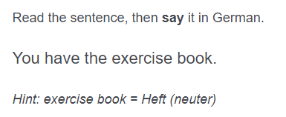
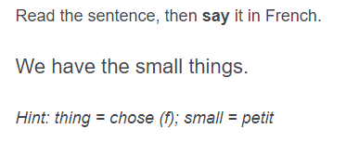
4. Test creation: examples items
No gloss provided for irregular verbs
(Irregular verb forms taught as individual lexical items, rather than transforming from the infinitive)
Isolating knowledge of gender / number (& case) agreement for articles (& adjectives)
(Noun form provided and gender indicated)
Testing oral productive knowledge
Testing ability to accurately produce the structure(s)
Combining a number of structures within each item

Slide 18
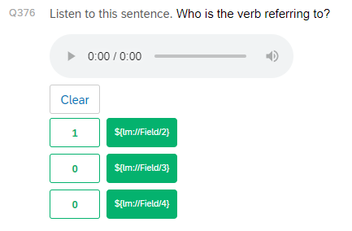
5. Scoring
Items testing written and oral receptive knowledge = multiple choice
One correct answer
Automated scoring
Correct option
Incorrect options

Slide 19
5. Scoring
Items testing written productive knowledge = open text response
Possible answers manually coded
1 mark per structure tested
Partial marks accounted for different elements of a structure being tested
e.g. article agreement (gender / number / case / definiteness)
subject-verb agreement (pronoun / verb ending)
Accents dealt with systematically
Tolerated, where absence does not alter the meaning (e.g. préparer vs. preparer) → no marks deducted
Semi-tolerant, where absence does alter the meaning (e.g. à la vs. a la) → 0.5 mark deducted
→ Not possible to account for any other spelling errors (note: target words provided in glosses)
Pilot phase: data from first round of testing will help to identify common learner errors

Slide 20
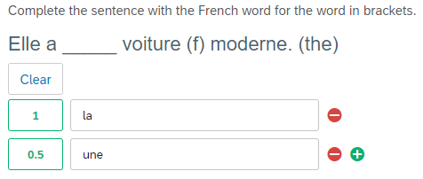
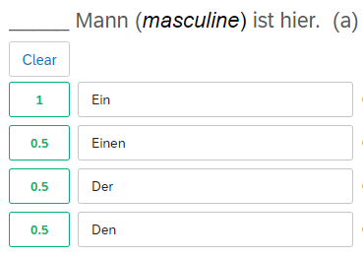
5. Scoring
Examples of partial marking
Examples of partial marking
0.5 mark for incorrect indefinite article (but gender correct)
0.5 mark for incorrect case
(but gender correct)
0.5 mark for incorrect indefinite article (but gender correct)
0.5 mark for incorrect case and indefinite article (but gender correct)

Slide 21
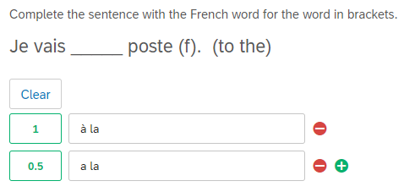
5. Scoring
Examples of partial marking
Examples of partial marking
0.5 mark deducted for missing accent (changes meaning)
0.5 mark deducted for missing accent (changes meaning)

Slide 22
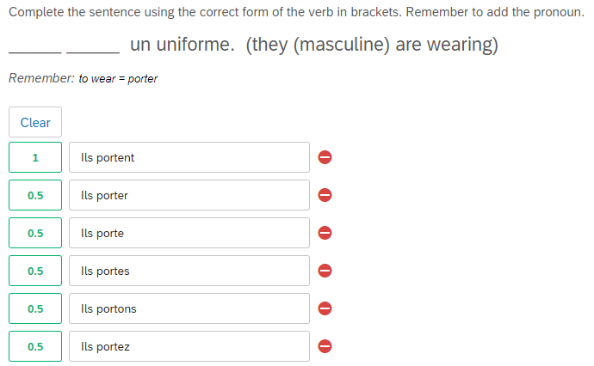
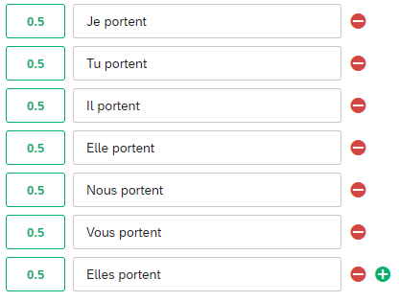
5. Scoring
Examples of partial marking
Examples of partial marking
0.5 mark for correct pronoun
0.5 mark for correct verb ending
0.5 deducted for incorrect verb ending
0.5 deducted for incorrect pronoun

Slide 23
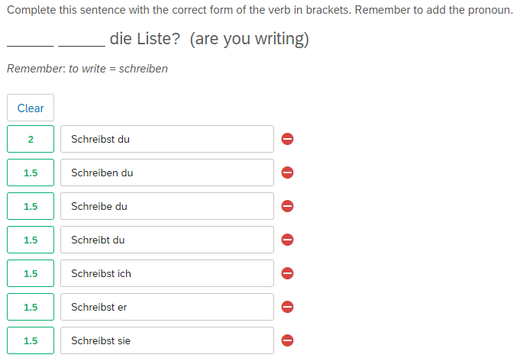
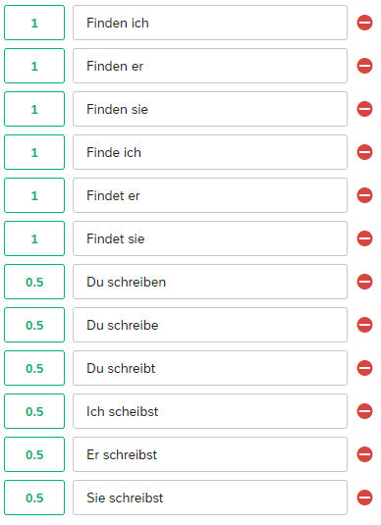
5. Scoring
Examples of partial marking
Examples of partial marking
0.5 deducted for incorrect verb ending
0.5 deducted for incorrect pronoun
1 mark for correct word order
1 mark for correct subject-verb agreement
0.5 deducted for incorrect verb ending
1 deducted for incorrect WO
0.5 deducted for incorrect verb ending
0.5 deducted for incorrect pronoun
1 deducted for incorrect WO
0.5 deducted for incorrect pronoun
1 deducted for incorrect WO

