Slide 1
Examples
Examples
production
(Freer) production tasks eliciting personal response

Slide 2
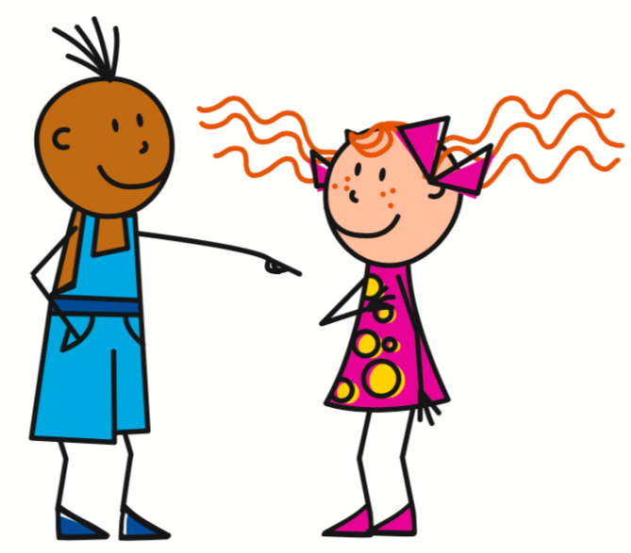
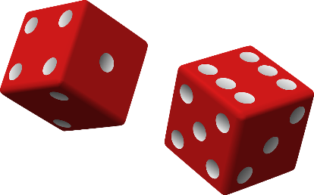
Nous sommes comment ?
écrire
Exemple:
Score 1
2=
Phrase possible:
Score 2
3=être
Tu es une avocate intelligente.
Score 3
6=noun (f.)
Score 4
4=adjectives that add –e in feminine
Notes:
8.1.1.3
Timing: 8 minutes
Aim: Semi-structured writing task consolidating the main grammar points and vocabulary presented this week. The slide following this one should be displayed during the activity.
Procedure:
1. Students roll 4 dice. The score on the first represents the person; the second represents the verb (avoir or être); the third represents the gender of the noun to be used; the fourth represents the type of adjective – all according to the table on the slide following this one, which should be displayed during the activity.
2. Students create a sentence of their own in writing according to the parameters indicated by the scores on the dice.
3. Complete five sentences at least.

Slide 3
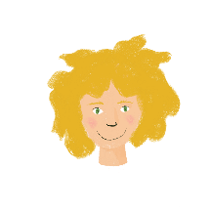
Nous sommes comment ?
écrire
1
1
1
1
adjectives that add –e in feminine
2
2
être
2
noun (m.)
2
3
/
3
3
3
adjectives that add
–euse in feminine
4
4
4
4
5
5
avoir
5
noun (f.)
5
adjectives with irregular feminine forms
6
+
6
6
6
Notes:
Display this slide during the activity.

Slide 4
Une interview
parler
Pose des questions sur la famille ou les amis d’un(e) partenaire.
intelligent
happy
calm
careful
nice
strict
well-behaved
hard-working
short
English
young
mean
funny
ambitious
interesting
sad
tall
Notes:
8.1.1.3
CTiming: 8 minutes
Aim: semi-structured oral production of adjectives following feminine agreement patterns 1-3; oral production of est-ce que questions.
Procedure:
1. Tell students they are going to choose one female person they know and one male person they know, and answer questions about what those people are like.
2. Students work in pairs. Student A asks Tu parles de qui ? Student B answers with the name of the person they are going to describe first. To clarify the gender of the person, Student A can ask C’est un homme/une femme/un garçon/une fille ?
3. Student A then asks six questions about Student B’s first person, using the adjectives on this slide as prompts. This slide lists all the regular adjectives students have learned to describe people so far. Explain to students that the adjectives are grouped by agreement pattern. Student A must pick two adjectives from each column, and agree them accordingly, e.g. Est-ce qu’il est intelligent ? Est-ce qu’elle est heureuse ?
4. Student B responds in a full sentence, e.g. Oui, il est intelligent. Non, elle n’est pas heureuse. At higher levels, encourage students to add their answers by adding mais/et and offering an alternative adjective.
5. Students swap roles. Repeat steps 2-4.
6. Repeat steps 2-5 for each student’s second person, taking care to agree the adjectives appropriately.
Word frequency of cognates used (1 is the most frequent word in French):
interview [3186], poser [218]
Source: Londsale, D., & Le Bras, Y. (2009). A Frequency Dictionary of French: Core vocabulary for learners London: Routledge.

Slide 5
C’est à vous!
écrire / parler
What are you doing today? What did you do yesterday?
Écris six phrases et parle avec un(e) partenaire.
Aujourd’hui je ….
Hier j’ai …
Notes:
8.1.2.1Timing: 8 minutes
Aim: To provide production practice (speaking and writing) in distinguishing between j’ai with past participle and j’aime with infinitive
Procedure:
1. Partner A chooses 3 things to say s/he did yesterday, and 3 things to say s/he likes doing (s/he may need to note these down for reference).
2. Partner A says the 6 sentences implied by the above to Partner B, in random order.
3. Partner B lists, in English, the things Partner A did and the things Partner A likes doing.
4. Partners check answers collaboratively, then swap roles and repeat.

Slide 6
Maintenant et dans le passé
lire / écrire
Écris une réponse à la question. Tu peux utiliser un dictionnaire !
Tu as fait quoi l’hiver dernier ?
Notes:
8.1.2.2
Timing: 16 minutes (2 minutes per question)
Aim: Written comprehension and production in response to information questions in the present and perfect tenses.
Procedure:
1. Students read the question and write their own response in the appropriate tense.
2. Students mayconsult a dictionary if needed.
3. There are eight questions in all. Each question is on a different slide.

Slide 7
Vacances de rêve
écrire
1. Imagine que tu as passé des vacances de rêve la semaine dernière ! Tu as fait quoi ? Écris quatre phrases sur ces vacances.
Par exemple : « La semaine dernière, j’ai voyagé aux États-Unis ! »
2. Donne tes phrases à un(e) partenaire. Il/elle doit écrire ces phrases à la forme il/elle.
Par exemple : « La semaine dernière, Natalie a voyagé aux États-Unis ! »
Notes:
8.1.2.3
Timing: 8 minutes
Aim: Written production of perfect tense sentences in the 1st and 3rd person singular forms.
Procedure:
1. Each student writes four perfect tense sentences in the first person singular about what they did on their dream holiday, using known vocabulary and a dictionary to look up new words if desired.
2. Click to reveal the second part of the task.
3. Students give their sentences to a partner. The partner rewrites the sentences in the third person.
4. Optional extension: select some students to present their partner’s holiday to the rest of the class by reading out the third person sentences they have written.
Word frequency of cognates used (1 is the most frequent word in French): imaginer [840], forme [369]
Source: Londsale, D., & Le Bras, Y. (2009). A Frequency Dictionary of French: Core vocabulary for learners London: Routledge.

Slide 8
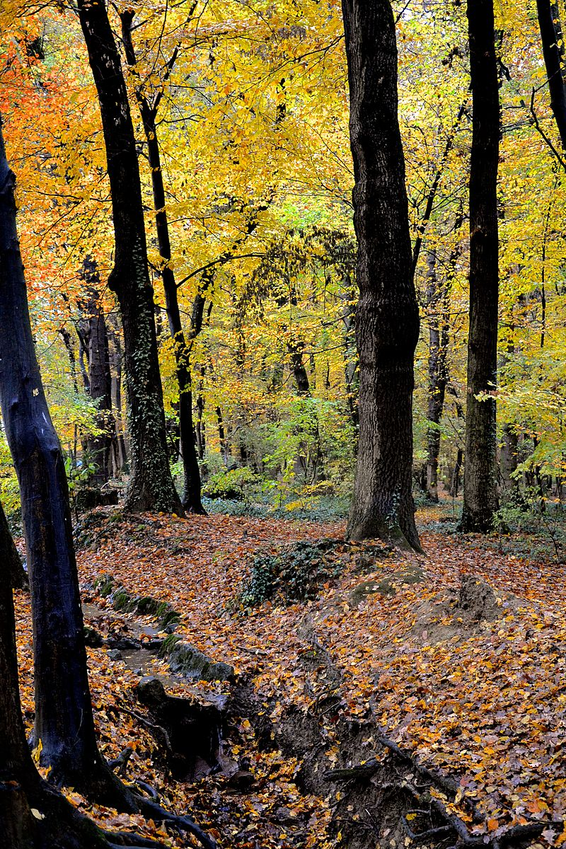
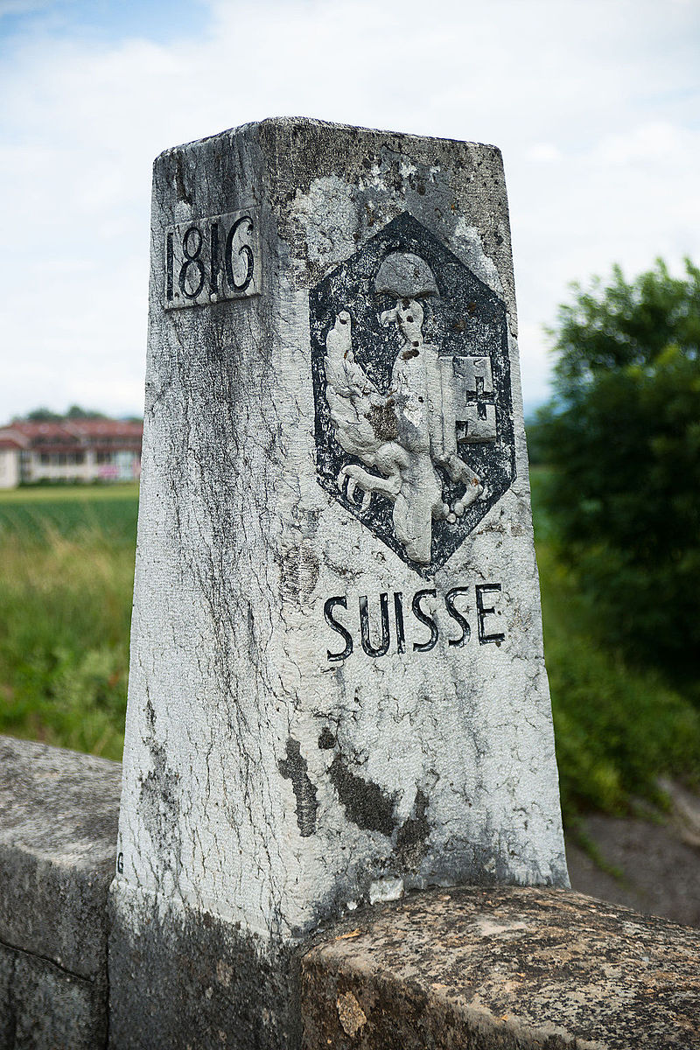
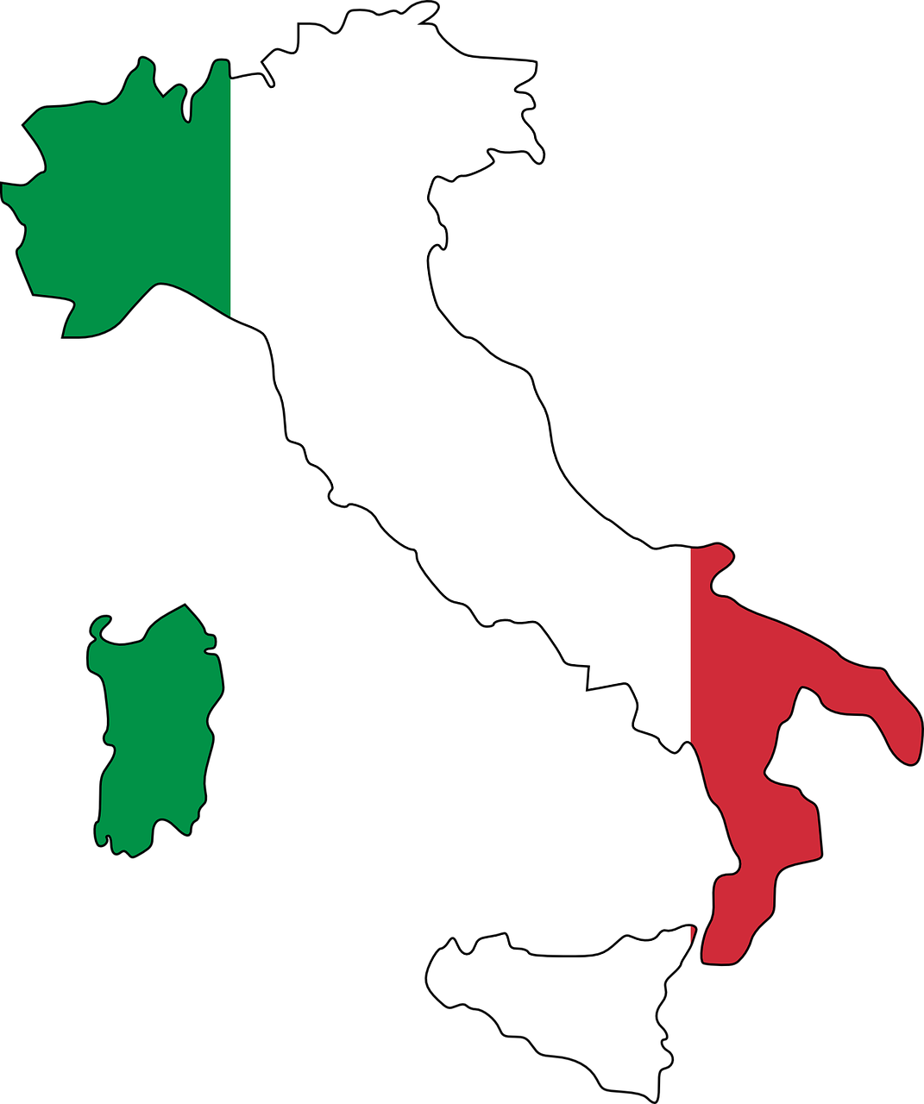
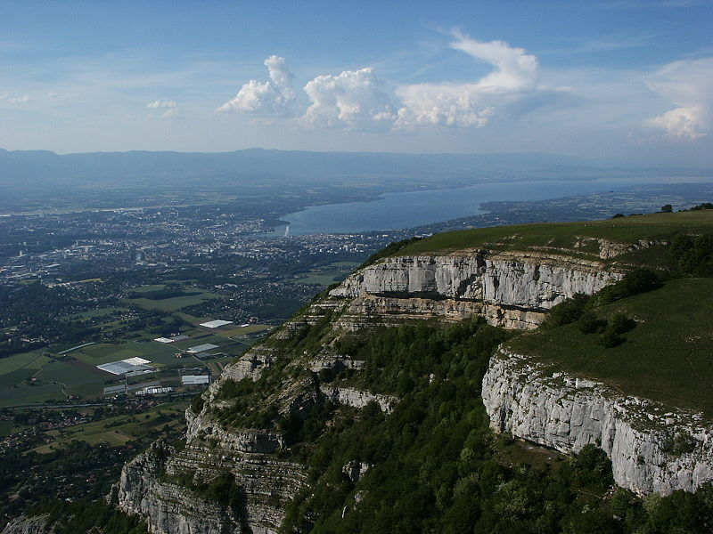
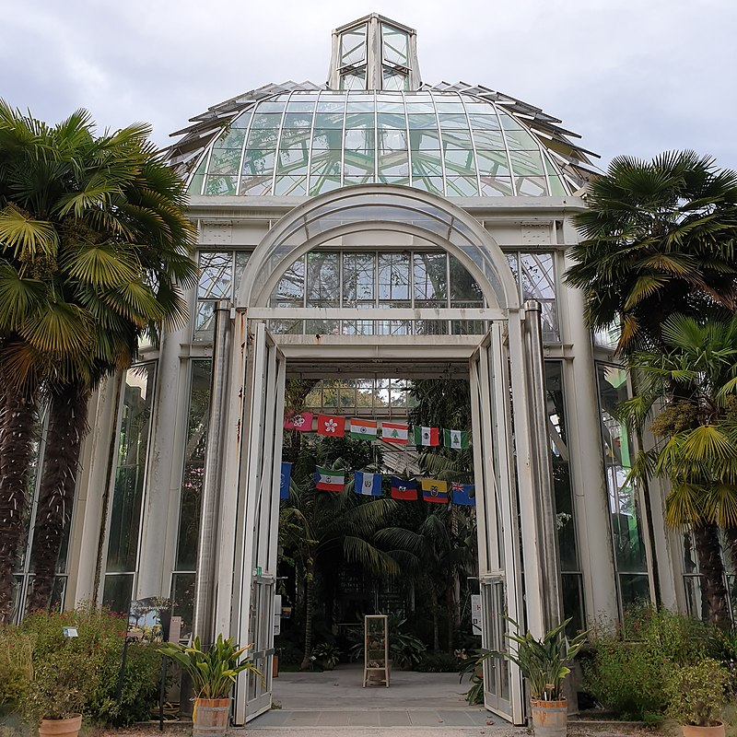
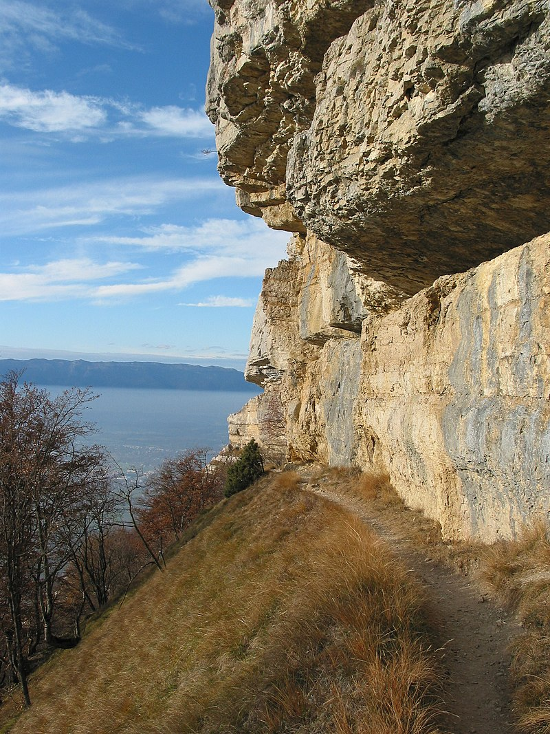
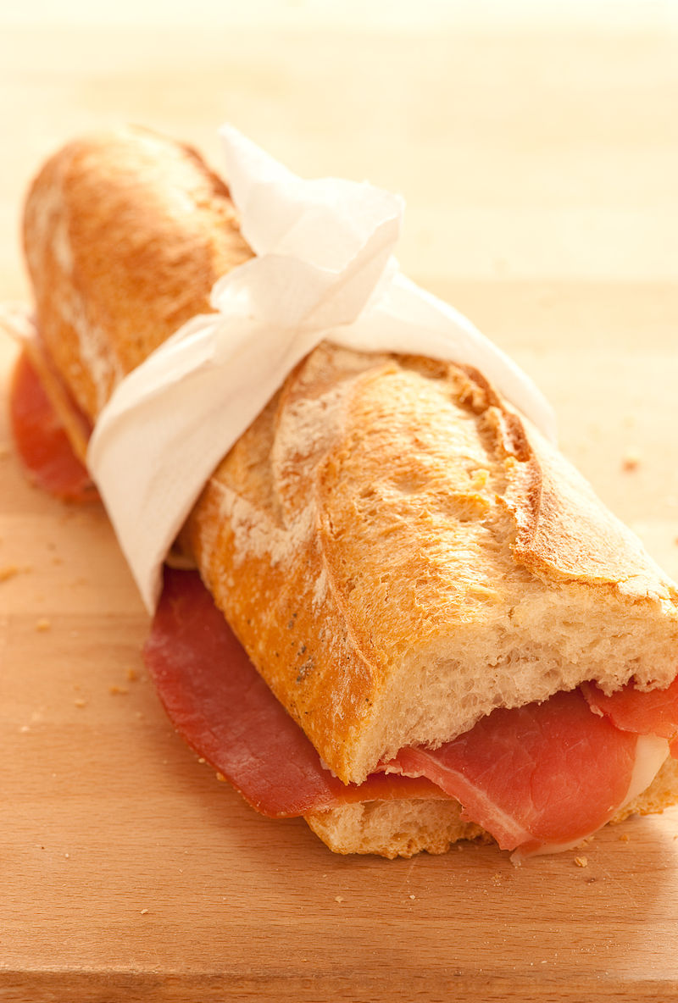
Deux voyages en Suisse !
parler
Partenaire A
?
jouer dans la forêt
chercher la frontière
voyager en Italie
regarder la vue
visiter le jardin botanique
traverser le pont
faire de la marche à la montagne
emporter un sandwich
Notes:
8.1.2.4
Timing: 10 minutes
Aim: practising oral production of questions and negative sentences in the perfect tense.
Procedure:
Students work together to determine which activities they have in common, and which are different.
Students take it in turn to form yes/no questions using the prompts provided (in any order) and respond with oui / non followed by an affirmative or negative sentence.
The student who asks the question also gives a full sentence stating whether they did or did not do the activity, and students note whether it is a match.
Continue until all activities have been asked about.
Word frequency of cognates used (1 is the most frequent word in French): botanique [>5000], sandwich [>5000]
Source: Londsale, D., & Le Bras, Y. (2009). A Frequency Dictionary of French: Core vocabulary for learners London: Routledge.
Image attribution:
Par Babsy — Travail personnel, CC BY-SA 4.0, https://commons.wikimedia.org/w/index.php?curid=37089073
Par Ludovic Péron — Travail personnel, CC BY-SA 3.0, https://commons.wikimedia.org/w/index.php?curid=20025169
Par Patrick Nouhailler's…, CC BY-SA 3.0, https://commons.wikimedia.org/w/index.php?curid=59465878
Par Benoit Kornmann — Travail personnel, CC BY-SA 3.0, https://commons.wikimedia.org/w/index.php?curid=1366663
Par Geneva photos — Travail personnel, CC BY-SA 4.0, https://commons.wikimedia.org/w/index.php?curid=82625475
By Norbert Aepli, Switzerland, CC BY 2.5, https://commons.wikimedia.org/w/index.php?curid=1254144
By Björn S., CC BY-SA 3.0, https://commons.wikimedia.org/w/index.php?curid=54431295
Par jules:stonesoup — https://www.flickr.com/photos/stone-soup/4143143813/, CC BY 2.0, https://commons.wikimedia.org/w/index.php?curid=12248164

Slide 9
Deux voyages en Suisse !
parler
Partenaire B
?
jouer dans la forêt
chercher la frontière
voyager en Italie
regarder la vue
visiter le jardin botanique
traverser le pont
faire de la marche à la montagne
emporter un sandwich

Slide 10
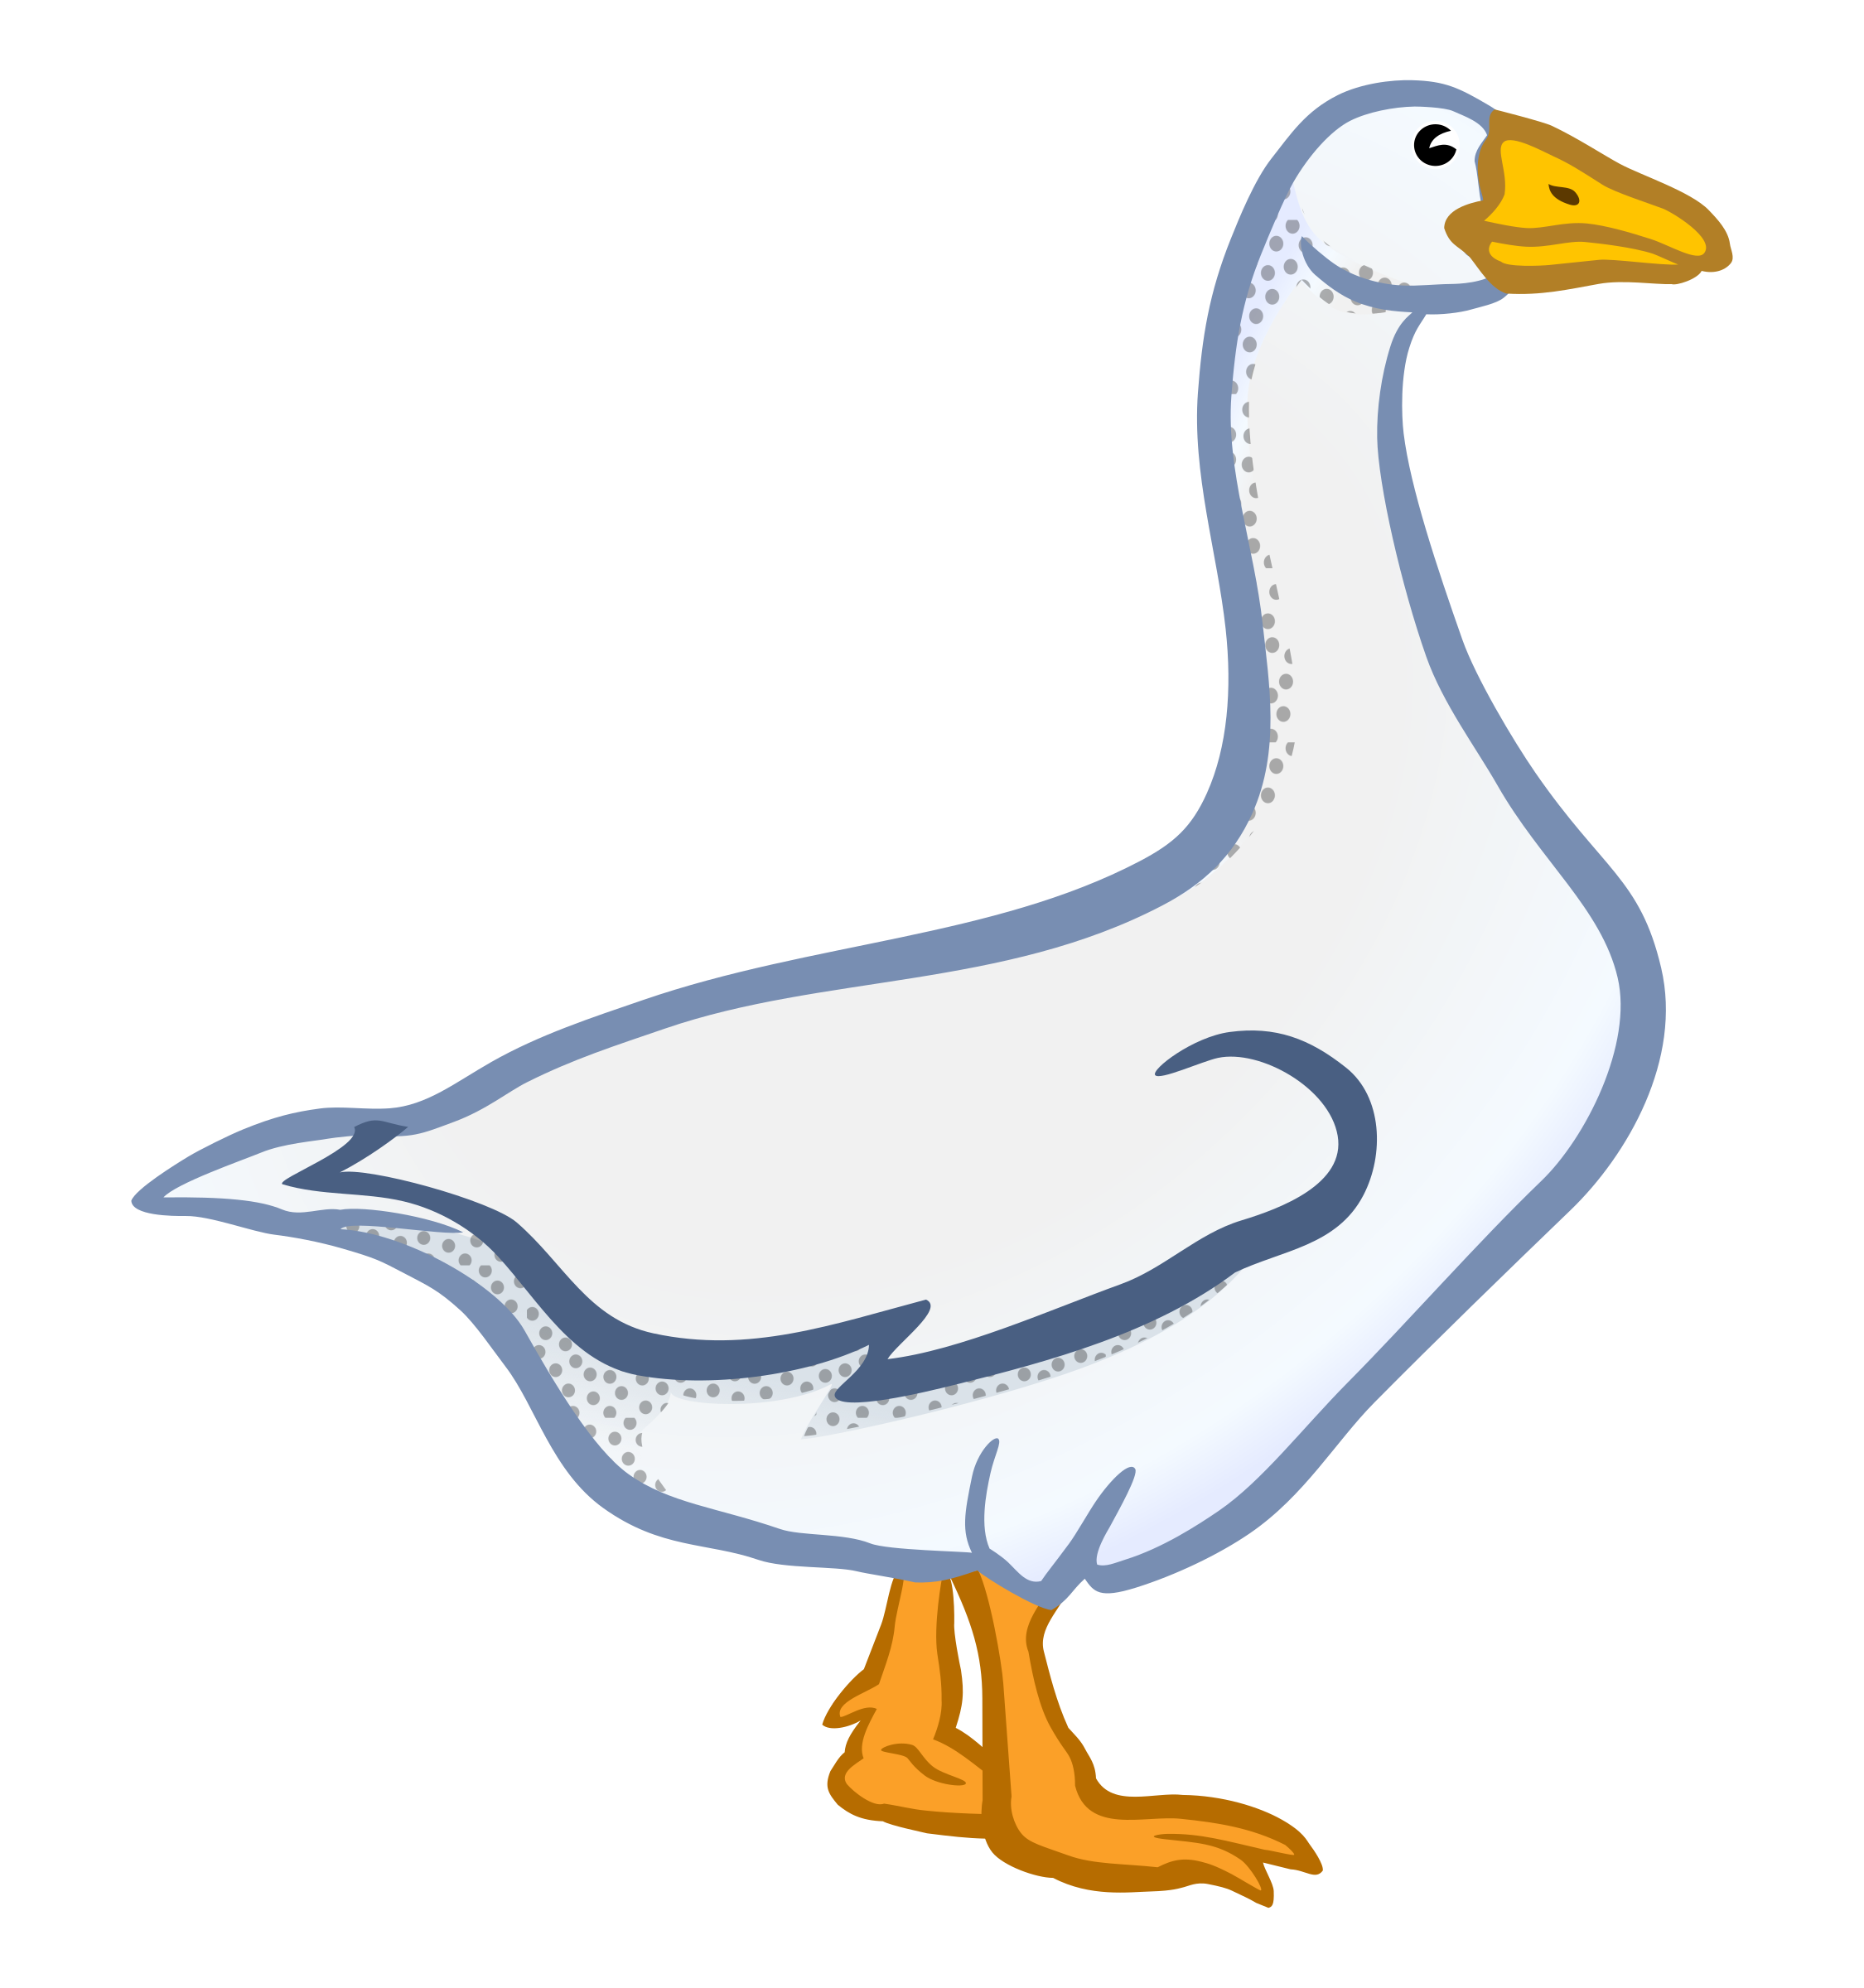
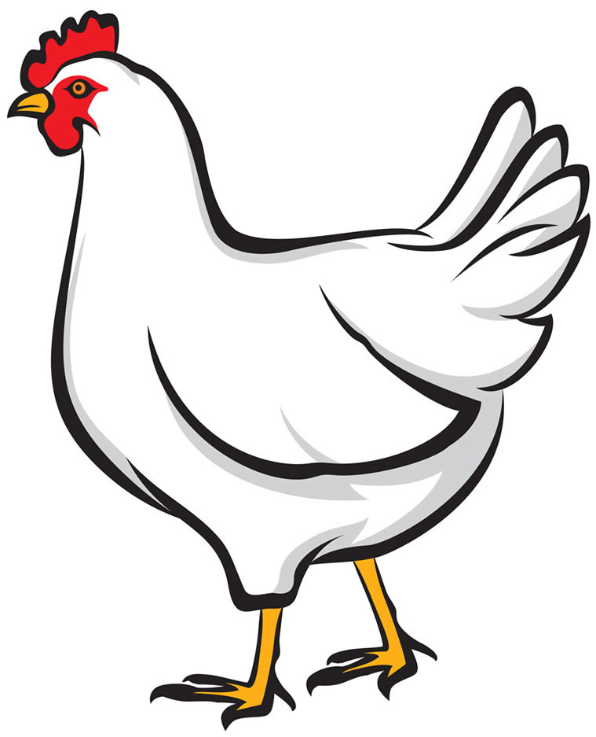
Le menu de Noël
lire
Use a dictionary and the internet!
As you know, French prepositions can often be translated in several ways.
For example, the preposition à can be translated as ‘at’, ‘to’, or ‘in’.
When talking about food, à can also be used to describe what a dish is made or served with.
Menu de Noël
langue de bœuf au foie gras
poulet au vin jaune
pain d’épice aux pommes
a)
b)
c)
Lis le menu de Noël.
On mange quoi avec quoi ?
Fais des paires pour chaque plat.
d)
e)
f)
Notes:
8.1.2.5
Timing: 5 minutes
Aim: introducing a specific use of preposition à, using a dictionary/research to understand the detail of the text
Procedure:
1. Introduce the specific use of à to indicate ingredients / accompaniments in a dish.
2. Bring up the Christmas menu. Students use dictionaries and/or websites to find out what food types are in each dish.
3. Students pair up pictures a-f, based on the pairings on the menu.
4. Click to reveal the answers (in the order of the menu).
5. Reactions to the menu can also be elicited – eg. ‘Qui aime le menu ?’, ‘Qui n’aime pas le menu ?’, ‘Quel plat aimes-tu ?’, ‘Pourquoi ?’
Word frequency of cognates used (1 is the most frequent word in French): menu [4370], paire [3926]
Source: Londsale, D., & Le Bras, Y. (2009). A Frequency Dictionary of French: Core vocabulary for learners London: Routledge.
Word frequency of unknown vocabulary (1 is the most frequent word in French):
bœuf [3914], foie [4817], gras [4018], poulet [4222], vin [2309], pain [2802], épice [>5000], pomme [2847]
Source: Londsale, D., & Le Bras, Y. (2009). A Frequency Dictionary of French: Core vocabulary for learners London: Routledge.

Slide 11
À ton tour !
écrire
Écris un article similaire : imagine que tu es astronaute !
C’est quoi ton menu idéal pour l’espace ?
C’est pour quelle occasion spéciale ?
Quel chef / restaurant / café / magasin prépare le repas ?
ou
Écris une interview avec Thomas Pesquet, avec un(e) partenaire :
Pourquoi aime-t-il ces plats français traditionnels ?
Pourquoi aime-t-il être astronaute ?
Notes:
8.1.2.5
Timing: 10 minutes
Aim: responding creatively to the text
Procedure:
1. Students choose whether to write an article about themselves, or write an interview with Thomas Pesquet.
2. They can use dictionaries and do research online to inform their writing.
3. The activity can be extended by using their writing as scripts for a TV news report / chat show interview, to be recorded or performed in class.
Word frequency of cognates used (1 is the most frequent word in French): tour [523], article [604], similaire [2632], imaginer [840], astronaute [>5000], menu [3470], idéal [1429], occasion [423], spécial [726], restaurant [2336], interview [3186], traditionnel [1574]
Source: Londsale, D., & Le Bras, Y. (2009). A Frequency Dictionary of French: Core vocabulary for learners London: Routledge.

Slide 12
Ma semaine
écrire
Que fais-tu cette semaine ? Et que fais-tu en général ? Écris sept phrases.
Le lundi je vais normalement en ville, mais ce lundi je reste à la maison.
On Mondays I normally go into town, but this Monday I’m staying at home.
1.
2.
3.
4.
5.
6.
7.
Notes:
8.2.2.2
Timing: 7 minutes
Aim: Written production of present tense with appropriate time adverbials to express future and habitual actions.
Procedure:
1. Click to animate the task explanation.
2. Make sure that students understand the intended format of each sentence, as per the example.
3. Ask students to make each sentence about a different day of the week.
4. Students write their sentences.
5. If time permits, students share their examples with one another.

Slide 13
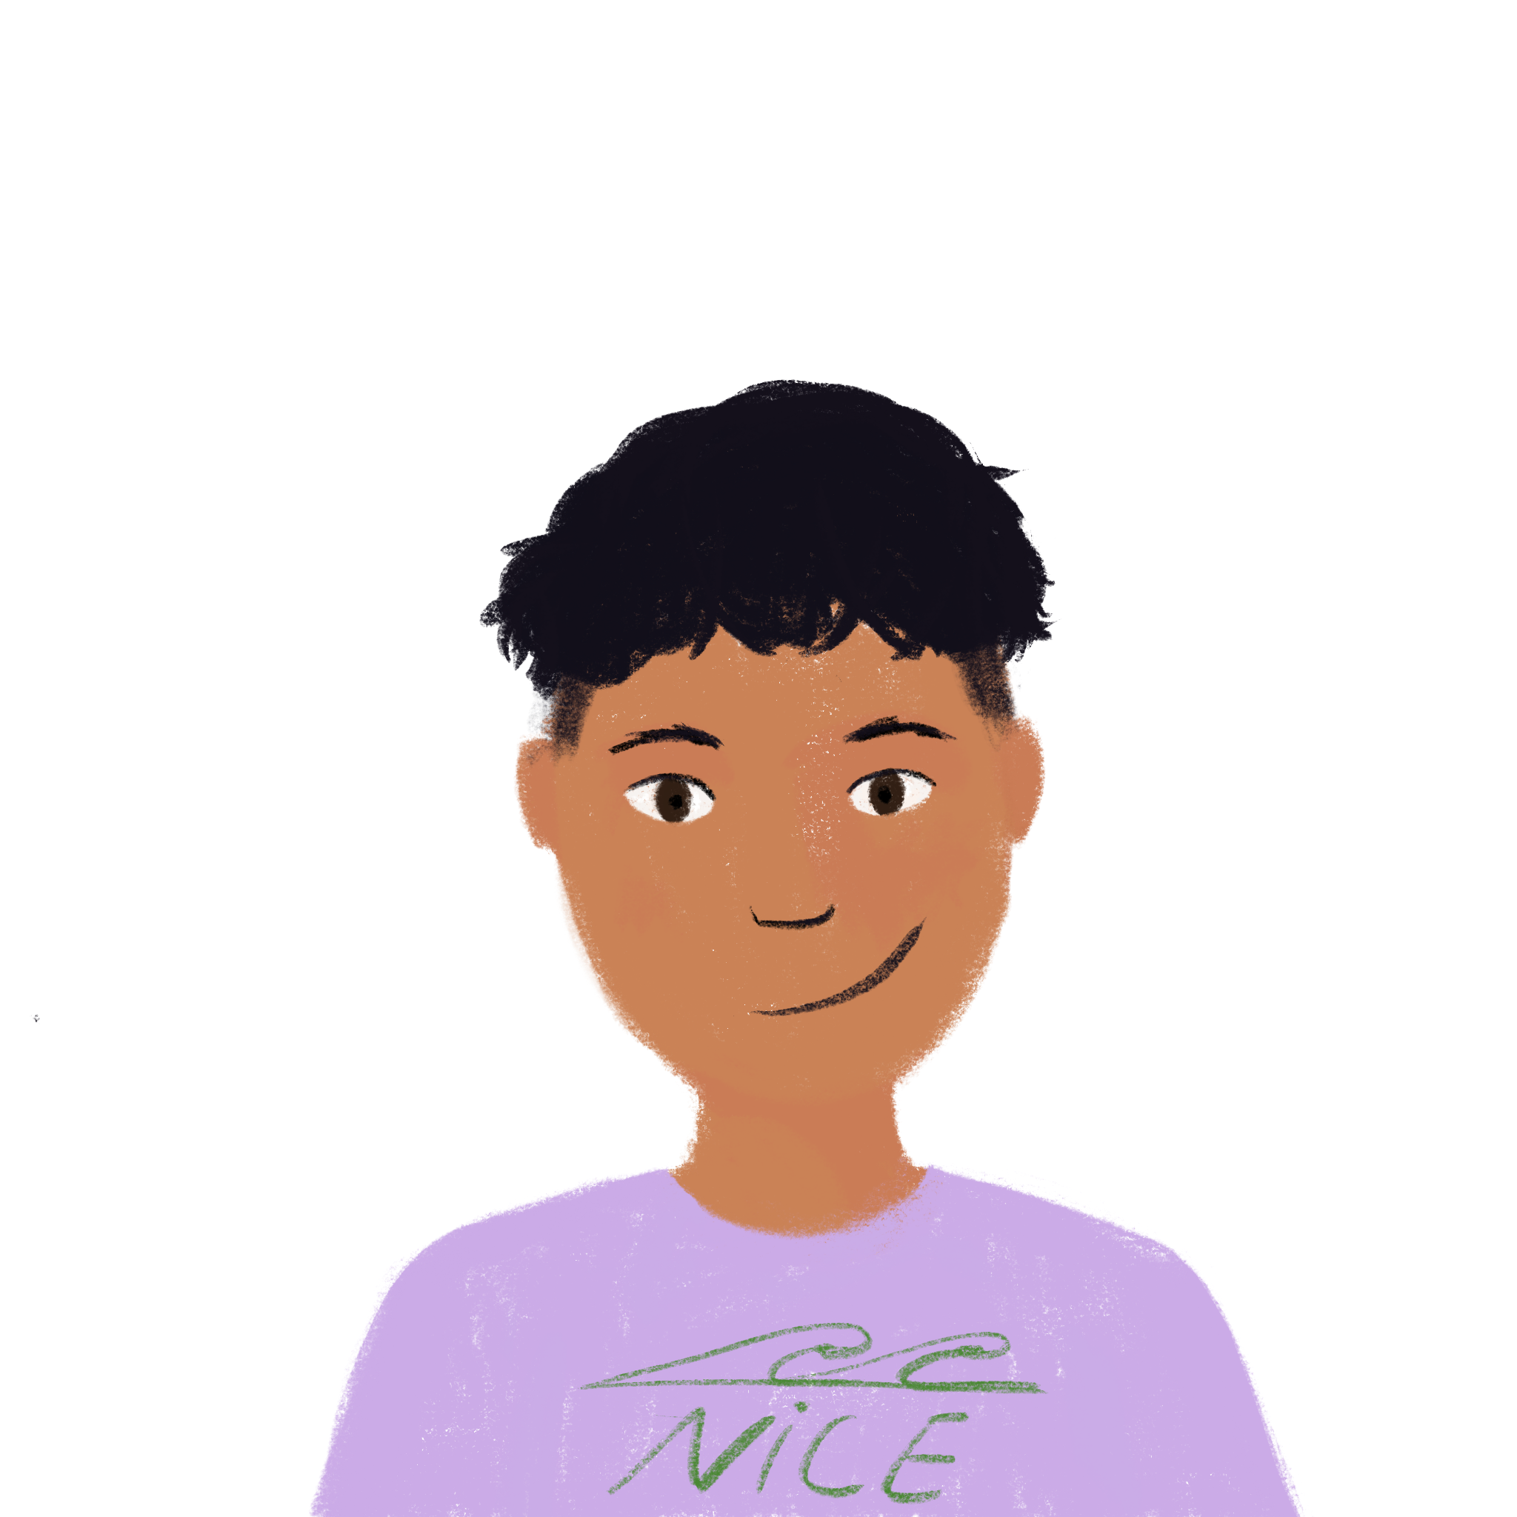
On décrit!
*
* décrire = to describe
écrire
Utilise deux ou trois adjectifs !
un petit oiseau jaune et bleu
un grand oiseau blanc et noir
Notes:
8.2.2.4
Timing: 8 minutes for 3 slides
Aim: Written production of noun phrases with multiple adjectives.
Procedure:
1. Students write descriptions in French of the two pictures using at least two adjectives in each case.
2. Click to bring up example responses.
Word frequency of cognates and unknown words used: (1 is the most frequent word in French) décrire [1176], adjective [>5000]
Source: Londsale, D., & Le Bras, Y. (2009). A Frequency Dictionary of French: Core vocabulary for learners London: Routledge.

Slide 14
On décrit!
écrire
Utilise deux ou trois adjectifs !
du bon vin blanc
du mauvais vin rouge
Notes:
Slide 2/3

Slide 15
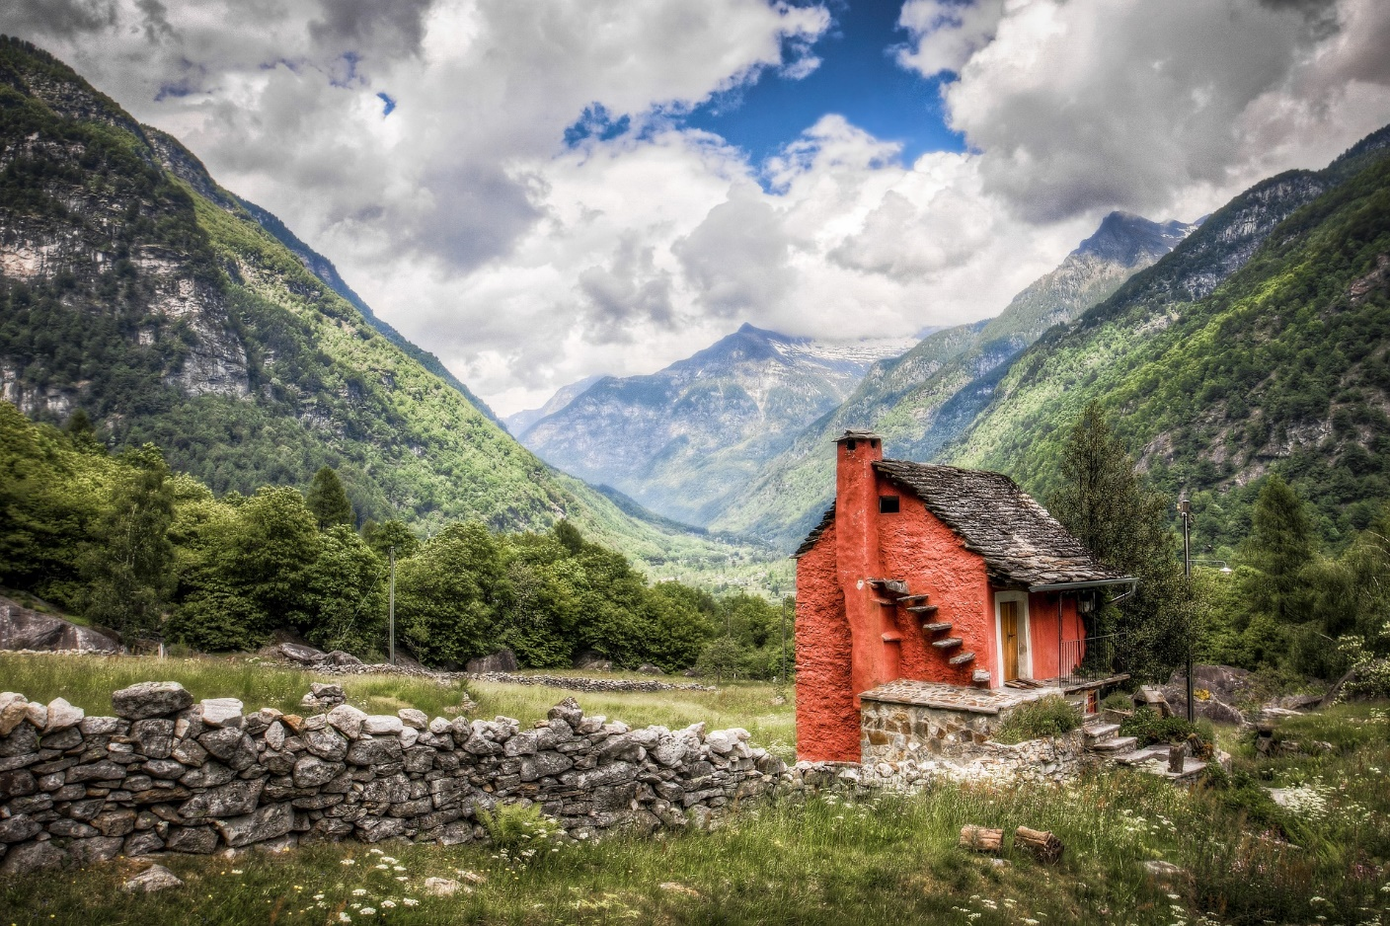
On décrit!
écrire
Utilise deux ou trois adjectifs !
une vieille petite maison rouge
un nouveau grand bâtiment moderne.
Notes:
Slide 3/3

