Slide 1
Talking about what I do on my own and what we do together
Present tense weak verbs: 1st person singular vs 1st person plural
SSC [v]
Y7 German
Term 2.2 - Week 1 - Lesson 39
Author name(s): Natalie Finlayson / Rachel Hawkes
Artwork: Steve Clarke
Date updated: 20/12//21
Notes:
Artwork by Steve Clarke. All additional pictures selected are available under a Creative Commons license, no attribution required.
Learning outcomes (lesson 1)
Introduction of SSC [v]
Introduction of present tense weak verbs in 1st person singular and 1st person plural.
Word frequency (1 is the most frequent word in German):
2.2.1 (introduce) schwimmen [1863] wir sind [4] beide [117] wir [26] Einzelkind [>5009] Moschee [>5009] Schlagzeug [>5009] gemeinsam [295] türkisch [1531] immer [64] zusammen [553] Angst vor [n/a] Additional known vocabulary or cognates to recycle: Vater [232] tanzen [1497]
2.1.3 (revisit) mögen, mag, magst [168] ihn [92] sie [7] Deutsch [112] Fach [1731] Fremdsprache [3770] Kunst [554] Mathematik [1636] Naturwissenschaft [4425]Additional known vocabulary or cognates to recycle: Sport [945] Englisch [662] Spanisch [>5009] lernen [288] Lehrer [695] Lehrerin [695] nicht [11] sehr [81]
1.2.4 (revisit) lesen [305] sprechen [161] wiederholen [988] zeigen [136] zuhören [1629] Antwort [522] freiwillig [1652] (Antworten) zeigen! Zuhören! Sprechen! Lesen! Schreiben! Wiederholen!
Source: Jones, R.L & Tschirner, E. (2019). A frequency dictionary of German: Core vocabulary for learners. London: Routledge.
The frequency rankings for words that occur in this PowerPoint which have been previously introduced in NCELP resources are given in the NCELP SOW and in the resources that first introduced and formally re-visited those words.
For any other words that occur incidentally in this PowerPoint, frequency rankings will be provided in the notes field wherever possible.

Slide 2
v
vor
Notes:
Timing: 1 minute
Aim: To introduce/consolidate SSC [v]
Procedure: 1. Present the letter(s) and say the [v] sound first, on its own. Students repeat it with you. 2. Bring up the word ”vor” on its own, say it, students repeat it, so that they have the opportunity to focus all of their attention on the connection between the written word and its sound.
3. A possible gesture for this would be to hold your hands, left in front of right, in front of your body, palms facing inward. Quickly move the right hand over the top of the left, as you say ‘vor’, to mime ‘in front’.
4. Roll back the animations and work through 1-3 again, but this time, dropping your voice completely to listen carefully to the students saying the [v] sound, pronouncing ”vor” and, if using, doing the gesture. Word frequency (1 is the most frequent word in German): vor [55] Source: Jones, R.L. & Tschirner, E. (2006). A frequency dictionary of German: core vocabulary for learners. Routledge

Slide 3
v
vor
Notes:
With sound and no pictures to focus all attention on the sound-symbol correspondence.

Slide 4
v
vor
Notes:
Without sound to elicit pronunciation (without first hearing the teacher).
Teacher to elicit pronunciation by asking “Wie sagt man…”

Slide 5
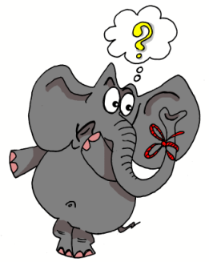
v
positiv
voll
vor
bevor
Vater
vergessen
Notes:
Timing: 2 minutes
Aim: To introduce/consolidate SSC [v]
Procedure:
Introduce and elicit the pronunciation of the individual SSC [v] and then the source word again ‘vor’ (with gesture, if using).
Then present and elicit the pronunciation of the five cluster words.
The cluster words have been chosen for their high-frequency, from a range of word classes, with the SSC (where possible) positioned within a variety of syllables within the words (e.g. initial, 2nd, final etc.). Additionally, we have tried to use words that build cumulatively on previously taught SSCs (see the Phonics Teaching Sequence document) and do not include new SSCs. Where new SSCs are used, they are often consonants which have a similar symbol-sound correspondence in English.
Word frequency (1 is the most frequent word in German): vor [55]; positiv [690] voll [357]; bevor[541]; vergessen [595]; Vater [216]. Source: Jones, R.L. & Tschirner, E. (2006). A frequency dictionary of German: core vocabulary for learners. Routledge

Slide 6
v
positiv
voll
vor
bevor
Vater
vergessen
Notes:
With sound and no pictures to focus all attention on the sound-symbol correspondence.

Slide 7
v
positiv
voll
vor
bevor
Vater
vergessen
Notes:
Without sound to elicit pronunciation (without first hearing the teacher).
Teacher to elicit pronunciation by asking “Wie sagt man…”

Slide 8
Wie sagt man …?
Volkswagen
Notes:
Timing: 1 minute
Aim: To introduce/consolidate SSC [v], as opposed to [w]
Procedure: 1. Students may be surprised to hear the pronunciation of this German car manufacturer! Ask students to sound out the word before leading whole-class pronunciation.
2. Students may also be interested in the translation of the word (the people’s car)., which is another example of compounding.

Slide 9
schwimmen
[to swim | swimming]
schwimmt
[swims | is swimming]
Notes:
Timing: 3 minutes for sequence of six verbs
Aim: To present the verb schwimmen in long and short forms.
Procedure:
Bring up the word schwimmen on its own, say it, students repeat it, and remind them of the phonics. Draw attention to [sch] and [w].
Try to elicit the meaning from the students. Students have had explicit teaching that the present tense in German communicates two different present tense meanings in English. This reinforces that learning. Emphasise the two meanings for the short form, reminding students that German only has one form and does not have a direct equivalent of the grammar for ‘is + ing’, the continuous form (as covered in previous weeks).
Bring up the picture, and, if using gestures, a possible gesture would be mime breaststroke or front crawl with hands and arms.
Then bring up the English translations. Emphasise the two meanings for the infinitive.
Bring up the short form schwimmt, say it, students repeat it. Draw attention to [sch] and [w].
Try to elicit the meaning from the students. Emphasise the two meanings for the short form.

Slide 10
schwimmen
[to swim | swimming]
schwimmt
[swims | is swimming]
Notes:
Cycle through the long and short form again.

Slide 11
schwimmt
[swims | is swimming]
Sie schwimmt jede Woche.
[She swims every week.]
Notes:
Introduce the short form in a sentence.

Slide 12
schwimmen
[to swim | swimming]
Ich kann auch schwimmen.
[I can also swim.]
Notes:
Introduce the long form in a sentence.

Slide 13
schwimmt
[swims | is swimming]
_____________
Sie schwimmt jede Woche.
[She swims every week.]
Notes:
Cycle through the short form in context again.

Slide 14
schwimmen
[to swim | swimming]
Ich kann auch ________________
schwimmen.
[I can also swim.]
Notes:
Cycle through the long form in context again.

Slide 15
Vokabeln
Add a capital letter to change an adjective (türkisch, deutsch) into a language (Türkisch, Deutsch).
hören / lesen
Zuhören! Was ist das?
1
das Türkisch, das Schlagzeug, die Moschee
2
das Einzelkind, Angst vor, gemeinsam
3
zusammen, immer, Angst vor
4
das Schlagzeug, die Moschee, das Einzelkind
5
zusammen, das Schlagzeug, schwimmen
6
immer, beide, gemeinsam
7
wir, immer, türkisch
8
das Schlagzeug, die Moschee, das Türkisch
Notes:
Timing: 5 minutes
Aim: To help students consolidate the meaning of vocabulary set for pre-learning.
Procedure: 1. Spoken clues are played on letter clicks.
2. Students underline the word they think fits best.
3. Teacher can elicit answers by asking ‘Was ist eine Fremdsprache? Was habe ich vor Monstern?’ etc.
4. Answers revealed on clicks.
Note: türkisch is introduced as an adjective in the vocabulary pre-learning exercise. Teacher to ask students what they think the work might mean in its nominal form, and give examples of other languages that may be formed from adjectives in this way (e.g. englisch/Englisch).
Transcript:
Das ist eine Fremdsprache.
Ich habe [beep] Monstern.
Mit Freunden.
Das ist ein Instrument.
Das ist ein Sport.
Nicht nie.
Du und ich zusammen.
Ein islamischer Ort.

Slide 16
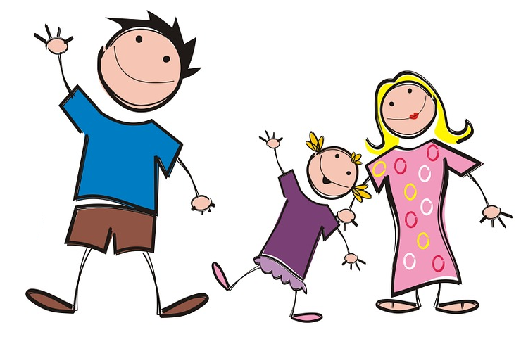
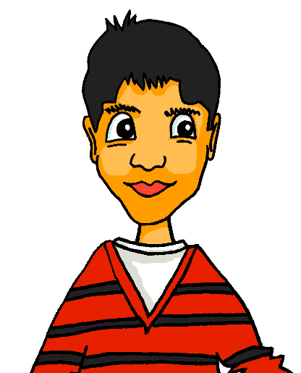
Vokabeln
Vokabeln
sprechen / schreiben
das Schlagzeug
das Einzelkind
die Moschee
schwimmen
Angst vor
das Türkisch
Notes:
Timing: 3 minutes
Aim: To provide teacher-led vocabulary practice.
Procedure: 1. On clicks, pictures representing words in this week’s vocabulary set appear.
2. Teacher asks ‘Wie sagt man das?’ to elicit a choral response.
3. Teacher repeats the word for pronunciation practice. Students repeat.
4. Teacher asks ‘Wie schreibt man das?’ Students write the word in their books, or practice spelling orally.
5. Teacher brings up the correct spelling of the word on click.
6. Repeat as many times as necessary.

Slide 17
Vokabeln
Vokabeln
lesen
zusammen, gemeinsam oder beide?
Schreib das Wort!
Wolfgang und Mia haben viel gemeinsam.
Wolfgang und Mia spielen oft zusammen.
Wolfgang und Mia sind beide nett .
______________
gemeinsam haben –
having something in common
______________
zusammen – together, doing something with someone else
______________
beide – both, comparing something yourself with someone
Notes:
Timing: 5 minutes
Aim: To help students consolidate the meaning of vocabulary set for pre-learning – here, three words with easily-confused meanings.
Procedure: 1. Students read the sentences and write the correct word of the three to fill the gap in each.
2. Click to bring up the correct answer, followed by an explanatory bubble, for each sentence in turn.

Slide 18
Talking about yourself and others (wir)
Grammatik
As you know, regular verbs have endings which match the subject pronoun.
To say wir (we) + regular verb:
The wir form of the verb is the same as the infinitive form that you find in the dictionary. ☺
Ich gehe jeden Tage in die Schule.
Du bleibst kaum zu Hause.
Sie heißt Sara.
___
___
___
Wir gehen jeden Tag in die Schule.
We go to school every day.
Wir bleiben kaum zu Hause.
We rarely stay at home.
Wir heißen Sara und Max.
We are called Sara and Max.
___
___
___
Notes:
Timing: 3 minutes
Aim: To introduce the first person plural verb form in German.
Note: It’s important to celebrate simplicity when it occurs! The fact that the wir form is the same as the infinitive is just one such moment. Hence the ☺.
Procedure: 1. Cycle through the information on the slide using the animation sequence.

Slide 19
Mein Freund Mehmet und ich
lesen
Wolfgang schreibt Oma eine Email. Was macht er allein? Was macht er mit Mehmet?
Schreib ich oder wir.
Hallo Oma,
Ich habe einen neuen Freund! Er heißt Mehmet und wir haben viel gemeinsam!
Ich gehe jeden Tag früh in die Schule. Ich habe um 8.00 Tanzunterricht. Mehmet kommt um 8.30. Wir sitzen im Klassenzimmer und reden.
Wir haben um 9.00 Unterricht. Wir mögen Kunst und Naturwissenschaften. Ich mag auch Sport.
Wir spielen nach der Schule oft Musik. Mehmet spielt Schlagzeug und ich spiele Gitarre. Wir gehen manchmal schwimmen. Wir machen auch natürlich immer Hausaufgaben …
___
___
___
___
___
___
___
___
___
___
___
___
Notes:
Timing: 5 minutes
Aim: To practise distinguishing between the first person singular and plural verb endings of the present tense (reading).
Note: Adverbs containing lexical clues (beide / zusammen) are avoided here, so that students focus on the verb endings.
Students have previously met all vocabulary in this task, with the exception of near-cognates allein [259] and natürlich [n/a], and um [47] used to introduce times. Students should be able to infer meaning from context when completing the exercise, but teacher should check and clarify during the feedback stage.
Procedure: 1. Students read he text and determine from the verb ending which pronoun, ich or wir, is missing in each gap.
2. Answers revealed on individual clicks.
Word frequency (1 is the most frequent word in German):
allein [259], natürlich [n/a], um [47]
Source: Jones, R.L & Tschirner, E. (2011). A frequency dictionary of German: Core vocabulary for learners. London: Routledge.

Slide 20
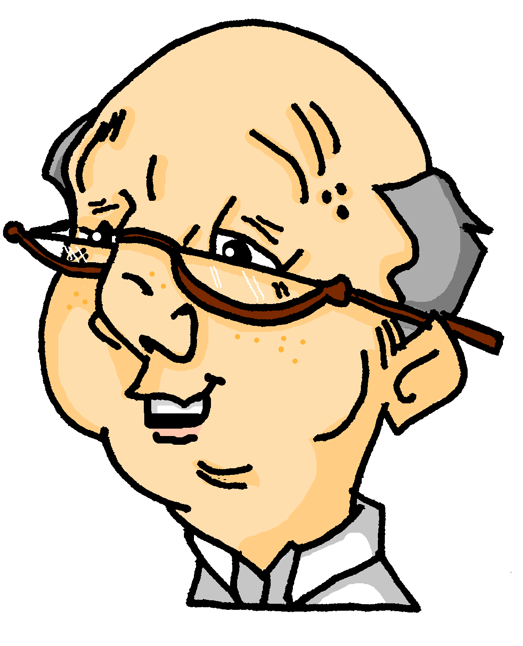
Meine Woche
hören
Wolfgang redet mit Opa am Telefon. Wie macht er die Aktivitäten? Mit Mehmet oder allein?
 | allein | zusammen
1
2
3
4
5
6
7
Notes:
Timing: 5 minutes
Aim: To practise linking verb endings with meaning (doing things alone, or together with someone else).
Procedure: 1. Audio (with subject and adverb obscured) plays on number clicks.
2. Students listen to the sentences and tick the appropriate column, according to whether the verb heard is first peron singular or plural.
3. The answers are revealed on the next slide.
Note: At more advanced levels, the teacher may prefer to ask students to write complete sentences, with the adverb in the correct position and a subject that makes sense.
Transcript:
[Mehmet und ich] hören [zusammen] Musik.
[Wir] schwimmen oft [zusammen].
[Ich] spiele [allein] Computer.
[Ich] bleibe [allein] zu Hause.
[Wir] hören [zusammen] Musik.
[Mehmet und ich] lernen [zusammen] Englisch.
[Ich] liege [allein] im Garten.

Slide 21
Meine Woche (Antworten)
hören
Wolfgang redet mit Opa am Telefon. Wie macht er die Aktivitäten? Mit Mehmet oder allein?
 | allein | zusammen
1
2
3
4
5
6
7
Notes:
Timing: 2 minutes
Aim: To reveal the answers to the listening exercise on the previous slide.
Procedure: 1. Answers (with subject and adverb included) play on number clicks.
Transcript:
Mehmet und ich hören zusammen Musik.
Wir schwimmen oft zusammen.
Ich spiele allein Computer.
Ich bleibe allein zu Hause.
Wir hören zusammen Musik.
Mehmet und ich lernen zusammen Englisch.
Ich liege allein im Garten.

Slide 22
Zusammen oder allein?
schreiben
Und was machst du mit Freunden zusammen? Was machst du allein? Finde Verben im Wörterbuch und schreib Sätze mit ich und wir!
Beispiel: Wir sitzen zusammen im Garten.
Ich lese allein im Zimmer.
1. Ich … 4. Wir …
2. Wir … 5. Ich …
3. Ich … 6. Wir …
Zusammen and allein are adverbs. Use them after the verb.
Notes:
Timing: 5 minutes
Aim: To provide dictionary practice.
Procedure: 1. First, ask students to use the dictionary to find the meaning of the example sentences given.
2. Then encourage students to find German translations for things they do alone and with friends. Students know that if they are using the wir form, verbs may be used as they are found in the dictionary. If they are using the ich form, they must change the ending appropriately.
3. Teacher can elicit some examples from the class by asking students ‘Was machst du mit Freunden zusammen?’ ‘Was machst du allein?’
Note: Students are safe to use the vast majority of verbs that they find in the dictionary, as strong verbs don’t change their stems in the ‘ich’ or ‘wir’ forms. They will be learning about strong verbs in the 2nd half of the spring term (Term 2.2 Week 3). Whilst students should be encouraged to use a dictionary for the verbs, teachers will probably want to insist that they draw on their own, known vocabulary for the remainder of the sentence.

Slide 23
Talking about what I do on my own and what we do together
Sein: 1st person singular vs 1st person plural
SSC [v]
Y7 German
Term 2.2 - Week 1 - Lesson 40
Author name(s): Natalie Finlayson / Rachel Hawkes
Artwork: Steve Clarke
Date updated: 20/1221
Notes:
Artwork by Steve Clarke. All additional pictures selected are available under a Creative Commons license, no attribution required.
Learning outcomes (lesson 2)
Consolidation of SSC [v]
Consolidation of present tense weak verbs in 1st person singular and 1st person plural.
Introduction of sein in 1st person singular and 1st person plural.
Word frequency (1 is the most frequent word in German):
2.2.1 (introduce) schwimmen [1863] wir sind [4] beide [117] wir [26] Einzelkind [>5009] Moschee [>5009] Schlagzeug [>5009] gemeinsam [295] türkisch [1531] immer [64] zusammen [553] Angst vor [n/a] Additional known vocabulary or cognates to recycle: Vater [232] tanzen [1497]
2.1.3 (revisit) mögen, mag, magst [168] ihn [92] sie [7] Deutsch [112] Fach [1731] Fremdsprache [3770] Kunst [554] Mathematik [1636] Naturwissenschaft [4425]Additional known vocabulary or cognates to recycle: Sport [945] Englisch [662] Spanisch [>5009] lernen [288] Lehrer [695] Lehrerin [695] nicht [11] sehr [81]
1.2.4 (revisit) lesen [305] sprechen [161] wiederholen [988] zeigen [136] zuhören [1629] Antwort [522] freiwillig [1652] (Antworten) zeigen! Zuhören! Sprechen! Lesen! Schreiben! Wiederholen!
Source: Jones, R.L & Tschirner, E. (2019). A frequency dictionary of German: Core vocabulary for learners. London: Routledge.
The frequency rankings for words that occur in this PowerPoint which have been previously introduced in NCELP resources are given in the NCELP SOW and in the resources that first introduced and formally re-visited those words.
For any other words that occur incidentally in this PowerPoint, frequency rankings will be provided in the notes field wherever possible.

Slide 24
Vokabeln
lesen / übersetzen
den Lehrer
die Fremdsprache
Deutsch
ein Buch
das Fach
die Antwort
Mathematik
freiwillig
wiederholen
sprechen
arbeiten
lesen
zuhören
mögen
interessant finden
verstehen
Notes:
Timing: 4 minutes
Aim: To revisit vocabulary introduced in 2.1.3 and 1.2.4, and encourage students to think about collocation by matching verbs with nouns and adjectives that they frequently occur with.
Procedure: 1. The teacher should explain to students that although there are many possible matches, some matches are more frequently encountered than others, they should used this principle to guide them (e.g. although it is grammatically correct to say Ich verstehe das Buch/I understand the book, is there a combination you are more likely to hear? Ich lese das Buch/I read the book.
2. The teacher should also advise students that they may only use each verb once, which will limit the number of possible combinations.
3. Suggested answers appear on clicks, though there is room for some variation (e.g. Deutsch and die Fremdsprache both work equally well with sprechen and verstehen). Multiple answers may be accepted at the teacher’s discretion, provided that students can provide accurate translations!
Note: Students are safe to use the vast majority of verbs that they find in the dictionary, as strong verbs don’t change their stems in the ‘ich’ or ‘wir’ forms. They will be learning about strong verbs in the 2nd half of the spring term (Term 2.2 Week 3). Whilst students should be encouraged to use a dictionary for the verbs, teachers will probably want to insist that they draw on their own, known vocabulary for the remainder of the sentence.

Slide 25
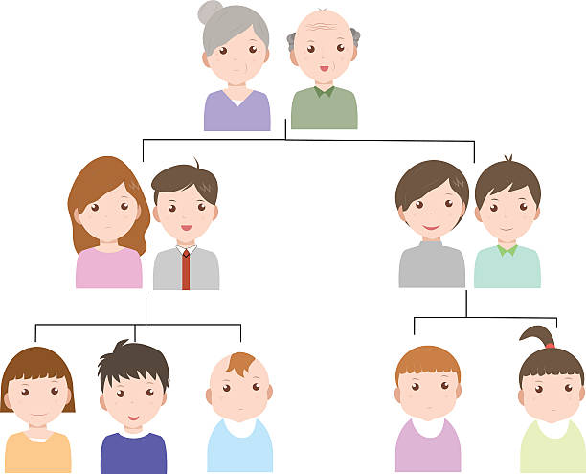
Minimalpaare
hören / sprechen
das Vieh
wie?
der Vetter
das Wetter
das Veilchen
das Weilchen
voll
die Wolle
Notes:
Timing: 2 minutes
Aim: To provide teacher-led pronunciation practice which draws attention to the importance of individual sounds in creating meaning.
Procedure: 1. Clicking on an image plays the German word(s).
2. Teacher leads class in imitating the pronunciation heard, drawing attention to the difference in meaning produced by changing between [v] and [w].
Word frequency (1 is the most frequent word in German):
Vieh [>5009] Veilchen [>5009] Weilchen [>5009] Vetter [>5009] Wetter [1881] voll [388] Wolle [>5009]
Source: Jones, R.L & Tschirner, E. (2011). A frequency dictionary of German: Core vocabulary for learners. London: Routledge.

Slide 26
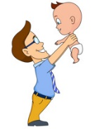
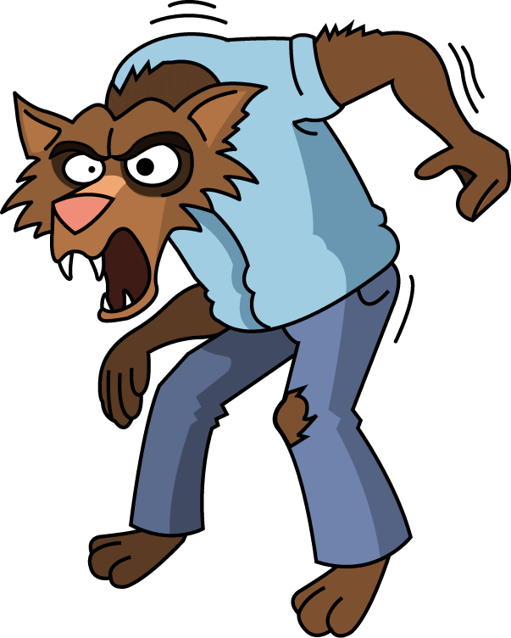
Wie sagt man das?
hören / schreiben
1
d e r W i k i n g e r
6
d e r V a t e r
__
__
2
S c h w e d e n
7
d e r W e r w o l f
__
__
__
3
d e r V o g e l
8
w i e v i e l e ?
__
__
__
4
d i e K r a w a t t e
9
v i e r u n d z w a n z i g
__
__
__
5
d a s V i e r e c k
10
w a r m
__
__
Notes:
Timing: 8 minutes
Aim: To help students strengthen the association with German SSC [v], and lose the interfering association with the English SSC [v].
Note: Words have been chosen which may have a surprising pronunciation in German (e.g. ‘Sweden vs Schweden’) or because they are pronounced similarly in German to English (e.g. Viking / Wikinger) which may throw students in terms of spelling.
Procedure: 1. Teacher to remind students to resist the temptation to write ‘v’ straight away for words they recognise from English. They must first listen, and focus on the sound.
2. Audio plays on clicking individual buttons.
3. Teacher can elicit responses by asking ‘Wie schreibt man das? Mit v oder mit w?’
4. Answers revealed on individual clicks.
Transcript:
1. der Wikinger
2. Schweden
3. der Vogel
4. die Krawatte
5. das Viereck
6. das Vater
7. der Werwolf
8. Wie viele?
9. Vierundzwanzig
10. warm
Word frequency (1 is the most frequent word in German):
Wikinger [>5009] Schweden [2478] Vogel [1701] Krawatte [>5009] Viereck [>5009] Vater [232] Werwolf [>5009] vierundzwanzig [>5009] warm [1281]
Source: Jones, R.L & Tschirner, E. (2011). A frequency dictionary of German: Core vocabulary for learners. London: Routledge.

Slide 27
Wie sagt man das?
sprechen
60
d e r W i k i n g e r
d e r V a t e r
S c h w e d e n
d e r W e r w o l f
Sekunden
d e r V o g e l
w i e v i e l e ?
d i e K r a w a t t e
v i e r u n d z w a n z i g
0
d a s V i e r e c k
w a r m
LOS!
Notes:
Timing: 3 minutes
Aim: To practise saying the words students have just learned.
Procedure: 1. Once they have practised a couple of times, the teacher can set the timer to see how many words students can pronounce correctly within ten seconds. Students act as jurors for one another. If a student pronounces a word incorrectly, they must start again!
2. Teacher may wish to run the times several times, depending on the needs of the class.
Word frequency (1 is the most frequent word in German):
Wikinger [>5009] Schweden [2478] Vogel [1701] Krawatte [>5009] Viereck [>5009] Vater [232] Werwolf [>5009] vierundzwanzig [>5009] warm [1281]
Source: Jones, R.L & Tschirner, E. (2011). A frequency dictionary of German: Core vocabulary for learners. London: Routledge.

Slide 28
Talking about what you and others are like
Grammatik
As you know, the verb sein has irregular forms which match the subject pronoun.
To say wir + sein:
The wir form of sein is the same as the sie (they) form.
Ich bin Einzelkind.
Du bist nett.
Sie ist Sängerin.
___
___
___
When using sein + noun to talk about yourself or others, no indefinite article is needed:
Ich bin Einzelkind.
This is different from English:
I am an only child.
Wir sind Einzelkinder.
We are only children.
Wir sind nett.
We are nice.
Wir sind Sänger.
We are singers.
___
___
___
Sie sind Einzelkinder.
They are only children.
Sie sind nett.
They are nice.
___
___
Notes:
Timing: 2 minutes
Aim: To introduce the wir form of the irregular verb sein.
Procedure: 1. Cycle through the information on the slide using the animation sequence.
2. Teacher to draw extra attention to the note on sein + no definite article in the bubble. Ask students what other structures this may refer to: Ich bin Student, Lehrer(-in), other job titles.

Slide 29
Was haben wir gemeinsam?
lesen
Wolfgang und Mehmet simsen. Wolfgangs Handy ist kaputt!
Was haben Wolfgang und Mehmet gemeinsam? Schreib beide (both) oder (-).
Mehmet: Ich denke, wir haben viel gemeinsam, nicht wahr?
Mehmet: Das ist toll! Wir wohnen auch beide in Berlin. Ich bin (-) auch kein Einzelkind.
Mehmet: Wir sind beide praktisch. Und wir haben beide Angst vor Katzen!
Mehmet: Ich gehe (-) aber in die Moschee.
___
___
___
___
___
Wolf: Ich gehe (-) manchmal in die Kirche. Sind wir beide nicht auch Zwillinge?!
Wolf: Ja! Wir lesen beide Krimis und hören beide auch Rockmusik.
___
___
Wolf: Haha, ja! Ich mag (-) Mias Katze nicht.
___
Wolf: Und ich bin
(-) Zwilling.
___
___
___
Notes:
Timing: 3 minutes
Aim: To practise linking verb endings with meaning (having things in common with someone, or not, according to whether the verb is first person singular or plural).
Procedure: 1. Teacher to draw attention to the verb simsen in the rubric. What kind of word is it? Students should be able to tell from the –en ending that it is a verb. They may be able to work out the meaning of simsen (to text) by recognising SMS and tying it into the context.
2. Teacher to draw attention to new word Krimis, presented with lesen. Teacher to ask students what kind of text this might be, and point to the importance of crime novels/films in German-speaking culture.
3. Students write ‘beide’ where the verb ending indicates a plrural subject; where the verb is sigular, they write (-). The prononuns are obscured to focus attention on the verb ending.
Note: Teachers need to make really clear to students that when the verb is singular (ich form) you cannot use ‘beide’ (both) so that’s when they would record (-). It will be clear once they get the hang of it, but will need clear explanation at the outset.
4. On individual clicks, each pronoun is revealed at the same time as the adverb beide, or (-), as applicable.
Word frequency (1 is the most frequent word in German):
Krimis [>5009] - kriminell [4289]
Source: Jones, R.L & Tschirner, E. (2011). A frequency dictionary of German: Core vocabulary for learners. London: Routledge.

Slide 30
Was haben wir gemeinsam?
Beide and auch are adverbs.
They come after the verb.
Remember
kein(e) + noun = ‘not a’
Was haben wir gemeinsam?
sprechen / schreiben
Einzelkind sein?
in die Moschee gehen?
“Bist du Einzelkind?”
“Ja, ich bin Einzelkind. Und du?”
“Ja, ich bin auch Einzelkind.”
Wir sind beide Einzelkinder.
“Bist du Einzelkind?”
“Nein, ich bin kein Einzelkind. Und du?”
“Nein, ich bin auch kein Einzelkind.”
Wir sind beide keine Einzelkinder.
“Gehst du in die Moschee?”
“Ja, ich gehe in die Moschee. Und du?
“Nein, ich gehe nicht in die Moschee. Ich gehe in die Kirche.”
Ich gehe in die Moschee und Sara geht in die Kirche.
Notes:
Timing: 3 minutes
Aim: To model questions, answers and sentences for the spoken and written exercise to come, which brings together the ich, er/sie and wir forms of all verbs studied so far.
Procedure: 1. Teacher to elicit questions, answers and written responses in each case, drawing attention to the following points:
- difference in meaning/usage between auch and beide;
- word order rule with Ich bin auch Einzelkind and Wir sind beide Einzelkinder. Which parts of speech are these? Where do they go in the sentence?
- use of kein(e) + noun to mean not a
Note: NCELP suggest that, having taught kein early on, it is important to include as much practice of the structure, in varied contexts and with varied lexis, as possible. However, if the teacher prefers to avoid this complexity introduced by kein + noun at this time, the task may by edited by substituting the sein + noun items for noun + adjective items (e.g. Bist du groß? Ja, ich bin groß / nein, ich bin nicht groß.)

Slide 31
Was haben wir gemeinsam?
Was haben wir gemeinsam?
sprechen / schreiben
1. Einzelkind sein? _________________________________________________________________________
2. in die Moschee gehen? ________________________________________________________________
3. Sänger(-in) sein? _______________________________________________________________________
4. Rockmusik hören? ______________________________________________________________________
5. streng sein? ____________________________________________________________________________
6. Kunst mögen? _________________________________________________________________________
7. schwimmen gehen? ___________________________________________________________________
8. Deutsch verstehen? ___________________________________________________________________
Notes:
Timing: 10 minutes
Aim: To practise productive use of the ich, er/sie and wir forms of verbs studied so far (speaking and writing), together with the use of the adverb beide to describe things they and their partner have in common.
Procedure: 1. Teacher to elicit some model answers from the class by saying ‘Was hast du mit deinem Partner gemeinsam?’
2. Students practise conversations such as those modelled on the previous slide.
3. They then write a summary statement along the lines of the examples on the previous slide.

Slide 32
Present simple or continuous?
Grammatik
English has two present tense forms.
I play the drums every week. I am playing the drums right now.
German has one present tense only. The BE + -ing form does not exist.
Ich spiele jede Woche Schlagzeug. Ich spiele jetzt Schlagzeug.
Present simple - normally; routine
Present continuous (BE + -ing) - ongoing; current
Adverbs of time tell us which English tense to choose.
Ich spiele =
I play AND
I am playing
In German, the present simple is used with all adverbs.
Notes:
Timing: 2 minutes
Aim: To continue to emphasise that one German present tense is equivalent to two English present tenses.
Note: Here, the metalanguage (present simple, present continuous and adverbs) used to talk about verbs in this and subsequent sequences is described and explained.
Procedure: 1. Cycle through the information on the slide using the animation sequence.
2. Teacher to highlight the distinction between present simple for routine actions and present continuous for current/ongoing actions.
3. Teacher to stress the fact that the BE + -ing form is an English construction only. Sein cannot be used with a verb this way.

Slide 33
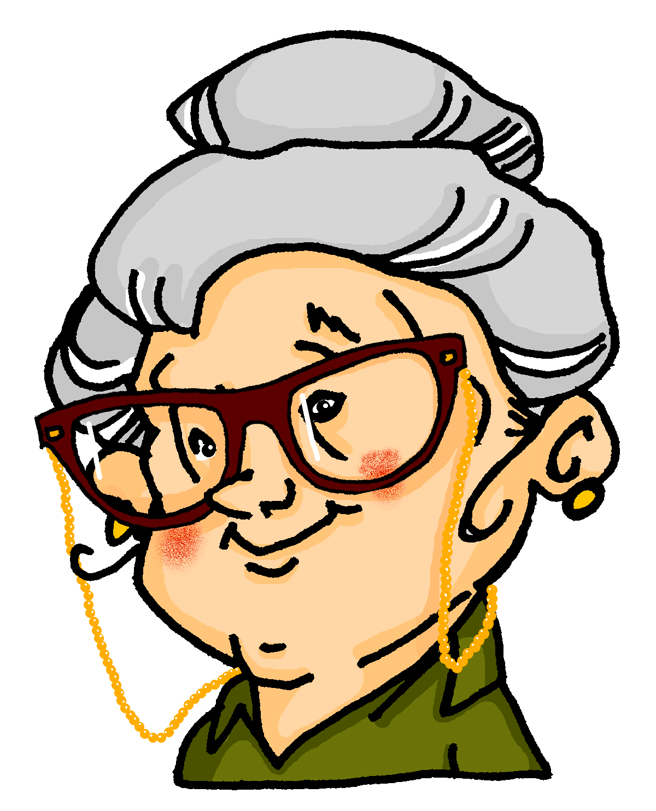
Present simple or continuous?
Present simple or continuous? [1/2]
Grammatik
Wolfgang and Mia are staying with Oma this week. She makes notes about their routine.
Choose the correct adverb.
A
Wolfgang is playing tennis at the moment/every week.
B
Mia wears a uniform at the moment/every week.
C
Mia is having lunch at the moment/every week.
D
Wolfgang is doing his homework at the moment/every week.
E
Mia goes for a walk at the moment/every week.
Notes:
Timing: 3 minutes
Aim: To teach students to connect temporal adverbs with tense.
Note: Awareness-raising exercise in English.
Procedure: 1. Students work out whether each sentence describes something happening ‘at the moment’ or ‘every week’.
2. Click to reveal the correct answers.
3. Teacher to ask students to explain how they knew the answer. By looking at the verb form in present tense, we can tell whether an action happens routinely (present simple) or is happening currently (present continuous). This tells us which adverb to use. Explain that as there is only one verb form in German, the verb does not give us this information.

Slide 34
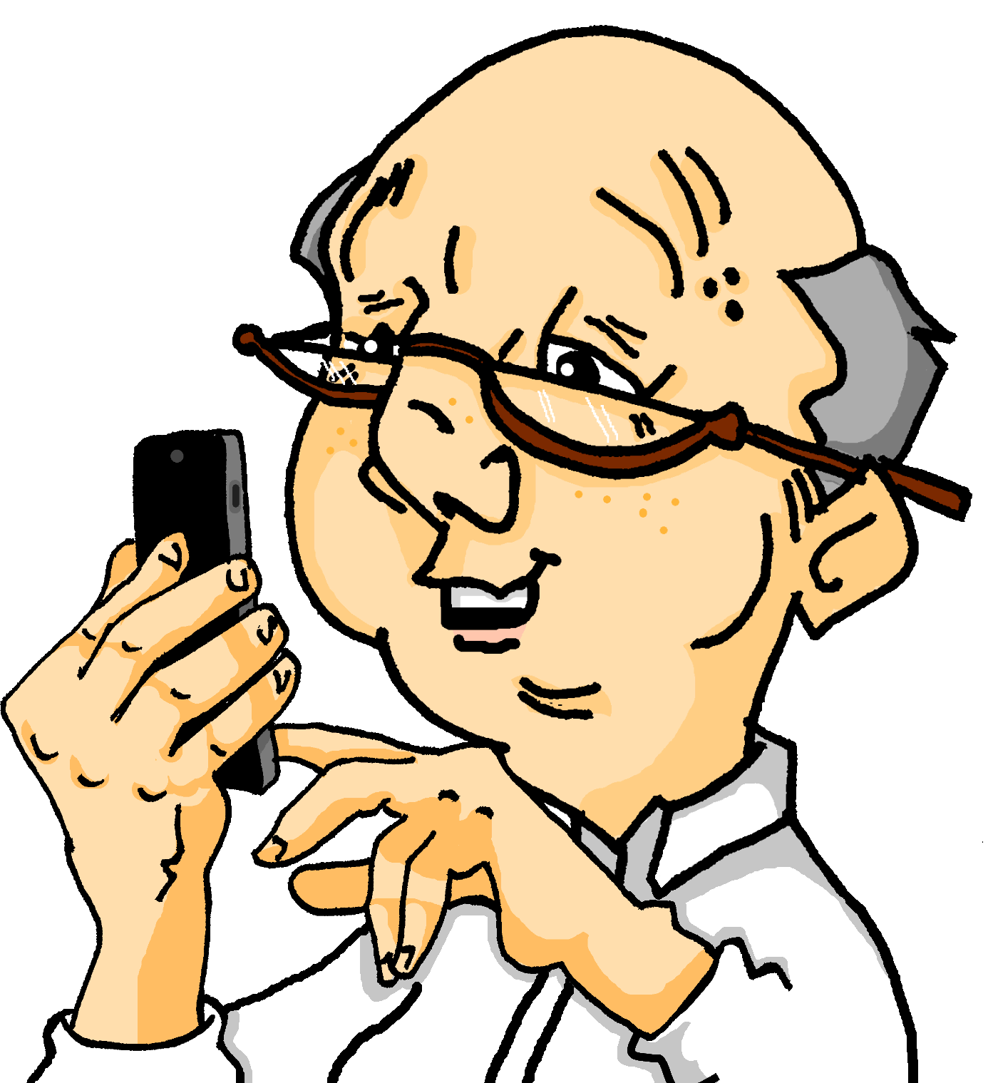
Present simple or continuous?
Speaking exercise
Present simple or continuous? [2/2]
hören
Oma calls Opa to tell him about Wolfgang and Mia.
Choose present simple or continuous.
A
Wolfgang does/is doing his homework.
B
Wolfgang and Mia go/are going to school.
C
Mia plays/is playing the clarinet.
D
Wolfgang and Mia plays/are playing on the computer.
E
Mia swims/is swimming.
Notes:
Timing: 3 minutes
Aim: To practise considering whether German sentences imply a simple or continuous present tense translation in the English (listening).
Procedure: 1. Students listen and work out whether each sentence heard is best translated into English by use of the simple or continuous present (as cued by ‘jede Woche’ and ‘jetzt’ respectively in the audio).
2. Answers revealed on the next slide.
Transcript:
A. Wolfgang macht jetzt Hausaufgaben.
B. Wolfgang und Mia gehen jetzt in die Schule.
C. Mia spielt jede Woche Klarinette.
D. Wolfgang und Mia spielen jetzt zusammen Computer.
E. Mia schwimmt jede Woche.

Slide 35
Present simple or continuous?
Speaking exercise
Antworten
hören
Oma calls Opa to tell him about Wolfgang and Mia.
Choose present simple or continuous.
A
Wolfgang does/is doing his homework.
B
Wolfgang and Mia go/are going to school.
C
Mia plays/is playing the clarinet.
D
Wolfgang and Mia plays/are playing on the computer.
E
Mia swims/is swimming.
Notes:
Timing: 2 minutes
Aim: To reveal the answers to the listening activity on the previous slide.
Procedure: 1. Answers revealed on clicks.
Note: There is no audio attached to this answer slide.

Slide 36
Wolfgang und Mia reisen nach Österreich
hören / schreiben
Wolfgang und Mia haben heute keine Schule. Sie reisen mit Opa und Oma nach Österreich!
Die Familie reist nach Wien und wohnt in einem Hotel. Opa und Oma haben zusammen ein Zimmer und Wolfgang und Mia auch. Wolfgang und Mias Zimmer ist sehr groß. Es gibt einen Tisch, viele Fenster und zwei Betten. Die Tür ist grün und der Boden ist gelb. Wolfgang mag das Zimmer, aber Mia mag das Zimmer nicht. Sie denkt, das Zimmer ist hässlich.
Wien ist sehr multikulturell. Wolfgang und Mia hören viele Fremdsprachen. Sie verstehen ein bisschen Englisch, und hören auch Französisch, Spanisch und Türkisch! Wien ist auch sehr schön. Wolfgang und Mia gehen zum Stephansplatz. Es gibt ein Museum, viele Cafés und eine Kirche. Die Kirche heißt “der Stephansdom” und sie ist sehr groß. Mia findet die Kultur in Wien interessant. Sie mag den Stephansplatz sehr.
Wolfgang denkt, die Kirche ist langweilig. Er findet Monumente nicht so interessant. Er findet das Café aber ganz toll! Das Essen ist sehr lecker. Es gibt Apfelstrudel! Wolfgang findet die Kultur in Wien jetzt auch interessant. Mehmet bekommt ein Stück Apfelstrudel als Geschenk!
______________
_____.
_____
_____________________________________.
____.
_______.
_______________.
________,
______________________________
____________.
___________.
______.
______________________
Notes:
Timing: 3 minutes
Aim: To provide a segmentation exercise.
Note: This consists entirely of known words and cognates, can be treated as a reading exercise, a listening exercise, or a multimodal exercise, as described below.
Procedure:
1. Teacher presses play. Students listen to the audio and read along.
2. Teacher pauses the audio before the gaps.
3. Students and teacher summarise the meaning of what has come before as a class.
4. Students are then given 10 seconds to propose a sensible word which could come next, and to write it down.
5. Teacher elicits suggestions from the class (Mit wem reisen sie? Wo wohnen sie?). Multiple suggestions are possible.
Students should be encouraged to be creative, and recap vocabulary from across the term.
6. Teacher reveals the written solution by clicking on the gap, and press play to continue.
Note: If time permits, students can write a summary from audio only, or work with the written text to produce a summary or full translation.

Slide 37
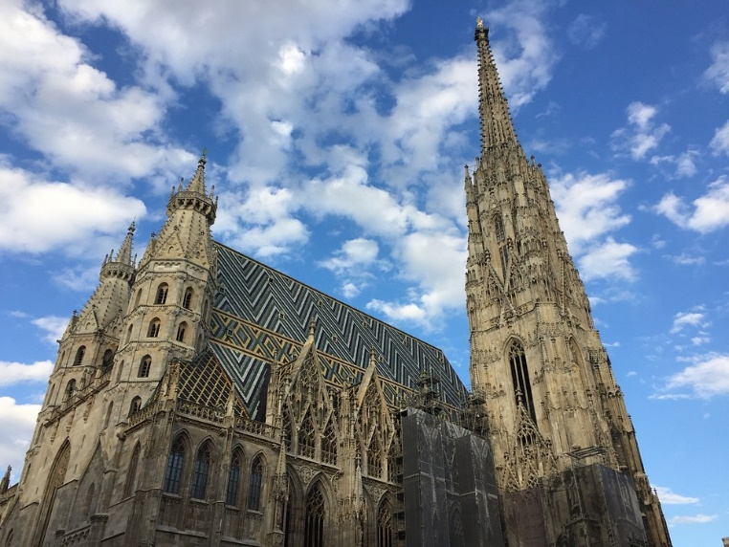
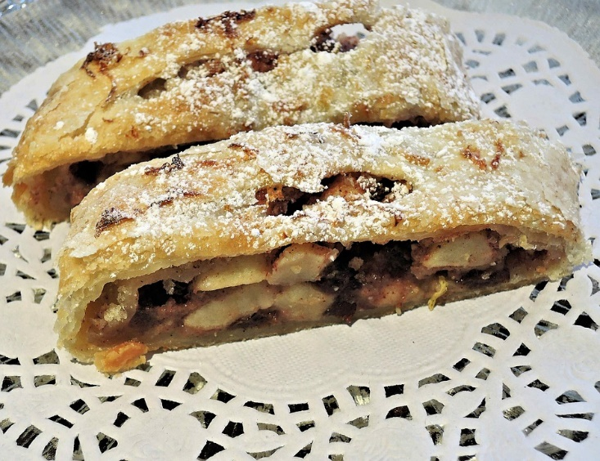
Wolfgang und Mia reisen nach Österreich
Wolfgang und Mia reisen nach Österreich
Der Stephansdom ist 136 Meter groß. Er ist eine der größten Kirchen der Welt!
Apfelstrudel kommt aus Wien. Man braucht für einen Strudel Äpfel, Rosinen, Zucker und viel Butter. Ein Strudel ist nicht sehr gesund, aber er ist sehr lecker!
Notes:
Supplementary slide with some additional information about some of the cultural aspects mentioned in the text.
Word frequency (1 is the most frequent word in German):
Apfelstrudel [>5009] Rosine [>5009] Zucker [2559] Butter [4960]
Source: Jones, R.L & Tschirner, E. (2011). A frequency dictionary of German: Core vocabulary for learners. London: Routledge.

Slide 38
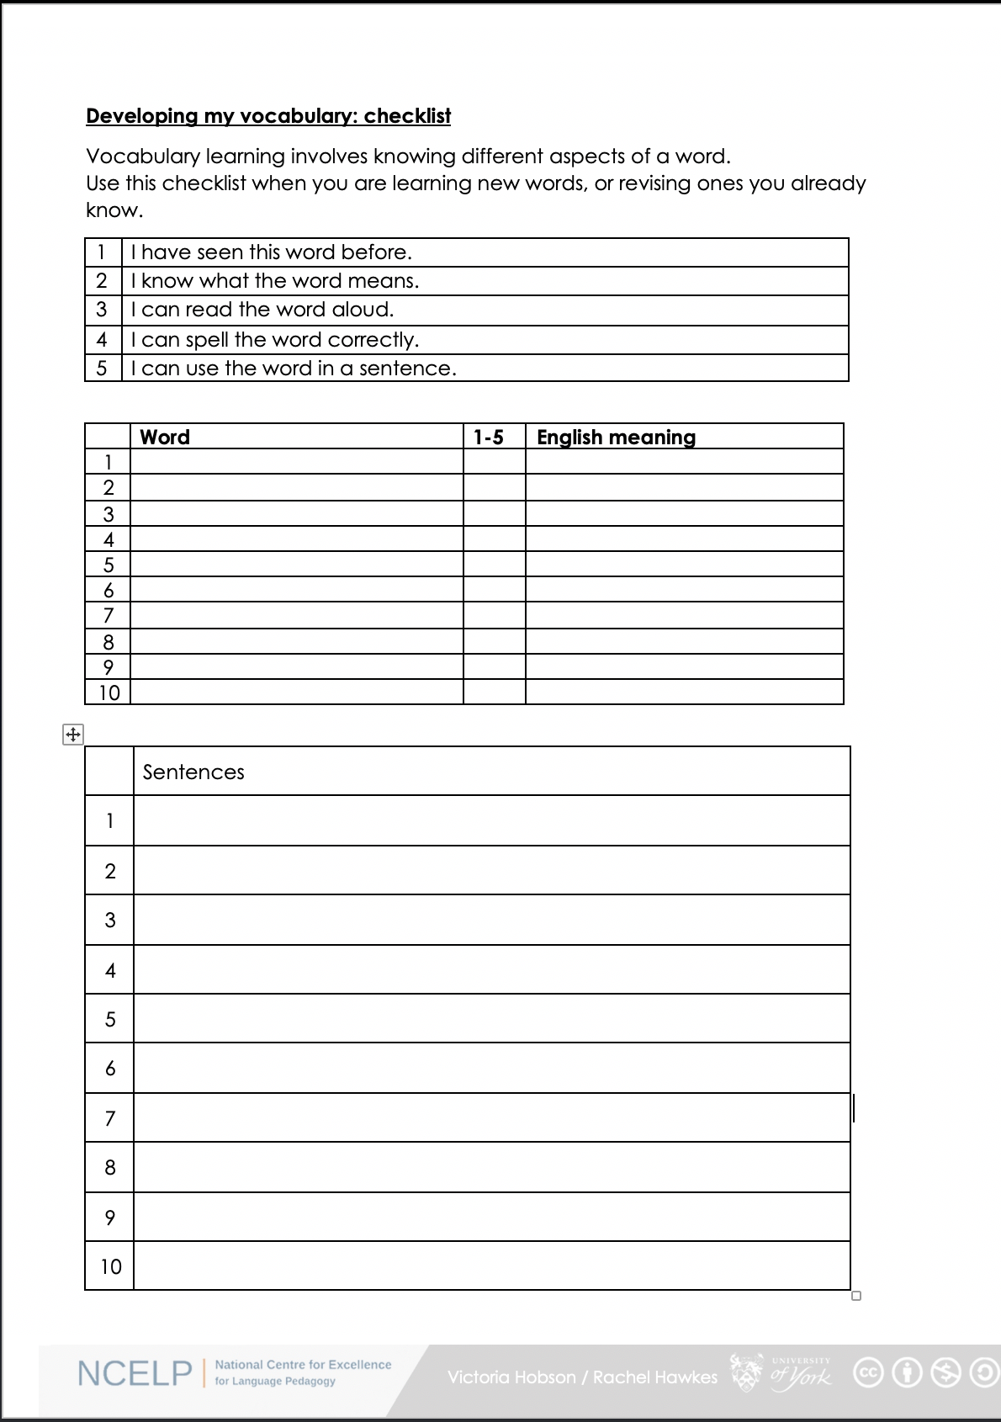
Wiederholung
How well do you know the words we have learned so far?
1. I have seen this word before.
2. I know what the word means.
3. I can read the word aloud.
4. I can spell the word correctly.
5. I can use the word in a sentence.
6. I know the gender of nouns.
All of these aspects will come up in the test!
Notes:
Timing: 2 minutes
Aim: To introduce a checklist to help students consider what it means to ‘know’ a word.
Procedure:
1. Teacher talks students through the checklist. Remind students that all these elements of word knowledge will be tested.
Vocabulary learning involves knowing different aspects of a word. Students can use this checklist when to check what they know when they are learning new words or revising ones they already know.
For each word the checklist asks students to assess whether the following statements apply:
1. I have seen this word before.
2. I know what the word means.
3. I can read the word aloud.
4. I can spell the word correctly.
5. I can use the word in a sentence.
2. Students then translate the word and try to use it in a sentence.
3. We suggest giving students a printout of the template.
A word template is available on the NCELP resource portal.
https://resources.ncelp.org/concern/resources/gf06g264k?locale=en

Slide 39
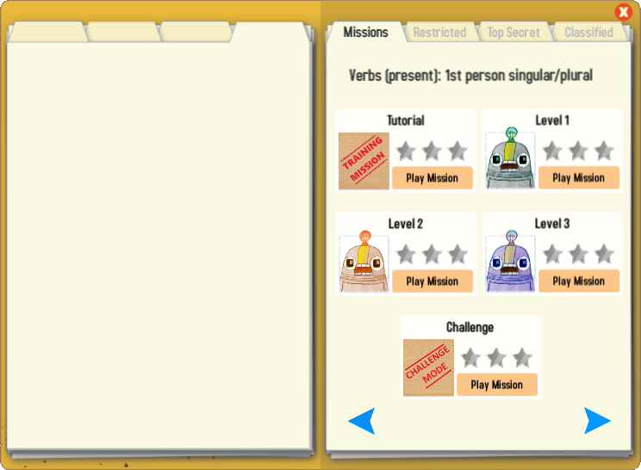
Gaming Grammar
Try the following Gaming Grammar missions to practise:

Slide 40
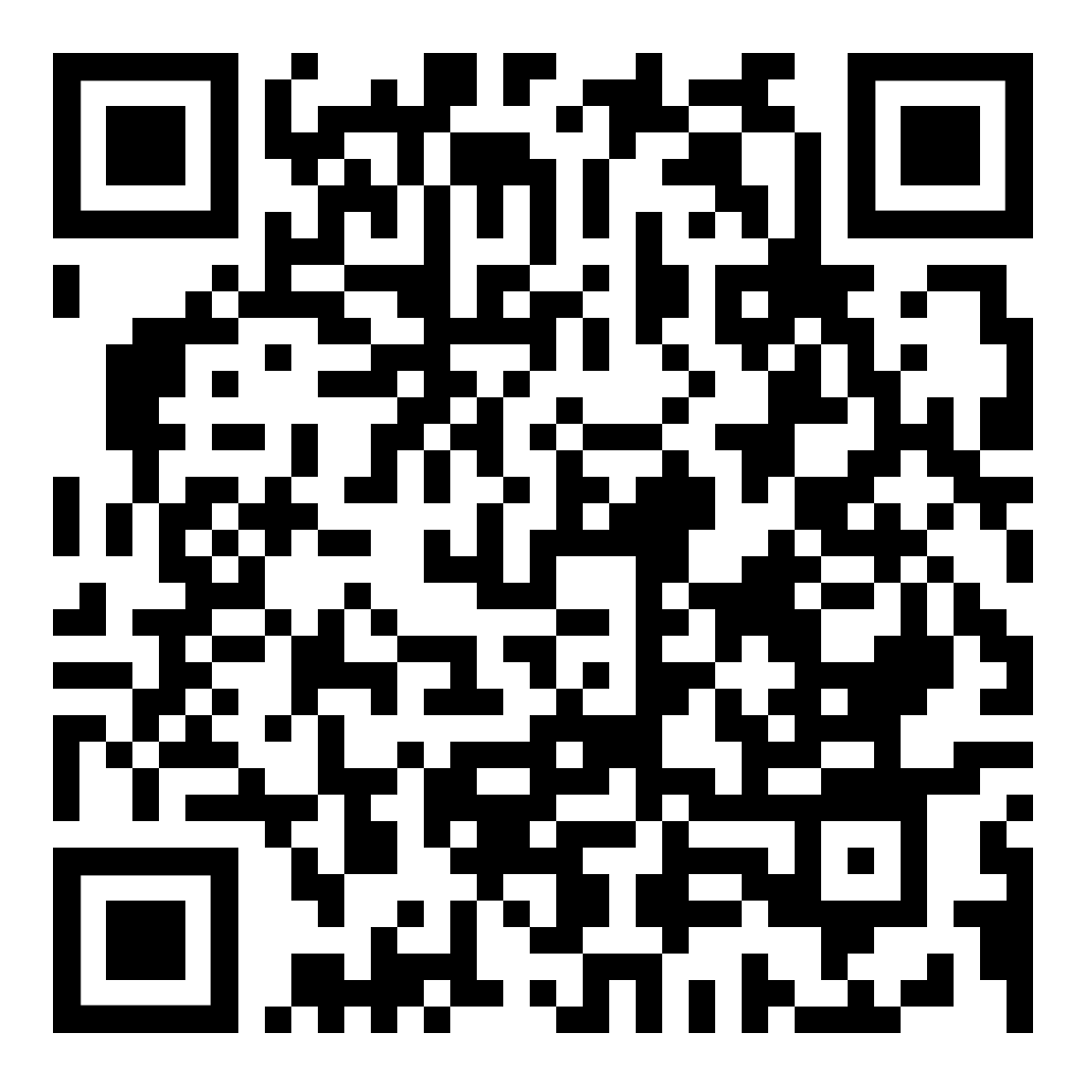
Hausaufgaben
Vocabulary Learning Homework (Y7, Term 2.2, Week 2)
Audio file
Audio file QR code:
Student worksheet
Quizlet link
In addition, revisit: Term 2.1 Week 4
Term 1.2 Week 5
Notes:
Use this slide to set the homework.

