Slide 1
Comparing where people go and went
‘Ir’ in the past (preterite) – ‘fui’ and ‘fuiste’
Using ‘al’ and ‘a la’ [revisited]
Y8 Spanish
Term 3.1 - Week 6 – Lesson 59
Amanda Izquierdo / Pete Watson / Nick Avery Artwork: Mark Davies
Date updated: 22/10/21
Notes:
Artwork by Mark Davies. All additional pictures selected are available under a Creative Commons license, no attribution required.
Native teacher feedback provided by Blanca Román.
Learning outcomes:
Introduction of ‘fui’ and ‘fuiste’
Consolidation of ‘voy’
Consolidation of final syllable stress and spelling rules
Consolidation of ‘para’ + infinitive
Word frequency (1 is the most frequent word in Spanish):
New vocabulary: fui [33]; fuiste [33]; fue [33]; apoyar [666]; celebrar [886]; zona [359]; septiembre [1150]; octubre [1242]; noviembre [1434]; diciembre [1165]; colegio [628]; avión [1399]; historia² [186]; directo [1029]; simplemente [731]; principalmente [1657]
Revisited vocabulary:
Y8 3.1.3
entrar [207]; prestar [1075]; ambiente [729]; cansado [1818]; enfermo [1092]; emocionado [>5000]; enojado [>5000]; peor [694]; menos [117]; que² [3]; vale [571]; ¿de verdad? [176]
Y8 2.2.3
interesar [575]; importar [506]; alegrar [2252]; molestar [1377]; gustar [163]; encantar [1202]; preocupar [852]; difícil [374]; fácil [584]
Source: Davies, M. & Davies, K. (2018). A frequency dictionary of Spanish: Core vocabulary for learners (2nd ed.). Routledge: London
The frequency rankings for words that occur in this PowerPoint which have been previously introduced in NCELP resources are given in the NCELP SOW and in the resources that first introduced and formally re-visited those words.
For any other words that occur incidentally in this PowerPoint, frequency rankings will be provided in the notes field wherever possible.

Slide 2
Vocabulario
leer
c
E
__aminar
__ste
o
p
i
s
bonit__
__eor
opc__ón
__eñor
t
a
u
__engo
v__le
m__cho
p
im__ortar
d
r
í
__ar
pe__der
t__a
d
a
__ónde
t__mbién
y
s
e
o
pre__tar
__s
per__
a
ñ
e
b__jo
ni__o
s
__nojado
can__ado
d
a
s
verda__
g__to
intere__ar
e
c
i
u
d
a
d
e
s
d
e
E
s
p
a
ñ
a
__res
s
y
o
t
r
o
s
p
a
í
s
e
s
__oy
Notes:
Starter
Timing: 2 minutes
Aim: to work out which letters are missing and to share the context for the next activity.
Procedure:
1. Students write the missing letter for each word.
2. Each vertical column of words will create a single word in Spanish. Together, these create ‘ciudades de España y otros países’, the context for the next activity.
3. Elicit the English translations of these words from students to ensure that they understand them.
Notes:
Some words could be given upfront to support students here, if helpful.
Vocabulary here is taken from both Year 7 and Year 8.

Slide 3
Ciudades de España y otros países de habla hispana
escuchar / escribir
Escucha y escribe la ciudad. Remember: if the stress is on the last syllable, and the word ends in a vowel or the consonants ‘n’ or ‘s’, there will be an accent on the last vowel.
 | palabras con tilde | palabras sin tilde
1
Bogotá
Remember, ‘tilde’ is another word for the written accent in Spanish.
2
Jaén
3
Guayaquil
4
Badajoz
5
Medellín
6
Santander
7
Potosí
8
León
Notes:
Timing: 5 minutes
Aim: to consolidate final syllable stress and use of the written accent
Procedure:
Students listen and write the word.
They’ll then need to decide whether it requires an accent or not above the final vowel.
Notes:
Alternatively, if teachers wish to focus students’ attention solely on the spelling rule (without any transcription), the words could be shown without accents. Students could still hear the words, but in fact they would only need to look at the final letter to decide whether or not an accent is needed.
‘De habla hispana’ has been used incidentally in some earlier resources (e.g. alternative homework slide in 8.3.1.3). It may be necessary to give students the meaning upfront.
Transcript:
Bogotá
Jaén
Guayaquil
Badajoz
Medellín
Santander
Potosí
León

Slide 4
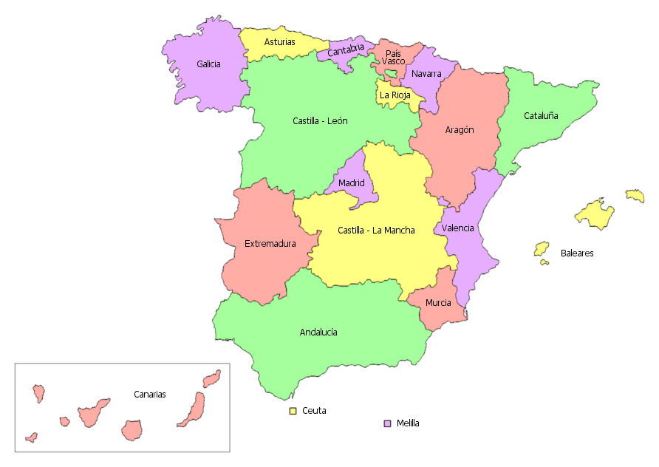
Ahora pronuncia los nombres de las ciudades.
¿En qué país está cada ciudad?
Las opciones son: Bolivia, España, Colombia y Ecuador.
leer / hablar
Guayaquil está en...
Ecuador.
Potosí está en...
Bolivia.
España.
Bogotá y Medellín están en...
Jaen, Badajoz, León y Santander están en...
Colombia.
Santander
Medellín
León
Bogotá
Guayaquil
Potosí
Badajoz
Jaén
Notes:
Timing: 2 minutes
Aim: to practise final syllable stress in oral production; to learn where the cities from the previous activity are located.
Procedure:
The teacher shows the names of the cities one by one with a mouse click whilst students say the name of the city out loud.
Students are then asked which country each city/set of cities belongs to. The four answer options are displayed in the title. This not intended to be a test of knowledge, although students are likely to be able to get the first two answers, given that earlier resources have taught students about the geogrpahy of both Spain and Bolivia using maps. Ecuador and Colombia may be less familiar, but this is an opportunity for learning.
Note: the pre-verbal position of prepositions (‘en qué país está…’) has not yet been taught explicitly. The question may well be understood, but it is worth asking students for a translation of the instructions to be sure, and clarifying if necessary. Year 9 resources will include teaching of this feature.

Slide 5
Lucía va de viaje a Badajoz con Daniel y sus amigos. Escribe las palabras que no están en inglés.
Diálogo 2
leer
Estoy menos enojado que Nadia.
I am _______ _______ _______ Nadia.
Diálogo 1
less
angry
than
¡Estoy muy cansada! No quiero entrar en el museo.
I am very ________!
I don’t want to _______ / _______ the museum.
¿De verdad? ¡Yo estoy muy emocionada!
________ ? I am very ________ !
Yo estoy un poco enfermo, ¡tengo mucho calor!
I am a bit _______. I’m very hot!
tired
enter
ill
go into
Really
excited
¿Te presto mi botella de agua?
Shall I ________ you my bottle of water?
El ambiente fuera del museo es peor que dentro.
The ______________ outside the museum is ________ ________ inside.
lend
atmosphere
¡Vale!
______!
worse
Ok
than
Notes:
Vocabulary practice slide [1/2]
Timing: 5 minutes
Aim: to practise receptive recall of vocabulary (this slide) and then oral productive recall (next slide)
Procedure: 1. Students read the sentences in Spanish and complete the English sentences.
2. On the next slide, students have to say the Spanish words themselves, reading each mini-dialogue aloud with a partner.
Note: In English, ‘shall…?’ is often used for suggestions, whereas there is no direct equivalent in Spanish (the present simple can be used on its own). Understanding of this is not needed to complete the activity, but it might be useful to point out.

Slide 6
Lucía va de viaje a Badajoz con Daniel y sus amigos. Lee el texto en español con un/a companera/a.
hablar
Estoy ________ _________ ____ Nadia.
I am less angry than Nadia.
¡Estoy muy __________! No quiero ________ en el museo.
I am very tired! I don’t want to enter/go into the museum.
menos
enojado
que
cansada
¿___________? ¡Yo estoy muy _______________!
Really? I am very excited !
entrar
De verdad
emocionada
Yo estoy un poco __________, ¡tengo mucho calor!
I am a bit ill. I’m very hot!
enfermo
¿Te ________ mi botella de agua?
Shall I lend you my bottle of water?
presto
El __________ fuera del museo es ________ ________ dentro.
The atmosphere outside the museum is worse than inside.
ambiente
peor
que
Vale
¡_____!
Ok!
Notes:
Vocabulary practice slide [2/2]
The activity continues from the previous slide (now involving L1 -> L2 oral translation).

Slide 7
Vocabulario
leer
el avión
to support
apoyar
To say ‘to go by plane’, use ‘ir en avión’.
la historia
to celebrate
celebrar
In Spain, ‘el colegio’ is used to refer to ‘school’ in general and ‘primary school’. ‘La escuela’ is used to talk about other types of schools: ‘escuela de idiomas’.
straight,
direct
directo
area, zone
la zona
simply
‘Directo’ is both adverb and adjective:
‘una pregunta directa’.
simplemente
mainly,
principally
el colegio
principalmente
Notes:
Vocabulary practice slide [1/2]
Timing: 6 minutes (two slides)
Aim: to introduce and embed this week’s new vocabulary.
Procedure:
Pupils either work by themselves or in pairs, reading out the words and recapping their English meaning.
Then the teacher removes the English words or pictures (one by one) and they try to recall the English orally (chorally), looking at the Spanish.
Then the Spanish meanings are removed (one by one) and they try to recall them orally (again, chorally), looking at the English.
Further rounds of learning can be facilitated by one pupil turning away from the board, and his/her partner asking him/her the meanings (¿‘Cómo se dice X en español?’). This activity can work from L2 → L1 or L1 → L2.
Follow the same procedure on the next slide with the new months of the year. Before the vocabulary activity, there is a callout about months not having capital letters in Spanish.
Note:
Regarding the differences between 'escuela' and 'colegio', the RAE says:
colegio m.Establecimiento de enseñanza para niños y jóvenes. m.Edificio del colegio. escuela f. Establecimiento público donde se da a los niños la instrucción primaria.
RAE defines these two words in a very similar way, and both words can be used indistinctively. However, there are some differences.
In Spain, the word 'colegio' is a much more frequent word used to refer to 'primary school'. This is the institutional word used to name all schools, whether they are public or private ('Colegio La Milagrosa', 'Colegio Mencey Bencomo', etc.). This means that the word 'colegio' is used to describe the official type of educational institution; the acronym for any primary school in Spain is CEIP (Colegio de Educación Infantil y Primaria), and it's also the word that people commonly use to talk about 'school’. The word 'escuela' is mainly used for extra-curricular education. It's the official name used for music schools, language schools, etc. ('Escuela Oficial de Música', 'Escuela Oficial de Idiomas', etc.). 'Escuela' is also used for small primary schools, for example rural schools ('Escuela rural').
‘Instituto’ is a state secondary school in Spain which is usually for the 12-16 age range. This word will be taught in Year 9.

Slide 8
Vocabulario
leer
septiembre
Remember, days and months in Spanish don’t have capital letters!
noviembre
octubre
diciembre
Notes:
Vocabulary practice slide [2/2]

Slide 9
Saying where people go ‘Voy’ and ‘vas’ [revisited]
gramática
Some verbs do not follow the general rules.
The verb ‘ir’ (to go) is one example.
Remember, to say ‘I go’ (or ‘I am going’) in Spanish, use ‘____’.
voy
I go by plane.
Voy en avión.
vas
To say ‘you go’ (or ‘you are going’), say ‘_____’.
You go by train.
Vas en tren.
Notes:
Timing: 1 minute
Aim: to revise the use of ‘voy’ and ‘vas’ as ‘I go’, ‘you go’ and ’I’m going to’ and ‘you are going to’.
Procedure:
Go through the grammar explanation with students, revealing each new sentence with a mouse click.

Slide 10
Saying where people went Using ‘fui’ and ‘fuiste’
gramática
The verb ‘ir’ (to go) is also irregular in the past (preterite).
To say ‘I went’ for a completed action, say ‘fui’:
Fui directo a la playa.
I went straight to the beach.
To say ‘you went’ for a completed action, say ‘fuiste’:
Fuiste en octubre.
You went in October.
Notes:
Timing: 2 minutes
Aim: to introduce the first and second person singular forms for the verb ‘ir’ in the preterite: ‘fui’ and ‘fuiste’.
Procedure:
Go through the grammar explanation with students, revealing each new sentence with a mouse click.

Slide 11
How to say ‘to the’ Using ‘a la’ and ‘al’ [revisited]
gramática
Remember that the word ‘a’ (to) is often used to say where someone goes.
a la
Before a singular feminine noun (e.g. tienda), ‘to the’ is ‘_____’.
Fui a la tienda.
I went to the shop.
al
Before a singular masculine noun (e.g. colegio), ‘to the’ is ‘___’.
Fui al colegio.
I went to the school.
When ‘el’ appears after ‘a’, these two words always come together as ‘al’.
Notes:
Timing: 1 minute
Aim: to revisit the use of ‘a la’ and ‘al’.
Procedure:
Go through the grammar explanation with students, revealing each new sentence with a mouse click.

Slide 12
fui
[I went]
fuiste
[you went]
Notes:
Timing: 3 minutes [1/6]
Aim: to introduce the 1st and 2nd person singular forms of the verb ‘ir’ in preterite.
Procedure:
Bring up the word ‘fui’ on its own, say it, students repeat it, and teachers remind them of the phonics involved.
Try to elicit the meaning from the students.
Then bring up the English translations.
Bring up the 2nd person form ‘fuiste’, say it, students repeat it.
Try to elicit the meanings from the students.

Slide 13
fui
[I went]
fuiste
[you went]
Notes:
[2/6]
Cycle through the 1st and the 2nd person singular again.

Slide 14
fui
[I went]
Fui al concierto.
[I went to the concert.]
Notes:
[3/6]
Introduce the 1st person singular form in a sentence.

Slide 15
fuiste
[you went]
Fuiste en avión.
[You went by plane.]
Notes:
[4/6]
Introduce the 2nd person singular form in a sentence.

Slide 16
fui
[I went]
Fui
____ al concierto.
[I went to the concert.]
Notes:
[5/6]
Cycle through the 1st person singular form in context again.

Slide 17
fuiste
[you went]
Fuiste
______ en avión.
[You went by plane.]
Notes:
[6/6]
Cycle through the 2nd person singular form in context again.

Slide 18
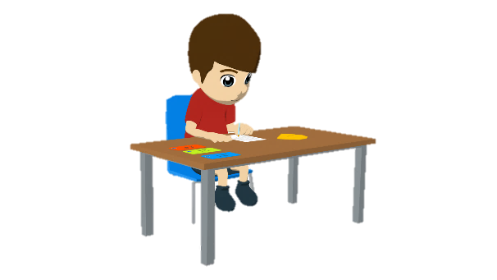
leer
Daniel escribe unas frases. Lee y marca: ¿es ‘normalmente’ o ‘en el pasado’?
¿Cuál es la palabra correcta? Finalmente, decide: ¿es raro o normal?
leer
 |  | Goes normally | Went in the past
1 | Voy al colegio / tienda para comprar ropa.
2 | Quién sabe por qué fui a la montaña / centro. ¿Quizás para celebrar el cumpleaños de un amigo?
3 | Fui al calle / partido principalmente para apoyar a los jugadores.
4 | Por la tarde voy a la jardín / estación para ver el mar.
5 | Fui al iglesia / mercado simplemente para comprar comida.
6 | Por la mañana voy a la concierto / plaza para escuchar música fuerte.
7 | Voy directo al torre / banco para prestar dinero a Hugo.
8 | Por la noche fui a la ciudad / campo para pasar tiempo en la naturaleza.
Piensa: ¿es normal o raro?
e.g. Es normal / raro ir al colegio para comprar ropa.
Notes:
Timing: 7 minutes
Aim: to practise choosing between the meanings of ‘voy’ and ‘fui’; to consolidate understanding of ‘al’ and ‘a la’; to test students’ comprehension of vocabulary.
Procedure: 1. Students read each sentence and decide which is the correct noun. To do this they need to pay attention to ‘al’ and ‘a la’.
2. They also decide if Daniel goes normally or went in the past. Some students will be able to do this at the same time as the last step.
3. The answers are shown for each question in turn by clicking. This first reveals the correct noun and then when the action occurs.
4. Lastly, students need to decide whether the sentence describes something that is ’normal’ or ‘raro’. The aim at this stage is to think about the meaning of the words in the sentence. This opinion can be given by using the infinitive ‘ir’ and ‘al’/’a la’, as shown in the example. It can be done as a whole class activity or in pairs. Answers may be disputed (which is why they are not provided on the screen), but we anticipate that sentences 1, 4 and 8 are likely to be considered strange!
Notes:
As one word used in the task is ‘estación’ (item 4), it might be useful to check whether students remember that all nouns ending in –ción are feminine (this was taught earlier in Y8).
In some parts of the Spanish-speaking world there is a preference for the word ‘alto’ to express ‘loud’.

Slide 19
Lucía habla con Daniel. Is she talking about herself (‘I went’) or about Daniel (‘you went’)? Where did that person go (dónde), and when (cuándo)?
leer / esuchar
[1/2]
 | ‘I went’ | ‘you went’ | ¿Dónde? | ¿Cuándo? (en inglés)
1 |  |  | colegio tienda pueden ser las dos
2 |  |  | montaña estación pueden ser las dos
3 |  |  | colegio tienda pueden ser las dos
4 |  |  | extranjero isla pueden ser las dos
5 |  |  | pueblo clase pueden ser las dos
1
in October
Sometimes both answers will be possible!
2
last weekend
3
in November
4
last year
5
yesterday
Notes:
Timing: 8 minutes [1/2]
Aim: to practise choosing between the meanings of ‘fui’ and ‘fuiste’; to also consolidate understanding of ‘al’ vs ‘a la’ and vocabulary.
Procedure: 1. The teacher explains how the task works. The first one or two could be done as examples, to ensure understanding of the task.
2. Students first listen to each sentence and tick the correct column depending on what they hear: ‘fui’ or ‘fuiste’.
3. They also select the correct option, a, b or c, depending on whether they hear ‘al’ or ‘a la’. In some cases, the answer options are the same gender and therefore the answer will be ‘c’. It is fine to play the audio again here, if needed, even if some students are able to complete both parts in one go.
4. Finally, students write when it happened in English. This may have been done already, or it may require the audio to be played again.
5. The answers for each item are shown by clicking anywhere on the screen.
Transcript:
Fui al [beep] en octubre.
Fuiste a la [beep] el fin de semana pasado.
Fuiste a la [beep] en noviembre
Fui al [beep] el año pasado.
Fui directo a la [beep] ayer.

Slide 20
leer / escuchar
Lucía habla con Daniel. Is she talking about herself (‘I went’) or about Daniel (‘you went’)? Which is the correct noun? Sometimes it can be both.
leer / esuchar
[2/2]
 | ‘I went’ | ‘you went’ |  | ¿Cuándo?
1 |  |  | pueblo campo pueden ser las dos
2 |  |  | cocina habitación pueden ser las dos
3 |  |  | zona de costa frontera pueden ser las dos
4 |  |  | frontera concierto pueden ser las dos
5 |  |  | fiesta de Año Nuevo. edificio alto. pueden ser las dos
6
last summer
7
yesterday in the morning
8
during the holidays
9
on the trip to Bogotá
10
in December
Notes:
Slide [2/2]
Transcript:
6. Fuiste al [beep] el verano pasado.
7. Fuiste directo a la [beep] ayer por la mañana.
8. Fui a la [beep] durante las vacaciones.
9. Fuiste al [beep] en el viaje a Bogotá.
10. Fui a la [beep] en diciembre.

Slide 21
¿Dónde fuiste?
escribir / hablar / escuchar
Hablamos en parejas.
El estudiante A elige una tarjeta y dice la frase en español. ¡No necesita ir en orden*!
El estudiante B escucha y completa la frase en la tarjeta correcta.
Ejemplo:
En diciembre fui al parque en San José.
Estudiante A habla
Estudiante B escribe
In December, I went to the park in San José.
In December, _________________________________.
¡Atención! Remember to use ‘al’ with masculine nouns.
I went to the park in San José
1
1
*orden - order
Notes:
Paired oral translation task
Timing: 10 minutes
Aim: to correctly produce and understand ‘fui’ and ‘fuiste’ and vocabulary, including time markers.
Procedure:
Student A is prompted in English to produce Spanish sentences with a time in the past, ‘fui’ or ‘fuiste’ and a noun. The task also encourages production of ‘al’ or ‘a la’, but this is secondary (see notes). Student A is encouraged to choose a random order in which to say the sentences (which means that the partner has to listen carefully to identify the correct card). However, this is optional; for some groups, it may be better to progress in numerical order.
Student B listens to the sentence and completes the corresponding sentence in English on the correct card. To choose the correct card, the correct time marker will need to be identified.
Students can compare their cards to check their answers afterwards. There is also an answer slide on slide 23 that can also be shown after the activity to facilitate feedback. Answers on that slide are animated to appear in order on each click.
Notes:
The activity is set up to allow students to continue practising ‘al’ vs ‘a la’ (now in production). These features are not an essential part of the task, but teachers can still monitor and give feedback on students’ accuracy in using them.
The activity could segue into a freer oral translation activity where students create their own sentences and share them with a partner.
Frequency of unknown words/cognates:
orden [421]

Slide 22
hablar / escuchar / escribir
Estudiante A
Estudiante B
escribir / hablar / escuchar
In October, I went to the new school in Concepción.
In November, you went to the centre of Medellín.
In October, _________________________________.
In November, _________________________________.
1
2
1
2
Last week, I went to the concert in Jaén.
Last summer, I went to the museum in Guayaquil.
Last week, _________________________________
Last summer, _________________________________.
3
4
3
4
In December, you went to the tower in Badajoz .
Last weekend, I went to the town in Potosí.
In December, _________________________________.
Last weekend, _________________________________.
5
6
5
6
Notes:
DO NOT DISPLAY DURING ACTIVITY

Slide 23
escribir / hablar / escuchar
Estudiante A
Estudiante B
Yesterday, _________________________________.
Last year, _________________________________.
Yesterday, you went to the beach in Bogotá.
Last year, you went to the station in Jaén.
1
2
1
2
In December, _________________________________.
In November, _________________________________.
In December, I went to the shop in Bogotá.
In November, you went to the theatre in Santander.
3
4
3
4
Yesterday, _________________________________.
In October, _________________________________.
Yesterday, I went to the old building in León.
In October, I went to the border in Medellín.
5
6
5
6
Notes:
DO NOT DISPLAY DURING ACTIVITY

Slide 24
escribir / hablar / escuchar
Respuestas: Estudiante A
Estudiante B
Yesterday, you went to the beach in Bogotá.
Last year, you went to the station in Jaén.
In October, I went to the new school in Concepción.
In November, you went to the centre of Medellín.
1
2
1
2
In December, I went to the shop in Bogotá.
In November, you went to the theatre in Santander.
Last week, I went to the concert in Jaén.
Last summer, I went to the museum in Guayaquil.
3
4
3
4
Yesterday, I went to the old building in León.
In October, I went to the border in Medellín.
In December, you went to the tower in Badajoz.
Last weekend, I went to the town in Potosí.
5
6
5
6
Notes:
ANSWER SLIDE - DO NOT DISPLAY DURING ACTIVITY

Slide 25
Comparing where people go and went
‘Ir’ in the past (preterite) – ‘fui’, ‘fuiste’ & ‘fue’
Final syllable stress and spelling rules
Y8 Spanish
Term 3.1 - Week 6 – Lesson 60
Amanda Izquierdo / Pete Watson / Nick Avery Artwork: Mark Davies
Date updated: 22/10/21
Notes:
Artwork by Mark Davies. All additional pictures selected are available under a Creative Commons license, no attribution required.
Native teacher feedback provided by Blanca Román.
Learning outcomes:
Introduction of ‘fue’
Introduction of adverbs ending in –mente and their correspondence with English -ly
Consolidation of ‘voy’, ‘vas’ and ‘va’
Consolidation of ‘fui’ and ‘fuiste’
Consolidation of final syllable stress and spelling rules
Consolidation of ‘para’ + infinitive
Word frequency (1 is the most frequent word in Spanish):
New vocabulary: fui [33]; fuiste [33]; fue [33]; apoyar [666]; celebrar [886]; zona [359]; septiembre [1150]; octubre [1242]; noviembre [1434]; diciembre [1165]; colegio [628]; avión [1399]; historia² [186]; directo [1029]; simplemente [731]; principalmente [1657]
Revisiting:
Y8 3.1.3
entrar [207]; prestar [1075]; ambiente [729]; cansado [1818]; enfermo [1092]; emocionado [>5000]; enojado [>5000]; peor [694]; menos [117]; que² [3]; vale [571]; ¿de verdad? [176]
Y8 2.2.3
interesar [575]; importar [506]; alegrar [2252]; molestar [1377]; gustar [163]; encantar [1202]; preocupar [852]; difícil [374]; fácil [584]
Source: Davies, M. & Davies, K. (2018). A frequency dictionary of Spanish: Core vocabulary for learners (2nd ed.). Routledge: London
The frequency rankings for words that occur in this PowerPoint which have been previously introduced in NCELP resources are given in the NCELP SOW and in the resources that first introduced and formally re-visited those words.
For any other words that occur incidentally in this PowerPoint, frequency rankings will be provided in the notes field wherever possible.

Slide 26
Ciudades de España y otros países de habla hispana
hablar / escuchar / escribir
Leemos, escuchamos y escribimos nombres de ciudades en Latinoamérica y en España.
El estudiante A lee los nombres de las ciudades.
San José (Costa Rica)
El estudiante B escucha y escribe los nombres. ¿Tienen tilde o no?
It needs the written accent because the final syllable is stressed and it ends in a vowel.
Ejemplo:
Estudiante A
Estudiante B
 | Nombres de ciudades
1 | San José
San José
 | Nombres de ciudades
1
San José
Notes:
Timing: 3 minutes.
Aim: to consolidate final syllable stress and use of the written accent.
Procedure:
Student A says each city name on the list. Most of the words have been seen in the previous lesson; however, there are four new place names: Alcalá, Popayán, Gijón, San Sebastián. All city names have final syllable stress, but they end in different letters.
Student B writes the name considering the use of the written accent.
Students swap roles.

Slide 27
Estudiante A
Estudiante B
 | Nombres de ciudades
1
2
3
4
5
6
 | Nombres de ciudades
1
2
3
4
5
6
Potosí
Bogotá
Medellín
Jaén
Badajoz
Santander
León
Alcalá
Gijón
Popayán
San Sebastián
Guayaquil
Notes:
SPEAKING CARDS - DO NOT DISPLAY DURING ACTIVITY

Slide 28
Estudiante A
Respuestas
Estudiante B
 | Nombres de ciudades
1
2
3
4
5
6
 | Nombres de ciudades
1
2
3
4
5
6
Bogotá
Potosí
Jaén
Medellín
Santander
Badajoz
Alcalá
León
Popayán
Gijón
Guayaquil
San Sebastián
Notes:
ANSWERS

Slide 29
¿Cuáles son las ciudades?
Ahora mira dónde están las otras.
leer / hablar
Gijón
5. Santander
5. S _ _ _ _ _ _ _ _
1. M _ _ _ _ _ _ _
1. Medellín
San Sebastián
6. L _ _ _
6. León
2. Bogotá
Popayán
2. B _ _ _ _ _
Alcalá
3. Guayaquil
3. G _ _ _ _ _ _ _ _
4. P _ _ _ _ _
7. B _ _ _ _ _ _
4. Potosí
7. Badajoz
8. J _ _ _
8. Jaén
Notes:
Timing: 3 minutes
Aim: (1) to see if students can recall the place names for cities that were already used in lesson 1; (2) to show students the locations of new city names used the previous activity; (3) to consolidate final syllable stress in oral production
Procedure:
Teacher asks students for the names of the cities they saw in the previous lesson. This is a low-stakes activity and is not intended to be a test! S/he could ask, e.g., ‘la ciudad número dos, ¿cuál es?’.
Students try to recall the name of each city and its pronunciation (i.e. with final syllable stress).
Teacher clicks anywhere to reveal the answers in numerical order.
Teacher shows the names of the new cities one by one with a mouse click.

Slide 30
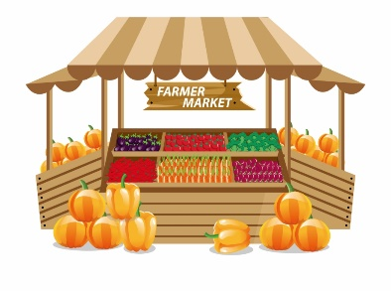
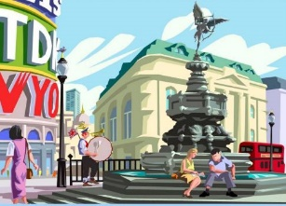
¿Qué piensa Lucía de las ciudades? Escribe la letra correcta. Escribe su opinión en inglés.
escuchar
A
B
 | ¿Qué letra? | ¿Qué piensa Lucía?
1
interests
A
The market in Guayaquil _________ her.
[market]
2
makes
happy
easy life
E
The square full of people in Bogotá _______ her _______.
D
C
3
The museum in Medellín _____________________ to her.
H
matters / is important
[landscape]
pleases
likes
4
C
The landscape in Popayán ________ her (she _____ it).
E
F
difficult
life
annoys
5
B
The noise in Santander _______ her.
6
G
matters / is important
The history of León ______________________ to her.
[square]
7
D
delights
The easy life in San Sebastián _________ her (she _____ it).
G
loves
H
8
F
worries
The difficult life in Potosí _______ her.
[museum]
Notes:
Timing: 6 minutes
Aim: to recap opinion phrases in the ‘s/he’ form with singular objects.
Procedure:
1. Students write 1-8 in their exercise books.
2. Teachers play the recording by clicking the number button. Students write the letter of the picture that the noun in the sentence corresponds to (e.g. 1=A).
3. Students listen again and complete the translation in English. The focus here is on the opinion phrase. It might take 2 listens for some students.
4. The answers are shown for each item (first the letter corresponding to the vocabulary item, then the missing word in the translation).
Transcript:
Le interesa el mercado en Guayaquil.
Le alegra la plaza llena de gente en Bogotá.
Le importa el museo en Medellín.
Le gusta el paisaje en Popayán.
Le molesta el ruido en Santander.
Le importa la historia de León.
Le encanta la vida fácil en San Sebastián.
Le preocupa la vida difícil en Potosí.
Note: Potosí was once one of the most economically important places in the entire Spanish empire. The mountain behind the city was mined for silver, and still continues to be mined today for zinc and tin, but this is dangerous, low-paid work. Those who work in the mines commonly suffer health issues from breathing in dust, even at a young age. Due to the lack of alternative employment opportunities in the region, miners often have little choice but to continue.

Slide 31
Trabaja en parejas. Crea frases para tu compañero.
hablar
Ejemplo:
Persona A: “2H”
Persona B: “Le interesa el museo en Medellín.”
A
B
the market in Guayaquil
the noise in Santander
 | Opinión
1) | It worries her.
2) | It interests her.
3) | It makes her happy.
4) | It delights her (she loves it).
5) | It annoys her.
6) | It matters / is important to her.
7) | It pleases her (she likes it).
D
the easy life
C
in San Sebastián
the landscape in Popayán
E
F
the difficult life
in Potosí
the square in Bogotá
G
H
the history of León
the museum in Medellín
Notes:
Timing: 4 minutes
Aim: speaking activity to practise production of opinion phrases using gustar-type verbs with singular objects.
Procedure:
1. It may be useful for the teacher to do a couple of examples first. Teachers pick a number and letter and students have to say the correct sentence, as per the example on the slide.
2. Then students work in pairs, taking it in turns to choose a letter and number and the partner has to answer. The number and letter should be said in Spanish.
3. Extension ideas: Teachers could encourage students to add a reason why using ‘porque es/son…’. Teachers could also add some negative phrases to the table ‘they don’t interest her/him’.
4. The activity could be adapted to involve listening too. One partner says a sentence such as ‘me gusta el museo en Medellín’, and the partner has to write down the correct number and letter.
Differentiation: Spanish word order is often flexible. Students could also practise giving their sentences with the subject first (e.g. El museo en Medellín le interesa). Both word orders have been covered already in the scheme of work.

Slide 32
Sayung where people go ‘Voy’, ‘vas’ and ‘va’ [revisited]
gramática
voy
Remember that in Spanish to say ‘I go’ (or I am going), say _____.
I go to a quiet area/zone.
Voy a una zona tranquila.
vas
To say ‘you go’ (or ‘you are going’), say _____.
You go in November.
Vas en noviembre.
To say ‘s/he goes’ or ‘it goes’ (or ‘s/he is going’), say ____.
va
S/he goes to school.
Va al colegio.
Notes:
Timing: 2 minutes
Aim: to revise the use of ‘voy’, ‘vas’ and ‘va’.
Procedure:
Go through the grammar explanation with students, revealing each new sentence with a mouse click.

Slide 33
Saying where people went ‘Ir’ in the past: fui, fuiste, fue
gramática
Remember that some verbs do not follow the general rules.
The verb ‘ir’ (to go) is one example.
fui
To say ‘I went’ for a completed action, say ____.
I went to the centre.
Fui al centro.
To say ‘you went’ for a completed action, say ______.
fuiste
You went straight to school.
Fuiste directo al colegio.
To say ‘s/he went’ or ‘it went’, say fue.
Fue en avión.
S/he went by plane.
Notes:
Timing: 2 minutes
Aim: to revise first and second person singular forms for the verb ‘ir’ in the preterite: ‘fui’ and ‘fuiste’; to introduce the third person singular ‘fue’.
Procedure:
Go through the grammar explanation with students, revealing each new sentence with a mouse click.
Note: for the third sentence, the Spanish is given first because the grammar feature is new, and students first work with it receptively (rather than being required to produce it, which is more challenging).

Slide 34
fui
[I went]
fue
[s/he went, it went]
Notes:
Timing: 3 minutes [1/6]
Aim: to introduce the 1st and 3rd person singular forms of the verb ‘ir’ in the preterite.
Procedure:
Bring up the word ‘fui’ on its own, say it, students repeat it, and remind them of the phonics.
Try to elicit the meaning from the students.
Then bring up the English translations.
Bring up the 3rd person form ‘fue’, say it, students repeat it.
Try to elicit the meanings from the students.

Slide 35
fui
[I went]
fue
[s/he went, it went]
Notes:
[2/6]
Cycle through the 1st and the 3rd person singular again.

Slide 36
fui
[I went]
Fui en septiembre.
[I went in September.]
Notes:
[3/6]
Introduce the 1st person singular form in a sentence.

Slide 37
fue
[s/he went, it went]
Fue en diciembre.
[S/he went or it went in December.]
Notes:
[4/6]
Introduce the 3rd person singular form in a sentence.

Slide 38
fui
[I went]
Fui
____ en septiembre.
[I went in September.]
Notes:
[5/6]
Cycle through the 1st person singular form in context again.

Slide 39
fue
[s/he went, it went]
Fue
______ en diciembre.
[S/he went or it went in December.]
Notes:
[6/6]
Cycle through the 3rd person singular form in context again.

Slide 40
Un viaje a otro país de habla hispana
leer
leer
Lee los extractos de una conversación entre Lucía (‘I’) y Nadia (‘you’). Lucía describe unos viajes del pasado.
Who… | Lucía (‘I’) | Nadia (‘you’) | Daniel (‘he’)
1. went to Popayán?
2. went by plane to Bogotá?
3. went to Medellín in December?
4. went to an area near the mountain?
5. went to the centre?
6. went mainly to get to know the history?
Completa la tabla.
1. “Fue a Popayán”.
2. “Fui en avión a Bogotá.”
3. “Fuiste a Medellín en diciembre.”
4. “Fui a una zona cerca de la montaña.”
5. “Fuiste al centro.”
6. “Fue principalmente para conocer la historia.”
Notes:
Timing: 6 minutes
Aim: reading activity to practise connecting the verb forms ‘fui’, ‘fuiste’ and ‘fue’ with their meanings
Procedure:
Students read the extracts in order to fill in the table, ticking the column for the person who did each action. If working in their exercise books, they can just write, e.g., 1. he.
Teachers click to reveal the answers.
Notes:
The activity could easily be adapted for a higher-achieving group by changing the order of the questions, which currently appear in the same order as in the text.
The text has been slightly adapted to facilitate grammar practice (e.g. by removing pronouns).
‘De habla hispana’ has been used incidentally in earlier activities. Its meaning may need to be given upfront by teachers.

Slide 41
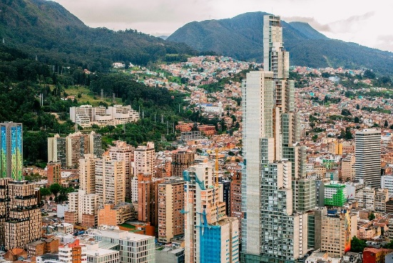
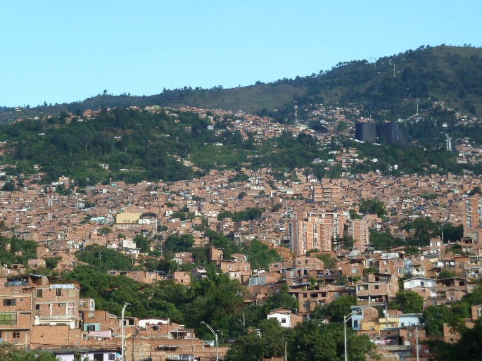
leer
Lucía habla con Nadia sobre viajes y ciudades.
Escucha y completa el texto.
leer / escuchar
¡Me encantan los viajes! El verano pasado fui en avión a Bogotá con Daniel, ________________ para conocer la historia del lugar. Él también fue a Popayán, pero yo no fui ______________ porque me molestan los autobuses antiguos. Tú fuiste a Medellín el año pasado en diciembre para celebrar la Navidad, ¿no? Yo fui a una zona cerca de la montaña allí, pero tú fuiste al centro con tu familia.
principalmente
simplemente
Bogotá
Medellín
Notes:
Timing: 7 minutes
Aim: to accurately transcribe the adverbs and understand the text
Procedure: 1. Students listen and complete the text with the missing adverbs. Their meaning can be elicited from students as both words as part of the new vocabulary this week. This will lead into the next activity, which focuses on the correspondence between –mente in Spanish and –ly in English.
2. With the text now complete, students can read it and be then be asked comprehension questions focusing on the vocabulary. This could be done using direct questions, e.g., 1. Why did Lucía and Daniel go to Bogotá? 2. Why didn’t Lucía go to Popayán? 3. When and why did Nadia go to Medellín? Which part of the city did she go to?

Slide 42
Vocabulario
hablar
¿Cómo se dice en español?
–ly words only have an accent if the original adjective has an accent!
principally
(mainly)
principalmente
NB: All these words are adverbs formed from adjectives:
simple = adjective
simplemente = adverb
simply
simplemente
-ly at the end of an English word often changes to –mente in Spanish.
Notes:
Timing: 1 minute
Aim: to explain the ‘–mente’ suffix in Spanish and its correspondence to ‘–ly’ in English.
Procedure:
The teacher elicits the Spanish for ‘principally’ and ‘simply’ (both words introduced this week).
The teacher reads through the follow-up explanations.
Note: on the next slide, a further rule will be introduced regarding the use of the feminine adjective to form such adverbs.

Slide 43
Vocabulario
hablar
exact (f) = exacta
Many adjectives have a masculine (‘-o’) and feminine (‘-a’) form.
basic (f) = básica
To create the adverb, take the ‘–a’ form and add ‘–mente’.
perfect (f) = perfecta
completo
completa
completamente
absolute (f) = absoluta
complete (m)
complete (f)
(completely)
¿Cómo se dice en español?
immediate (f) = inmediata
correctly
basically
básicamente
seguramente
correctamente
perfectly
surely, safely
perfectamente
clearly
directly
directamente
immediately
claramente
inmediatamente
absolutely
absolutamente
Notes:
Timing: 3 minutes
Aim: to practise word formation with the ‘–mente’ suffix and to reinforce its connection with ‘–ly’ in English.
Procedure:
The teacher clicks to bring up the rule regarding adverb formation.
Students are given one minute in pairs to think about the Spanish for the eight ‘–ly’ words. 5 of the 8 words are unknown, so their adjective forms are given upfront. The 3 remaining adjectives are known vocabulary items (correcto, seguro, directo).
The teacher asks students to say the Spanish for the English words (this can be in any order).
Answers are revealed by clicking on the English text box.
Frequency values of unknown words/cognates:
básico [1156]; absoluto [1096]; exacto [1486]; inmediato [1166]; perfecto [1115]

Slide 44
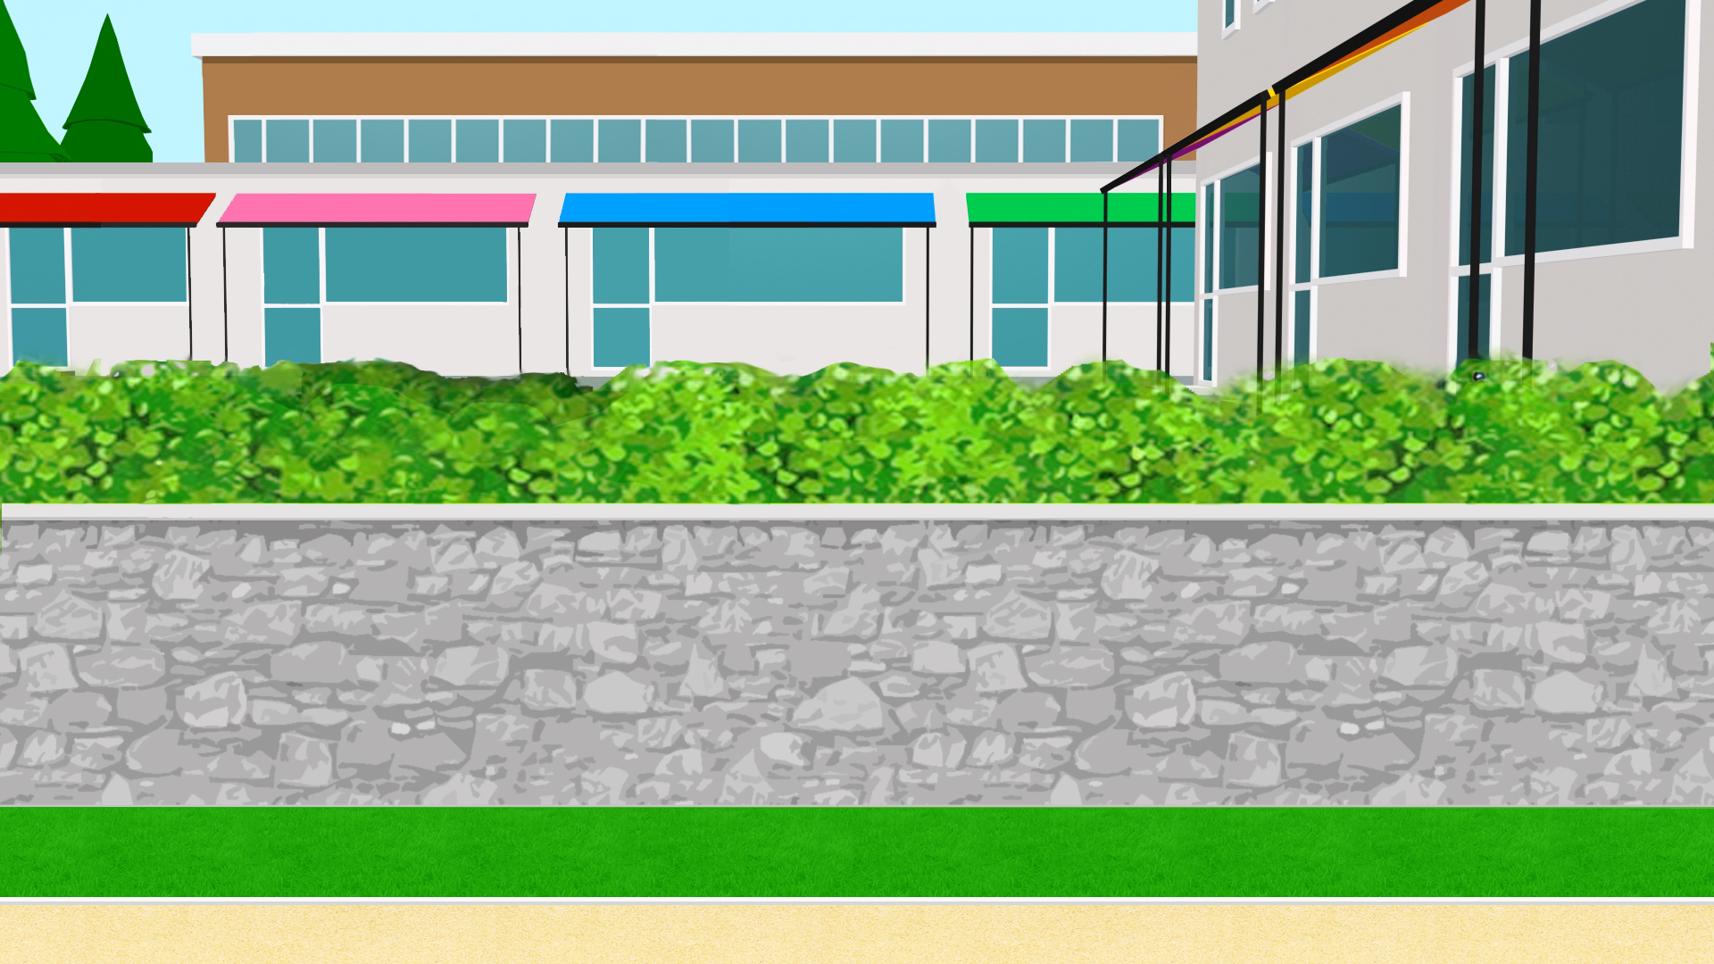
Nadia habla sobre dónde va en meses diferentes del año. También habla sobre su hermana.
escuchar / escribir
Durante las vacaciones en diciembre voy a...
Escucha la primera parte y toma notas:
¿Dónde va Nadia? ¿y su hermana?
¿Cuándo, y para qué (e.g. para visitar algo)?
Luego escucha la segunda parte y toma notas:
¿Dónde fue Nadia? ¿y su hermana?
¿Cuándo, y para qué (e.g. para visitar algo)?
Compara tus notas con un/a compañera/a después de escuchar. Luego intenta escribir unas frases completas con la información.
1
Primera parte: los viajes cada año
2
Segunda parte: los viajes del año pasado
Notes:
Timing: 7 minutes
Aim: to practise listening and note-taking in Spanish; to work collaboratively to reconstruct information from a text using some of the features practised and revisited this week.
Procedure:
Students work in pairs or small groups, with each person being given a different question or pair of questions to take notes on in each part.
Students listen to each recording a couple of times and take notes on key information related to the questions.
Students then work together in their pairs or small groups to reconstruct the text themselves. This is likely to involve using a number of known features (see below), though it isn’t a necessity to use them (students might be able to express the meaning in alternative ways).
Text reconstruction may include
different singular forms of ‘ir’ in present and past (preterite)
time markers
para + infinitive
-ly adverbs
‘al’ and ‘a la’
all the vocabulary items introduced this week
Note: Although students have practised extensively with ‘para’ + infinitive in Year 8, the intended meaning of ‘para qué’ may need to be made clear during instructions. It may be useful to give a literal English translation here (‘in order to do what’?). Both ‘para qué’ and ‘por qué’ may translate as ‘why’, so it may be best not to use that word here, to avoid confusion.
Transcript:
1. Cada año
Durante las vacaciones en diciembre voy a León para aprender sobre la historia de la ciudad. Frecuentemente mi hermana también va, pero no le interesan los edificios antiguos, así que voy sola cuando quiero visitar los edificios. Voy al centro principalmente para entrar a museos porque me encanta el arte. En noviembre generalmente voy en avión a Medellín para ver a mis abuelos, aunque mi hermana simplemente va a la costa en Gijón para disfrutar el ambiente.
2. El año pasado
El año pasado en septiembre fui a Jaén para apoyar al equipo de fútbol, mientras que mi hermana fue a San Sebastián para celebrar su cumpleaños. Después, en octubre, ella no fue al colegio durante una semana, básicamente porque fue con la clase a la montaña en Santander para conocer la naturaleza de la zona.

Slide 45
Lee el texto y compara con tus notas:
escuchar / escribir
1. Primera parte (los viajes cada año)
Durante las vacaciones en diciembre voy a León para aprender sobre la historia de la ciudad. Frecuentemente mi hermana también va, pero no le interesan los edificios antiguos, así que voy sola cuando quiero visitar los edificios. Voy al centro principalmente para entrar a museos porque me encanta el arte. En noviembre generalmente voy en avión a Medellín para ver a mis abuelos, aunque mi hermana simplemente va a la costa en Gijón para disfrutar el ambiente.
2. Segunda parte (los viajes del año pasado)
El año pasado en septiembre fui a Jaén para apoyar al equipo de fútbol, mientras que mi hermana fue a San Sebastián para celebrar su cumpleaños. Después, en octubre, ella no fue al colegio durante una semana, básicamente porque fue con la clase a la montaña en Santander para conocer la naturaleza de la zona.
Notes:
Timing: 2 minutes
Aim: for students to check their answers to the previous activity by looking at the transcript.
Procedure:
Students read the transcript and compare the information they find with their notes.
It may be useful to continue working with a partner here to clarify any meanings that are still unclear.
Notes:
It would also be correct to say ‘disfrutar del ambiente’ (see final line of the first text). See https://dle.rae.es/disfrutar
Students could also use these texts for a paired read aloud and/or L2->L1 oral translation.

Slide 46
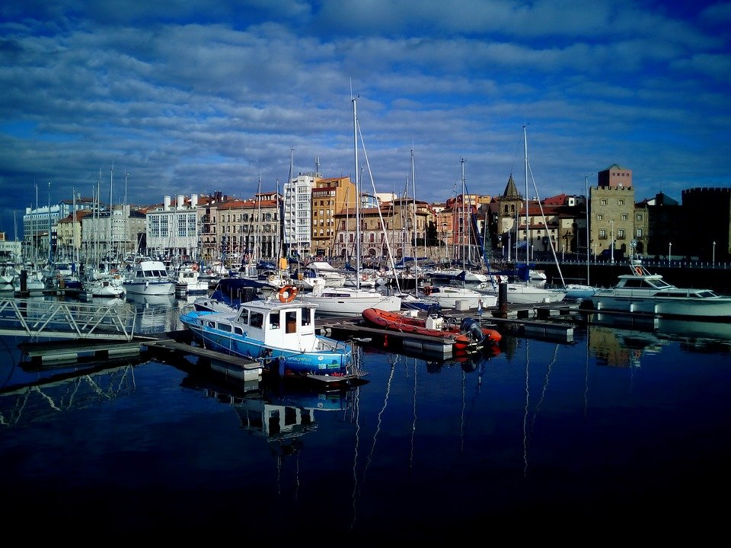
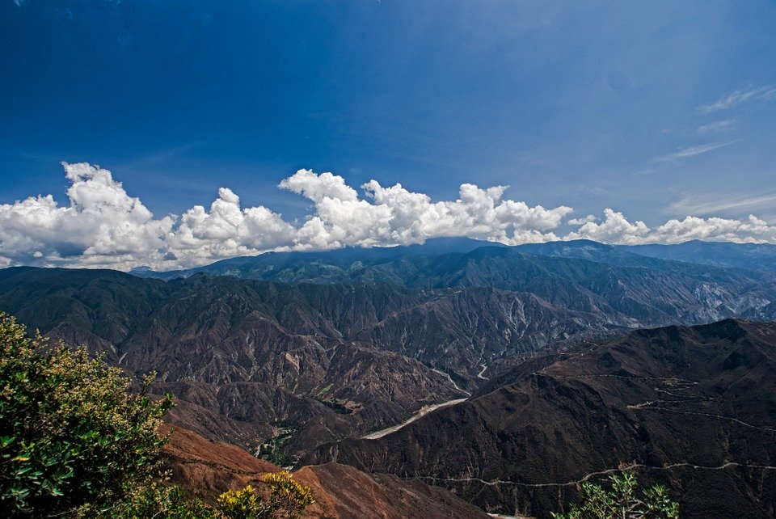
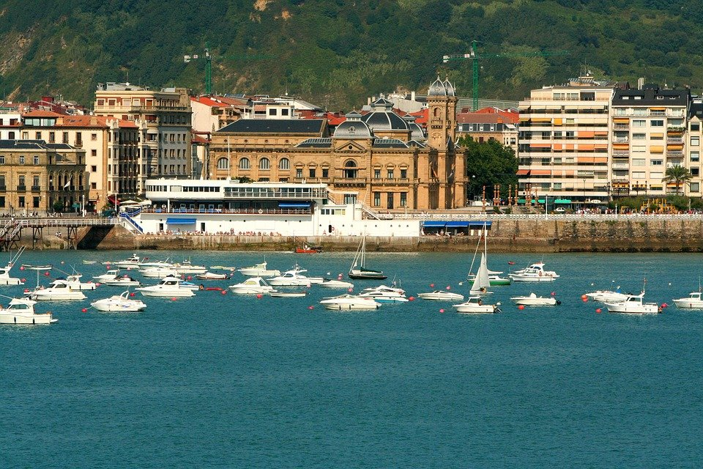
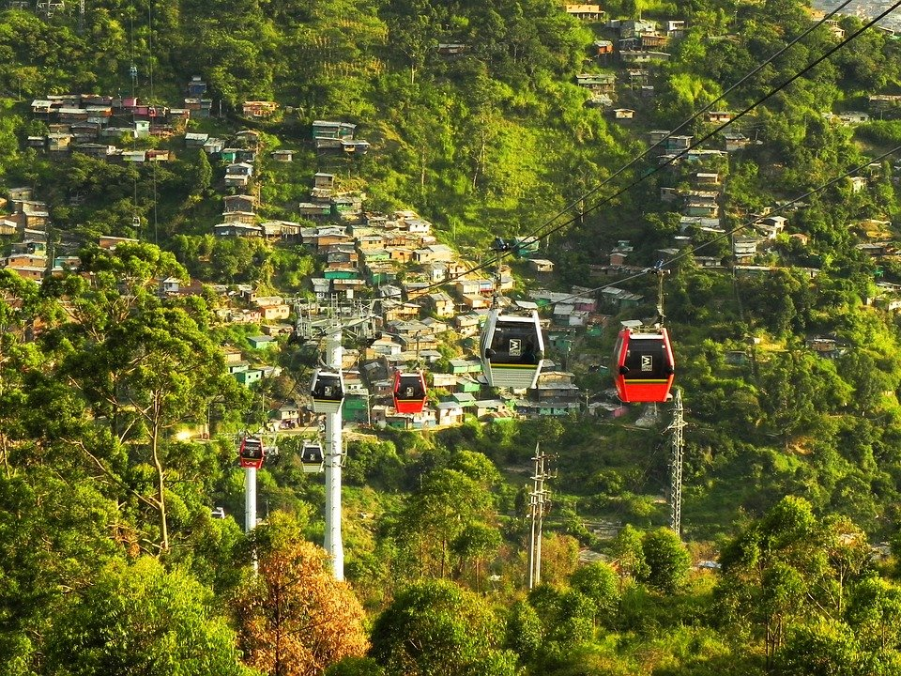
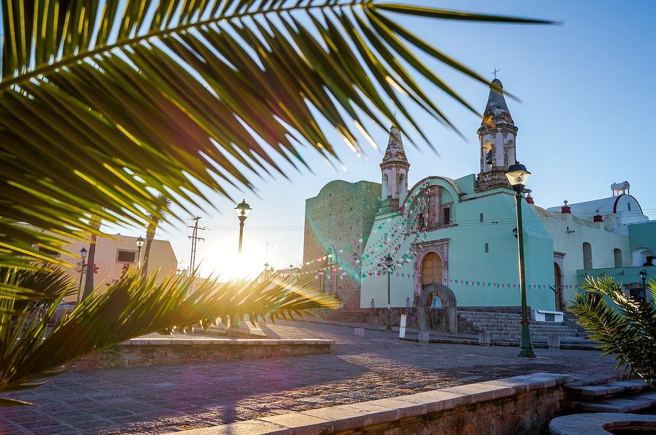
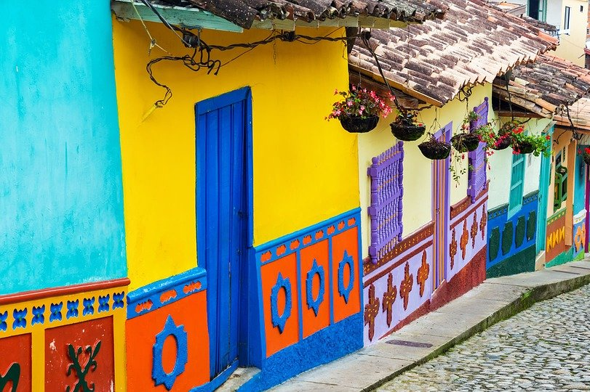
escribir
¡Ahora tú!
Escribe un texto.
Write about where you went and where someone else went.
Use ‘fui’ and ‘fue’ and a pronoun (e.g. ‘yo’, ‘ella’) if you are comparing different people.
Mention:
- when it happened (e.g. diciembre, ayer).
- what the purpose of going was (use ‘para’ + infinitive).
Notes:
Timing: 10 minutes
Aim: to produce some of the features practised this week in a final writing activity; to use the language more freely and creatively
Procedure:
Students follow the instructions to write a text of their own including all the grammar features studied this week.

Slide 47
Deberes
Vocabulary Learning Homework (Term 3.2, Week 1)
There is no vocabulary learning homework this week, but go to this mashup to revisit words from Year 7!

