Slide 1
Describing what people have
avoir (je, tu, il/elle)
l’alphabet
SSC [u]
Y7 French
Term 1.1 - Week 4 - Lesson 7
Stephen Owen / Rachel Hawkes / Catherine Morris
Artwork by: Chloé Motard
Date updated: 04/08/2022
Notes:
Learning outcomes (lesson 1):
Introduction of SSC [u]
Introduction and practice of French alphabet
Consolidation of first and third person singular forms of avoir
Introduction of second person singular form of avoir
Word frequency (1 is the most frequent word in French):
7.1.1.4 (introduce) frère [1043], sœur [1558], parent [546], ouvert [897], prudent [1529], strict [1859], jeune [152]
7.1.1.1 (revisit) être [5], es [5], suis [5], lire [278], écrire [382], écouter [429], parler [429], je [22], tu [112], anglais¹ [784], anglaise¹ [784], français¹ [251], française¹ [251], grand¹ [59], petit¹ [138], grande² [59], petite² [138], et [6], au revoir [1274], bonjour [1972]
Source: Londsale, D., & Le Bras, Y. (2009). A Frequency Dictionary of French: Core vocabulary for learners London: Routledge.
The additional English meanings of the following words have been added to Quizlet since the creation of this resource: voici, voilà: here is, this is, there is, there are

Slide 2
u
tu
Notes:
Timing: 1 minute
Aim: To introduce SSC [u]
Procedure: 1. Present the letter(s) and say the [u] sound first, on its own. Students repeat it with you. 2. Bring up the word ”tu” on its own, say it, students repeat it, so that they have the opportunity to focus all of their attention on the connection between the written word and its sound.
3. A possible gesture for this would be to point to someone else as though addressing him/her ‘you’. 4. Roll back the animations and work through 1-3 again, but this time, dropping your voice completely to listen carefully to the students saying the [u] sound, pronouncing ”tu” and, if using, doing the gesture.
Word frequency (1 is the most frequent word in French):
tu [112]
Source: Londsale, D., & Le Bras, Y. (2009). A Frequency Dictionary of French: Core vocabulary for learners London: Routledge.

Slide 3
u
tu
Notes:
With sound and no pictures to focus all attention on the sound-symbol correspondence.

Slide 4
u
tu
Notes:
Without sound to elicit pronunciation (without first hearing the teacher).
Teacher to elicit pronunciation by asking “Comment dit-on …"

Slide 5
u
Salut !
vue
amusant
tu
utiliser
[to use]
sur
[on]
Notes:
Timing: 2 minutes
Aim: To introduce SSC [u]
Procedure:
1. Introduce and elicit the pronunciation of the individual SSC [u] and then the source word again ‘tu’ (with gesture, if using). 2. Then present and elicit the pronunciation of the five cluster words.
The cluster words have been chosen for their high-frequency, from a range of word classes, with the SSC (where possible) positioned within a variety of syllables within the words (e.g. initial, 2nd, final etc.). Additionally, we have tried to use words that build cumulatively on previously taught SSCs (see the Phonics Teaching Sequence document) and do not include new SSCs. Where new SSCs are used, they are often consonants which have a similar symbol-sound correspondence in English.
Word frequency (1 is the most frequent word in French): tu [112]; salut ! [2205] vue [191]; sur [16]; amusant [4695]; utiliser [345]. Source: Londsale, D., & Le Bras, Y. (2009). A Frequency Dictionary of French: Core vocabulary for learners London: Routledge.

Slide 6
u
Salut !
vue
amusant
tu
utiliser
sur
Notes:
With sound and no pictures to focus all attention on the sound-symbol correspondence.

Slide 7
u
Salut !
vue
amusant
tu
utiliser
sur
Notes:
Without sound to elicit pronunciation (without first hearing the teacher).
Teacher to elicit pronunciation by asking “Comment dit-on …"

Slide 8
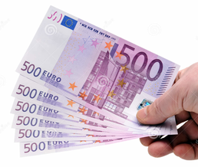
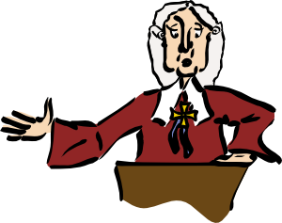
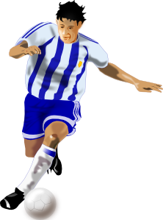
Phonétique
écouter
Écoute. C’est [u] ou [eu] ?
2
pl u s
généreux
cell u le
deux
diff u ser
_
_
_
_
_
j u ry
joueur
véhic u le
fameux
_
_
_
_
Notes:
Timing: 4 minutes
Aim: Aural recognition of SSC [u], and revision of SSC [eu] introduced in week 1.1.2.
Procedure:
1. Click on a picture to hear the word said aloud.
2. Student writes [u] or [eu] in their books.
3. Answer revealed on a click.
4. Clarify the meaning of the word.
Transcript and word frequency (1 is the most frequent word in French): plus [19], généreux [2015], deux [41], fameux [2060], cellule [2151], véhicule [1959], diffuser [1995], joueur [2003]
Source: Londsale, D., & Le Bras, Y. (2009). A Frequency Dictionary of French: Core vocabulary for learners London: Routledge.

Slide 9
Phonétique
parler
mesure
30
public
pur
adulte
culture
super
secondes
multiple
stupide
duc
Duke
nature
0
DÉBUT
Notes:
Timing: 3 minutes
Aim: To practice production of SSC [u]. To raise awareness of cross-linguistic pronunciation differences. Words chosen are cognates or near-cognates consisting of SSC [u] and consonants which are equivalent or near-equivalent to the English SSC, purposefully chosen for unlearning the connection between the SSC and the English sound. The pronunciation of letter ‘u’ in the English translations of these words varies. Students should be made aware that as the pronunciation of [u] in French is consistent, SSC equivalence with English is variable – sometimes it will differ, sometimes it will be the same.
Procedure:
1. Students work in pairs, alternately saying one of the words and listening to spot errors in their partner’s pronunciation.
2. Students get one point for each correct French pronunciation of the SSC and lose a point if they say the English equivalent!
3. Click on the words to check pronunciation. Students repeat.
4. Go over the meaning of the words.
Word frequency (1 is the most frequent word in French): public [285], pur [1643], mesure [262], culture [993], super [2993], adulte [1580], multiple [2072], stupide [3407], duc [4804], nature [542]
Source: Londsale, D., & Le Bras, Y. (2009). A Frequency Dictionary of French: Core vocabulary for learners London: Routledge.

Slide 10
Vocabulaire
parler
français
anglais
un ordinateur
a computer
article (determiner) + noun
un vélo
a bike
un livre
a book
une voiture
a car
cher
expensive, dear (m)
chère
expensive, dear (f)
adjective
moderne
modern
rapide
fast, quick
Notes:
Timing: 5 minutes
Aim: recognition of nouns and adjectives introduced this week
Procedure:
1. Class repetition of the French modelled by the teacher, each French word followed by the teacher showing the written English equivalent.
2. Check the students know what type (part of speech) these words are (this will be useful later and is revision). Use the animations to illustrate which are the: a) articles or the determiners (they might know them as ‘determiners’ from primary school – both terms are fine). Remind them ‘un’ and ‘une’ are the words for ‘a’ and ‘an’ b) nouns c) adjectives – remind them, these words describe nouns.
3. DESCRIBING WHAT A NOUN IS. Very briefly remind students that “nouns are the words for the ‘who’ or the ‘what’ of a sentence. They are the words that ‘drive’ the verbs (the dog eats the food) or ‘receive’ the verbs (the dog eats the food). Nouns are things (grass, air), people (girl, Mary), or abstract ideas (peace, love), or even the idea of an action (‘running is good’).”
Note. Notice that this definition emphasises the roles of nouns in sentences. Definitions that just rely on ‘a noun is a thing or a person’ misleads students, because nouns are not always things or people. There is no need to dwell on this definition. Just a brief reminder here is sufficient.
4. French to English practice. This should provide lots of opportunities to hear and read the French. Some practice will use this slide i.e., providing the written form. Animations are provided in the slide for this. Critically, however, some practice should AURAL INPUT only. Say the French and the students either say or write down the English.

Slide 11
Un dialogue français
lire
Voici un dialogue! Complète. Use each word only once!
Tu as ____________ ?
____ , c’est ______ !
Ah.
Mais j’ai _______ .
C’est ______ ?
- ____ !
oui
un vélo
cher
rapide
non
une voiture
Notes:
Timing: 3 minutes
Aim: To use some of this week’s new words in context.
Procedure:
1. Check understanding of the blue words in the gap fill, introduced in weeks 7.1.1.1-7.1.1.3.
2. Students fill the gaps with words, paying attention to the context. NB: if students query why cher is not presented in the feminine form, explain briefly that this is a ‘standalone adjective’ referring to ‘owning a car’, rather than describing the car itself, but don’t labour the point.
3. A solution is provided on the next slide.
Transcript:
Word frequency (1 is the most frequent word in French): ah [1405]
Source: Londsale, D., & Le Bras, Y. (2009). A Frequency Dictionary of French: Core vocabulary for learners London: Routledge.

Slide 12
Un dialogue français
lire
Une solution
Tu as une voiture ?
- Non, c’est cher !
Ah.
- Mais j’ai un vélo.
C’est rapide ?
- Oui !
Notes:
Suggested solution for the activity on the previous slide.

Slide 13
Letters of the alphabet
L’alphabet
écouter / parler
A
B
C
D
E
F
G
H
I
J
K
L
M
N
O
P
Q
R
S
T
U
V
W
X
Y
Z
Notes:
Timing: 5 minutes
Aim: To present and practise the names of the letters of the alphabet in French. As well as being of general use, e.g. to permit the giving/understanding of word spellings in the target language, this will facilitate entry into the Spelling Bee competition for those who wish to participate (see next slide but one for more details).
Procedure:
1. Click on the letter for audio.
2. Suggest a chant/song to help students memorise the alphabet. Teacher will lead first but after some practice, individuals can take on this role, or class can be split into two halves etc. Have fun with it.

Slide 14
Pair exercise
L’alphabet
parler
 | A | B | C | D | E | F | G | H | I | J | K | L | M
R | c | n | z | k | v | g | r | d | o | a | l | l | j
S | d | o | a | l | w | h | s | e | p | b | m | x | u
T | e | p | b | m | x | i | t | f | q | c | n | i | f
U | f | r | c | n | y | j | u | g | r | d | o | t | q
V | g | s | d | o | z | k | v | h | s | e | p | e | c
W | h | t | e | p | a | l | w | i | t | f | q | p | n
X | i | u | f | q | b | m | x | j | u | g | r | b | z
Y | j | v | g | r | c | n | y | k | v | h | s | m | k
Z | k | w | h | s | d | o | z | l | w | i | t | y | a
Notes:
Timing: 5 minutes
Aim: Oral production of alphabet letter names.
Procedure
Students pair up.
Student A chooses grid coordinates (e.g. C, X) and student B says the letter at which those coordinates meet at (e.g. F).

Slide 15
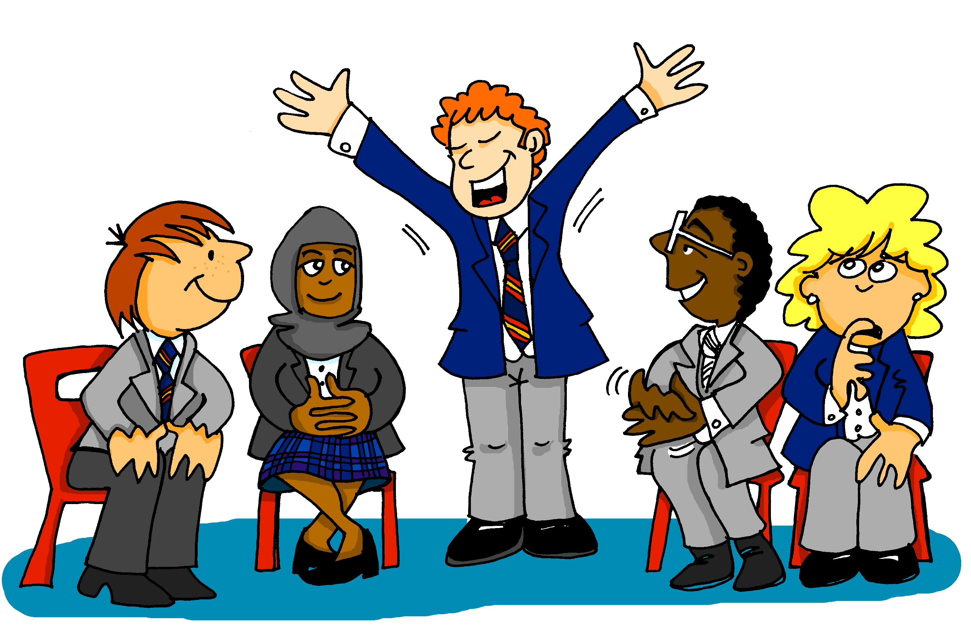
SPELLING BEE
Listen and write!
Notes:
Timing: 1 minutes
Aim: Students may want to put themselves forward for the Spelling Bee where they have to spell words aloud within a time limit. Teacher may repeat the word only once. This should encourage the students to repeat the word for themselves and retain it in their heads until the spelling becomes clearer – a good strategy for later listening work. The rest of the class members must write down what they think is the correct spelling and mark the speller right or wrong.

Slide 16
Comment ça s'écrit ?
écouter
Comment ça s'écrit ?
[How do you spell that?]
Notes:
Timing: 1 minute Aim: To introduce the phrase Comment ça s'écrit ?

Slide 17
Comment ça s'écrit ?
parler
a car - une voiture
English (m) - anglais
a bedroom - une chambre
and - et
to speak, speaking - parler
goodbye - au revoir
short (f) - petite
computer – un ordinateur
a dog - un chien
tall (m.) - grand
hello - bonjour
you are - tu es
I am - je suis
to read, reading - lire
Notes:
Timing: 5 minutes Aim: Recall and spelling of words learned so far.
Procedure:
Students pair up.
Click to reveal a known word.
Student A calls in English, Student B faces away from the board, translates the word into French (saying the article for nouns, but not spelling the article) and spells the word.
Student A says ‘oui’ or ‘non’.
Student B turns round to check.
Swap roles (either alternate words, or a column each).

Slide 18
Using the verb avoir
grammaire
Remember, to talk in French about what you have, use the verb avoir.
j’ai I have
il a he has
elle a she has
tu as you have
_____
_____
Tu as
Don’t say the final –s!
_____
To say ‘you have’, use ‘tu as’:
_____
J’ai un animal. I have an pet. Tu as un vélo. You have a bike.
Il a un chien. He has a dog. Elle a une idée. She has an idea.
Notes:
Timing: 2 minutes
NB: There will be opportunities later to talk about the differences between tu and vous. For now, ‘tu’ is being introduced and practised as the word for ‘you’.

Slide 19
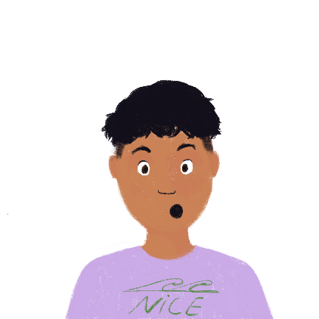
C’est qui, je ou tu ?
lire
Léa writes to Amir about what she has (I have - j’ai) and what he has (you have - tu as). Her computer has a bug! It deleted the pronouns: je/j’ (I) and tu (you). Write the missing words in English in the right column on the next slide.
1 | ai un vélo | 5 | as une règle
2 | as un ordinateur | 6 | ai une chambre
3 | as un animal | 7 | as un chien
4 | ai une voiture | 8 | ai un portable
Notes:
Timing: 5 minutes
Aim: to connect the written form of the first and second person singular forms of avoir with their meanings.
Procedure:
Explain, if necessary, that Léa is writing about herself in the first person, whereas she is talking about Amir using the second person.
Students sketch a grid in their books with the column headers ‘Léa’ and ‘Amir’.
Students complete their tables by writing English nouns in the appropriate columns. Remind students that it is the form of the verb that will give them the necessary information. NB: masculine and feminine nouns are equally distributed between Léa and Amir to avoid any potential for the incorrect supposition at any point on the part of the student that the indefinite article is the key to the answer here.
Answers on the next slide.

Slide 20
Writing exercise
Réponses
lire
 | what I have | what you have
1
2
3
4
5
6
7
8
bike
computer
pet
car
ruler
bedroom
dog
mobile phone
Notes:
Answers to the activity on the previous slide.

Slide 21
Asking questions
Remember, to ask a question in French, raise the pitch of your voice at the end of a sentence:
Tu as un animal. You have a pet.
Tu as un animal ? Do you have a pet?
Tu as
Don’t say the final –s!
There is no phrase for ‘do you’ in French. We translate this with raised pitch.
Notes:
Timing: 2 minutes
Aim: Very quick listening and oral rehearsal to remind students about raised intonation and to increase confidence.
Procedure:
Provide a model for the students by reading out the French with a ‘flat intonation’ then with the raised intonation.
Ask the whole class to say this then to to repeat it to their partner.
Ask a few individuals to repeat it out loud to the class.
Remind the students – ‘do you’ is the way we ask questions in English - there is no way of saying ‘do you’ in French.

Slide 22
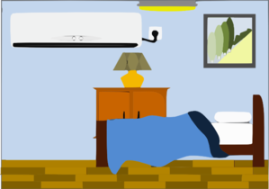
Statement or question?
écouter
Léa leaves Amir a voicemail. Is she telling Amir what he has, or asking him?
Statement
Question
Statement
Question
1
5
2
6
3
7
4
8
Notes:
Timing: 6 minutes
Aim: To determine whether utterances are statements or a questions, using the intonation alone.
Procedure:
Students write 1-8.
Click on a number to hear a sentence.
Students write whether what they hear is a question or a statement.
Click to check.
NB: For a more difficult task, the items can be played in a mixed order. Students then have to do TWO things: they have to (a) listen to intonation and connect it to a statement versus a question (b) listen to the noun and understand which image it belongs to.
The activity could be done twice: once with a lower cognitive load, where students just focus on the grammar (intonation functioning as a question) and again where they have to also focus on the meaning of the vocabulary.
Word frequencies of cognates used (1 is the most frequent word in French):
photo [1412]
Source: Londsale, D., & Le Bras, Y. (2009). A Frequency Dictionary of French: Core vocabulary for learners London: Routledge.
Transcript
Tu as un chien.
Tu as un livre?
Tu as une règle.
Tu as une idée?
Tu as une photo?
Tu as un portable.
Tu as une chambre.
Tu as un ordinateur?

Slide 23
Describing what people have
post-nominal position of adjectives (attributive, i.e. with noun)
SSC [ou]
Y7 French
Term 1.1 - Week 4 - Lesson 8
Stephen Owen / Rachel Hawkes / Catherine Morris
Artwork by: Chloé Motard
Date updated: 04/08/2022
Notes:
Learning outcomes (lesson 1):
Introduction of SSC [ou]
Consolidation of first and third person singular forms of avoir
Introduction of second person singular form of avoir
Word frequency (1 is the most frequent word in French):
7.1.1.4 (introduce) frère [1043], sœur [1558], parent [546], ouvert [897], prudent [1529], strict [1859], jeune [152]
7.1.1.1 (revisit) être [5], es [5], suis [5], lire [278], écrire [382], écouter [429], parler [429], je [22], tu [112], anglais¹ [784], anglaise¹ [784], français¹ [251], française¹ [251], grand¹ [59], petit¹ [138], grande² [59], petite² [138], et [6], au revoir [1274], bonjour [1972]
Source: Londsale, D., & Le Bras, Y. (2009). A Frequency Dictionary of French: Core vocabulary for learners London: Routledge.
The additional English meanings of the following words have been added to Quizlet since the creation of this resource: voici, voilà: here is, this is, there is, there are

Slide 24
ou
nous
Notes:
Timing: 1 minute
Aim: To introduce SSC [ou]
Procedure: 1. Present the letter(s) and say the [ou] sound first, on its own. Students repeat it with you. 2. Bring up the word ”nous” on its own, say it, students repeat it, so that they have the opportunity to focus all of their attention on the connection between the written word and its sound.
3. A possible gesture for this would be to have both hands draw semi-circles out away from the body. Hands start by the sides of the body, circle swiftly outwards and join up again in front, indicating the inclusion of the self in a larger group. 4. Roll back the animations and work through 1-3 again, but this time, dropping your voice completely to listen carefully to the students saying the [ou] sound, pronouncing ”nous” and, if using, doing the gesture.
Word frequency (1 is the most frequent word in French):
nous [31]
Source: Londsale, D., & Le Bras, Y. (2009). A Frequency Dictionary of French: Core vocabulary for learners London: Routledge.

Slide 25
ou
nous
Notes:
With sound and no pictures to focus all attention on the sound-symbol correspondence.

Slide 26
ou
nous
Notes:
Without sound to elicit pronunciation (without first hearing the teacher).
Teacher to elicit pronunciation by asking “Comment dit-on …"

Slide 27
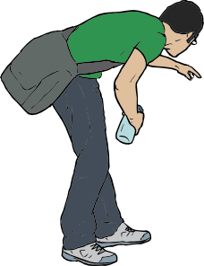
ou
trouver
jouer
Bonjour !
nous
douze
toujours
[always; still]
Notes:
Timing: 2 minutes
Aim: To introduce SSC [ou]
Procedure:
1. Introduce and elicit the pronunciation of the individual SSC [ou] and then the source word again ‘nous’ (with gesture, if using). 2. Then present and elicit the pronunciation of the five cluster words.
The cluster words have been chosen for their high-frequency, from a range of word classes, with the SSC (where possible) positioned within a variety of syllables within the words (e.g. initial, 2nd, final etc.). Additionally, we have tried to use words that build cumulatively on previously taught SSCs (see the Phonics Teaching Sequence document) and do not include new SSCs. Where new SSCs are used, they are often consonants which have a similar symbol-sound correspondence in English.
Word frequency (1 is the most frequent word in French): nous [31]; trouver [83] jouer [219]; bonjour [1972]; toujours [103]; douze [1664].
Source: Londsale, D., & Le Bras, Y. (2009). A Frequency Dictionary of French: Core vocabulary for learners London: Routledge.

Slide 28
ou
trouver
jouer
Bonjour !
nous
douze
toujours
Notes:
With sound and no pictures to focus all attention on the sound-symbol correspondence.

Slide 29
ou
trouver
jouer
Bonjour !
nous
douze
toujours
Notes:
Without sound to elicit pronunciation (without first hearing the teacher).
Teacher to elicit pronunciation by asking “Comment dit-on …"

Slide 30
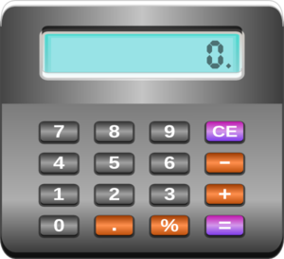
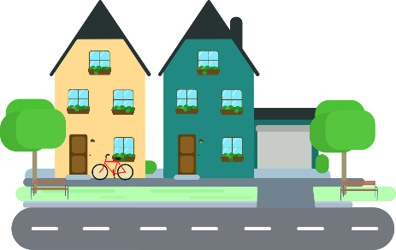
Phonétique
écouter
Écoute. C’est [ou] ou [u] ?
ouvert
calc u ler
b u reau
poule
_
_
_
_
[job]
amour
boulot
disc u ter
r u e
_
_
_
_
Notes:
Timing: 5 minutes
Aim: Aural recognition of SSC [ou], contrasting with [u] introduced in lesson 1.
Procedure:
1. Click on a picture to hear the word said aloud.
2. Student writes [ou] or [u] in their books.
3. Answer revealed on a click.
4. Clarify the meaning of the word.
Transcript and word frequency (1 is the most frequent word in French): ouvert [897], calculer [2331], bureau [273], poule [4321], amour [967], boulot [2929], discuter [737], rue [598]
Source: Londsale, D., & Le Bras, Y. (2009). A Frequency Dictionary of French: Core vocabulary for learners London: Routledge.

Slide 31
Phonétique
lire / parler
couleur
45
couple
soupe
double
secondes
troupe
touriste
coutume
groupe
0
DÉBUT
Notes:
Timing: 5 minutes for 3 slides
Aim: To correctly pronounce near-cognate words containing [ou] in decreasing amounts of time, helping automisation of SSC production. The words chosen otherwise contain sounds that are equivalent (or very similar) to English SSCs, so that students can focus fully on the [ou] (allowances are made for English pronunciation of [r], which is covered in year 8).
Procedure:
1. Students pair up.
2. Teacher starts 20 second timer.
3. Student A tries to say the words without pronouncing [ou] the English way.
4. Student B makes speaker pause for 3 seconds for every error.
5. Complete before 20 seconds runs out.
6. Swap roles.
7. Click on the word to hear pronunciation by a native speaker. Students repeat.
7. Move onto the next slide.
Transcript and word frequency (1 is the most frequent word in French): double [574], couple [1167], couleur [1211], coutume [3228], soupe [4563], troupe [1282], groupe [187], courage [1431], touriste [6253], routine [3120]
Source: Londsale, D., & Le Bras, Y. (2009). A Frequency Dictionary of French: Core vocabulary for learners London: Routledge.

Slide 32
Phonétique
lire / parler
couleur
30
couple
soupe
double
secondes
troupe
touriste
coutume
groupe
0
DÉBUT
Notes:
As previous with 15 fewer seconds on the timer.

Slide 33
Phonétique
lire / parler
couleur
15
couple
soupe
double
secondes
troupe
touriste
coutume
groupe
0
DÉBUT
Notes:
As previous with 15 fewer seconds on the timer still.

Slide 34
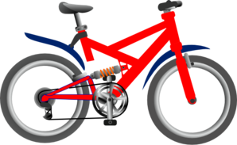
Vocabulaire (1/3)
parler 1/8
parler
5
Secondes
un ordinateur
un vélo
une voiture
0
DÉBUT
Notes:
Timing: 1 minute for three slides Aim: Productive (oral) recall of three words within a given time. This is slide 1/3.
Procedure:
1. Say all three words before three seconds elapse.
2. Click to reveal answers.
3. Repeat if additional practice needed.

Slide 35
Vocabulaire (2/3)
parler 1/8
parler
5
[fast]
[here is/this is, there is/are]
expensive (m)
Secondes
rapide
voici
cher
0
DÉBUT
Notes:
This is slide 2/2.

Slide 36
Vocabulaire (3/3)
parler 1/8
parler
5
[modern]
expensive (f)
Secondes
moderne
un livre
chère
0
DÉBUT

Slide 37
Révisions (être)
lire / écrire
Léa parle. C’est qui ? – Écris ‘je suis’ (Léa) ou ‘tu es’ (Amir).
1. Je suis française.
2. Je suis petite.
3. Tu es grand.
4. Je suis intelligente.
?
5. Je suis/tu es malade.
6. Tu es amusant.
7. Je suis /tu es calme.
8. Tu es content.
?
?
?
?
?
?
?
Notes:
Timing: 5 minutes
Aim: To revisit vocabulary introduced in week 7.1.1.1, combined with vocabulary introduced in later weeks. To revise adjective agreement rules in preparation for extending this knowledge to nouns in the slides that follow.
Procedure:
Check students understand the task instructions. Draw attention to SSC [é] in revisions. Students have not yet encountered the third person singular form of parler. Explain that this is the short form, and that students will encounter it in task instructions going forward.
Ask students where they need to look to find the solutions (the end of the adjective).
Students write 1-8 in their books, and je suis or tu es.
Click to reveal the answers.
Elicit oral translations of each sentence.
Word frequency of near-cognates used in task instructions (1 is the most frequent word in French): révision (2748)
Source: Londsale, D., & Le Bras, Y. (2009). A Frequency Dictionary of French: Core vocabulary for learners London: Routledge.

Slide 38
Position of adjectives
grammaire
In English, adjectives come before the noun.
In French, they normally come after the noun.
un ordinateur cher an expensive computer
un vélo rapide a fast bike
un livre anglais an English book
une voiture française a French car
Notes:
Timing: 2 minutes
Aim: To highlight the difference between the positioning of adjectives in French and English.

Slide 39
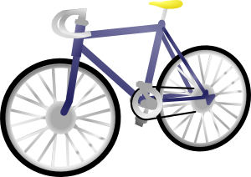
Vocabulaire
écouter
1
française
2
moderne
rapide
3
cher
4
Match the adjectives to the nouns.
Notes:
Timing: 3 minutes
Aim: Aural recognition of adjectives.
Procedure:
Students write 1-4 in their books.
Students write down the English for the noun and the adjective that they hear.
Check answers on the following slide.
Transcript
J’ai une voiture moderne.
J’ai un ordinateur rapide.
J’ai une chose française.
J’ai un vélo cher.

Slide 40
Vocabulaire
lire / parler
Which adjective changes its spelling and sound to match the feminine noun?
une chose française
un ordinateur rapide
un vélo
cher
une voiture
moderne
Some adjectives already have an ‘e’ at the end –
don’t add another e!
français → française
Notes:
Timing: 5 minutes
Aim: To revise the idea that adjectives add an -e if they describe a feminine noun.
Procedure:
1. Remind students of the rule, which they first encountered in week 7.1.1.1 with adjectives describing people (je suis grande, elle est petite)
2. Ask which adjective changes its spelling and sound to match the feminine noun?
3. Click to reveal answer.
4. Click to reveal a bubble drawing attention to moderne, which doesn’t change. The guiding principle “Some adjectives already have an ‘e’ at the end – don’t add another e!” is ‘good enough’ for now.
5. Phonics: Briefly point out that the e at the end of words is silent. Sound out the consonant if there is a final e. They will get more practice on this soon.
6. Remove the slide. Ask students to read out their (English) answers to the previous listening activity in French. This translation activity pushes them to reverse the order of the noun and the adjective and also practice the pronunciation of the adjectives. They could do this first as a whole class together, and then once they have the correct answers, to their partner.
7. Optional extension for advanced levels: Partner A mixes up the order of the sentences they read out in French, and their partner has to give the correct English. This forces the partner to listen to and understand the French.

Slide 41
Grammaire
écrire
How many different ways can you combine these nouns and adjectives? Write down as many as you can. Remember to agree your adjectives for feminine nouns!
français
moderne
rapide
cher
Some adjectives already have an ‘e’ at the end –
don’t add another e!
Notes:
Timing: 5 minutes
Aim: Written production of noun/adjective phrases
Procedure:
Students write as many combinations of nouns and adjectives as they can in four minutes (a total of 16 combinations is possible!)
Elicit some examples from students and collect them on a slide.

Slide 42
Partenaire A
parler
You are speaking to your friend on the telephone. Tell him/her what you have, and ask what s/he has. S/he will also ask you. Take turns. Partner A starts.
Ask your friend if s/he has these (circle the ones s/he has):
When asked, say you have these:
Notes:
Timing: 6 minutes
Aim: Oral production of intonation questions and statements about having in the first and second person singular.
Procedure:
Print and distribute small copies of this slide (recommend 2 slides/per page) or have students take turns to look at this slide and the next to write down what they need to ask about and what they have before turning away.
Check students remember how to say ‘you have’. Then check they know how to ask it as a question -> ‘do you have’ = tu as ? Remind them about raising the pitch of their voice. NB: In fact, both partners have all of the items about which they are to be asked – however, they will not know this at the outset! This avoids the problem of needing to express the negative, which has not yet been covered.
Check students remember how to say ‘I have’ -> J’ai. Many learners will just say ‘oui’ and ‘non’, which is also fine as this is most natural in conversation.
Students take turns to ask and answer questions.
Possible extension if time allows: In whole class, the teacher asks individuals to say what they have ‘J’ai un / une…’ Ask individuals to say what their partner has ‘Il a / Elle a un / une …’ This revises grammar from previous lessons.
Extension for more advanced levels: Ask learners to also add an adjective when they reply. Their partner has to make a note in English about this on their sheet next to each image.

Slide 43
Partenaire B
parler
You are speaking to your friend on the telephone. Tell him/her what you have, and ask what s/he has. S/he will also ask you. Take turns. Partner A starts.
When asked, say you have these:
Ask your friend if s/he has these (circle the ones s/he has):
Notes:
This is partner B’s rolecard for the activity described on the previous slide.

Slide 44
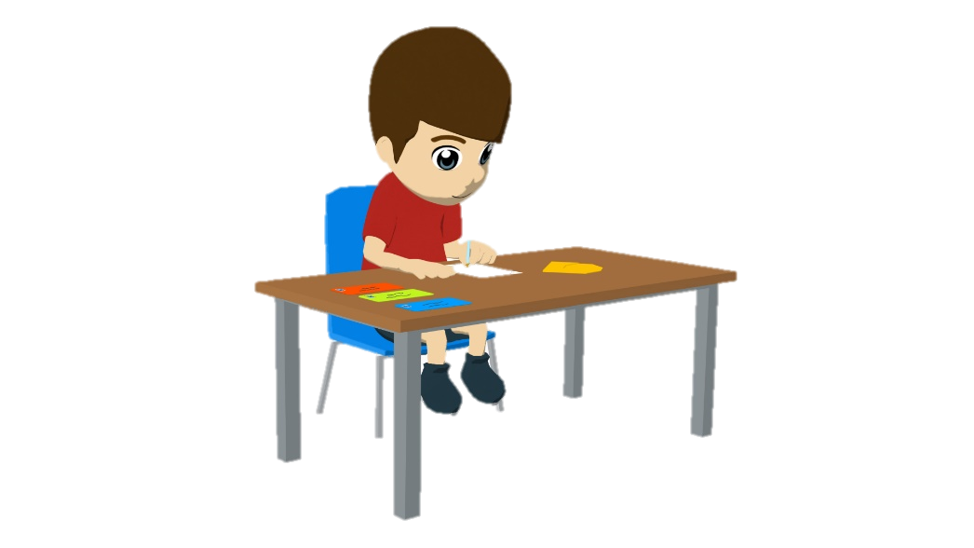
Écris !
écrire
1. I have a fast car.
Translate the sentences into French.
Remember to agree adjectives for feminine nouns
J’ ai une voiture rapide.
2. You have an expensive computer.
Tu as un ordinateur cher.
3. I have a modern bike.
J’ ai un vélo moderne.
4. You have an intelligent idea.
Tu as une idée intelligente.
Notes:
Timing: 10 minutes
Aim: L1 > L2 translation exercise bringing together vocabulary and grammar structures practised in this and previous lessons (j’ai and tu as, vocabulary knowledge, order of nouns & adjectives, indefinite articles (un/une), adjective agreement).
Procedure:
1. Recap the grammar points outline above as ‘things to remember’ before students begin the task.
2. Ask students to translate the first two sentences. Give the them time and ensure these are done correctly before letting them do more.
3. Click to reveal answers.
4. Move on to the next slide which contains more challenging items.

Slide 45
Écris !
écrire
5. You have a fast car.
Translate the sentences into French.
Remember to agree adjectives for feminine nouns
Tu as une voiture rapide.
6. Do you have a modern bike?
Tu as un vélo moderne ?
7. I have an expensive computer.
J’ ai un ordinateur cher.
8. Do you have an intelligent idea?
Tu as une idée intelligente ?
Notes:
These are extension items which require learners to remember that ‘do you’ does not have a direct translation equivalent in French.
Learners are expected to simply put a question mark at the end of the sentence.

Slide 46
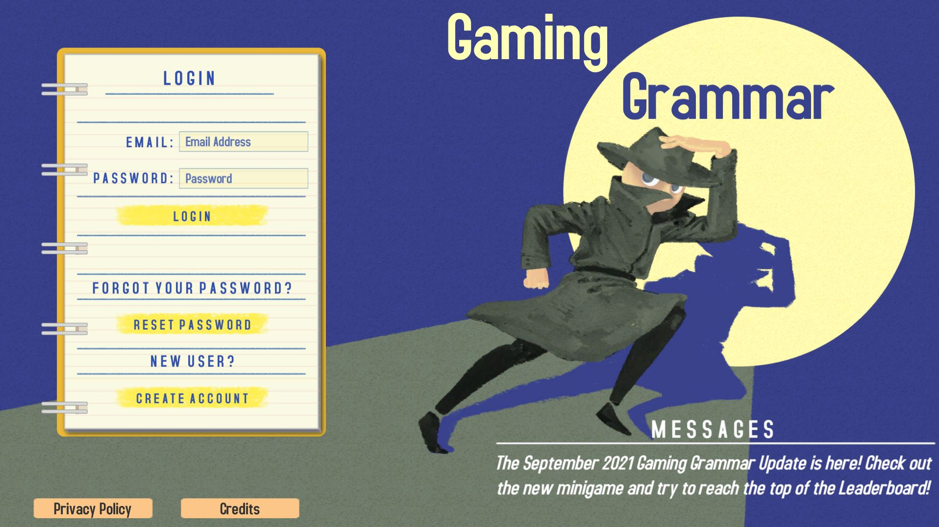
Gaming Grammar
Gaming Grammar
Relevant mini game(s):
Indefinite articles: Gender (Article Agreement)
To have and to be: 1st person and 3rd person singular
Notes:
This slide links to Gaming Grammar login screen. The appropriate mission can then be selected from the menu page.
Students will progress through the game at their own rate; teachers should use the teacher interface to check progress. This will help to inform future lesson planning.

Slide 47
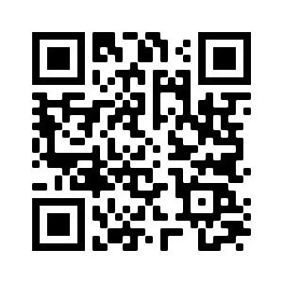
Devoirs
Vocabulary Learning Homework (Y7, Term 1.1, Week 5)
Audio file
Audio file QR code:
Student worksheet
Quizlet link
In addition, revisit: Term 1.1 Week 2

