Slide 1
French Phonics Collection
SSC [th]
Artwork by: Chloé Motard
Date updated: 30/08/2022
Notes:
Artwork by Chloé Motard. All additional pictures selected are available under a Creative Commons license, no attribution required.

Slide 2
SSC [th]
phonétique
Introduction

Slide 3
th
thé
Notes:
Timing: 1 minute
Aim: To introduce SSC [th]
Procedure: 1. Present the letter(s) and say the [th] sound first, on its own. Students repeat it with you. 2. Bring up the word ”thé” on its own, say it, students repeat it, so that they have the opportunity to focus all of their attention on the connection between the written word and its sound.
3. A possible gesture for this would be to mime drinking tea. 4. Roll back the animations and work through 1-3 again, but this time, dropping your voice completely to listen carefully to the students saying the [th] sound, pronouncing ”thé” and, if using, doing the gesture.
Word frequency (1 is the most frequent word in French):
thé [3517]
Source: Londsale, D., & Le Bras, Y. (2009). A Frequency Dictionary of French: Core vocabulary for learners London: Routledge.

Slide 4
th
thé
Notes:
With sound and no pictures to focus all attention on the sound-symbol correspondence.

Slide 5
th
thé
Notes:
Without sound to elicit pronunciation (without first hearing the teacher).
Teacher to elicit pronunciation by asking “Comment dit-on …”

Slide 6
th
théâtre
bibliothèque
sympathique
thé
maths
[nice]
méthode
[method]
Notes:
Timing: 2 minutes
Aim: To introduce SSC [th]
Procedure:
Introduce and elicit the pronunciation of the individual SSC [th] and then the source word again ‘thé’ (with gesture, if using). Then present and elicit the pronunciation of the five cluster words. The cluster words have been chosen for their high-frequency, from a range of word classes, with the SSC (where possible) positioned within a variety of syllables within the words (e.g. initial, 2nd, final etc.). Additionally, we have tried to use words that build cumulatively on previously taught SSCs (see the Phonics Teaching Sequence document) and do not include new SSCs. Where new SSCs are used, they are often consonants which have a similar symbol-sound correspondence in English.
Word frequency (1 is the most frequent word in French): thé [3517]; méthode [1149]; théâtre [1701]; bibliothèque [2511]; maths [3438]; sympathique [4164]. Source: Londsale, D., & Le Bras, Y. (2009). A Frequency Dictionary of French: Core vocabulary for learners London: Routledge.

Slide 7
th
théâtre
bibliothèque
sympathique
thé
maths
méthode
Notes:
With sound and no pictures to focus all attention on the sound-symbol correspondence.

Slide 8
th
théâtre
bibliothèque
sympathique
thé
maths
méthode
Notes:
Without sound to elicit pronunciation (without first hearing the teacher).
Teacher to elicit pronunciation by asking “Comment dit-on …”

Slide 9
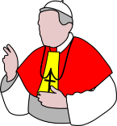
Comment dit-on… ?
parler
[th]is not a typical French SSC. All French words containing [th]come from other languages.
You will recognise a lot of the words from English. Be careful to pronounce them correctly!
45
 | athlète
 | mammouth
 | éthique [ethic]
 | menthe
 | thon
 | marathon [marathon]
 | authentique [authentic]
 | théorie
 | télépathie [telepathy]
 | catholique
 | enthousiaste [enthusiastic]
 | Mathieu
secondes
0
Début
Notes:
Timing: 5 minutes for three slides.
NB: This is one of a set of three slides with different timer settings. The speed of the exercise can be chosen to match the ability level of the class, or the teacher may wish to start with the slowest speed and increase gradually.
Aim: oral production of unknown cognate words containing SSC [th]
Procedure:
1. Click début to start the timer
2. Student A reads the list of words out loud to student B. Student B listens carefully to their partner’s pronunciation and stops Student A if the [th] sound is pronounced the English way. They only stop their partner if the [th] is pronounced incorrectly. If an incorrect stress of other mispronunciation is noticed, the listening student should note this and correct it at the end of the round.
3. Students count how many words Student A managed to say correctly.
4. Students swap roles. The student with the most points at the end is the winner.
5. After two rounds, the teacher plays the correct pronunciation by clicking on the audio. Students repeat.
6. Optional extension: Teacher reminds students about stress patterns in French. Even though the words look like English, the stresses are in different places. Students repeat the exercise, being careful to stress all parts of the words equally (with a slight emphasis on the final syllable).
Word frequency (1 is the most frequent word in French): athlète [4722], mammouth [>5000], éthique [2747], menthe [>5000], thon [>5000], marathon [>5000], télépathie [>5000], authentique [3961], théorie [1773], mythe [2910], catholique [1578], enthousiaste [4287], Mathieu [n/a], rythme [1662]
Source: Londsale, D., & Le Bras, Y. (2009). A Frequency Dictionary of French: Core vocabulary for learners London: Routledge.

Slide 10
Comment dit-on… ?
parler
[th]is not a typical French SSC. All French words containing [th]come from other languages.
You will recognise a lot of the words from English. Be careful to pronounce them correctly!
30
 | athlète
 | mammouth
 | éthique [ethic]
 | menthe
 | thon
 | marathon [marathon]
 | authentique [authentic]
 | théorie
 | télépathie [telepathy]
 | catholique
 | enthousiaste [enthusiastic]
 | Mathieu
secondes
0
Début

Slide 11
Comment dit-on… ?
parler
[th]is not a typical French SSC. All French words containing [th]come from other languages.
You will recognise a lot of the words from English. Be careful to pronounce them correctly!
15
 | athlète
 | mammouth
 | éthique [ethic]
 | menthe
 | thon
 | marathon [marathon]
 | authentique [authentic]
 | théorie
 | télépathie [telepathy]
 | catholique
 | enthousiaste [enthusiastic]
 | Mathieu
secondes
0
Début

Slide 12
Phonétique
écouter / écrire
Écoute les mots. Trouve les paires et écris les mots complètes.
1
ath
lète
[athlete]
athon
2
éth
ique
[ethical]
ique
3
mam
mouth
[mammoth]
lète
4
mar
athon
[marathon]
mouth
5
men
the
[mint]
on
6
télé
pathie
[telepathy]
orie
7
th
on
[tuna]
pathie
8
thé
orie
[theory]
the
Notes:
Timing: 4 minutes
Aim: aural / written recognition of SSC [th] using word fragments (the SSC cannot be distinguished from [t] by listening alone)
Procedure:
1. Click the numbers to play the audio.
2. Students write 1-8 and choose an orange word fragment to write the full words they hear.
3. Click to reveal the answers.
Transcript:
athlète
éthique
mammouth
marathon
menthe
télépathie
thon
théorie
Word frequency (1 is the most frequent word in French): athlete [4722], éthique [2747], mammouth [>5000], marathon [>5000], menthe [>5000], télépathie [>5000], thon [>5000], théorie [1773]
Source: Londsale, D., & Le Bras, Y. (2009). A Frequency Dictionary of French: Core vocabulary for learners London: Routledge.

Slide 13
Phonétique
Use your knowledge of English to help you!
écouter
Écoute ! Écris les mots avec ‘t’ ou ‘th’.
 | t | th |  | t | th
 | politique |  |  | quantité
 |  | sympathie |  | test
 |  | ethnique |  |  | thème
 | hostile
 |  | hypothèse |  |  | thérapie
1
6
2
7
3
8
4
9
esthétique
esthétique
5
10
Notes:
Timing: 3 minutes
Aim: To connect pronunciation of [th] with pronunciation of [t], and to differentiate between the two based on knowledge of English spelling.
Procedure:
Click numbers to play audio.
Ask students which English word the recording sounds like.
Students decide, based on their knowledge of English spelling, whether the word is spelled with [th] or just [t].
Answers appear on clicks.
Transcript:
politique
sympathie
ethnique
hostile
hypothèse
quantité
test
thème
esthétique
thérapie
Word frequency (1 is the most frequent word in French): politique [128], sympathie [3017], ethnique [3083], hostile [3091], hypothèse [1669], quantité [1680], test [1788], theme [1720], esthétique [4612], thérapie [4420].
Source: Londsale, D., & Le Bras, Y. (2009). A Frequency Dictionary of French: Core vocabulary for learners London: Routledge.

Slide 14
SSC [th]
phonétique
Consolidation [1]

Slide 15
th
thé
Notes:
Timing: 1 minute [2 slides]
Aim: To consolidate SSC [th]
Procedure: 1. Present the letter(s) and say the [th] sound first, on its own. Students repeat it with you. 2. Bring up the word ”thé” on its own, say it, students repeat it, so that they have the opportunity to focus all of their attention on the connection between the written word and its sound.
3. A possible gesture for this would be to mime drinking tea. 4. Roll back the animations and work through 1-3 again, but this time, dropping your voice completely to listen carefully to the students saying the [th] sound, pronouncing ”thé” and, if using, doing the gesture.
Word frequency (1 is the most frequent word in French):
thé [3517]
Source: Londsale, D., & Le Bras, Y. (2009). A Frequency Dictionary of French: Core vocabulary for learners London: Routledge.

Slide 16
th
théâtre
bibliothèque
sympathique
thé
maths
[nice]
méthode
[method]
Notes:
Aim: To consolidate SSC [th]
Procedure:
Introduce and elicit the pronunciation of the individual SSC [th] and then the source word again ‘thé’ (with gesture, if using). Then present and elicit the pronunciation of the five cluster words. The cluster words have been chosen for their high-frequency, from a range of word classes, with the SSC (where possible) positioned within a variety of syllables within the words (e.g. initial, 2nd, final etc.). Additionally, we have tried to use words that build cumulatively on previously taught SSCs (see the Phonics Teaching Sequence document) and do not include new SSCs. Where new SSCs are used, they are often consonants which have a similar symbol-sound correspondence in English.
Word frequency (1 is the most frequent word in French): thé [3517]; méthode [1149]; théâtre [1701]; bibliothèque [2511]; maths [3438]; sympathique [4164]. Source: Londsale, D., & Le Bras, Y. (2009). A Frequency Dictionary of French: Core vocabulary for learners London: Routledge.

Slide 17
Des groupes consonantiques
écouter / écrire
Coche chaque fois que tu entends une des SSCs [th], [ch] ou [qu].
 | th | ch | qu | phrase
 |  |  |  | Mathieu est athlète.
 |  |  |  | Il cherche des marathons au Québec…
 |  |  |  | …parce qu’il est enthousiaste.
 |  |  |  | Son chat, Thibaut, mâche du thon québécois.
 |  |  |  | Son chien, Véronique, est chez Monique.
1
Mathieu is an athlete.
Ma__ieu est a__lète.
He looks for/is looking for marathons in Quebec…
Il __er__e des mara__ons au __ébec…
2
3
…because he is enthusiastic.
…parce __’il est en__ousiaste.
His cat, Thibaut, chews/is chewing tuna from Quebec.
4
Son __at, __ibaut, mâ__e du __on __ébecois.
Son __ien, Véroni__e, est __ez Moni__e.
His dog, Véronique, is at Monique’s place.
5
Notes:
Timing: 8 minutes
Aim: Aural recognition of SSCs [th], [ch], [qu] in longer contexts. Raising awareness of cross-linguistic differences in the pronunciation of these consonant clusters through use of cognate words.
Procedure:
1. Click on the buttons to play the audio.
2. Students listen and tick or transcribe the target SSCs.
3. Click to reveal answers (with more advanced classes, skip this step and move to step 4 to challenge students to translate the sentences through listening alone).
4. Students use the answers to try to translate the sentences into English, noticing the cognate words that they have transcribed.
5. Click to reveal answers.
6. Ask students to identify other SSCs in the sentence that sound identical to [th] and [qu] ([t] and hard [c] in enthousiaste and Québec).
Transcript:
1. Mathieu est athlète.
2. Il cherche des marathons au Québec…
3. …parce qu’il est enthousiaste.
4. Son chat, Thibault, mâche du thon québécois.
5. Son chien, Véronique, est chez Monique.
Word frequency of cognates used (1 is the most frequent word in French):
athlète [4722], marathon [>5000], enthousiaste [4287], groupe [187], consonantique [<5000]
Word frequency of unknown words used (1 is the most frequent word in French):
mâcher [>5000], thon [>5000]
Source: Lonsdale, D., & Le Bras, Y. (2009). A Frequency Dictionary of French: Core vocabulary for learners London: Routledge.

Slide 18
Phonétique
écouter / écrire
Personne A lit la phrase. Personne B coche chaque fois qu’il/elle entend [th, [ch] ou [qu].
Charles va chez Thérèse chaque dimanche.
1
2
3
 | th | ch | qu | en anglais
1 |  |  |  | Charles goes to Thérèse’s place every Sunday.
2
3
4
Notes:
Timing: 8 minutes. This is slide 1/7.
Aim: Oral production and aural recognition of SSCs [th], [ch], [qu].
Procedure:
1. Students prepare for the activity by sketching the grid pictured on this slide. Use the sentence on this slide as an example to model steps 2-6 below.
2. Students work in pairs. Student A faces the board. Student B turns away.
3. Student A reads the sentence from the board. Student B has their back to the board and ticks the SSCs they hear.
4. Student B turns back to the board to check the answer, revealed on clicks.
5. Students use their knowledge of cognates to guess the English meaning of the sentence, revealed on a further click. At more advanced levels, the listening student could try to do this as part of step 3.
6. Both students practice saying the sentences at increasing speeds to increase fluency of production. Click on the numbers 1-3 to hear the sentences read aloud at different speeds. Students listen and repeat.
7. Repeat steps 2-7 for the remaining sentences.

Slide 19
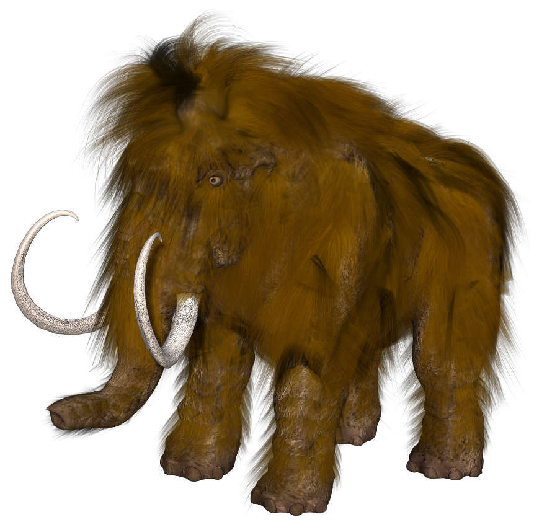
Phonétique
écouter / écrire
Michel le mammouth explique qu’il vient de Belgique.
Michel the mammoth explains that he comes from Belgium.
1
2
3
Notes:
This is slide 2/7
Word frequency of cognates used (1 is the most frequent word in French):
mammouth [<5000]
Source: Lonsdale, D., & Le Bras, Y. (2009). A Frequency Dictionary of French: Core vocabulary for learners London: Routledge.

Slide 20
Phonétique
écouter / écrire
Frédérique choisit la musique catholique.
Frédérique chooses Catholic music.
1
2
3
Notes:
This is slide 3/7
Word frequency of cognates used (1 is the most frequent word in French):
catholique [1578]
Source: Lonsdale, D., & Le Bras, Y. (2009). A Frequency Dictionary of French: Core vocabulary for learners London: Routledge.

Slide 21
Phonétique
écouter / écrire
Les quatre chats sympathiques cherchent quatre chaises chaudes.
The four nice cats are looking for four warm chairs.
1
2
3
Notes:
This is slide 4/7
Word frequency of unknown words used (1 is the most frequent word in French):
chaise [3419]
Source: Lonsdale, D., & Le Bras, Y. (2009). A Frequency Dictionary of French: Core vocabulary for learners London: Routledge.

Slide 22
Phonétique
écouter / écrire
Les dimanches, Agathe va au théâtre, aux champs, et à la bibliothèque.
On Sundays, Agathe goes to the theatre, to the fields, and to the library.
1
2
3
Notes:
This is slide 5/7
Word frequency of cognates used (1 is the most frequent word in French):
théâtre [1701]
Word frequency of unknown words used (1 is the most frequent word in French):
champ [847]
Source: Lonsdale, D., & Le Bras, Y. (2009). A Frequency Dictionary of French: Core vocabulary for learners London: Routledge.

Slide 23
Phonétique
écouter / écrire
Le chef fait des recherches sur le thé à la menthe.
The boss is doing research on mint tea.
1
2
3
Notes:
This is slide 6/7
Word frequency of unknown words used (1 is the most frequent word in French):
chef [386], recherche [357], menthe [>5000]
Source: Lonsdale, D., & Le Bras, Y. (2009). A Frequency Dictionary of French: Core vocabulary for learners London: Routledge.

Slide 24
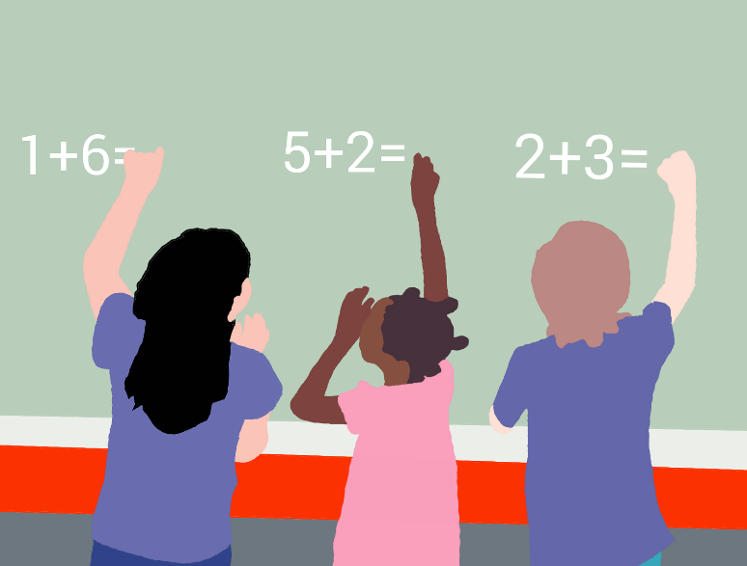
Phonétique
écouter / écrire
Dominique a des questions sur les méthodes chinoises de maths.
Dominique has some questions about Chinese maths methods.
1
2
3
Notes:
This is slide 7/7
Word frequency of cognates used (1 is the most frequent word in French):
méthode [1149], chinois [1914]
Source: Lonsdale, D., & Le Bras, Y. (2009). A Frequency Dictionary of French: Core vocabulary for learners London: Routledge.

Slide 25
SSC [th]
phonétique
Consolidation [2]

Slide 26
th
thé
Notes:
Timing: 1 minute
Aim: To consolidate SSC [th]
Procedure: 1. Present the letter(s) and say the [th] sound first, on its own. Students repeat it with you. 2. Bring up the word ”thé” on its own, say it, students repeat it, so that they have the opportunity to focus all of their attention on the connection between the written word and its sound.
3. A possible gesture for this would be to mime drinking tea. 4. Roll back the animations and work through 1-3 again, but this time, dropping your voice completely to listen carefully to the students saying the [th] sound, pronouncing ”thé” and, if using, doing the gesture.
Word frequency (1 is the most frequent word in French):
thé [3517]
Source: Lonsdale, D., & Le Bras, Y. (2009). A Frequency Dictionary of French: Core vocabulary for learners London: Routledge.

Slide 27
th
théâtre
bibliothèque
sympathique
thé
maths
[nice]
méthode
[method]
Notes:
Timing: 2 minutes
Aim: To consolidate SSC [th]
Procedure:
Consolidate and elicit the pronunciation of the individual SSC [th] and then the source word again ‘thé’ (with gesture, if using). Then present and elicit the pronunciation of the five cluster words. The cluster words have been chosen for their high-frequency, from a range of word classes, with the SSC (where possible) positioned within a variety of syllables within the words (e.g. initial, 2nd, final etc.). Additionally, we have tried to use words that build cumulatively on previously taught SSCs (see the Phonics Teaching Sequence document) and do not include new SSCs. Where new SSCs are used, they are often consonants which have a similar symbol-sound correspondence in English.
Word frequency (1 is the most frequent word in French): thé [3517]; méthode [1149]; théâtre [1701]; bibliothèque [2511]; maths [3438]; sympathique [4164]. Source: Lonsdale, D., & Le Bras, Y. (2009). A Frequency Dictionary of French: Core vocabulary for learners London: Routledge.

Slide 28
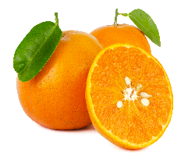
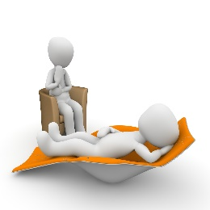
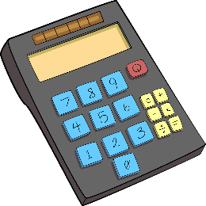
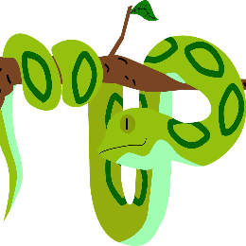
Phonétique: SSC [th]
Qui va avec chaque phrase?
parler
Catherine
Mathéo
Nathalie
Théophile
Elizabeth
Nathan
Elizabeth
1
Catherine
2
Théophile
3
…veut être
athlète.
…mange de la menthe avec sa mandarine.
…trouve les
maths difficiles.
Nathalie
4
Nathan
5
Mathéo
6
…a besoin
de thérapie.
…adore les
pythons.
…est enthousiaste
pour la météo.
*menthe = mint, météo = weather forecast
Notes:
Timing: 4 minutes
Aim: Consolidation of SSC [th]
Procedure:
Students read the phrases aloud in pairs and match them to each person.
Click on buttons to play the audio.
Students listen and check their answers.
Click to reveal answers.
Word frequency of cognates used (1 is the most frequent word in French): athlète [4722], mandarine [>5000], thérapie [4420], python [>5000], enthousiaste [4287]
Source: Lonsdale, D., & Le Bras, Y. (2009). A Frequency Dictionary of French: Core vocabulary for learners London: Routledge.
Word frequency (1 is the most frequent word in French): menthe [>5000], météo [4574]
Source: Lonsdale, D., & Le Bras, Y. (2009). A Frequency Dictionary of French: Core vocabulary for learners London: Routledge.

Slide 29
Des virelangues
Écoute. Combien de fois entends-tu les SSCs [th] et [ch] ?
écouter/parler
[th] and [t] sound the same, but in this task, if you hear a ‘t’ sound, it is written [th].
 |  | [th] | [ch]
 | Cinq chiens chassent six chats. |  | |||
 | Charlène cherche une chemise sans manches. |  | |||||
 | Édith est sympathique mais son chapeau est moche. | || | ||
 | Thierry marche sur chaque chemin sans changer de chaussures. | | | |||||
 | L'athénien charmant aime les bonbons à la menthe. | || | |
 | Sacha le professeur de chimie aime les maths et l'éthique. | || | ||
1
2
3
4
#
5
6
Notes:
Timing: 6 minutes
Aim: Consolidation of recognition of SSCs [th] and [ch]
Procedure:
Click the buttons to play audio.
Students tally how many times they hear [th] and [ch].
Click to reveal answers and sentences.
Transcript:
Cinq chiens chassent six chats.
Charlène cherche une chemise sans manches.
Édith est sympathique mais son chapeau est moche.
Thierry marche sur chaque chemin sans changer de chaussures.
L’athénien charmant aime les bonbons à la menthe.
Sacha le professeur de chimie aime les maths et l’éthique.
Word frequency of unknown words used (1 is the most frequent word in French): chaser [2364], manche [3437], moche [>5000], chaussure [3638], athénien [>5000], charmant [4030], bonbon [>5000], menthe [>5000], chimie [4073], éthique [2747]
Source: Lonsdale, D., & Le Bras, Y. (2009). A Frequency Dictionary of French: Core vocabulary for learners London: Routledge.

Slide 30
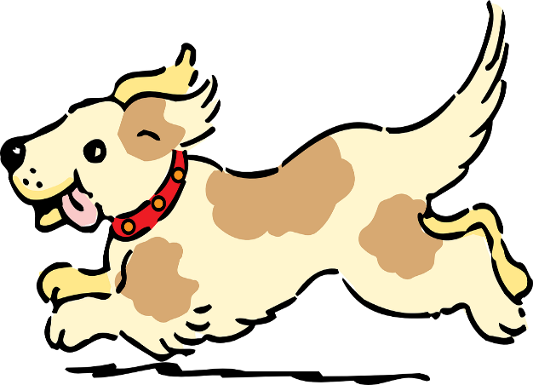
Des virelangues avec [ch] et [th]
lire / parler
Parle aussi vite que possible!
Cinq chiens chassent six chats.
[Five dogs chase six cats]
A
B
C
Notes:
Slide 1 of 6
Timing: 6 minutes for 6 slides
Aim: Practise pronunciation of SSC [ch] and [th] in the form of tongue twisters
Procedure:
1. Students read the sentences aloud, aiming for accurate pronunciation as quickly as possible.
2. Click audio buttons to hear three different speeds (A = slowest, C = fastest).
3. Repeat on next three slides for three more tongue twisters.
Transcript:
Cinq chiens chassent six chats.

Slide 31
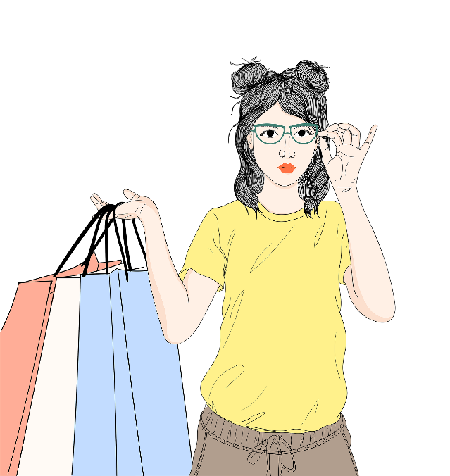
Des virelangues avec [ch] et [th]
lire / parler
Parle aussi vite que possible!
Charlène cherche une chemise sans manches.
[Charlène is looking for a blouse with no sleeves.]
A
B
C
Notes:
Slide 2 of 6
Transcript:
Charlène cherche une chemise sans manches.

Slide 32
Des virelangues avec [ch] et [th]
lire / parler
Parle aussi vite que possible!
Édith est sympathique mais son chapeau est moche.
[Édith is nice but her hat is ugly.]
A
B
C
Notes:
Slide 3 of 6
Transcript:
Édith est sympathique mais son chapeau est moche.

Slide 33
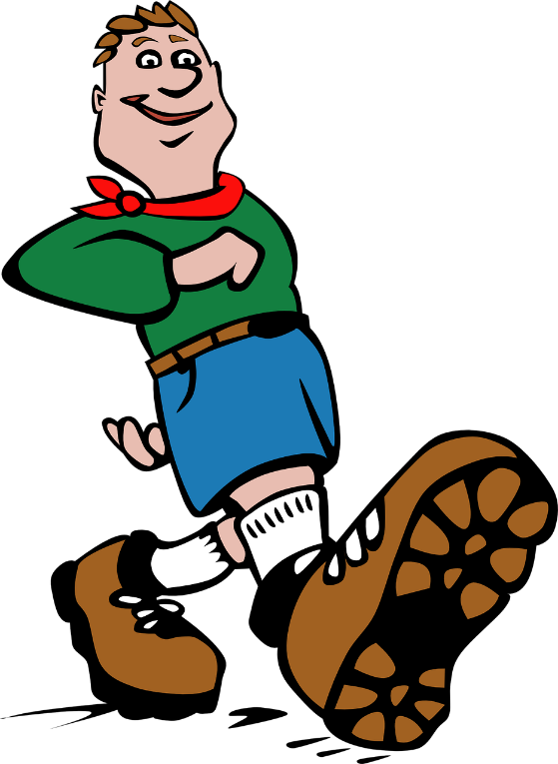
Des virelangues avec [ch] et [th]
lire / parler
Parle aussi vite que possible!
Thierry marche sur chaque chemin sans changer de chaussures.
[Thierry walks on every path without changing shoes.]
A
B
C
Notes:
Slide 4 of 6
Transcript:
Thierry marche sur chaque chemin sans changer de chaussures.

Slide 34
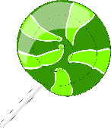
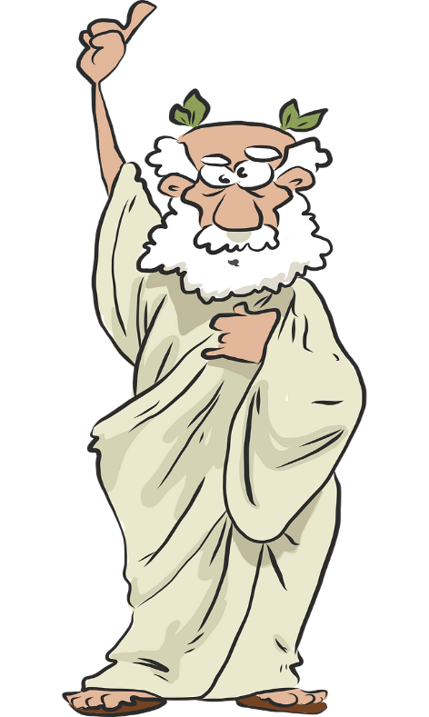
Des virelangues avec [ch] et [th]
lire / parler
Parle aussi vite que possible!
L’athénien charmant aime les bonbons à la menthe.
[The charming man from Athens likes mint sweets.]
A
B
C
Notes:
Slide 5 of 6
Transcript:
L’athénien charmant aime les bonbons à la menthe.

Slide 35
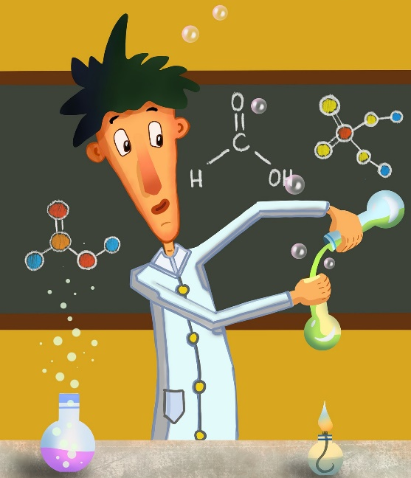
Des virelangues avec [ch] et [th]
lire / parler
Parle aussi vite que possible!
Sacha le professeur de chimie aime les maths et l’éthique.
[Sacha the chemistry teacher likes maths and ethics.]
A
B
C
Notes:
Slide 6 of 6
Transcript:
Sacha le professeur de chimie aime les maths et l’éthique.

